Slide 1
CERN Scientific Information Service
An introduction
Alexander Kohls
18 September 2024

Slide 2
Agenda
1 General Introduction
History of the Scientific Information Service
SIS expanding its mandate to Open Science
SCOAP³ – one of our flagship projects

Slide 3
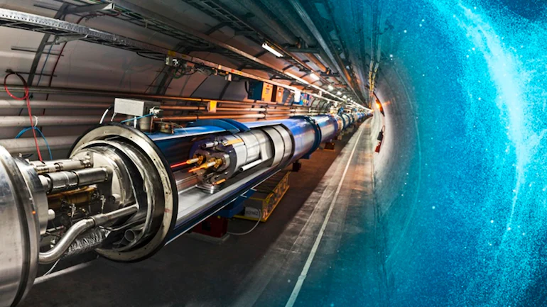
  CERN’s Mission
  Perform world-class research in fundamental physics
  Provide a unique range of particle accelerator facilities that enable research at the forefront of human knowledge, in an environmentally responsible and sustainable way.
  Unite people from all over the world to push the frontiers of science and technology for the benefit of all.
  Train new generations of physicists, engineers and technicians, and engage all citizens in research and in the values of science.

Slide 4

In 1954 CERN started with 12 Member States
Today CERN has 23 Member States and is still growing
Geographical & cultural diversity
110 nationalities,
from 77 countries
23 Member States
3 Associate Member States in the pre-stage to membership
8 Associate Member States
~ 2’600 Staff members
~ 2‘000 contractors’ employees
~ 13‘000 physicists /users
Yearly budget ~ 1‘100 MCHF
Notes:
The speaker can highlight CERN’s second mission as stated when it was established: to foster peaceful collaborations between nations that had recently been at war.
This slide will have information on the country of the visiting delegation:
Location on the world map
Date of accession (if Member State or Associate Member State)
For information:
Member States – Austria, Belgium, Bulgaria, Czech Republic, Denmark, Finland, France, Germany, Greece, Hungary, Israel, Italy, Netherlands, Norway, Poland, Portugal, Romania, Slovak Republic, Spain, Sweden, Switzerland, United Kingdom
Associate Member States in the pre-stage to membership – Cyprus, Serbia, Slovenia
Associate Member States – India, Lithuania, Pakistan, Turkey, Ukraine
Observers – USA, Russia, Japan, (EU, JINR, UNESCO)

Slide 5
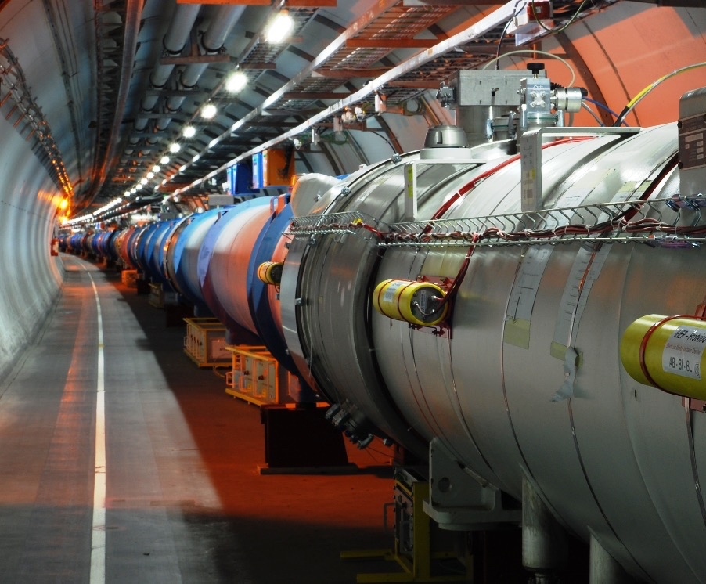
CERN‘s flagship:
The Large Hadron Collider
  Ca. 100m underground
  27 km circumference
  Coldest known place in the universe
  (Magnets cooled down to -271°C)
  Hottest place in the solar system
  (Collision temperature 100‘000x hotter than the sun)
  1 billion+ particle collisions per second
  Detectors collect 1PB/sec of data
18 September 2024
Alexander Kohls | SIS Intro

Slide 6
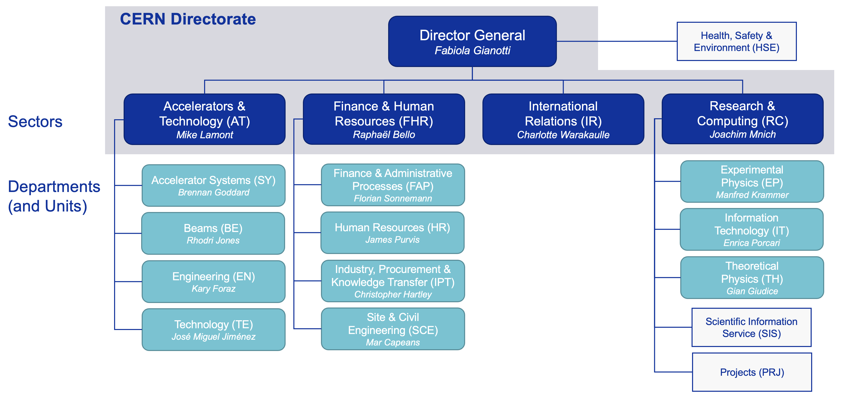
SIS within CERN
A central unit supporting all CERN departments

Slide 7
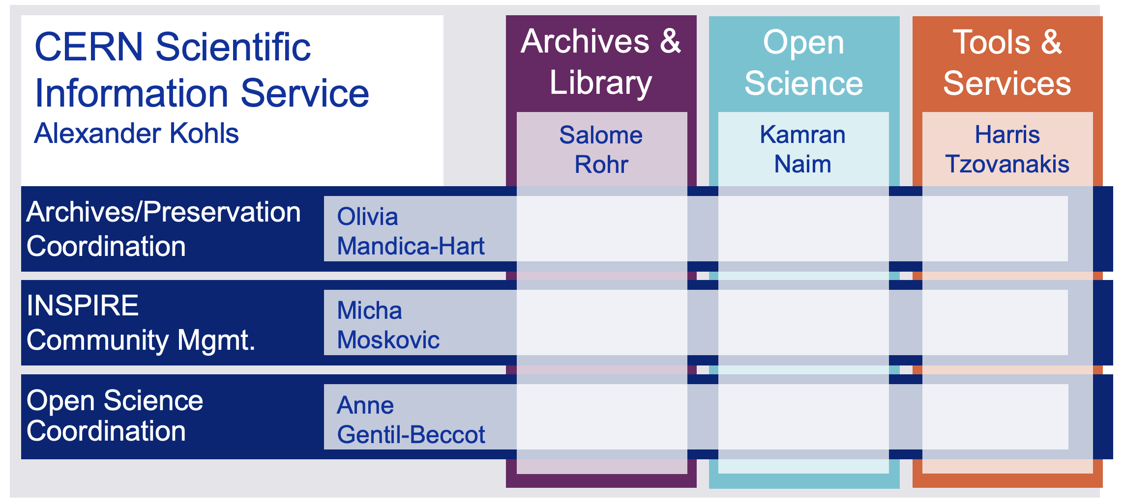
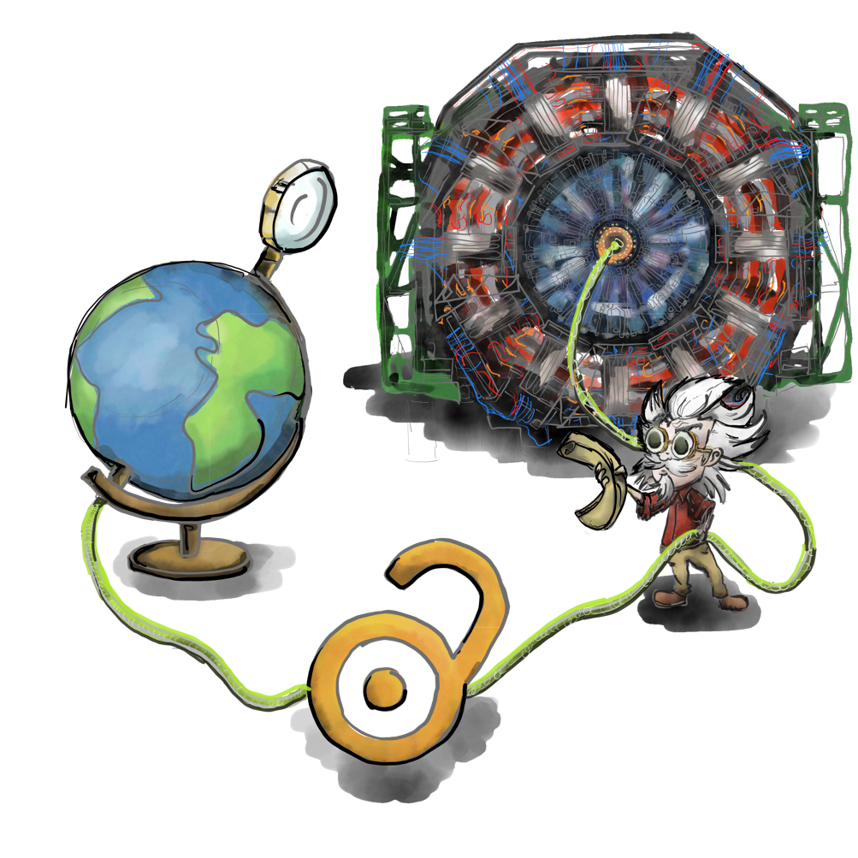
The CERN Scientific Information Service
Connecting the CERN Community with global research
The CERN Scientific Information Service aims at efficiently managing, preserving and disseminating scientific information to make it openly accessible and reusable to CERN and the worldwide High-Energy Physics community.
Le Service d’Information Scientifique du CERN a pour mission de gérer, conserver et diffuser efficacement l’information scientifique afin de la rendre accessible et utilisable pour le CERN et pour la communauté mondiale de la physique des hautes énergies.

Slide 8
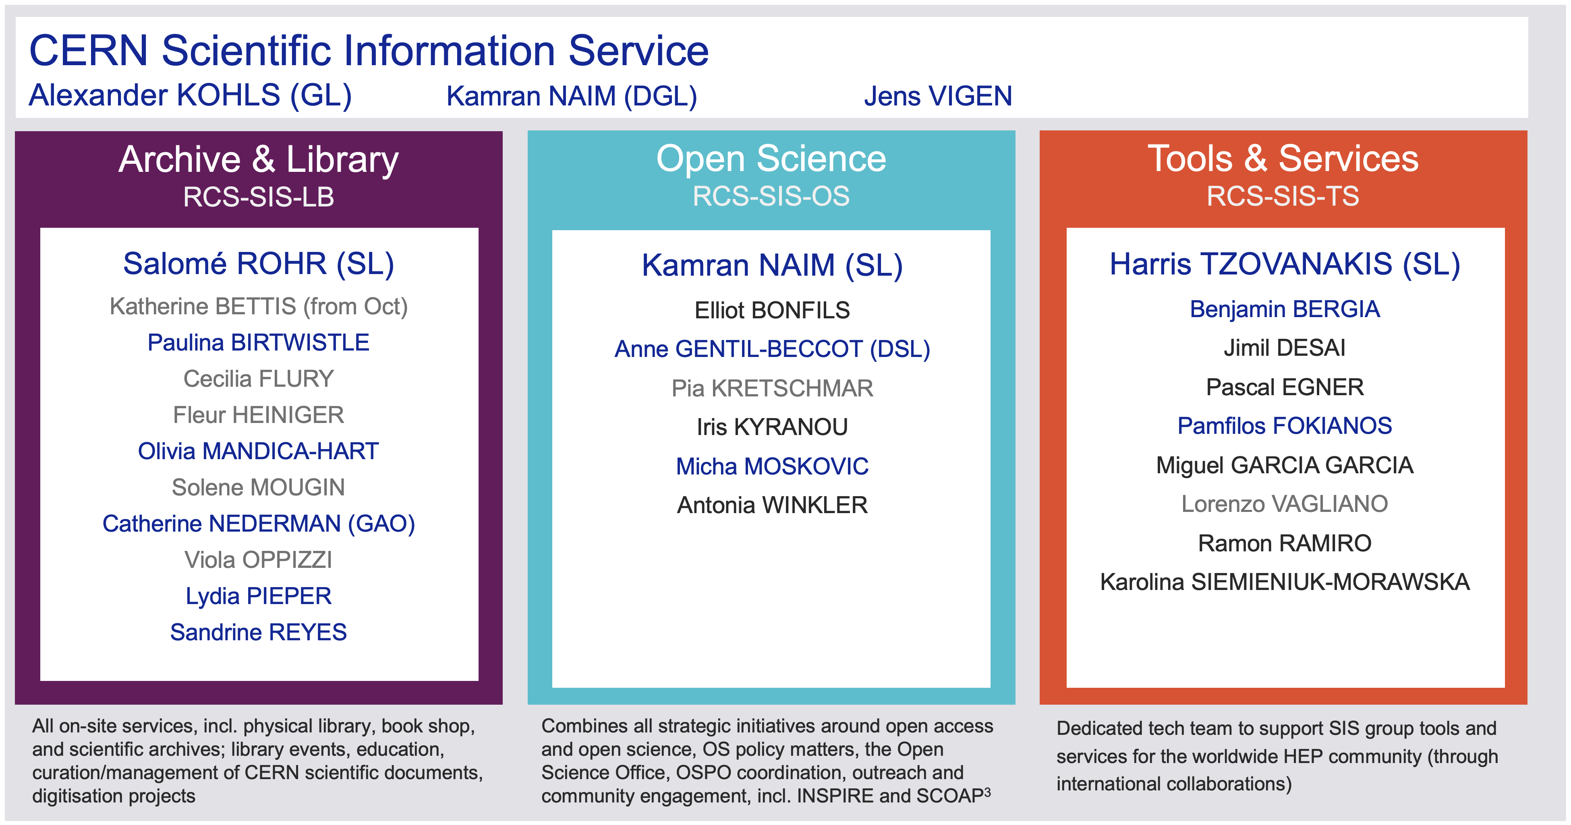
The CERN Scientific Information Service
Connecting the CERN Community with global research

Slide 9
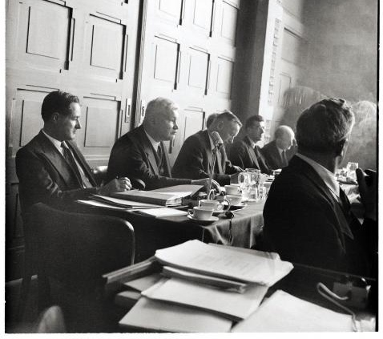

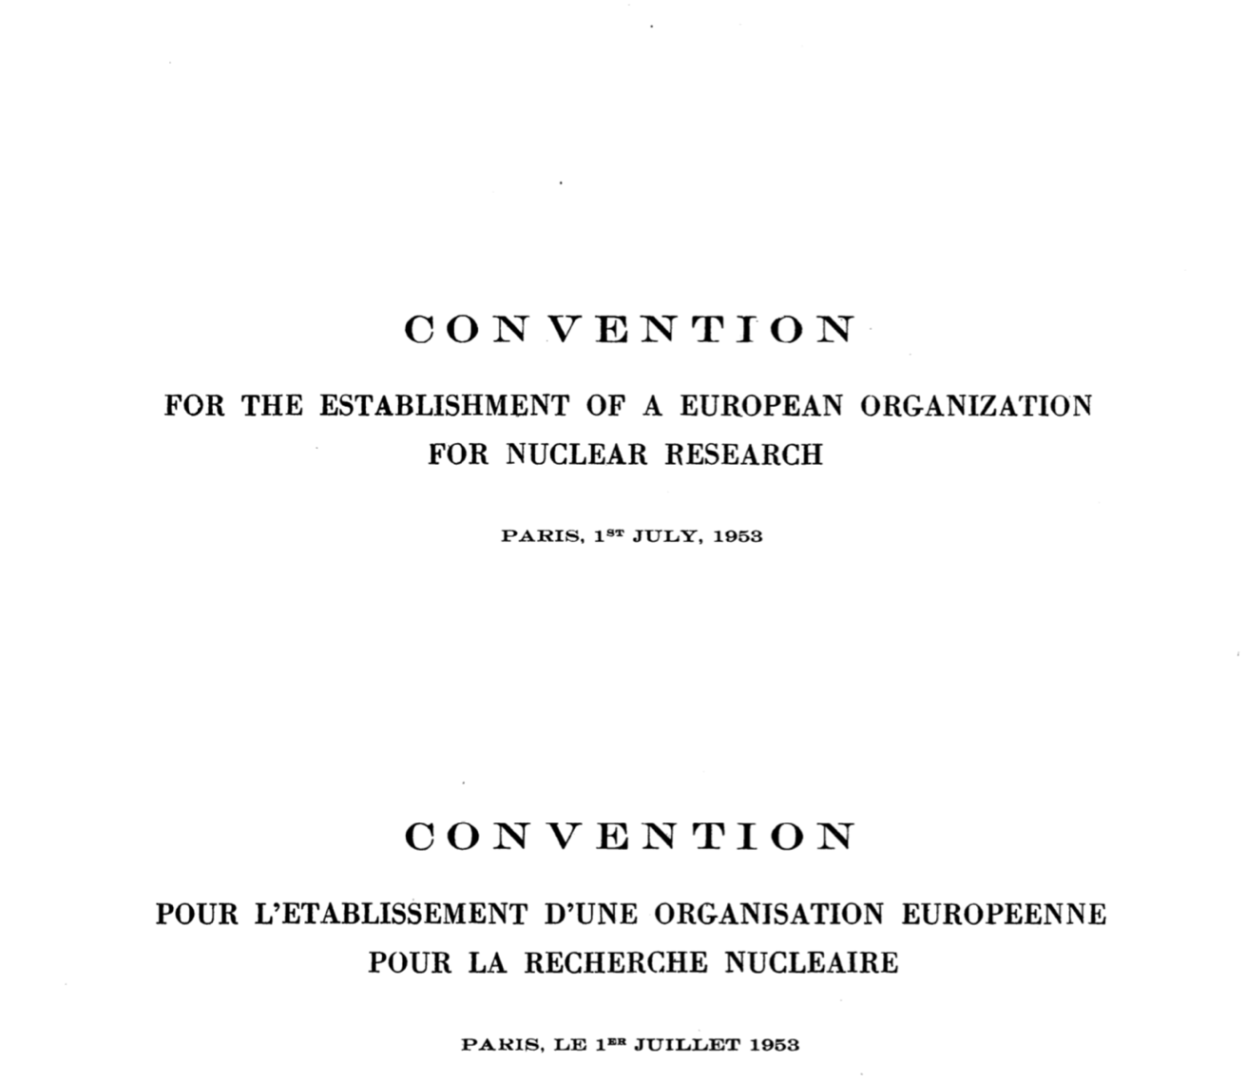
CERN was built for openness of information.

Slide 10
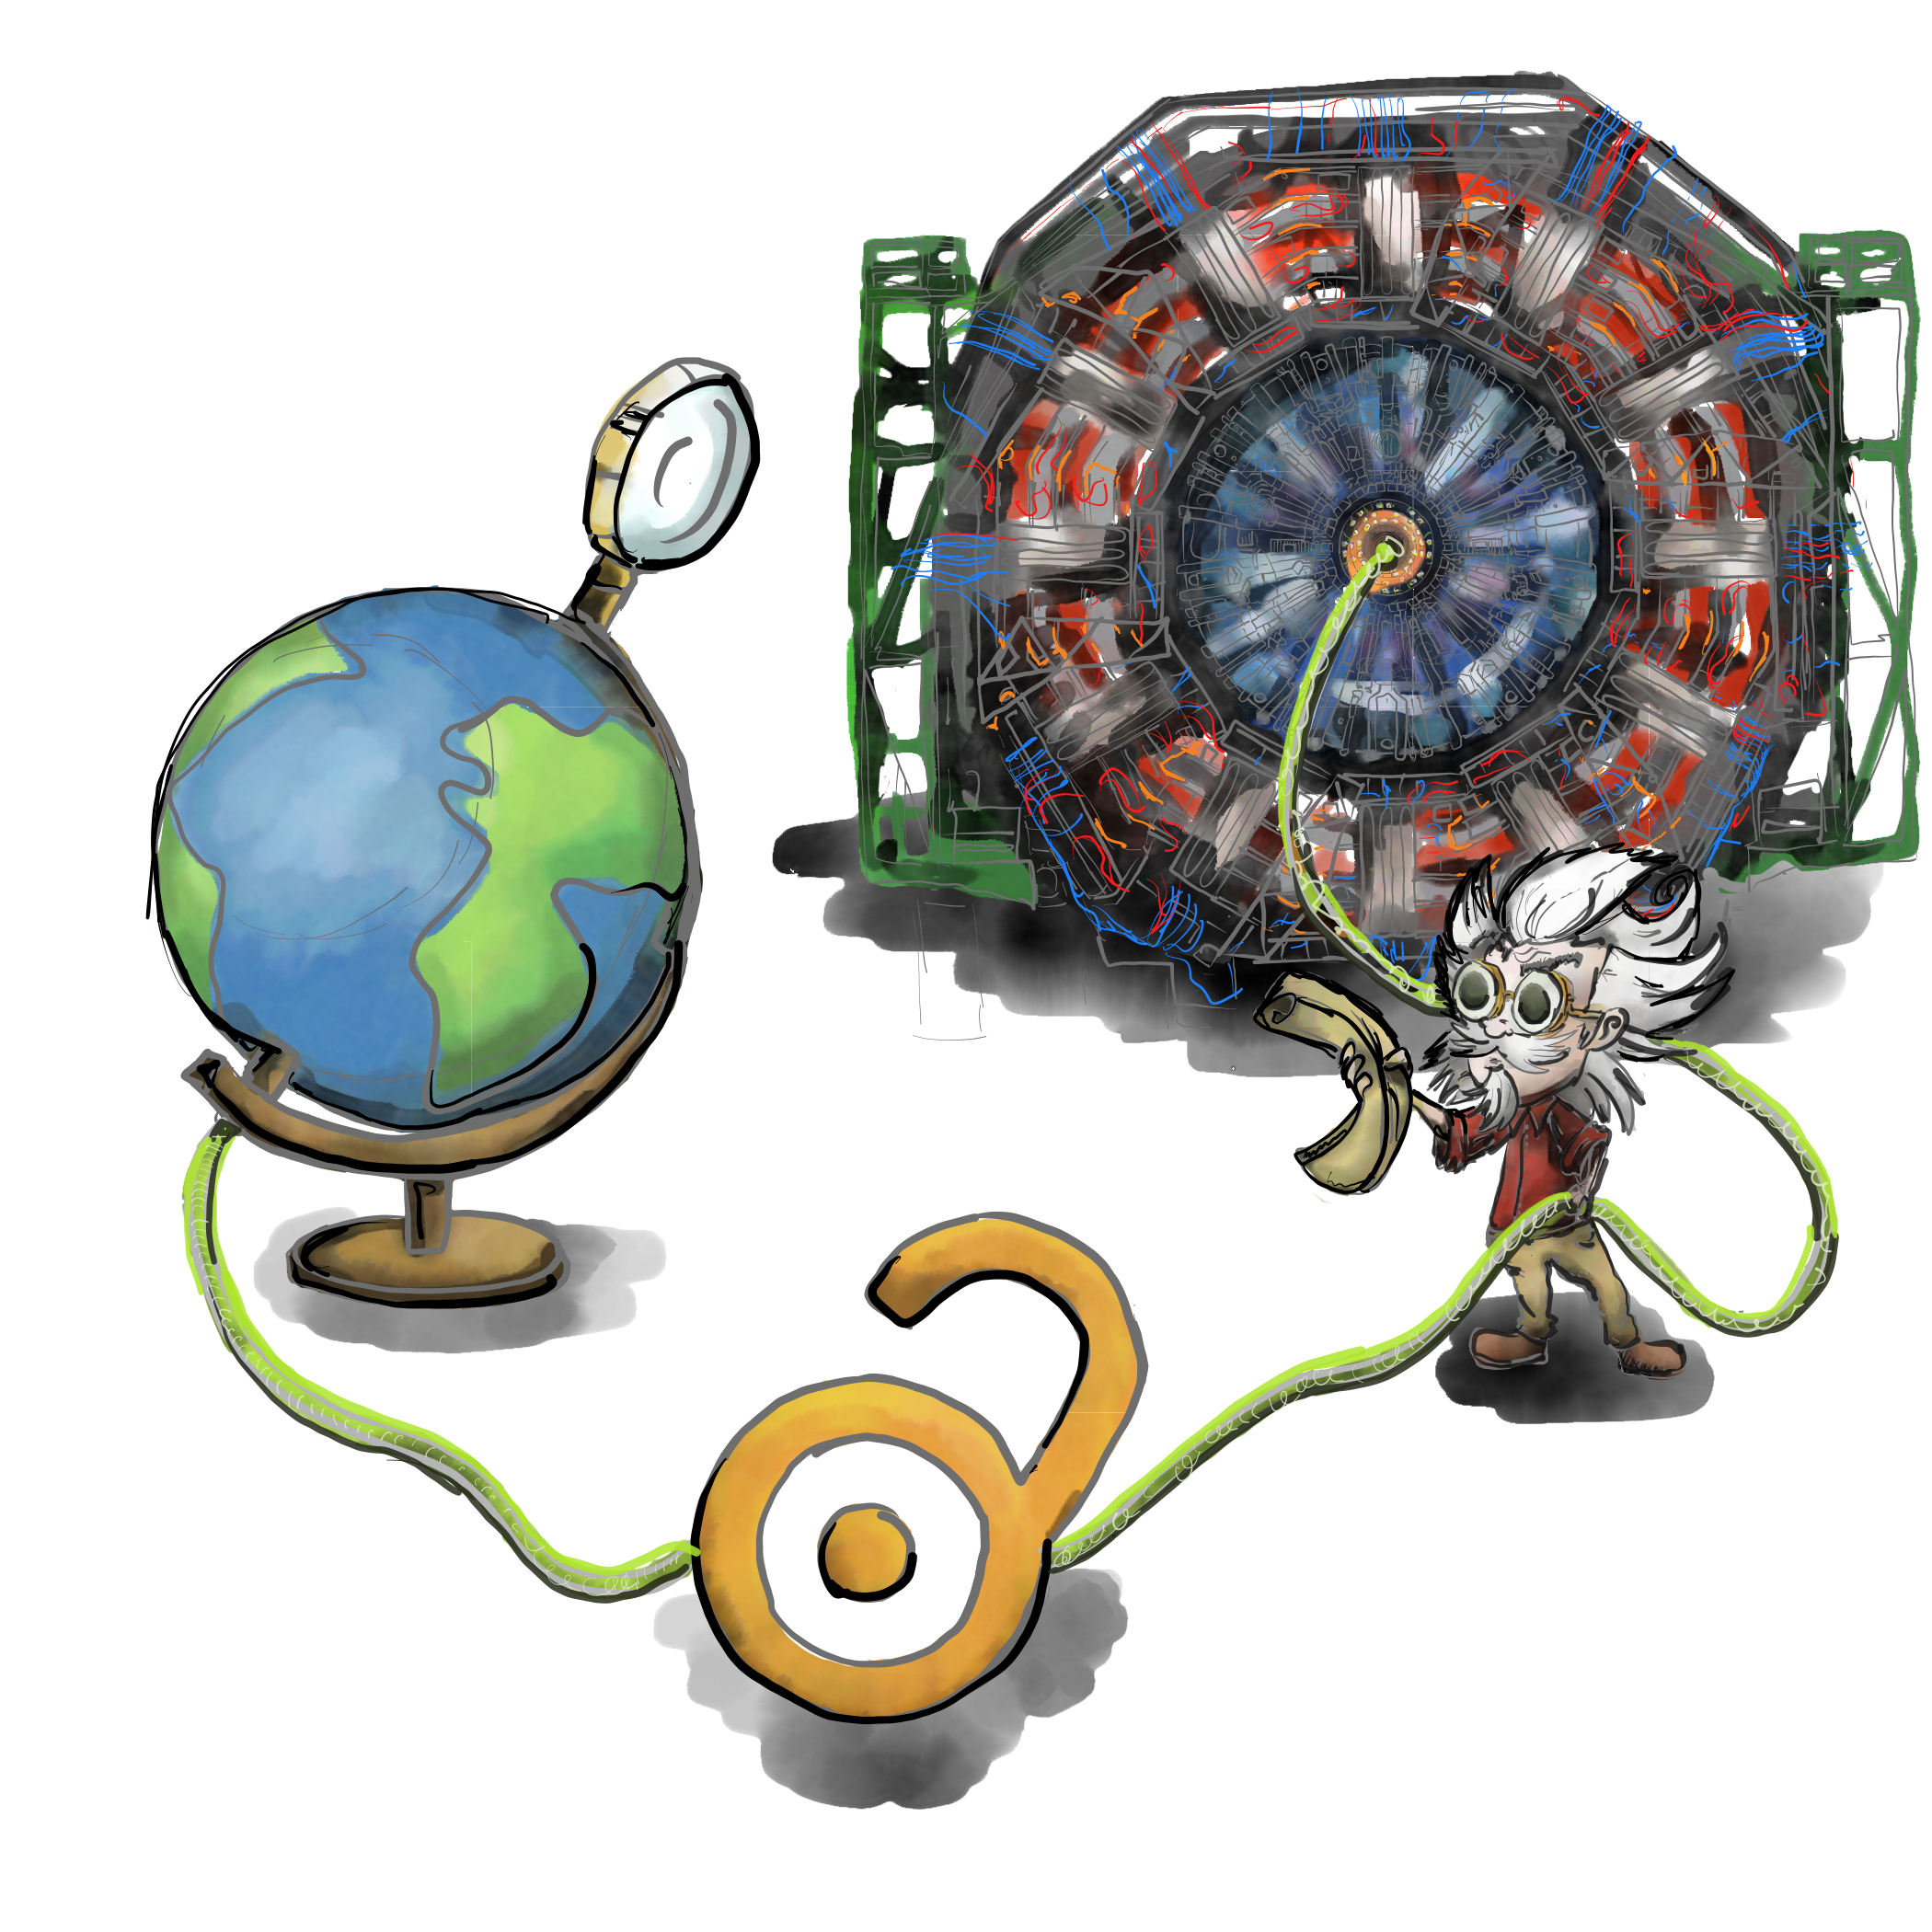
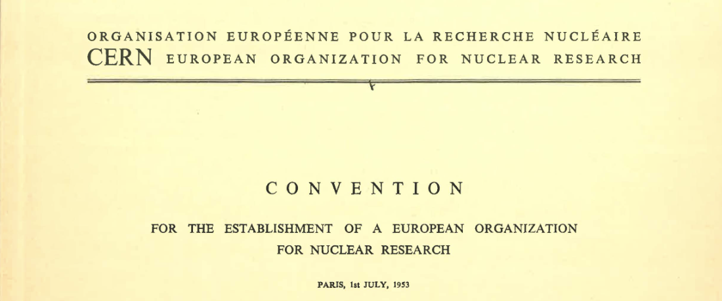
“…and the results of its experimental and theoretical work shall be published or otherwise made generally available”
CERN Founding Convention (1953)
Illustration by Stephanie van de Sandt

Slide 11
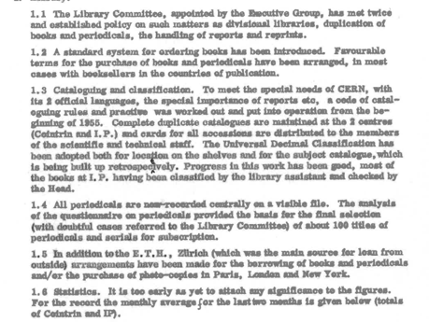
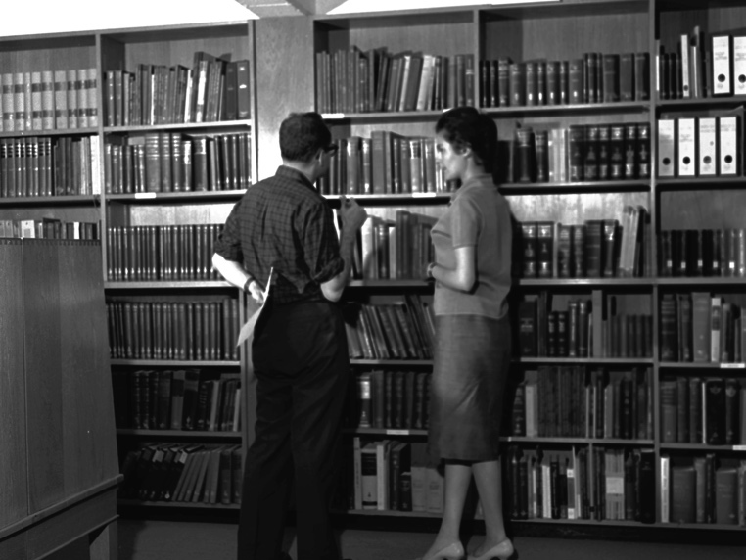
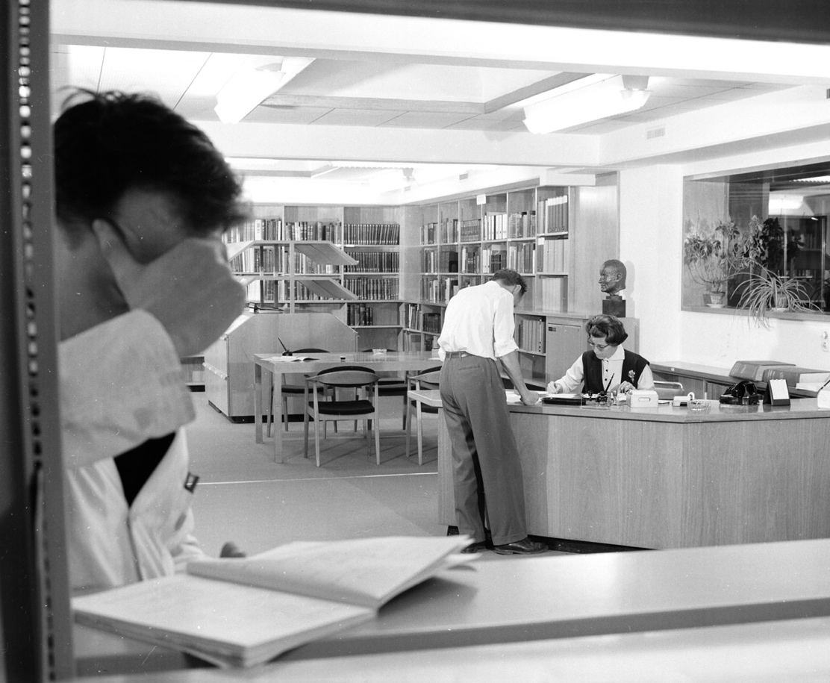
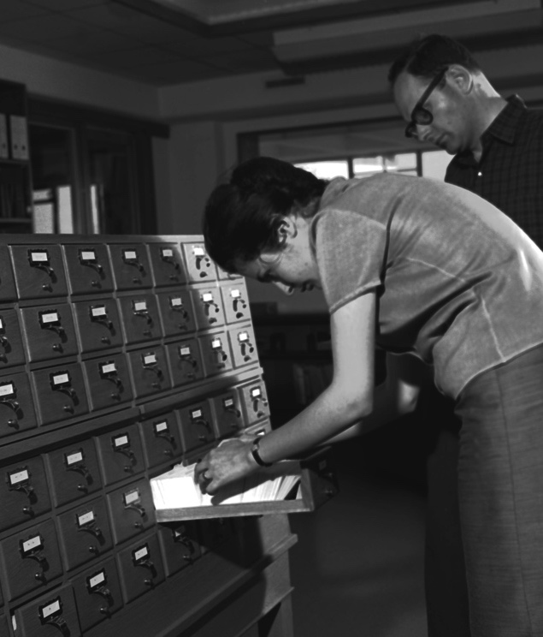

The Scientific Information Service (SIS) has existed throughout these 70 years but its role has evolved over time.

Slide 12








CERN Scientific Information Service activities today
Manage, preserving and disseminate knowledge
Preserve, safeguard and exploit the historic knowledge and heritage of CERN
Provide access to all required scientific literature to the CERN community
and openly disseminate the organisational research products
Enable accessibility, preservation, reuse and reproducibility of HEP research
Promote and enable best practices on open and collaborative science in
particle physics and beyond
CERN OSPO
18 September 2024
12

Slide 13
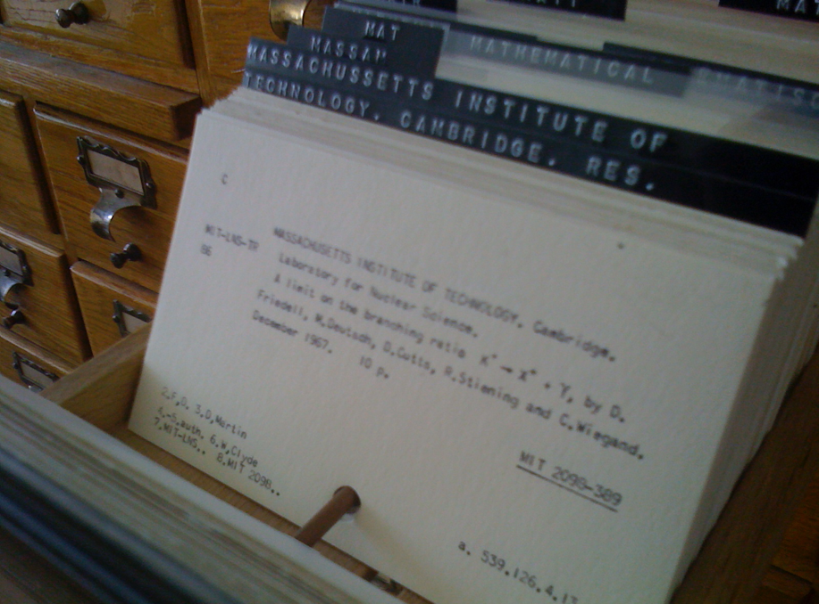
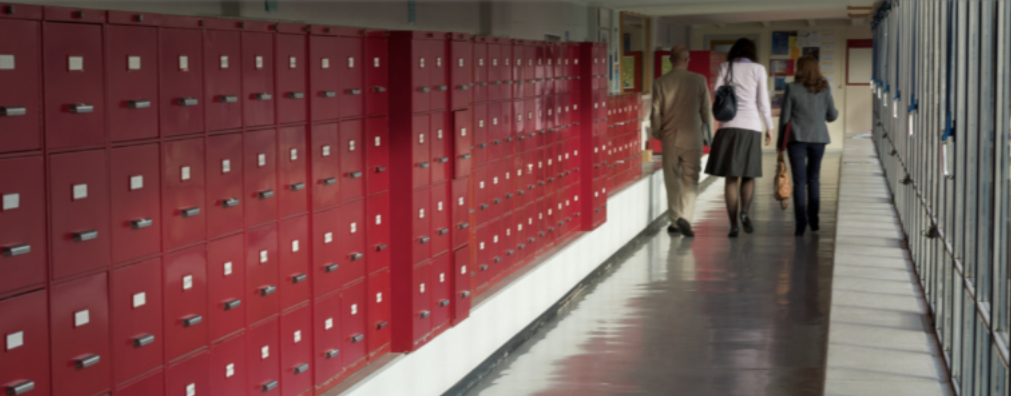
Preprint culture in HEP
1954

Slide 14
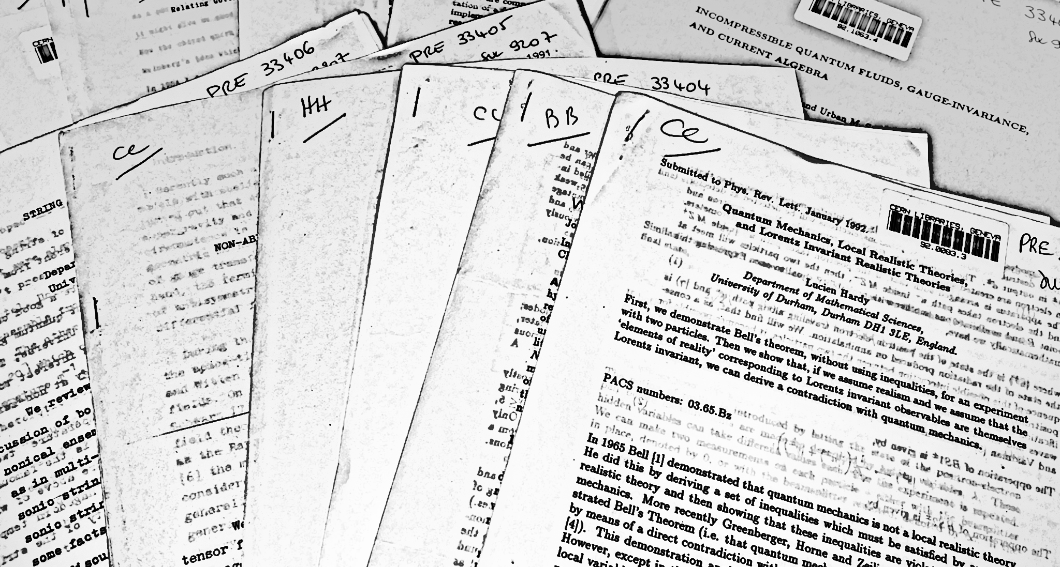
Preprints used to be distributed on paper.

Slide 15
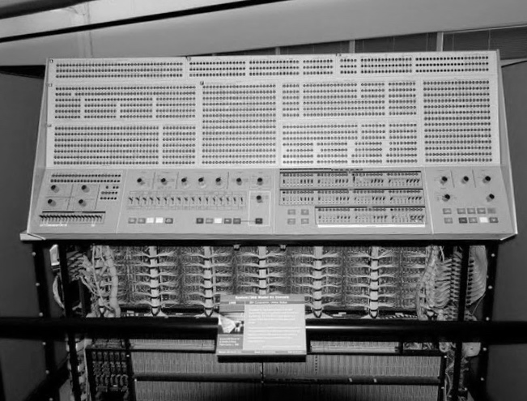
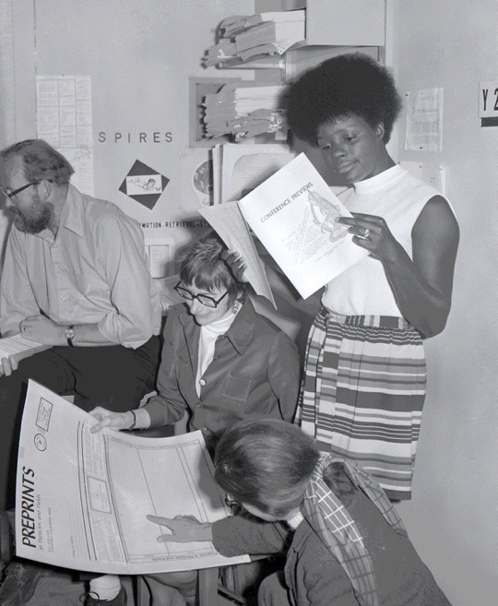
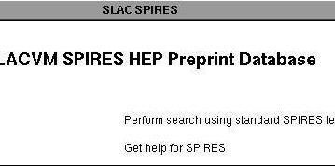
The first electronic preprint catalogue was established at SLAC.
1969

Slide 16
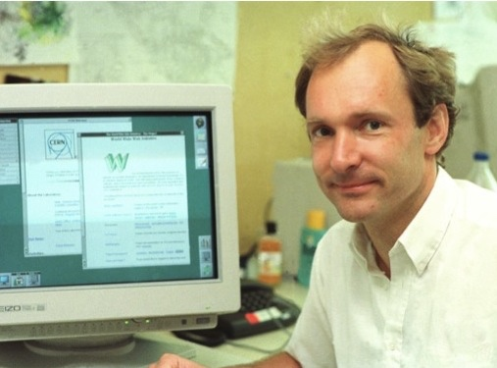
The WWW changed everything
1989

Slide 17
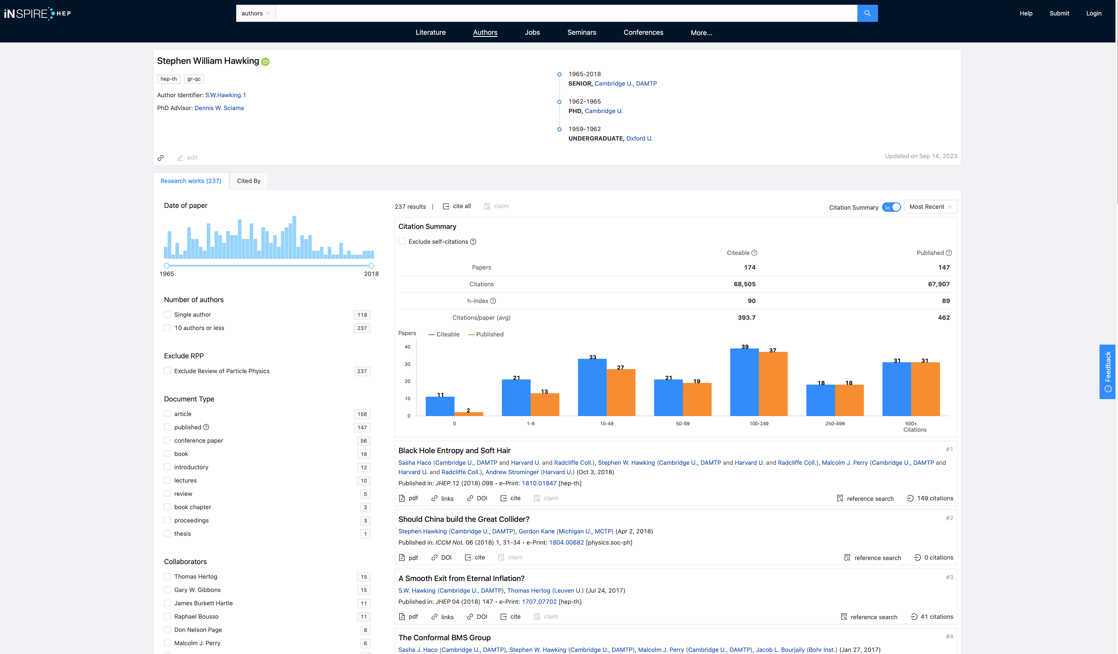
The preprint catalogues SPIRES has evolved into INSPIREhep
a global knowledge hub for particle physics, hosted by CERN.

Slide 18
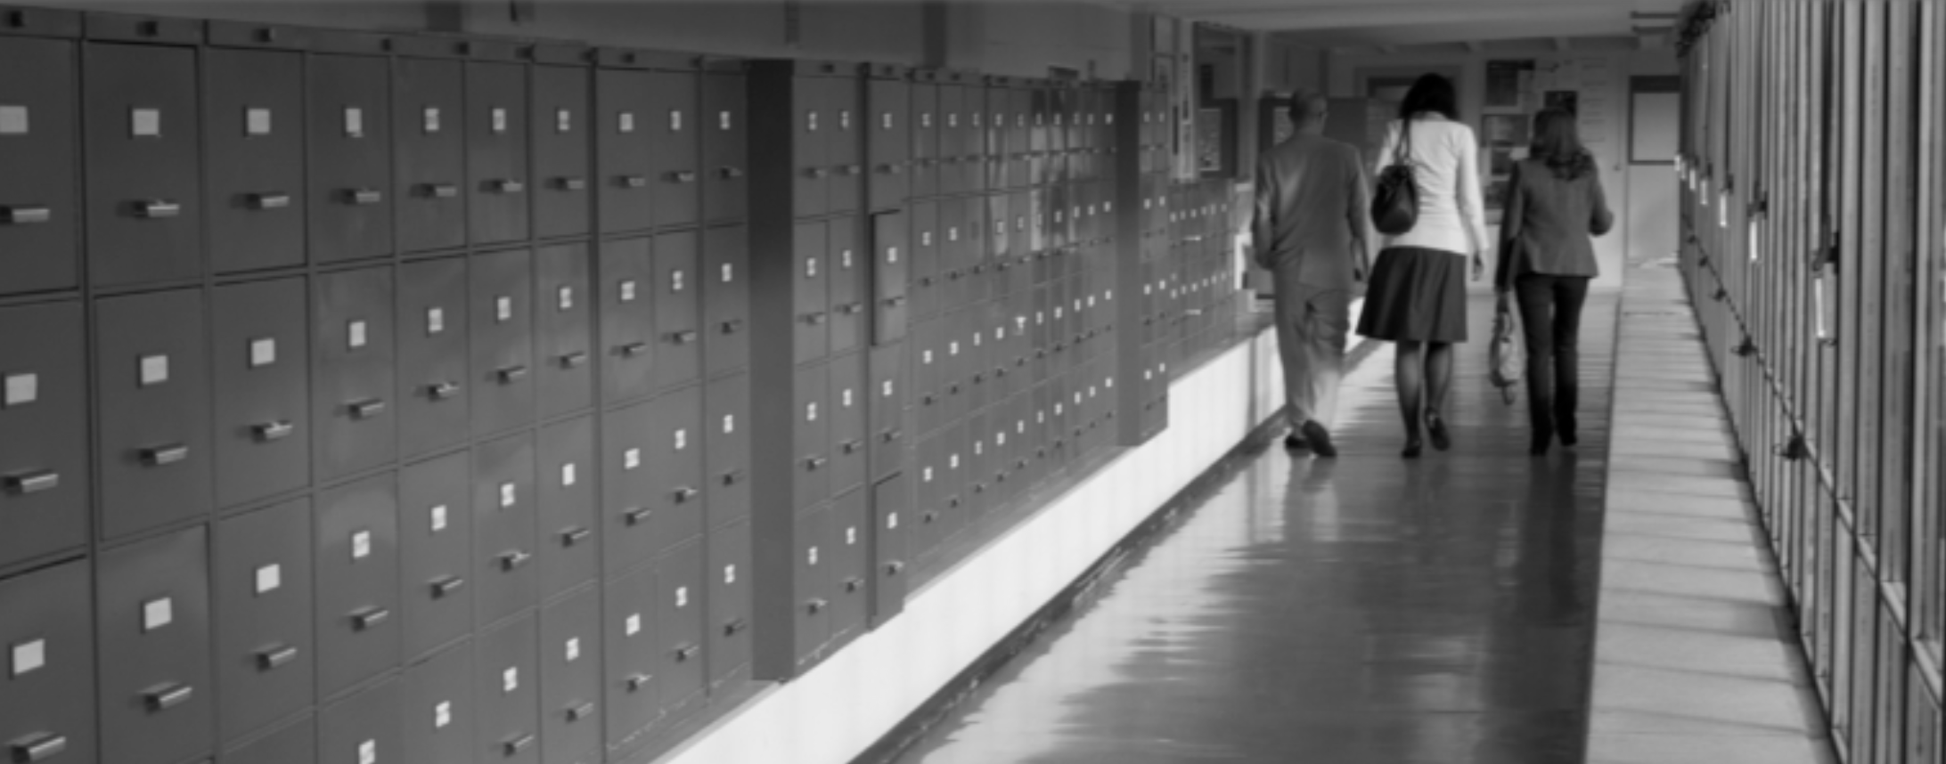
Preprint culture and CERN Convention give historic context of SIS’ evolutioin

Slide 19
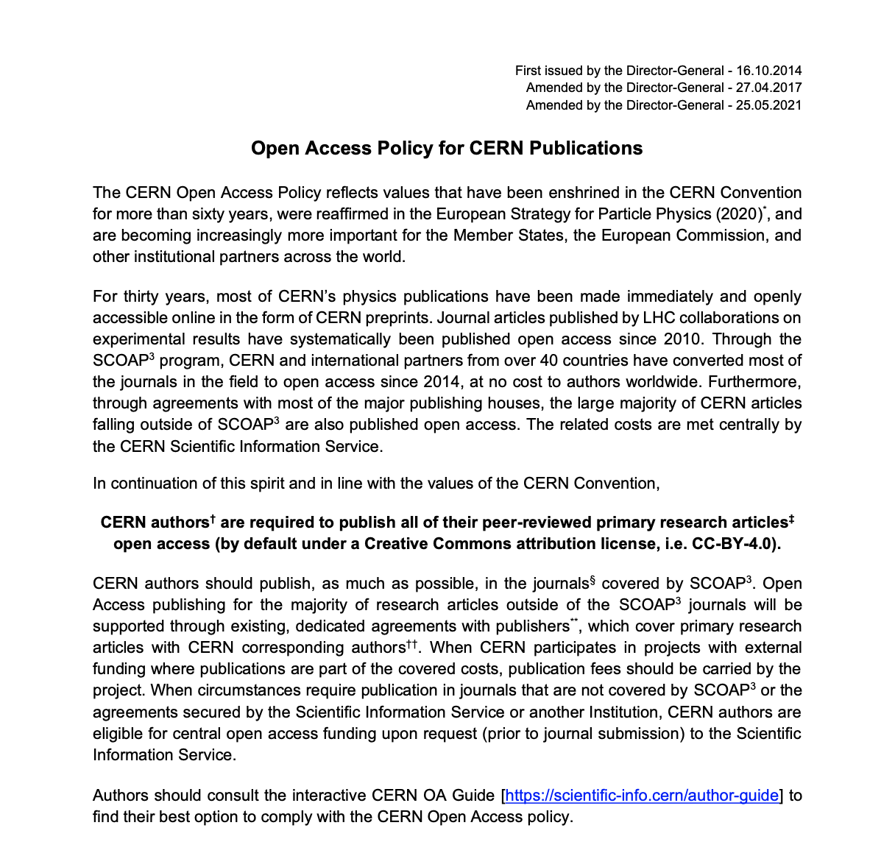
The Open Access policy

Slide 20




The Open Access Mechanisms at CERN
Sponsoring Consortium for Open Access Publishing in Particle Physics
Other collective OA models transparent to the author
(S2O, sponsorship)
SCOAP³
Collective
models
CERN has negotiated Open access agreements with 10+ publishers, covering 4000+ journals
For other articles the fees can be centrally covered under certain conditions
OA agreements
Individual APC

Slide 21
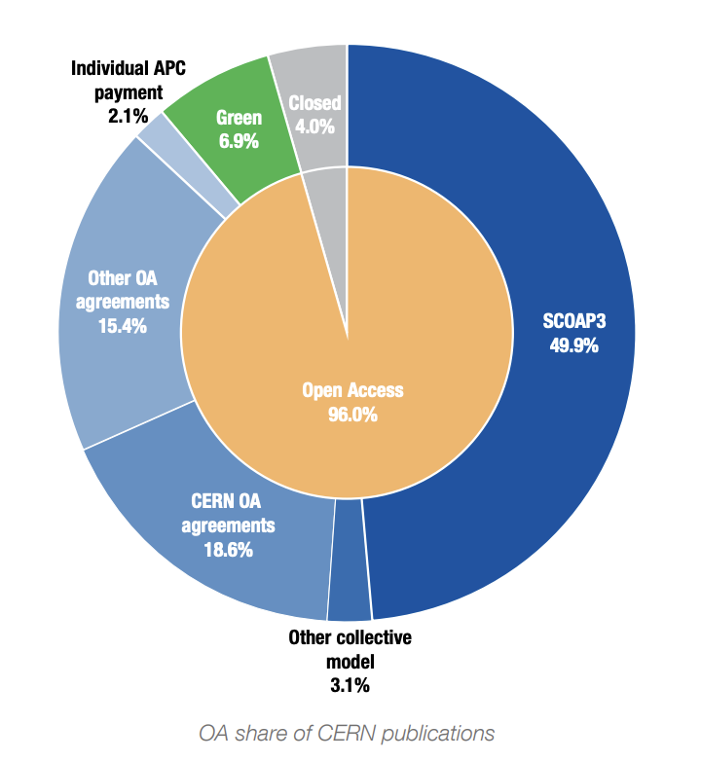
Aiming for 100% Open Access
Requires all research publications to be made fully open
CC-BY licenses required
Challenging to achieve the remaining 4%

Slide 22







Support the global OA/OS infrastructure
Open access and Open science need a global infrastructure
Standardized metadata and persistent identifiers (ORCID, ROR, CrossRef, OA Switchboard..)
Open infrastructure created/used by the community (arXiv, DOAJ, OAPEN, OJS…)
OA agreements

Slide 23
What is Open Science?
The UNESCO definition
Open science is defined as an inclusive construct that combines
various movements and practices aiming
to make multilingual scientific knowledge openly available, accessible and reusable for everyone,
to increase scientific collaborations and sharing of information for the benefits of science and society, and
to open the processes of scientific knowledge creation, evaluation and communication to societal actors beyond the traditional scientific community.
[…] it builds on the following key pillars: open scientific knowledge, open science infrastructures, science communication, open engagement of societal actors and open dialogue with other knowledge systems.
https://unesdoc.unesco.org/ark:/48223/pf0000379949.locale=en

Slide 24
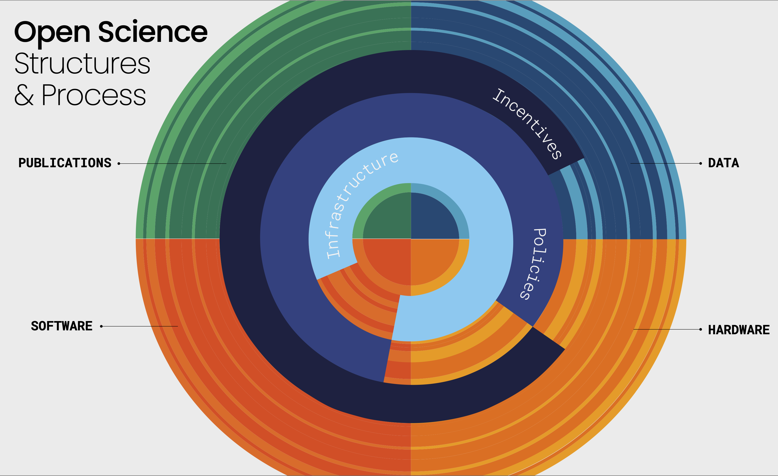
Open Science
Structures & Process
Hardware
Software

Slide 25
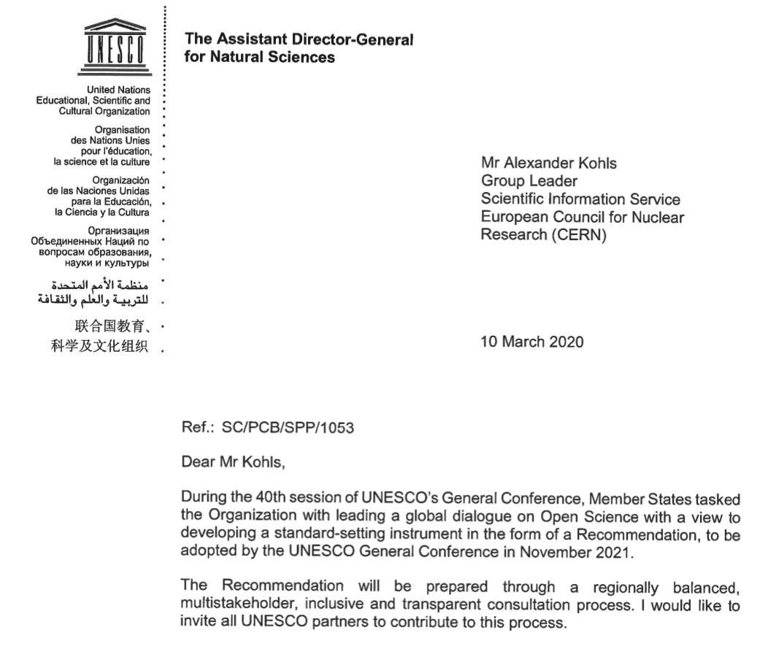
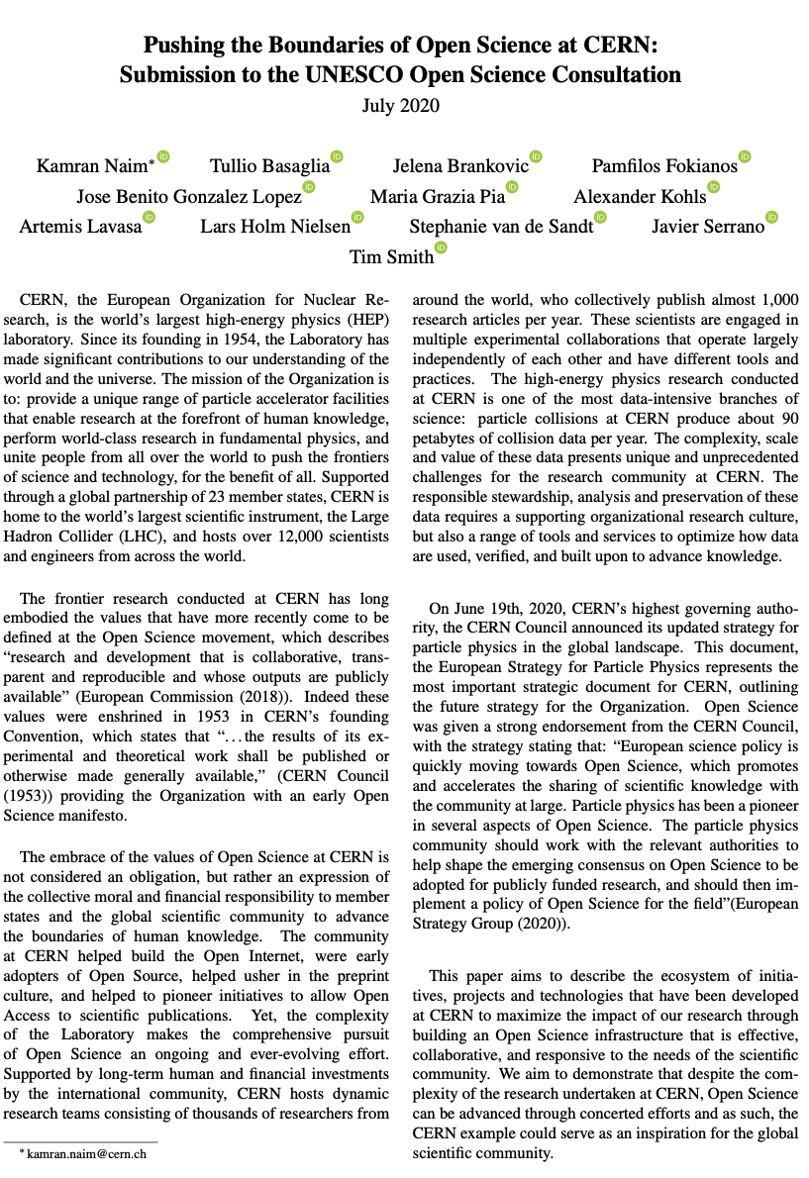

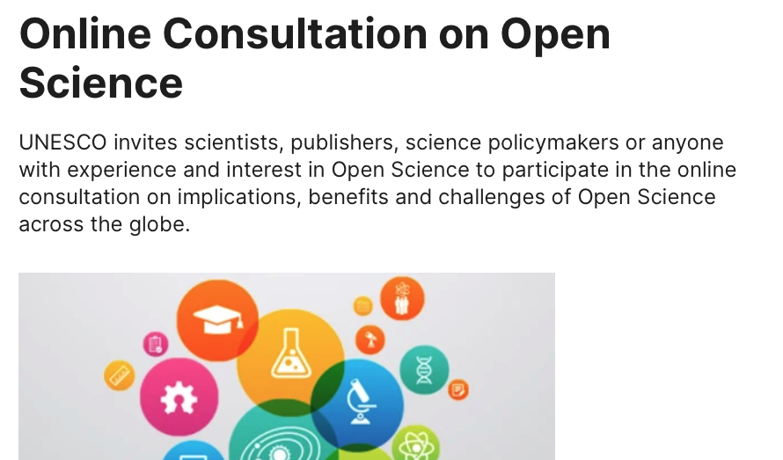

UNESCO Recommendations on Open Science created the momentum
https://doi.org/10.17181/CERN.1SYT.9RGJ
CERN is proud to have joined
UNESCO on the journey towards
Recommendations on Open Science

Slide 26


Developing the CERN Open Science Policy
Decentralised institutional efforts &
grassroots movements
Policy frameworks & best practices
+

Slide 27
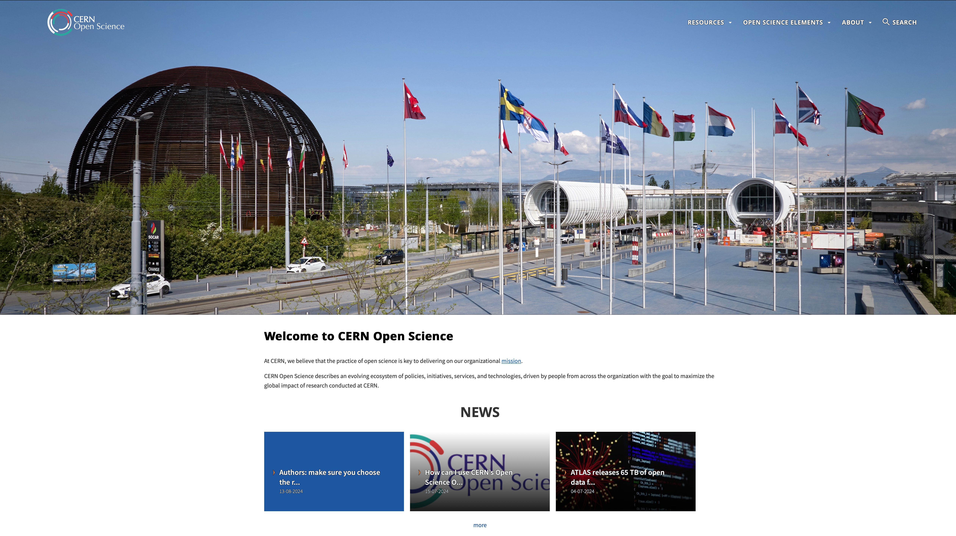
CERN Open Science Policy
Captures current practice and states progressive vision across multiple
Open Science domains:
Policy is governed and implemented by the community
Policy text (V1.0, Oct 2022) and more details available
on the CERN OS website: https://openscience.cern
Open Access to Publications | Research Integrity, Reuse & Reproducibility
Open Research Data | Infrastructure for Open Science
Open Software | Research Assessment & Evaluation
Open Hardware | Education, Training & Outreach
 | Citizen Science

Slide 28
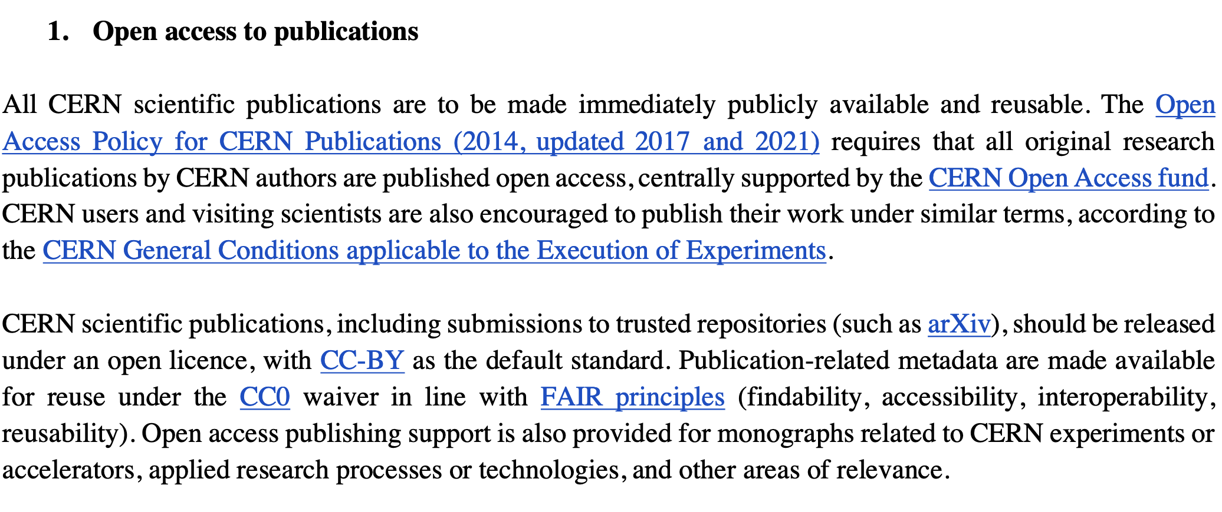
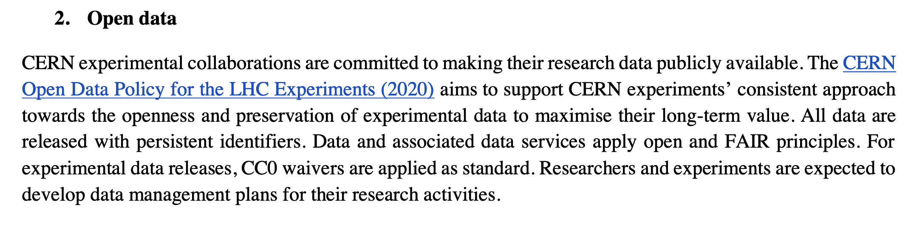
CERN Open Science Policy
Examples of policy statements
https://cds.cern.ch/record/2835057

Slide 29
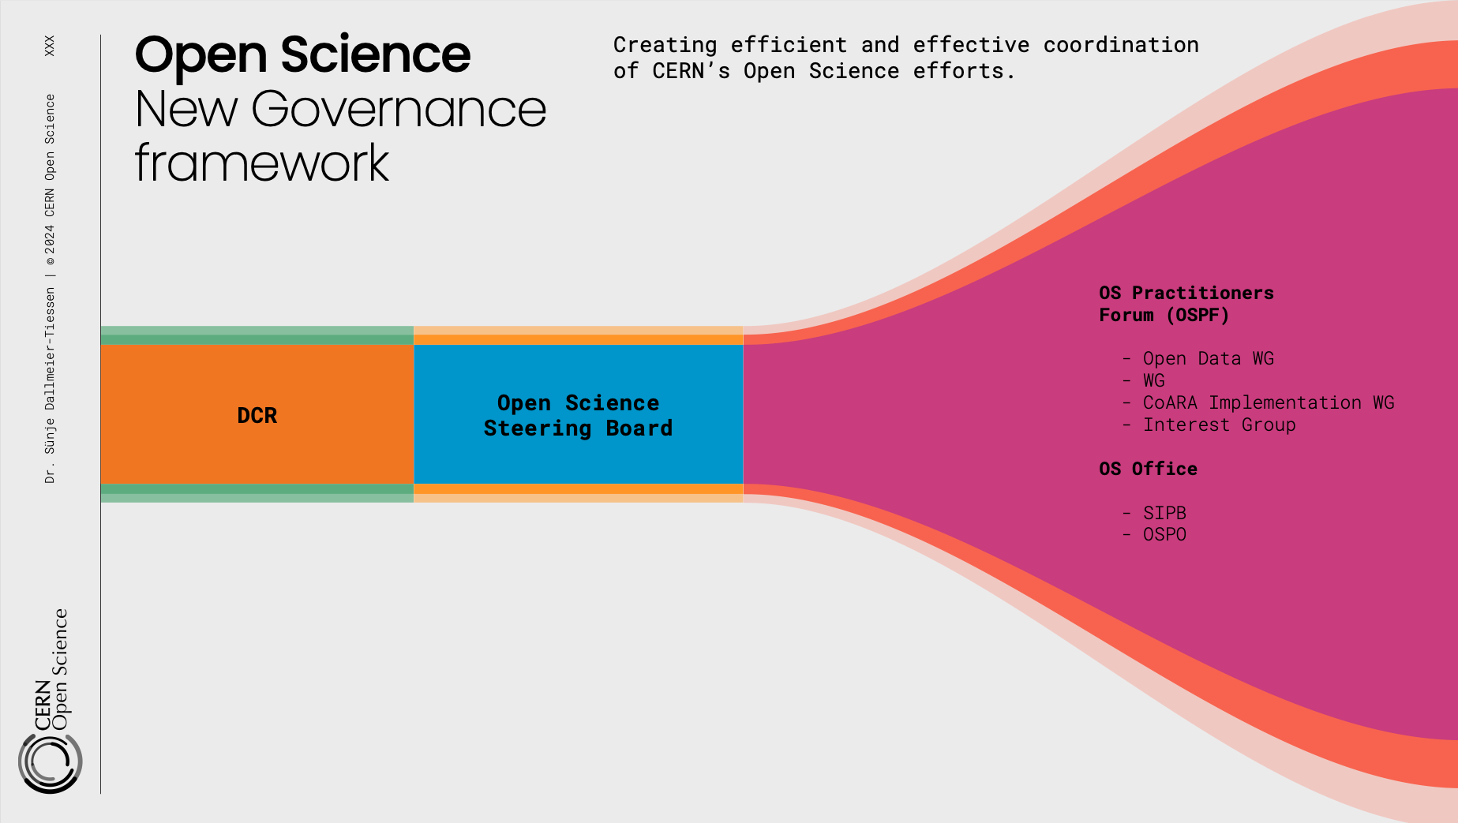
Open Science
New Governance Framvework
Creating efficient and effective coordination
of CERN’s Open Science efforts

Slide 30

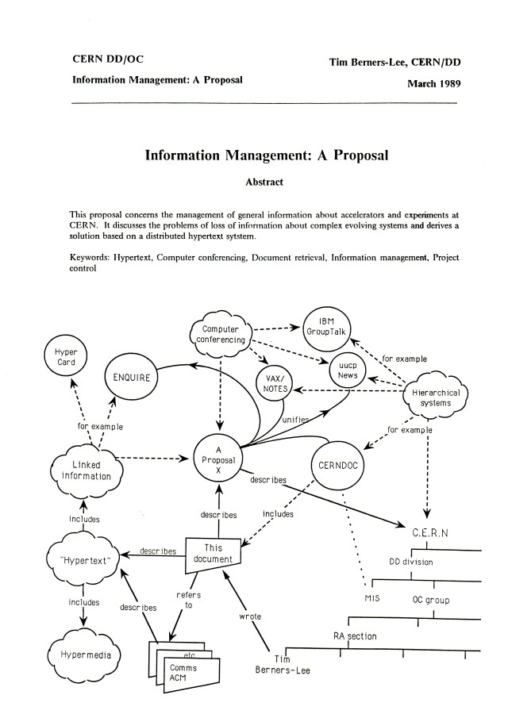




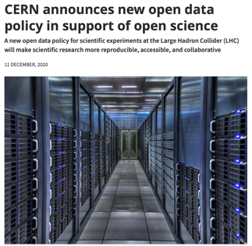


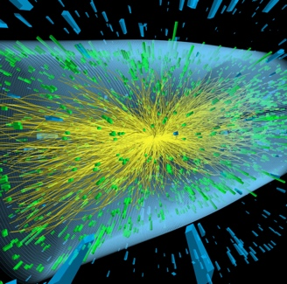
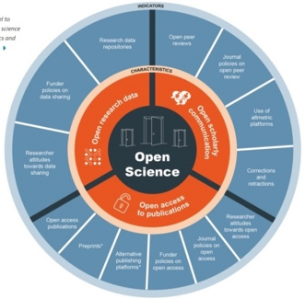
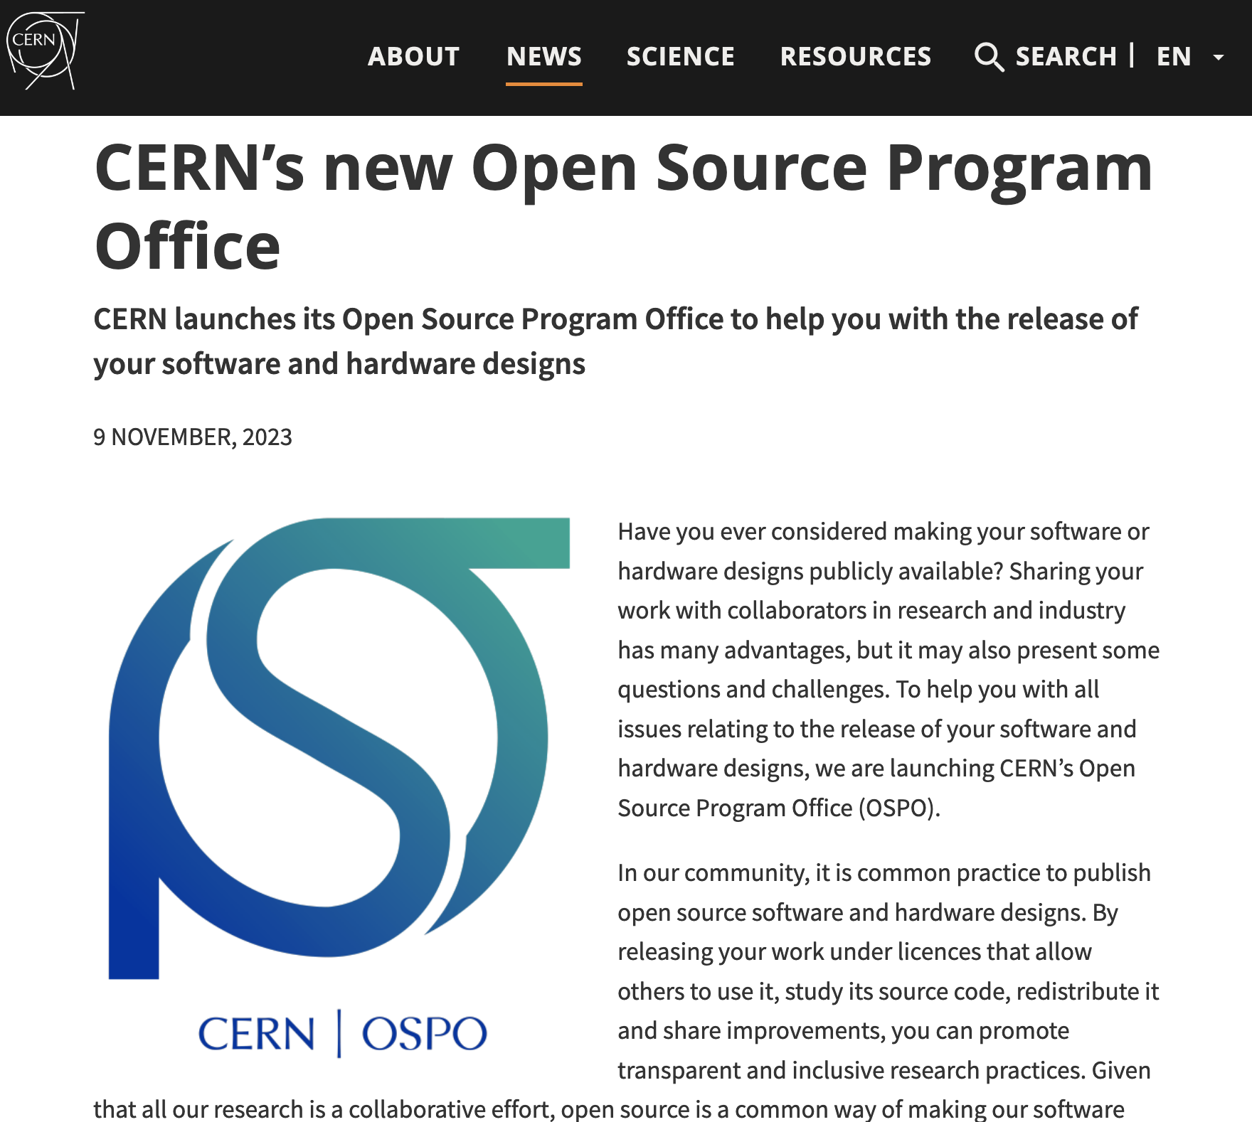


CERN – Open Science Highlights 1989-2023
SIS has played a key role and is coordinating OS at CERN
Open Data Policy
CERN/NASA OS Summit
Article/Data
linking
SCOAP3: 90% OA
WWW
OA Policy
Accelerating the Adoption of Open Science
1989
1991
2011
2014
2018
2020
2022
2023
OSPO
Open Hardware License V1.0
Launch Open Data Portal
Reuse and Reproducability Framework
Open Science Policy

Slide 31
CERN OSPO

