Slide 1
Spill Optimisation for eXperiments
(SOX)
P. Arrutia, D. Banerjee
173rd EATM
13/08/2024

Slide 2
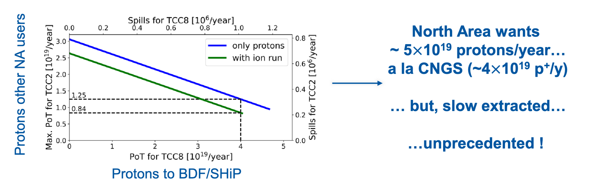
Context
With a new dedicated experimental user (SHiP) joining the SPS North Area, a coherent strategy is needed to deliver the desired flux and quality to the different CERN facilities, of both protons and ions.
M. Fraser 2024

Slide 3
Context (ii)
Focused effort concluding end of 2024
Injectors and Experimental Facilities Committee
(IEFC)
mandated
Spill Optimisation for eXperiments
(SOX)
actions
SLow Extraction Working Group
(SLAWG)
proton Sharing Across the Complex
(pSAC)
SLAWG mandate

Slide 4
Context (ii)
Injectors and Experimental Facilities Committee
(IEFC)
NA + EA users
mandated
Spill Optimisation for eXperiments
(SOX)
actions
SLow Extraction Working Group
(SLAWG)
proton Sharing Across the Complex
(pSAC)
SLAWG mandate

Slide 5
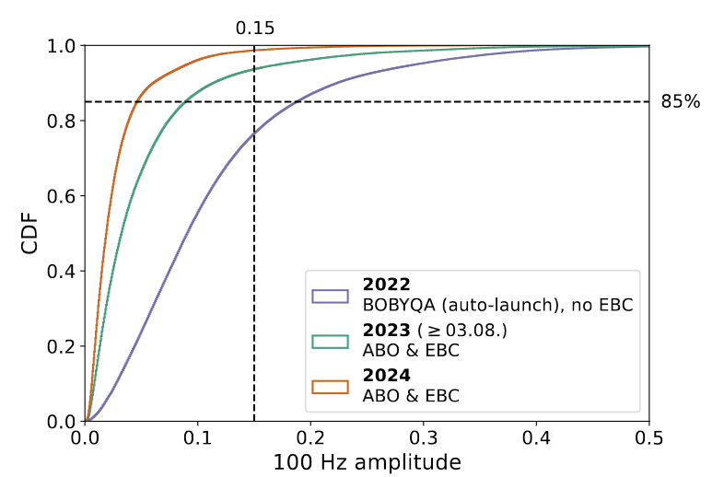
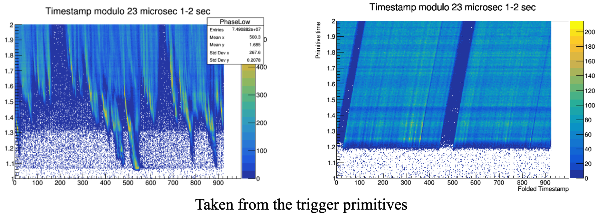
Goals
Document the spill quality, intensity and spill length requirements of North and East Area users.
Propose measures to optimise beam transport and delivery + define future R&D to overcome limits.
For example,
  Minimisation of RF structure at beginning of spill (RF manipulations)
  Minimisation of 50 Hz, 100 Hz ripple (automatic controllers, EBC)
[2]
[1]
[1] R. Piandani 2022
[2] V. Kain 2024

Slide 6
How to achieve it?
Documentation of present and future experimental spill requirements, proton-flux and spill quality bottlenecks
Development of common terminology between the ATS technical groups and the EP users/experiments to characterize the spill quality
Study and propose options to optimise beam delivery to the North Area with the aim to maximise its exploitation
1. Boundary conditions
2. Performance metrics
3. Optimisation strategies
Input from SOX to be employed for cost and resource estimates for the most promising options, with motivation linked to physics reach

Slide 7
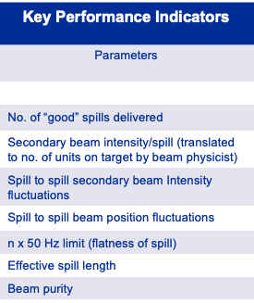
“Food for thought” for users
Spill quality requirements + common terminology:
How could a “good spill” be quantified, i.e. Key Performance Metrics (KPIs)?
Could these KPIs be published live for the beam physicists to use spill-by-spill?
Could (some of) these KPIs be computed by beam physicists directly on their own detectors? E.g. maximum rate variation at timescale X
Limitations:
Is the current setup flux-limited? E.g. could the spill time-length be halved if the flux was doubled to keep total proton counts constant?
Could the current setup handle different spill time-lengths within same super-cycle? E.g. 5 s, 1 s, 5 s, 1 s …
Could current setup handle different # of protons per spill within the same supercycle? E.g. 40e11 protons per spill, 10e11 protons per spill, 40e11 …

Slide 8
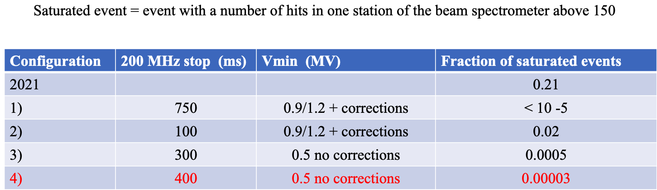
Example of KPI
Minimisation of RF structure at the beginning of the spill, performed by RF team and NA62 in 2022:

Slide 9
Next steps
We ask users to start thinking about points concerning spill quality, requirements and limitations.
Plan to follow up with focused discussions on specific topics, inviting necessary representatives from users and technical side.

Slide 10
Extra slides

Slide 11
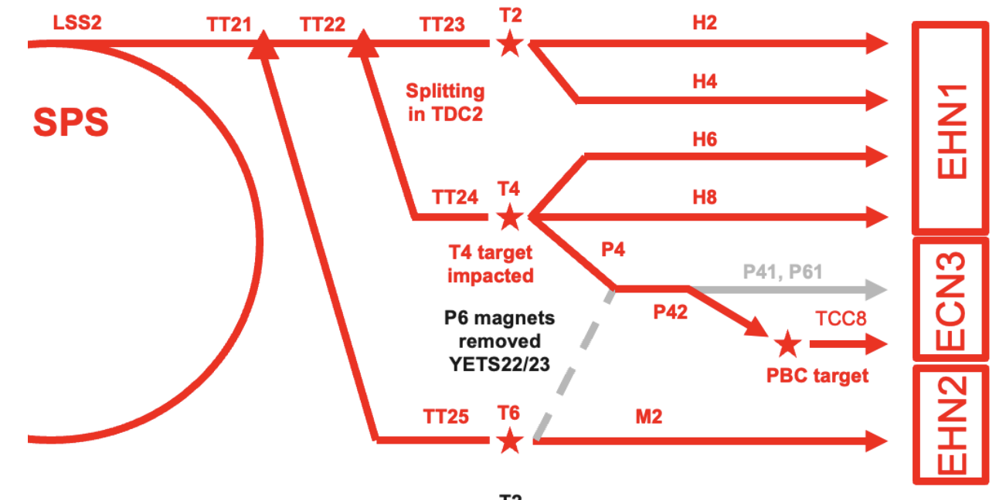
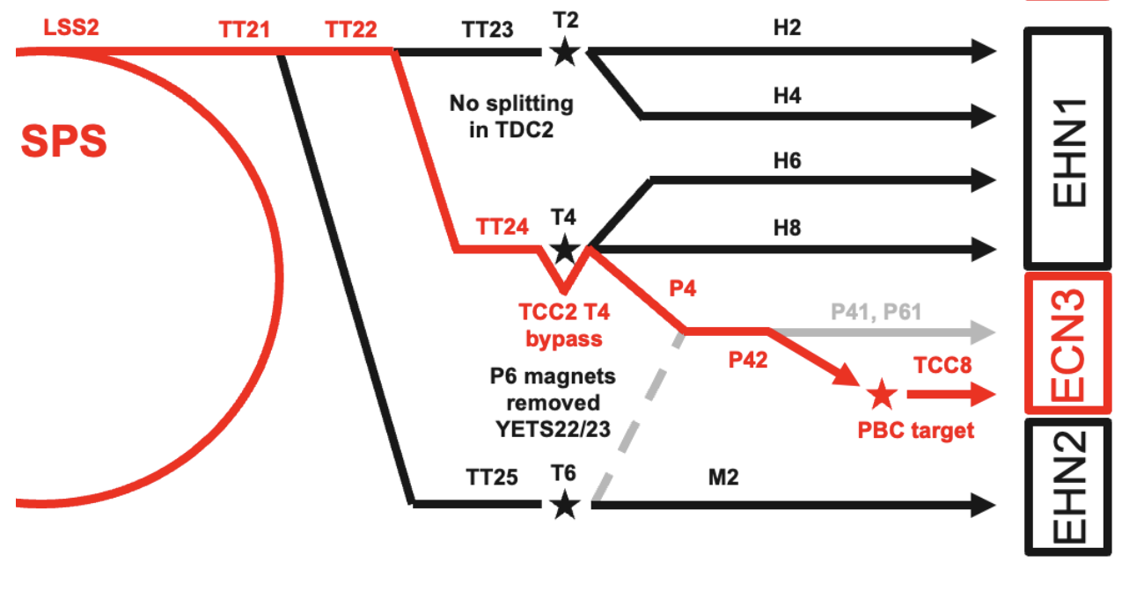
SFTPRO shared
ECN3 dedicated
M. Fraser 2024

