Slide 1
New e-gun for AD e-cooler
(Brainstorming with Jean and Gerard)
G. Khatri for e-cooling team | SY-BI-XEI
03 July 2024,

Slide 2
Outline
Simulations: chosen the best geometry (A. Pikin, 2019)
Transformed to production design (proto & final)
Proto gun test results (Gunn, Alex, Jean, Gerard)
What we learned

Slide 3
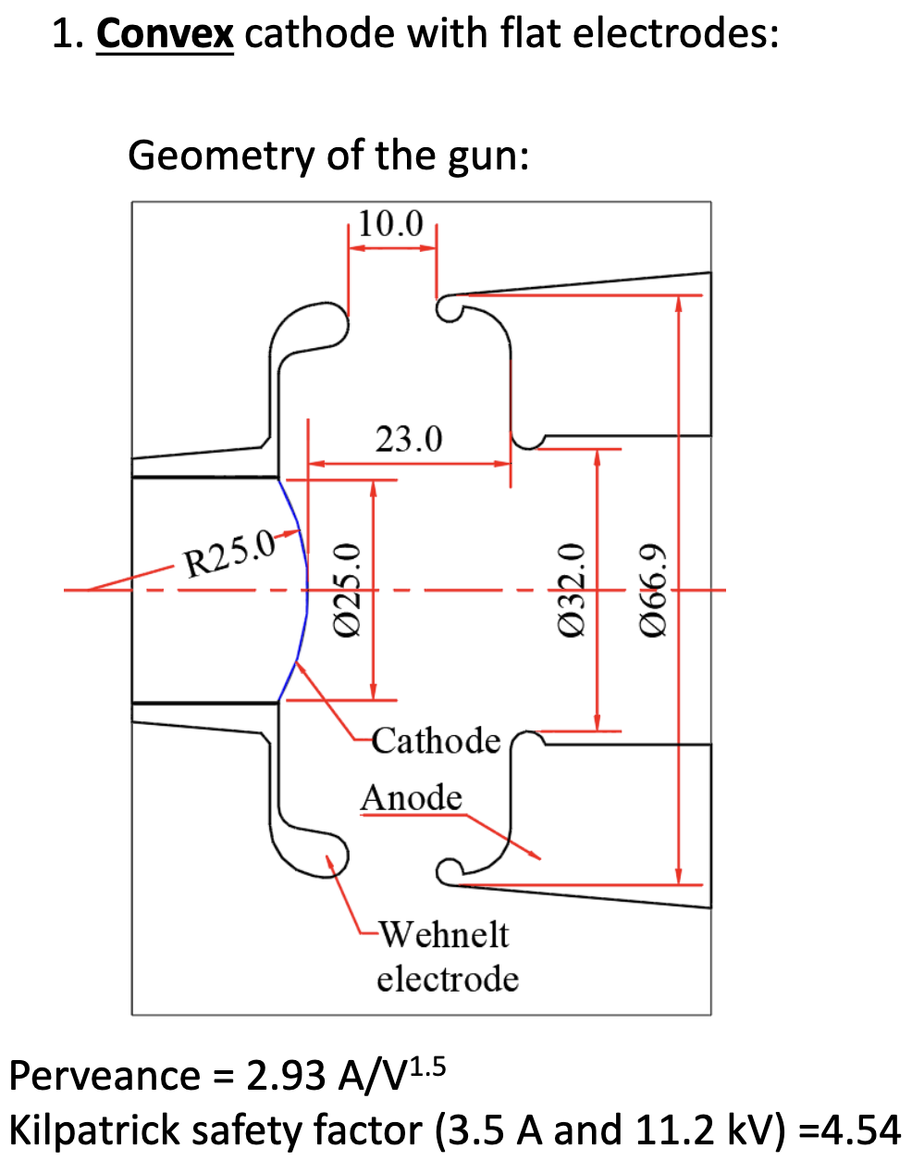
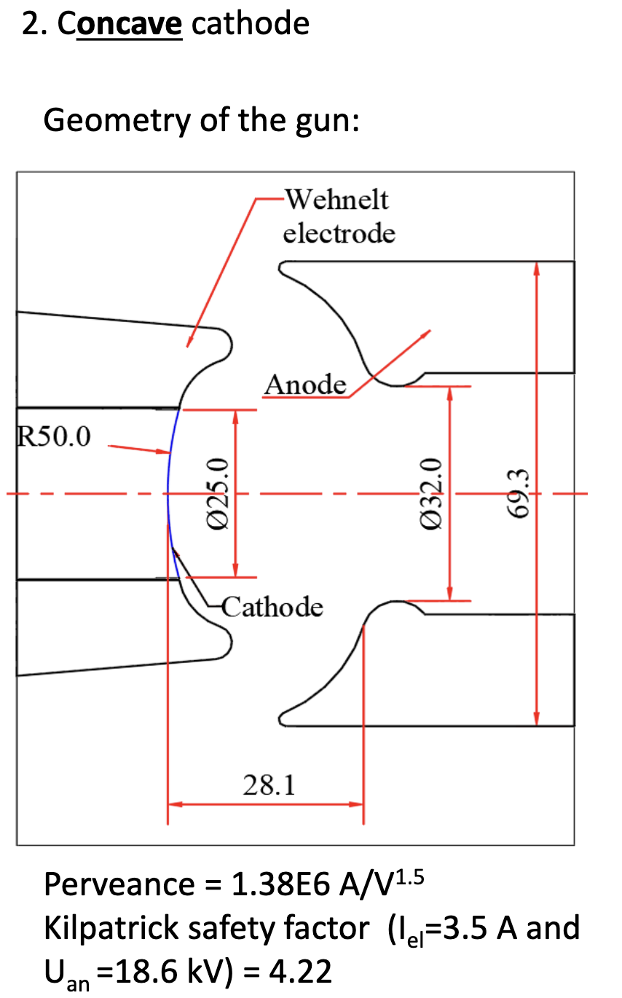
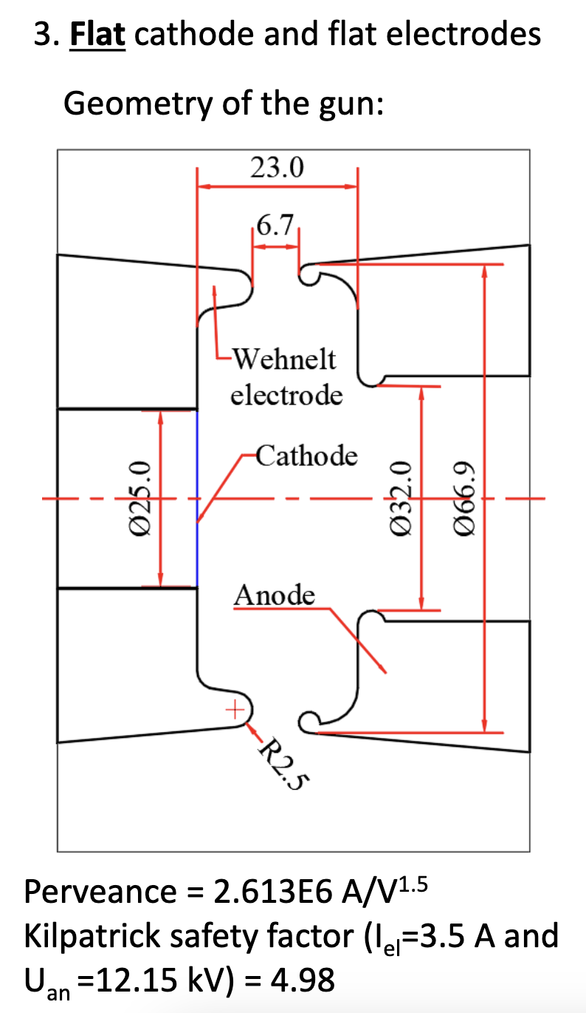
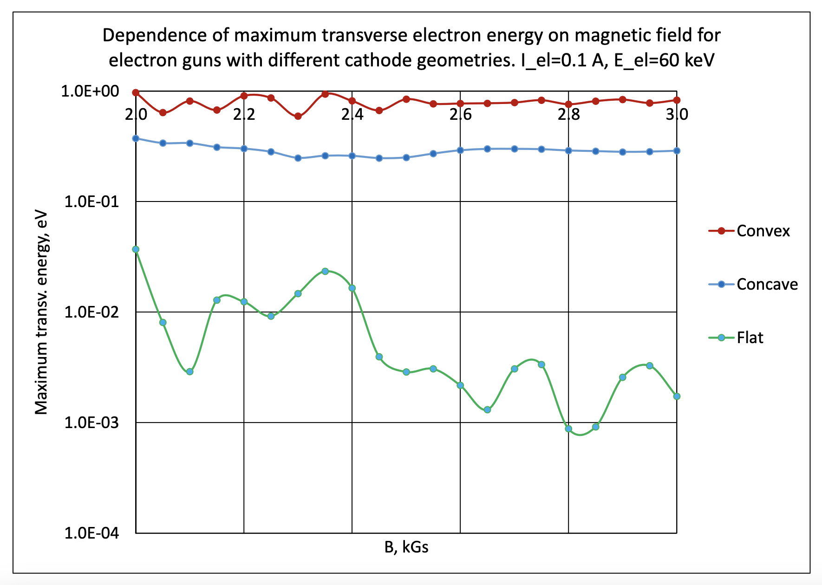
2019 Simulations by Sasha (A. Pikin)
Link to slides
Flat cathode design gives the lowest transverse temperature !!!

Slide 4
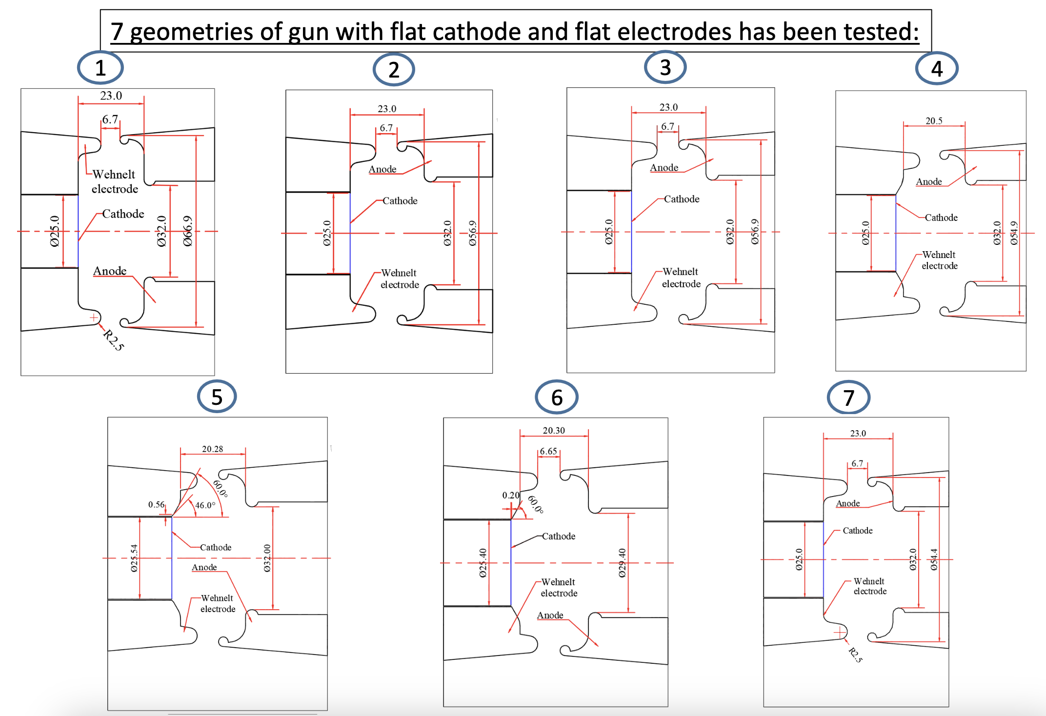
2019 Simulations by Sasha (A. Pikin)
Link to slides
7 different variation
of flat cathodes tried
to find optimum design.

Slide 5
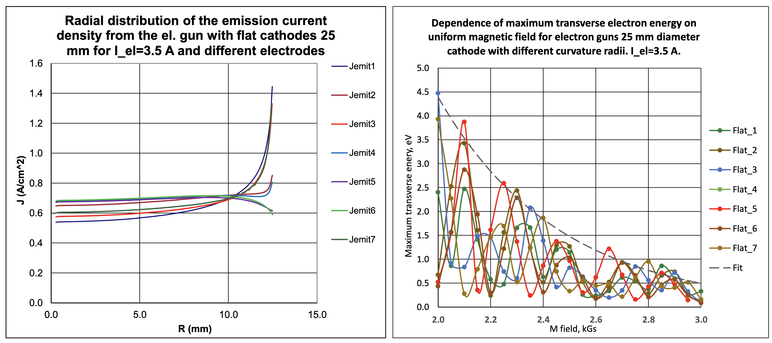
2019 Simulations by Sasha (A. Pikin)
Link to slides
All 7 flat design comparison in:
current density vs radius
Transverse temp vs B field

Slide 6
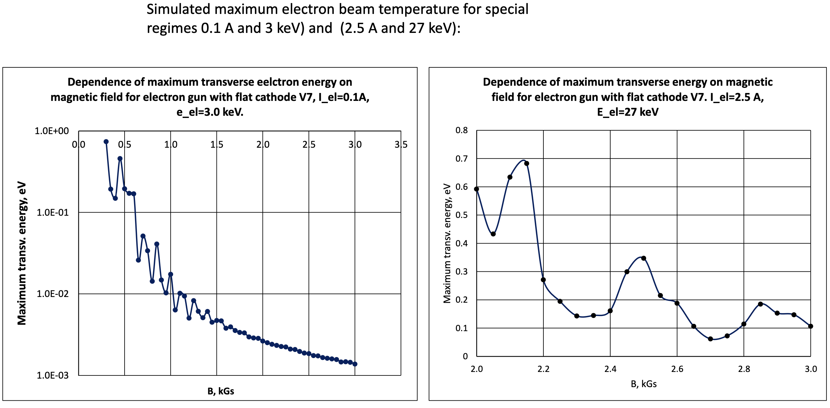
2019 Simulations by Sasha (A. Pikin)
Link to slides

Slide 7
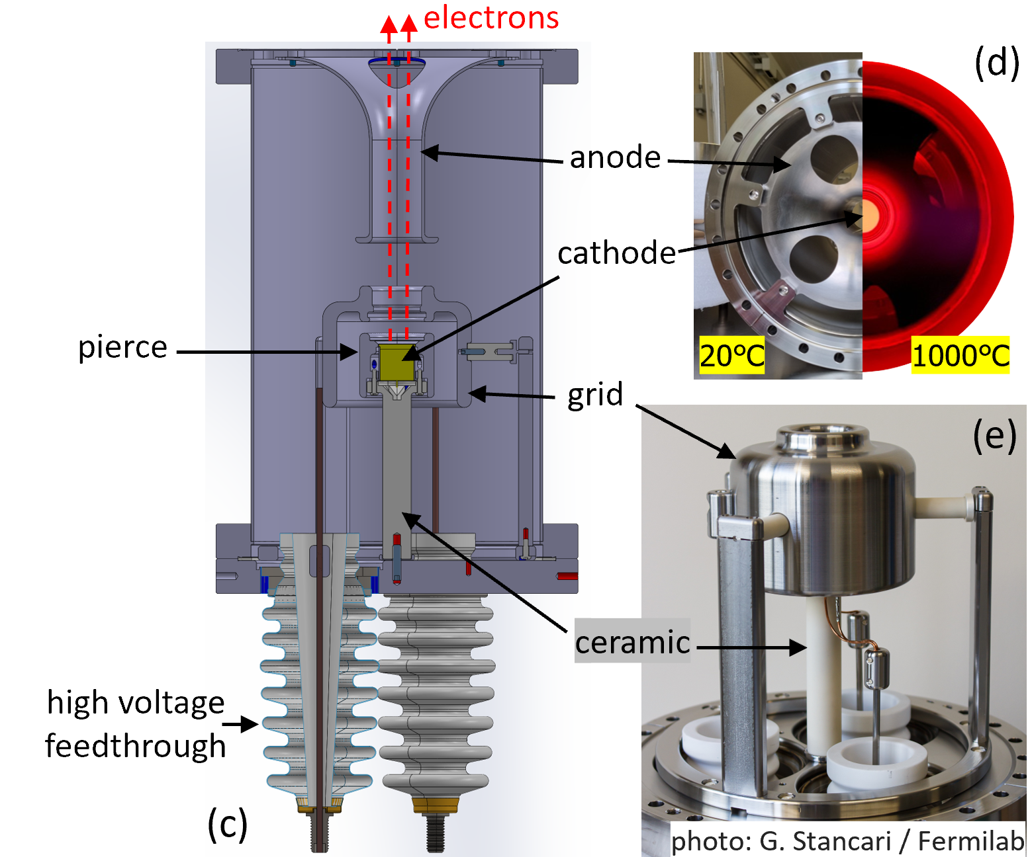
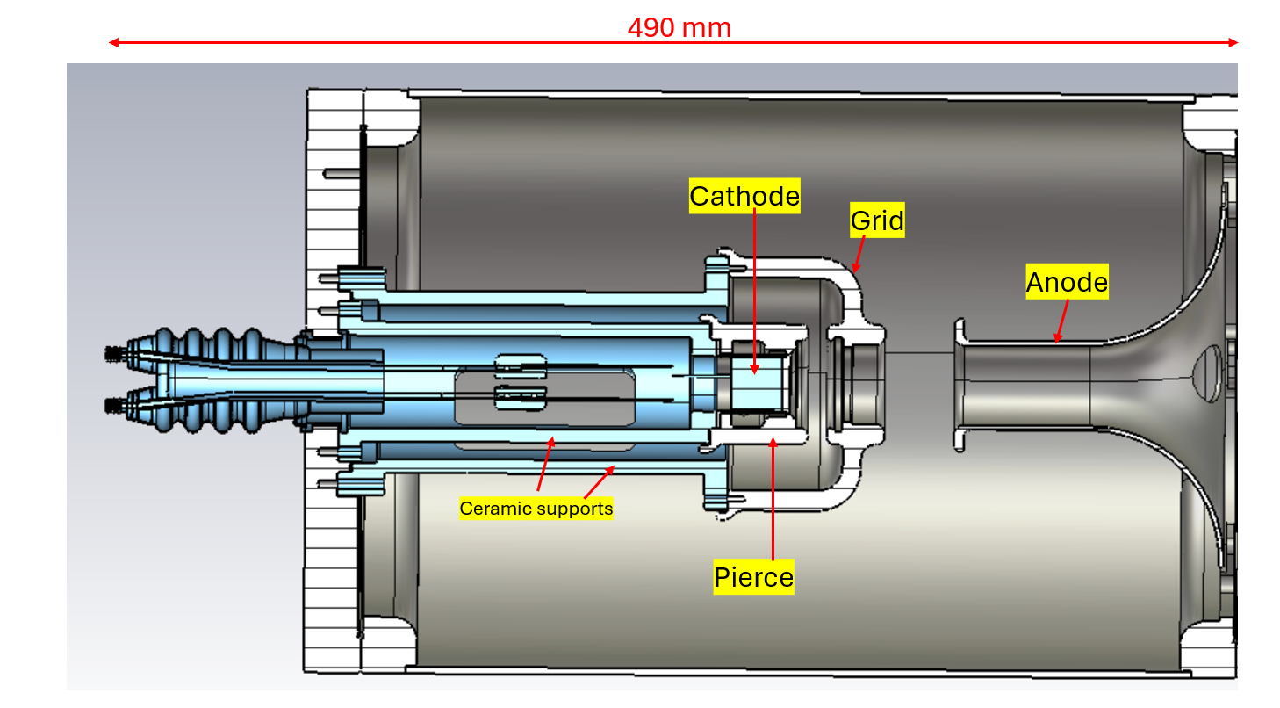
Proto and final gun design
Larger vacuum chamber,
Different ceramic support !
PROTO
Final

Slide 8
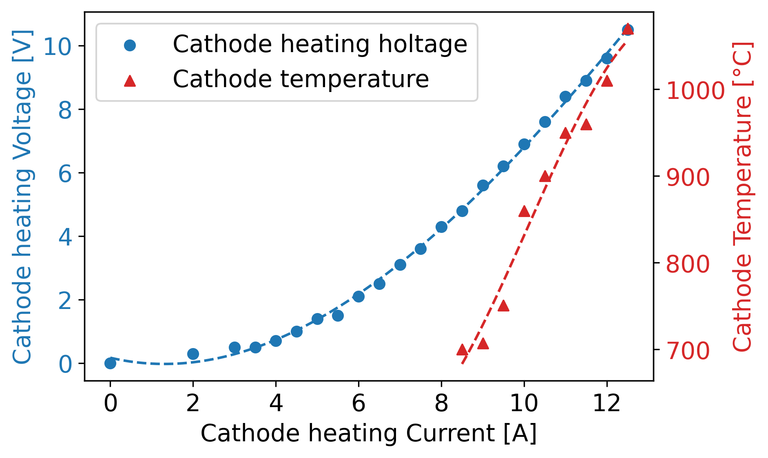
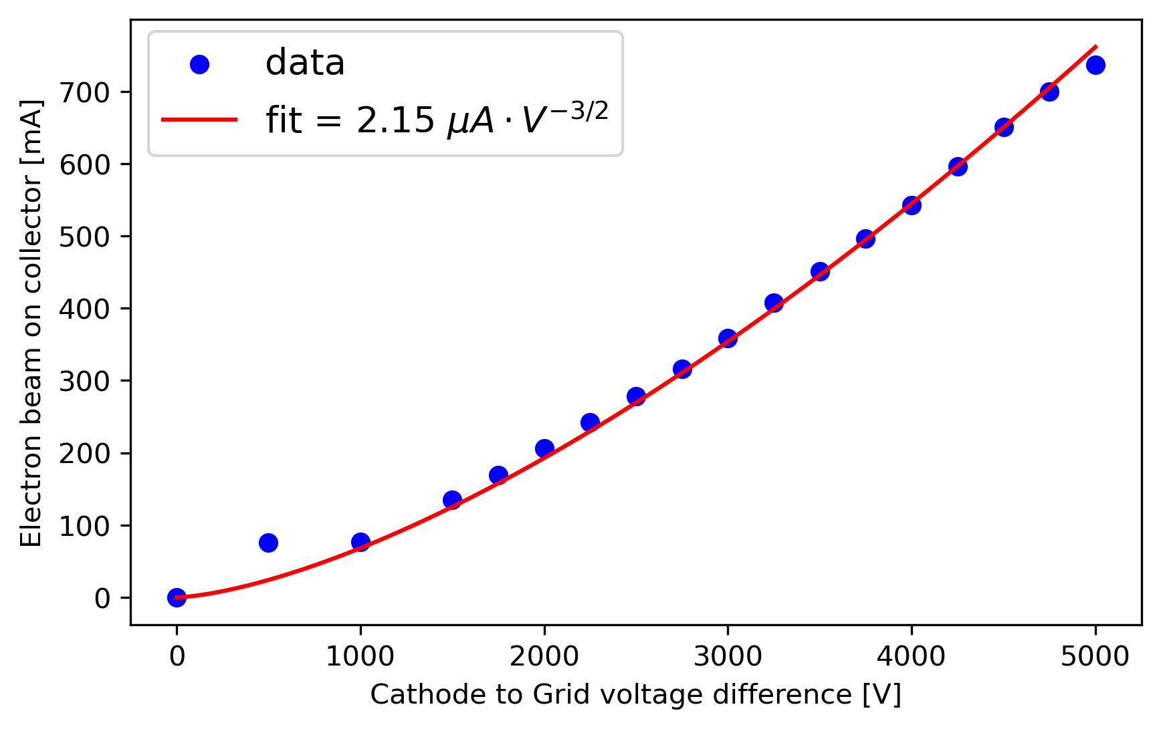
Proto gun test results
Beam extracted up to 5 keV and perveance measured !
Close to simulated design pervance 2.2-2.5 uP
(CST, Comsol, TRAK, EGUN)
Heated cathode to 1070 ℃
(measured with pyrometer, 1% max variation at the center)

Slide 9
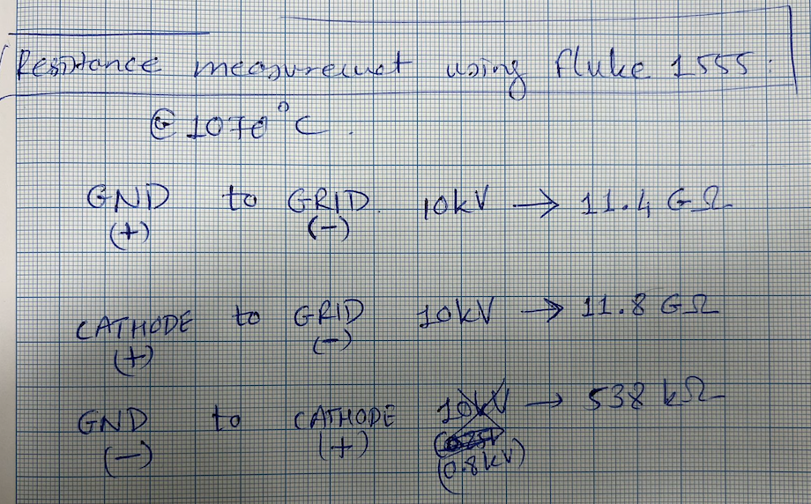
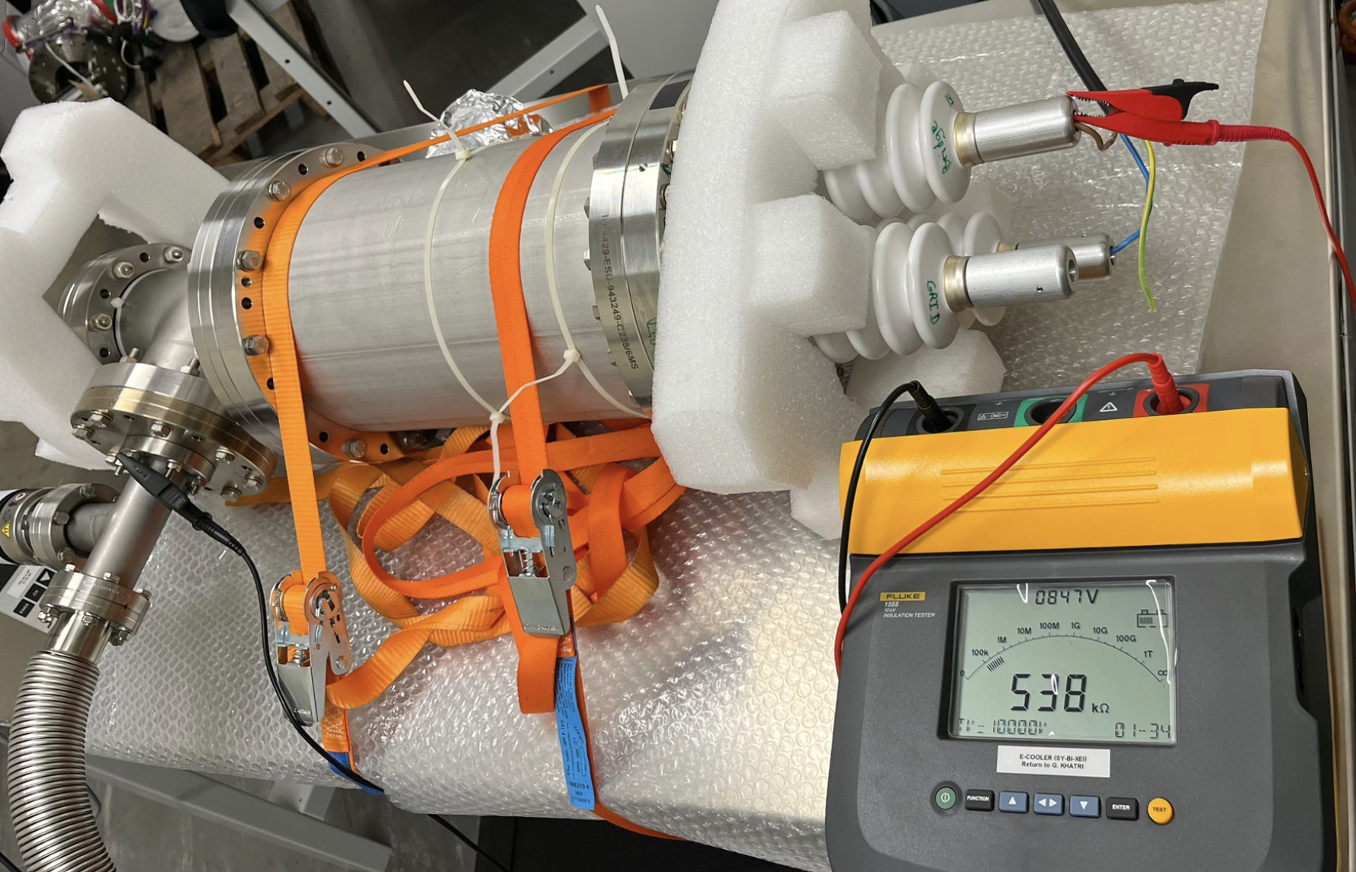
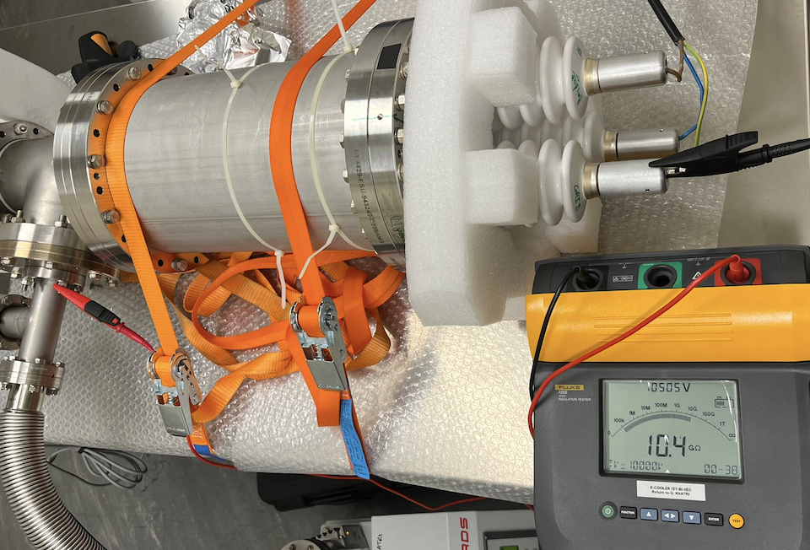
Weak points: ceramic resistance low when hot
Ceramic in the vacuum – cathode heating power of 100 W discipates mainly through conduction in the cathode support ceramic.
Grid gets hot mainly through thermal radiation.
As a result, the cathode ceramic reached 800 ℃ temperature on on end and 200 ℃ on the cold end. And the grid temperature reached 500 ℃ and grid ceramics around 400 ℃
The resistance of the ceramic (cathode to ground) was measured to be 540 kΩ hot. (> 1 TΩ when cold).
The resistance of the grid ceramics (grid to ground) was measured to be 10.4 MΩ hot. (> 1 TΩ when cold).

Slide 10
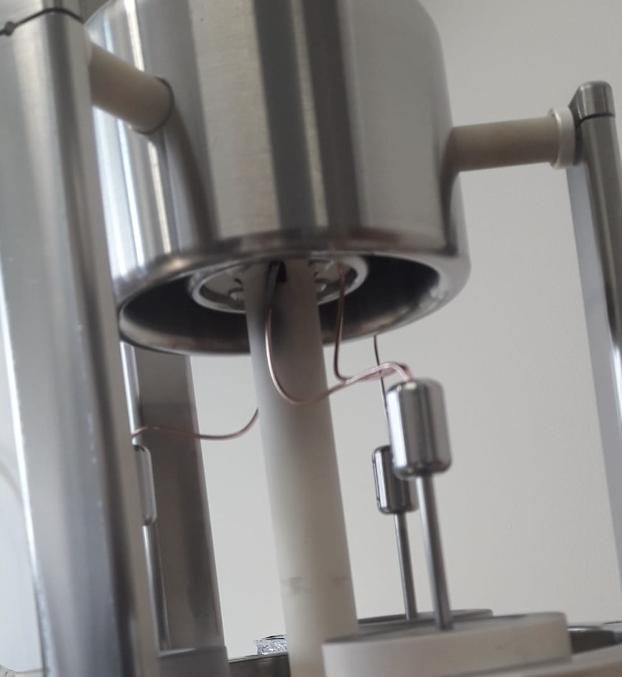
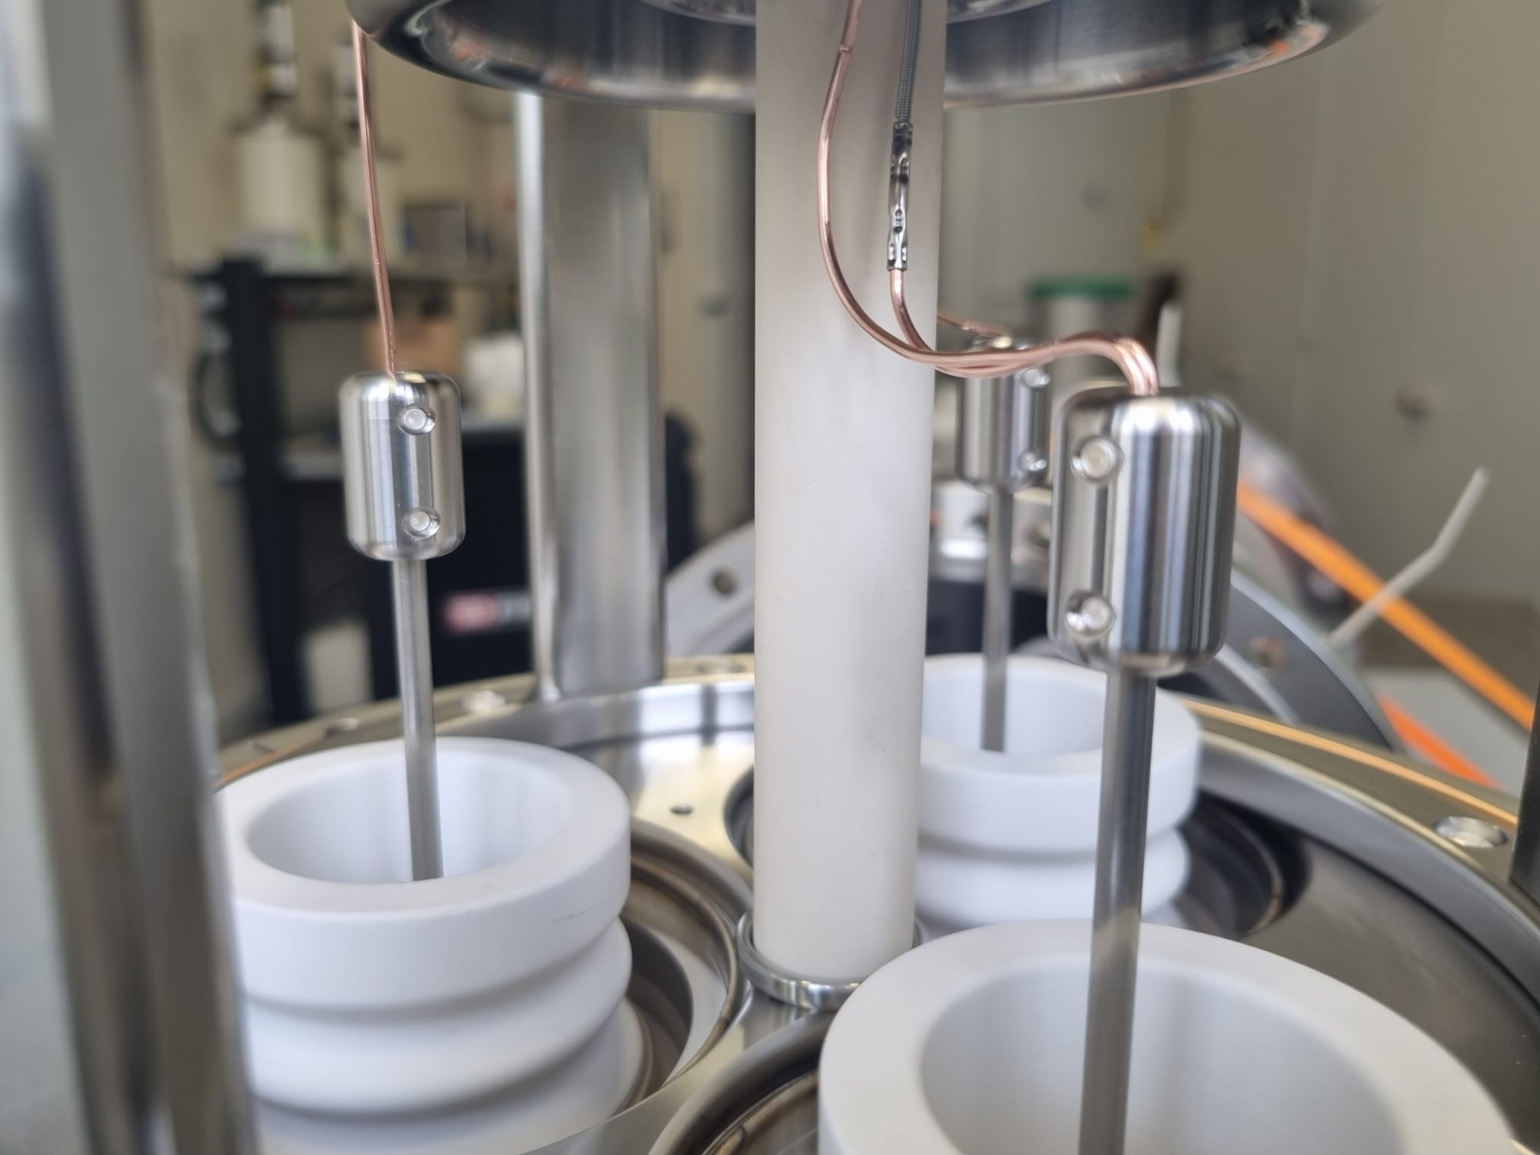
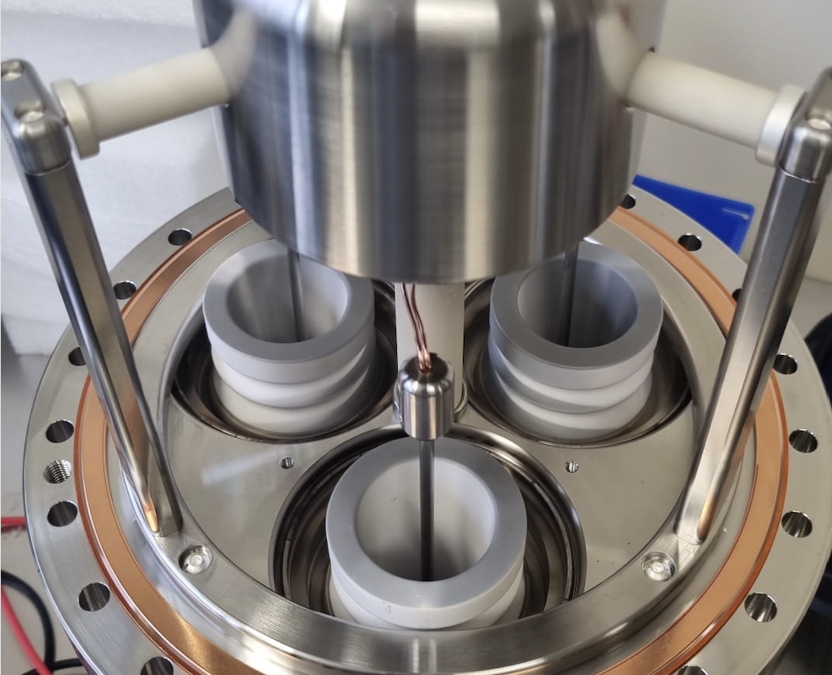
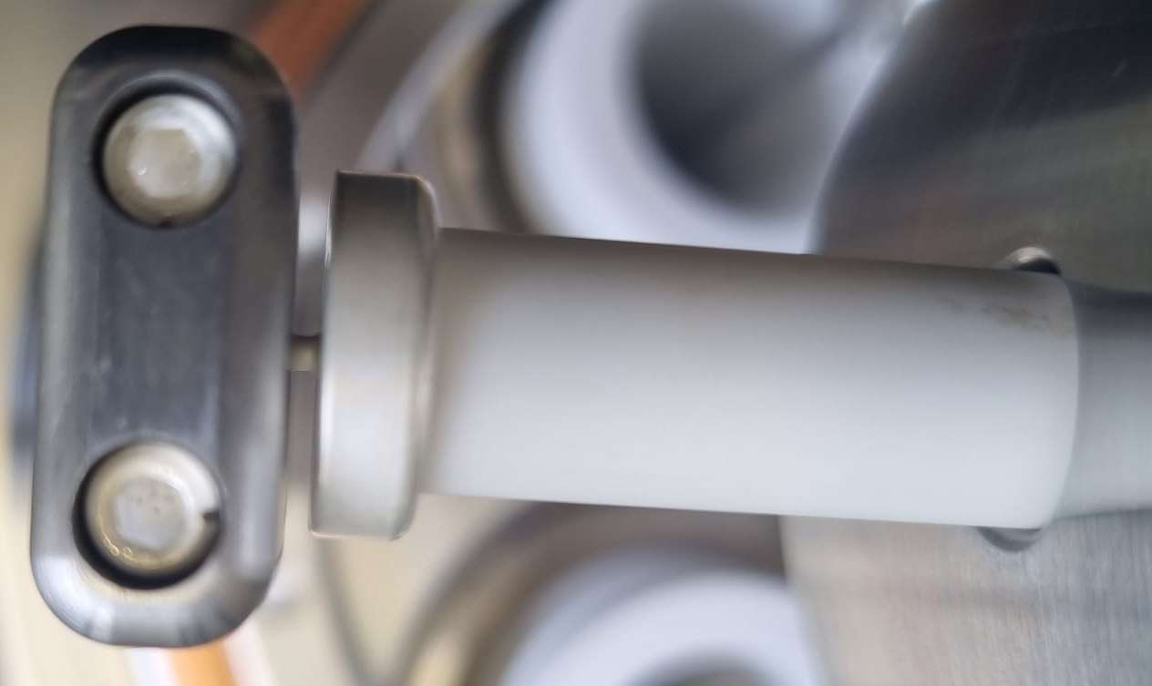
Molybdenum coating after overheating cathode
Proto gun open after cathode over heated @ 18 A !
Proto gun open after first filament heating in b8,
no grey sputtering found on ceramic, it looked clean !
Molybdenum sputtering
after overheating cathode

Slide 11
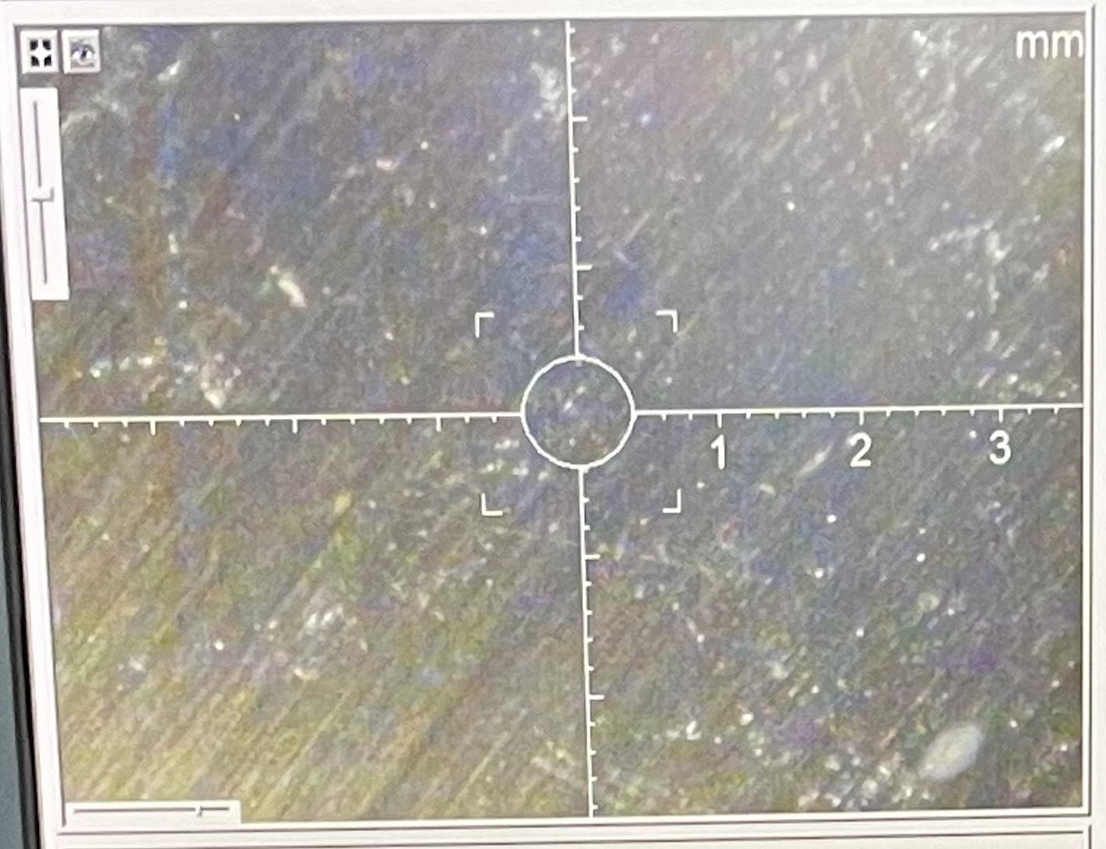
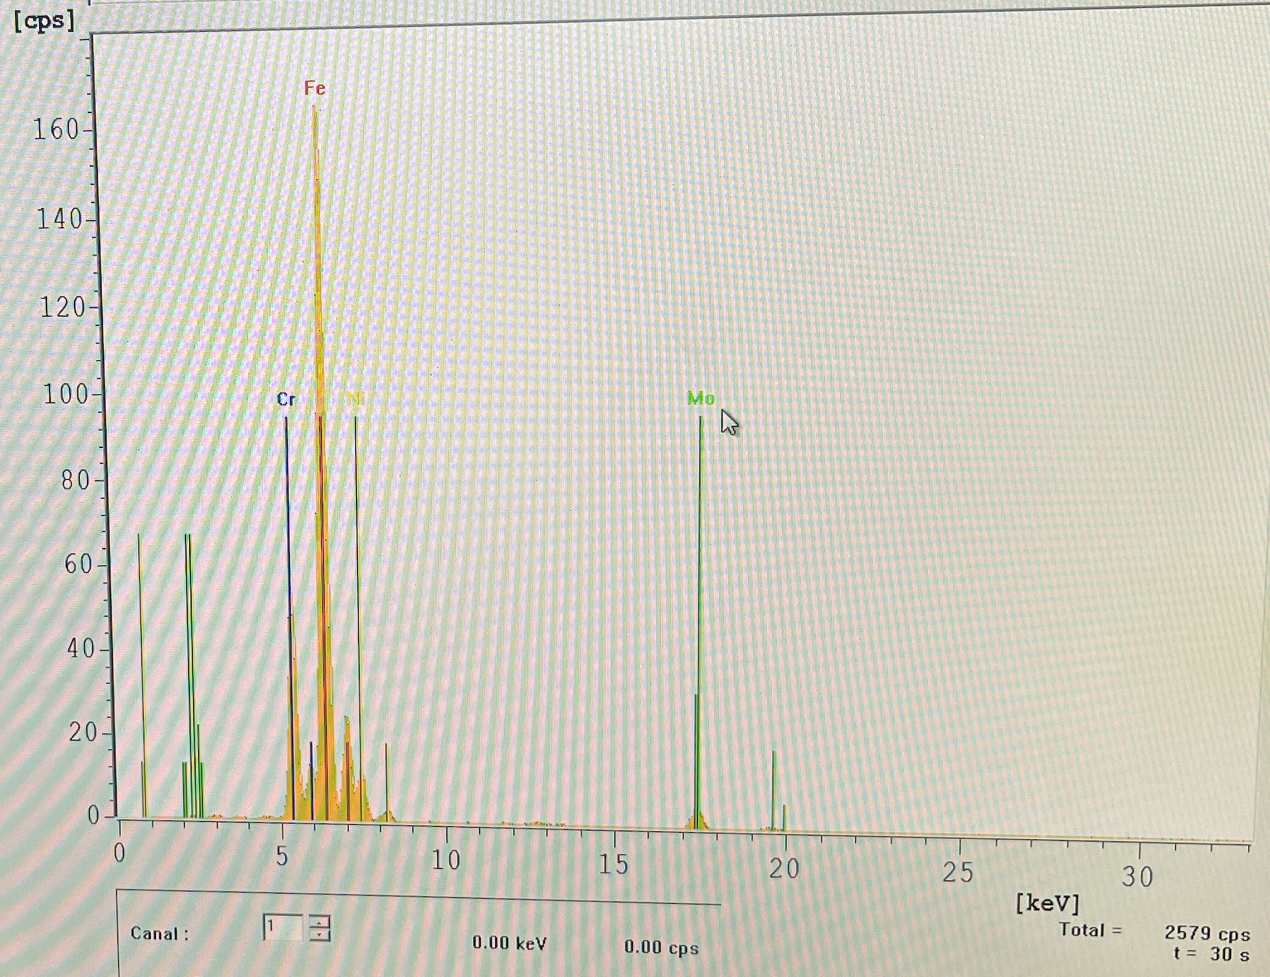
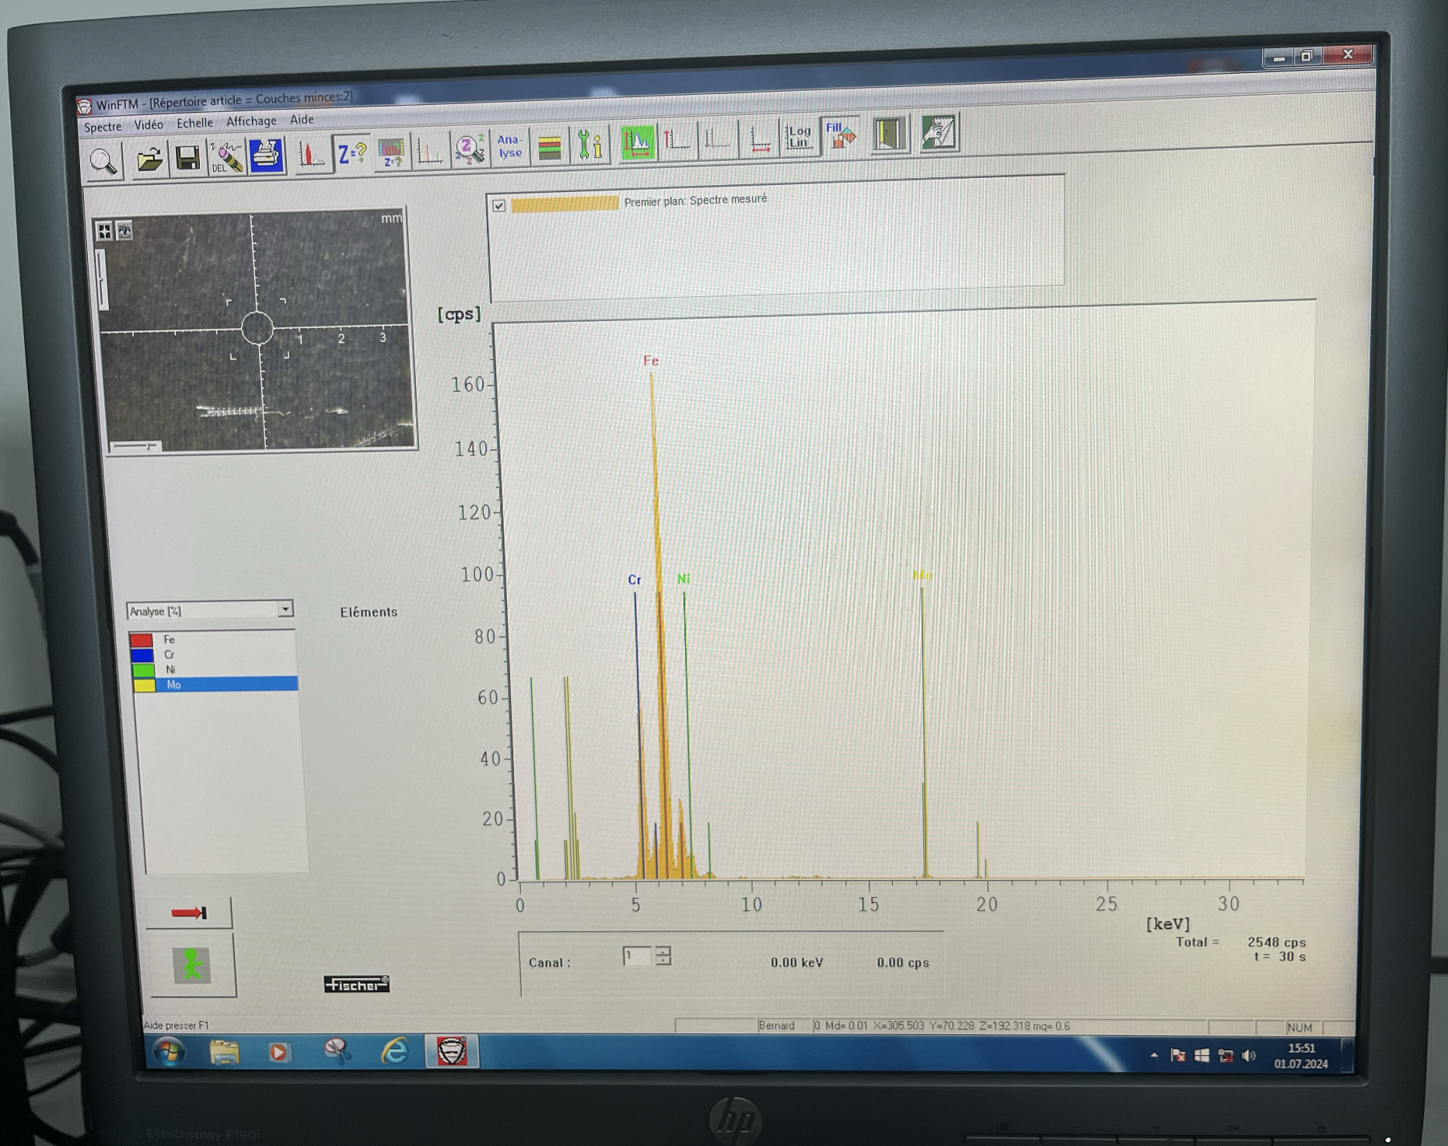
Weak points: heat shield and outgassing of Mo
The cathode nominal operating temperature is 1000 ℃ (12.5 A, 10.5 V, i.e. 132 W) however during first activation phase, the heating current is raised above 14 A for few hours, as a results some part of the cathode such as the casing and the lead would reach 1600 degree C where Molybdenum start to evaporate.
During proto gun test, we raised the cathode heating to 17-18 A, which lead damaging the test cathode (old from 1980). After opening the gun we noticed grey metalic coating due to ion sputtering. After doing the x-ray fluoroscent spectroscopy of the contaminated ceramic and stainless steel, we found it was Molybdenum.
The cathode ceramic resistance dropped from 1TΩ to 200 MΩ due to molybdenum coating.
Image courtesy: Marc Thiebert (TE-VSC)
Molybdenum (Mo)
Stainless steel

Slide 12
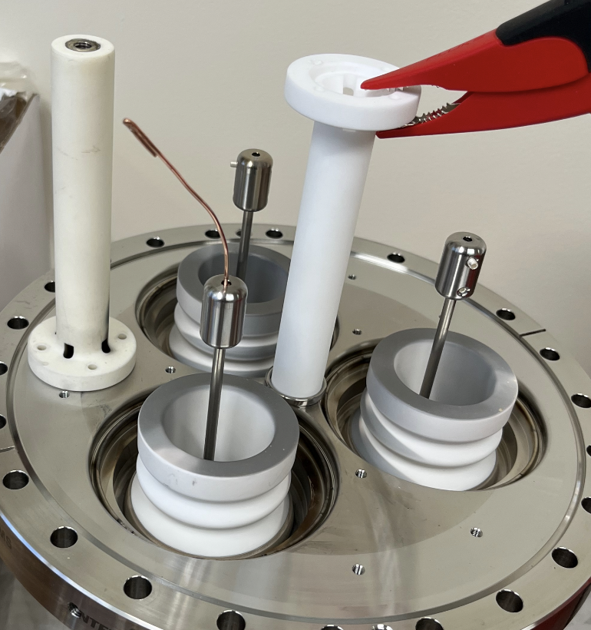
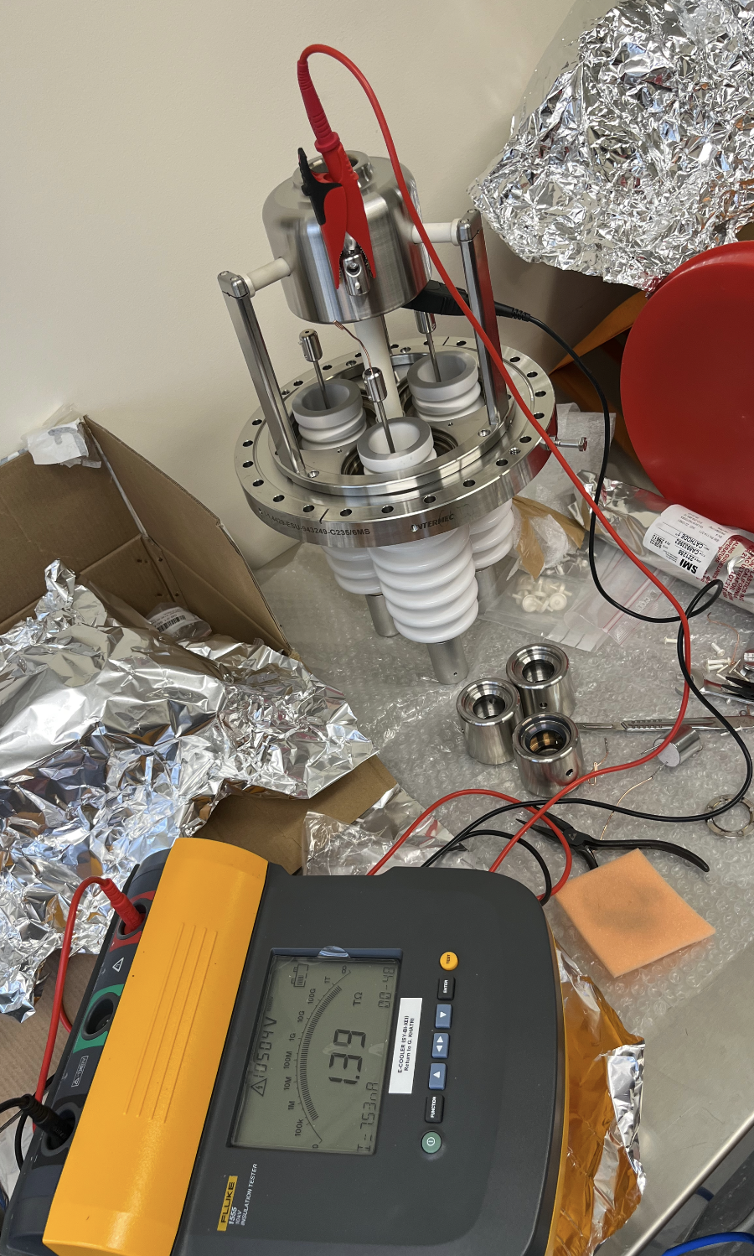
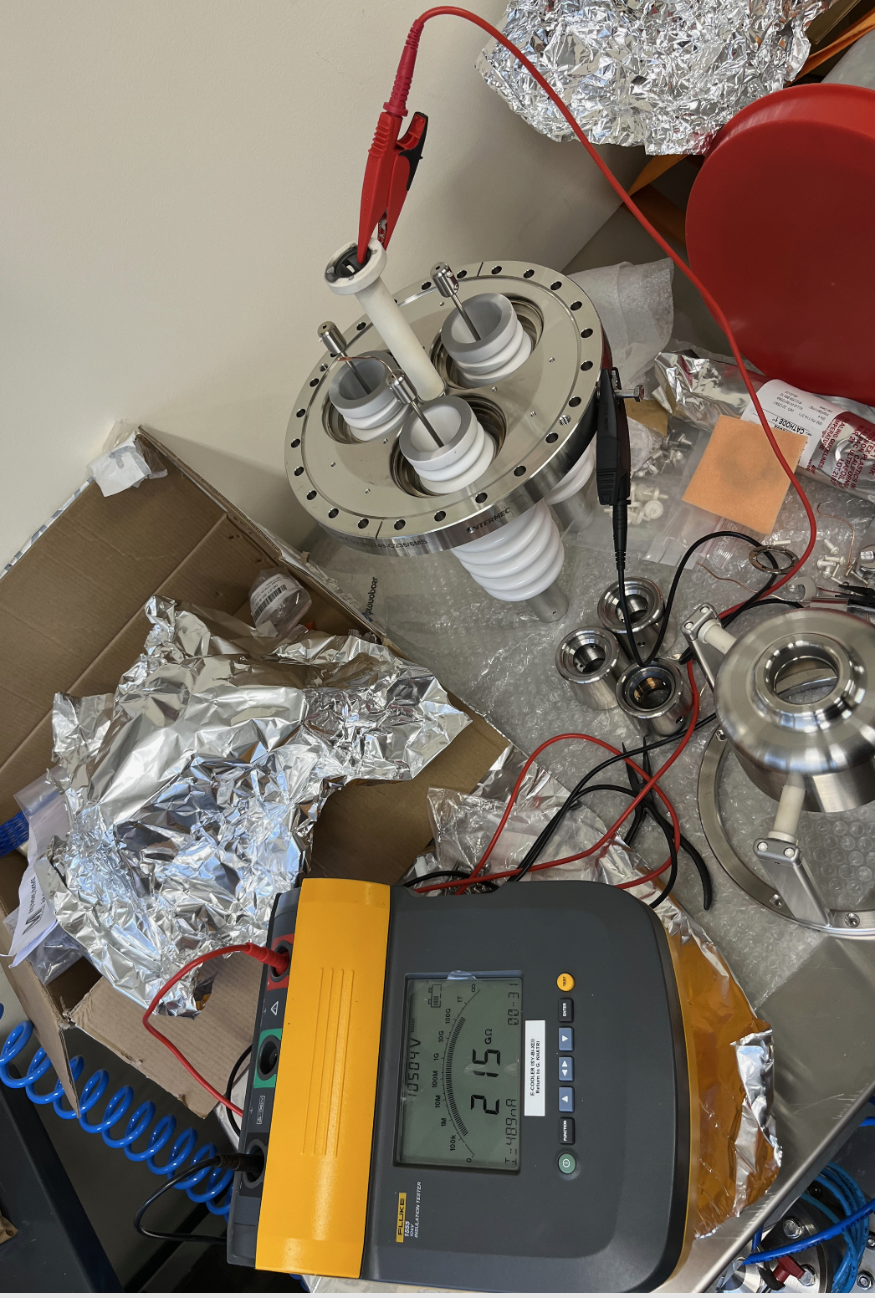
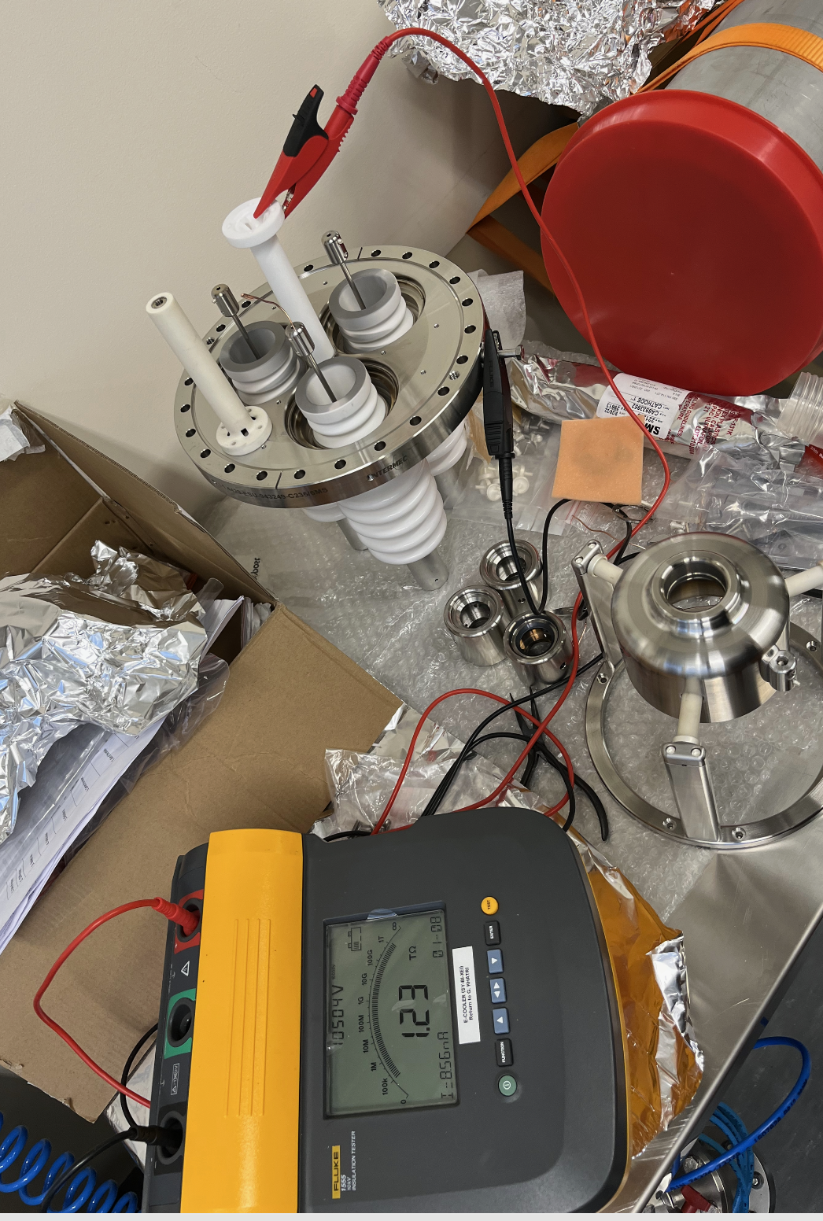
Resistance of ceramic dropped due to Mo
Resistance after gun tests
Grid-to-Ground > 1 TΩ
Cathode-to-Ground 200 MΩ

Slide 13
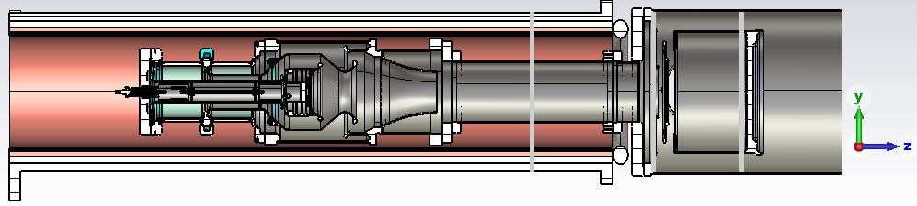
Solutions: proto gun and final gun
Do not heat cathode above 1100 ℃ (avoid high temperature activation), let it outgass slow and for longer duration.
Add tantalum foil on the side/back of the cathode to improve homogeneity of the cathode temperature, this also will reduce molybdenum evaporation and prevent it from reaching it to the ceramic.
Increase the distance between cathode and ceramic:
  For proto gun, make shorter ceramic and add ss piece between cathode and ceramic to reduce thermal conduction.
  For final gun, copy the concept from old russian gun where ceramic is part of the vacuum chamber

Slide 14
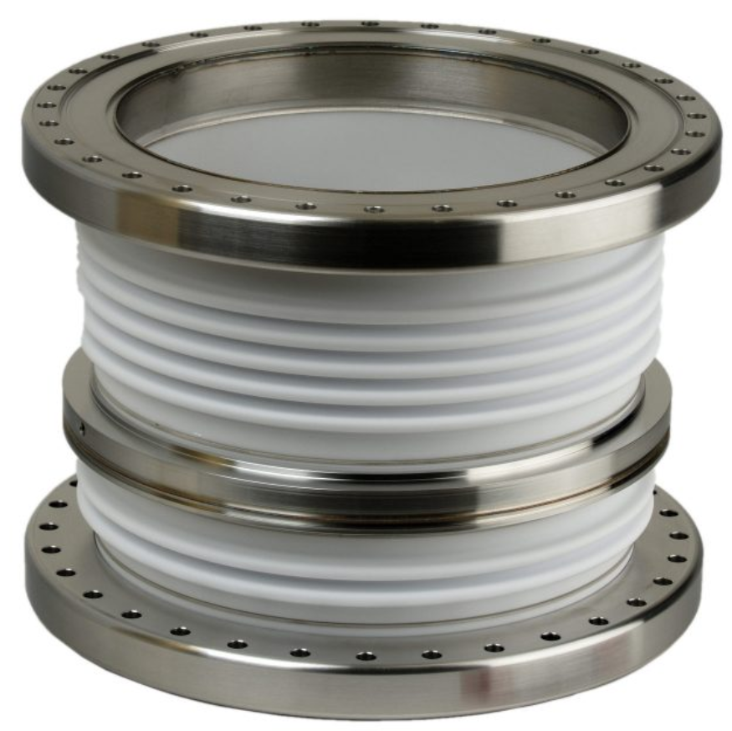
Example wavy ceramic for final gun ! (in DN160CF flange)
V_cathode
V_ground
V_grid
Image from: https://www.sct-ceramics.com/en/markets/electron-tubes/

Slide 15
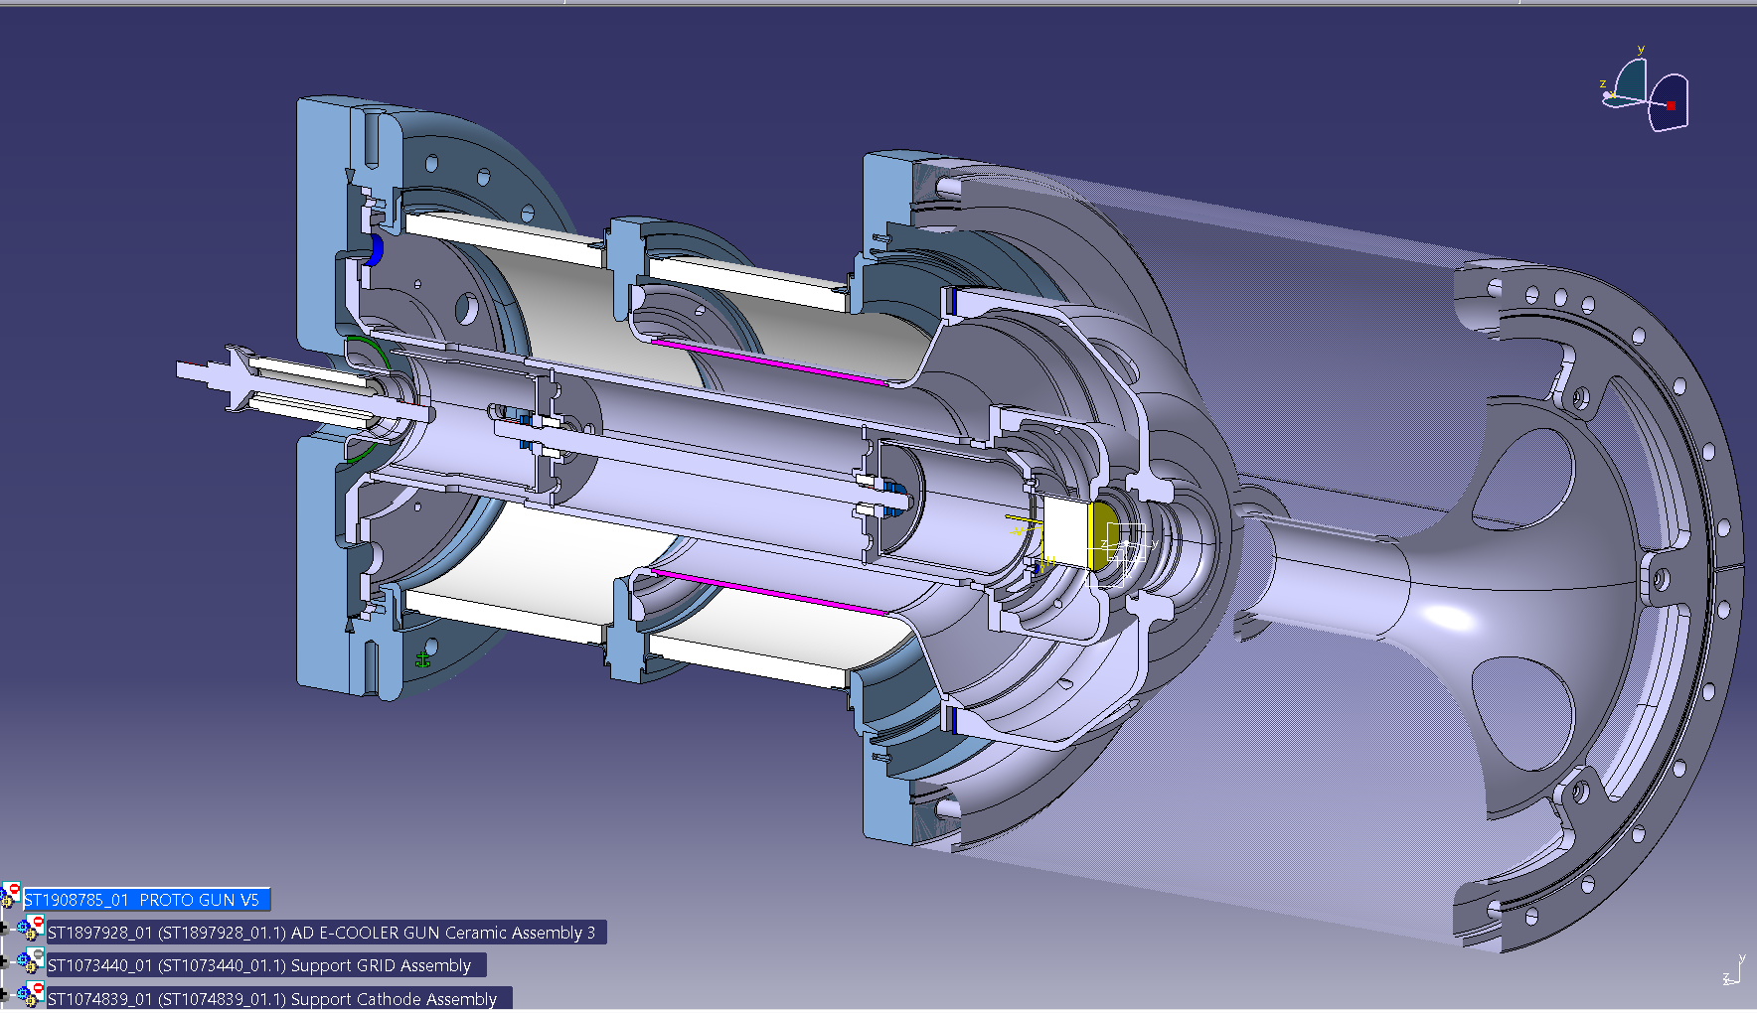
Jean design proposal, gun v5 (July 2024)

Slide 16
What should be ceramic length ?
Normally in vacuum 1mm/1kV and 2mm/1kV in air
But for a hot ceramic, > 60℃ this limit goes up
For Russian gun, for 35 kV, they had in air 100 mm, that is also hot ceramic, which is 2.8 mm/kV in air, and it works. So we aim for 3 mm/kV in air, with a wavy ceramic, the ceramic length can be shortened to about half, that is 50 mm.
With security margin, we make it 60mm long each ceramic tube.

Slide 17
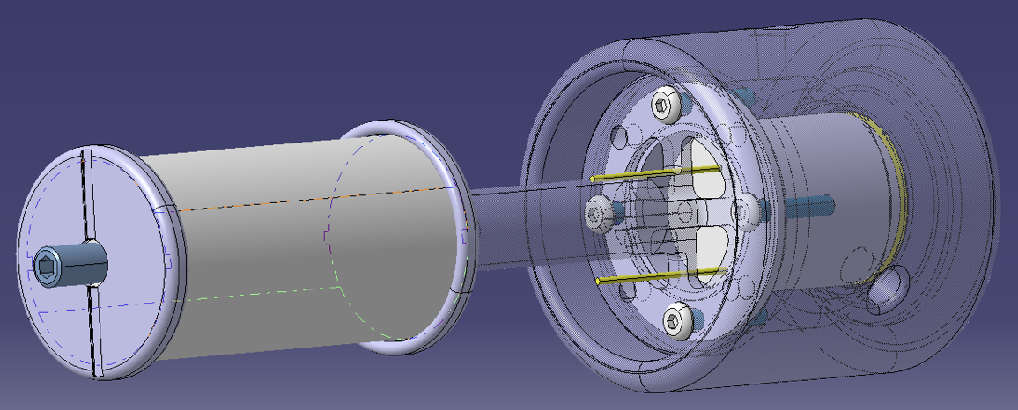
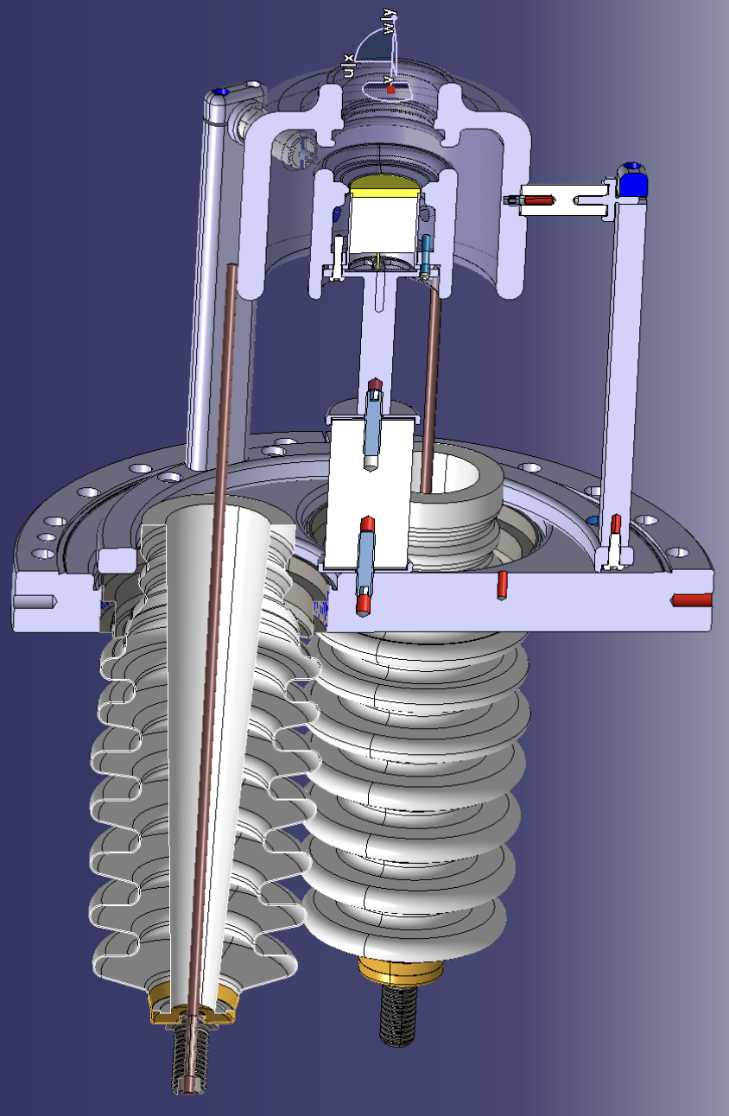
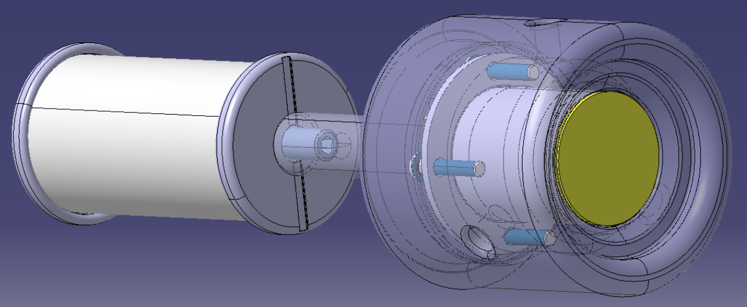
Proto gun modification
Ceramic of 12cm was originally for 68 kV but since then we reduced requirement to 30 kV, this reduced ceramic length and keep it away from cathode

Slide 18
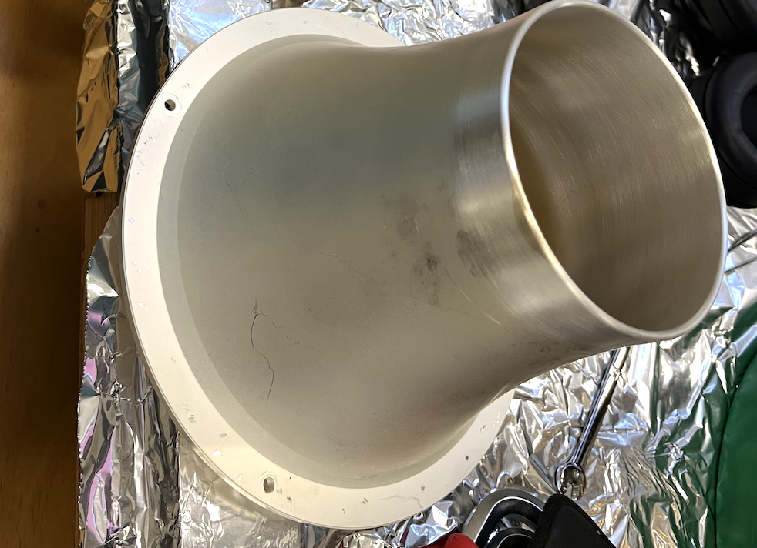
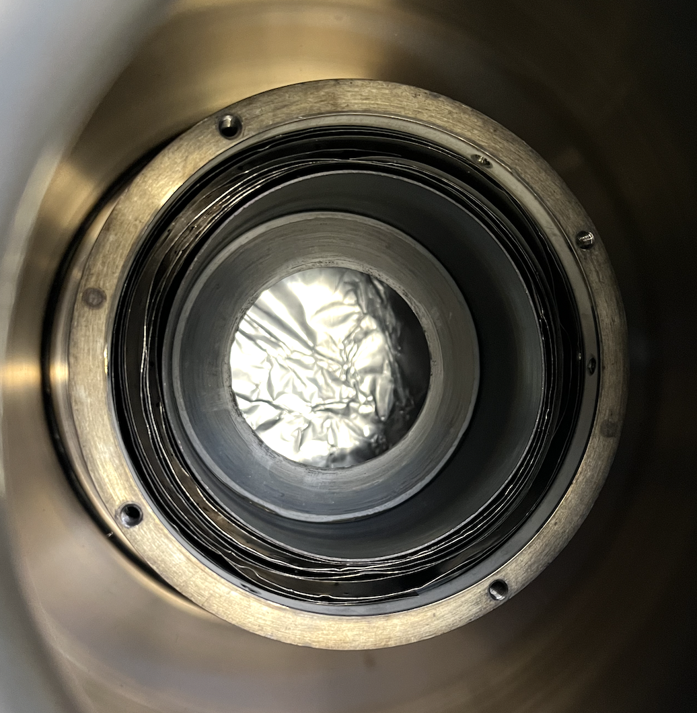
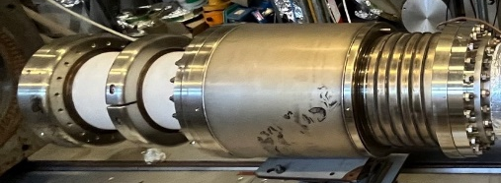
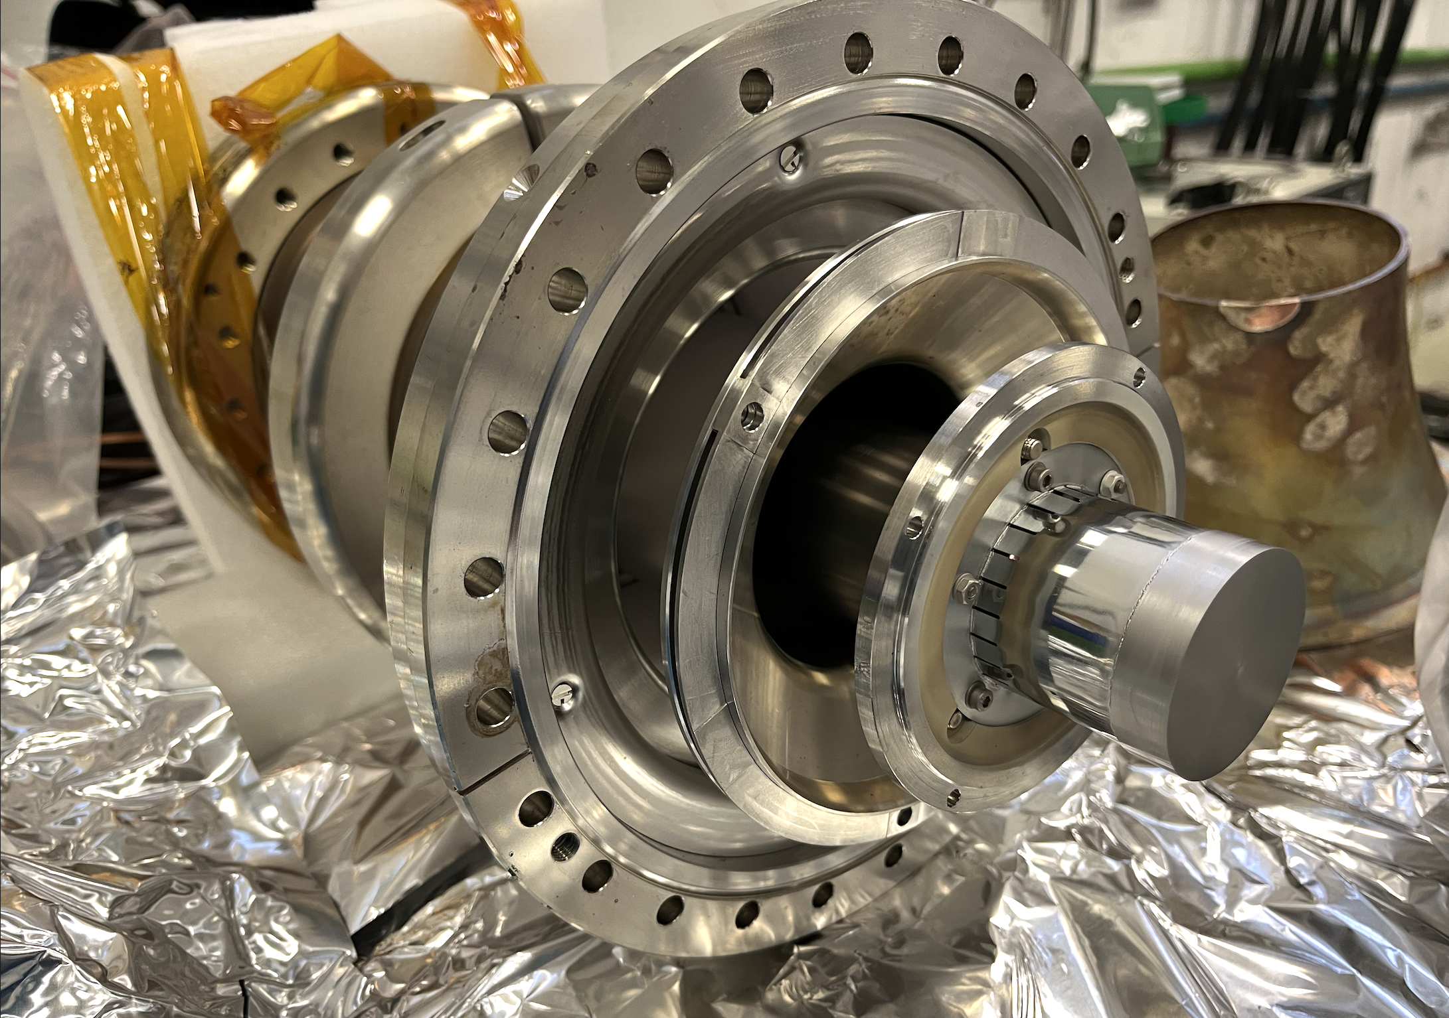
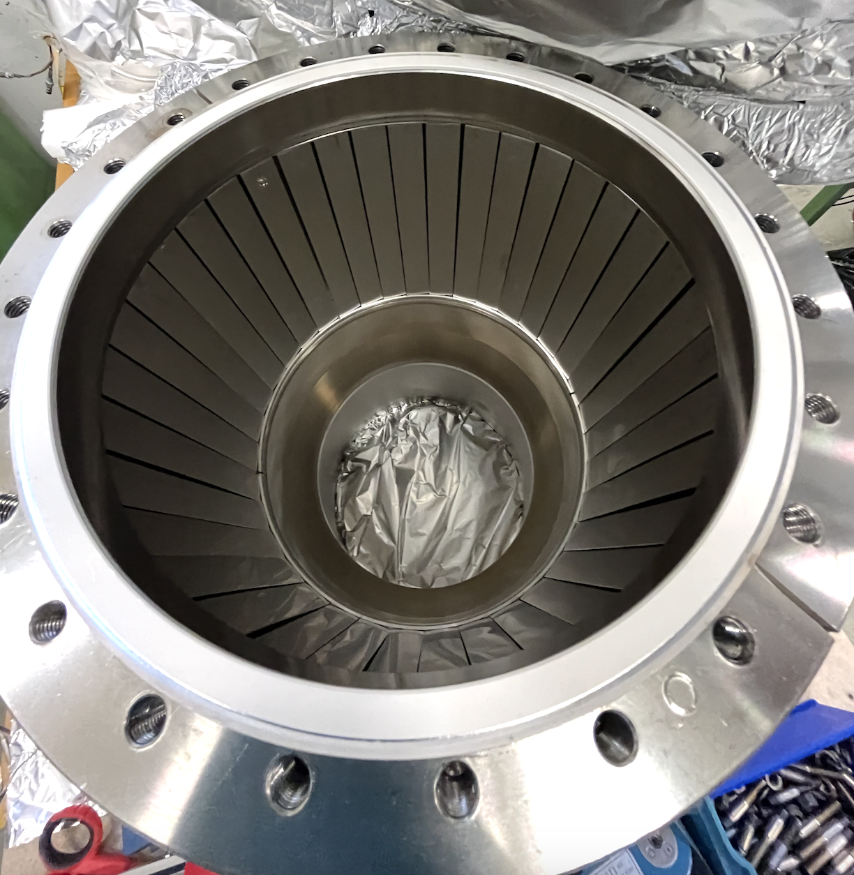
Old gun details for comparison
Russians had thought through about the thermal management very carefully !
Silver coated anode (thermal emissivity is about 10 times lower than that of ss
ceramic
cathode
Cooling water
on the outside of anode
chamber
Tantalum foils for radiative heat shield
inside hollow pierce electrode
Cathode is far from ceramic, large ceramic tube air side,
Icathode inside chamber that has metal strips for low emissivity ?

Slide 19
Old russian gun – 2D drawings info
Anneal after machining at 900 + 150 degree C
All electrodes vacuum fire at 400 degree after electropolish for better homogeneity in terms of magnetism
Weld joint/roughness kept small
Vibration treatment to remove weld stresses
Silver plating anode for reducing thermal emissivity (10 times less than ss)

Slide 20
Old gun details

Slide 21
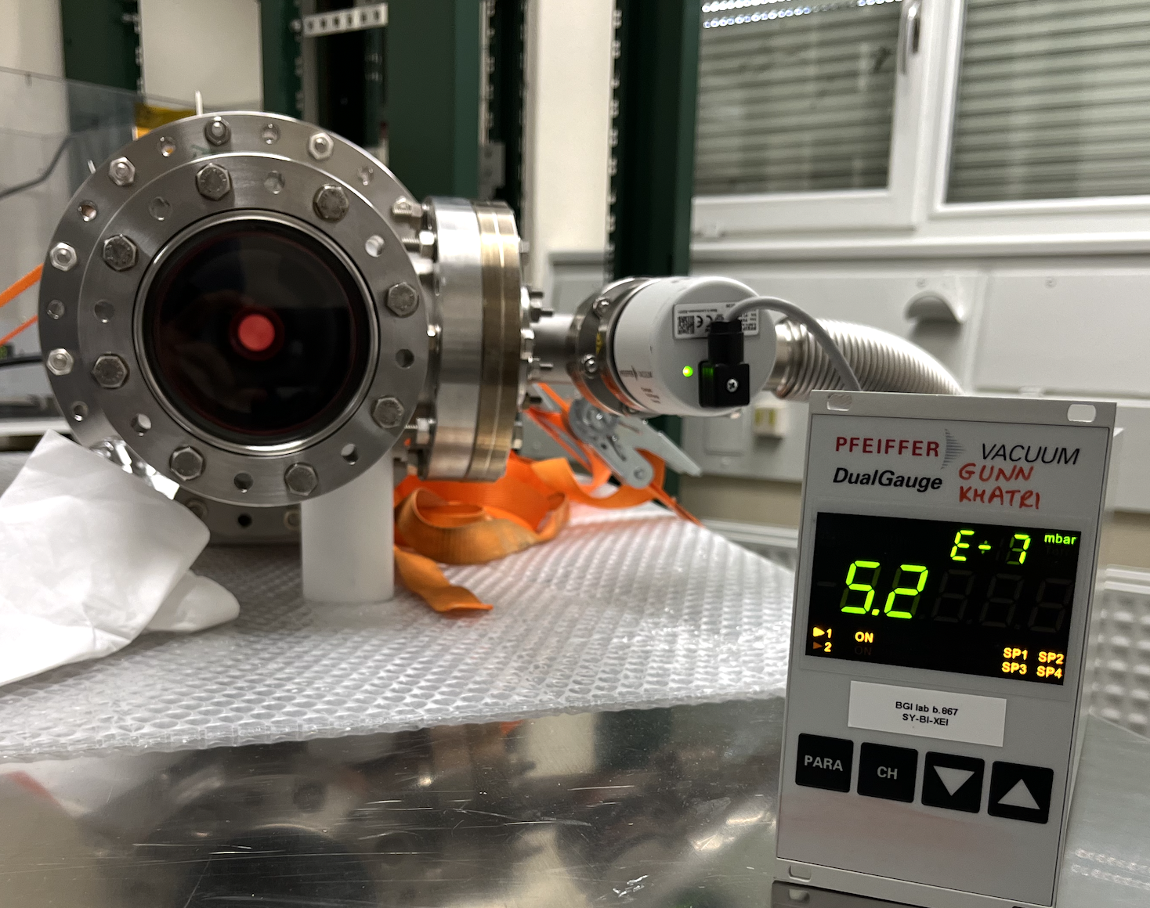
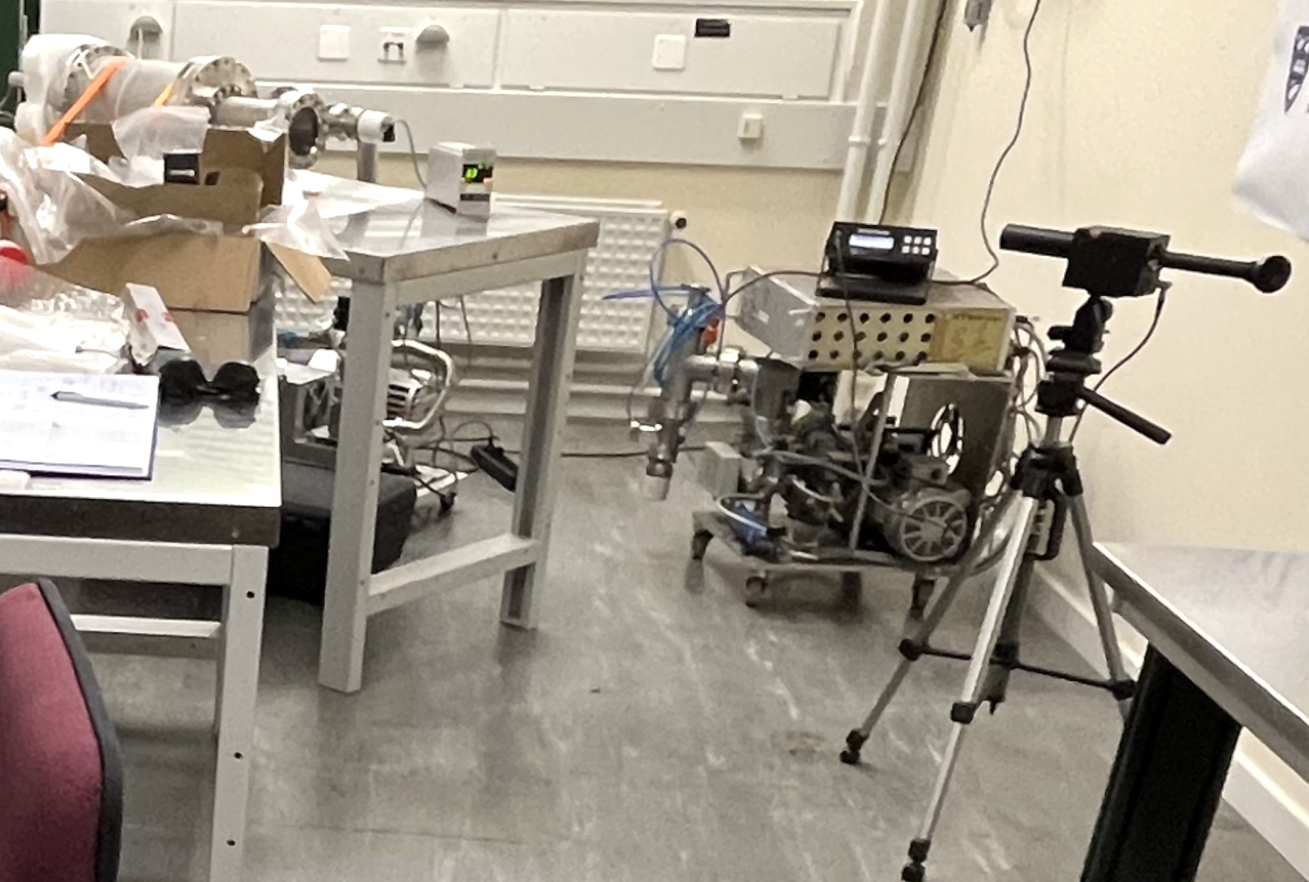
Temperature measurement with pyrometer

Slide 22
Conclusion and plan of action
Electrode geometry validated (perveance !)
Add heat shield (Tantalum foil) around cathode
Increase distance between ceramic and cathode to reduce ceramic temperature and thus keep high ceramic resistance as possible.
For proto gun, quick fix: shorten cathode ceramic (away from cathode) and add Ta foil
For final gun, adapt the Russian design (remove ceramic from the vacuum and away from cathode)

Slide 24
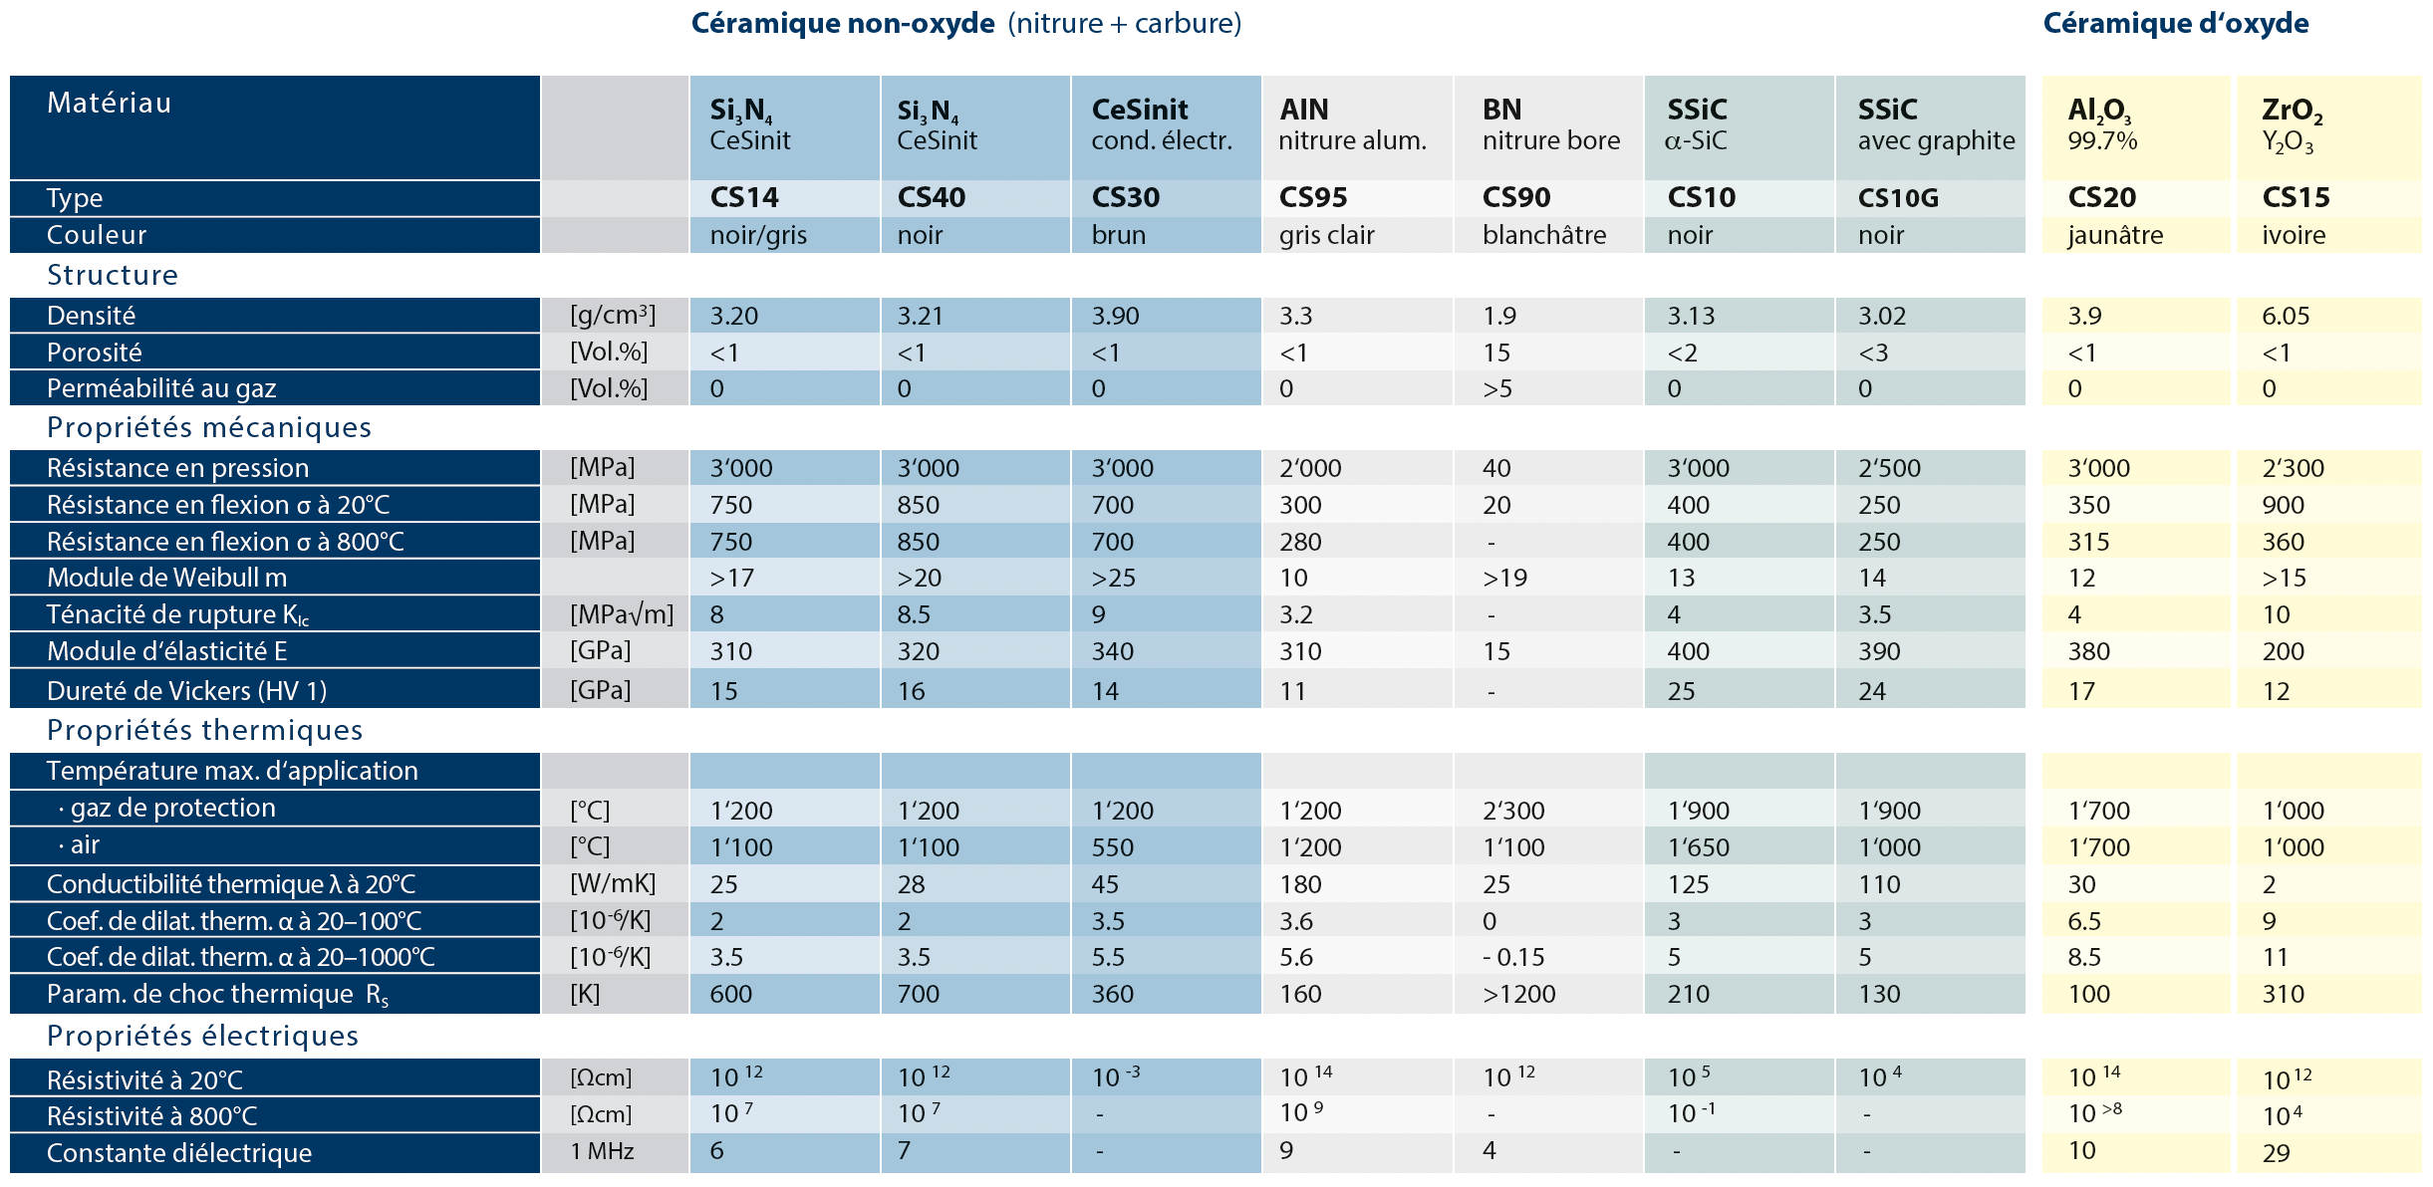
Ceramic resistivity @25 C vs 800 C

Slide 25
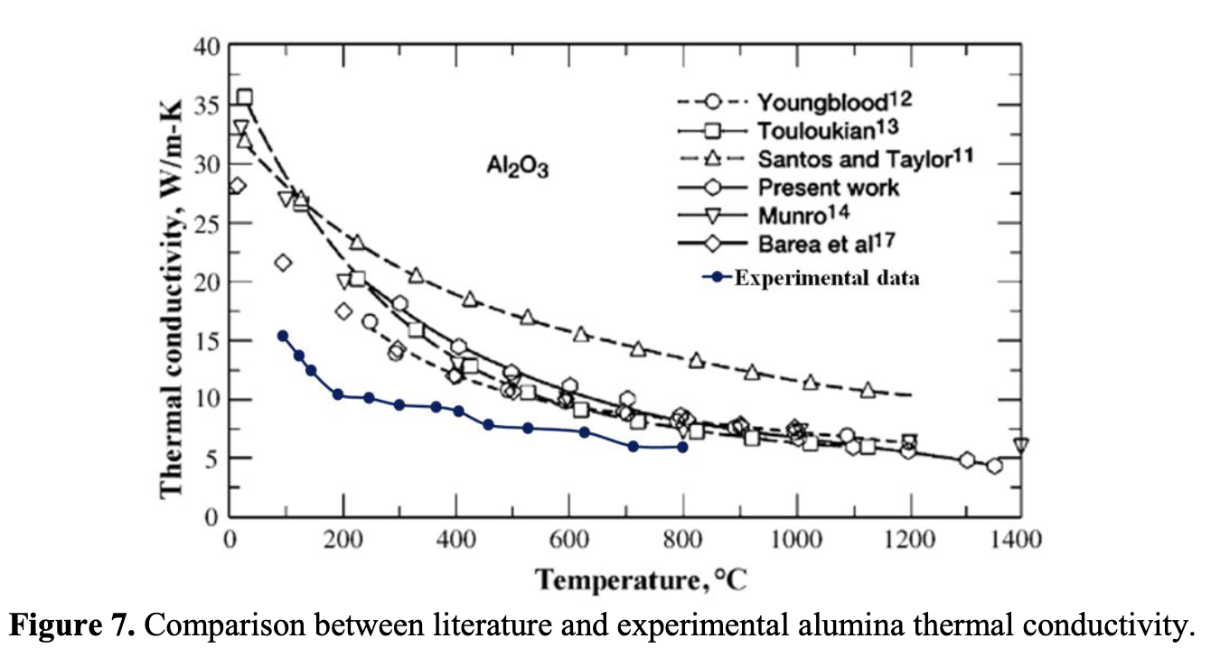
References
thermal conductivity for ceramic: https://iopscience.iop.org/article/10.1088/1742-6596/655/1/012057

