Slide 1
LGC:
Open-Source initiative
G. Kautzmann (BE-GM-APC)
07/11/2024

Slide 2
LGC?
Main software for CERN Surveyors to determine position and align the accelerator for nearly 40 years (first version around 1985)
“Logiciel Général de Compensation” → “General Adjustment Software”
What does LGC do?
Process the position of objects (points, plane, reference system, etc…) and their associated precisions using geometrical observations (distances, angles, etc..) through a weighted least square statistical analysis
For what?
Giving surveyors a reliable way to process and analyse their measurements with a non-black box software

Slide 3


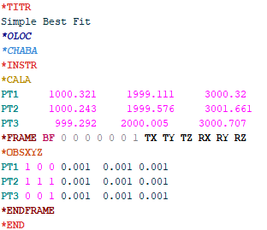
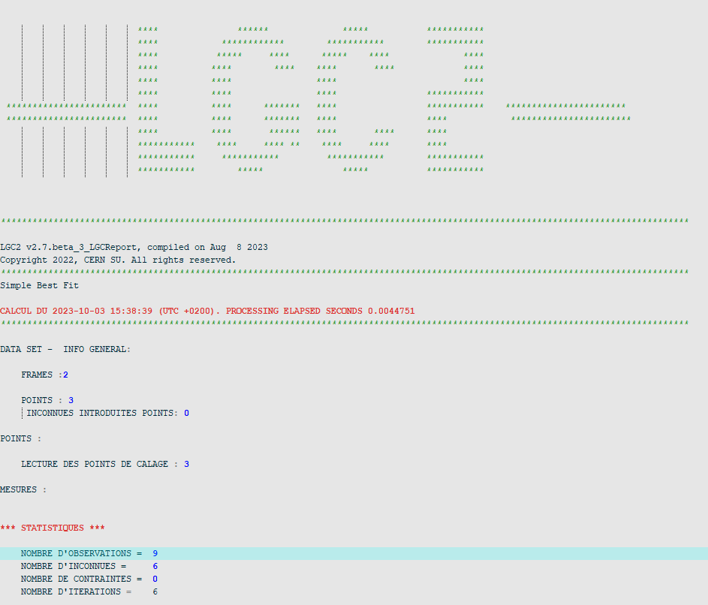
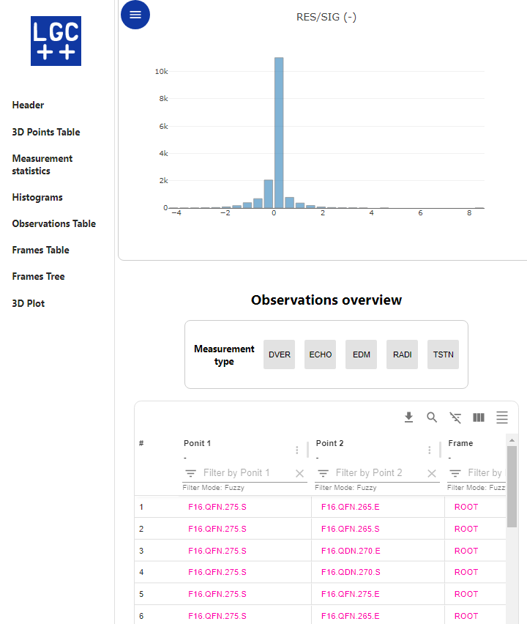
Interacting with LGC today
SurveyPad Interface
(v1.1.0 official release in May 2024 )
Command line mode
lgc.exe –i inputPath
Input file
Result files
API
Fileless mode
myLGC.updateMeas(id, new_measurement);
status = myLGC.adjust();
myLGC.getPointEstimatePrec(pointName, "ROOT");
myLGC.getSigma0();
Other APP
(ex.: Monitoring)
7 November 2024

Slide 4
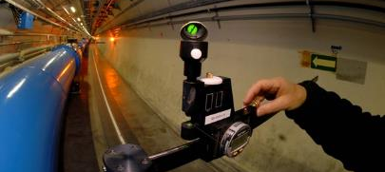
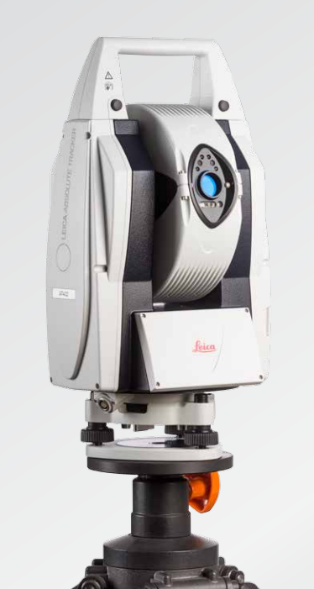
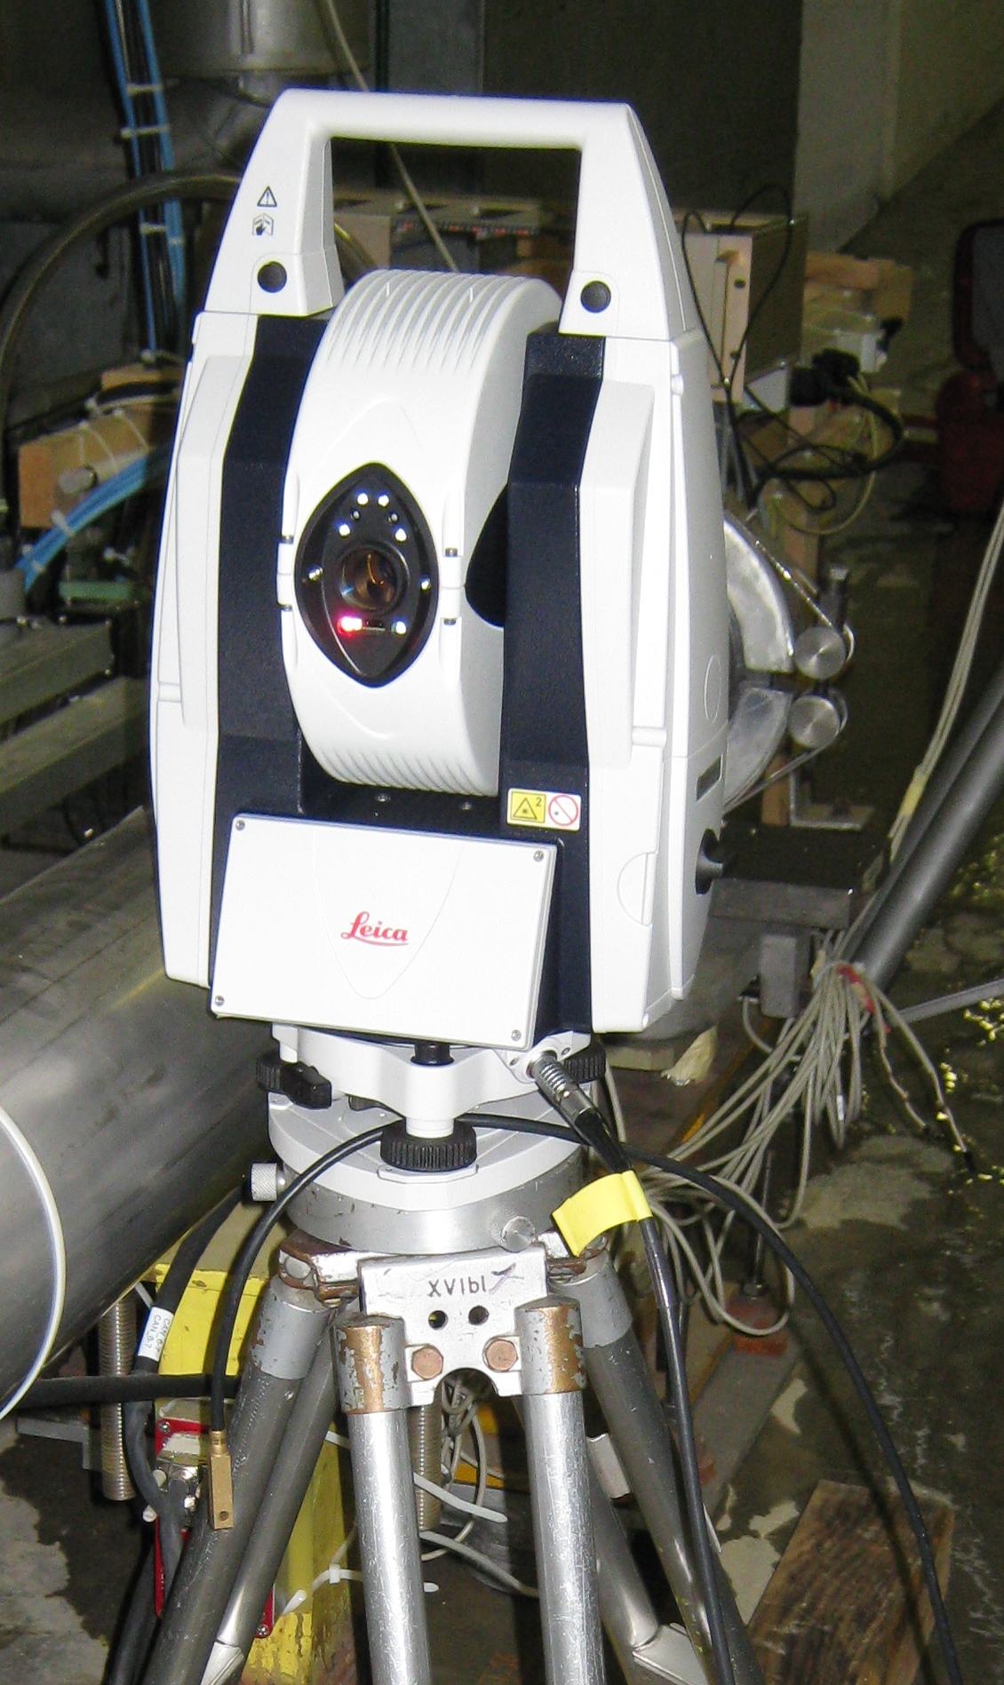
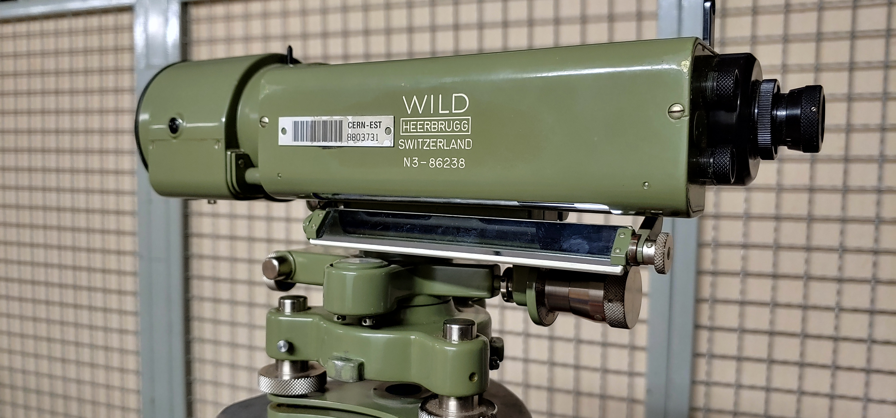
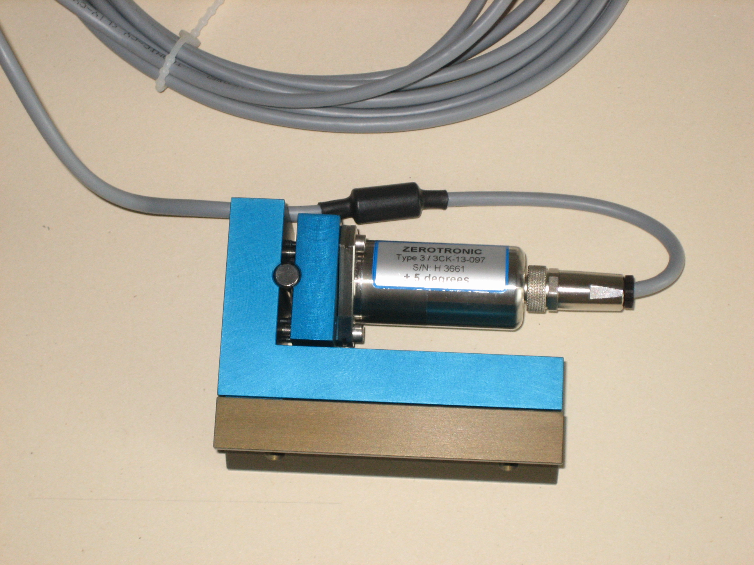
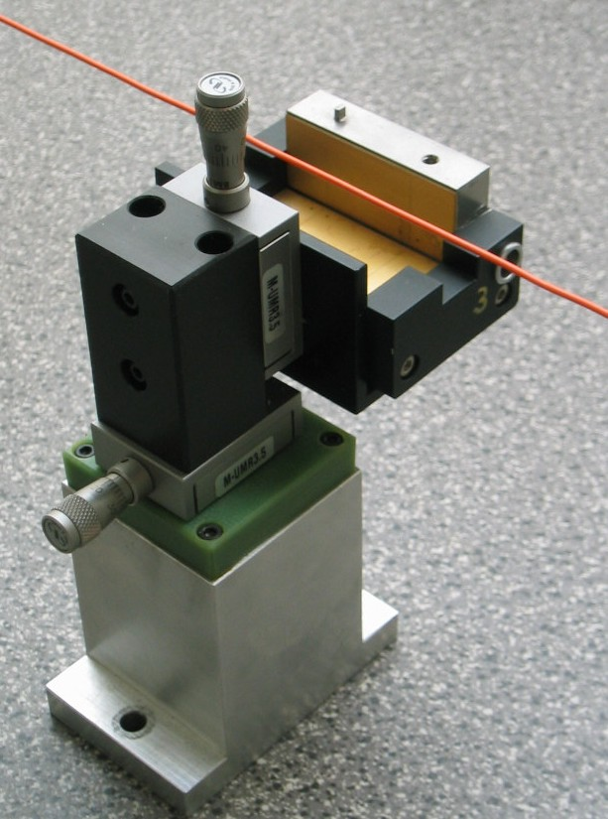
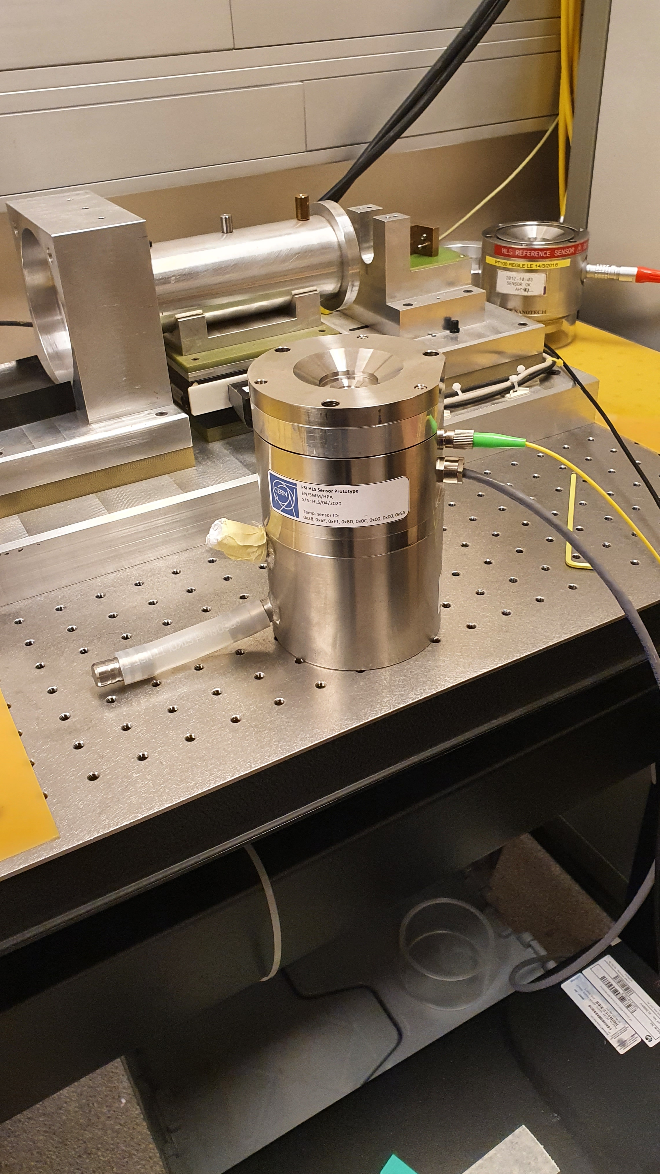
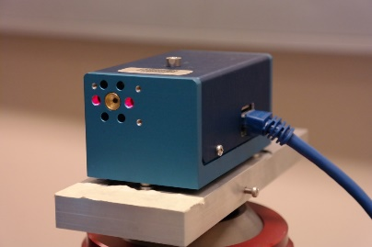
Specificity
21 observation models implemented today
  Total Station / Laser Tracker
  Levels
  Distance measurement
  Offset to wire
  BCAM
  Basic Coordinate Measurement Machine
  Inclinometers
  Gyroscope
  HLS
  WPS
  …
7 November 2024

Slide 5
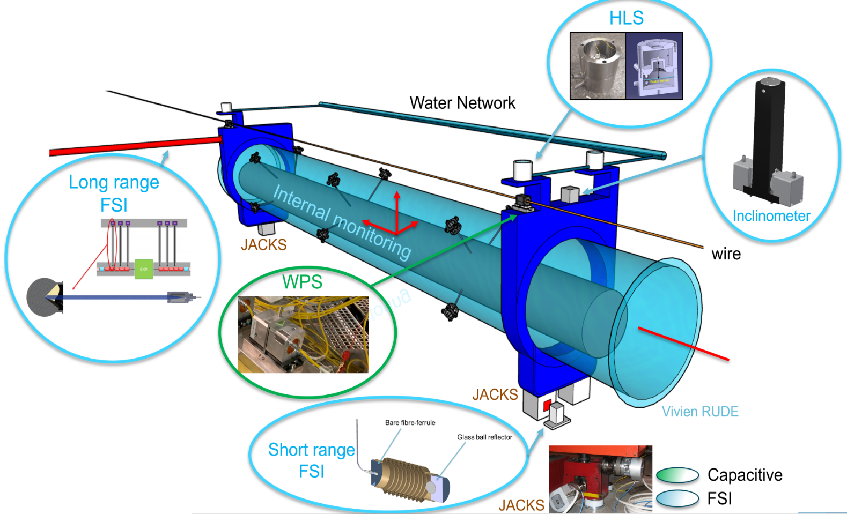
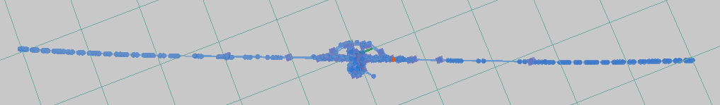
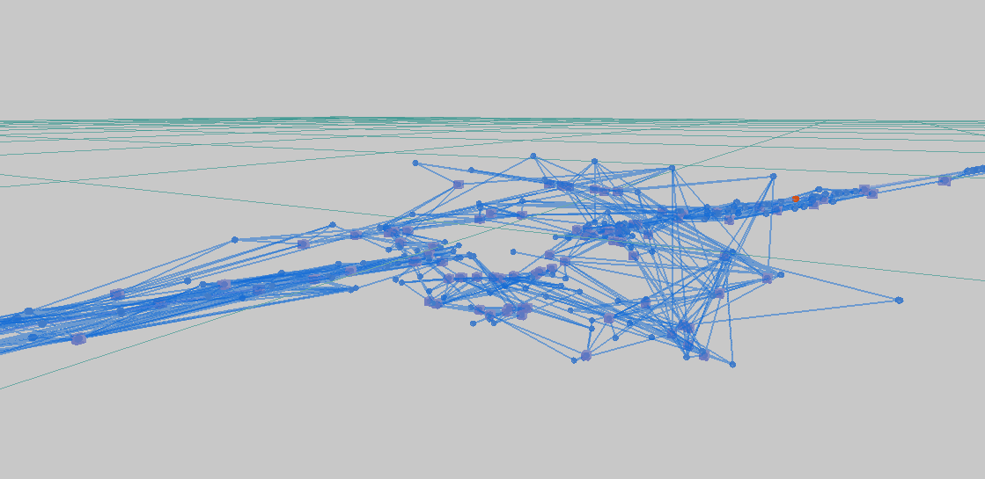
LGC usage
HL-LHC Low Beta monitoring (FRAS)
Courtesy: BE-GM-HPA
Used daily by CERN Surveyors
Main adjustment software
GUI : SurveyPad (in-house dev.)
Files creation and upload via:
  GEODE (web interface to CERN Survey Database)
  field acquisition software TSUNAMI
Computation core for Monitoring Systems
(HIE-ISOLDE Cryomodule, LHC Low Beta, etc.)
Used for R&D projects (HL-LHC, FCC, etc.)
500 m
2019 computation ATLAS + galleries + accelerator
7 November 2024

Slide 6
Open-Source: Motivations?
  European Surveying Accelerator Seminars held in 2023 and 2024 (9 facilities).
  wish to use and contribute to a common adjustment software based on transparent/documented algorithms
  Allow external (physics institutes / university / industry ) to use and contribute to LGC.
  Potentially have a bigger LGC community to get contributions, bug reporting, improvement ideas, potentially resources, etc. → more use cases and mutual aids!
  Develop an open ecosystem of post- and pre-processing tools shareable within the community.
  Overall increase LGC quality, transparency and functionality.
7 November 2024

Slide 7
Open-Source: What have been done?
  Official request to the OSPO in May 2024 to help with the transition
  Audit and recommendation under finalisation by the OSPO (contact: P. Elson)
  Outreach efforts
  Presentation at the International Workshop on Accelerator Alignment 2024 @SLAC
  Discussions with interested external partners from academia, accelerator surveying groups and industry
  Beginner training session in the pipeline
  Binaries distribution (with access to sources) to interested partners for LGC and GUI ESRF, SOLEIL
  https://gitlab.cern.ch/apc/susofts/processing/LGC2 https://gitlab.cern.ch/apc/susofts/interfaces/SurveyPad
7 November 2024

