Slide 1

RF PMT: A Picosecond-Resolution Timing Sensor Current Status and Future Perspectives
S. Zhamkochyan for RF Timer collaboration
(Yerevan Physics Institute)

Slide 2
OUTLINE
Radio-Frequency Timer
RF Timer based photo-electron emission detection system
Experimental results with nanostructures
RF Timer based Heavy Ion Detector
Other applications
Summary

Slide 3
Precise timing of single photons and electrons
Regular timing technique, such as PMTs, APDs and HPDs
Time resolution: > 25ps; Counting rate: MHz; Readout: Fast
SNSPD (Superconducting Nanowire single-photon detector)
Time resolution: <10ps; Counting rate: MHz; Readout: Fast
Streak Camera
Time resolution: ~1ps; Counting rate: Few tens KHz; Readout: Slow
RF PMT
Time resolution: similar to Streak Camera, can be ~1ps; Counting rate: MHz; Readout: Fast
The new RF Timer combines the advantages of regular and the RF timing techniques, resulting in high resolution, high rate and high stability for single particle detection.

Slide 4
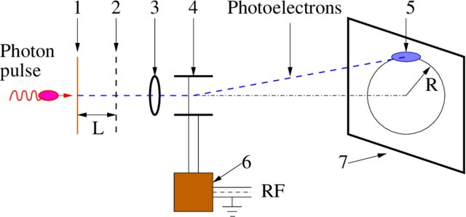
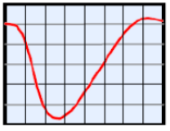
Circular scanning RF PMT
Schematic of RF PMT
Helical Shape RF Deflector
v – Electron velocity
T – RF Voltage period
Λ – Perod of deflector
T = Λ/v - Resonance condition; no reduction of the deflector sensitivity due to transit time
1 - photocathode, 2 - electron transparent electrode, 3 -electrostatic lens, 4 – the helical shape RF deflector, 5 - spot of PE on the PE detector, 6 - RF generator, 7 - PE detector.
The RF Timer is a sensitive photo-detector, capable of registering single photons: optical photons produce electrons on a photocathode, which are accelerated to keV energies, multiplied and detected.
The time information is converted into a spatial domain: the keV electrons are scanned by means of helical RF deflectors.
The position sensitive detector, based on MCPs and delay line anode, provides ns signals. Detection is processed and accomplished by regular electronics.

Slide 5
Time resolution of the RF Timer
Physical time resolution of the photocathode or secondary electron source
The time spread of the photoelectrons at the surface of the photocathode or SE source.
Physical and technical time resolution of the electron tube
Transit time spread and of the photoelectrons and electron beam spot size at the PSD.
Technical time resolution of the RF deflector
Δτ_{d} = d/v
d - convolution of the size of the electron beam spot and the position resolution of the electron detector, v = 2πR/T.

Slide 6
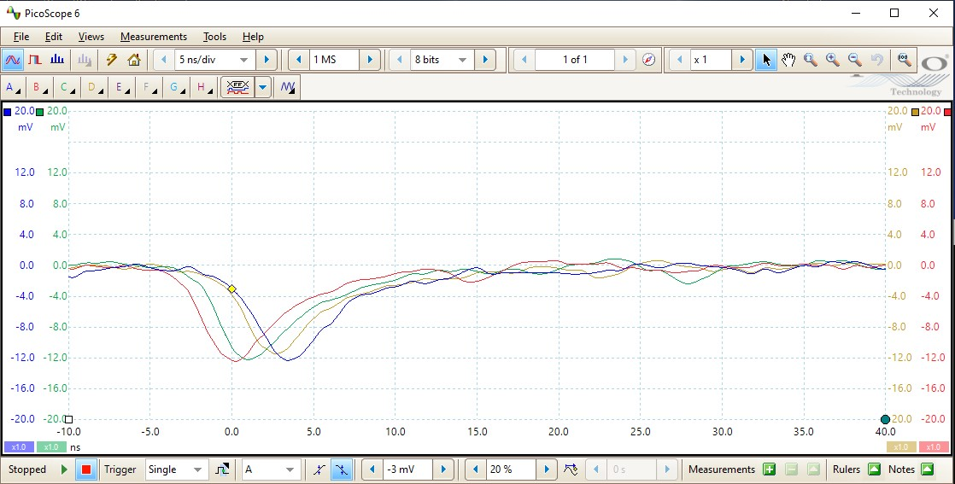
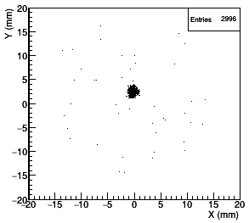
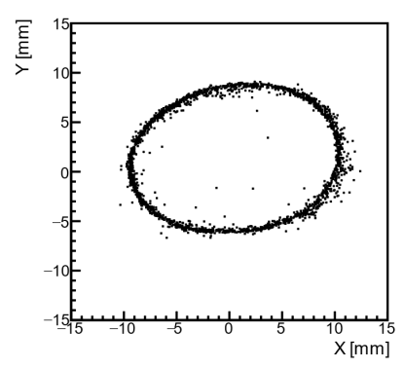
Lab studies with CW electrons and photons
Typical nanosecond signals from the DL anode detected by PICOSCOPE
Left: 2D image of the electrons in focus mode (RF is OFF)
Right: 2D image of the scanned electrons (RF is ON).

Slide 7
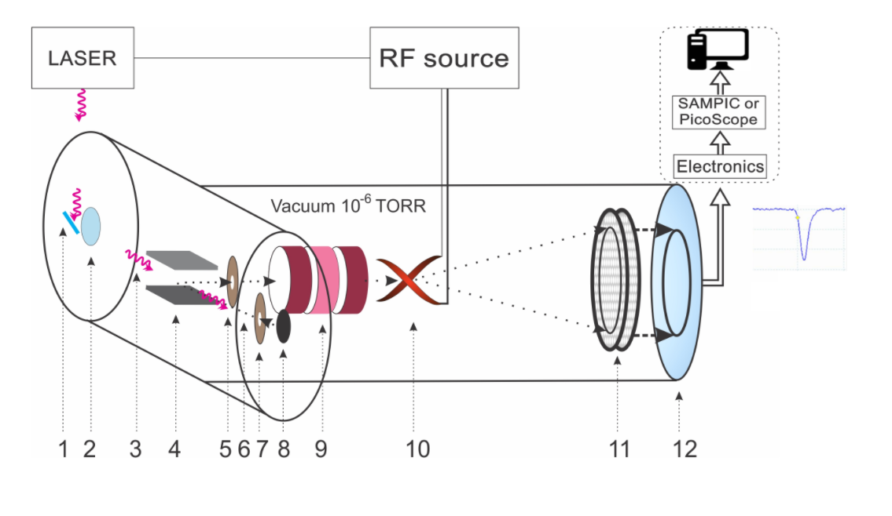
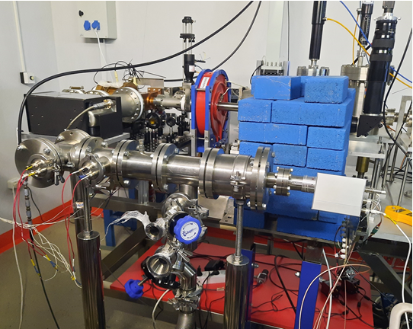
Studies with synchronized femtosecond pulsed laser at CANDLE
Schematic of the RF Timer: (1) mirror, (2) quartz-glass window, (3) incident photons, (4) permanent magnet, (5) collimator, (6) photoelectron, (7) electron transparent electrode, (8) photocathode, (9) electrostatic lens, (10) RF deflector, (11) MCP detector, (12) position sensitive anode.
The RF Timer at CANDLE facility in Yerevan: first test studies with femtosecond synchronized laser

Slide 8
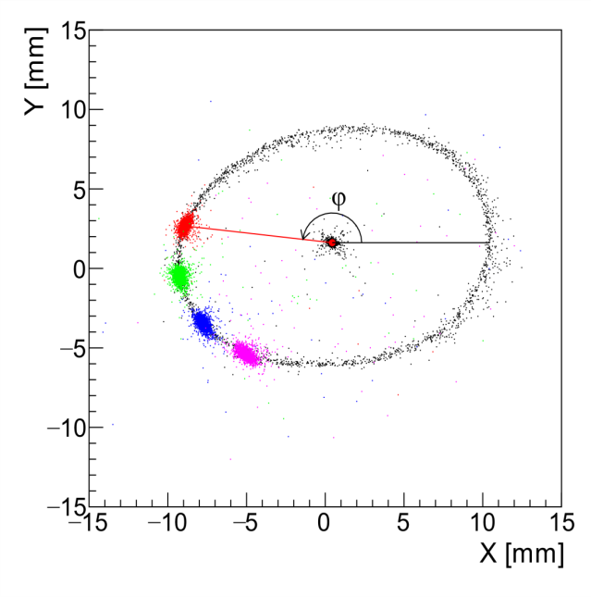
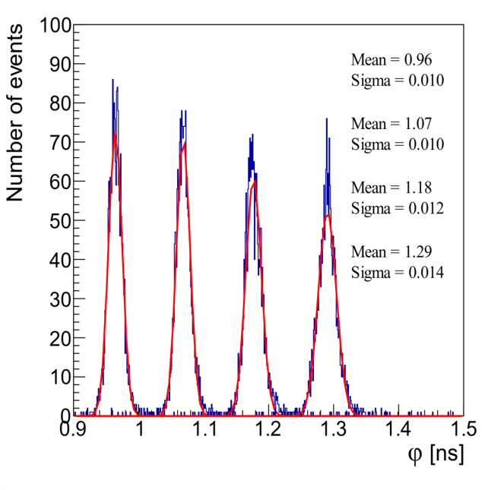
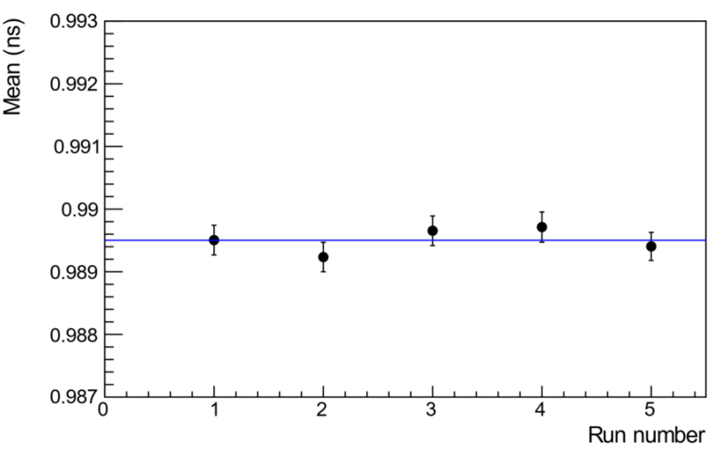
Studies with synchronized femtosecond pulsed laser at CANDLE
Left: 2D image of anode hit positions. The point in the center of the circle is the image of electrons with RF turned OFF. The circle is an image of the scanned electrons when the 500 MHz RF is ON, but not synchronized with the laser. The color spots on the circle correspond to phase distributions of the scanned, RF-synchronized photo-electrons for four different fixed phases.
Middle: Distribution of phases (φ), converted into ns, of the scanned electrons in the case of RF synchronized laser.
Right: The mean values of sequentially measured time distributions in a one hour period.
A. Margaryan et al., Nucl. Instr. & Meth. A 1038, 166926 (2022)
S. Zhamkochyan et al., JINST 19 C02014 (2024)

Slide 9
Monte-Carlo Simulations
The SIMION 8 based model was developed to replicate the experiment.
The simulations take into account the detector’s precise geometry, applied voltages, electrons’ initial direction and energy spread.
Predicted transit time spread: ~8ps
Predicated beam size: ~0.2mm, which corresponds to ~6.5ps technical resolution.
In quadrature they amount to 10.3 ps total detector time resolution, whish is in good agreement with the experimental results
The simulations are used to design the optimized detector components. It is shown that the time resolution can be improved even further, to ~1 ps range

Slide 10
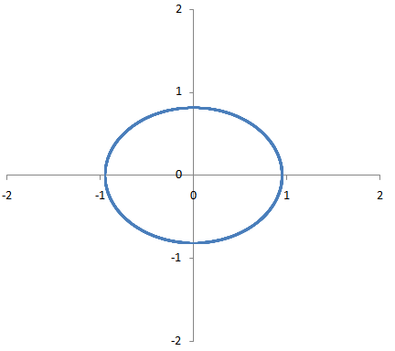

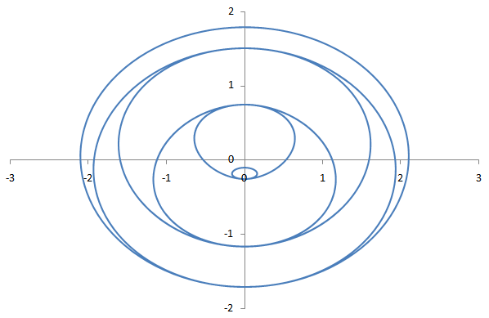
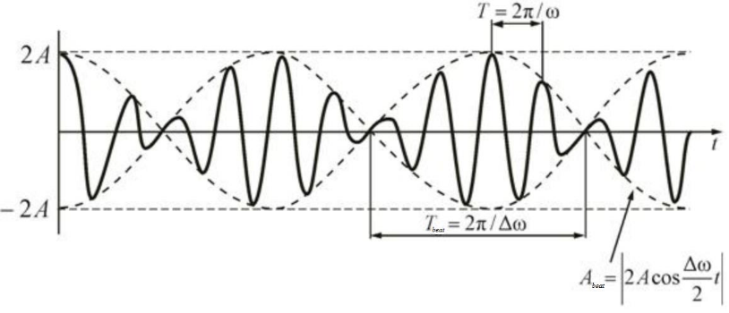
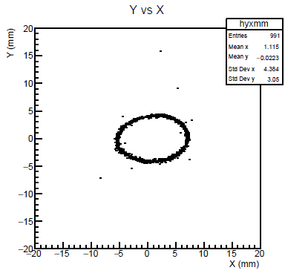
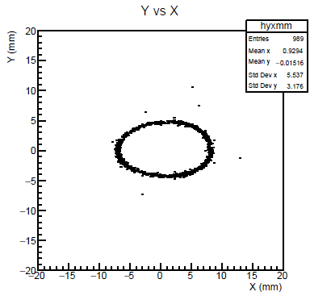
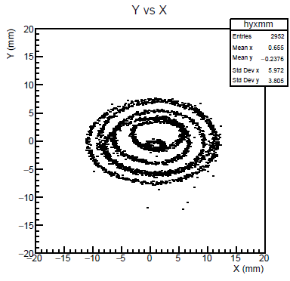
Spiral scanning studies with thermoelectrons
Using two circular scanning RF deflectors with slightly different frequencies results in spiral scanning due to “amplitude beating” effect.
500 MHz
600 MHz
500 MHz and 600 MHz
Theory
Theory
Theory
Experiment
Experiment
Experiment
Spiral scanning allows increasing the dynamic range of the RF Timer by an order of magnitude

Slide 11
Lifetime of hot carriers studies
The lifetime of hot carriers is a critical parameter in various materials, such as graphene. The ability to harness hot carriers efficiently for technological applications, such as in photodetectors, solar cells, and ultrafast electronics, depends largely on their lifetime.
Theoretically, the lifetime of hot carriers in graphene should be quite long (hundreds of picoseconds to a few nanoseconds)
R. Bistritzer, A. H. MacDonald, Phys. Rev. Lett. 2009, 102, 206410.
However, numerous experimental measurements in the past decade employing various pump-probe methods have always measured a few ps decay time. This is probably caused by high exciting light intensities used in such measurements
M. Breusing, et al., Phys. Rev. B 2011, 83, 153410; X.-Q. Yan, et al., Phys. Rev. B 2014, 90, 134308; I. Gierz, et al., Nat. Mater. 2013, 12, 1119-1124; U. Soren, et al., J. Phy. Condens. Matter 2015, 27, 164206; and many others…
Longer lifetime of hot carriers was observed for the first time implementing time resolved ARPES method with low intensity light source. The measurement precision was > 64ps
Lin Fan et al., Phys Chem. Lett., 9(7), 2018
The RF Timer based system allows photoemission time measurements under low light intensities with the precision 10 ps or better

Slide 12
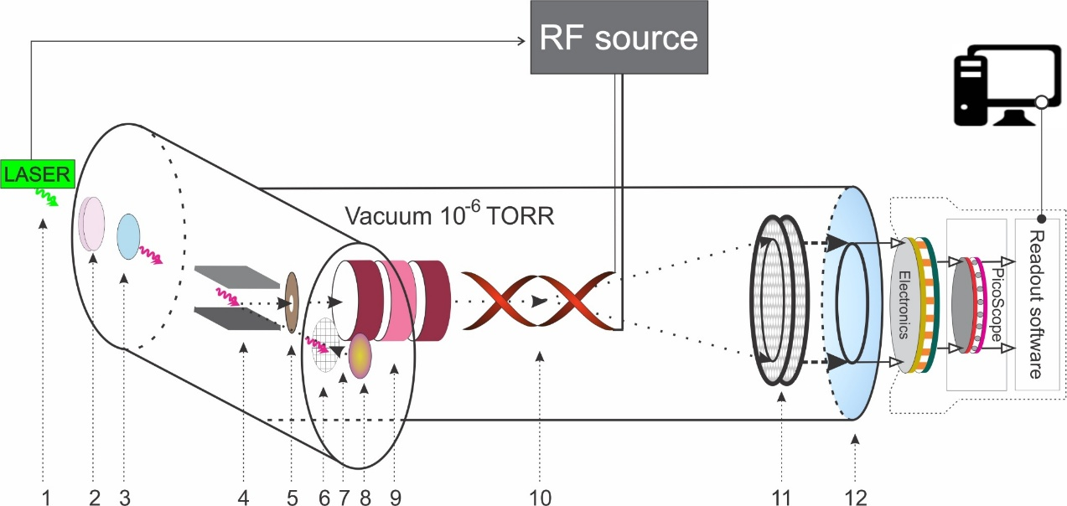
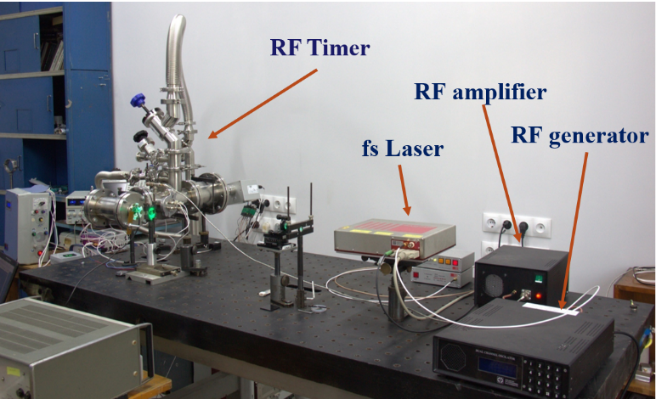
Time Resolved Photo-Electron Detection System
500 -1000 MHz
1-laser photon pulse; 2-nonlinear crystal; 3-quartz window; 4-magnet; 5-collimator; 6-accelerating electrode; 7-photoelectron; 8-photocathode; 9-electrostatic lens; 10-RF deflector; 11-MCP detector; 12- delay line anode
Laser: NKT ORIGAMI; Repetition rate: 40 MHz; Wavelength: 515.4 nm, halved to 257.7 nm; Photon bunch length: 166 fs

Slide 13
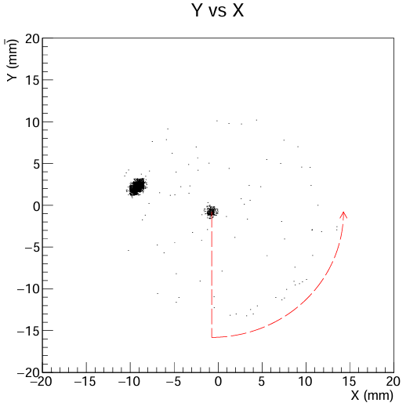
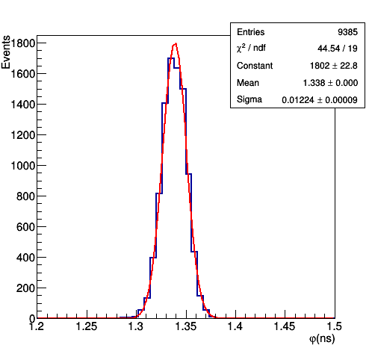
Photoemission time measurements
0.6 μm gold layer
For gold, tantalum and other non- 2D materials the measured photoemission time is on par with the system’s time resolution

Slide 14
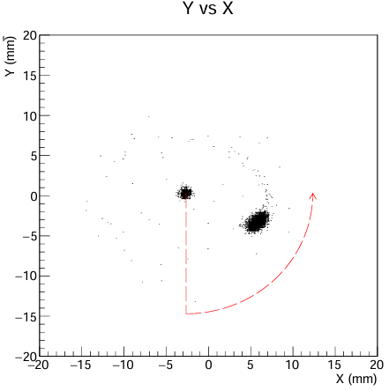
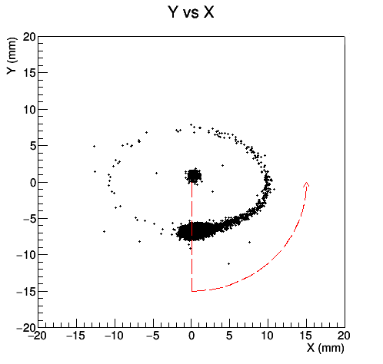
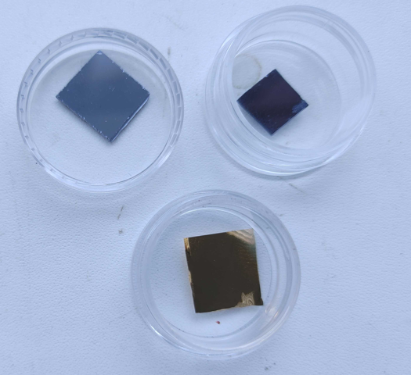
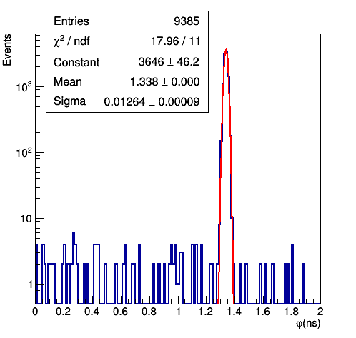
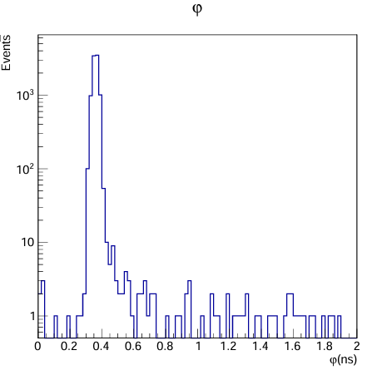
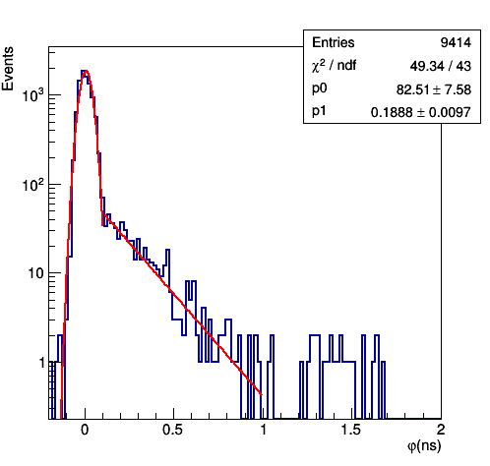
Nanostructures’ photoemission time
Graphene
MoS2
Gold
Differences in photoemission timing properties for different materials are clearly seen. In particular, nanosecond scale emission time is observed for graphene
gold (for comparison)
MoS2
Graphene

Slide 15
Λ hypernuclei lifetime
Λ hypernucleus is a nucleus containing Λ hyperon along with protons and neutrons
Hyperon is a baryon containing strange quark(s)
Λ hyperon has uds quark structure (“strange neutron”)
Λ hypernuclei play important role in astrophysical objects, such as neutron stars
“Hyperon puzzle” is one of the most important problems to be solved for the nuclear physics
New precise measurements of Λ hypernuclei lifetimes and binding energies are needed
JLab results - red open circles, KEK experiment - blue triangles, black square - earlier experiments, COSY result and a black open circle - CERN experiment on Bi. The two most recent theory calculations are shown as dot–dash and dash lines.
For heavy hypernuclei the experimental results are contradictive: from ~125 ps to ~3ns

Slide 16
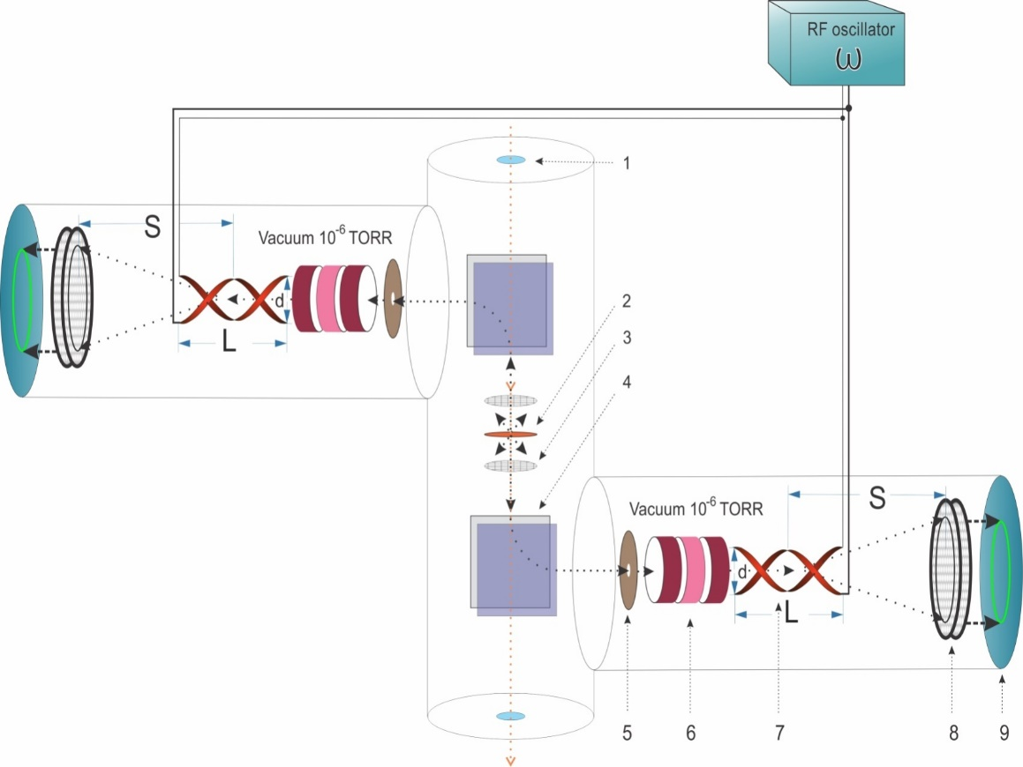
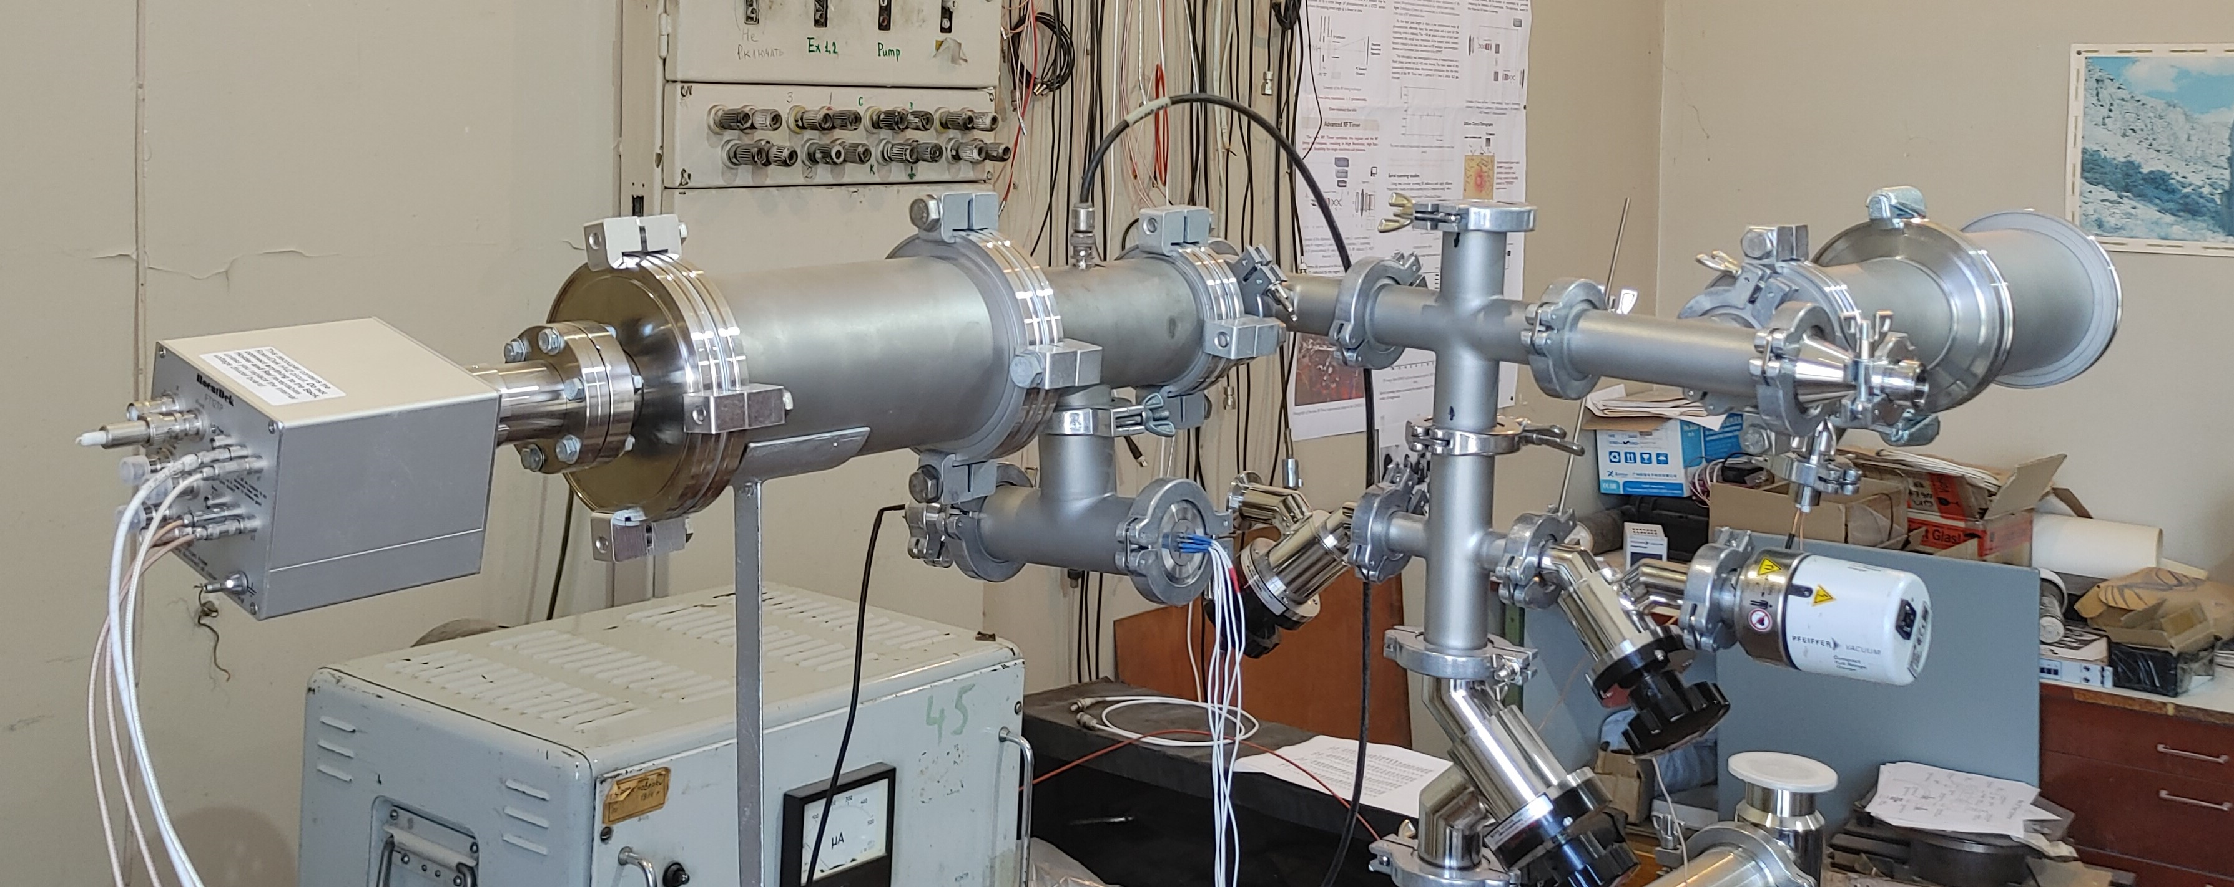
Heavy Ion Detector
Heavy Ion Detector, based on the RF Timer, is proposed for Λ hypernuclei and fission isomer studies. The detector is being tested in Lab using α source. The next step will be testing with high energy synchronized beam
1 – beam window, 2 – Target, 3 – Accelerating electrode, 4 – Magnet, 5 – Collimator, 6 – Electrostatic lens, 7 – RF deflector, 8 – MCP detector, 9 – Readout electronics

Slide 17
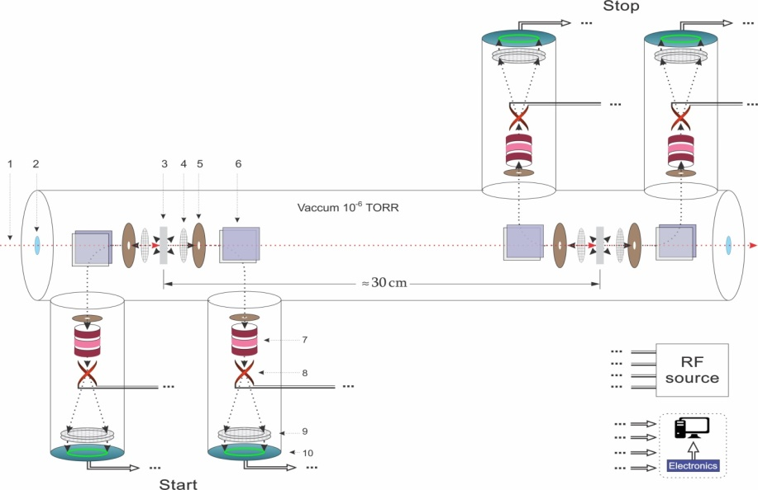
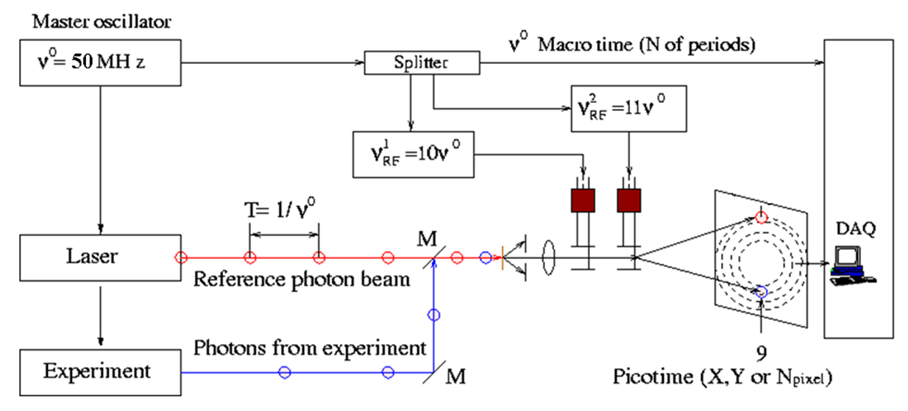
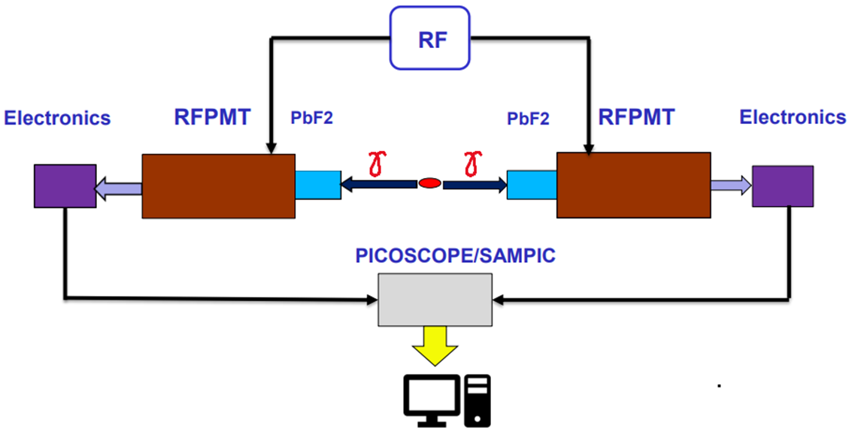
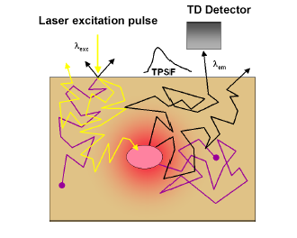
Other applications of the RF PMT / RF Timer
α particle absolute spectrometry
Time-Correlated Single Photon Counting (TCSPC)
Positron Emission Tomography (PET)
Diffuse Optical Tomography (DOT)

Slide 18
Summary
  New ultra-high precision timer, based on RF circular scanning (RF Timer), is developed and tested.
  The RF Timer provides:
  ~ 10 ps time resolution
  MHz counting rate
  ≤ 0.5 ps/h (FWHM) stability
Optimizations are in progress, we expect to achieve a few ps resolution (in principle ~1 ps resolution is achievable).
RF Timer based time-resolved photo-electron emission detection system is built and is being used for measuring lifetimes of hot carriers in nanostructures.
RF Timer Heavy Ion Detector, designed for Λ hypernuclear studies is built and being tested.
Vacuum sealed version of the RF PMT prototype is planned to be built by Photek

Slide 19








Our Collaboration
A.I. Alikhanyan National Science Laboratory (Yerevan Physics Institute), Yerevan, Armenia
V. Kakoyan, S. Zhamkochyan, S. Abrahamyan, H. Elbakyan, H. Rostomyan, A. Safaryan, A. Papyan, A. Kakoyan,
A. Ghalumyan, A. Margaryan
School of Physics & Astronomy, University of Glasgow, Scotland, UK
J. Annand, K. Livingston, R. Montgomery
Jefferson Laboratory, Newport News, USA
P. Achenbach
Institut für Kernphysik, Johannes Gutenberg-Universität Mainz, Germany
J. Pochodzalla
Extreme Light Infrastructure- Nuclear Physics (ELI-NP), Bucharest-Magurele, Romania
D. L. Balabanski
Department of Physics, Graduate School of Science, the University of Tokyo, Japan
S. N. Nakamura
Department of Physics and Astronomy, University of Notre Dame, USA
A. Aprahamian, M. Brodeur, Kh. Manukyan
Département de Physique des Particules Centre de Saclay, France
D. Yvon, V. Sharyy

Slide 20
Thank you for your attention!

