Slide 1
LGAD For Radiotherapeutic Beams
FAST 2025, Elba Island
May 19-22, 2025
Pablo Yepes, Wei Li, Diego Cristancho, Rachel Kovach-Fuentes, Wei Li, Javier Murillo-Quesada, Saul Rodriguez-Ramirez, Christophe Royon, Emil Schuler, Tonatiuh Garcia Chavez, Brett Velasquez

Slide 2
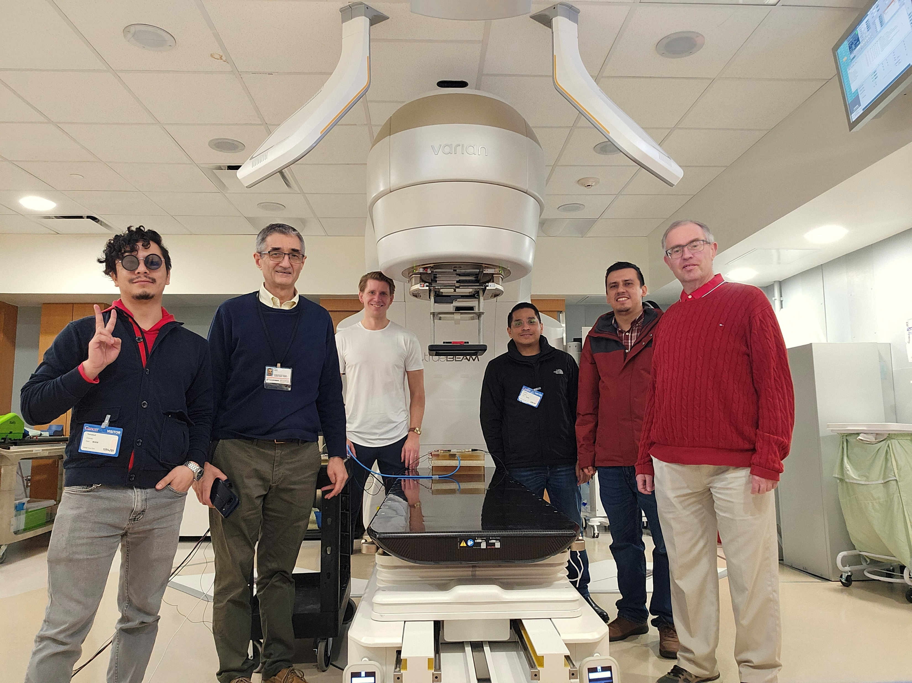
The First Day at the Hospital
Part of our team

Slide 3
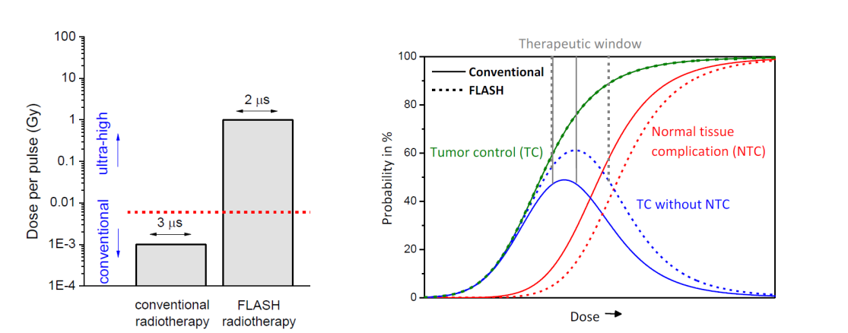
FLASH Therapy
FLASH effect: Irradiations with UHDR (Ultra-high Dose Rates) > 40 Gy/s reduced toxicity in healthy tissue while preserving the effect on the tumor (Favaudon et al, Sci Transl. Med 2014 6 2014)
There is a need for real-time dosimetry
Schuller et al., Physica Medica 80 (2020) 135

Slide 4
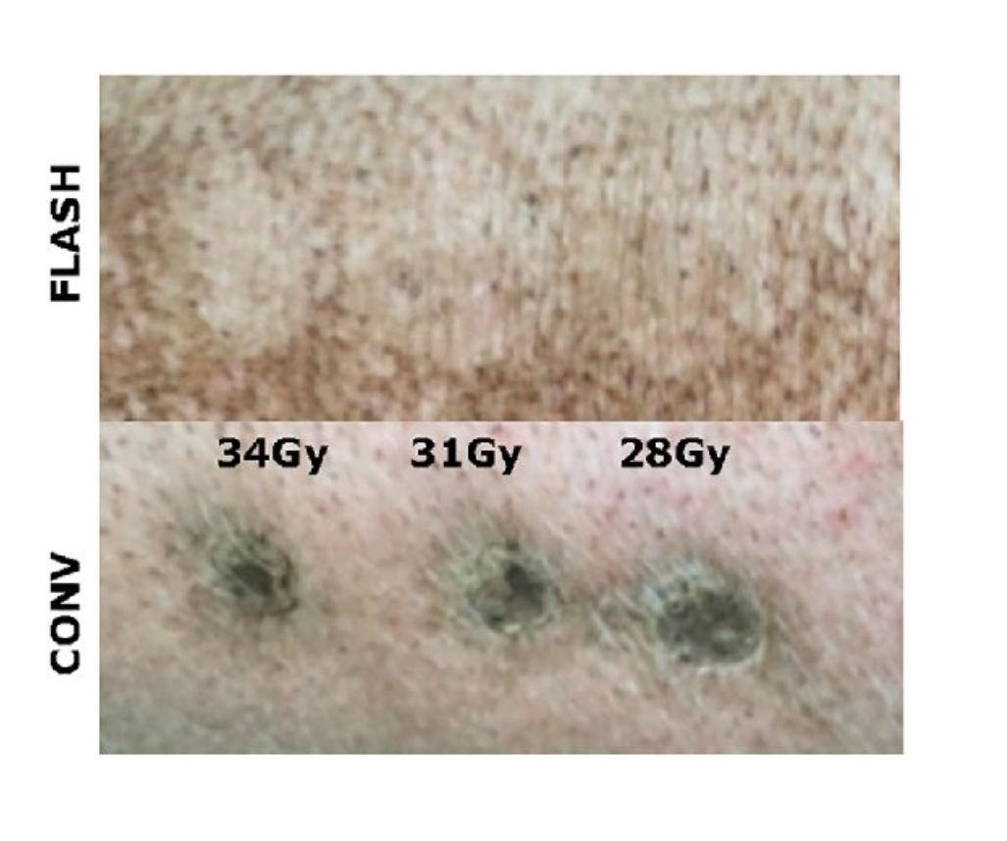
FLASH Therapy in Action
Schuller et al., Physica Medica 80 (2020) 135

Slide 5
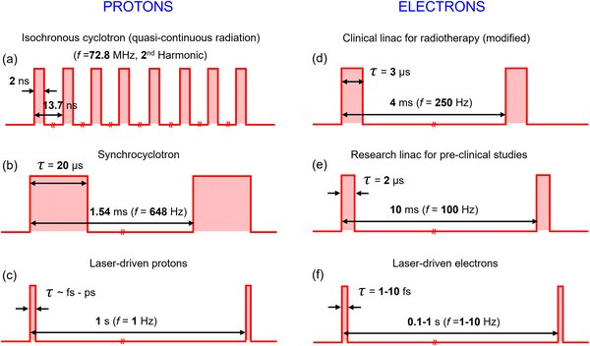
Beams come in all shapes and Structures
Two kinds of dose rates:
  Average: over basic irradiation time (fraction)
  Instantaneous: over the smallest beam structure (pulse, spill)
Most results seem to favored average dose, but some results seem to indicate otherwise (Schueler et al.)
Romano et al., Medical Physics 49(7) , May 2022

Slide 6
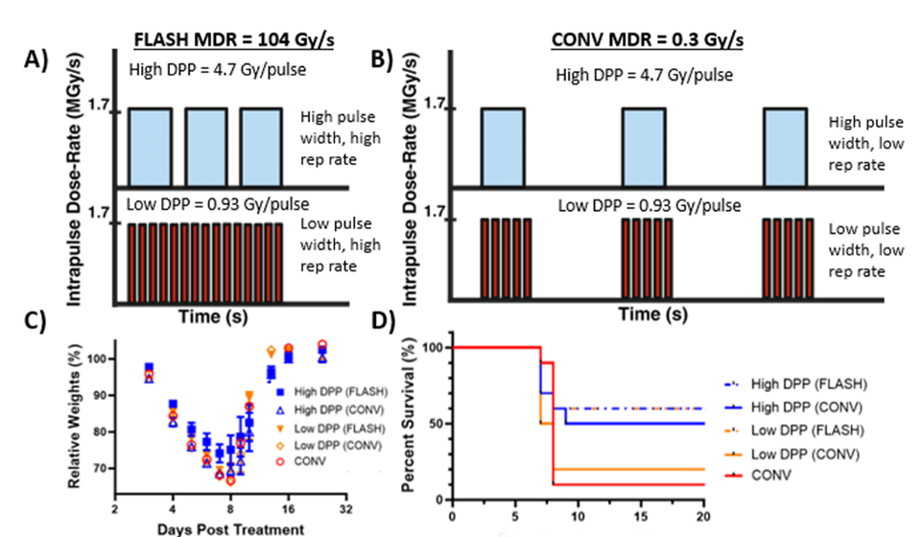
Temporal Structure of the Beam Matters
K. Liu et al., Redefining FLASH RT: the impact of mean dose rate and dose per pulse in the gastrointestinal tract. Int J Radiat Oncol Biol Phys, (2024).

Slide 7
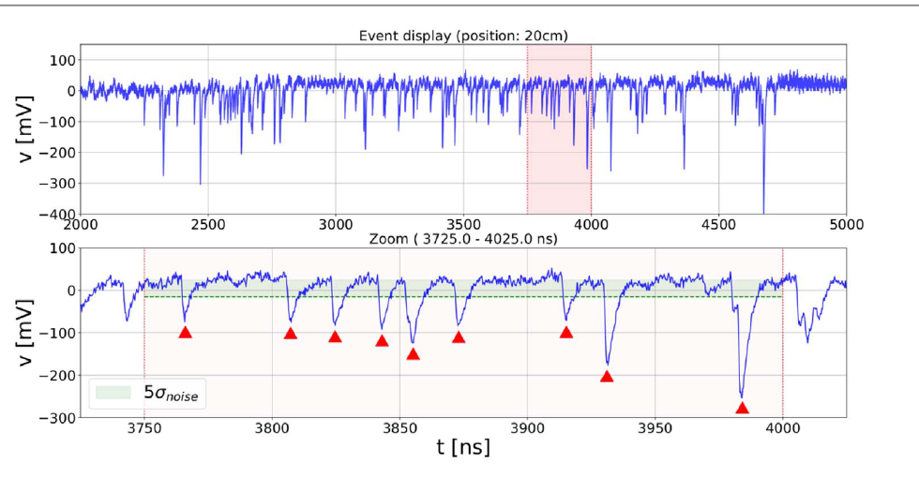
LGAD Signal Versus Time
T. Isidori et al., Performance of a low gain avalanche detector in a medical linac and characterization of the beam profile. Phys Med Biol 66, (2021).

Slide 8
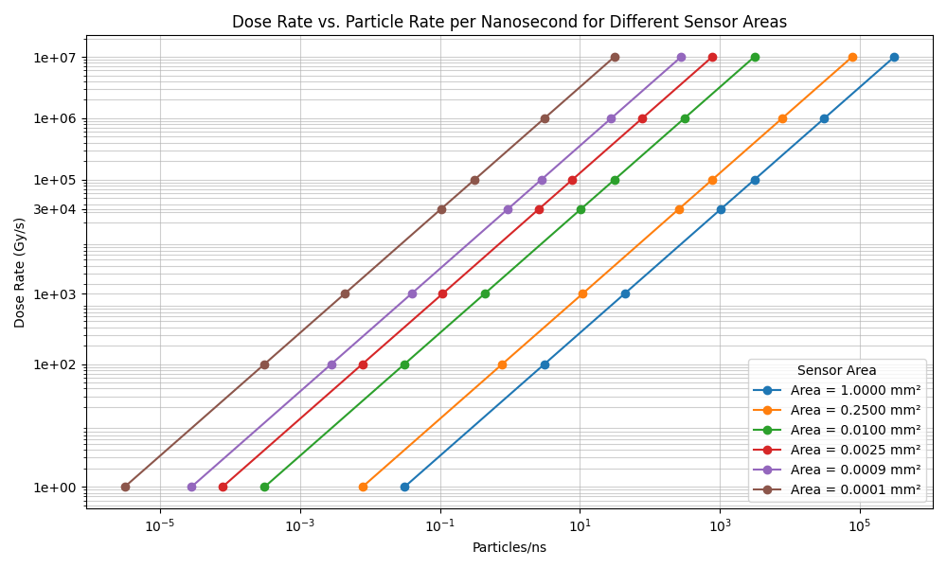
Dose Rates to Particles Fluxes
Radiation Therapy Dose unit is Gray= 1 Joule / Kilogram
Typical patient dose is 50-70 Gy on target (tumor), 2 Gy/fraction

Slide 9
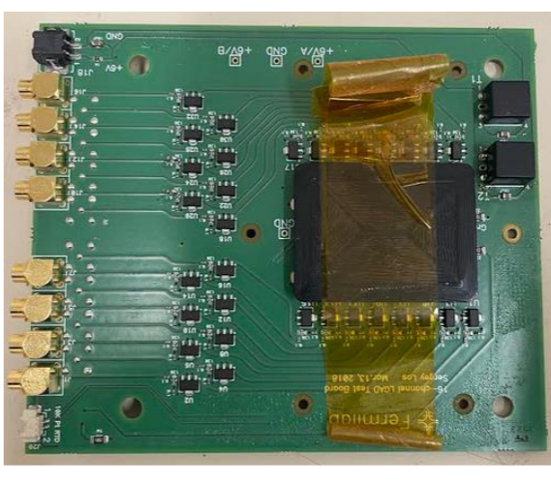
LGAD Detector
Various sensors available to us in the context of the Encap TOF for CMS at the HL-LHC (2028), Wei Li
Most results were obtained with an Si LGAD on Fermilab board (Italy made) provided by BNL (Gabriele Giacomini et al)
LGAD:
  Voltage ~100 V
  30 um thick
  Active area 1.3x1.3 mm²
Tested the sensor with Sr90 source and even cosmics (one an hour)

Slide 10
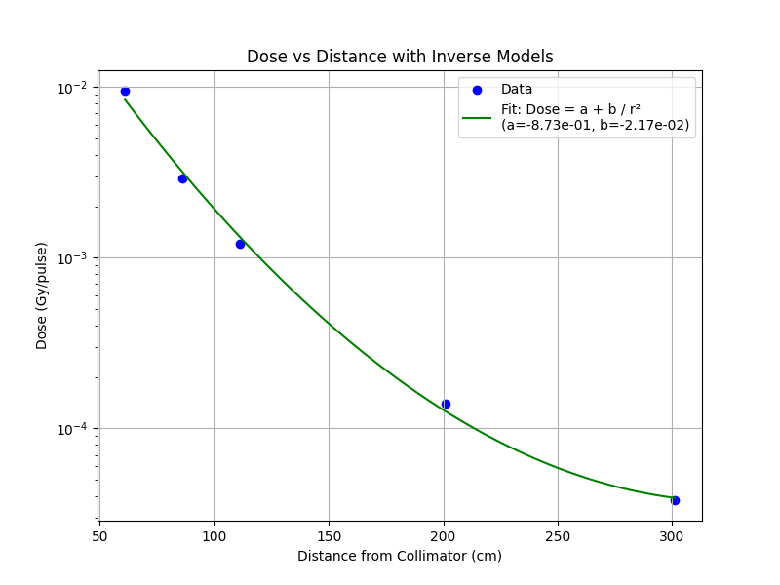
Electron Beam Parameters
Vault dedicated at FLASH Research at the University of Texas MD Anderson Cancer Center (Schueler’s group)
Three levels of dose rates depending on the machine HV=85, 110, 190 V
7MeV Electrons
Without and with 2 or 5 cm diameter, 50 cm long collimators
Dose provided with an ionization chamber, standard for dose measurements, but with no timing information.

Slide 11
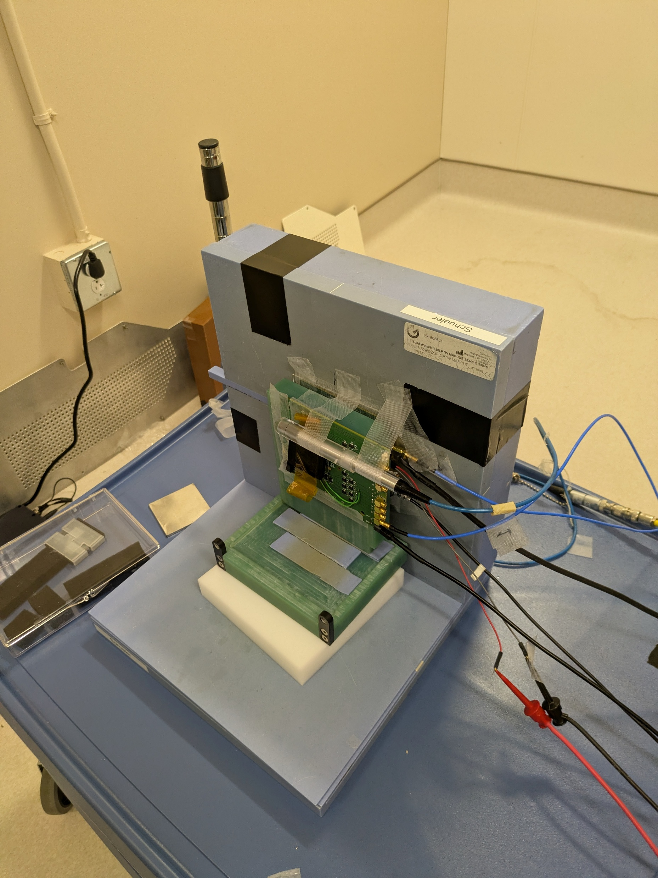
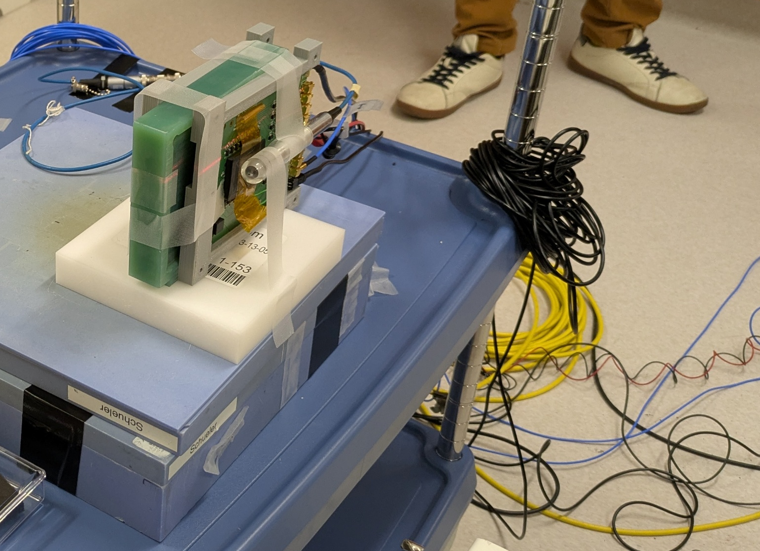
Electron Setup First Tests
With Holders

Slide 12
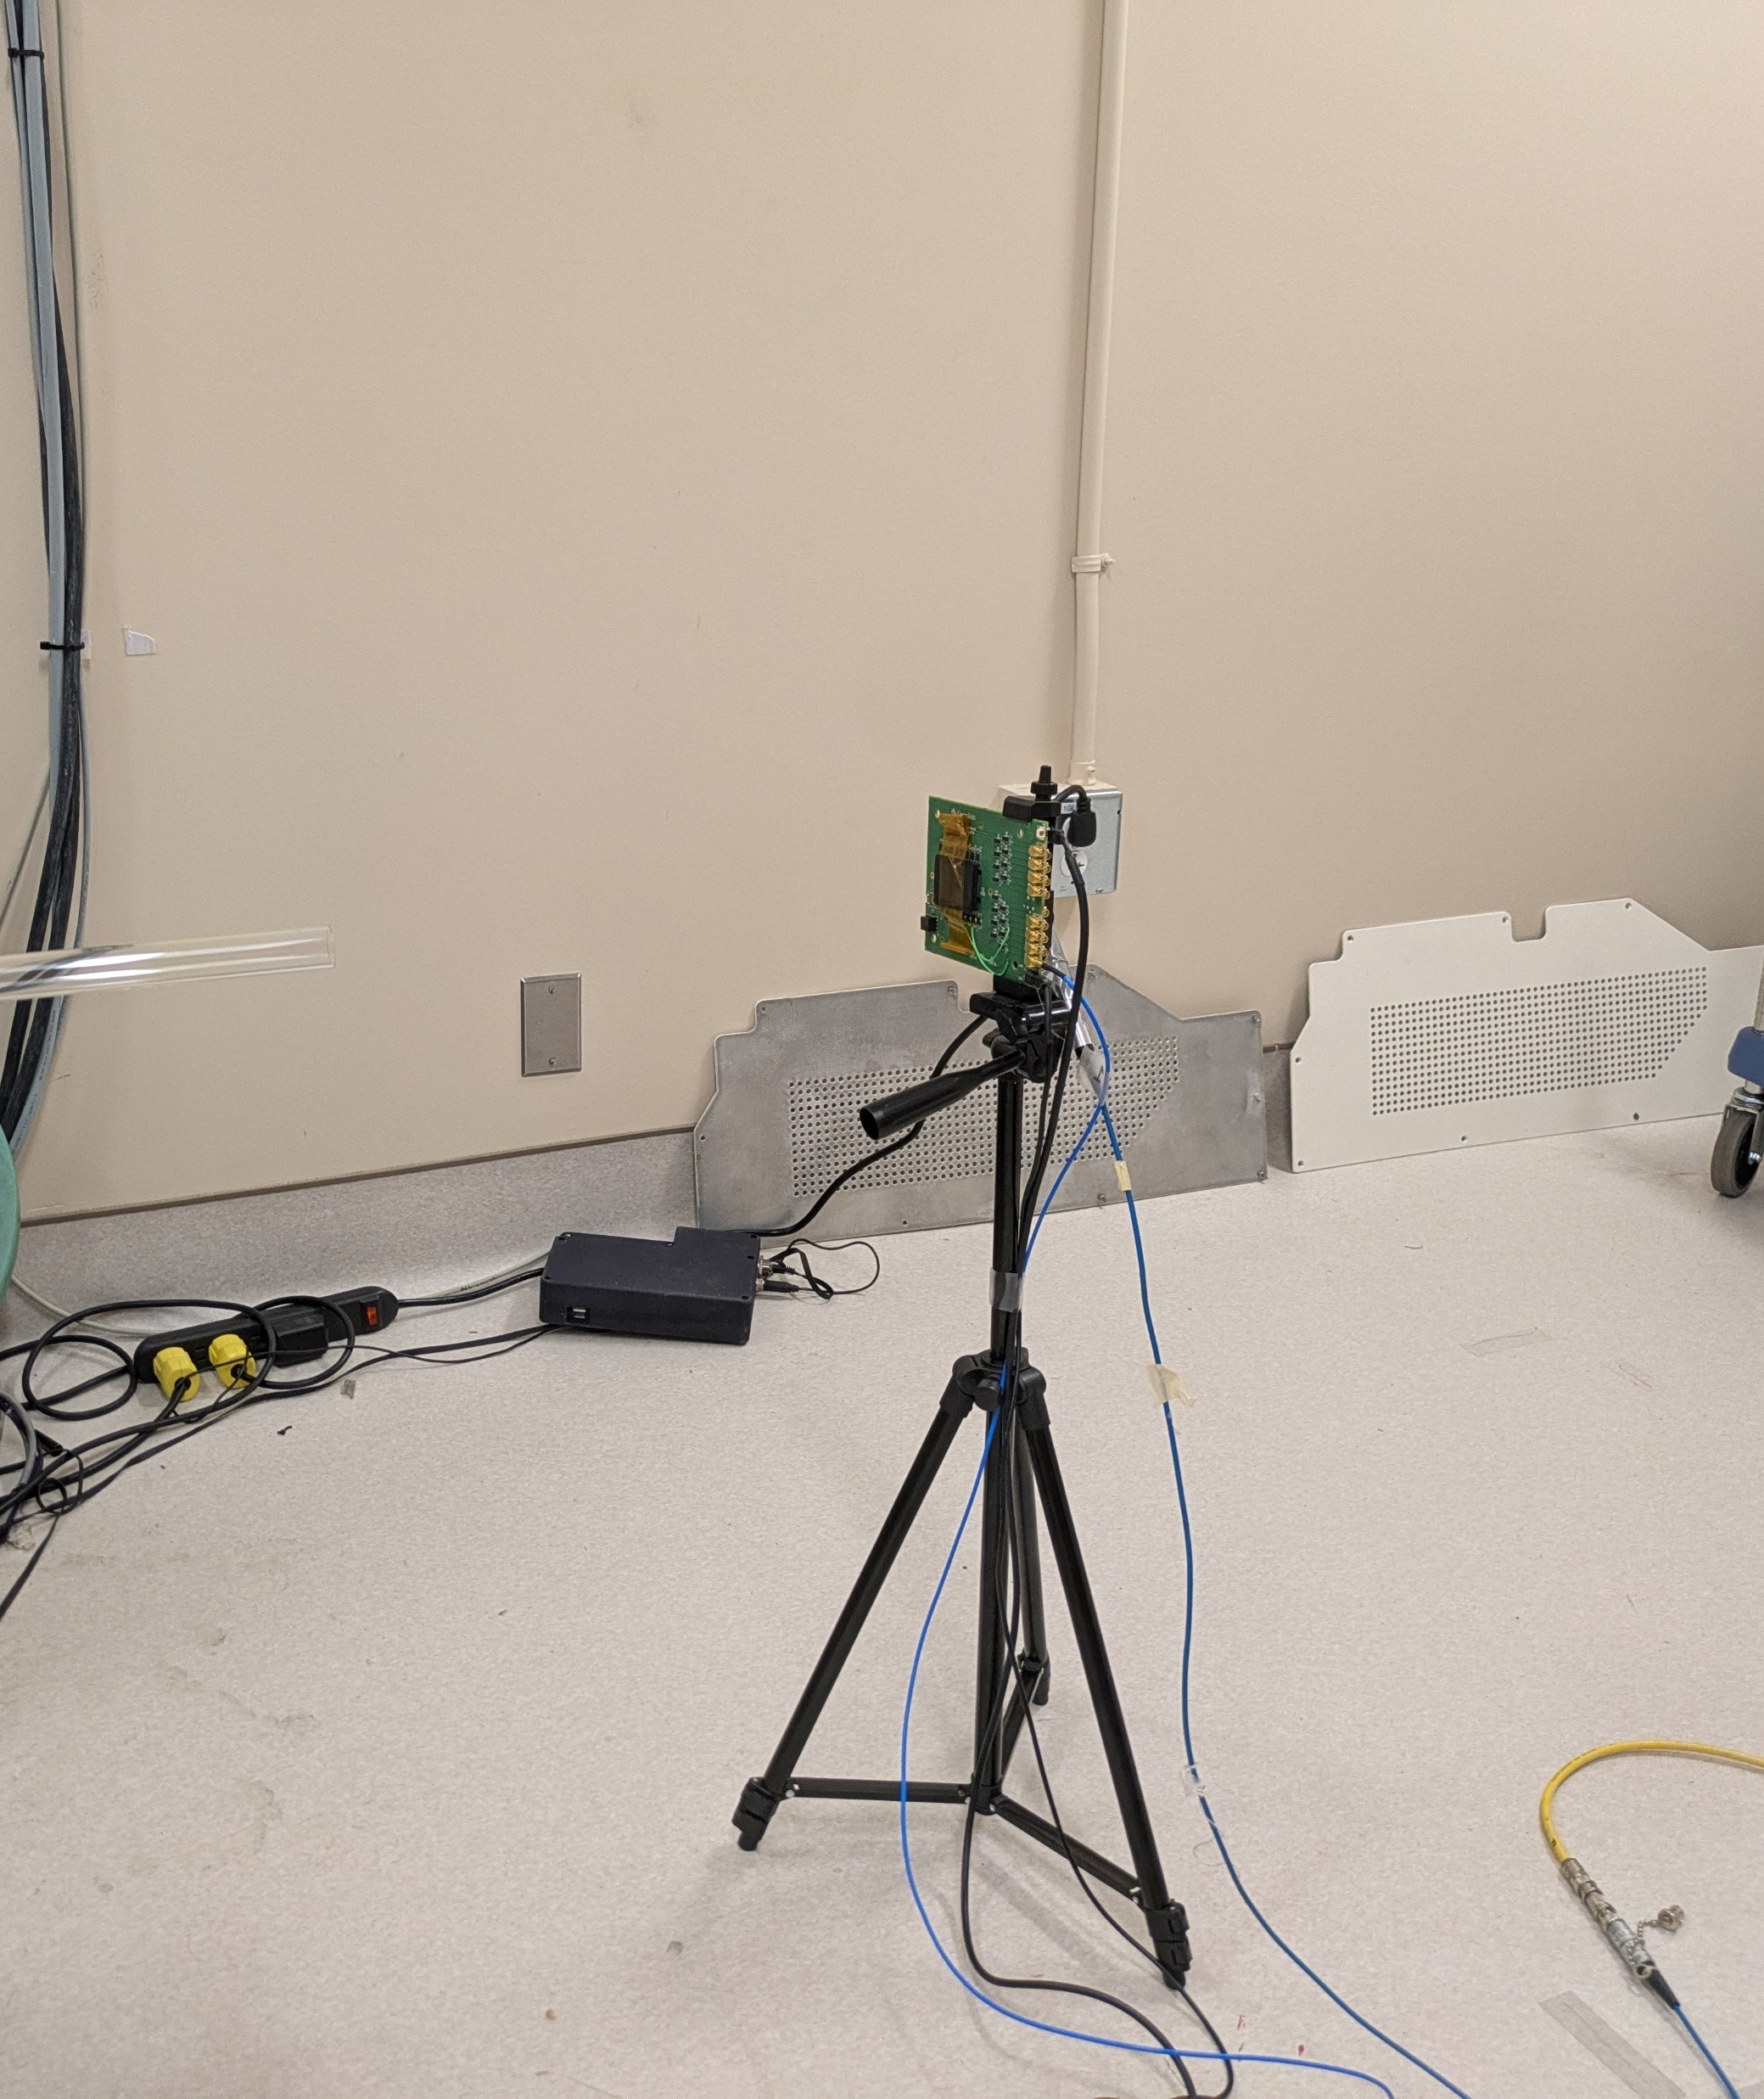
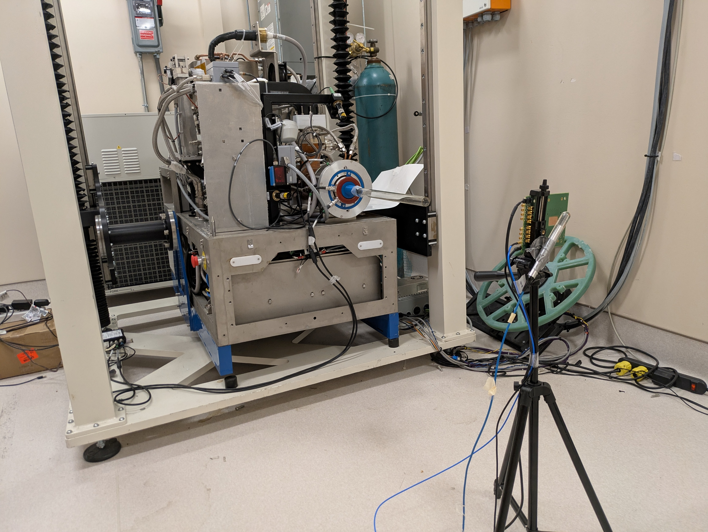
Simplified Setup in Later Tests

Slide 13
Varying Parameters
LGAD Bias Voltage=0-100 V
LV=5.5-6 V
Position (Z)=-26-250 cm (End of collimator Z=0)
Electron Beams:
  Conventional: HV=85 V
  Low Flash: HV=110 V
  High Flash: HV=190V
Pulses: 0.5, 1, 2, 3 μs

Slide 14
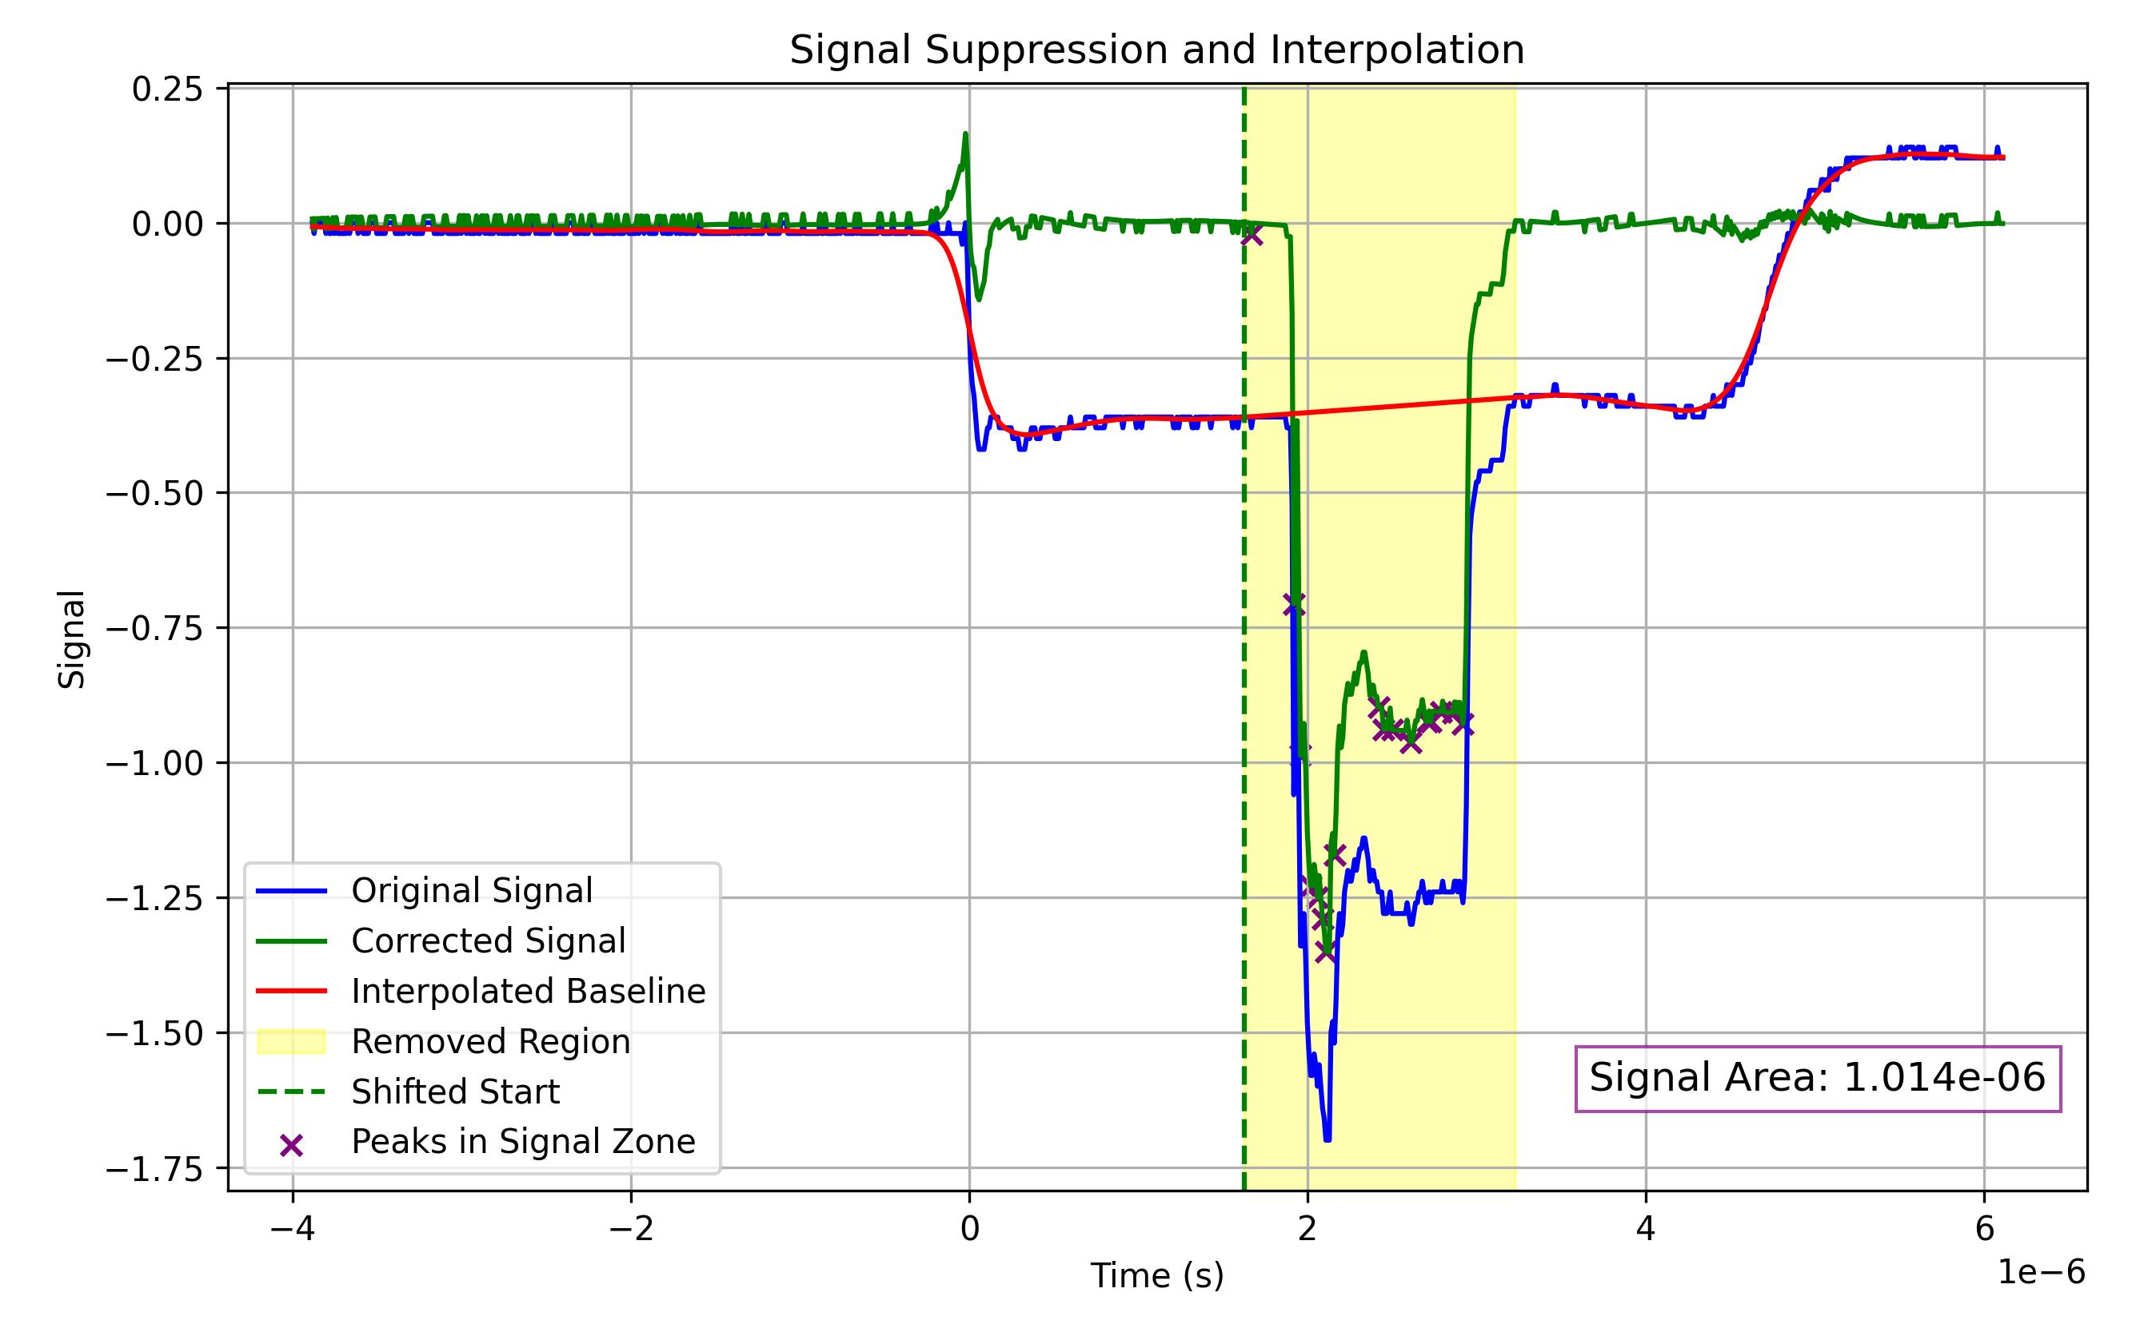
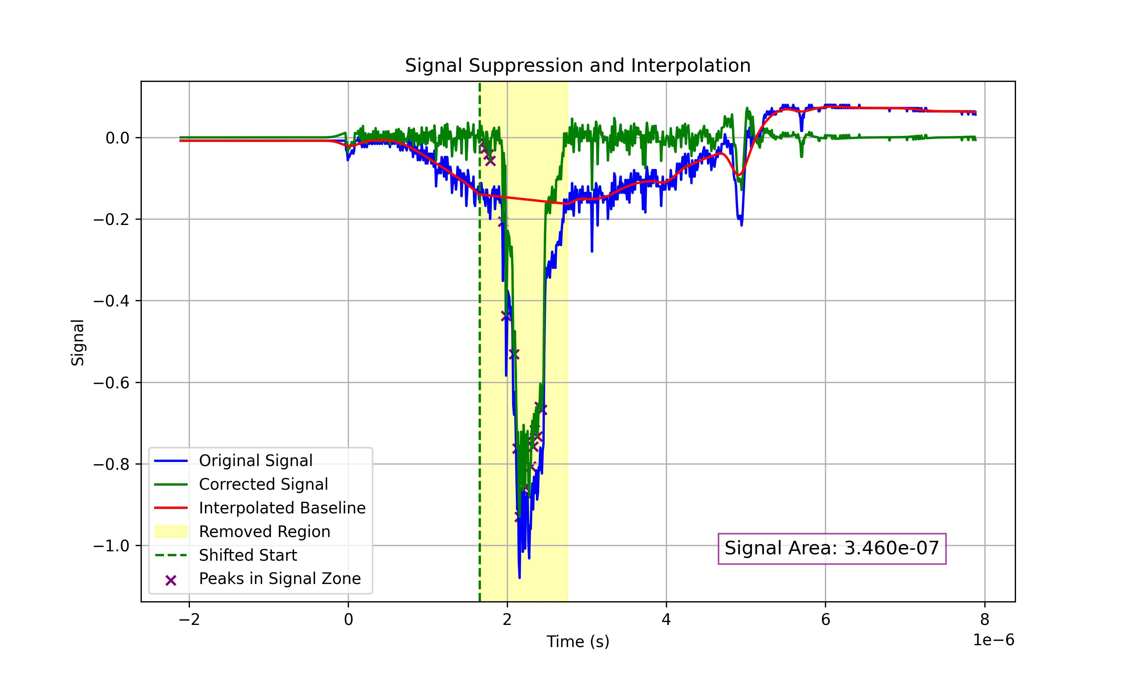
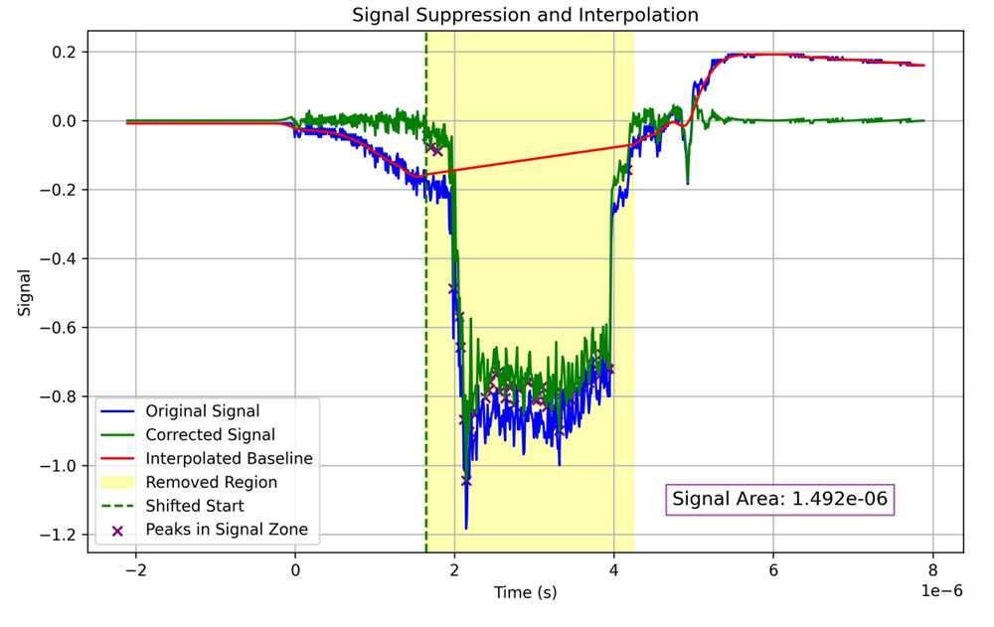
Signal examples
Baseline is stable for a set of conditions
Seems to change significantly with position and beam intensity

Slide 15
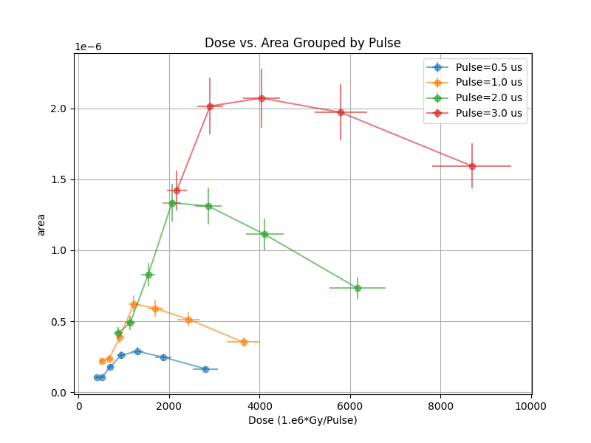
Charge Integration versus Measure Dose
With Standard operations conditions
LGAD BV=100 V
Saturation at about 1000 Gy/s
That would correspond to around 30 particles/ns on the sensor.

Slide 16
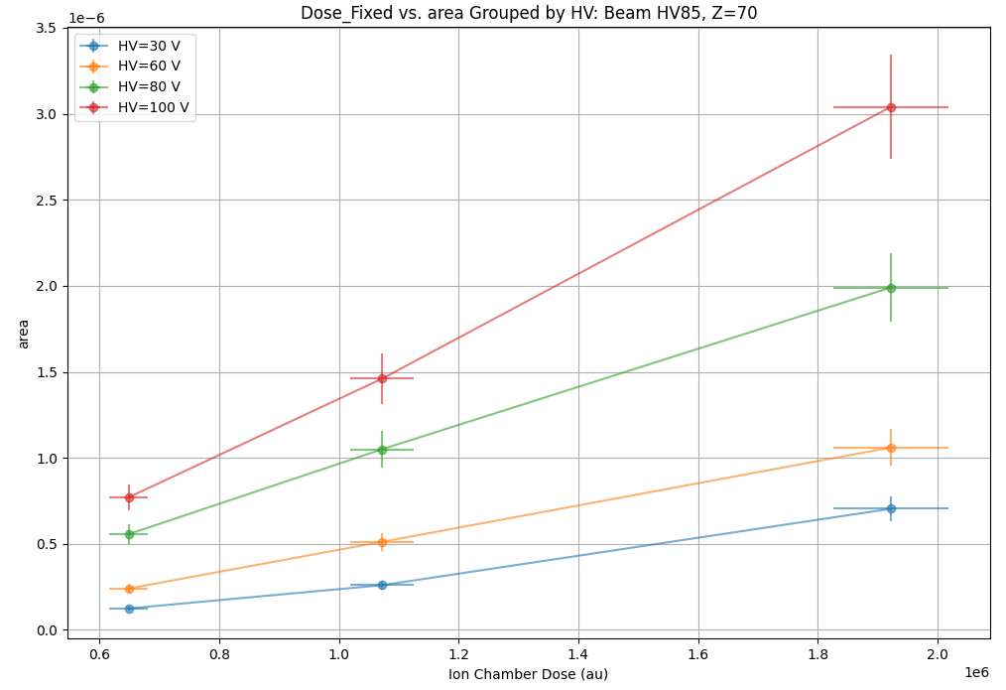
Gain Versus Voltage

Slide 17
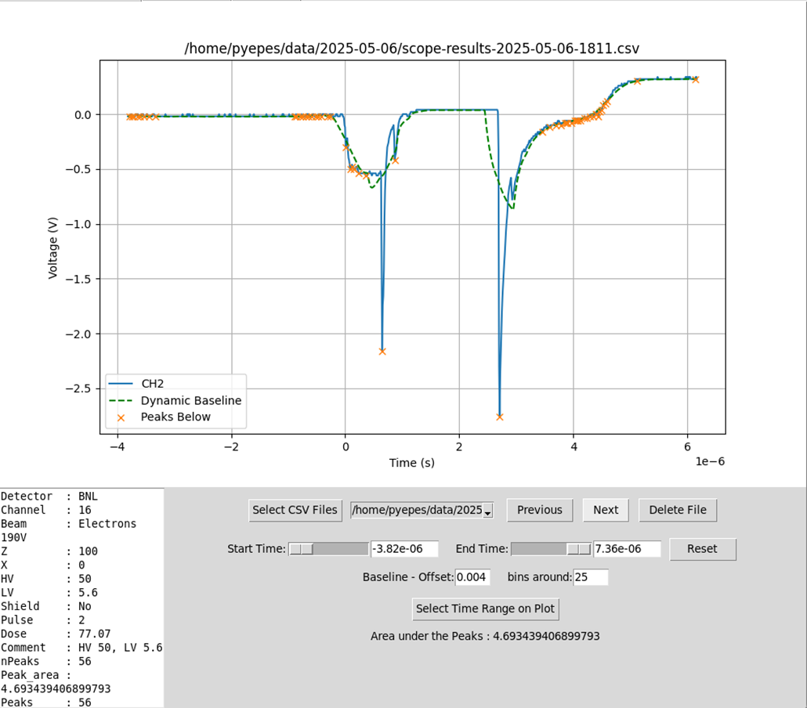
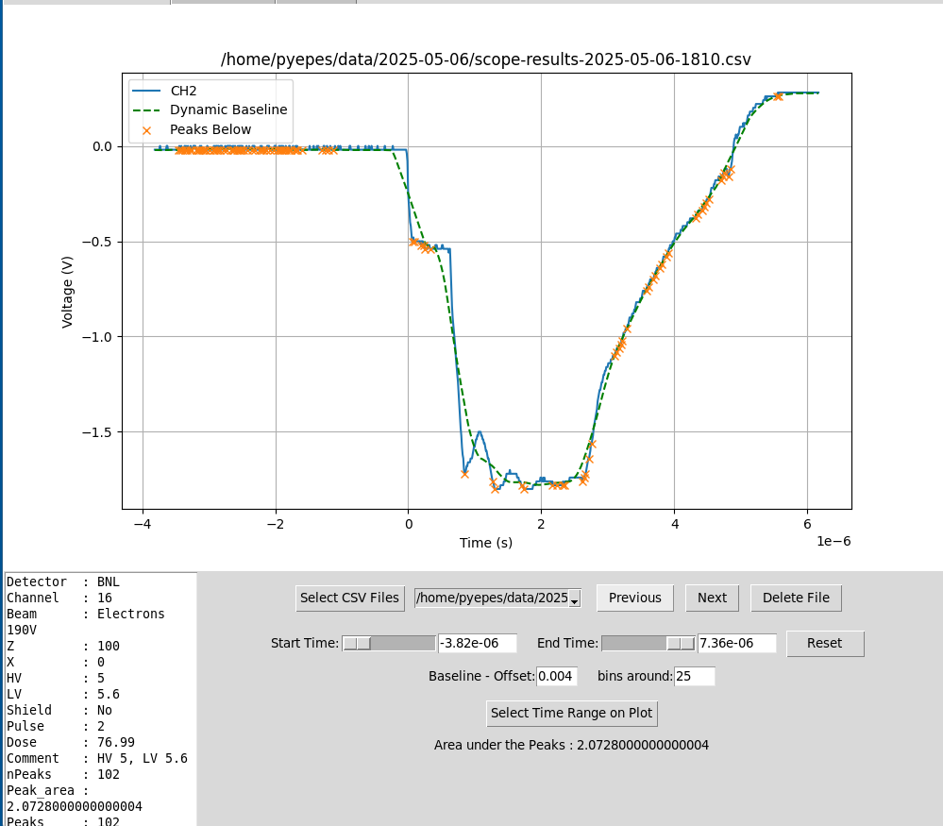
High Dose Rate Signal “Collapses” from BV=5 to 50 Volts

Slide 18
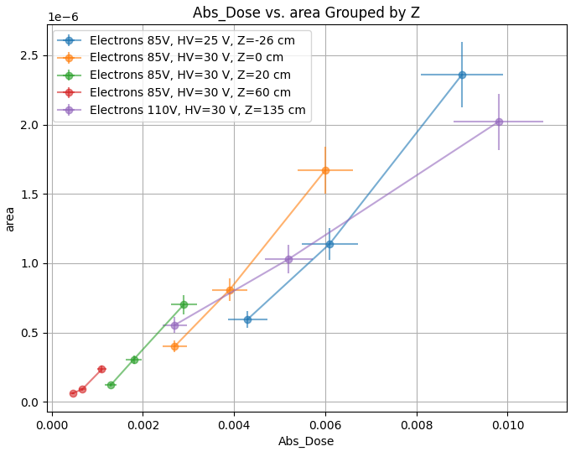
Integrated Charged versus Dose Various Conditions (Distance and Beam Intensity)
Higher Dose Rates
Lower BV=25-30 V

Slide 19
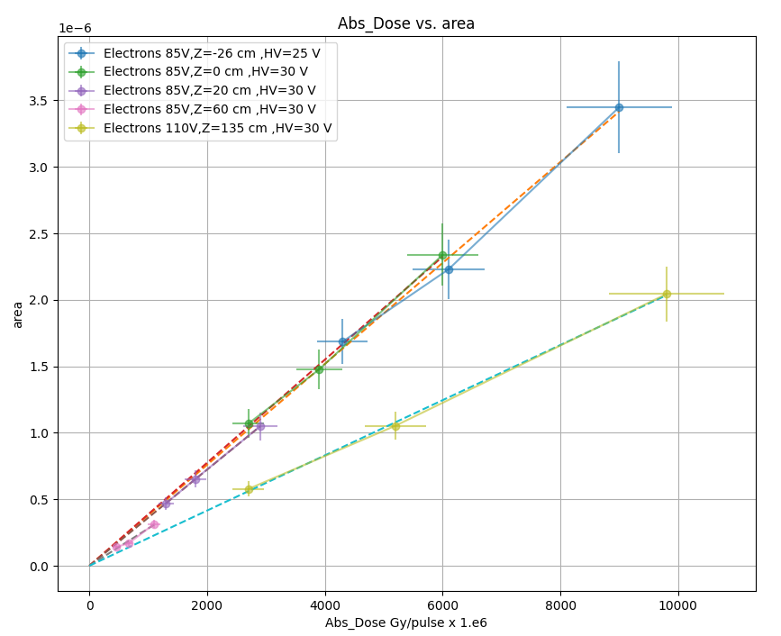
Corrected Signals
Require integrated charge to be null for zero measured dose
Actually, it looks like the selected area is underestimating the charge (negative intercept)

Slide 20
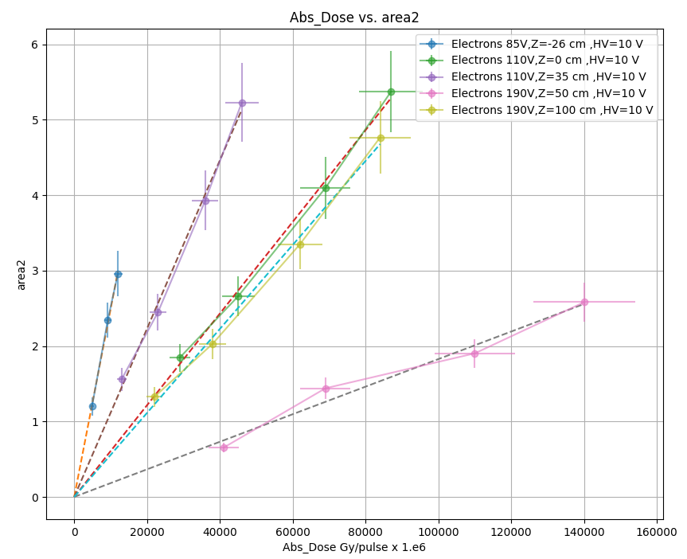
LGAD at BV=10 V Linear Within Conditions

Slide 21
Proton Beam
Proton Therapy Center 1 at University of Texas MD Anderson Cancer Center
A new PTC(2) has started operations in the last year
Line used exclusively for research
Hitachi Cyclotron
A FLASH beam achieved in small volumes with beam shaping elements (collimators, etc)
Beam is delivered in spills ranging 30-100 ms.

Slide 22
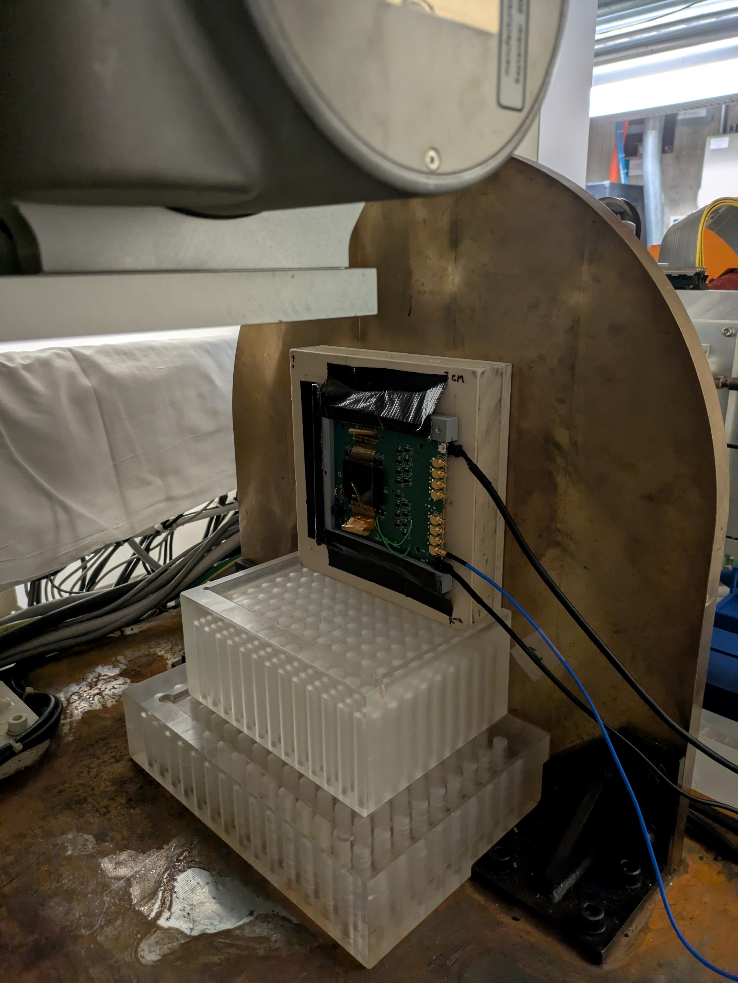
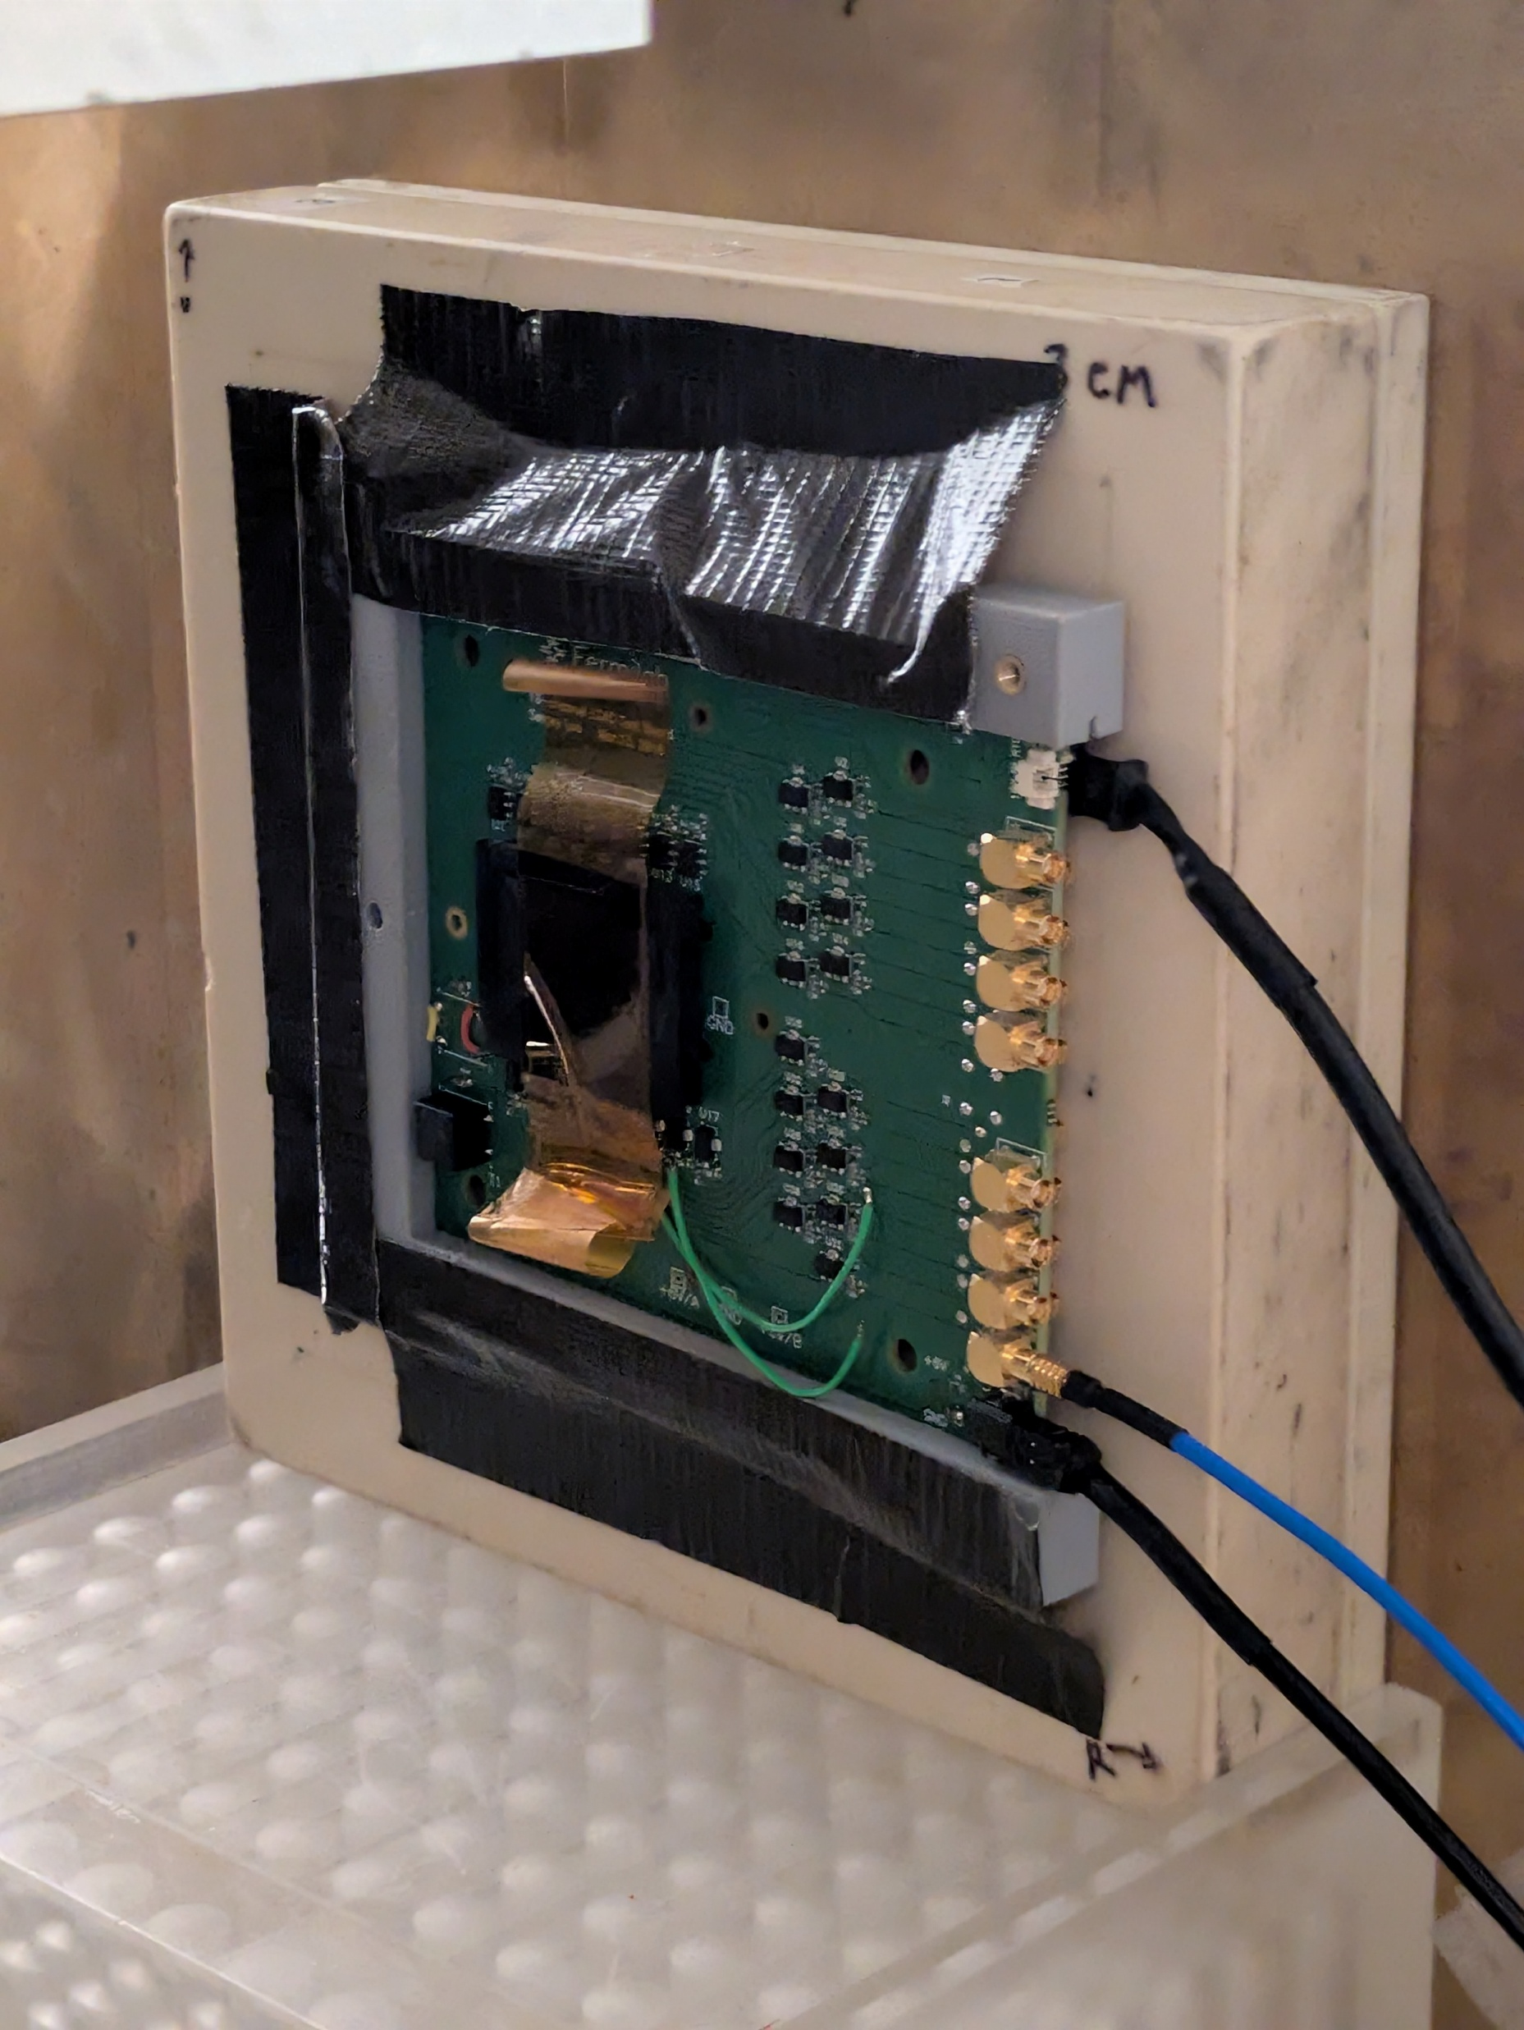
Proton Setup

Slide 23
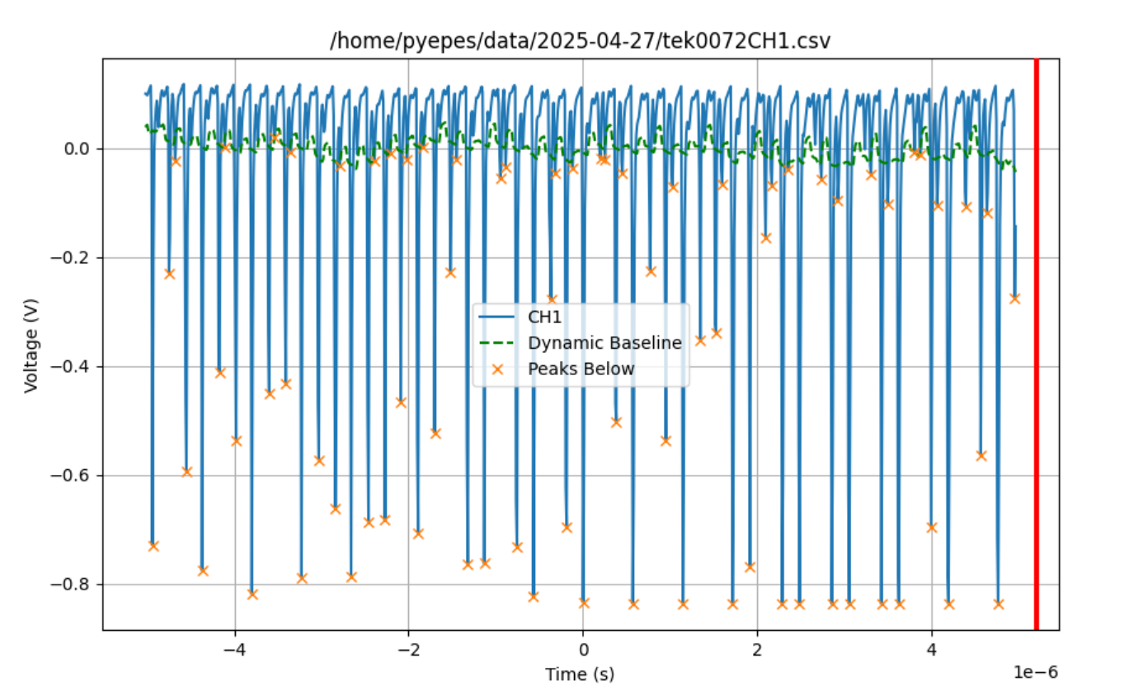
Typical Proton Signal
We are only seeing one small window of the spill
Baseline is essentially flat
Peaks seem to contain more than one particle
Peaks related to cyclotron revolutions?

Slide 24
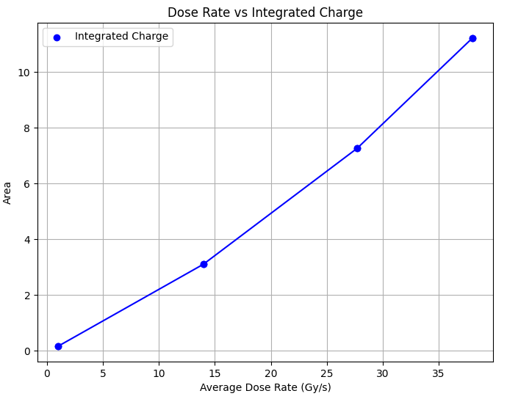
Integrated Charge versus Dose for Protons
Integrated charge under peaks is linear with “Average Dose” up to ~40 Gy/s
However, dose is concentrated in peaks of around 10 ns every 200 ns.
Instantaneous dose is about a factor of 20 times higher
Detector saturates at about 20 * 50 Gy/s = 800 Gy/s of instantaneous dose. Roughly the same as for electrons for BV=100 V.

Slide 25
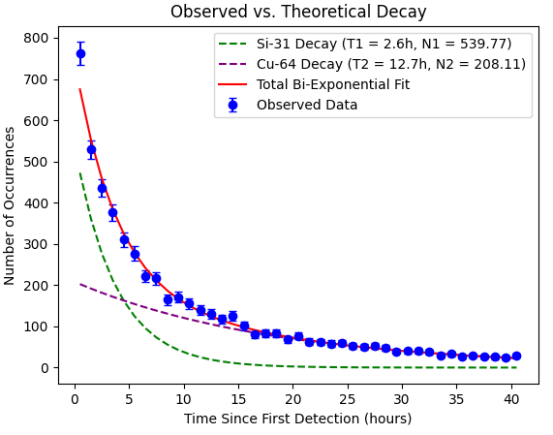
The Sensor/Board was radioactive after Proton Irradiation
Sensor saw signals before irradiation from radioactivity in materials around it.
After tests detector itself kept seeing signals back at the lab
Left detector running for a couple of days
Counted occurrences and fitted with possible radioactive decays with life-time in appropriate range
After a few days, activity completely ceased

Slide 26
Conclusions
Tested response of LGAD in conventional and FLASH electron and proton therapeutic beams
Particle counting is challenging for dose rates above a few Gy/s
Electrons:
  Integrated charge linear with pulse length
  Signal at BV=100 V (standard operations) saturates at ~1000 Gy/s
  For lower BV~30 V linearity can be increased ~5.
Protons:
  The beam has a time substructure
  Instantaneous dose should be around ~20 higher
  Signal saturates for average dose rate ~40 Gy/s. Instantaneous dose seems to saturate at a value compatible with that for electrons.

