Slide 1
The SCALE Demonstrator Test
212th TE-TM
C. Barth, F. Pasdeloup, Y. Leclercq & A. Ballarino on behalf of WP6a

Slide 2
Motivation: SCALE
CERN & Airbus UpNext collaboration:
‘Superconducting Technologies for Future Electric/Hybrid Planes Power Distribution Systems’
Development, construction and test of a superconducting powertrain transmission line SCALE (‘Super-Conductors for Aviation with Low Emissions’)
  rely on technologies of SC-link
  ≈ 7 m flexible, coaxial transmission line with trajectory representative of usage in a plane
  target performance: 0.5 – 1.0 kA in DC @ ≥ 20 K, 250 V – 500 V insulation voltage
  optimize superconductor cable of transmission line for low weight

Slide 3
Motivation: SCALE
Components & trajectory of the power transmission line:
current leads
short-circuit
transmission line

Slide 4
Motivation: SCALE
Mock-up of the power transmission line & trajectory:
short-circuit
aka ‘E-motor’
coaxial transmission line with representative trajectory
current leads
aka ‘Fuel Cell’
vertical bend
horizontal + vertical bend
R = 350 mm
R = 500 mm
vertical access
horizontal + vertical bend
vertical bend

Slide 5
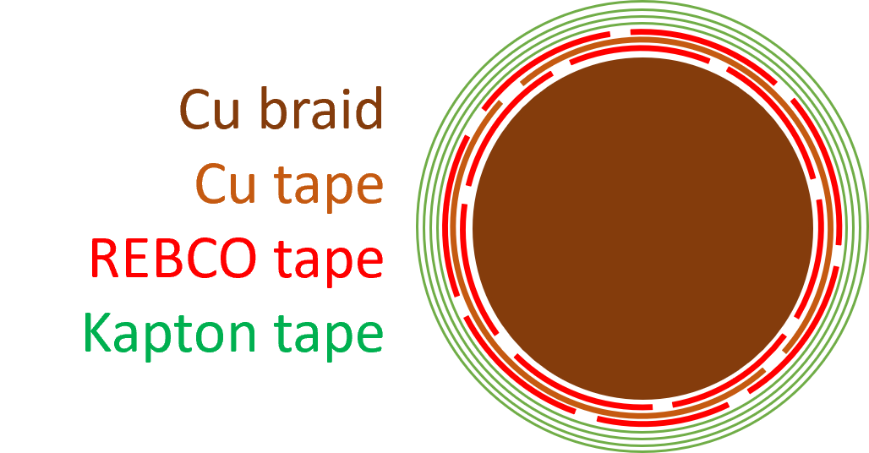
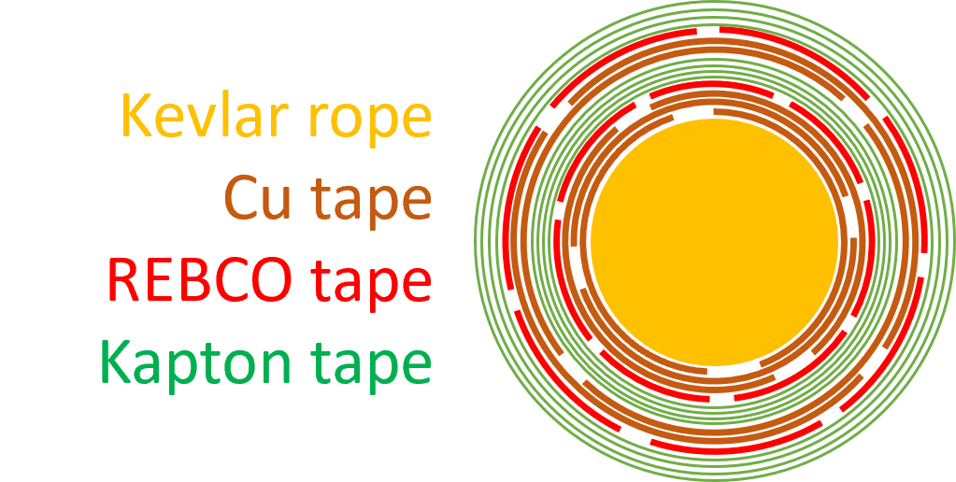
SCALE HTS cable
Based on WP6a HTS cable:
Cu braid as core for stabilization
2 REBCO layers (7 tapes each),
separated by Cu buffer layer: 3 kA @ 50 K
Kapton tape layers for el. insulation
(2 layers, each 50 % overlap): 10 kV air, 5 kV (gHe)
Optimizations of HTS cable for SCALE:
Coaxial: Kapton el. insulation layers
between REBCO tape layers
Low weight: Kevlar rope instead of Cu
braid core, multiple Cu tape layers required
for electrical & mechanical stabilization
(winding direction change between layers)
WP6a
SCALE

Slide 6
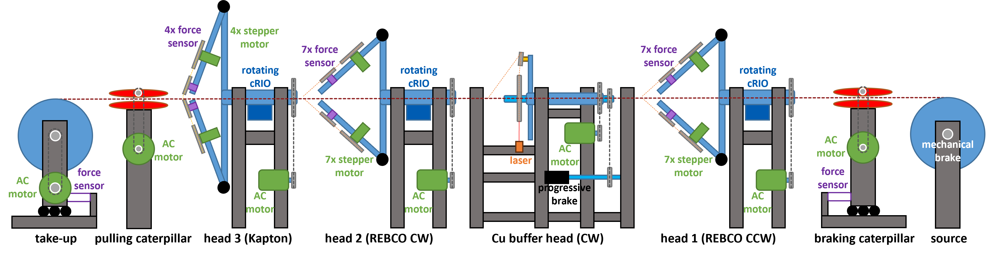
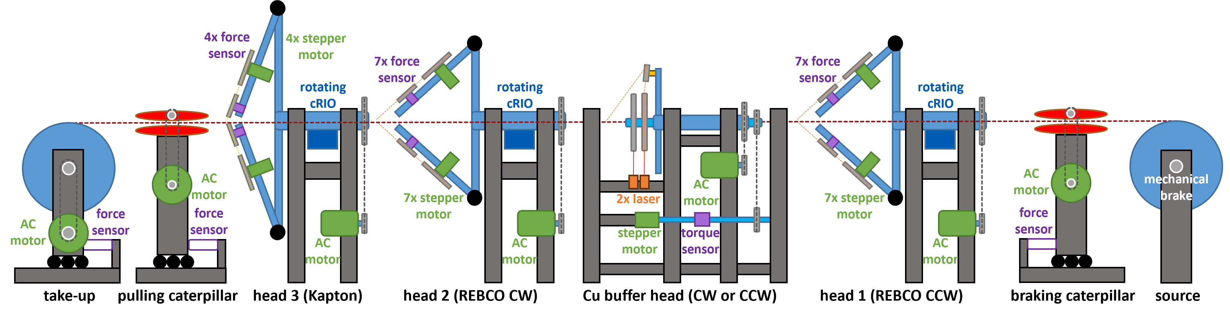
SCALE HTS cable
Upgrade of HTS cabling machine:
Multiple passes needed: → full reel-to-reel operation
  grooves in caterpillar belts
  pulling caterpillar with force limiter
CW & CCW Cu buffer layers: → upgrade of Cu buffer head
  2x Cu tape source spools (CW & CCW), 2x radius measure laser
  stepper motor + rotational torque meter instead of prop. brake
  → more precise tension control (while stationary & in rotation)
  → protect cable

Slide 7
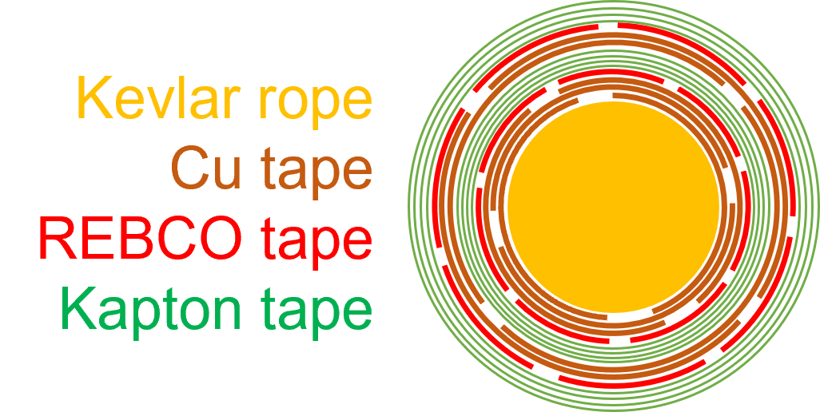
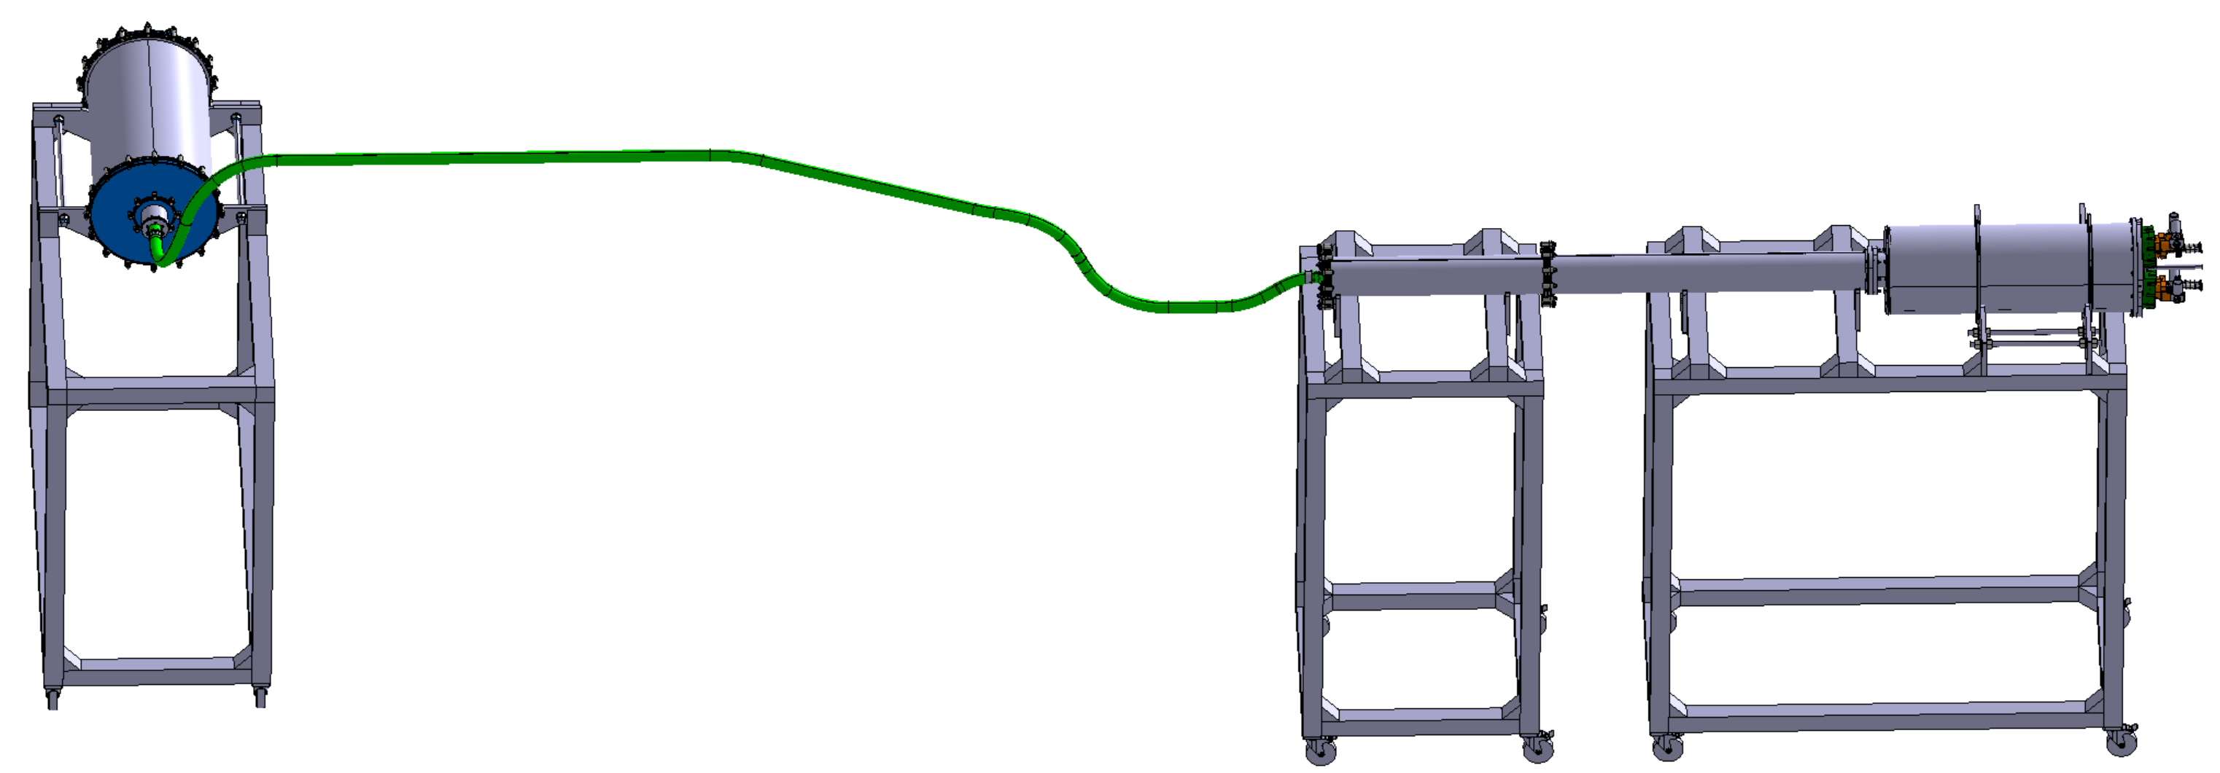
SCALE demonstrator
Schematic overview:
SCALE coaxial HTS cable
4x 600A HL-LHC current leads
(2 per polarity)
cryogenic connection to SM18 ‘Diode’ test station
13 mm OD, 284 g/m
short-circuit:
aka ‘E-motor’
current injection:
aka ‘Fuel Cell’
7m long flexible cryostat: 15 mm ID
injection of cold He gas
ref. temp. sensor
warm He gas return

Slide 8
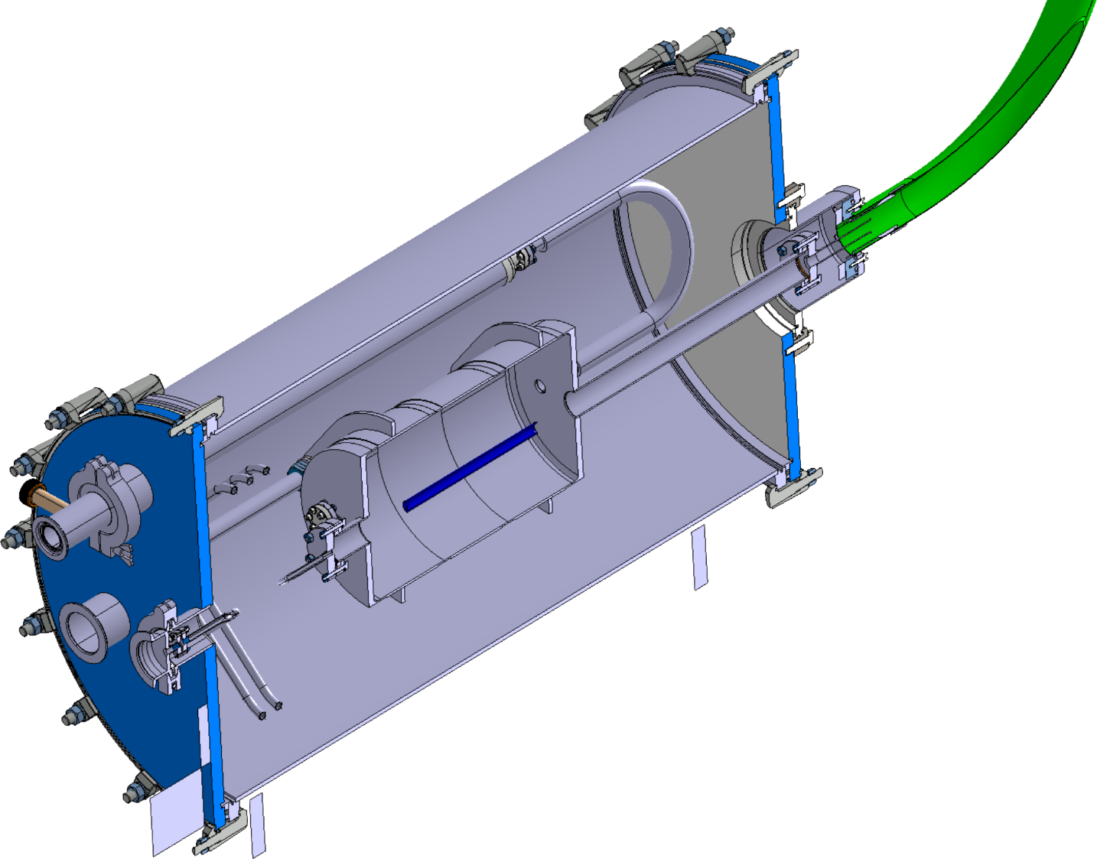
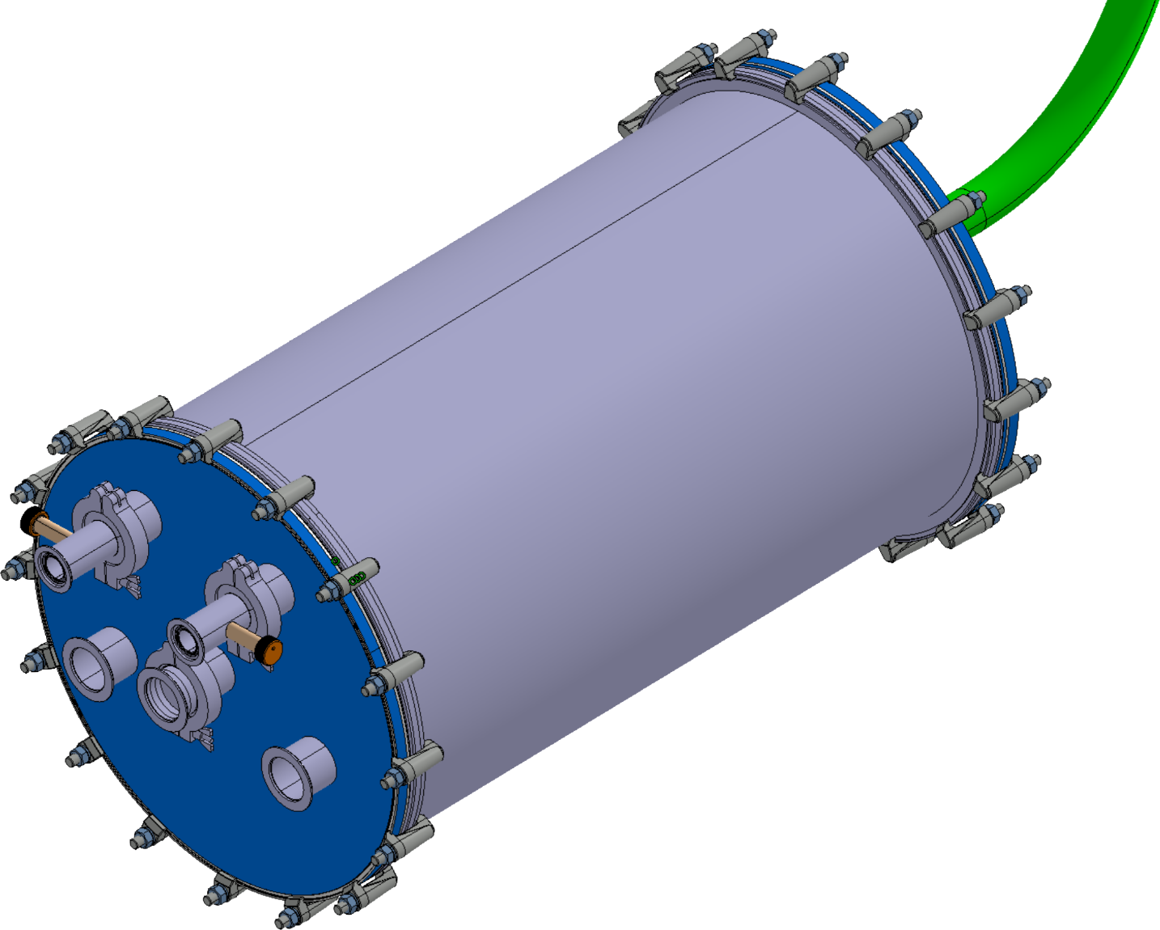
SCALE demonstrator
gHe vessel
Schematic overview:
(short-circuit)
capillary for instrumentation
distance for
thermal expansion compensation
cold gHe injection
(20 – 65 K)
vacuum pumping port
short-circuit of
the 2 coaxial layers
temp. sensor
for gHe temp. regulation
instrumentation feedthrough (IFS)
cold gHe bypass
(needed for flow regulation)
vacuum volume over-pressure protection

Slide 9
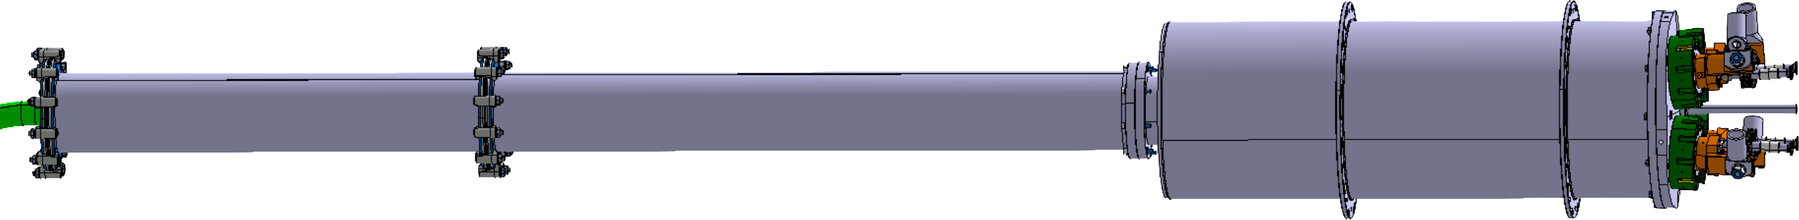
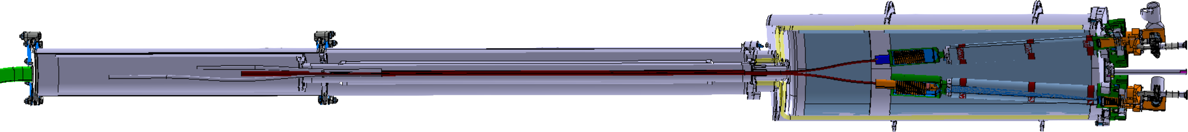
SCALE demonstrator
HL-LHC 600A
HTS cables
lower heat exchanger
RT current connection
warm gHe
return
Schematic overview:
(current leads)
2x HL-LHC 600A HTS cables to coaxial layer splices
resistive
part
ref. temp. sensor
splice cryostat
lead cryostat extension
current lead cryostat
4x 600A HL-LHC current leads

Slide 10
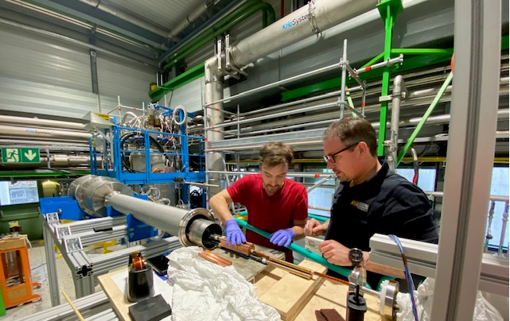
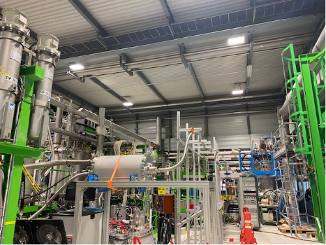
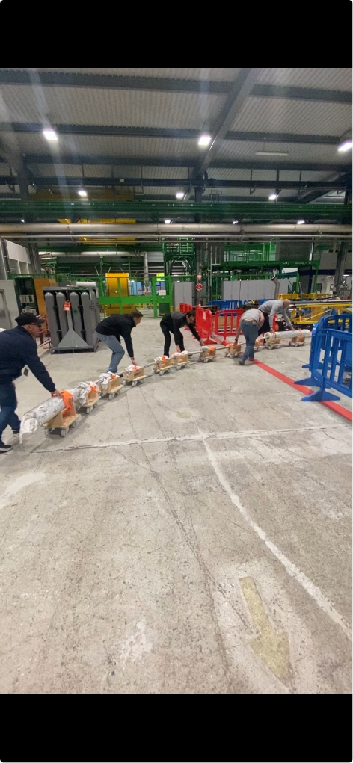
SCALE demonstrator
Realization:
current leads
splices
short-circuit
transmission line
transmission line
current leads

Slide 11
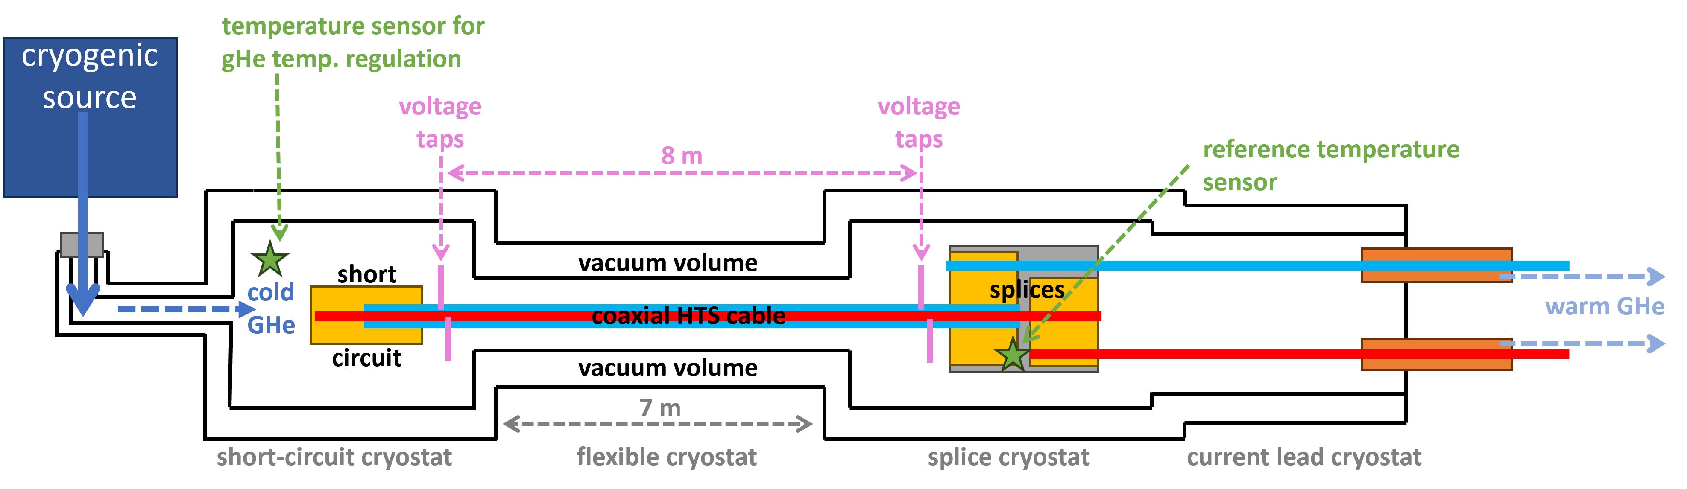
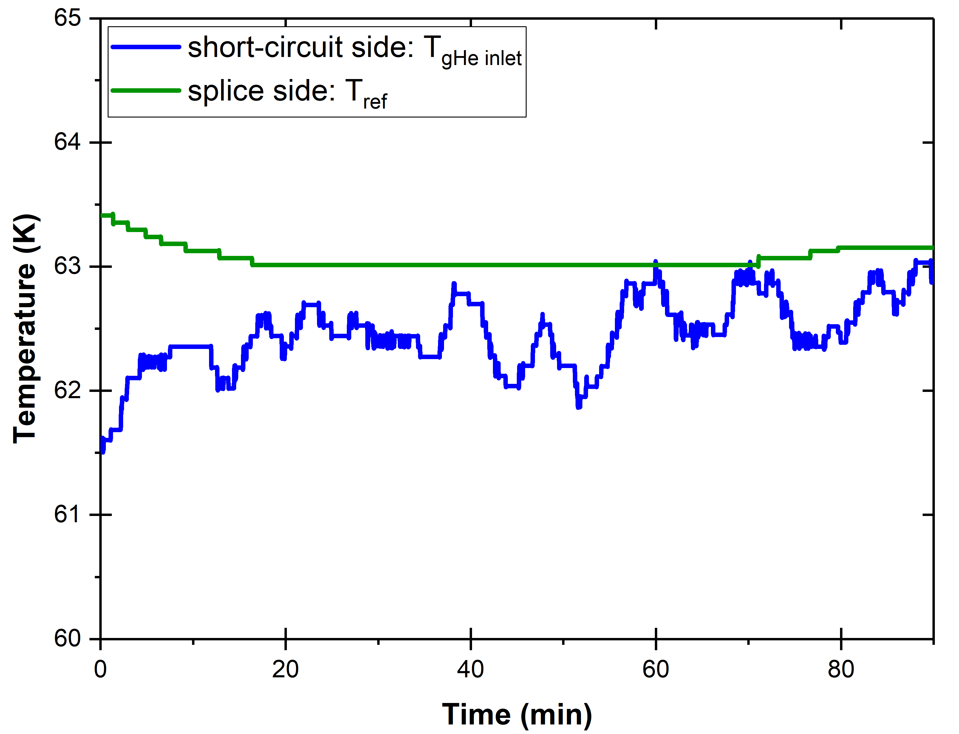
SCALE demonstrator
Simplified schematic overview:
gHe temperature:
Oscillations on short-circuit side
due to gHe temp. regulation
Splice side temp. (T_{ref}) stable
<1 K temp. gradient along
flexible cryostat (@ ≈0.6 g/s)
gHe flow: ≈0.6 g/s

Slide 12
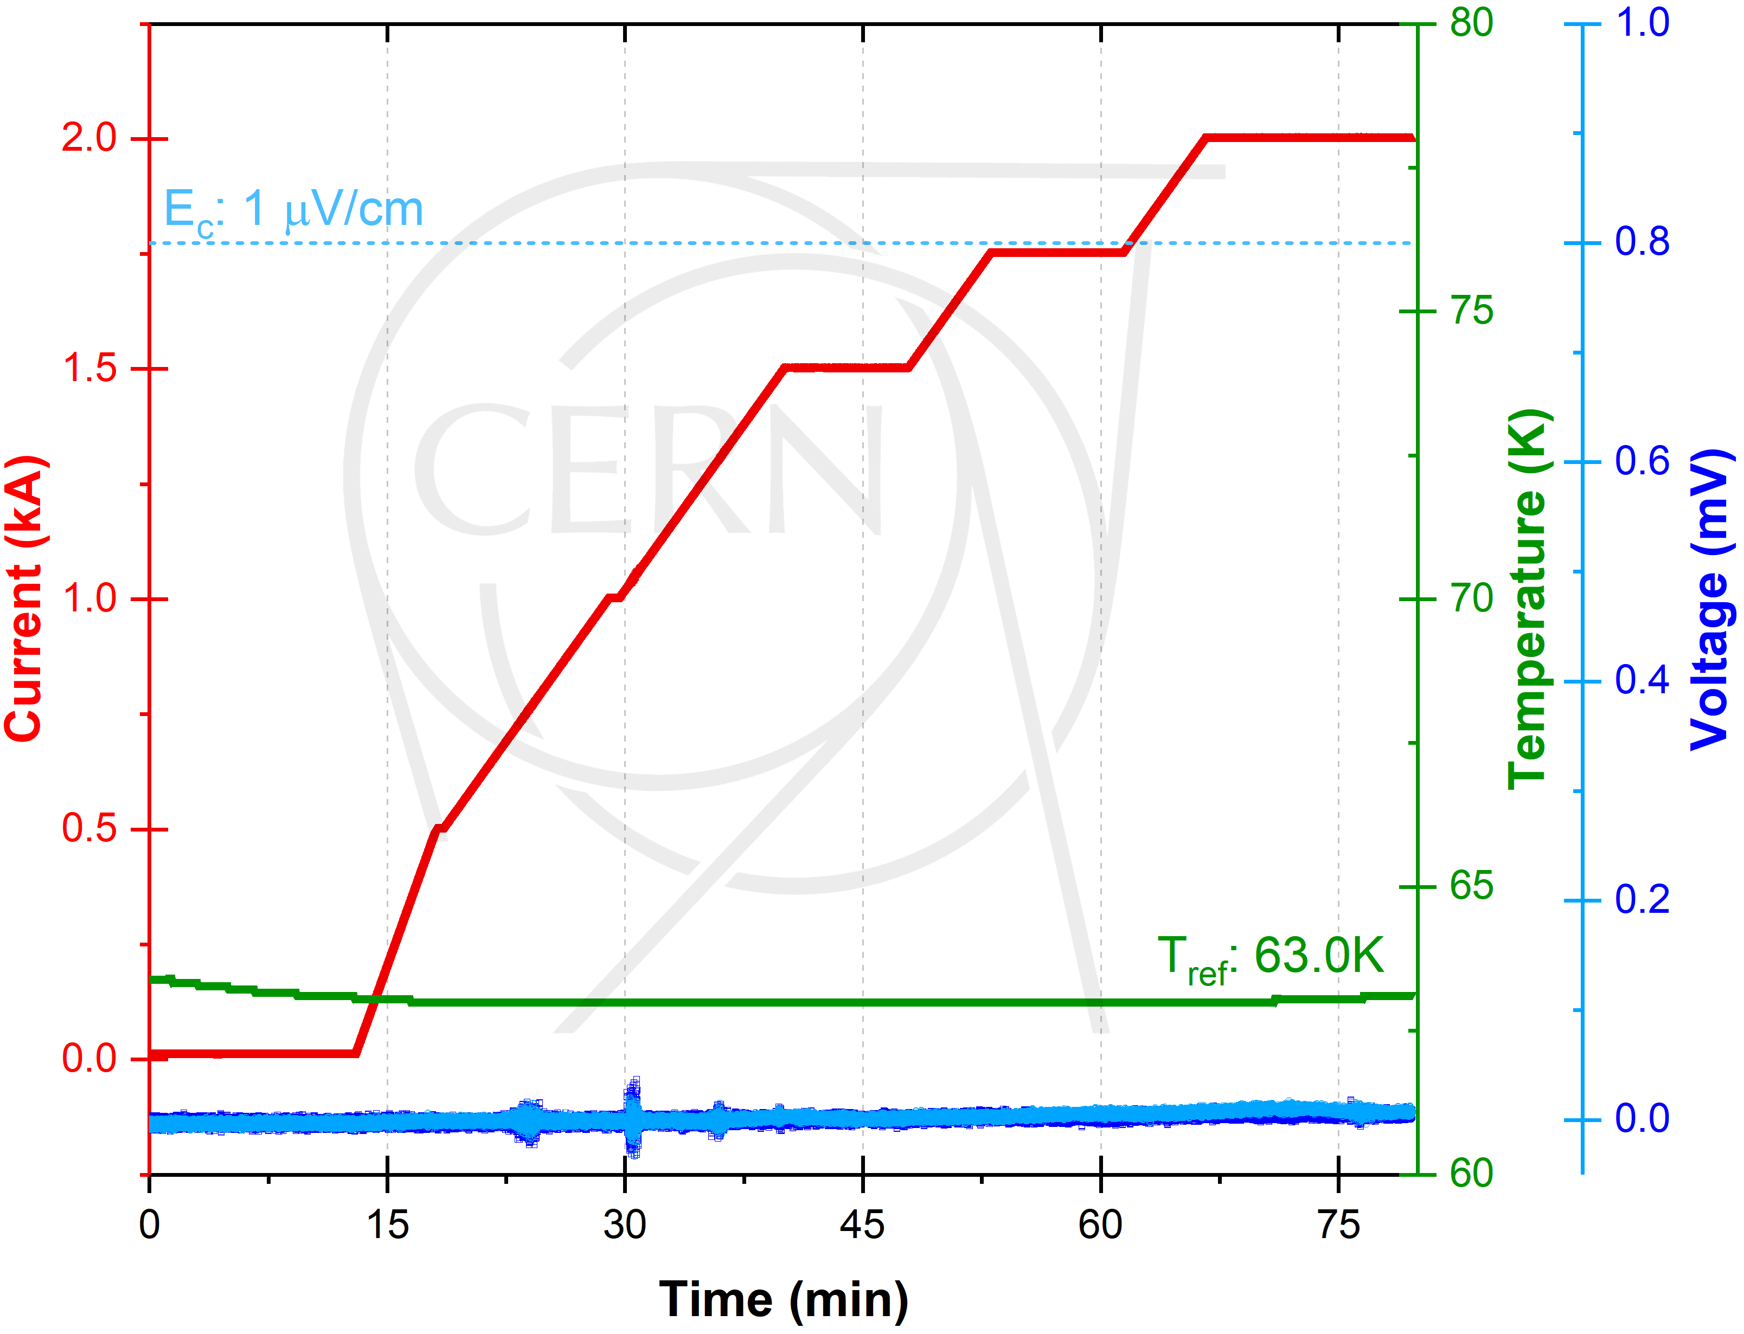
Test results
Reference temperature of 63 K:

Slide 13
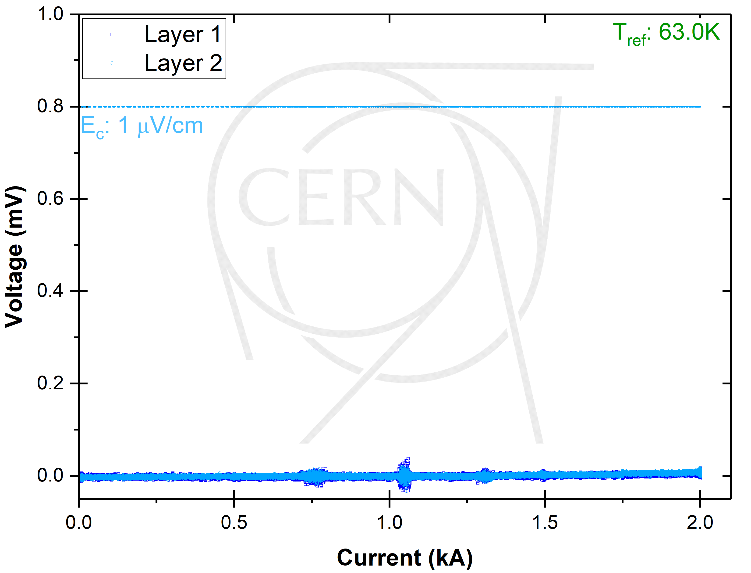
Test results
No voltage at 2 kA
Reference temperature of 63 K:

Slide 14
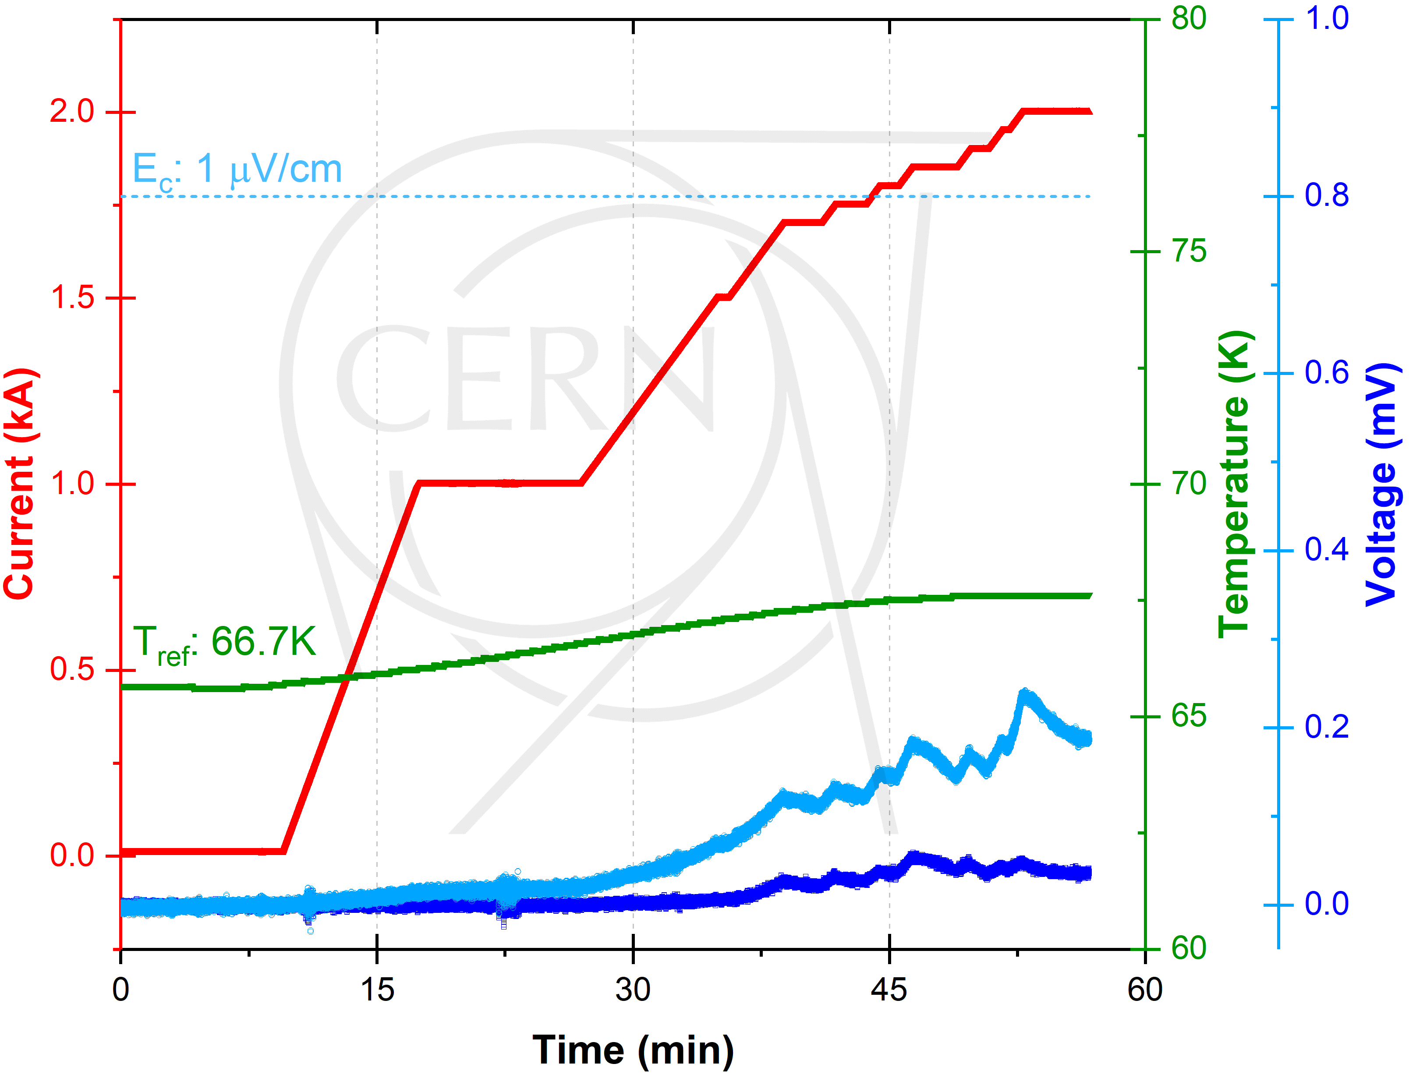
Test results
Reference temperature of 66 K:

Slide 15
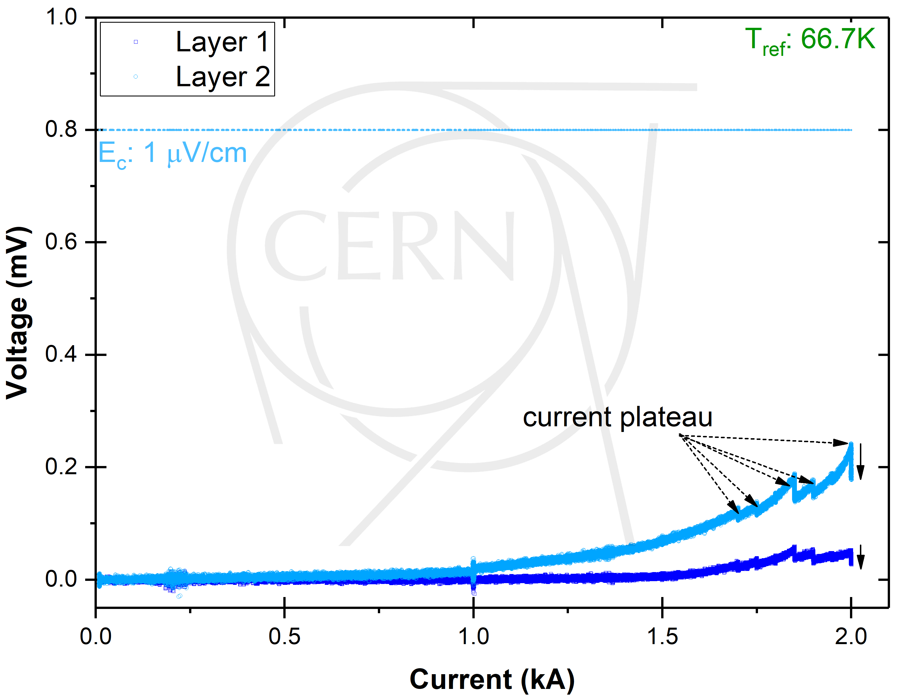
Test results
Stable at 2 kA
Reference temperature of 66 K:
current re-distribution
during plateau
→ stable

Slide 16
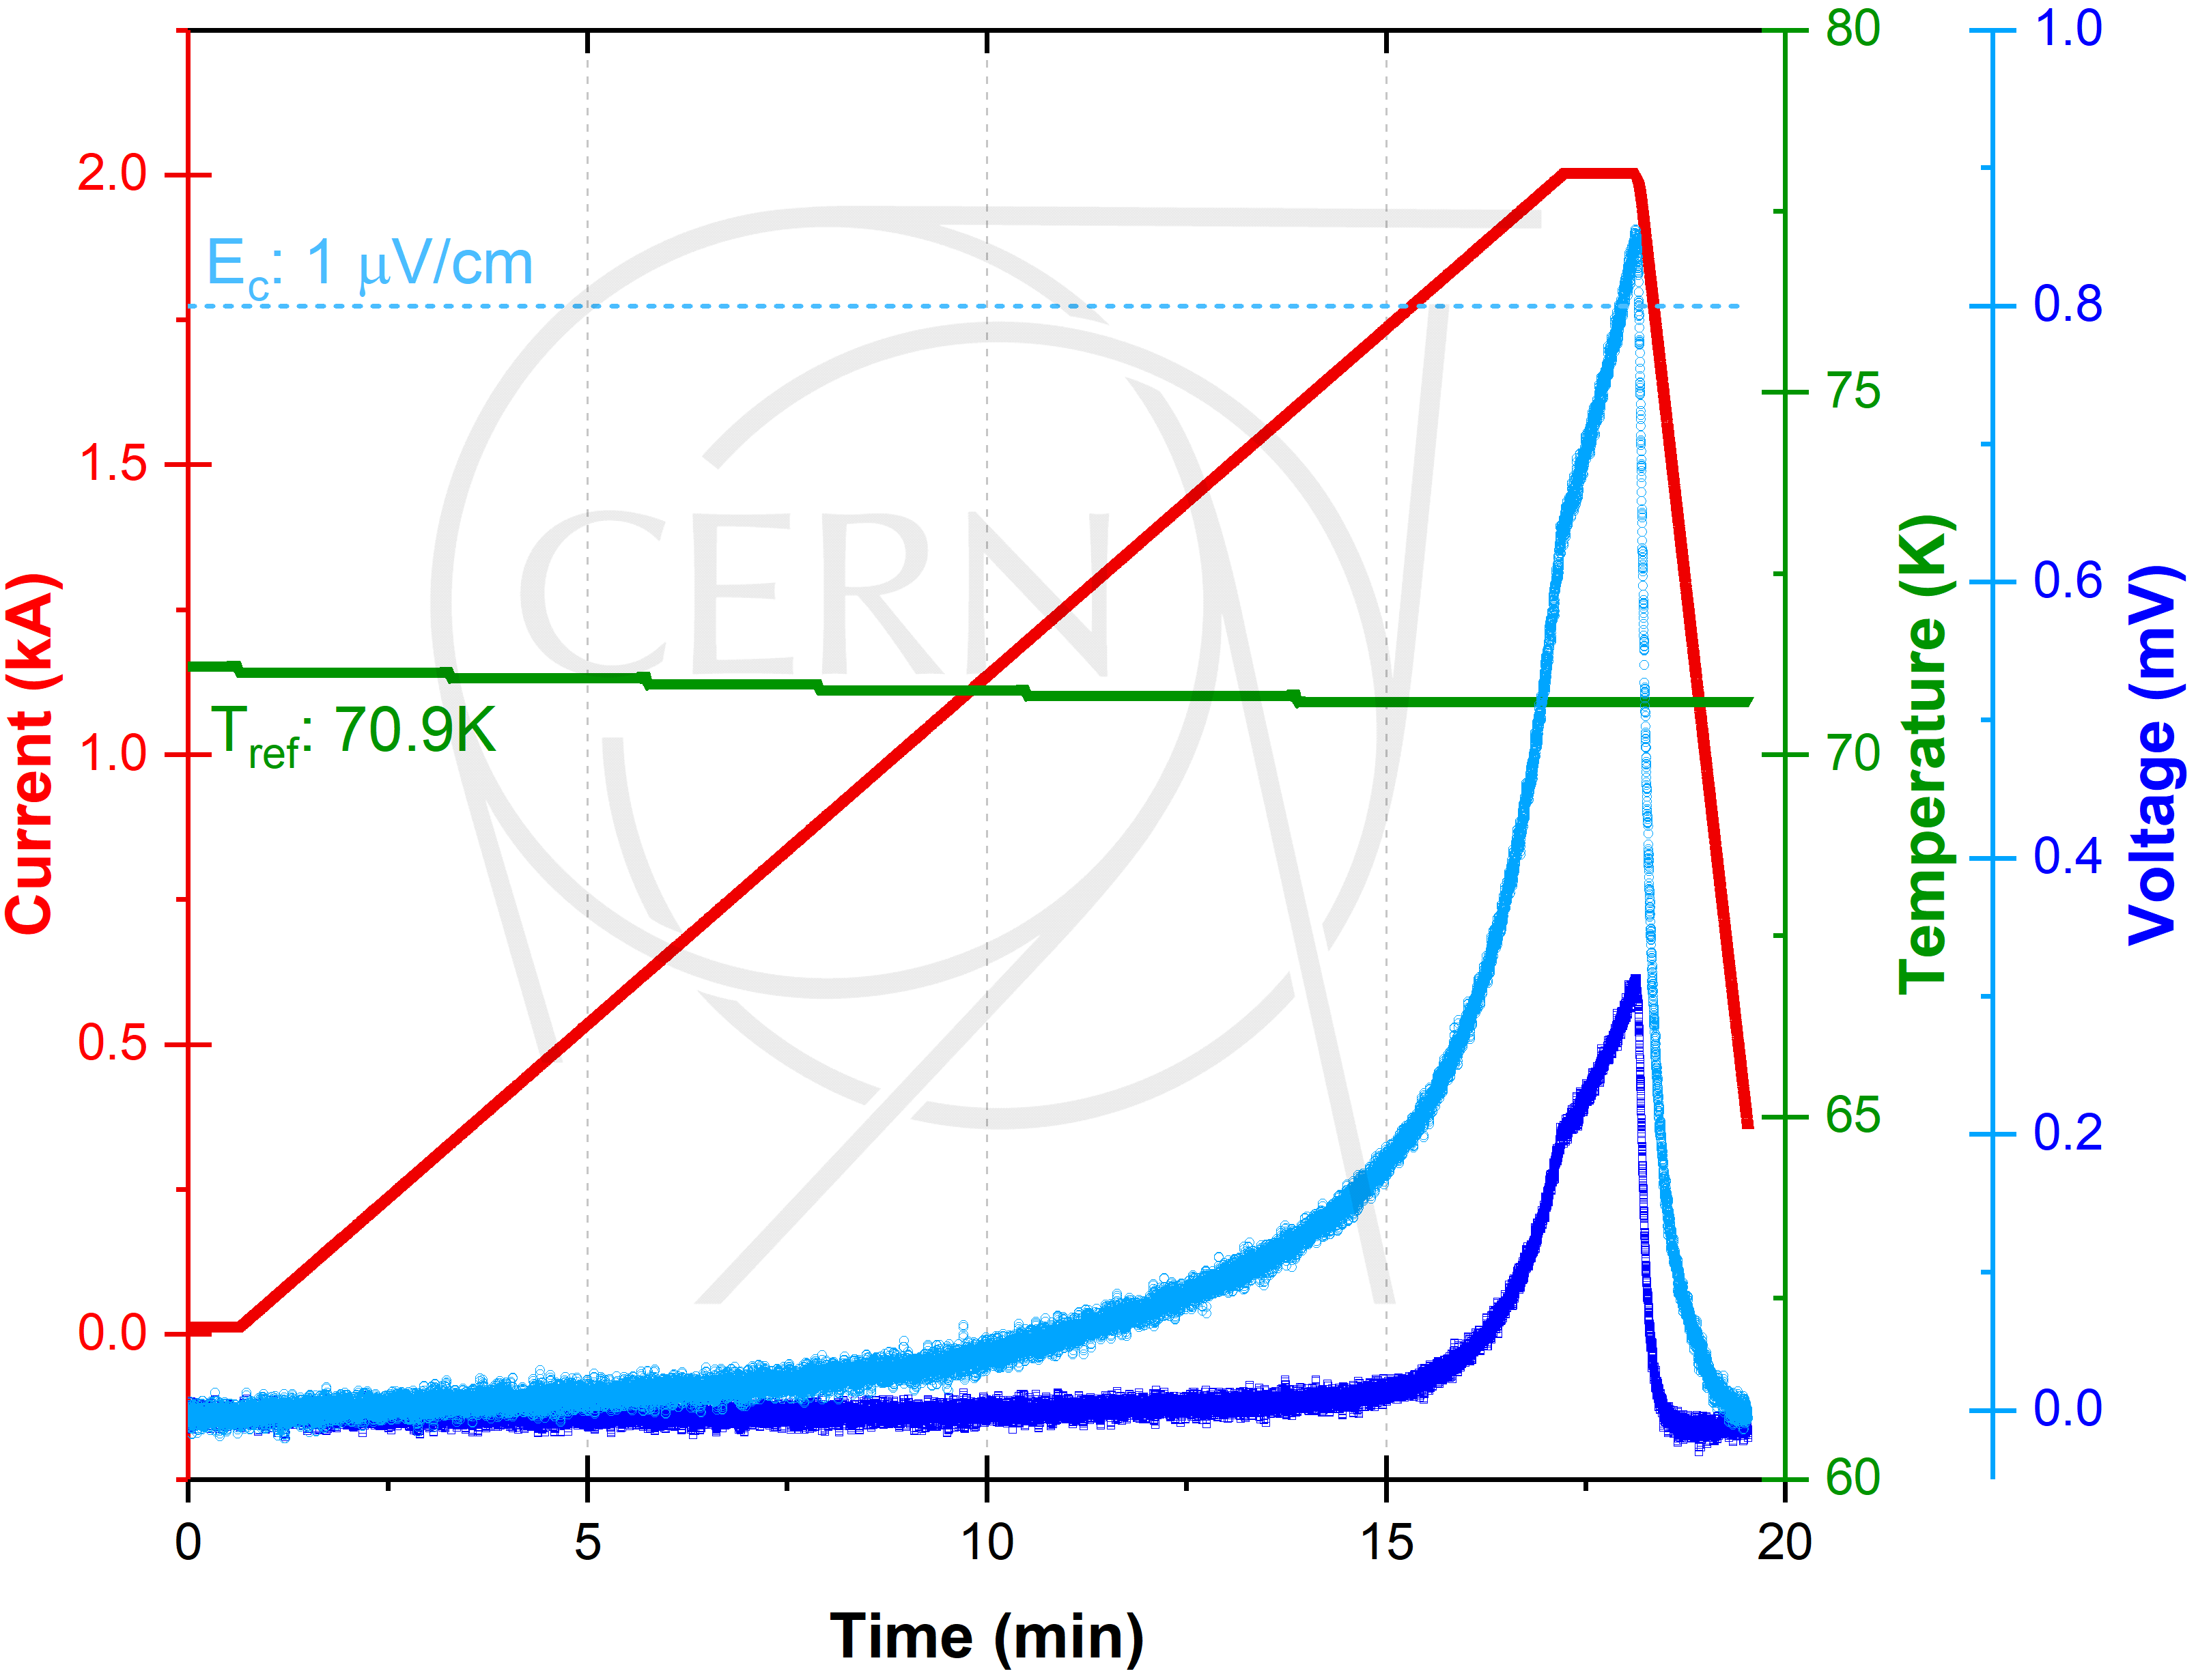
Test results
Reference temperature of 70 K:

Slide 17
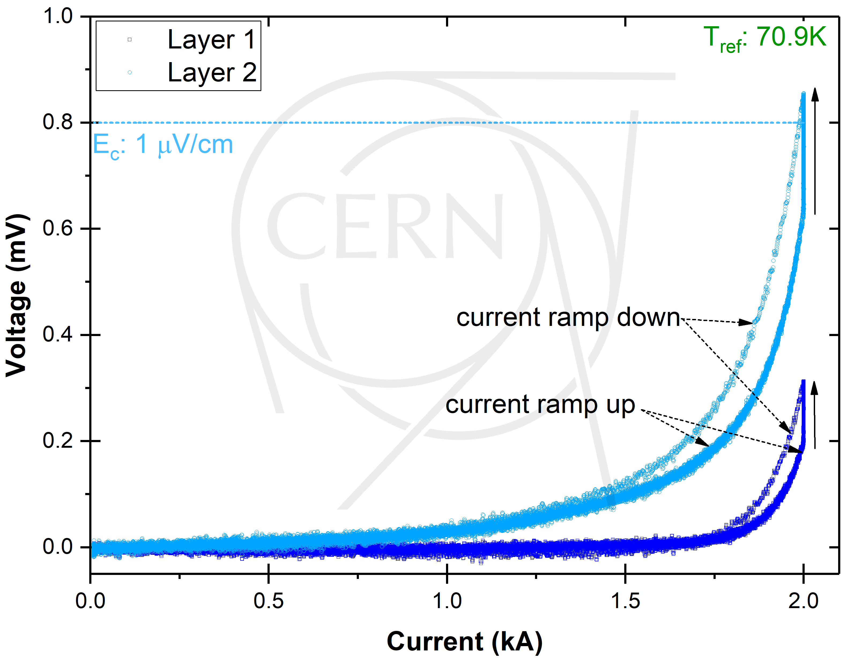
Test results
Unstable at 2 kA
Reference temperature of 70 K:
heating
during plateau
→ unstable

Slide 18
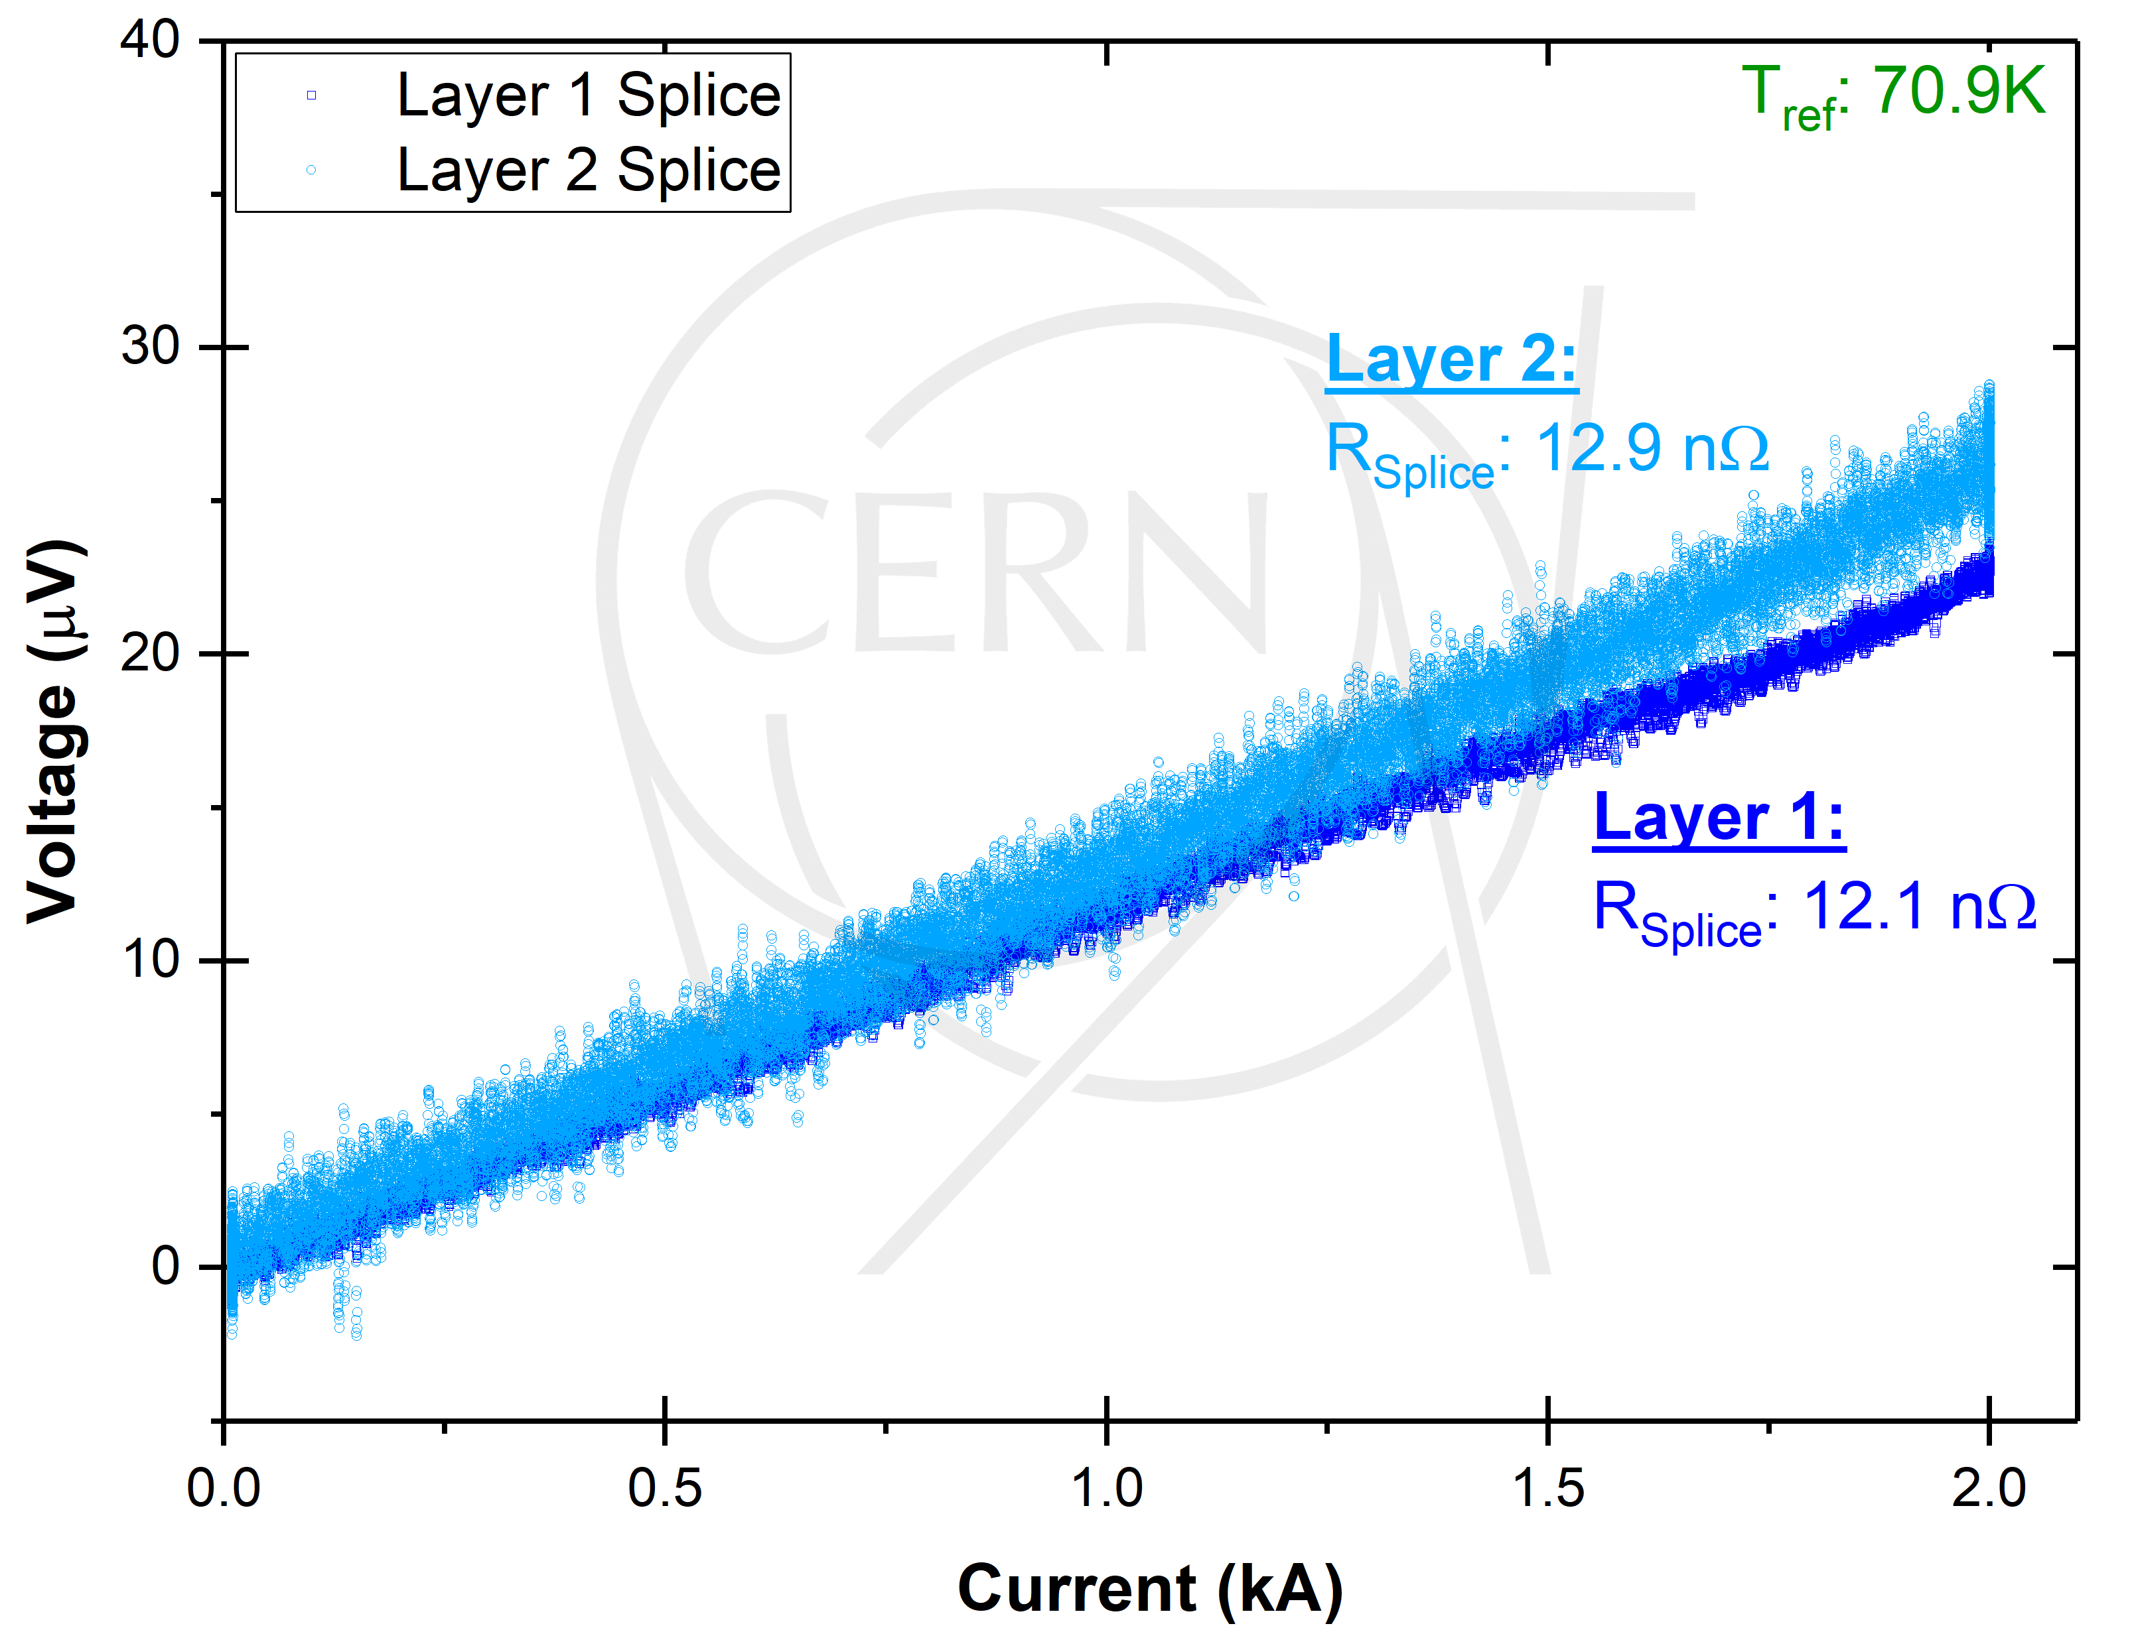
Test results
Splice resistance:

Slide 19
Summary
Successful cold powering test of SCALE demonstrator that by far exceeded the performance targets:
Low cable weight: 284 g/m
Homogenous resistance splice resistances <13 nΩ
63 K reference temperature (temperature of the splices on the current lead side): no voltage on the coaxial HTS cable at 2 kA
66 K reference temperature: ≈0.25 µV/cm on the coaxial cable, stable at 2 kA current plateau (voltage is slowly decreasing due to current re-distribution)
70 K reference temperature: ≈0.9 µV/cm on the coaxial cable after ramp to 2 kA (20 A/s), unstable at 2 kA current plateau (voltage is increasing due to local heating)

Slide 20
Thank you for your attention
Acknowledgements:
TE-MSC-HSD: M.-P. Careil, J. Hurte, J. Mazet, A. Saba, S. Morisi & P. Denis
TE-MSC-LSC: A. C. Zurita
TE-MSC-CMI: J. B. Deschamps
TE-MSC-TM: P. Viret, J. Feuvrier, S. Juberg & F. J. Mangiarotti
TE-CRG-ME: O. Pirotte
TE-MPE-EP: J. Steckert
EN-MME-FS: P. Moyret
EN-MME-EDM: R. Betemps
BE-CEM-MTA: P. Koziol
the collaborators from industrial support

