Slide 1
UQDS – a versatile quench detection and measurement system for the HiLumi era
Jens Steckert, Reiner Denz, Tomasz Podzorny, Jelena Spasic
David Bailey, Daniel Blasco Serrano, Magnus Christensen, Adam Hollos, Josef Kopal, Surbhi Mundra, Guzman Martin, Andrzej Skoczen, Dragos Gabriel Vancea & MPE-EP Colleagues
Thanks to SM18 & Test bench crews for their support !

Slide 2
Introduction
Motivation
HiLumi comprises of many different new and complex magnets:
➔ Big variety but small numbers per item (compared to LHC)
Design one generic system with enough resources to perform quench detection and monitoring of all HiLumi circuit elements
MQXFA
MCBRDHA
MCBXFA
MQSXF
MCBXFB
MBRD
SC Link
MQXFB
MBXF
MCBRDVA
Implementation
Base new design on programmable Logic (FPGA) in combination with a number of galvanically isolated front-end channels
Quench detection algorithm defined in Gateware of FPGA
Design is a quench detection AND measurement system

Slide 3
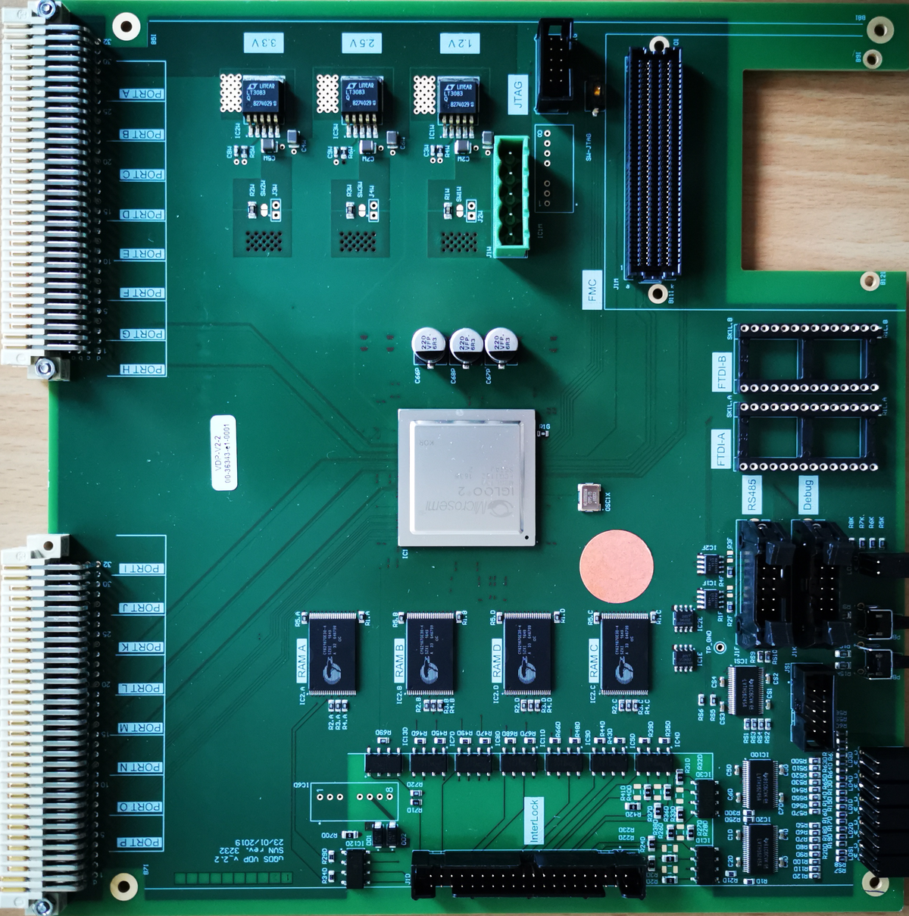
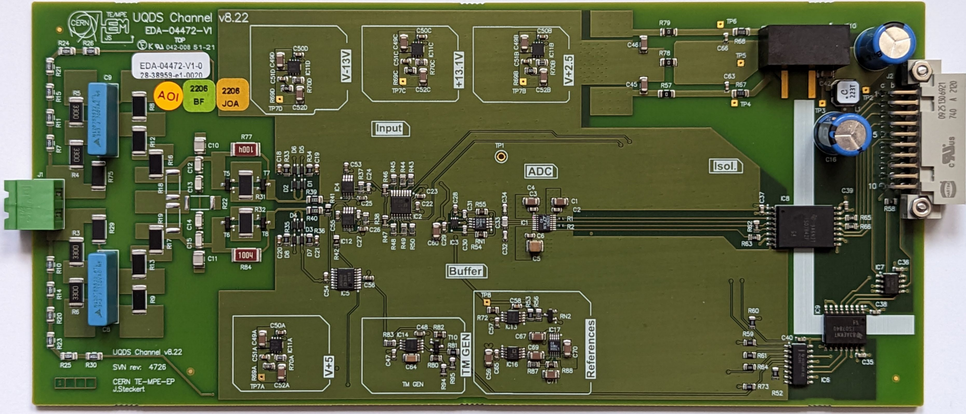
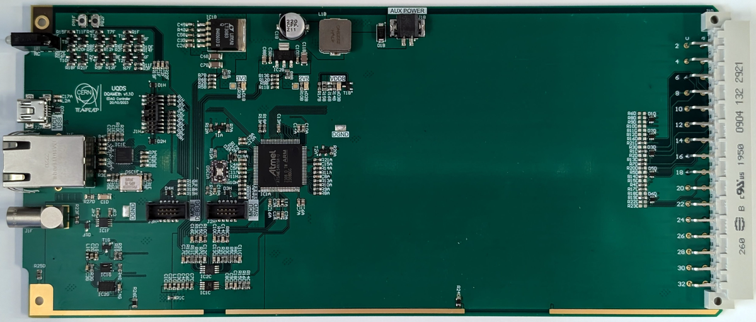
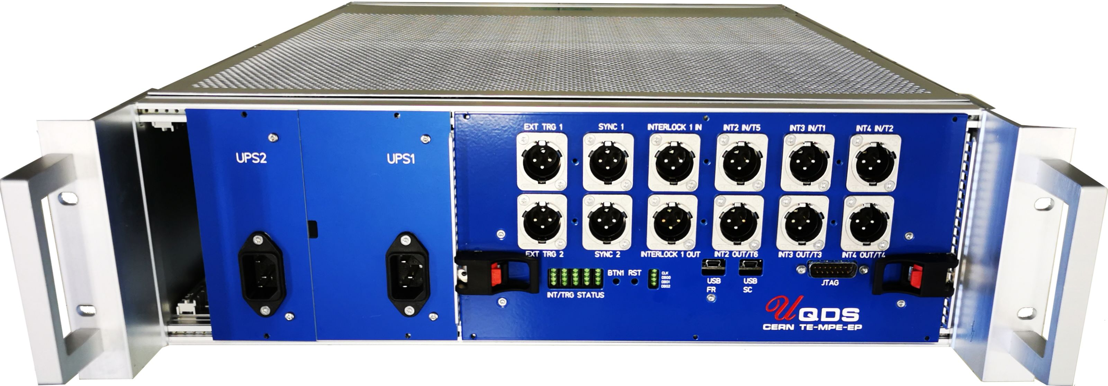
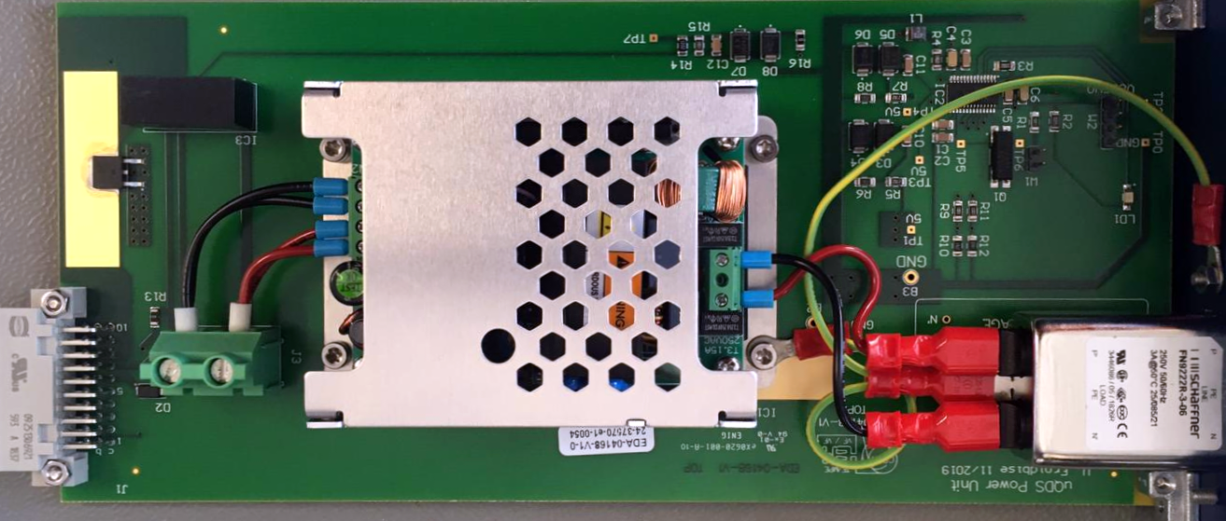
System overview (UQDSv2)
Insulated font-end channel
Digital platform
Processing Element
(FPGA)
Interlocks
&
Active
triggers
Insulated font-end channel
.
.
.
Voltage taps
Insulated font-end channel
Passive mid-plane
Up to 16 channels
galvanic insulation
Communication interface
Power Supply (monitored) 230V AC
Power Supply (monitored) 230V AC

Slide 4
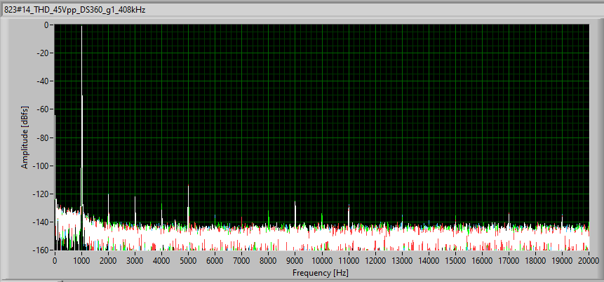
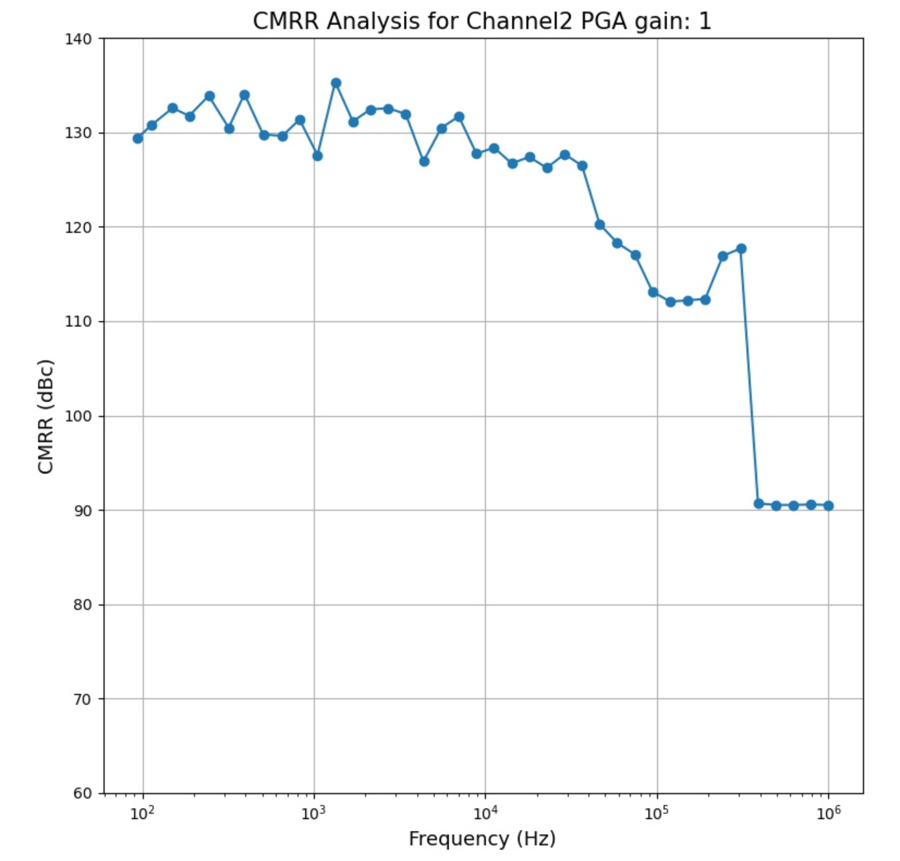
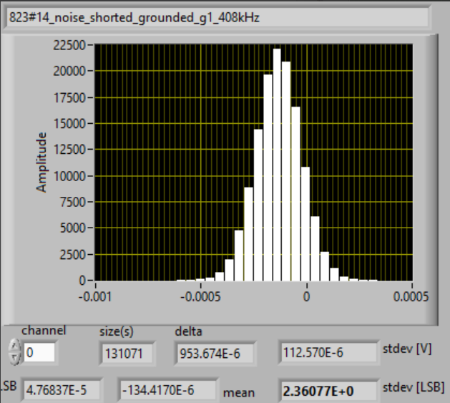
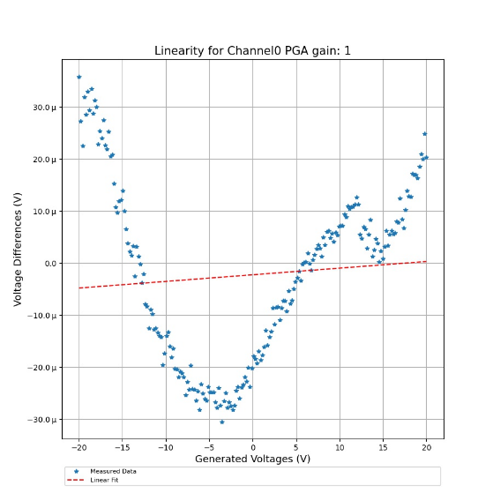
System performance
Total Harmonic distortion
<-110dBfs @ 1kHz
Excellent analogue performance both in AC and DC measurements
Common mode
rejection vs frequency
> 100dB
Real time digital signal processing on FPGA (filters, gain/offset correction)
Quench detection algorithms or other user code in FPGA
Various interlocking options and standards (modular design)
Post Mortem event recording
Absolute time synchronization on microsecond level
Fast logging up to 10kHz via EDAQ
Linearity (calibrated):
< 5ppm
(uncalibrated ~0.1%)
Noise: 2.3ppm
standard deviation
Parameter | Value
Resolution (20-bit ADC) | 105 nV/LSB .. 48 uV/LSB
ADC speed | Up to 909 kS/s
Analogue bandwidth | 120 kHz @ G=1
Active input voltage range | +/-50 mV (G=450) .. +/-22.5 V (G=1) (1.2kV with divider)
Max differential input voltage | 1 kV/1 s
Galvanic insulation | 2.5 kV/1h, 5kV/1min

Slide 5
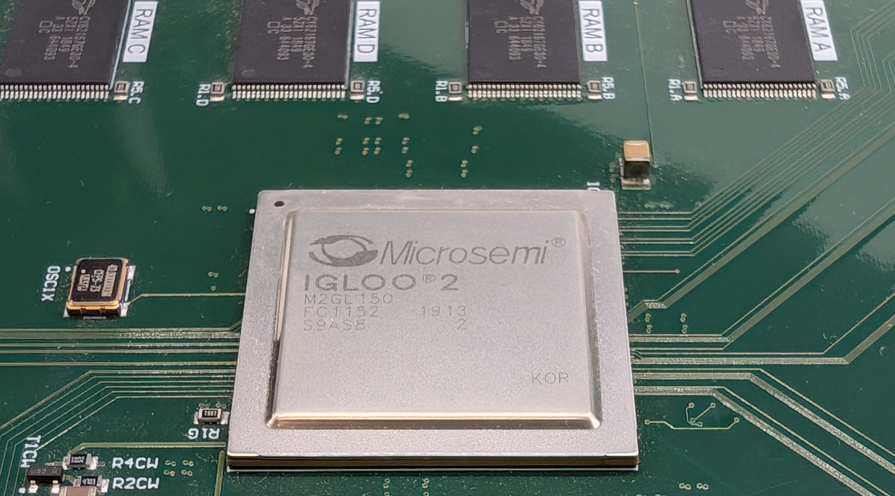
Gateware structure – One platform multi-purpose
Superconducting Link
protection
Common UQDS services
(interfaces, communication & control)
Hardware abstraction Layer
Hardware specific interfaces
Static for each hardware
Interfaces to payload code “config block”
Payload code
“config block”
Inner triplet protection
Swiss Knife

Slide 6

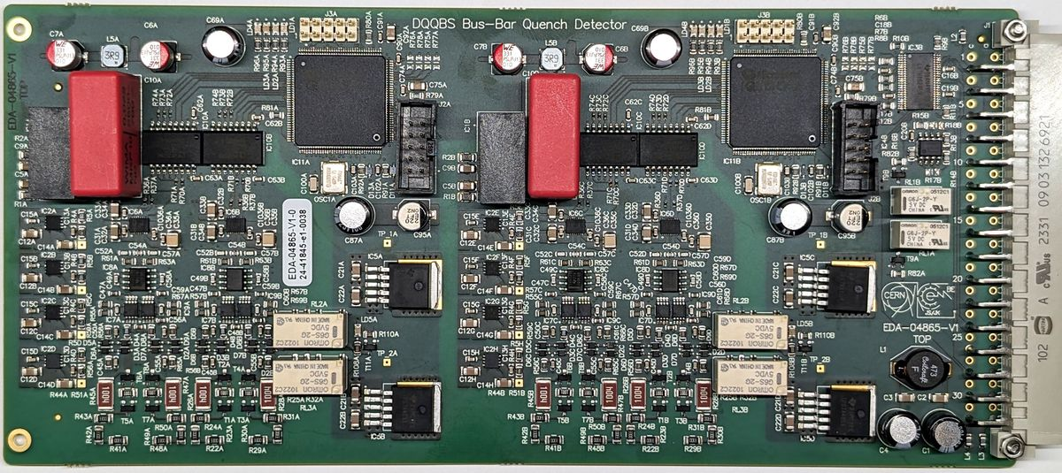
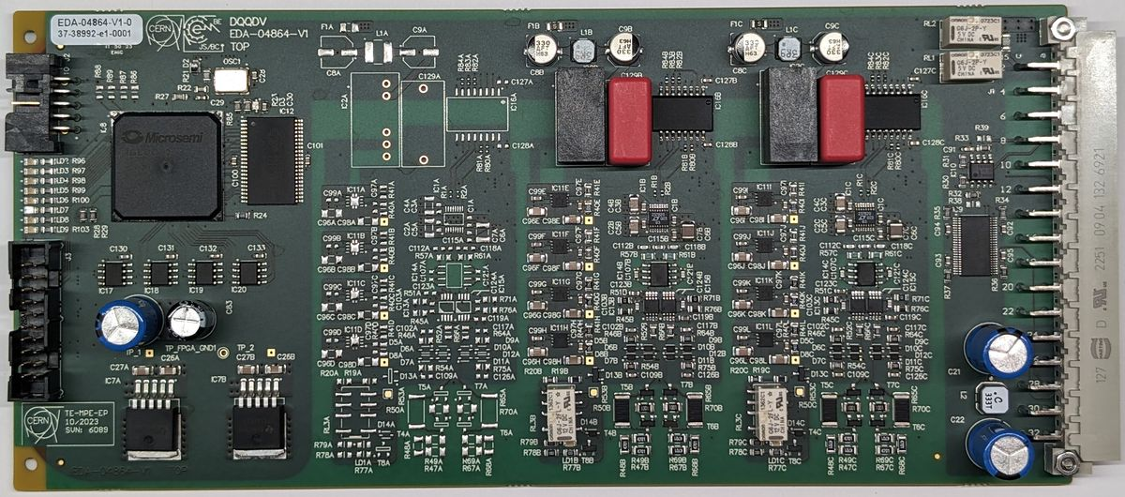
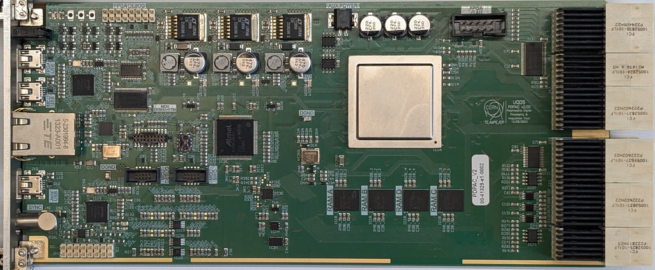
Multi-purpose Gateware on multiple Hardware
Spreadsheet
(config block specific)
Common Codebase
Configuration files & HAL
➔ Toolchain allows selection of target hardware
and config block
Toolchain
Gateware compiled from common code base
Common Repository
Application specific parts defined in HDL and Spreadsheet
Automatic VHDL code generation for register map and interfaces
Toolchain heavily scripted (Python & tcl)
Hardware-in-the loop verification techniques
Common Logic & communication interface
Config blocks
Hardware abstraction Layer
Hardware abstraction Layer
Hardware abstraction Layer
HAL

Slide 7
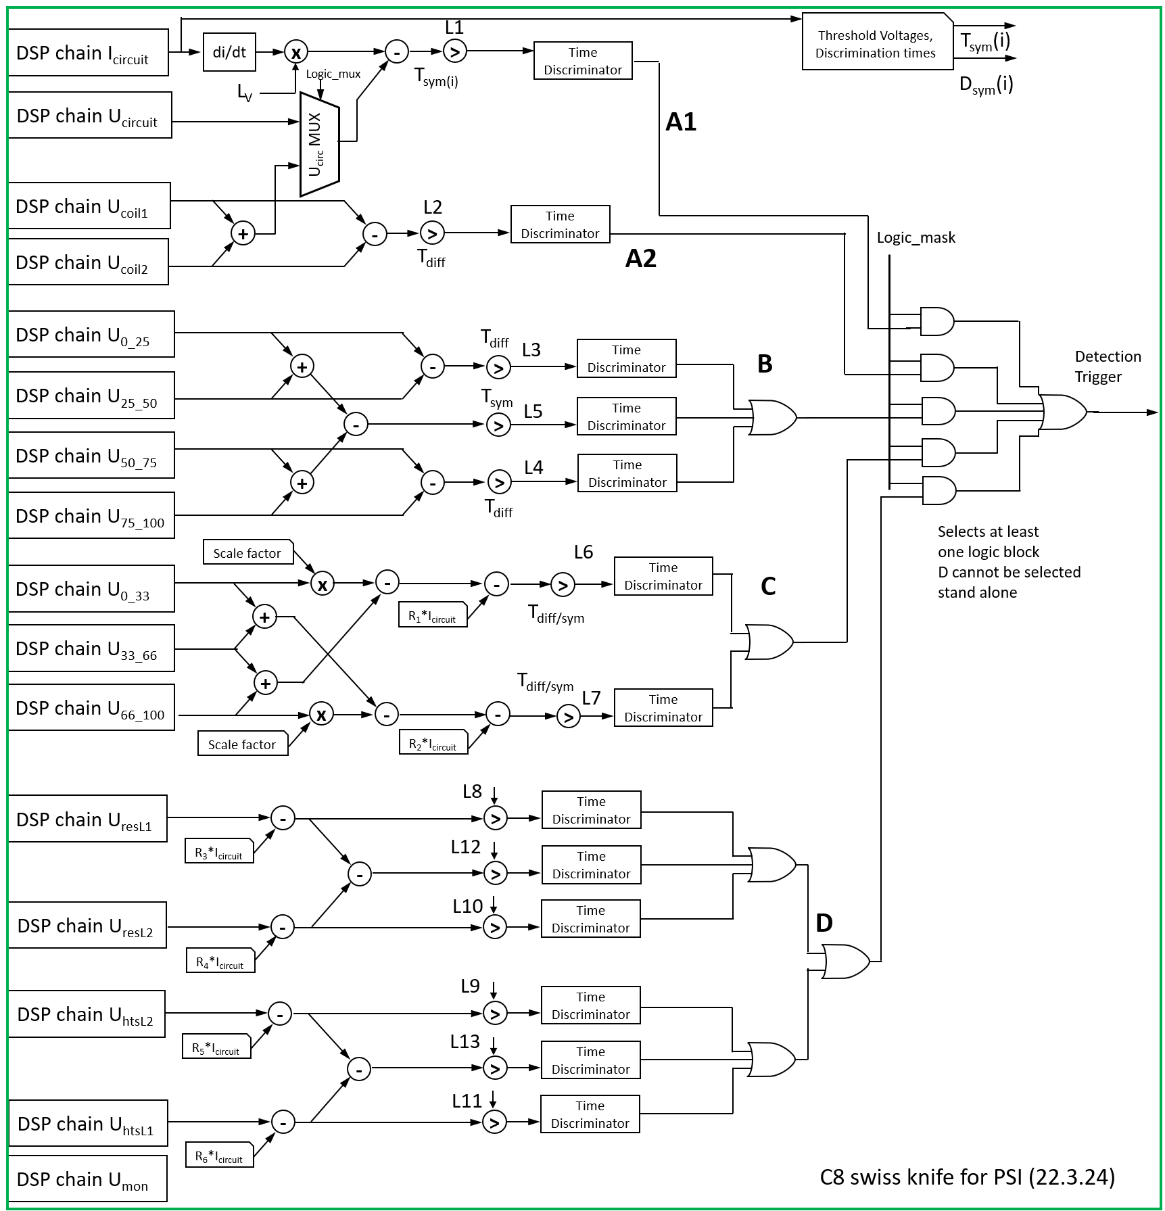
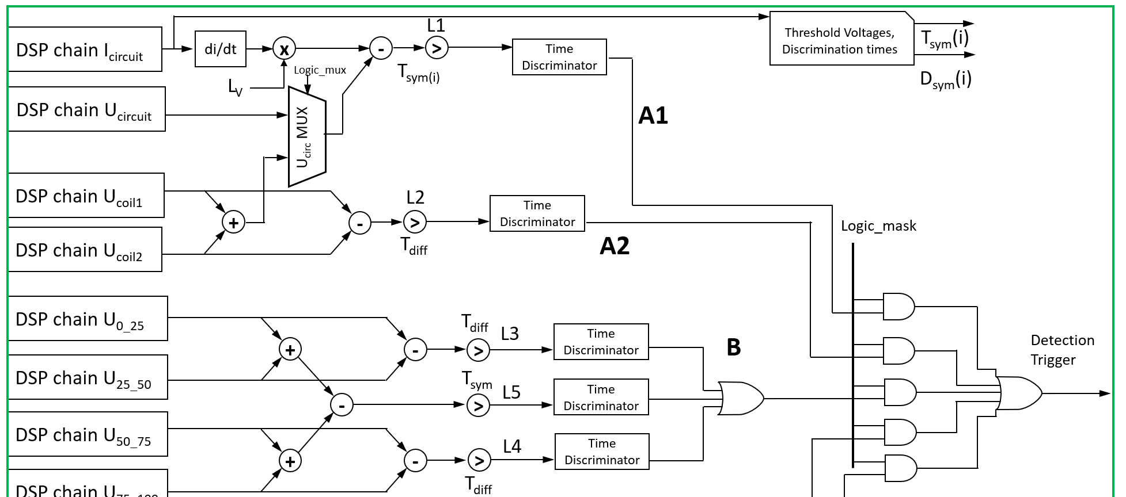
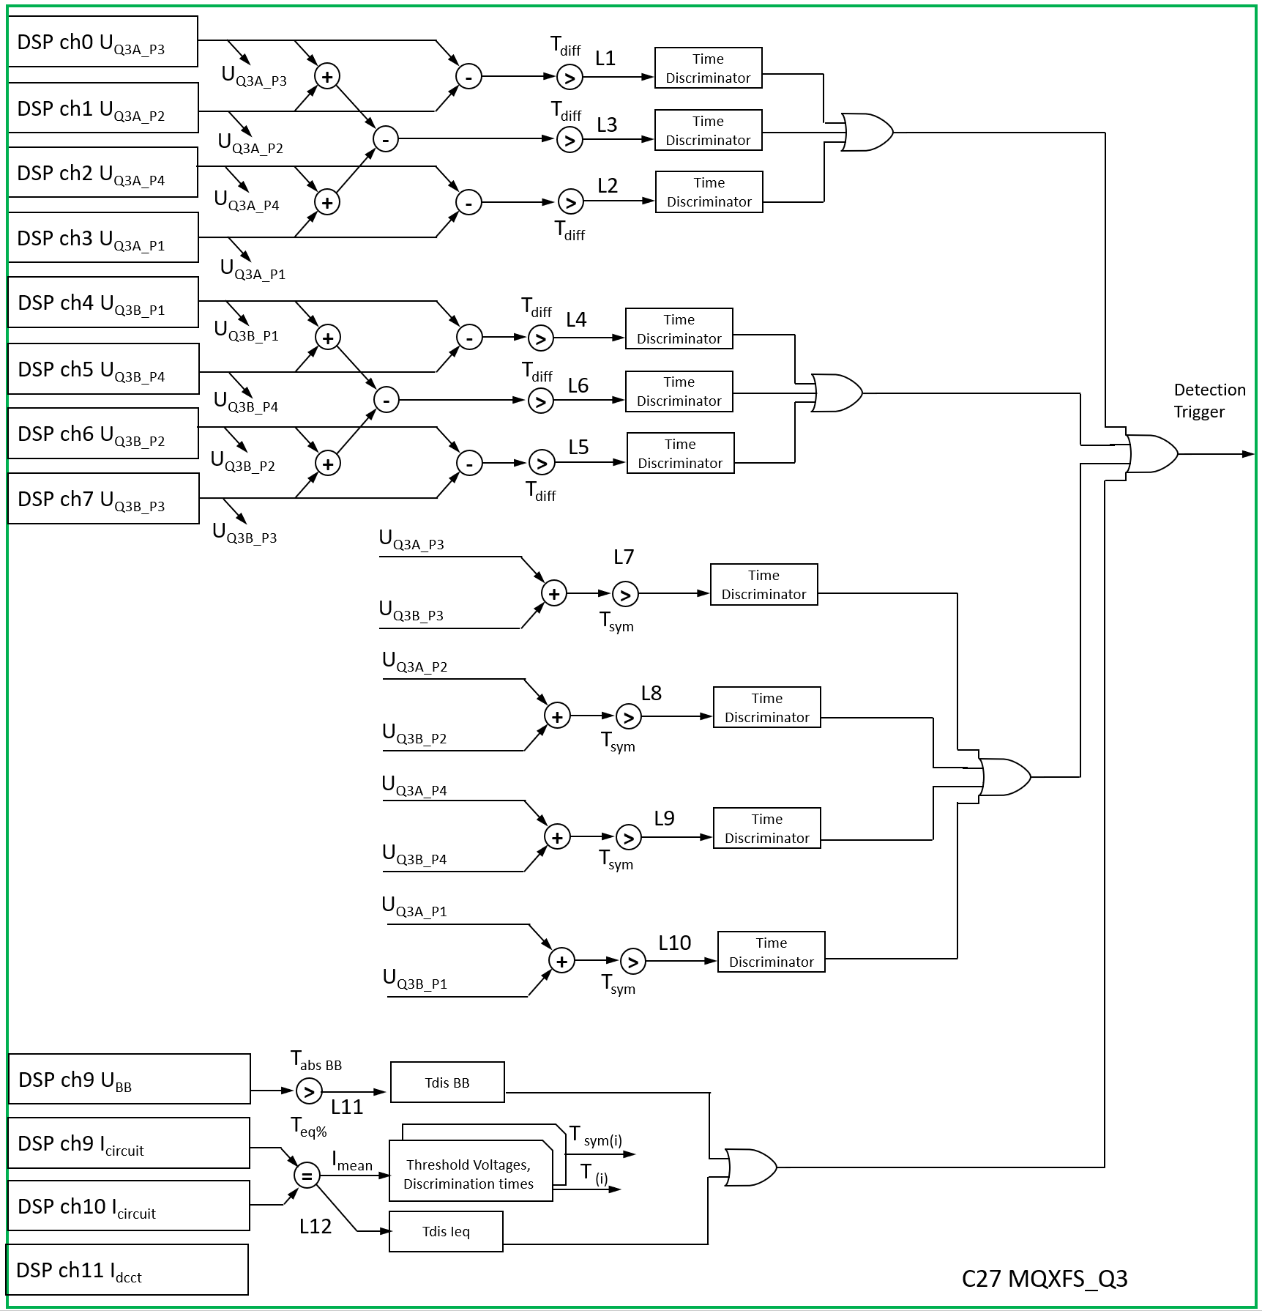
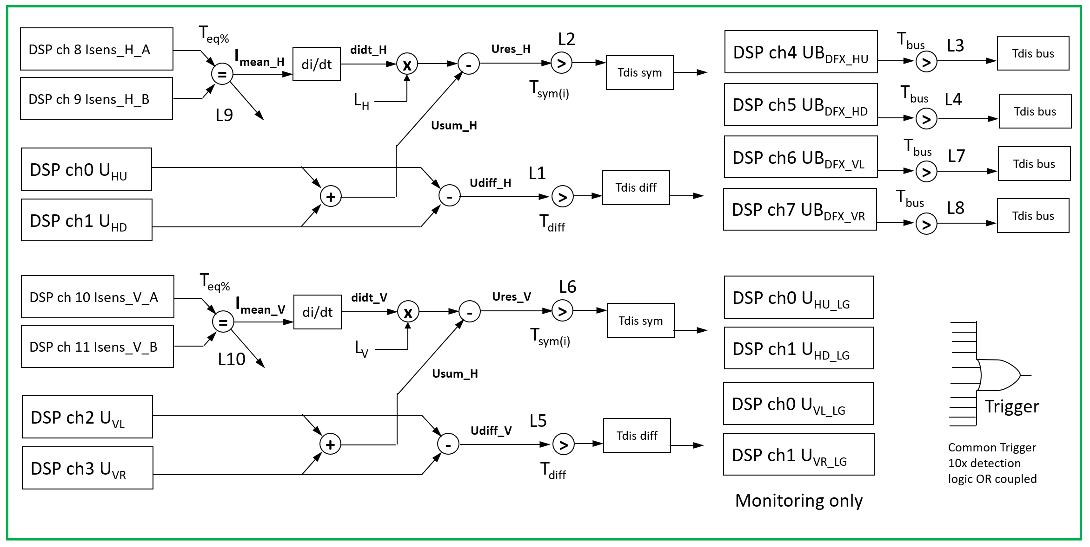
Gateware structure – “config block” examples
IT corrector Prot.
Q3 protection
Swiss Knife

Slide 8



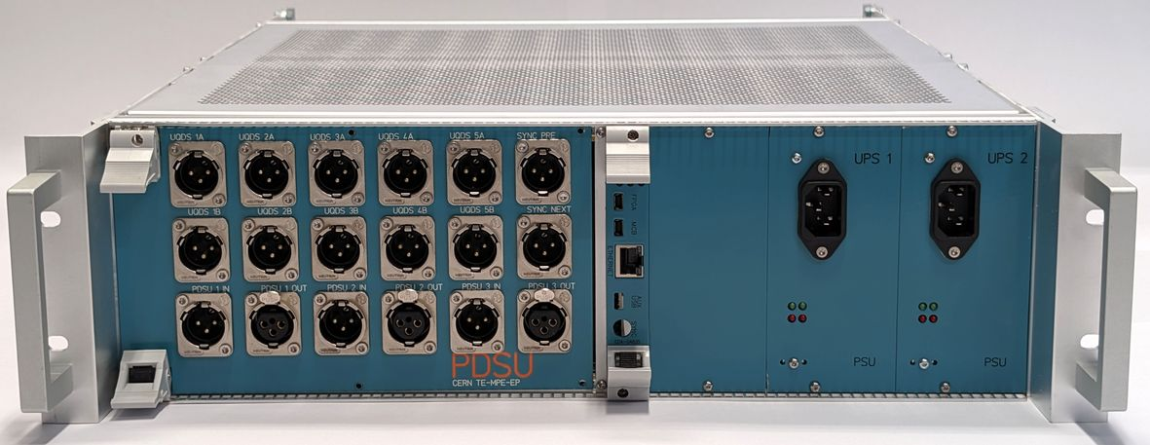
UQDS ecosystem (produced devices)
Image Description Configuration Status
Bus-bar and
current lead monitor
120 boards produced
Pilot installation in LHC
2 config blocks
Versatile quench
detector board for
LHC CONS
60 boards produced
production of
630 boards pending
3 config blocks
planned
~120 systems
produced and in use
(usage: see next slides)
UQDSv2
16 isolated channels
27 configurations
… and counting
Protection Devices Supervision
Unit for HiLumi
3 configurations planned
10 systems produced
for IT STRING

Slide 9

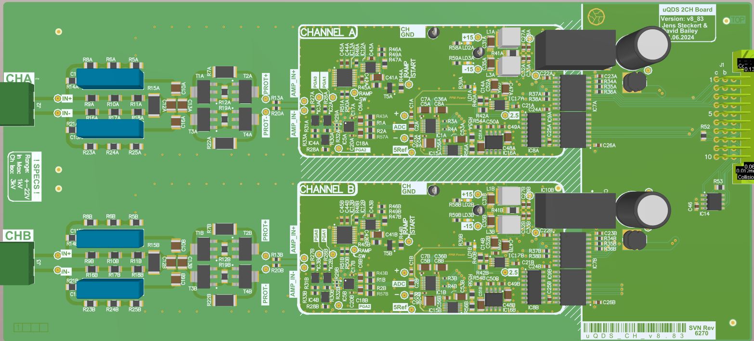
UQDS ecosystem (in development/prototyping)
UQDS v3
Up to 32 isolated channels,
Faster acquisition speed
Optimized mechanics
Evolutionary upgrade of UQDSv2
Baseline for the HiLumi quench detection system
First prototype in final implementation stage
Upgrade of LHC dipole
quench detection
Big production of 2500 pieces to be installed
at the end of LS3.
Variable threshold & radiation tolerant
➔ Evolutionary upgrades and extensions of the ecosystem

Slide 10
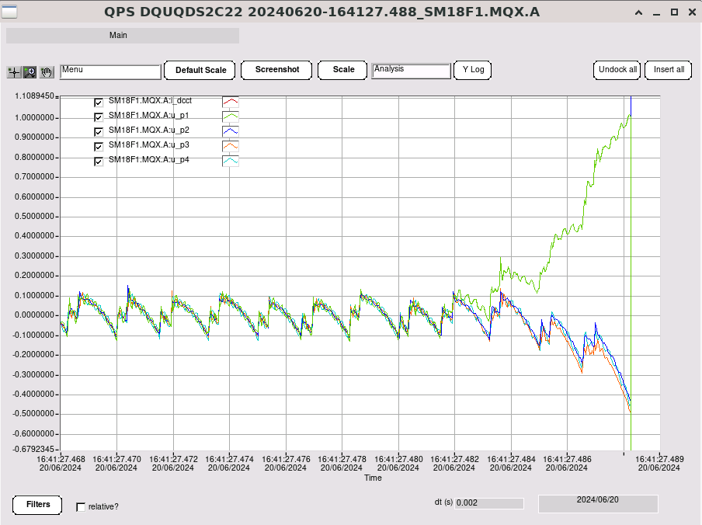
EDAQ – timing and communication for UQDS
Ethernet based solution with ~ 1000x the throughput compared to field bus used in LHC
(~10Mbit per client)
Timing precision > 1000x better than previous solution using ethernet precision timing protocol ➔ absolute precision better than 1us
Fully integrated in CERN controls infrastructure
Connects to services such as logging and post mortem
Q2 quench in cluster F1

Slide 11
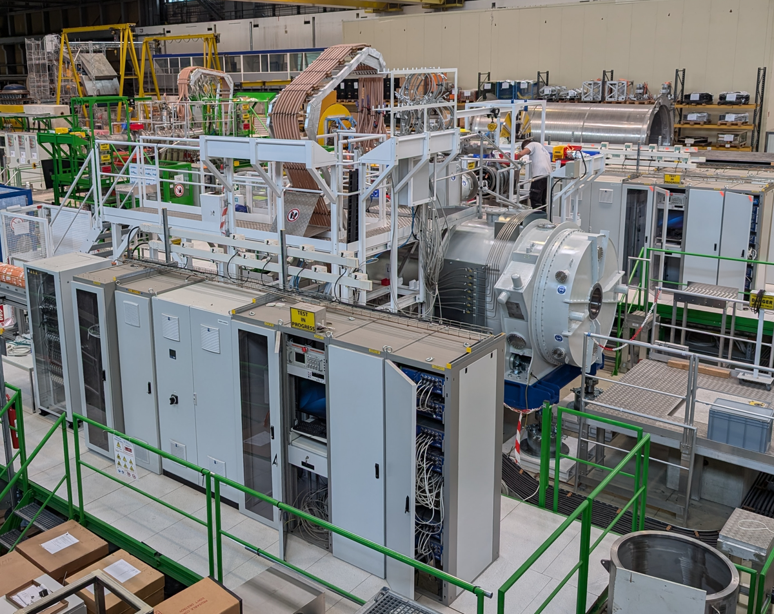
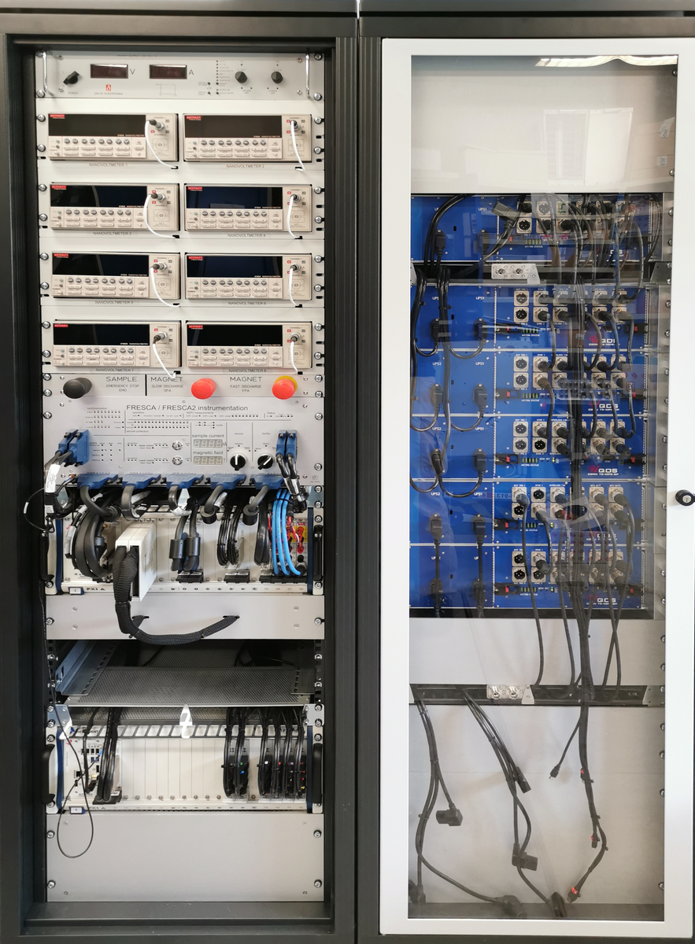
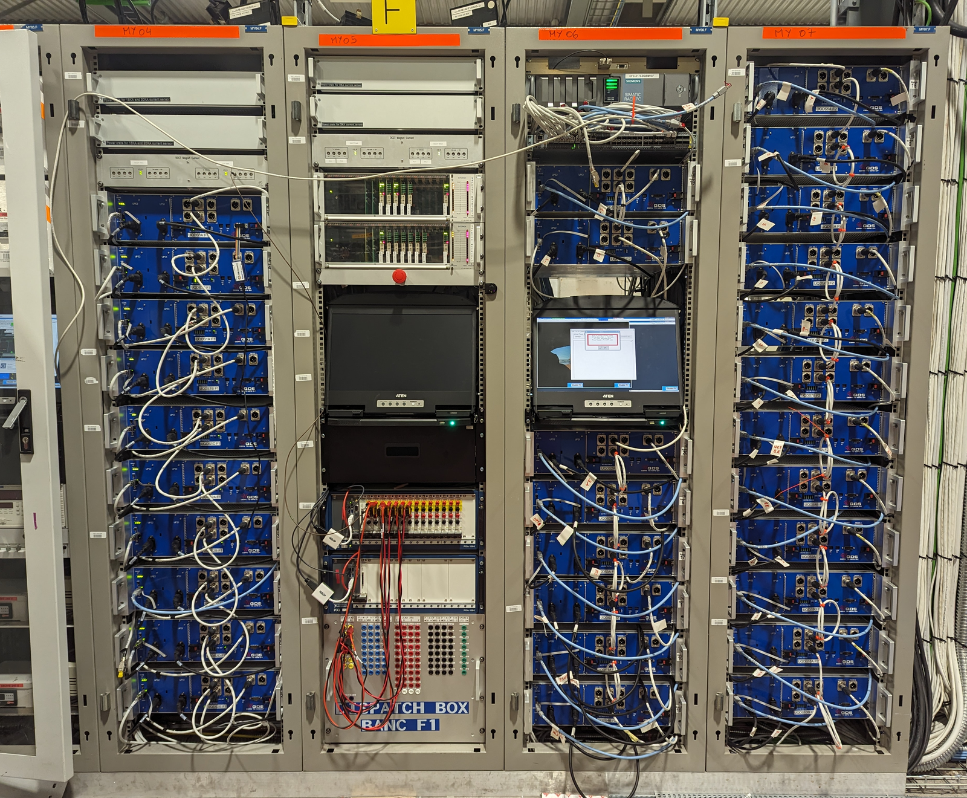
Applications at CERN
FAIR magnet test stand in
B180
18 x UQDSv2
C3
C3
FRESCA facility B163
6 x UQDSv2
C7
C19
C20
SM18 cluster F1 & F2
(HiLumi Q2 & SC Link testing)
30 x UQDSv2
C22
C23
C24
C6
➔ Full exploitation of flexible Gateware to follow the rich test program in SM18
SM18 clusters A, B, C, D
10 x UQDSv2
SM18 HiLumi STRING
35 x UQDSv2
6 configurations
LHC tunnel
8 x Busbar Monitor
(more in TS#2)

Slide 12


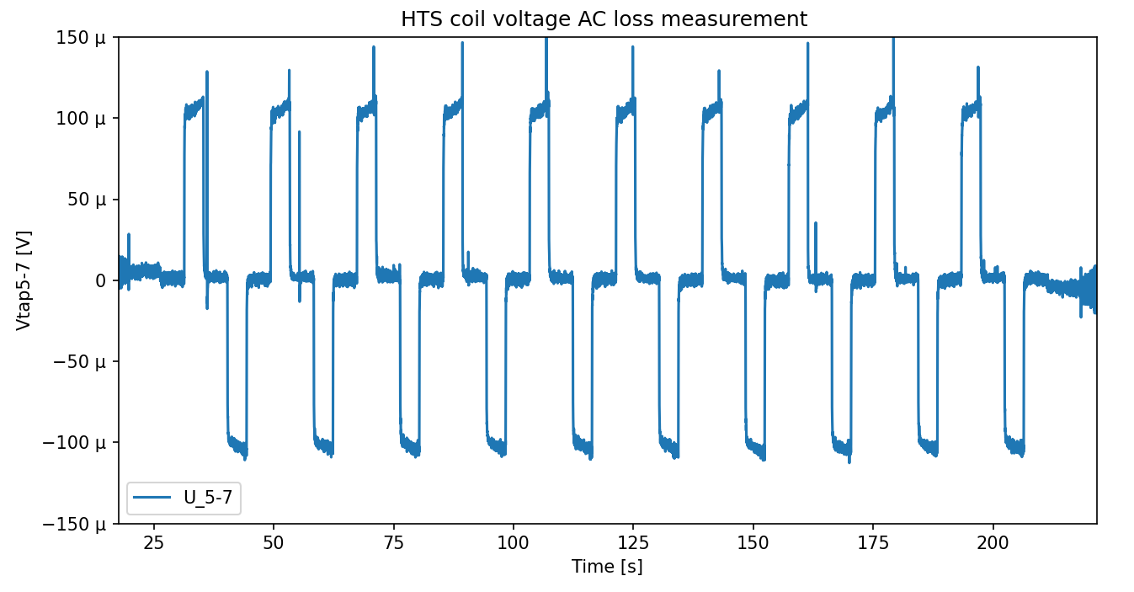

Applications outside CERN
FREIA test facility
Uppsala Sweden
2x UQDSv2
For test of HiLumi magnets
C3
PSI Villingen
Switzerland
2x UQDSv2 for SC Magnet Lab
7x UQDSv2 quench detection of
SLS2.0 2x super bend magnet
C8
C16
300 uV
IFJ PAN
Krakow Poland
2 x UQDSv2
➔ INFN LASA (Milano) showed interest in UQDS for their test lab
Data: M. Duda PSI
50Hz moving average filter

Slide 13
Summary
Established platform with full system integration in CERN controls services
Inhouse solution with full control about all elements
→ We can cope with obsolescence etc…
Quite unique feature set
  High performance measurement channels with galvanic insulation of ~5kV peak
  FPGA for real time processing of data & hardware interlocks
Flexible adaptable design which can serve many purposes
Focus now in completion of units for IT STRING
➔ We’re open for new applications

