Slide 1
Mini-Chamonix Introduction
Where do we stand?
What are the possibilities?
Mike Lamont

Slide 2
2011 parameters
Energy [TeV] | 3.5
beta* [m] | 1.5, 10, 1.5, 3.0 m
Emittance [microns] | 2.5 – 3.1 start of fill
Bunch intensity | 1.1 - 1.2e11
Number of bunches | 1380 1318 collisions/IP1&5
Bunch spacing | 50 ns – good choice
Stored energy [MJ] | ~90
Peak luminosity [cm⁻²s⁻¹] | 1.27e33
Beam-beam tune shift | ~0.015 – 0.017

Slide 3
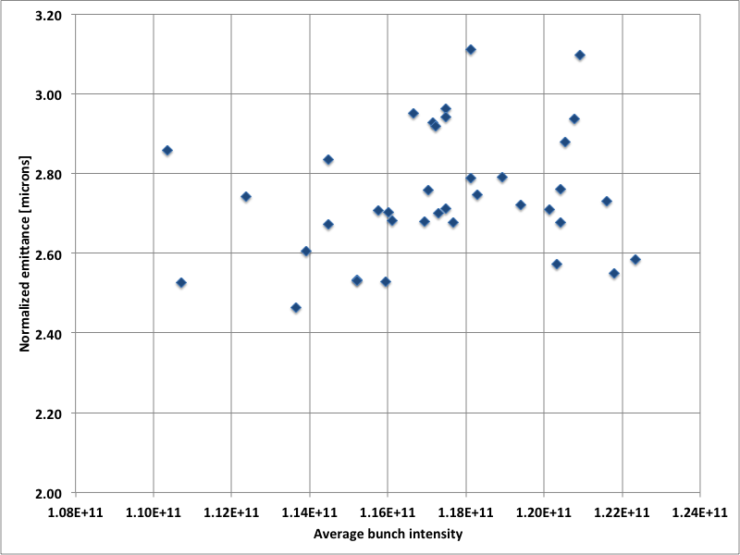
Recent bunch intensity/emittance

Slide 4
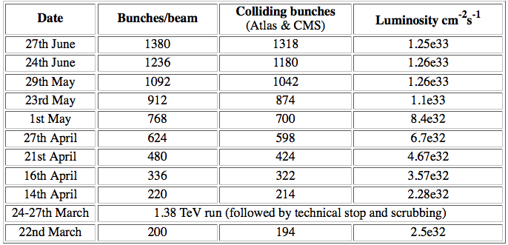
Performance
Integrated Luminosity to date (IR1-5/IR8) | 1.3 fb⁻¹/0.44 fb⁻¹
Peak Stable Luminosity Delivered | 1.28 x 10³³ cm⁻²s⁻¹
Maximum number of bunches | 1380
Maximum number of colliding bunches/experiment | 1318
Maximum intensity in collision | 1.64 x 10¹⁴ p/beam
Maximum Luminosity Delivered in one day | 63 pb⁻¹
Maximum Luminosity Delivered in 7 days | 242 pb⁻¹

Slide 5
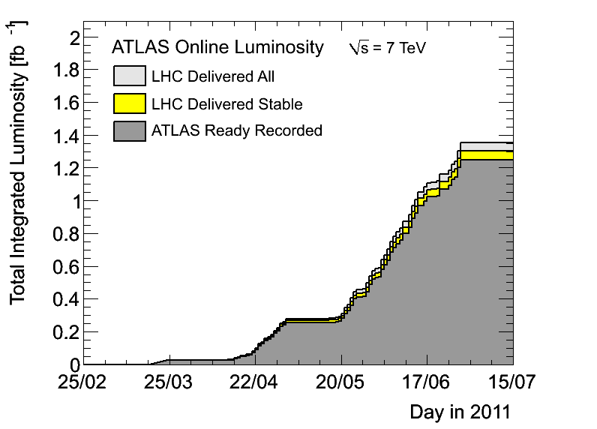
Luminosity
26 pb⁻¹/day

Slide 6
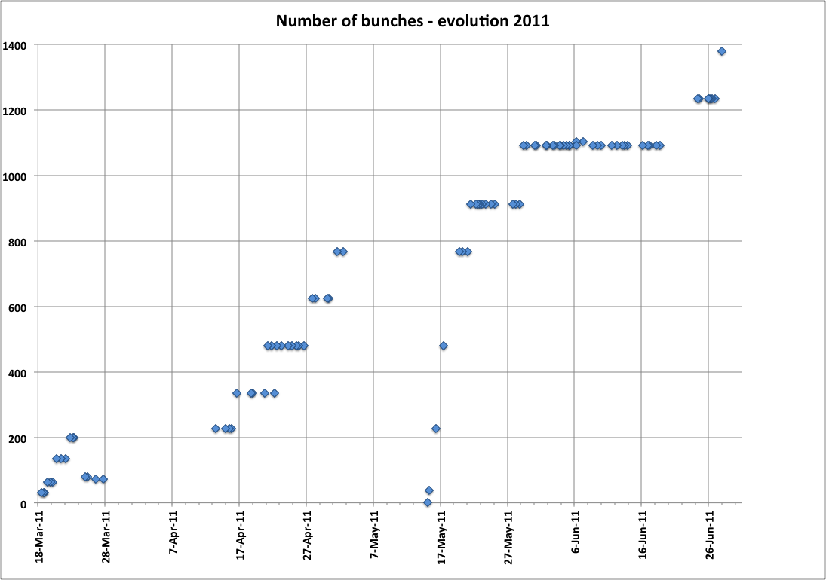
Ramp-up
MD, technical stop
Intermediate energy, TS, scrubbing
15 weeks

Slide 7
Ramp-up: not all plain sailing
From 3 to 1380 with a previous maximum of 368 in 15 weeks elapsed (via MD, TS, scrubbing, intermediate energy) has to be regarded as impressive, however…
UFOs
  In particular MKIs
SEUs
  QPS et al
RF
  Couplers
  RF wave-guide arc detectors
Beam induced heating
  injection kickers, cryogenics, collimators..
Vacuum activity
All to be discussed today

Slide 8
Increasing intensity – machine protection
Collimation loss of hierarchy at 450 GeV
  Orbit stability. Regular loss maps performed – inefficiency has increased
72 (108/144) bunches from SPS
  Beam quality from injector very important
  144 bunches per injection from SPS > 1 MJ down the lines
High temperature superconducting current lead quenched (7th April)
  Invoked quench of 11 magnets
Injection Kicker Flashover (18th April)
  Not pretty, heavy beam loss

Slide 9
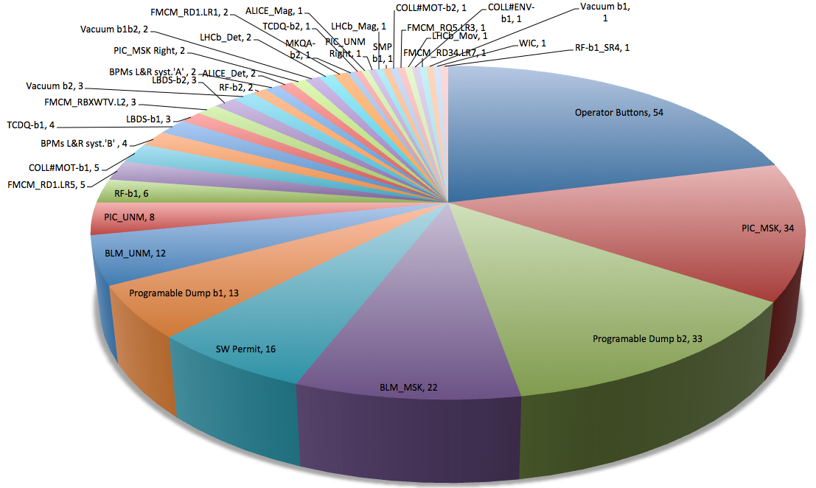
Wrestling with a mixed bag

Slide 10
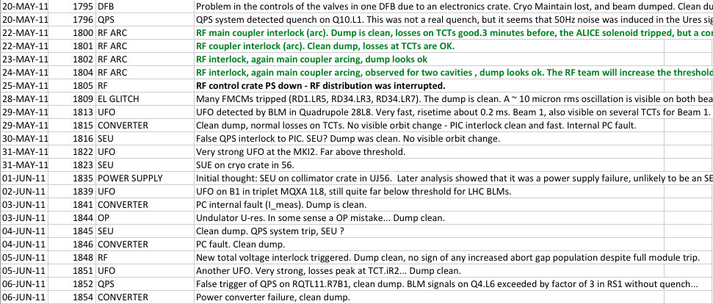
Dumps from Stable beams 1/2

Slide 11
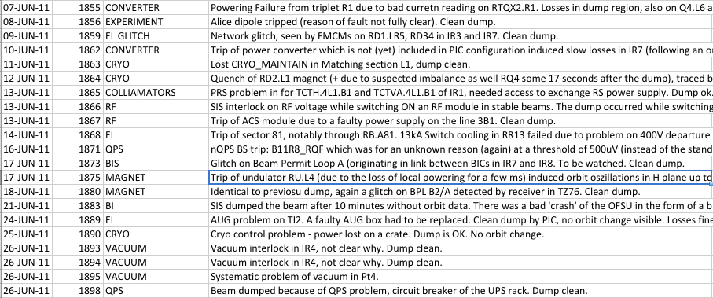
Dumps 2/2
Clear number of these related to the increase in intensity
Some problems revealed and solved or in the process of being solved

Slide 12
Summary 1/2
How has the observed performance been possible?
Ramp & squeeze essentially without loss
Excellent performance of Machine Protection related systems
  No quenches with beam above 450 GeV
Optics close to model (and well corrected)
Excellent reproducibility and stability
  Magnetic machine, orbit, collimation…
Aperture as expected
Better than nominal emittance and intensity from injectors

Slide 13
Summary 2/2
Beam-beam – no problem (head-on/long range)
Excellent single beam lifetime
Healthy luminosity lifetime
Emittance growth
  Minimal through the cycle
  Acceptable in collisions
Excellent machine availability via performance:
  Cryogenics, QPS, BIS, LBDS, injection, power converters, ADT, RF, collimators, controls, instrumentation, vacuum, access, EL, CV…

Slide 14
Next few months

Slide 15
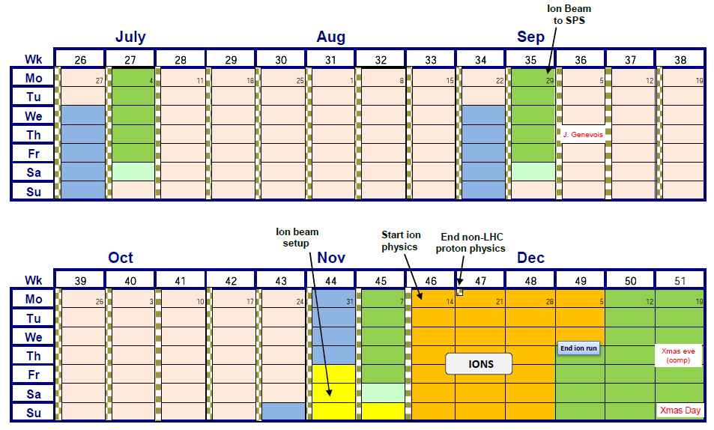
Schedule

Slide 16
What are days for?
Ah, solving that question
Brings the priest and the doctor
In their long coats
Running over the fields.
15th July to 29th October inclusive
 | Days
Calendar | 107
Special runs | 3 (say, see Anders..)
Technical stop | 5
TS recovery | 1
Ramp-up | 1+3
Machine development | 5
Floating MD | 2
Physics | ~87
+25 ns studies to come during MDs (to sort out injection and beam stability issues) and possibly an operational development period to validate scrubbing and future operation

Slide 17



Maximize peak luminosity
N | Number of particles per bunch
K_{b} | Number of bunches
f | Revolution frequency
 | Beam size at interaction point
F | Reduction factor due to crossing angle
 | Emittance
 | Normalized emittance
 | Beta function at IP

Slide 18
Maximize integrated luminosity
Possible turnaround time is ~2.5 hours
Effective turn around time is long:
  Problem resolution, accesses etc…
Message that long fills are good has got through
Exposed to the intersecting failure space of a number of complex systems with huge number of components.
This failure space is inflated by high intensity
Holding is sometimes more effective than raising although “conditioning” and mitigation (UFOS, vacuum, RF, QPS, SEUs) is clear…
1380 * 1.5e11 = 2e14 protons per beam is over 60% nominal intensity… machine protection is, as always, the priority

