Slide 1


Transfer and injection into LHC, is this a bottleneck?
C. Bracco, W. Bartmann, B. Goddard, V. Kain, M. Meddahi, V. Mertens, O. Mete, L. Norderhaug Drosdal, A. Nordt, R. Schmidt, J. Uythoven
Acknowledgments: BLM, OP, CO, RF, MPE, Collimation team

Slide 2
Outline
Operation achievement in 2011
Issues and possible limitations
Studies for future operation (nominal emittance, 25 ns bunch spacing)
Summary and Conclusions

Slide 3
Losses at Injection and Intensity Limitations
Loss maxima per injected intensity (Verena’s talk)
Possible solutions for higher intensity:
  Un-captured beam:
    Abort gap and injection cleaning
    Improved injectors diagnostics
    TDI Shielding (×10 reduction at MQX BLMs)
    BLM sunglasses
  Cross-talks from TCDI:
    TCDI shielding
    TCDI larger aperture
    BLM sunglasses
    Increase BLM thresholds for short running sums
Operation related intensity limitations,
no machine protection issue!!
2010
2011
Loss type | Losses in % of dump threshold B1/B2
 | 8b | 16b | 24b | 32b | 48b | 96b | 144b
TCDI shower | 1/2 | 3/5 | 4/6 | 5/8 | 23/24 | <50? | <75?
Uncaptured beam | 4/2 | 12/3 | 12/5 | 16/8 | 20/8 | <40? | <60?
Unsafe beam (> 1×10¹² p⁺)
Linear extrapolation for 2011 operation, still ok without mitigation
Presented in Chamonix 2011
!
!

Slide 4
Losses at Injection and Intensity Limitations
Loss maxima per injected intensity (Verena’s talk)
Possible solutions for higher intensity:
  Un-captured beam:
    Abort gap and injection cleaning
    Improved injectors diagnostics
    TDI Shielding (×10 reduction at MQX BLMs)
    BLM sunglasses
  Cross-talks from TCDI:
    TCDI shielding
    TCDI larger aperture
    BLM sunglasses
    Increase BLM thresholds for short running sums
Operation related intensity limitations,
no machine protection issue!!
2010
2011
Loss type | Losses in % of dump threshold B1/B2
 | 8b | 16b | 24b | 32b | 48b | 96b | 144b
TCDI shower | 1/2 | 3/5 | 4/6 | 5/8 | 23/24 | <50? | <75?
Uncaptured beam | 4/2 | 12/3 | 12/5 | 16/8 | 20/8 | <40? | <60?
Unsafe beam (> 1×10¹² p⁺)
Linear extrapolation for 2011 operation, still ok without mitigation
Presented in Chamonix 2011
!
!
Injection with 144 bunches is now operational !

Slide 5
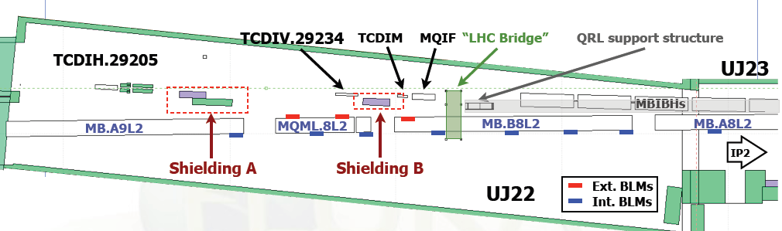
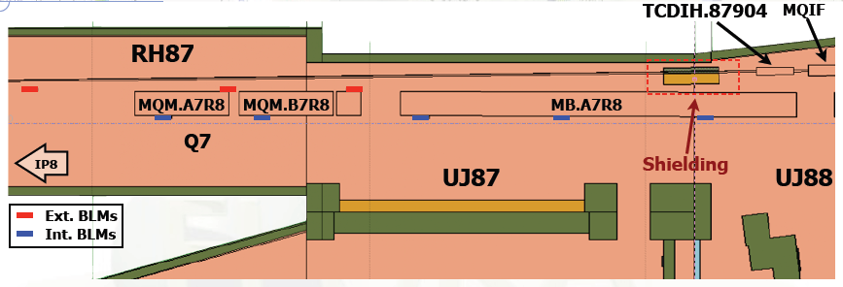
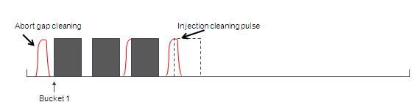
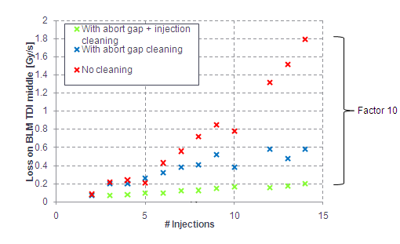
Applied Mitigations
Shielding to reduce crosstalk losses from TCDI installed in TI 2 and TI 8
Loss reduction at downstream magnets by a factor of 2-3. Good agreement with FLUKA simulations: factor 4 predicted
Injection and abort gap cleaning to reduce losses at TDI and downstream elements
Now operational (sequencer)
V. Kain, Chamonix 2011

Slide 6
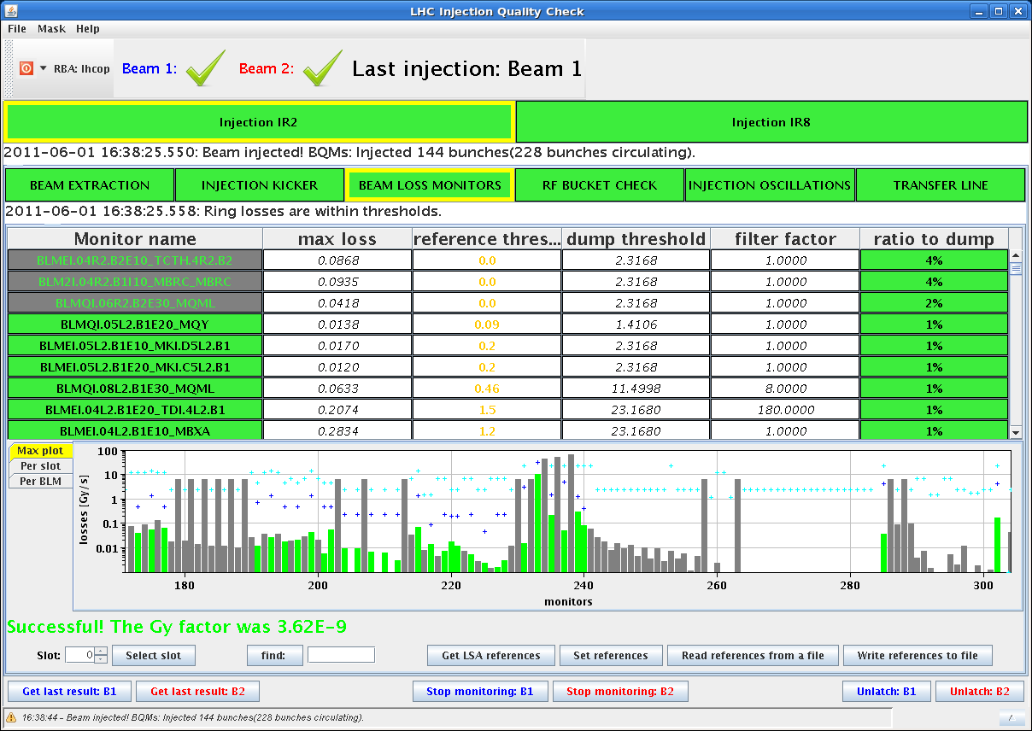
2011 Operation with 144 bunches
First injection of 144 bunches for Physics (1st June)
B1, max loss
4% dump

Slide 7
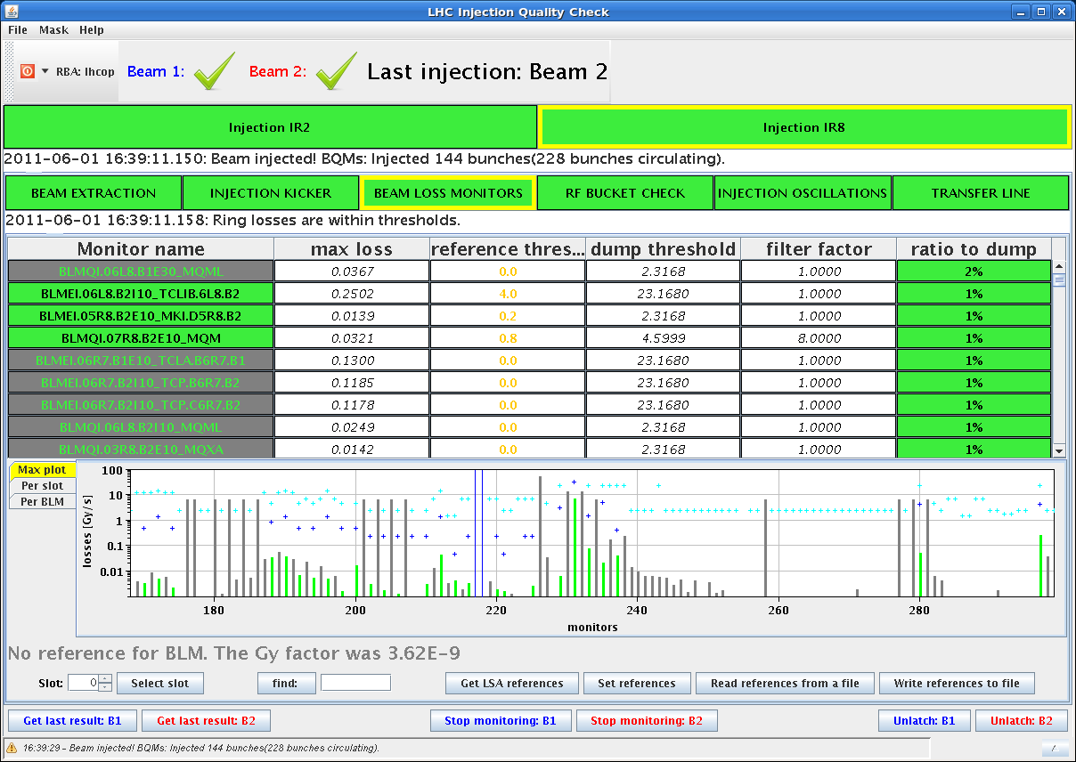
2011 Operation with 144 bunches
First injection of 144 bunches for Physics (1st June)
B1, max loss
4% dump
B2, max loss
2% dump

Slide 8
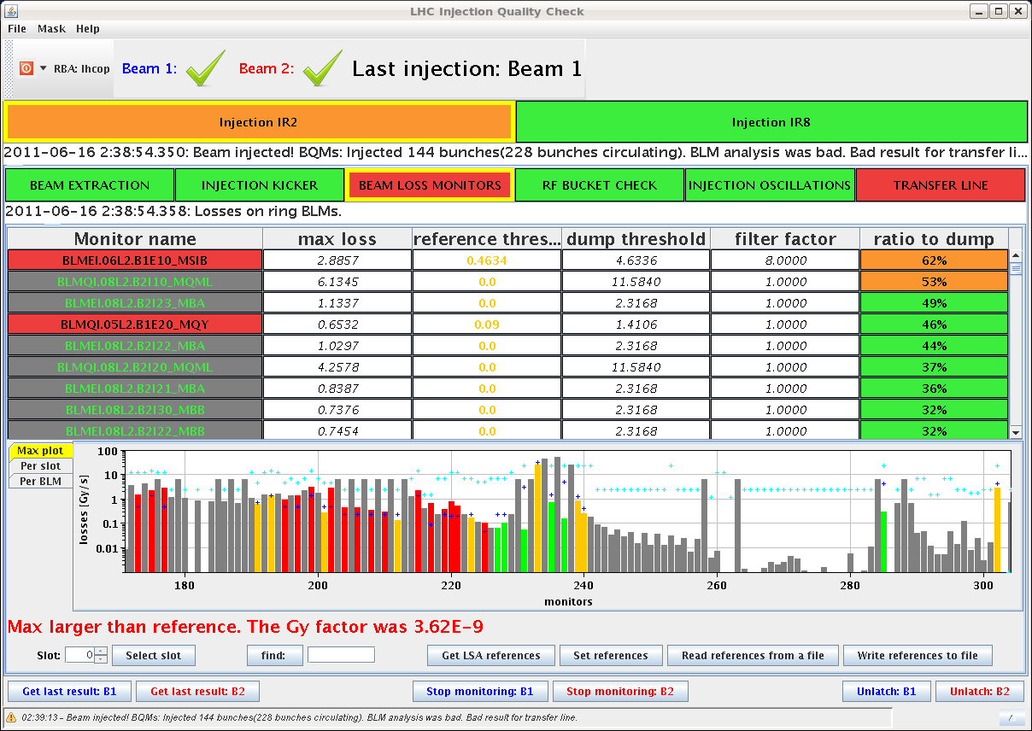
2011 Operation with 144 bunches
Injection degradation for B1 (16th June)
B1, max loss
62% dump

Slide 9
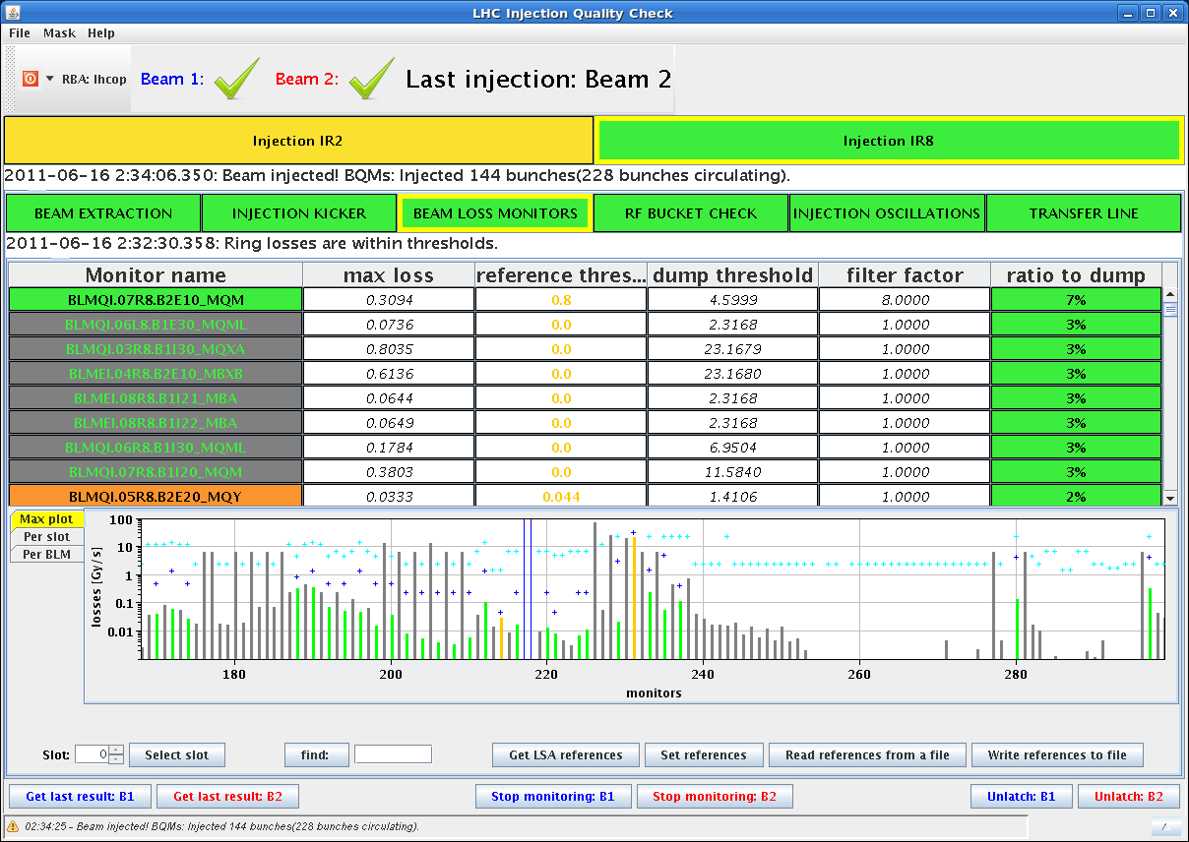
2011 Operation with 144 bunches
Injection degradation for B1 (16th June)
B1, max loss
62% dump
B2, max loss
7% dump

Slide 10
Observations on B1
TL trajectories were not reproducible from shot to shot ➔ different corrections proposed by YASP
Local variations of trajectory at the location of the TCDI (end of the line: 29012-29509)
High loss level at the MSIB already when injecting 12 bunches (5%)
500-600 μm oscillations coming from the line
Difficult to correct and to find a good tradeoff between injection oscillations and losses

Slide 11
Observations on B1
TL trajectories were not reproducible from shot to shot ➔ different corrections proposed by YASP
Local variations of trajectory at the location of the TCDI (end of the line: 29012-29509)
High loss level at the MSIB already when injecting 12 bunches (5%)
500-600 μm oscillations coming from the line
Difficult to correct and to find a good tradeoff between injection oscillations and losses
Why is Beam 1 more critical?
Flattop of the SPS extraction kicker (MKE) longer for B1 than for B2 ➔ more satellites from the SPS?
MST septum in extraction channel
High dispersion collimator close to the end of the line (29205) ➔ more sensitive to any Δp or wrong SPS harmonic?
Higher sensitivity to steering ?
Dedicated MD to investigate these options and to check operation with nominal emittance.

Slide 12
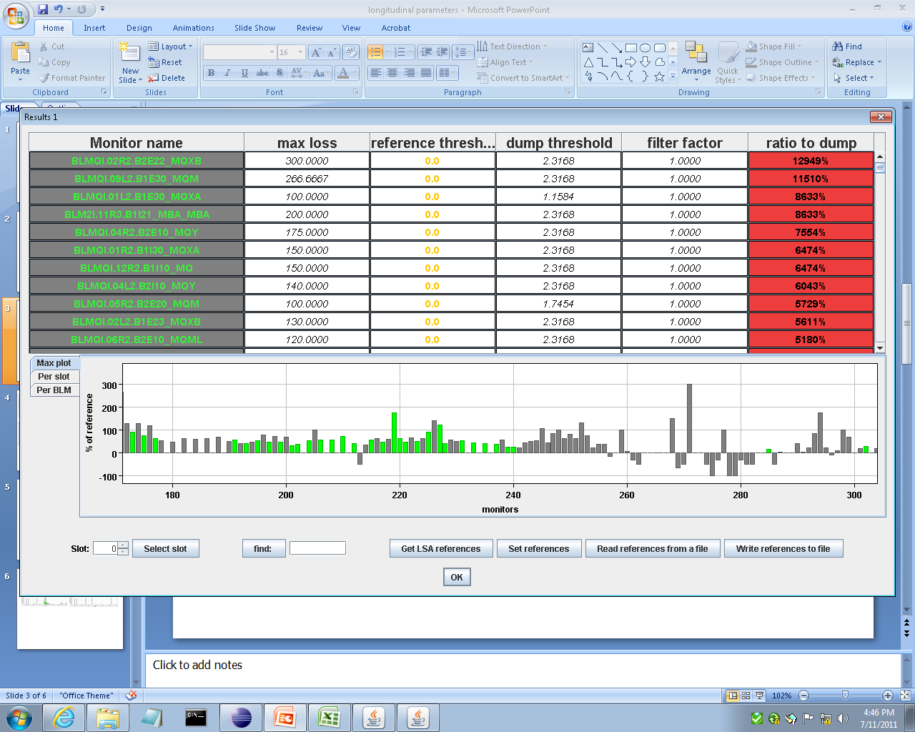
MD: Effect of longitudinal parameters
Most cases gave low/same losses as reference:
Bad radial steering
Satellites from PS
RF on for all booster rings
SPS 800 MHz on wrong harmonic
Radial steering affected the scraping efficiency – but: radial steering can move the beam at the scraper → increase losses
Longitudinal parameter changes determine similar increase in losses as sudden oscillations down the line from MSE ripple.
Losses from sudden oscillation down the line
% ref. losses
Losses on TCDIs
Losses on TDI, triplet,…ALICE,…up to Q6R2
Courtesy of L. Norderhaug Drosdal

Slide 13
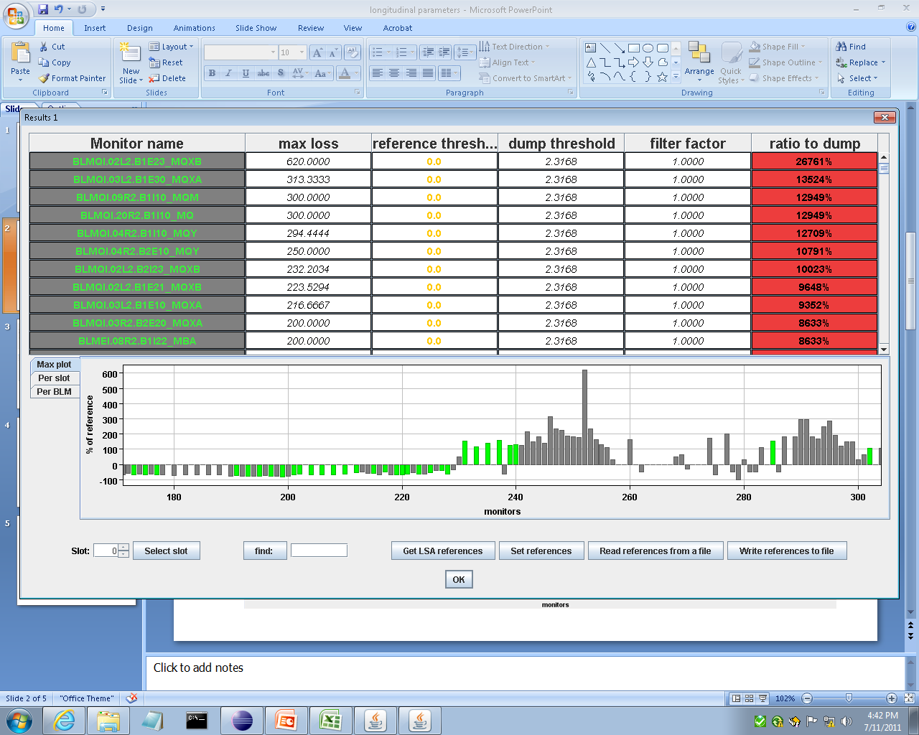
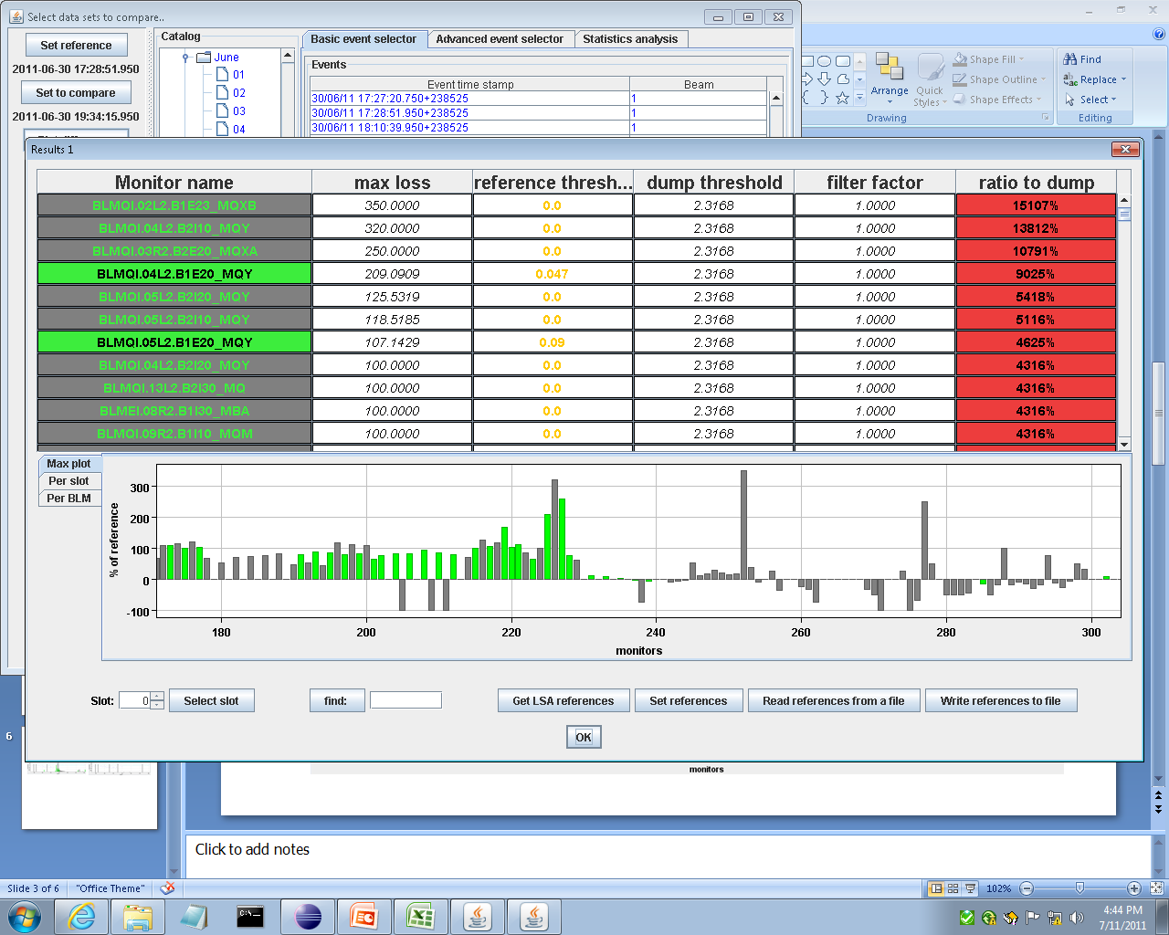
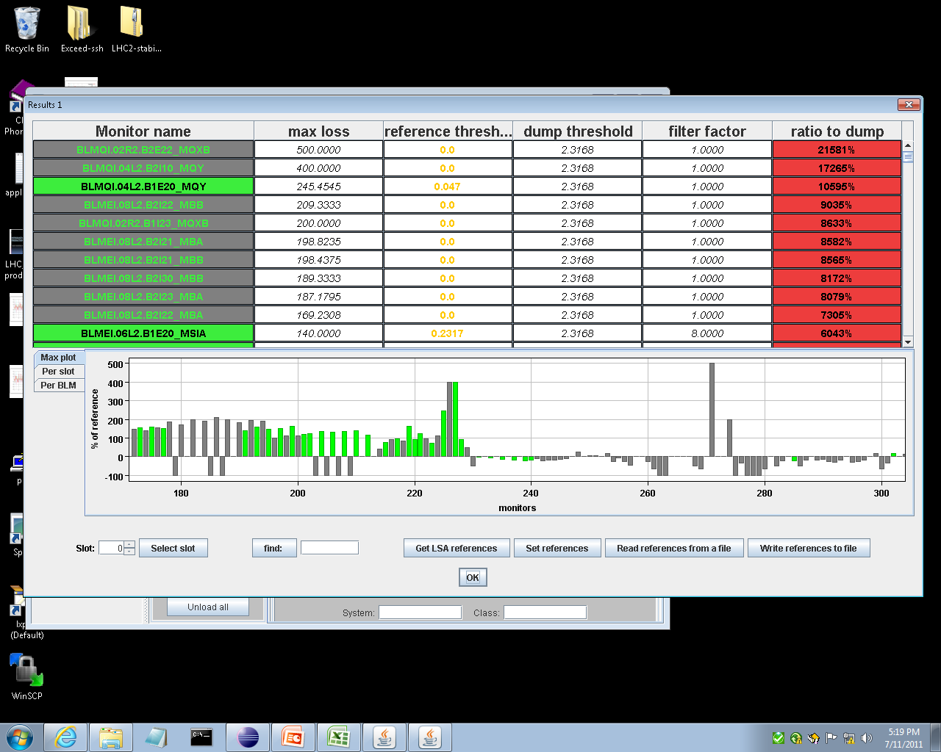
MD: Effect of longitudinal parameters
Increased injected bunch length into the SPS: 4.1 → 4.9ns (SPS BQM warning, but no interlock)
➔ Observed losses on the TDI/MQX
Increased Δp/p at extraction: bunch length at extraction: 1.5 → 2.2 ns ➔ Losses on the TCDIs
Turned off the 800 MHz in SPS ➔ Losses on the TCDIs
TDI
% ref. losses
MQX
MKIs and Q5
MSI
% ref. losses
MKIs and Q5
MSI
% ref. losses
Courtesy of L. Norderhaug Drosdal
Notes:
Special plot from IQC without thresholds and logscale

Slide 14
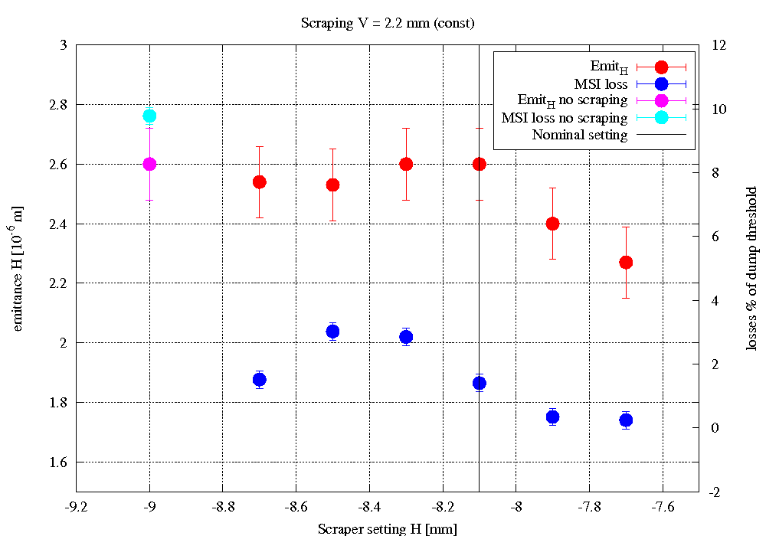
MD: SPS Scraping and Nominal Emittance
No blow up
H scraping (V constant)
No emittance cut
(only tails)
Scraper out
Virtual scraper setting
Losses @ MSI ~ 1%
Courtesy of L. Norderhaug Drosdal

Slide 15
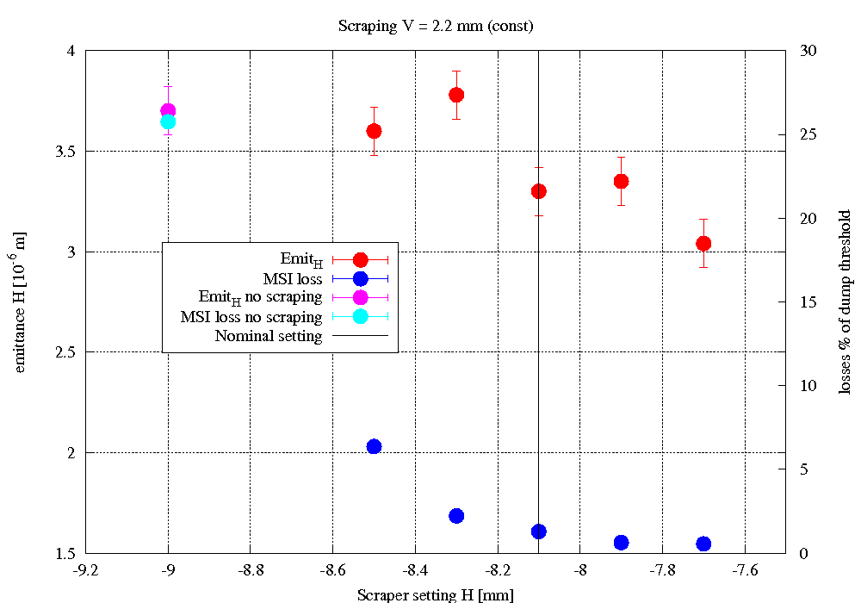
MD: SPS Scraping and Nominal Emittance
No blow up
H scraping (V constant)
Blow up: Nominal Emittance
H scraping (V constant)
No emittance cut
(only tails)
No emittance cut
(only tails)
Scraper out
Virtual scraper setting
Losses @ MSI ~ 1%
Losses @ MSI ~ 1.9%
Courtesy of L. Norderhaug Drosdal

Slide 16
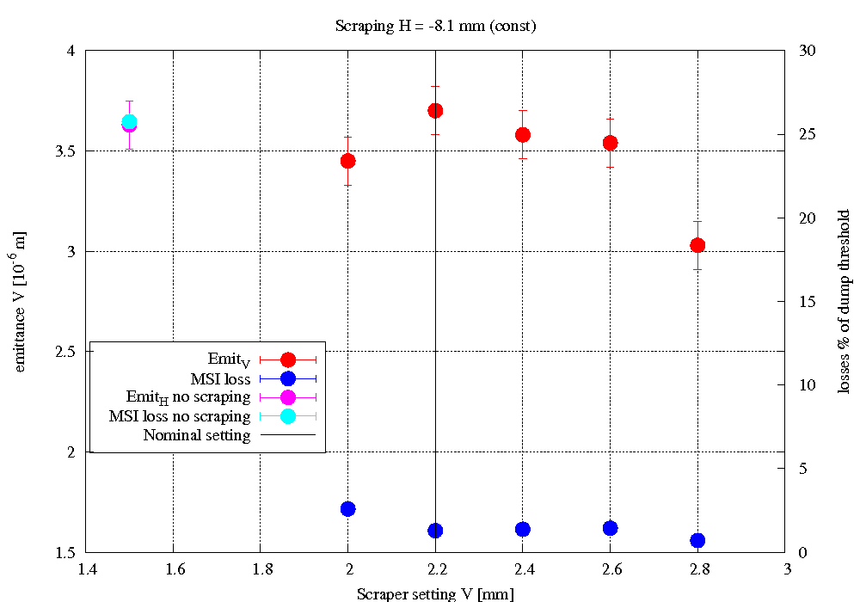
MD: SPS Scraping and Nominal Emittance
No blow up
H scraping (V constant)
No limitations expected!
Blow up: Nominal Emittance
V scraping (H constant)
No emittance cut
(only tails)
Scraper out
Virtual scraper setting
No emittance cut
(only tails)
Losses @ MSI ~ 1%
Losses @ MSI ~ 1.9%
Courtesy of L. Norderhaug Drosdal

Slide 17
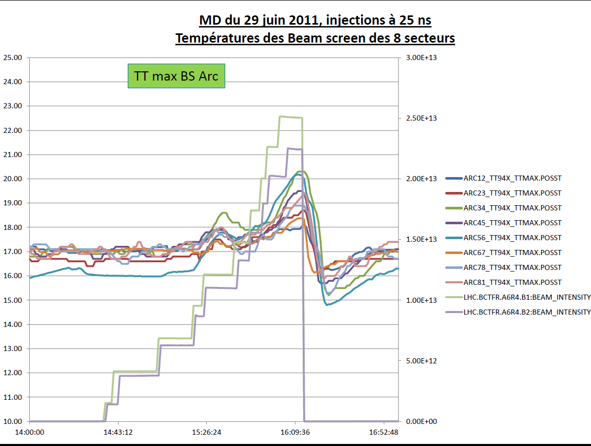
Operation with 25 ns Bunches
MD: injection of 24 nominal bunches separated by 25 ns
  2.8 μm normalized emittance
  SPS Scraping ON
  Good trajectories without steering (50 ns reference)
  Clean injection with low transversal and longitudinal losses
  Accumulation of 216 bunches in the LHC, preliminary RF and damper setup ➔ some emittance blowup to be studied
  Slight increase in beam screen temperature (T_{max} ~ 20 K)
  Moderate vacuum activity (e-cloud higher intensity?)
No limitations expected !

Slide 18
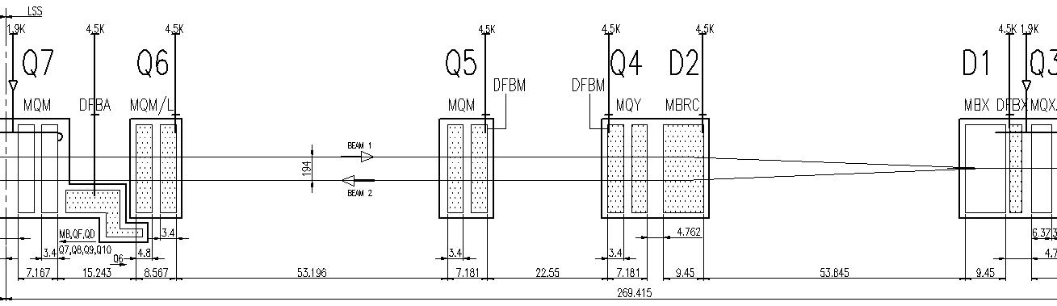
MKI Flashover
18/04/2011 MKI D flashover
  36 bunches hitting the TDI with 75-90% of the nominal MKI deflection
  Nearly all p+ of these 36 bunches impacted TDI/TCLIB ➔ 12 magnets quenched
Follow-up:
  TDI setup, in particular angular alignment (4 m long jaw: 1 mrad tilt ➔ 4 mm offset), re-checked ➔ improved MP!
  TCLIB aperture relaxed by 1.5σ to reduce the load of primary protons on Q6 (right downstream) ➔ OK for half nominal injected intensity (validations required for higher intensity)
  Check loss rate at Q6 w.r.t. TCLIB setting ➔ scale for 288 bunches (MD)
TCLIB (TDI + 340º)
TCLIA (TDI + 200º)

Slide 19
Quench Margin at Injection (MD)
With view to better understand BLM thresholds in injection regions…..
First Method (gentle):
  Checked BLM (@ TCLIB, Q6 and Q7) and QPS for different TCLIB settings from nominal (8.3 σ) to 1.3 σ + offset (full beam on TCLIB).
  Repeated measurements for 3 different intensities: 1e10p+, 2e10p+ and 3e10p+
No quench/quenchino observed
Second Method (aggressive):
  Injection of 2e9 p+ with a horizontal bump at Q6 ( 21-23-25 mm)
Losses at 1000% above dump thresholds but
No signal from QPS ➔ Can we increase BLM thresholds?

Slide 20
Summary and Conclusions
Nominal operation with 144 bunches reliably achieved (TCDI shielding + injection and abort gap cleaning)
B1 seen to be more critical in operation
  Periodical re-steering of the TL (with 12 bunches) is needed
  Good tradeoff between injection oscillations and losses to define
  MD studies to define origin of Beam 1 problems:
    No evidence of strong dependence on SPS longitudinal parameters (BQM already “selecting good beams”)
    Nominal settings of SPS scraper provide the best solution to reduce losses without reducing emittance (orbit control at the scraper, not too high losses at SPS)
    Still pending: sensitivity of TI 2 to steering
MD results:
  Injection with nominal emittance does not look like a limit (provided correct scraping)
  Injection with 25 ns does not look like it will be a limit – to check 144 bunches and more (next MD)
Possible improvements in case of continued issues:
  Maybe needs more frequent setup of TCDIs….each 4-6 weeks?
  Relaxed setting of TCDI to 5σ (factor of 4 improvement)
  Better understanding/increase of BLM thresholds, sunglasses,…..

