Slide 1
LMQXFA01 test results at CERN
Magnets: MQXFA04, MQXFA03
MAB meeting
G. Willering
Thanks to F. J. Mangiarotti, G. Ninet, R. Bouvier, G. Pichon, S. Juberg, P. Rogacki, S. Russenschuck, S. Izquierdo et al.
14 August 2024

Slide 2
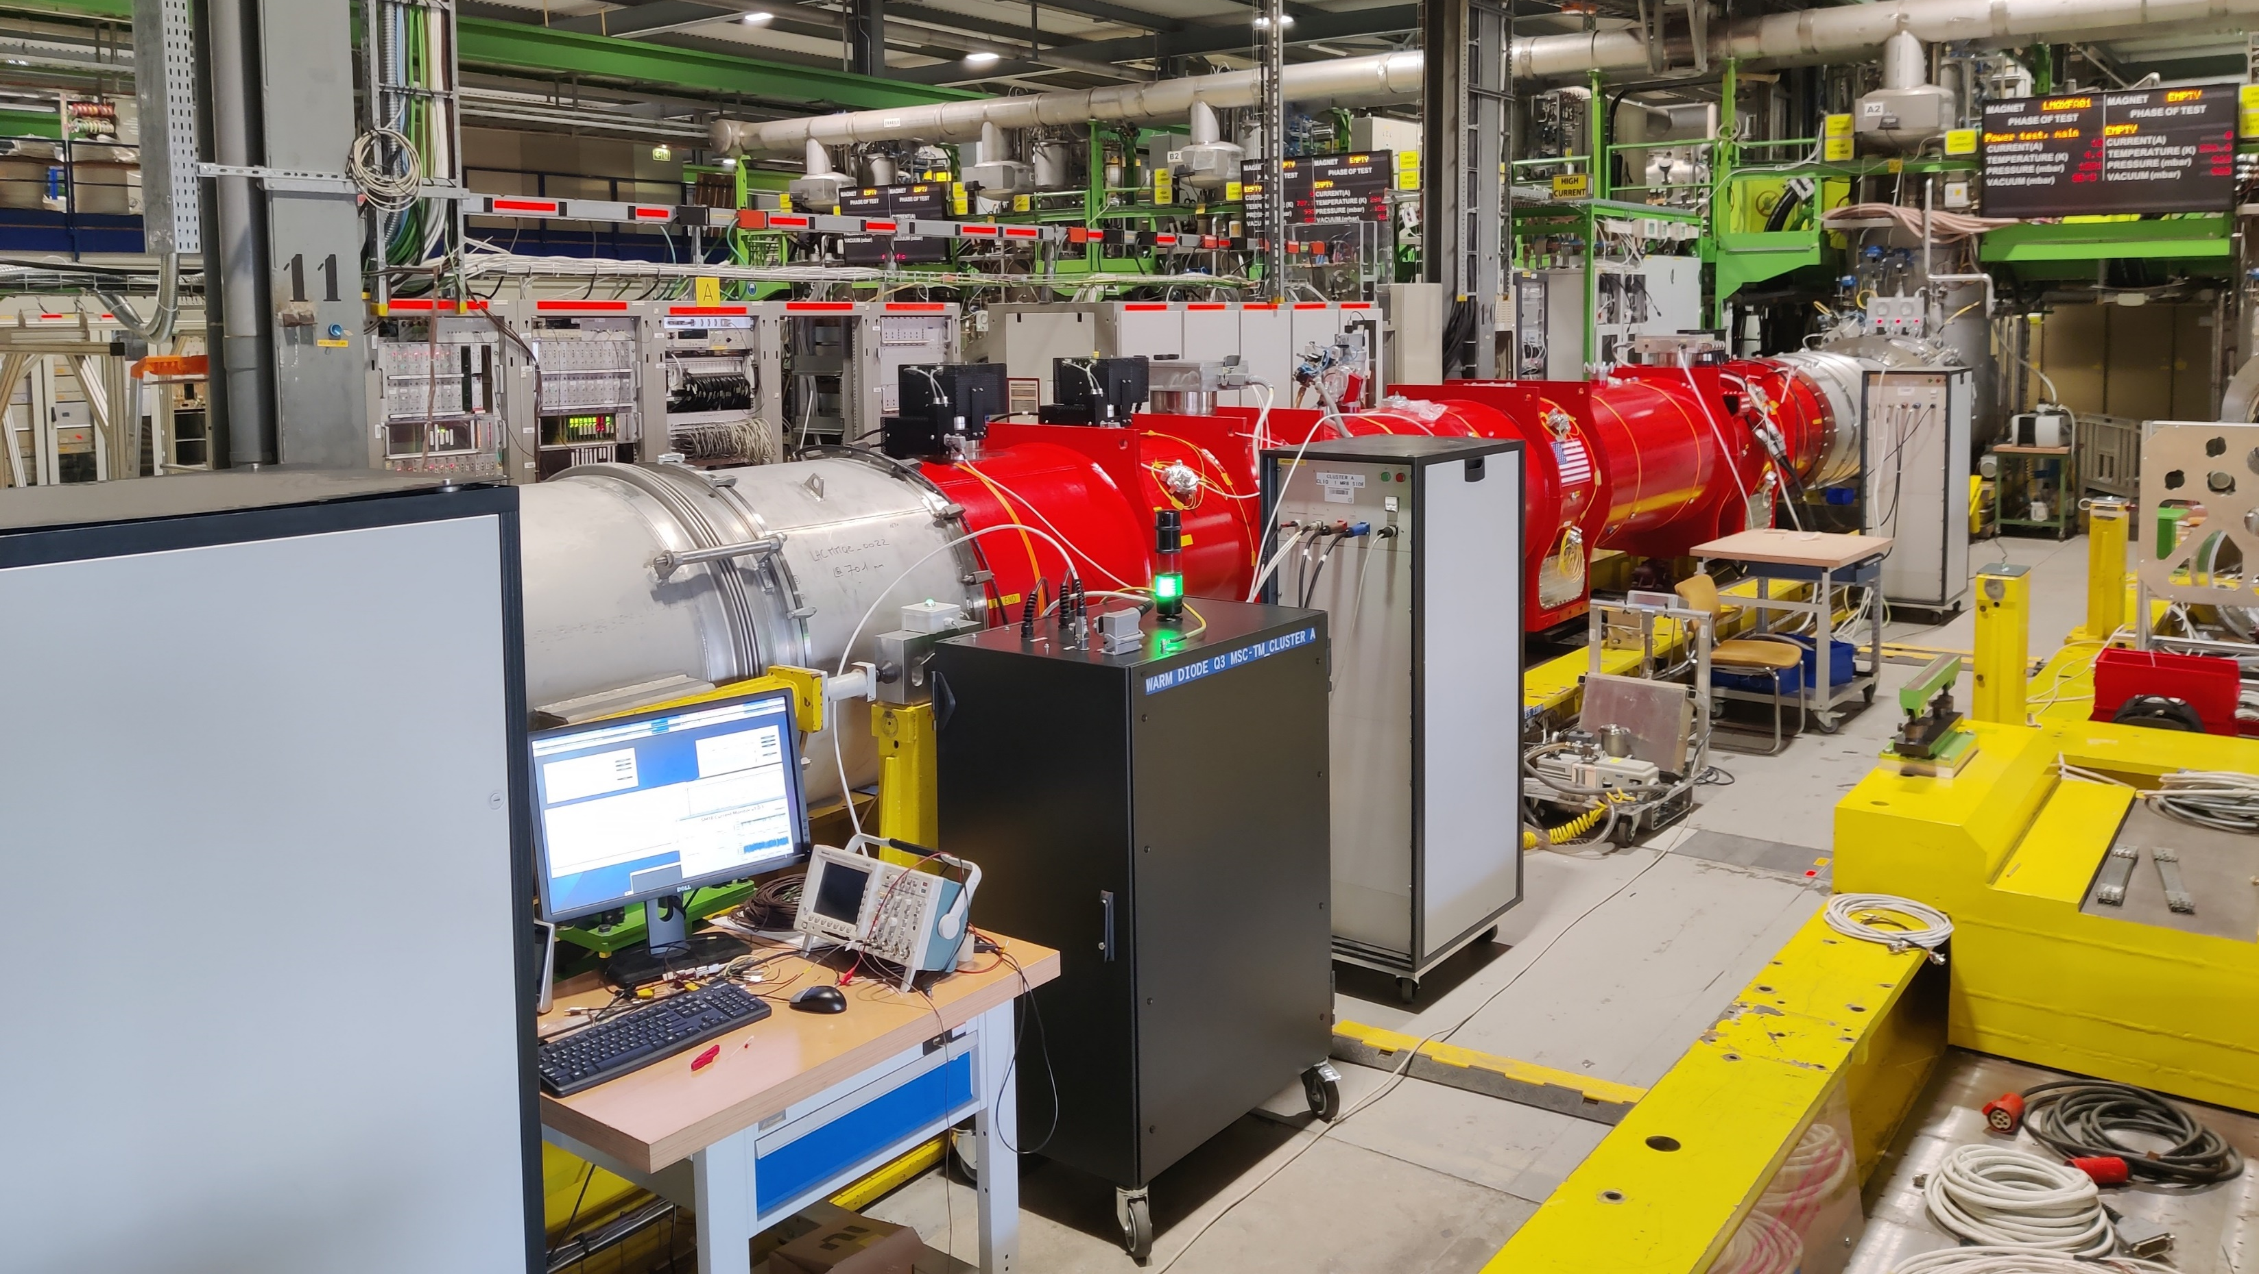

Slide 3
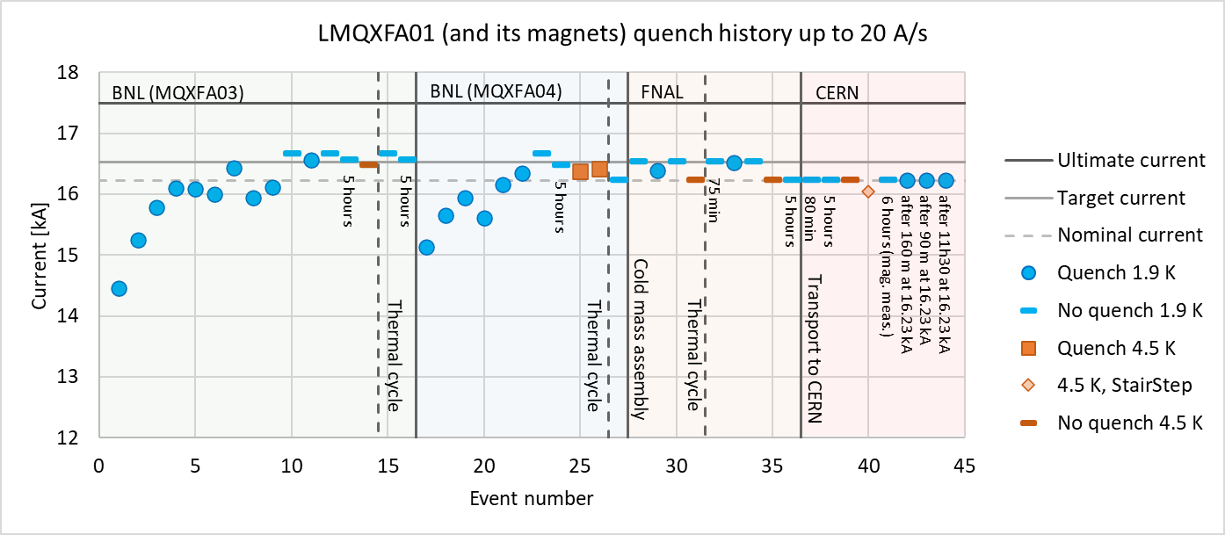
Magnet test history
Both magnets vertically tested separately at BNL with 2 cool downs.
During individual vertical tests, 16.67 kA was used as target.
Then the cold mass was assembled and cryostated and tested horizontal at FNAL with 2 cool downs.
During acceptance tests at FNAL 16.53 kA was the target (I_nom + 300 A)
Then tested at CERN with 1 cool down so far.
During acceptance tests at CERN 16.23 kA nominal current tests were performed.

Slide 4
The longest plateaus in the standard test plan have a duration of 5 hours (partially linked to test station capacity in the US benches).
For CERN Q2 magnets, the standard test program includes nominal current powering (16.23 kA) for 8 hours.
Focus in this presentation on the flattop quenches seen at CERN at nominal operating conditions.
Note:
The maximum test current at CERN was nominal current.

Slide 5
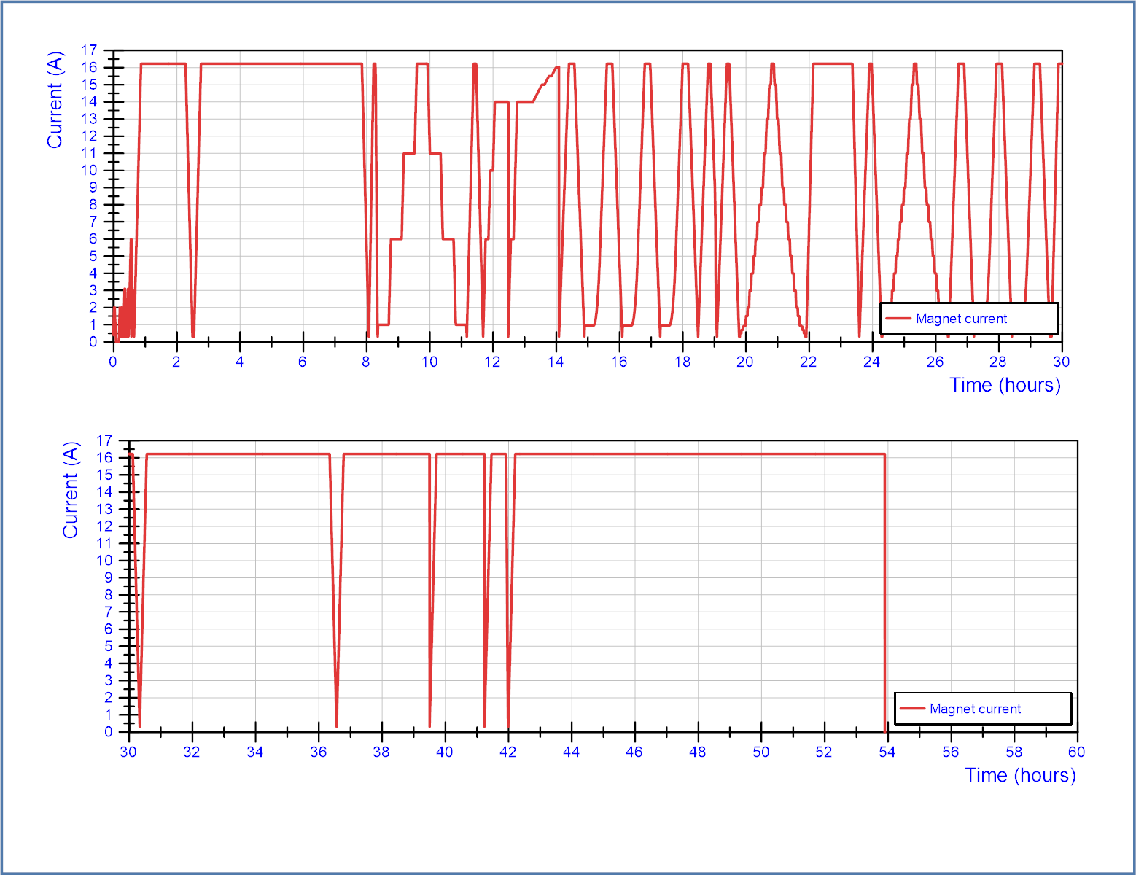
Q3 – LMQXFA01 – 1st CD at CERN – accumulated time with current > 300 A.
FPA trip
Q1
Full powering overview
No training quenches at 1.9 K.
Plateau of 5 hours OK.
No quench at 4.5 K to I_nom
1 quench at 4.5 K during a VI/splice cycle (not repeated afterwards)
Magnetic measurement cycles without issues.
Plateau of 5 hours OK.
Quench after 2h40 flattop
Quench after 1h30 at flattop
Quench after 11h30 at flattop.
1.9 K
4.5 K
1.9 K
Q2
Q3
Q4
Note:
Except for during the quenches and the trip, no protection QH/CLIQ firing was done and the magnet remained in superconducting state.

Slide 6
Quenches
4.5 K, 16.05 kA, Q3a-P2, during stairstep cycle
1.9 K, 16.23 kA, Q3a-P3, after 2h40 at flattop
1.9 K, 16.23 kA, Q3a-P1, after 1h30 at flattop
1.9 K, 16.23 kA, Q3a-P3, after 11h30 at flattop. QA segments 6 and 7, large signal, no sign of motion. Quench in the pole turn.
Cycles at 1.9 K to nominal: 23
7 cycles with plateau longer than 1 hour:
1h20 (OK)
5h (OK)
1h15 (OK)
5h45 (OK)
2h40 (quench)
1h30 (quench)
11h30 (quench)
Cycles at 4.5 K to nominal: 1 successfull, 1 cryo-loss with QH and CLIQ firing, 1 quench
Number of heater/CLIQ firings at high current:
2 at 4.5 K and 3 at 1.9 K

Slide 7
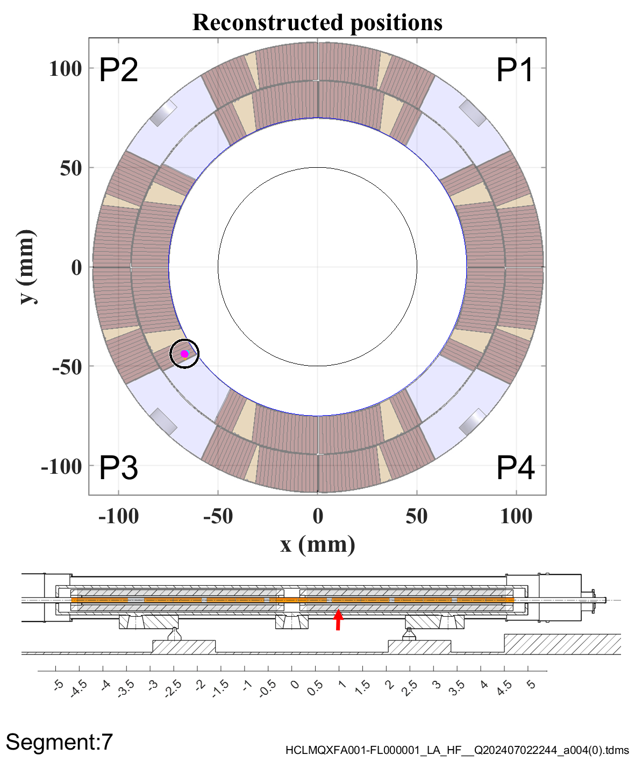
Quench localization
Unfortunately, only during the last quench the quench antenna were in the magnet. The other quenches occurred while the magnetic measurement shafts in the magnet.
Quenches
4.5 K, 16.05 kA, Q3a-P2, during stairstep cycle
1.9 K, 16.23 kA, Q3a-P3, after 2h40 at flattop
1.9 K, 16.23 kA, Q3a-P1, after 1h30 at flattop
1.9 K, 16.23 kA, Q3a-P3, after 11h30 at flattop. QA segments 6 and 7, large signal, no sign of motion. Quench in the pole turn.
All quenches happen in magnet “Q3a”, but not in the same pole.

Slide 8
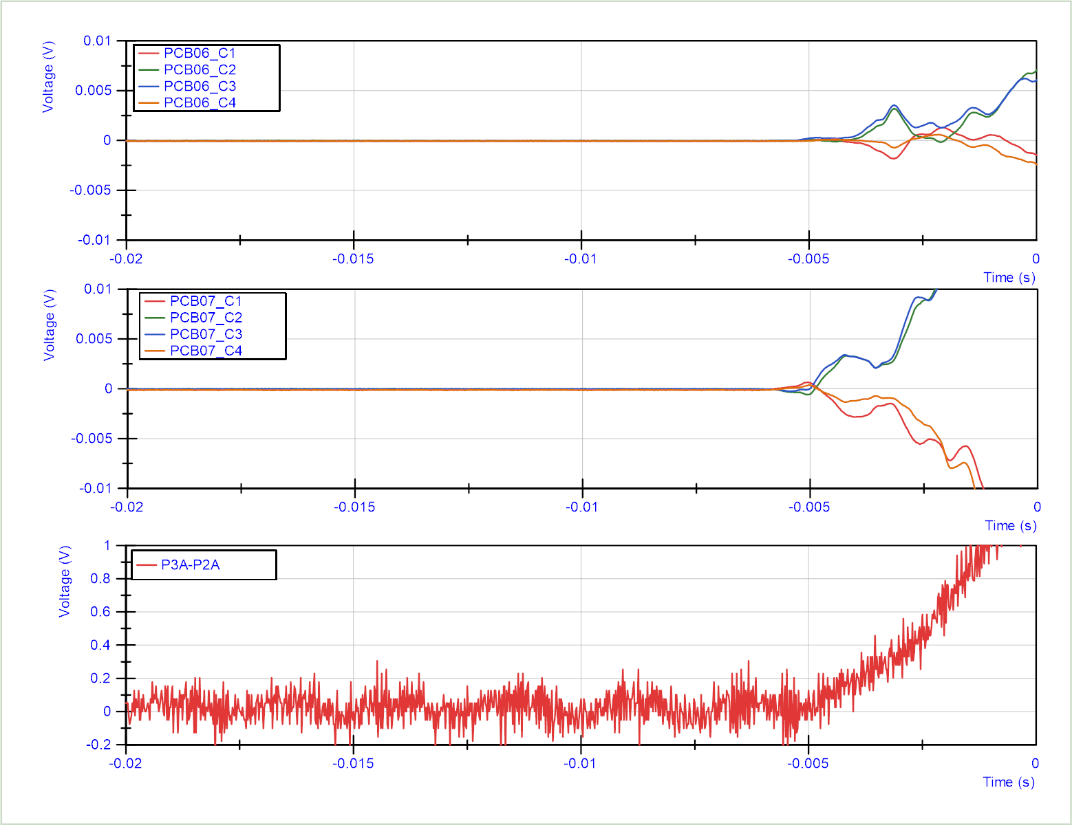
No sign of mechanical vibration
Quench 4:
Quench antenna signals from longitudinal segments 6 and 7. Other segments show no voltage buildup before t = 0 s.
Much larger signal than in normal quenches, even saturating the measurements.

Slide 9
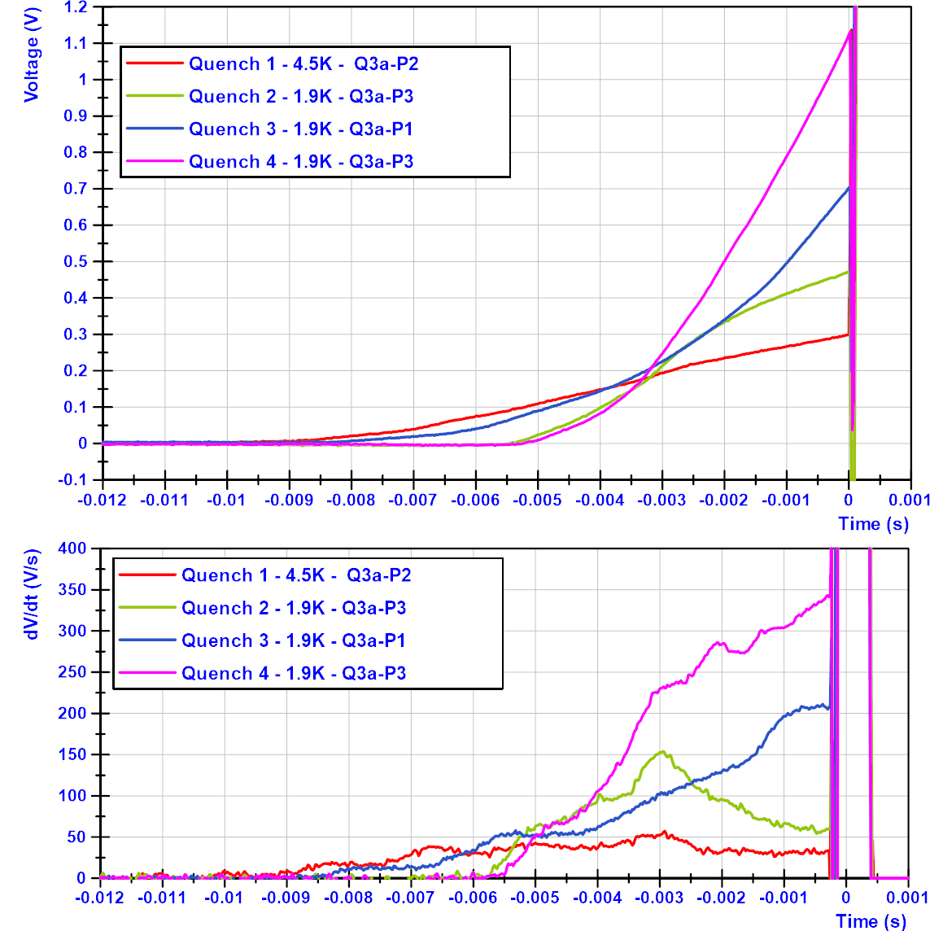
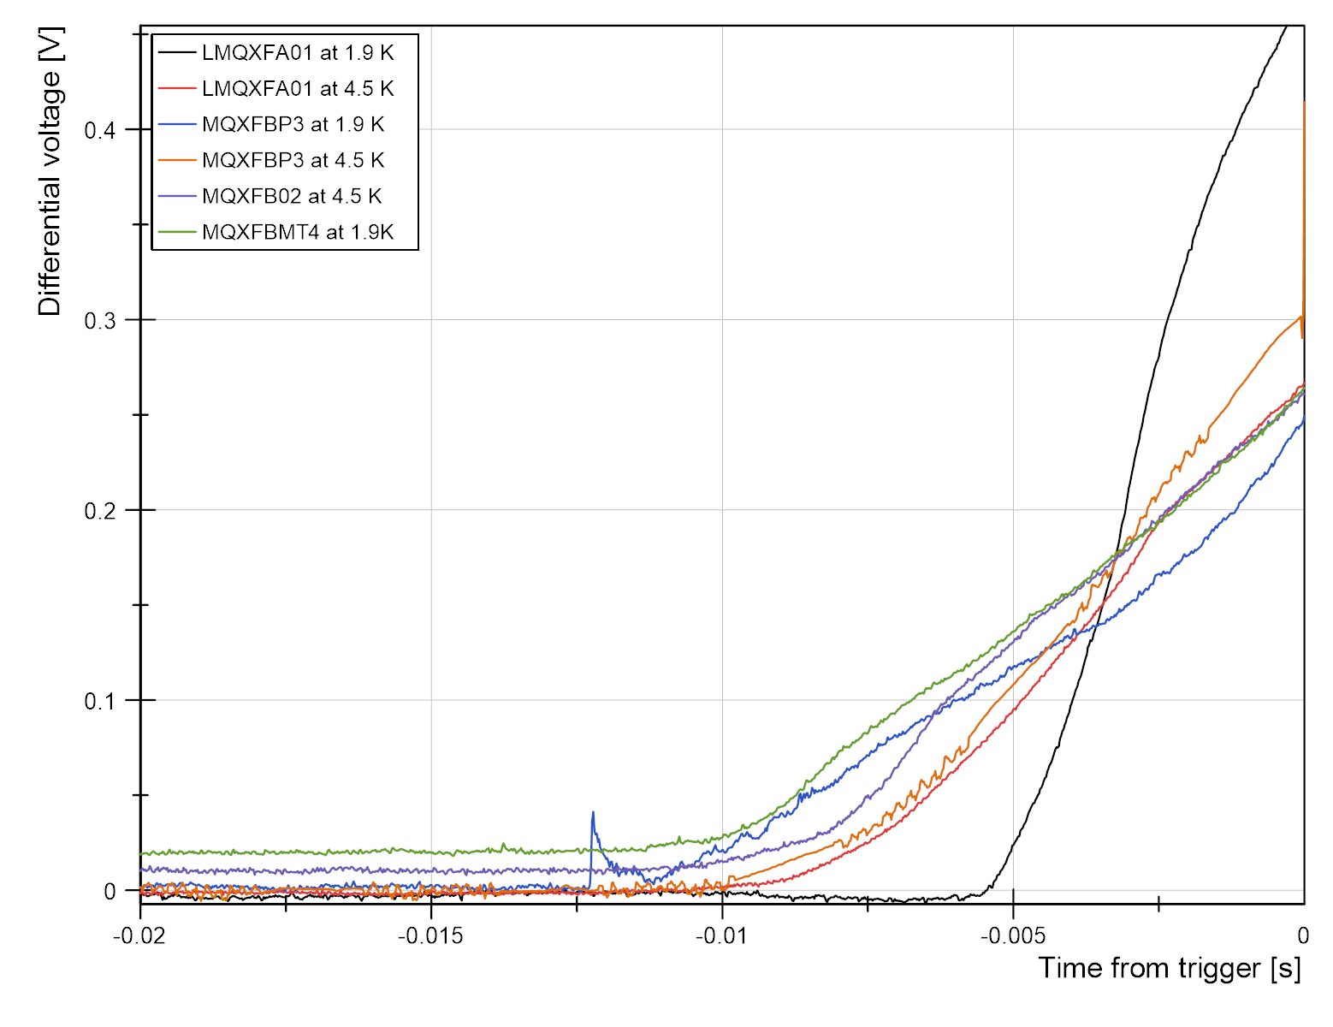
Voltage development during quench and dV/dt
Quench 2 at 1.9 K stands out in terms of dV/dt.
Voltage build up in various MQXF magnets
The two quenches in P3 have a similar quench start, but deviate after a few ms.
The two quenches in P3 have a similar quench start, but deviate after a few ms.
The 4.5 K quench has a significantly lower dV/dt and in the normal range.

Slide 10
Interpretation:
High dV/dt (high propagation velocity) is associated with being very close to the critical surface of the superconductor.
The ‘global temperature margin’ has been verified at 4.5 K, but likely the ‘local temperature margin’ at 1.9 K during flattop is strongly reduced
The most likely cause of reduced ‘local temperature margin’ is current redistributition (local conductor degradation or non-homogeneous splices)
Doubts
At 1.9 K two quenches were in pole 3, while one quench was in pole 1. Normally we don’t expect a correlation between quenches in different poles.
There is no 100 % reproducibility between the two quenches in pole 3. This could be attributed by a different precycling history or by small perturbations that cause the magnet finally to quench.
There was no training margin, so ‘delayed training’ cannot be excluded with the available data.
What to test:
This is the first time we encounter these quench types in the long Nb₃Sn magnets. (Note that the amount of testing at long flattops has always been limited).
From now we can perform continuous operation during nights and weekends, giving a large amount of test time ‘for free’.
The focus during retest should be on understanding the phenomena.
References:
Test plan Q3 acceptance: https://edms.cern.ch/document/2959525
Standard test plan Q2 magnets: https://edms.cern.ch/document/2873724
Acceptance report for Q3, following criteria: https://edms.cern.ch/document/3094617
Full test report Q3: pending.

Slide 12
Appendix

Slide 13
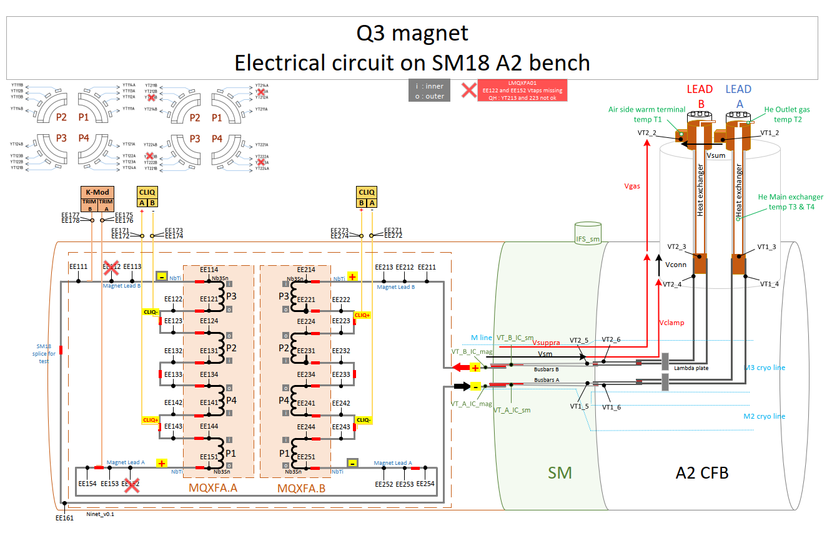

Slide 14
Appendix: Full powering history at CERN

Slide 15
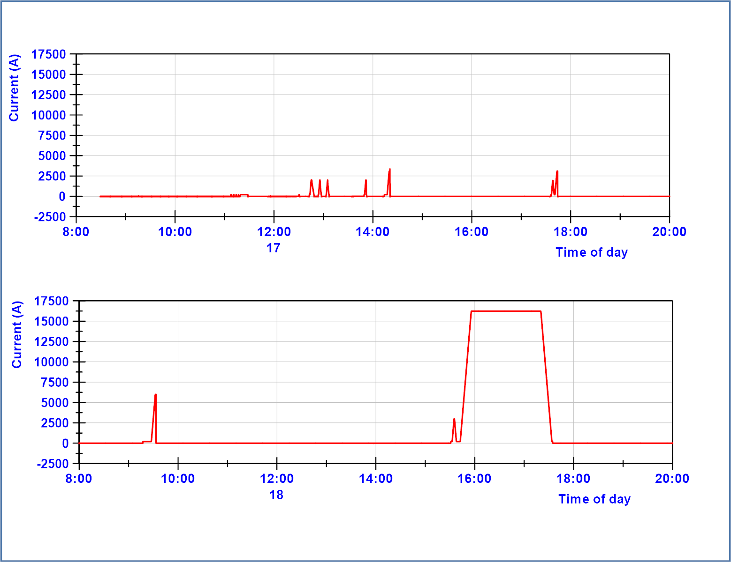
17 June 2024
1.9 K
Preparation tests
18 June 2024
Nominal current – 1h20
Ramp down
1.9 K
Protection check

Slide 16
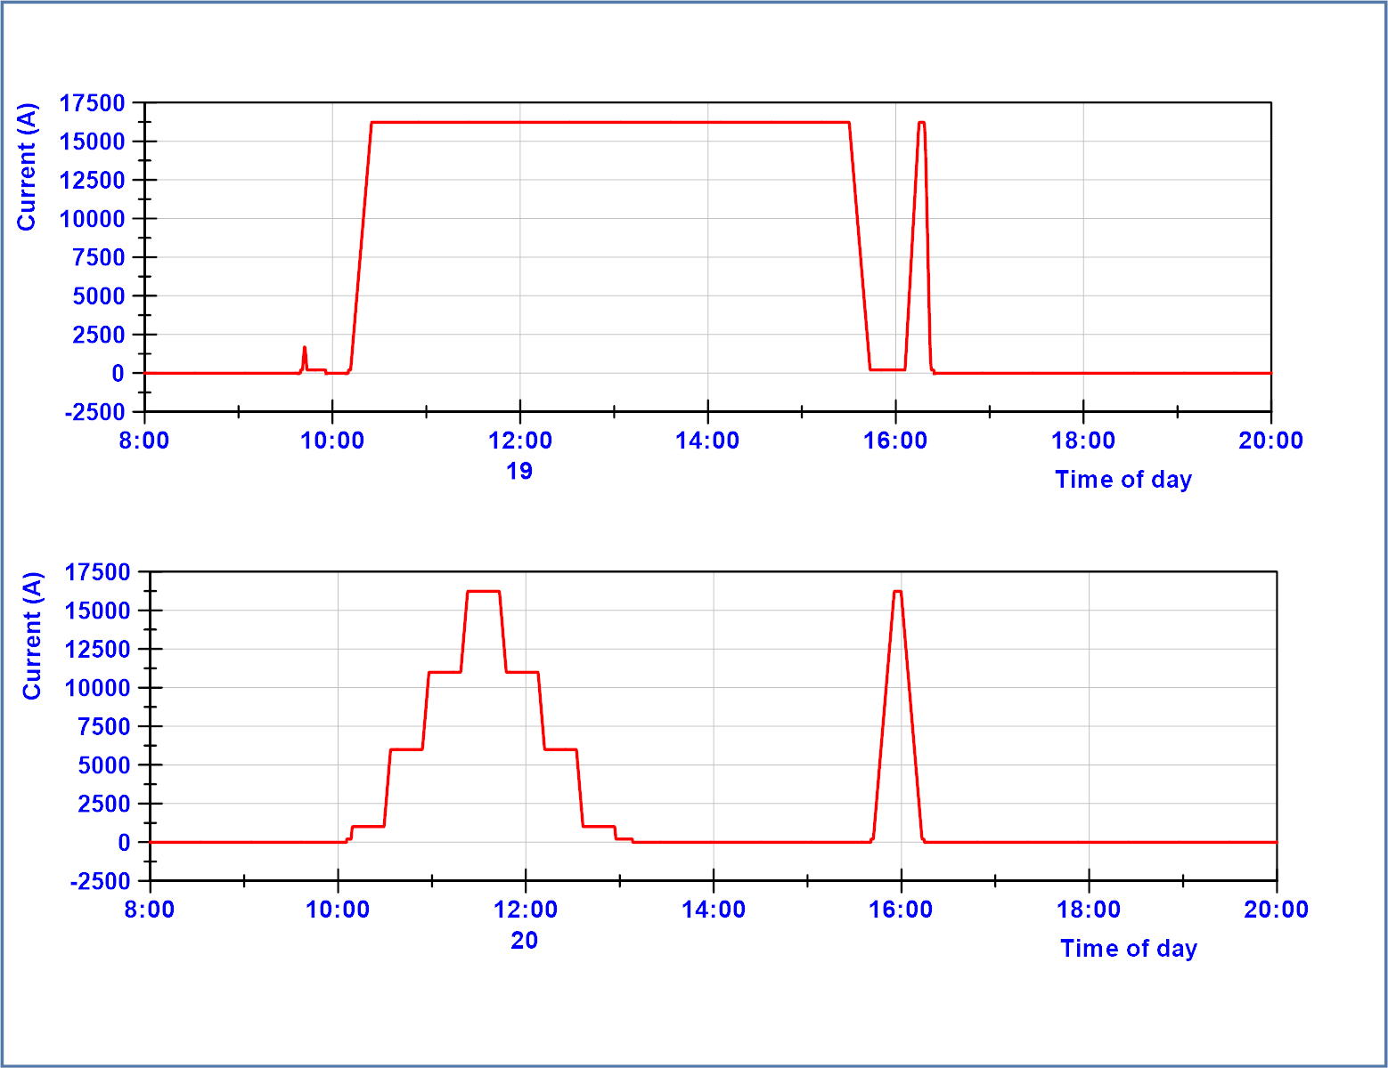
19 June 2024
Nominal current – 5h
Ramp down
30 A/s ramp up
75 A/s ramp down
1.9 K
1.9 K
20 June 2024
Splice cycle
Nominal current at 4.5 K
1.9 K
4.5 K

Slide 17
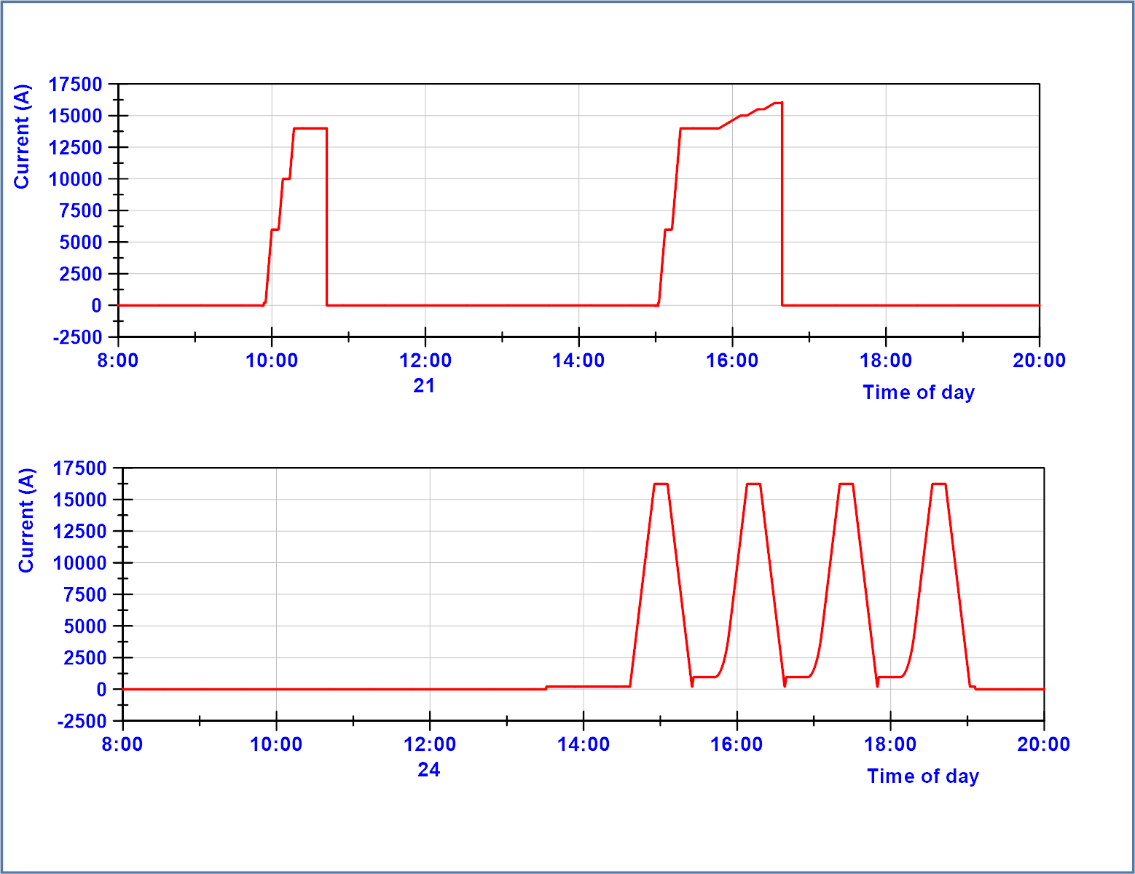
21 June 2024
4.5 K
4.5 K
Quench 1 in Q3a-P2
16.05 kA
Protection trip
Due to cryo-loss
22 June 2024
Magnetic measurments – Machine cycle
1.9 K

Slide 18
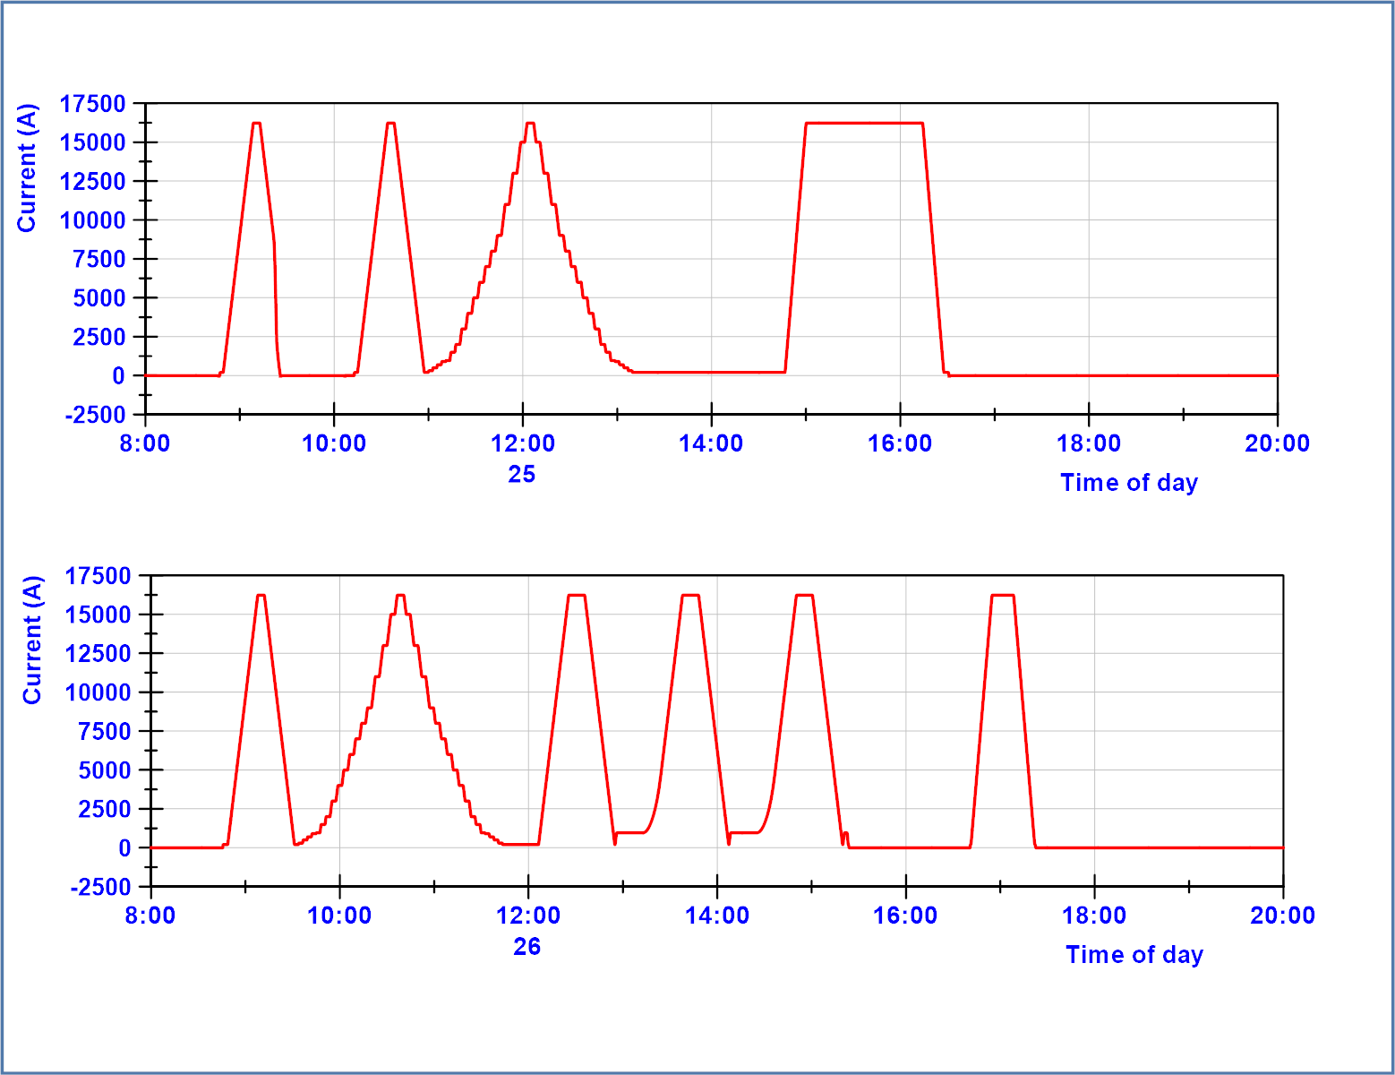
25 June 2024
Magnetic measurments – nominal current
nominal current 1h15
1.9 K
26 June 2024
Magnetic measurment cycles – nominal current
1.9 K

Slide 19
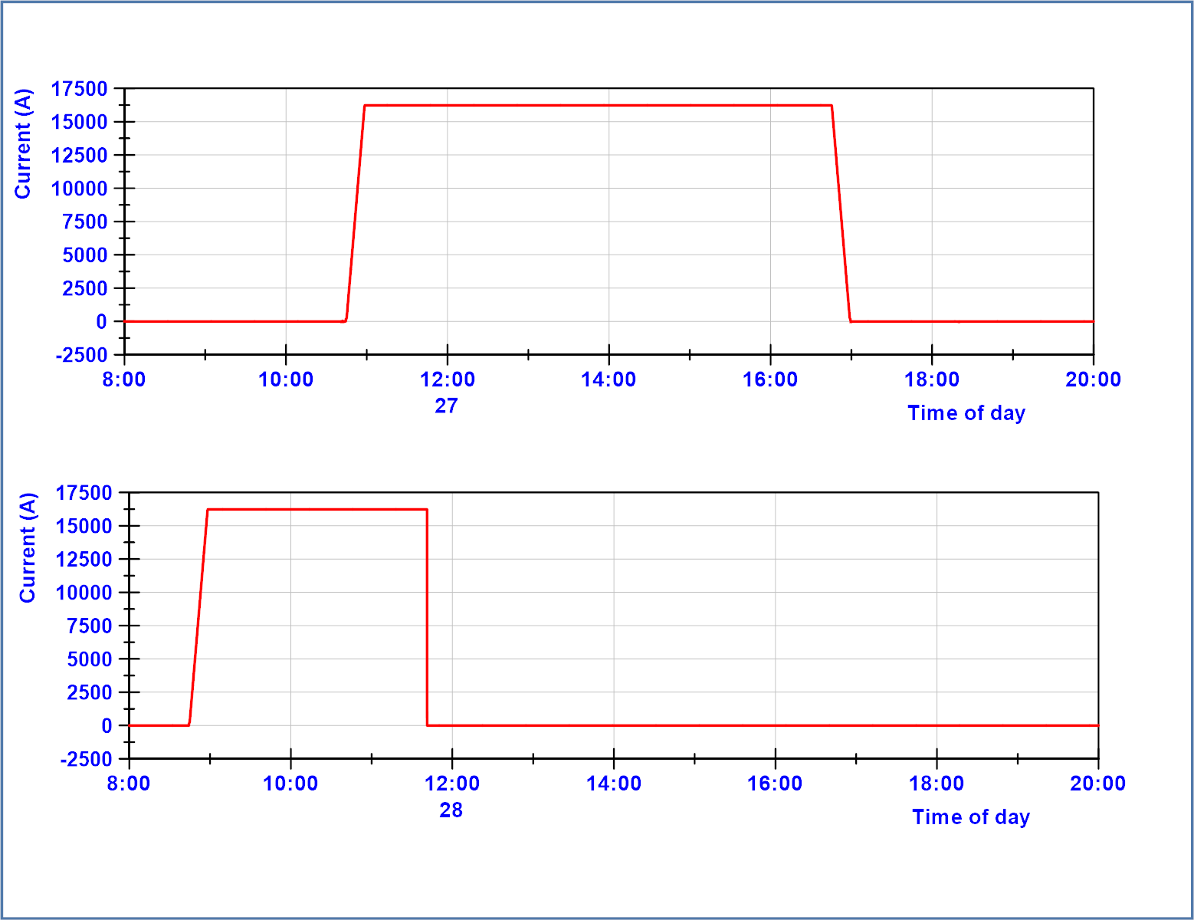
27 June 2024
Magnetic measurments – nominal current – 5h45 flattop – ramp down
1.9 K
28 June 2024
Flattop nominal – quench 2 after 2h40 in Q3a_P3 (during stretched wire measurements)
1.9 K

Slide 20
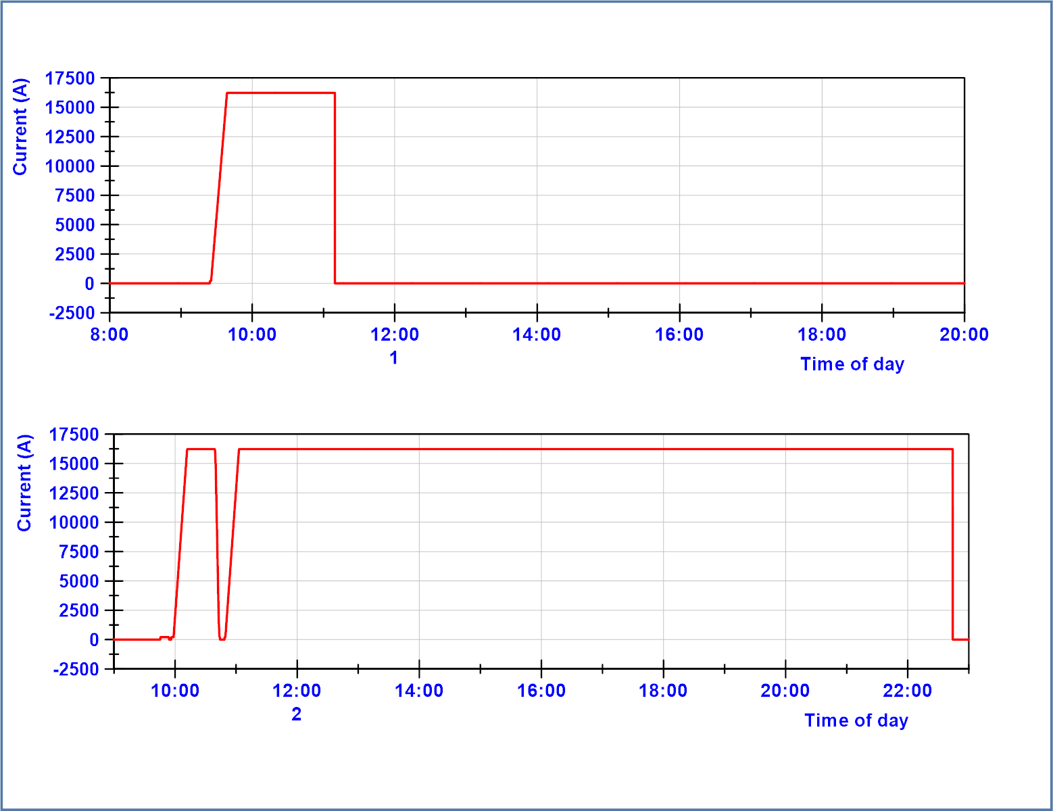
1 July 2024
Flattop nominal – quench 3 after 1h30 in Q3a_P1 (during stretched wire measurements)
1.9 K
30 min flattop
Slow power abort
Flattop nominal – quench 4 after 11h30 in Q3a_P3)
1.9 K
The slow power abort (controlled ramp down at -75 A/s) was triggered by an wrong button pushed.
Powering in this cool down completed after 2 July.

