Slide 1
BLM threshold strategy for the reduced sensitive of newly installed BLMs in 6L7
B.Salvachua, S.Morales (SY-BI) and A.Lechner (SY-STI) on behalf of the BLMTWG
Inputs from E.Effinger, C.Zamantzas, MPP and OP
17 April 2024 - Joint MPP / Collimation WG / BLM Thresholds WG

Slide 2
Introduction
During 2023 proton run, losses in IR7 during injection were dumping the beam with 236b injection trains and only in Beam 1.
These are fast losses in RS01 (40us) reaching the BLM maximum electronics limit of 23 Gy/s at the primary horizontal and skew collimators.
Since then there were a series of follow-up meetings and actions:
  BLMTWG (16th Jun 2023): https://indico.cern.ch/event/1291619
  BLMTWG (27th Nov 2023): https://indico.cern.ch/event/1350470/
  LBOC (20th Jun 2023): https://indico.cern.ch/event/1291758/
  JAPW 2023:
    Session 2 (5th Dec 2023): https://indico.cern.ch/event/1337597/sessions/515527/#20231205
    Session 5 (6th Dec 2023): https://indico.cern.ch/event/1337597/sessions/515567/#20231206
  MPP (15th Dec 2023): https://indico.cern.ch/event/1356938/
  BLMTWG (23rd Feb 2024): https://indico.cern.ch/event/1385086/
  MPP (22nd Mar 2024): https://indico.cern.ch/event/1395422
  LMC (27th Mar 2024): https://indico.cern.ch/event/1397614/

Slide 3
How many protons impact the primary collimator?
Estimation of protons at 450 GeV impacting the primary collimators during saturation by calibrating another BLM downstream that does not saturate.
S.Morales
RS01 6.8e8 p in 40 us or 8e-4% train
For the injections that made it:
RS09: 4e10 p in 1.3 s or 0.1% train
0.1% of train
RS12: 8e11 p in 83 s or 2% train
Equivalent of 50 Joules in 40us
Solution to this problem implies a change on a MPP Critical system: BLMs
Saturation level of the TCP.C

Slide 4
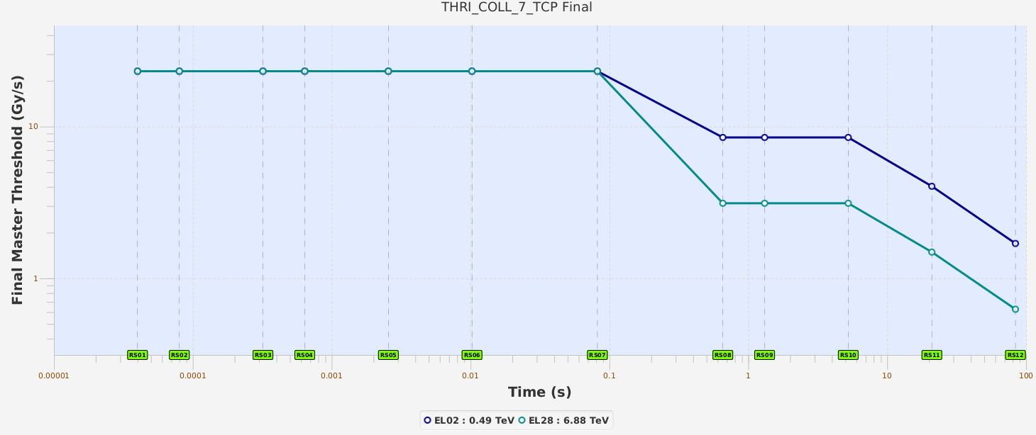
BLM Thresholds for collimators
The BLM saturation of short running sums is possible in several locations and could affects multiple energies (not only injection). This limitation was observed during the last proton quench test.
23.6 Gy/s read-out electronics saturation limit.
Measurement from 10pA to 1mA
Steady state losses set to 500kW
Tolerate higher beam power for shorter period - different regime
125 kJ
Curves are based on measured data taking into account the BLM response and expected energy depositions confirmed by simulations.
They correspond to the maximum allowed BLM signal.
TCP.B Skew

Slide 5
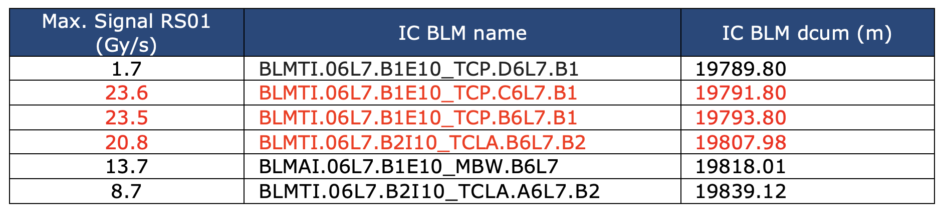
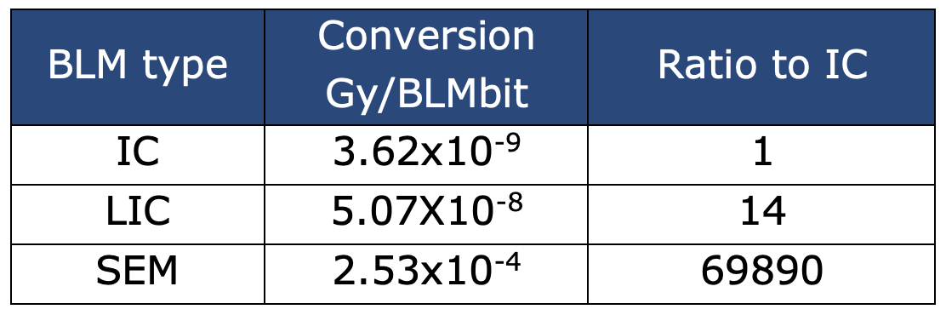
BLM signals during injection of Beam 1
Identify the most limiting locations during one of the injections with high losses in IR7.
Aim to gain a factor 2 margin for 2024
Proposed two system modifications in order to study what would be the strategy for LS3:
  The installation of transversally displaced Ionization Chambers (IC) in order to reduce its response and eventually move the interlock functionality to these new IC.
  The replacement of SEM detectors by Little Ionization Chambers (LIC) in the 6L7 area.
The SEM provide a response that is too low, while for the LIC the response is expected to be 14 times lower.
We need to understand what is the factor needed in view of a possible upgrade of the BLM system

Slide 6
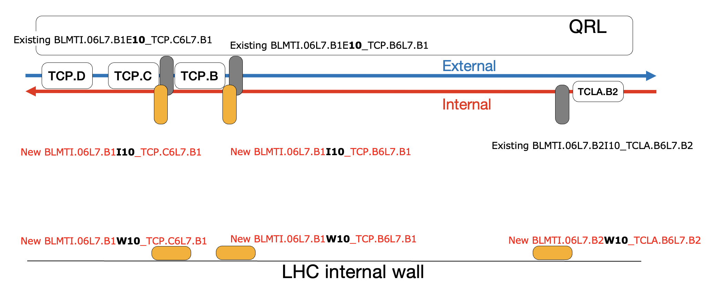
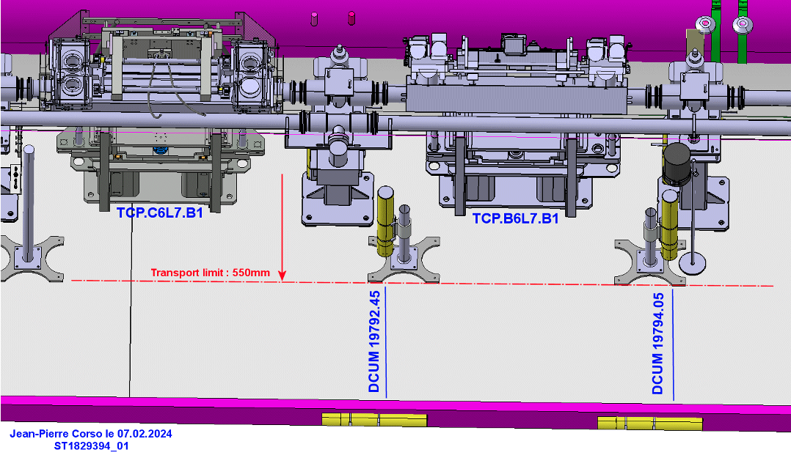
New IC BLM installation in 6L7
Over EYETS we have proceed with the installation of 5 additional Ionisation chambers in 6L7 and the replacement of 10 SEM detectors at the collimators by LICs:
LHC-BLM-EC-0019, Addition of BLM detectors and replacement of several SEM by LIC
2 IC BLM in position about I3 for the TCP.C and TCP.B —> 60% response expected TCP.C and 96% at TCP.B from FLUKA (https://indico.cern.ch/event/1371132/)
3 IC BLM installed in the tunnel passage WALL, about 2 m transversal displacement from the beam pipe for TCP.C, TCP.B and TCLA.B
10 LIC BLM replacing 10 SEM BLM, at the same location

Slide 7
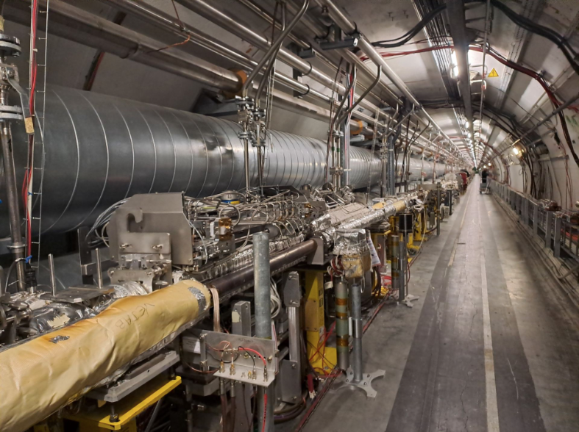
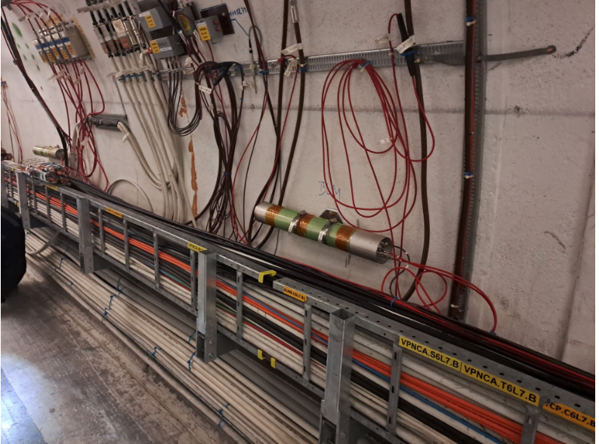
Installation pictures

Slide 8
Test at injection - 11th March
Thanks to OP for taking the data!
Injecting a pilot beam about 8.8e9 p (test repeated 3 times per collimator)
TCP.C
TCP.B
TCP.D
Beam 1
TCLA.B2
Beam 2
BLM displaced 30-40 cm —>
BLM on the passage WALL —>

Slide 9
Test at injection - 11th March
Thanks to OP for taking the data!
Injecting a pilot beam about 8.8e9 p (test repeated 3 times per collimator)
TCP.D
TCP.B
Beam 1
TCP.C
TCLA.B2
Beam 2
BLM displaced 30-40 cm —>
BLM on the passage WALL —>

Slide 10
Test at injection - 11th March
Thanks to OP for taking the data!
Injecting a pilot beam about 8.8e9 p (test repeated 3 times per collimator)
TCP.D
TCP.C
Beam 1
TCP.B
TCLA.B2
Beam 2
BLM displaced 30-40 cm —>
BLM on the passage WALL —>

Slide 11
Summary of test at injection - 11th March
The IC BLM displaced by 40 cm do not show any significant improvement, with 8.8e9 p we observed saturation.
The IC BLM on the WALL they show at injection lower response, if we use these BLMs the new limits on the injection will be:
For Horizontal: loss saturation above 3.0e10 p first rom TCP.B WALL
For Skew: loss saturation above 3.4e10 p first from TCLA.B2 WALL
2023 limit at 6.8e8 p

Slide 12
Factors between Ionisation chambers
The slope of these measurements could be used to estimate the expected response change.
Still final numbers will be calculated with the validation loss maps.
Very low intensity scraping at top energy (done in collaboration with OP!) indicates that the BLM on the WALL can detect beam losses from direct impact at the collimator above 1e6-1e7 protons. Final numbers will be shown by S.Morales (next presentation)

Slide 13
Thresholds strategy
BLM name 2023 | Family 2023 (B1+B2) | Additional BLM 2024 for same protected element | Family 2024 (B1-wall)
BLMTI.06L7.B1E10_TCP.D6L7.B1 (external beam line) | THRI_COLL_7_TCPPM
BLMTI.06L7.B1E10_TCP.C6L7.B1 (external beam line) | THRI_COLL_7_TCPPM | BLMTI.06L7.B1I10_TCP.C6L7.B1 (internal beam line) BLMTI.06L7.B1W10_TCP.C6L7.B1 (internal wall) | THRI_COLL_7_TCPPM_WALL
BLMTI.06L7.B1E10_TCP.B6L7.B1 (external beam line) | THRI_COLL_7_TCP | BLMTI.06L7.B1I10_TCP.B6L7.B1 (internal beam line) BLMTI.06L7.B1W10_TCP.B6L7.B1 (internal wall) | THRI_COLL_7_TCP_WALL
BLMTI.06L7.B2I10_TCLA.B6L7.B2 (internal beam line) | THRI_COLL_7_TCLA_HI | BLMTI.06L7.B2W10_TCLA.B6L7.B2 (internal wall) | THRI_COLL_7_TCLA_HI_WALL
Use the new BLMs on the WALL - this will provide more margin to the injection losses.
Notice that the BLM in the vertical collimator remains untouched - no limitation was observed in 2023.
New families will have the same collimation model but the response will be updated. We have proceed to create the new families in collaboration with BE-CSS (M.Peryt and A.Tsounis)
The signal of the LIC will be monitored along the Run to define the final strategy for the upgrade of the BLM system.

Slide 14
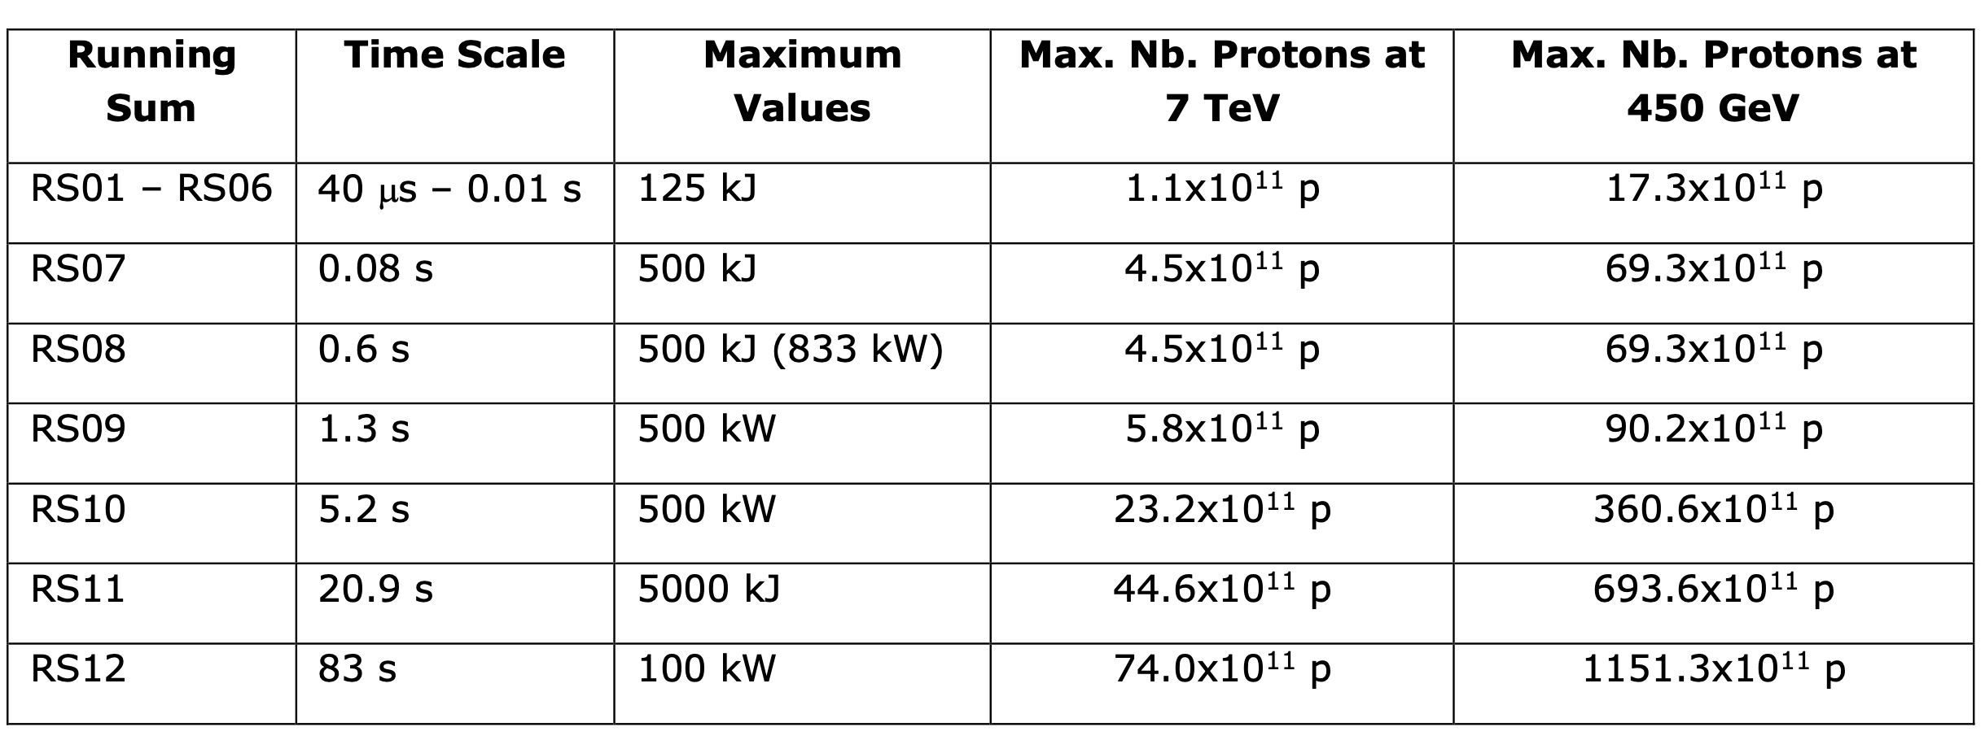
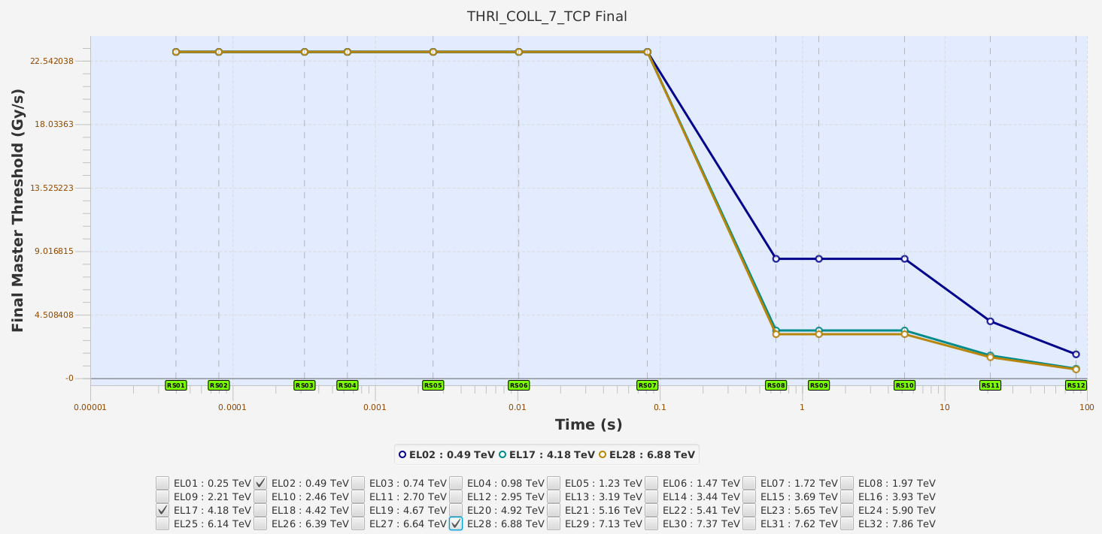
First look at the needed response factors
With the response factors from slow losses (loss map analysis of RS09) the collimation families are created, following the Collimation maximum losses specifications
The BLM Thresholds curves for the families in IR7 already show the saturation of the short running sums.
A first estimate can be assessed by calculating the needed factor not to saturate for the collimation specifications.

Slide 15
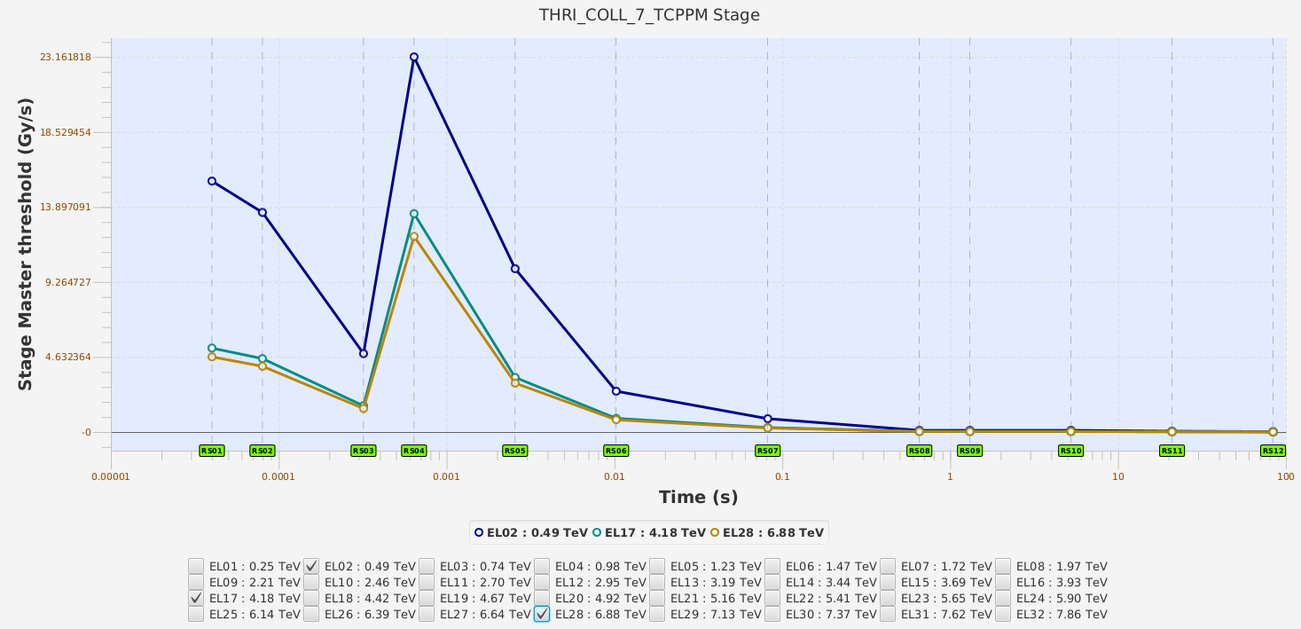
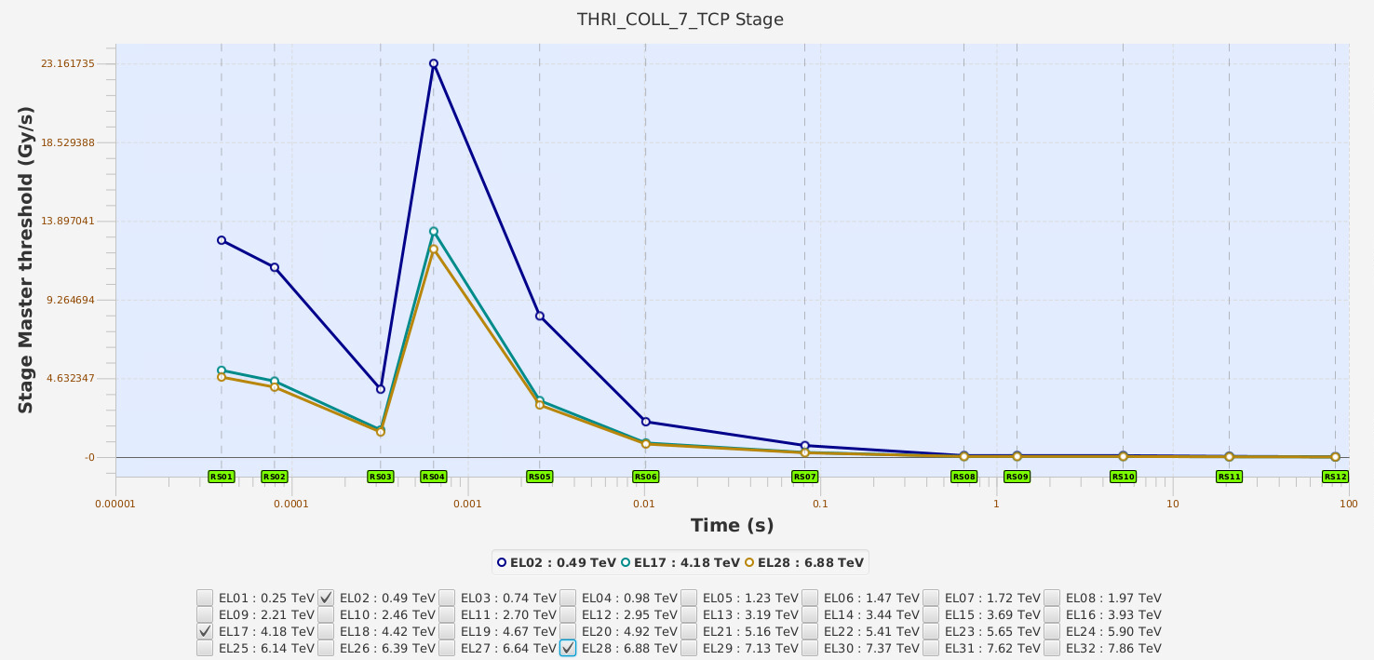
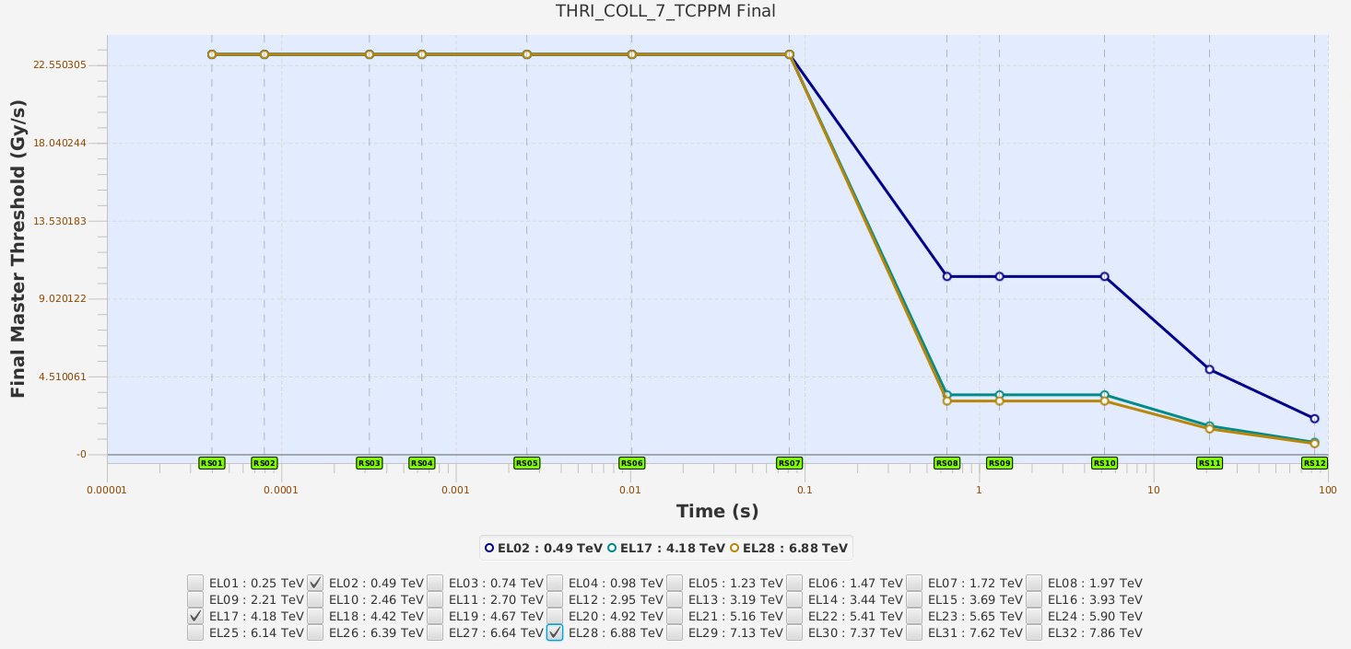
TCP families: need a factor 100/0.06 = 1700
Thresholds include a reduction factor for very fast losses
D1 correction of 0.06 for very fast running sums on the primary collimators (RS01-RS03).
Needs to be re-evaluated being the D1 SC for HL-LHC
Factor 100 with D1
Factor 1700 without D1
Factor 100 with D1
Factor 1700 without D1

Slide 16
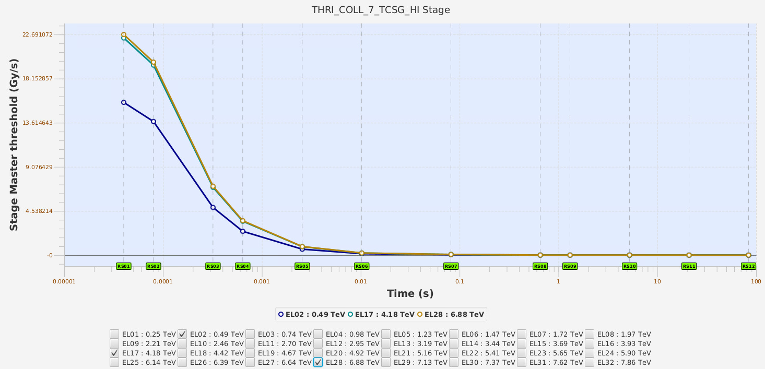
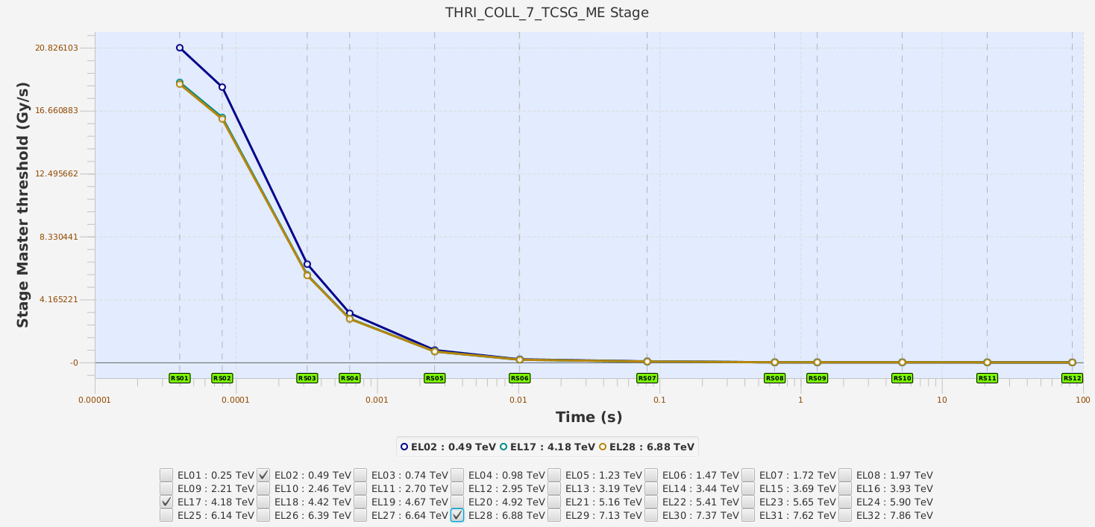

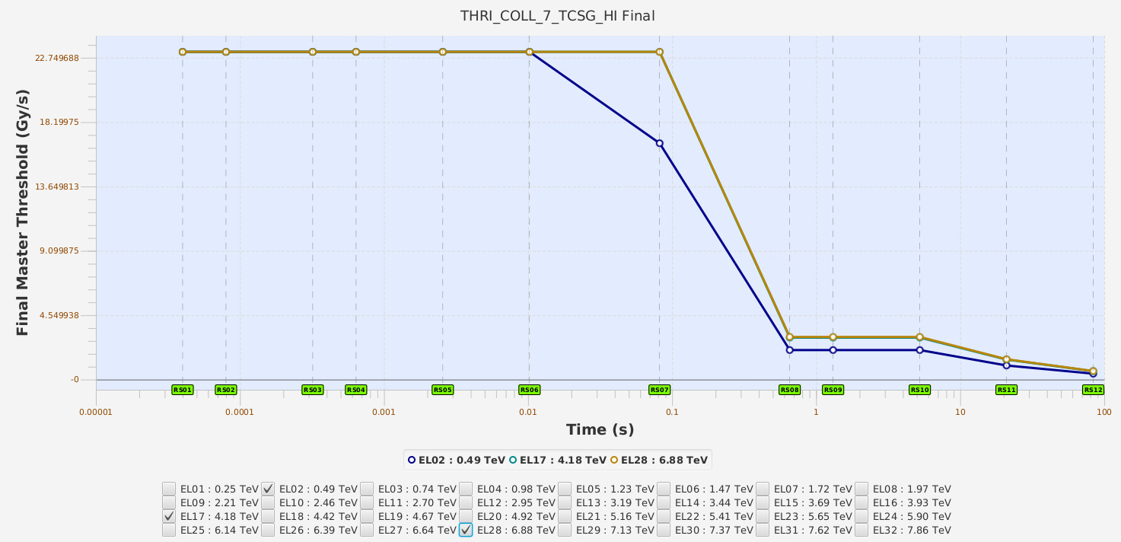
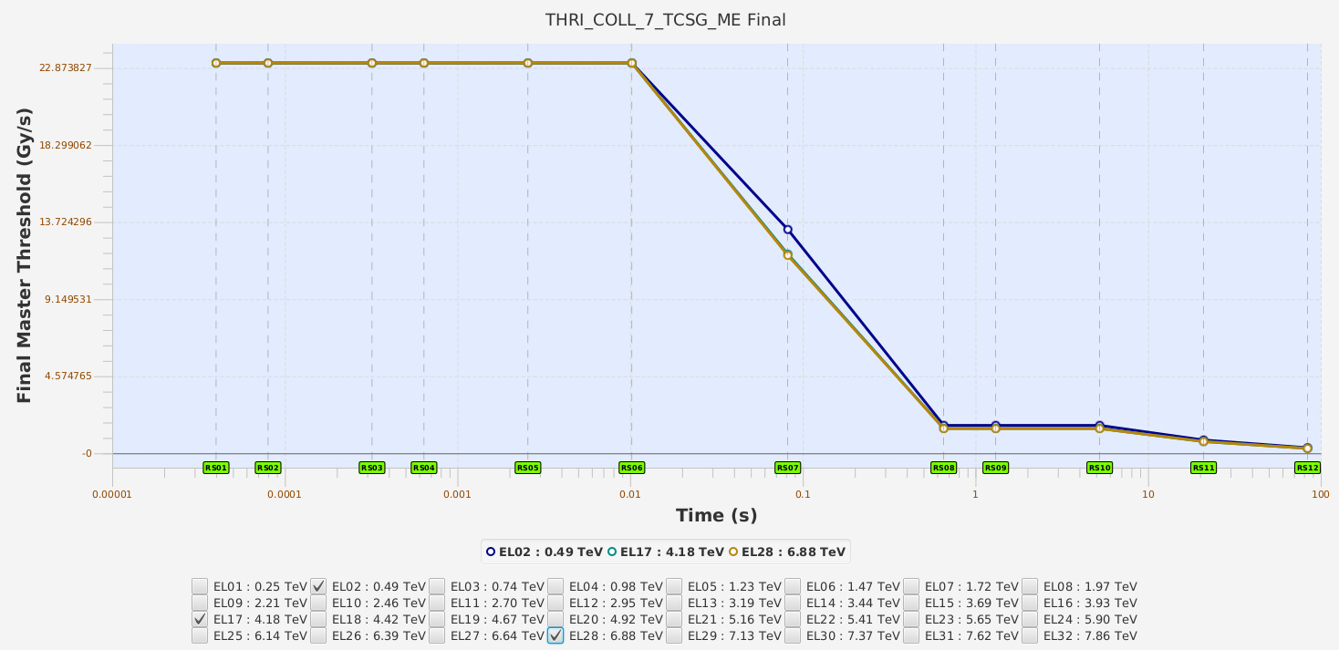
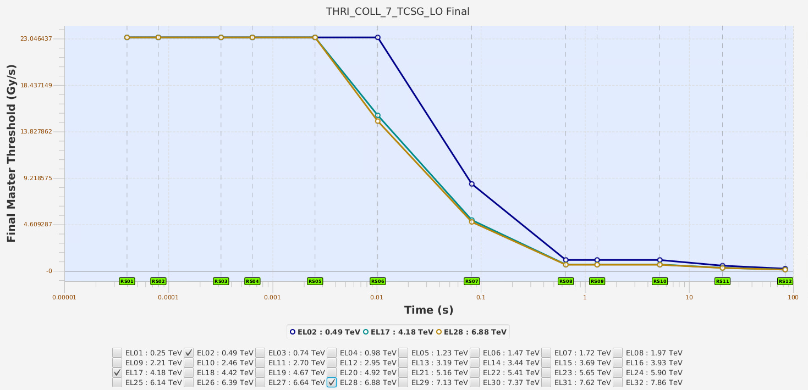
TCSG families: need a factor between 333 to 111
There are 3 TCSG families with different response factors: high, medium and low.
Depending on the collimation hierarchy and the loss distribution the limitation comes at injection or at top energy
Factor 333
Factor 200
Factor 111

Slide 17


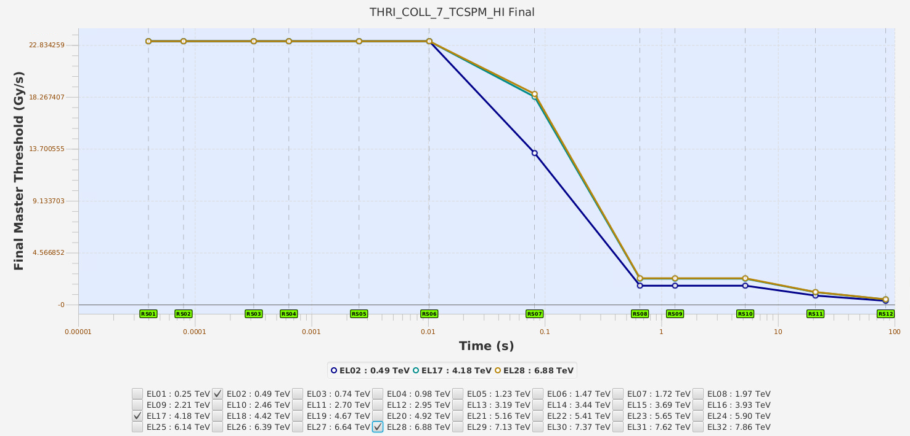
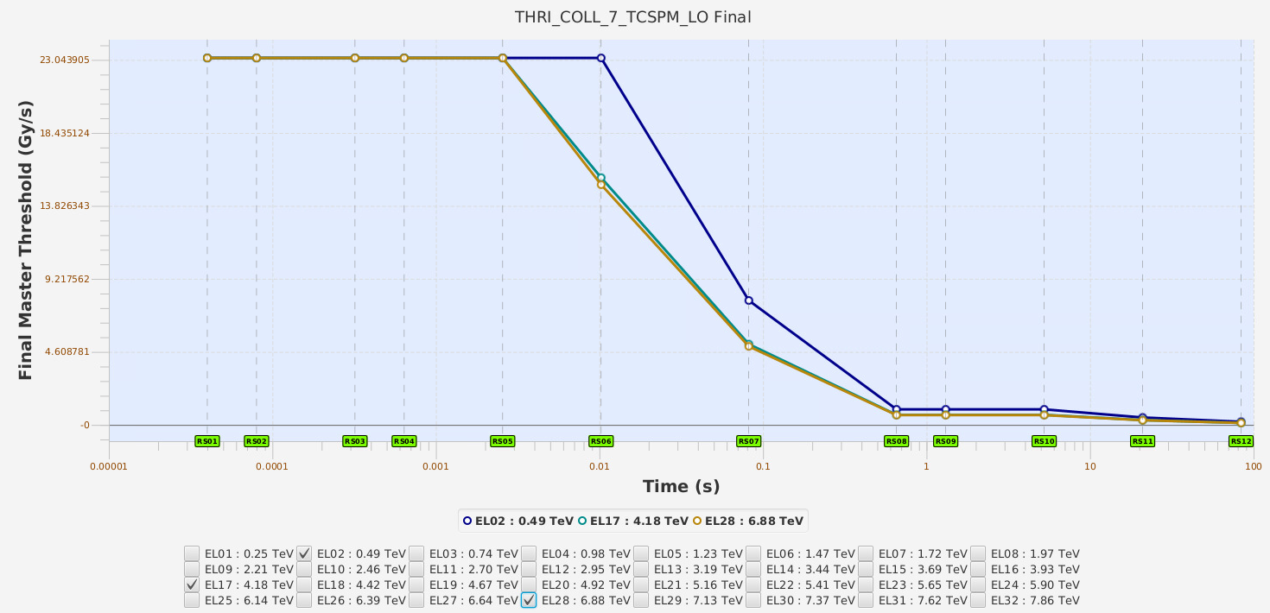
TCSPM families: need a factor between 250 to 100
There are 2 TCSPM families with different response factors: high and low.
Depending on the collimation hierarchy and the loss distribution the limitation comes at injection or at top energy
Factor 250
Factor 100

Slide 18
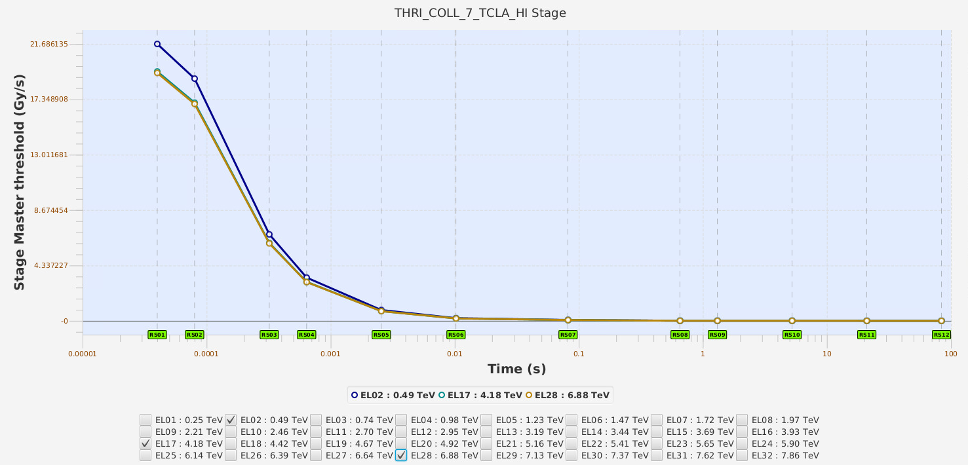
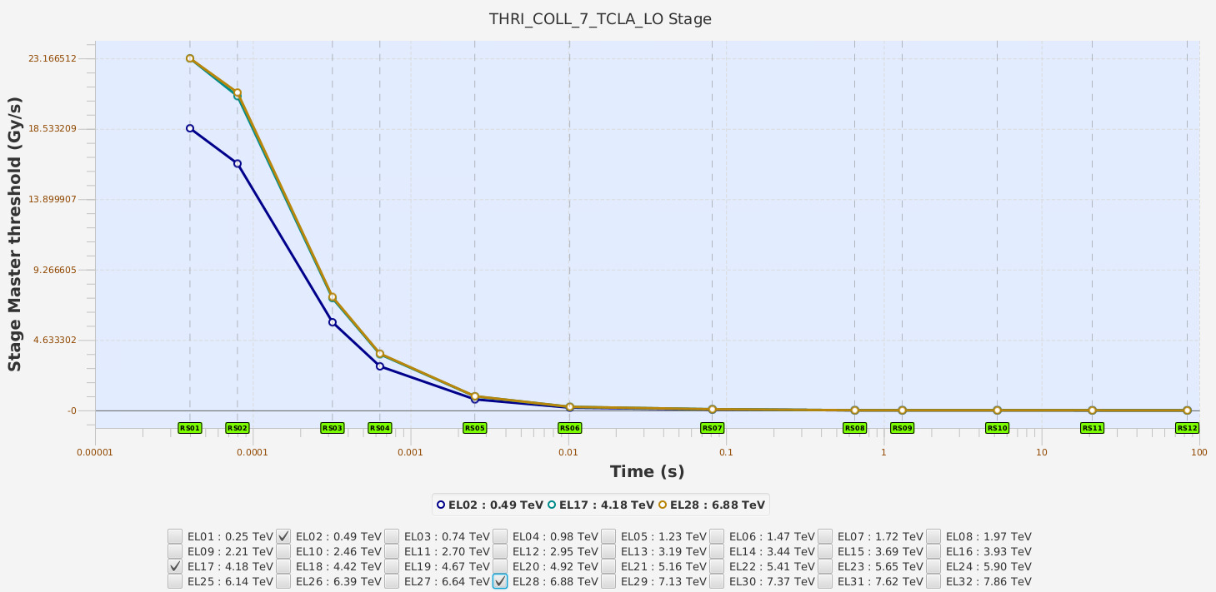
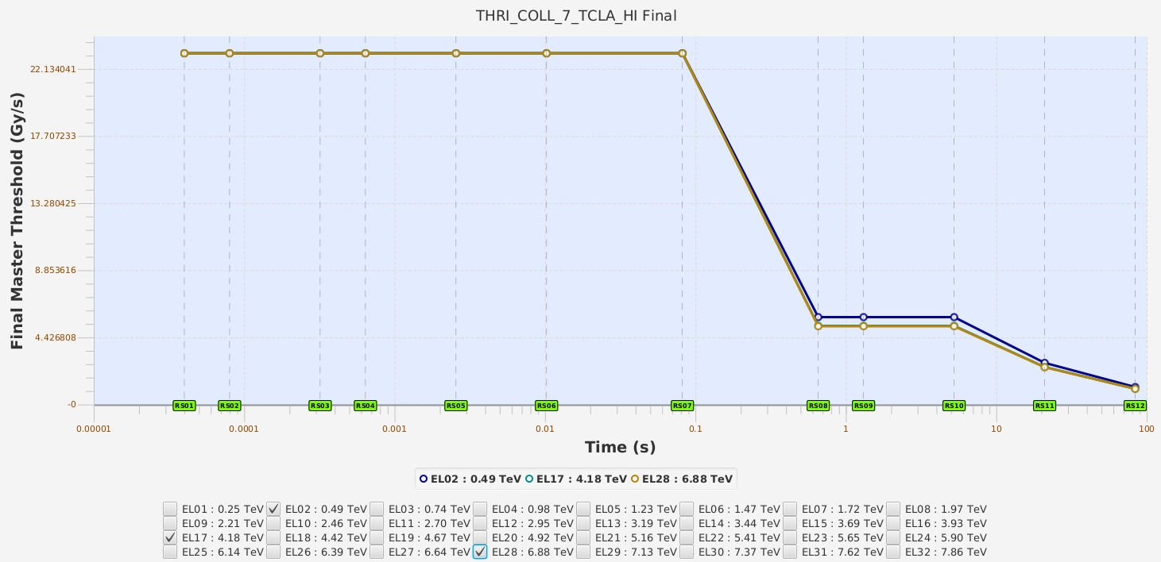
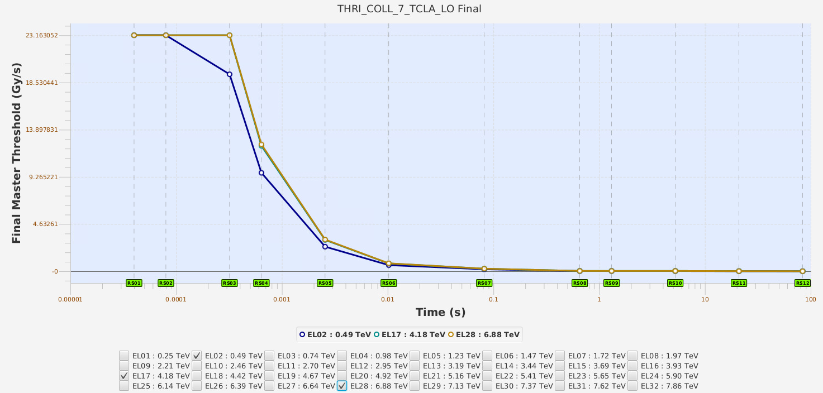
TCLA families: need a factor between 666 to 3.3
There are 2 TCLA families with different response factors: high, medium and low.
Depending on the collimation hierarchy and the loss distribution the limitation comes at injection or at top energy
Factor 666
Factor 3.3

Slide 19
Summary of needed factors for short running sums
Family Name | Factor needed (0.06 D1 correction for TCPs) | Main Limit
THRI_COL_7_TCPPM [4] | 100/0.06 = 1700 | Injection
THRI_COLL_7_TCP [2] | 100/0.06 = 1700 | Injection
THRI_COLL_7_TCSG_HI [2] | 333 | Top Energy
THRI_COLL_7_TCSG_ME [8] | 200 | Top Energy/Inj
THRI_COLL_7_TCSG_LO [11] | 111 | Injection
THRI_COLL_7_TCSPM_HI [2] | 250 | Top Energy
THRI_COLL_7_TCSPM_LO [2] | 100 | Injection
THRI_COLL_7_TCLA_HI [4] | 666 | Injection
THRI_COLL_7_TCLA_LO [8] | 3.3 | Top Energy
The 3 BLMs installed on the wall mitigate (not solve) this limit for Beam 1 during 2024.
This is a ‘temporal and quick’ solution that could be implemented over YETS, but an upgrade of the BLM system needs to be considered.
The beam loss specifications for HL-LHC need to be reviewed.

Slide 20
Draft plan
Review of beam loss specifications, transition from LHC to HL-LHC
Find overall the margin needed for IR7 (IR3)
Tentative timeline:
  Response studies between IC and LIC starting this year (June 2024 - Technical Student)
  Design of new prototype (2025-2028)
  Production of new detectors (not before 2029)

Slide 21
Conclusion
The usage of the IC BLM installed over EYETS on the passage wall seems to be the best option to mitigate the problem of the BLM signal saturation during injection.
They do not fully solve the problem but the provide more margin for injection losses:
For Horizontal: loss saturation above 3.0e10 p first rom TCP.B WALL
For Skew: loss saturation above 3.4e10 p first from TCLA.B2 WALL
In 2023 the limit was found at 6.8e8 p
Further studies are needed to finish the preparation of the threshold and to take a decision on the BLM upgrades in IP7.
A plan is being draft aiming for a new detector after LS3.

