Slide 1
Sensitivity, response and thresholds; first experience during scrubbing and intensity ramp up
17/04/2024
Sara Morales, Belen Salvachua on behalf of the SY-BI-BL section and BLMTWG
Joint MPP, LHC Collimation WG and BLMTWG

Slide 2
Outline
Sensitivity of new detectors in the wall (RS09)
  Top energy
  Injection energy/scrubbing
Losses during injection (RS01 and RS09)
New response factors from betatron lossmaps (RS09)
New BLM thresholds families

Slide 3
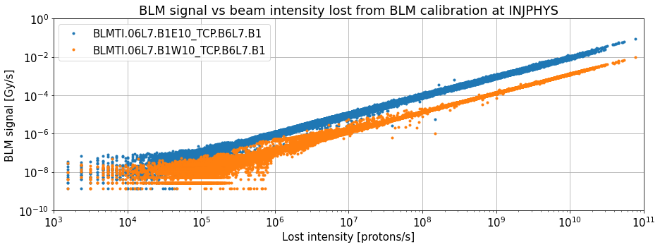
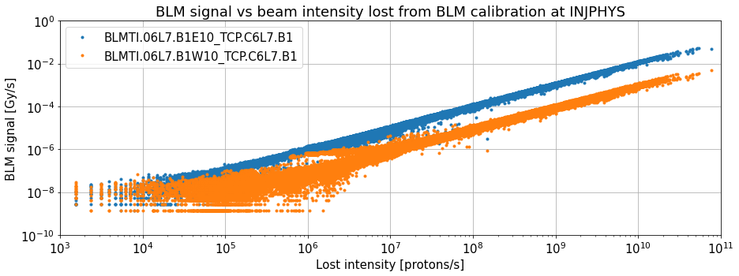
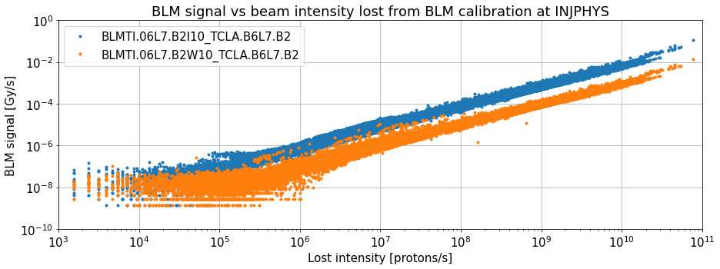
Sensitivity of new detectors on the wall
Comparison of signal of “wall” and “old” BLM vs lost intensity from BLM calibration
INJPHYS beam modes a minimum of 1e12 protons per beam in the machine (scrubbing included)
5e9 - pilot
5e9 - pilot
In all cases signal in new BLMs visible from at least losses around 1e6 protons/s
5e9 - pilot

Slide 4
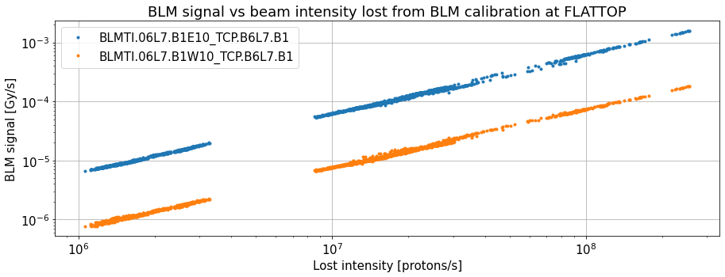
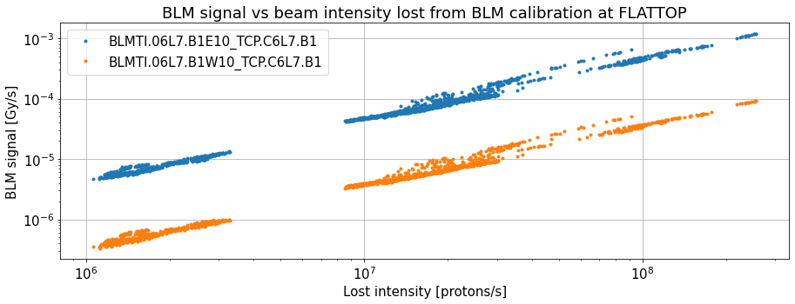
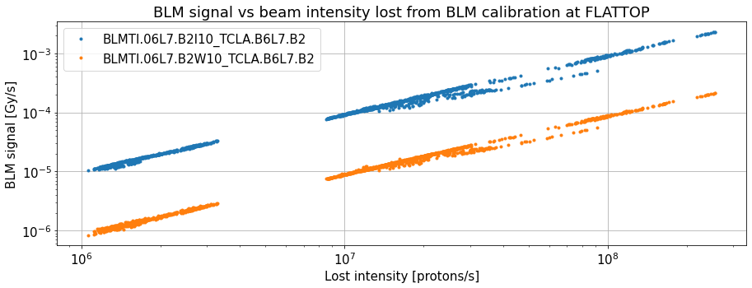
Sensitivity of new detectors on the wall
Comparison of signal of “wall” and ”old” BLM vs lost intensity from BLM calibration
FLATTOP beam modes with a minimum of 1e12 protons per beam in the machine (intensity ramp-up from 12 bunches included)
In all cases signal in new BLMs visible from losses well below 1e6 protons/s

Slide 5
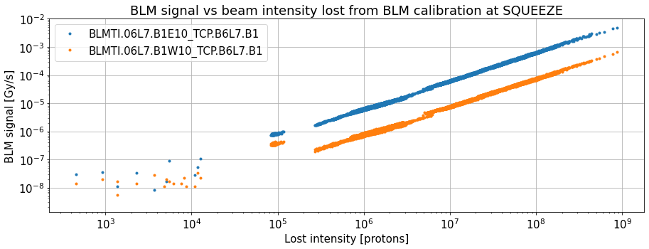
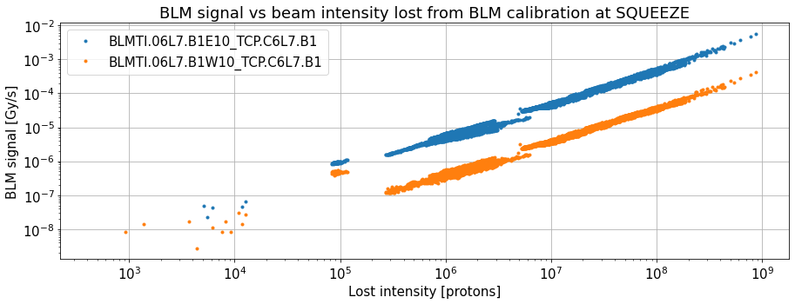
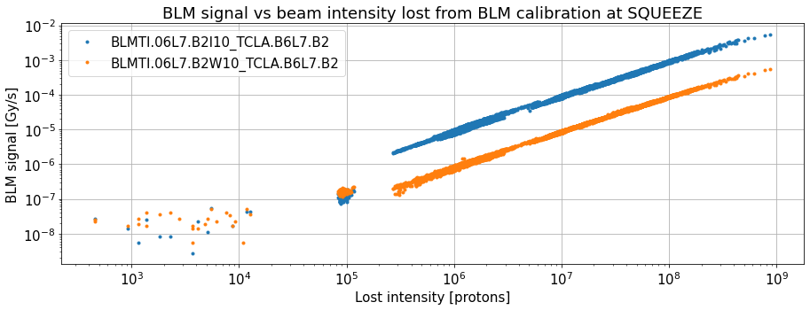
Sensitivity of new detectors on the wall
Comparison of signal of “wall” and ”old” BLM vs lost intensity from BLM calibration
SQUEEZE beam modes with a minimum of 1e12 protons in the machine (intensity ramp-up from 12 bunches included)
Signal in red circle corresponding to minutes after a beam dump in which beam mode was not changed -> mix of residual radiation and signal noise
Removed for next slide
In all cases signal in new BLMs visible from losses around 3e5 protons/s

Slide 6
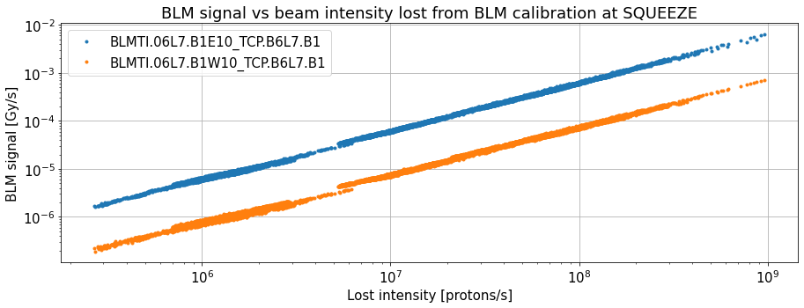
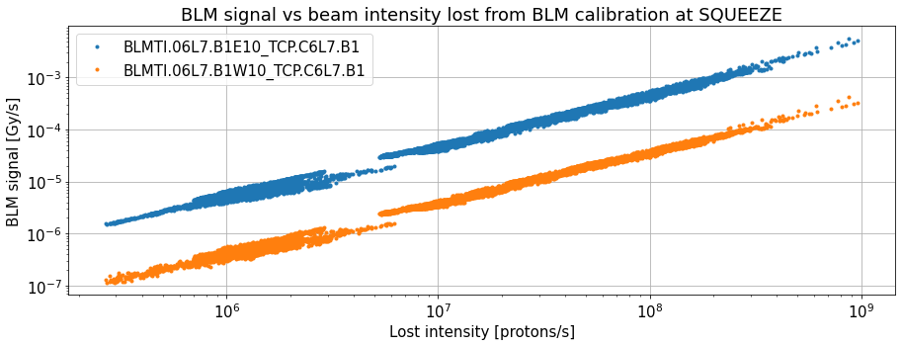
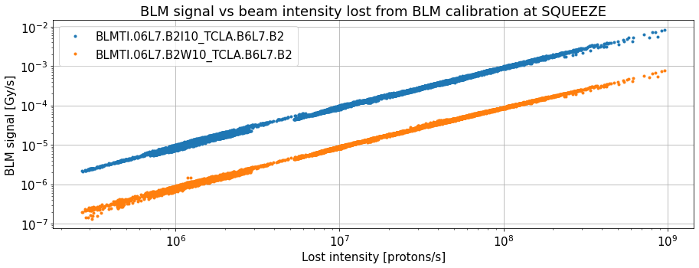
Sensitivity of new detectors on the wall
Comparison of signal of “wall” and ”old” BLM vs lost intensity from BLM calibration
SQUEEZE beam modes with a minimum of 1e12 protons in the machine (intensity ramp-up from 12 bunches included)
500kW -> 5.8e11 protons/s
Good sensitivity around 6 orders of magnitude below max loss allowed for RS09
In all cases signal in new BLMs visible from losses around 3e5 protons/s

Slide 7
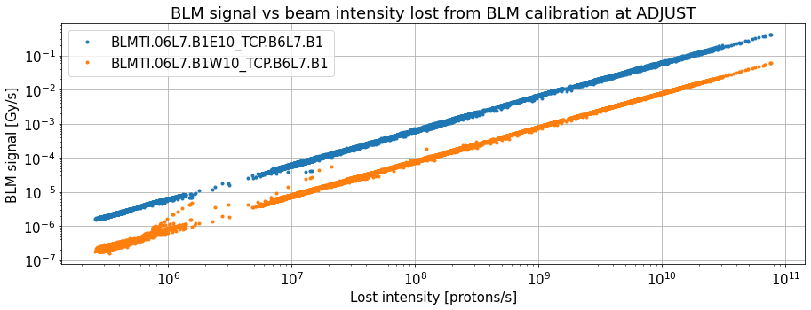
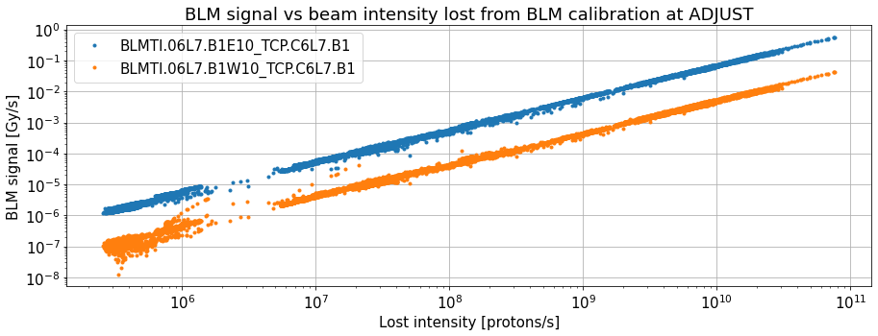
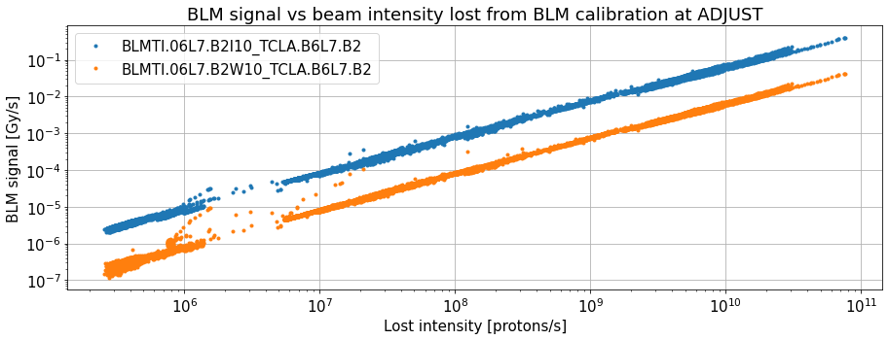
Sensitivity of new detectors on the wall
Comparison of signal of “wall” and ”old” BLM vs lost intensity from BLM calibration
ADJUST beam modes with a minimum of 1e12 protons in the machine (intensity ramp-up from 12 bunches included)
500kW -> 5.8e11 protons/s
Good sensitivity around 6 orders of magnitude below max loss allowed for RS09
In all cases signal in new BLMs visible from losses around 3e5 protons/s

Slide 8
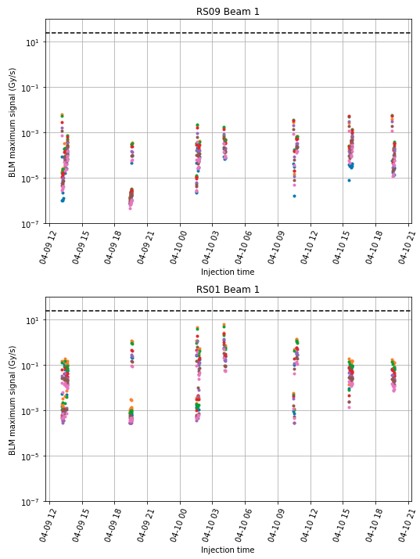
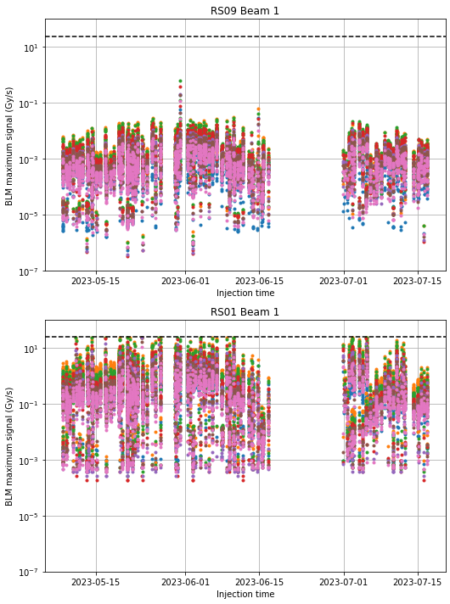
Losses during injection
2024
2023

Slide 9
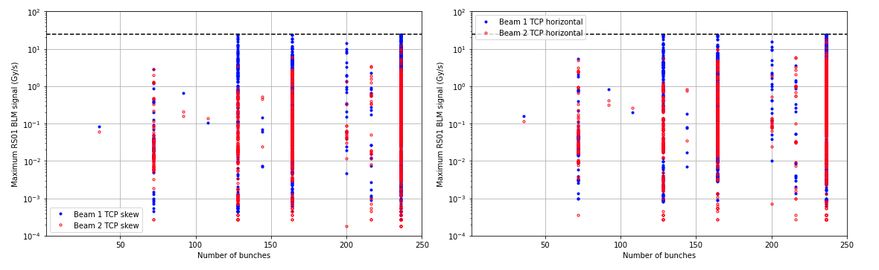
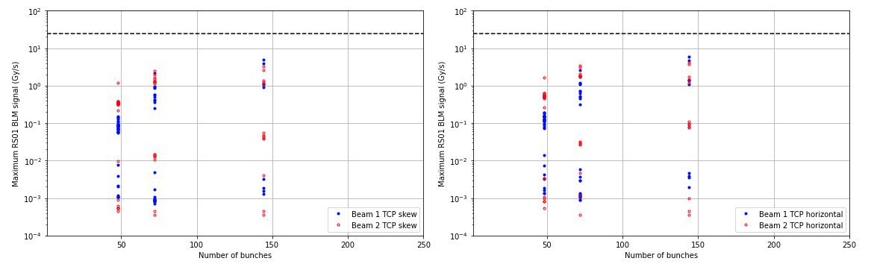
Maximum loss vs number of bunches
2023
2024

Slide 10
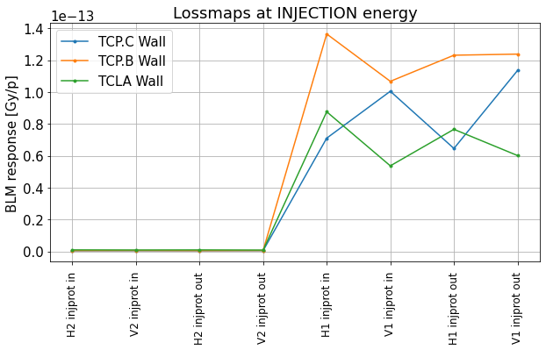
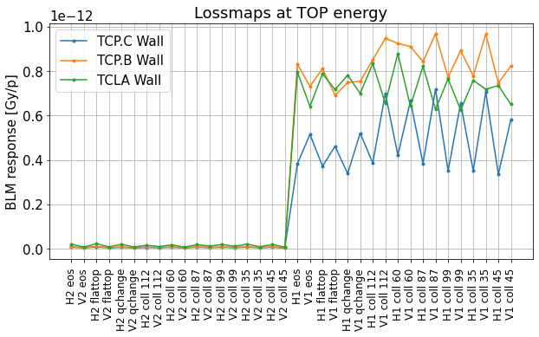
Response from lossmaps for new detectors in the wall
Response analyzed from 2024 betatron lossmaps with final collimation settings at:
  INJECTION: INJPROT IN and OUT
  TOP energy: FLATTOP, EOS, QCHANGE, and during collisions with 6 different beta star values
  Reduction in response consistent with primary observations by Belen
Response for B2 losses much lower -> We keep only B1 lossmaps

Slide 11
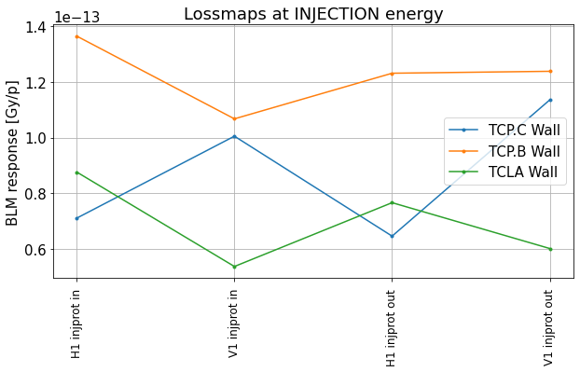
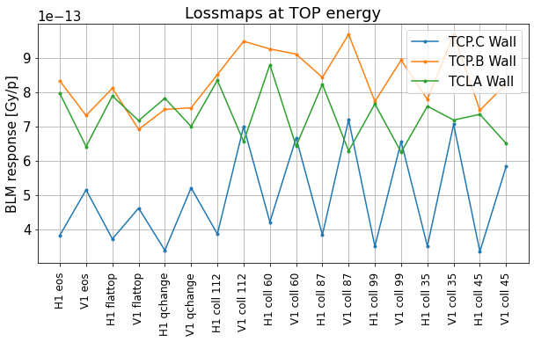
Response from lossmaps for new detectors in the wall
Response analyzed from 2024 betatron lossmaps with final collimation settings at:
  INJECTION: INJPROT IN and OUT
  TOP energy: FLATTOP, EOS, QCHANGE, and during collisions with 6 different beta star values
  Reduction in response consistent with primary observations by Belen
We keep only the maximum from each set of B1 lossmaps

Slide 12
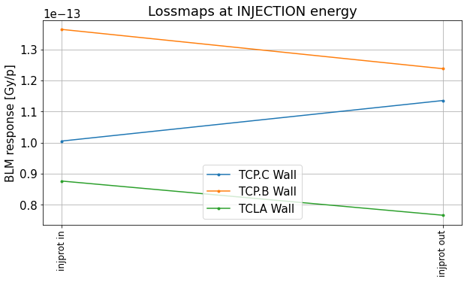
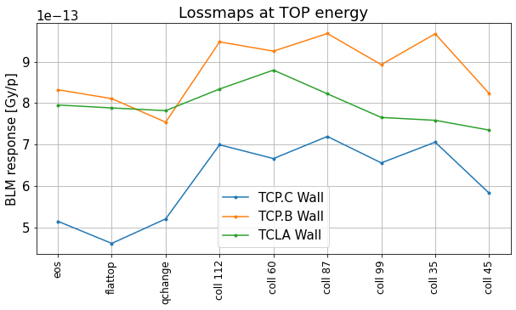
Response from lossmaps for new detectors in the wall
Response analyzed from 2024 betatron lossmaps with final collimation settings at:
  INJECTION: INJPROT IN and OUT
  TOP energy: FLATTOP, EOS, QCHANGE, and during collisions with 6 different beta star values
  Reduction in response consistent with primary observations by Belen
We compute the mean for INJECTION and TOP separately, convert to aC/p and do a linear fit with energy to get response curve

Slide 13
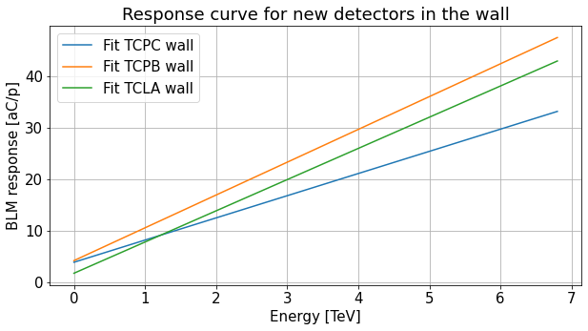
Response from lossmaps for new detectors in the wall
Response analyzed from 2024 betatron lossmaps with final collimation settings at:
  INJECTION: INJPROT IN and OUT
  TOP energy: FLATTOP, EOS, QCHANGE, and during collisions with 6 different beta star values
  Reduction in response consistent with primary observations by Belen

Slide 14
Proposal of BLM thresholds families for detectors in the wall
Family Name | 2022 loss map values per proton [aC, aC/TeV] | Family Name | 2024 loss map values per proton [aC, aC/TeV] | Ratio 2024 / 2022 [offset, slope]
THRI_COL_7_TCPPM | [66,44] | THRI_COLL_7_TCPPM_WALL | [3.8, 4.3] | [0.06,0.098]
THRI_COLL_7_TCP | [ 49, 47 ] | THRI_COLL_7_TCP_WALL | [4.2, 6.4] | [0.09,0.14]
THRI_COLL_7_TCLA_HI | [ 6, 88 ] | THRI_COLL_7_TCLA_HI_WALL | [1.7, 6.1] | [0.3,0.07]
Maximum allowed power loss from loss maps WITHOUT these BLMs:
H1 : 322.5 kW
V1 : 309.8 kW

Slide 15
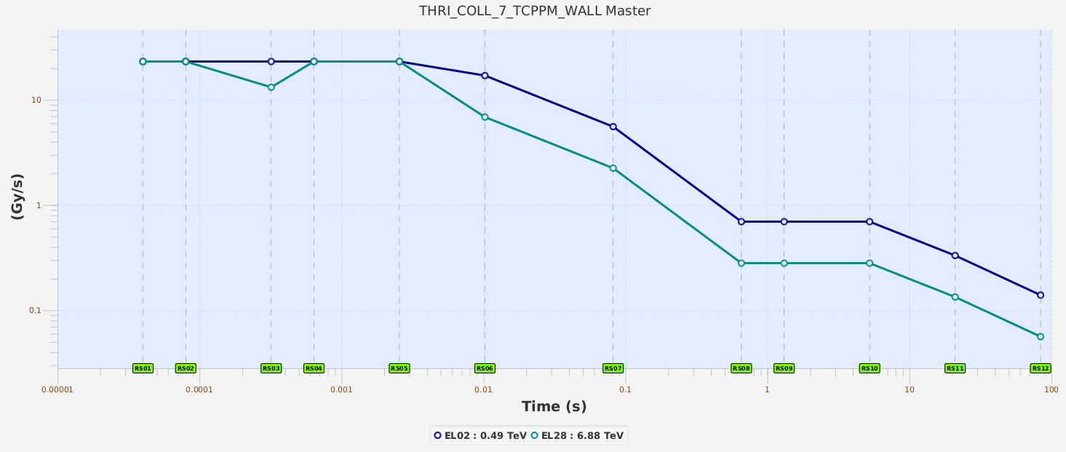
Proposal of BLM thresholds families for detectors in the wall
Master thresholds for TCP.C Wall at injection and top energy

Slide 16
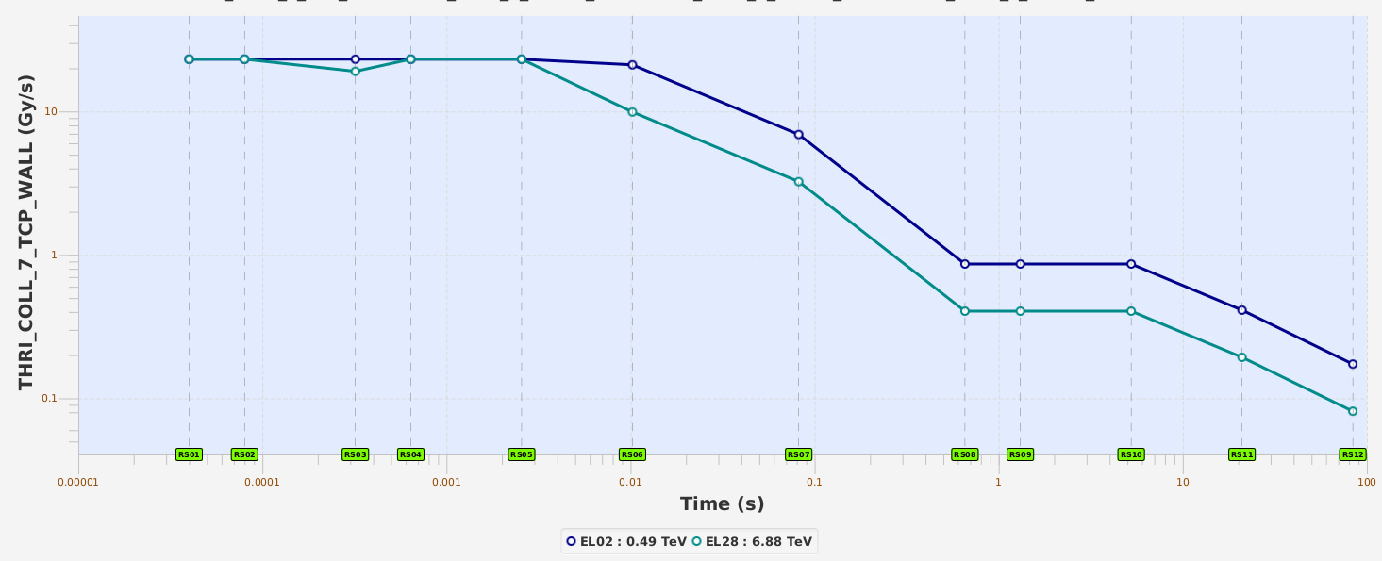
Proposal of BLM thresholds families for detectors in the wall
Master thresholds for TCP.B Wall at injection and top energy

Slide 17
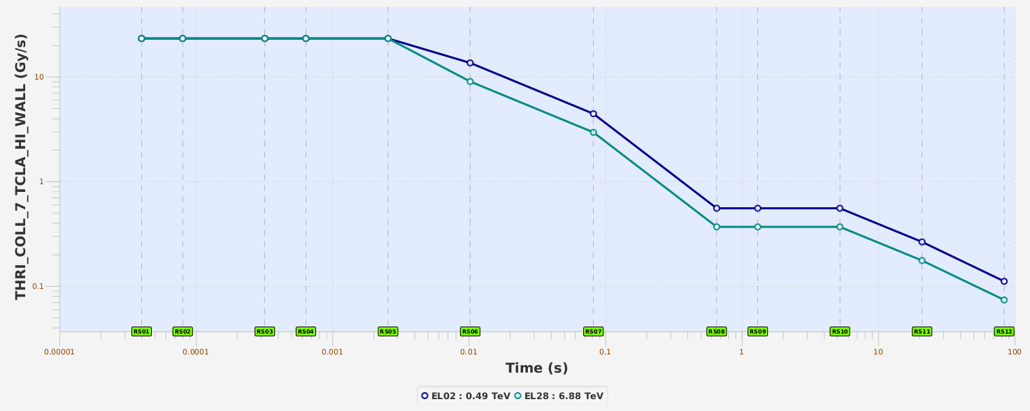
Proposal of BLM thresholds families for detectors in the wall
Master thresholds for TCLA.B Wall at injection and top energy

Slide 18
Conclusions
Sensitivity of new BLMs in the wall:
  Injection: capable of observing losses from 1e6 protons/s
  Top Energy: capable of observing losses below 3e5 protons/s
Beam losses at injection seem to be of similar order than in 2023 for 144 bunches
New response factors calculated from loss maps for the 3 new families

