Slide 1


Preparation of SiPMs for Antiproton Gravity Measurements
Elizaveta Gavrilova
Mentor: Ina Carli
August 22nd, 2024

Slide 2
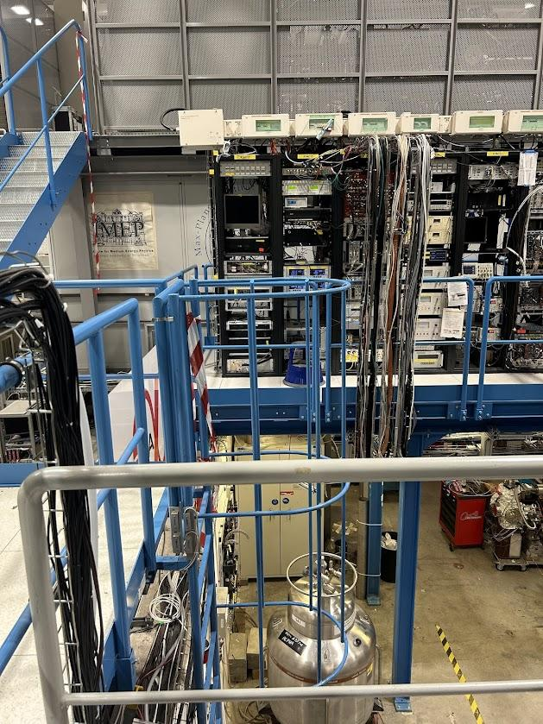
CERN Project
Goals
  Connect scintillators around ALPHA-g to hardware so that they can take data.
  Analyze the count rate that the scintillators detect and compare it to data from 2022 when ALPHA-g was last run.
  Participate in shifts to help with ongoing experiments at ALPHA
Elizaveta Gavrilova (University of Michigan)
1

Slide 3
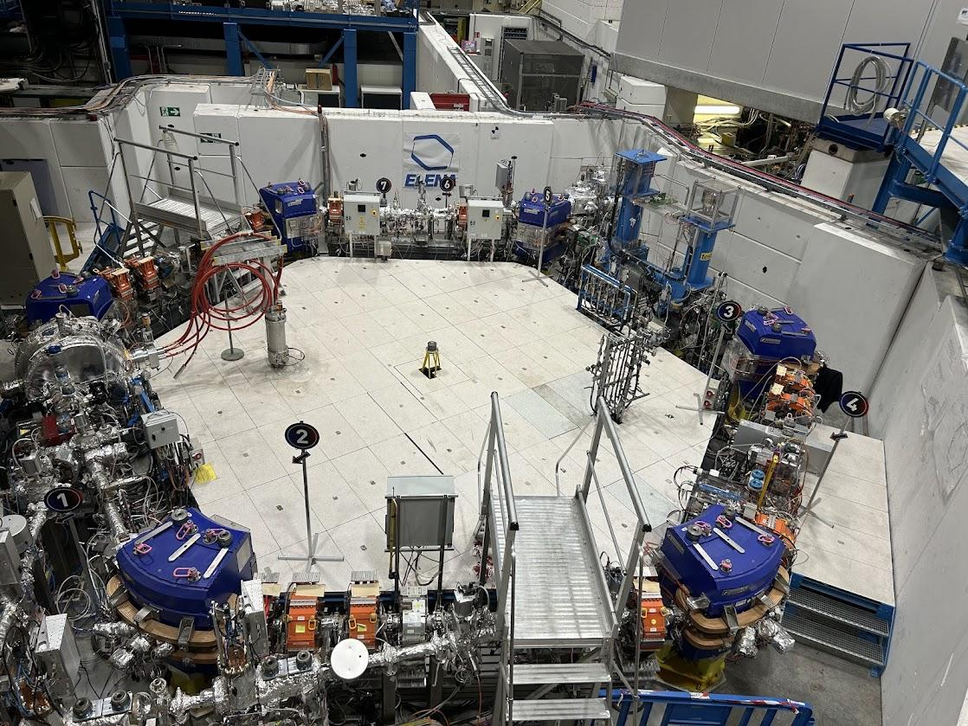
Anti-hydrogen Production At ALPHA
Anti-protons are injected from the Proton Synchrotron and slowed down in the AD and ELENA decelerators
Transferred to ALPHA, further cooled with electron plasma, and combined with cold positrons to create anti-hydrogen!
Anti-hydrogen plasma further cooled with Doppler cooling
Produces about 150 anti-hydrogen per mixing
Elizaveta Gavrilova (University of Michigan)
2

Slide 4
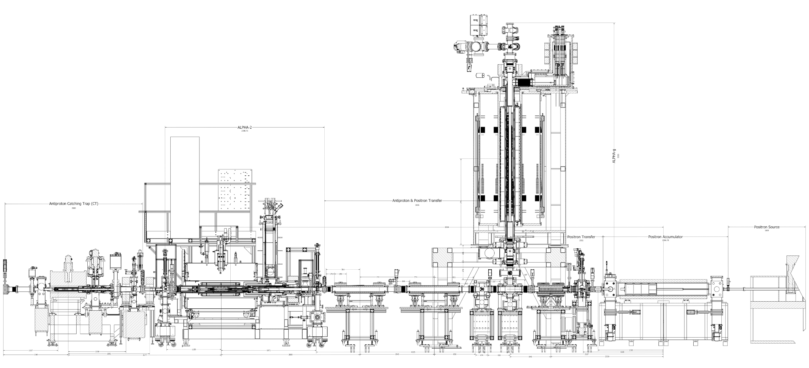
Alpha-g
Goal: measuring the g acceleration of antihydrogen atoms
Antihydrogen released from magnetic wells and annihilate on the walls
  The measurement of g is based on where the antihydrogen annihilates, taking into account the thermal energy of the atoms
Annihilations are detected by scintillators placed around Alpha-g
Elizaveta Gavrilova (University of Michigan)
3

Slide 5
Scintillators
Plastic (polyvinyltoluene) scintillators with Silicon Photomultipliers (SiPMs)
  Charged particle enters scintillator, excites electrons in the atoms. They then fall back to the ground state and release a photon
  Photon is reflected within the scintillator and then arrives at one of the SiPMs, which amplifies the signal
4 rectangular scintillators are positioned around Alpha-g, more will be installed later
  They are used for counting occurrences of annihilations
Purpose
  SiPM A, SiPM D, SiPM F: monitors the mixing triggers
  SiPM E : counts from cold dumps
Elizaveta Gavrilova (University of Michigan)
4

Slide 6
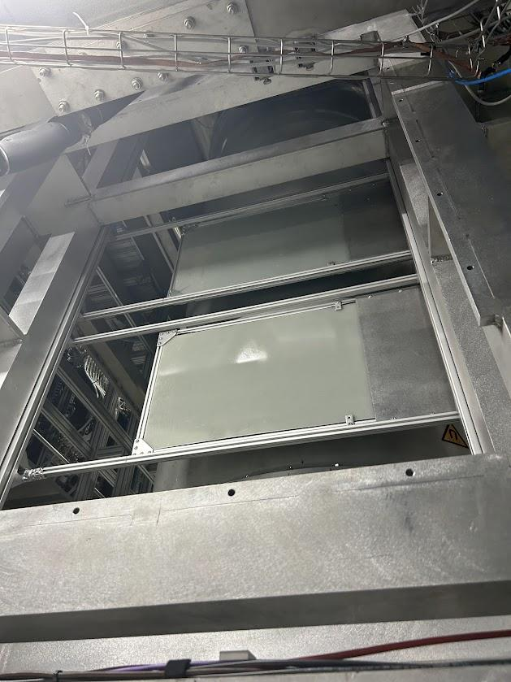
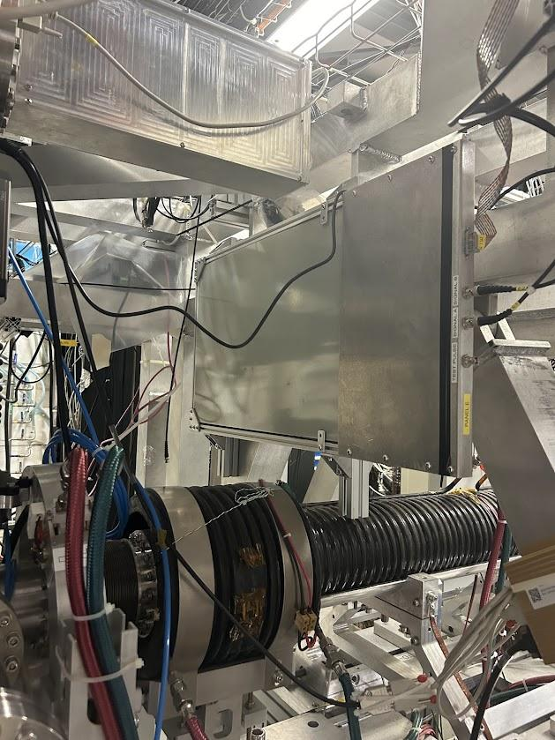
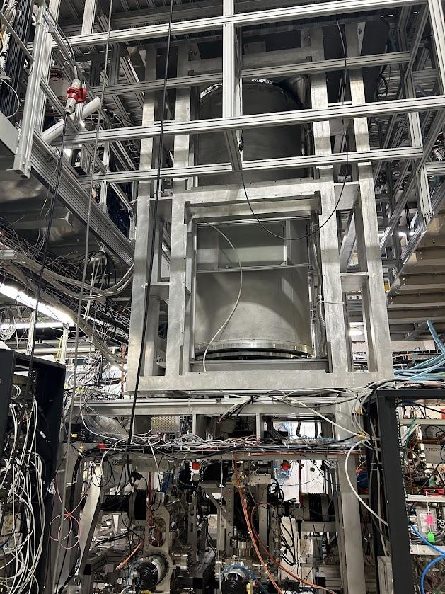
Scintillators
Elizaveta Gavrilova (University of Michigan)
5

Slide 7
Setting Up Hardware

Slide 8
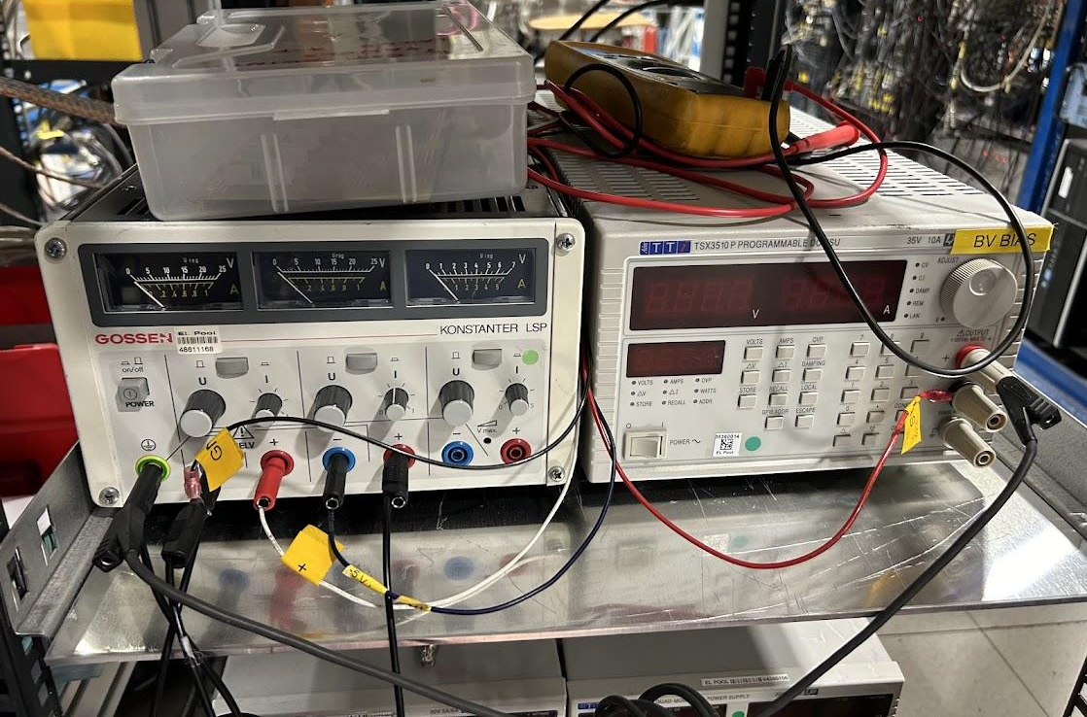
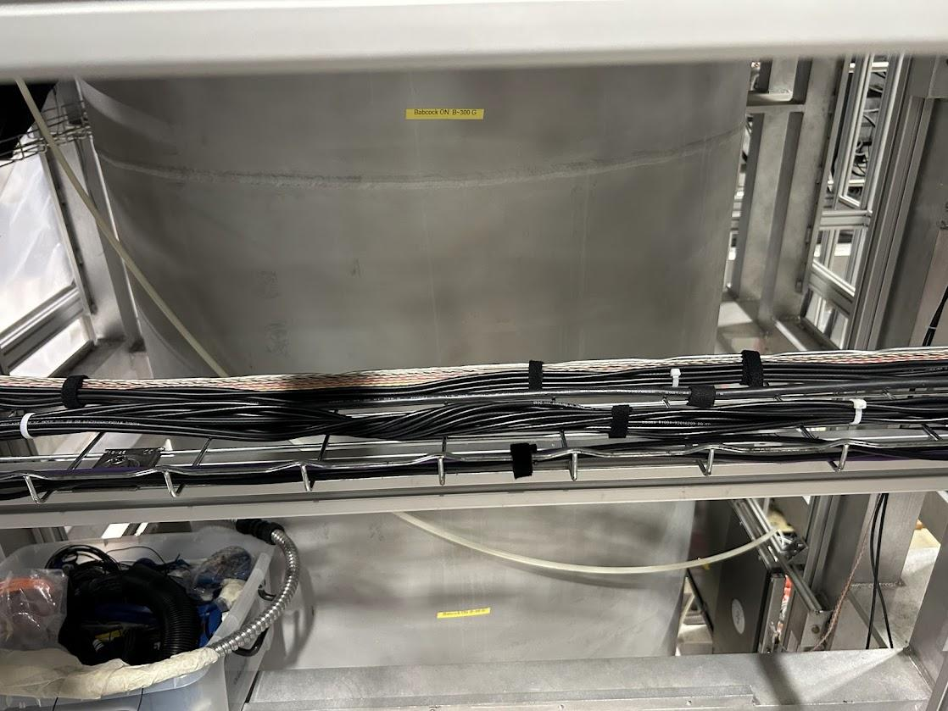
Connecting Hardware
Four scintillators connected to modules
  Two channels + power cables
Set up power supply
Connected cables to monitor the start and stop processes of various parts of ALPHA for time coordination
Elizaveta Gavrilova (University of Michigan)
6

Slide 9
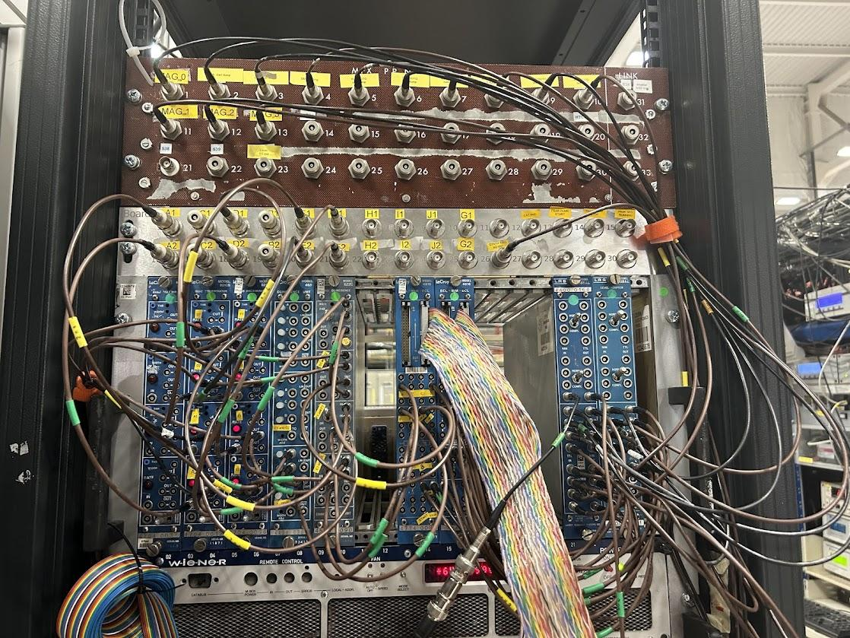
Data received from scintillators using these wires.
Coincidence: Two inputs and two modes. For ‘and’ has to have both inputs send in a true to output a true. For ‘or’, has to have one signal input a true to output a true.
Discriminator: checks that the pulse is at a certain threshold before sending a true (in this case the pulse has to be at least 100 mV to be significant)
Data is then sent to this module and then sent to the counter underneath this shelf.

Slide 10
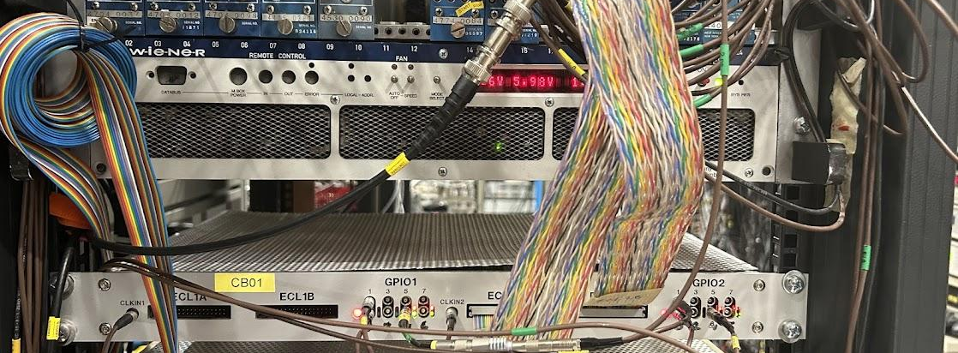
Connecting Hardware
The data from the counter is transmitted to a master computer and compiled with other data in the experiment
  Master computer also sets the time for the experiment
Elizaveta Gavrilova (University of Michigan)
7

Slide 11
Finding the Average Cosmic Count Rate

Slide 12
Objective
Goals
Develop code that took a file of counts from the scintillators, isolated the counts from the cosmic background, and found the average count rate
Suppress spikes from ELENA and AD
Find the average count rate to 3 sigma
Elizaveta Gavrilova (University of Michigan)
8

Slide 13
Procedure
Estimate average by fitting a series of histograms
  Pass 1
    Make a histogram of original data, make a kernel density estimation and fit the result points with a Gaussian distribution
  Pass 2
    Make a cut based on which counts are within 3 sigma of the average
    Make a histogram of original data, make a kernel density estimation and fit the result points with a Gaussian distribution
    Final result is the average of Pass 2 +/- 3 sigma
All of this is compressed into an executable file that takes in a data file and returns a pandas dataframe with all the calculated data.
Elizaveta Gavrilova (University of Michigan)
9

Slide 14
Example: SiPM-A

Slide 15
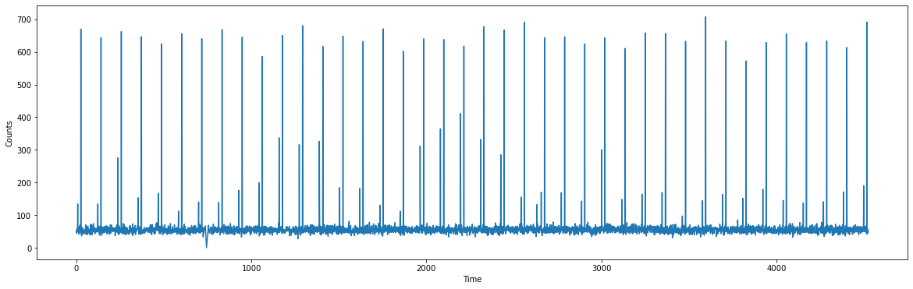
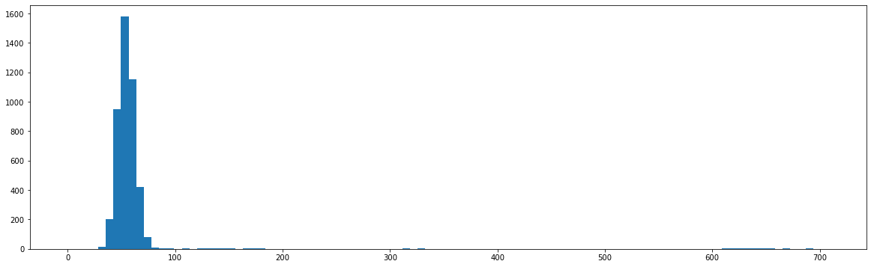
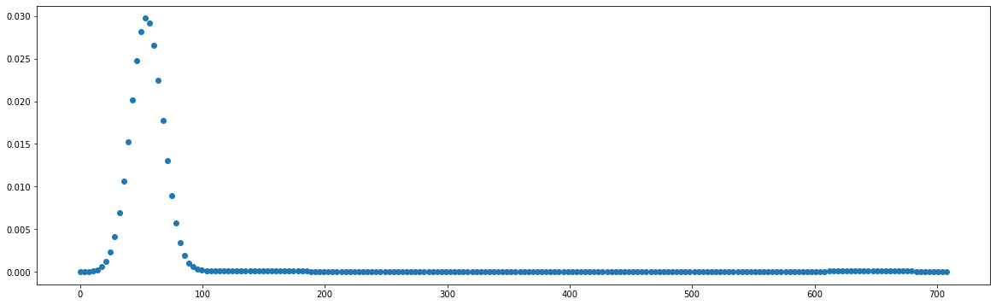
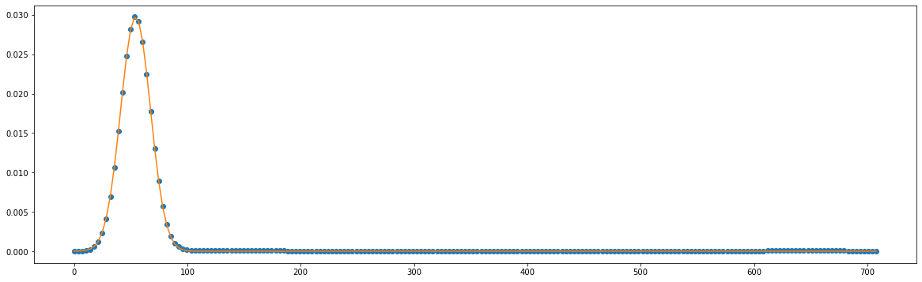
Original data with spikes from AD and ELENA
Using KDE to fit the histogram and fit a Gaussian function to the KDE.
Elizaveta Gavrilova (University of Michigan)
10

Slide 16
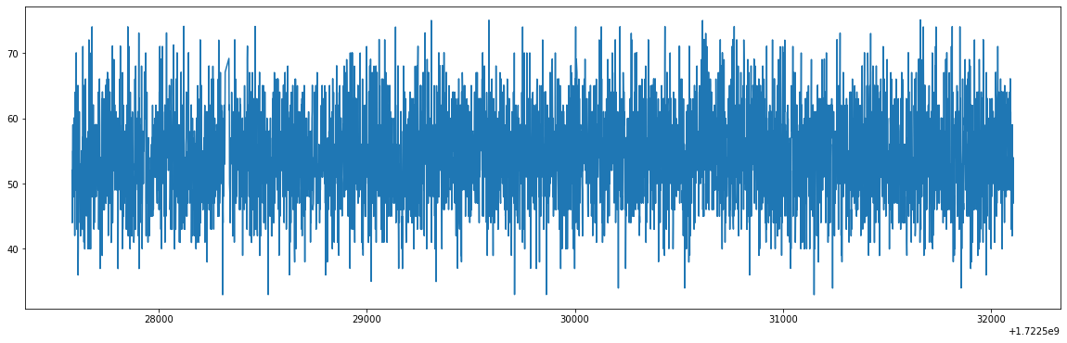
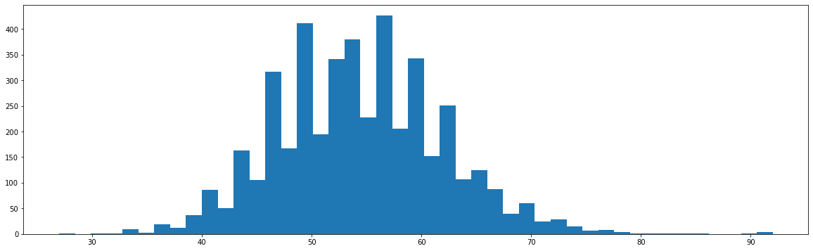
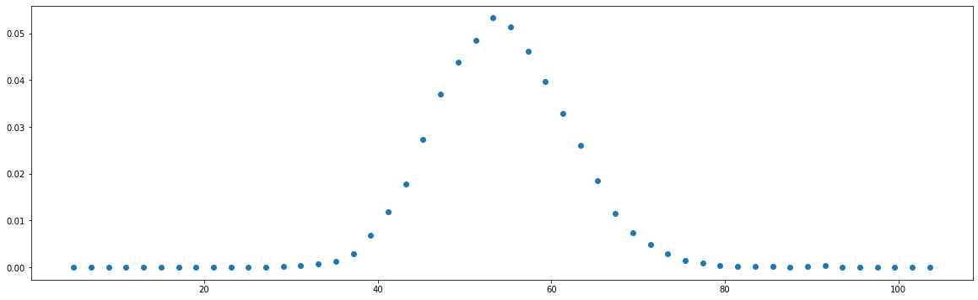
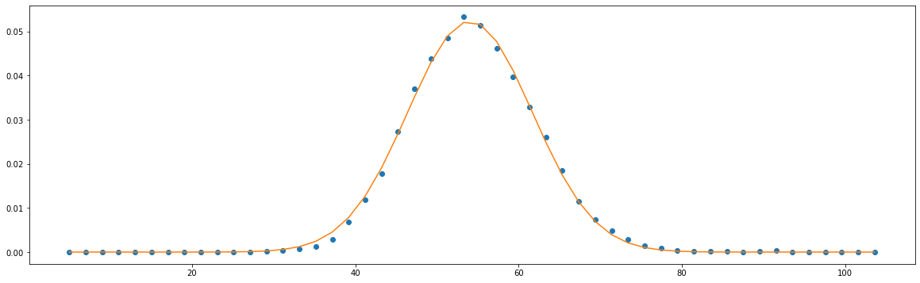
Data without spikes, any count that was not within 3 sigma of the average was removed.
Using KDE to fit the histogram and fit a Gaussian function to the KDE.
Elizaveta Gavrilova (University of Michigan)
11

Slide 17
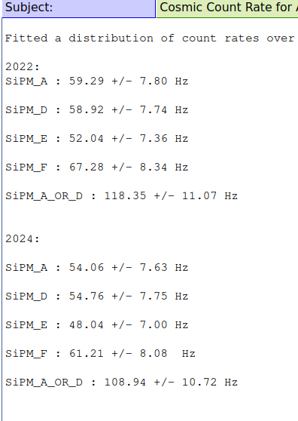
Cosmic Rate Results
Similar within the bounds of the error, so it’s good
About 5-10% decrease in rates between 2022 and 2024, though unsure why
  Age? Different connections?
Elizaveta Gavrilova (University of Michigan)
12

Slide 18
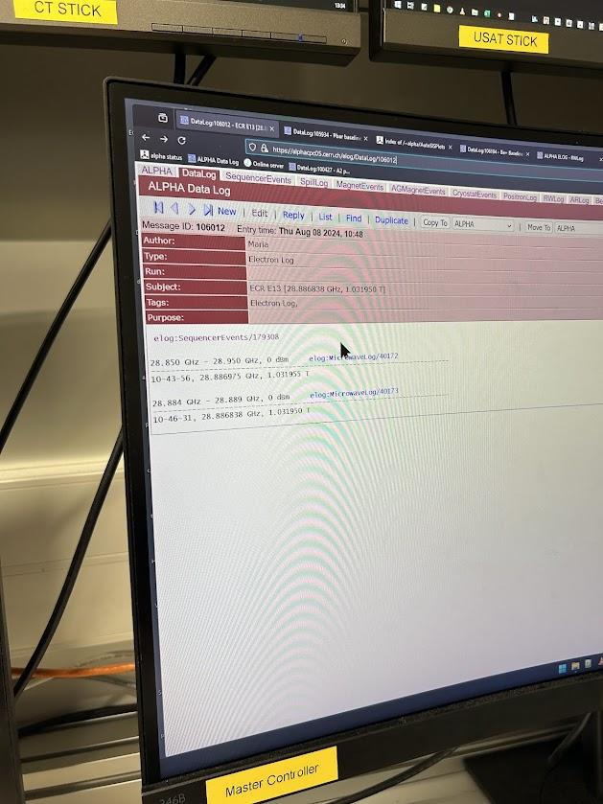
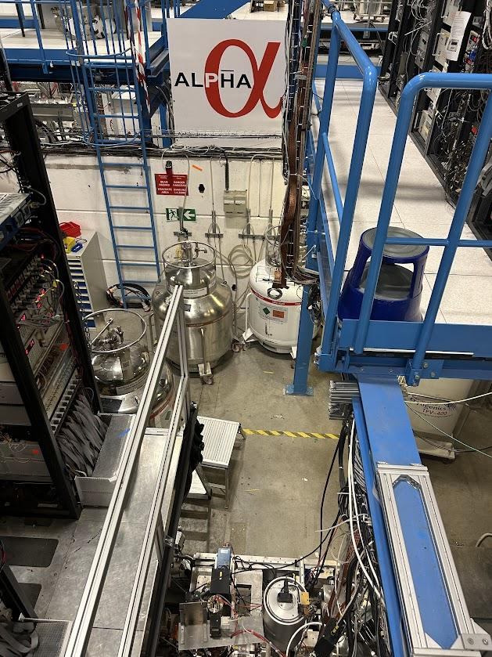
Shift Work
Help with data logging and analysis of ongoing experiments (ALPHA-2)
Hands-on experiences
  Cryogenics
  Unwrapping the ALPHA-g bake
Production of antihydrogen → stacking
Elizaveta Gavrilova (University of Michigan)
13

Slide 19
Future Goals
Cross-calibration with other detectors around ALPHA-g
Ready for gravity measurements in September
Elizaveta Gavrilova (University of Michigan)
14

Slide 20
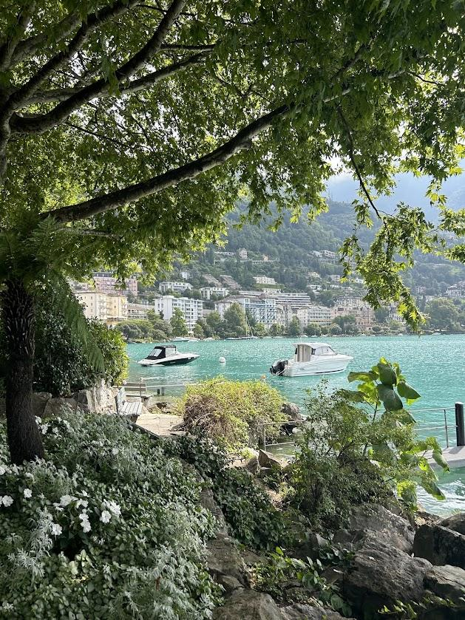
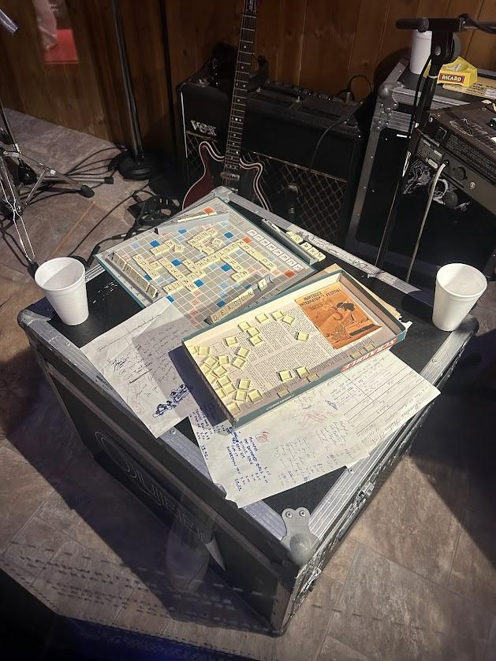
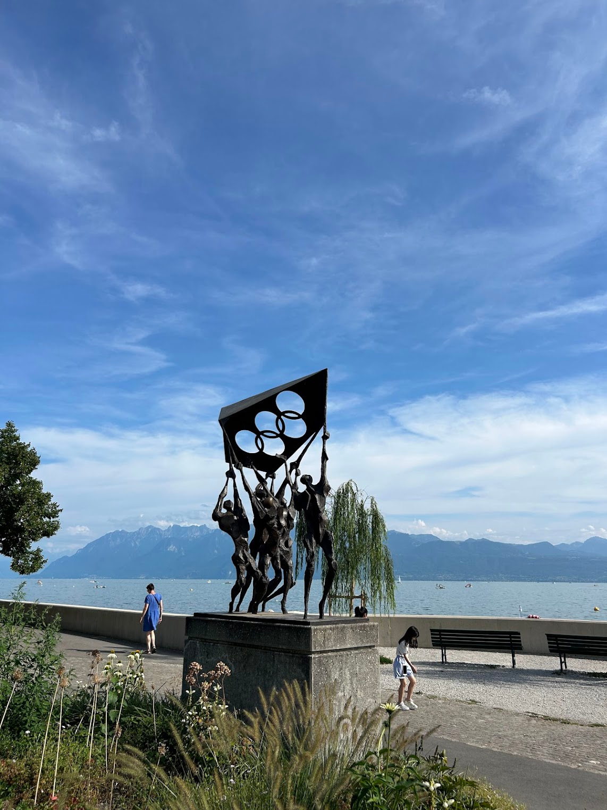
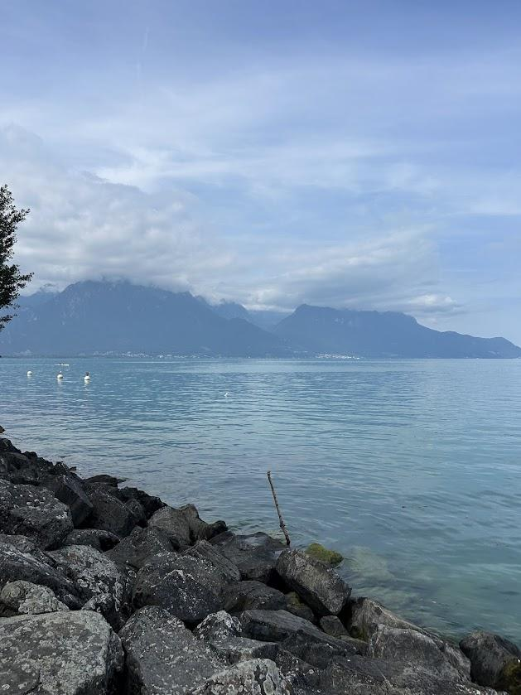
Culture
Lausanne + Montreux

Slide 21
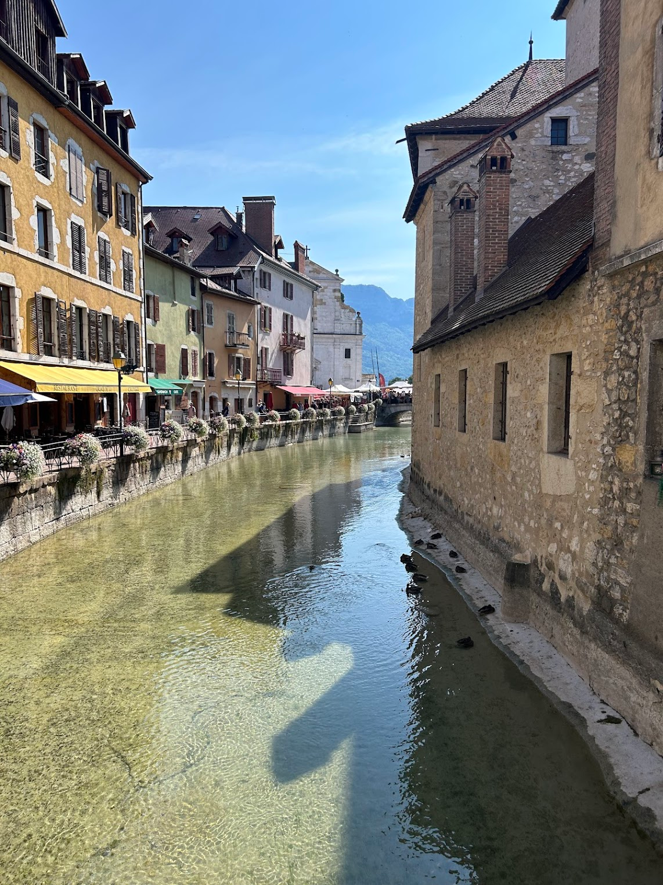
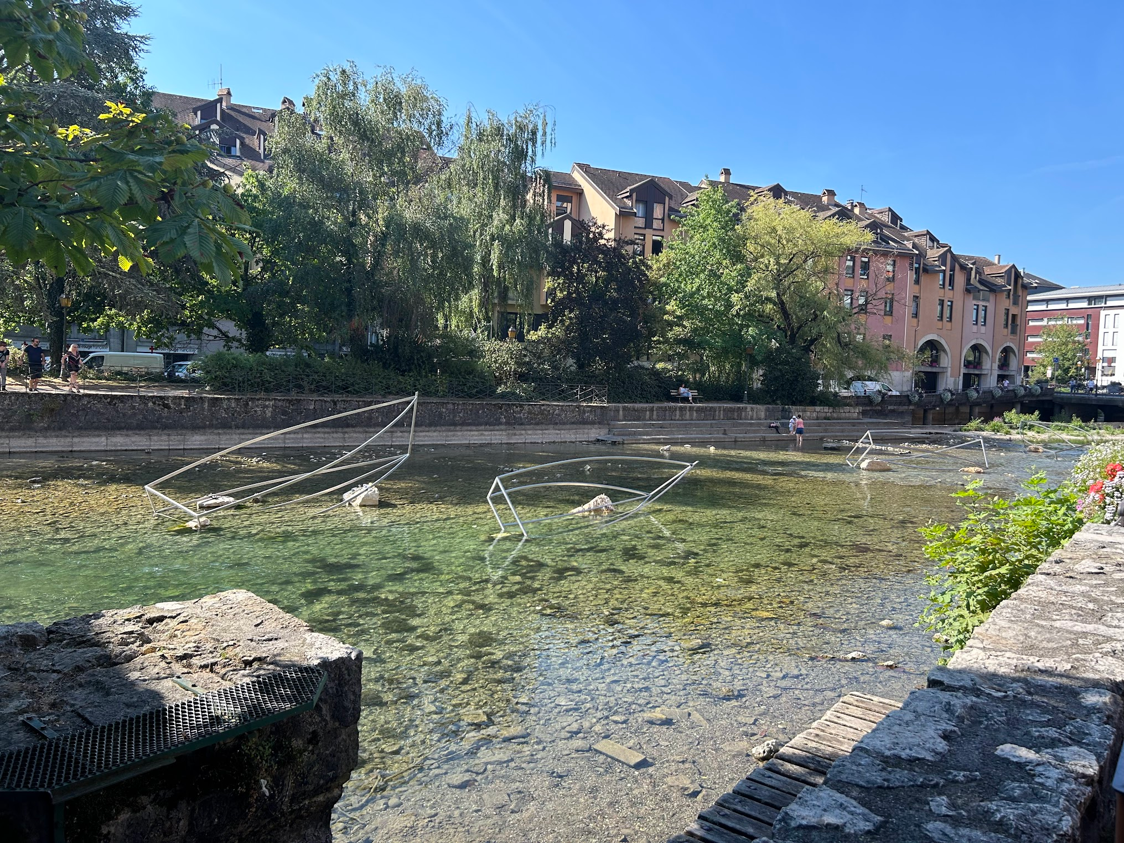
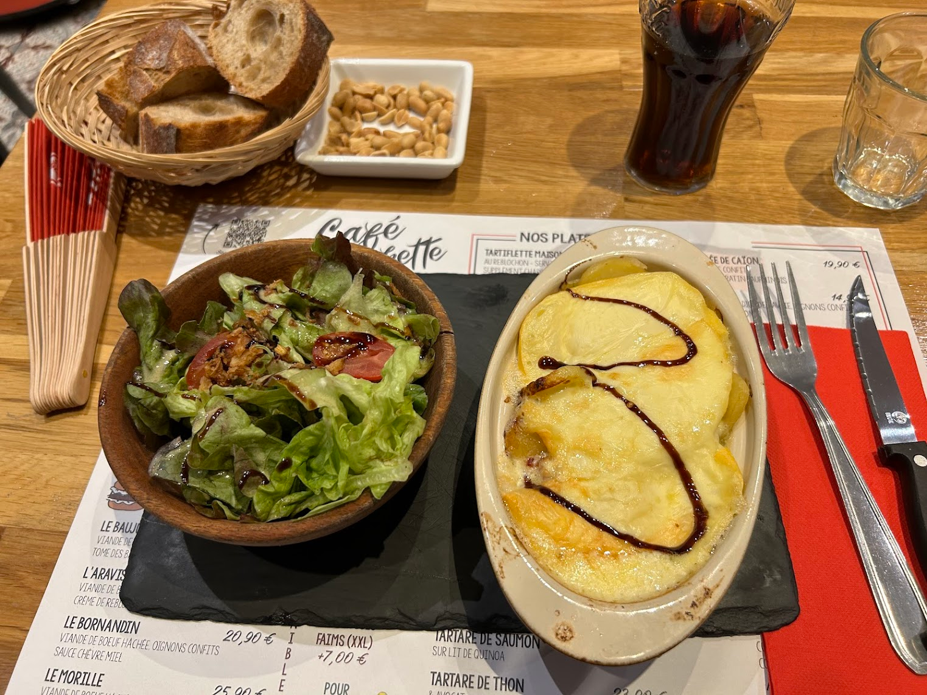
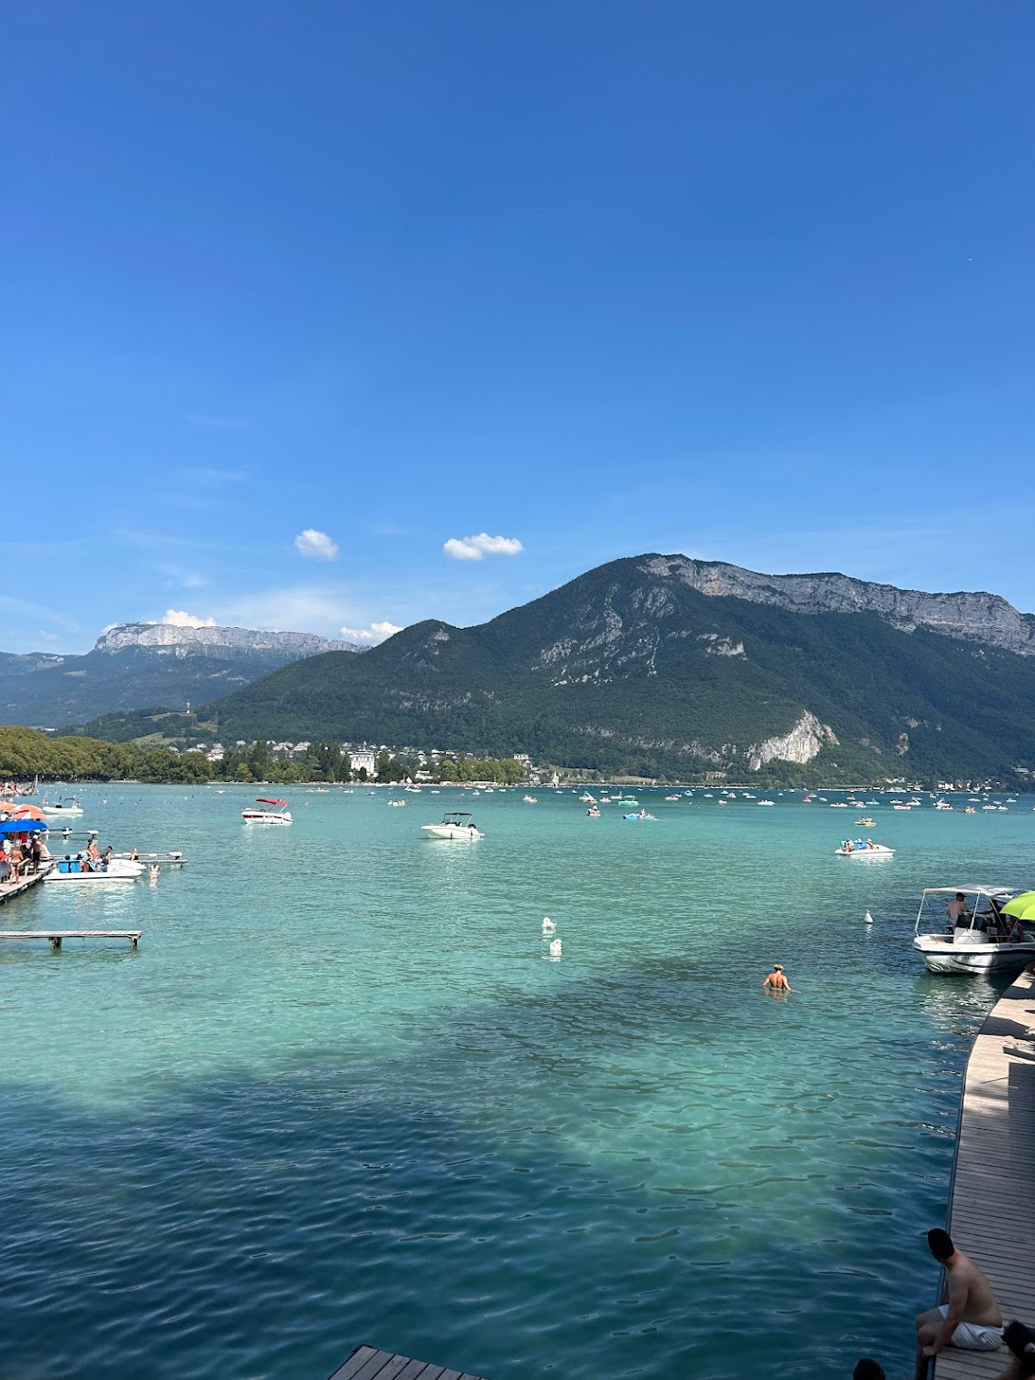
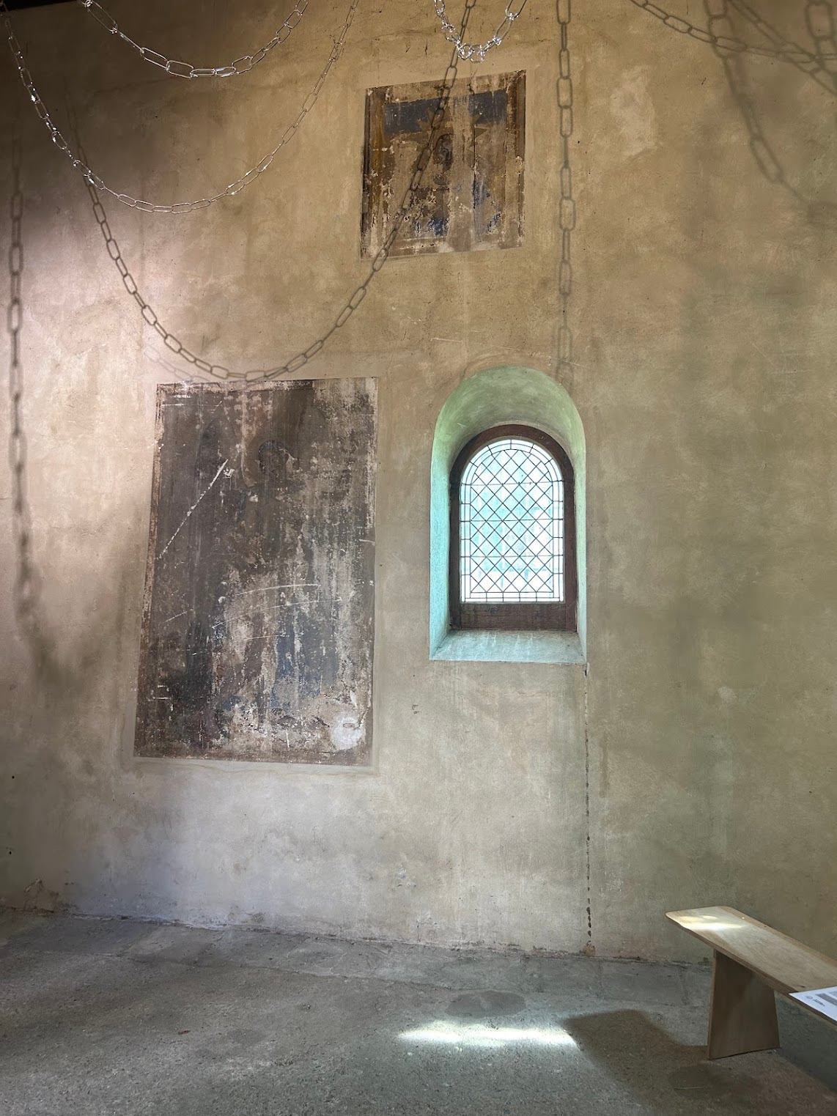
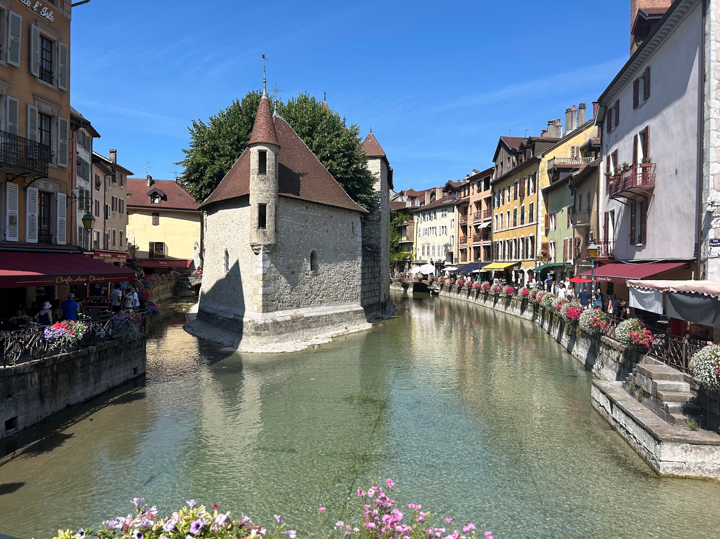
Culture
Annecy

Slide 22
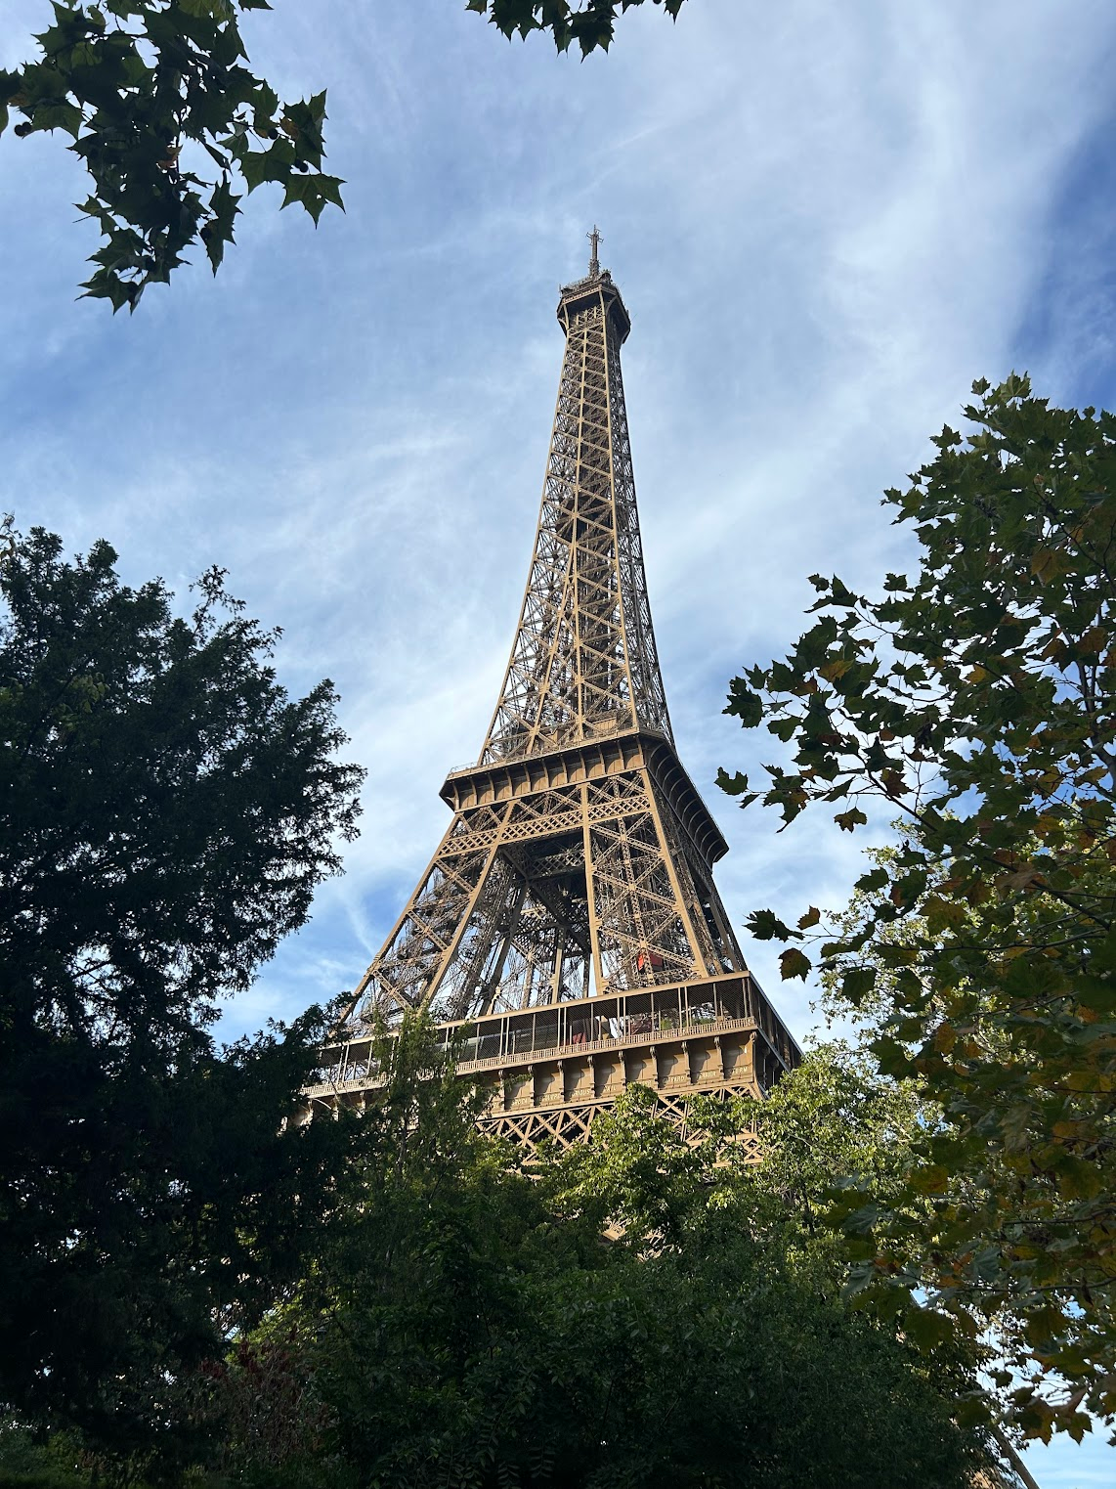
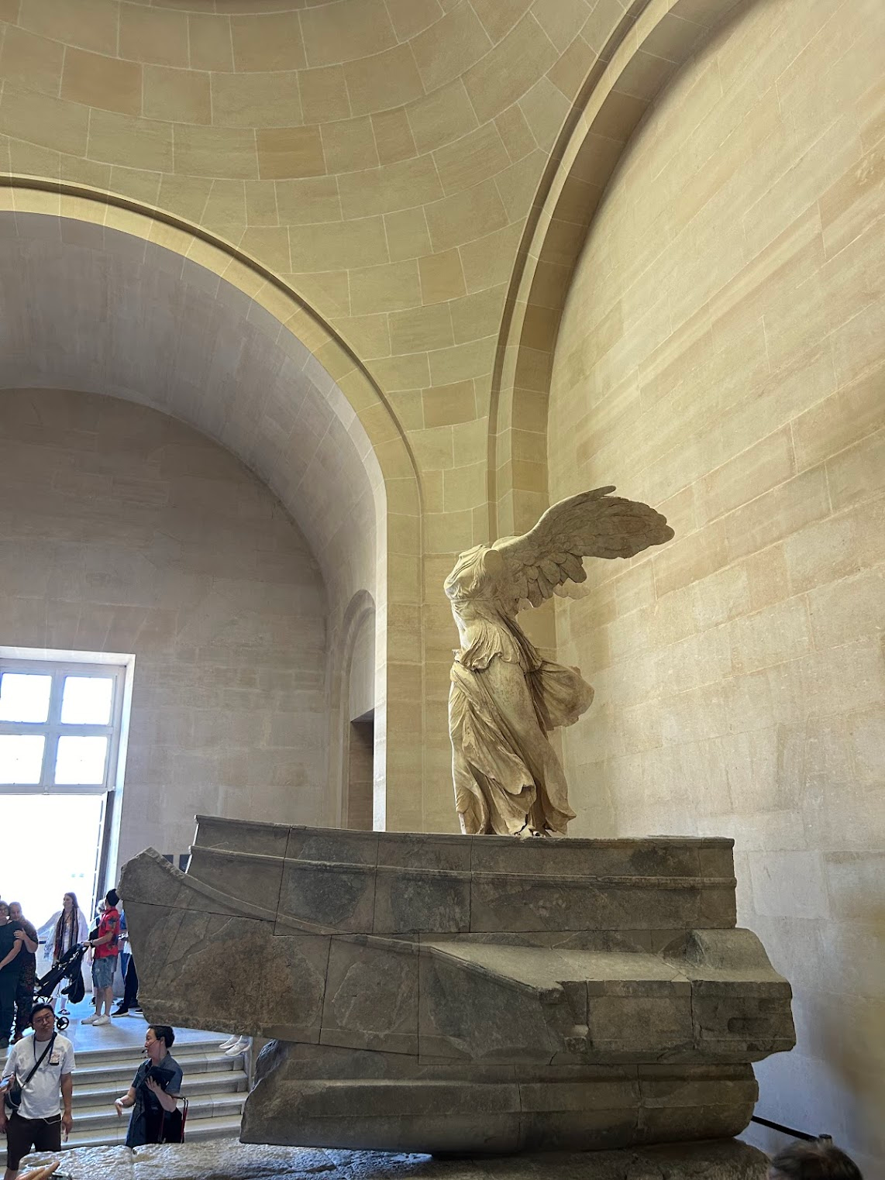
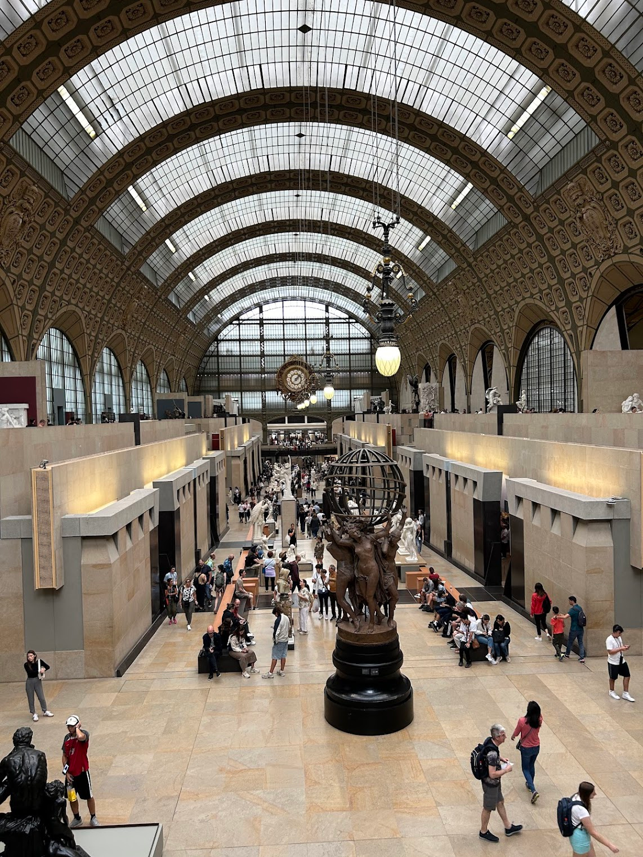
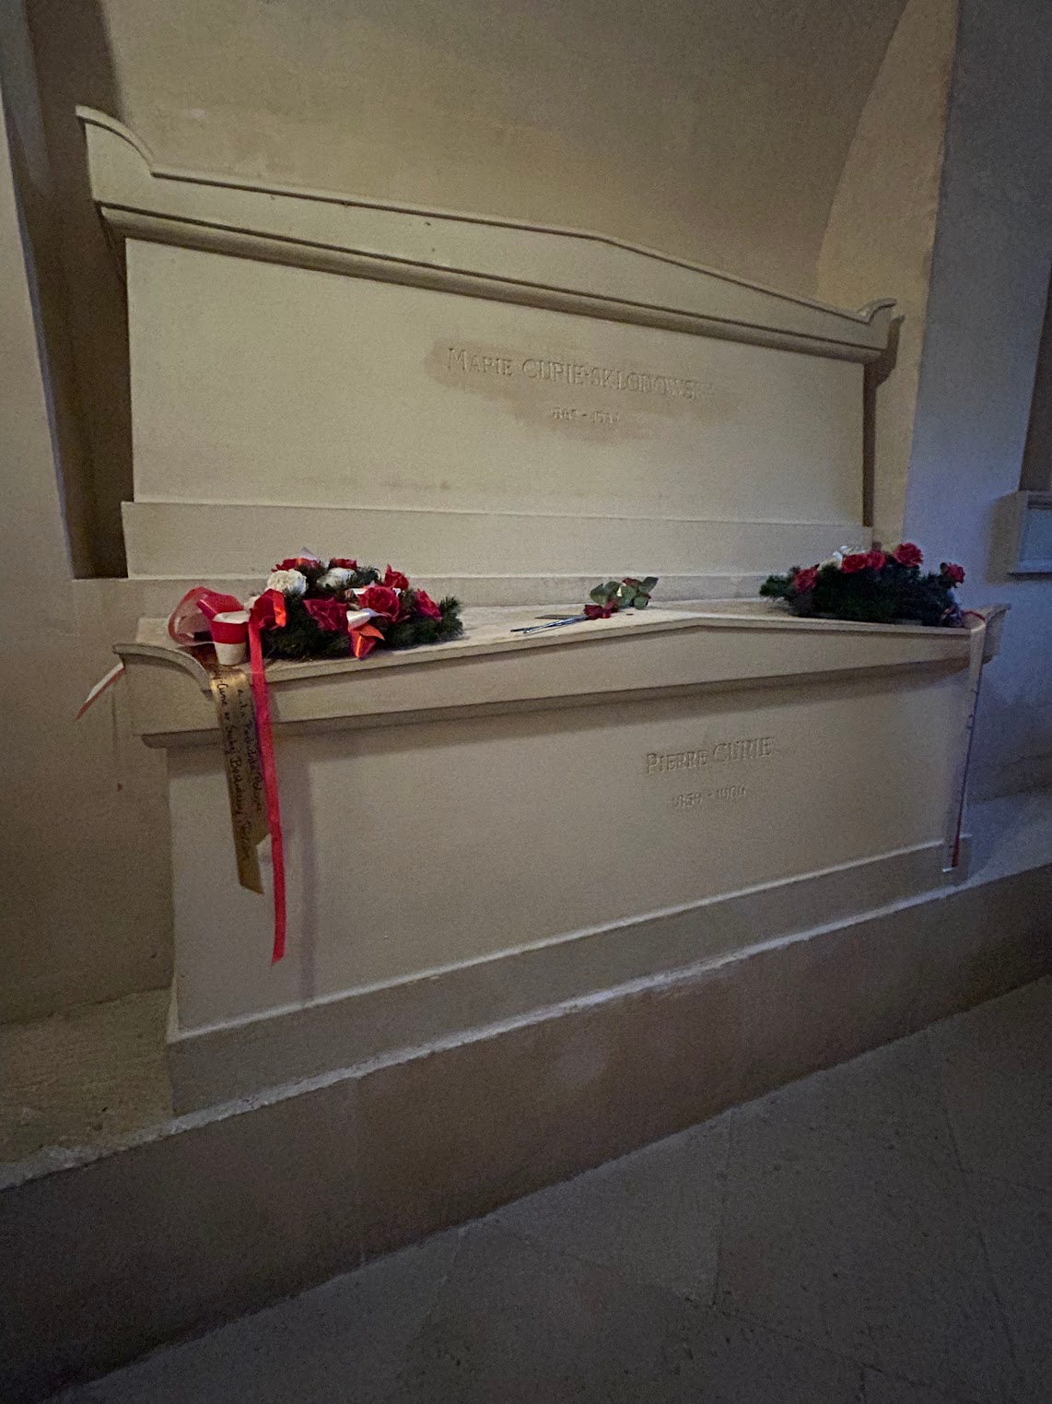
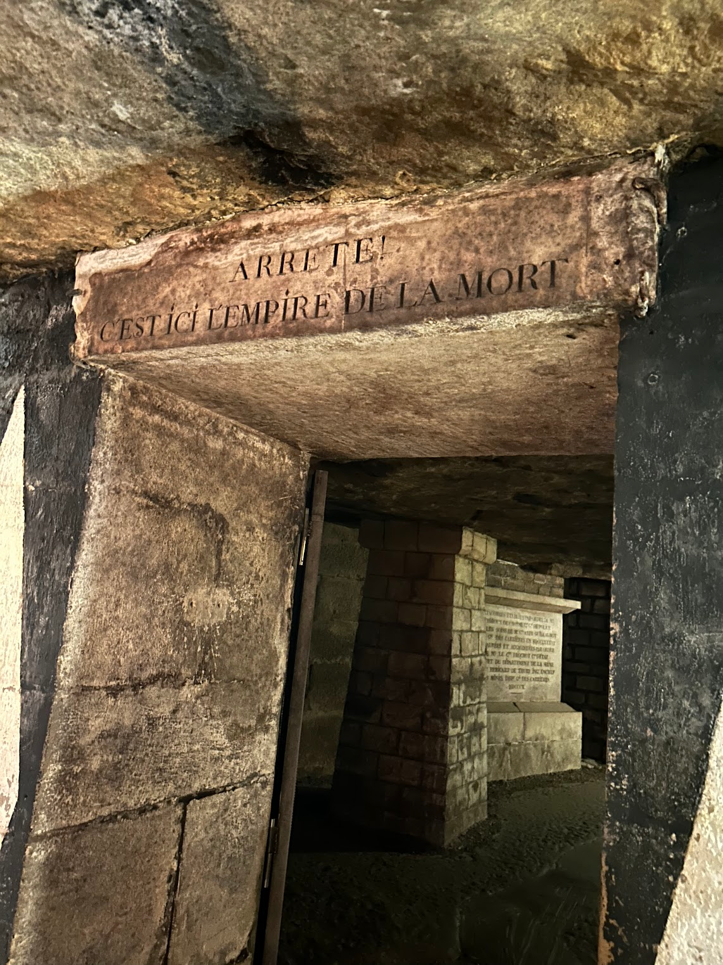
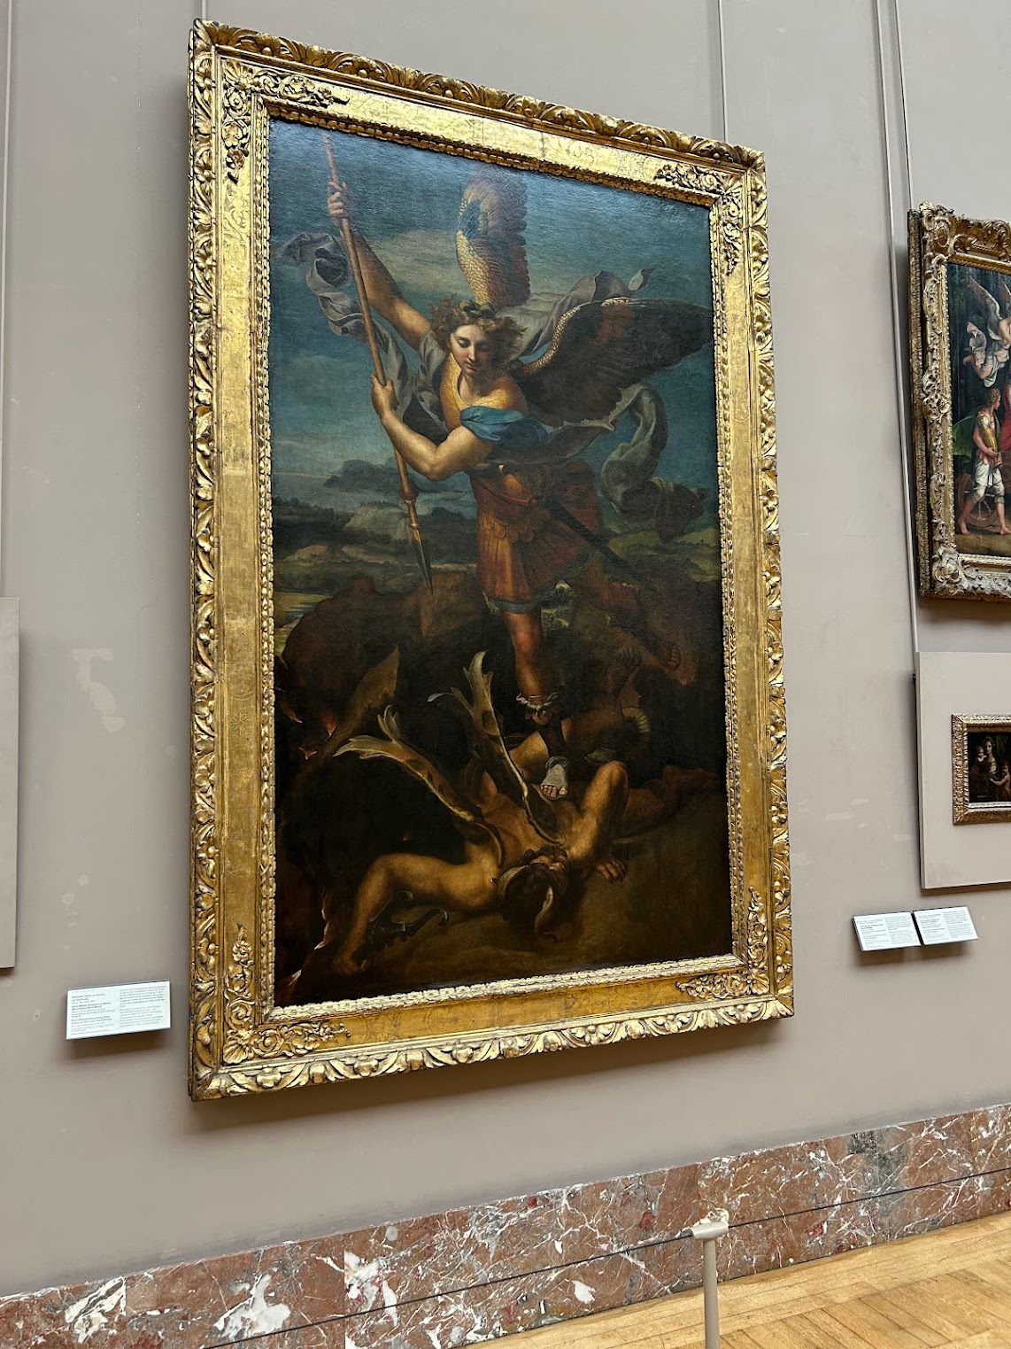
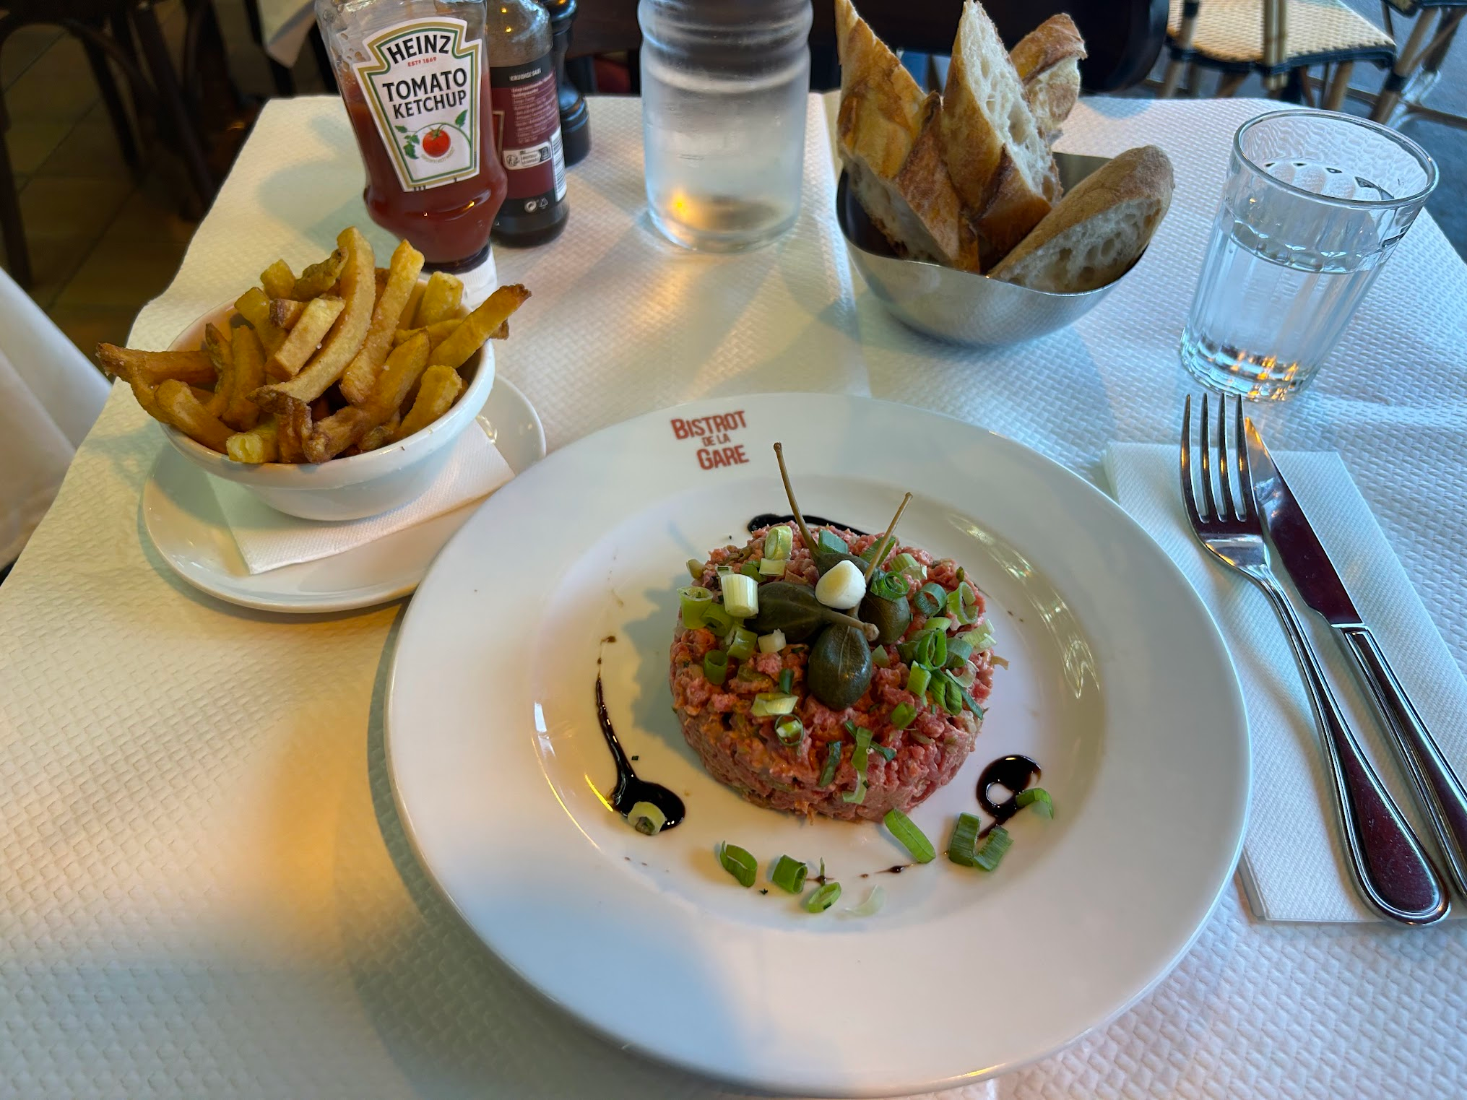
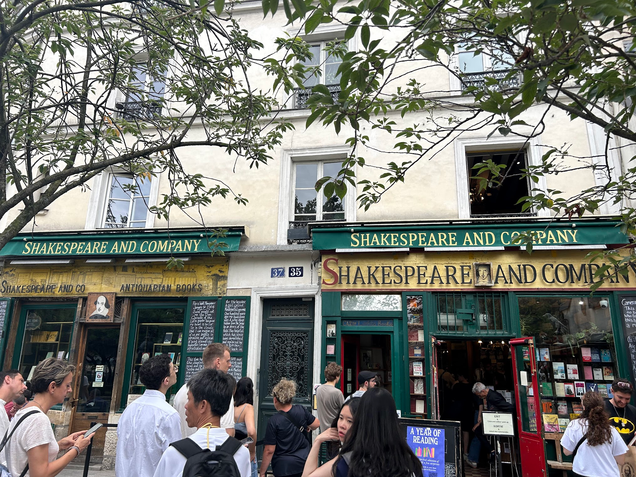
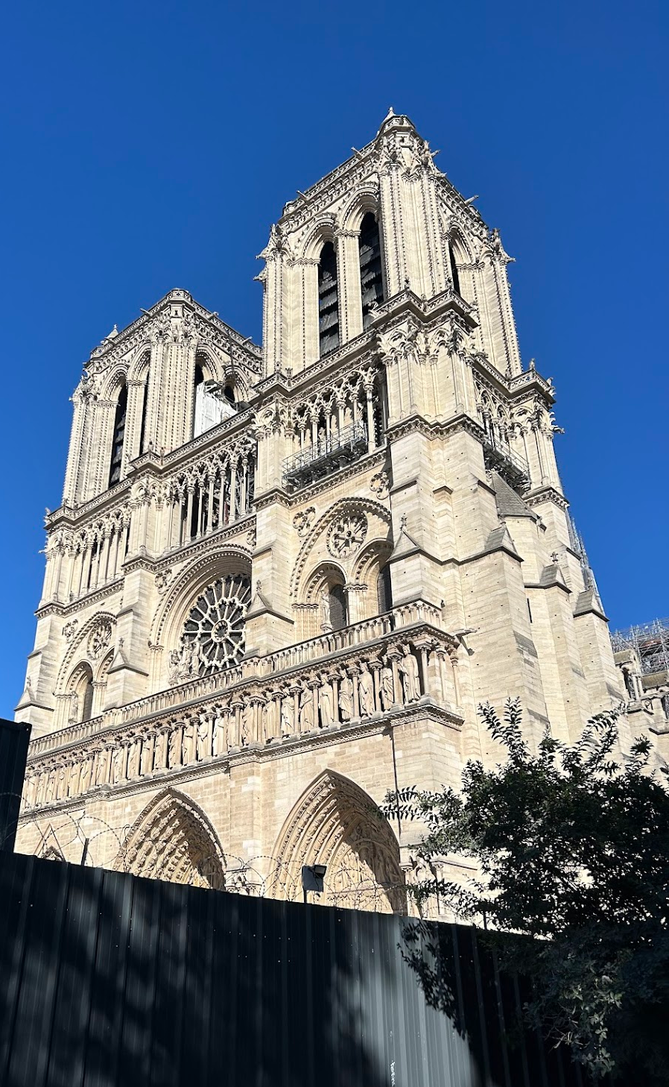
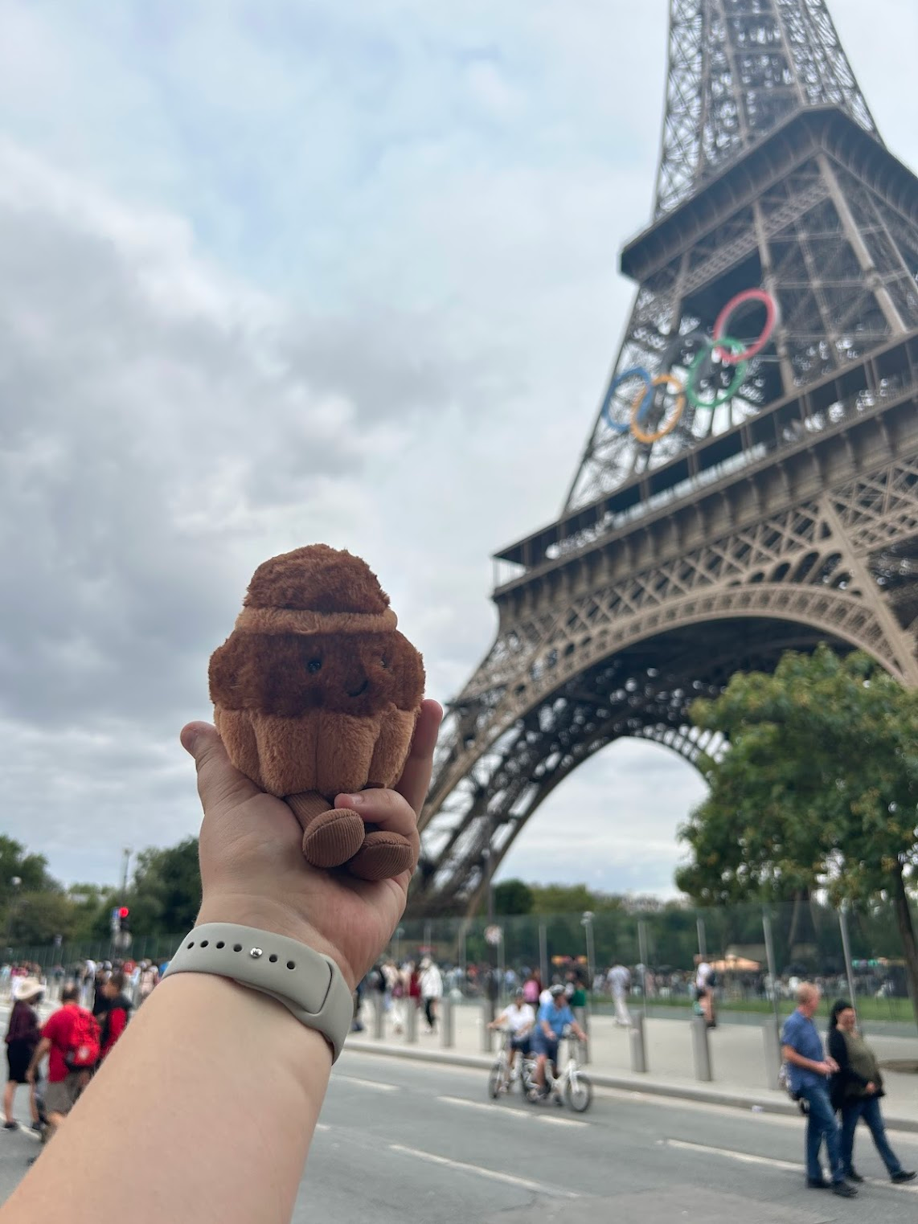
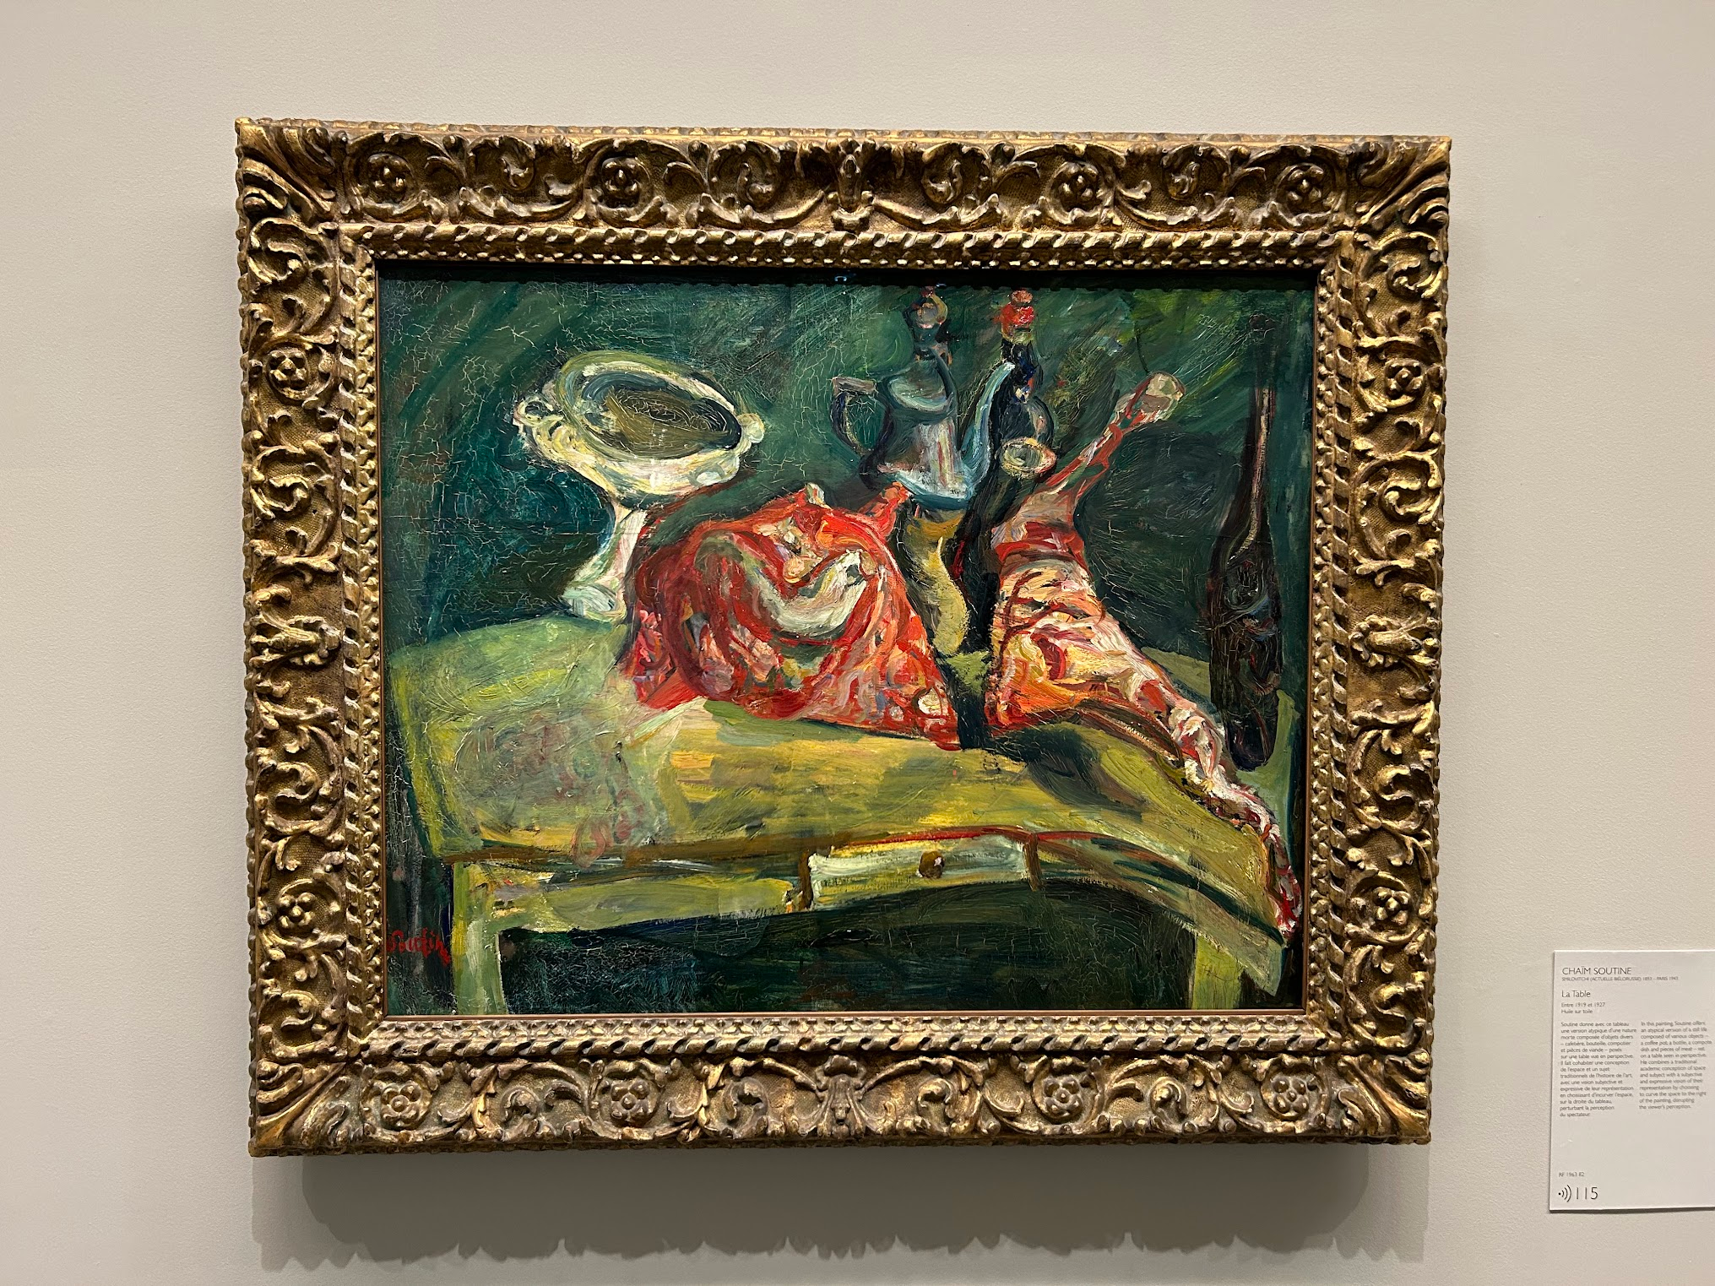
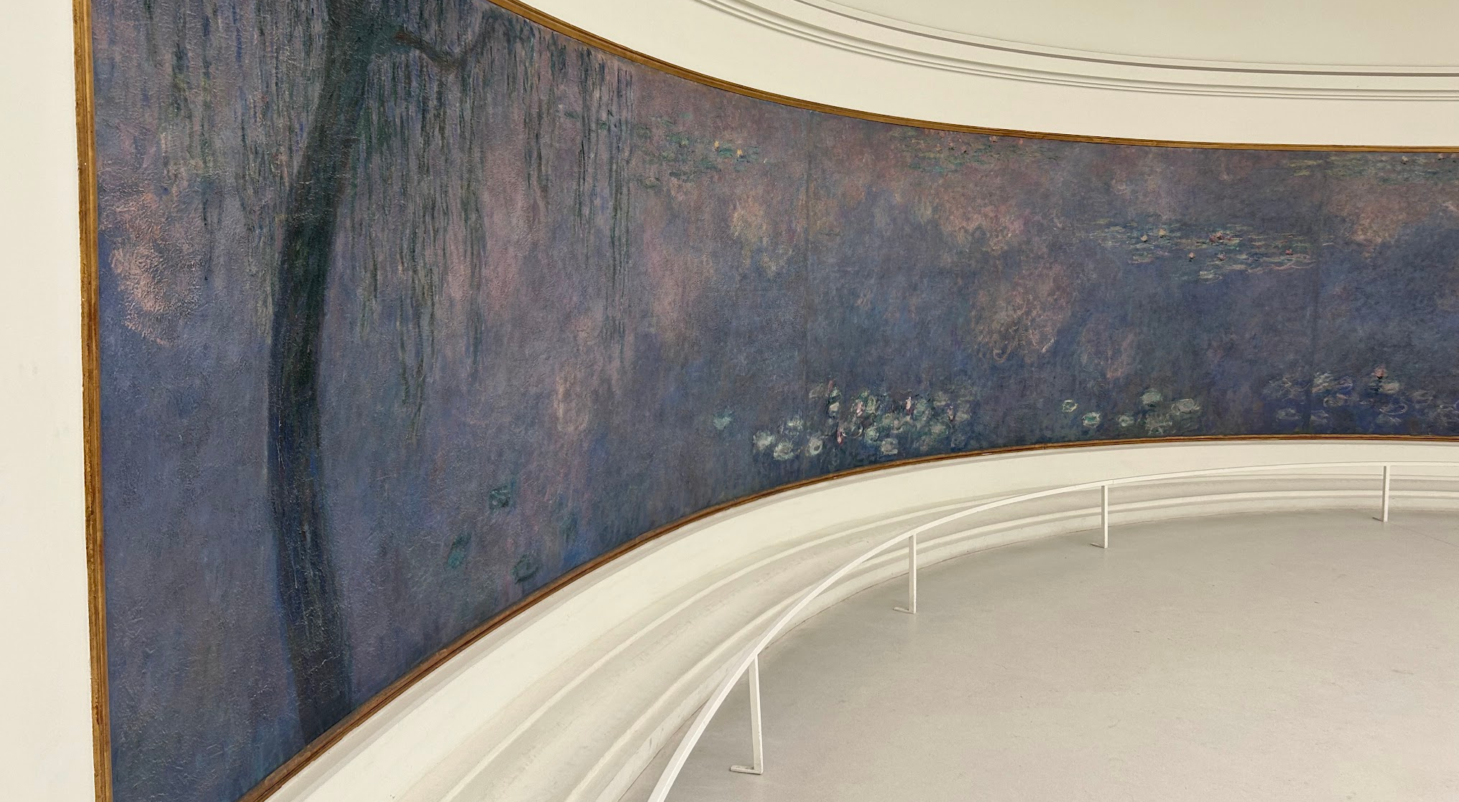
Culture:
Paris

Slide 23
Thank You for a Great Summer!
Big thank you…
to the UMich Physics Department for this opportunity…
to my mentor, Ina Carli, and everyone at ALPHA that helped me and made me feel welcome…
and everyone who supported me through my visa process – the leads of the UMich CERN Study Abroad program, my family, my friends, and my research group in the UM Astronomy Department!

