Slide 1
ISOLDE MR-ToF MS
Status of the MIRACLS hardware
2024-09-04
Lukas Nies (EP-SME-IS)

Slide 2
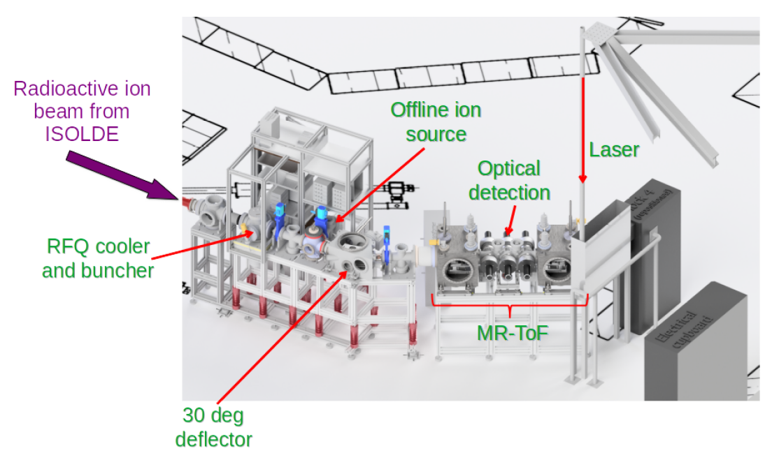

MIRACLS @ ISOLDE
Colinear laser spectroscopy in an electrostatic ion trap
Paul trap for ion beam bunching
Multi-Reflection Time-of-Flight device for ion storage
Currently located at LA2@ISOLDE with experiments planned until the end of 2024
15/12/2023

Slide 3
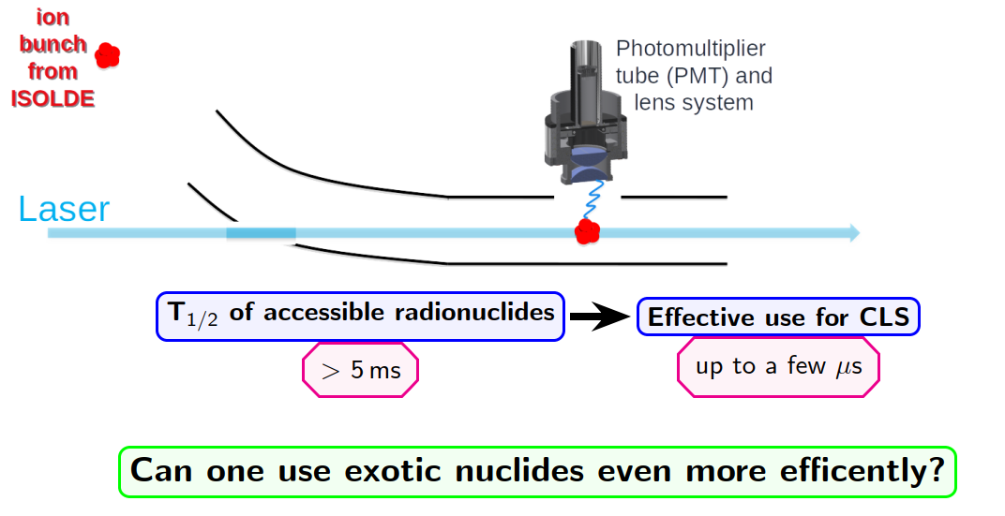
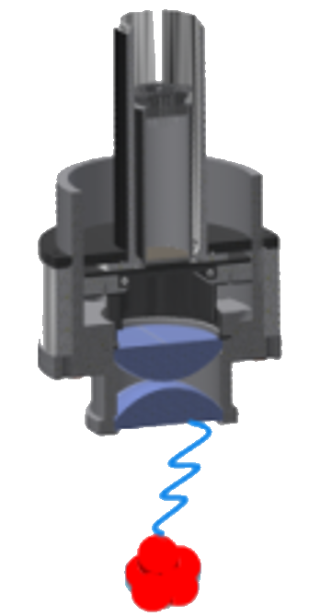
Collinear Laser Spectroscopy

Slide 4
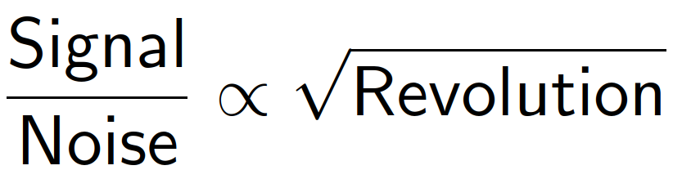
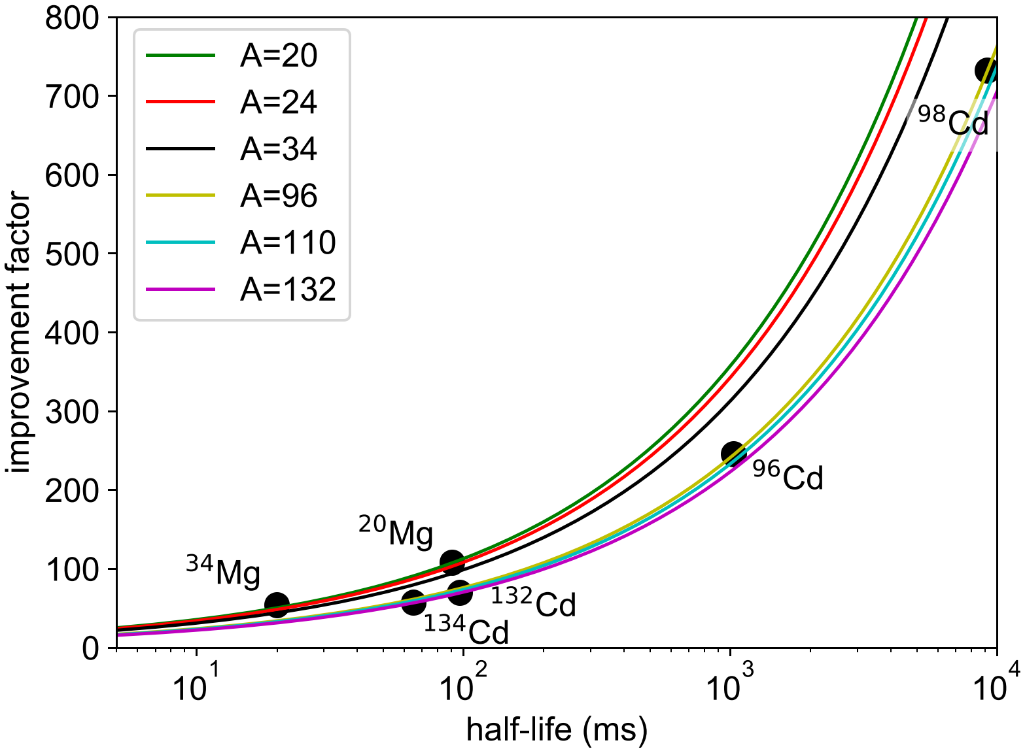
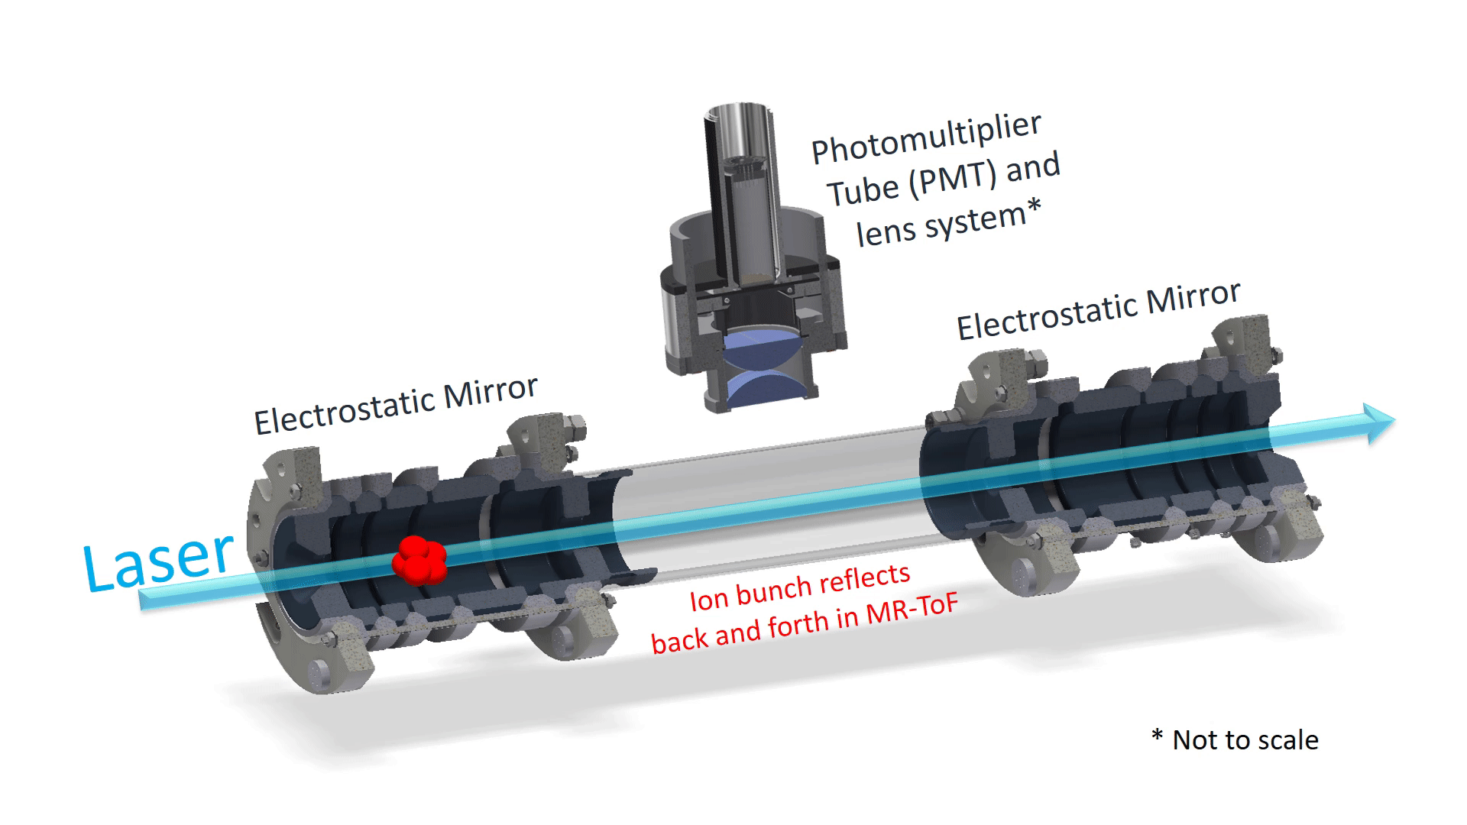
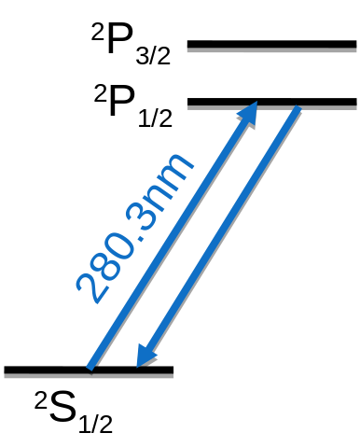
MIRACLS: Multi-Ion-Reflection Apparatus for Collinear Laser Spectroscopy
Longer observation time through ion “recycling”
Higher sensitivity through
Limited to ionic transitions
Slide by S. Lechner

Slide 5
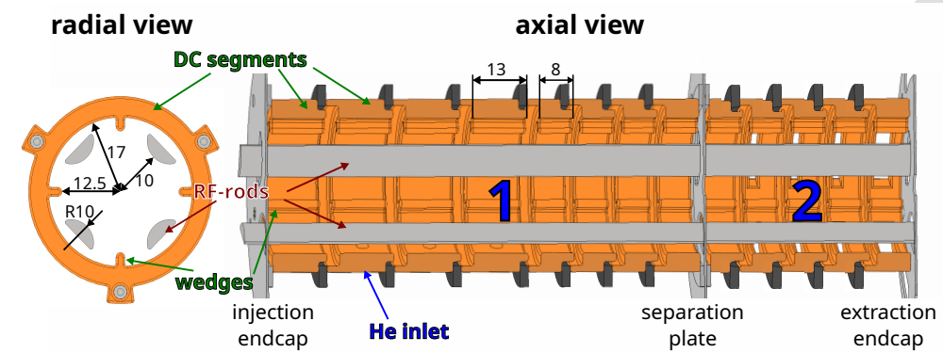
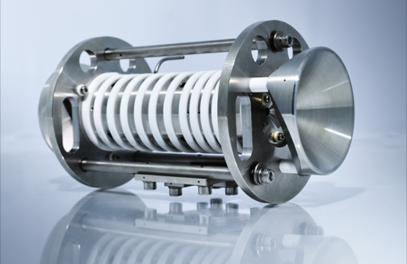
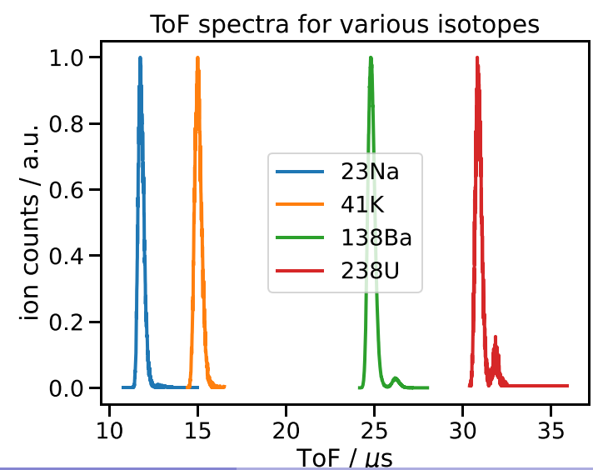
PAUL TRAP FOR BEAM BUNCHING
Lecher, Sels, et. al. (2024) https://doi.org/10.1016/j.nima.2024.169471
Paul Trap commissioned to deliver ion bunches of at <500ns FWHM with up to 25% efficiency for mass range of 23u – 238u
Stronger ejection would lead to better ToF focussing for mass separation -> needs improvement of channel crosstalk
15/12/2023

Slide 6
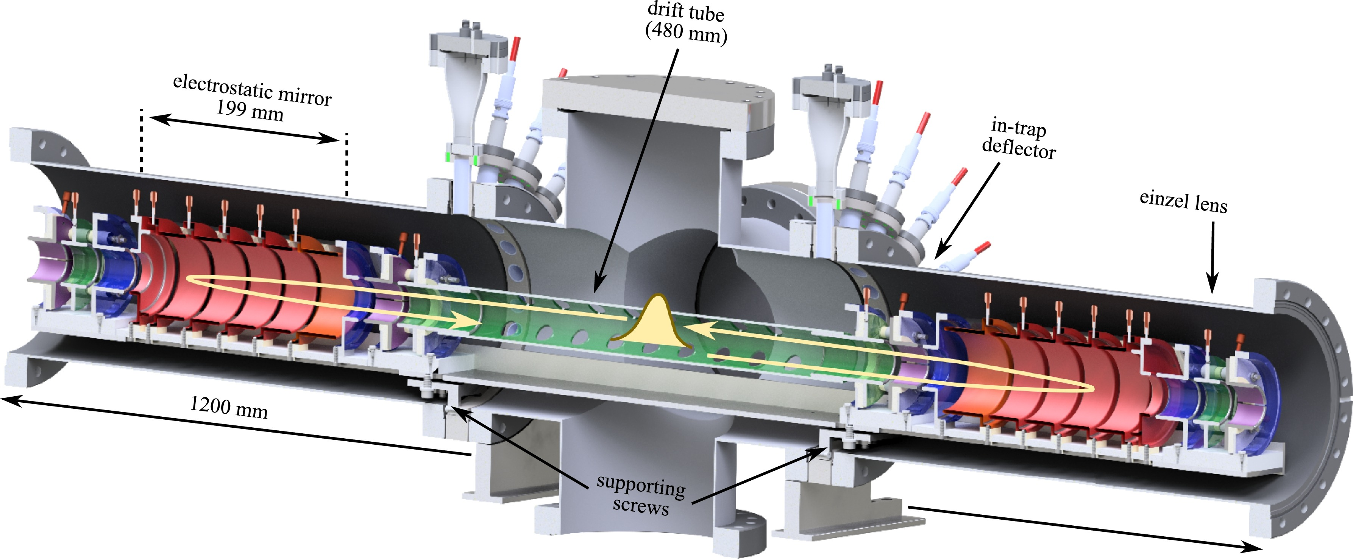
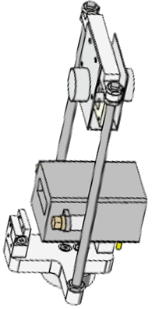
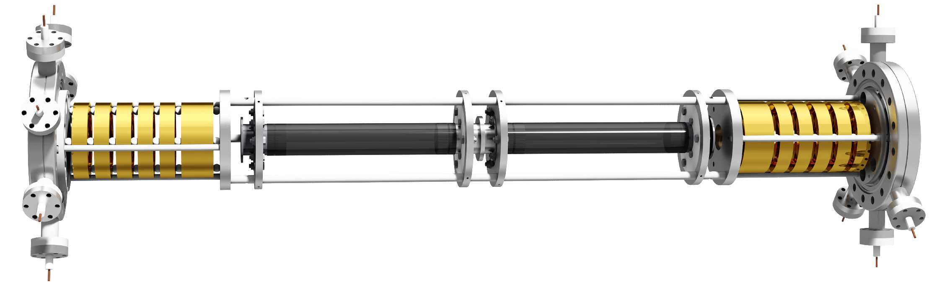
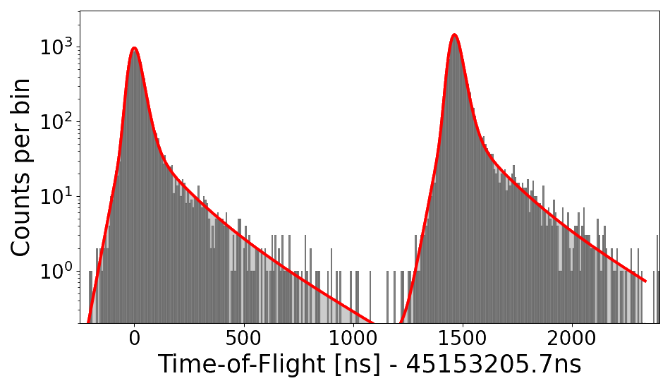
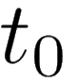
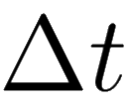
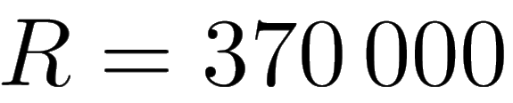
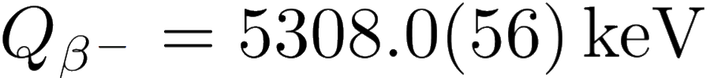
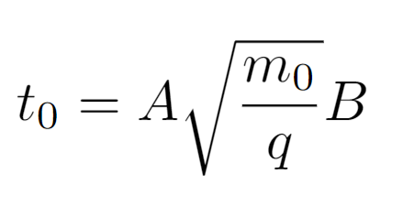
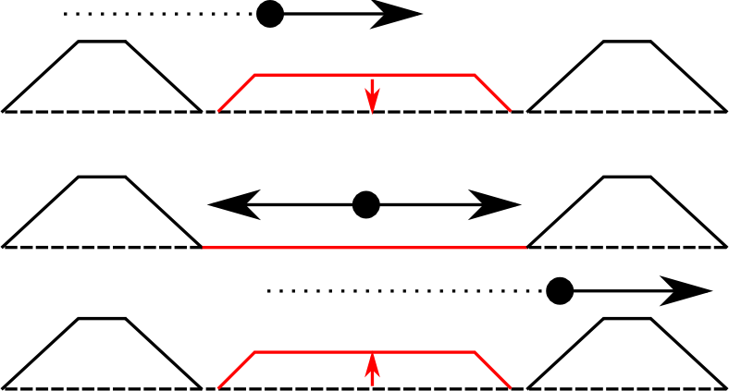
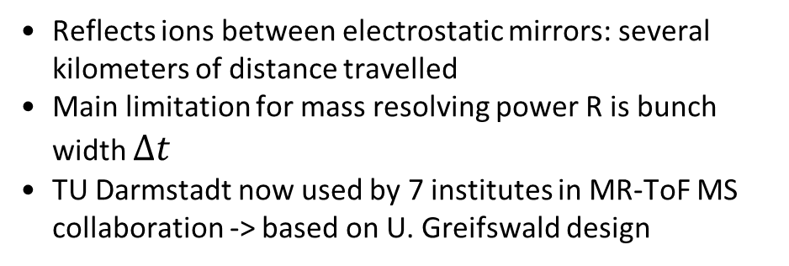
MULTI-REFLECTION TIME-OF-FLIGHT DEVICES
M. Schlaich et al., Int. J. Mass Spectrom. (2023)
Reflects ions between electrostatic mirrors: several kilometers of distance travelled
Main limitation for mass resolving power R is bunch width $Δt$
  TU Darmstadt now used by 7 institutes in MR-ToF MS collaboration -> based on U. Greifswald design
Mirror 1
Pulsed Drift Tube
Mirror 2
ToF detector
Injection
⁸⁸Sr
⁸⁸Rb
Storage
in-trap lift
Ejection
* Spectra from ISOLDE online MR-ToF MS at ISOLTRAP

Slide 7
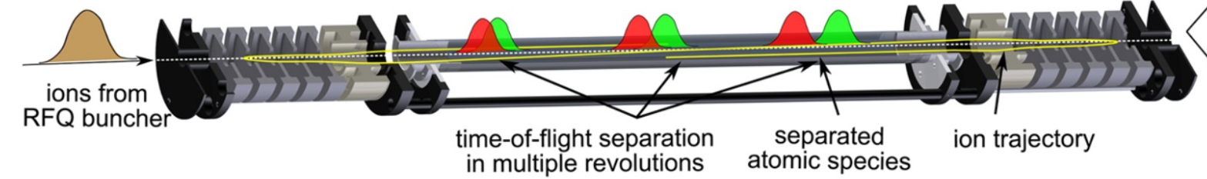
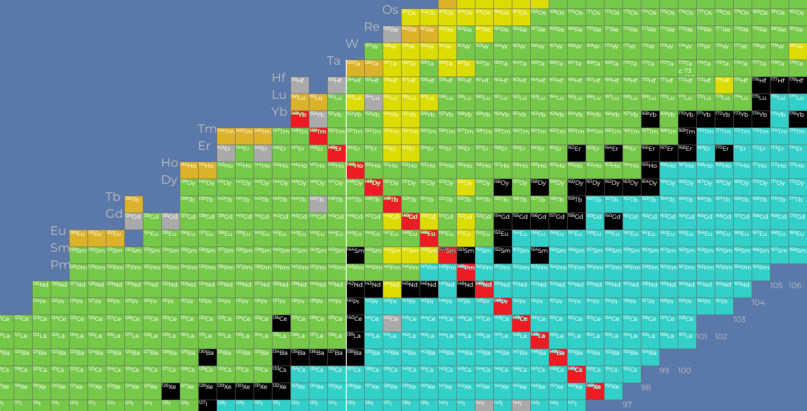
MULTI-REFLECTION TIME-OF-FLIGHT DEVICES
Ion mixture
time-of-flight separation in multiple revolutions
separated ion species
ion trajectory
Fig. courtesy R. Wolf
A=149
 | current MR-ToF devices | MIRACLS 30-keV Device | Magnetic mass separators
R = (2-3) x m/Δm | > 100,000 | > 100,000 | a few 1000
Processing time | (tens of) ms | 3 ms | continuous
Ion flux | ~10³-10⁷ ions/s depending on m/Δm | ~10⁵-10⁹ ions/s depending on m/Δm | 10¹³ pps
Slide by F. M. Maier
15/12/2023

Slide 8
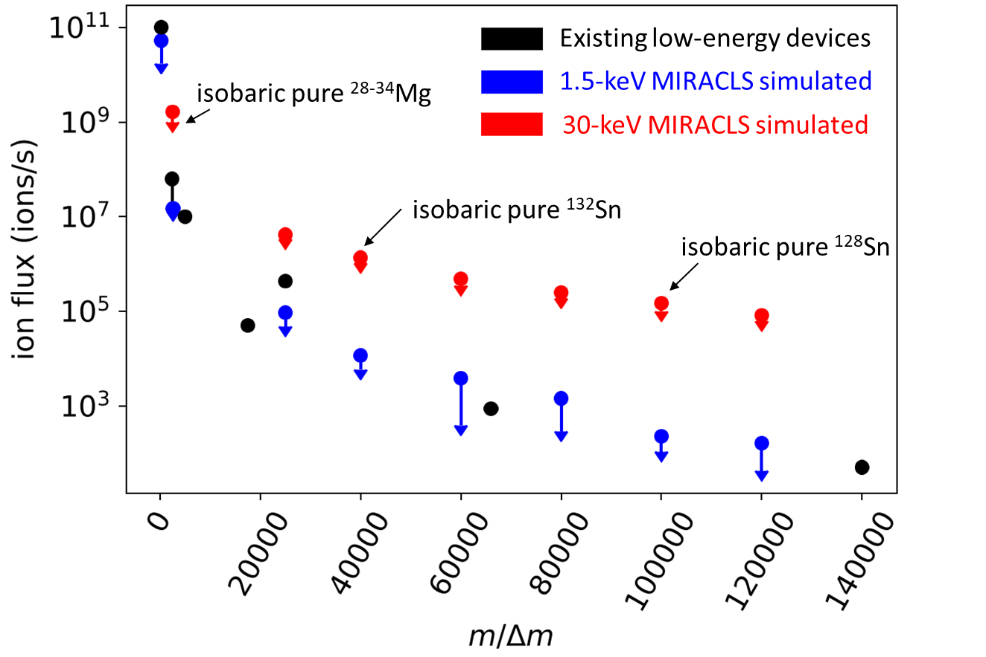
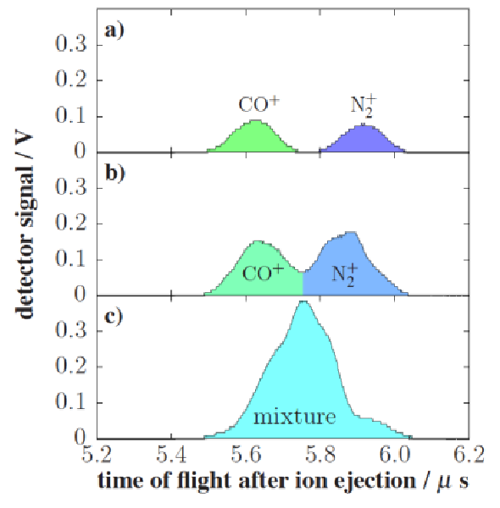
SPACE CHARGE LIMITS ION FLUX
F.M. Maier, NIM A, 1056, 168545, (2023)
Experimental studies with m/Δm ≈ 2500:
A few 100 ions/bunch
Counts
Ion intensity
A few 1000 ions/bunch
Coulomb interaction of stored charges leads to smearing of bunch structure
Ion optical simulations show: higher beam energy yields higher ion flux
Time-of-Flight (µs)
L. Schweikhard, X LASNPA, 2013.
Slide by F. M. Maier
15/12/2023

Slide 9
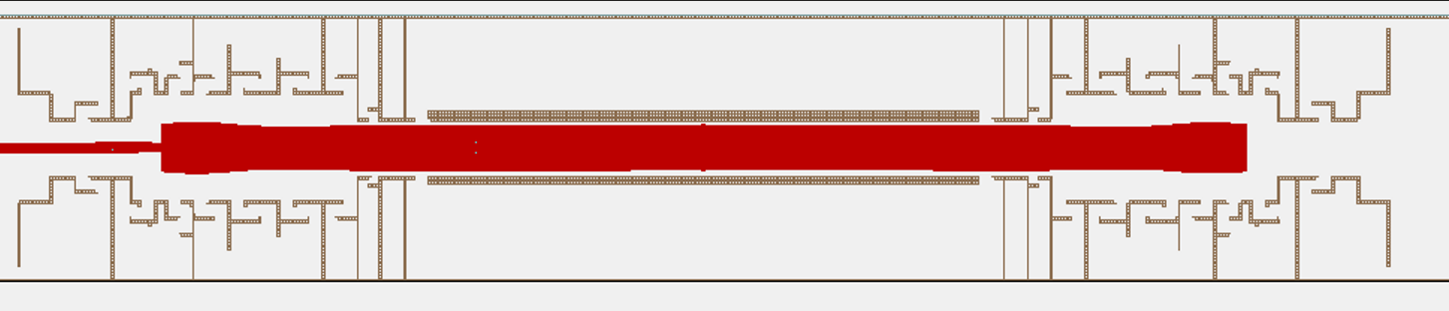
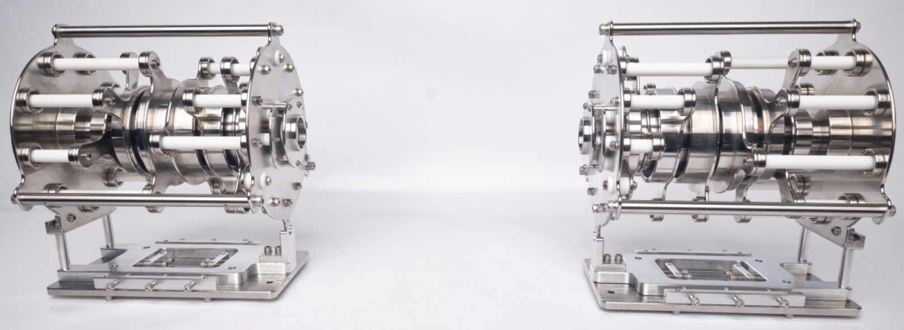
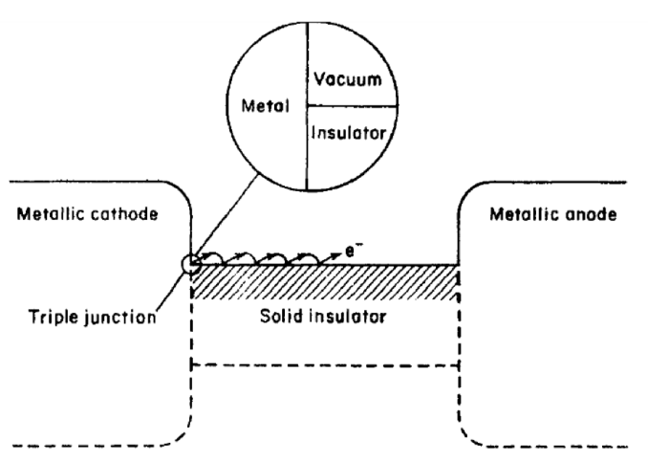
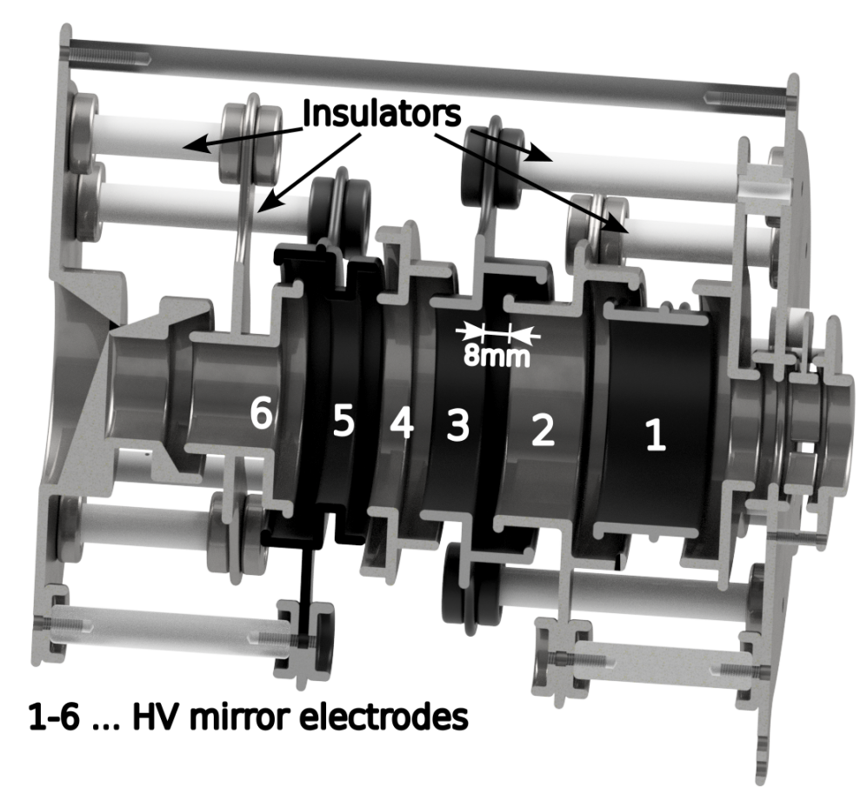
30 keV MR-ToF MS DESIGN
Two main challenges:
  Triple junction
  Vacuum gap
Cup design for triple junction held
60 kV in test setup
Discharge between electrode vacuum
gap at 12 to 21 kV Limits MR-ToF operation to < 10 keV
Recent upgrade: Electropolishing of all electrodes
Both mirrors stable for 11 keV beam energy and max. 35 kV between 2 electrodes during the last 6 months
Tests for 18 keV beam energy shows stable mirrors for 2 days, after which the test was ended
Slide by S. Lechner
15/12/2023

Slide 10
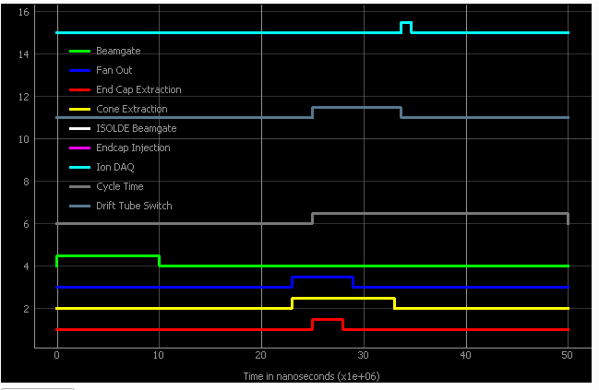
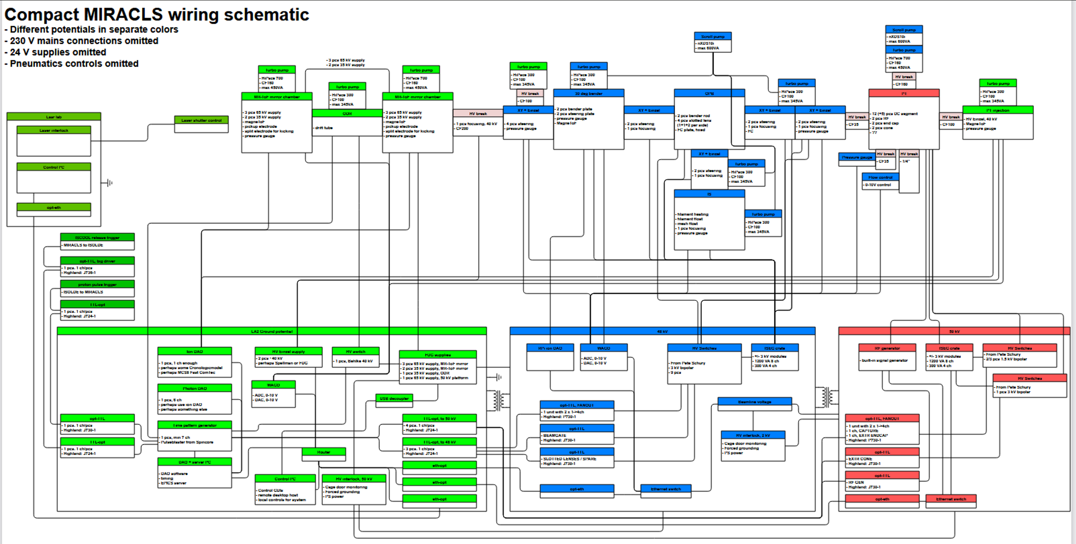
30 keV MR-ToF MS OPERATION
EPICS-based operating system with time-sequence generation
15/12/2023

Slide 11
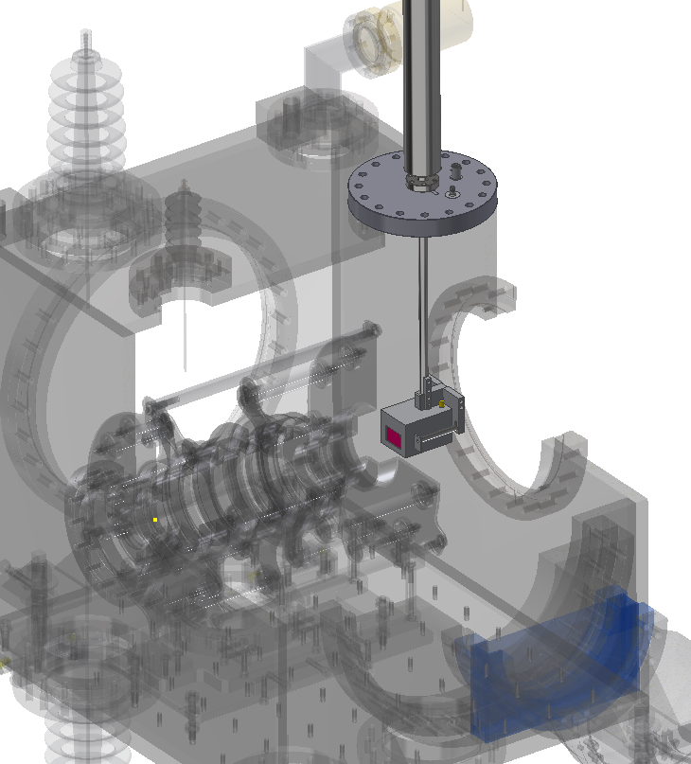
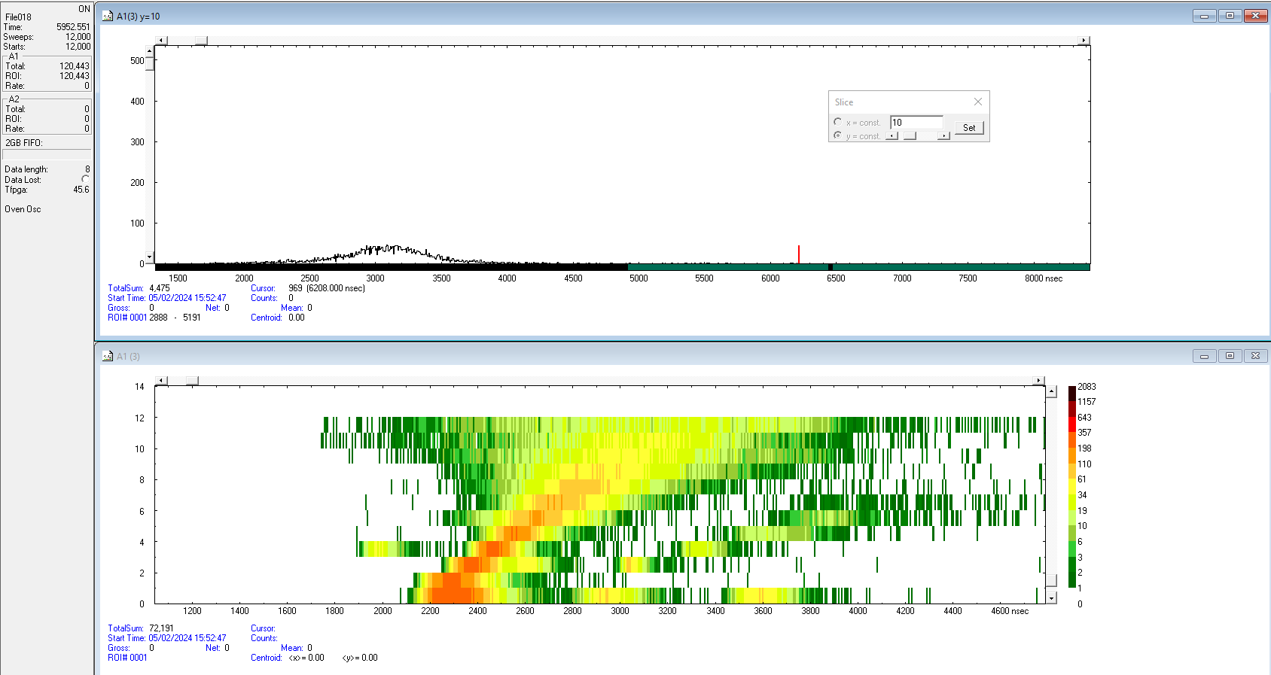
30 keV MR-ToF MS OPERATION
Pneumatic linear actuator
EPICS-based operating system with time-sequence generation
Commercial data acquisition and ion detection from FastComtec with a MagneToF electron multiplier
CF100 base flange
w/ 1xSHV5 and SMA feedthrough
MagneToF mini
15/12/2023

Slide 12
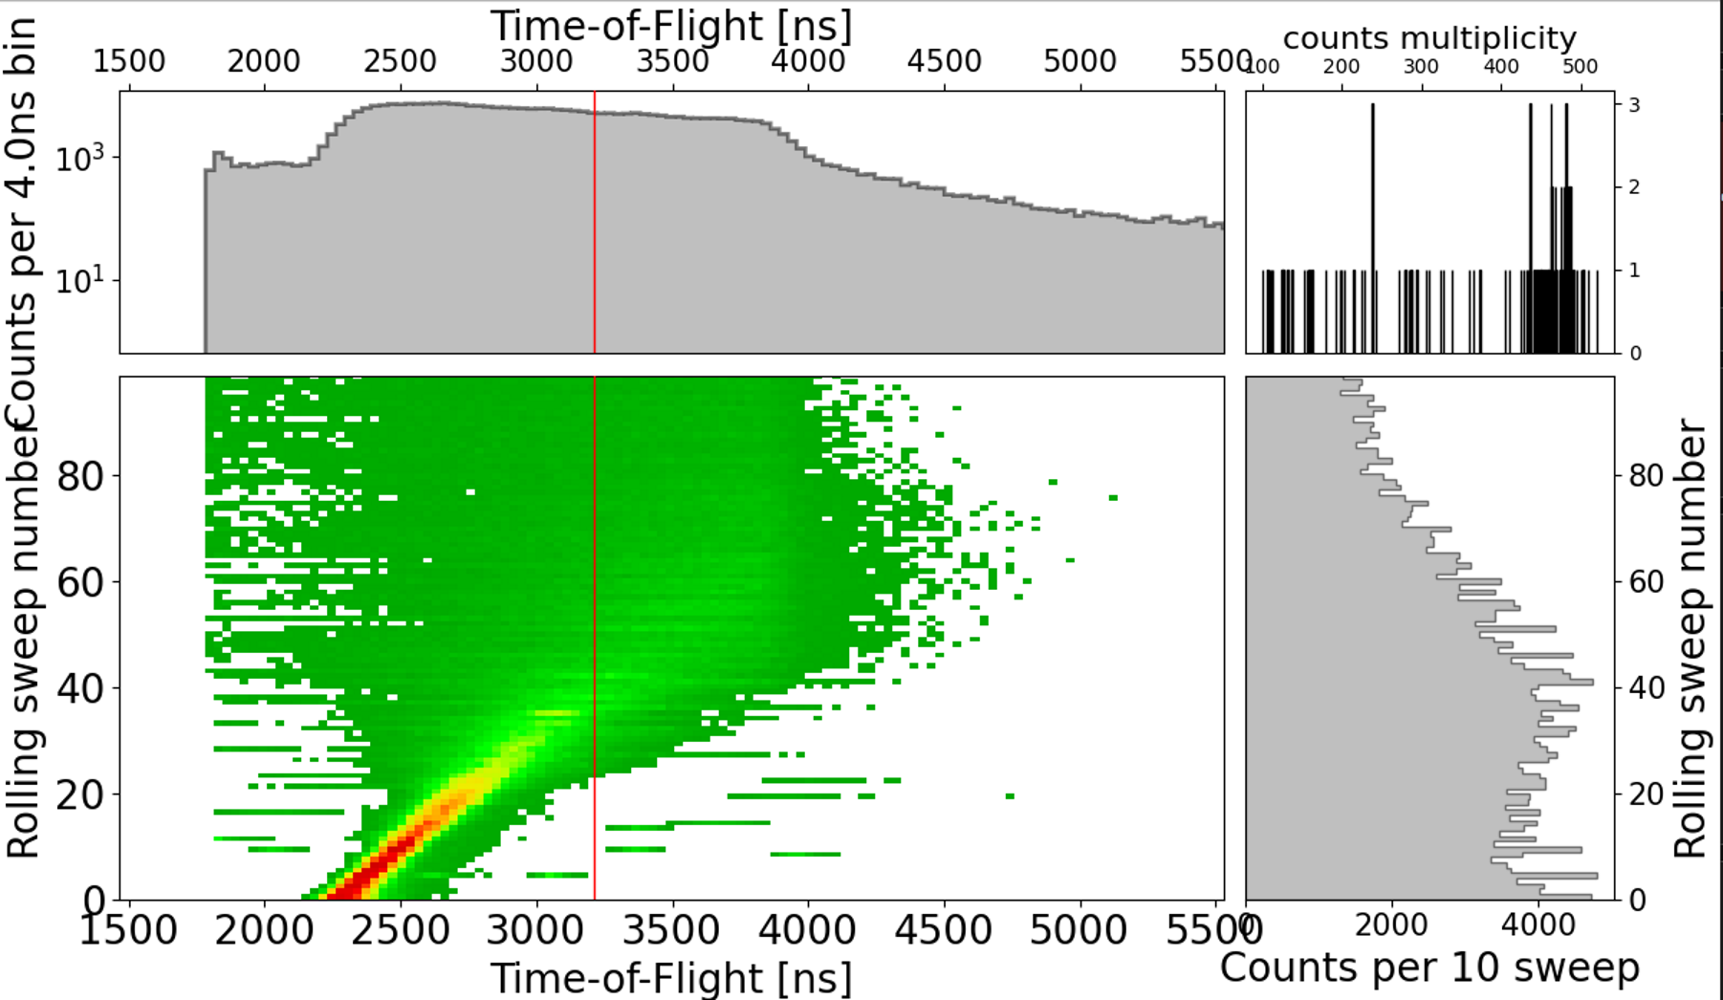
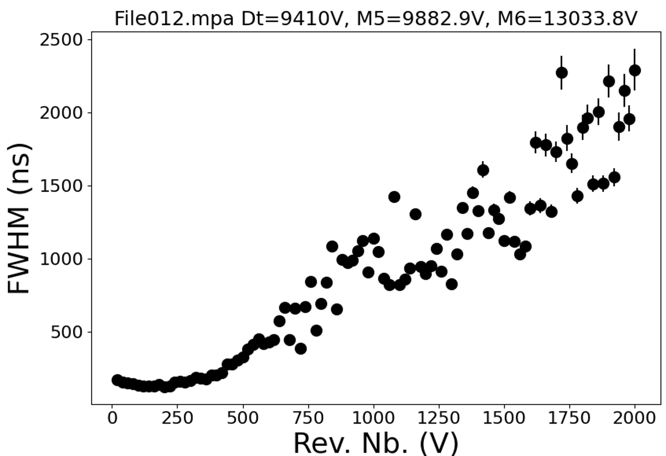
30 keV MR-ToF MS OPERATION
EPICS-based operating system with time-sequence generation
Commercial data acquisition and ion detection from FastComtec with a MagneToF electron multiplier
First commissioning tests confirm simulated mirror potential voltages, trapping of coherent ion bunches up to 1000 revolutions, extensive tuning needed for better mass separation performance
15/12/2023

Slide 13
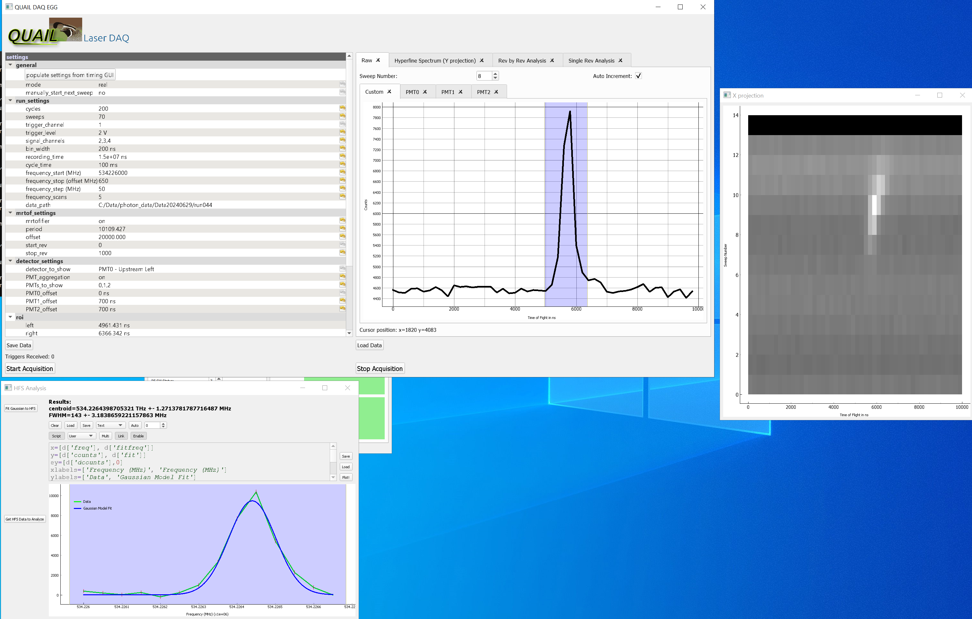
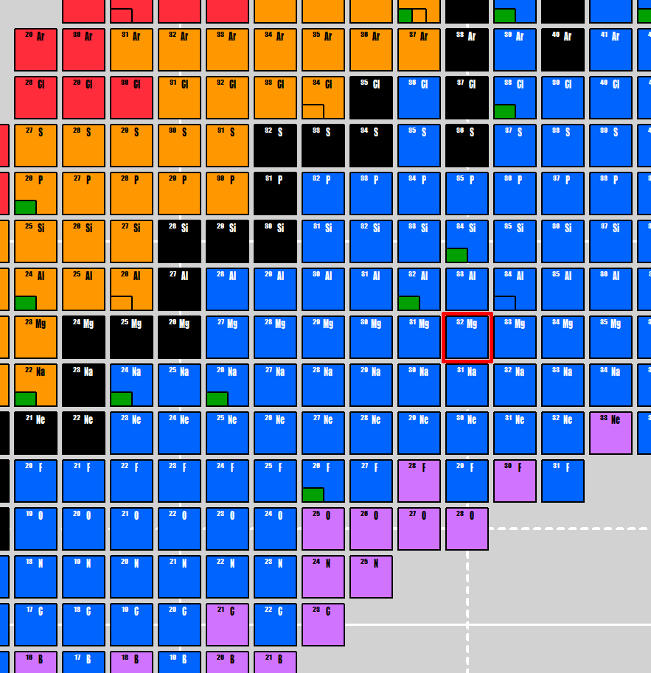
30 keV MR-ToF LASER SPECTROSCOPY
Laser spectroscopy on 24Mg – 32Mg with ISOLDE beam
15/12/2023

Slide 14
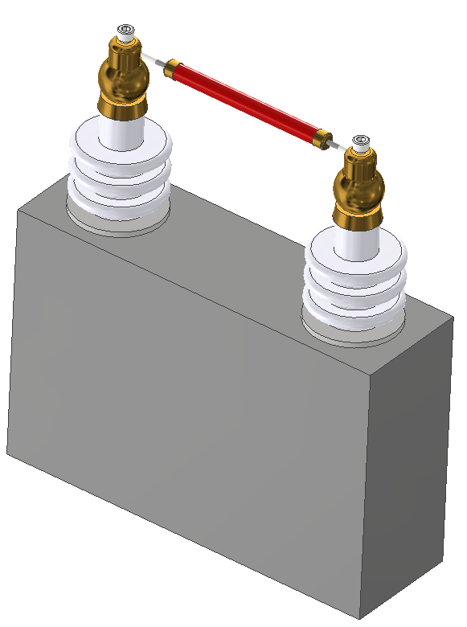
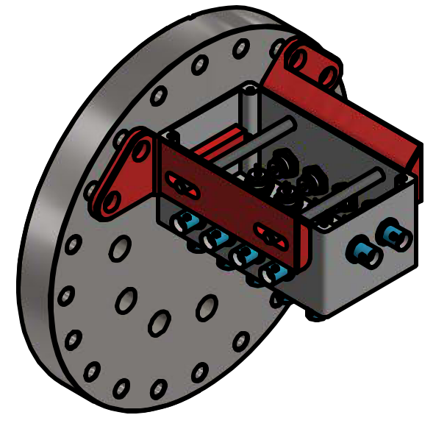
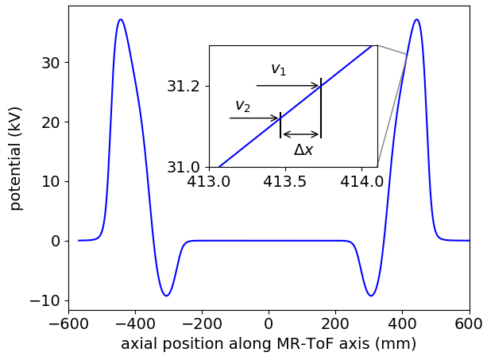
MODIFICATIONS NEEDED
Paul Trap
Change DC coupling of electrical feedthrough flange
Change cabling inside chamber
MR-ToF MS
Replace drift tube with shorter version
(currently 690mm, simulations yield
best results for 420mm for mass separation)
Update vacuum design
Install HV buffer capacitor
15/12/2023

Slide 15
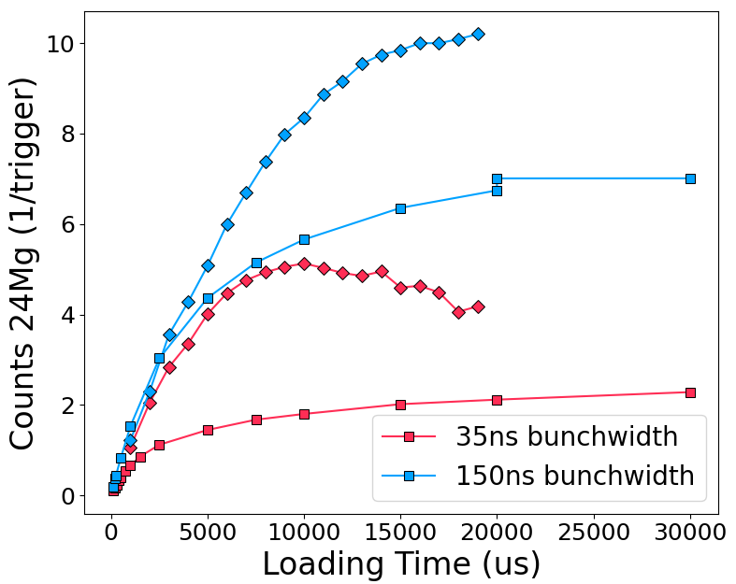
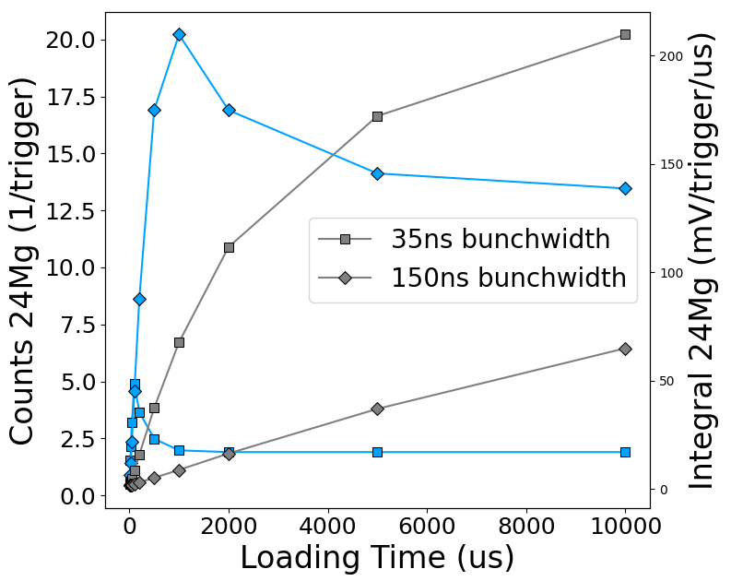
MODIFICATIONS NEEDED
Paul Trap
Change DC coupling of electrical feedthrough flange
Change cabling inside chamber
MR-ToF MS
Replace drift tube with shorter version
(currently 690mm, simulations yield
best results for 420mm for mass separation)
Update vacuum design
Install HV buffer capacitor
Update detector readout
15/12/2023

