Slide 1
Beam Instrumentation for Puma@Isolde
M. Martin Nieto , P. Martins, J.Tassan-Viol
W.Andreazza, S.Bart Pedersen
C.Pasquino, F. Roncarolo
Puma@Isolde Day – 09-Sept-2024

Slide 2
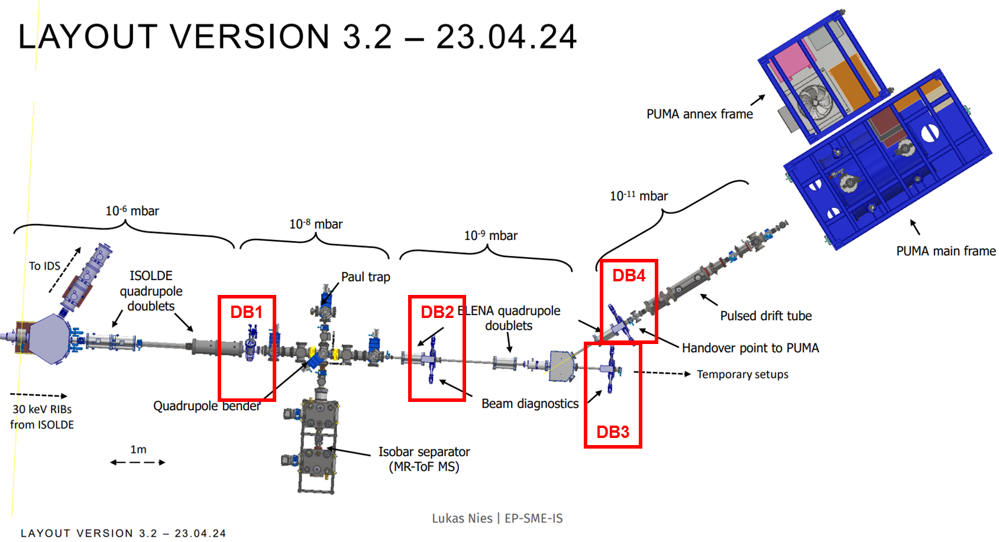
Beamline Layout – Beam instrumentation
Continuous beam from ISOLDE:
- 30-60keV
- Current of 1pA to a maximum of 1nA in rare cases
- Transversal emittance of 30 pi mm mrad (tbc)
Pulsed beam (after Paul trap/separator):
- Expected energy spread and bunch length tbc, a maximum DeltaE of 5%
- bunch length of 100ns-100mus
- Expect 1 (for unstable ions) to 10^5 (for stable ions) ions per bunch
BI work kind of boosted recently, meetings organized by Puma@Isolde
https://indico.cern.ch/category/15189/

Slide 3
Diagnostics Boxes (BD) - Overview
DB1 :
  Standard low energy ISOLDE DB equipped with 1 FC and 1 scanner
  DAQ : continuous acquisition
    signal acquisition with integration time can be changed from 200ms to 1s. Max rep rep rate 5Hz.
    FC signal via low noise high sensitivity electronics – Pico Ampere Meters (PAM)
    Scanner acquisition correlated to motor movement, via dedicated VME electronics
DB2,3,4 :
  Standard (long) HIE DBs with multiple ports
    Possibility to install different detectors with different actuators, either IN out or motorized - see
    DAQ: detector signals sync to pulsed beam

Slide 4
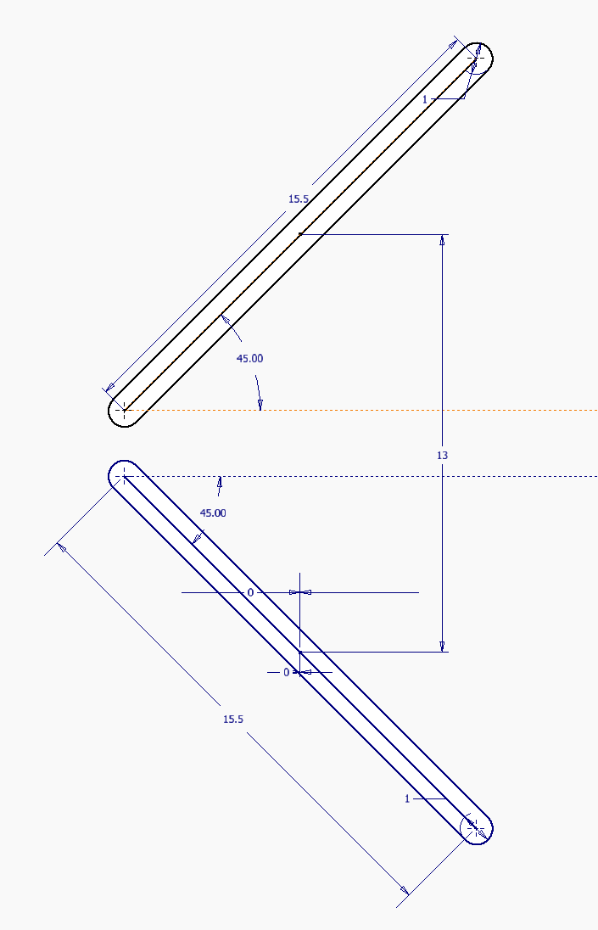
DB2,3,4 – Layout + Use cases / modes of operation
Recently agreed to equip all 3 DBs with
1 (ISOLDE-type) scanner (to be compatible with the option of having FC IN at the same time).
1 H+V slit, 45 degrees actuator.
  Aperture to be confirmed.
  May want to have two sets of H/V slits with different aperture on the same actuator.
  Concept: only one slit at a time overlapped to MagneTOF acceptance.
1 FC (IN-OUT).
1 MagneTOF (IN-OUT).
Operation Mode | Beam Mode | Scanner | H+V Slit | FC | MagneTOF
#1 | DC | OUT | OUT | IN (fixed) | OUT
#2 | DC | IN (scan) | OUT | IN (fixed) | OUT
#3 | DC | IN (scan) | OUT | OUT | OUT
#4 | Pulsed | OUT | IN (scan) | OUT | IN (fixed)
#5 | Pulsed | OUT | OUT | OUT | IN (fixed)

Slide 5
Status&Plans of DBs mechanical design/integration/procurement

Slide 6
DB1
1x Scanner & Faraday cup, 10-8mbar for DC beam ( low energy Isolde)
  New design from Standard Models with CF Flange. 2 Instruments SC+FC on same Flange.
  Study made @ 70%, forecast @ end of June 2024.
  X,Y, Z Adjustment box table to be done and added to the instrument.
  As production drawings ready, order (material & components) will be done by main workshop, delay to be discussed this week with main workshop.
  Update:
    Beam diameter 26mm
    Alignment table added
    2D drawings being done
    Job discussed with the Main Workshop
    Discussion with VSC foreseen for next week.
    Raw Material being purchased next week & critical standard components ( gaskets & bellows)
    Great collaboration with EN-MME design office

Slide 7
DB2,3,4
3 (+1) HIE Isolde (Long) DBs, 10-9mbar/10-11 mbar for DC and Pulsed Beam
  1 Instrument per Flange.
  Slits & FC instruments study ready.
  Complete study made @ 30%, forecast @ end of July 2024.
  X,Y, Z Adjustment box table to be done and added to the instrument.
  As production drawings ready, order (material & components) will be done by main workshop, delay to be discussed this week with main workshop.
  MagneToF, supplied by the collaboration.
  Update:
    Beam diameter 26mm → confirmed?
    Alignment table added
    2D drawings being done
    Job discussed with the Main Workshop
    Discussion with VSC foreseen for next week.
    Raw Material being purchased next week & critical standard components ( gaskets & bellows)
    Great collaboration with EN-MME design office

Slide 8
Mechanical Production Planning (Updates)
Raw material purchasing – orders to be launched in the coming 2 weeks;→ several design modifications over summer. 2D drawings being produced, material purchase in the coming week (316LN – 2D forged instead of 3D forged).
Design completion within June 2024 for the first instrument; July 2024 for the DBs; → design completed in August.
Production with Main Workshop → likely the instruments will be ready not earlier than Q1 2025 → feasible but tight. To be added to this timeline the following: metrology measurements ,cleaning, assembly and VSC acceptance test. 2 – 3 months estimated.
Budget envelop : 200 KCHF for the mechanical production. This was based on the previous estimates without the MagneToF: 45 KCHF should be added to this envelop.→ no updated

Slide 9
Status&Plans of DBs electronics architecture, cabling, racks etc…

Slide 10
DB1
Standard ISOLDE FC-Scanner electronics.
IN-OUT and FC charge meas via PLC
PAM (Pico-Amper Meter) via profinet communication. PAM connected on free channels in rack50 (same rack off all Isolde’s faraday-cup)
Scanner driven by stepping motors, read out ISO-SCANNER VME boards
Habia PTFE coaxial cable with low noise layer for the scanner was cleaned and RGA tested (150°C-24h-30°C/h). The cleaning method is validated with Isopropylic alcool at 40°/ 20mn in ultrasonic cleaner. It shows an acceptable outgassing. https://www.habia.com/en/products/industry-standard-cables/coaxial-cables/
DB2,3,4
Slit control via Standard HIE Isolde electronics and motor drivers
Baseline specs → only MagneTOF expected to be used with pulsed beam, but to cope with uncertainty about absolute signal levels and signal/noise:
  FC DAQ: recently agreed to prepare both low energy FC DAQ (spare channels available as for DB1) and HIE Isolde readout (with max integration time == xx us) to cope.
MagneTOF signal via TDC (next slide)

Slide 11
MagneTOF – DAQ via TDC
Needed resolution is ~1ns, for 10-20 ns windows
Current best choice is PicoQuant TimeHarp 260 NANO
  250 ps time bin
  Single input channel, multiplexer at the input to select MagneToF
    MagneToFs stop the beam, so there is only one channel active at any time → can use multiplexer
  Same model (different variant) of the upcoming LHC BSRL upgrade → Standarisation
  5.6 kEUR for card, multiplexer <500 EUR
In-depth discussion to happen on 5/6/2024 (for PUMA and HIE Isolde silicon detectors DAQ CONS)

Slide 12
Schedule and budget (electronics)
Electronics chassis and components being prepared / procured. Plan to be ready for end of the year
Cables and racks requested (next slide)
Budget: 70k foreseen in initial envelope may not be enough, depends on real cable costs (EN-EL to answer ticket) and TDC choices.
(Also related to HV platform plates, see next slides):
+15-20k for additional PAMs + DSS work for procurement, reception, chassis assembly/tests
Will come back ASAP with best estimate.

Slide 13
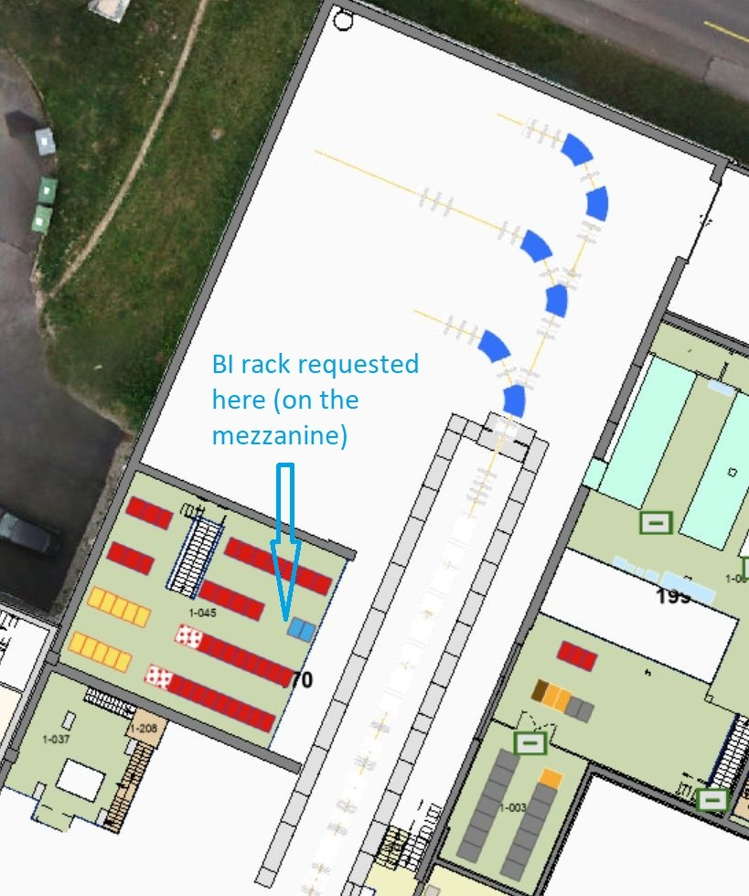
Cables and Rack
Requests submitted and being processed:
RQF2634357 DIC
RQF2597896 Rack
RQF2749174 - Electrical connection of the rack
RQF2783961 - Installation d'un chassis VME

Slide 14
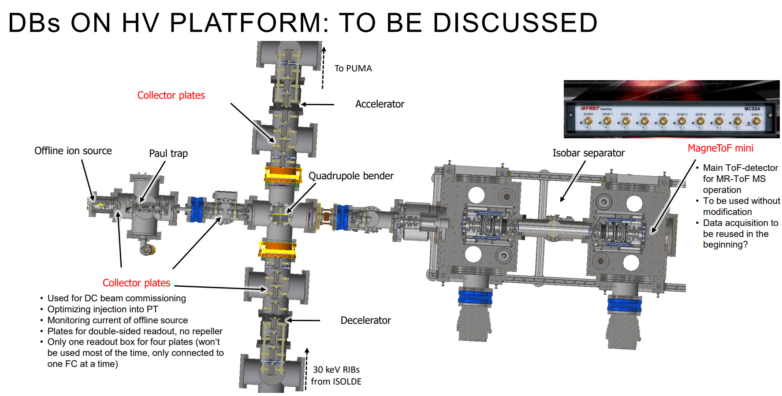
Collector Plates – Additional request
4 Collector Plates:
  Manually Actuated;
  Alu Plate DN35, no requirements on the thickness (1 mm?);
  We will take charge of the design and production;
1 MagneToF mini:
  Manually Actuated;
  We will take charge of the design and production;
  Is the MagneToF supplied by the collaboration or purchased by us?
Budget:15X5 KCHF (75 KCHF) t o be added to the previous envelop.
Single MagneToF mini in the cage (?)
Reused from MR-ToF MS operation
If at 30 kV, isolation is challenging
Single/Individual PAM for 4 collector plates, to be connected one at a time (Seldom used)
HV isolation for data to PLC-profinet: made via an ethernet-fibre adapter – no issue with 30kV isolation
Power (24V) taken from inside the power supplies available in the cage

Slide 15
Outlook
DBs layout ~finished, integration being completed, procurement and manufacturing to start
Both DAQ types (low energy Isolde and HIE Isolde version) will be prepared
Schedule
  Best effort in place. Will do all possible to be in line with overall project schedule. Will come back ASAP to confirm or announce delays
Budget
  Initial budget estimate (270kCHF)
  likely to need
    + 45k for MagneTof + 20-30k for relatd electronics (TBC)
    +75k for HV platform collector plates
    +20k for additional PAMs + DSS work
SW
  We still need to look at details about SW solutions to combine Low energy ISOLDE and HIE control + DAQ (e.g sync DB2-3-4 scanners DAQ wtth motor movements)
  TDC SW development in parallel to new LHC LDM and HIE Isolde Si detectors – almost surely not completed before Q1 2025

