Slide 1
WP3: Vacuum
Jose A. Ferreira Somoza and Alice Michet (TE-VSC)
4th September 2024

Slide 2
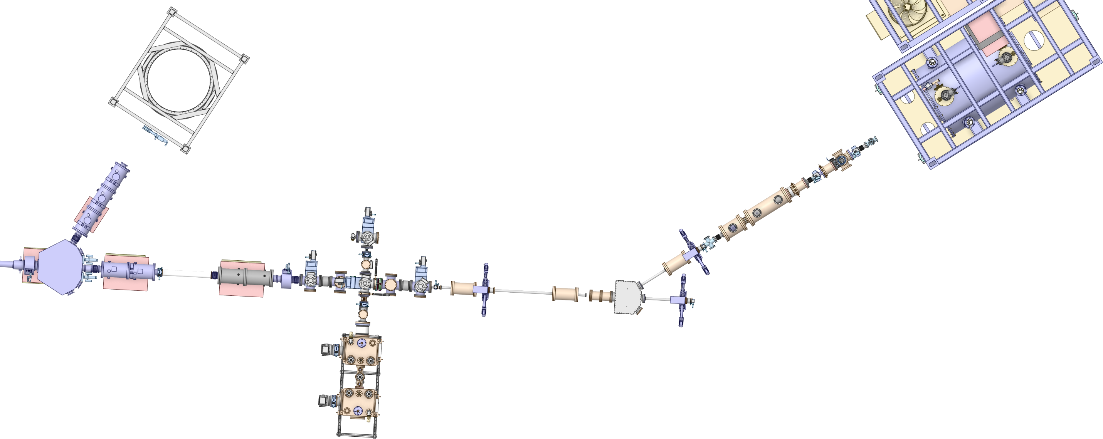
PUMA beam line sectorization
PUMA line <10⁻¹¹ mbar
MRTOF vacuum sectors 10⁻⁸ mbar (unbaked)
Transfer line 10⁻¹⁰ mbar (baked)
ISOLDE vacuum 10⁻⁶ mbar
Sector valve
Sector valve
Anybody here should target 10⁻¹⁰ mbar
Sector valve
Sector valve
Sector valve
Sector valve
4×Vacuum sectors + experiment beam line

Slide 3
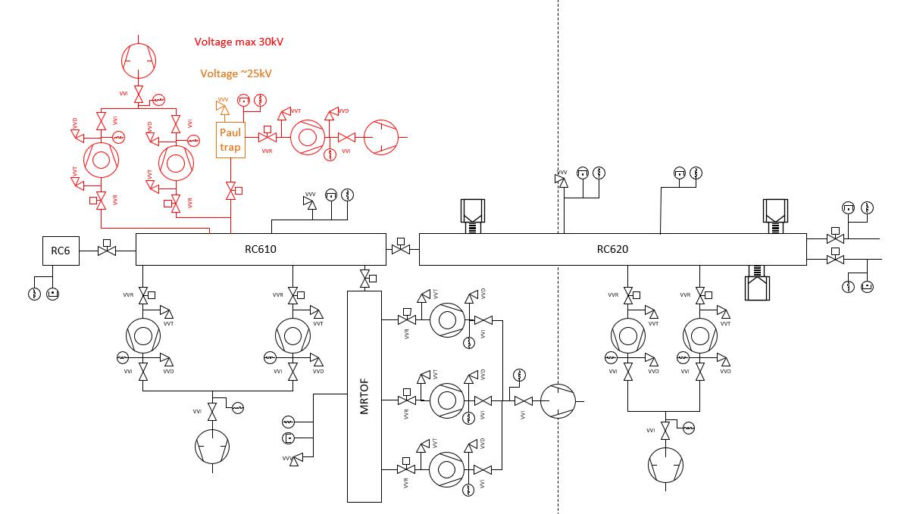
Vacuum layout
Layout was progressing and ready to order the equipment
Some pumps recovered from the MR-TOF => Onboard electronics. Despite not standard the other 6 turbos will have onboard electronics
At least the two last pumps should be H (high compression for light gases)
Pirani gauges for turbo baking => active
Cable request evolving with the changes (Abel)
Baking of the turbos still under discussion => Oil pumps for unbaked and dry for baked sector? => No venting

Slide 4
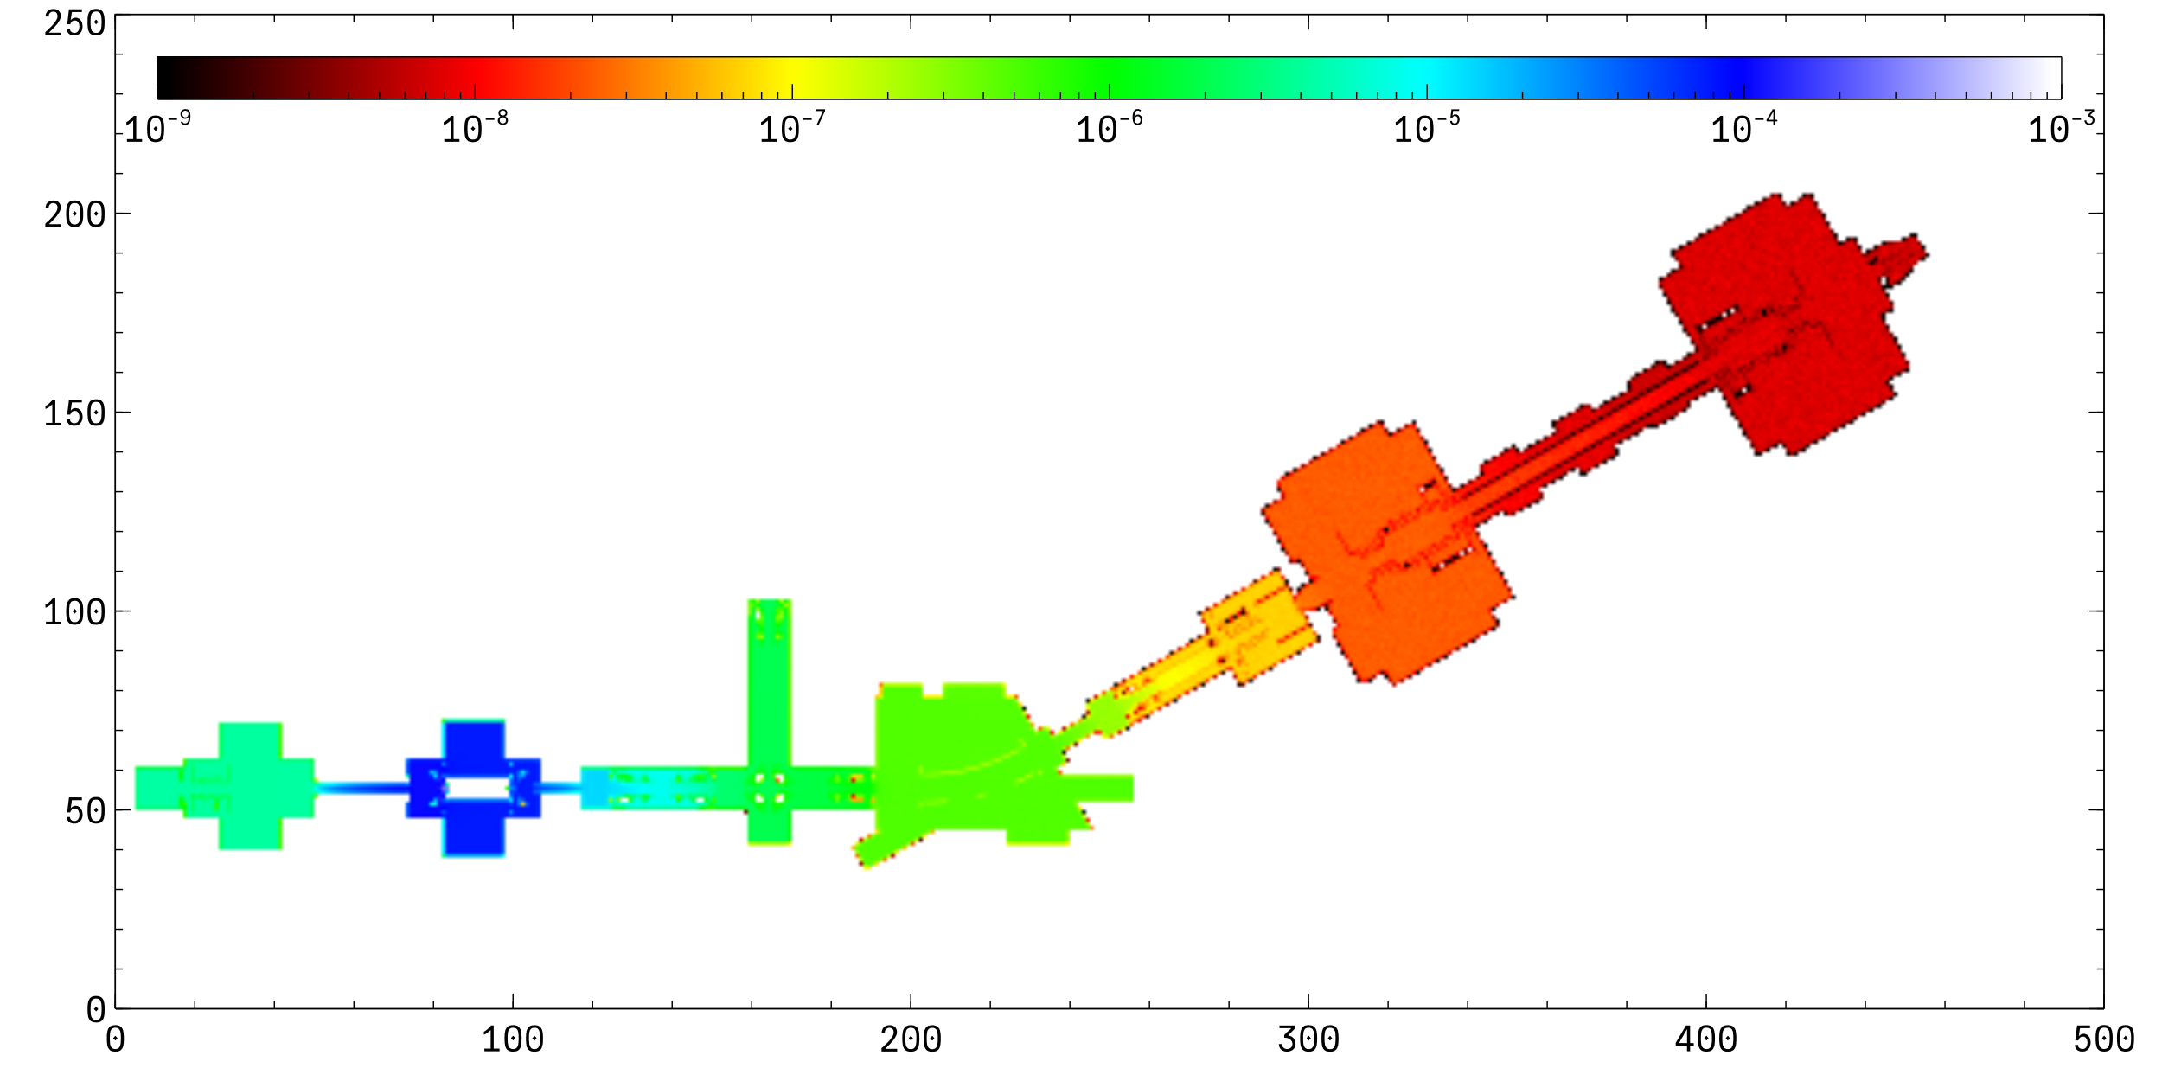
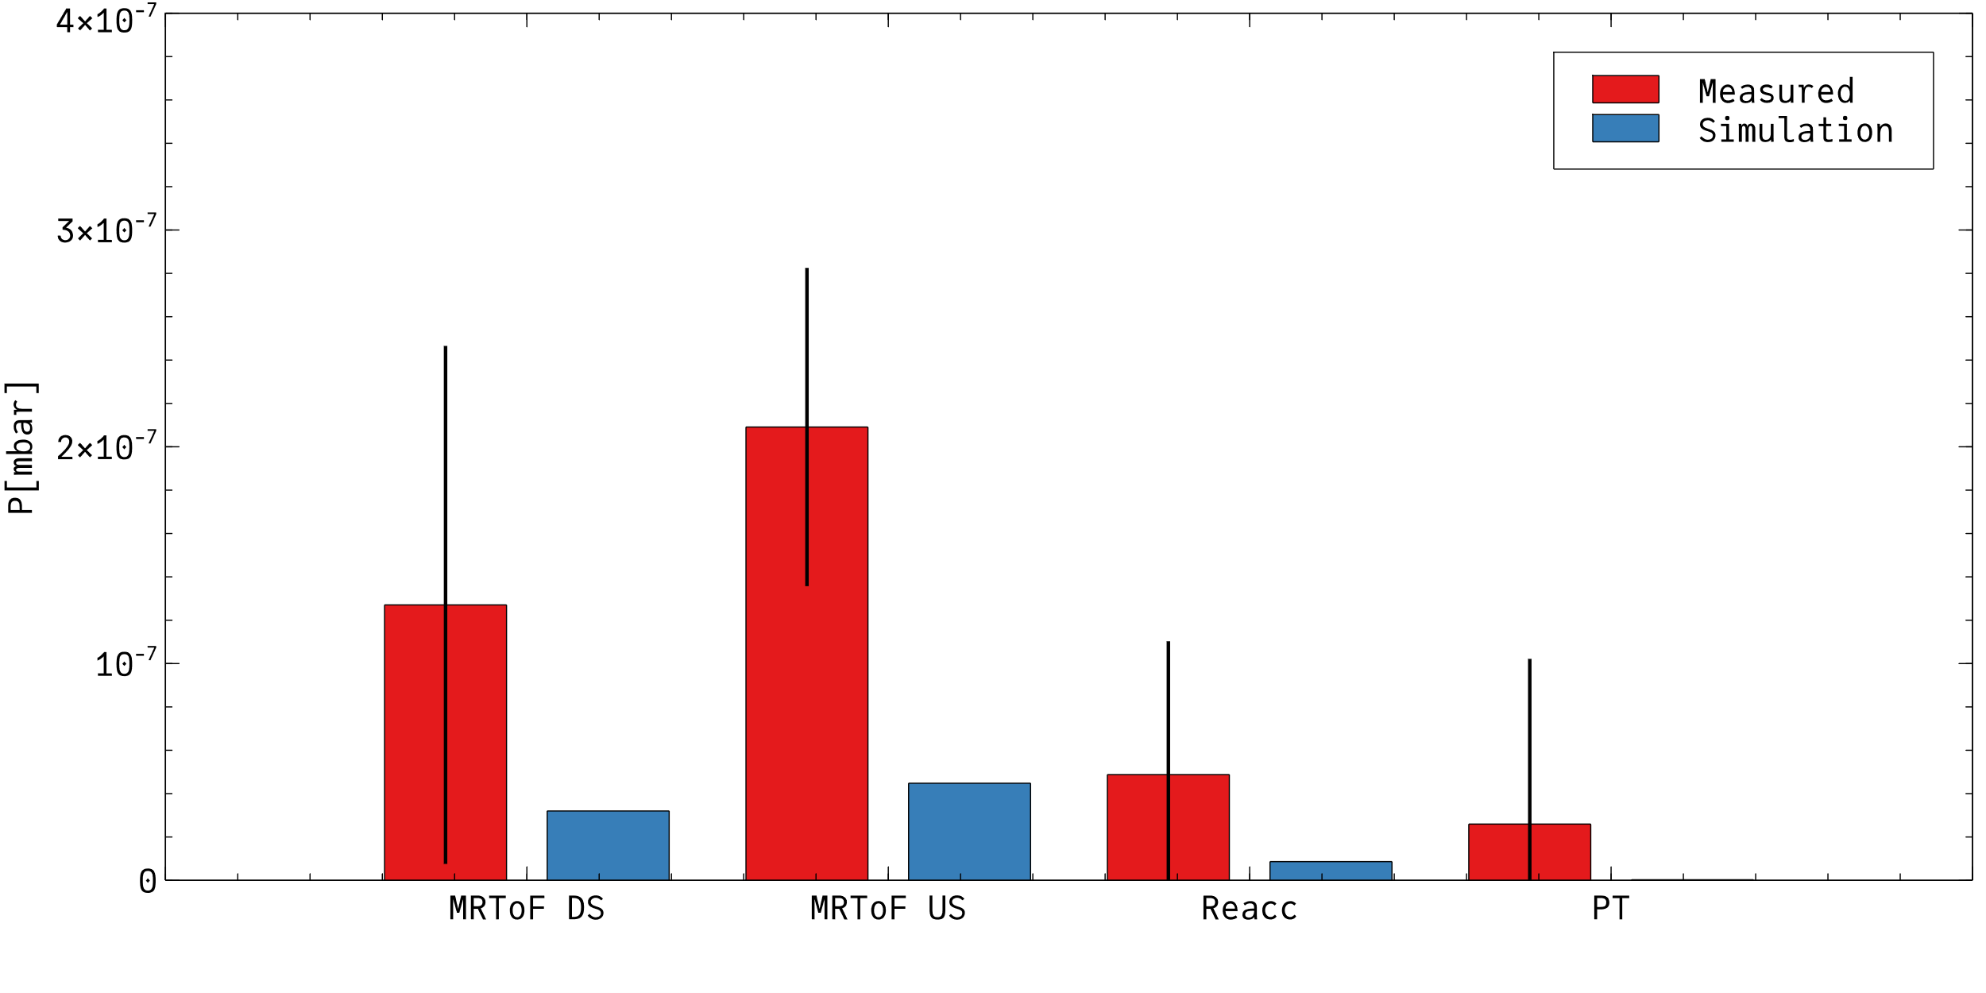
Benchmarking with He gas injection
Calibrated leak of 4.86e-9 mol/s (≈10⁻⁴ mbar×l/s)
Early results => 5 times discrepancy between simulated and observed profile => Same for the injection from the Paul trap
Possible explanations:
  Geometry errors => Recheck model (2 years old)
  Insufficient compression ratio?
  Check the baking pump model and repeat test with and without ballast => Primary pumps do not provide compression ratios

Slide 5
Paul Trap set point
Between SP 2 and 3 the requirement of 10⁻⁸ mbar is not met
It may require modifications of the turbo baking system (i.e. booster TMPs?)
Stresses the importance of reducing the conductance along the line
Not enough resources to do a thorough analysis. How critical is this for the project? Resources?

Slide 6
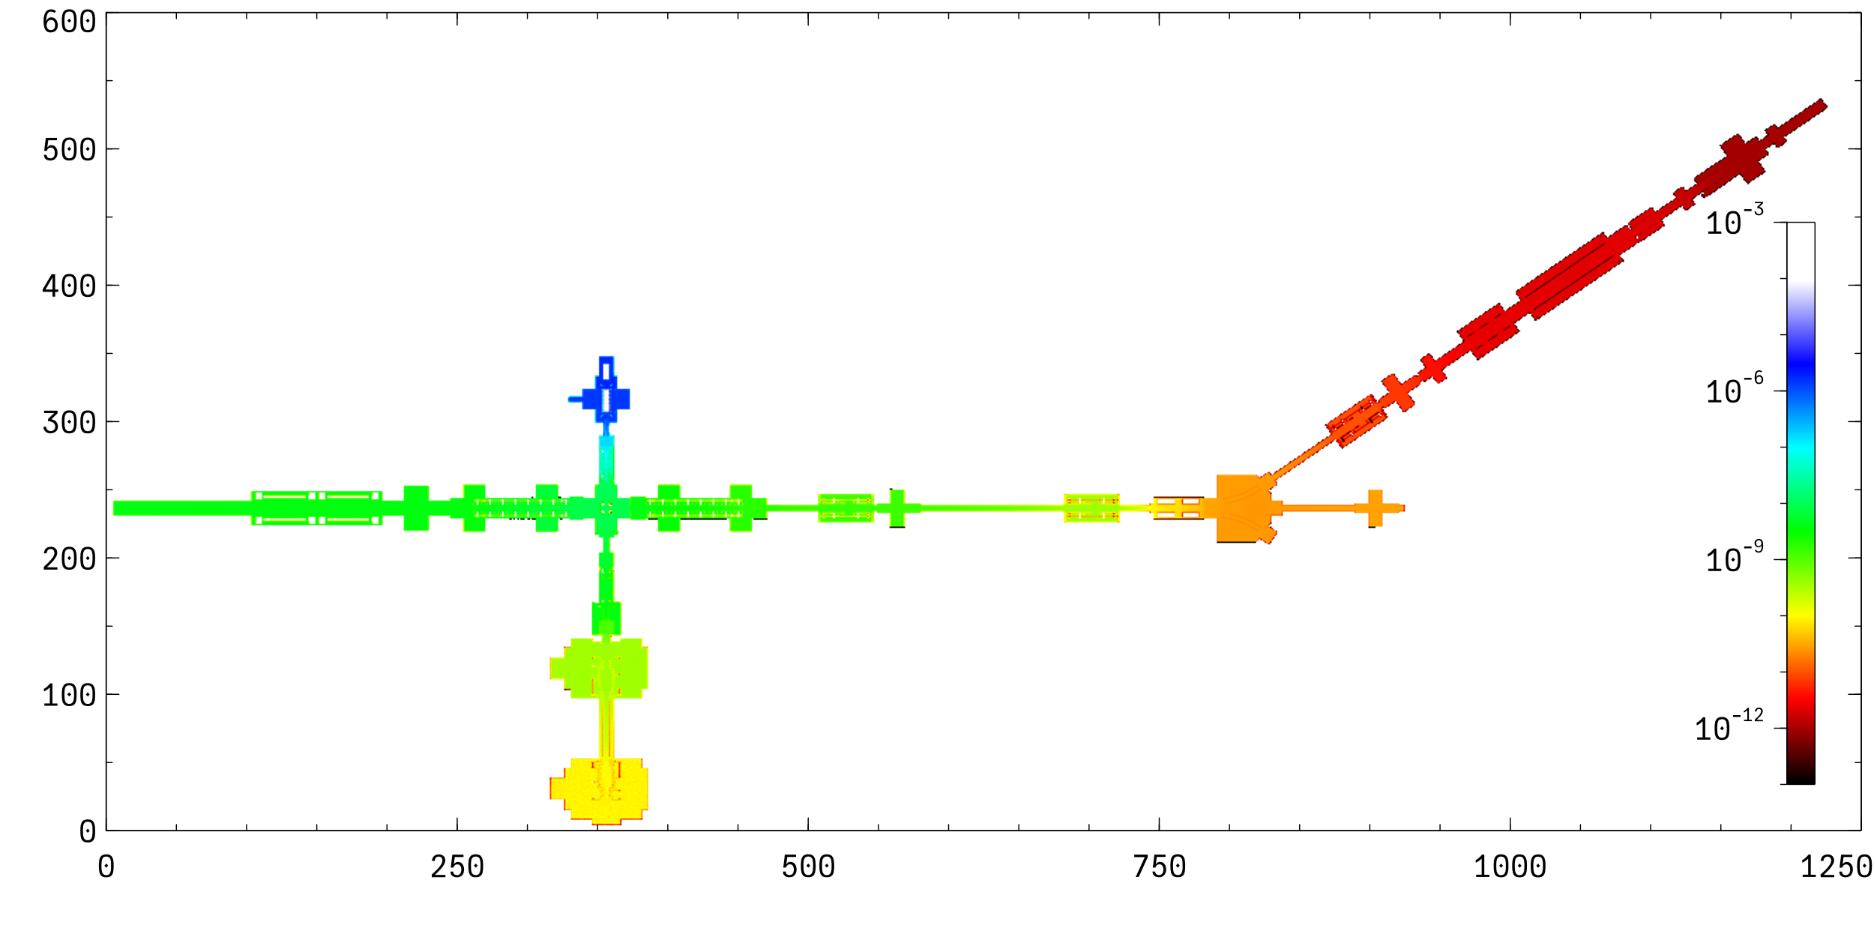
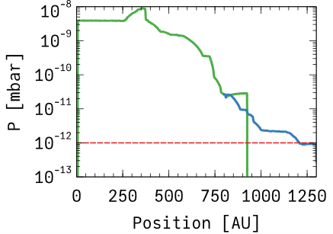
He propagation
10⁻⁴ mbar He pressure inside Paul trap
Simulation in two steps to overcome the lack of statistics (MC simulation)
2×StarCell 300 as in PUMA at ELENA
No pumping from the trap
Effect of irises conductance restriction not considered
P<10⁻¹² mbar next to the trap

Slide 7
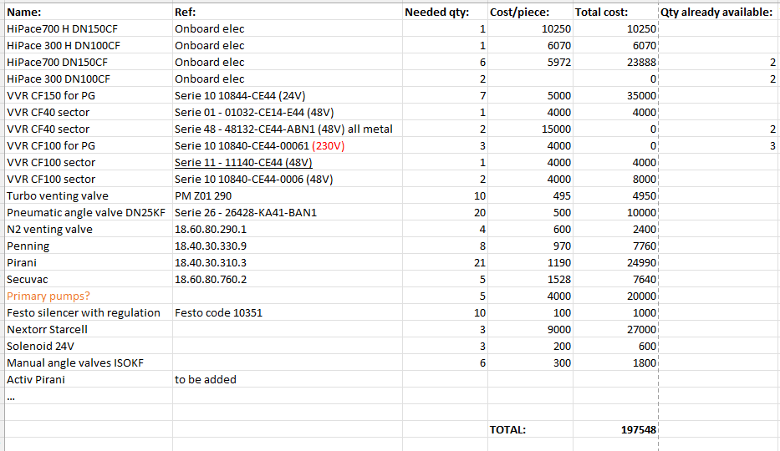
Equipment and budget
Item | Q | CHF/piece | Total
Series 10 DN100CF | 7 | 4 | 28
Series 10 DN40CF | 1 | 4 | 4
HiPace 700 | 7 | 7 | 49
Series 10 DN150CF | 7 | 5 | 35
Angle valve DN25KF | 18 | 0.5 | 9
Hipace 300 | 3 | 6 | 18
Angle valve DN16KF | 6 | 0.5 | 3
Venting valve TMP | 10 | 1 | 10
VGR | 21 | 1.5 | 31.5
Primary pumps | 5 | 4 | 20
VGP | 7 | 1 | 7
VVV | 4 | 2 | 8
Series 48 DN40CF | 2 | 15 | 30
NexTorr 500 -StarCell | 3 | 9 | 27
 |  | TOTAL | 279.5
Savings:
  Recover TMPs with onboard electronics for MR-TOF
  Valves from MR-TOF
  Other pumps with onboard electronics
  Reduce the number of valves (1×automatic + 1×manual leak detection valve per sector)
  2×old all metal DN40CF in stock before the experiment => reuse them after testing
200 kCHF + bakeout equipment + controls
Evaluation 2024

Slide 8
What do we have and what do we need?
What we have:
Vacuum layout defined
Main risk => He propagation. Disagreement between model and measurements to be analysed, but present injection levels put a question mark about compatibility with PUMA trap. Possible mitigation increasing compression ration => booster TMPs
TMPs H version, still for the last part of the beam line for maximum compression ratio (50 times higher for H₂ and 30 for He)
What we need:
Schedule and testing and installation planning
List of vacuum signals to provide to the “users” (power supplies, etc.)
How many elements are at high voltage and where to place those racks?

Slide 9
Thank you

Slide 10
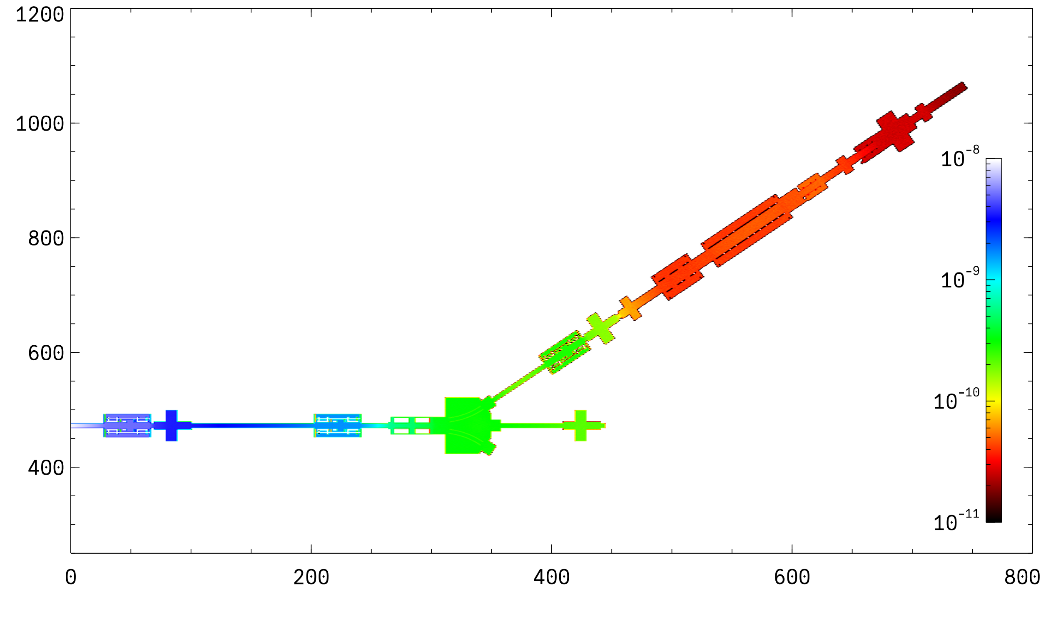
H₂ propagation
10⁻⁸ mbar at entrance of the previous sector
Assuming NEG coating in the first drift towards PUMA and in most of PUMA elements (0.005 sticking factor)
2×StarCell 300 as in PUMA at ELENA
Outgassing pessimistic assumption 5×10⁻¹² mbar×l/s/cm²
Effect of irises conductance restriction not considered
Not considered pumping from the trap, neither NEG cartridges.
P~10⁻¹¹ mbar next to the trap

Slide 11
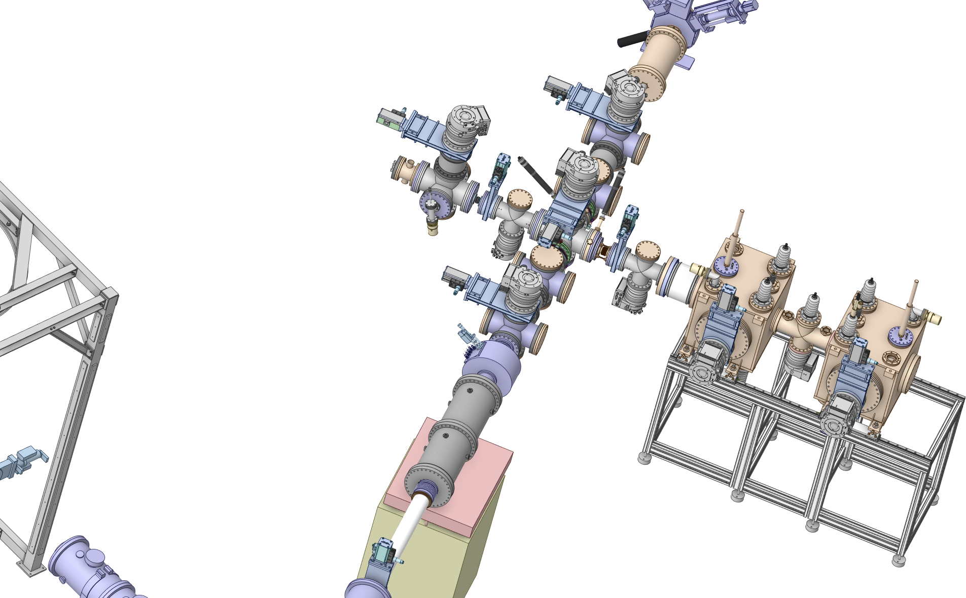
PUMA beam line vacuum equipment:
Sector RC610
Common primary pump?
1×HiPace 300
3×HiPace 700
2×Penning + Pirani
Venting valve
Instrumentation?
Missing valve. High voltage?
Instrumentation?

Slide 12
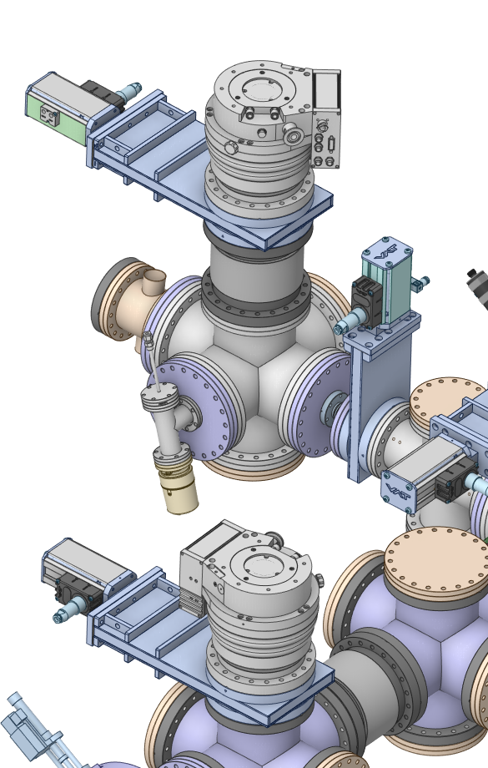
PUMA beam line vacuum equipment:
Sector RC611
1×HiPace 700
Penning + Pirani
Venting valve
Sector valve
Instrumentation and venting?

Slide 13
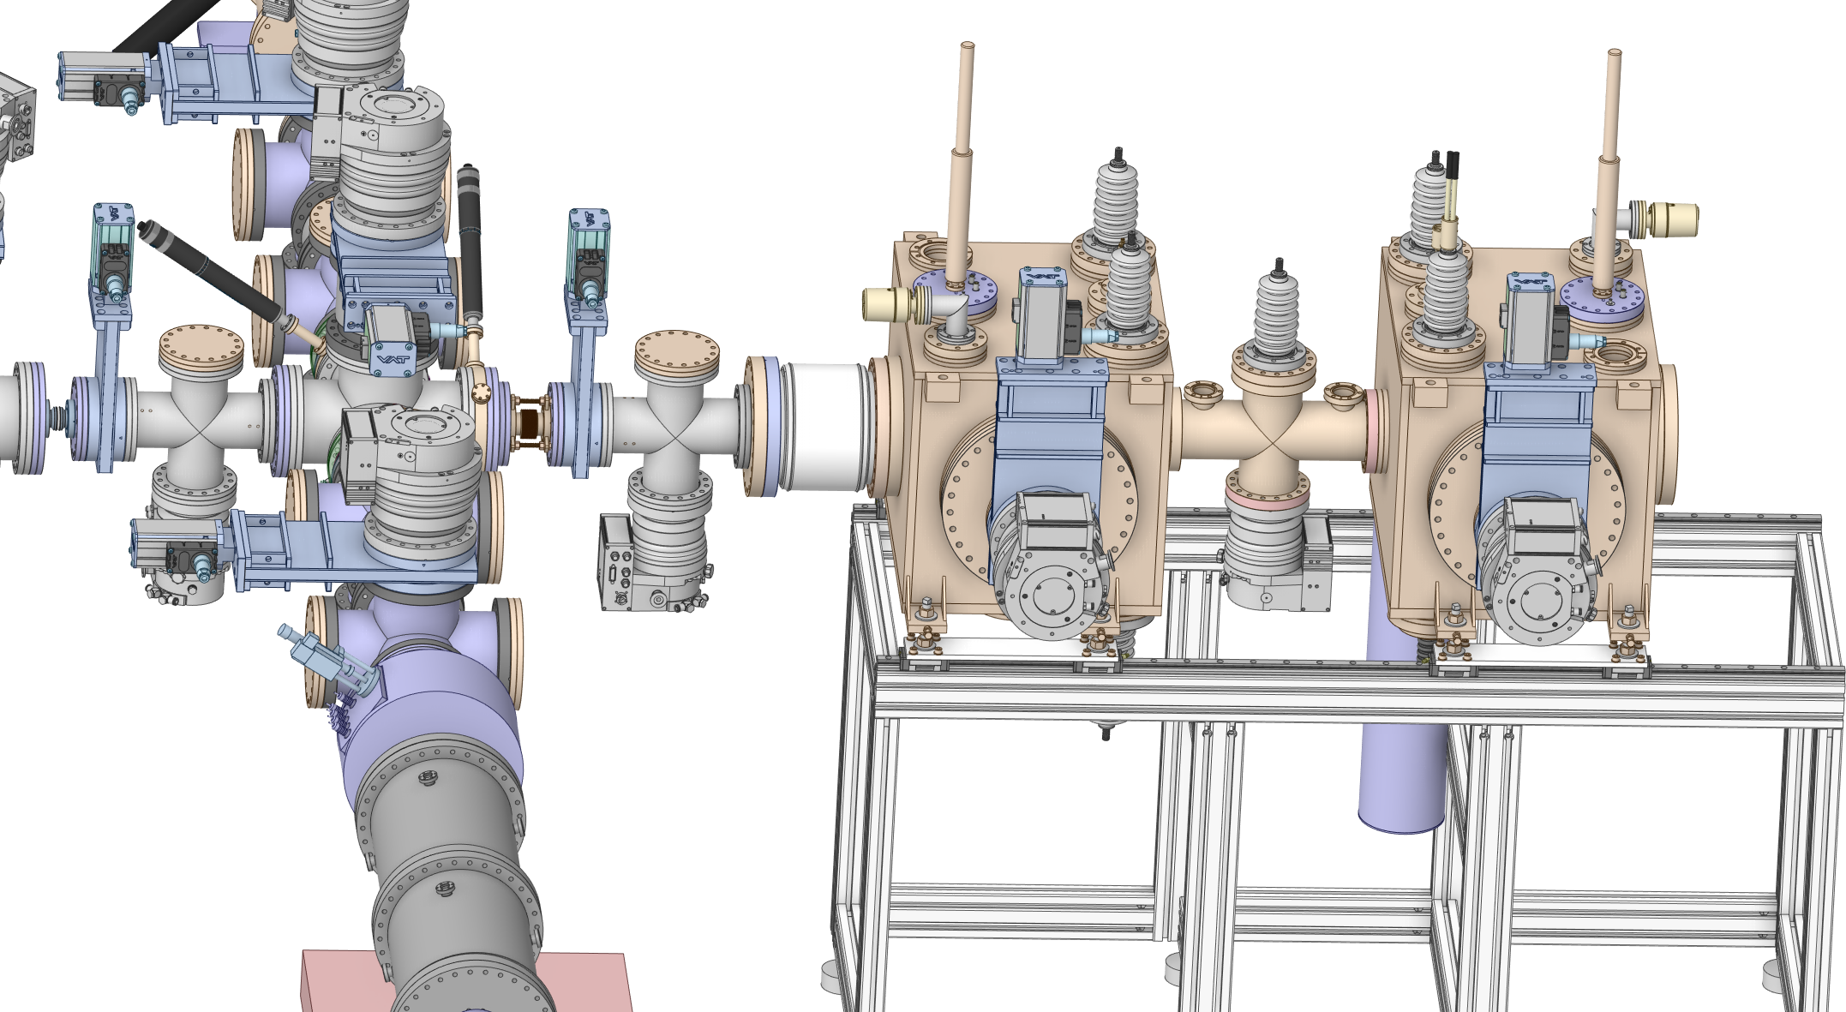
PUMA beam line vacuum equipment:
Sector RC612
Sector valve
Instrumentation?
2×HiPace 700
1×HiPace 300
Penning + Pirani
Venting valve
Common primary pump? High voltage?
Not considered
Missing valve

Slide 14
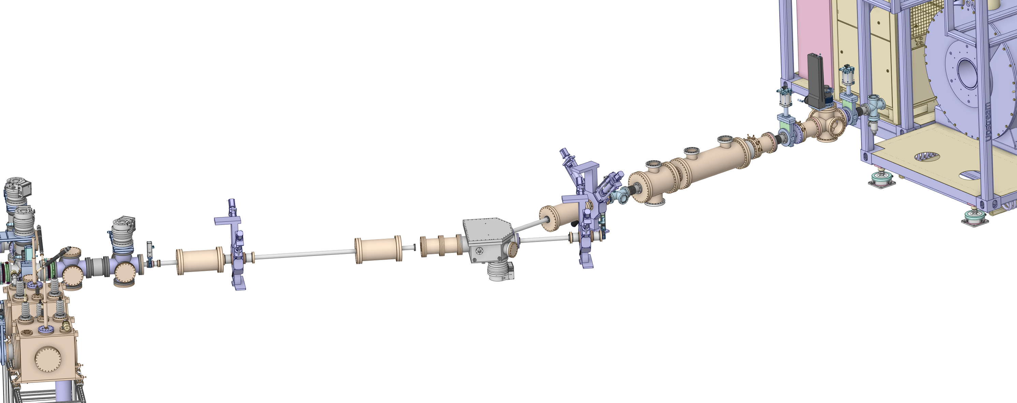
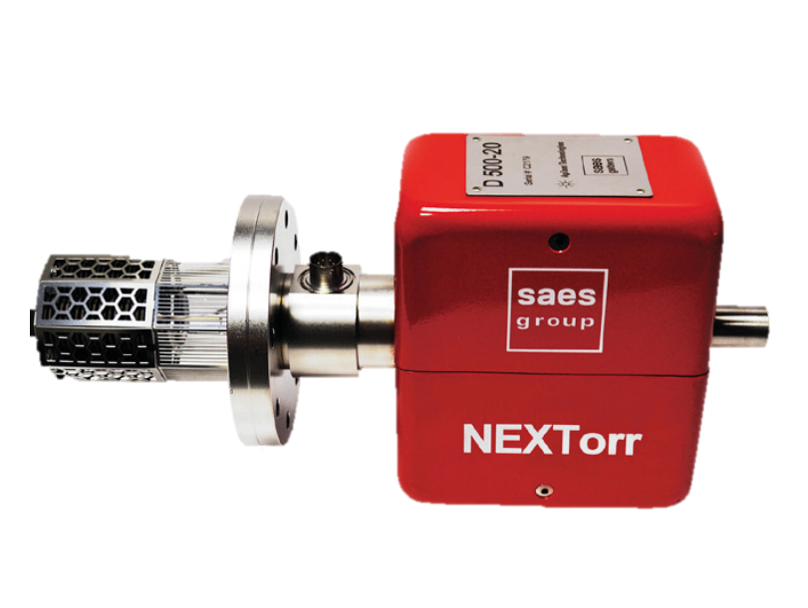
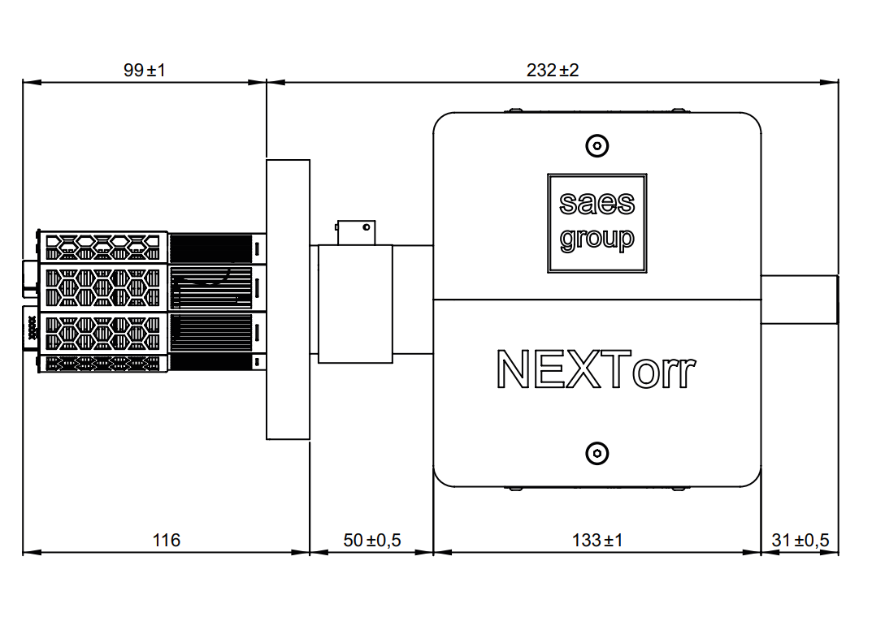
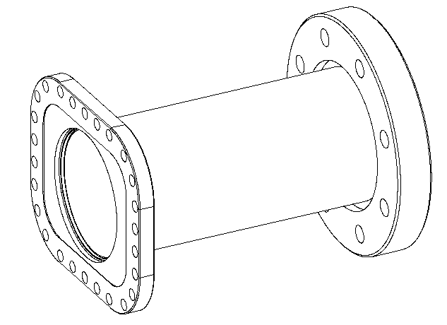
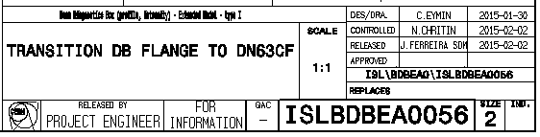
PUMA beam line vacuum equipment:
Sector RC620
1×HiPace 700
1×HiPace 300
3×NexTorr 500 StarCell
2×Penning + Pirani
Venting valve
Add H₂ pumping speed (NEG)
Sector valve
Add arm for instrumentation and possible extra-pumping
Sector valve
Add H₂ pumping speed
Extra TMP
Common primary pump
Sector valve
Add H₂ pumping speed

