Slide 1
Outlook
Compact agenda with all work packages, thanks to everyone for your effort
More dedicated meetings - ongoing
Goal of today's meeting:
Update everyone on the progress of the project
Verify and share information between teams (What is still missing? Do you need input from others?)
Budget: Please revise the 2023 numbers
Project timeline

Slide 2
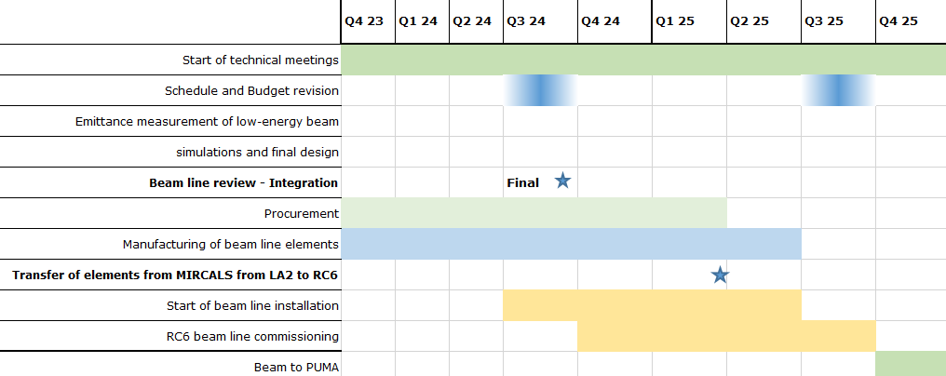
Tentative schedule

