Slide 1
ICOOL
J. Scott Berg
Brookhaven National Laboratory
Ionization Cooling Software Mini-Workshop
17 October 2024

Slide 2
ICOOL Overview
Software written specifically to model ionization cooling
Written primarily by Rick Fernow, currently “maintained” by me
  Available at https://www.cap.bnl.gov/ICOOL/
Underlying physics model
  Originally Geant3 plus integration through EM fields, spin
  Additional models for ionization cooling processes have been added over the years
Beamline as a sequence of longitudinal regions
  Radial build within each region

Slide 3
Beamline Layout
Laid out longitudinally with respect to a “reference particle”
  Reference can curve, often determined by field
Sequence of “SREGION”s with specified longitudinal lengths
  Can be divided into radial sub-regions
Each region has a
  Field (can come from neighboring regions as well)
  Material, possibly with more complex shaping
Three nested layers of looping possible, sort of

Slide 4
Field Types
Accelerator magnets (dipole, quadrupole, sextupole, etc.)
  Different “model”s for handling of ends, etc.
Numerous ways to get solenoid fields
  SOL: accelerator-like, field map, expanding from on-axis field
  COIL: current loop
  SHEET: cylinder of current
  BLOCK: annulus with rectangular cross-section
  BSOL: bent solenoid
Acceleration (ACCEL): RF cavity or other
Generic field maps
A few others…

Slide 5
Interactions
Average energy loss
  Bethe-Bloch, possibly with density effect, most probable loss
Multiple scattering
  Gaussian, Moliere, Rutherford, Fano, Tollestrup, ELMS, …
Straggling
  Gaussian, Landau, Vavilov, ELMS, …
Decays
Primitive nuclear interaction, space charge models

Slide 6
Input/Output
Initial distribution
  Can be generated, many models
  File with particles
Output
  File with particles
    At select locations, each region, steps within regions
    Included ecalc9f post-processing program
  Will also process data (histograms, etc.), but not so useful

Slide 7
Code Maintenance
Currently I am the primary “maintainer”
  But not my day job, no time allocated to this
I have done some updates to handle evolving Fortran support, fix bugs (new version posted soon)
Send bug reports, I will try to fix them, and will make a best effort to answer questions. Feature requests will go in the queue…
There is also an MPI version, ran on NERSC (needs a couple changes to get working again)
I have a TODO list…

Slide 8
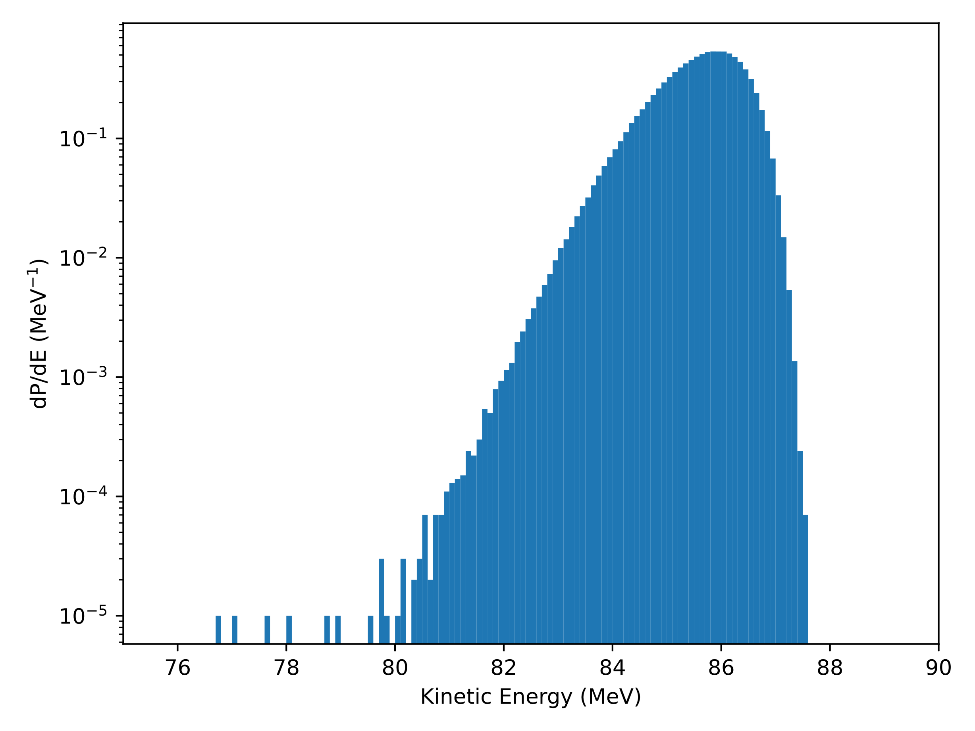
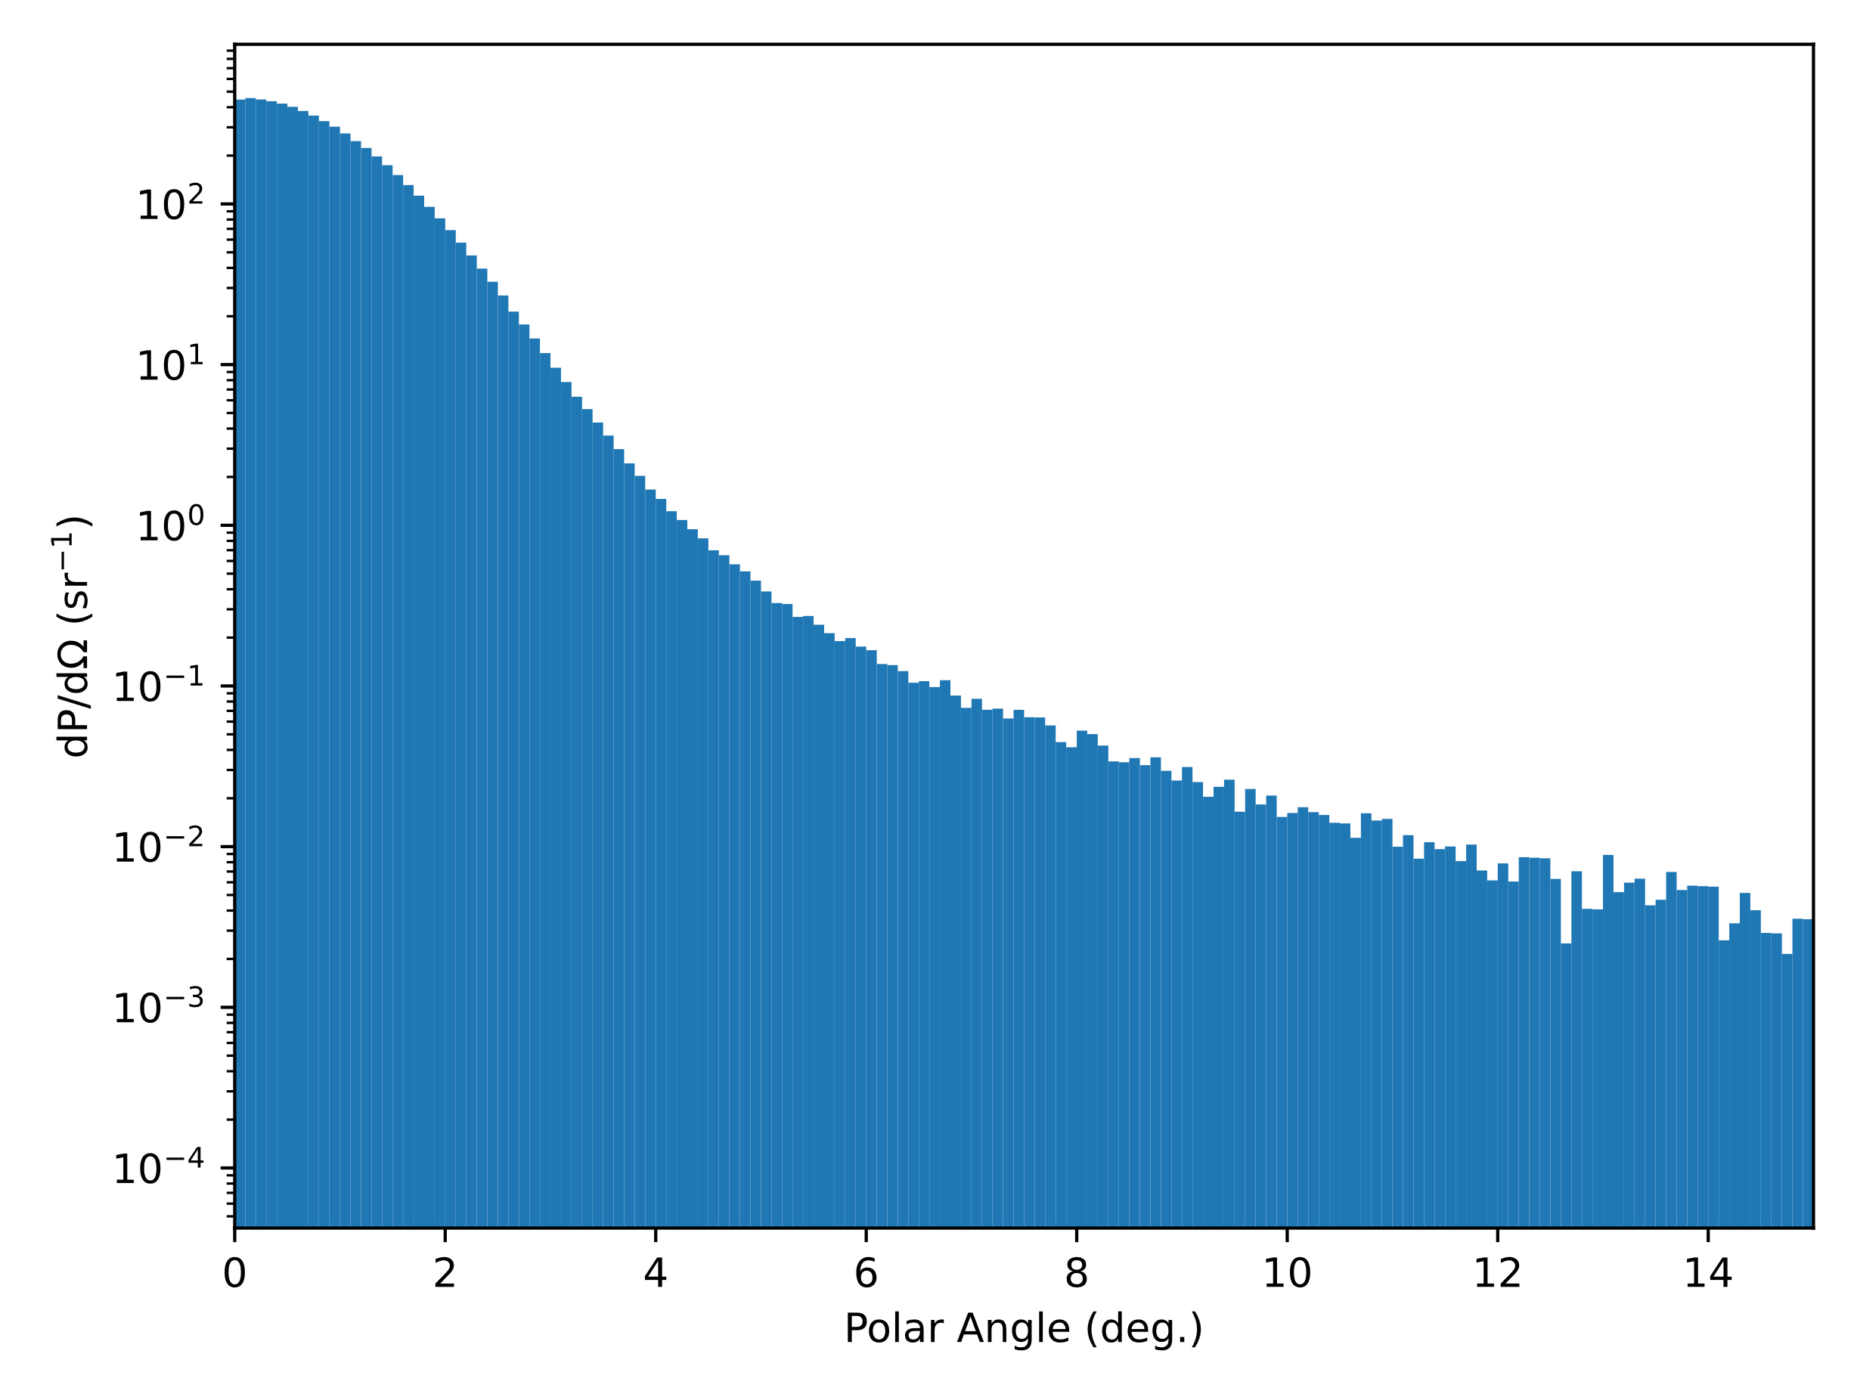
Benchmarking
Time limits what I am able to get to
Ran very first example (absorber, LiH, 171.55 MeV/c muons)
  Default physics model
  Can’t specify isotopic composition (TODO list…)
Out of 10⁶ particles, 71 decay, 13 going backward
Default interactions, should compare other models (lots of combinations)

Slide 9
Final Thoughts
ICOOL is a good code for cooling simulations, used heavily in MAP and earlier design studies
  Can quickly get many cooling channel (and other beamline) simulations running
I have limited time to maintain & improve it
  I have a TODO list, feature suggestions welcome
  Collaborators are of course welcome
Doesn’t have a complete physics model behind it like Geant4
  E.g., modeling of nuclear interactions incomplete (e.g., pion absorption)

