Slide 1


Software Mini-Workshop, online, 17.10.2024
RF-Track
Bernd Stechauner^{1,2}, Rebecca Taylor², Rudolf Frühwirth^{1,4}, Andrea Latina², Chris Rogers³, Daniel Schulte², & Jochen Schieck^{1,4}
¹University of Technology, Vienna
²CERN, Geneva
³STFC Rutherford Appleton Laboratory, Didcot
⁴Institute of High Energy Physics (HEHPY), Vienna

Slide 2
Overview
Focus on RF-Track [1] as a novel simulation tool for final cooling
Overview of implemented particle-matter interaction models
Compare RF-Track with ICOOL[2] and G4BL[3]
To-Dos
Conclusion

Slide 3
About the RF-Track software
C++ code for accelerator physics simulations.
Utilizes GNU Scientific Library (GSL) and the FFTW library .
Software supports parallel processing for increased computational efficiency in complex particle tracking within field maps.
Users have the option to interface with RF-Track using Python or Octave.
Collective Effects:
  Space charge forces
  Short- and long-range wakefields
  Beam loading phenomena
Single-Particle Effects:
  Incoherent synchrotron radiation
  Magnetic multipole kicks
  Multiple Coulomb scattering
Many RF-Track contributions [4-8]

Slide 4
Particle-material interactions that are relevant for ionization cooling
Energy loss/ loss fluctuation
Multiple Coulomb scattering
Implementation into the RF-Track code

Slide 5
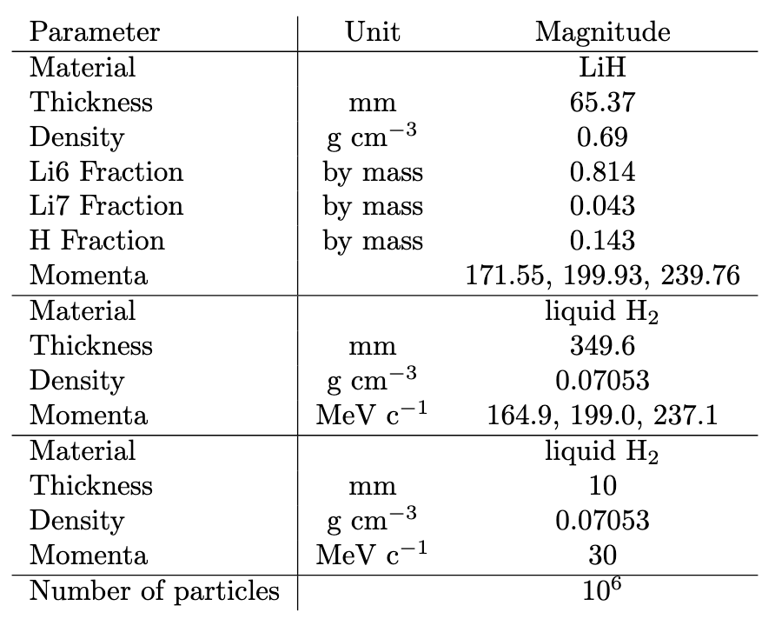
Reference materials for benchmarkings studies
Performed benchmarkings:
  Absorbers
    Liquid hydrogen
    Lithium hydride
    Beryllium
  Solenoid
  Single final cooling cell

Slide 6
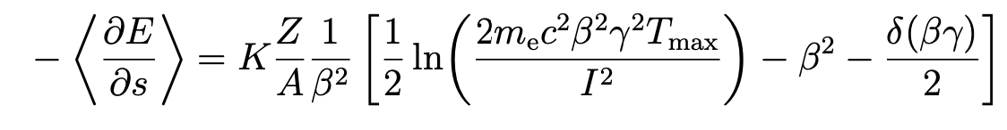
Energy loss liquid hydrogen
Bethe-Bloch equation
Energy loss of muons depends on:
Energy of the particle
Material properties
Path length
Compare RF-Track energy loss of liquid hydrogen with ICOOL
Error is less than 0.3%
Results show good agreement.
Error increase in case of particle losses (see lower right plot).

Slide 7
Energy loss lithium hydride (LiH)
The ICOOL manual presents LiH with a different density and a varying composition of Li6 and Li7 compared to the LiH sample form MICE.
Mixing a specific material with ICOOL might require some additional clarification, as the process isn't immediately intuitive.
Therefore, RF-Track energy loss benchmarking of LiH with G4Bl.
How to mix material in RF-Tack and G4BL – code example:
frac_Li = 0.86
frac_H = 0.14
A_Li_Mice, A_H = 6.05, 1.0079 #atomic numbers
Li = RF_Track.Absorber(abs_len, X0_Li, Z=3., A=A_Li_Mice, rho_LiH * frac_Li, I=40.)
H = RF_Track.Absorber(abs_len, X0_H, Z=1., A=A_H , rho_LiH * frac_H, I=21.)
V.add(Li, 0, 0, 0, 'entrance')
V.add(H, 0, 0, 0, 'entrance')
RF-Track
material Li6 Z=3 A=6 density=0.539
material Li7 Z=3 A=7 density=0.534
material LiH Li6,0.814 Li7,0.043 H,0.143 density=0.69
G4Bl
Special thanks to D. Kaplan

Slide 8
Energy loss lithium hydride (LiH)
Error slightly higher, than compared to LH
Might come from different mixing techniques

Slide 9
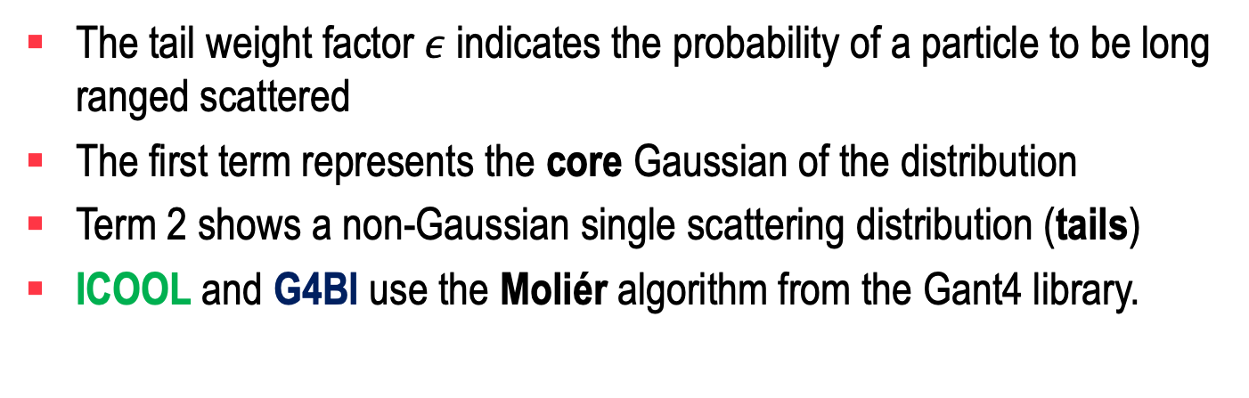
Semi-Gaussian distribution as scattering model in RF-Track [9,10]
The tail weight factor $ε$ indicates the probability of a particle to be long ranged scattered
The first term represents the core Gaussian of the distribution
Term 2 shows a non-Gaussian single scattering distribution (tails)
ICOOL and G4Bl use the Moliér algorithm from the Gant4 library.

Slide 10
First try: ICOOL vs RF-track: Beryllium
1E6 muons for each simulation
Start: 1 GeV mono energetic pencil beam
Absorber length: 1% of radiation length
The shape of the distribution changes minimally with the number of integration steps.
The Moliér model lacks on the convolution property, indicating potential for further improvement.

Slide 11
ICOOL vs RF-Track: Liquid hydrogen
1E6 muons for each simulation.
Example with 1, 10, 100 and 1000 steps.
Excellent agreement is observed with ICOOL.
Exception: the ICOOL model overestimates the tails slightly .

Slide 12
Std. scatter angle benchmarks
Liquid hydrogen Examples
Error are in the range of 5%.
Exception: low energy example, due to high losses.
LiH Examples

Slide 13
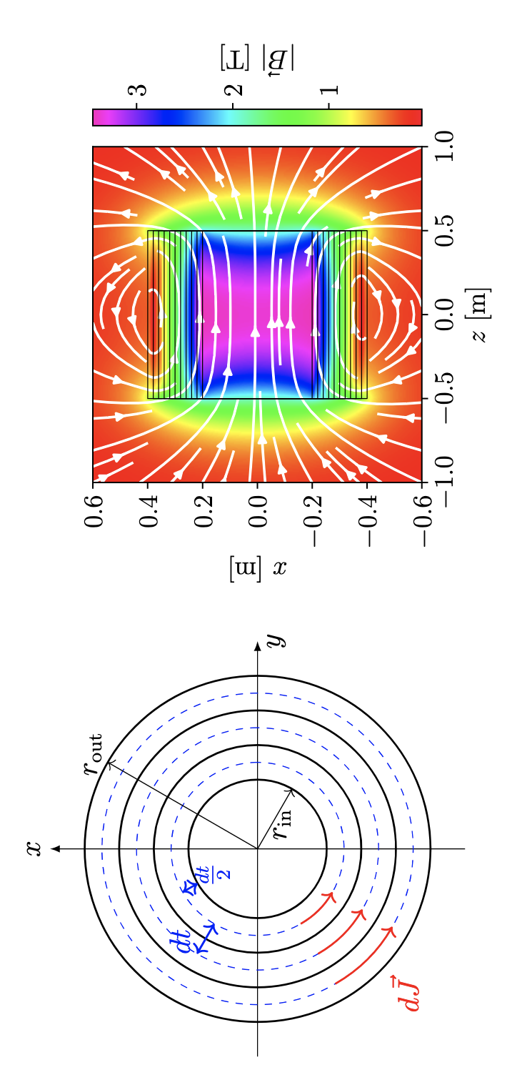
Solenoid model
RF-Track uses the current sheet model for solenoids.
The model is based on elliptical integral functions.
These functions come from GSL but require more computational time to evaluate field strength for all particle positions.
Solution: RF-Track creates a meshgrid of the 3D solenoid field and uses an interpolation function to provide field strengths during particle tracking.

Slide 14
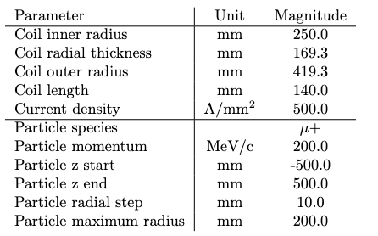
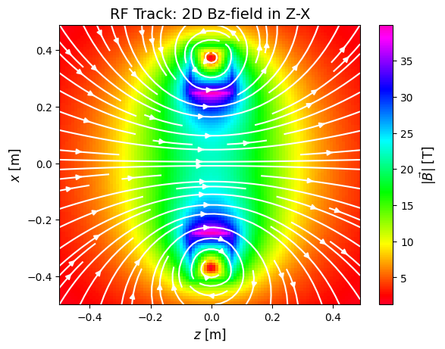

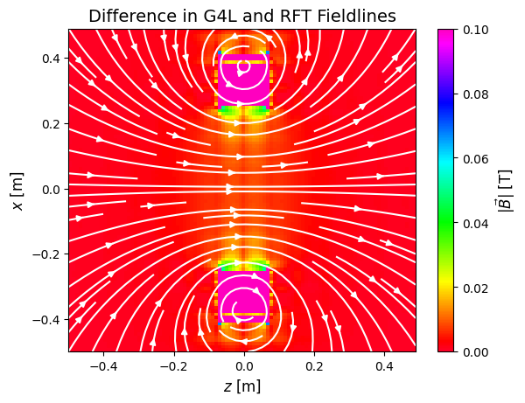
Solenoid field benchmarking
Comparison RT-Track with G4BL.
Sheet number: 200
We find slightly differences in the off-axis and coil regions.
difference
Analysis from R. Taylor

Slide 15
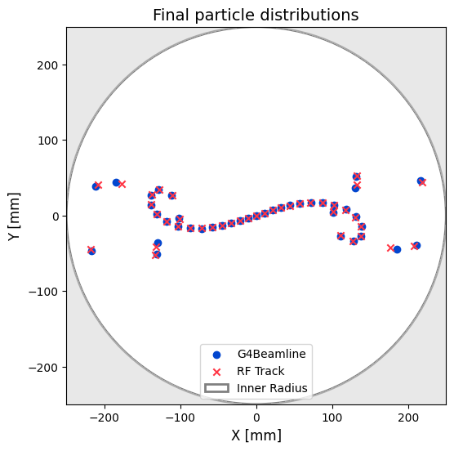
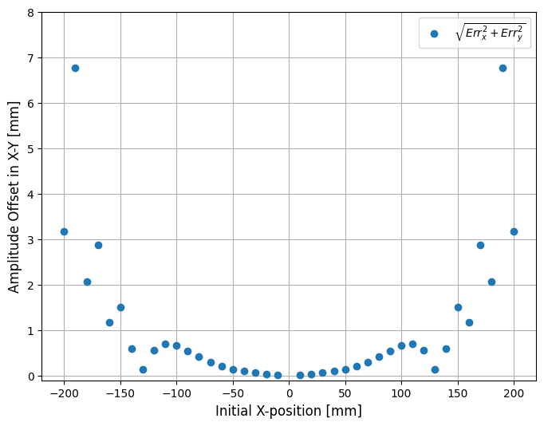
Solenoid field: particle tracking benchmarking
Analysis from R. Taylor

Slide 16
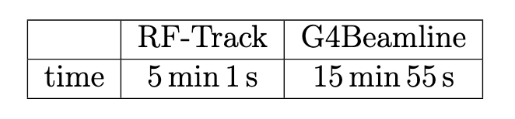
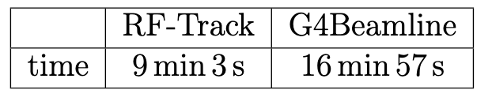
Final cooling cell example
No absorber
With absorber
Computation time
Slightly higher cooling with RF-Track, which must be investigated.
Computation time
Initial emittances taken form [11]

Slide 17
To-do list for RF-Track
RF-Track assumes the energy fluctuation as normal distributed.
It must be Vavilov/Landau distributed.
The Gauss approximation is valid for very thick materials.
Comparison of tracking in cavities.
RF-Track uses TM011 mode; G4BL uses TM010 mode.
TM011 is the better option, since we consider window less cavites in final cooling.

Slide 18
Summary & outlook
Energy loss model in RF-Track show high agreement with ICOOL and G4BL
A multiple Coulomb scattering model based on a semi-Gaussian mixture model was added in RF-Track and compared with ICOOL.
Results were compared with ICOOL, showing excellent benchmarking results.
This new tool enables an optimized design of ionization cooling channels for a future muon collider.
Next step: Focus on longitudinal beam distributions

Slide 19



Thank you for your attention

Slide 20
Reference list
[1] A.Latina,RF-TRACK, https://gitlab.cern.ch/rf-track.
[2] R. Fernow, "COOL: a simulation code for ionization cool- ing of muon beams", Proc. of the 1999 Particle Accelerator Conference, New York, NY, USA, 1999, pp. 3020-3022 vol.5, doi:10.1109/PAC.1999.792132.
[3] T.J. Roberts, "G4beamline simulation program for matter- dominated beamline", IEEE Particle Accelerator Conference (PAC), Albuquerque, NM, USA, 2007, pp. 3468-3470, 2007, doi: 10.1109/PAC.2007.4440461.
[4] S. Benedetti et al., “High gradient linac for proton therapy”
[5] C. Rossi et al., “The deep electron flash therapy facility”
[6] Y. Han et al., “Optimization of the clic positron source using a start-to-end simulation approach involving multiple simulation codes”.
[7] Y. Zhao et al., “Comparison of Different Matching Device Field Profiles for the FCC-ee Positron Source,”
[8] V. Musat et al., “A high-energy and high-intensity inverse Compton scattering source based on compact light technology,”

Slide 21
Reference list
[9] R. Frühwirth, M. Liendel: Mixture models of multiple scattering: computation and simulation.
[10] R. Frühwirth, M. Regler: On the quantitative modelling of core and tails of multiple scattering by Gaussian mixtures .
[11] B. Palmer: Muon final cooling in 30-50T solenoids.

