Slide 1
BDF target station
Design limits of responsabilities
R. Franqueira Ximenes, J-L. Grenard, C. Mucher – WP3, WP4
15-08-2024

Slide 2
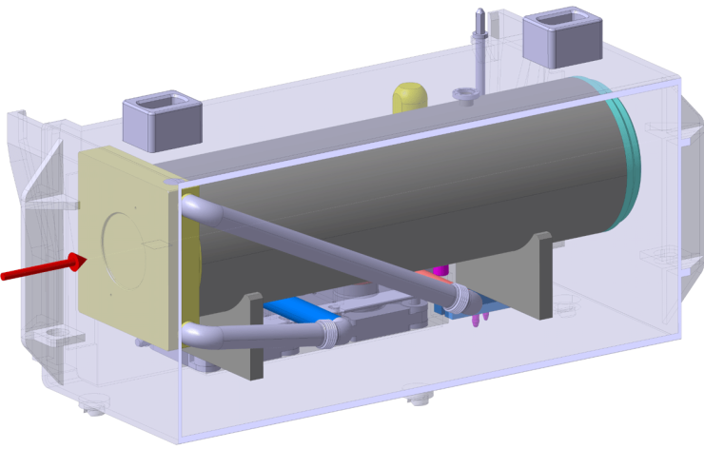
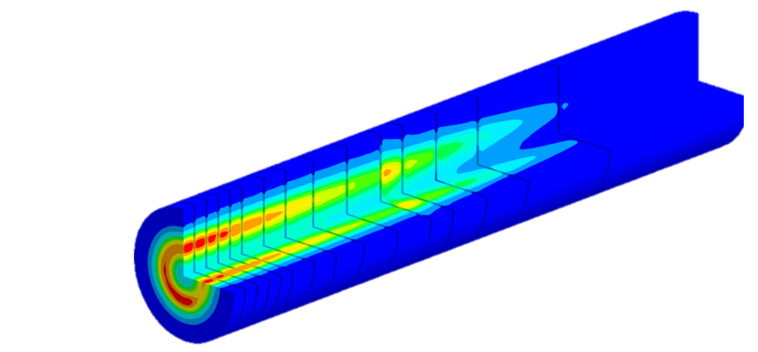
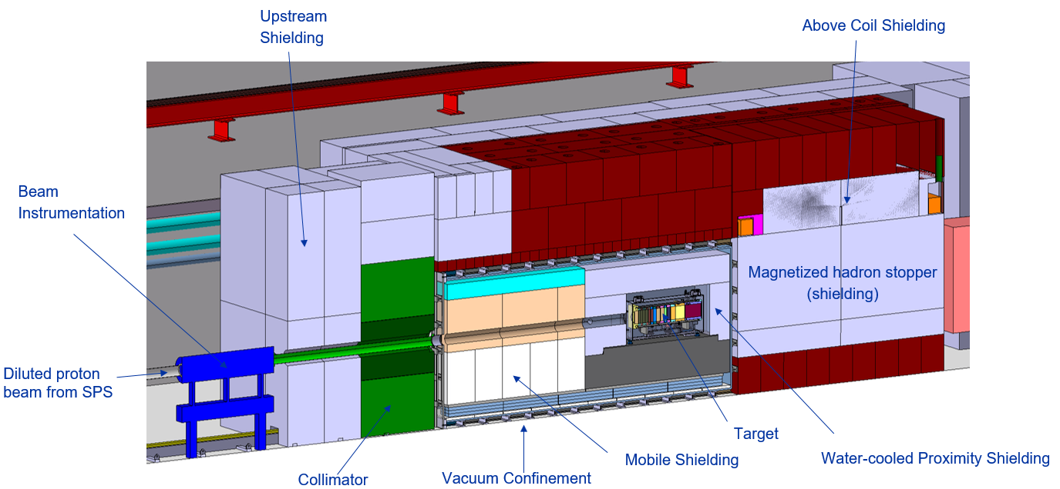
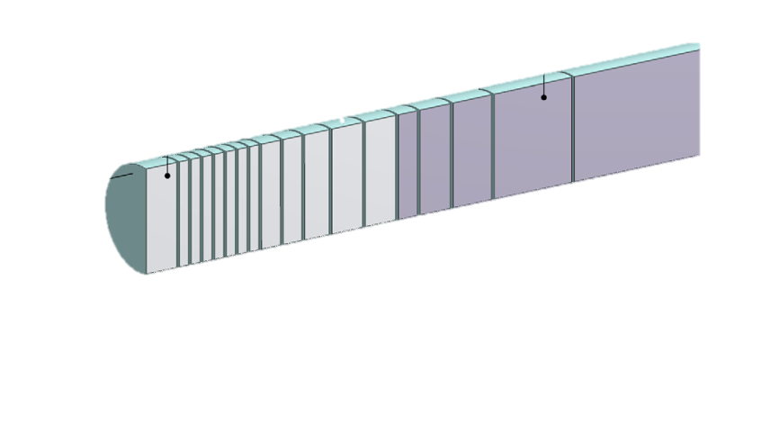
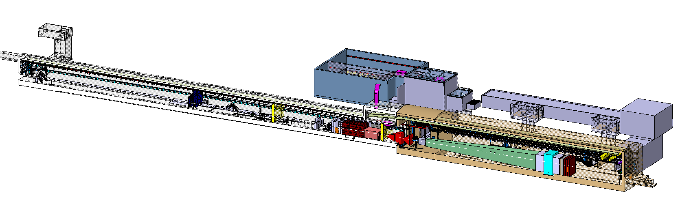
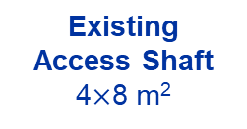
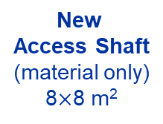
BDF/SHiP Target
Baseline Design → To be improved during TDR
WP4
WP3
13 x TZM blocks (580 mm)
5x W blocks (780 mm)
New
Service Building
~ 500 – 700 m²
New
Access Shaft
(material only)
8$×$8 m²
Existing
Access Shaft
4$×$8 m²
WP4
B911
B918
Beam Dilution System
TCC8
WP2
WP4
ECN3
WP6,WP7 +al.
New Target Complex
containing the Beam Dump Target
WP5+SHiP
Overall integration
BE-EA integartion team coordinated by J-L. Grenard and F. Butin

Slide 3
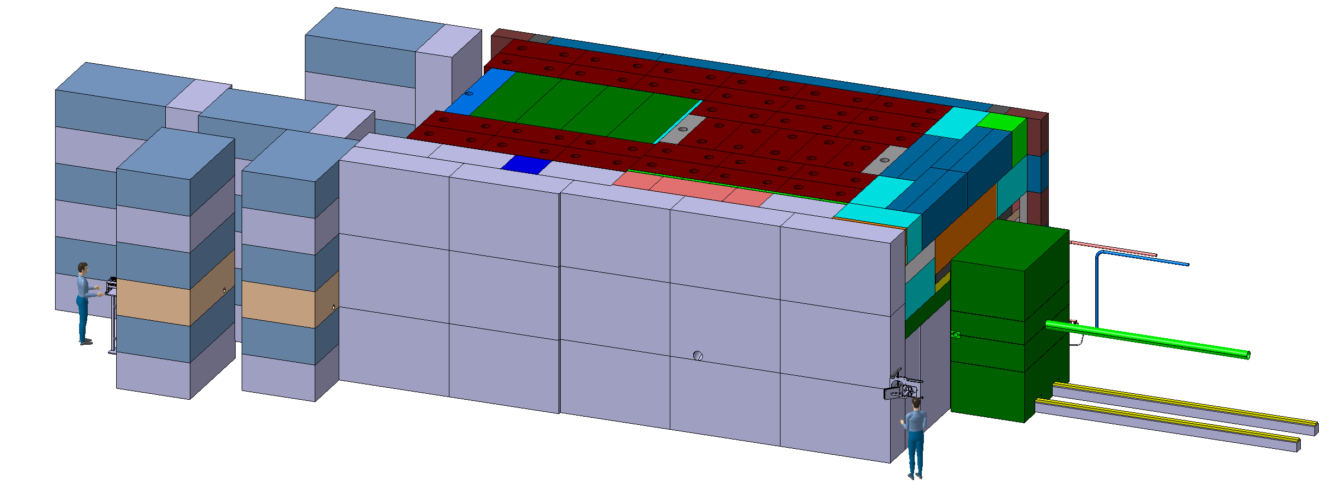
BDF Target complex integration - shielding
~4,8m
~8m
~ 180 m³ (~1400t) of cast iron + US1010
~ 360 m³ (~800t) of concrete / marble
~12m

Slide 4
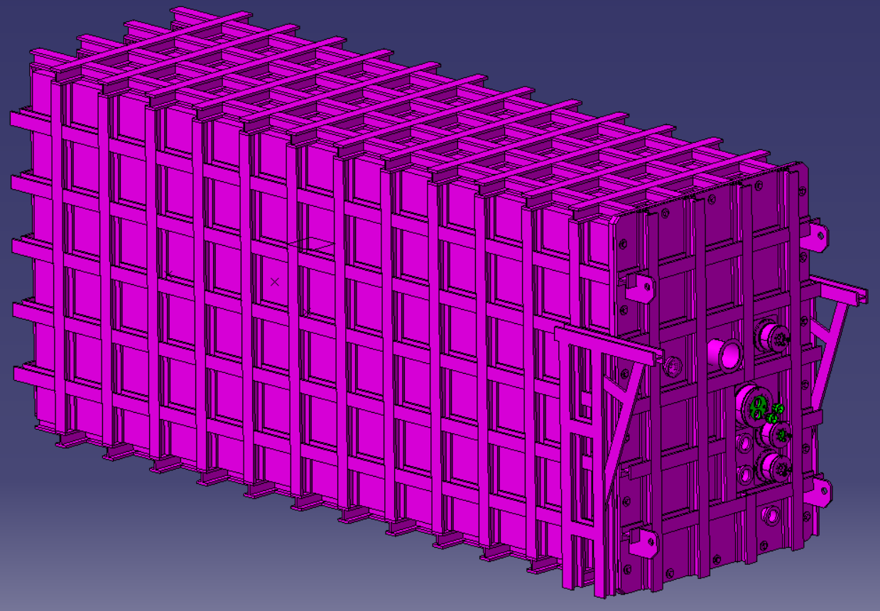
SY-STI design
EN-MME design
Overall integration
SY-STI
Ref: ST1760441_01

Slide 5
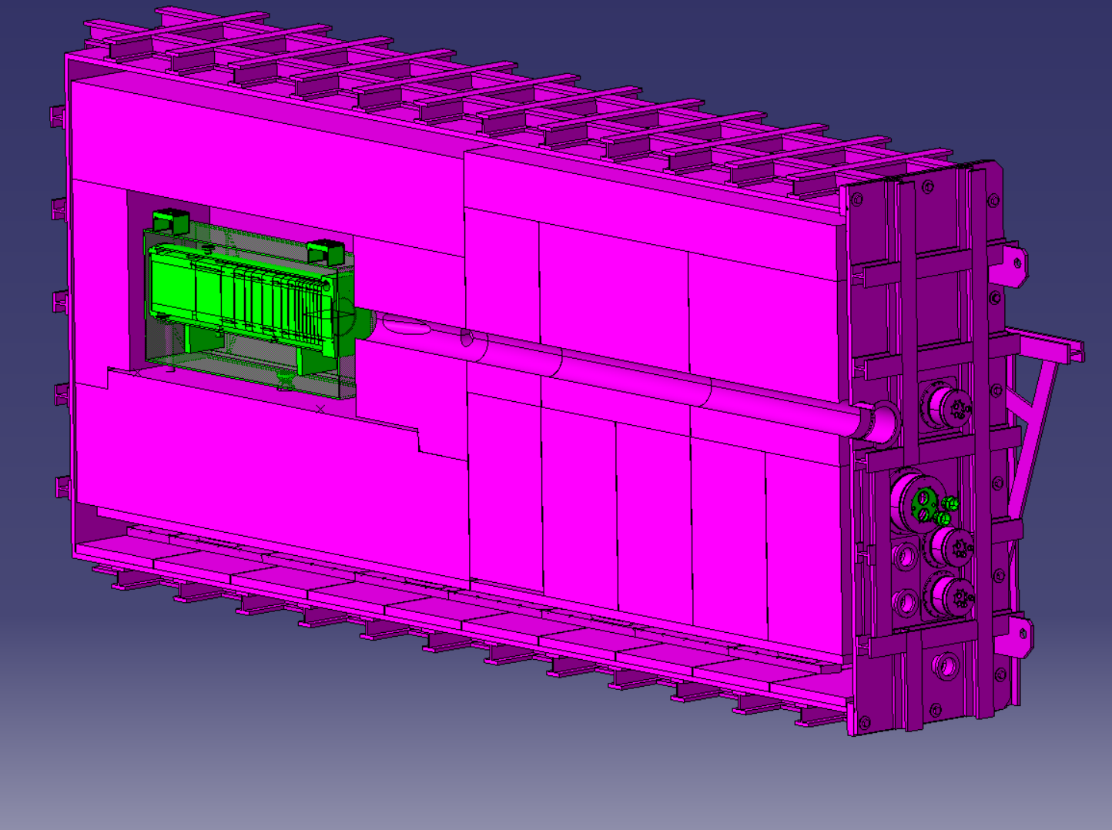
Lifting features
Alignement features
(interface with trolley)
Pipes interface with
Vacuum vessel

Slide 6
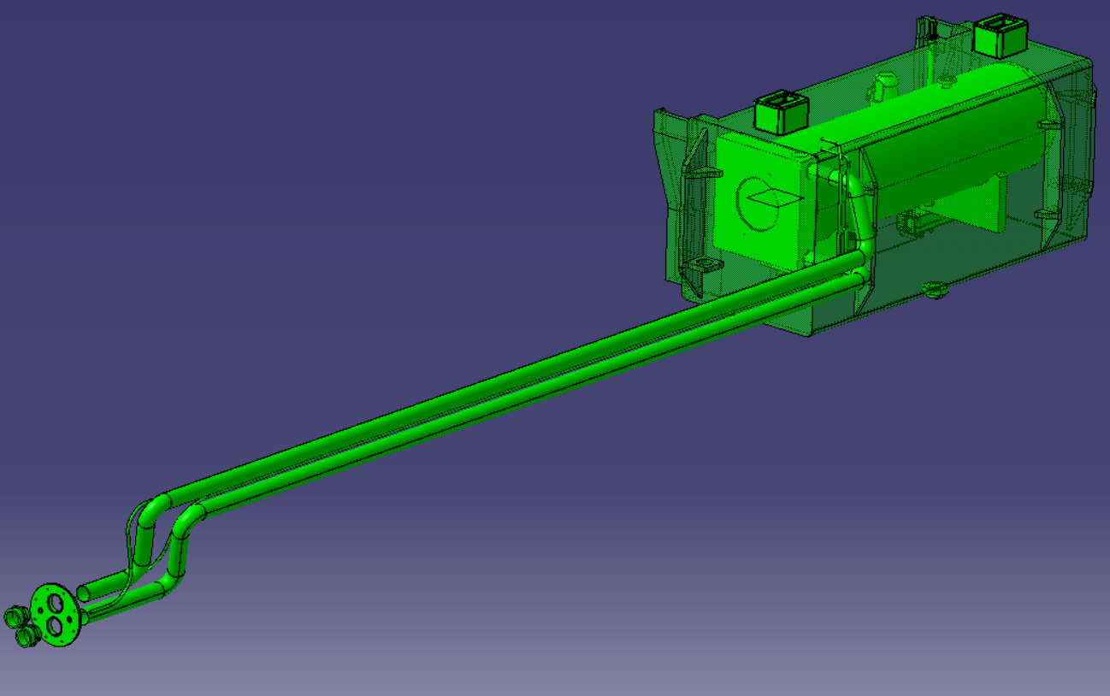
Pre guides features
Pipes interface with
Vacuum vessel
Pipes routing

