Slide 1
Fire Safety
Integration updates
Iliasse Derrag
21/08/2024

Slide 2
Dry Risers/CAFS
REQUESTOR | TITLE | AUTHOR | EDMS LINK | ECR STATUS | INTEGRATION REQUIRED | INTEGRATION PROGRESS | ICEA VALIDATION | COMMENTS
NACONS | Dry Risers GL812 → TDC8 | Jani Lehtinen, Miikka Leinonen | TBA | In work | YES | 100% | YES
NACONS | Dry Risers BA80 → TCC2 | Jani Lehtinen, Miikka Leinonen | TBA | In work | YES | 100% | YES
NACONS | Dry Risers B912 → TCC8 | Jani Lehtinen, Miikka Leinonen | TBA | In work | YES | 50% | YES | Standby HIECN3.
NACONS | Dry Risers B911 → ECN3 | Jani Lehtinen, Miikka Leinonen | TBA | In work | YES | 50% | YES | Standby HIECN3.
NACONS | Dry Risers EHN1 → TT81 & TT82 | Jani Lehtinen, Miikka Leinonen | TBA | In work | YES | 25% | YES | Visit to be done.
NACONS | Dry Risers EHN2 → TT84 | Jani Lehtinen, Miikka Leinonen | TBA | In work | YES | 40% | YES | Scans done. Visit to be re-done.
NACONS | CAFS North Area (x14) | Miikka Leinonen | TBA | In work | YES | 0% | TBD | Integration T.B.S. Input from Fire Brigade received.

Slide 3
Fire Doors
REQUESTOR | TITLE | AUTHOR | EDMS LINK | ECR STATUS | INTEGRATION REQUIRED | INTEGRATION PROGRESS | ICEA VALIDATION | COMMENTS
NACONS | Fire doors 21, 34, 35, 36, 37, 39, 55, 56, 57, 58a, 58b | Adem Kaymak | 3119539 - SPSX-SF-EC-0010 | Under approval | YES | 100% | YES | Filipa Carvalho: The replacement of the door 35 is out of the perimeter. In any case, this door will be cancelled or postponed until further notice, waiting the decision of the passage width > 60cm, by HSE.
NACONS | Fire doors 7, 32, 21, 34, 35, 36 | Adem Kaymak | 3120106 - SPSX-SF-EC-0011 | Under approval | YES | 100% | YES | Door 7, 1, 2, 4, 5, 8, 20, 27, 28 Standby for ECN3

Slide 4
Air Sampling
REQUESTOR | TITLE | AUTHOR | EDMS LINK | ECR STATUS | INTEGRATION REQUIRED | INTEGRATION PROGRESS | ICEA VALIDATION | COMMENTS
NACONS | Fire Detection BA81 Extension | Rachid Haddad | 3126083 - SPSX-SF-EC-0012 | In work | YES | 100% | YES
NACONS | Fire Detection BA81 Building | Michael Jeckel | SPSX-SF-EC-0015 v.0.1 | Engineering check | YES | 50% | YES | False floor to be validated on site (No 3D model, phase 2).
NACONS | Fire Detection BA81 Underground | Rachid Haddad | TBA | In work | YES | 90% | YES | Awaiting integration of GHN galleries.
NACONS | Fire Detection BA80 Ex-toilette | Florian Deperraz | 2997829 - SPSX-SF-EC-0005 | Under approval | YES | 100% | YES
NACONS | Fire Detection BA80 Building | Michael Jeckel | TBA | In work | YES | 0% | YES | Installation in LS3.
NACONS | Fire Detection BA80 Underground | Florian Deperraz | TBA | Under approval | YES | 100% | YES
NACONS | Sprinkler Installation TA801/PGT802-GL802 | Florian Deperraz | 2930745 - SPSX-SF-EC-0004 | Released | YES | 100% | YES
NACONS | Fire Detection EHN1 Galleries | Michael Jeckel | 3072500 - SPSX-SF-EC-0008 | Under approval | YES | 100% [No model yet] | YES | Validated on-site.

Slide 5
Air Sampling
REQUESTOR | TITLE | AUTHOR | EDMS LINK | ECR STATUS | INTEGRATION REQUIRED | INTEGRATION PROGRESS | ICEA VALIDATION | COMMENTS
NACONS | Fire Detection ECN3 | Rachid Haddad | 3126099 - SPSX-SF-EC-0013 | In work | YES | 50% | YES | Integration on stand-by. Equipment integrated in B911. Routing planned.

Slide 6
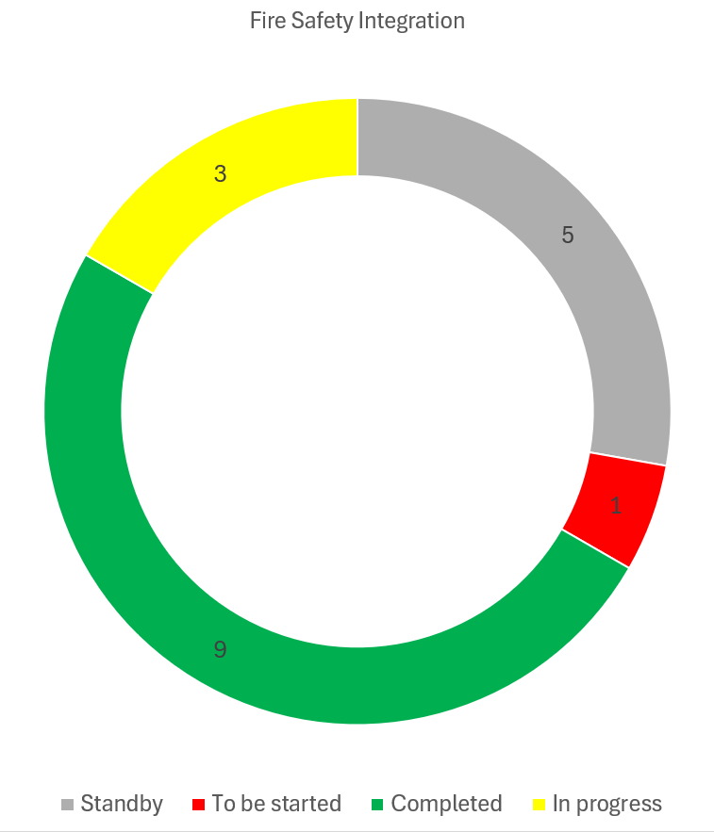
Integration Donut
Standby: Integration study started but waiting for inputs.
To be started: Activity needs an integration study, not yet started.
Completed: Study completed and approved by ICEA.
In progress: Integration study started.

