Slide 1
Fire Detection underground system
NA-CONS WP5.1.1
2024-08-21
https://indico.cern.ch/event/1446798/

Slide 2
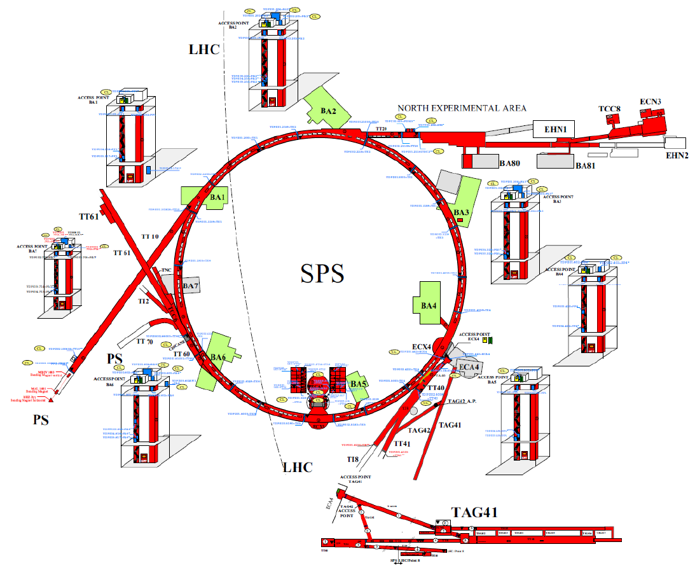
Schematic overview of the SPS complex

Slide 3
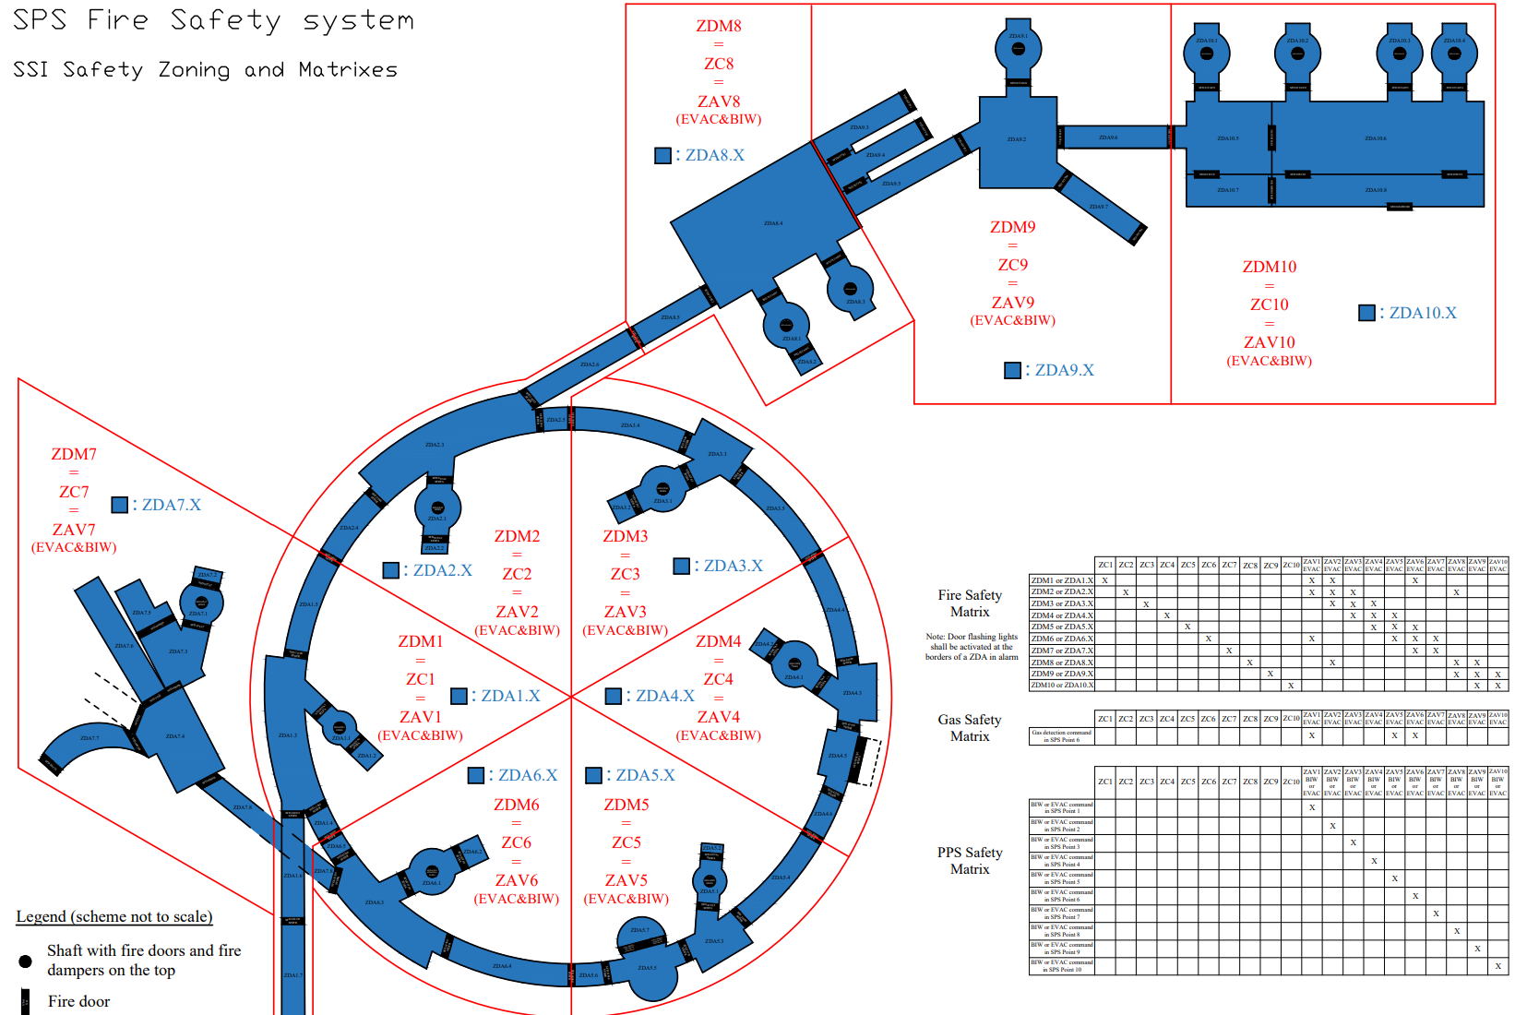
SSI safety zoning

Slide 4
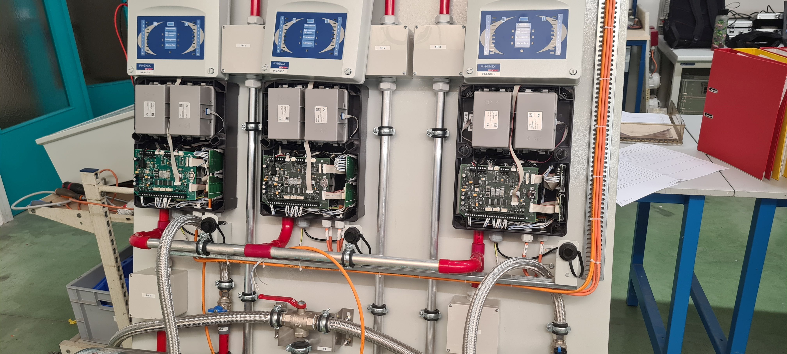
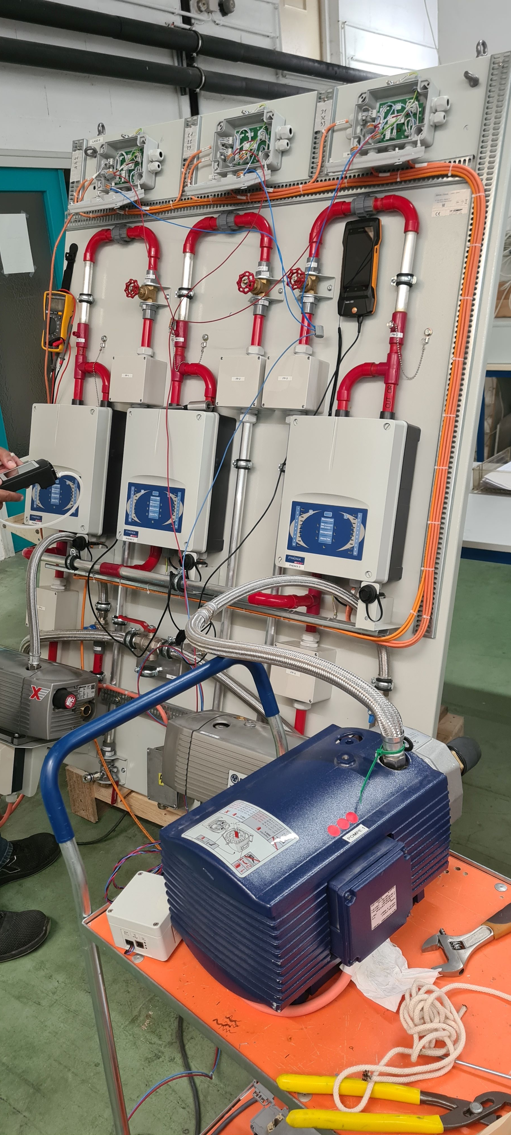
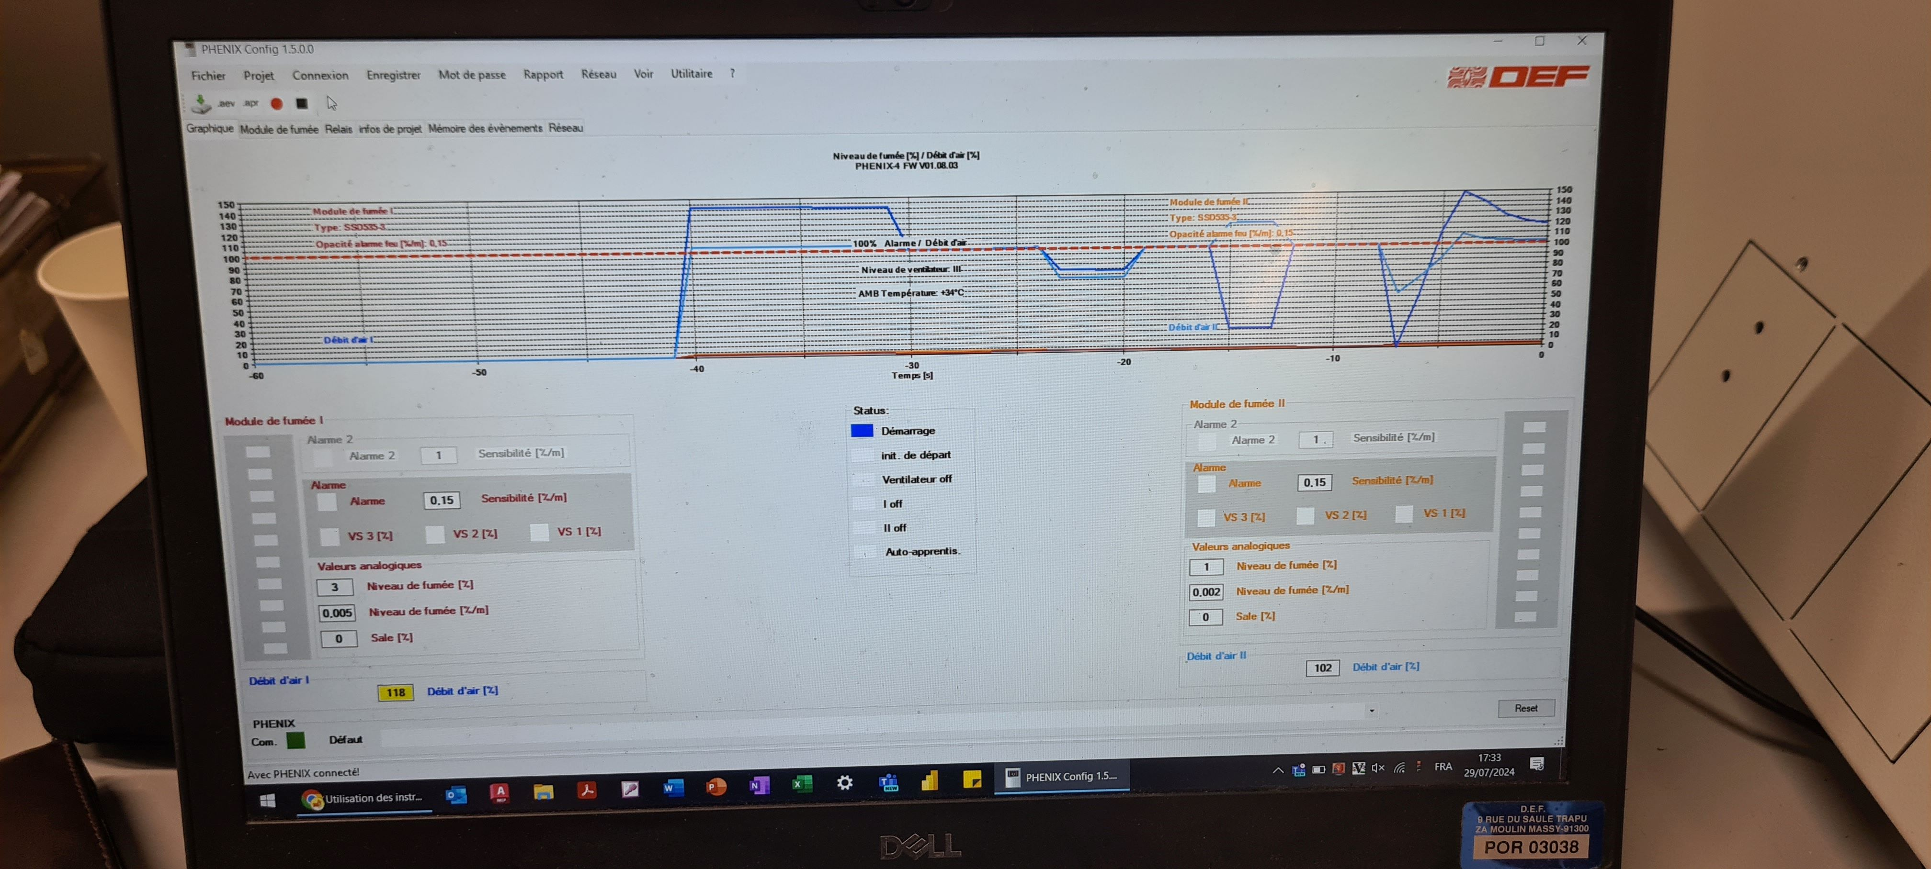
Factory Acceptance test LASD2 (x17)
All tests completed with no issues

Slide 5
BA81 (ZDM9) - Update
    Claim for around €50k in DEF in relation to work during the last EYETS (currently being processed)
    Initiation of storage requests for LS3 and discussions with stakeholders to seek solutions
    Ongoing discussions with EN-CV for updating the DICs for fire dampers and ventilation
    ECR BA81 Extension : Engineering check
    ECR BA81 Fire Detection Underground : In work
    Extension (room SSI):
      7 cm higher building
      HSE requires the implementation of a fire-resistant door (discussion in progress)
      Several follow-ups to get an updated schedule (without success)
    Progress on integration
TT81 | ST1759874_01
TT82 | ST1759978_01
TT83+TDC8 | ST1760470_01
TT84 | ST1760425_01
TT85+TDC85 | ST1760394_01
BA81+GL811+GL812 | ST1635664_01
GL812 | ST1842471_01
GL811 | ST1868013_01
GHN galleries (EHN1) | In study
Courtesy of Iliasse

Slide 6
BA81 (ZDM9) – Activities scheduled YETS 24/25
    Installation of the SSI room (Run 2024)
    The installation of the pipes is not guaranteed for the next YETS (deadline 09/26/2024)
    Subcontractor visit on September 4 (SIGEDI-France)
    Electrical connection of the equipment (awaiting details on the no-access time slot)
    Planning : EDMS 3093614
    Instrumentation of the doors and Site Acceptance Test planned during the LS3

Slide 7
BA80 (ZDM8) – Activities scheduled
    ECR BA80 Fire Detection Building : In work (Florian)
    Ongoing discussions with integration room SSI and underground (Iliasse)
    No work scheduled for the next YETS
    ECR BA80 Fire Detection Underground : before December 31, 2024
    Installation and Site Acceptance Test scheduled for LS3

Slide 8
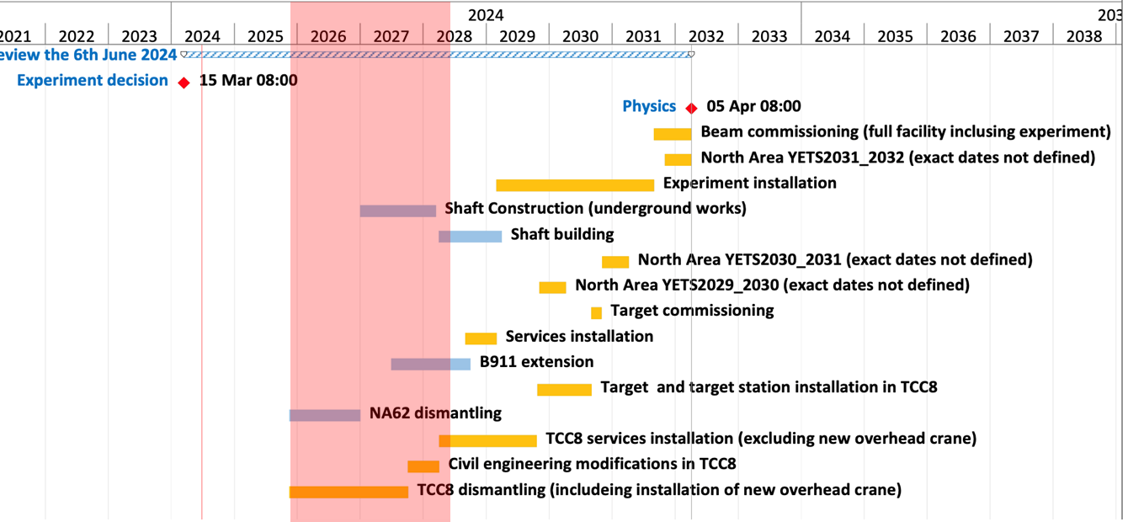
ECN3 (ZDM10) – Latest Project Schedule

Slide 9
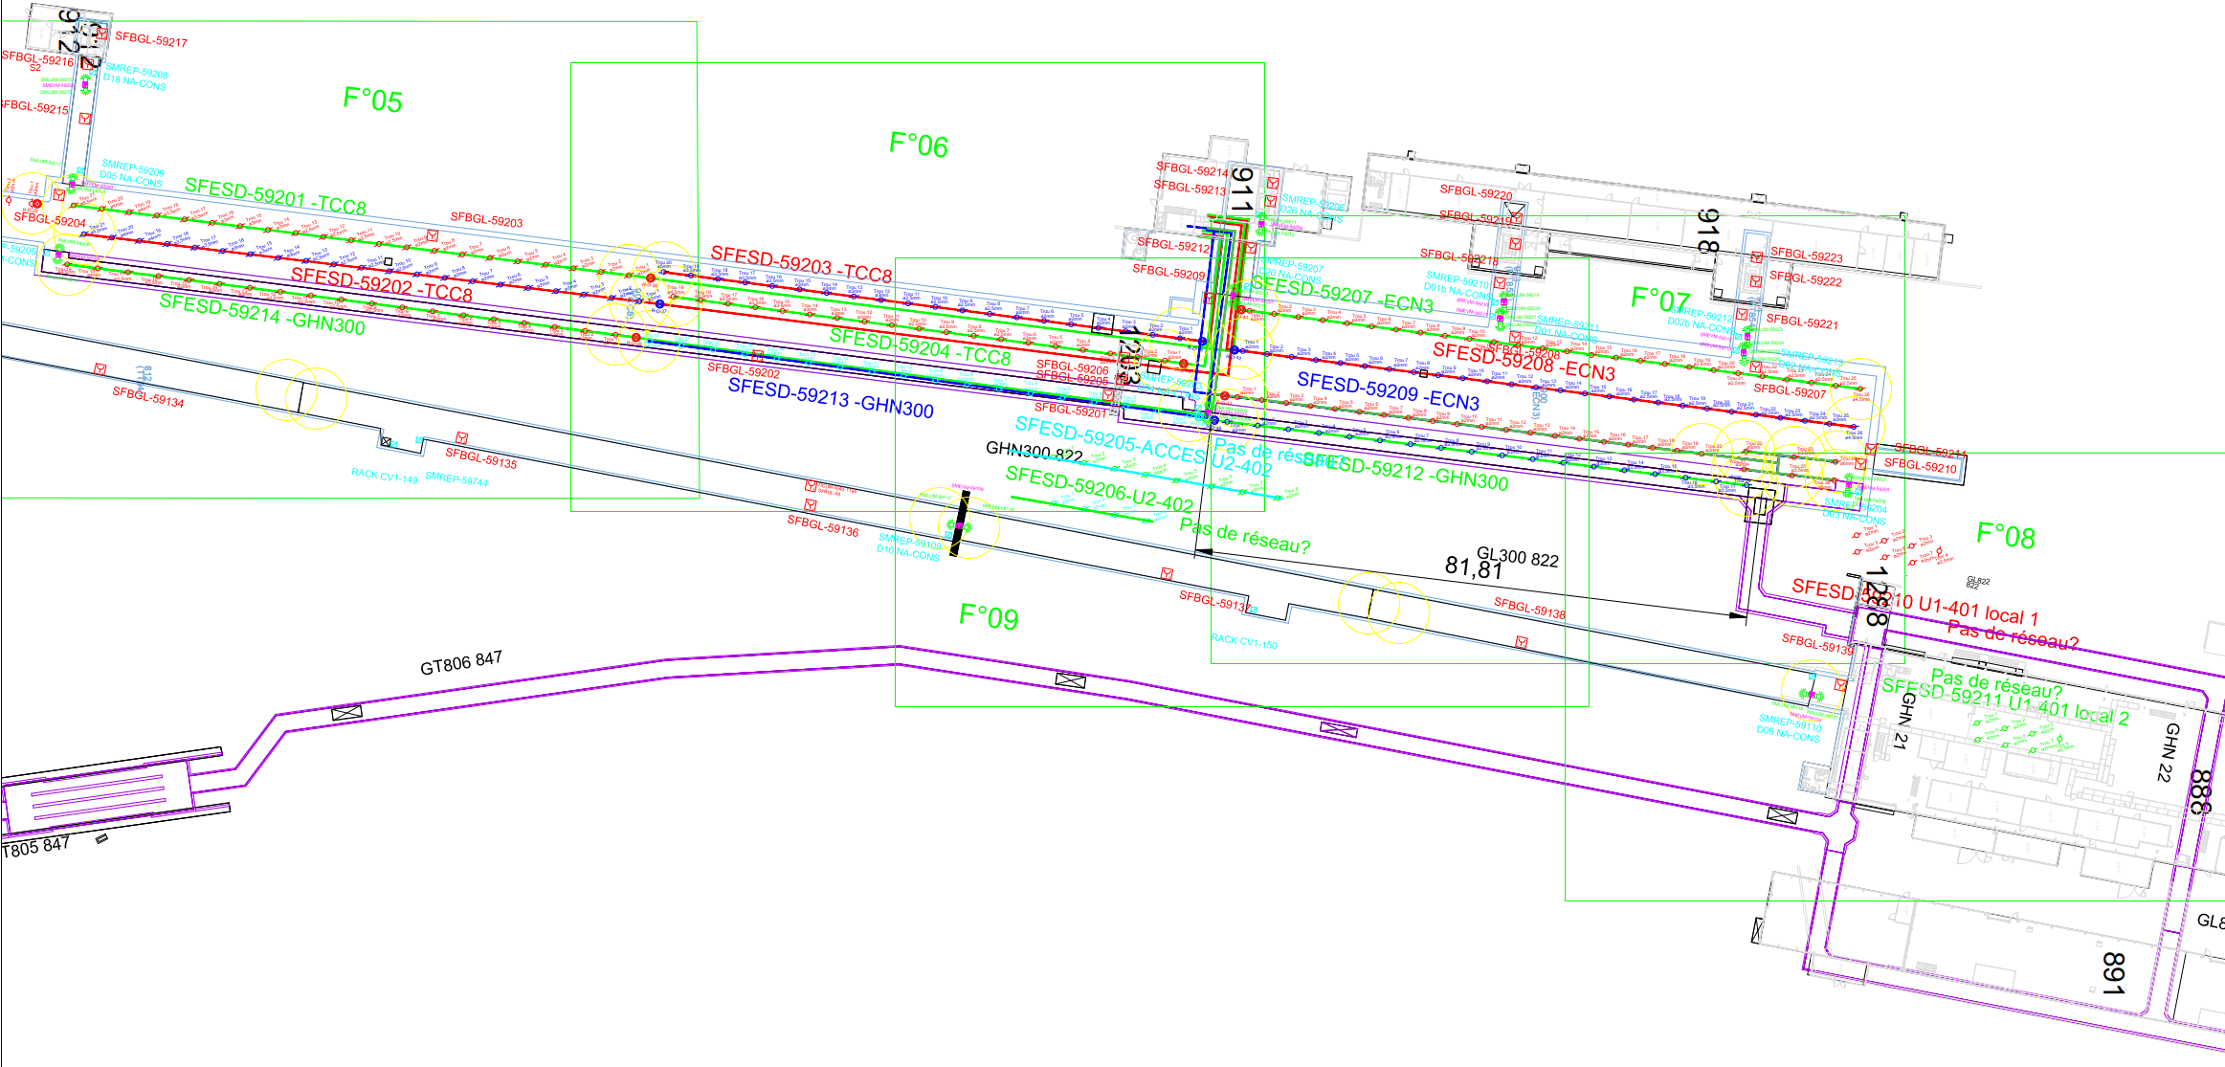
Installation equipment ECN3, TCC8, GHN300, PP851, PT851, TT851, PA852, PT852, TT852, PT853, PT854, TT854
61 Loudspeakers
23 Manual call points
33 Flashing lights
10 LASD
3 ASD

Slide 10
Power request ECN3 Fire Safety
Lieu | Designation/Utilisateur | Racks/Equipement | Type de Reseau | Type d'alimentation | Type de Depart | Diff. | Un (V) | In (A)
ECN3 PA852 | SDI CIE | SFDIN-00592 | Secour/Safety | Mono | Disj. | No | 230 | 20
ECN3 PA852 | SMSI CIE | SMSMS-00592 | Secour/Safety | Mono | Disj. | No | 230 | 20
ECN3 PA852 | SSS CIE | SESSS-00592 | Secour/Safety | Mono | Disj. | No | 230 | 32
ECN3 PA852 | SDI - LASD - Pompe 25 | SFESD-59201 | Secour/Safety | 3 Ph | Disj. | No | 400 | 6
ECN3 PA852 | SDI - LASD - Pompe 26 | SFESD-59201 | Secour/Safety | 3 Ph | Disj. | No | 400 | 6
ECN3 PA852 | SDI - LASD - Pompe 27 | SFESD-59203 | Secour/Safety | 3 Ph | Disj. | No | 400 | 6
ECN3 PA852 | SDI - LASD - Pompe 28 | SFESD-59203 | Secour/Safety | 3 Ph | Disj. | No | 400 | 6
ECN3 PA852 | SDI - LASD - Pompe 29 | SFESD-59207 | Secour/Safety | 3 Ph | Disj. | No | 400 | 6
ECN3 PA852 | SDI - LASD - Pompe 30 | SFESD-59207 | Secour/Safety | 3 Ph | Disj. | No | 400 | 6
ECN3 PA852 | SDI - LASD - Pompe 31 | SFESD-59206 | Secour/Safety | 3 Ph | Disj. | No | 400 | 6
ECN3 PA852 | SDI - LASD - Pompe 32 | SFESD-59206 | Secour/Safety | 3 Ph | Disj. | No | 400 | 6
ECN3 PA852 | SDI - LASD - Pompe 33 | SFESD-59212 | Secour/Safety | 3 Ph | Disj. | No | 400 | 6
ECN3 PA852 | SDI - LASD - Pompe 34 | SFESD-59212 | Secour/Safety | 3 Ph | Disj. | No | 400 | 6
ECN3 PA852 | SDI - LASD - Reserve | (réserve) | Secour/Safety | 3 Ph | Disj. | No | 400 | 6
ECN3 PA852 | SDI - LASD - Reserve | (réserve) | Secour/Safety | 3 Ph | Disj. | No | 400 | 6
ECN3 - PA851 | SDI - ASD | SFASD-59503-59504 | Secour/Safety | Mono | Disj. | No | 230 | 10
ECN3 - PA851 | SDI - ASD - Reserve | (réserve) | Secour/Safety | Mono | Disj. | No | 230 | 10
ECN3 - PA853 | SDI - ASD | SFASD-59505-59506 | Secour/Safety | Mono | Disj. | No | 230 | 10
ECN3 - PA853 | SDI - ASD - Reserve | (réserve) | Secour/Safety | Mono | Disj. | No | 230 | 10
ECN3 - PA854 | SDI - ASD | SFASD-59507-59508 | Secour/Safety | Mono | Disj. | No | 230 | 10
ECN3 - PA854 | SDI - ASD - Reserve | (réserve) | Secour/Safety | Mono | Disj. | No | 230 | 10

Slide 11
Interface with the CERN ventilation system
Tenant |  | Aboutissant |  | Cable |  | Fil | Utilisation | Centrale | Numéro | Localisation | Type d'interface
 | Rack CMSI |  | Rack CV | MHF2 |  | 1 | ARRET VENTILATION SPS 1 (CONTACT SEC -) | Centrale N°16 | 888 CV1 151 | TT 84 | - Commande envoyée par le CMSI - Contact sec NF - Transmission en sécurité positive
 |  |  |  |  |  | 2 | ARRET VENTILATION SPS 1 (CONTACT SEC +)
 | Rack CMSI |  | Rack CV | MHF2 |  | 1 | ARRET VENTILATION TT10 (CONTACT SEC -) | Centrale N°17 | 900 W2 85 | TCC8 | - Commande envoyée par le CMSI - Contact sec NF - Transmission en sécurité positive
 |  |  |  |  |  | 2 | ARRET VENTILATION TT10 (CONTACT SEC +)
 | Rack CMSI |  | Rack CV | MHF2 |  | 1 | ARRET VENTILATION TT10 (CONTACT SEC -) | Centrale N°18 | 900 CV1 152 | ECN3 | - Commande envoyée par le CMSI - Contact sec NF - Transmission en sécurité positive
 |  |  |  |  |  | 2 | ARRET VENTILATION TT10 (CONTACT SEC +)
 | Rack CMSI |  | Rack CV | MHF2 |  | 1 | ARRET VENTILATION TT10 (CONTACT SEC -) | Centrale N°19 | 900 CV1 153 | GHN3 | - Commande envoyée par le CMSI - Contact sec NF - Transmission en sécurité positive
 |  |  |  |  |  | 2 | ARRET VENTILATION TT10 (CONTACT SEC +)
 | Rack CMSI |  | Rack CV | MHF2 |  | 1 | ARRET VENTILATION TT10 (CONTACT SEC -) | Centrale N°20 | 900 CV1 154 | TCC8 | - Commande envoyée par le CMSI - Contact sec NF - Transmission en sécurité positive
 |  |  |  |  |  | 2 | ARRET VENTILATION TT10 (CONTACT SEC +)

