Slide 1
NA-CONS WP5.1 meeting
Surface DI & EVAC
Michael JECKEL EN-AA-AS
2024-08-21

Slide 2
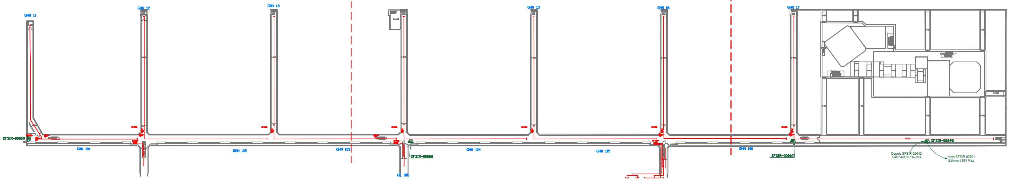
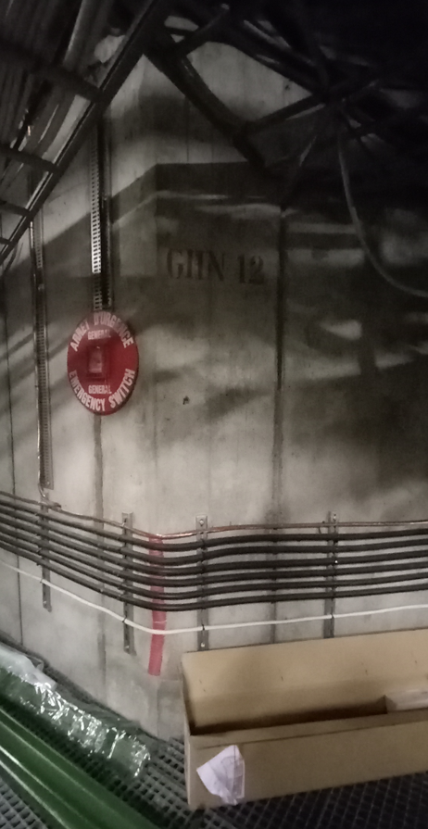
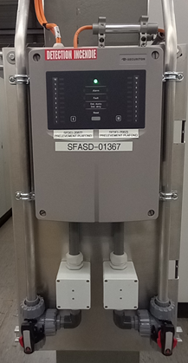
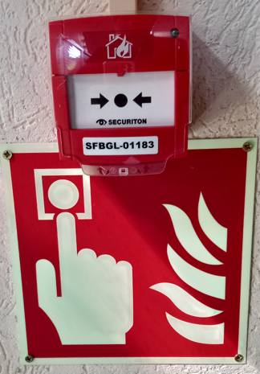
«Air sampling detector (ASD) replacement in EHN1 galleries”
Installation of
10 ASD & 7 BGL

Slide 3
Schedule
«Air sampling detector (ASD) replacement in EHN1 galleries”
During Run 2024:
Installation of 1 ASD on ground floor for TT81 & TT82
Installation of 10 ASD & 7 BGL in galleries
Installation of cables & pipes by EN-AA contractor
Installation of pipes in transversal galleries GHN11-17 on Wednesdays or TS
September 2024:
Change of Fire Detection Centrals and reception of new ASDs
November 2024:
Removal of old ASD system and PVC pipes

Slide 4
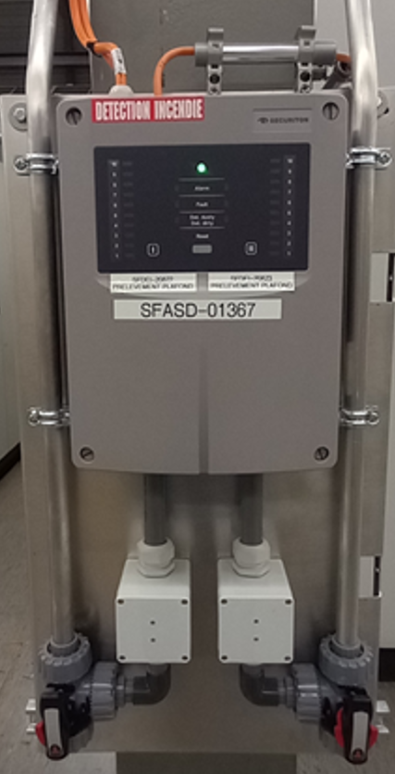
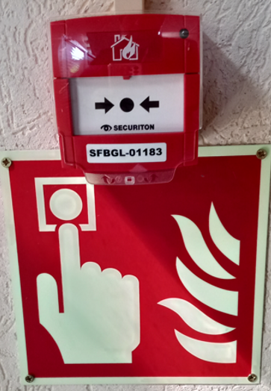
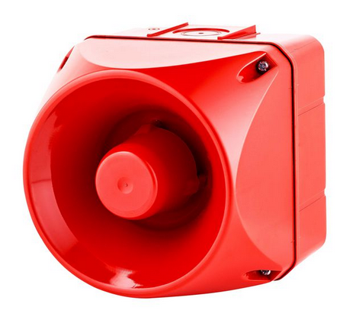
DI & EVAC @ BA81 YETS 2024/2025
Air Sampling Detector (ASD) installation:
Four double in the false floor
Six on HVACs
Five manual call points (BGL)
Six sirens

Slide 5
Schedule DI & EVAC @ BA81
November 2024
Installation of 10 ASDs on ground floor
Beginning of YETS 2024-2025:
Installation of air sampling pipes in the false floor and on the HVAC units
End of YETS 2024-2025
Cable pulling EN-EL
During Run 2025:
Installation of 5 manual call points and 6 sirens by EN-AA contractor
Change of Fire Detection Central rack RA9922 and reception of new equipment

Slide 6
DI & EVAC @ BA80 LS3
Air Sampling Detector (ASD) installation:
Two double in the false floor
Six on HVACs
Five manual call points (BGL)
Four sirens

Slide 7
Schedule DI & EVAC @ BA80 LS3
Towards the end of LS3 tbc
Installation of 8 ASDs on ground floor with dedicated air sampling pipes in the false floor and on the HVAC units
Cable pulling EN-EL
Installation of 5 manual call points and 4 sirens by EN-AA contractor
Reception of new equipment

