Slide 1
WP5.1.6 Access control
T. Lang (EN-AA)
2024-08-21
https://indico.cern.ch/event/1446798/

Slide 2
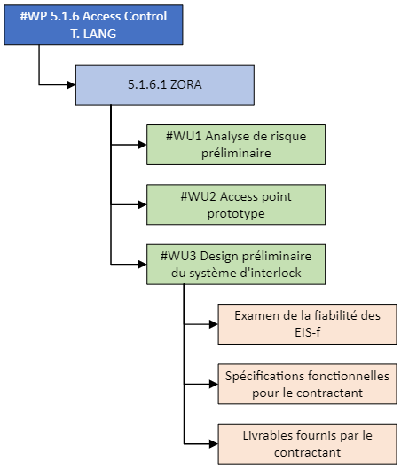


NA-CONS WP5.1.6
EHN1 (EDMS 2683693)
EHN2 (EDMS 3087026)
SAS PPE (prototype)
Evaluation of the input signals used by the personnel protection system via the instrumented safety functions (compliance with CERN safety requirements and the cabling convention).
(EDMS 3124131)
Preliminary technical study to implement the changes and consolidate/renovate the architecture of the access system.
2

Slide 3
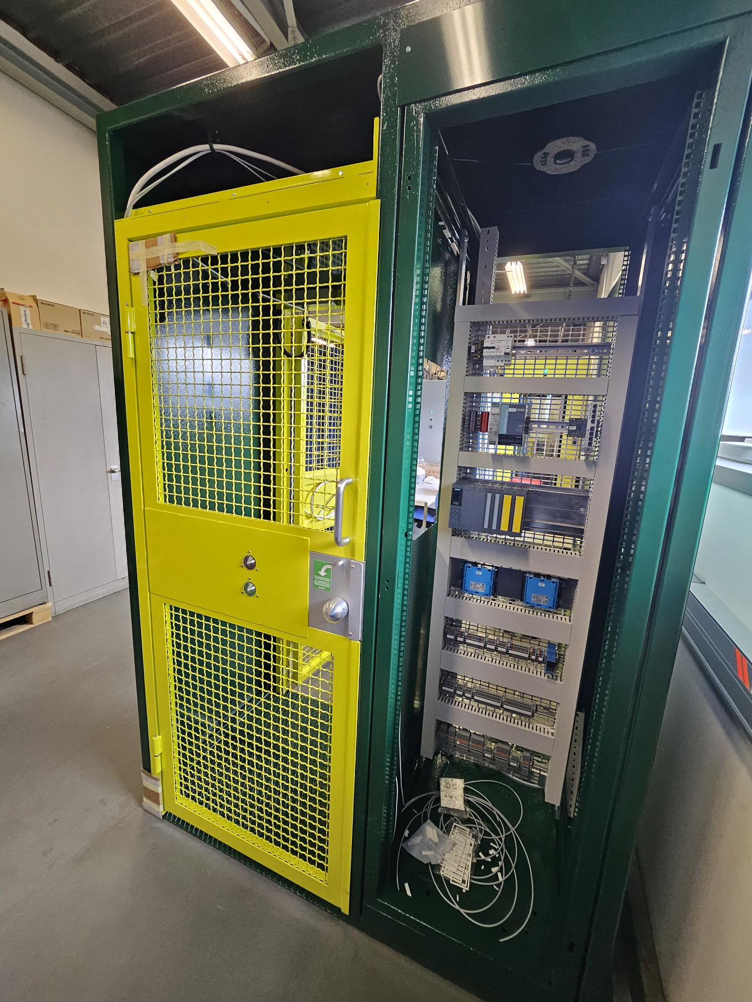
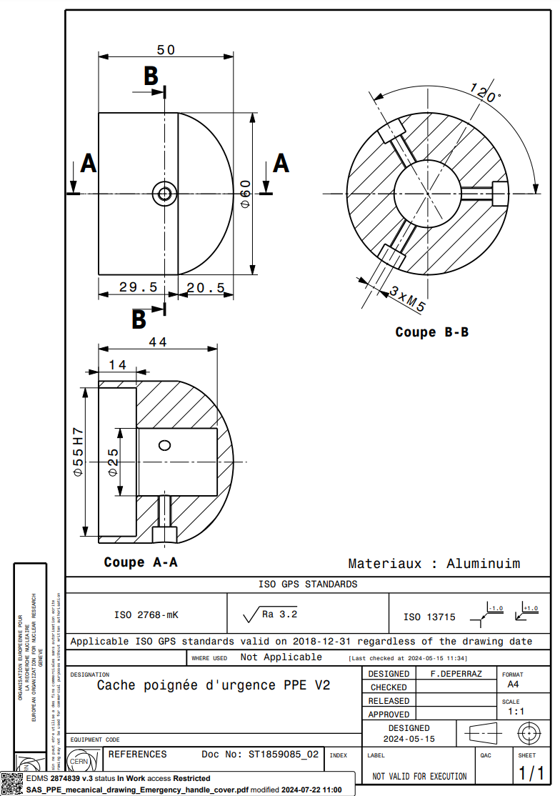
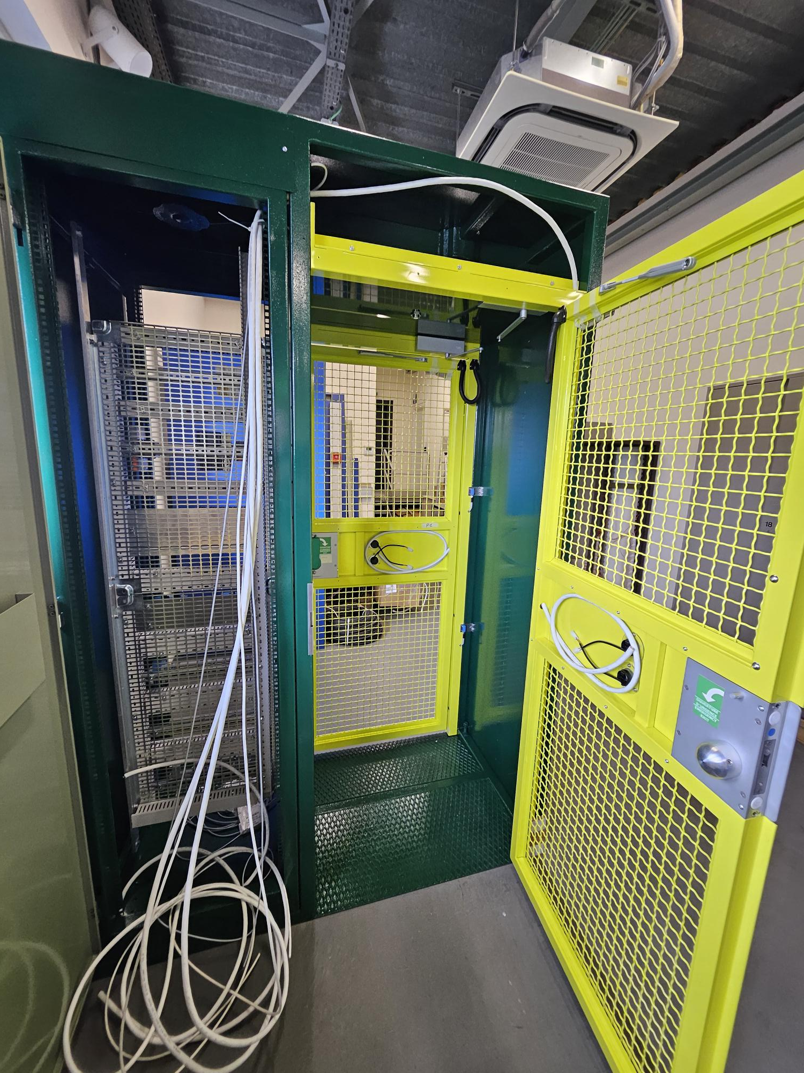
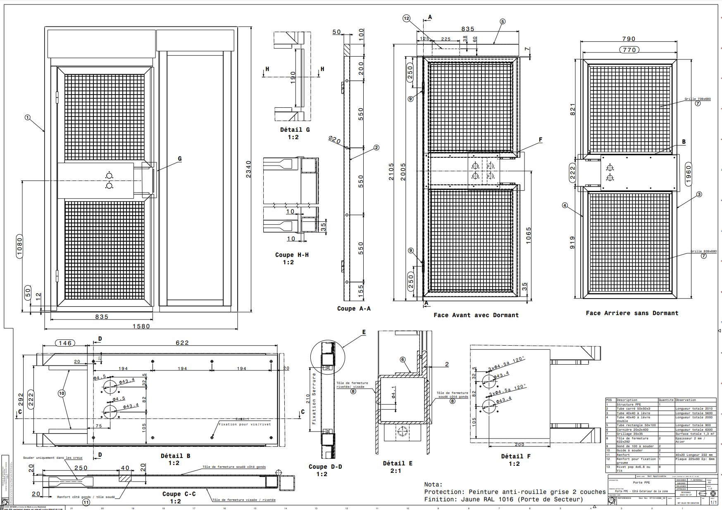
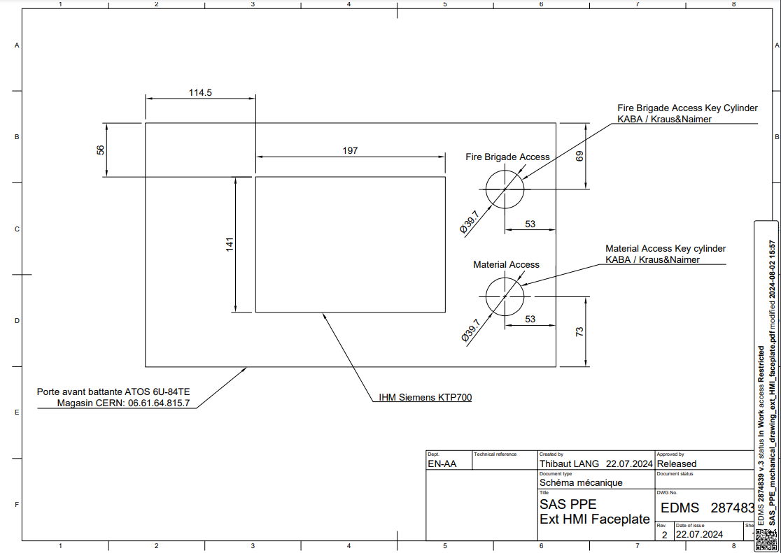
1. Access Point (SAS PPE)
    2nd SAS PPE under construction at the PS test platform (b.271)
    Improvements have been made (alloy emergency handle, serigraphie, new LED indicators, Key cylinders for material/fire brigade access)
    All mechanical drawings have been produced (EDMS 2874839)
    The goal is to have a second SAS PPE ready at the end of September 2024.

Slide 4
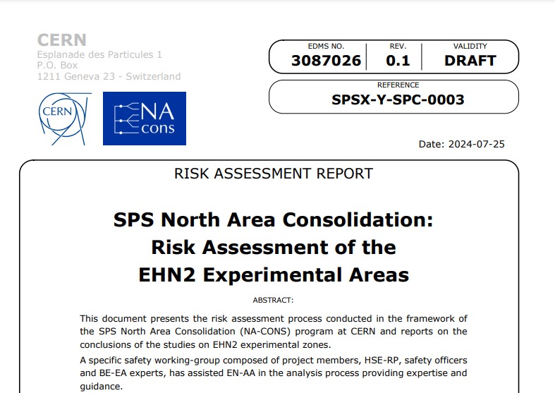
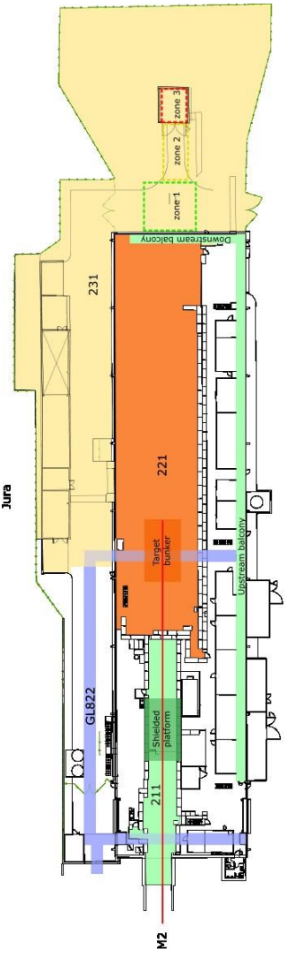
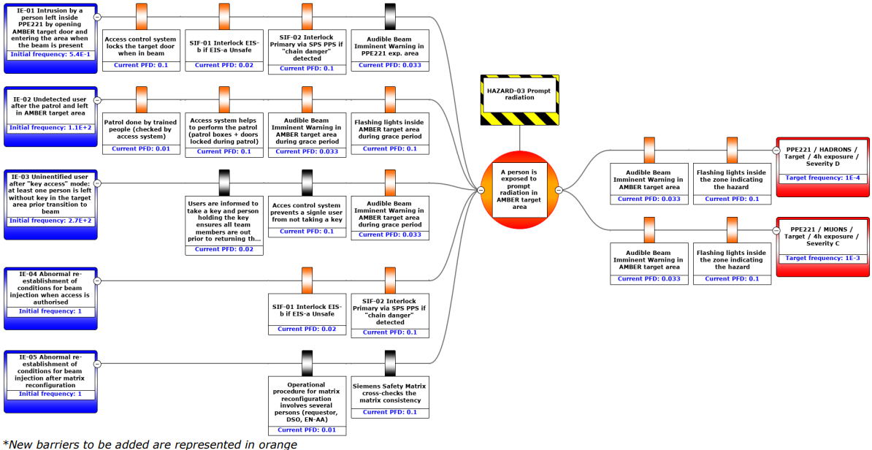
2. EHN2 Risk Assessment
    The first version of the risk assessment for EHN2 experimental areas is completed.
    A presentation is being organized for the NA-CONS working group on September 17, 2024.
    New measures to be implemented for the PPE211 / 221 / 231 and Amber target.
    Work to be prepared and carried out during the LS3 to be ready for the first Drell Yan run (after LS3?)

Slide 5
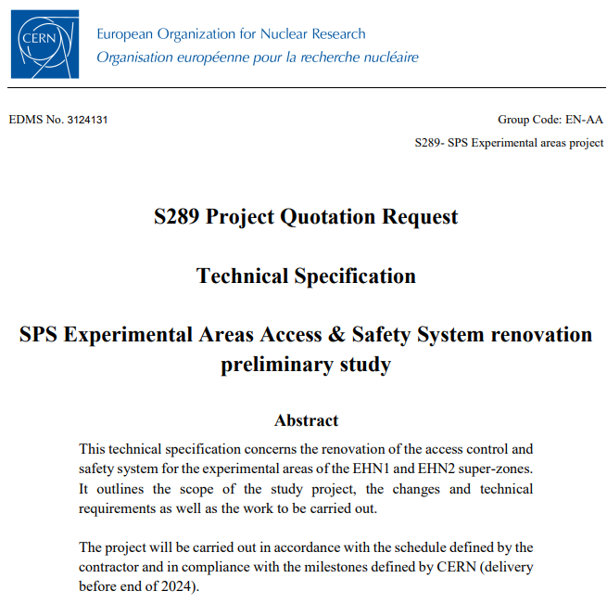
2. EHN1/EHN2 PPS renovation preliminary study
    The task will be carried out under the S289 contract. The contractor is required to conduct, document, and provide a preliminary study for the future SPS experimental areas access and safety system :
      Recommendations from the risk assessment process for EHN1 and EHN2 (new safety functions, integration of SAS PPE, etc…)
      Update the ageing automation infrastructure to address the obsolescence of Siemens S7-300 and S7-400 components
    Quotation request (Technical specification) has been sent to the contractor
    Delivery before the end of 2024
    Preliminary study deliverables:
    System requirements specification
    Impact analysis
    Project documentation plan
    System design
    Hardware design

