Slide 1


FoCal positioning system
Mikołaj Kucharski
on behalf of ALICE - FoCal

Slide 2
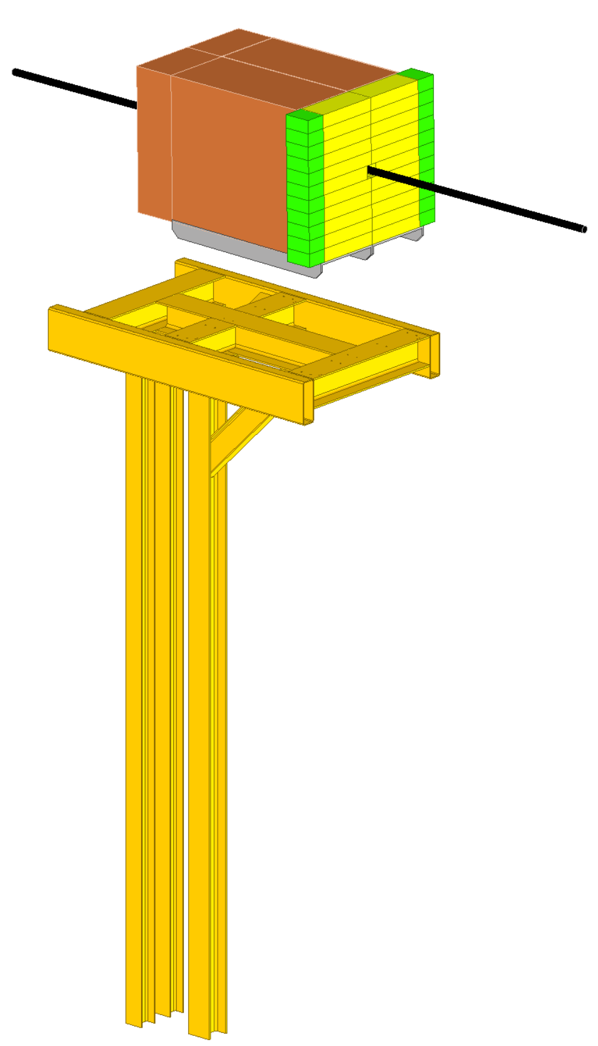
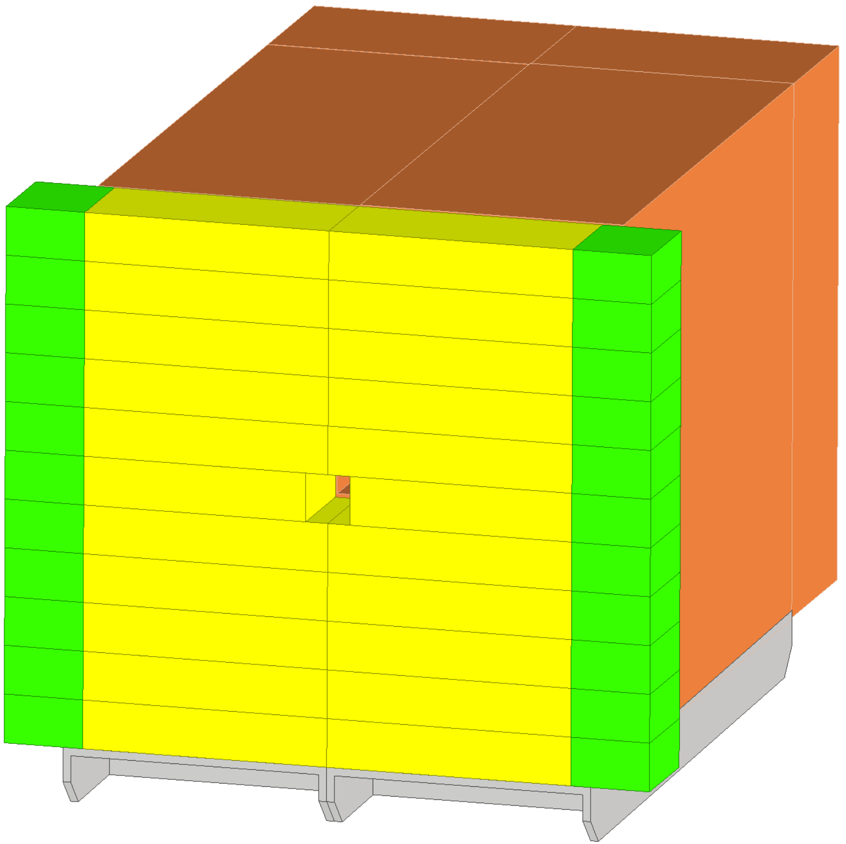
Positioning System - general concept
General project requirements:
System must be constructed on a frame designed by CERN Civil Engineering department.
System must allow the two halves of the FoCal detector to be moved by 250mm and closed around the beampipe.
M. Kucharski

Slide 3
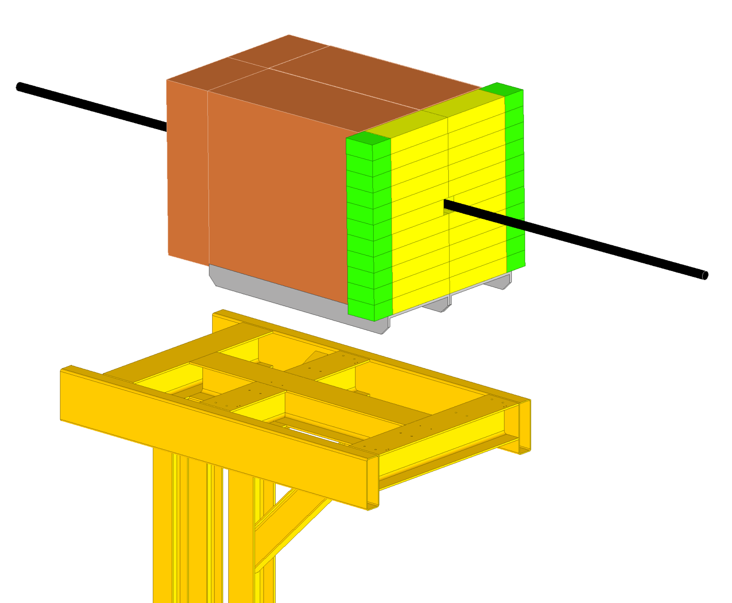
Positioning System - general concept
Y+
Z-
φ
X-
General project requirements:
The system must allow adjustment of the detector position in all degrees of freedom with a repeatable accuracy of 0.1mm.
The structure must be able to operate under the load of the detector (14 tons).
It must be possible to operate and position only one half of the detector (7 tons).
X+
Z+
ϑ
Y-
M. Kucharski

Slide 4
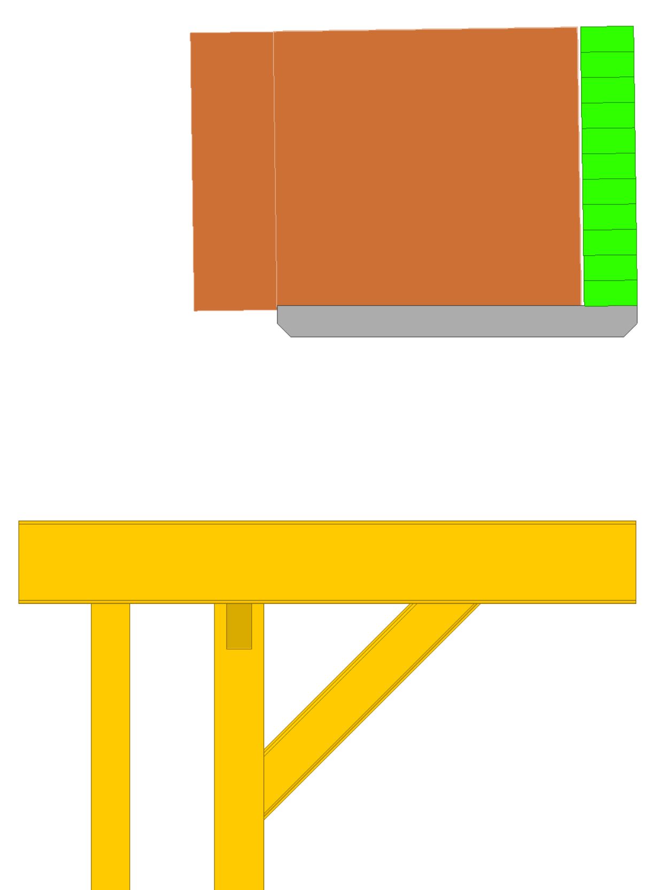
Deflections of suport frame
From the information provided, the frame designed by CERN civil engineering, can flex up to 13mm (≈0.69°).
The exact nature of the deflections is not known which makes it even more difficult to ensure good positioning accuracy (0,1 mm).
13 mm
M. Kucharski

Slide 5
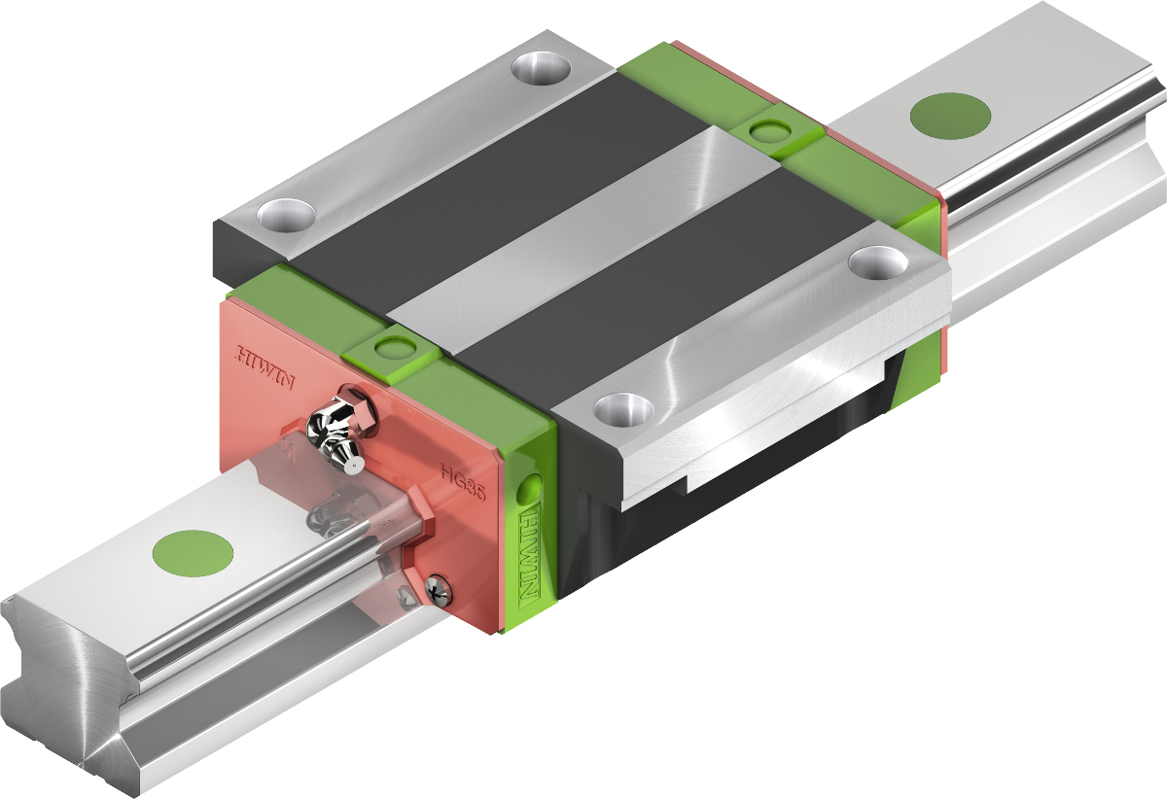
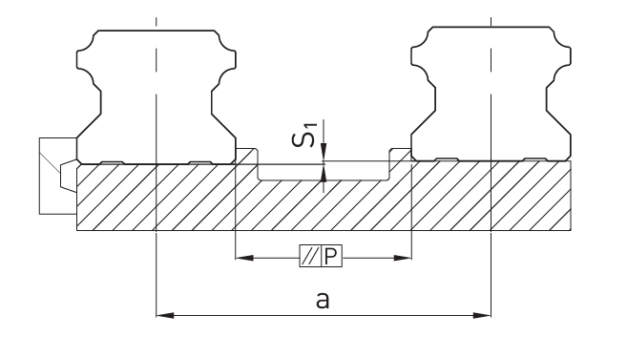

Problems caused by deformations of suport frame
The height tolerance between rails (S1) for HIWIN HG/HQ series is maximum 0.455 mm (≈0.02°).
The maximum tolerance of parallelism between rails (P) for HIWIN HG/HQ series is 0.05 mm.
This, combined with the significant deformation of the support frame, makes the use of carts problematic.
S1 Maximum height tolerance [mm]
a Distance between rails [mm]
K Coefficient of height tolerance
(from table)
Source: HIWIN catalog
M. Kucharski

Slide 6
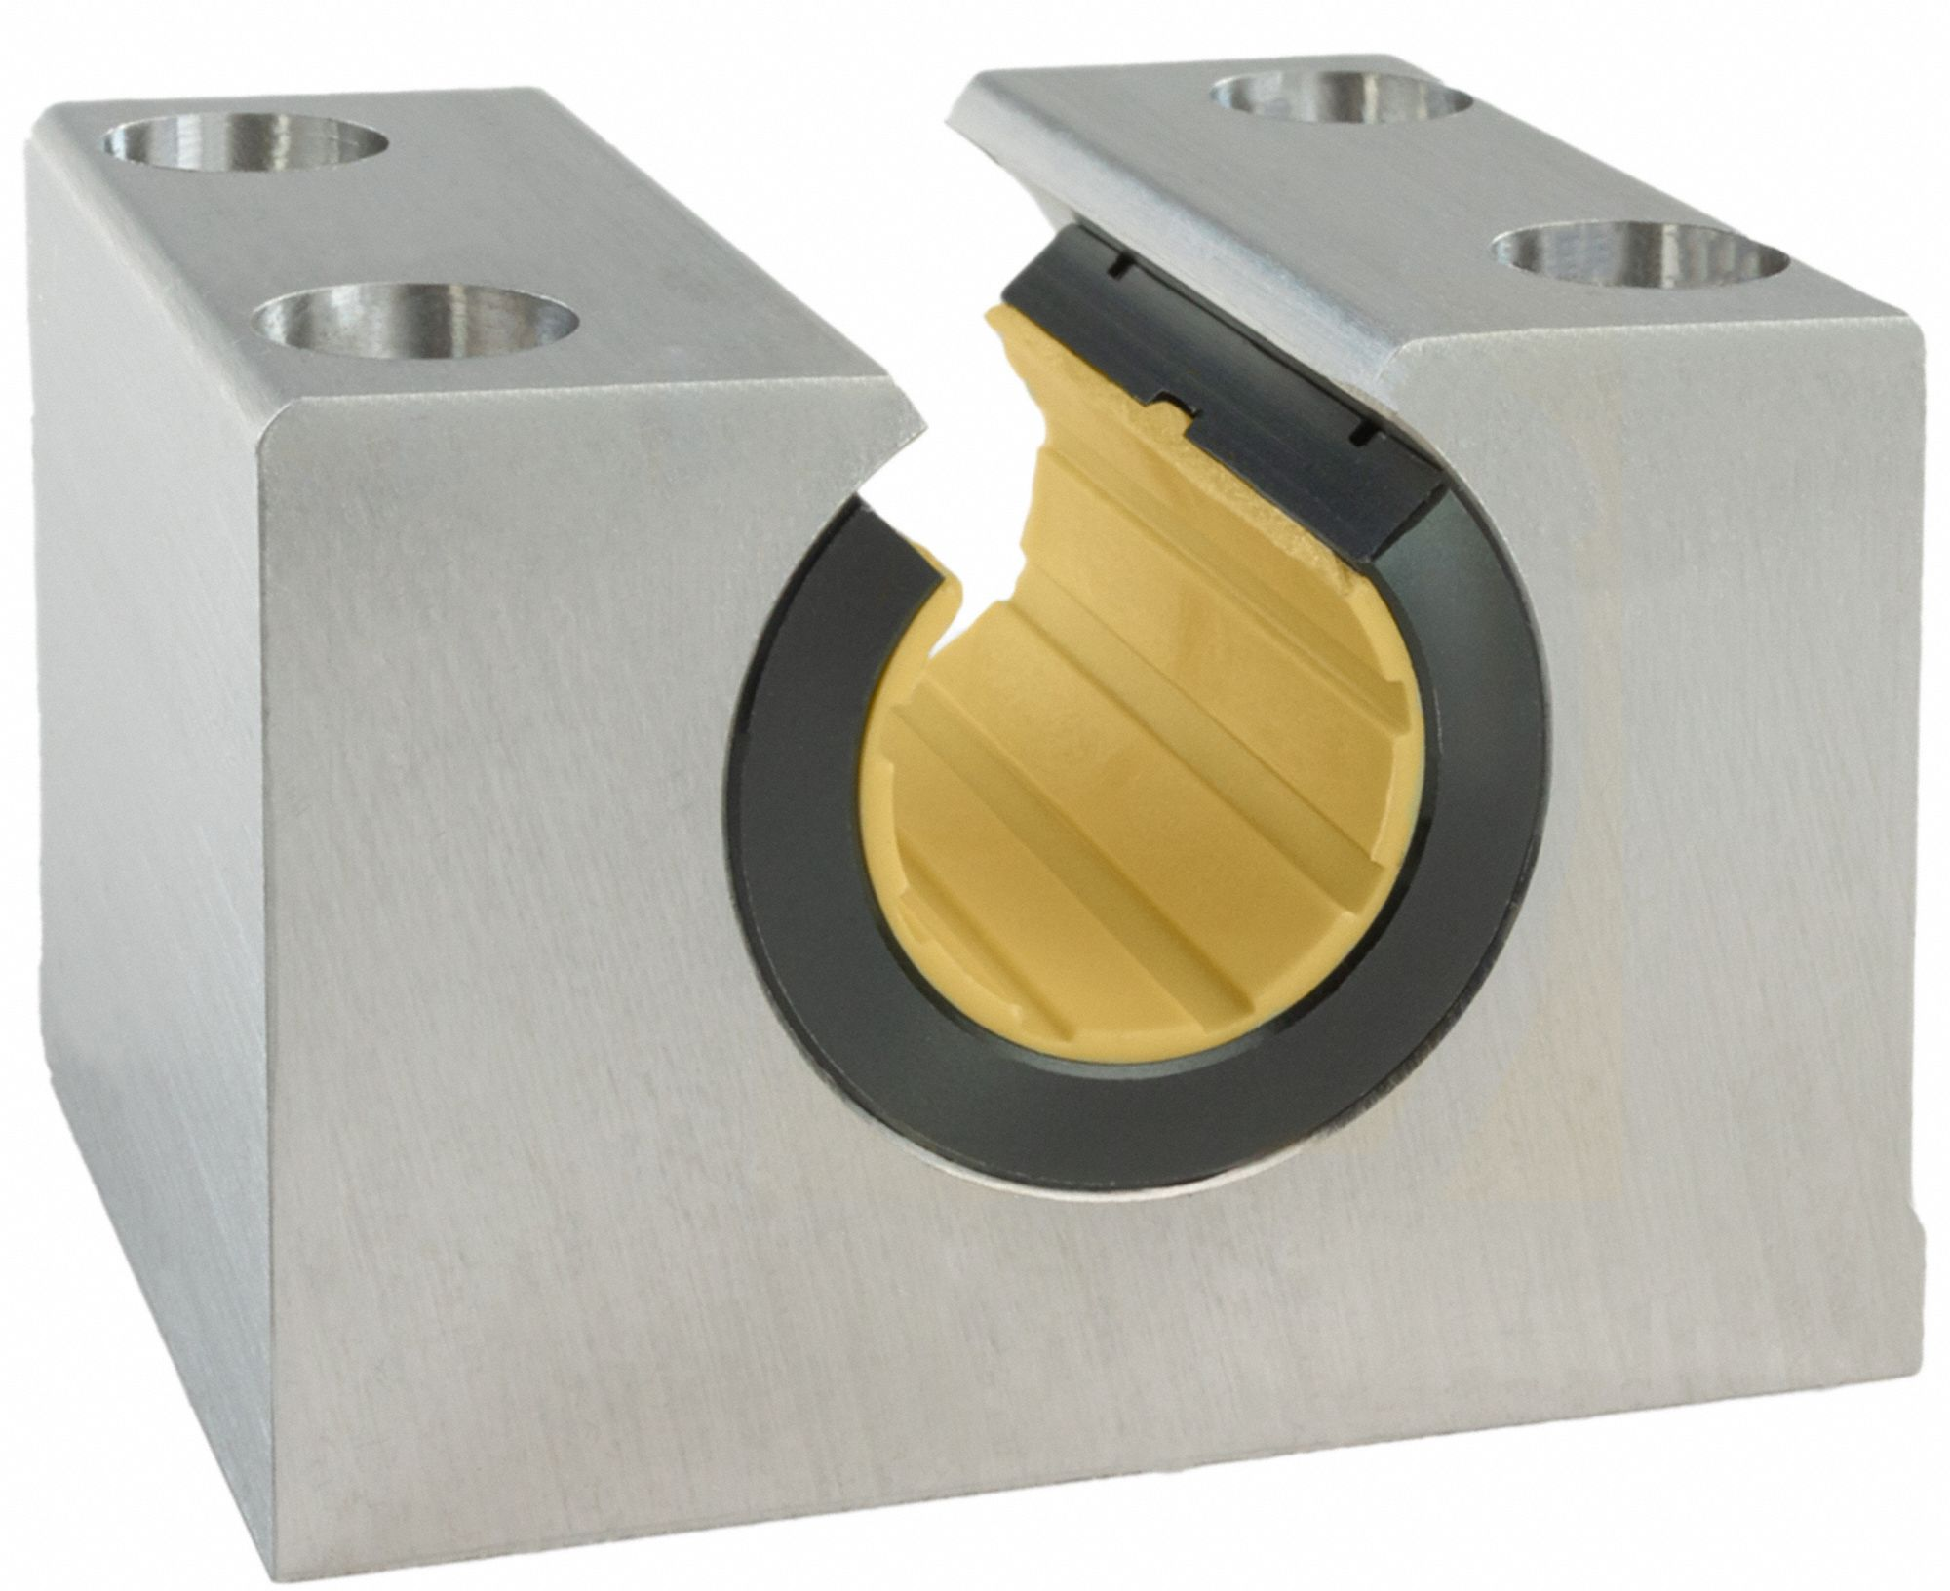
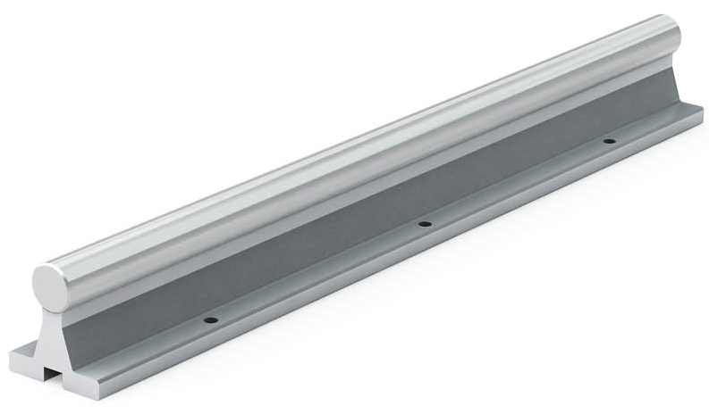
Problems caused by radiation
Due to the radiation inside the cavern, it was not possible to use many commercially available components such as linear plain bearings or slide plates.
Many products use polymers such as PTFE that degrade rapidly in radiation enviroment.
This forced a change in the initial design concept using linear bearing shafts, which were unsuitable despite discussions with many companies.
Source: THOMSON Plain Linear Bearing
PBC Linear
M. Kucharski

Slide 7
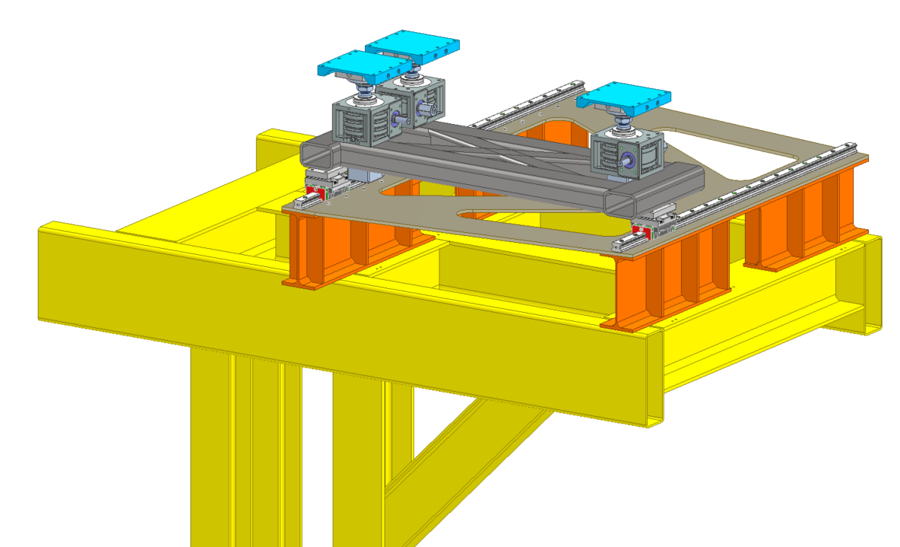
Current design of positioning system
Current design proposal can be divided into 3 basic components:
movement module (FoCal closing module)
lifting module and vertical angle setting
fine traverse and rotation module (positioning head)
M. Kucharski

Slide 8
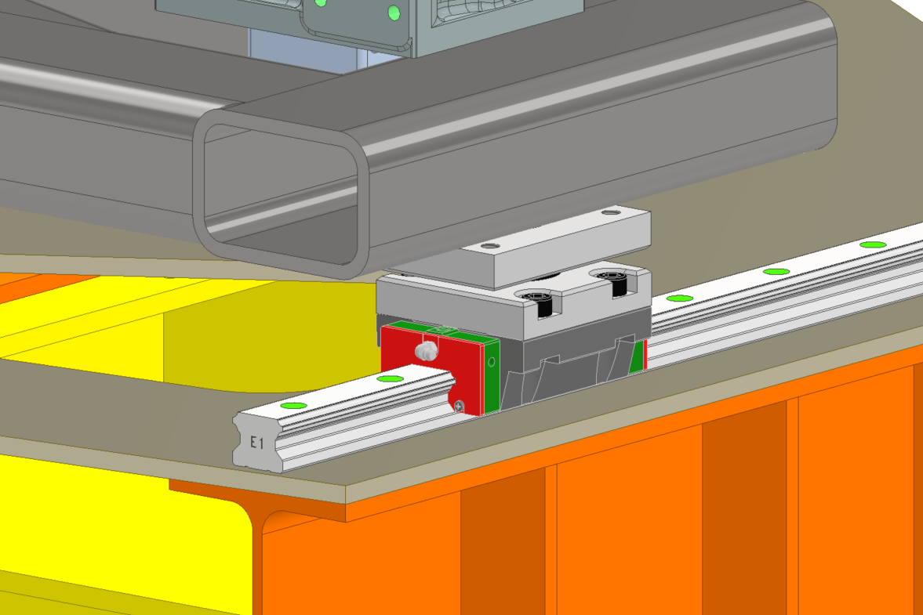
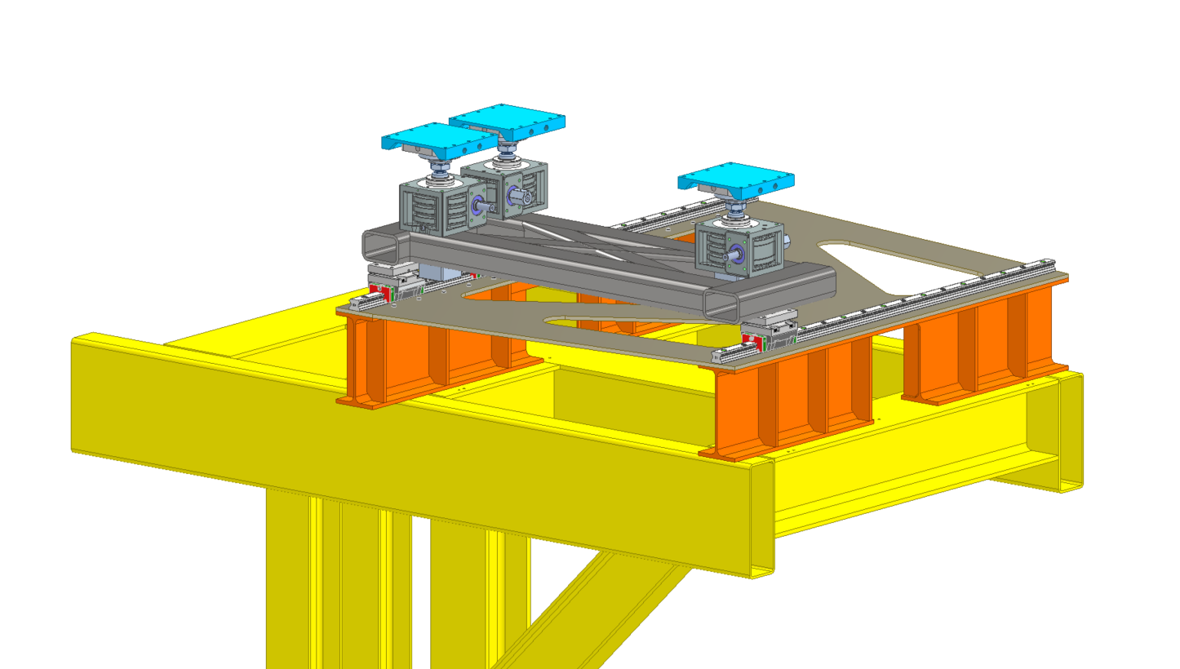
Movement module (FoCal closing module)
The movement of the entire system is proposed to be carried out using HIWIN linear guides with INA spherical bearings.
We are currently in discussions with HIWIN about using their product in our design.
M. Kucharski

Slide 9
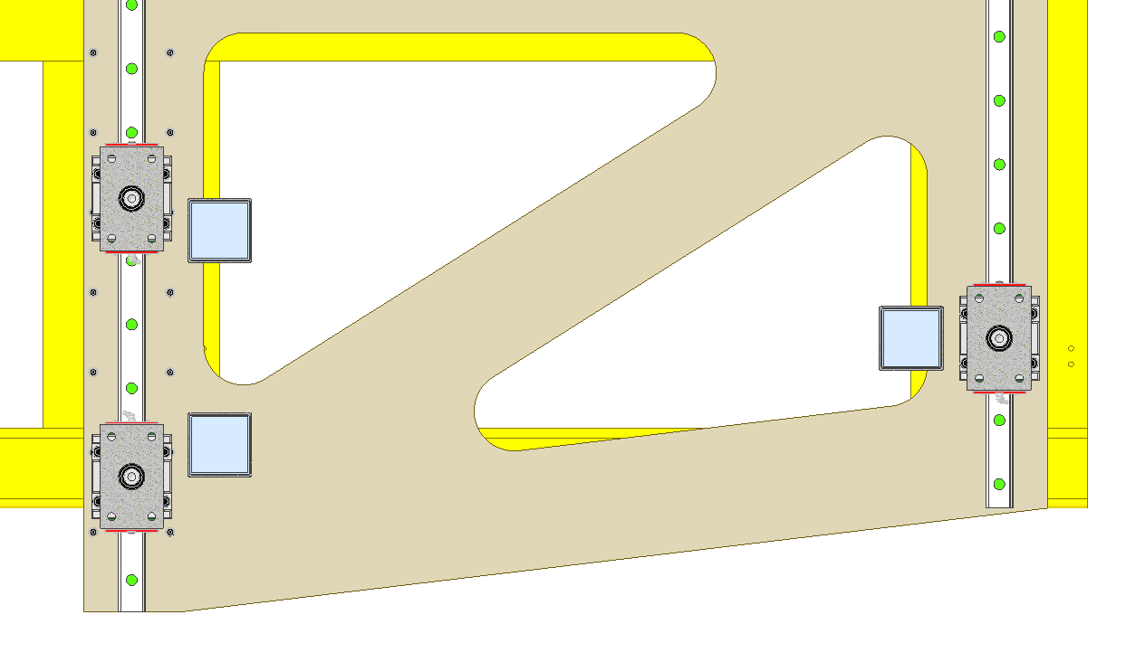
Movement module (FoCal closing module)
Half of the detector is proposed to be supported on 3 carriages forming a plane regardless of the deflection of the support frame.
The distance between the two rails of the linear guides will be provided by a plate (beige) that will be fixed only on the side of the two support points (left). The side with one support point (right) will be able to slide on top of the
I-beam.
Fixed
Sliding
M. Kucharski

Slide 10
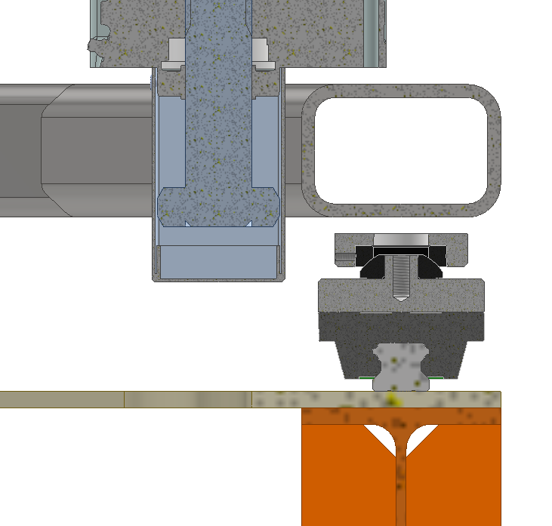
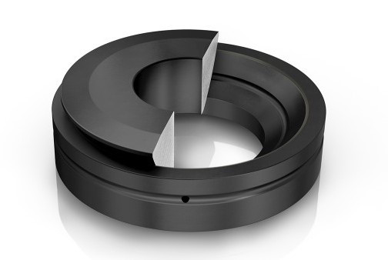
Movement module (FoCal closing module)
The spherical bearing mounted on each linear carriage is to allow absorption of frame deformation and ensure correct operation of the carriage.
α
Source: INA GE20-AX Prumex.cz
M. Kucharski

Slide 11
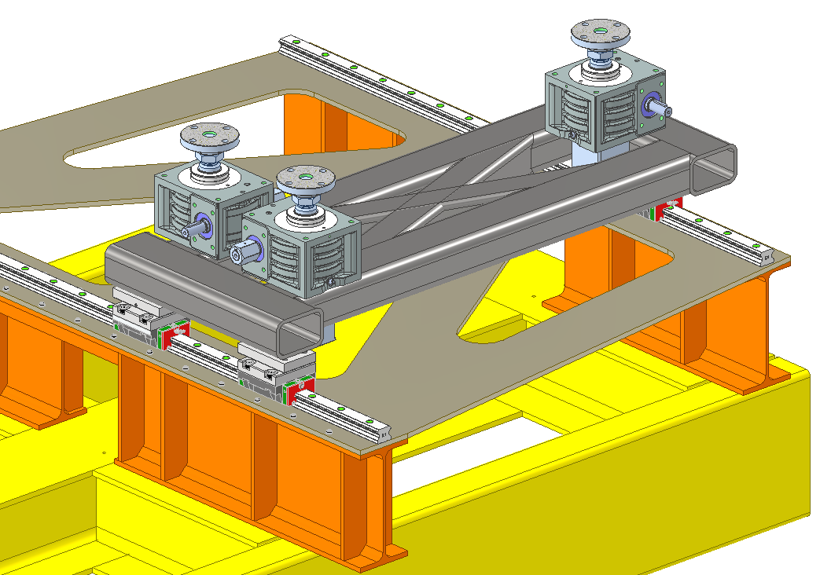
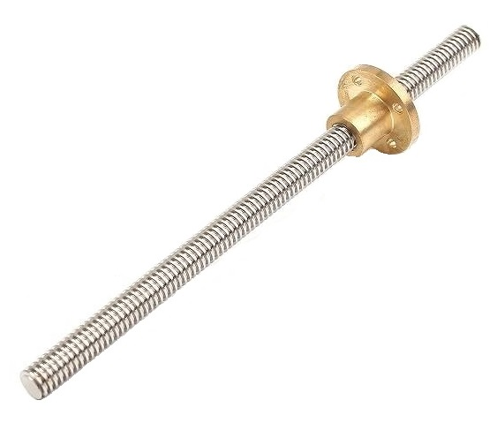
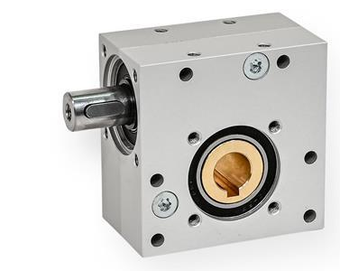
Movement module (FoCal closing module): drive unit
The current drive module concept is based on a trapezoidal screw and a worm gear.
The system is to be manually driven and move half of the FoCal detector.
Source:
Poltech S.C.
HanserAG
M. Kucharski

Slide 12
Lifting module and vertical angle setting
The vertical movement of each half of the FoCal detector is to be accomplished by three screw jacks.
These can allow for fine adjustment of the height and angle of the detector.
M. Kucharski

Slide 13
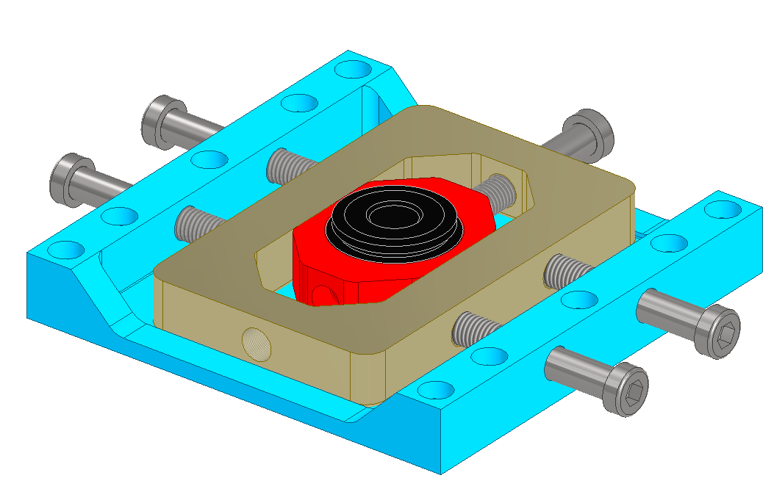
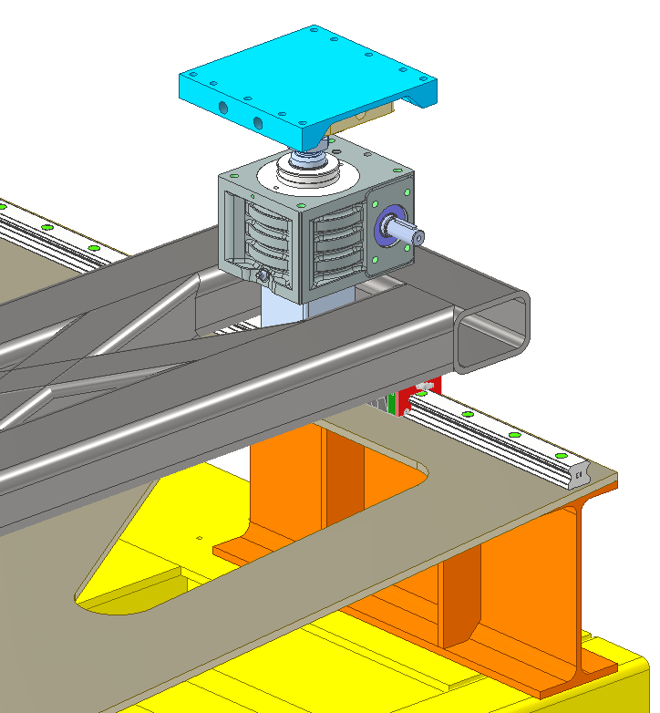
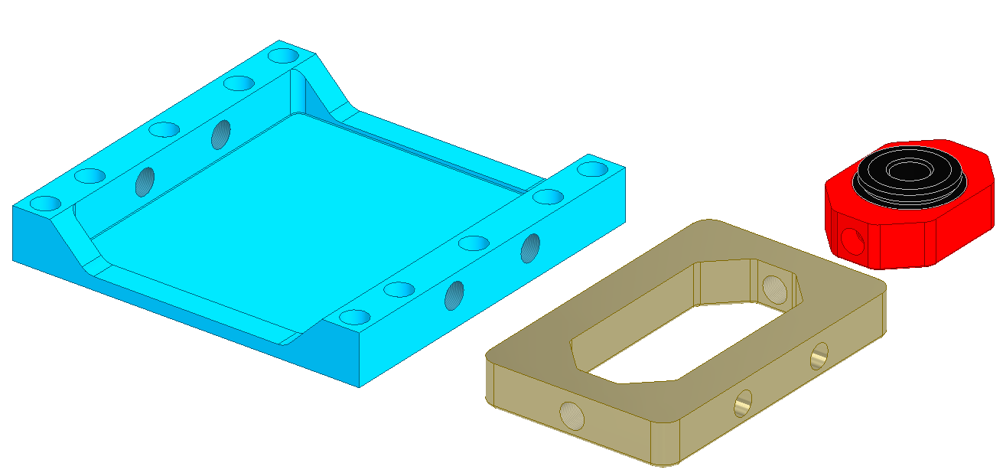
Fine traverse and rotation module (positioning head)
The positioning head, consisting of 3 main parts and a spherical bearing, is designed to allow accurate movement (0.1 mm) and rotation of half of the FoCal detector by means of bolts.
The spherical bearings are intended to allow for changes in the angle of the detector accomplished with screw jacks.
M. Kucharski

Slide 14
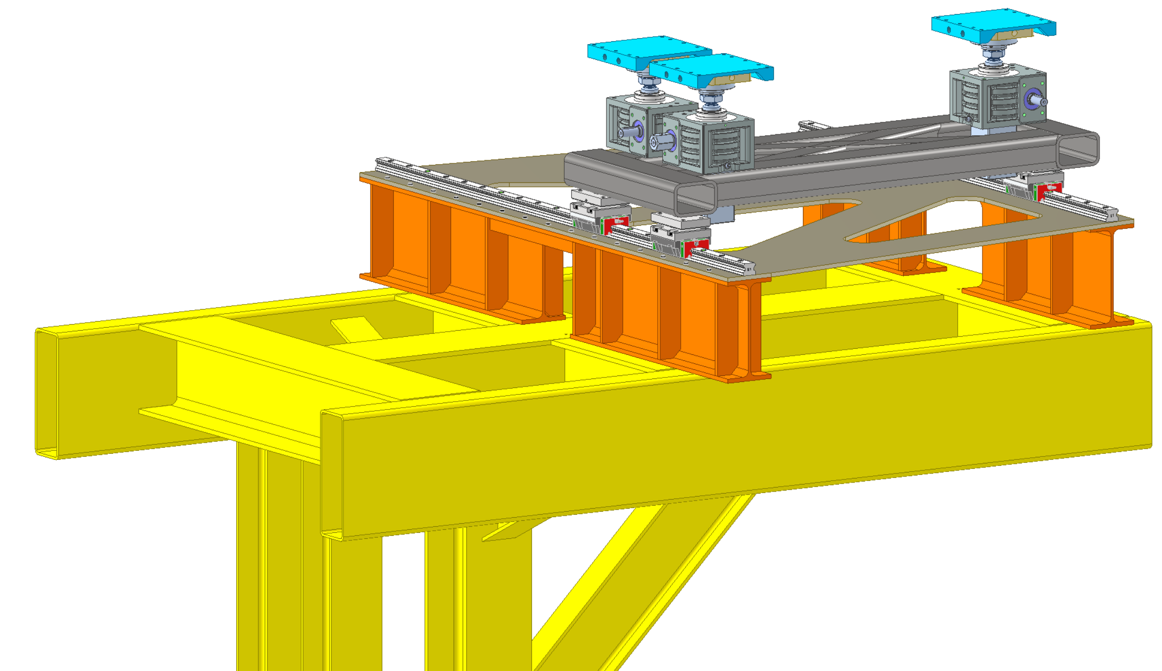
Summary
During the course of the project, a number of problems were identified and solutions were proposed. The selection of components and contacting companies was also an important element of work.
Due to the couple unresolved problems, resulting from the deflection of the support frame, alternative versions of the design are still being considered.
M. Kucharski

Slide 15
Thank you for your attention
mikolaj.jacek.kucharski@cern.ch
Contact person:
Maciej Czarnynoga
maciej.marek.czarnynoga@cern.ch
M. Kucharski

