Slide 1


FoCal Detector Lifting Frame on behalf of ALICE-FoCal
Gabriela Jas
22.08.2024
Notes:
Good morning,…, Today i will present to you my work done in connection with the project Liftifting Frame for the Focal Detector

Slide 2

Main aims and objectives of the project
An optimal design must be made to enable the detector to be carried and to allow for the installation of other components
Structure must carry a load of 7 tons [Source: Technical Design Report of the ALICE Forward Calorimetr]
Strive to minimize mass
During lifting, the force must be transmitted axially upward, without introducing torsional torque into the structure
Rules should be created for standardized naming and numbering of all detector parts
There should be a document describing the procedure for placing the detector in final position
Notes:
I would like to start my presentation by showing the assumptions that guided me during the project work. The main objective of the entire project was to create a structure for installing the detector at the target site. The structure was to be designed so that additional components could be easily installed and the detector could be placed on a positioning system. Additional design considerations were to ensure the structure's strength under a 7-ton load while minimizing its weight and cost. The final stage of the work was to be the creation of technical documentation. For this purpose, a document as a standard for naming and numbering detector parts had to be created . Documentation describing the procedure for placing the detector in service position was also to be done.

Slide 3
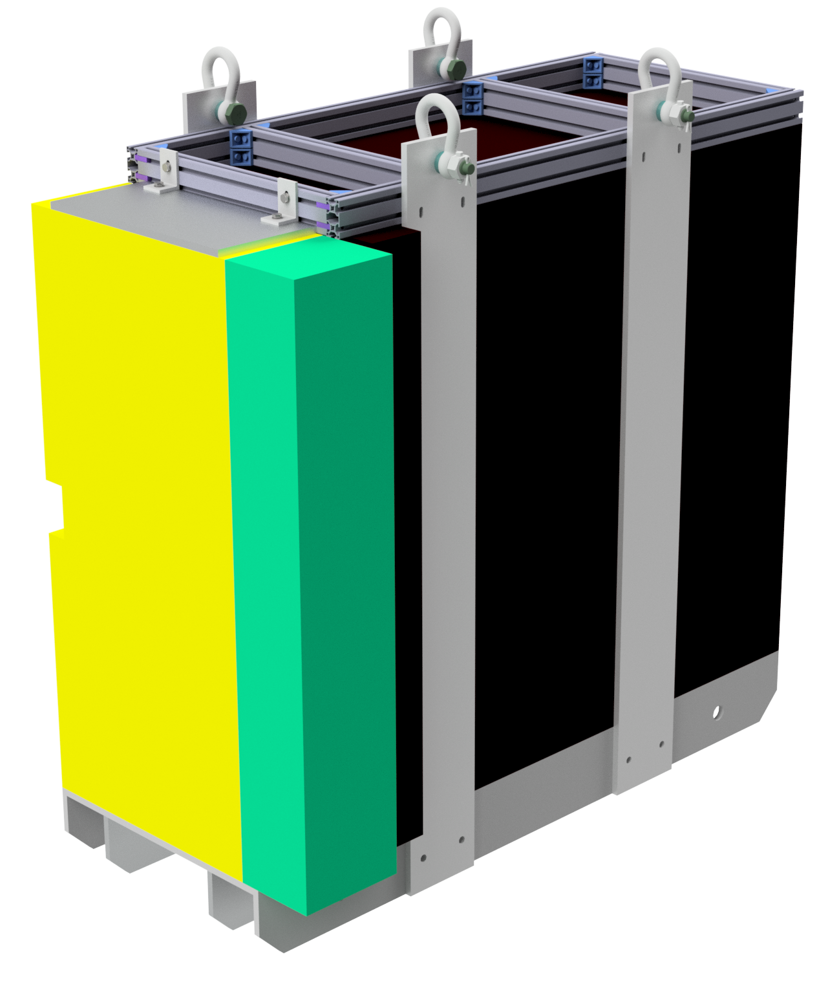
Structure description
The design is intended to allow the detector to be moved to it’s target location
It can be divided into 3 main components: Support platform (1), Top Box (2) and Side Panels (3)
The design is identical for both halves of the Detector
Proper calculations and simulations have been made
2
3
1
Notes:
I would like to start structure description with showing you the final concept of whole structure, and then move on to show the various sub-components. So this is a single detector half with mounted lifting structure. This structure can be diveded to 3 main components – support platform, top box and side panels. Structure is the same for both halves of the detector. During the creation of the structure, appropriate calculations were made to determine its strength and allow for changes to be made to improve its properties. Main material used in this structure are stainless steel a304 and anodized aluminium. These materials were selected for their non-magnetic nature.

Slide 4
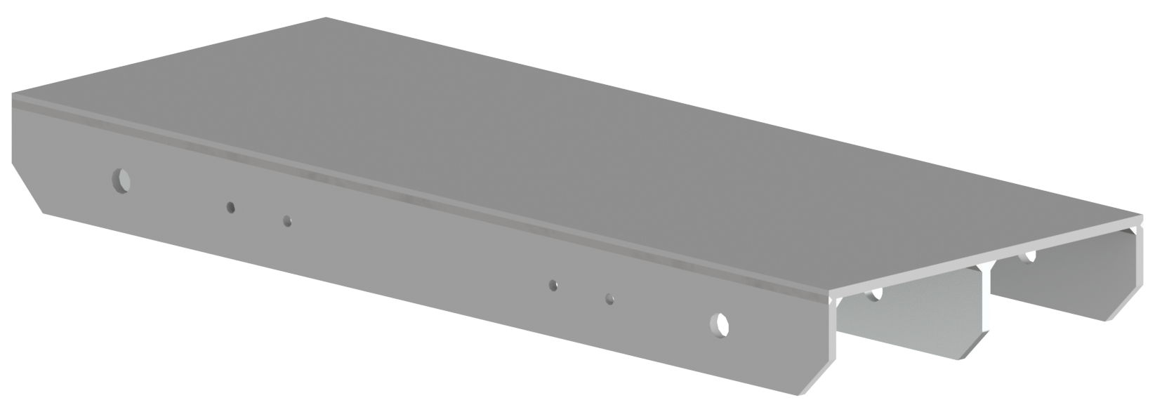
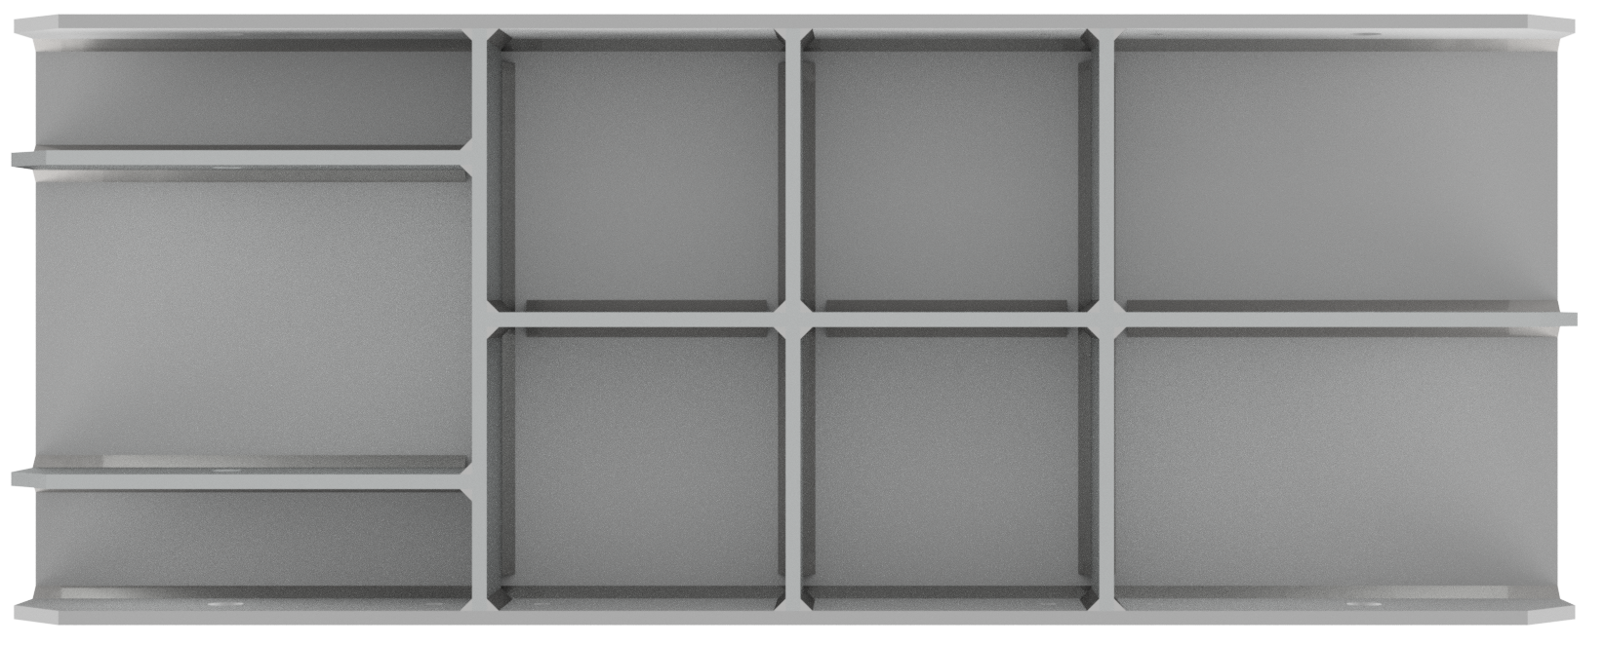
Support platform
Support platform consist of a plate, walls and ribs welded toghether
Side panels are connected to the platform with M12 grade 8.8 bolts - the relevant calculations have been made
Holes are provided in the walls to allow access to the positioning system
Notes:
I will start the description of the components with the Support platform. Support platform consist of a plate, walls and ribs welded toghether. The platform is intended to provide a base for the detector while it is being built, and then allow the detector to be placed on the positioning system. Side panels will be attached to the platform with 8 M12 bolts and will carry the entire weight of the detector. Holes have been provided in the walls and ribs of the platform - to access the positioning system.

Slide 5
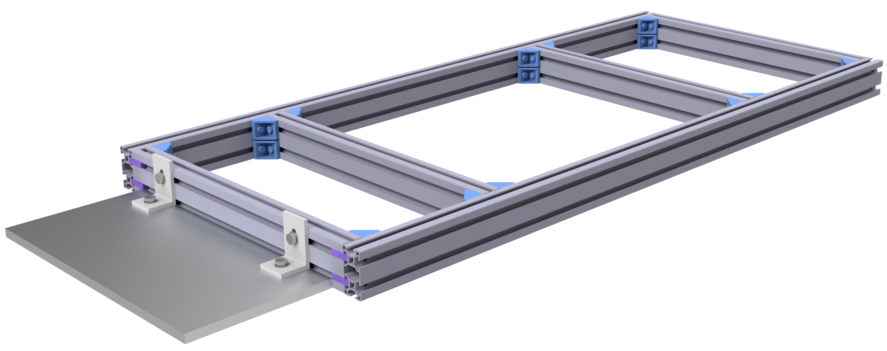
Top Box
Top box consist of aluminium profiles with dimensions of 30x60 mm
The plate, which is tightened with angle brackets, is to allow the mounting of FoCal-E
The design of the frame is intended to ensure easy attachment of side panels and that additional components are easily installed
Notes:
The top box is intended to provide the structure with sufficient rigidity and allow the attachment of other components, such as an electronics housing. Thirty by sixty millimeter aluminum profiles were chosen for their easy installation and light weight. The frame does not carry any load. The side panels are bolted to the frame with M8 bolts.

Slide 6
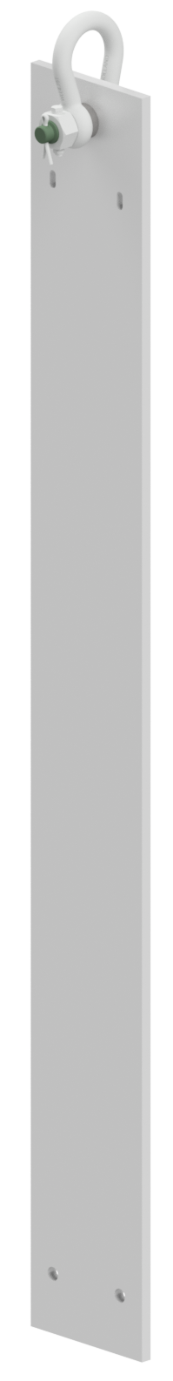
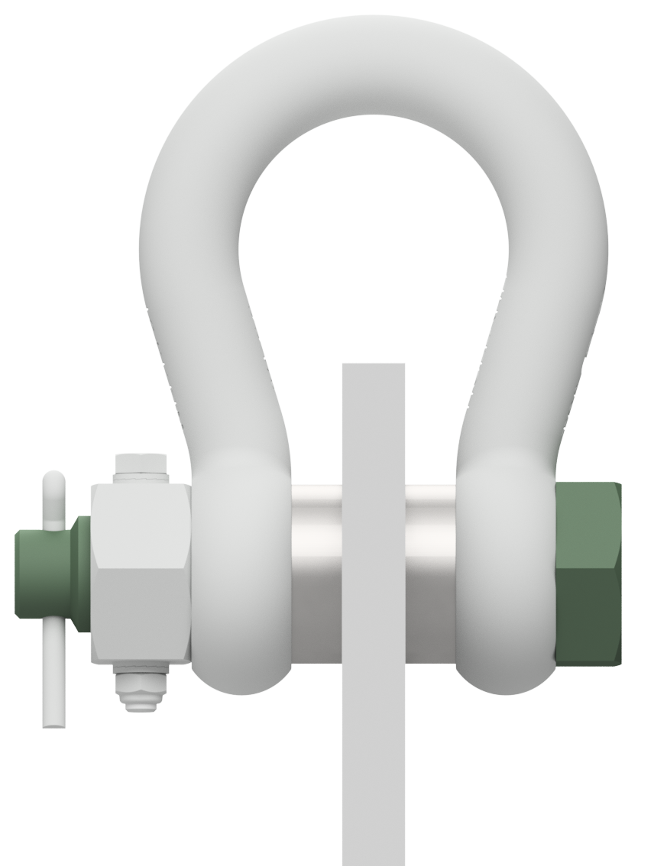
Side Panels
Shackle
Four panels connect Top Box and Support Platform with bolt connections
Shackles have been provided for lifting the detector
Carbon steel flange bushings and spacers have been used to reinforce the material at the hole site
Bushing
Spacer
Notes:
Side panels are made of twelve-millimeter sheet metal with a width of fifteen centimeters. Four shackles are provided for lifting the detector - they with adapter cross beam will provide a very simple solution and ensure that the force is transmitted only in one axis, without additional torques. Due to the inferior properties of the stainless steel from which the panels are made, a carbon steel sleeve will be placed in the shackle holes. A spacer will also be added to prevent shackle movement in the holes. The use of a reinforcing sleeve is not yet confirmed - a better look at strength analyzes is required. Before placing the detector in final position ,the two inner side panels from each half need to be removed.

Slide 7
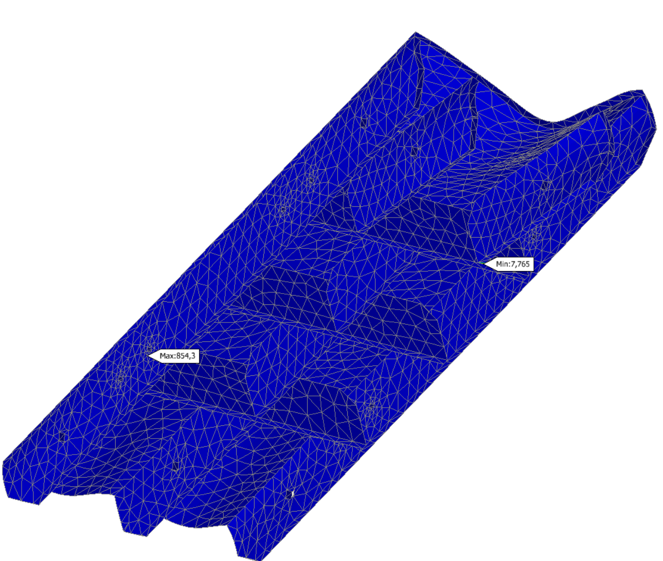
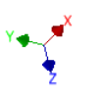
Simulations – Support Platform
Simulation assumptions:
Surface load equal to 68670 N
Force applied along the z-axis
Locking movement in the z-axis
Maximum stress value – 36.042 Mpa
Maximum displacment value – 0.113 mm
Minimal safety factor value – 7.76
Component can work under given load with big safety margin.
Safety Factor
Notes:
Now I would like to present some of the strength simulations performed. This slide shows the results for the Support Platfrom, placed on a flat surface and loaded with 7 tons. The maximum stresses that occur have a value of thirty-six mega pascals. The maximum deformation, marked in red, is zero comma one hundred and twelve millimeters. The minimum safety factor for this design is seven comma seven hundred and sixty-five. The results indicate that the structure was designed with a large safety margin and can operate under a given load condition.

Slide 8
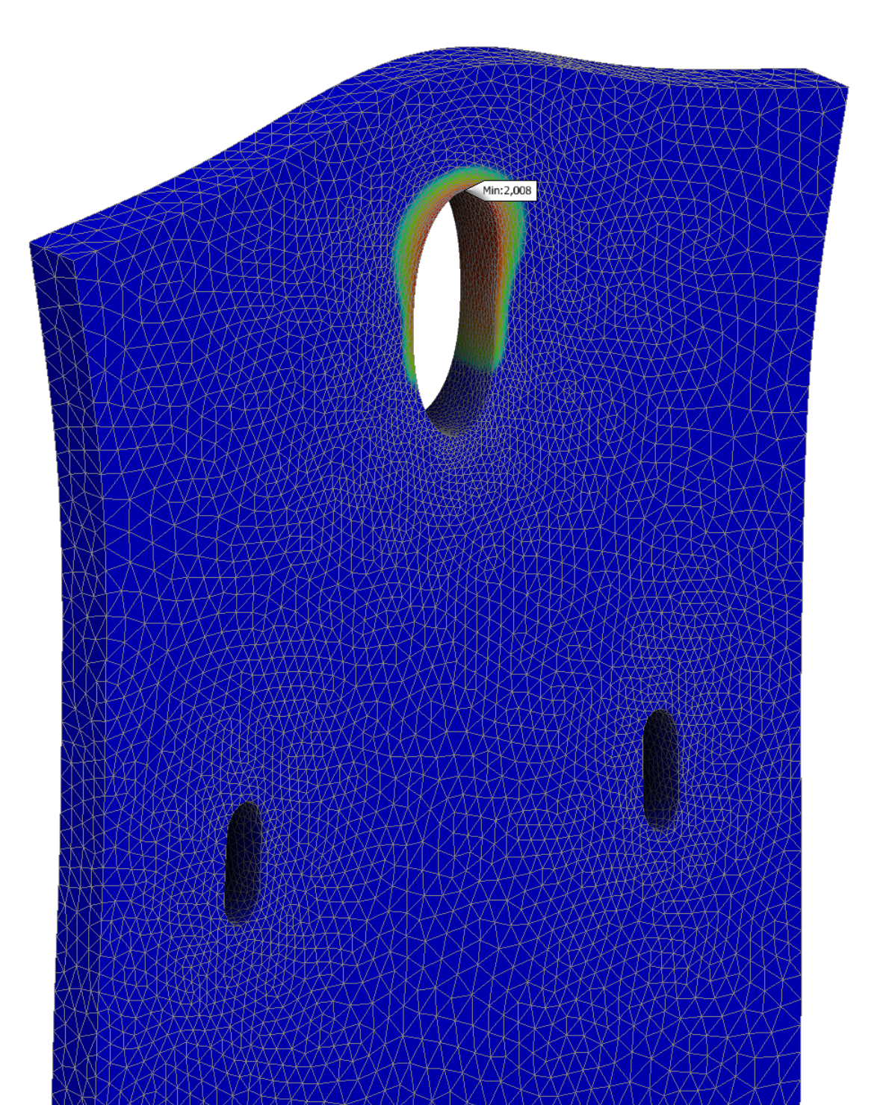

Simulations – Side panels without bushing
Simulation assumptions:
Surface load equal to 17167.5 N
Bearing force applied along the y-axis, positively directed
Locking movement in the z-axis
Maximum stress value – 110.2 MPa
Maximum displacment value – 0.07 mm
Minimal safety factor value – 2.008
Average safety factor value – 5
Component can work under given load, reinforcment bushing may not be needed.
Safety Factor
Notes:
Here the simulation results for side panels without sleeve reinforcement are shown. The maximum stresses are 110 megapascals. maximum deformation is 0 comma zero seven. The minimum safety factor is 2, but this is the value occurring at one point, the safety factor in a significant area is more than 3. This allows to conclude that in the case of design without a reinfrocing sleeve the structure can also operate under given condition

Slide 9
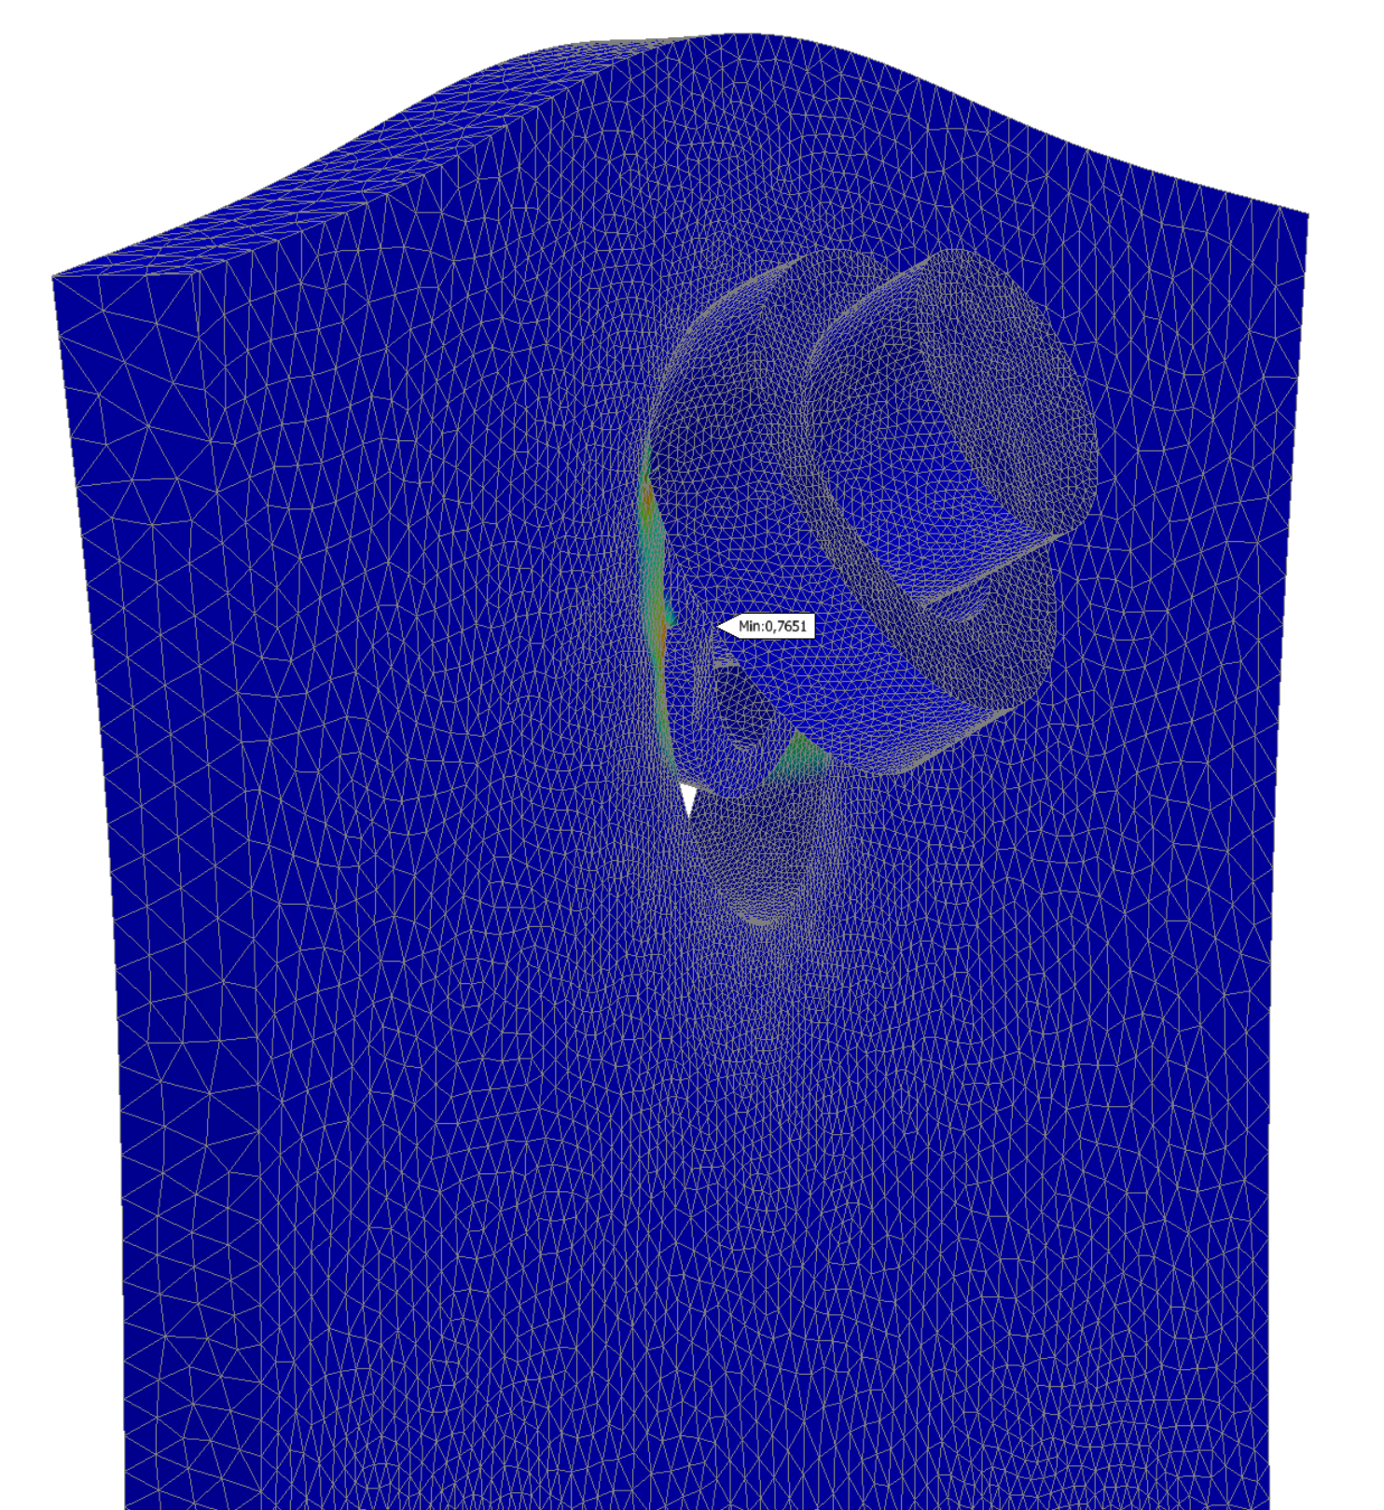

Simulations – Side panels with the bushing
Simulation assumptions:
Surface load equal to 17167.5 N
Bearing force applied along the y-axis, positively directed
Locking movement in the z-axis
Maximum stress value – 455.8 Mpa
Average stress value – 150 MPa
Maximum displacment value – 0.074 mm
Minimal safety factor value – 0.7651
Average safety factor value – 5
Component can work under given load.
The use of reinforcement does not significantly increase mechanical properties.
Safety Factor
Notes:
In the case of sleeve reinforcement, stresses remain at 150 megapascals , with point stresses reaching 455 megapascals. Deformations also do not exceed 0 comma 0 7 mm. Here, the safety factor is also 3 and above in most areas, pointwise falling to 0 comma 7. The results indicate that the use of sleeves may not be necessary.

Slide 10
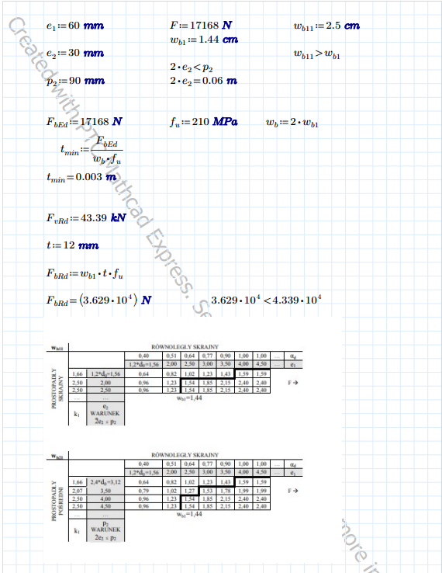
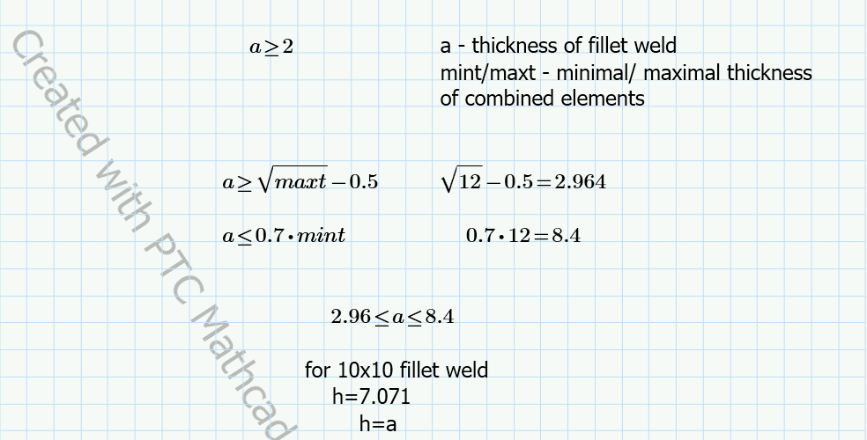
Calculations
Bolt capacity calculations:
Thickness of the parts - 12 mm
Assumed 1/4 load per side panel
There are 2 bolts per panel
M12 grade 8.8 bolts have been selected
Fillet weld thickness calculations:
Thickness of the parts - 12 mm
The thickness of the weld must be within < 2.96;8.4 >
A fillet weld of 10x10 was adopted
Notes:
The necessary calculations were made to verify the various components of the structure. In order to select the bolts carrying the entire load, calculations of bolt load capacity were made, allowing to conclude that M12 bolts will provide adequate strength. The required weld thickness range for Support platforms was also calculated. The calculations show that the weld must be in the range of two coma ninety-six millimeters to eight coma four. The results indicate that a 10 by 10 fillet weld will provide adequate thickness. In both cases, the calculations were made assuming a part thickness of 12 mm

Slide 11
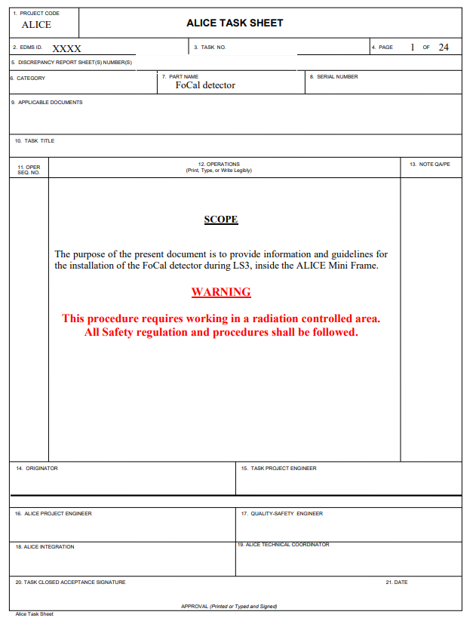
FoCal task sheet
FoCal task sheet:
Description of the procedure for assembling the structure
Description of the procedure for placing the detector in the target position
Assembly drawings
Calculations
Notes:
A preliminary draft describing the detector installation procedure was created. It contains a detailed description of all the steps that need to be taken to prepare the structure for installation. It also contains technical documentation of some parts and components that are part of the lifting structure. The document still requires changes to specify some data, such as lifting cap acity of the hooks or adding other attachments. It is also required to prepare other assembly and manufacturing drawings.

Slide 12
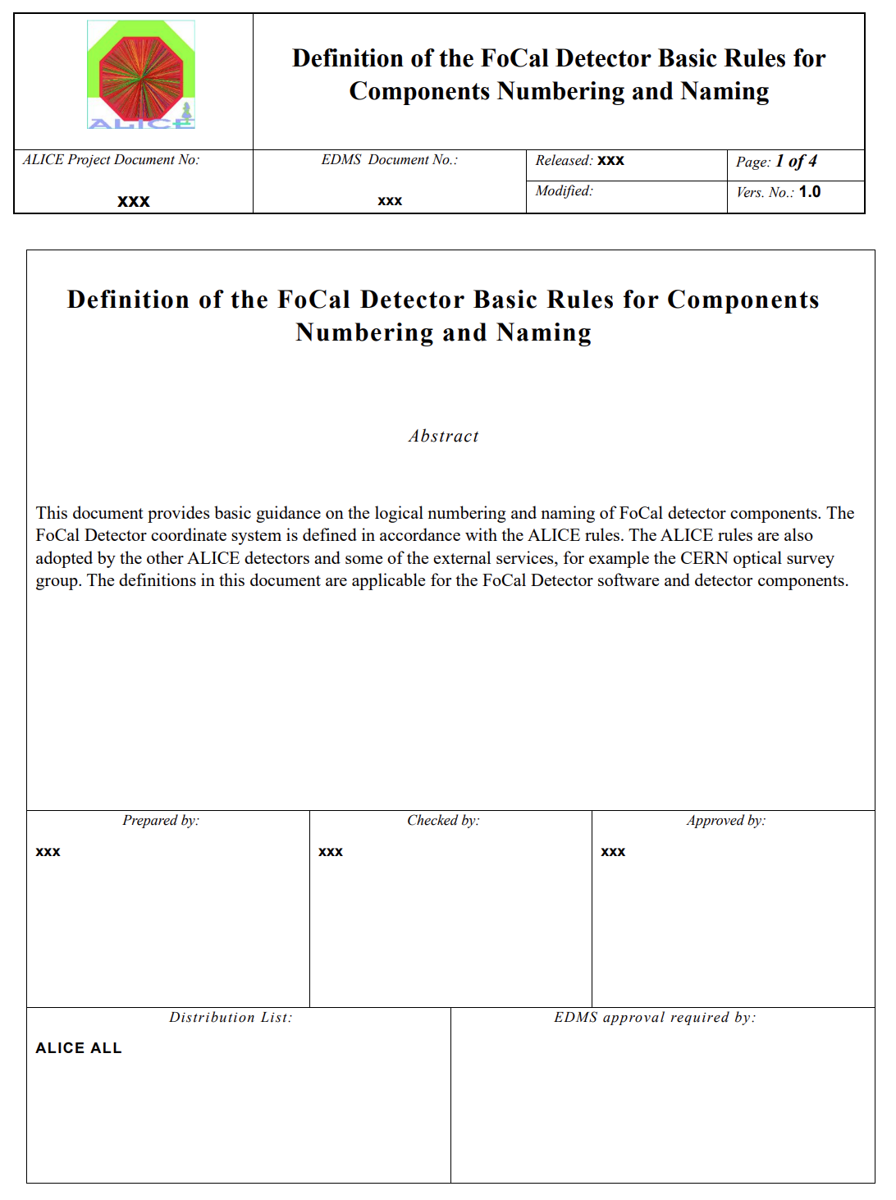
FoCal Naming and Numbering
Definition of the FoCal Detector Basic Rules for Components Naming and Numbering:
Description of distinguishing the detector halves
Description of rules for naming components and parts
Description of the principles of numbering components and parts
Notes:
In order to efficiently describe all parts and components, a document had to be made on how to name and number all parts of the detector. For this purpose the initial draft of Definition of the Focal Detector Basic Rules for Components Naming and Numbering was created. The number will distinguish between detector halves and sub-components. Document may be developed as new numbering and naming rules emerge.

Slide 13
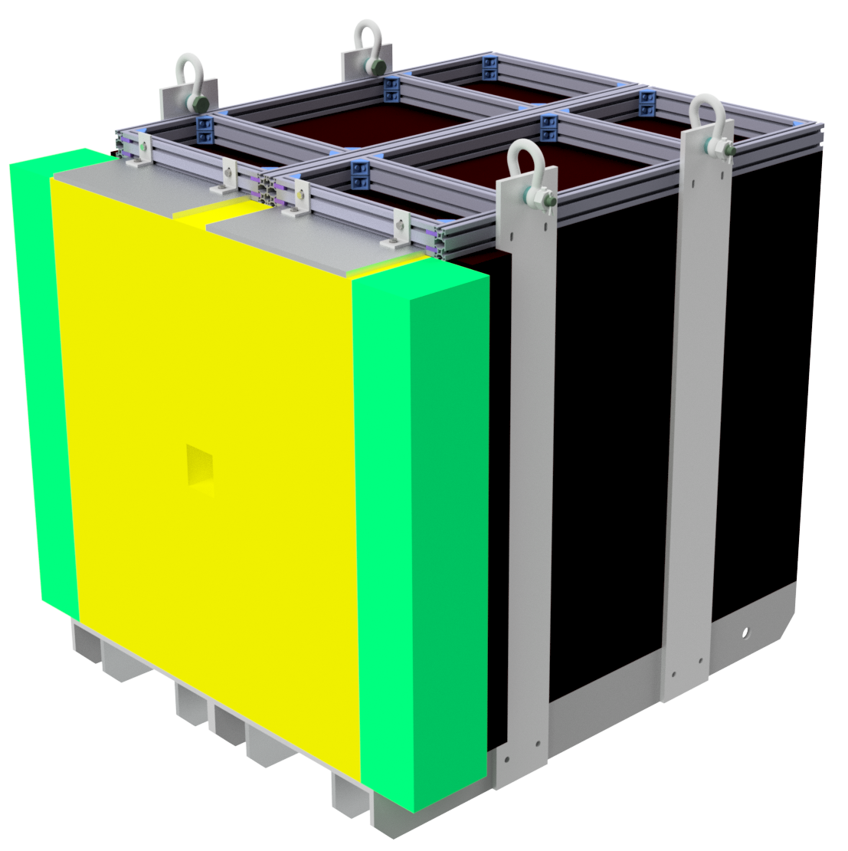
Summary
During the design process, the most optimal solution was selected
The performed simulations allow to confirm that the design data were selected correctly
The documentation should be further developed to improve its functionality

Slide 14
Thank you for your attention
Gabriela Jas
gabriela.jas.stud@pw.edu.pl
Contact Person:
Maciej Czarnynoga
maciej.czarnynoga@pw.edu.pl

