Slide 1


Introduction to FIT projects
Author:
Krystian Roslon
22.08.2024

Slide 2
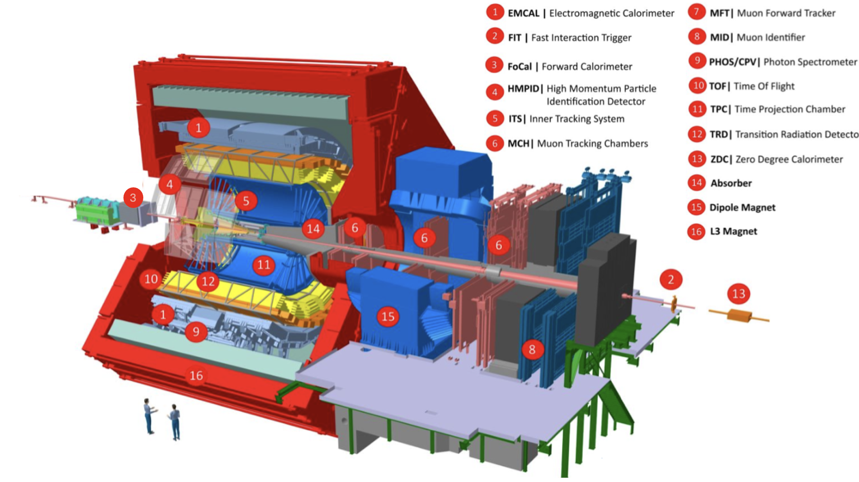
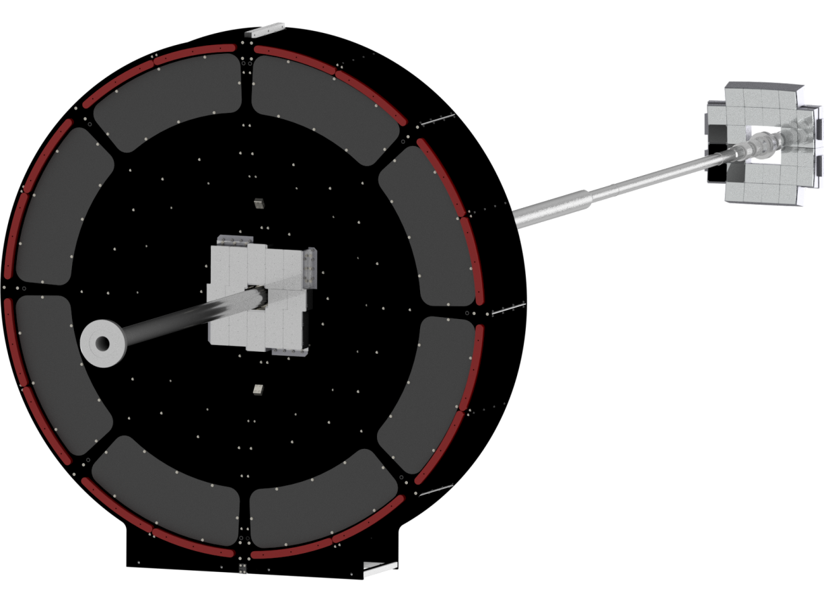
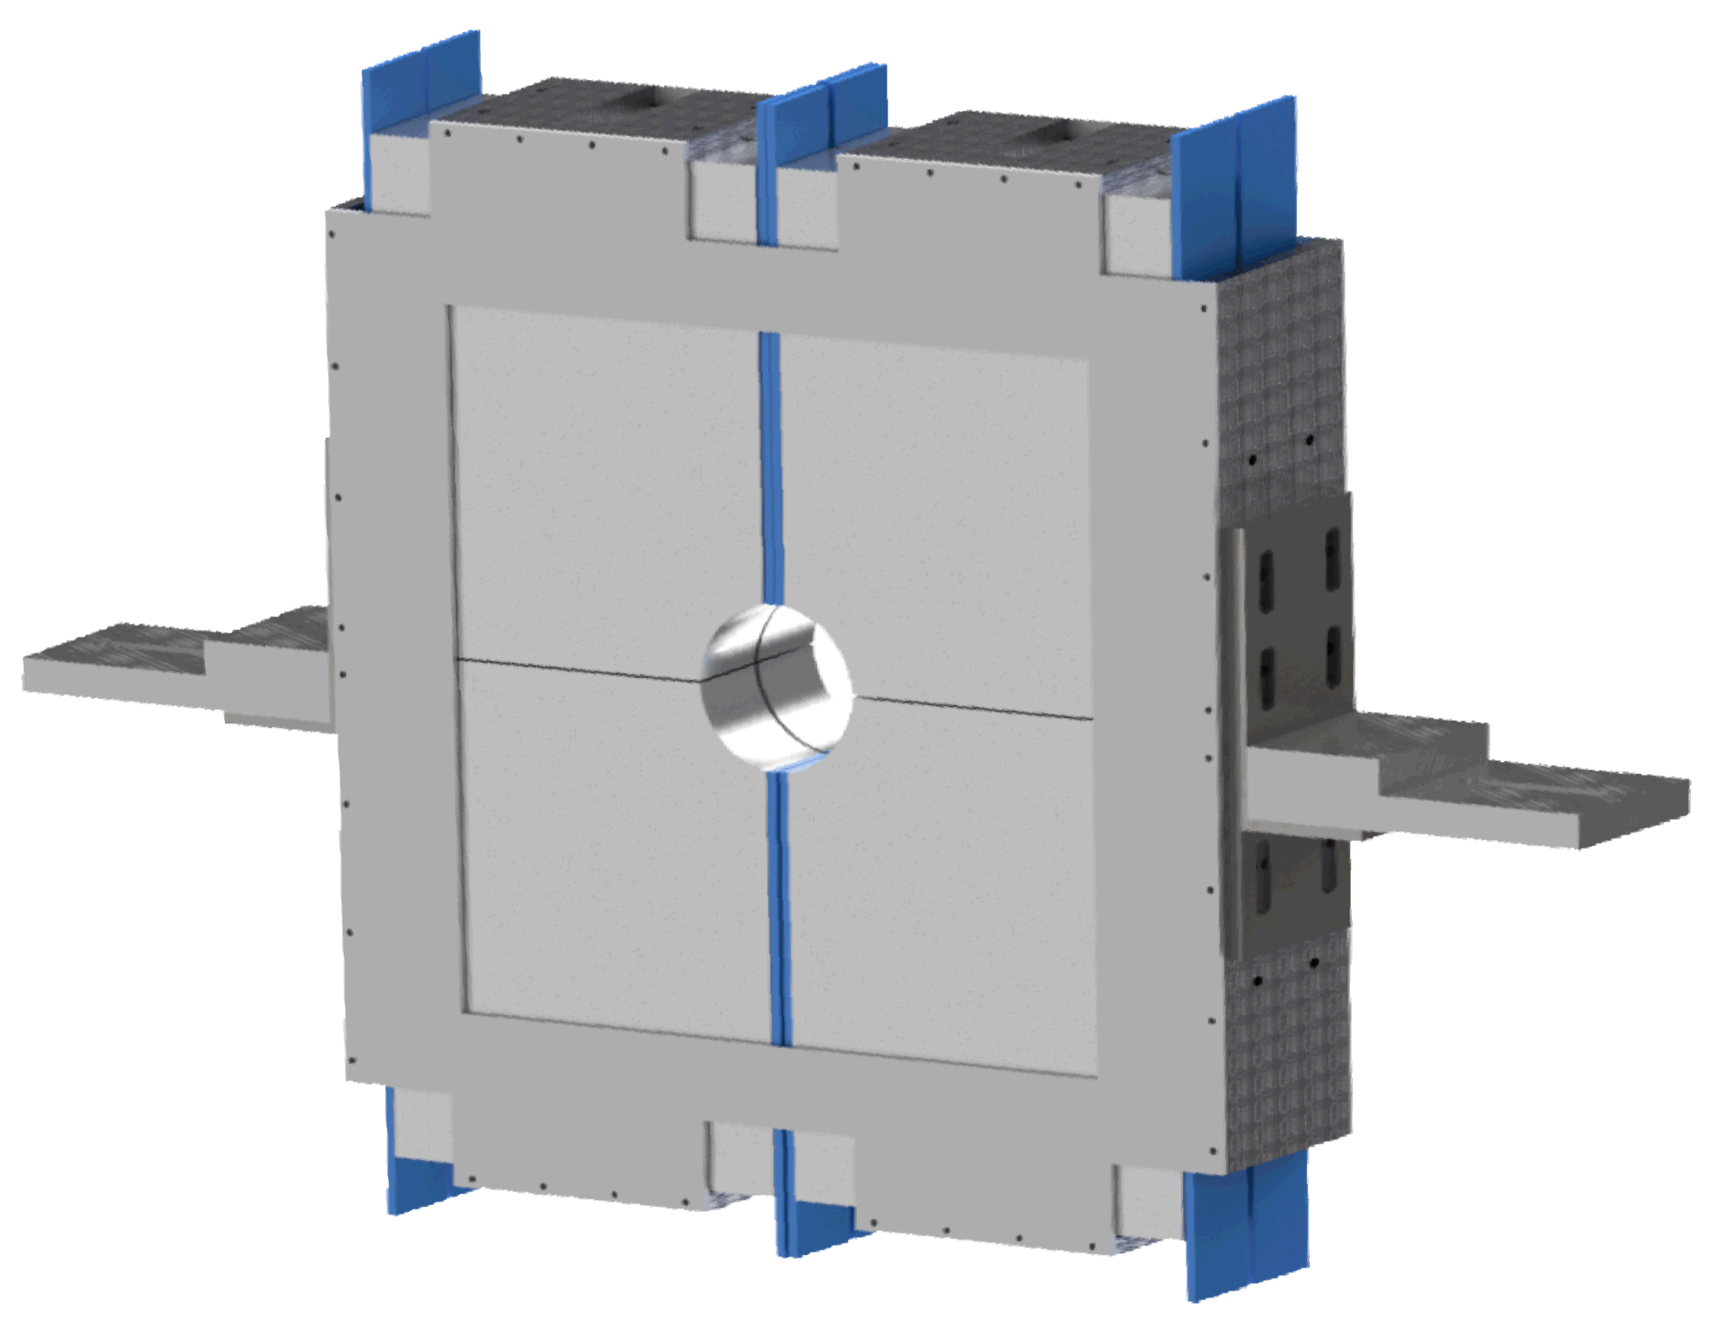
ALICE Fast Interaction Trigger (FIT)
Delivered Functionality
Fast min. bias collision trigger with latency < 425 ns;
Time resolution: 5 ps in Pb-Pb and 18 ps in pp collisions;
Luminosity and background monitor;
Centrality measurement;
Event plane determination;
FDD-C
-7.0 < η < -4.9
-20m from IP
FV0: 2.2 < η < 5.1
3m from IP
FT0-C
-3.3 < η < -2.1
-1m from IP
Fig. 1: ALICE detector
FDD-A
4.8 < η < 6.3
17m from IP
FT0-A
3.5 < η < 4.9
3m from IP
Fig. 2: ALICE FIT detector

Slide 3
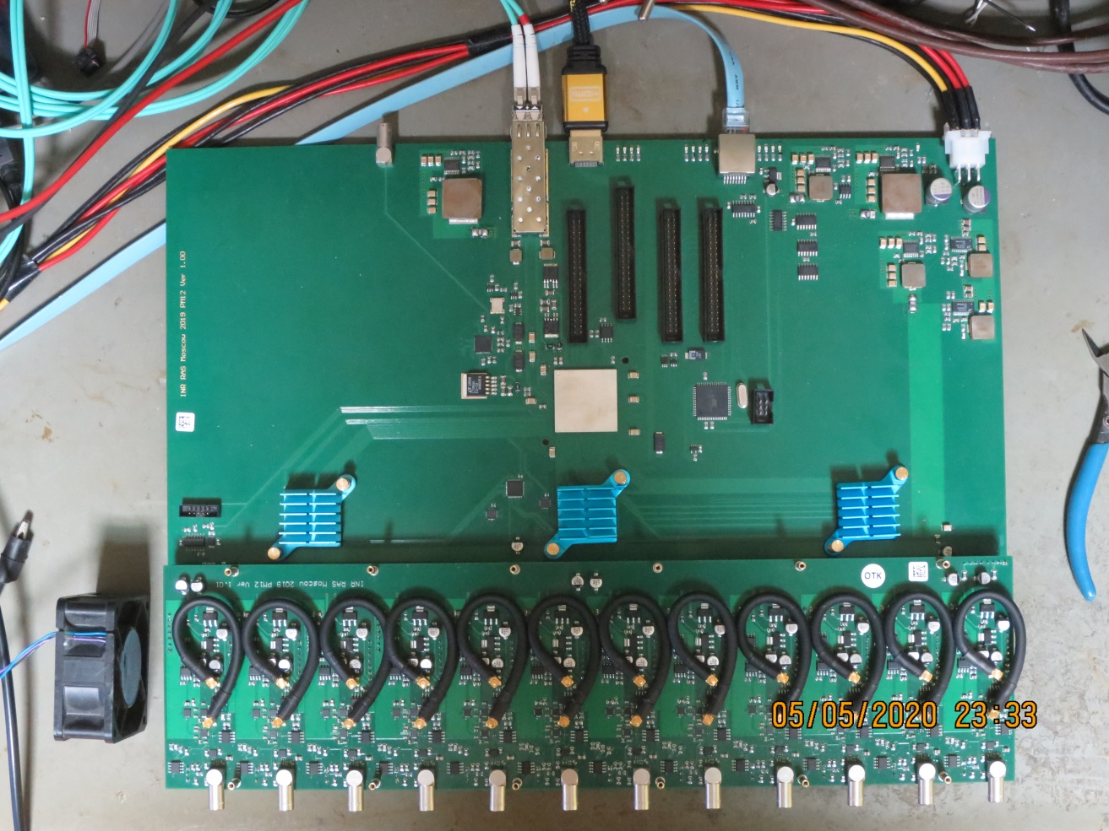
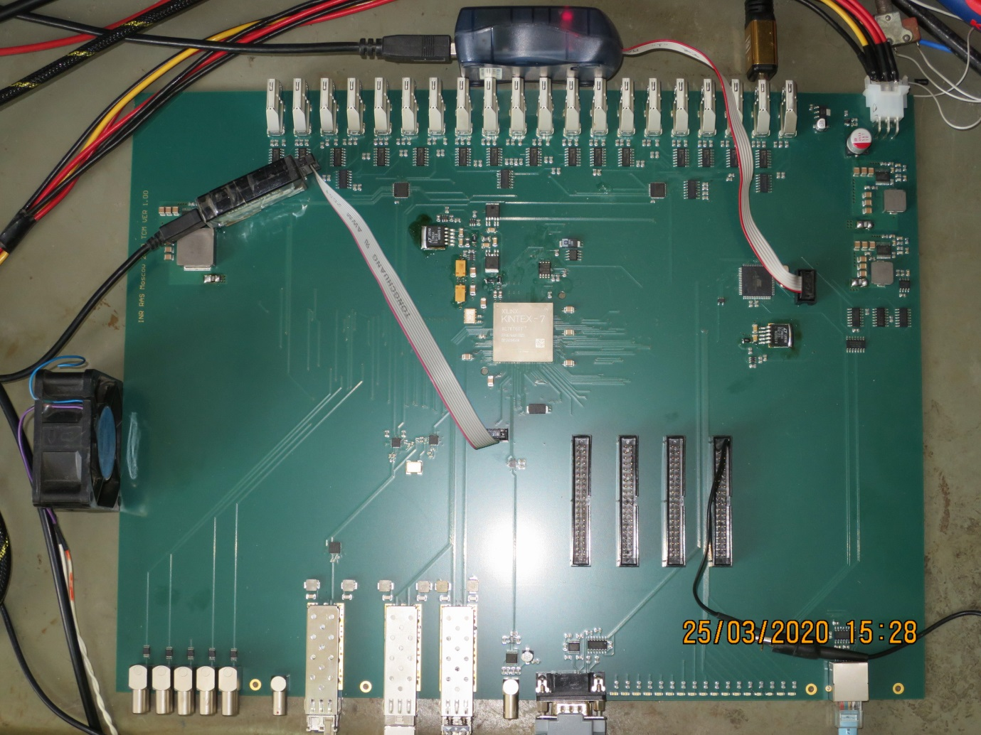
ALICE FIT detector setup
FIT PM (Processing Module):
12 independent inputs;
Very simillar for all FIT detectors;
FIT TCM (Trigger and Clock Module):
One TCM;
May connect 20 PMs via an HDMI cable;
Connected to the FIT DCS via IPbus;

Slide 4
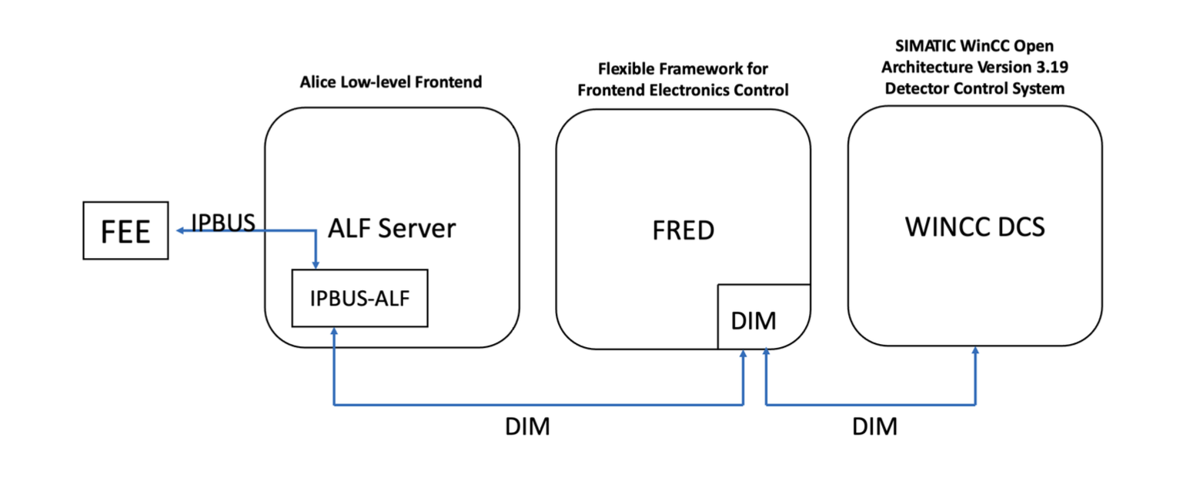
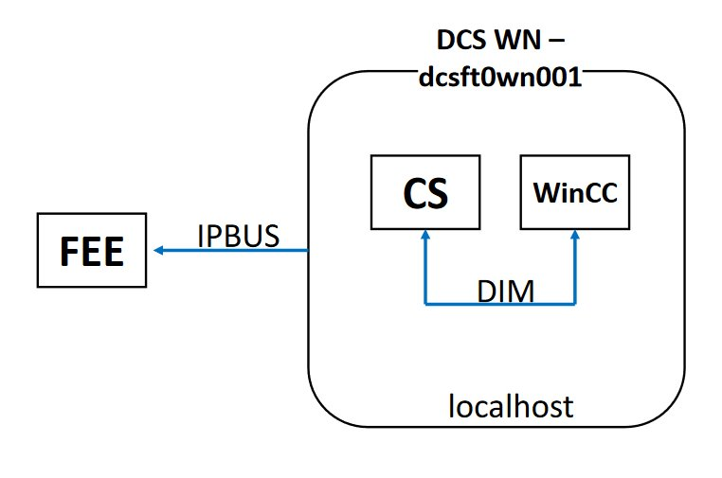
Implementation of ALFRED
Second Project (Front-end)
WINCC OA
ALICE Low Level
Front End Device
(ALFRED)
FRED
Front End Device
ALF
ALICE low-level front-end
frontend

Slide 5
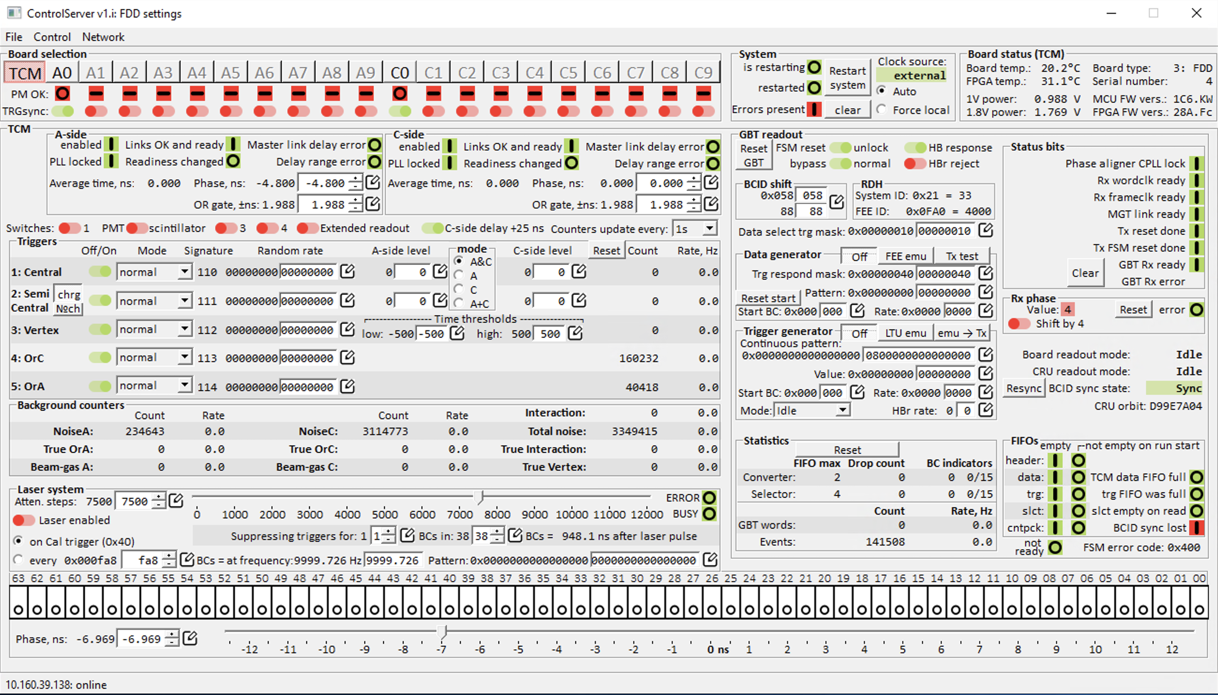
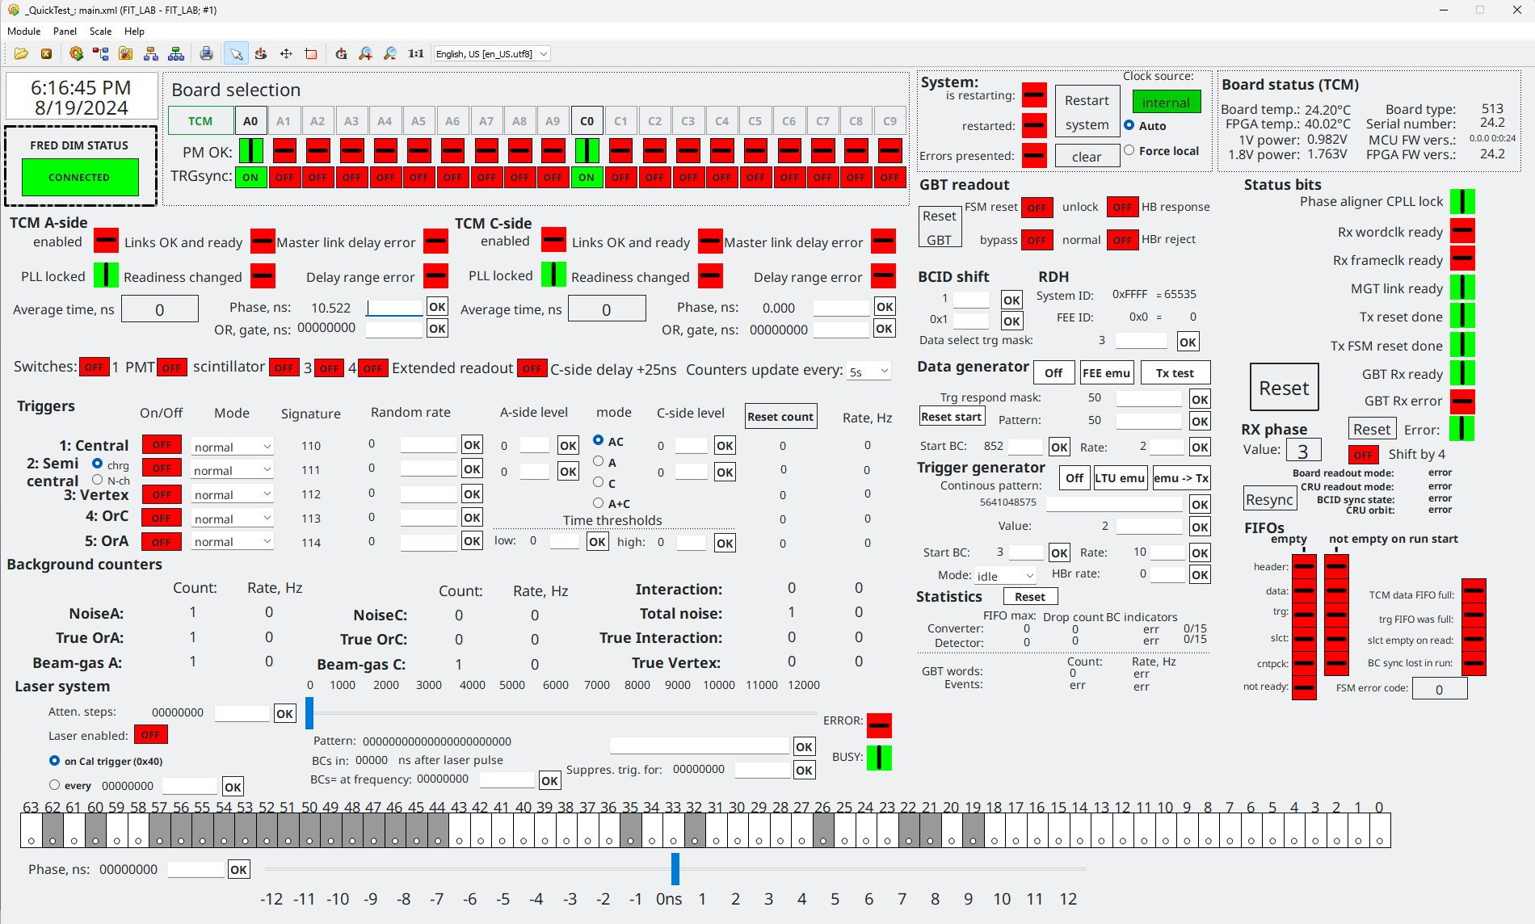
WinCC O.A SCADA system

Slide 6
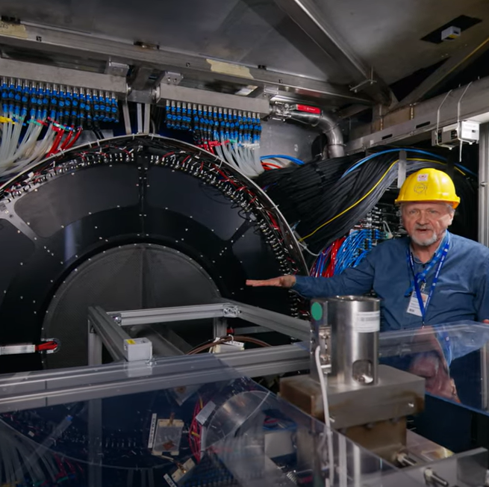
FIT videos viewed
YouTube:
  English; https://youtu.be/PjsBIbKsuO0
  Spanish; https://youtu.be/qR_lG7K3pfs
  Polish; https://youtu.be/31s8jix2omo
  Russian; https://youtu.be/phN0AohEDKI

