Slide 1


Strong Gravitational Lensing for Inference of Small-Scale Dark Matter Structure
SUSY 2025
Sebastian Wagner-Carena

Slide 2
Outline
Science review: dark matter, strong lensing, and things in-between
How to measure the matter underlying strong lenses: simulation-based inference
How much information about low-mass halos can we extract?
How can a data-driven prism help us push beyond our sensitivity limits?

Slide 3
Outline
Science review: dark matter, strong lensing, and things in-between
How to measure the matter underlying strong lenses: simulation-based inference
How much information about low-mass halos can we extract?
How can a data-driven prism help us push beyond our sensitivity limits?

Slide 4
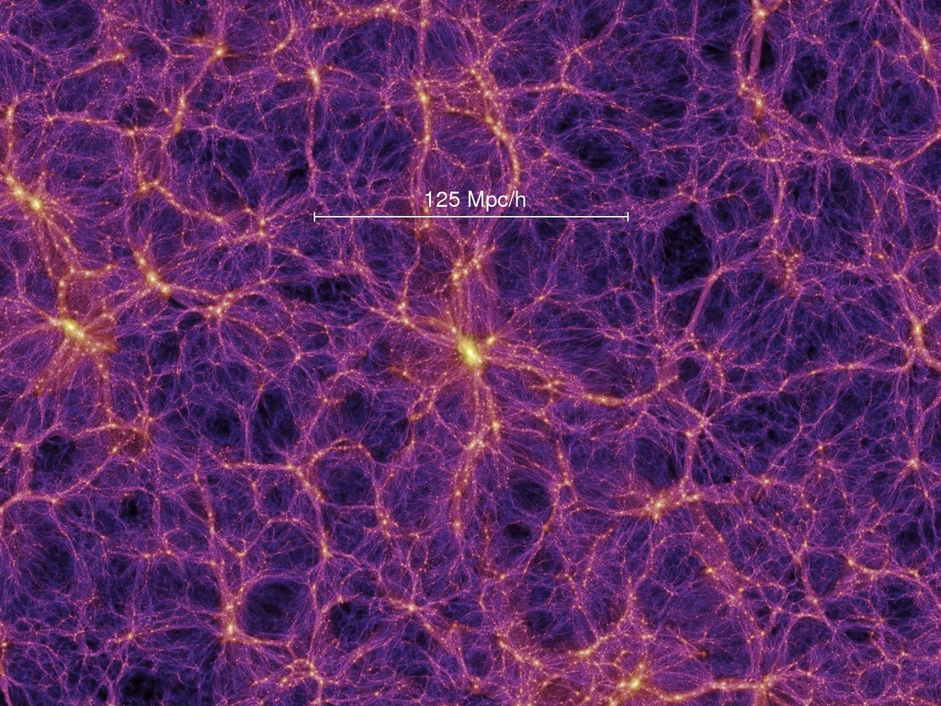
Cold, Collisionless Dark Matter
Springel et al., 2005
Dark matter clumps and forms dark matter halos
  Galaxies form near the center of these halos

Slide 5
Cold, Collisionless Dark Matter
Rodríguez-Puebla et al., 2016
Dark matter clumps and forms dark matter halos
  Galaxies form near the center of these halos
A halo mass function that extends to sub-solar masses

Slide 6
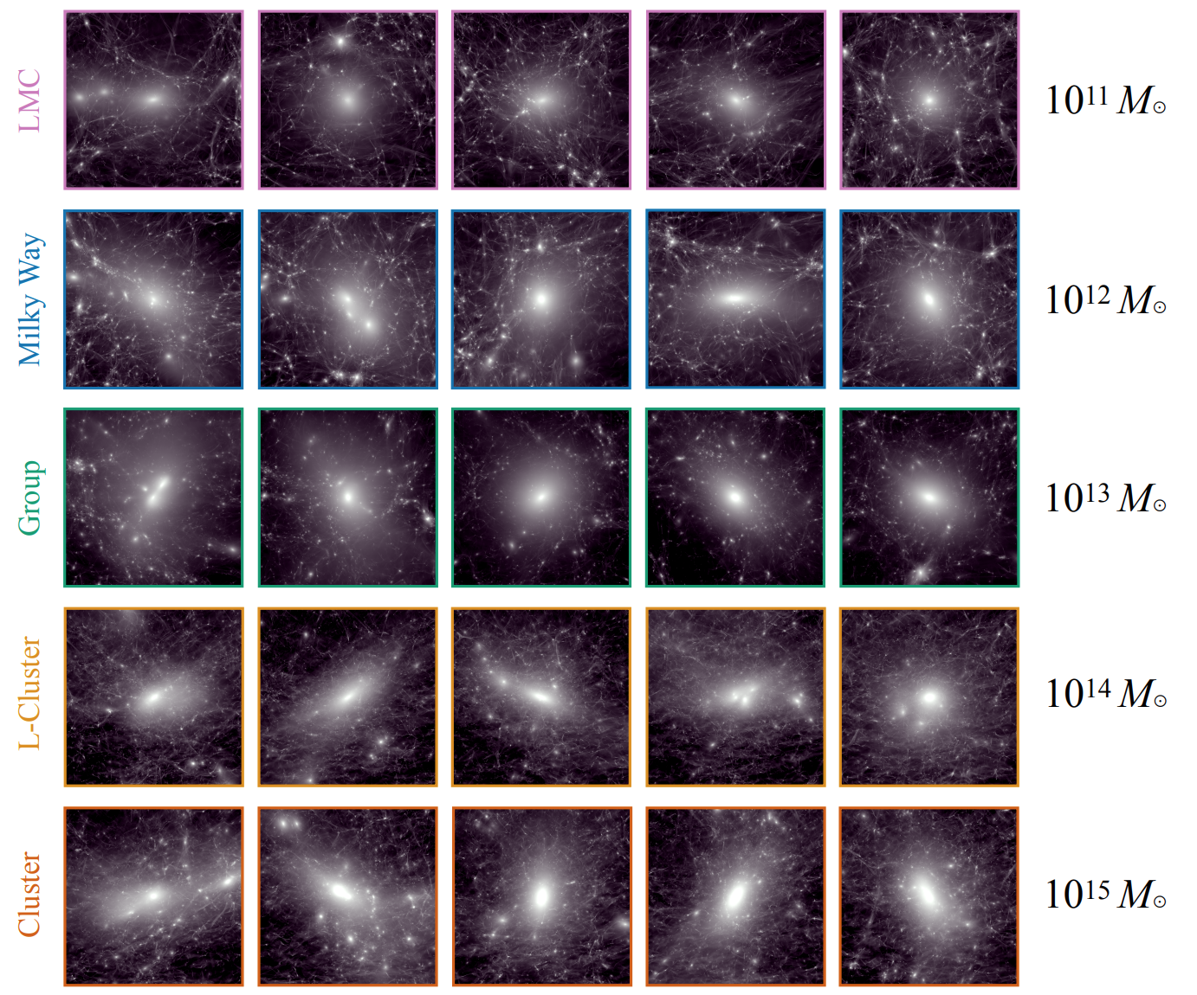
Cold, Collisionless Dark Matter
Nadler et al., 2023
Dark matter clumps and forms dark matter halos
  Galaxies form near the center of these halos
A halo mass function that extends to sub-solar masses
Halos grow through a process of hierarchical merging
  Subhalos within larger host halos

Slide 7
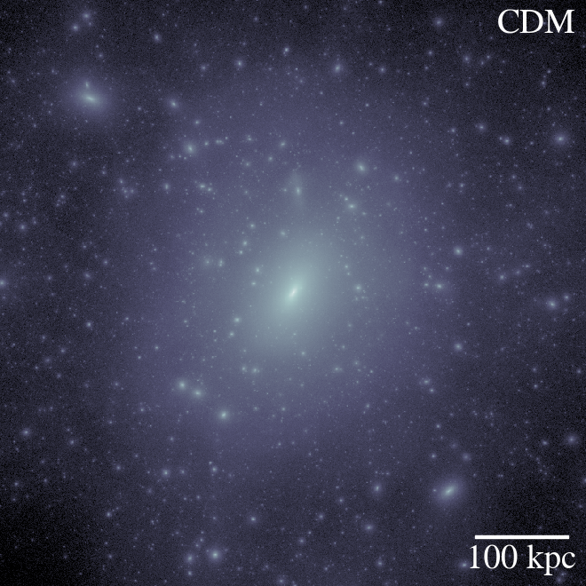
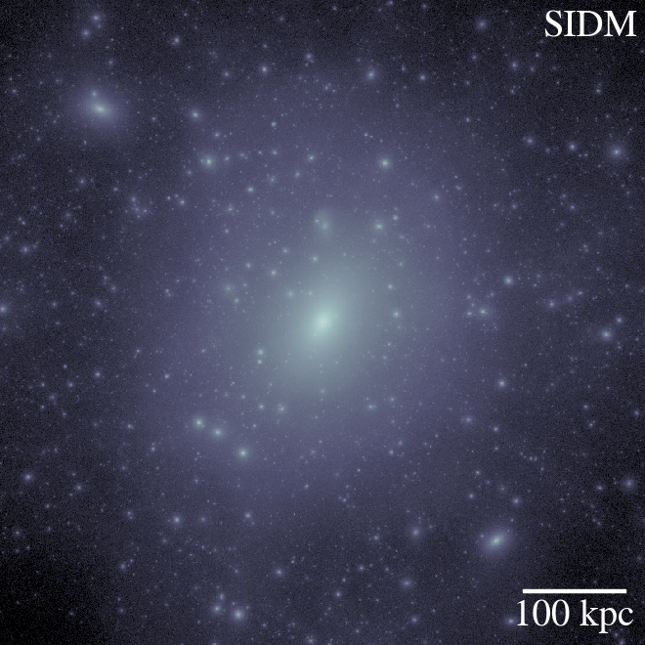
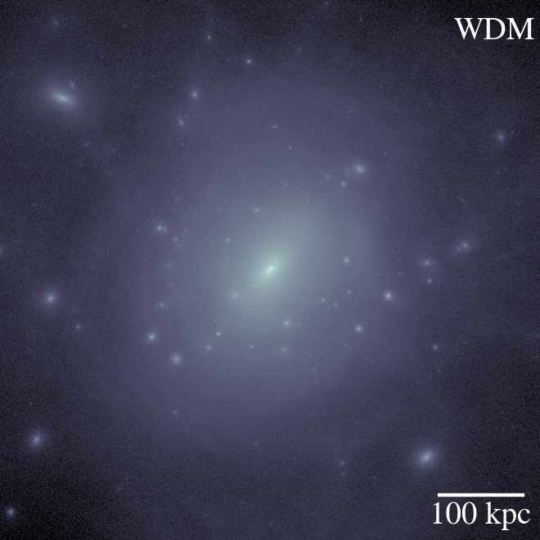
CDM Open Question
Bullock & Boylan-Kolchin, 2017
CDM is a description of the behavior of dark matter, not a fundamental model
What is the fundamental nature of dark matter?
Many compelling theories for dark matter violate the CDM paradigm
Low-mass halos → dark matter physics

Slide 8
Measuring Halos Through Galaxies
Wechsler & Tinker, 2018
Galaxies are hosted in halos, so why not use galaxies as a tracer?
Low-mass halos are inefficient at forming stars
  Light halo + small fraction mass converted to stars → very dim
  Dark halos: halos so light that no stars form
?

Slide 9
Measuring Halos: Strong Lensing
Wagner-Carena et al., 2022

Slide 10
Measuring Halos: Strong Lensing
Wagner-Carena et al., 2022

Slide 11
Measuring Halos: Strong Lensing
Wagner-Carena et al., 2022

Slide 12
Measuring Halos: Strong Lensing
Wagner-Carena et al., 2022

Slide 13
Outline
Science review: dark matter, strong lensing, and things in-between
How to measure the matter underlying strong lenses: simulation-based inference
How much information about low-mass halos can we extract?
How can a data-driven prism help us push beyond our sensitivity limits?

Slide 14
“Statistical” Detection
Wagner-Carena et al., 2022

Slide 15
“Statistical” Detection
Wagner-Carena et al., 2022

Slide 16
“Statistical” Detection
Wagner-Carena et al., 2022

Slide 17
The Framework: Neural Posterior Estimation

Slide 18
Population Constraints
Wagner-Carena et al., 2022

Slide 19
Outline
Science review: dark matter, strong lensing, and things in-between
How to measure the matter underlying strong lenses: simulation-based inference
How much information about low-mass halos can we extract?
How can a data-driven prism help us push beyond our sensitivity limits?

Slide 20
Sequential Neural Posterior Estimator

Slide 21
Sequential Neural Posterior Estimator

Slide 22
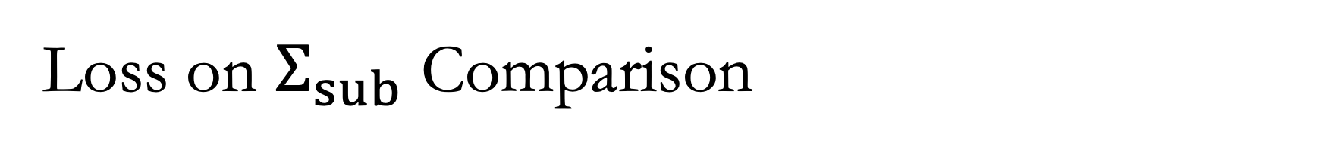
Loss on $Σ_{sub}$ Comparison
Wagner-Carena et al., 2024

Slide 23
Loss on $Σ_{sub}$ Comparison
Wagner-Carena et al., 2024

Slide 24
Hierarchical Inference - Comparison
Wagner-Carena et al., 2024
SNPE: 10 Lenses
NPE: 30 Lenses

Slide 25
Hierarchical Inference - Comparison
Wagner-Carena et al., 2024

Slide 26
Outline
Science review: dark matter, strong lensing, and things in-between
How to measure the matter underlying strong lenses: simulation-based inference
How much information about low-mass halos can we extract?
How can a data-driven prism help us push beyond our sensitivity limits?

Slide 27
Simulations: Source Limitations
Wagner-Carena et al., 2024

Slide 28
Simulations: Source Limitations
Wagner-Carena et al., 2024
?

Slide 29
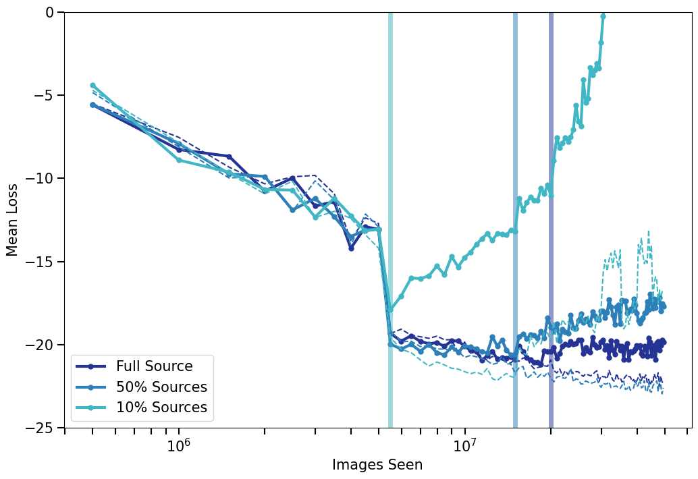
Simulations: Source Limitations
Wagner-Carena et al., 2024
We have a limited number (~2k) high-quality sources available from the COSMOS survey
Sources are the limiting factor in our simulation diversity and therefore our constraining power

Slide 30
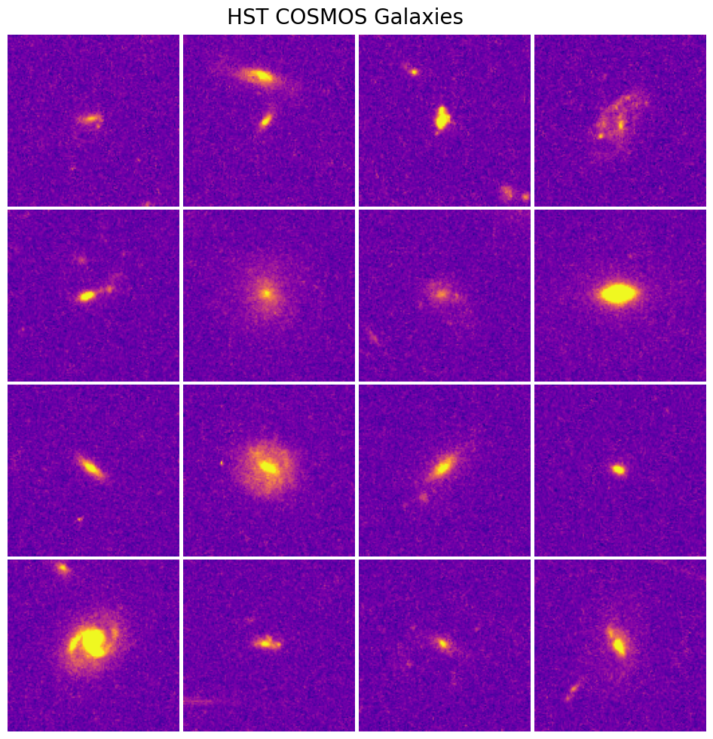
Simulations: Source Limitation
Wagner-Carena et al., submitted
Why do we have so few “high-quality” galaxies?
  Noise, size, line-of-sight contamination (blending), hot-pixels, cosmic rays
We need isolated, low-noise galaxies with resolved structure

Slide 31
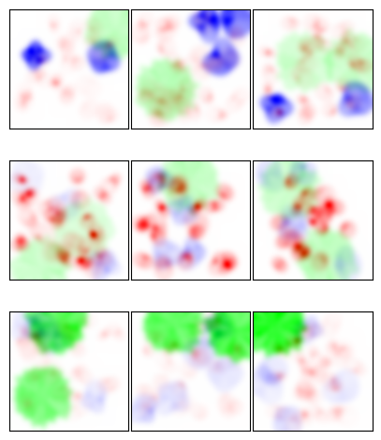
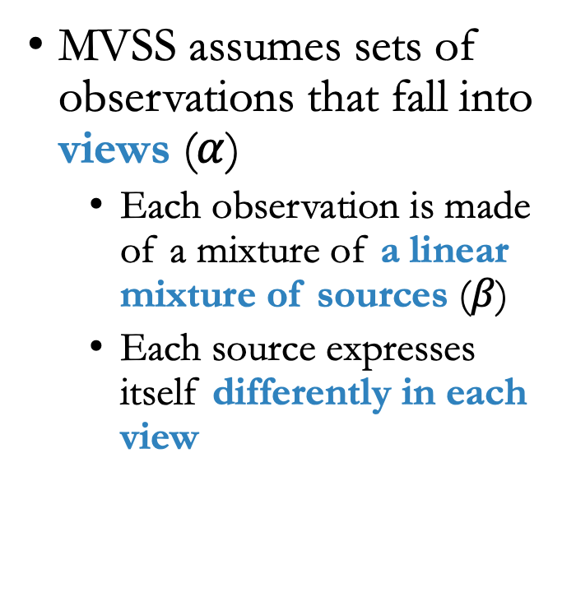
Multi-View Source Separation
Wagner-Carena et al., submitted
MVSS assumes sets of observations that fall into views ($α$)
  Each observation is made of a mixture of a linear mixture of sources ($β$)
  Each source expresses itself differently in each view

Slide 32
Multi-View Source Separation
Wagner-Carena et al., submitted
MVSS assumes sets of observations that fall into views ($α$)
  Each observation is made of a mixture of a linear mixture of sources ($β$)
  Each source expresses itself differently in each view

Slide 33
Multi-View Source Separation
Wagner-Carena et al., submitted
MVSS assumes sets of observations that fall into views ($α$)
  Each observation is made of a mixture of a linear mixture of sources ($β$)
  Each source expresses itself differently in each view

Slide 34
Multi-View Source Separation
Wagner-Carena et al., submitted
MVSS assumes sets of observations that fall into views ($α$)
  Each observation is made of a mixture of a linear mixture of sources ($β$)
  Each source expresses itself differently in each view

Slide 35
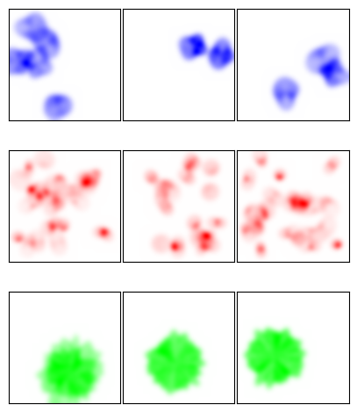
Multi-View Source Separation
Wagner-Carena et al., submitted
Goals:
  We aim to infer the individual prior distributions of each source.

Slide 36
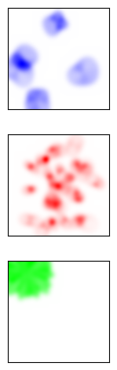
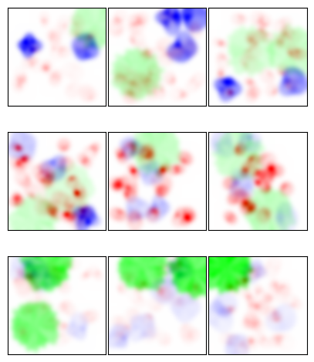
Multi-View Source Separation
Wagner-Carena et al., submitted
Goals:
  We aim to infer the individual prior distributions of each source.
  We then want to separate the sources by sampling from the joint posterior:

Slide 37
Joint Posterior Sampling with Diffusion Priors
Wagner-Carena, Akhmetzhanova, et al., submitted.
Observations
Expectation
Maximization

Slide 38
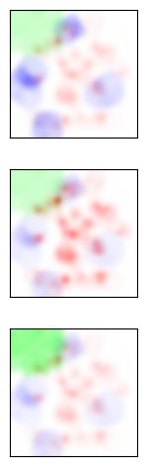
Joint Posterior Sampling with Diffusion Priors
Wagner-Carena, Akhmetzhanova, et al., submitted.
Observations
Expectation
Maximization

Slide 39
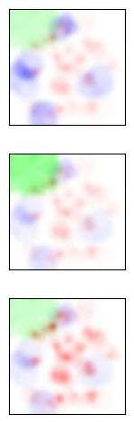
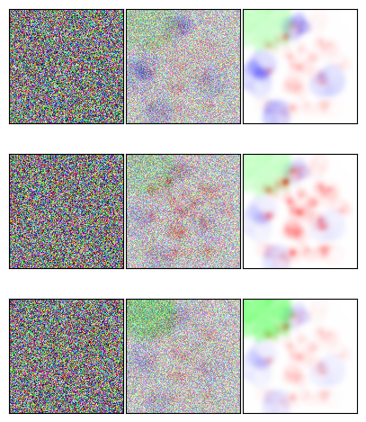
Joint Posterior Sampling with Diffusion Priors
Wagner-Carena, Akhmetzhanova, et al., submitted.
Observations
Expectation
Maximization

Slide 40
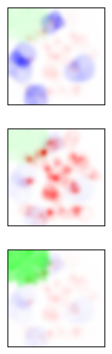
Joint Posterior Sampling with Diffusion Priors
Wagner-Carena, Akhmetzhanova, et al., submitted.
Observations
Expectation
Maximization

Slide 41
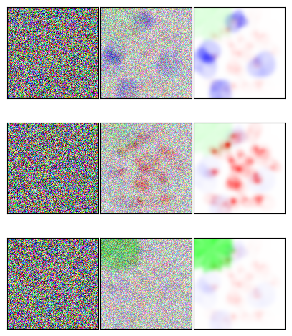
Joint Posterior Sampling with Diffusion Priors
Wagner-Carena, Akhmetzhanova, et al., submitted.
Observations
Expectation
Maximization

Slide 42
Joint Posterior Sampling with Diffusion Priors
Wagner-Carena, Akhmetzhanova, et al., submitted.
Observations
Expectation
Maximization

Slide 43
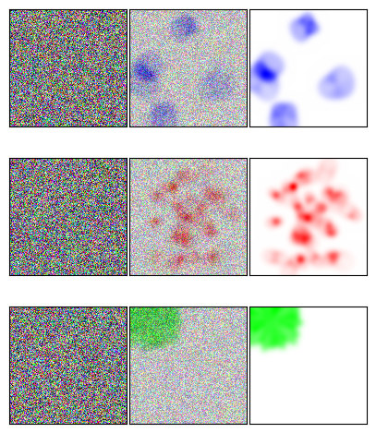
Joint Posterior Sampling with Diffusion Priors
Wagner-Carena, Akhmetzhanova, et al., submitted.
Observations
Expectation
Maximization

Slide 44
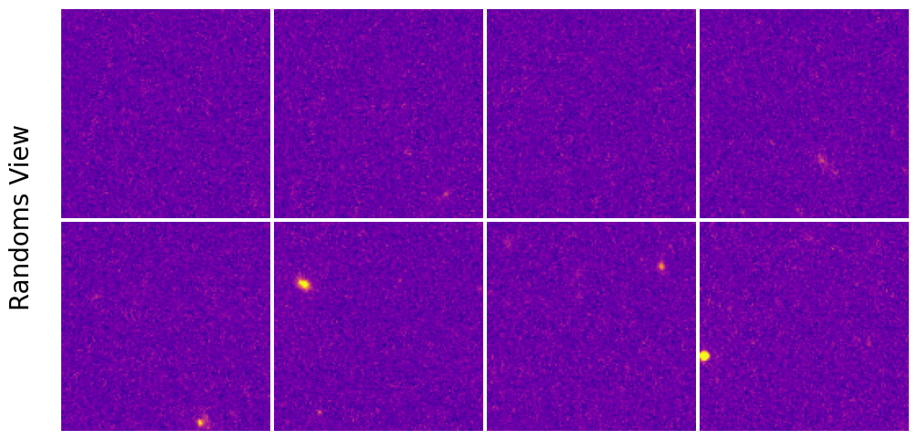
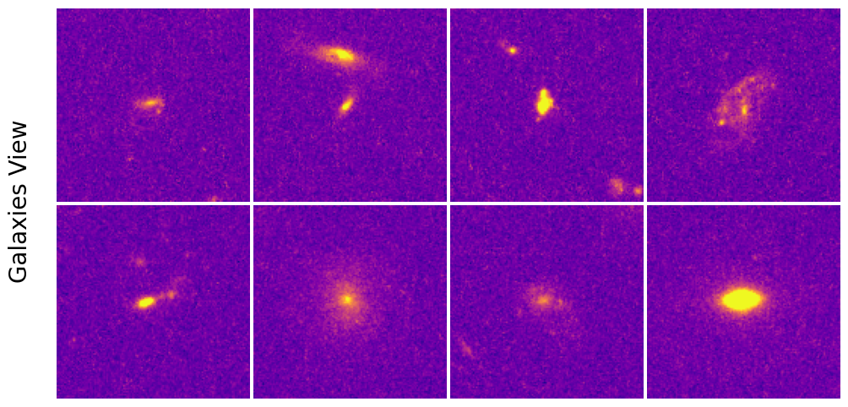
Galaxies: Contrastive
Wagner-Carena et al., submitted
Two views:
  Random foreground / background
  Galaxies with the foreground / background
Goal: separate two source distributions (galaxies and randoms)

Slide 45
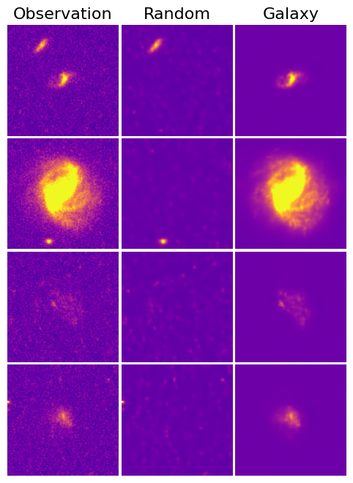
Galaxies: Contrastive
Wagner-Carena et al., submitted
Two views:
  Random foreground / background
  Galaxies with the foreground / background
Goal: separate two source distributions (galaxies and randoms)

Slide 46
Galaxies: Contrastive
Wagner-Carena et al., submitted
Two views:
  Random foreground / background
  Galaxies with the foreground / background
Goal: separate two source distributions (galaxies and randoms)

Slide 47
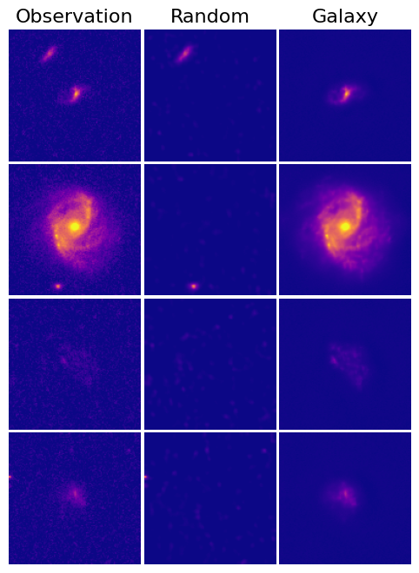
Galaxies: Contrastive
Wagner-Carena et al., submitted
Two views:
  Random foreground / background
  Galaxies with the foreground / background
Goal: separate two source distributions (galaxies and randoms)

Slide 48
Galaxies: Contrastive
Wagner-Carena et al., submitted
Two views:
  Random foreground / background
  Galaxies with the foreground / background
Goal: separate two source distributions (galaxies and randoms)
We now have 80k pristine galaxy images!
  Analysis in progress

Slide 49
Conclusions
Strong Lensing
Strong gravitational lenses contain rich information about low-mass dark matter halos → dark matter physics (constraint on HST forthcoming)
Sequential methods drastically improve constraining power – similar improvements from naïve approach are computationally untenable

Slide 50
Conclusions
Strong Lensing
Strong gravitational lenses contain rich information about low-mass dark matter halos → dark matter physics (constraint on HST forthcoming)
Sequential methods drastically improve constraining power – similar improvements from naïve approach are computationally untenable
Broader Implications
We need to treat training set generation and model optimization as interconnected stages of our analysis
MVSS advances have broad applications: allows us to disentangle signals without simulations or strong theoretical assumptions.

Slide 51
Extra Slides

Slide 52
Individual Constraints
Wagner-Carena et al., 2022

Slide 53
Individual Constraints
Wagner-Carena et al., 2022
How Big is the Ring?
How much Substructure?

Slide 54
Individual Constraints
Wagner-Carena et al., 2022

Slide 55
Individual Constraints
Wagner-Carena et al., 2022

Slide 56
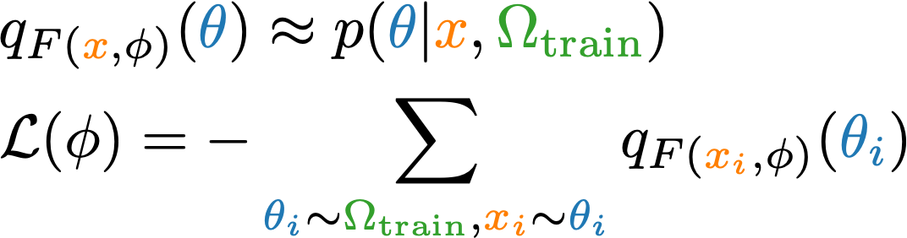
Individual Constraints
Wagner-Carena et al., 2022

Slide 57
Individual Constraints
Wagner-Carena et al., 2022
Data Dominated
Prior Dominated

Slide 58

Hierarchical Modeling with NPEs
Wagner-Carena et al., 2021
Ω
We are interested in the hyperparameters Ω, we are not interested in assuming Ω_{train}:
θ_{k}
z_{k}
x_{k}
x_{k}
lenses k

Slide 59
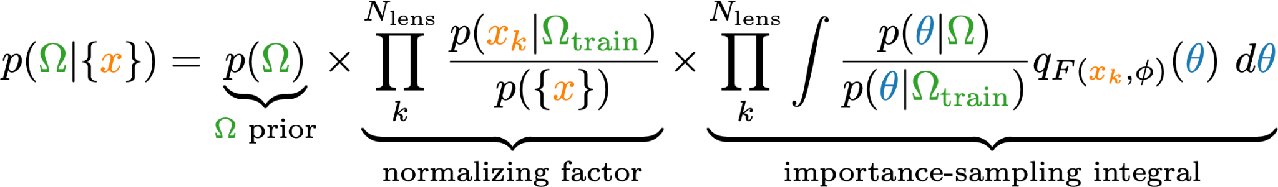
Hierarchical Modeling with NPEs
Wagner-Carena et al., 2021
We are interested in the hyperparameters Ω, we are not interested in assuming Ω_{train}:
Two birds with one stone: correct for unrepresentative training set (interim prior) and infer true hyperparameters:

Slide 60
Limits: Optimization
Wagner-Carena et al., 2024

Slide 61
Limits: Model
Wagner-Carena et al., 2024

Slide 62
Limits: Training Set Size
Wagner-Carena et al., 2024

Slide 63
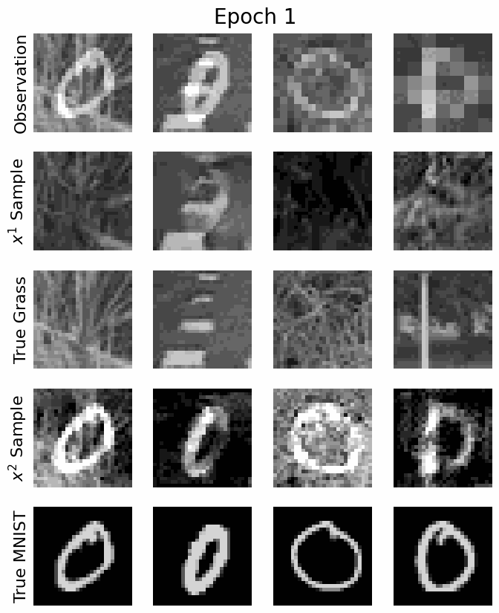
Image Data: Contrastive
Two views:
  Pure grass background
  Mixture of digits and grass background
Assume we have noisy and incomplete data
Goal: separate two source distributions
  Start by training initial grass distribution from first view, then train MNIST distribution using second view

Slide 64
Image Data: Contrastive
Two views:
  Pure grass background
  Mixture of digits and grass background
Assume we have noisy and incomplete data
Goal: separate two source distributions
  Start by training initial grass distribution from first view, then train MNIST distribution using second view
Successfully disentangled sources!

Slide 65
Review: Diffusion Models
Song et al., 2021
Start with observed samples and perturb them through a diffusion process given by the SDE:
The reverse SDE is given by:

Slide 66
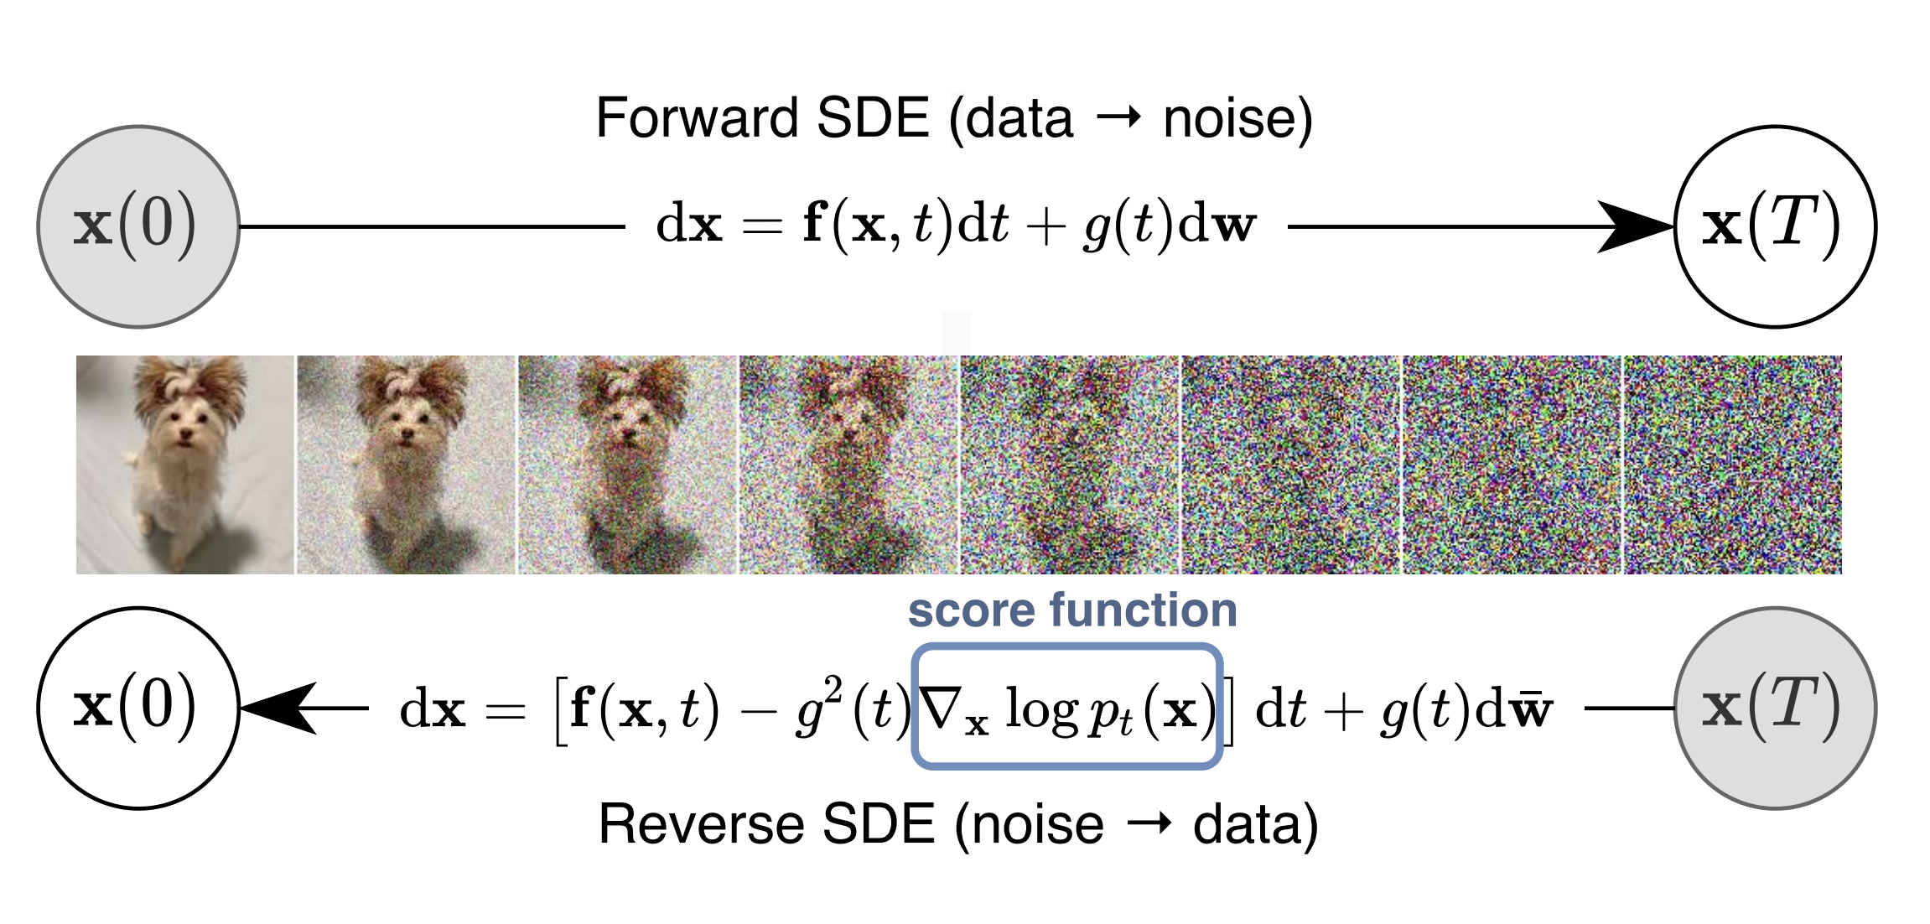
Review: Diffusion Models
Song et al., 2021
Start with observed samples and perturb them through a diffusion process given by the SDE:
The reverse SDE is given by:
With enough perturbation, final timestep is equivalent to noise.
Integrating backwards with reverse SDE gives a sample from the original distribution. We just need the score. Train a model to estimate it.

Slide 67
Review: Diffusion Models as Priors
Song et al., 2021
What if we want to condition on an observation? We need the score of the posterior:
From Bayes rule:
First term we already have, second term comes from integral:

Slide 68
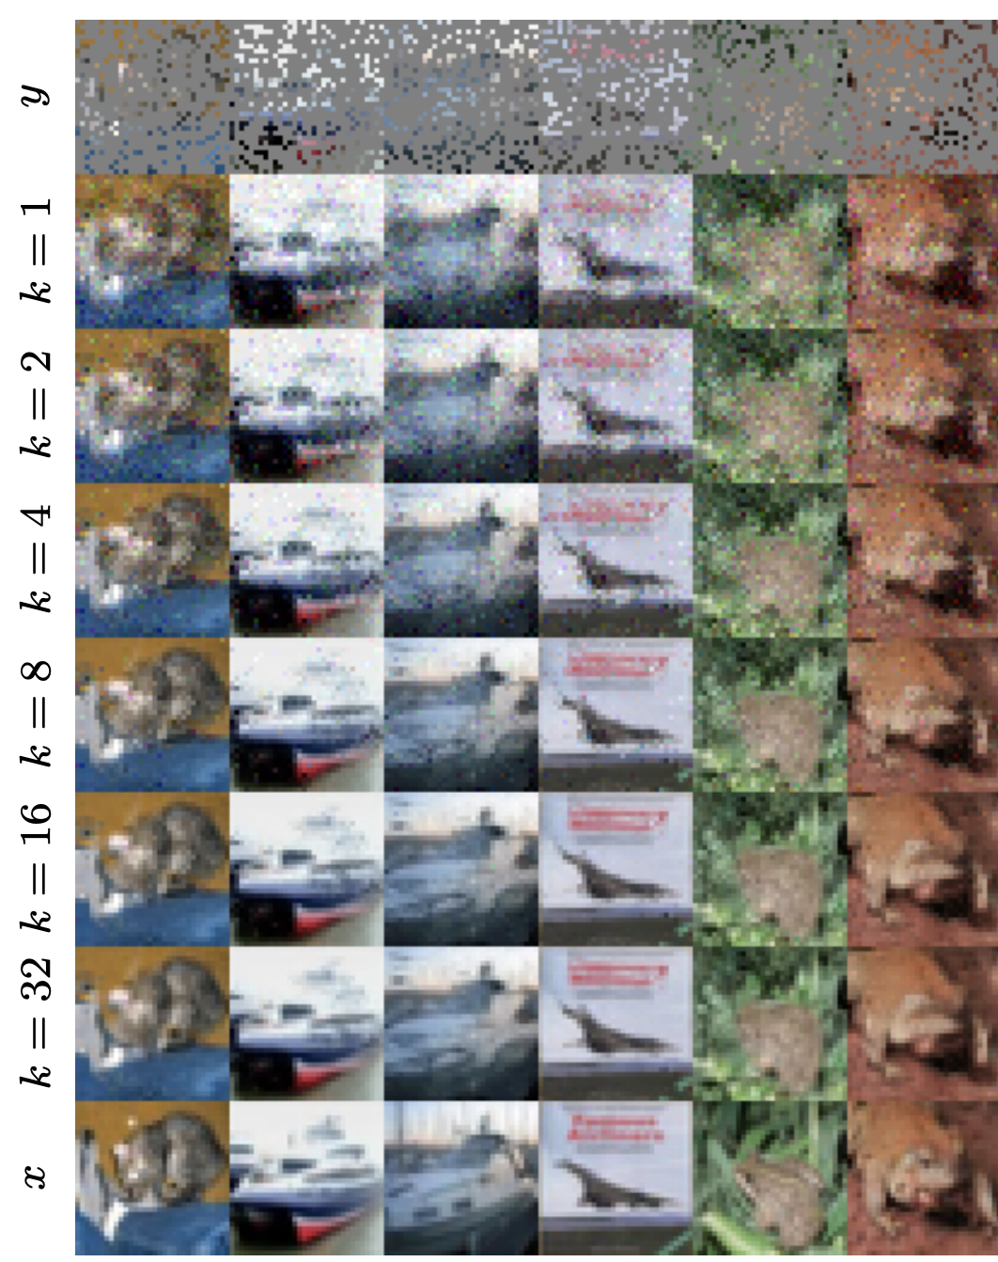
Review: Diffusion Priors from Observations
Rozet et al., 2024
In MVSS, we don’t know the prior, so we still can’t sample from the likelihood. The solution is Expectation-Maximization:
  Start from an initial diffusion model
  Expectation: Sample from the posterior of your observations given current diffusion model
  Maximization: Fit the diffusion model to posterior samples
  Return to step 2 until converged

Slide 69
Joint Posterior Sampling with Diffusion Priors
Wagner-Carena, Akhmetzhanova, et al., submitted.
Observations
Expectation
Maximization

Slide 70
Joint Posterior Sampling with Diffusion Priors
Wagner-Carena, Akhmetzhanova, et al., submitted.
Observations
Expectation
Maximization

Slide 71
Joint Posterior Sampling with Diffusion Priors
Wagner-Carena, Akhmetzhanova, et al., submitted.
Observations
Expectation
Maximization

Slide 72
Joint Posterior Sampling with Diffusion Priors
Wagner-Carena, Akhmetzhanova, et al., submitted.
Observations
Expectation
Maximization

Slide 73
Joint Posterior Sampling with Diffusion Priors
Wagner-Carena, Akhmetzhanova, et al., submitted.
Observations
Expectation
Maximization

Slide 74
Joint Posterior Sampling with Diffusion Priors
Wagner-Carena, Akhmetzhanova, et al., submitted.
Observations
Expectation
Maximization

Slide 75
Joint Posterior Sampling with Diffusion Priors
Wagner-Carena, Akhmetzhanova, et al., submitted.
Observations
Expectation
Maximization

Slide 76
Robustness Tests: Line-of-Sight Halos
Running inference on tests sets is cheap: can quickly quantify the impact of different priors

Slide 77
Resolution Tests

Slide 78
Einstein Radius Tests

