Slide 1


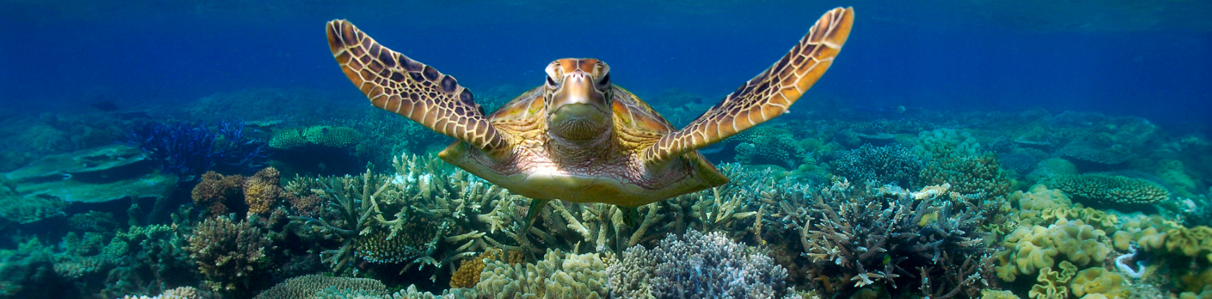
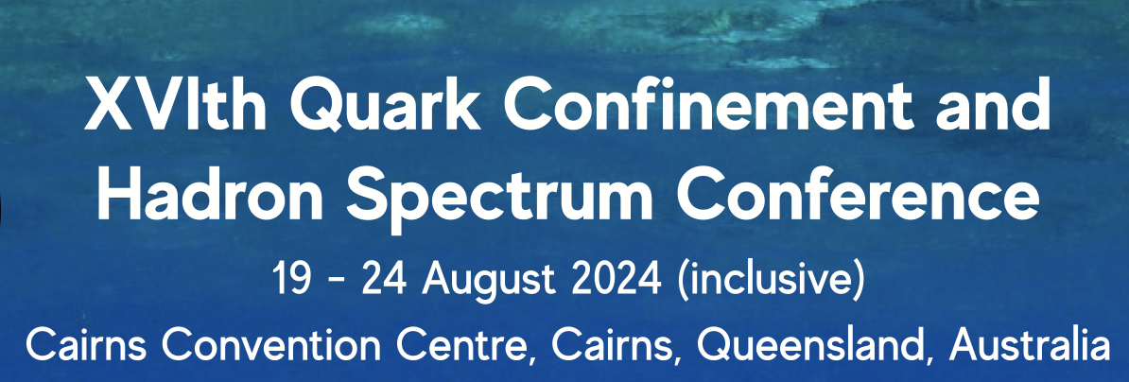
ALICE MC
and other outreach activities
in the occasion of the
Quark Confinement Conference
in Cairns Australia
Yiota Foka (GSI/CERN)

Slide 2
Participation to outreach activities
in Australia in a nutshell
Tuesday 20 august 2024, Cairns
  10:00 Plenary presentation on PTMC and WG “Outreach of Applications for Society” (similar to the one in ICHEP)
  11:00 ALICE MC
  Conference web page: https://confinement24.org.au
  Timetable: https://indico.cern.ch/event/1293041/timetable/#20240818
Saturday 17 august 2024, Townsville
  Outreach Workshops in Townsville focusing on Dark Matter by IPPOG Australian representative Jackie Bondel
  as part of full day event organized by a college for the region’s schools
Wednesday 14 august 2024, Melbourne
  Outreach Workshops in Melbourne by IPPOG Australian representative Jackie Bondel and colleagues
  as part of a half day event of “science week” organized by university
  https://us21.campaign-archive.com/?e=__test_email__&u=47467255c3c5953fcc07ccd51&id=cd8c870d04
  Youtube: https://www.youtube.com/watch?v=2ByOfkXZGaM

Slide 3
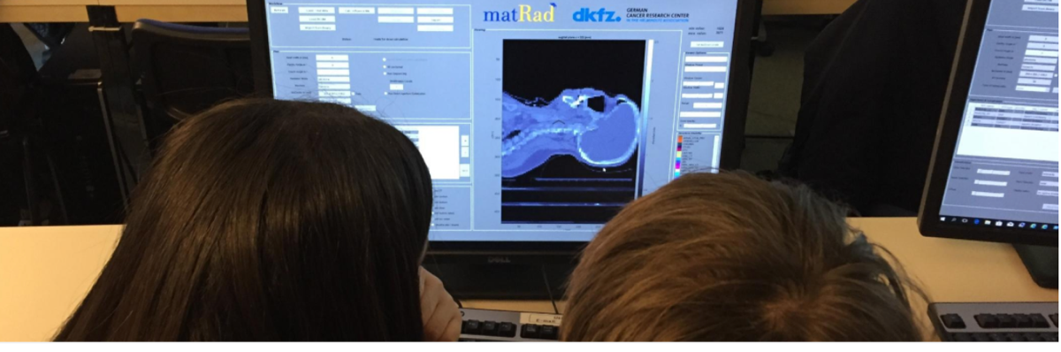

IPPOG activities on benefits for society
Particle Therapy MasterClass
Contacts:
yiota.foka@cern.ch
https://indico.cern.ch/e/PTMC
Tangible examples of connecting fundamental research and everyday life
Contacts:
yiota.foka@cern.ch
barbora.gulejova@cern.ch
https://ippog.org/for-ippogers/outreach-application-society

Slide 4
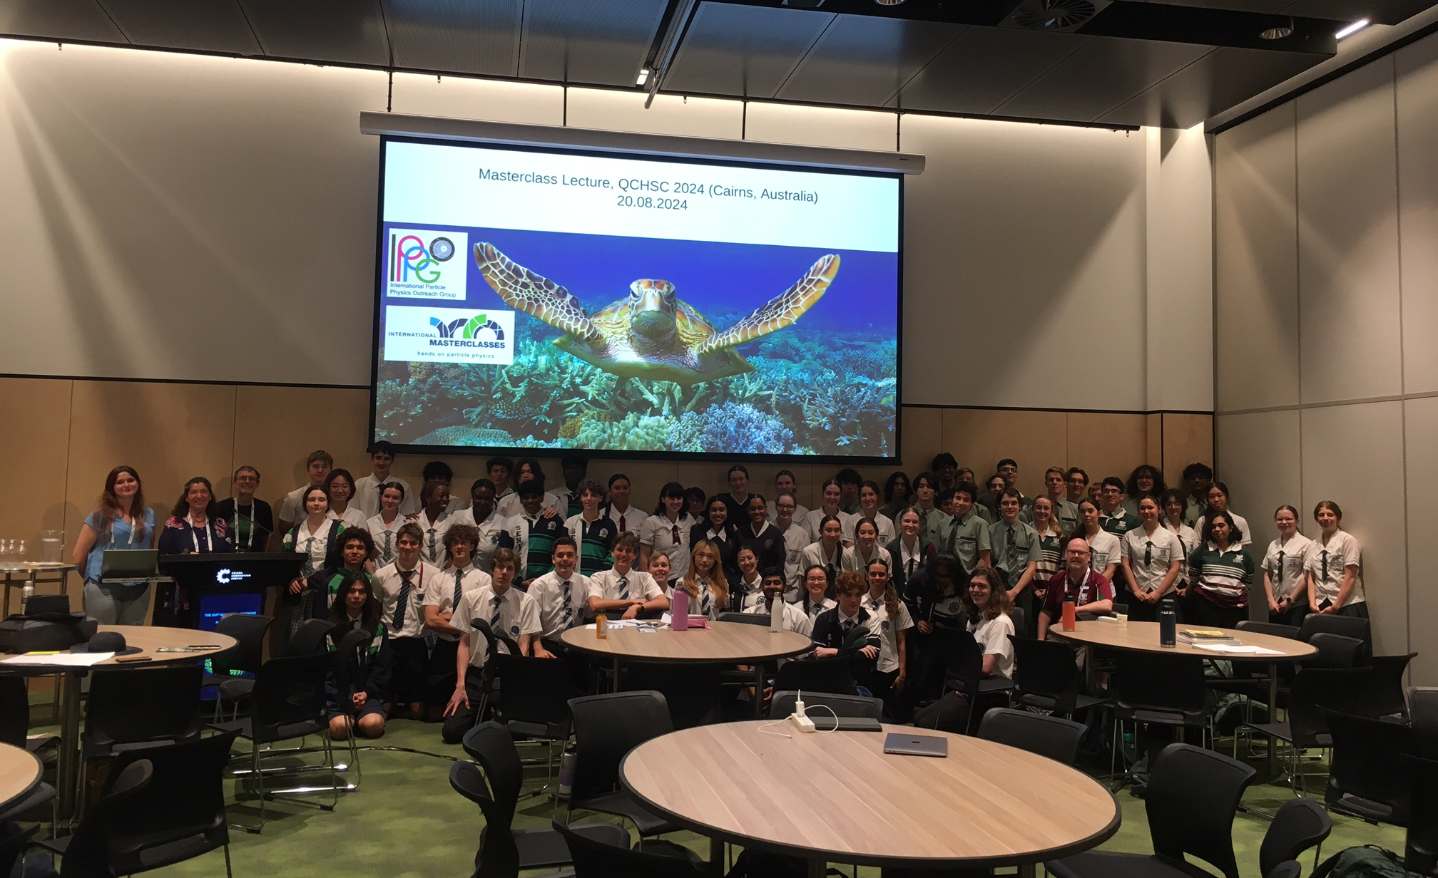
ALICE Masterclass
Tuesday 20 august 2024, Cairns
  Attended by about 65 high-school students from 5 schools accompanied by their teachers
  Presented by: Jon-Ivar Skullerud jonivar@thphys.nuim.ie from Maynooth, Wioleta Rzesa wioleta.rzesa@cern.ch from WUT
  Assisted by 6 “local” PhD students and Francesca Ercolessi from Bologna
Group Photos in: https://cernbox.cern.ch/index.php/s/2We9DoacU4qd8UK

Slide 5
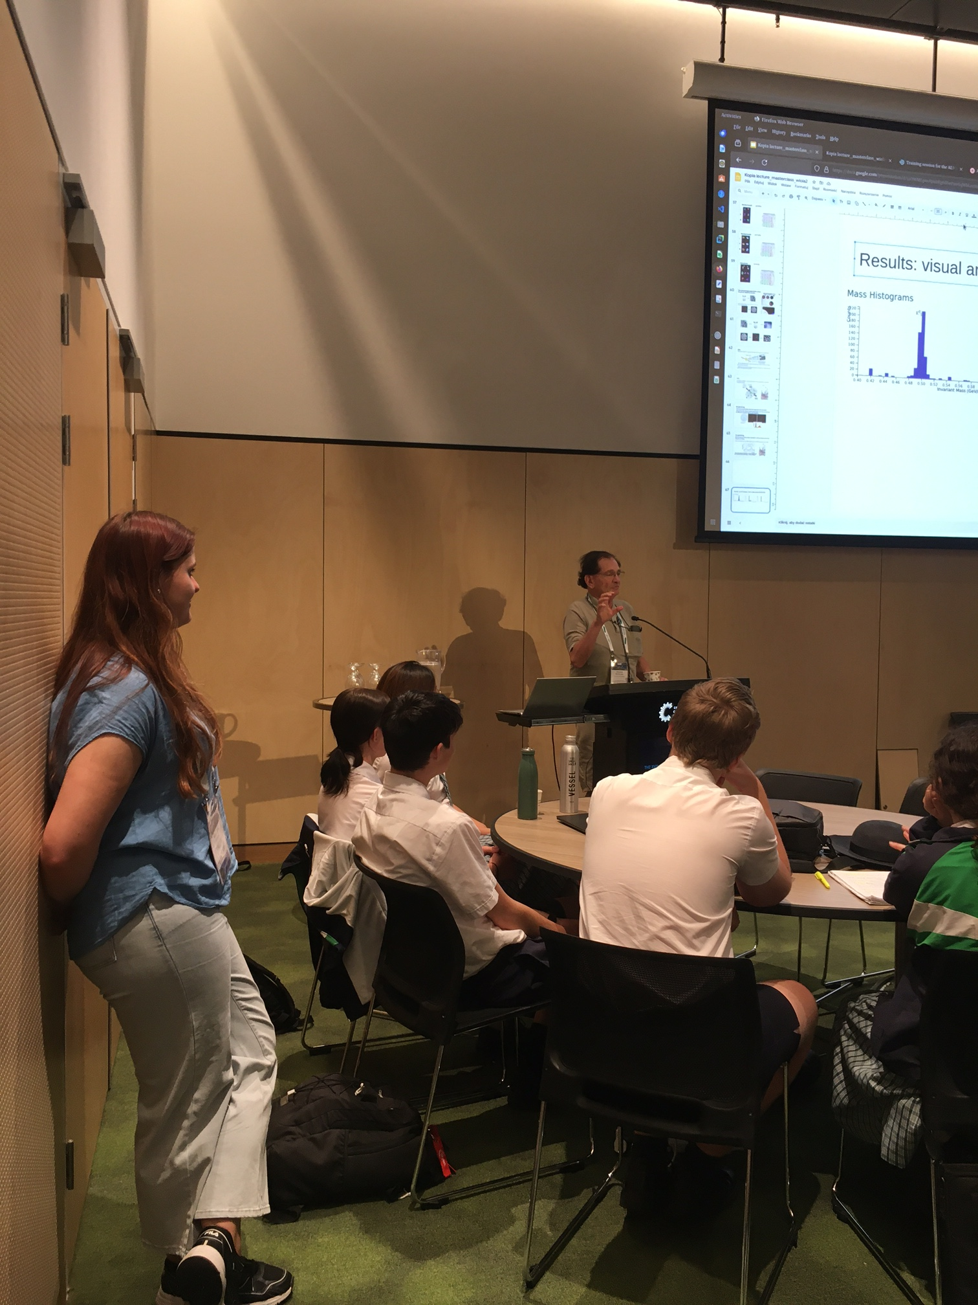
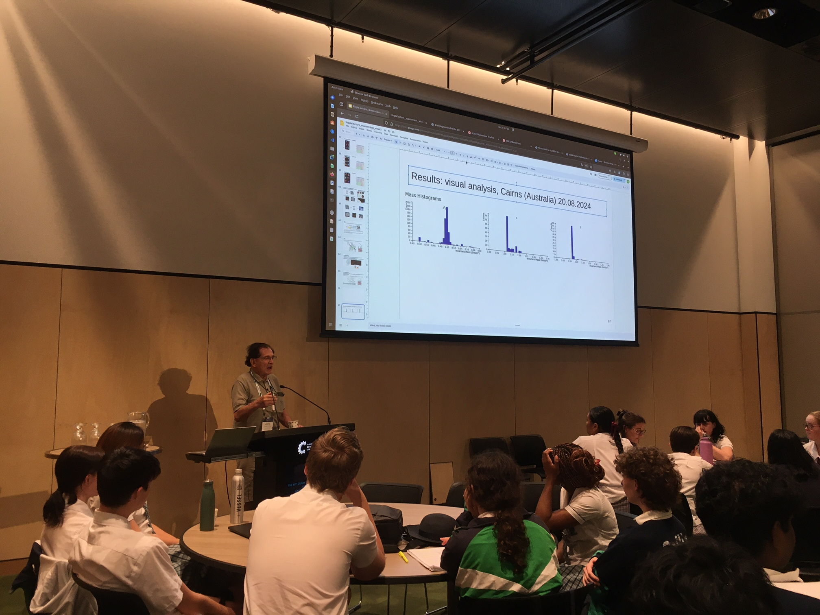
ALICE Masterclass
Comments by Jan Rafelski
More Photos in: https://cernbox.cern.ch/index.php/s/MsjnZFBPsD4Pby1

Slide 6
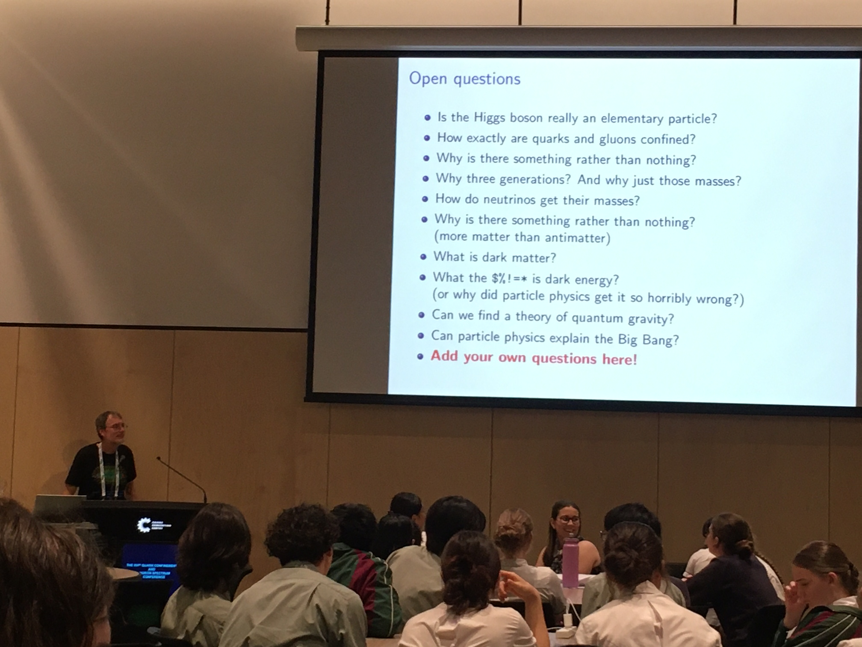
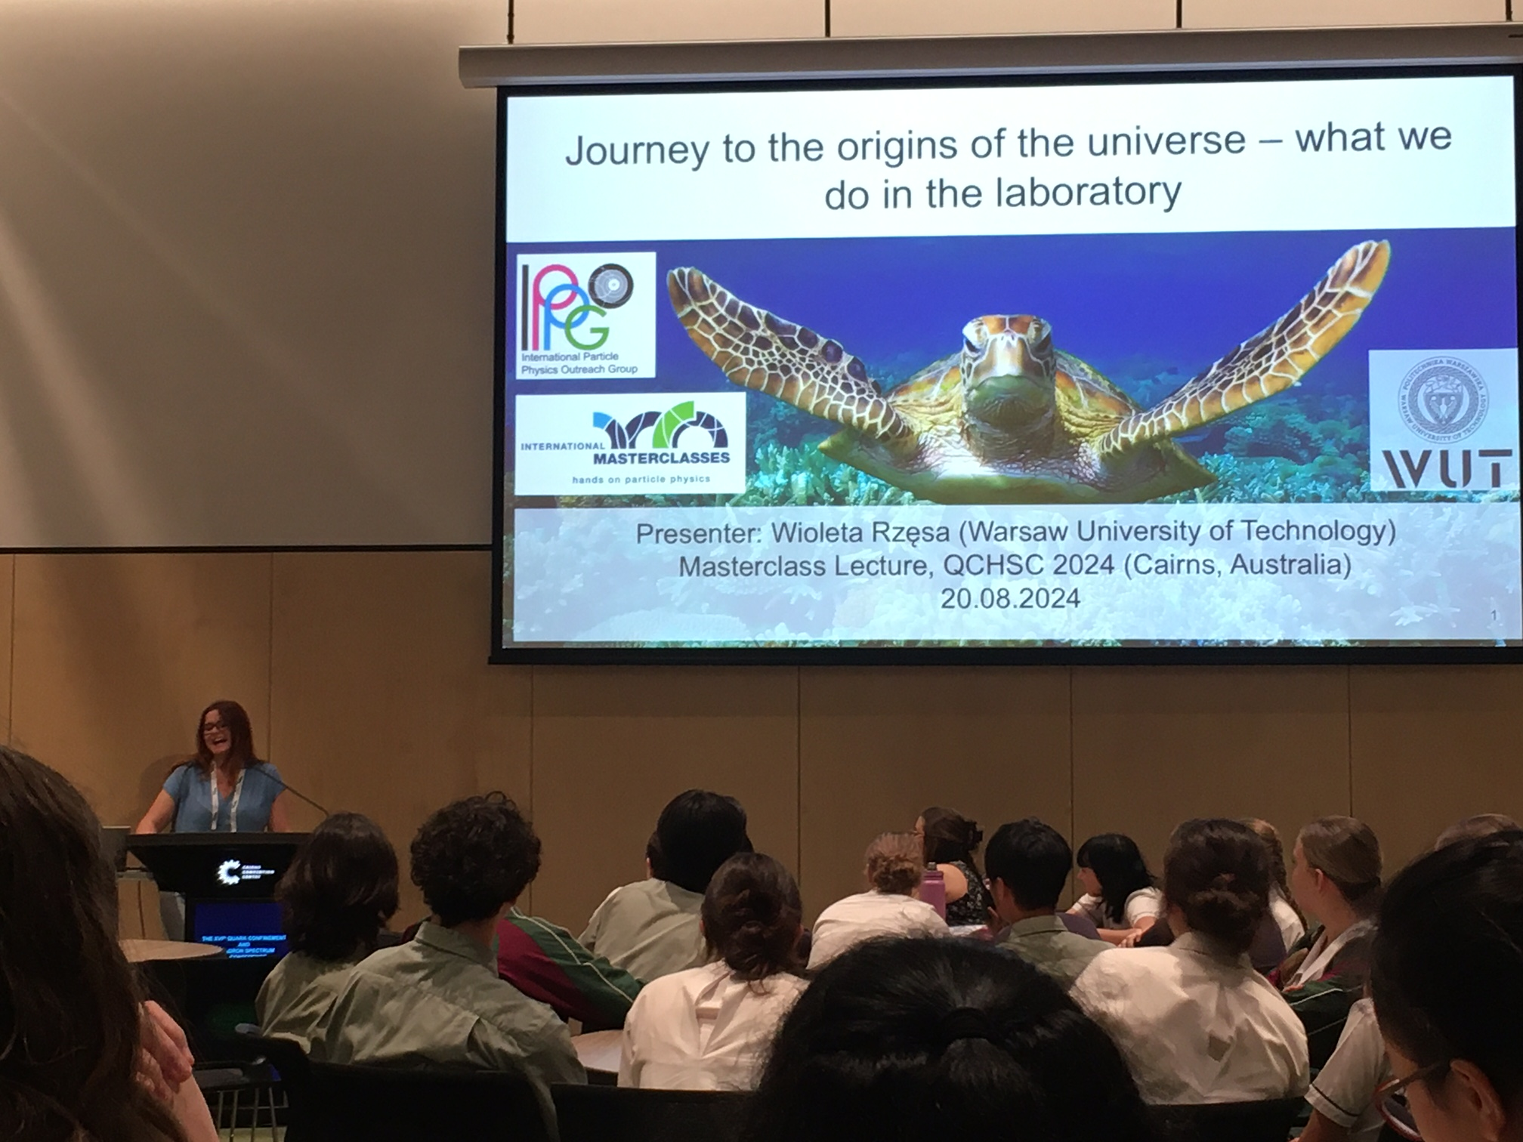
ALICE Masterclass
Lectures
By Jon-Ivar Skullerud jonivar@thphys.nuim.ie from Maynooth, Wioleta Rzesa wioleta.rzesa@cern.ch from WUT
Many questions from students (one could be on the 2nd year at uni)
More Photos in: https://cernbox.cern.ch/index.php/s/BFfKVDuQJqgPEnB

Slide 7
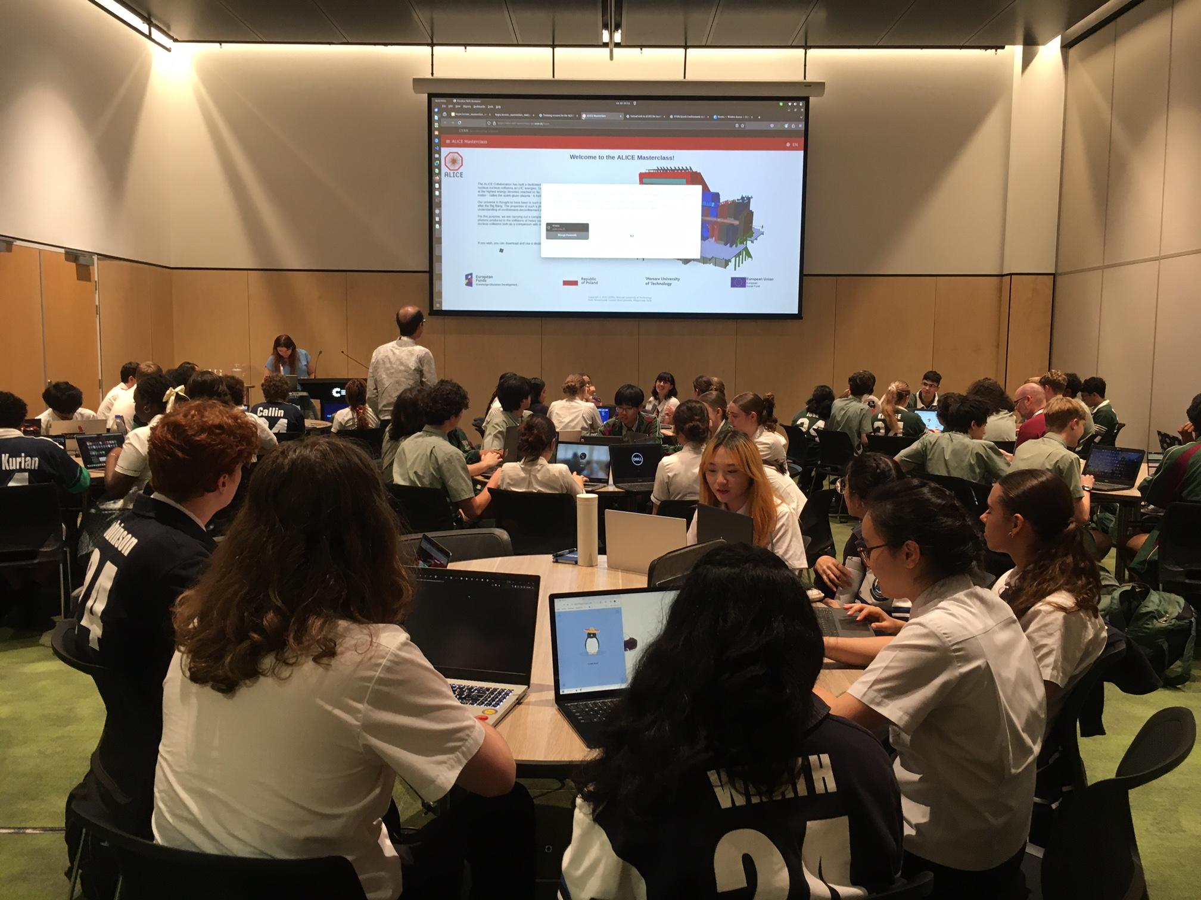
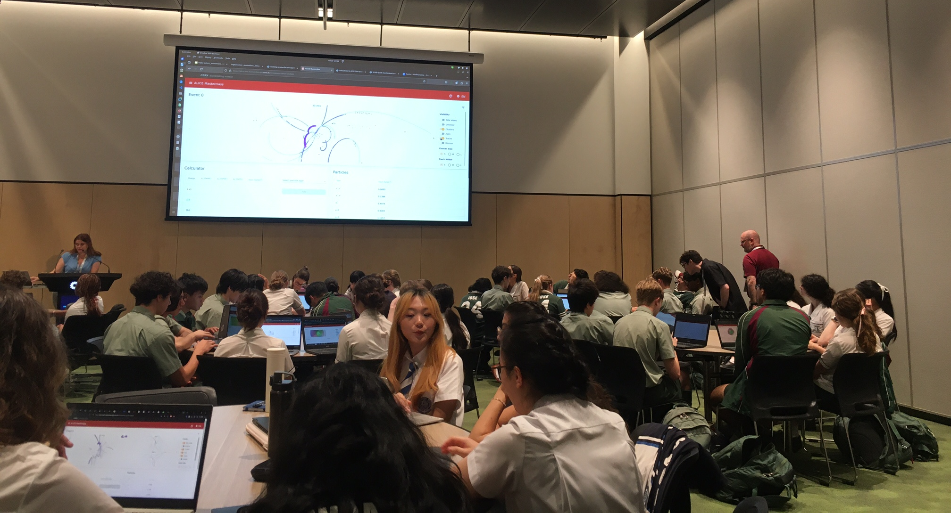
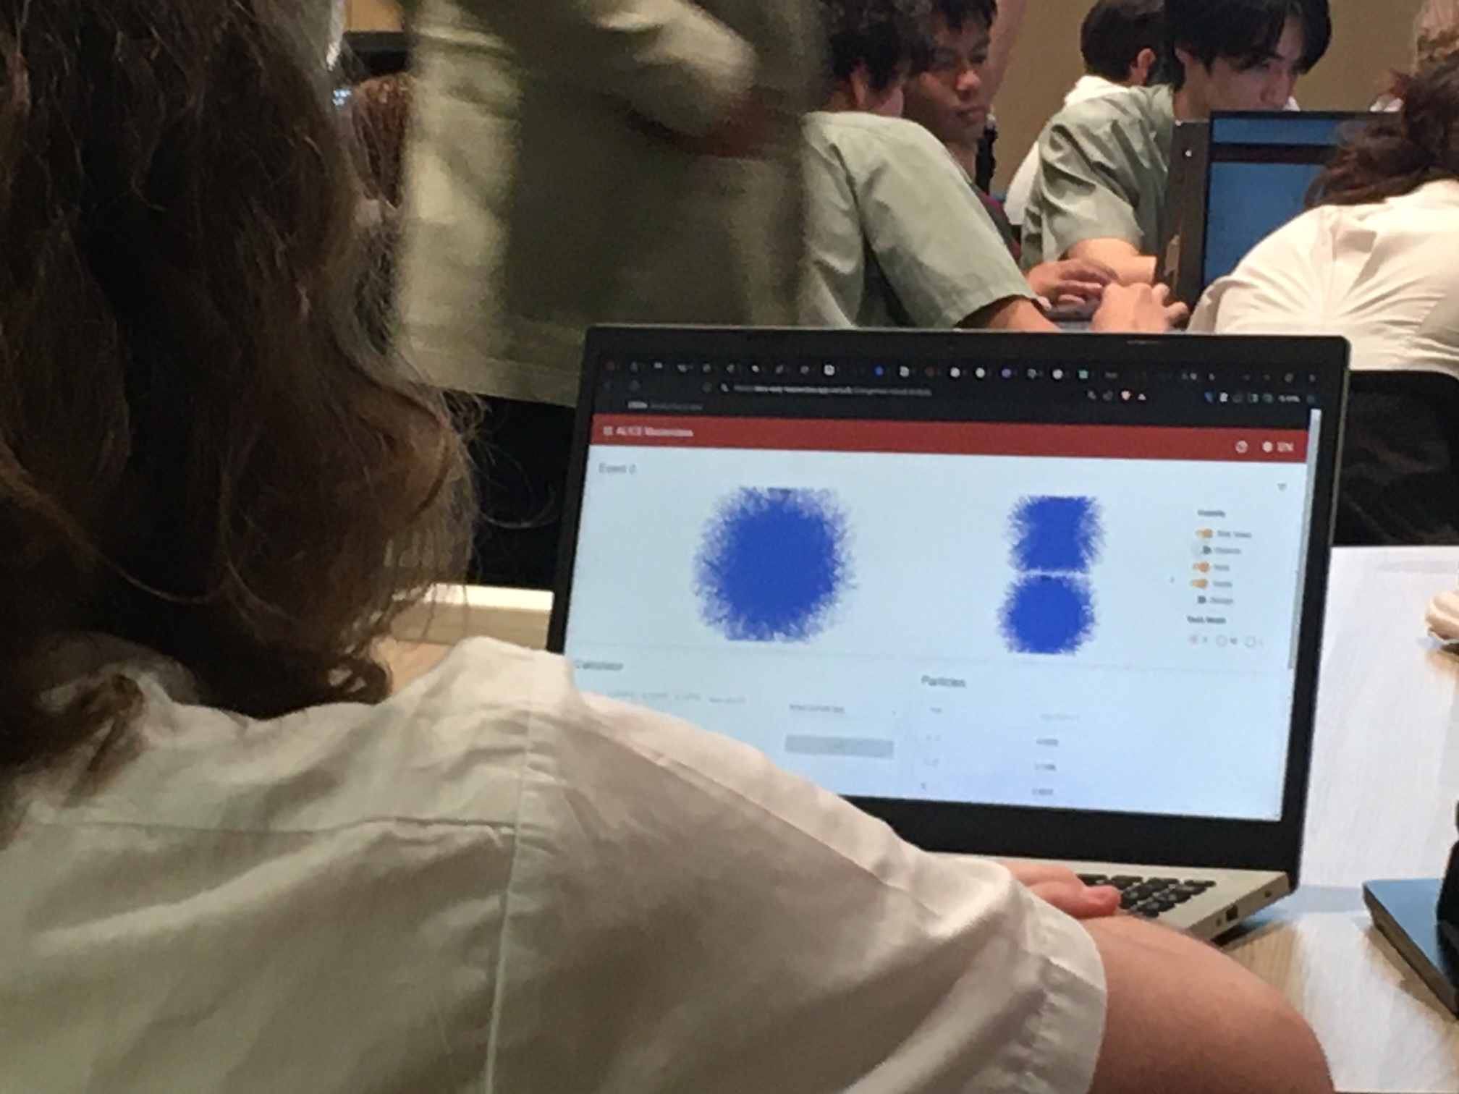
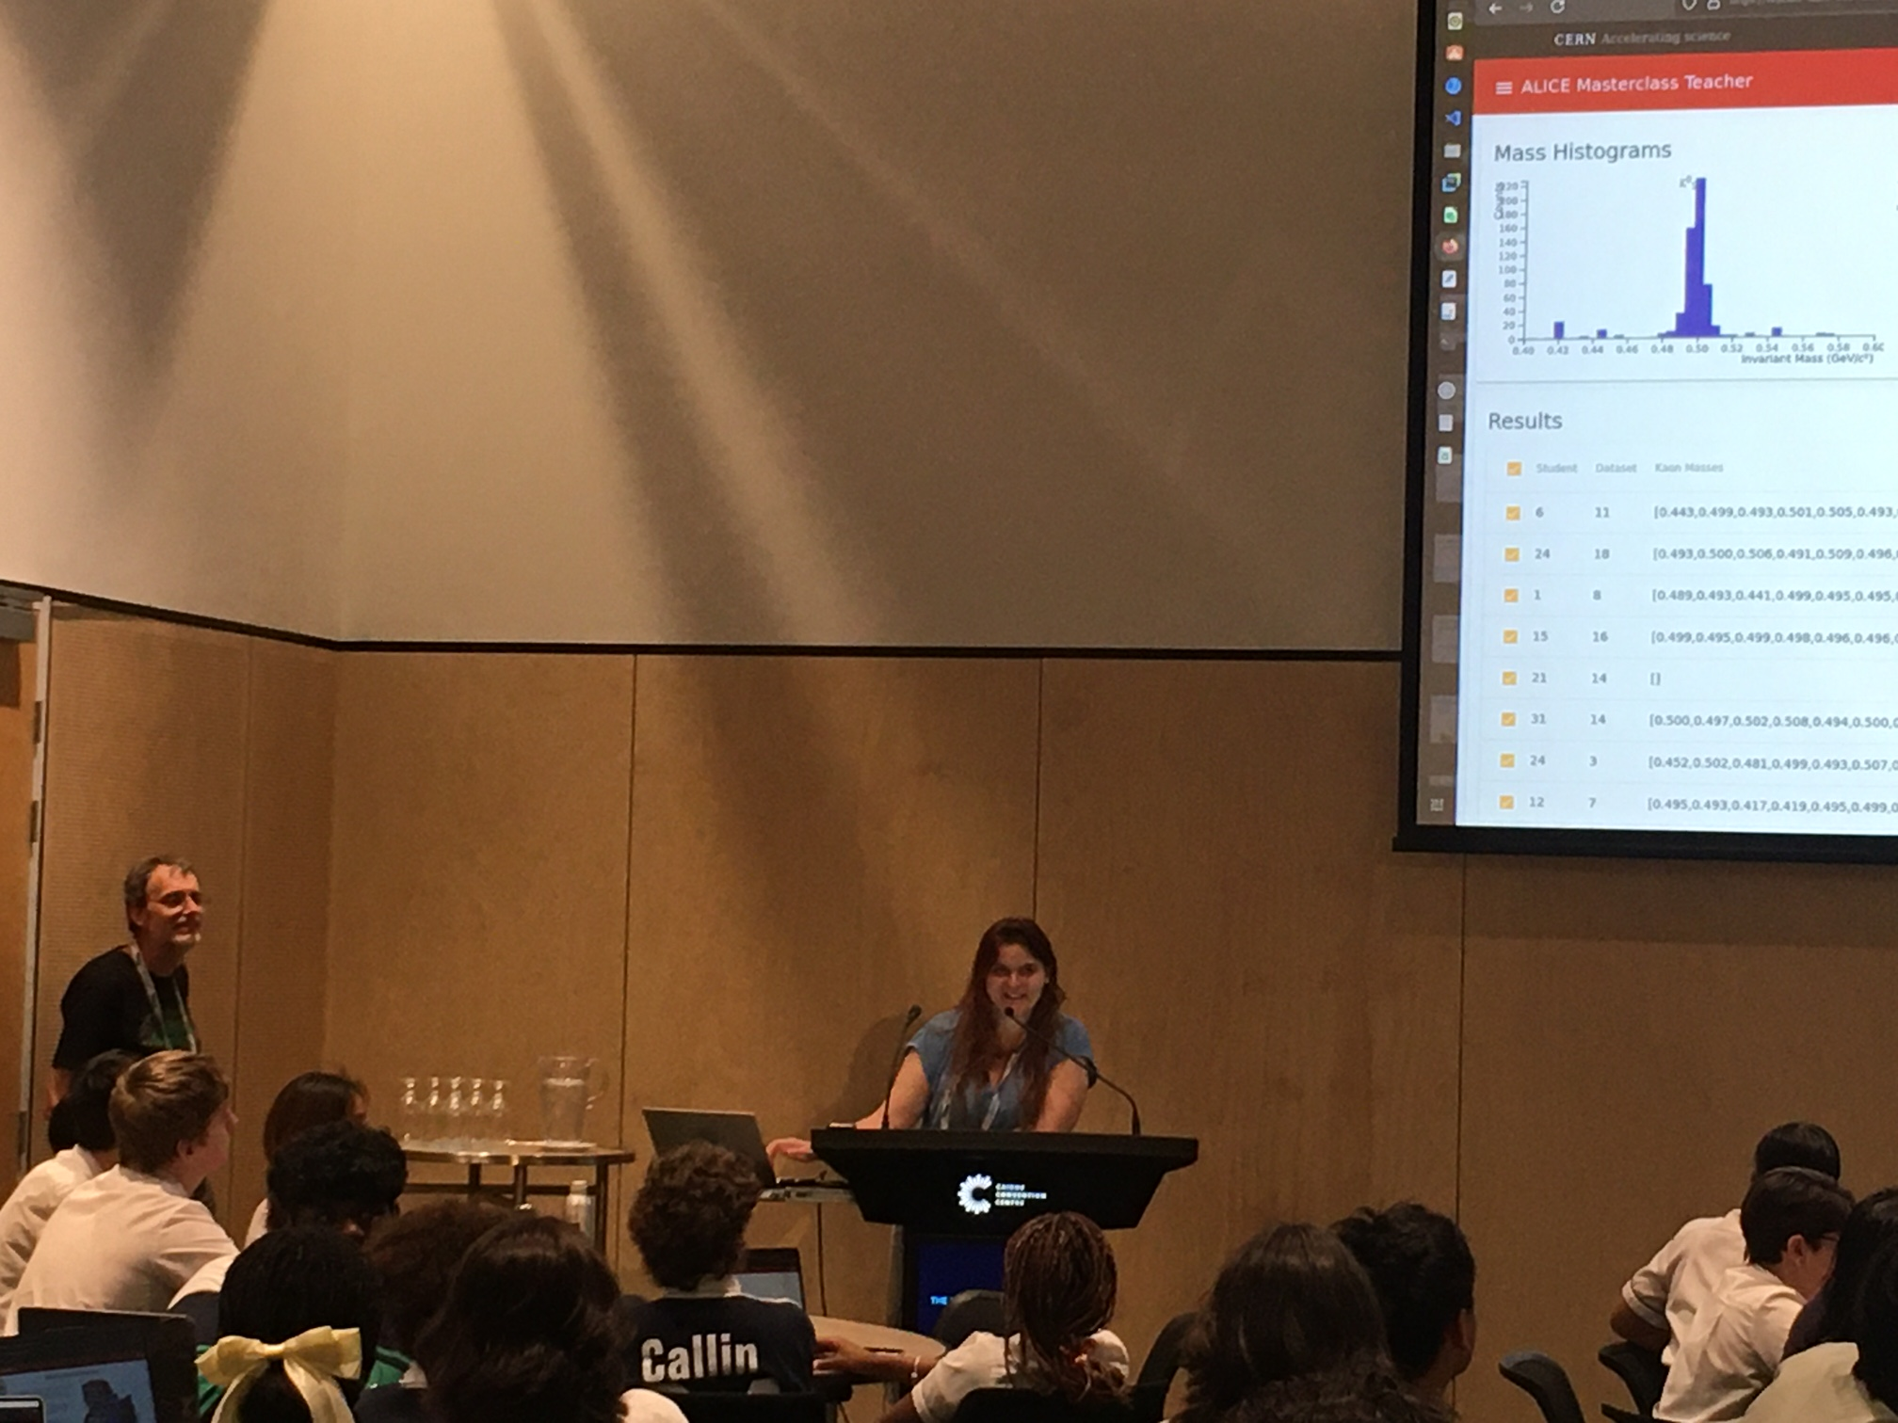
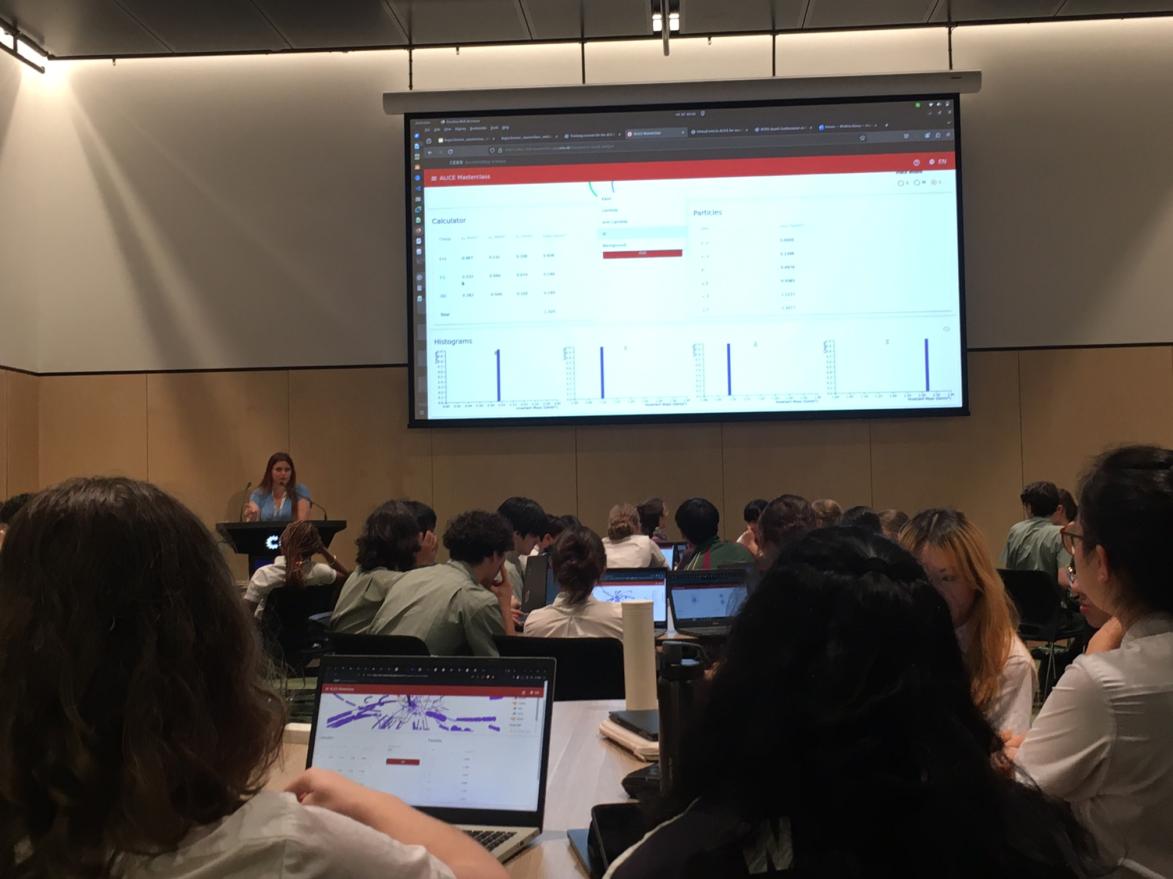
ALICE Masterclass
Hands-on
By Wioleta Rzesa wioleta.rzesa@cern.ch
More Photos in: https://cernbox.cern.ch/index.php/s/7vat4yF7EHSsvZp

Slide 8
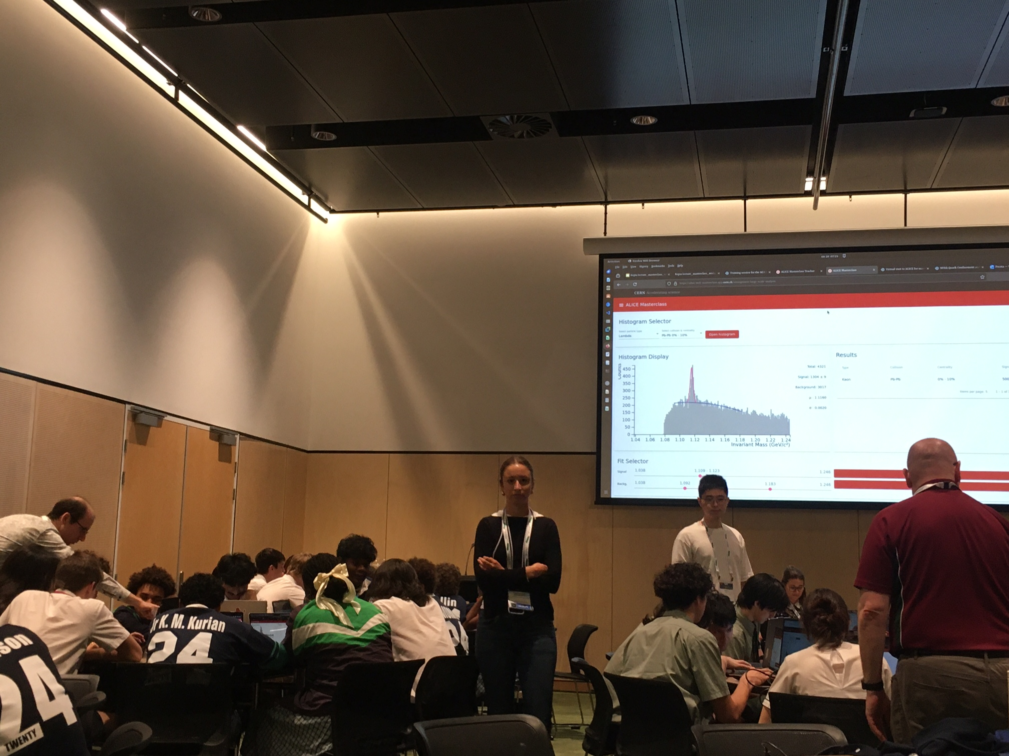
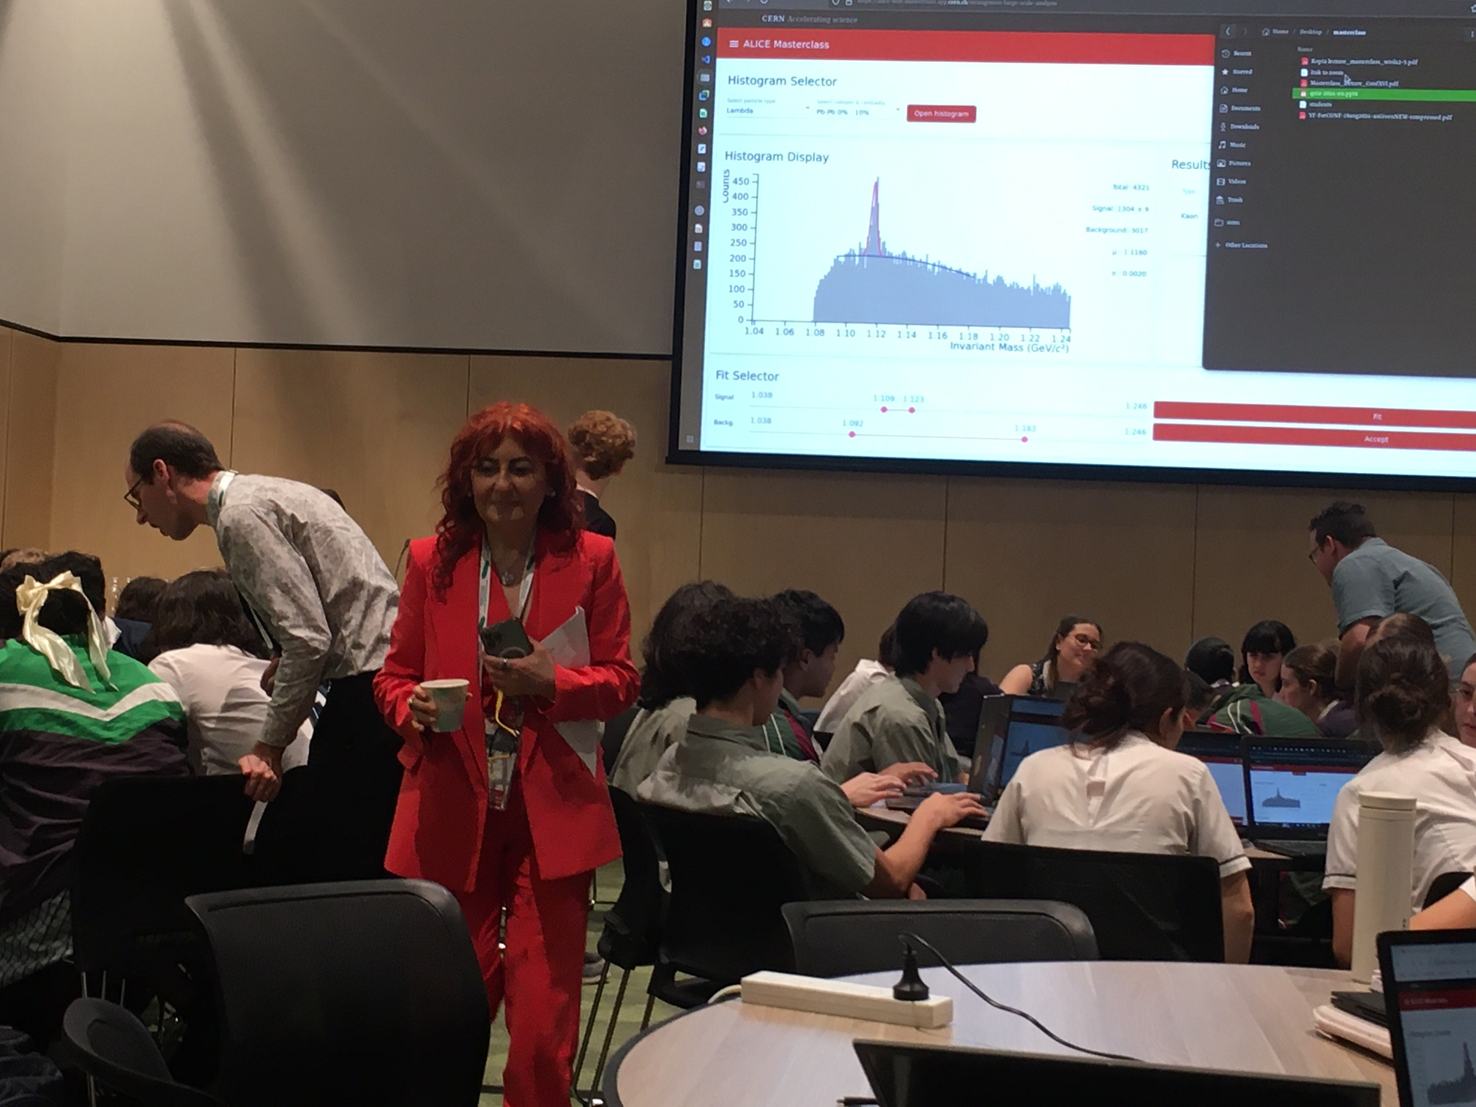
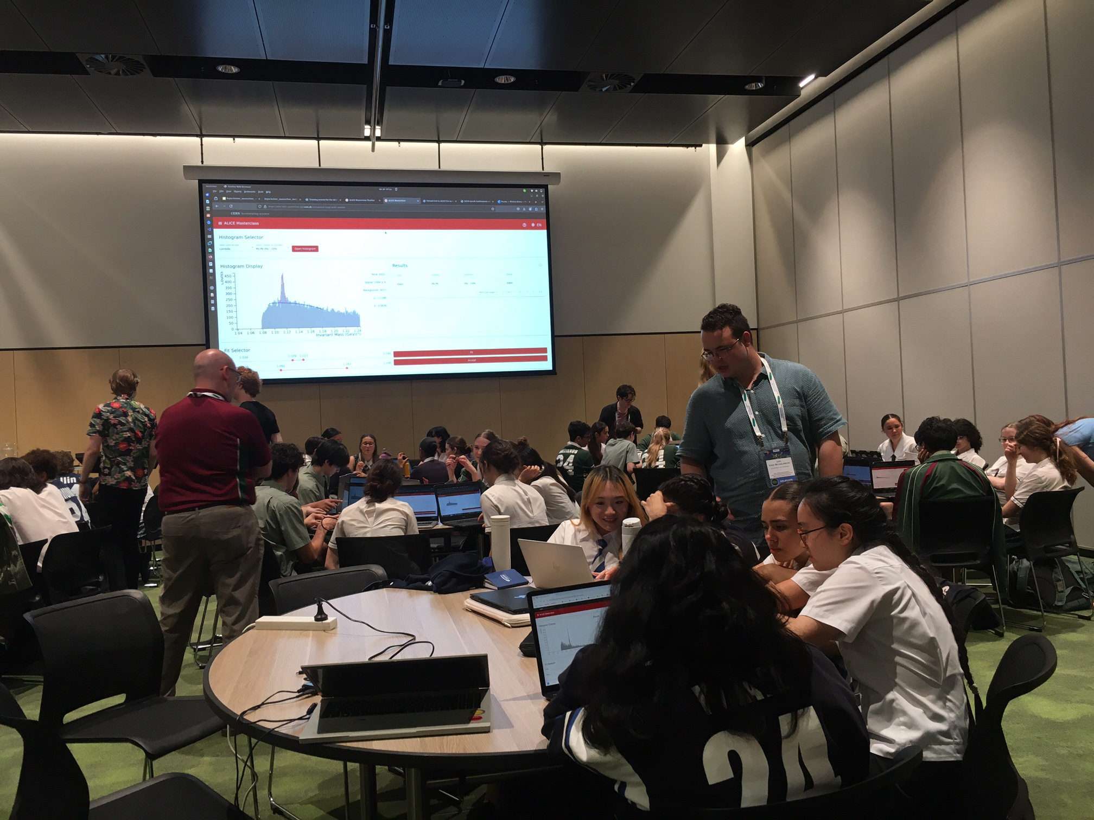
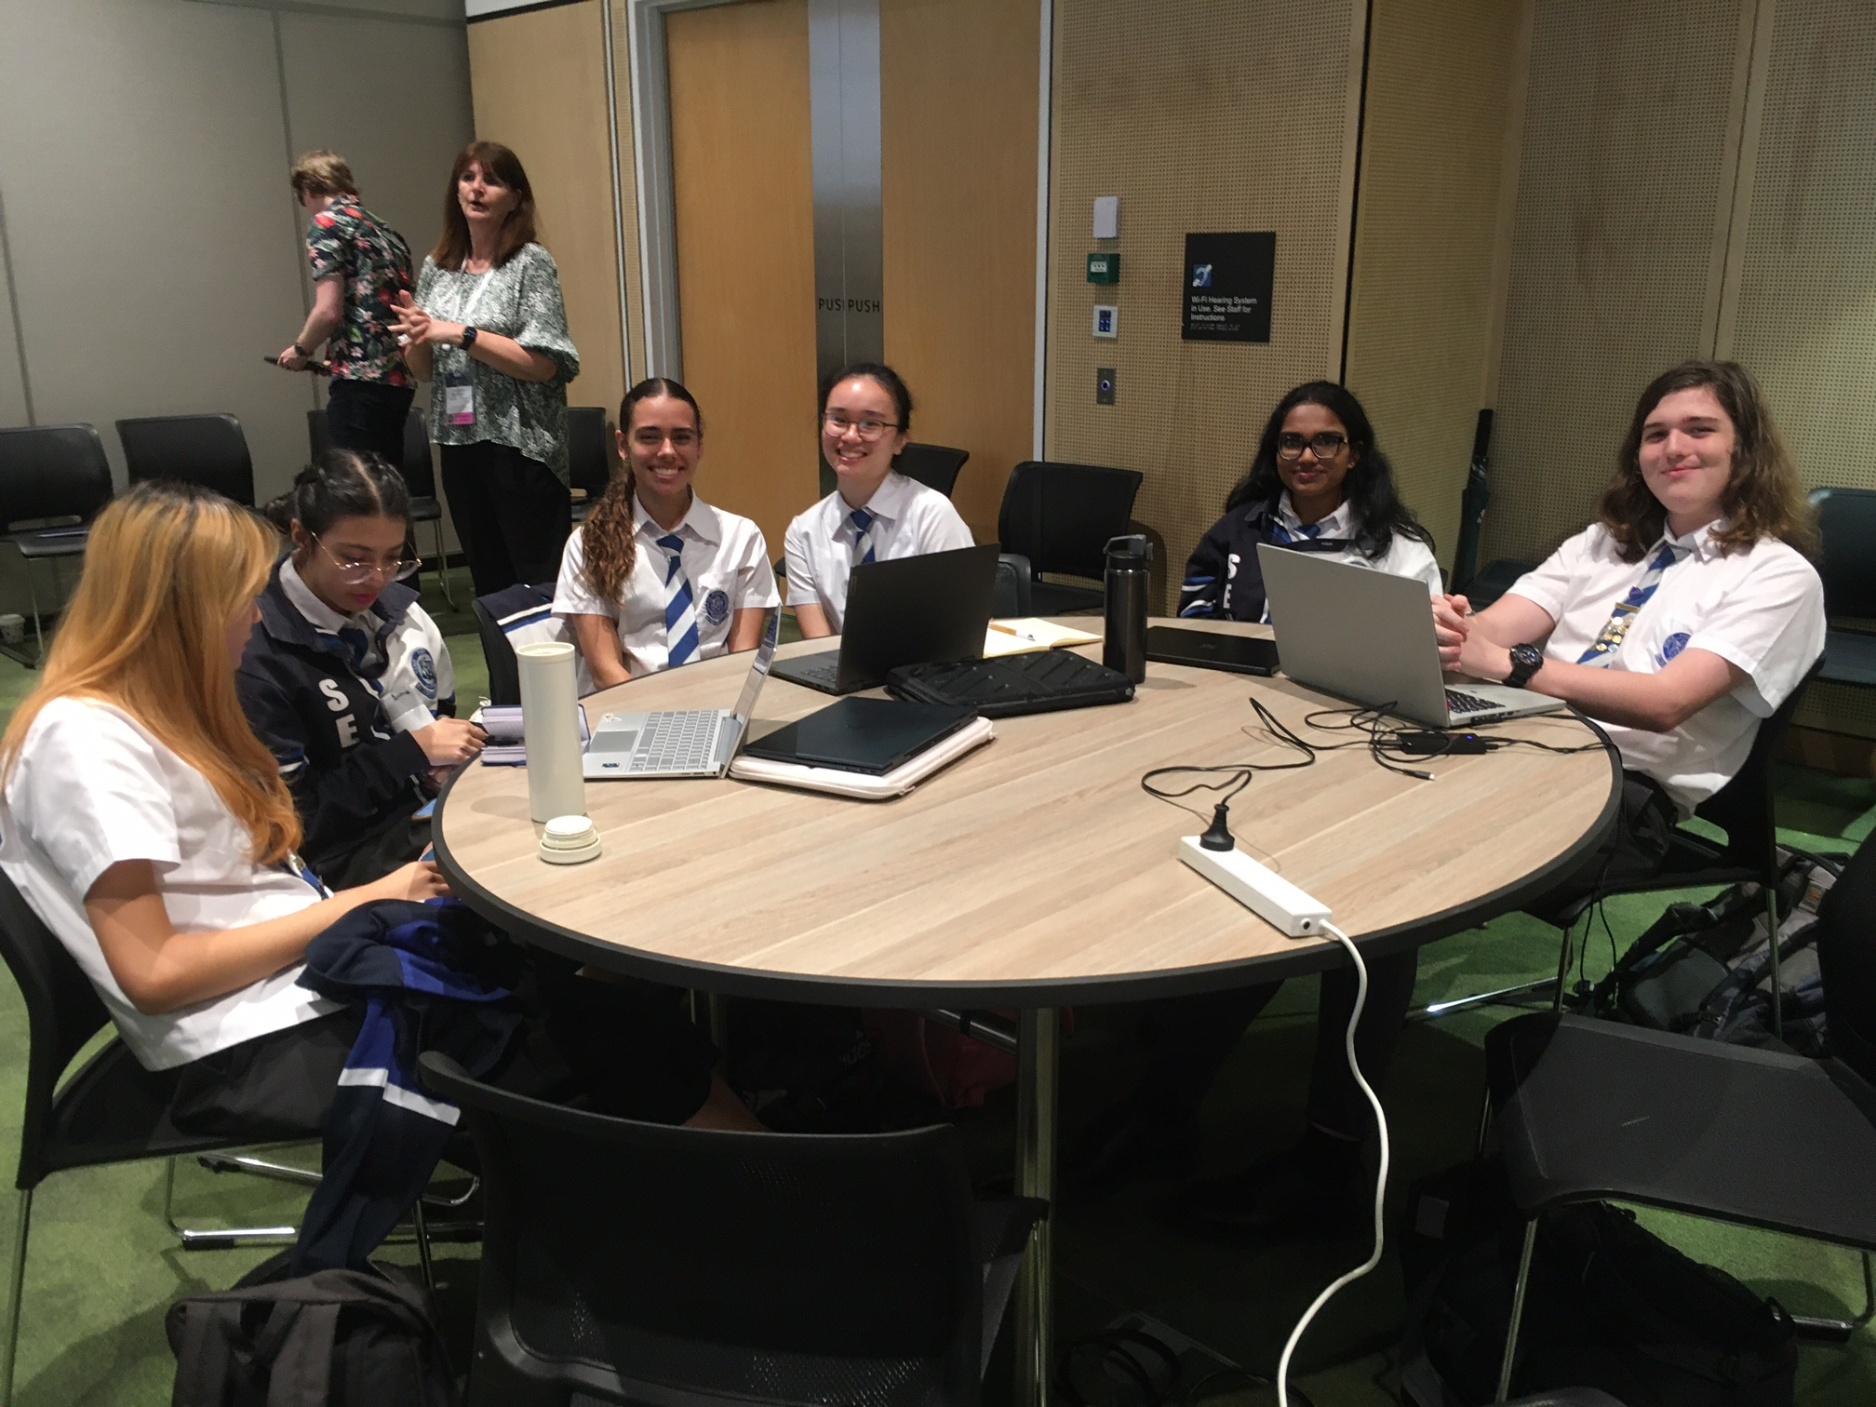
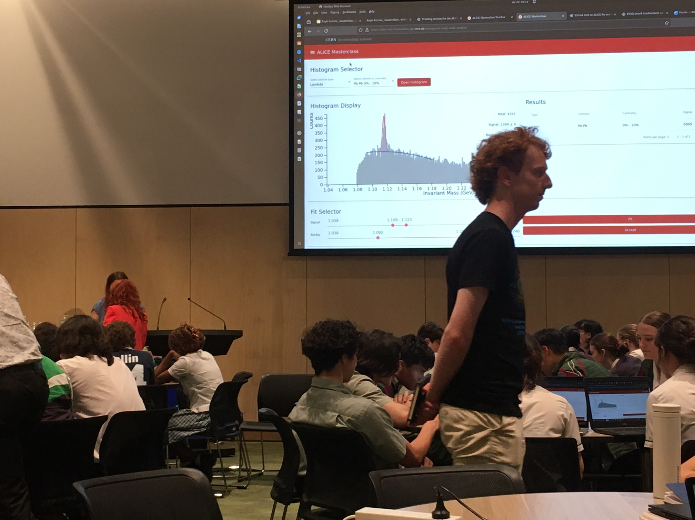
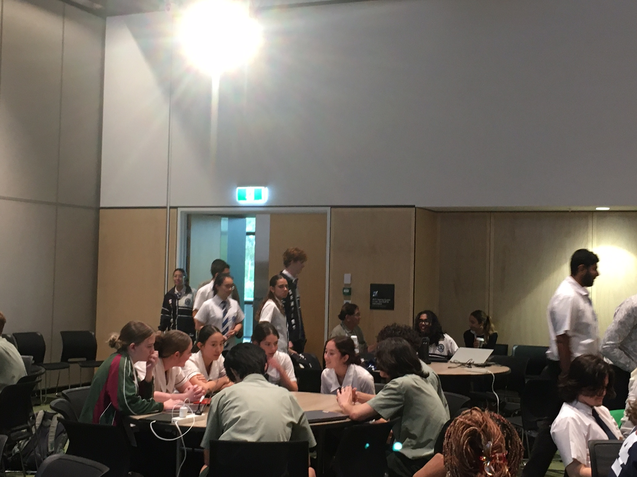
ALICE Masterclass
More Photos in: https://cernbox.cern.ch/index.php/s/8kR7vNJUpYfvrye

Slide 9
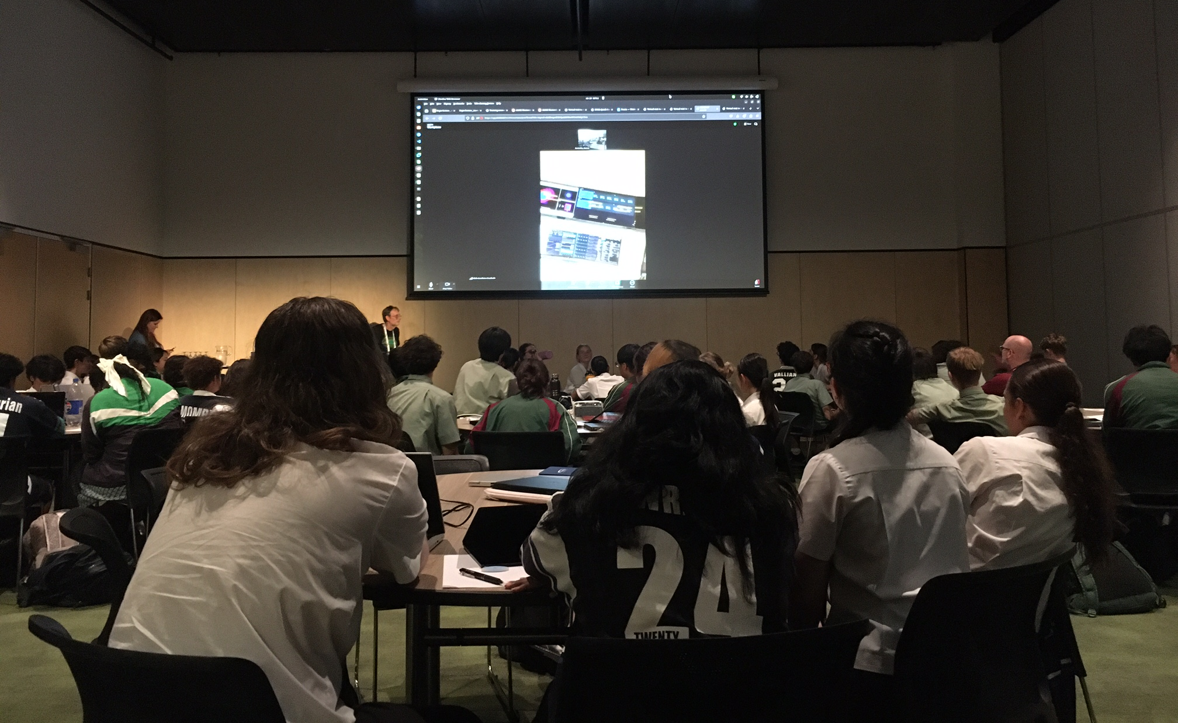
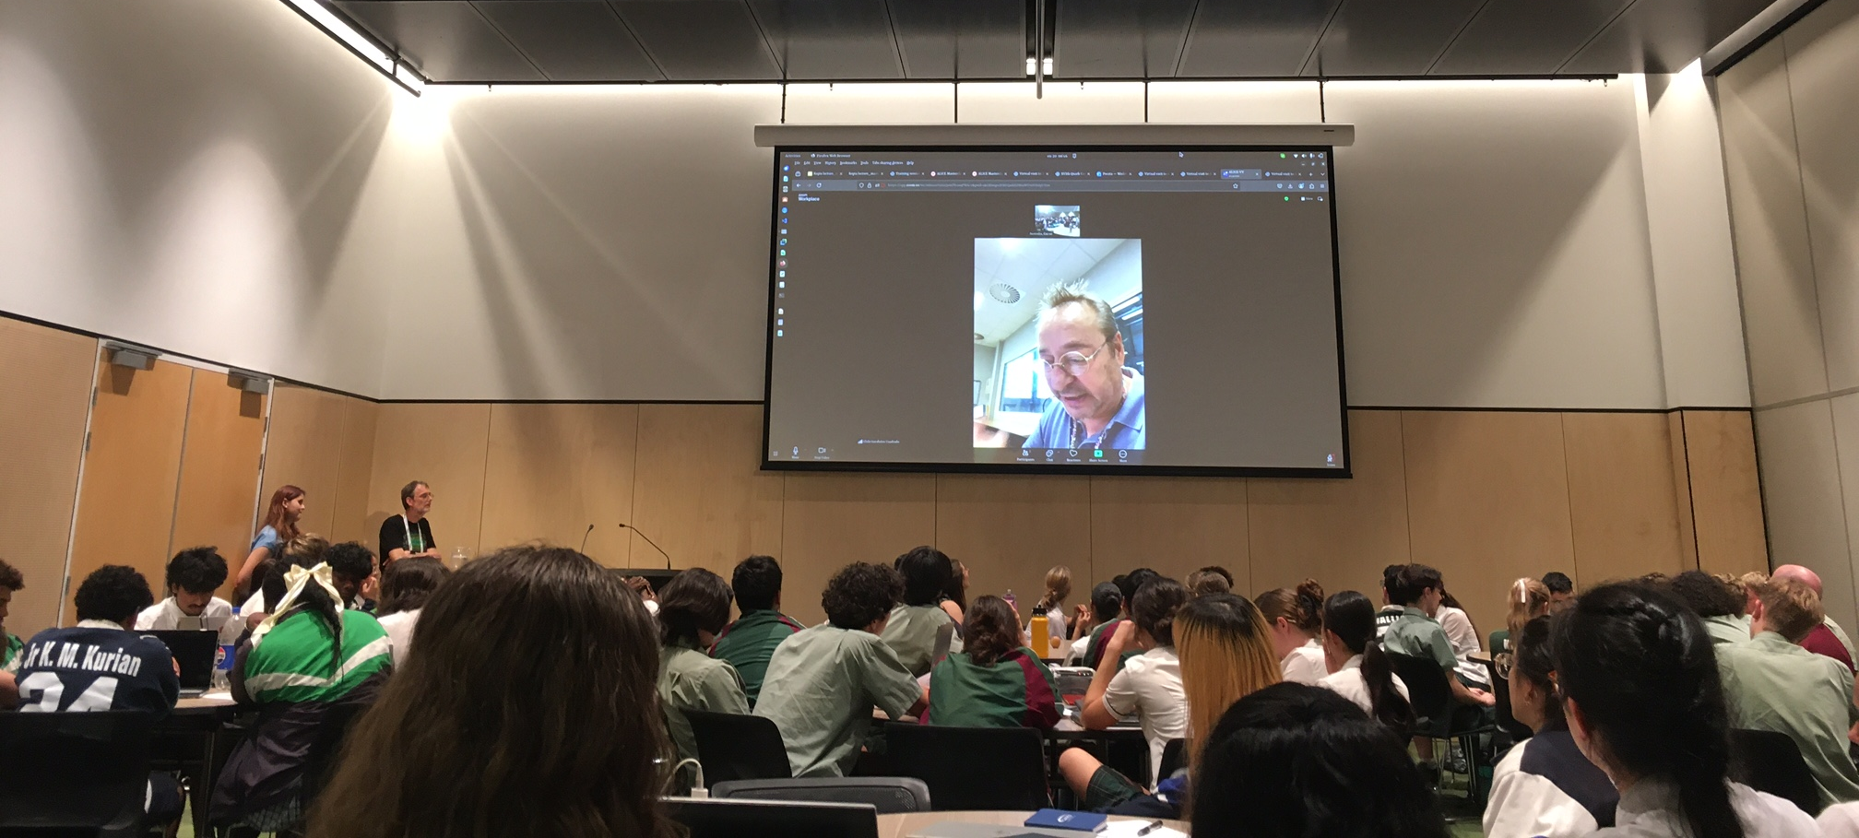
ALICE Masterclass
Connection to ALICE Control Room
By Chilo Garabatos
Over half an hour virtual tour and discussions
A lot of interest by the students and many questions

Slide 10
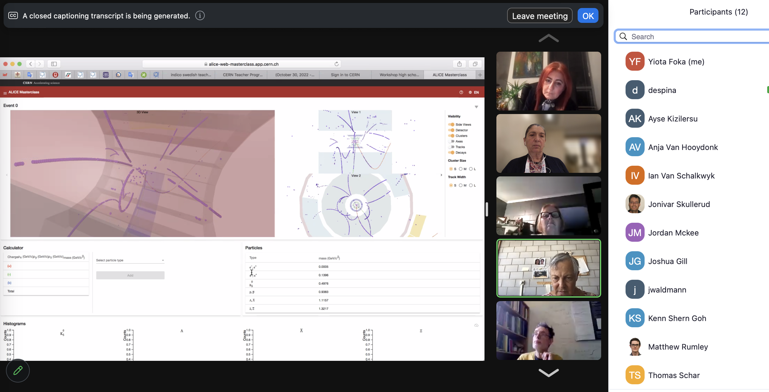
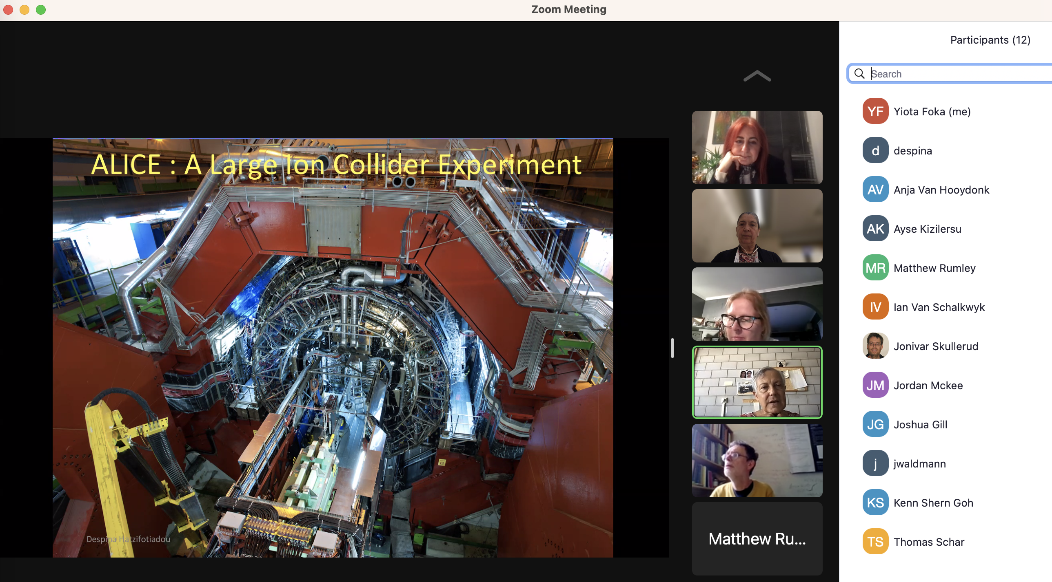
ALICE Masterclass Preparations
Trainings by Despina et al: 23 July and 6 august, attended by teachers and PhDs
Arranged for ALICE Virtual Visit :
https://indico.cern.ch/event/1441889/
Set up the MC, provide presentations, material….

Slide 11
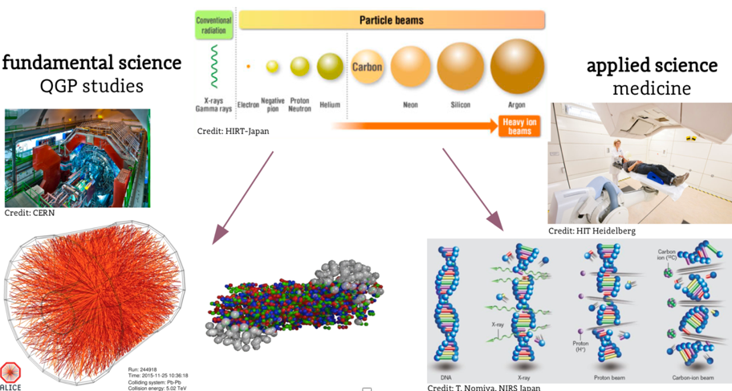
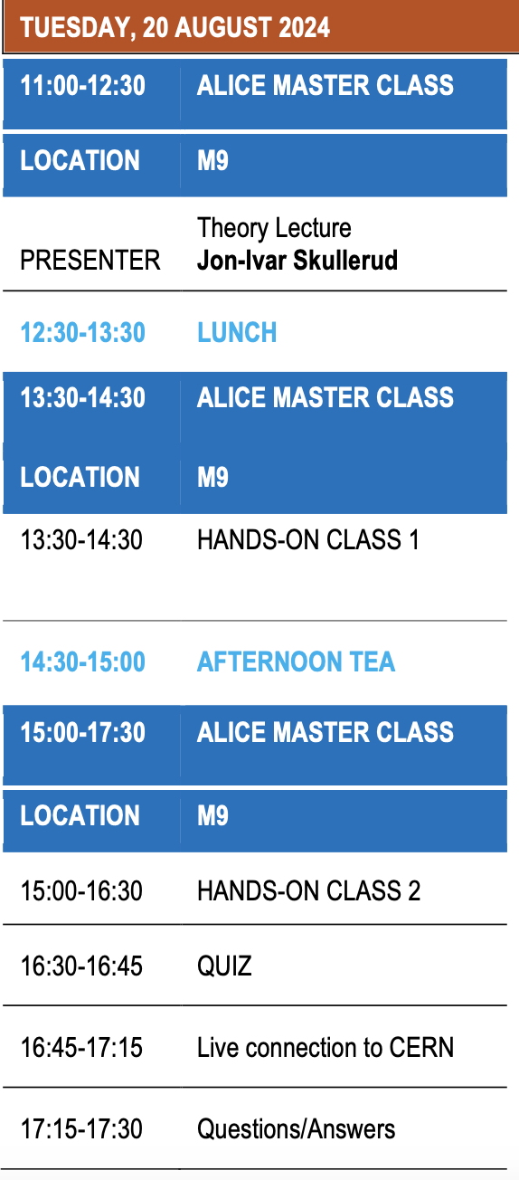
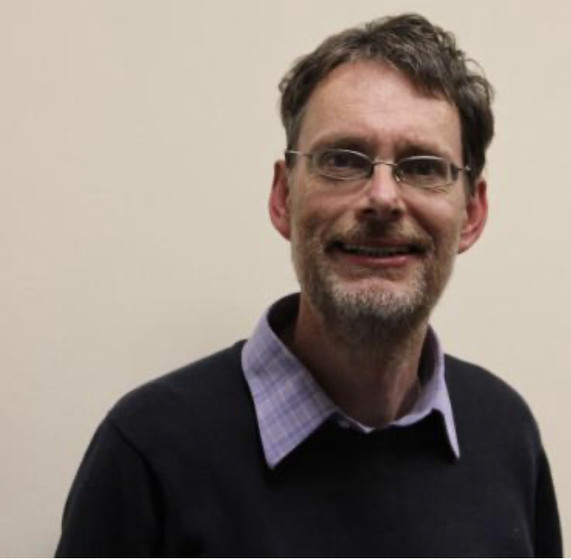
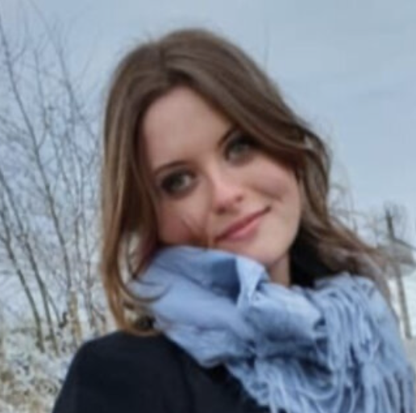
ALICE MasterClass on Strangeness
Pb-Pb at 5.5 TeV
pp at 14 TeV
Jon-Ivar Skullerud
Wioleta Rzesa

Slide 12
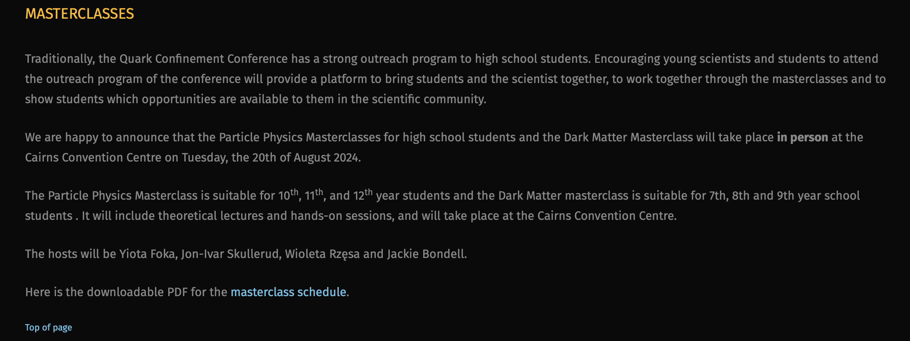
MasterClass in Confinement Conference
We are paid to produce Knowledge !
and
Knowledge is Power
We share it empowering Students
and
the Broader Society

