Slide 1
An Overview of the Power Converters at CERN
F. Boattini (fulvio.boattini@cern.ch), D. Aguglia (davide.aguglia@cern.ch)
European Organization for Nuclear Research, Accelerator Systems Department, Electrical Power Converter Group
10th September 2024 – FEPPCON 2024

Slide 2
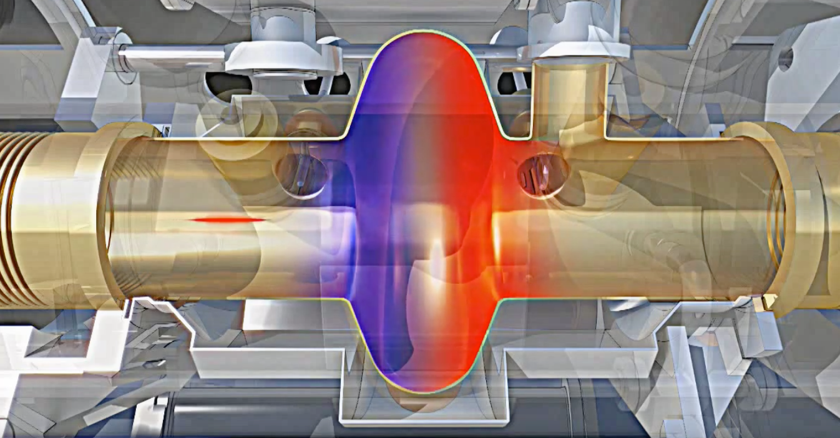
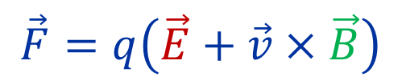
What are power converters used for at CERN ?
Beams are composed of charged particles (q). These must be guided along the accelerators
$$\vec{F}=q\left(\vec{E}+\vec{v}×\vec{B}\right)$$
Acceleration
Trajectory control
Particles pass through an electrical field oriented in the direction of their movement.
As the energy of particles
increases the magnetic field controlling
the trajectory must also increase
Need for HV to create
strong electric fields
Need for strong magnetic fields:
Electro magnets are used
Power Converters
F. Boattini | Overview of the Power Converters at CERN

Slide 3
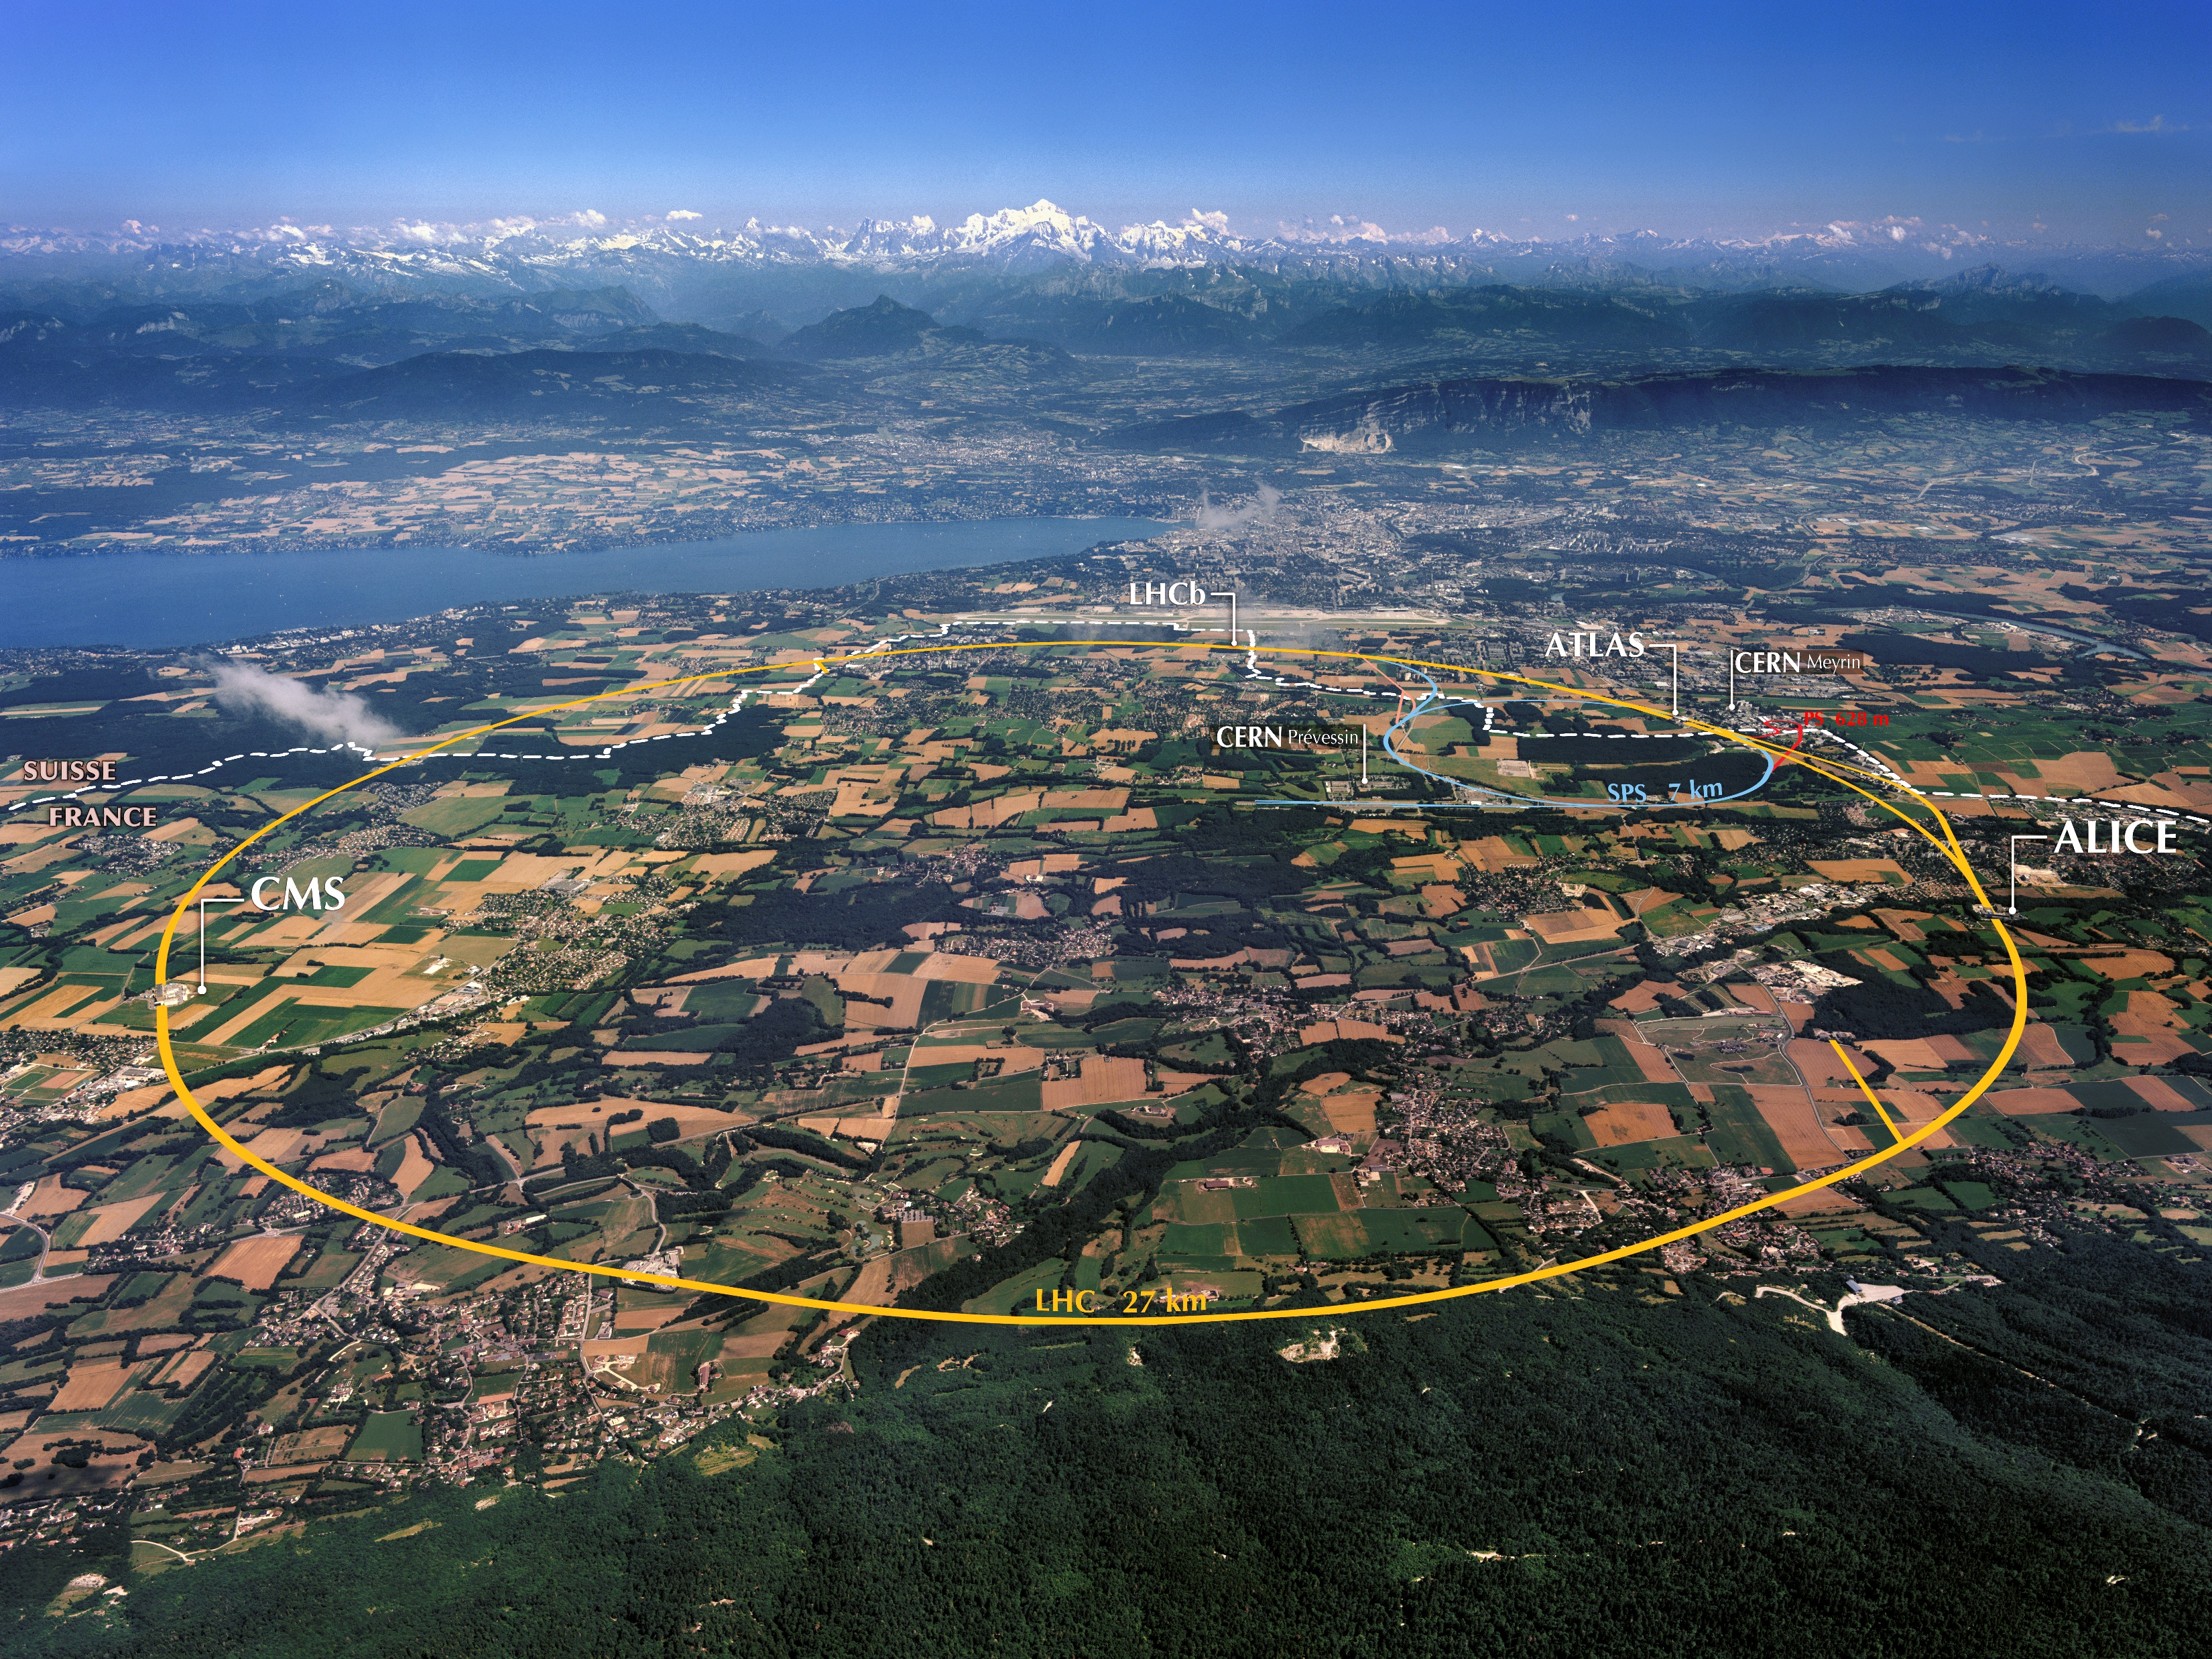

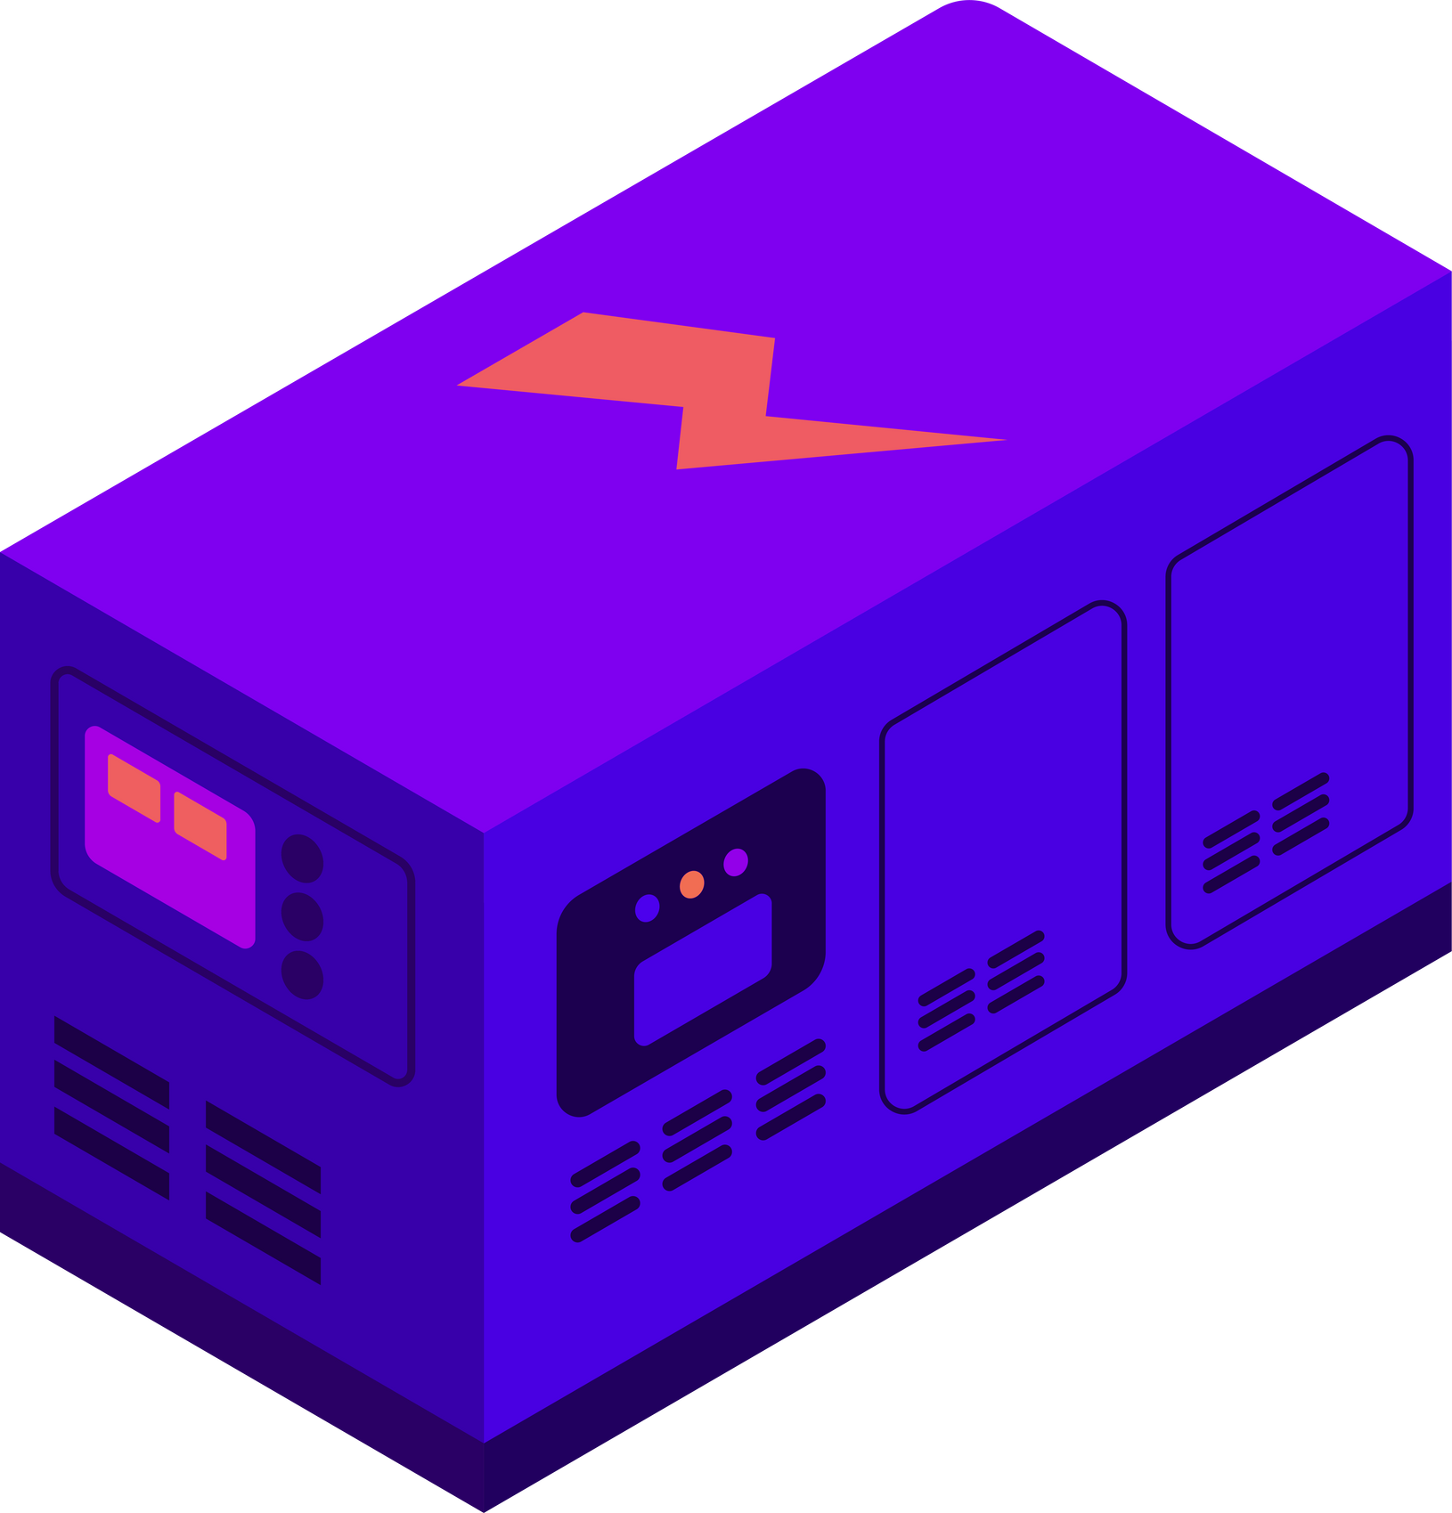
5300 power converters
from 100 W up to some MW
from 1A up to some kA
from V to some hundred kV
from DC to Cycled or Pulsed mode
from low to high-precision
Spread in the region
On surface and in tunnels
MAGNETS
RF SYSTEMS
PARTICULE
SOURCE
SEPTA
ELECTRICAL
NETWORK
POWER
QUALITY
Very different power converter topologies
F. Boattini | Overview of the Power Converters at CERN

Slide 4

Power converters around the accelerator complex
HV pulsed low current pulsed
H⁻ source in LINAC4
F. Boattini | Overview of the Power Converters at CERN

Slide 5
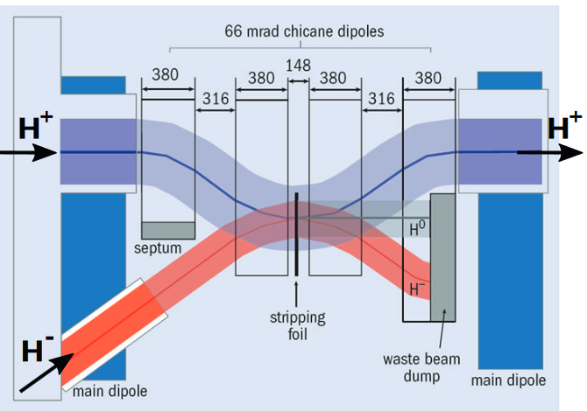
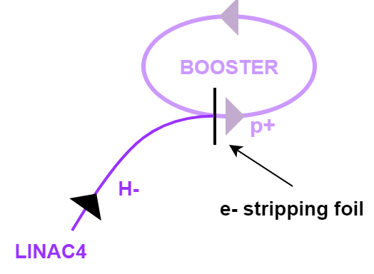
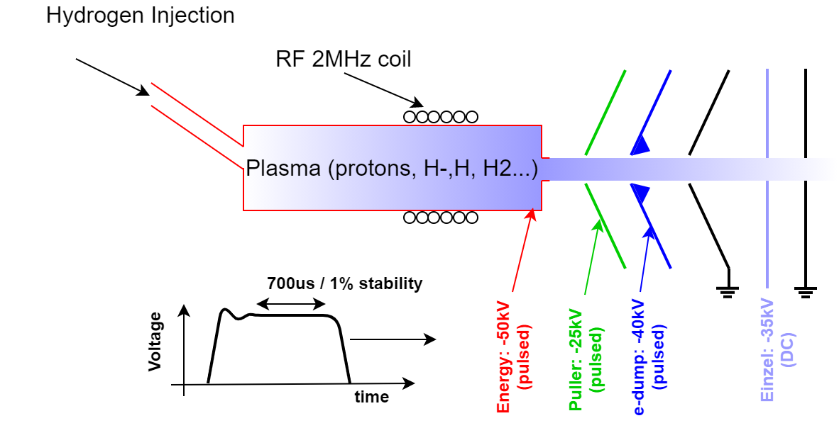
Linac4 H- ions source power supply
H- beam to p+
  Linac4 accelerates hydrogen ions;
  At entrance in the PS Booster, the extra e- are stripped away (a more intense p+ beam is obtained)
H⁻ ions source power supply
  H based ions and e- are generated in a plasma source;
  H⁻ (an unwanted e-) are accelerated by a set of HV electric fields (pulsed and DC)
Voltage power supplies specification
Principle of H⁻ source
F. Boattini | Overview of the Power Converters at CERN

Slide 6
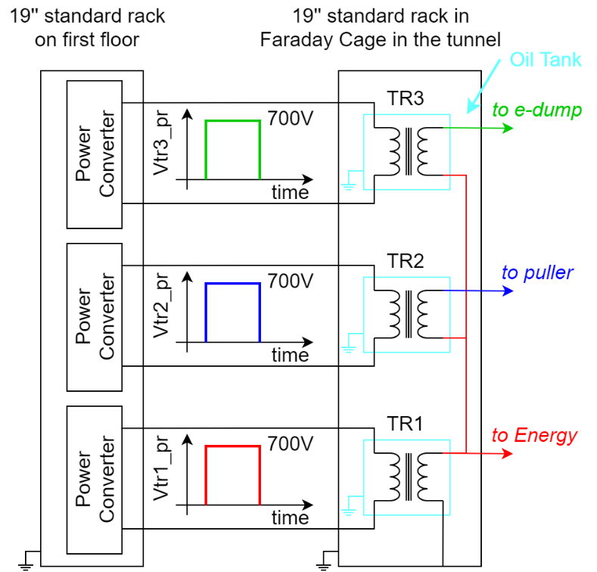
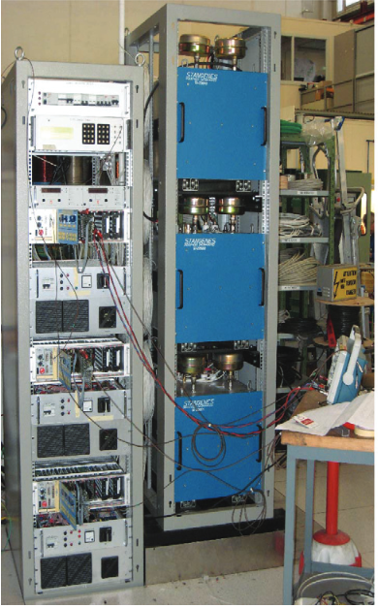
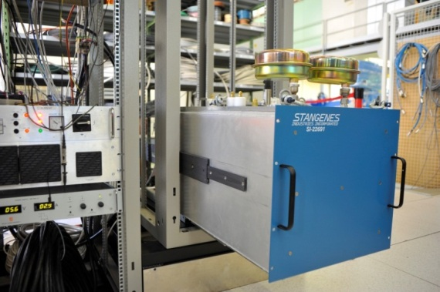
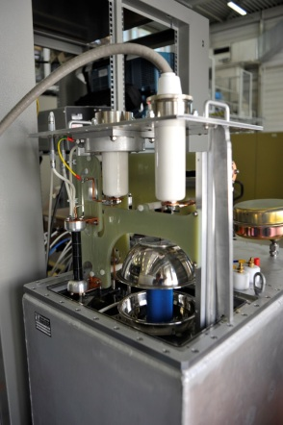
Linac4 H⁻ ions source power supply
H- generation
One Quadrant linear IGBT regulation
  HV oil insulated pulse transformer generates a trapezoidal voltage pulse;
  The 1% stability on the flattop is achieved by linear regulation of the return IGBT
Arc limiter
Topology choice: simple (reliability), no ripple (IGBT in linear mode)
Linearly regulated IGBT
Preload for IGBT linear regulation
Pulse TR magnetic discharge
Voltage oscillations dumping
Controller
Capacitor charger
Oil Tank
F. Boattini | Overview of the Power Converters at CERN

Slide 7
Power converters around the accelerator complex
Klystron modulator
F. Boattini | Overview of the Power Converters at CERN

Slide 8
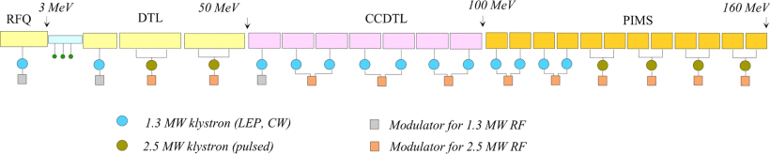
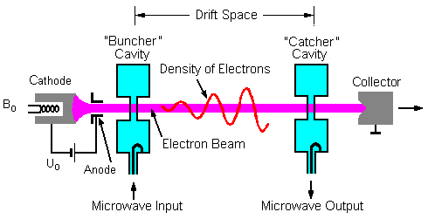
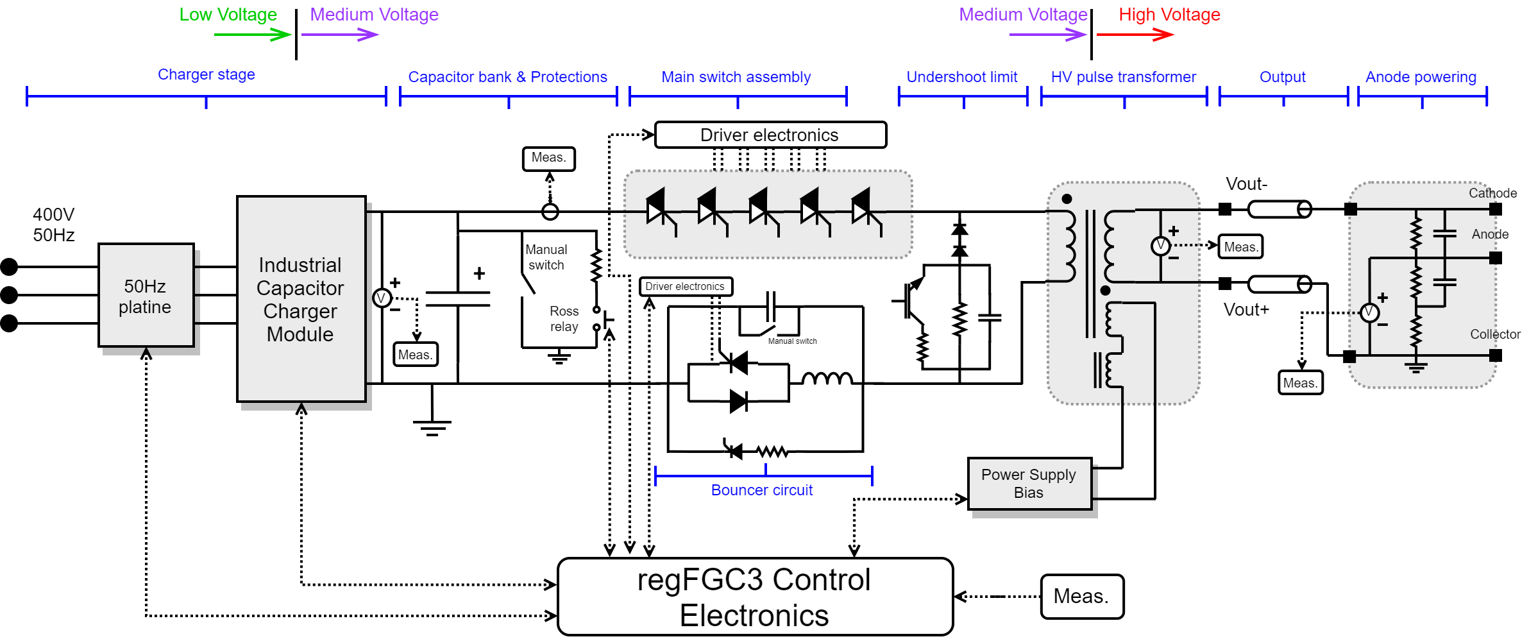
Linac4 RF klystron modulator
H- acceleration to PSB
RF power amplifier
Topology: Capacitor discharge, HV pulse transformer, voltage drop correction with bouncer circuit
  Output voltage/current: 110kV / 50A, pulsed at 2Hz
  Voltage drop: 0.5%
  Voltage precision: ±0.5%
  Load pulse length: 1.4ms
  Load: Klystron 2.8MW
F. Boattini | Overview of the Power Converters at CERN
8

Slide 9
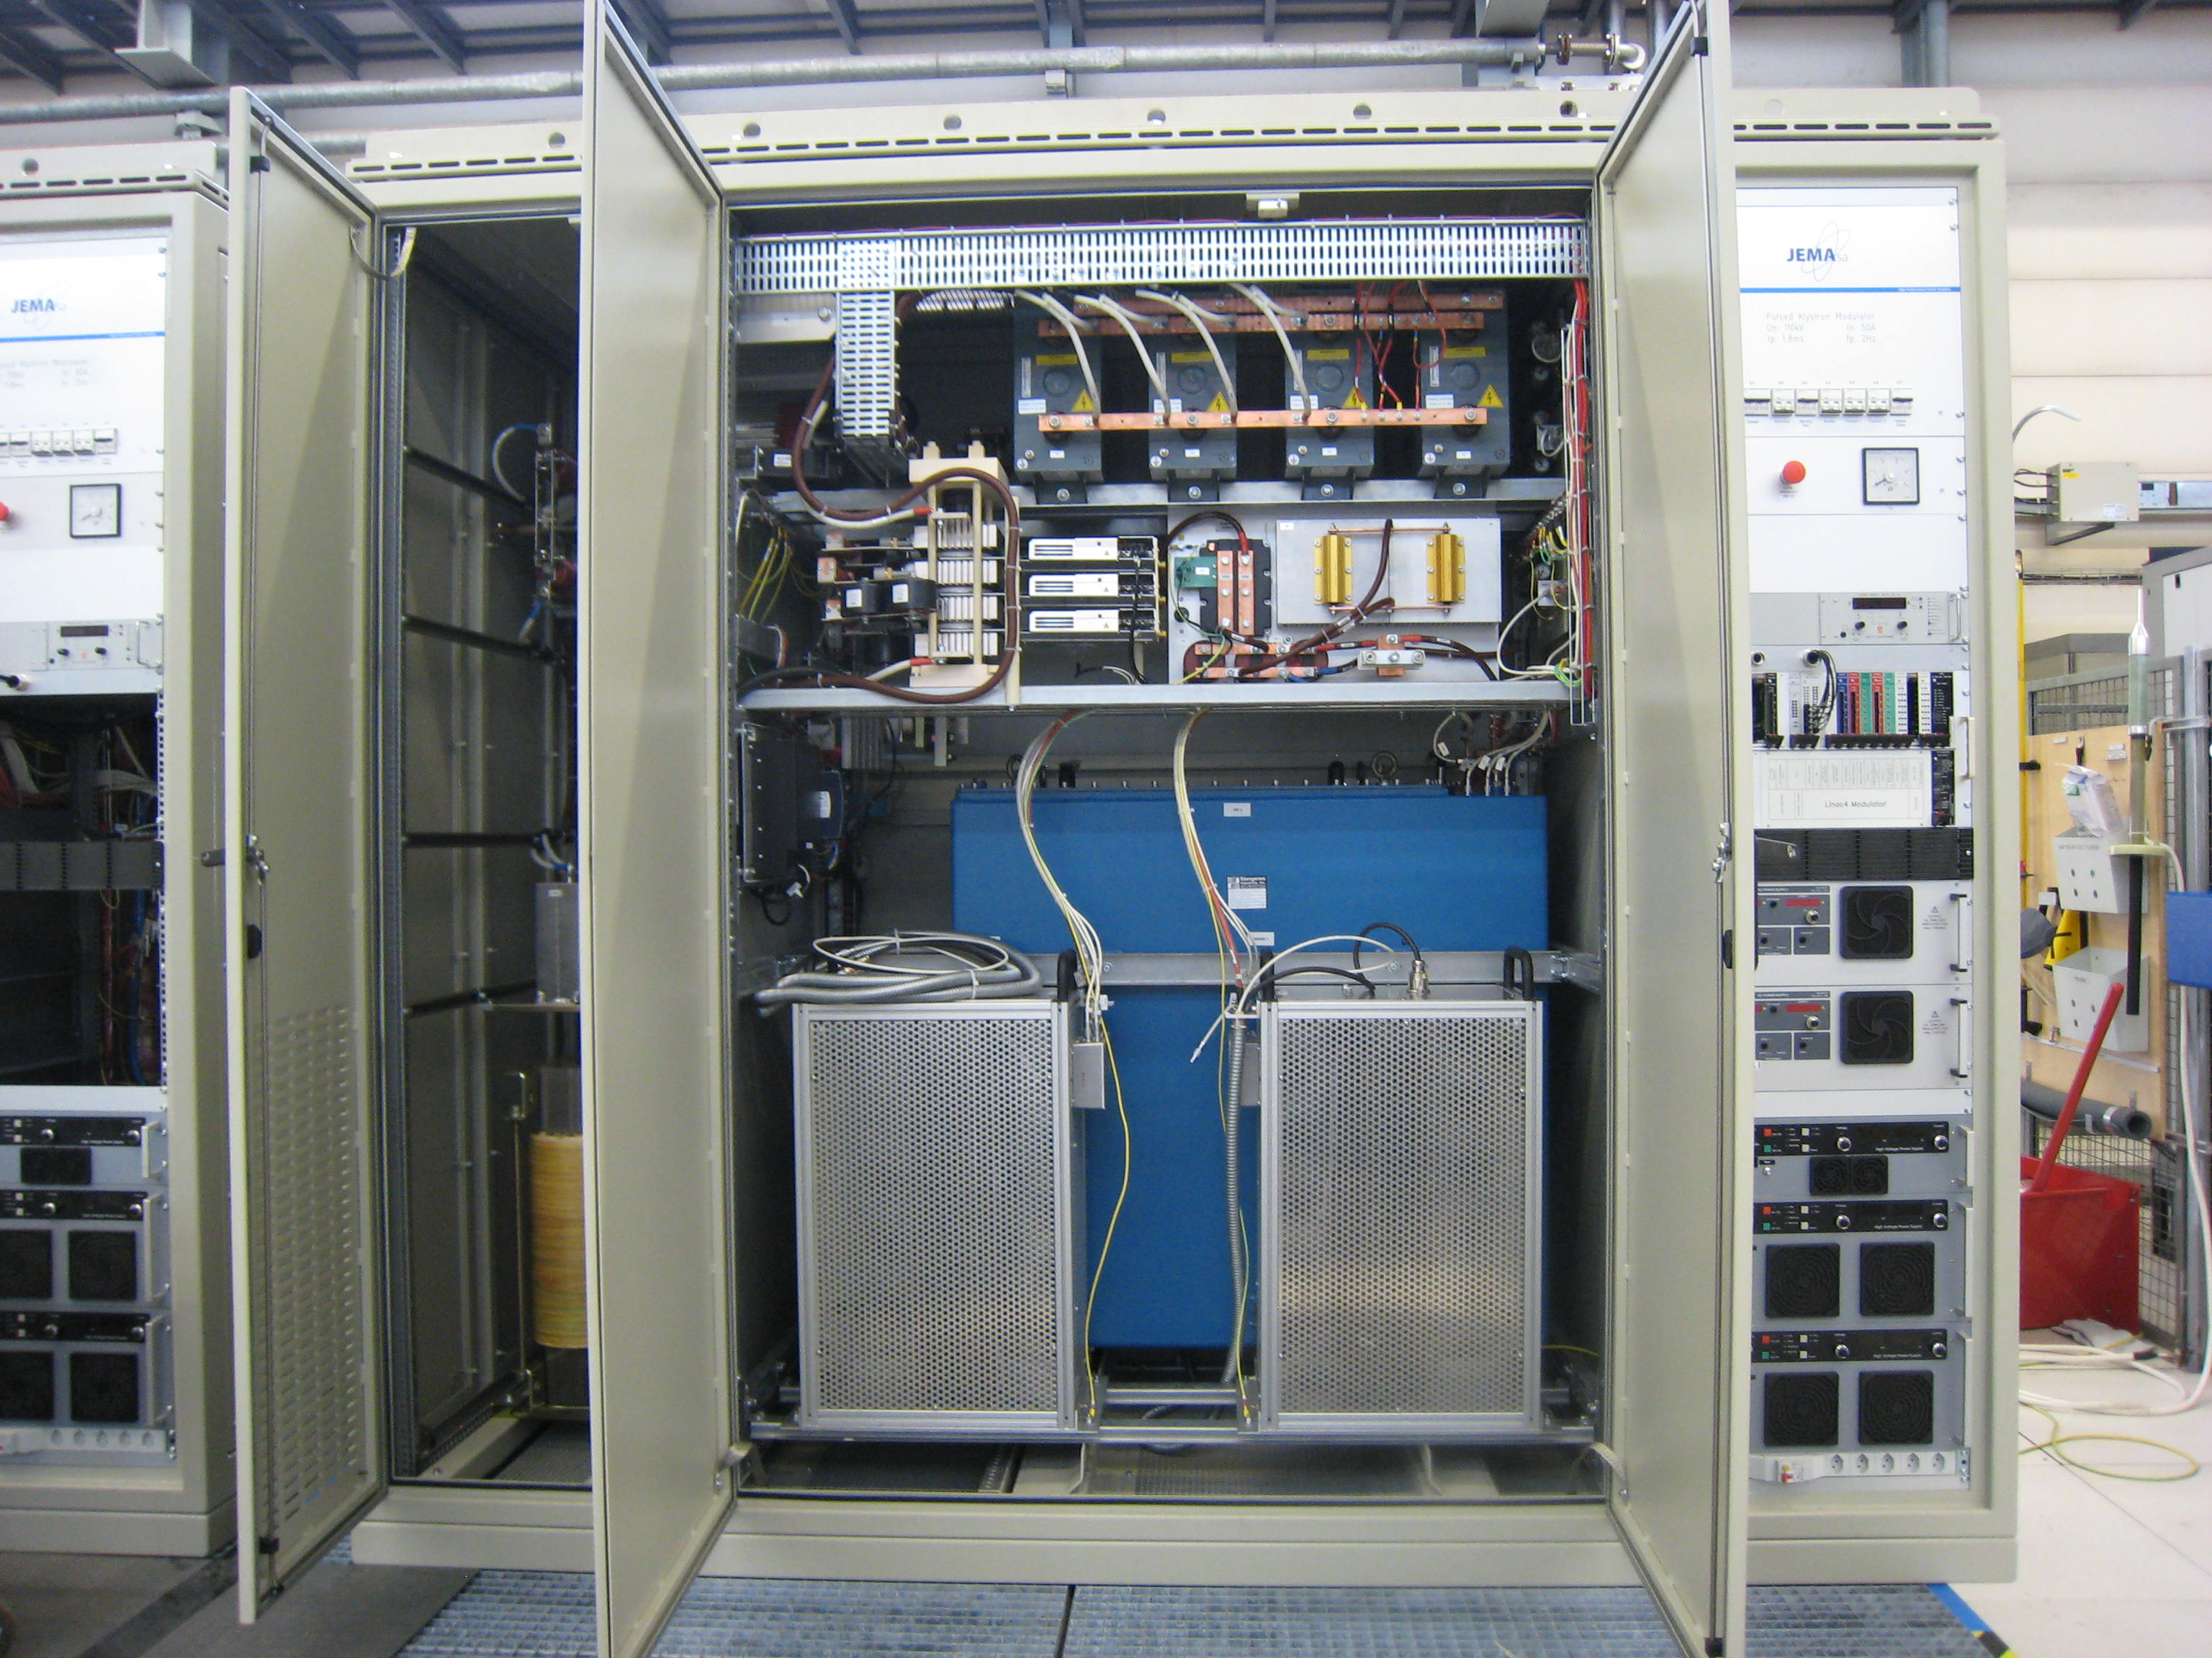
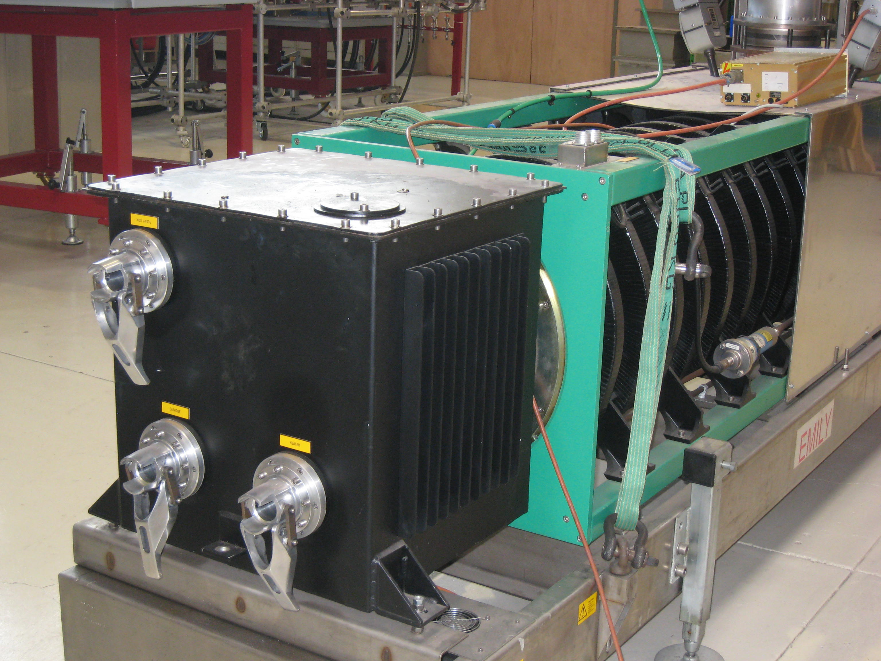
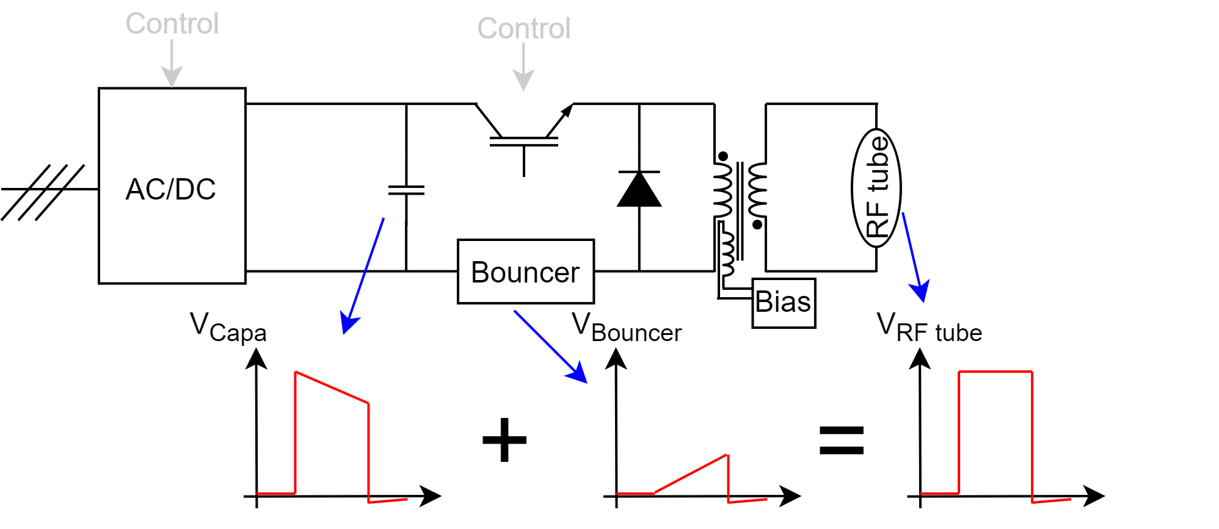
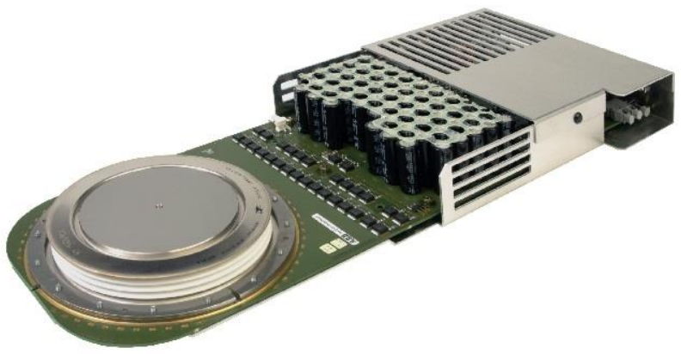
Linac4 RF klystron modulator
Bouncer correction
Reverse Conducting IGCT
Topology: Capacitor discharge, HV pulse transformer, voltage drop correction with bouncer circuit
  Output voltage/current: 110kV / 50A, pulsed at 2Hz
  Voltage drop: 0.5%
  Voltage precision: ±0.5%
  Load pulse length: 1.4ms
  Load: Klystron 2.8MW
F. Boattini | Overview of the Power Converters at CERN
9

Slide 10
Power converters around the accelerator complex
Clean with Energy Storage
PSB and PS “main” power supply
F. Boattini | Overview of the Power Converters at CERN

Slide 11
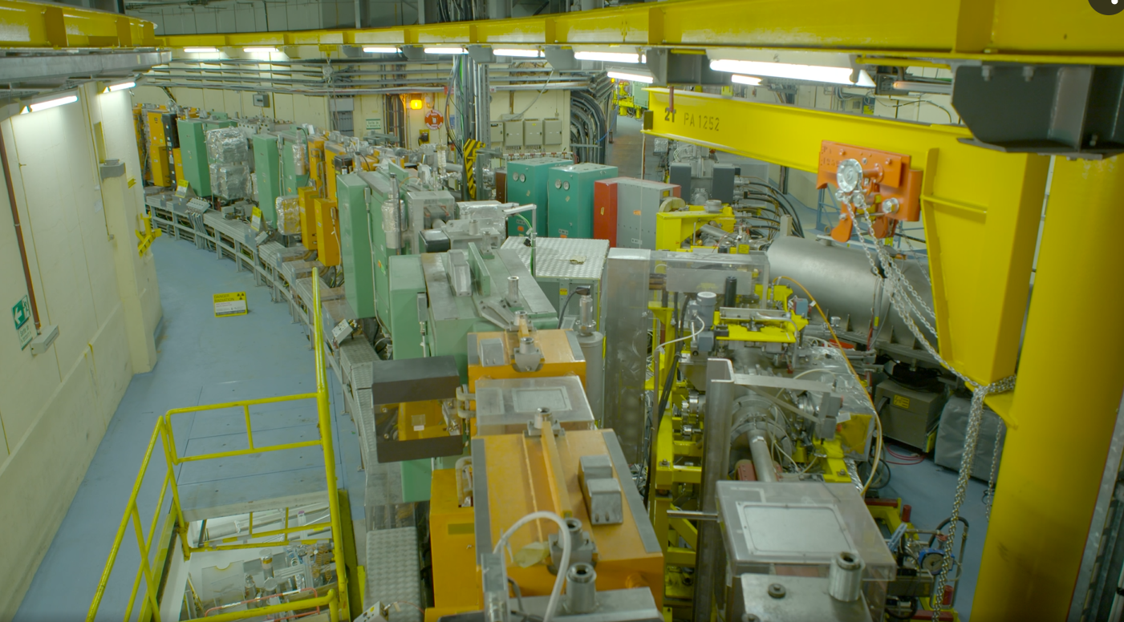
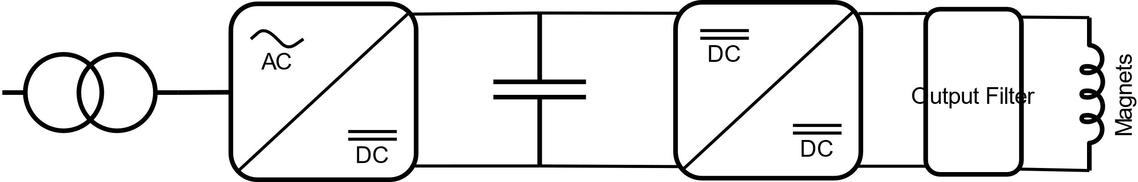
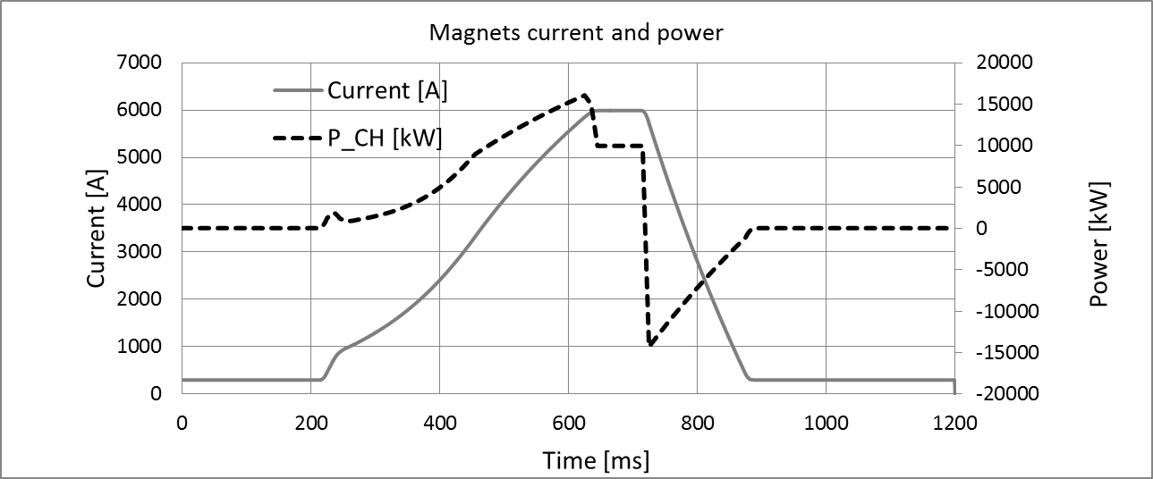
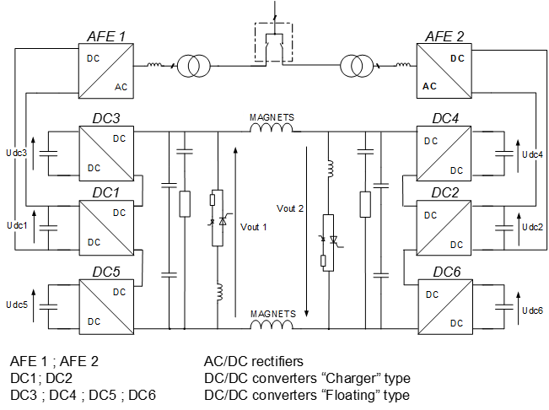
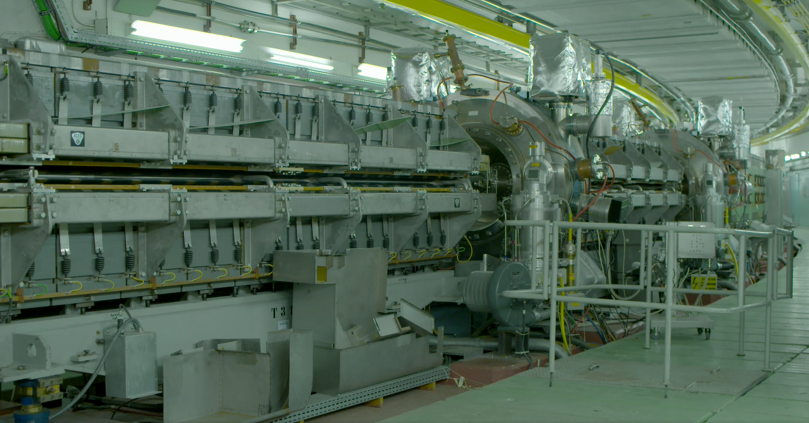
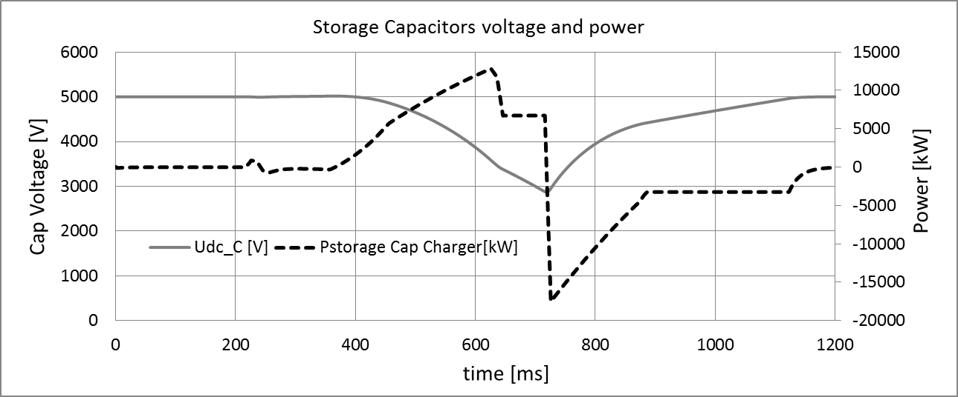










PS and PSB power supplies
PSB and PS beam bending magnets supply
AC-DC 3phase boost rectifier
DCDC stage to power electromagnets
Energy exchange from Capacitors
PSB
$$I_{peak}=6 kA$$
$$V_{peak}=3 kV$$
$$P_{peak}=18 MW$$
$${Mag}_{nergy}=2.6 MJ$$
$${Cap}_{energy}=3.5 MJ$$
PS
$$I_{peak}=6 kA$$
$$V_{peak}=10 kV$$
$$P_{peak}=60 MW$$
$${Mag}_{nergy}=12 MJ$$
11
$${Cap}_{energy}=18.7 MJ$$
F. Boattini | Overview of the Power Converters at CERN

Slide 12
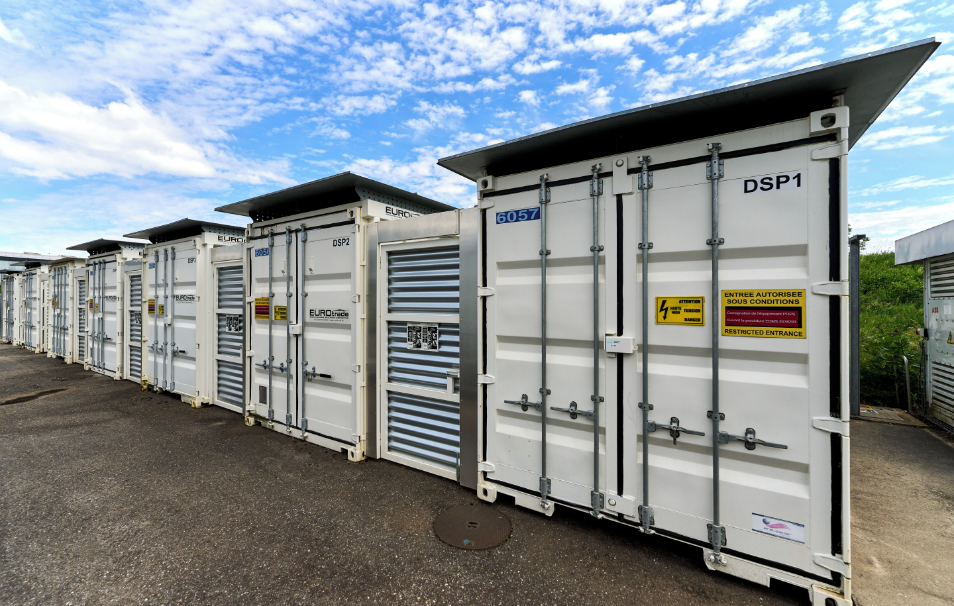
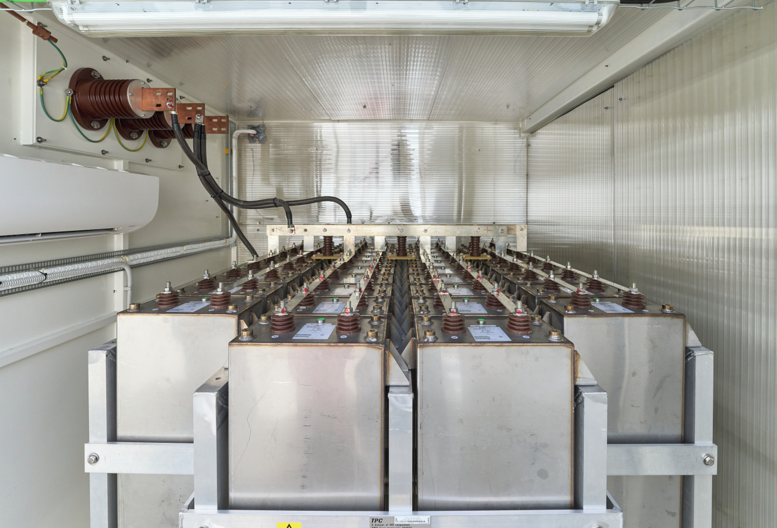
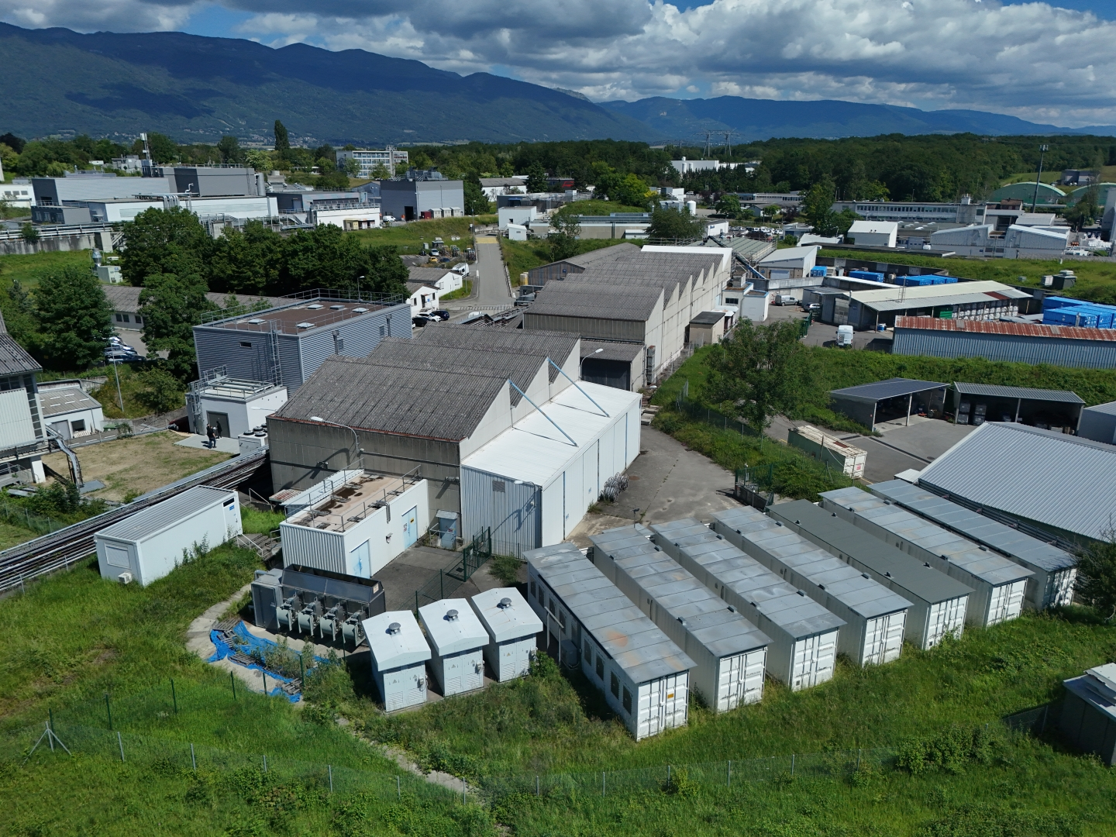
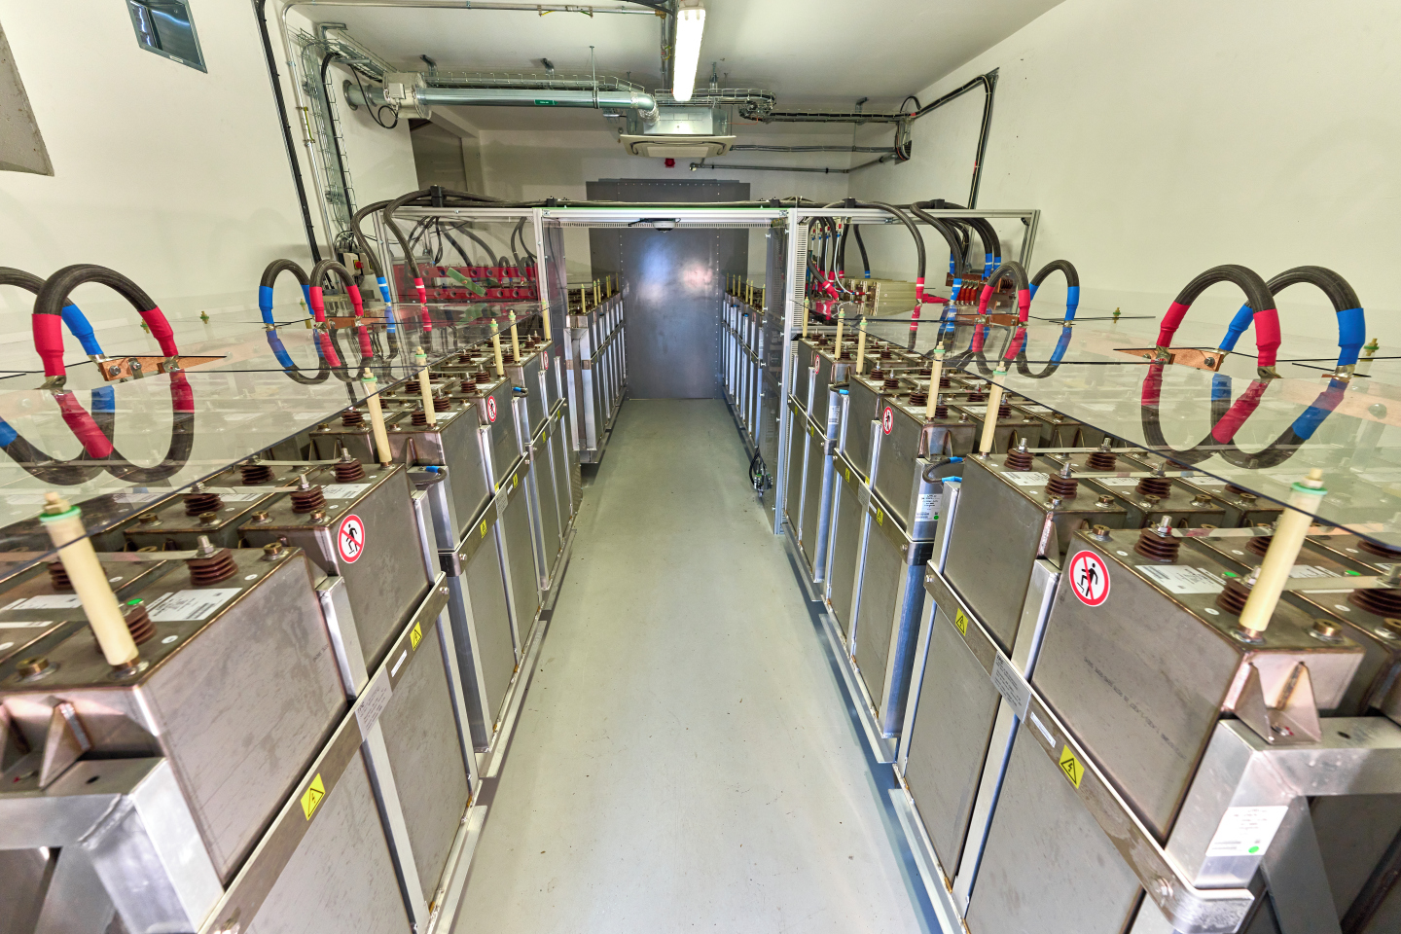
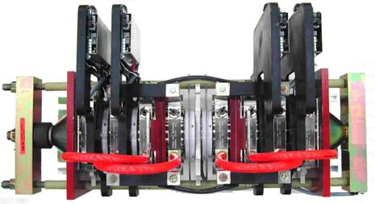
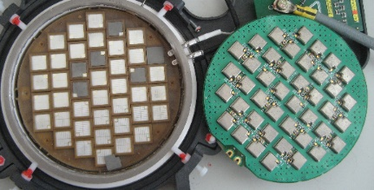
PS and PSB power supplies
Three-Level NPC type (3phase) brick.
3300V motor drive re-arranged with interleaving
Press-pack technology: 4500V, 2200A
Standard building blocks for 3300V motor applications (marine propulsion, steel makers, LNG compressors etc..)
IEGT 4.5kV 2200A PP IGBT
F. Boattini | Overview of the Power Converters at CERN

Slide 13
Power converters around the accelerator complex
Classical thyristor rectifier
SPS “mains”
Reactive power compensation is required
F. Boattini | Overview of the Power Converters at CERN

Slide 14
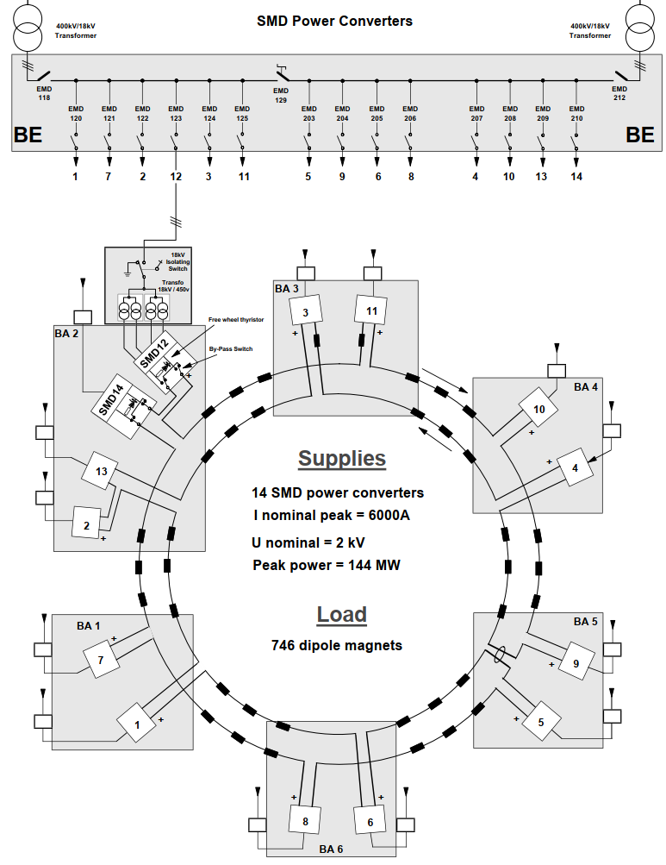
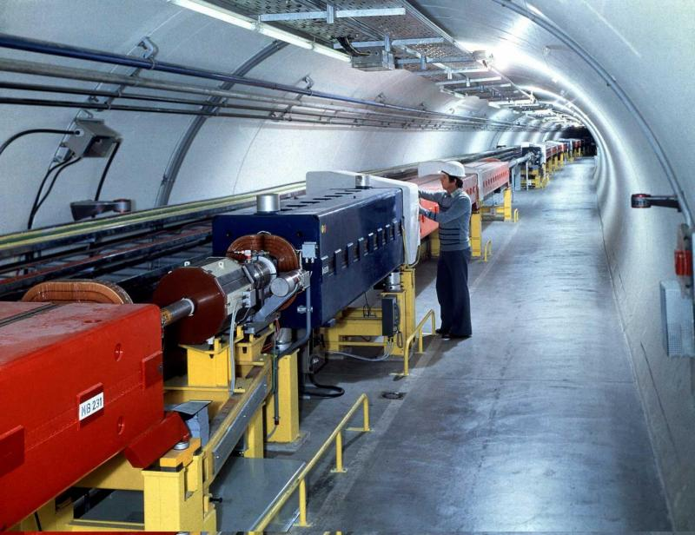
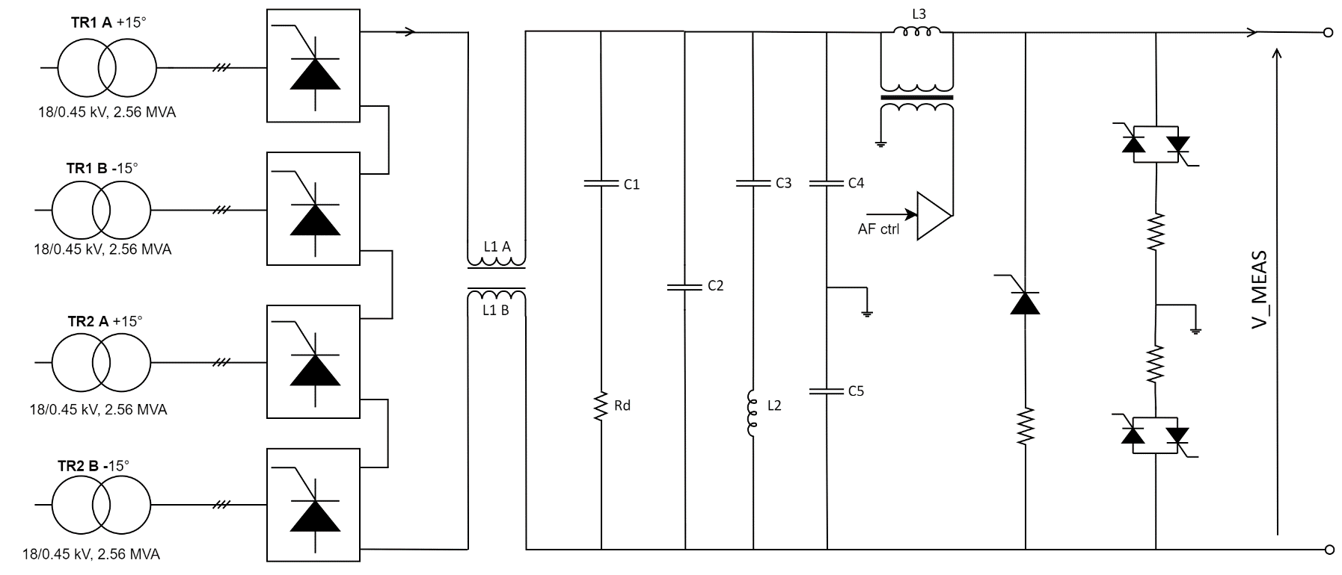
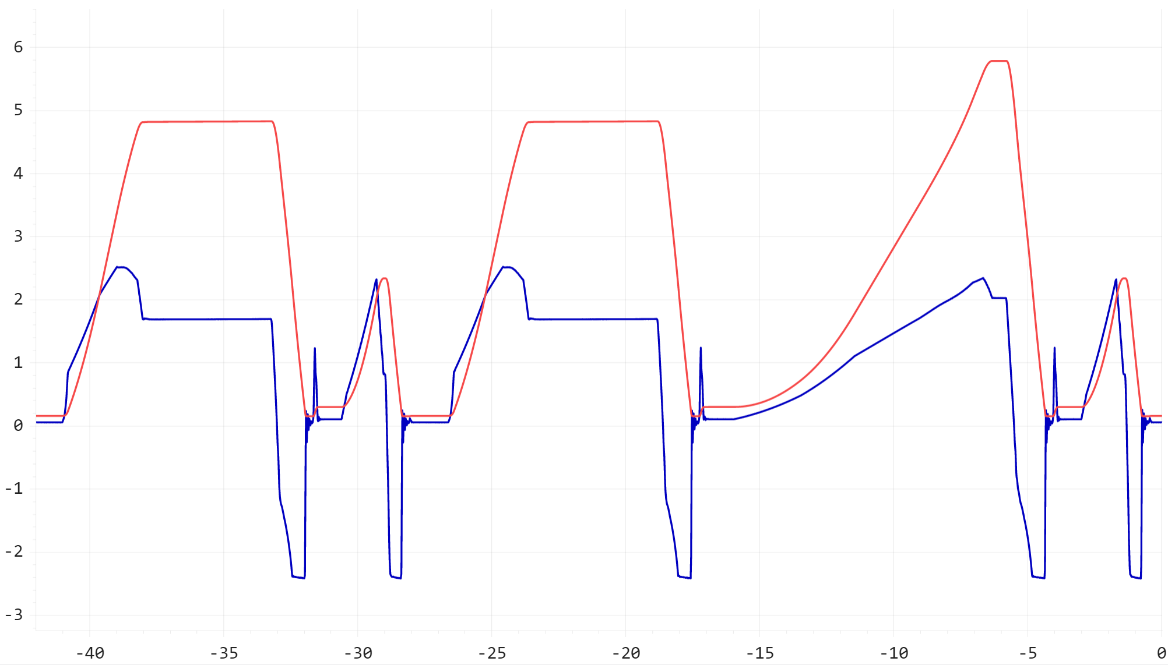
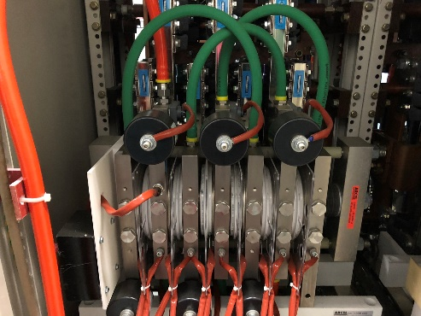



SPS “mains” power converter
SPS beam bending magnets supply
Power: 6 kA / 25 kV, < 20 ppm
12 SMD stations in series + 2 spares
Standard 12 pulse rectifiers
$$I_{peak}=6 kA$$
$$V_{peak}=25 kV$$
$$P_{peak}=150 MW$$
5.8 kA
25 kV
Phase control PP thyristor
[A] / [V]
[s]

Slide 15
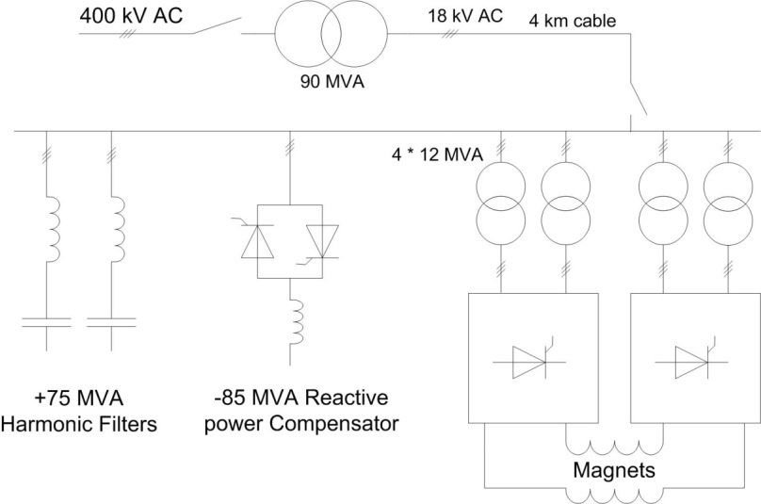

SPS “mains” Static Var Compensators
Thyristor rectifiers:
$$V_{out}=\frac{3}{π}{\hat{V}}_{in,L−L}\cos\left(α\right)$$
AC current is shifted by α (fundamental)
AC side active and reactive power (neglecting harmonics):
P=3*V_{phase}*I_{line}*cos(α)
Q=3*V_{phase}*I_{line}*sin(α)
~150MW/Mvar in about 15s
Huge reactive power at low DC voltages…
[A] / [V]
SVC
Solution
[s]
15

Slide 16
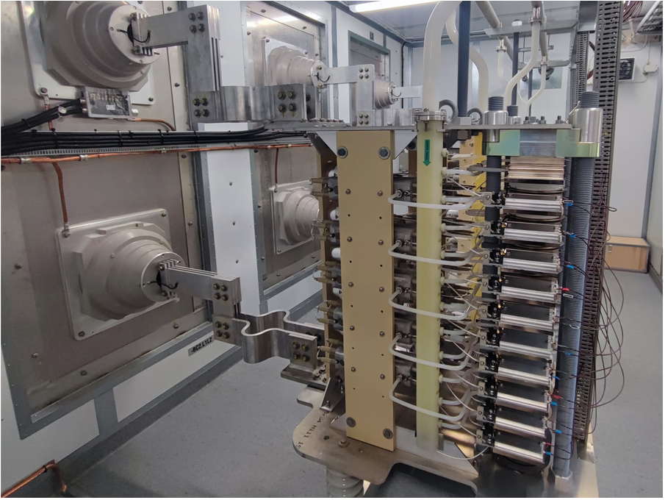
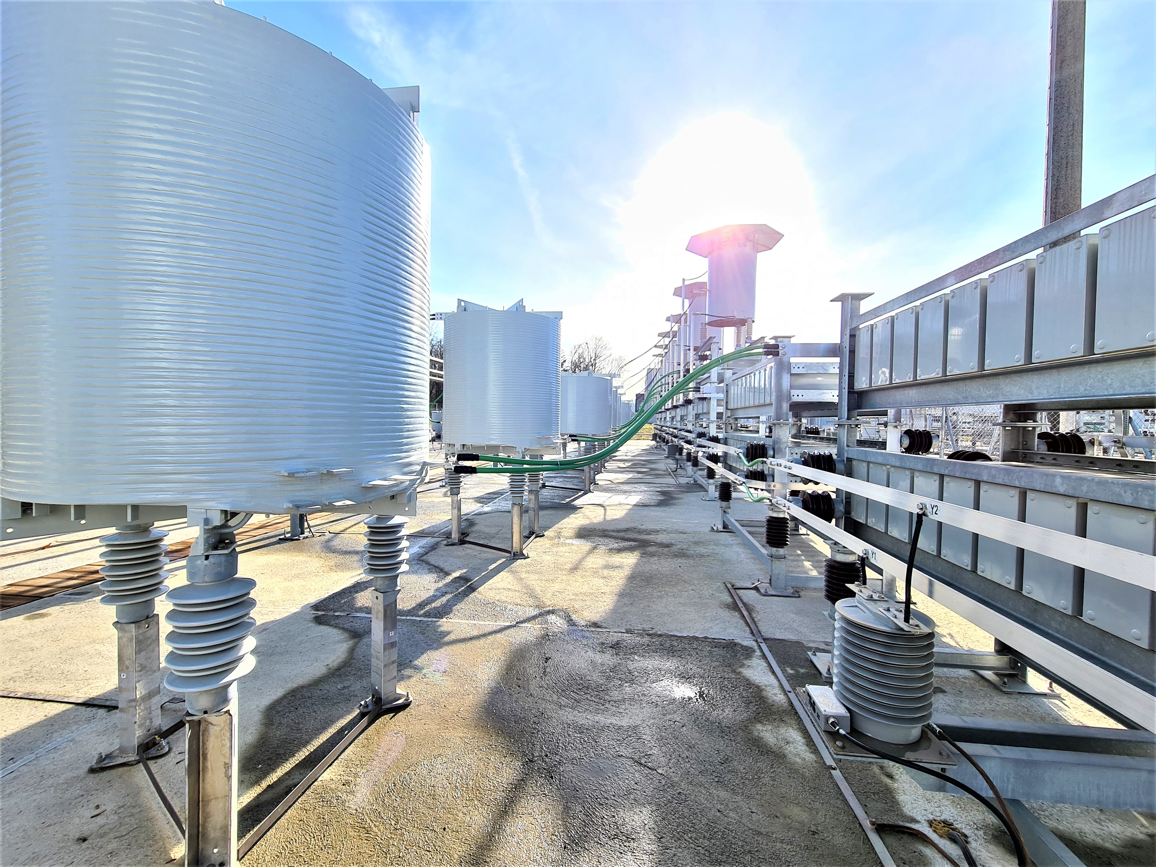
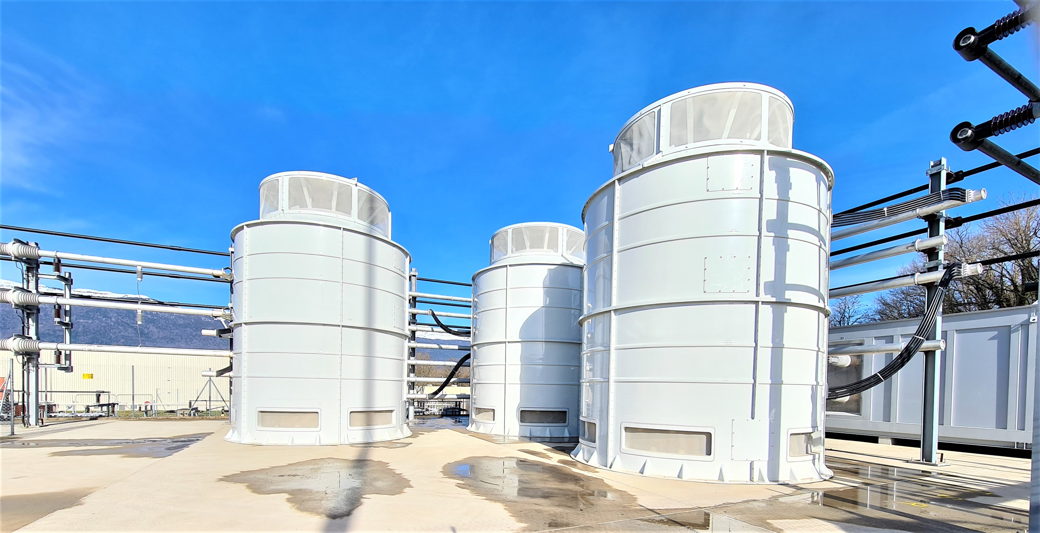
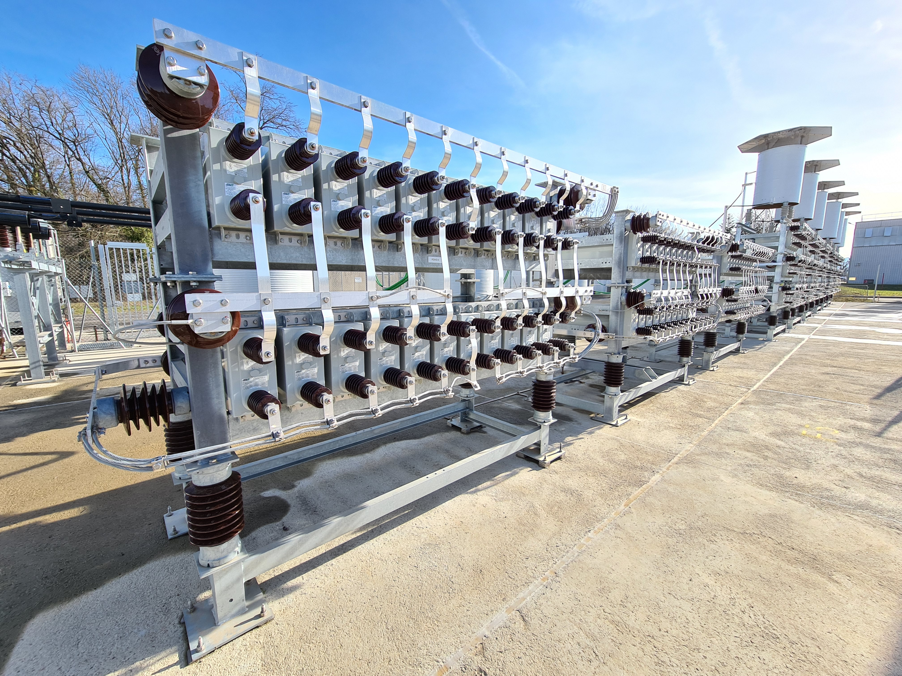
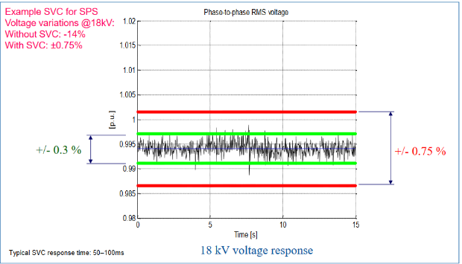
SVC: Static Var Compensator for the SPS
Harmonic Filters: 130 Mvar
Thyristor Controlled Reactor: 150 Mvar
Phase control PP thyristor
  Harmonic filtering
  Network voltage stabilization
F. Boattini | Overview of the Power Converters at CERN

Slide 17
Power converters around the accelerator complex
Superconducting magnets in the LHC
F. Boattini | Overview of the Power Converters at CERN

Slide 18
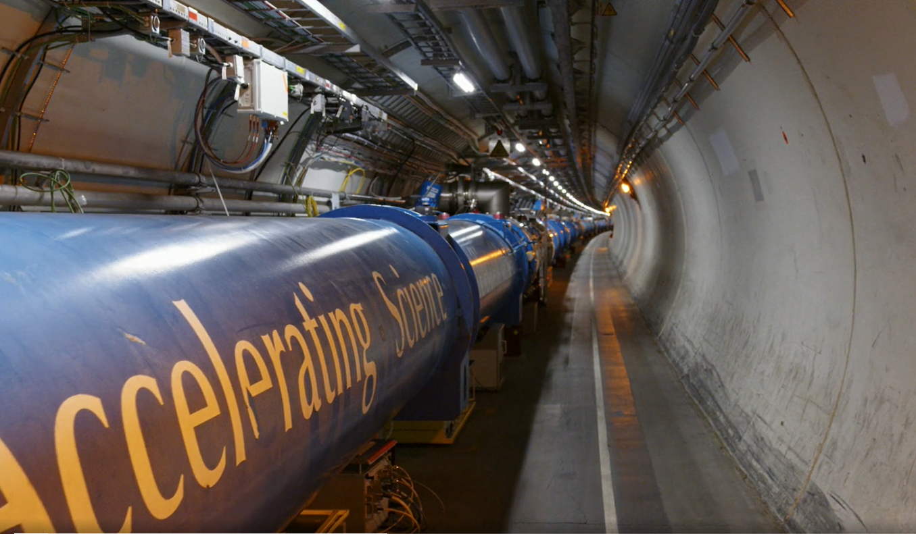
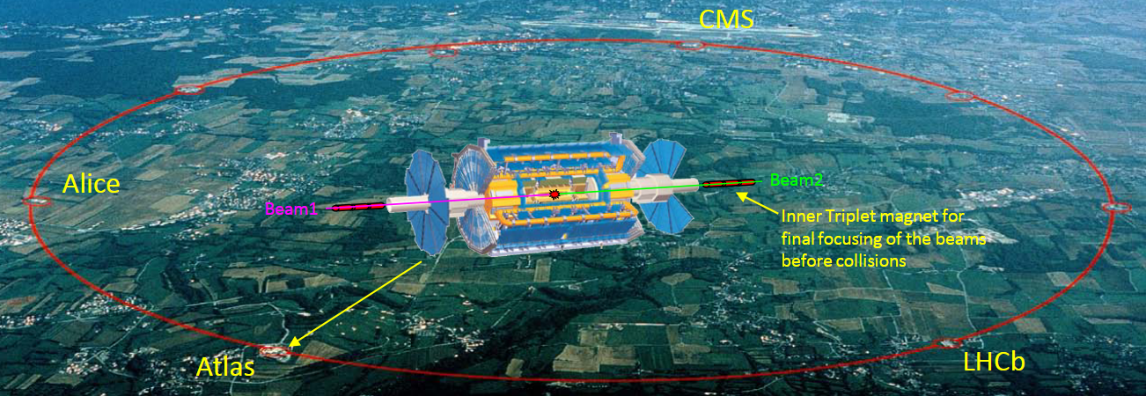
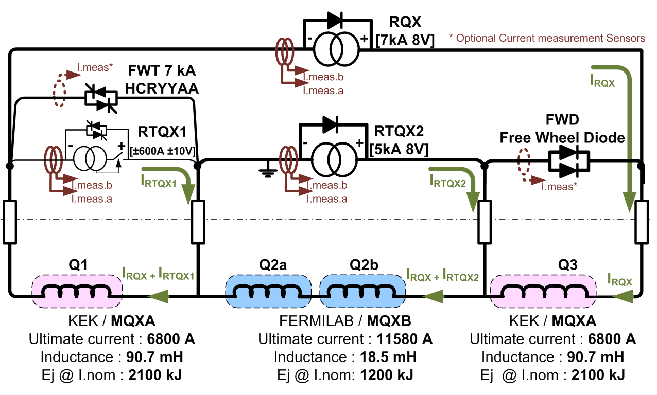
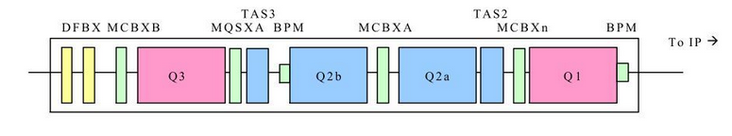
Power converters for superconducting magnets in the LHC
LHC beams bending / focusing magnets supply
High currents up to 13kA and low voltages up to 180V
  Example: Inner triplet
  Provides proton beams final focusing before Interaction Points (IP)
  Powering with independent regulation:
  2kA 8V basic block
  Three quadrupole magnets focus the beams down to 16um before collision
F. Boattini | Overview of the Power Converters at CERN

Slide 19
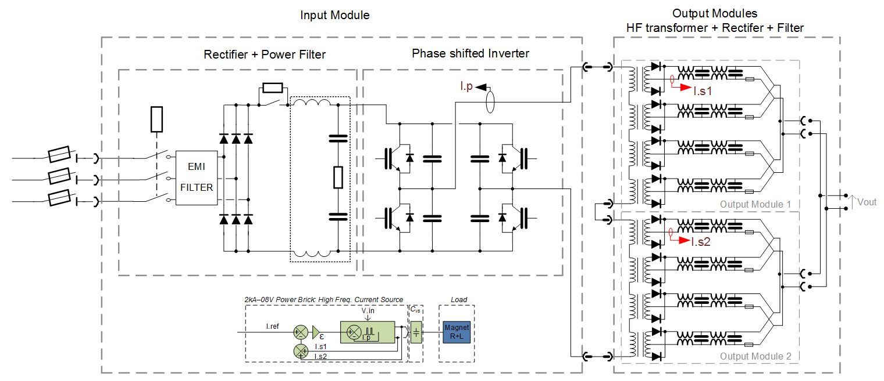
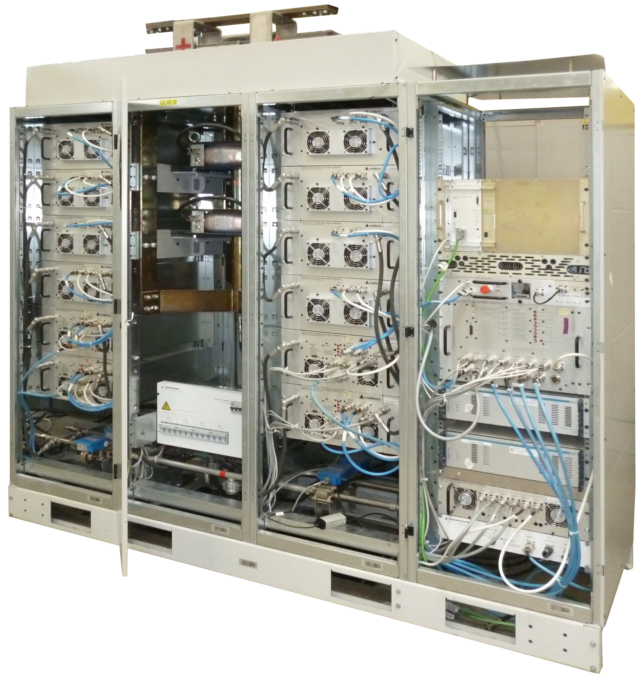
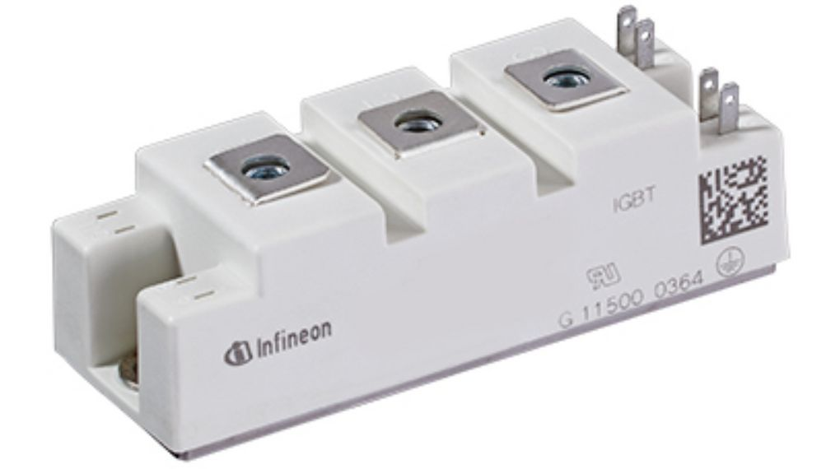
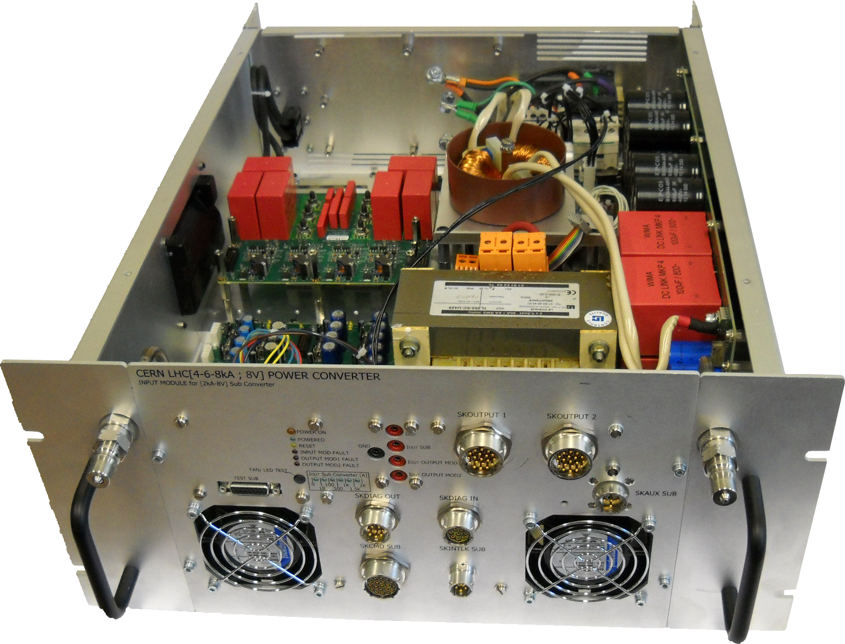
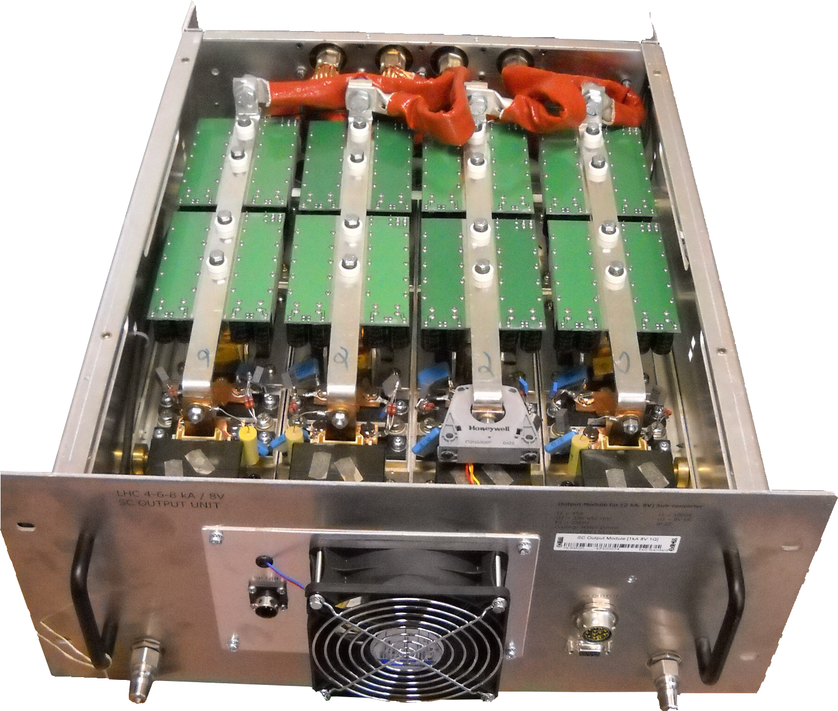
Power converters for superconducting magnets in the LHC
  One quadrant soft switching power converter
  Basic power block: 2kA, 8V
  1.2kV, 150A IGBT module
  Input Module
  Output Module
F. Boattini | Overview of the Power Converters at CERN

Slide 20
The biggest challenge?
All 5300 Power Converters, the control, the cooling, the vacuum …. Humans…
They all must work together, reliably and at the same time!
At CERN we do it!
Thanks for your time
F. Boattini | Overview of the Power Converters at CERN

Slide 22
Power converters around the accelerator complex
Transfer lines, Experimental areas etc..
Power converters with energy storage
F. Boattini | Overview of the Power Converters at CERN

Slide 23












SIRIUS: Energy recovery in transfer lines
Transfer to other accelerators or experiments
Energy Recovery with Elco capacitors
SIRIUS 4P+
Extra large dipoles & high energy beams
SIRIUS 4P
Large dipoles & series-connected magnets
Interface card
IGBT drivers
SIRIUS 2P
Small quadrupoles & dipoles
IGBT legs
DC-link capacitors
SIRIUS S
IGBT module
Small quadrupoles & correctors
150 power converters across all the families
F. Boattini | Overview of the Power Converters at CERN

