Slide 1
FEPPCON 2024
Welcome to CERN
Karsten Kahle
10 Sept. 2024

Slide 2
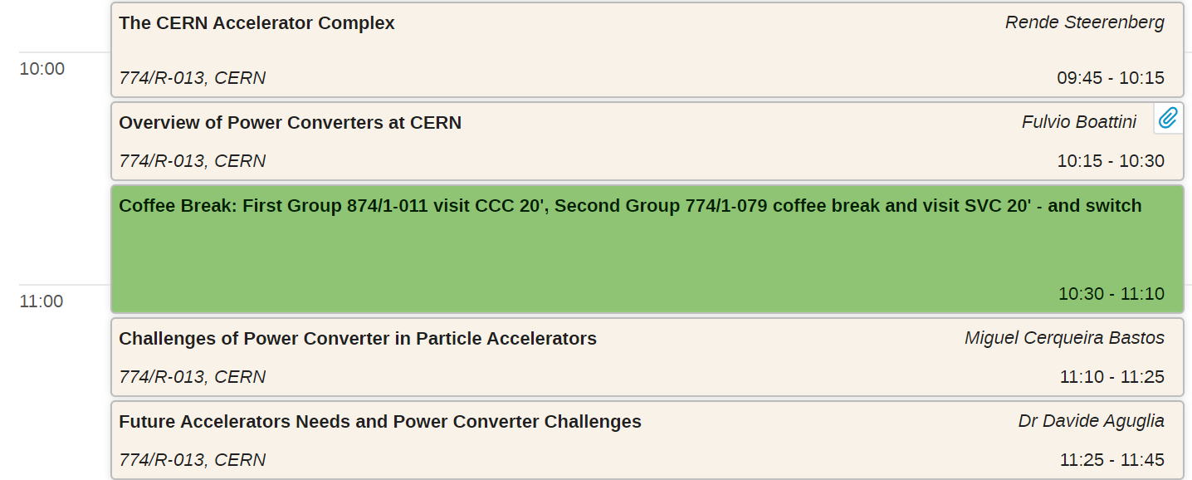

Technical Session
Coffee Break
  Orange group : SVC overview, followed by CCC overview
  Green group : CCC overview, followed by SVC overview

Slide 3
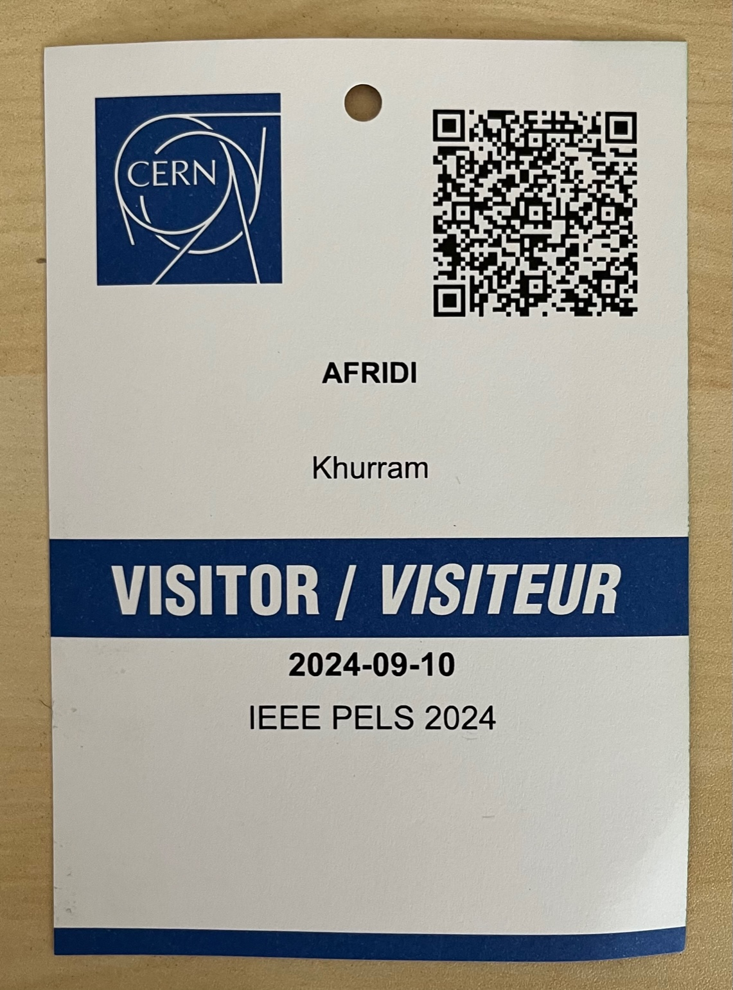
Visitor Badges
Group for morning coffee visits
Family Name
First Name
Group for afternoon visits

