Slide 1
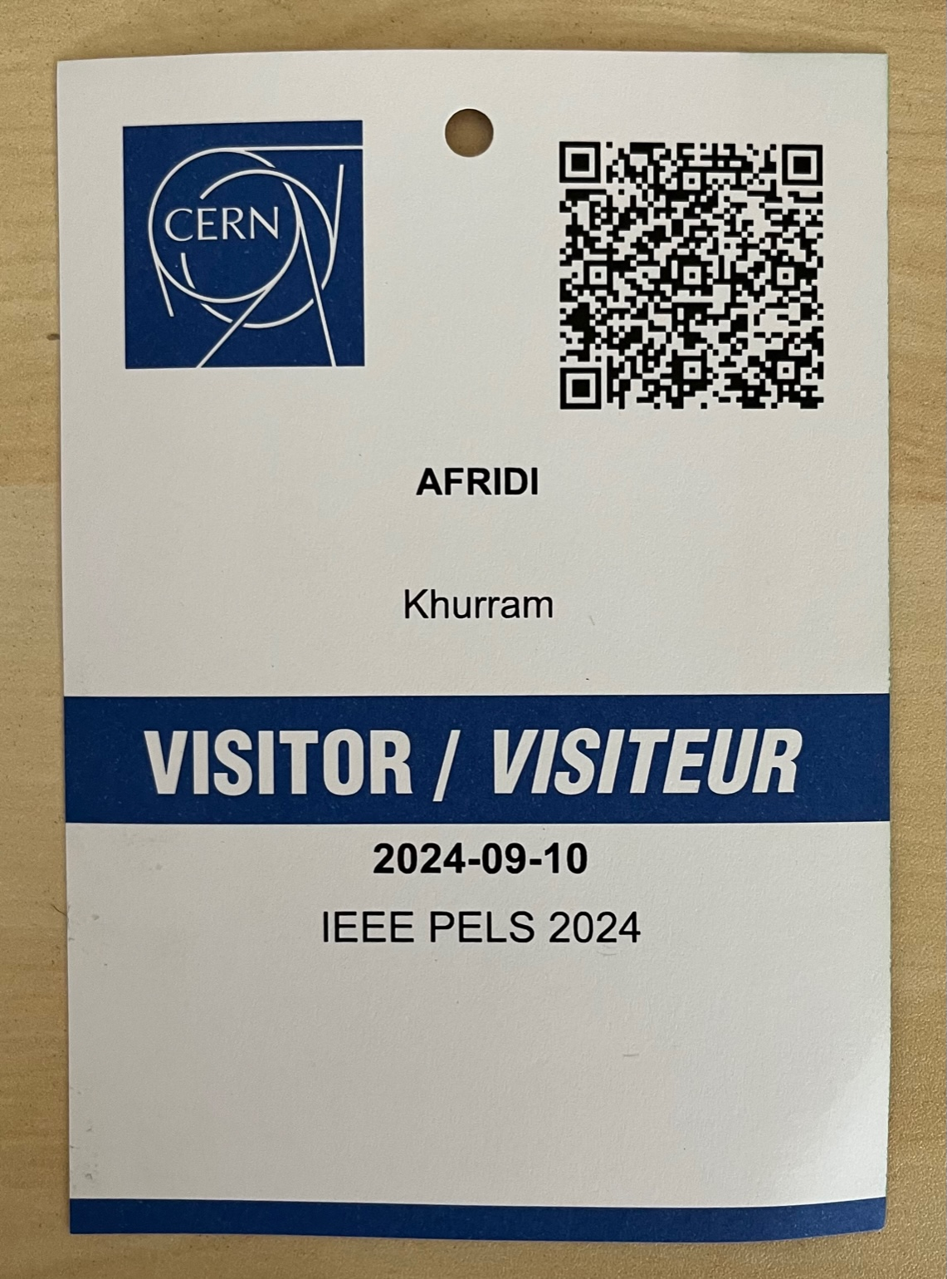
Visitor Badges
Group for morning coffee visits
Family Name
First Name
Group for afternoon visits

Slide 2

Safety Rules (For the technical visits in the afternoon)
Keep your Visitor Badge with you and wear it visibly during the entire day!
Accessibility: The technical visits are not suitable for persons with reduced mobility.
The technical visits take place in CERN machine buildings, the floors may be uneven. We also need to pass a couple of stairs.
Wear closed flat shoes.
Please watch your step.
At all times, please respect the instructions provided by your guides!
Enjoy the visits!

Slide 3


Safety Rules (For the technical visits in the afternoon)
Electrical risks: Please do not touch!
Most of our installations are in service, as the accelerators are currently in operation.
Many of our power converters have door contacts that trip the machines. Do not touch the cubicle doors or lean against them, as you may stop our accelerators.
Please keep 1 meter distance from electrical installations
Strong magnetic and electric fields:
Access is not allowed neither for persons carrying medical assistive devices (heart rhythm devices) nor for pregnant women.
Enjoy the visits!

