Slide 1
Picosec uLoop
Updates

Slide 2
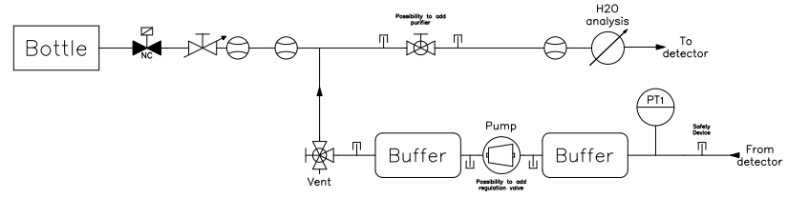
Components
What’s missing
Not delivered:
Already delivered:
Rotameter
Electro-valve coil
FBO gas fitters
2x Buffer volume 0.75l (cleaning)
Flowmeters
Widgetlords boards
Swagelok (except for soldering cross)
Raspberry
Power Supply
Vaisala
Pressure sensor
Bosch profiles
Bubbler
Electro-valve
Environmental sensor
Swagelok soldering cross
Pump

Slide 3
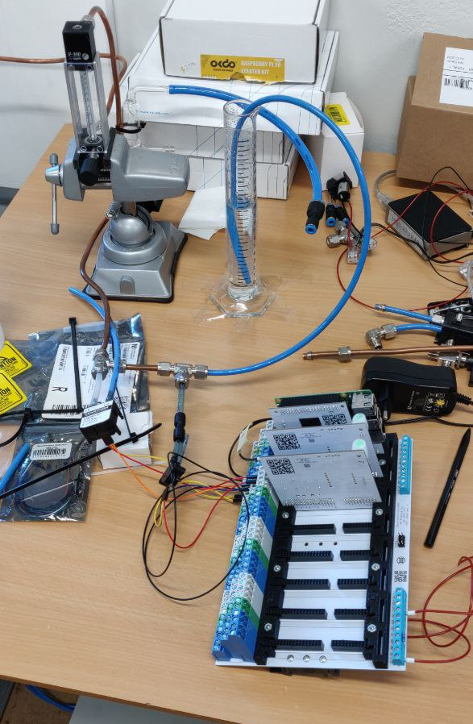
Pressure sensor test
Tested sensors:
 |  | range low (mbar) | range high (mbar)
sensirion | SDP200-L | -1 | 35
motorola | MPX5010 | 0 | 100
Test up to +/- 18 mbar

