Slide 1
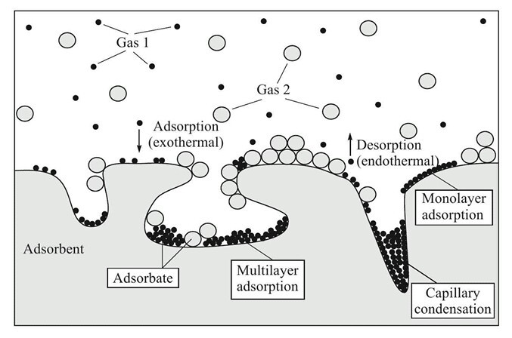

ADSORPTION Tests – LAB256
D. Galassi – 22/08/24

Slide 2
GOALS
STEPS
The data for the tests have been merged (vertical concatenation) to visualize the behavior of different columns and column combinations.
The main goal of the tests is to verify the capabilities of zeolites (z5 and z10/13x) to selectively separate some of our mixtures.
The knowledge of the interactions of the gases used in CMS with the adsorbents (solid zeolites) can be useful in several applications.
R134a – Air separation (ATLAS ventilation)
SF6 – Air separation (post CMS – FGR)
R134a – SF6 separation (parallel to CMS - FGR)
Many more…
The procedure consists in building breakthrough curves for different mixtures. To do so one has to feed a mixture to the cartridge at a specific operating flow rate, F, and a working pressure, P (which dictates the solid-fluid equilibria).
To make an example, imagine we want to separate a binary mixture (A and B). We start feeding a mixture A+B (at a given volumetric concentration) to an adsorption cartridge and monitor the output concentration. If the adsorbent (filling the cartridge) selectively adsorb B, the outlet stream will contain:
- A only for a time [0, t1]
- A(t) + B(t) = 1 – A(t) for a time [t1, t2]
- A + B (feed concentration) for a time [t2, inf]rops
3. The best performers are C3 and C4

Slide 3
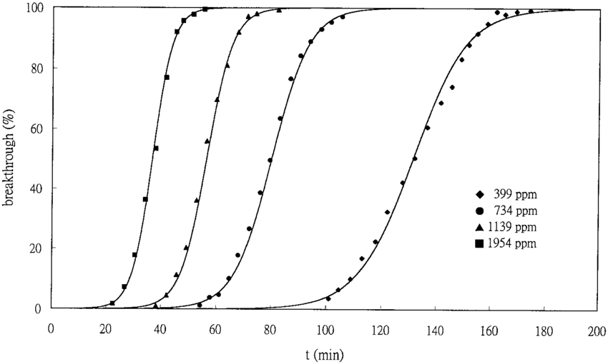
BREAKTHROUGH CURVES
As molecules (adsorbates) are trapped in the solid material (adsorbent) the sites available decrease and the solid is slowly saturated. At saturation, the adsorbent is not able anymore to work as a “sieve”.
Given a mixture-solid pair, how much does it take to saturate the solid (at given F, P and T)?
BK curves help us to answer this question!
How tests are performed?
Adsorption test procedure file
Simply, these curves show how much gas a given mass of solid can trap before reaching saturation.
Specifically, what I decided to highlight are:
Breakthrough time (t_bk): time needed to see in the outlet stream the first traces of the adsorbed gas
Time to 95 (t_95): time needed to see in the outlet stream a composition of the adsorbed gas equal to 95% of the fed one.
Time to 99 (t_99): time needed to see in the outlet stream a composition of the adsorbed gas equal to 99% of the fed one. This is basically the saturation time!
t_bk
t_95
t_99

Slide 4
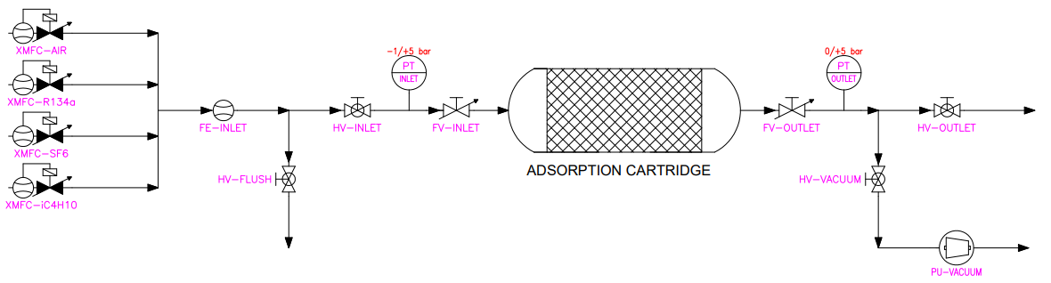
SET-UP & PROCEDURE
The steps to perform the tests are:
Regenerate the cartridge (thermal regeneration)
Put under vacuum to make it ready for the adsorption (opening FV-OUTLET, HV-VACUUM) and activating the vacuum pump (PU-VACUUM)
Fix an inlet flow-rate and composition (for the first tests we set 7 l/h, 85% AIR – 15% R134a)
Flush the inlet line using the dedicated line
Let the cartridge reach the desired pressure by feeding gas (300 mbar for these tests) by keeping open HV and FV INLET and FV-OUTLET closed
Once the set pressure is reached slowly open the outlet valves and let the outlet gas go to the GC for analysis
Stop the test when saturation is reached
To perform this test the following set-up is used (later I will show a future proposal).
Actual Set-Up

Slide 5
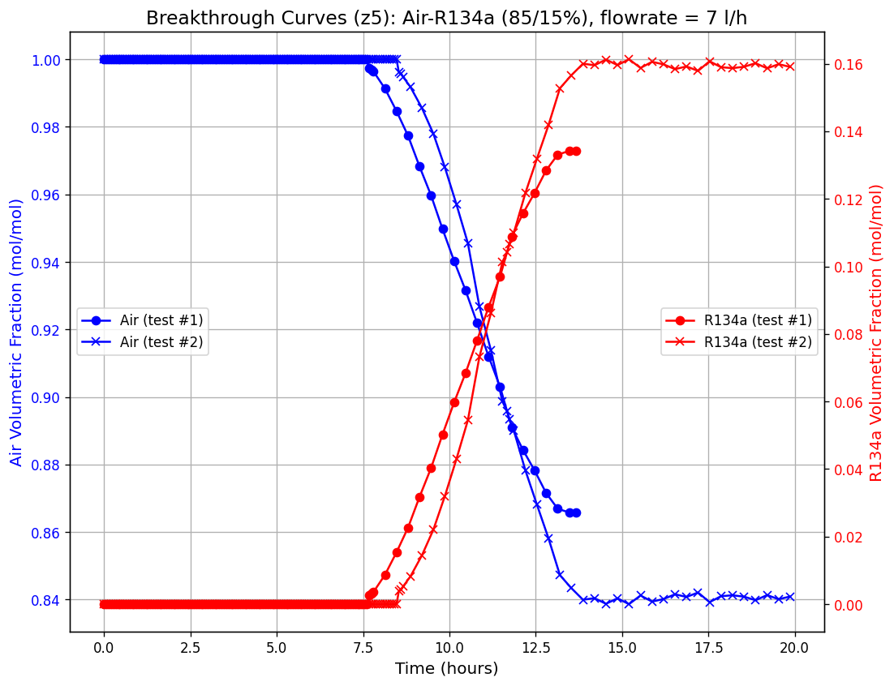
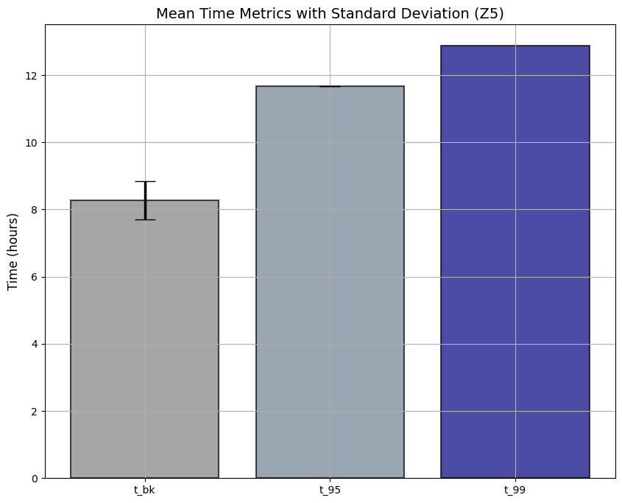
Z5 – BK CURVES
Z5 – KEY TIMES
- Up to now only two tests have been performed
- More tests must follow, anyway it is interesting to show up the first trends
- Z5 is capable of adsorbing R134a, but how selectively?
Here we report the mean characteristic times
Clearly, since we performed only two tests until now there is no statistical significance!

Slide 6
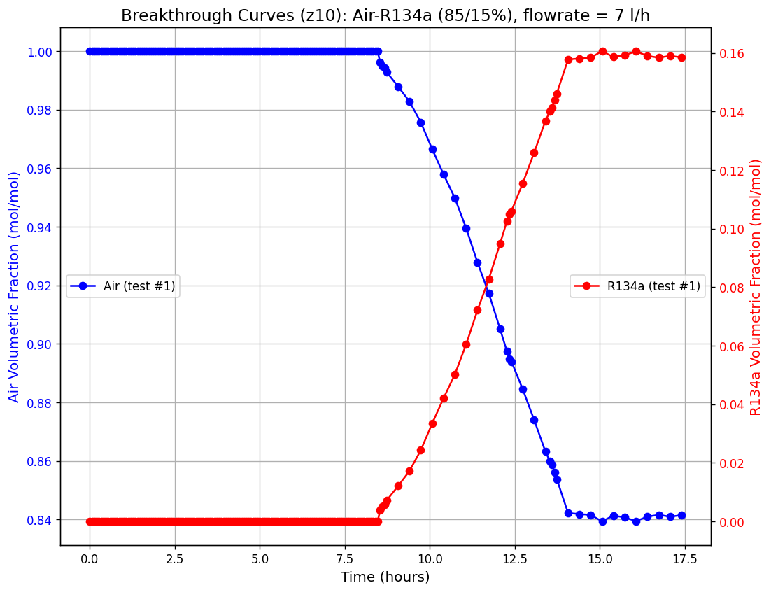

Z10 – BK CURVES
Z10 – KEY TIMES
- Using Z10, right now, only one result is available due to loss of data during a night update
- Here we report the characteristic times of the only test performed with Z10
- More tests will follow if considered interesting

Slide 7
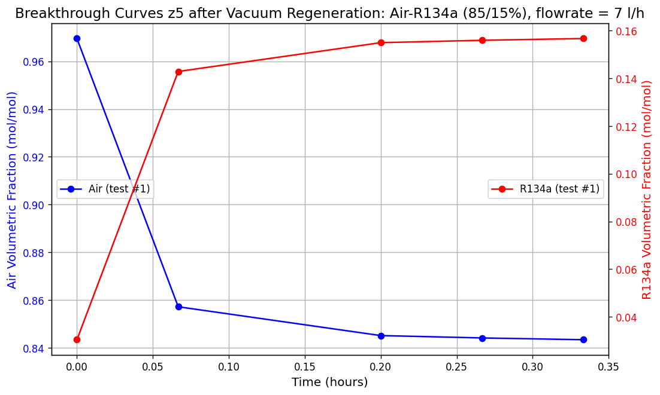
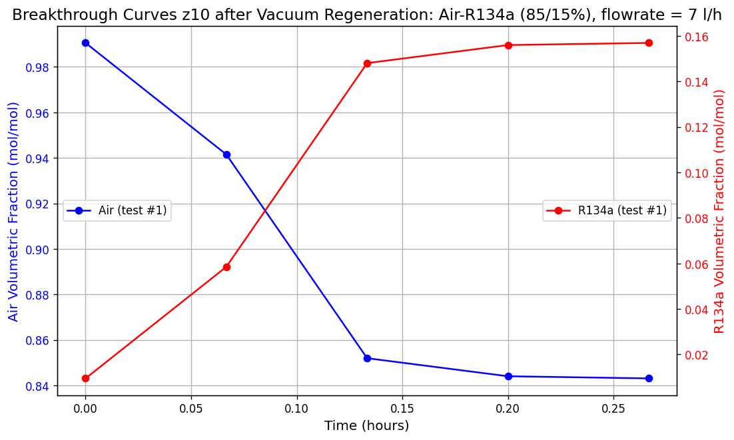
Z5 & Z10 – VACUUM REGENERATION

Slide 8
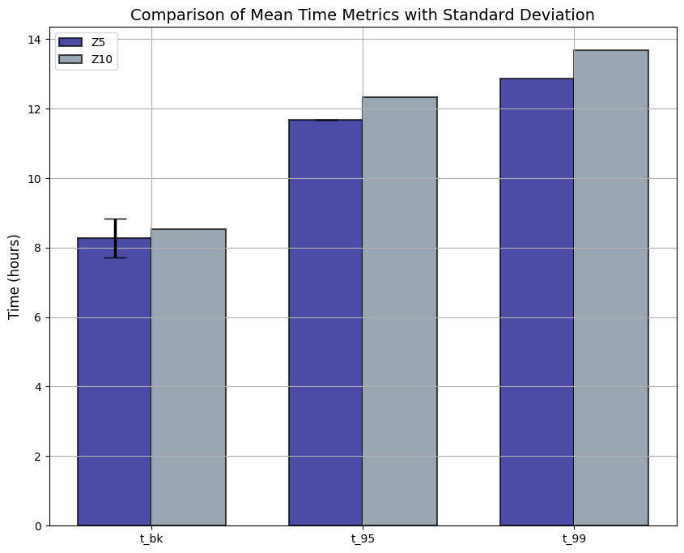
KEY TIMES COMPARISON
To conclude here it is reported a comparison of the characteristic times between Z5 and Z10.
Overall, Z10 seems to behave better then Z5 as time required to reach a specific condition is bigger in each of the three cases.
Again, the selectivity can’t be measured with this set up, so a final choice can’t be made!!!

Slide 9
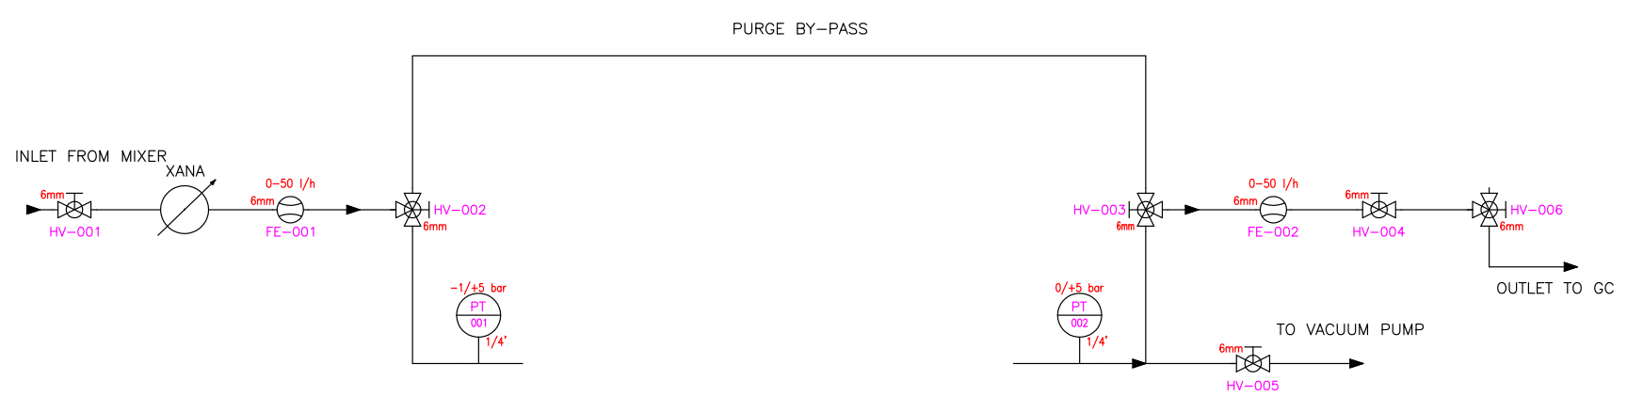
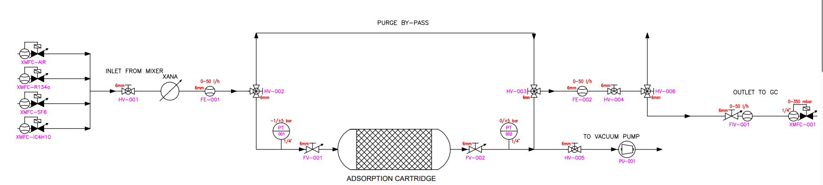
NEW SET-UP PROPOSAL: “ADSORPTION BOX
Box only (actual proposal)
How the box looks like inserted in LAB-256

Slide 10
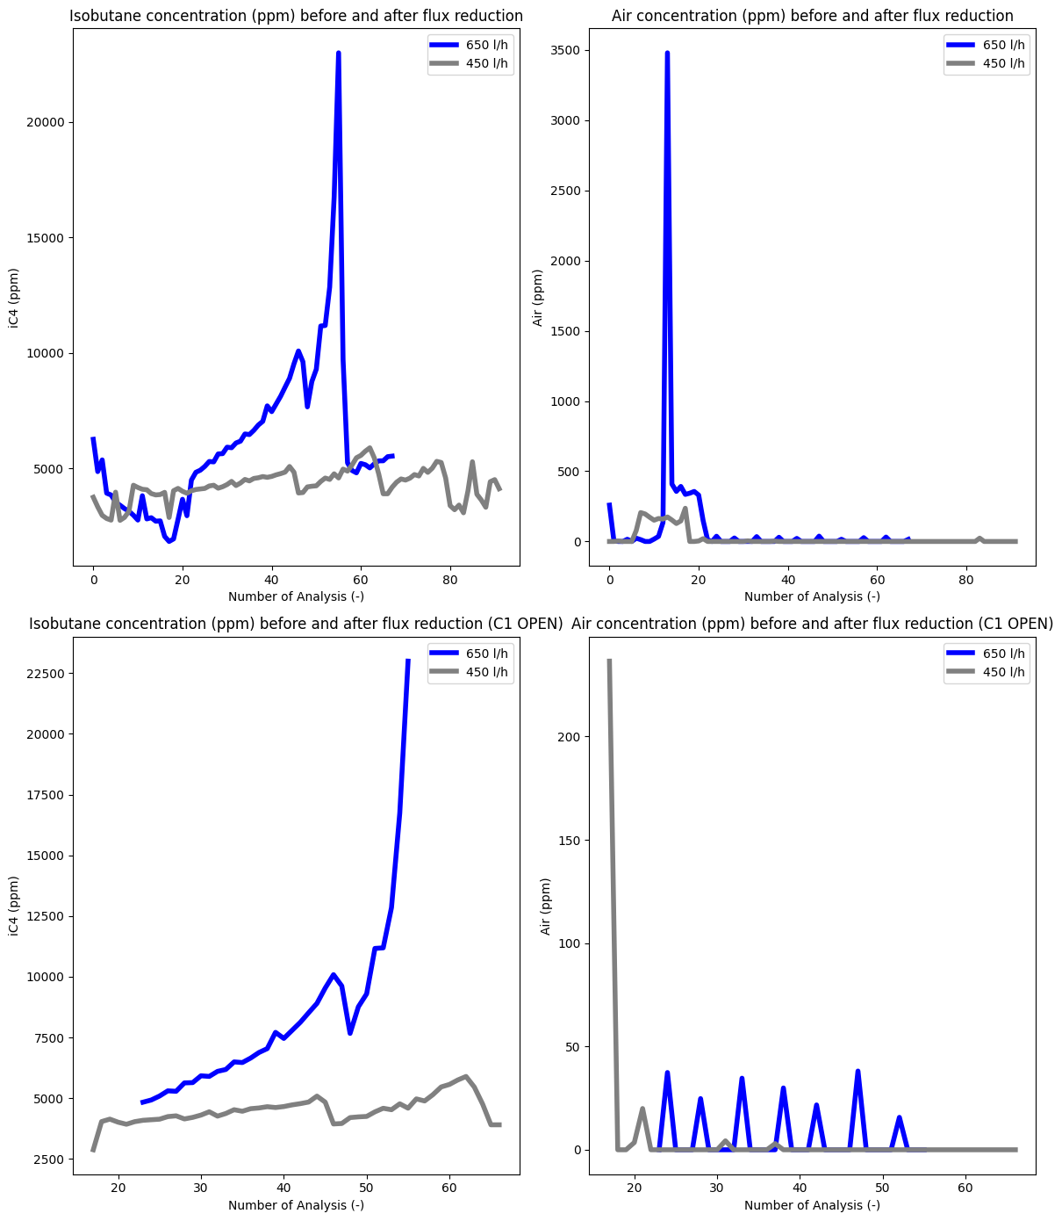
FLUX REDUCTION

