Slide 1

Magnetic measurements on the LMQXFA01 at 1.9 K
Lucio Fiscarelli, Guy Deferne, Mariano Pentella, Piotr Rogacki,
and all TM colleagues
12 September 2024

Slide 2
Outline
Measurement setups: Stretched Wire and Rotating Coil
Performed tests and results: Nominal current, Machine cycles, Stair-step cycles
Additional results: voltage spikes
Conclusions
Results of alignment tests are nor reported here since test are still ongoing.

Slide 3
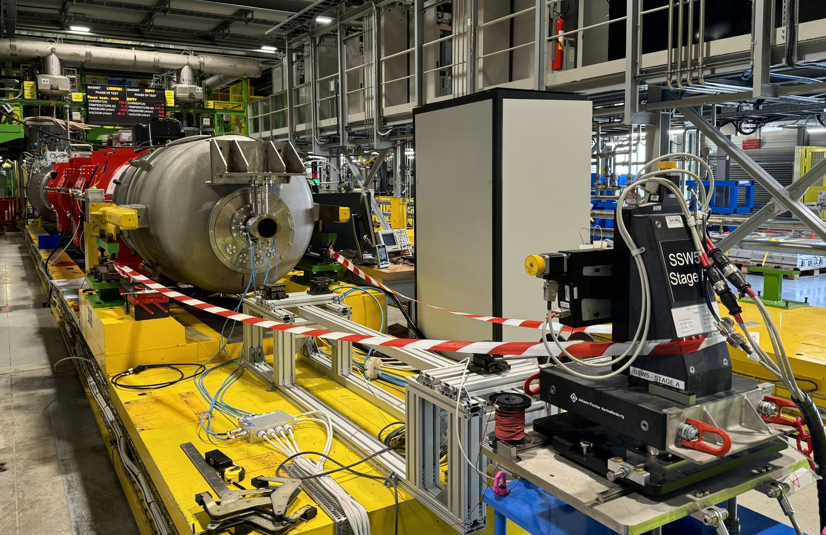
Stretched wire
Standard system used for Q2 and other magnets
PI X-Y tables
FDI integrators
FFMM control software
Copper beryllium wire ⌀ 0.125 mm
Wire length ~21 m
A careful sag correction is required

Slide 4
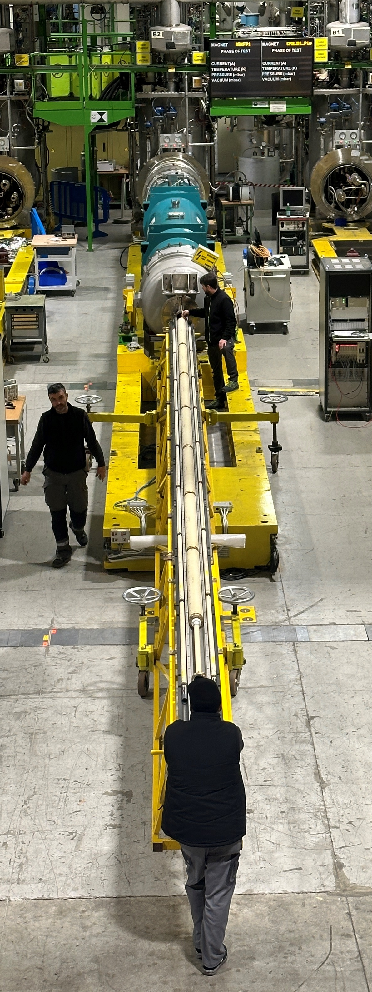
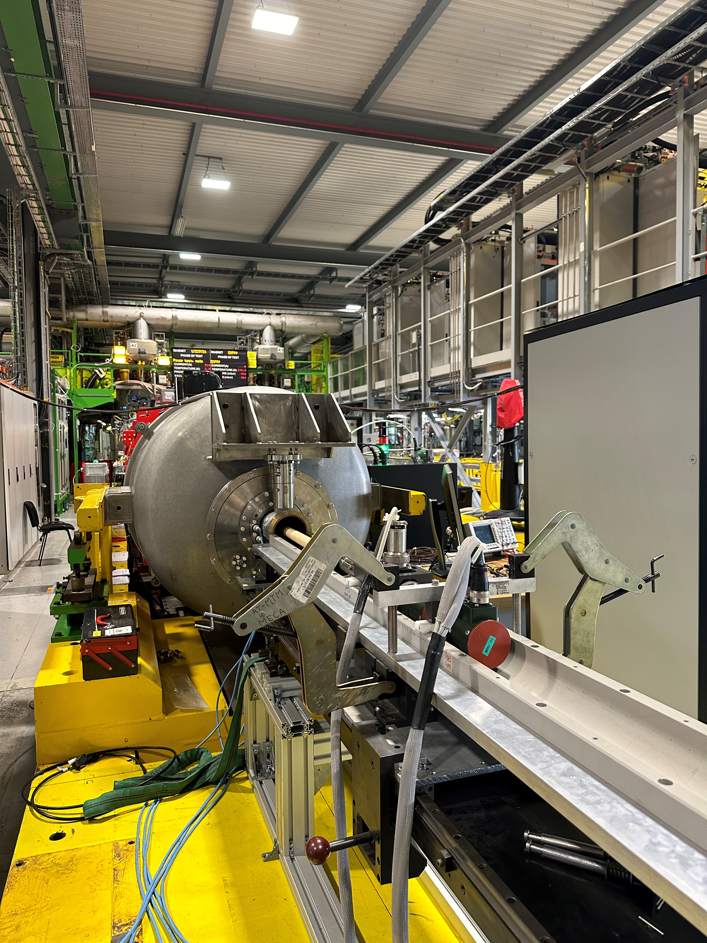
Rotating coils
Same system used on the Q2
6-segment rotating shaft
Each segment is 1.3 m + 0.1 m gap
12 FDI integrators
FFMM software for control and online processing
Continuous measurement at 1 turn/s
Not optimal for Q3

Slide 5
Rotating coils
Anticryostat flange
Longitudinal center
Shaft too short to cover at the same time both magnets
Two measurement positions
Cycles repeated twice

Slide 6
Performed tests
Performed tests
Integrated gradient with Stretched wire
  Nominal current
Field quality with Rotating Coils
  Machine cycles and Stair-step cycles

Slide 7
Main field and magnetic length
Current | A | 16230
 |  | A03 | A04 | Integral
CERN
Integrated gradient | T | 559.53 | 559.62 | 1119.15 | SSW | 1119.03
Central gradient TF | T/m/kA | 8.1790 | 8.1828
Lm | m | 4.215 | 4.214
Nodal distance | m | 4.770
FNAL
Integrated gradient | T | 559.70 | 559.95 | 1119.60
Difference | units | 8 | 1 | 4
Nodal distance | m | 4.772
Difference | mm | -2

Slide 8
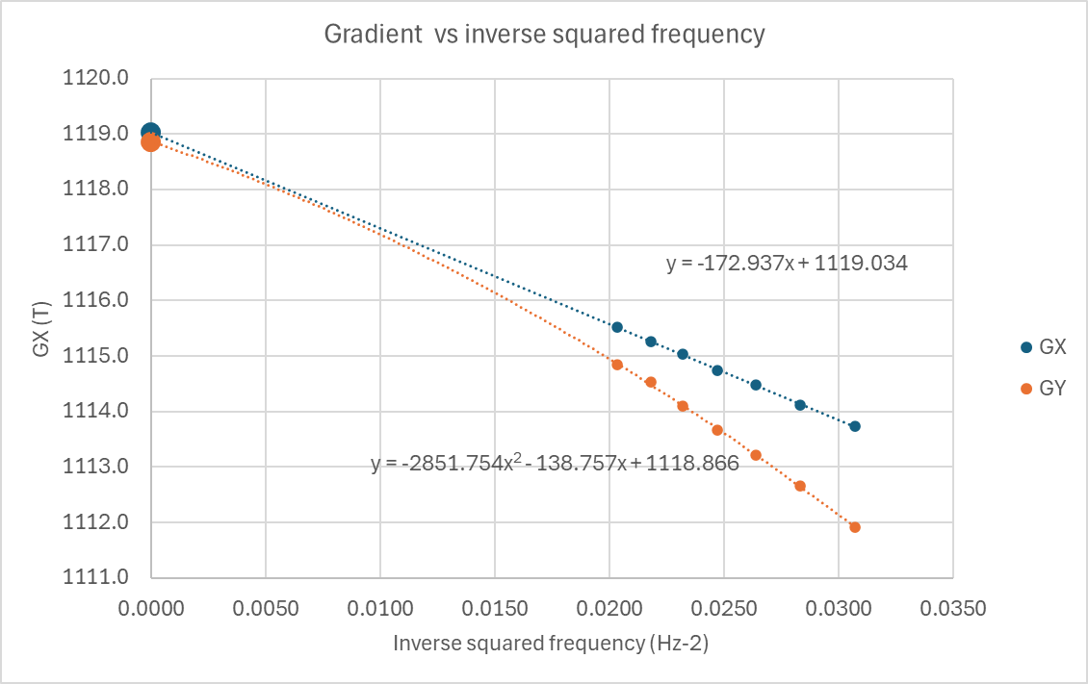
Sag correction on stretched wire
The gradient measured with a vertical displacement (GY) is affected both by gravity and wire diamagnetism: correction is more difficult
The gradient measured with a horizontal displacement (GX) is affected mainly by the wire diamagnetism: more effective extrapolation

Slide 9
Field quality at nominal 16230 A
Current 16230 A
 | A04 | A03 | Integral* |  |  | A04 | A03 | Integral*
b3 | 1.39 | 0.46 | 0.93 |  | a3 | -1.36 | 1.35 | -1.36
b4 | -0.09 | -1.18 | -0.64 |  | a4 | 2.03 | 1.76 | 0.13
b5 | -0.40 | 1.62 | 0.61 |  | a5 | -0.93 | 1.90 | -1.42
b6 | -0.47 | -2.87 | -1.67 |  | a6 | -1.19 | -0.28 | -0.45
b7 | -0.15 | 0.20 | 0.03 |  | a7 | 0.27 | -0.12 | 0.19
b8 | 0.12 | 0.09 | 0.10 |  | a8 | -1.49 | -0.57 | -0.46
b9 | 0.06 | 0.13 | 0.10 |  | a9 | -0.08 | 0.05 | -0.07
b10 | 0.27 | 0.33 | 0.30 |  | a10 | -0.15 | -0.03 | -0.06
b11 | 0.09 | 0.14 | 0.11 |  | a11 | -0.01 | 0.05 | -0.03
b12 | -0.02 | -0.01 | -0.01 |  | a12 | 0.07 | 0.03 | 0.02
b13 | 0.17 | 0.14 | 0.15 |  | a13 | -0.11 | 0.19 | -0.15
b14 | -0.95 | -0.97 | -0.96 |  | a14 | 0.15 | 0.02 | 0.07
b15 | 0.00 | 0.00 | 0.00 |  | a15 | 0.00 | 0.01 | -0.01
Harmonics are given in units at the reference radius of 50 mm
* reference frame of A04

Slide 10
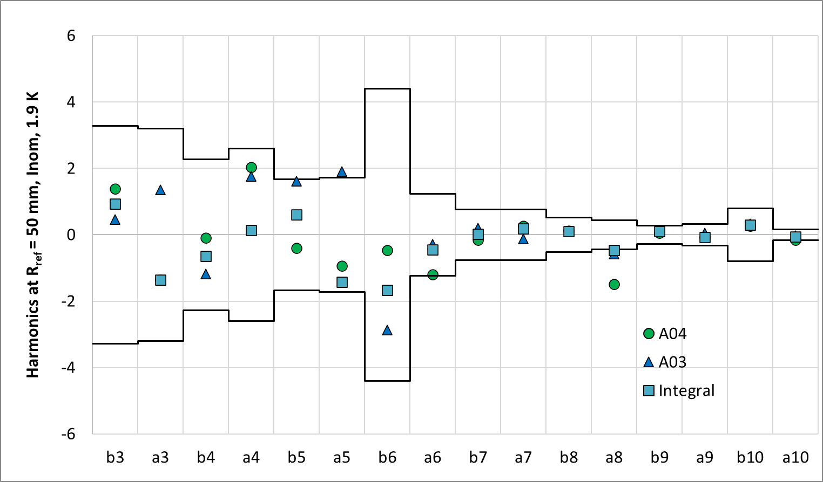
Field quality at nominal
Lines show the expected range at ±(3+1) σ

Slide 11
Field quality at injection current (960 A)
Current 960 A (precycle at 16230 A and reset at 200 A)
 | A04 | A03 |  |  |  | A04 | A03
b3 | -1.08 | 1.32 |  |  | a3 | -0.18 | -2.38
b4 | -0.58 | -1.08 |  |  | a4 | -1.85 | 0.26
b5 | 1.11 | 1.26 |  |  | a5 | -0.07 | 1.16
b6 | -1.00 | -3.38 |  |  | a6 | -1.17 | -0.22
b7 | 0.19 | -0.22 |  |  | a7 | 0.24 | -0.52
b8 | 0.20 | 0.14 |  |  | a8 | -1.54 | -0.99
b9 | -0.41 | -0.12 |  |  | a9 | 0.18 | -0.51
b10 | 2.60 | 2.90 |  |  | a10 | -0.22 | 0.01
b11 | 0.00 | 0.09 |  |  | a11 | -0.01 | 0.04
b12 | 0.00 | 0.00 |  |  | a12 | 0.06 | 0.03
b13 | 0.15 | 0.08 |  |  | a13 | -0.07 | 0.08
b14 | -0.56 | -0.57 |  |  | a14 | 0.05 | 0.01
b15 | 0.01 | 0.00 |  |  | a15 | 0.00 | 0.02
Harmonics are given in units at the reference radius of 50 mm

Slide 12
TF vs current - ramp-up of machine cycle

Slide 13
Harmonics vs current - ramp-up of machine cycle

Slide 14
Harmonics vs current - ramp-up of machine cycle

Slide 15
Decays after ramping – ramp up of stair-step cycle - integral

Slide 16
Decays after ramping - individual segments on magnet A04
The decays look uniform along the magnet length.

Slide 17
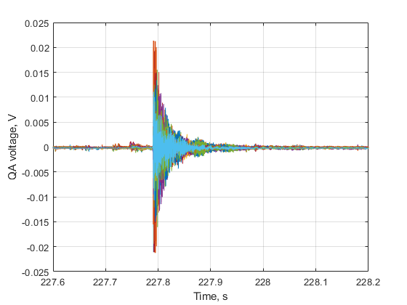
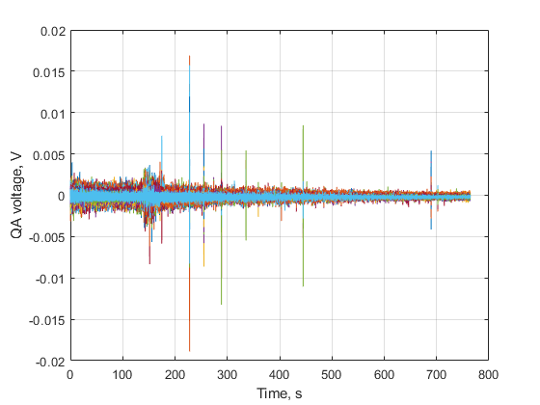
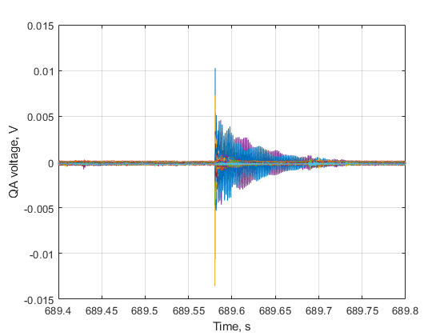
Quench antenna signals and voltage spikes
First ramp after second cooldown

Slide 18
Conclusions
  Measurements of integral gradient and field quality performed during the first campaign at CERN
  Main results:
    Integral gradient and nodal distance in agreement with results from AUP
    Field quality within the expected range
    On plateaus after ramping, some harmonics show a decay up to 2/3 units. Similar effect already seen on MQXFB magnets.
    Quench antenna signals don’t show events like the voltage spike seen on other MQXFA magnets. The events at intermediate and high current look of mechanical nature.
  Alignment measurements were not completed during first campaign. They are ongoing now.

