Slide 1
Results from the 1st Q3 AUP Cryo-Assembly at CERN
(LMQXFA01, containing magnets MQXFA04 and MQXFA03)
Gerard Willering
Franco Julio Mangiarotti, Ezio Todesco, Susana Izquierdo Bermudez
Thanks to G. Ninet, R. Bouvier, G. Pichon, S. Juberg, P. Rogacki, S. Russenschuck, A. Milanese et al
12 September 2024
https://indico.cern.ch/event/1447894/

Slide 2
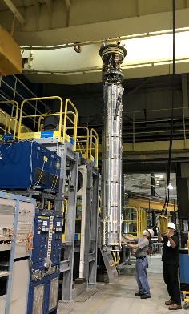
Introduction
First cryo-assembly from AUP (MTF link: HCQQXF_SC002-FL000001)
MQXFA04 vertical test
Contains MQXFA03 and MQXFA04 magnets, the first AUP pre-series magnets
  Coils manufactured in 2018-2019 (FNAL/BNL)
  Individual magnets tested vertically in 2019-2020 (LBNL)
  Cryo-assembly tested horizontally in Spring-Summer 2023 (FNAL)
CA02 horizontal test

Slide 3
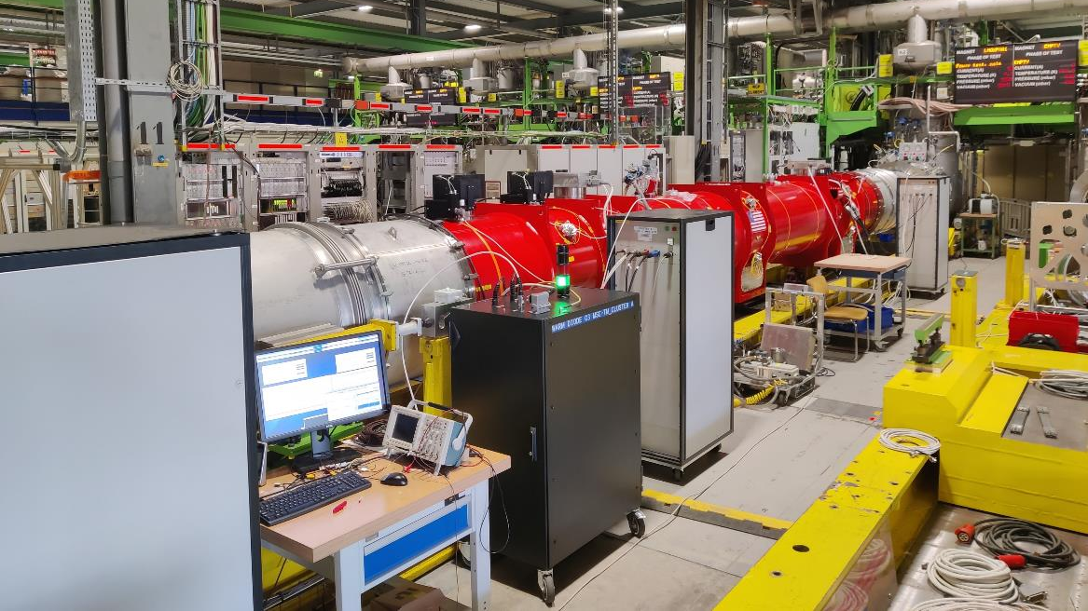
Test at CERN in SM18

Slide 4
Q3 - Qualification tests at CERN
LMQXFA01 passed the acceptance tests foreseen in the test plan EDMS 2959525. This included
Powering to nominal current at 1.9 K at nominal ramp rate of 20 A/s and at 30 A/s.
Nominal current reached at 4.5 K.
Nominal current flattop powering of 5 hours.
No (re-)training quenches
Magnetic measurements.
Insulation tests and other electrical quality assurance tests.
However, during the stretch wire measurements, the MQXFA04 magnet had two flattop current quenches at nominal current and nominal cryogenic conditions. This required further investigation.
The first cooldown ended in July 2024, while a second cool down was launched august 2024 after test station maintenance was completed.

Slide 5
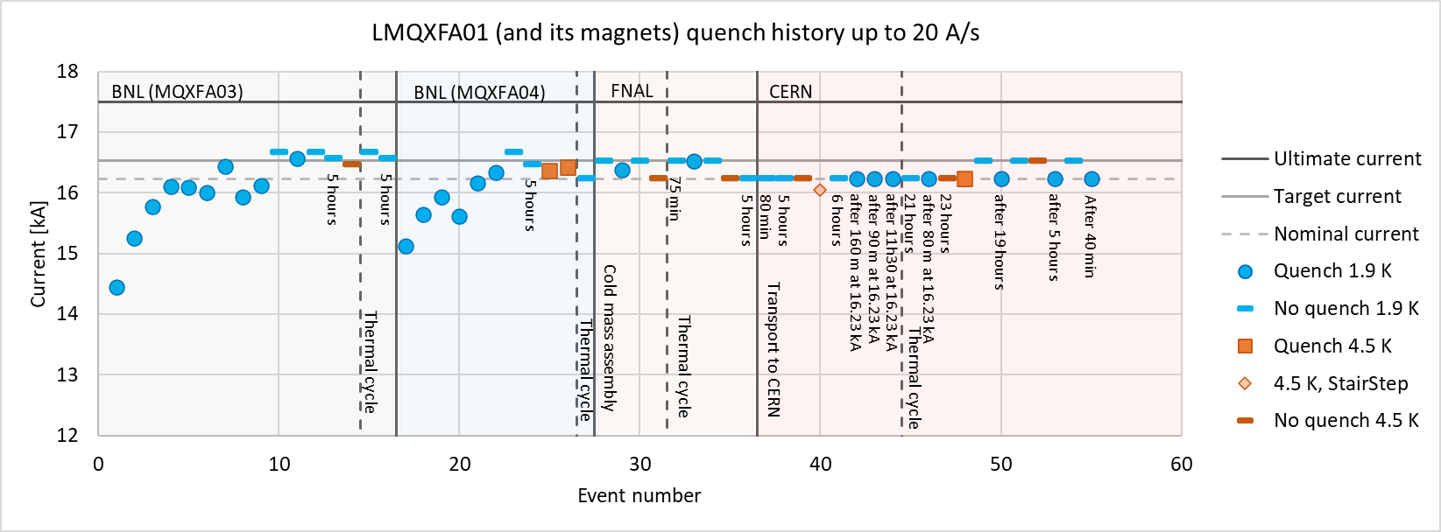
Cold powering tests
Focus of this presentation: Flattop quenches at nominal current at nominal temperature
DRAFT

Slide 6
Cold powering tests
Very good results during tests at CERN concerning powering:
Perfect memory, no (re-)training quenches up to 16.23 kA in CD1 and up to 16.53 kA in CD2.
At 4.5 K reached 16.53 kA with ramp rates up to 75 A/s.
At 1.9 K reached 16.53 kA with ramp rates up to 100 A/s, in total 9 ramps without quench.
Up to 21 hours flattop tests at 16.23 kA at 1.9 K without quench.
Up to 23 hours flattop tests at 16.23 kA at 4.5 K without quench.

Slide 7

Cold powering test - quenches
A01
Number | Temperature (K) | RR (A/s) | Quench current (kA) | Moment | Quenched coil | Quench Antenna | Time to reach 100 mV (ms)
CD1-1 | 4.5 | 1 | 16.05 | During ramp | Q3a-P2 | - | 4.6
CD1-2 | 1.9 | 20 | 16.23 | After 160 min | Q3a-P3 | - | 1.5
CD1-3 | 1.9 | 20 | 16.23 | After 90 min | Q3a-P1 | - | 3.5
CD1-4 | 1.9 | 20 | 16.23 | After 11h30 | Q3a-P3 | 7 → 6 | 1.5
CD2-1 | 1.9 | 20 | 16.23 | After 80 min | Q3a-P3 | 7 → 6 | 1.6
CD2-2 | 4.5 | 20 | 16.23 | During ramp | Q3a-P3 | 6 | 4.0
CD2-3 | 1.9 | 20 | 16.23 | After 19 hours | Q3a-P3 | 7→ 6 | 1.6
CD2-4 | 1.9 | 20 | 16.23 | After 5 hours | Q3a-P3 | 7→ 6 | 1.5
CD2-5 | 1.9 | 20 | 16.23 | After 40 min | Q3a-P3 | 7→ 6 | 1.5
CD2-6 | 4.5 | 100 | 15.60 | Fast ramp | Q3b-P2 | 13 & 1 | 1.0
CD2-7 | 4.5 | 20 | 16.45 | During ramp – splice cycle | Q3a-P1 | 7→ 6 | 4.5
CD2-8 | 4.5 | 100 | 15.63 | Fast ramp | Q3b-P2 | 13 & 1 | 1.0
In total 12 quenches recorded.
Q3a-P2 one quench at 4.5 K early during the tests.
Q3a-P1 one quench at 1.9 K at flattop
Q3b-P2 two quenches at 100 A/s at 4.5 K, identical characteristics.
Q3a-P3 – 6 quenches at flattop at 1.9 K and 2 quenches at 4.5 K, all in the same location.
Note: in our labeling, Q3a = MQXFA04 and Q3b = MQXFA03

Slide 8
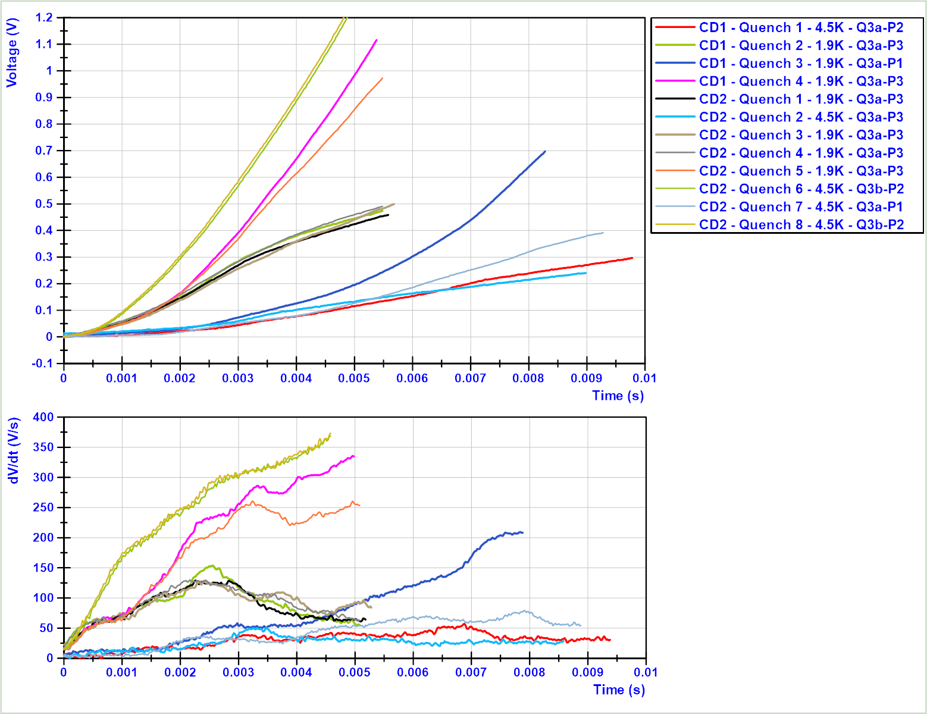
Characteristics quenches – voltage build up
4 quenches with normal voltage buildup for quenches, with a slope of 20-40 V/s.
All Q3a-P3 flattop quenches at 1.9 K have a very fast voltage buildup already in the first ms of > 60 V/s.
The Q3b-P2 quenches at 4.5 K at 100 A/s show an even faster voltage buildup.
In none of the quenches any precursor is visible, also not in the Quench Antenna data.
Q3b-P2
4.5 K
100 A/s
Q3a-P3, 1.9 K, flattop, 16.23 kA
Q3a-P1, 1.9 K, flattop, 16.23 kA
Q3a-P1, 4.5 K, 16.45 kA Ramp
Q3a-P2, 4.5 K, 16.05 kA Ramp
Q3a-P3, 4.5 K, 16.23 kA Ramp
The slope will depend on two parts:
Longitudinal propagation velocity & turn to turn propagation, see next slides.

Slide 9
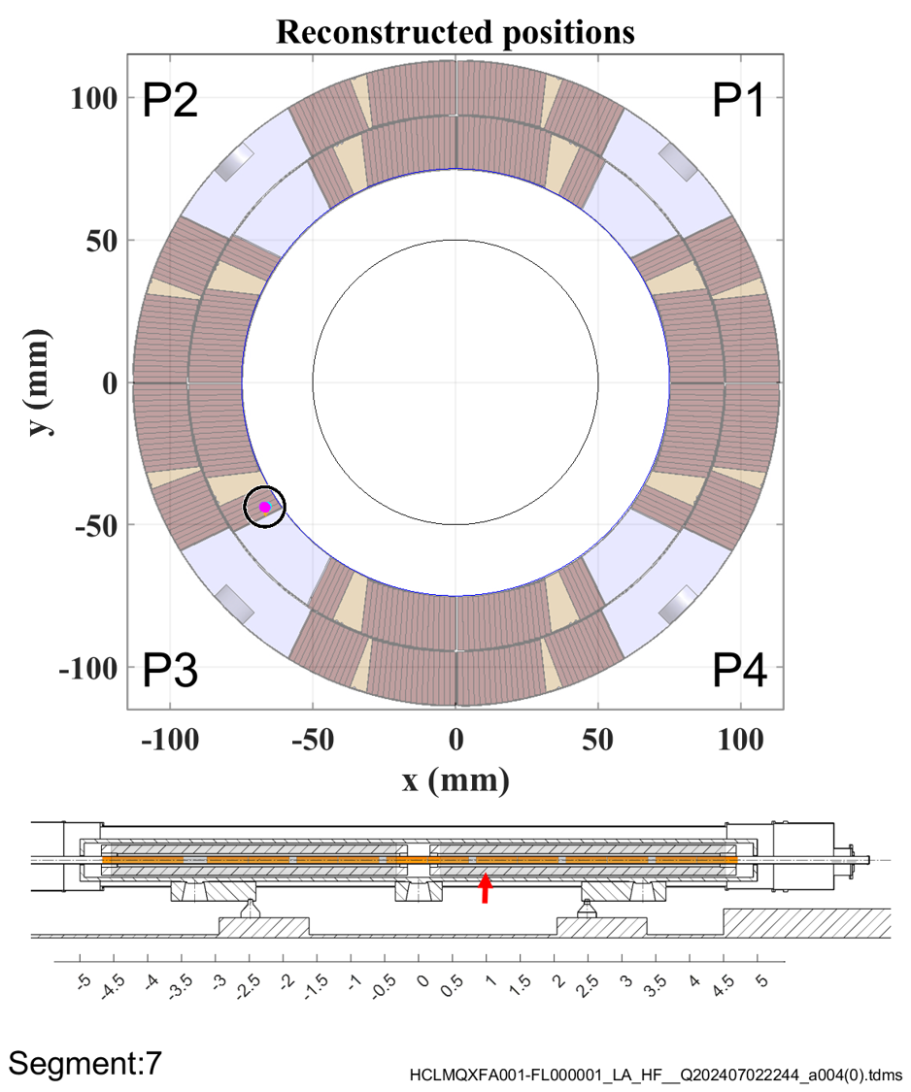
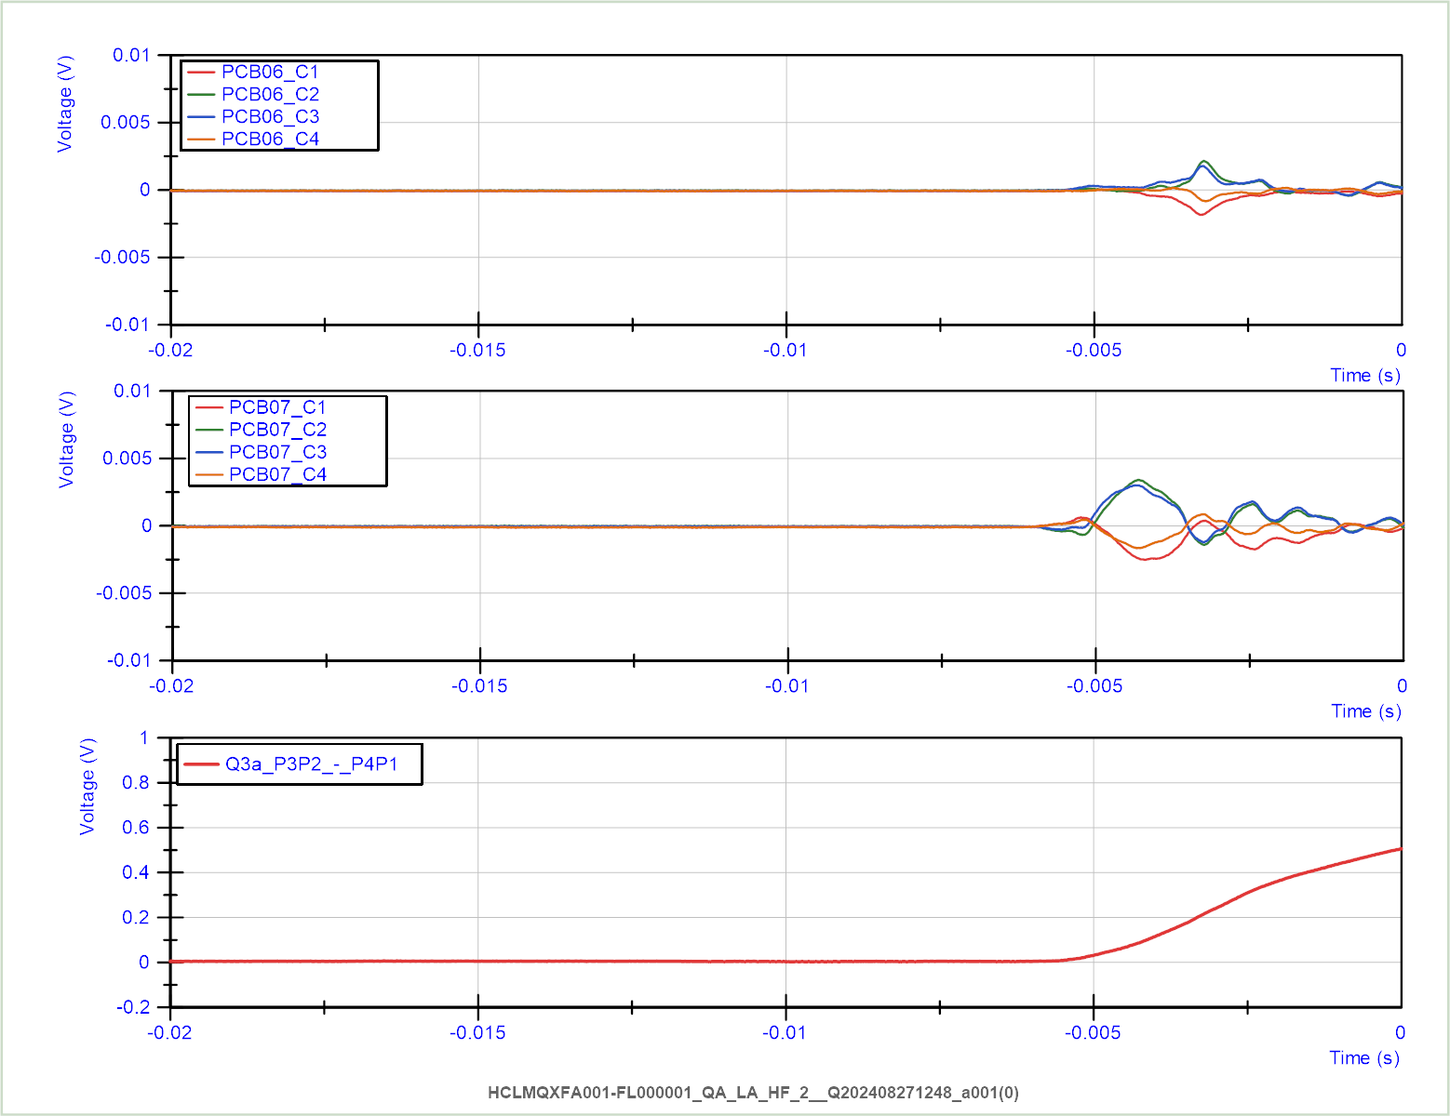
Characteristics quenches – Quench antenna
Example data CD1 – quench 4 – Q3a-P3 – 1.9 K, 11h at 16.23 kA
PCB 6
PCB 7
13
1
2
3
4
5
6
7
8
9
10
11
12
All quenches in Q3a-P3 were localized in the pole turn of the magnet.
Note that the during the first 3 quenches in CD 1 the QA were not installed.
The quenches at 100 A/s at 4.5 K were seen in segments 13 and 1, but radial and angular localization has no unique solution.

Slide 10
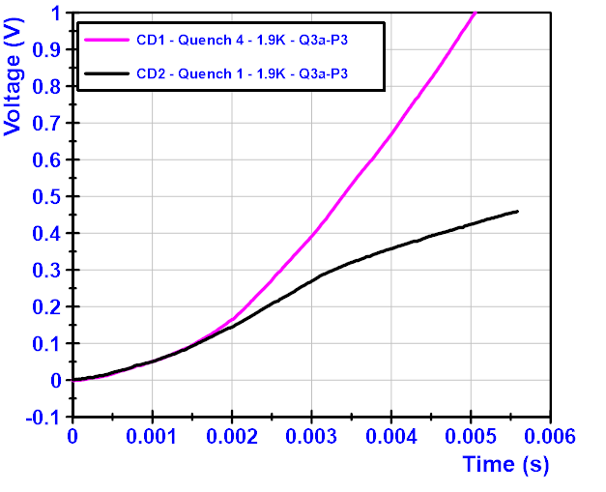
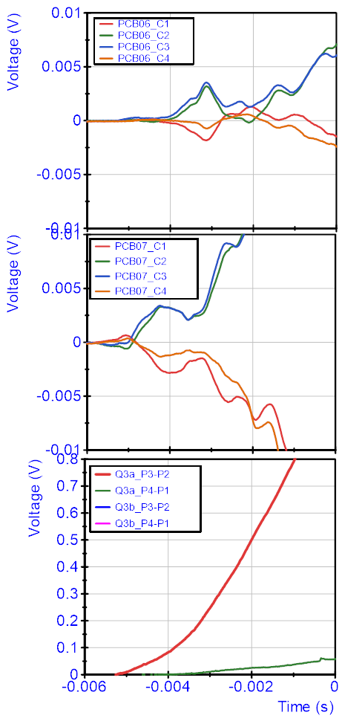
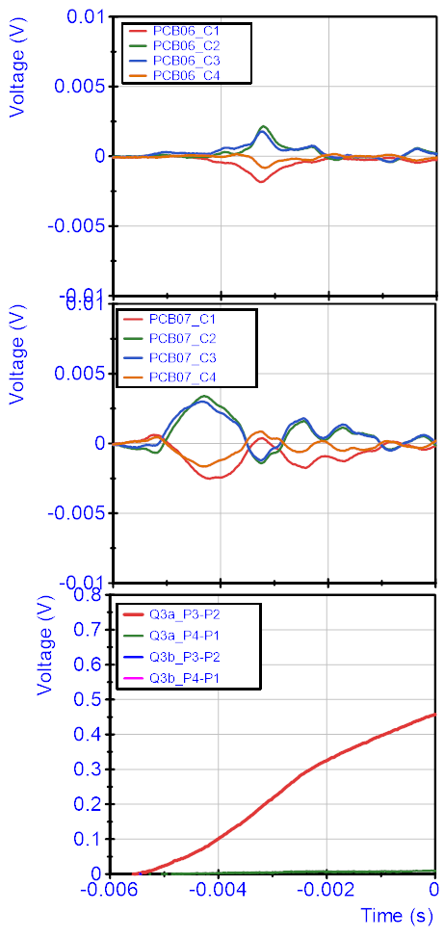
Characteristics quenches in Q3a-P3 – Quench antenna
CD1 – quench 4
CD2 – quench 1
Two voltage behaviors for the quenches in Q3a-P3, but with identical voltage buildup at the start.
The quench antenna also have an identical start, showing that the quench develops identically in the first 2 ms.

Slide 11
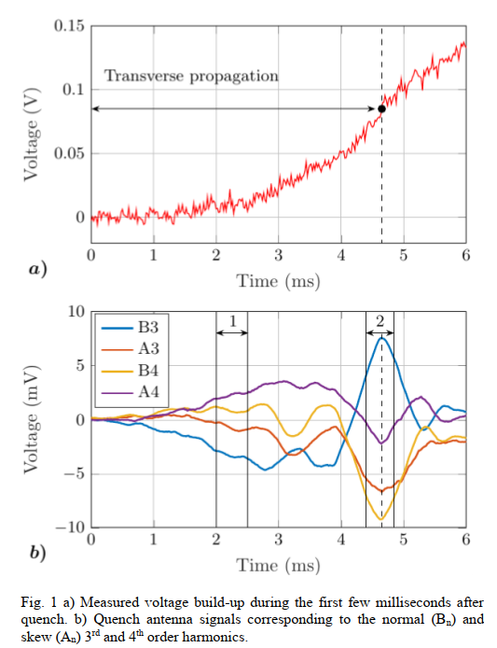
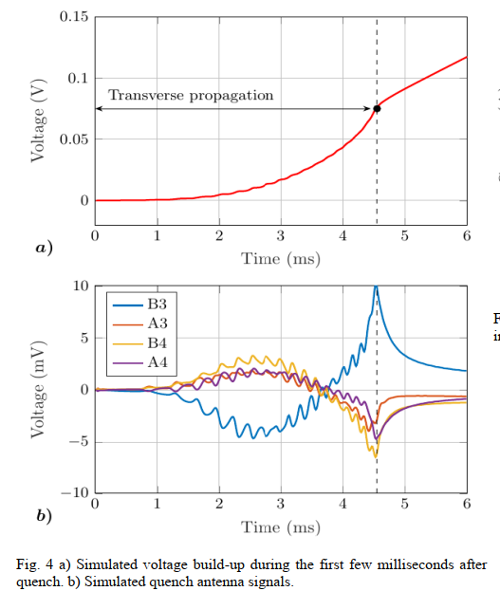
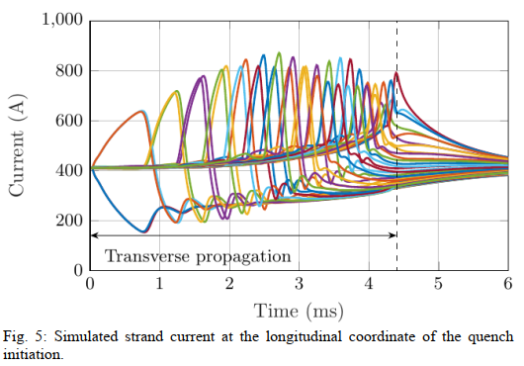
Recent work on Initial Quench Development
R. Keijzer et al., Measurement and Modelling of Initial Quench Development in Nb₃Sn Accelerator Magnets, Submitted for publication, ASC-2024
Measurement MQXFB
Simulation
Current distribution in the cable.
All strands quenched at ~4.5 ms. Fully developed quench front.
At 4.5 ms a peak is detected in QA signal
At 4.5 ms the slope changes to a linear slope, at < 100 mV.
Note: this is a single turn quench.

Slide 12
Characteristics quenches in Q3a-P3 – Quench antenna
CD1 – quench 4
CD2 – quench 1
Reaching a peak in the Quench Antenna signals, and reaching the end of voltage acceleration, suggests that the initial quench development phase is over.
The fast continuation of Quench Antenna signal and voltage rise in the earlier quench suggests that additional turns start quenching too, even if the quench start show identical behavior.
Reaching 300 mV within 4 ms, and having 300 mV at the moment the quench has developped in all strands suggests that a 3 times longer segment than normal is quenched (very fast propagation).

Slide 13
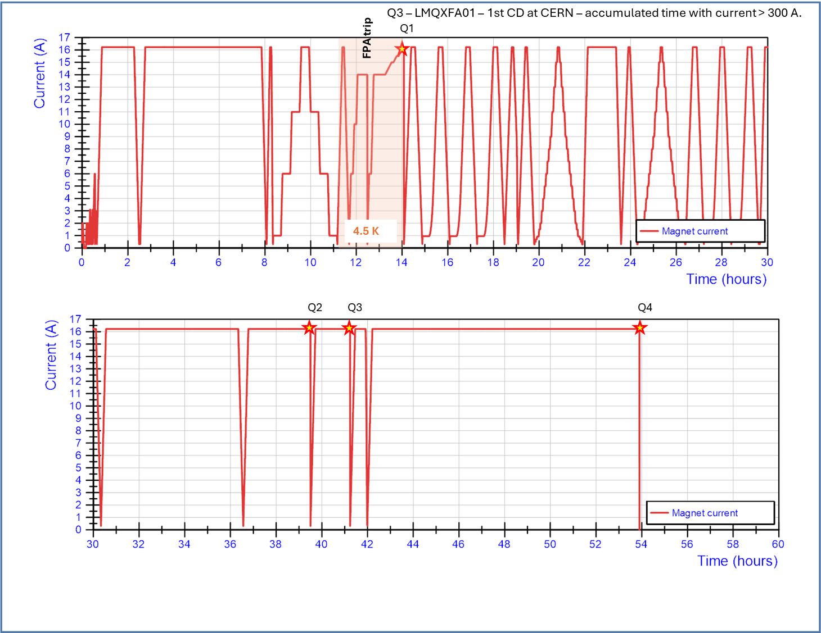
In cool down 1 in total 54 hours of powering was done from 17 June to 2 July 2024.
The quenches 2 and 3 at 1.9 K at nominal current of 16.23 kA triggered additional measurements.

Slide 14
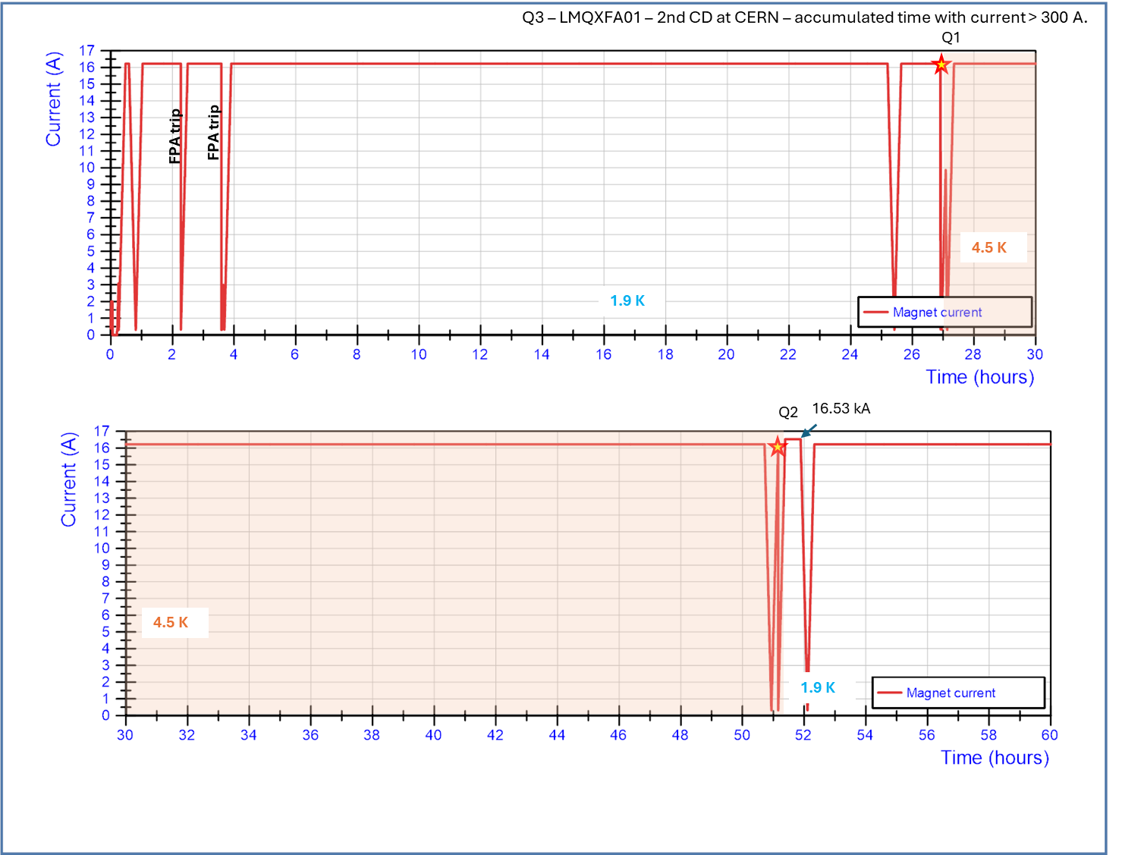
Cooldown 2 powering was performed for ~200 hours from 22 August to 11 September.

Slide 15
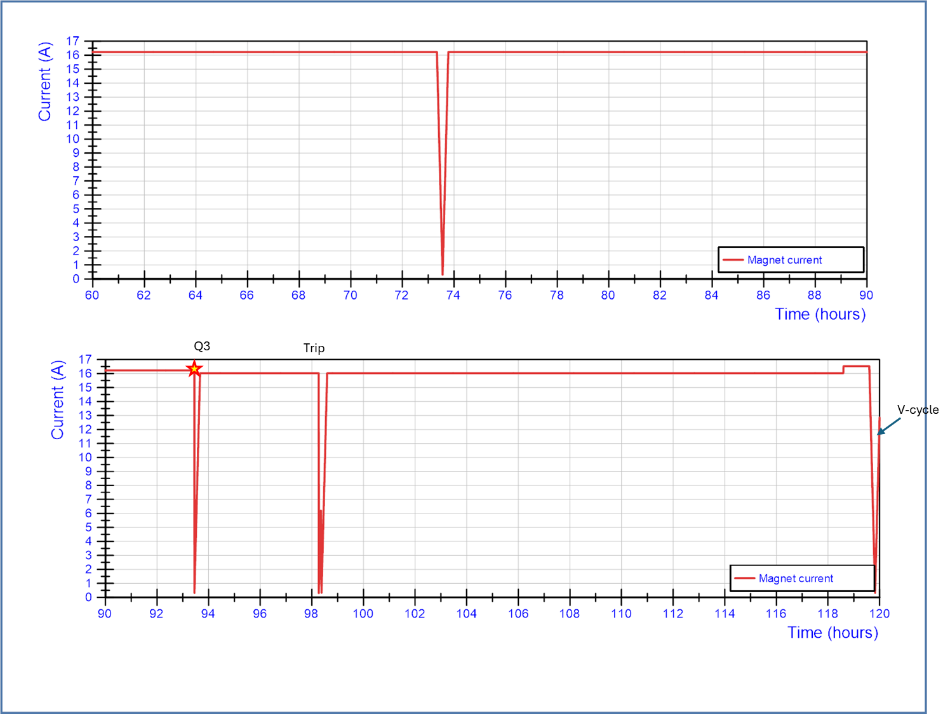
Cooldown 2 powering part 2

Slide 16
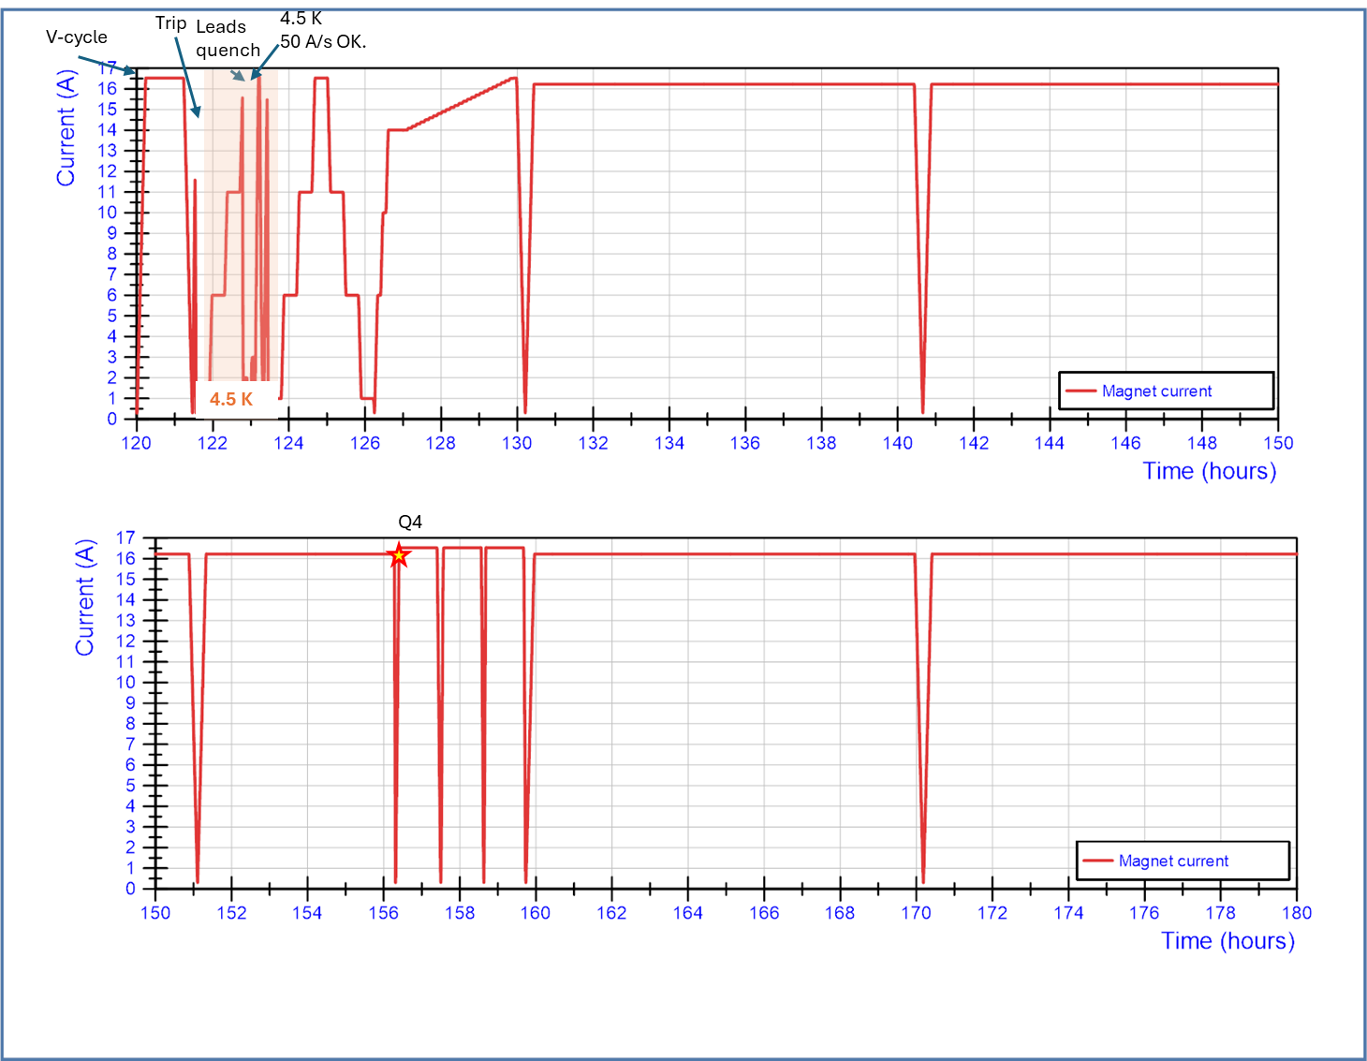
Cooldown 2 powering part 3

Slide 17
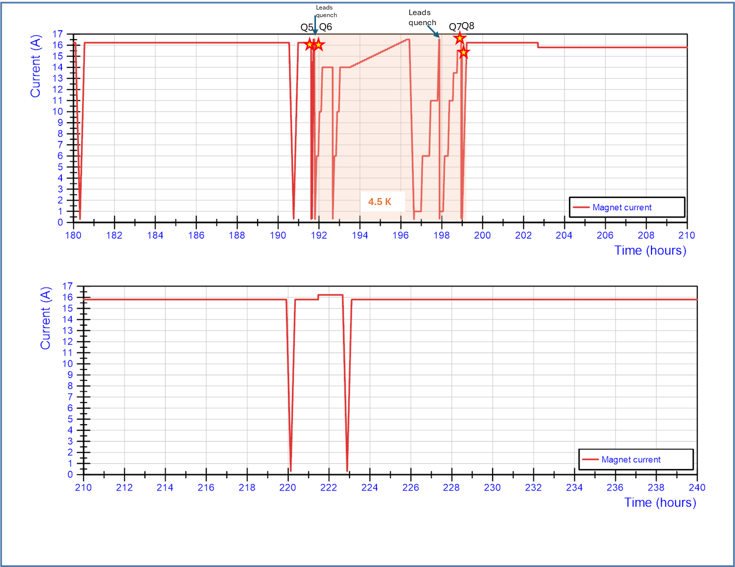
Cooldown 2 powering part 4

Slide 18
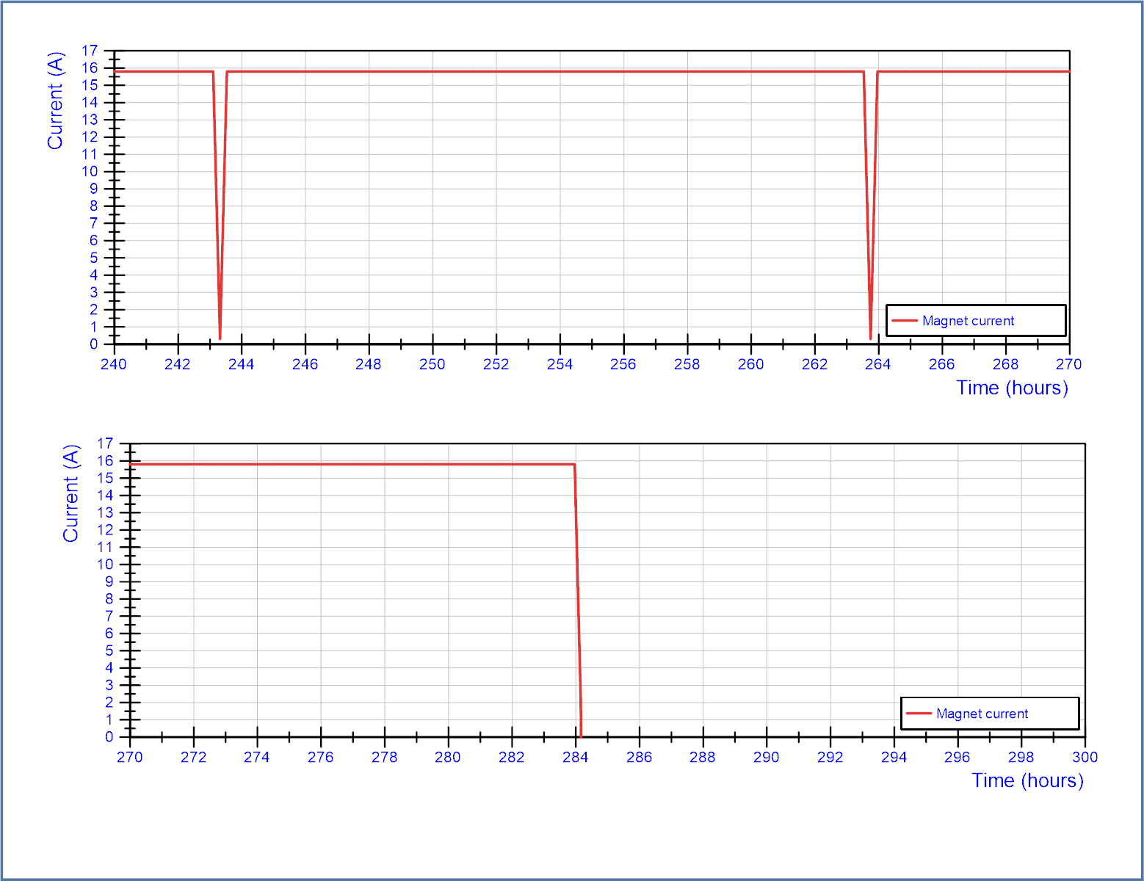
The long powering runs were possible due to changes in procedures, allowing running tests automated during nights and weekends.
Note: For Q2 magnets we were also bound for the duration of a powering run to a working day (~ 8 hours), but this will be changed for future magnets.
Note: 200 hours is still far from yearly stable operation needs for the HL-LHC

Slide 19
Flattop quenches with fast quench propagation, some background:
Very fast quench propagation velocity can be explained by strands that are saturated, causing a propagation velocity of ~3 times higher. R. Keijzer et al., Effect of Strand Damage in Nb₃Sn Rutherford Cables on the Quench Propagation in Accelerator Magnet, Trans. Appl. Supercond., Vol 33, No. 5., August 2023
Saturated strands can be explained by slow processes of current redistribution around defects in a conductor. Depending on the distance to the defect this takes minutes to hours. R. Keijzer et al., Modelling V-I measurements of Nb3Sn accelerator magnets with conductor degradation, IEEE Trans. Appl. Supercond., vol. 32, no. 6, Sep. 2022, Art. no. 4001105.
Saturated strands can be explained by slow processes of current distribution in the splices of magnet, or due to boundary induced coupling currents. A. Verweij, Electrodynamics of Superconducting Cables in Accelerator Magnets, PhD thesis, University of Twente, The Netherlands, 1995.

Slide 20
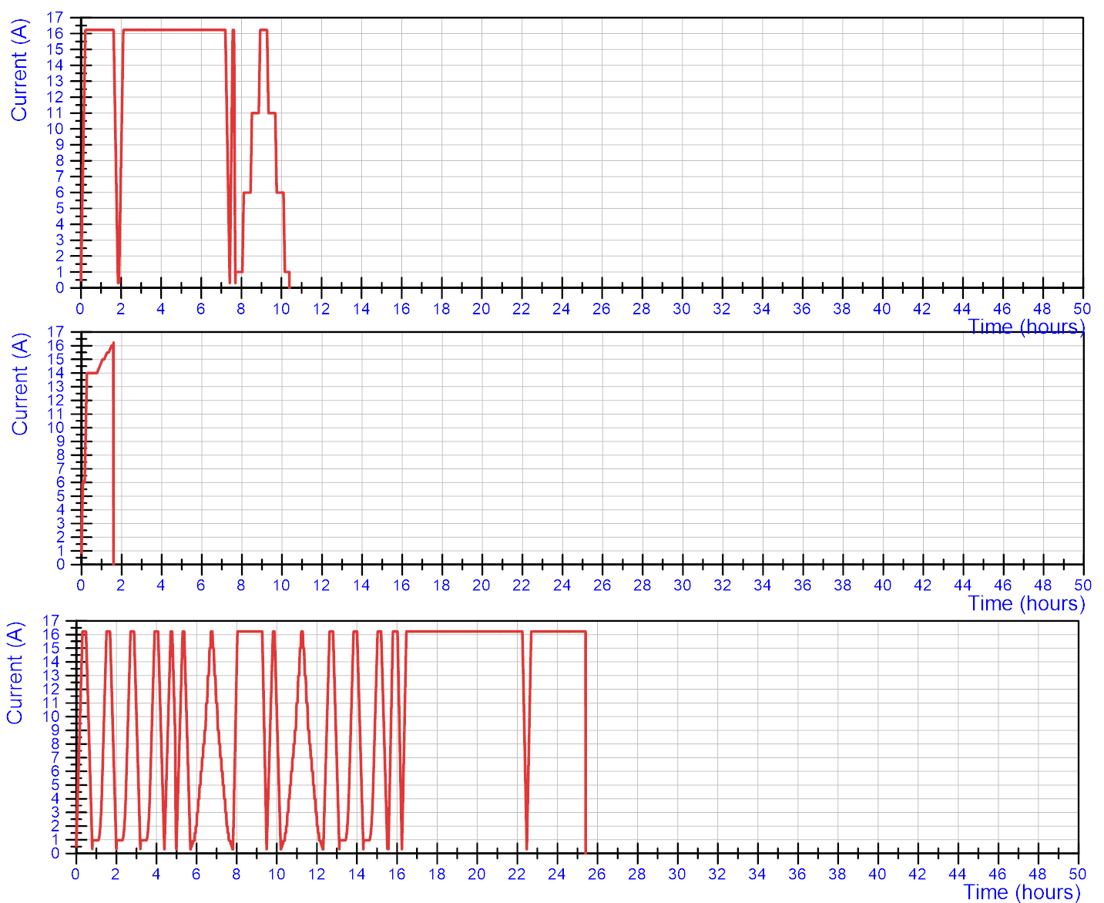
Current cycles leading to quench (starting in ‘virgin’ conditions).
Cool down 1
Each of the plots and time lines starts after magnetization and induced current have been ‘reset’ by a quench.
First training at 1.9 K: no quench
4.5 K V-I cycle
Quench in Q3a-P2
CD1 – Q2 Many magnetic measurement cycles at 1.9 K. Quench in Q3a-P3

Slide 21
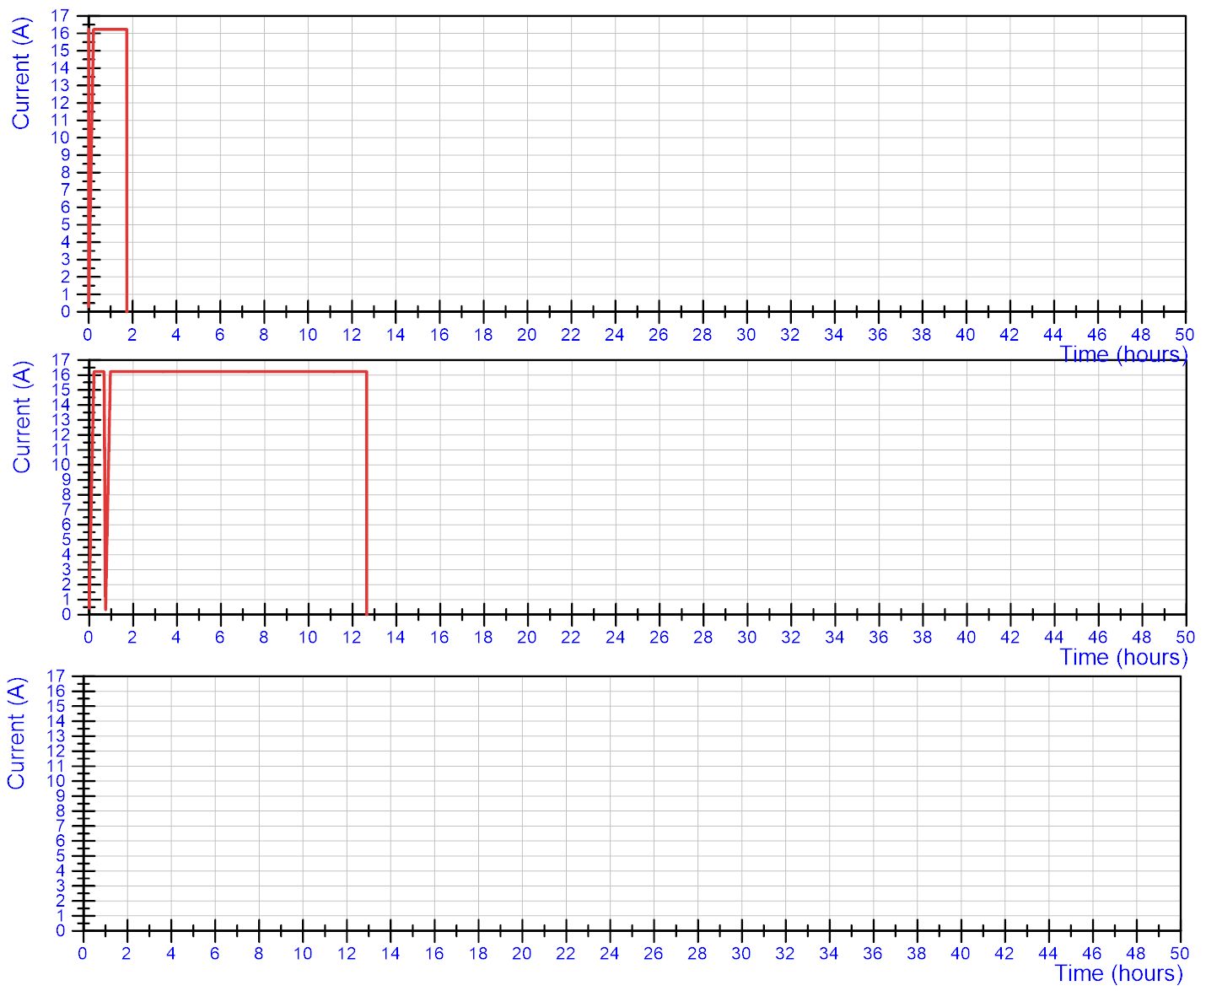
CD1 – Q3: Quench in Q3a-P1 after 1h30
Cool down 1
CD 1- Q4: Cycles at 1.9 K. Quench in Q3a-P3

Slide 22
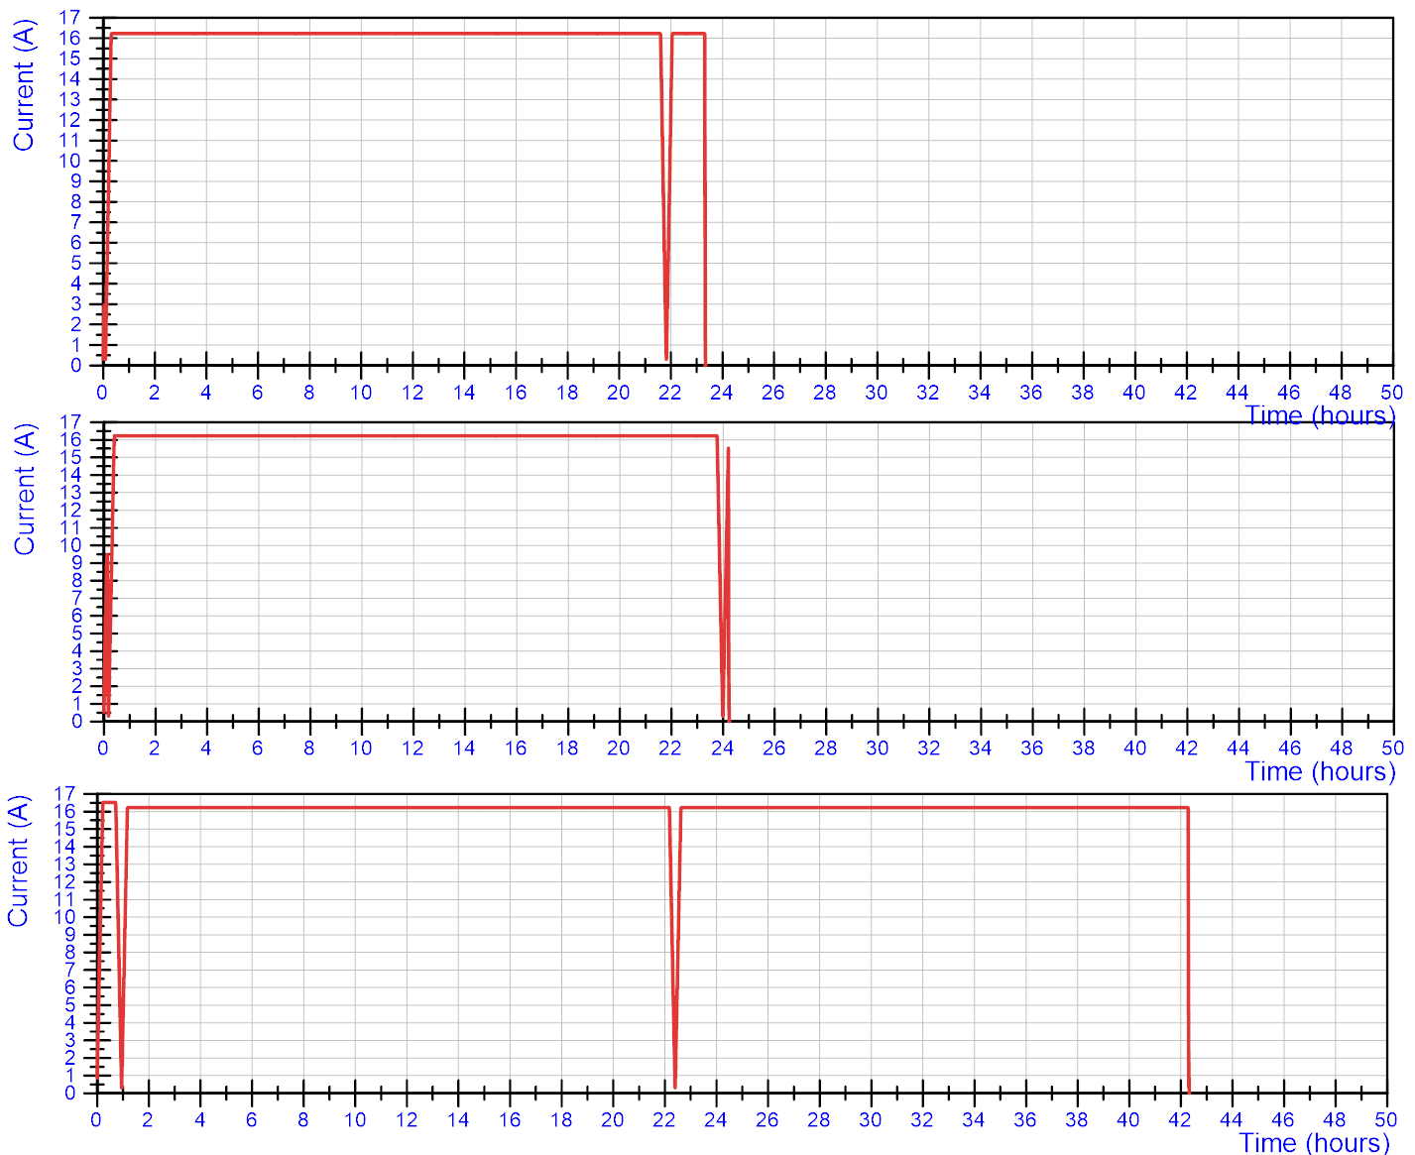
Cool down 2
CD 2 – Q1: 1.9 K. Quench in Q3a-P3
CD 2 – Q2: 4.5 K. Quench in Q3a-P3 at end of second ramp
Training to 16.53 kA
CD 2 – Q3: 1.9 K. Quench in Q3a-P3

Slide 23
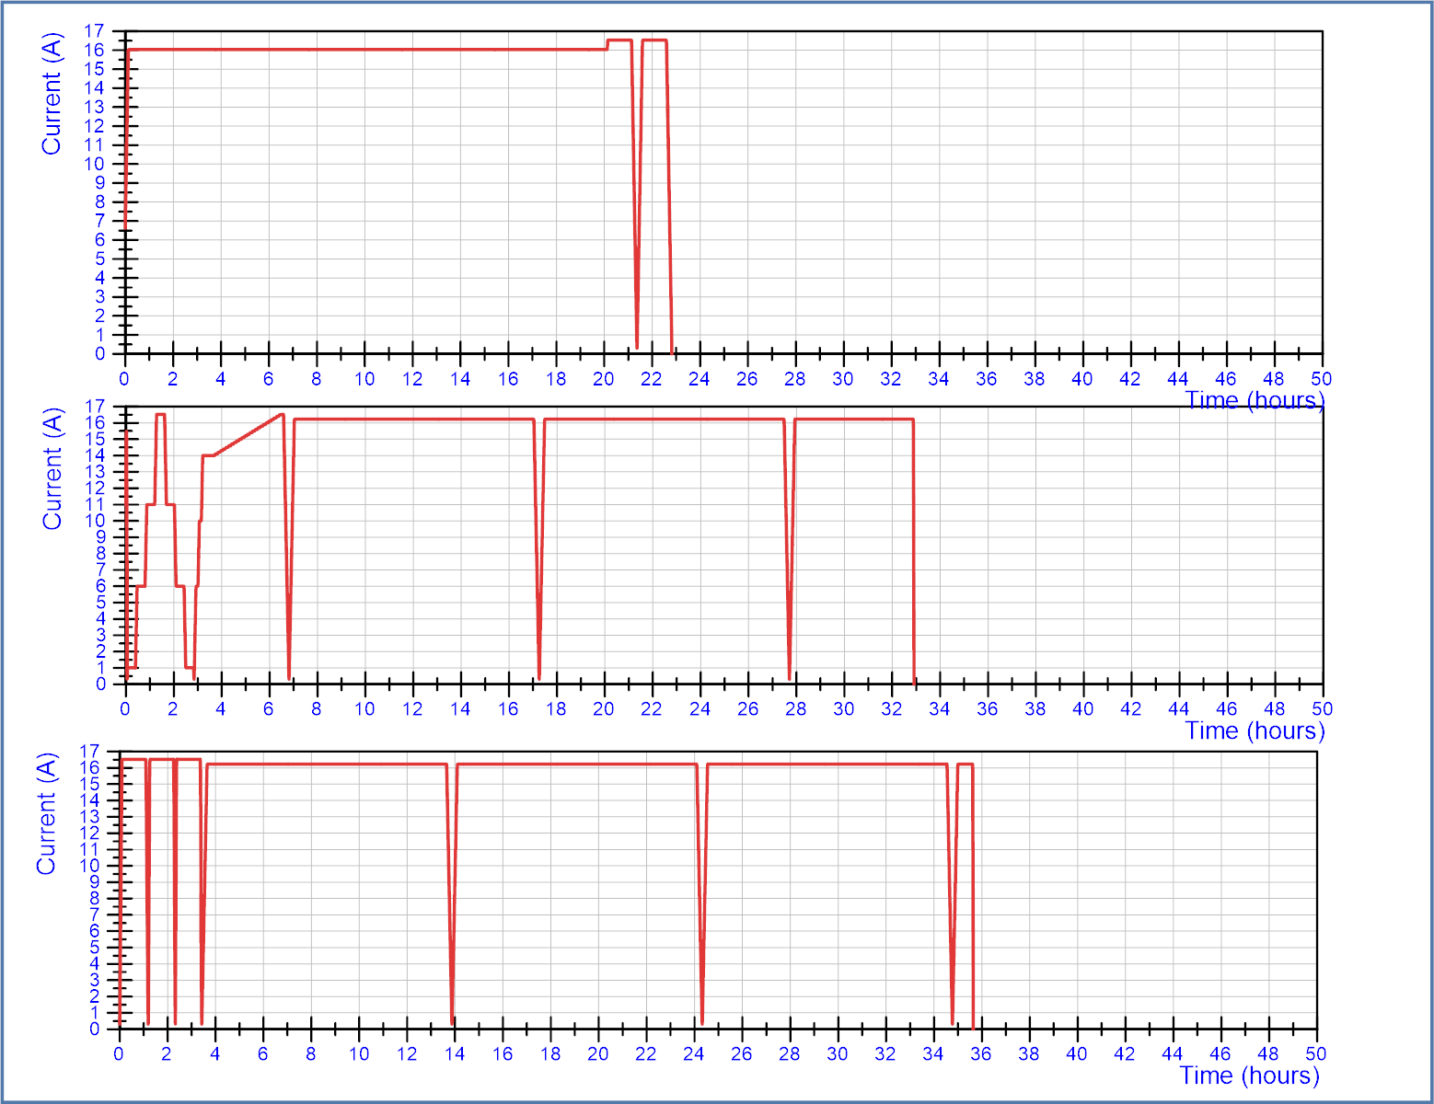
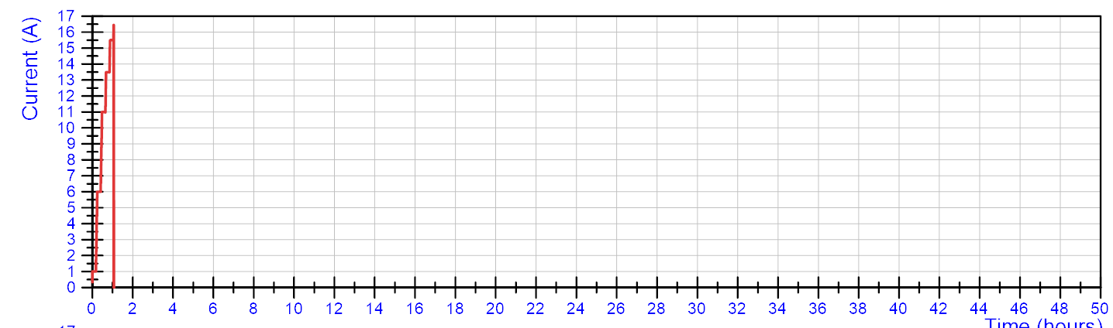
CD2 1.9 K. No quench
(long plateau at 16.03 kA, followed by 16.53 kA)
All cycles are different, but we can observe:
All six cycles staying at 16.23 kA for long time quenched between 12 and 42 hours into the accumulated time at this current.
3 times 1 hour at 16.53 kA (using fast ramp rates) did not quench the magnet.
A long plateau at 16.23 kA at 4.5 K did not quench the magnet, but the following ramp at 4.5 K did.
At 1.9 K the quench never occurred in the first ramp, but in the second to 5th. However, since we always had variations in ramps, it is difficult to say how the ramp down/up impacts the moment of the quench.
CD2-Q4: 1.9 K. Quench in Q3a-P3.
(after reaching 16.53 kA twice)
CD2 – Q5: 1.9 K. Quench in Q3a-P3.
(after reaching 16.53 kA three times)
CD2-Q7: 4.5 K. Quench in Q3a-P3 during splice cycle.

Slide 24
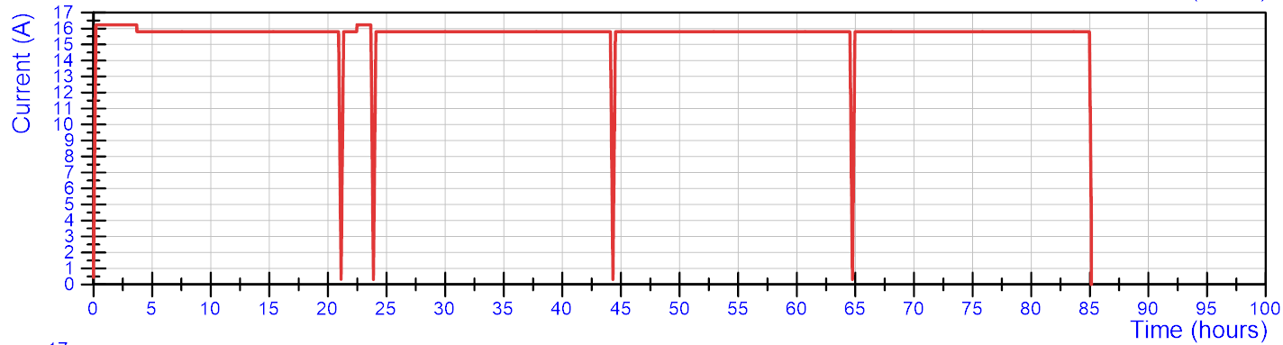
This slide is added after the meeting to include a full overview of the powering.
5 consecutive cycles at 15.8 kA with accumulated time of ~85 hours.
In the two first cycles, a few hours powering were at nominal current 16.23 kA to complete the stretched wire measurements.

Slide 25
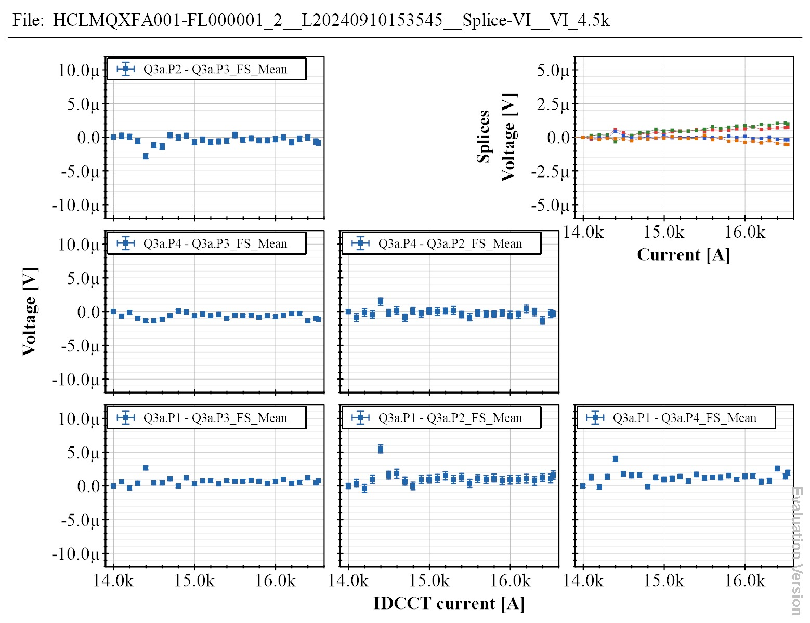
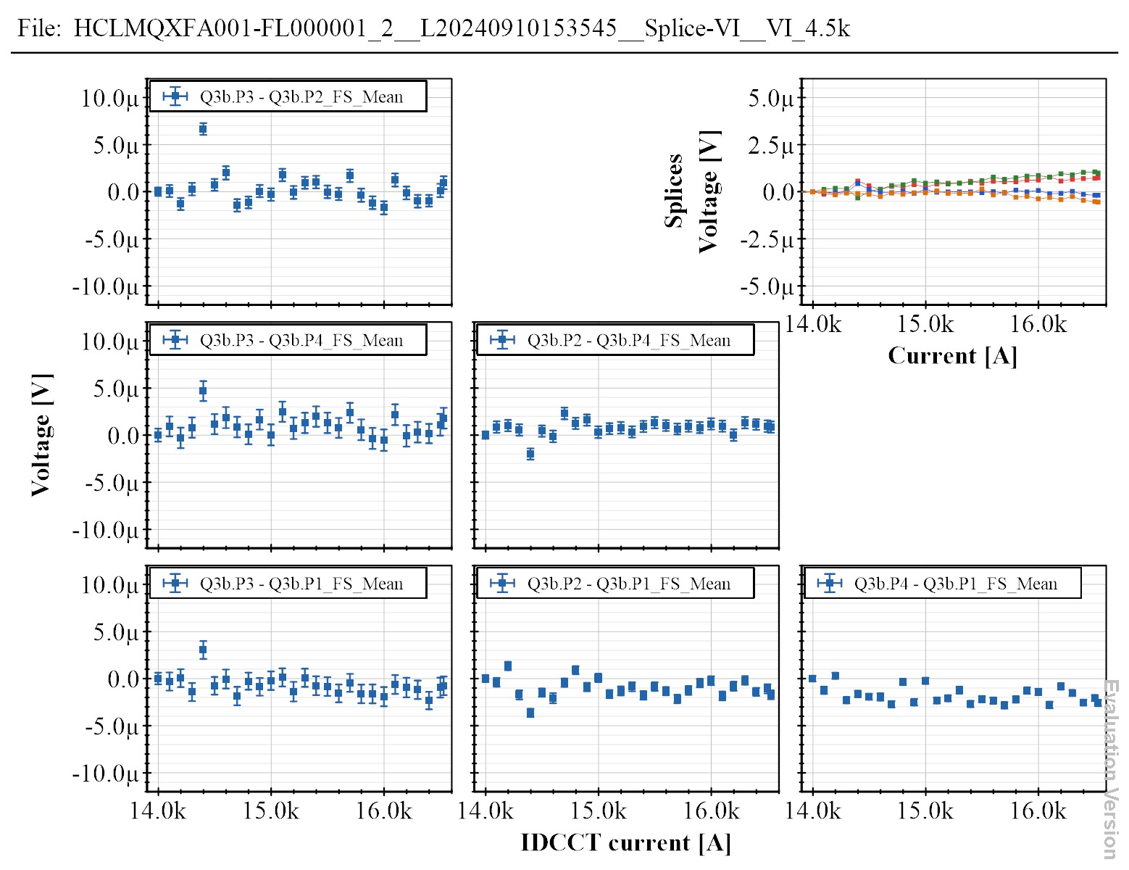
V-I measurements
V-I measurements were performed at 1.9 K and at 4.5 K up to 16.53 kA.
Below the results are shown for the latest measurement at 4.5 K. No significant voltage increase is seen in any of the coils.

Slide 26
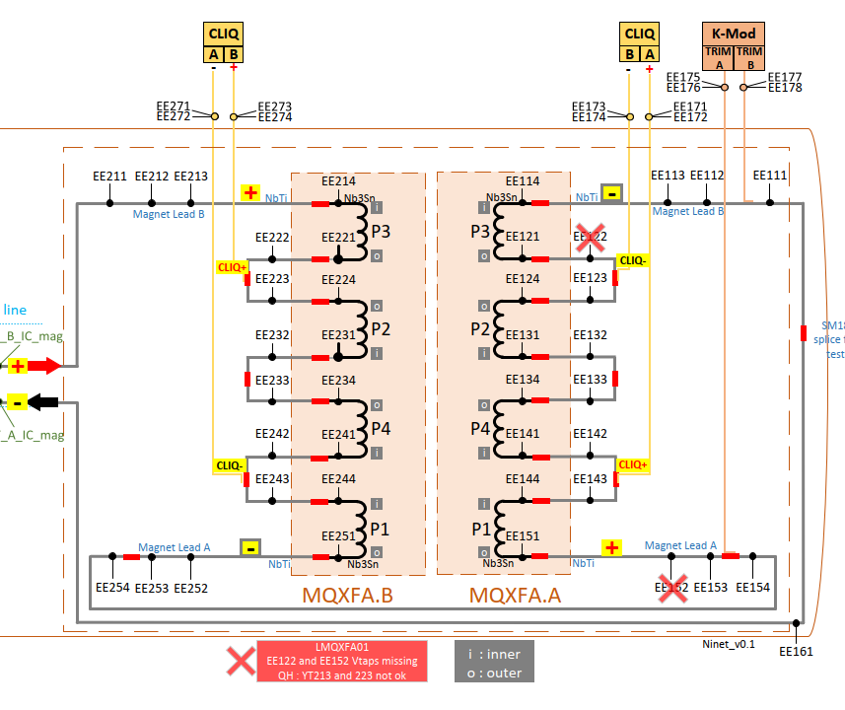
Splice measurements
From a measurement in CD 2 at 4.5 K up to 15.5 kA
Voltage taps | Resistance (nOhm) | Number of splices
213-214 | 0.33 | 1
221-224 | 0.71 | 3
231-234 | 0.68 | 3
241-244 | 0.73 | 3
251-151 | 0.69 | 4
144-141 | 0.61 | 3
134-131 | 0.44 | 3
124-121 | 0.47 | 3
114-113 | 0.18 | 1
All splice resistances show a low resistance, linear behavior up to high current and stable voltage at flattop.

Slide 27
Other possible cause for fast quench propagation and flattop quenches
Anti-cryostat be a source of heat: A high temperature in the cable over a long length could also trigger fast quench propagation.
Very unlikely since:
The 1.5 annular space between cryostat and magnet of 1.5 mm is filled with HeII with every 50 mm a radial escape path for heat extraction is designed for 250 W extraction for each 5 meter of magnet.
If suchs a loss would occur, this would show up immediately in the cryogenic load and disrupt the cryo system.
23 hours of continuous operation at 4.5 K a nominal current did not lead to a quench, while one should expect 4.5 K to be much more prone to a heat leak and quench than 1.9 K.
There is no sign of any condensation or low temperature inside the anticryostat and the vacuum (linked to the magnet vacuum) always has been good.
Lack of training margin
There no is precursor or any sign of mechanical motion in the Quench Antenna data.
In the first cool down, the maximum current of 16.23 kA was agreed. In the second cool down, the quenches in Q3a-P3 at flattop seems not to have changed after powering to 16.53 kA, which suggests that the quenches are not due to lack of training margin.

Slide 28
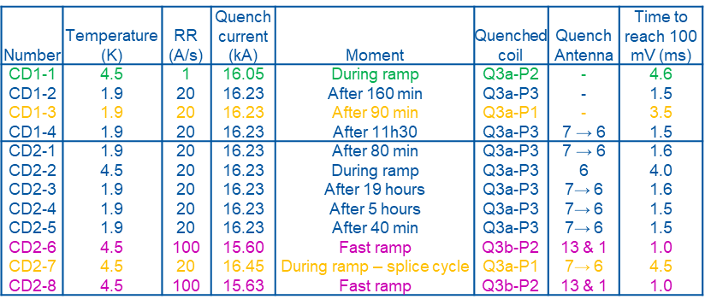
Classification of other quenches - interpretation
Quenches CD1-1, CD1-3, CD2-7 have a normal voltage build up, do not seem to repeat in the same spot (no quench antenna for CD1-1 and CD 1-3). Those three quenched occurred with a very limited training margin.
We lack data to properly classify, but since they do not seem to repeat and since we see similar behavior in MQXFB magnets it seems of not concern.
The quenches at 4.5 K, 100 A/s in Q3b-P2 (MQXFA03) are repetitive and with very high quench propagation velocity. It seems that here we reach locally the critical surface of the conductor.

Slide 29
Discussion flattop quenches and their origin.
Even with repetitive quench location, it does not mean that the principle cause for current sharing is in that location. Long duration at the flattop even suggests that current redistribution could be initiated far away from the quench location, even in the splice.
Fast ramps at 4.5 K should be instrumental to find the location with a possible degradation. However, at 4.5 K 16.53 kA was reached at 75 A/s, and at 100 A/s the magnet was limited by another coil. The could suggest the cause of current redistribution in Q3a-P3 is in a low-field region.
With the available data we cannot tell if an additional quench trigger is needed (coil motion, epoxy cracking, flux motion, etc.) besides having an unstable situation due to uneven current distribution.
Summary: Analysis points in a clear direction, but details remain impossible to extract from measurement.

Slide 30
Conclusions
All powering tests used for qualification, including reaching target current of 16.53 kA at 1.9 K and 4.5 K.
It did not show any sign of detraining.
Coil Q3a-P3 (MQXFA04) consistently quenches within 12 to 42 hours (6 times) in normal operating conditions at 1.9 K, 16.23 kA (7TeV).
During 5 consecutive cycles with an accumulated time of 85 hours at 15.8 kA (6.8 TeV) was stable.
All results point at slow current redistribution effects causing instability in the conductor with a time constant of hours.
Important:
The consistent quenching in Q3a-P3 was accidentally discovered. In none of the test programs for MQXFA or MQXFB magnets this would have been seen, since long duration is not standard.
The extended powering campaign in the second cool down could only be done due to a procedural change to allow testing overnight and during the weekend, extending a week from maximum ~40 working hours to 168 hours of powering.
We prepare for future testing of Q2 magnets with long plateaus (3*20 hours over 1 weekend).
Future:
To be discussed by the MAB: Installation in the String could be OK, but regular quenches at nominal current (7TeV) would be very uncomfortable for HL-LHC operation.
We may have the possibility to do 3*20 hours of flattop at 6.8 TeV (15.8 kA) over the coming weekend, delaying the warm up by 1 – 2 days (note that the quench antenna is in use on the Q2).

Slide 31
Appendix: Voltage and quench antenna measurements for each quench.

Slide 32
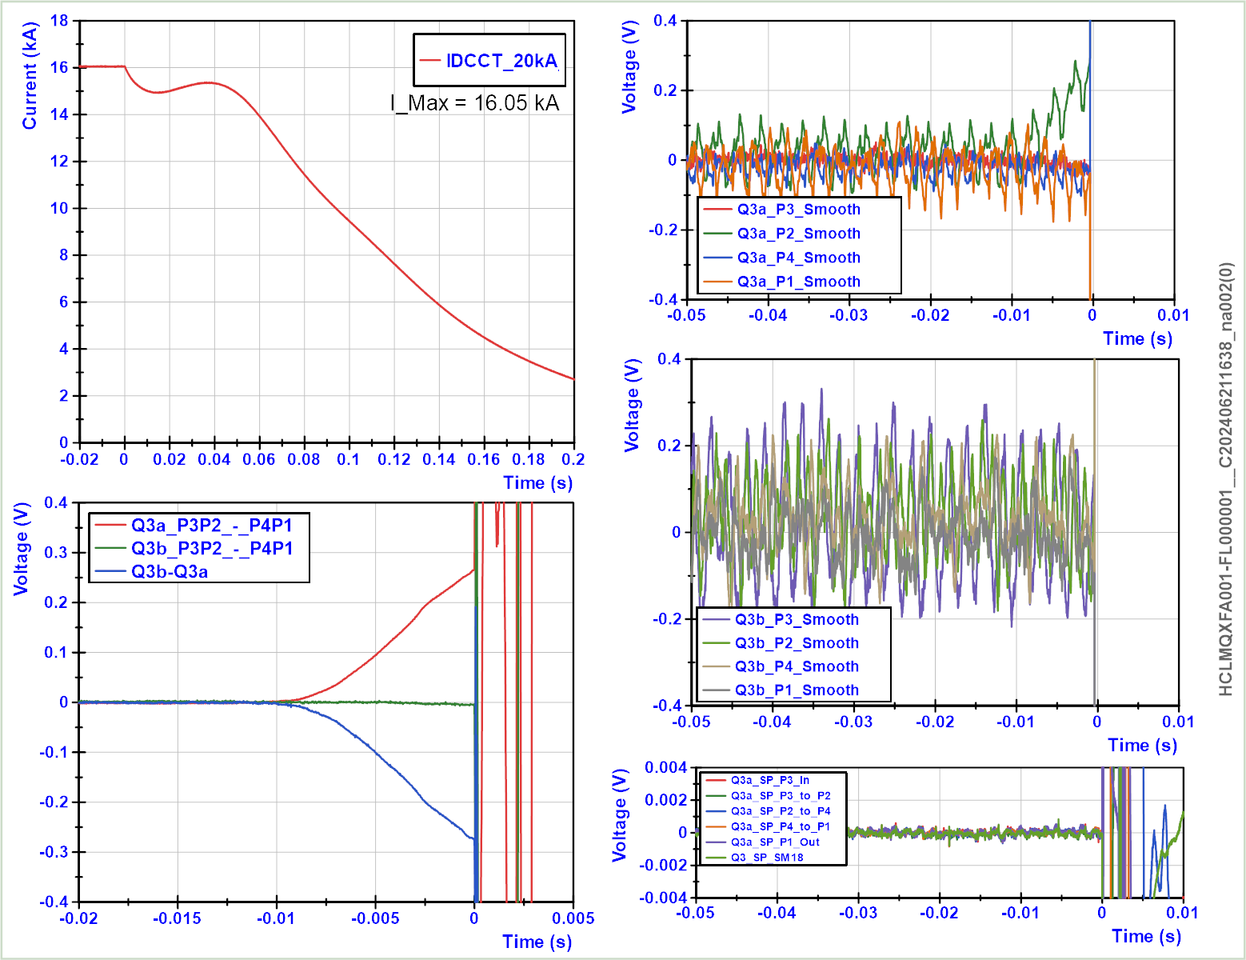
Cool down 1, Quench 1
(no quench antenna)
4.5 K, 16.05 kA, Q3a-P2

Slide 33
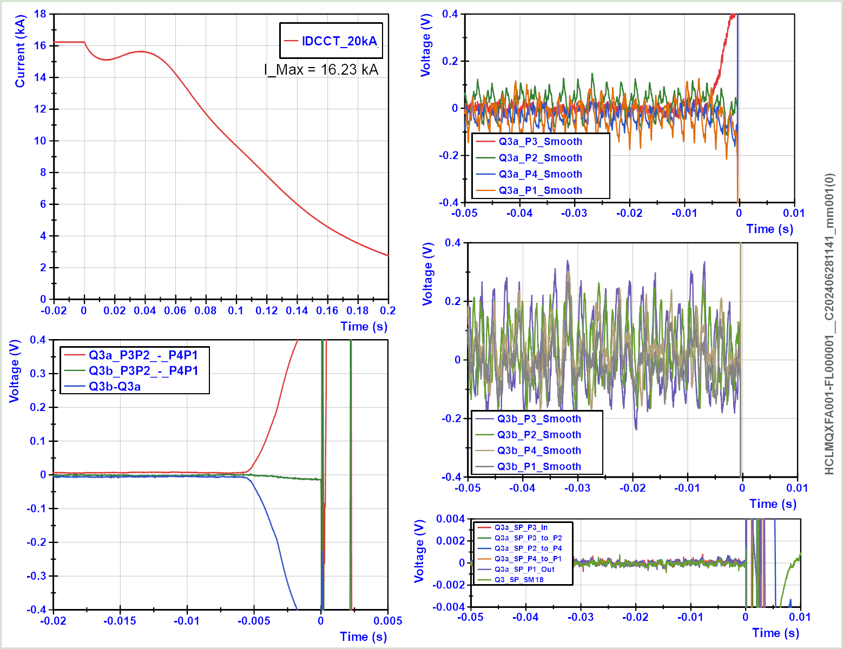
Cool down 1, Quench 2
(no quench antenna)
1.9 K, 16.23 kA, Q3a-P3

Slide 34
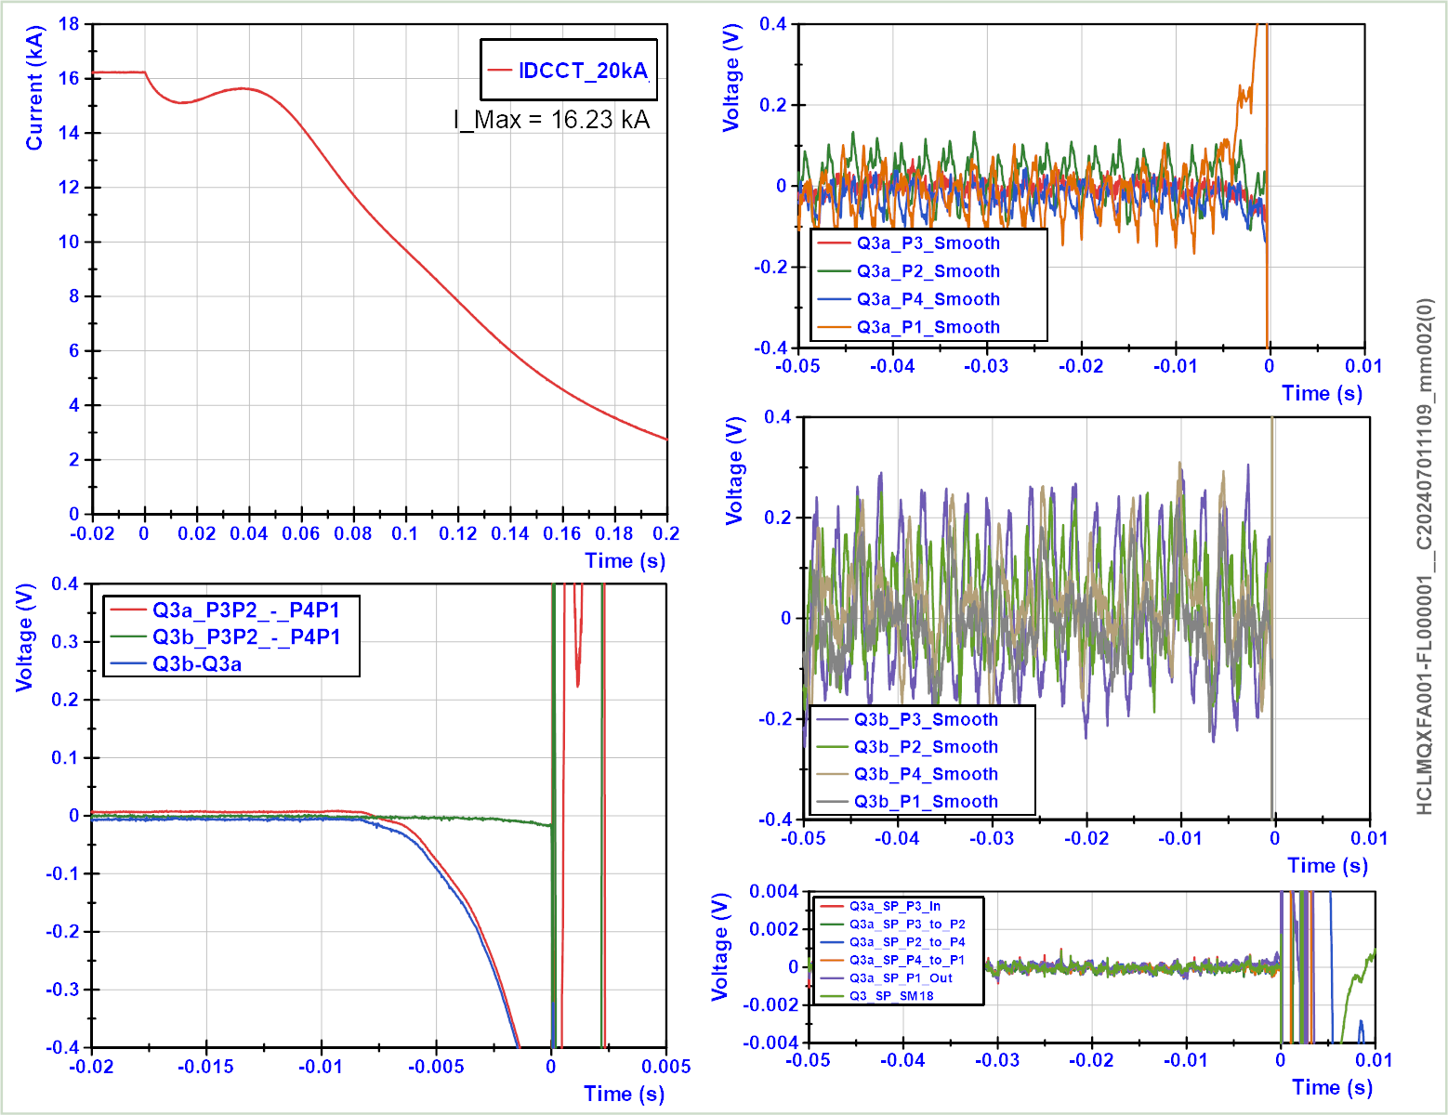
Cool down 1, Quench 3
(no quench antenna)
1.9 K, 16.23 kA, Q3a-P1

Slide 35
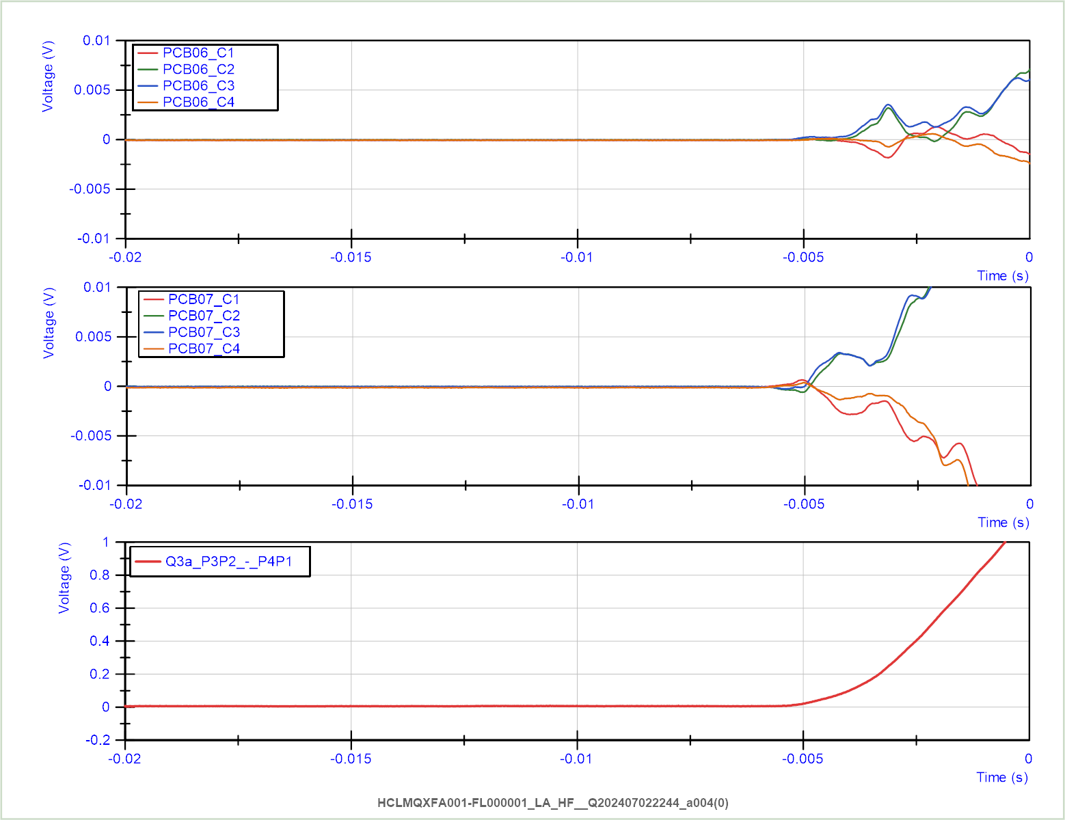
Cool down 1, Quench 4
1.9 K, 16.23 kA, Q3a-P3

Slide 36
Cool down 2, Quench 1
1.9 K, 16.23 kA, Q3a-P3

Slide 37
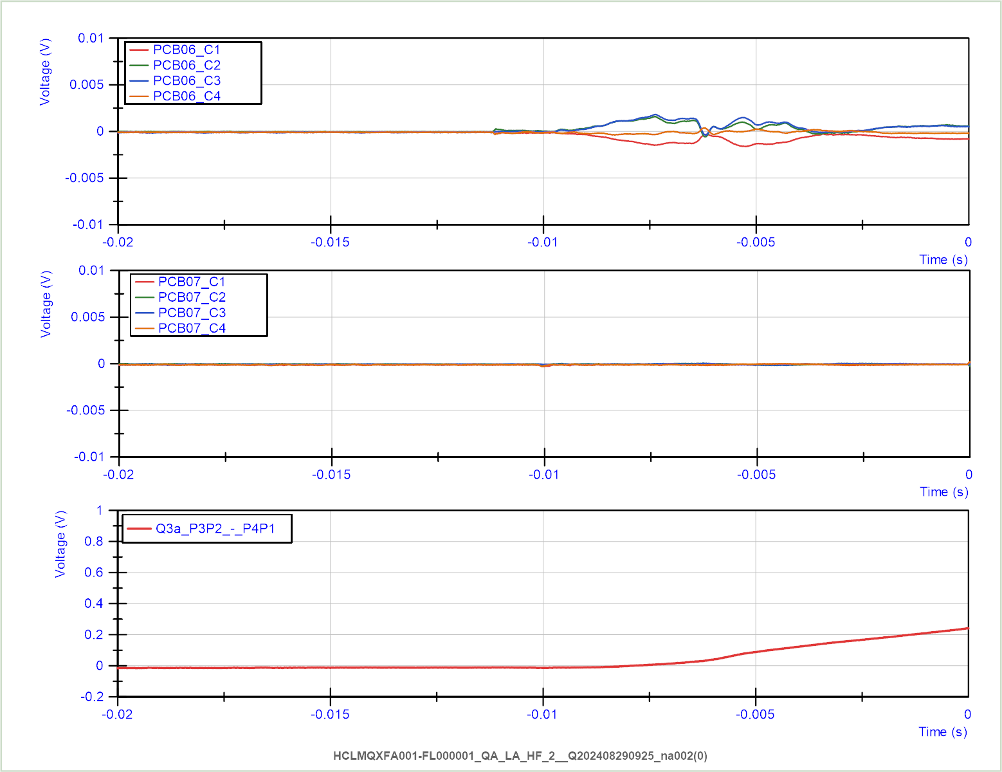
Cool down 2, Quench 2
4.5 K, 16.23 kA, Q3a-P3

Slide 38
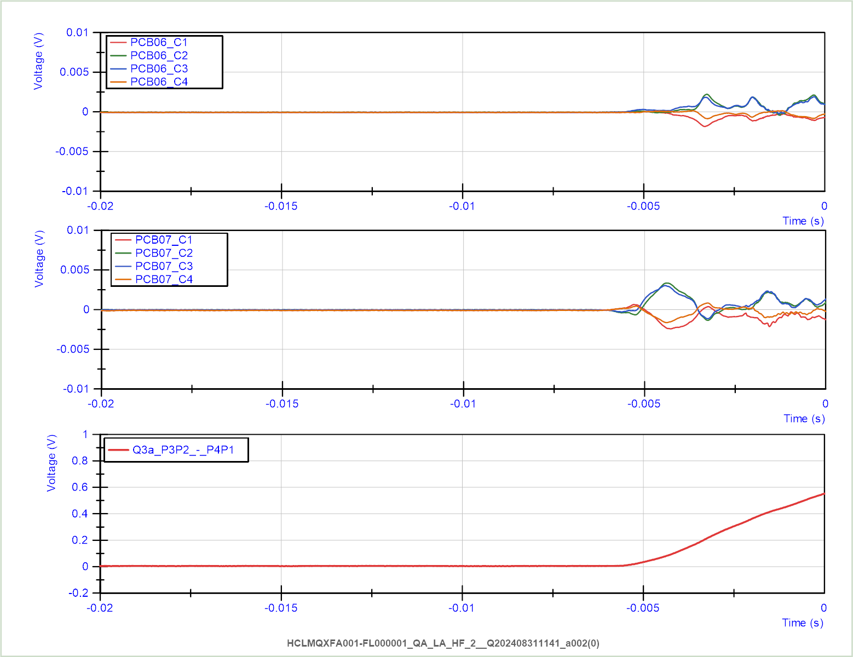
Cool down 2, Quench 3
1.9 K, 16.23 kA, Q3a-P3

Slide 39
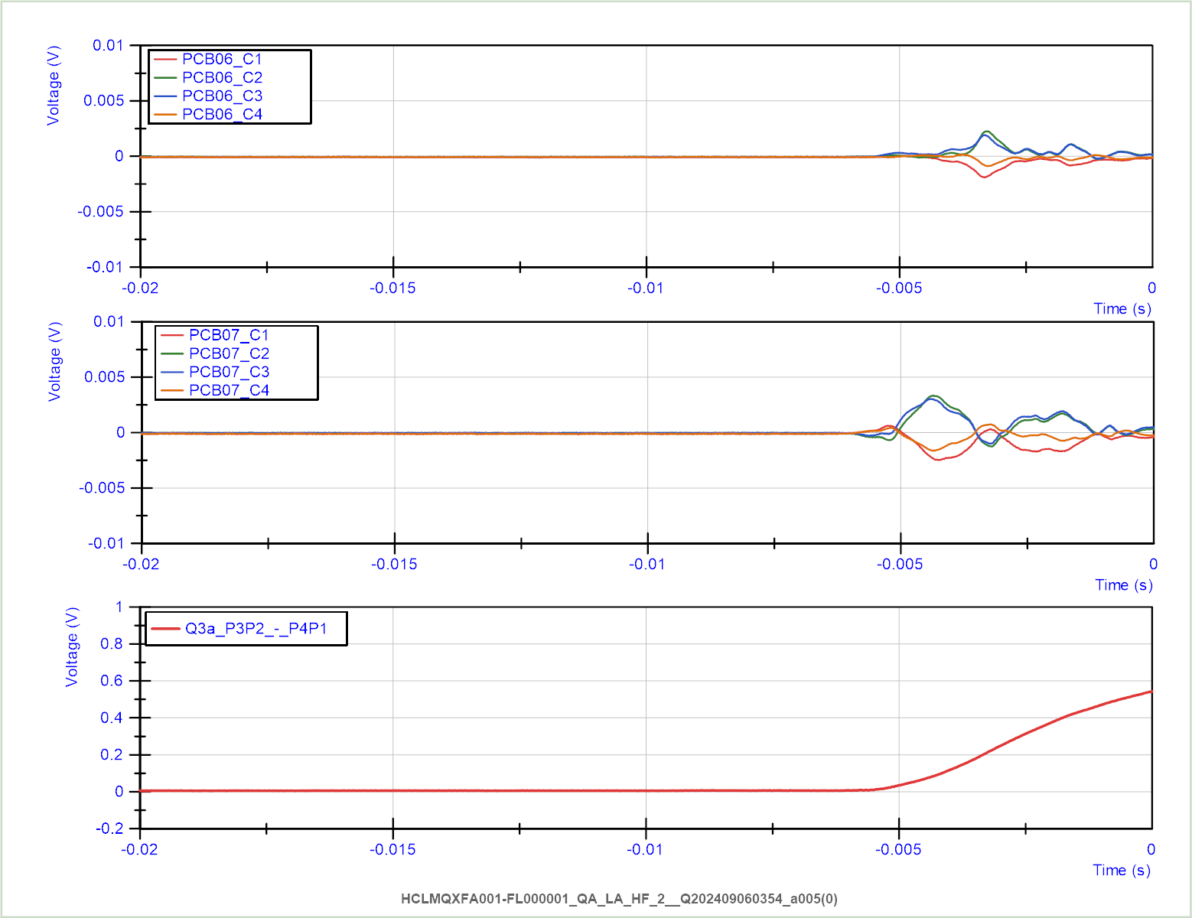
Cool down 2, Quench 4
1.9 K, 16.23 kA, Q3a-P3

Slide 40
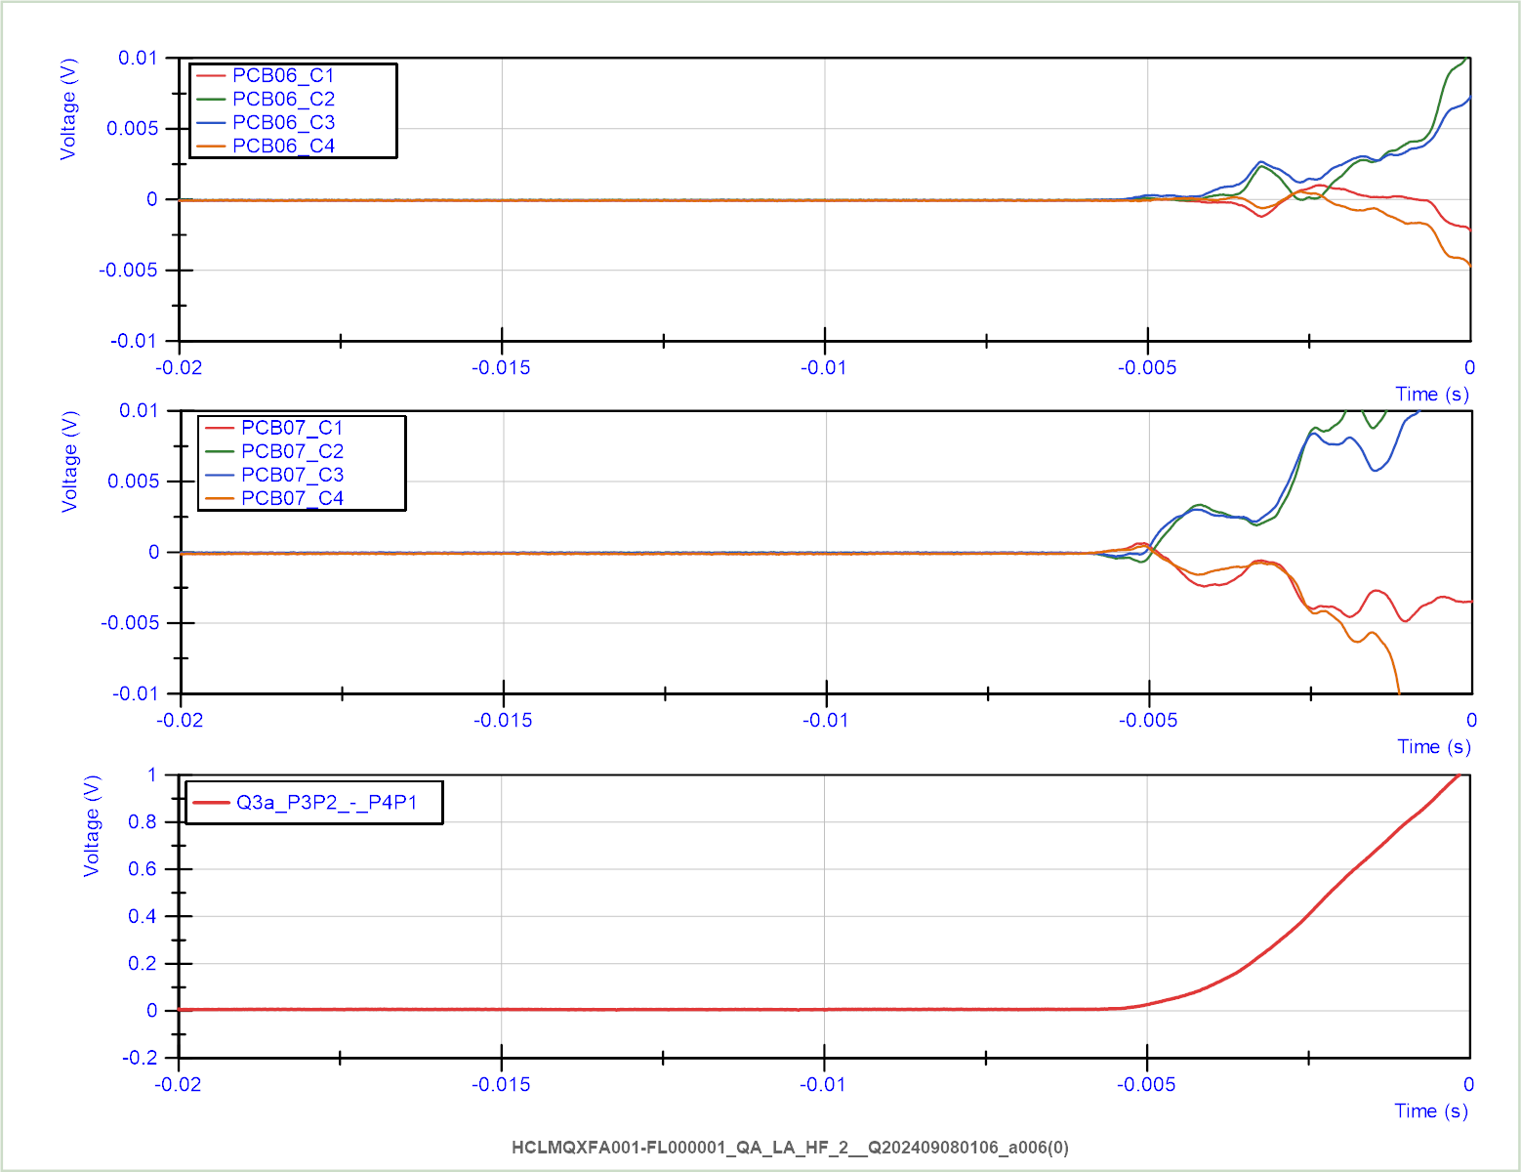
Cool down 2, Quench 5
1.9 K, 16.23 kA, Q3a-P3

Slide 41
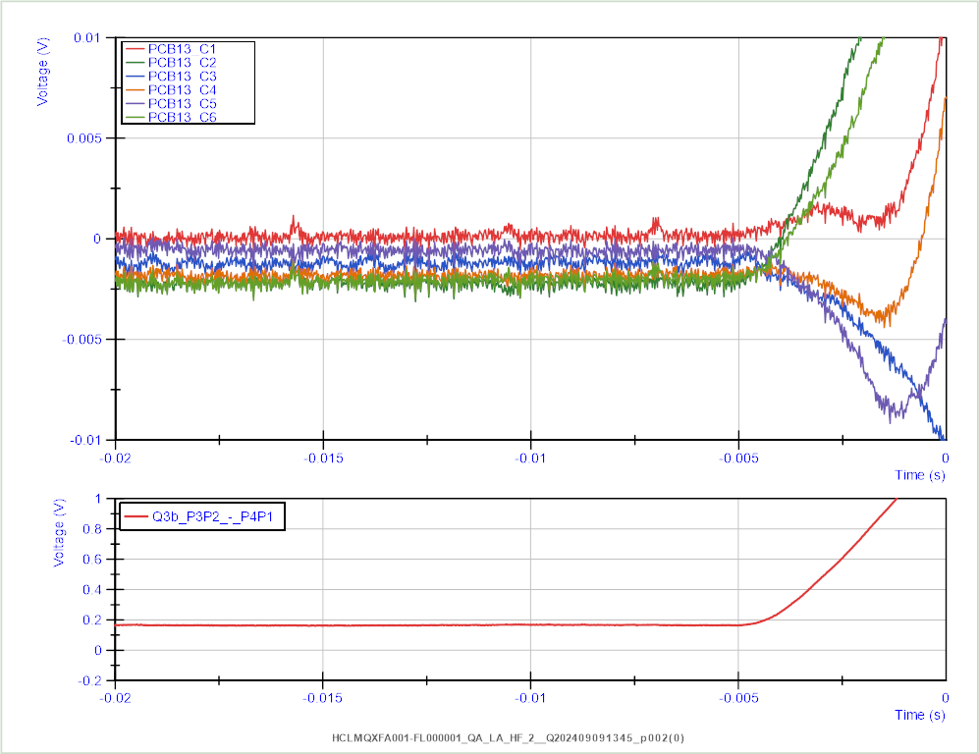
Cool down 2, Quench 6
4.5 K, 15.60 kA, Q3b-P2
100 A/s

Slide 42
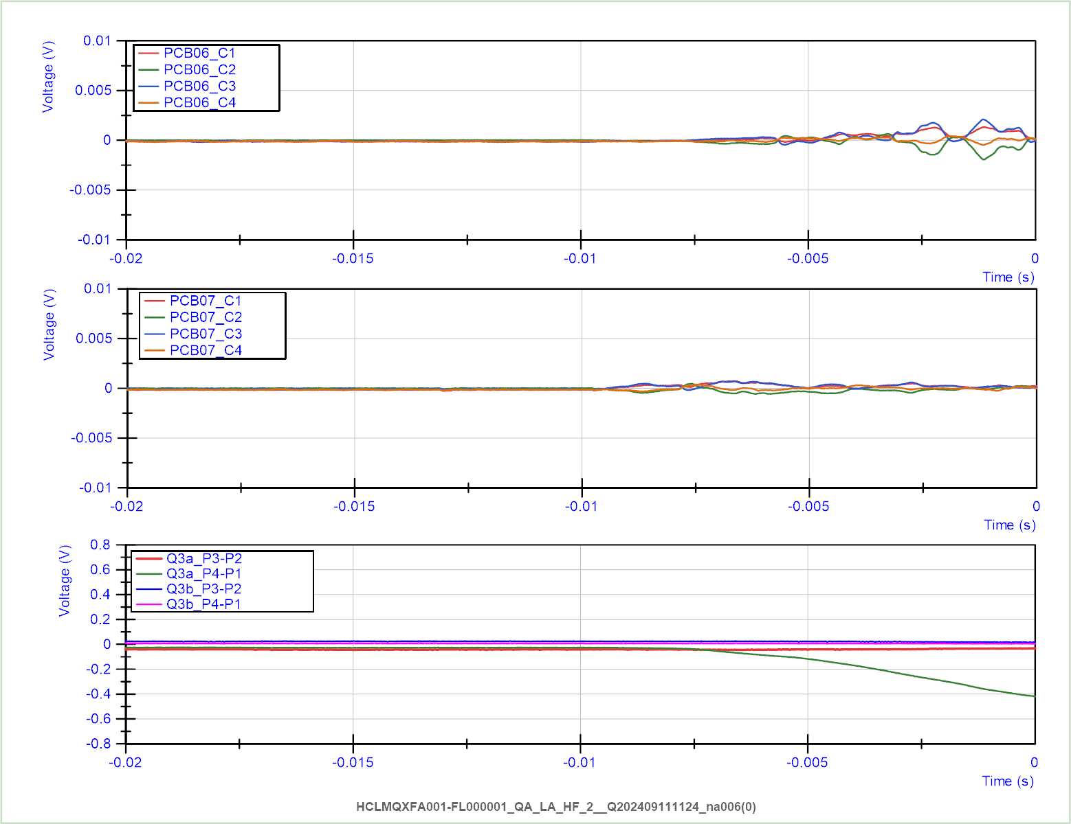
Cool down 2, Quench 7
4.5 K, 16.45 kA, Q3a-P1

Slide 43
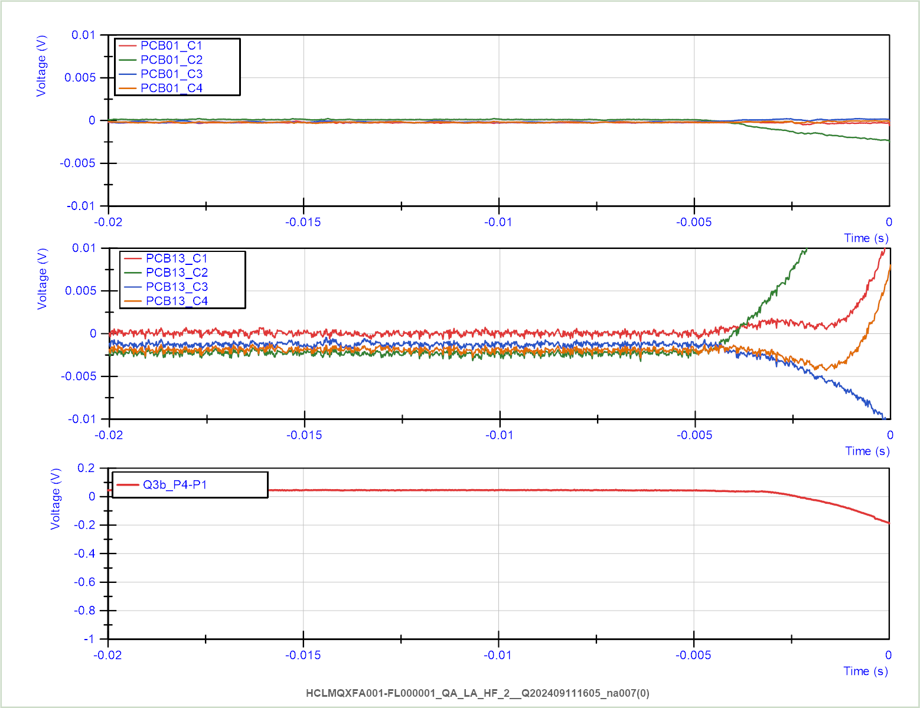
Cool down 2, Quench 8
4.5 K, 15.63 kA, Q3b-P2
100 A/s

