Slide 1
Integration and Configuration Management Status
Michael Lazzaroni and Giulia Romagnoli (BE-EA)
3 September 2024

Slide 2
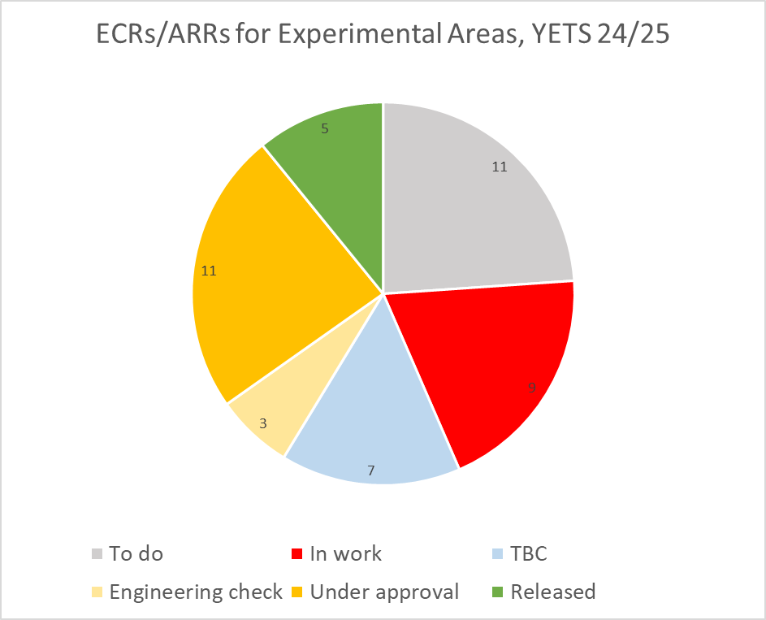
ECRs for Experimental Areas YETS24-25
To do: activity in need of ECR from planning/PLAN, author contacted, waiting for answer
In work: draft version available/author is writing
TBC: activities still do be confirmed with the responsible group
Engineering check: document circulating for first round of comments
Under approval: document circulating for final approval
Released: document approved and presented to EATM/IEFC
 | ECR | ARR | SRR | TOTAL
North Area | 32 | 6 | 1 | 39
East Area | 3 | 0 | 0 | 3
AD Complex | 2 | 0 | 0 | 2
HiRadMat | 2 | 0 | 0 | 2
TOTAL | 39 | 6 | 1 | 46

Slide 3
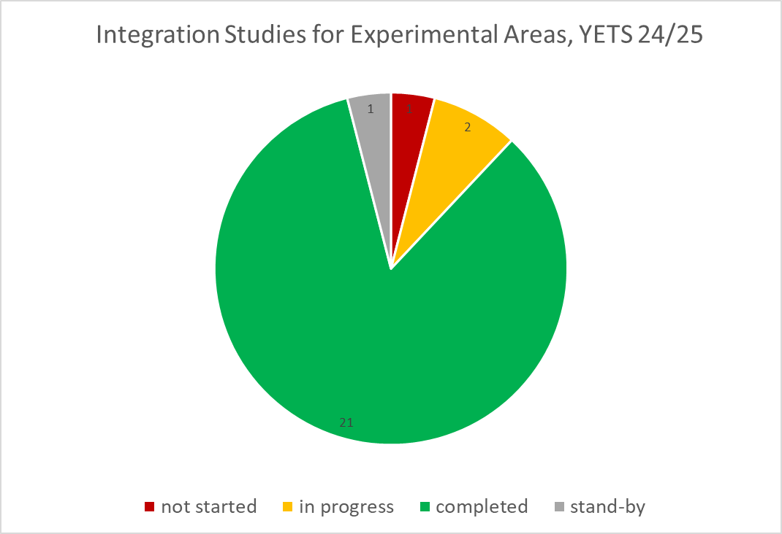
Integration Studies Experimental Areas YETS24-25
Not started: activity needs an integration study, not yet started
In progress: integration study started
Stand-by: integration study started but in stand-by waiting for external inputs
Completed: study completed and approved by ICEA* (where applicable)
 | Integration Studies
North Area | 21
East Area | 2
AD Complex | 1
HiRadMat | 1
TOTAL | 25
*Integration Committee for Experimental Areas (ICEA)
https://indico.cern.ch/category/14476/

Slide 4
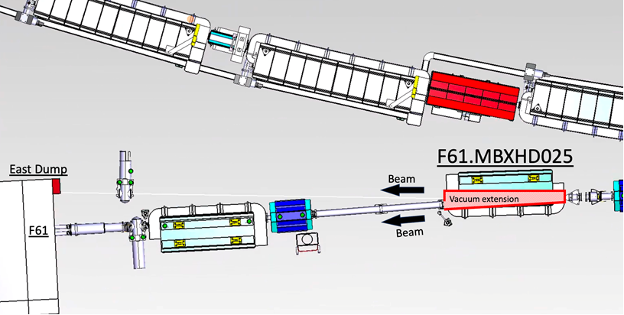
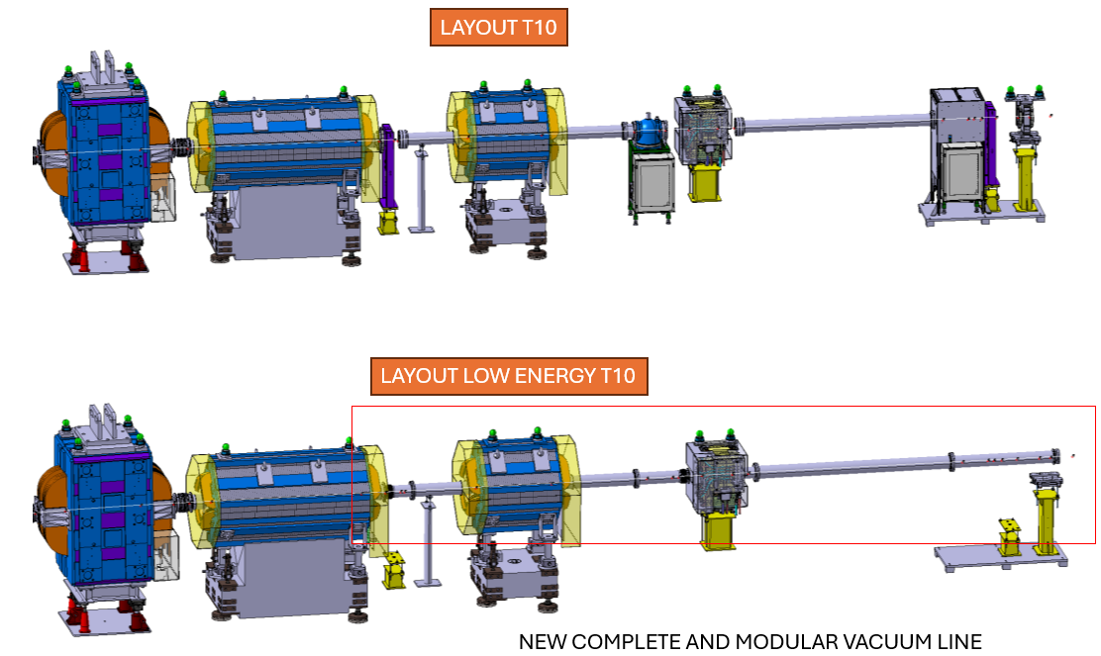
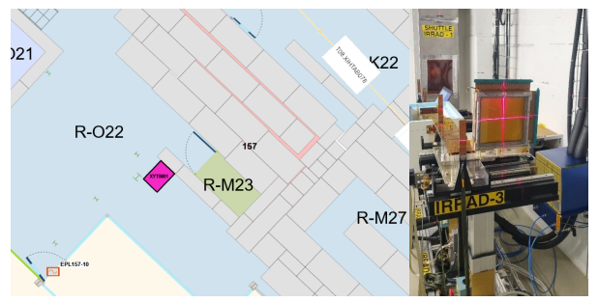
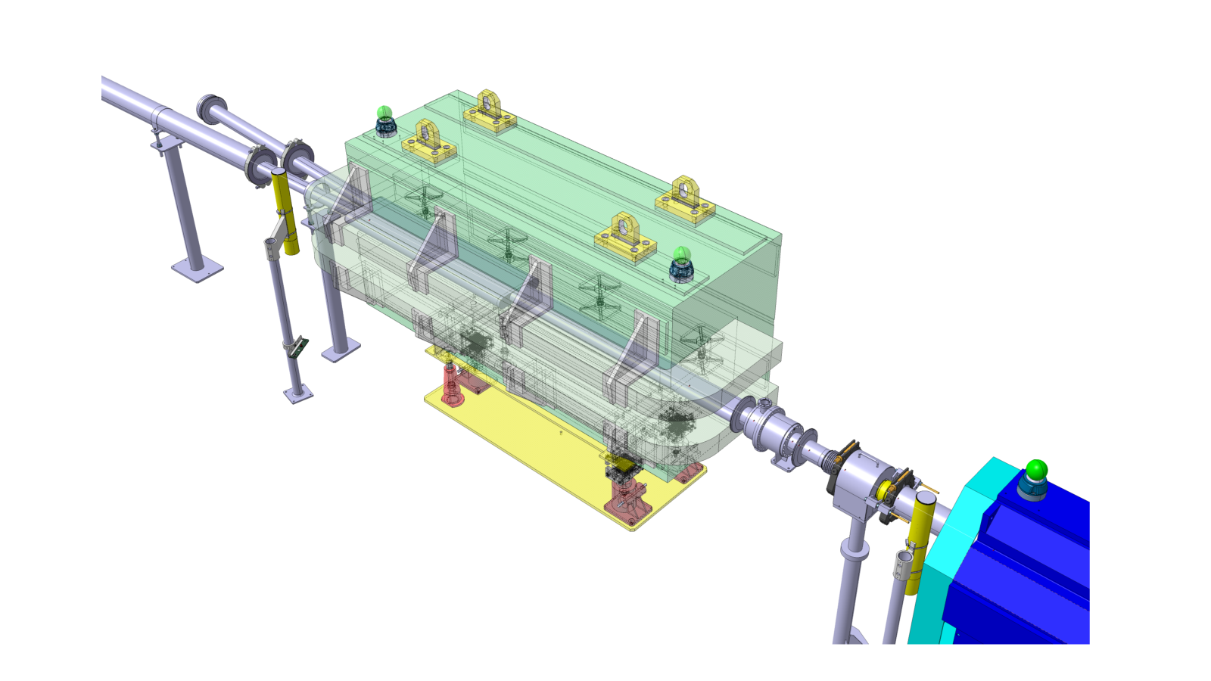
ECRs and Integration East Area – YETS24-25
PERIOD | ZONE | REQUESTOR | TITLE | AUTHOR | TYPE | EDMS link | ECR STATUS | Integration Model NEEDED | Integration Status | ICL/EATM validation
YETS 24/25 | East Area | Operation/users | Vacuum Chamber Installation in F61.MBXHD025 for CHIMERA/HEARTS | Dipanwita Banerjee | ECR | 3138917 - PSZ-V-EC-0001 | In work | YES | Completed | YES
YETS 24/25 | East Area | Operation/users | Low-energy Beams in the T10 Beamline of the East Area | Maarten Van Dijk | ECR |  | In work | YES | Completed | N/A
YETS 24/25 | East Area | CHARM | Installation of Multi-Wire Proportional Chamber (MWPC) in IRRAD Zone 1 | Federico Ravotti | ECR | 3136064 - PSZ-B-EC-0006 | Under approval | NO |  | N/A
New vacuum chamber installation in F61
Low-energy configuration in T10, East Area
New MWPC CHARM

Slide 5
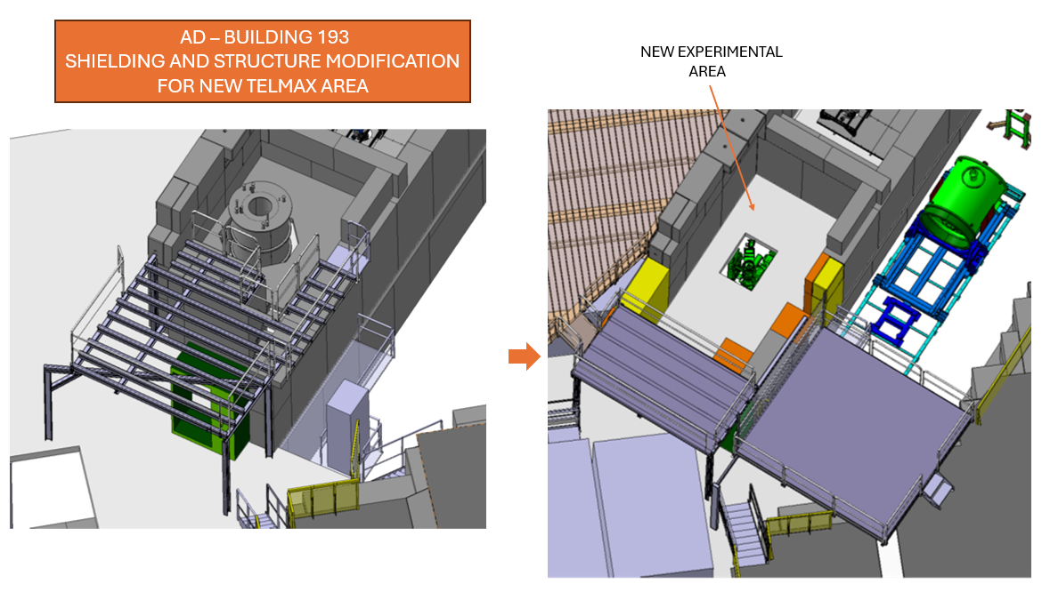
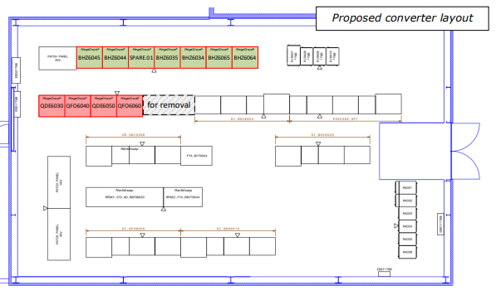
ECRs and Integration AD Complex – YETS24-25
PERIOD | ZONE | Requestor | TITLE | AUTHOR | TYPE | EDMS link | ECR STATUS | Integration Model NEEDED | Integration Status
YETS 24/25 | AD | Operation/users | INSTALLATION OF “TELMAX”, A NEW TEST BEAM EXPERIMENTAL AREA AT AD/ELENA | Francois Butin | ECR | 2975107 - AD-LJ-EC-0026 | Released | YES | Completed
YETS 24/25 | AD | ADCONS | Power Converters for the Quadrupole Magnets DI.QDE6030, DI.QFO6040, DI.QDE6050 and DI.QFO6060 for AD injection | Jean-Marc Cravero | ECR | 3076867 - AD-R-EC-0006 | Released | NO
New Power Converter b.370
Installation of TELMAX

Slide 6
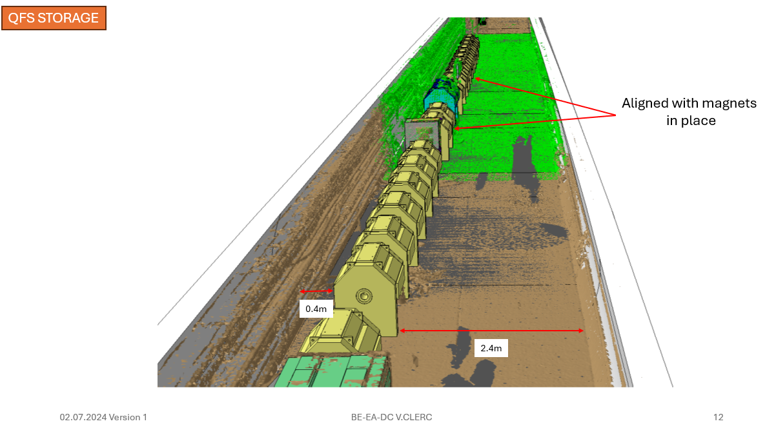
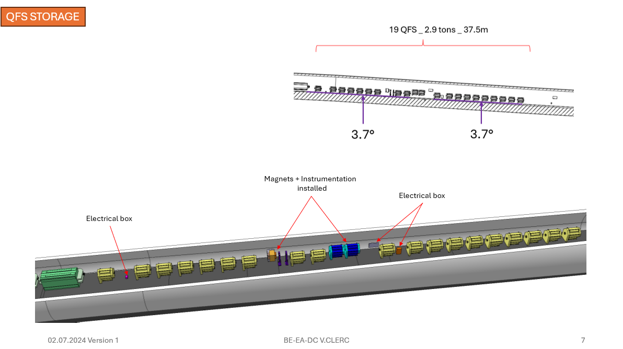
ECRs and Integration HiRadMat/TT61 – YETS24-25
PERIOD | ZONE | PROJECT | TITLE | AUTHOR | TYPE | EDMS link | ECR STATUS | Integration Model NEEDED | Integration Status
YETS 24/25 | HiRadMat | Einstein Telescope (ET) & BST | TT61 MAGNET STORAGE | Cedric Halbert | ECR |  | To do | YES | completed
YETS 24/25 | HiRadMat |  | TT61 decabling | EN-EL | ECR |  | To do | NO
TT61 magnets storage

Slide 7
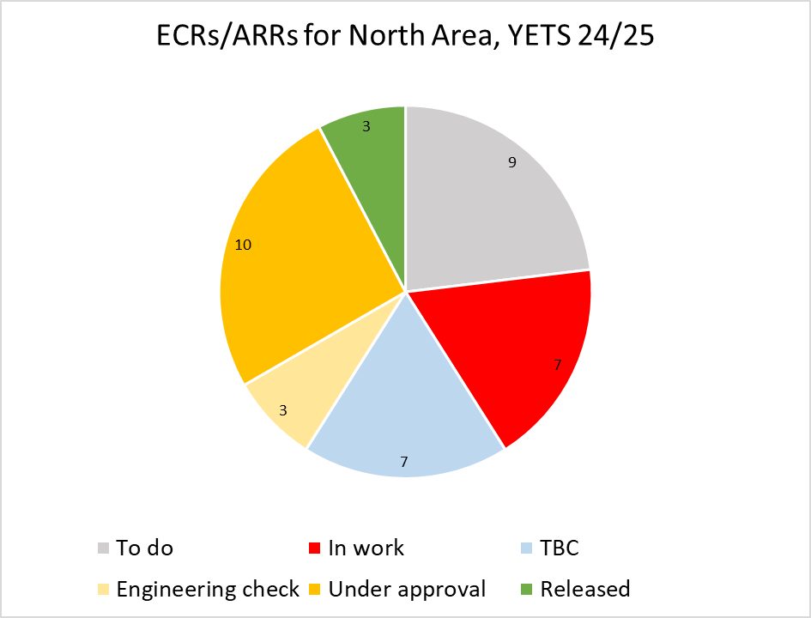
ECRs for North Area YETS24-25
 | ECR | ARR | SRR | TOTAL
North Area | 32 | 6 | 1 | 39
East Area | 3 | 0 | 0 | 3
AD Complex | 2 | 0 | 0 | 2
HiRadMat | 2 | 0 | 0 | 2
TOTAL | 39 | 6 | 1 | 46

Slide 8
ARRs/SRR for North Area YETS24-25
Asset Replacement Requests:
TITLE | AUTHOR | TYPE | EDMS link | JIRA link | STATUS
QNL.041.096 + LSXV.022134 replacement | Philip Schwarz | ARR |  |  | In work
Collimator replacement TBC TDC2/TCC2 | Giulia Romagnoli | ARR |  |  | In work
Replacement/installation tables XTDV.041.528, XTDV.042.500, XTDV.021.612 | Miguel Santos | ARR |  |  | In work
HVAC control cubicles installation BA81, TT84 | Helmut Jena | ARR | 3139745 - SPSX-U-ARR-0003 | https://its.cern.ch/jira/browse/EADOC-497 | Under approval
Pumping units in TCC2 | Philippe Boisseaux-Bourgeois | ARR |  | https://its.cern.ch/jira/browse/EADOC-498 | In work
Elevator installation B911 | Damien Lafarge | ARR | 3154271 - SPSX-J-ARR-0001 | https://its.cern.ch/jira/browse/EADOC-521 | Under approval
Space Reservation Request:
TITLE | AUTHOR | TYPE | EDMS link | JIRA link | STATUS
Fire doors Doors 21, 34, 35, 36, 37, 39, 55, 56, 57, 58a, 58b | Adem Kaymak | SRR | 3119539 - SPSX-SF-EC-0010 | https://its.cern.ch/jira/browse/EADOC-461 | Under approval
Fire doors Doors 7, 32, 21, 34, 35, 36 | Adem Kaymak | ECR | 3120106 - SPSX-SF-EC-0011 | https://its.cern.ch/jira/browse/EADOC-463 | Under approval

Slide 9
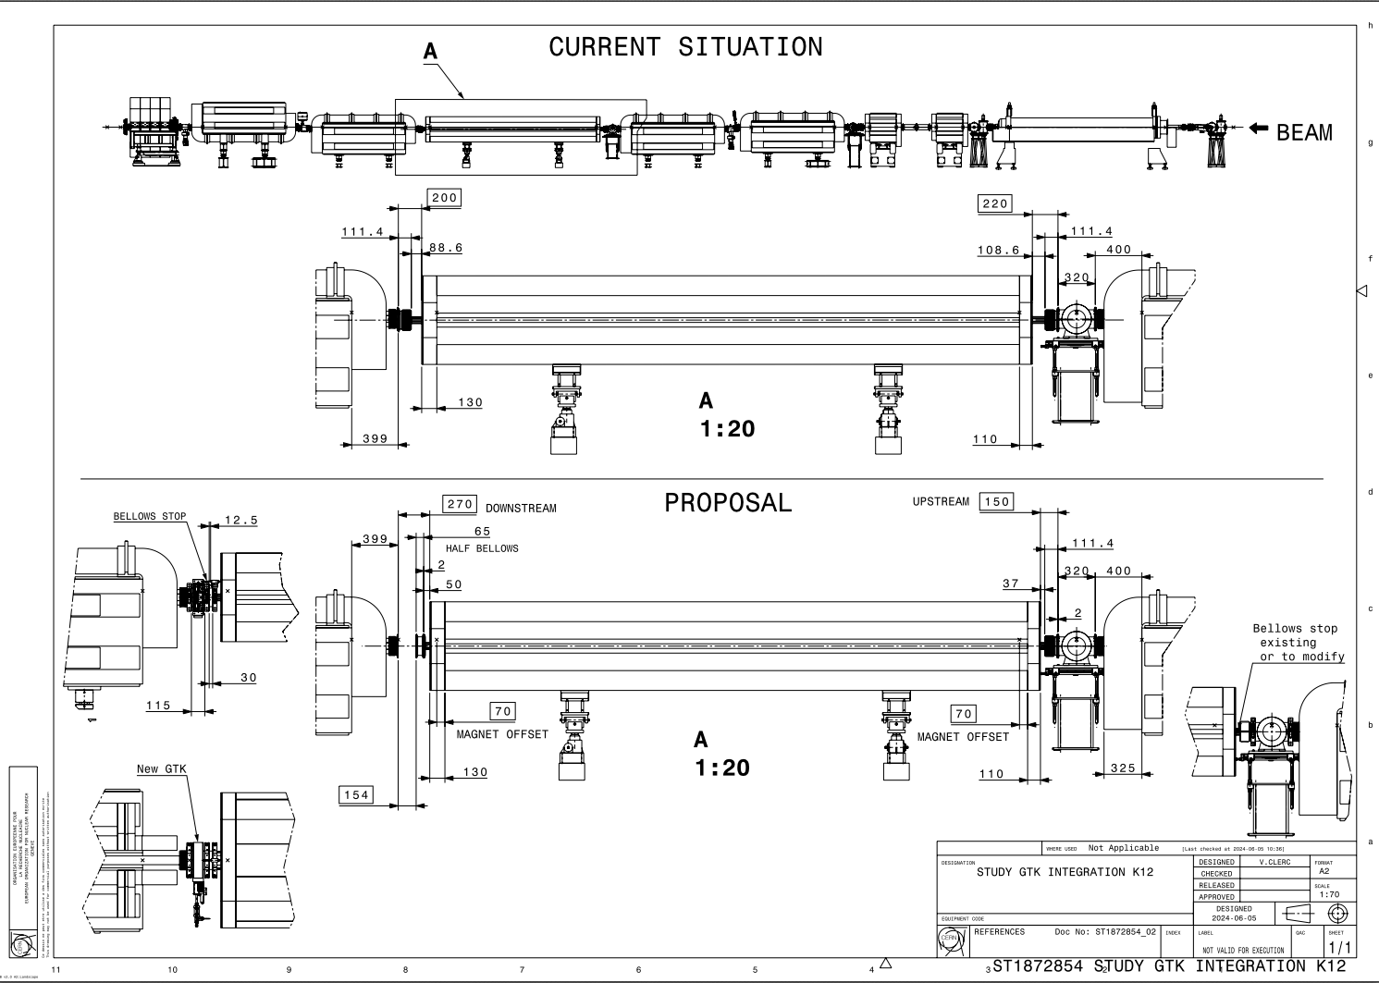
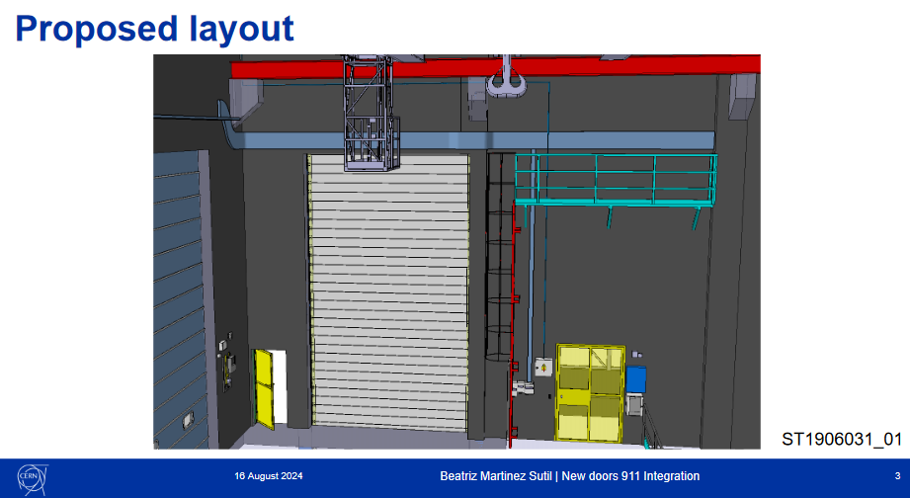
Integration North Area – YETS24-25 – ECN3
PERIOD | ZONE | REQUESTOR | TITLE | AUTHOR | TYPE | EDMS link | ECR STATUS | Integration Model NEED | Integration Status | ICEA/EATM Validation
YETS 24/25 | North Area | Operation/users | Displacement of GTK 4 in ECN3/TCC8 (NA62) | Hans Danielsson | ECR |  | TBC | YES | Completed | NO
YETS 24/25 | North Area | HI-ECN3 | Bldg.911 door | Jean-Louis Grenard | ECR |  | To do | YES | Completed | YES
Displacement of GTK4 in ECN3
Bldg.911 door

Slide 10
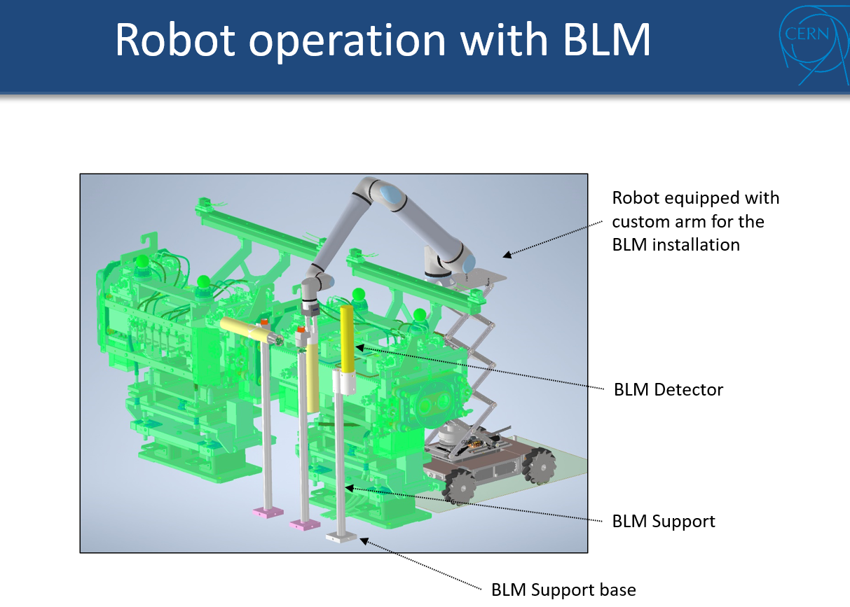
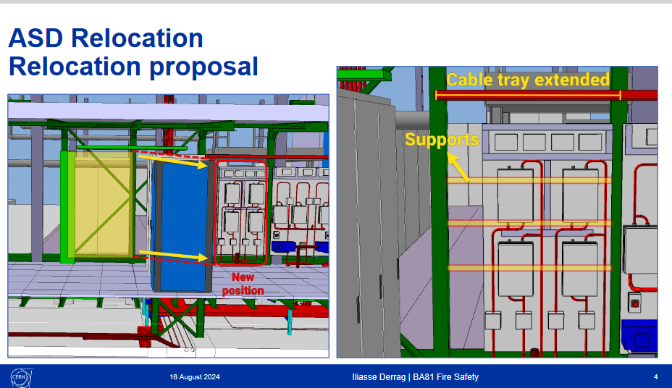
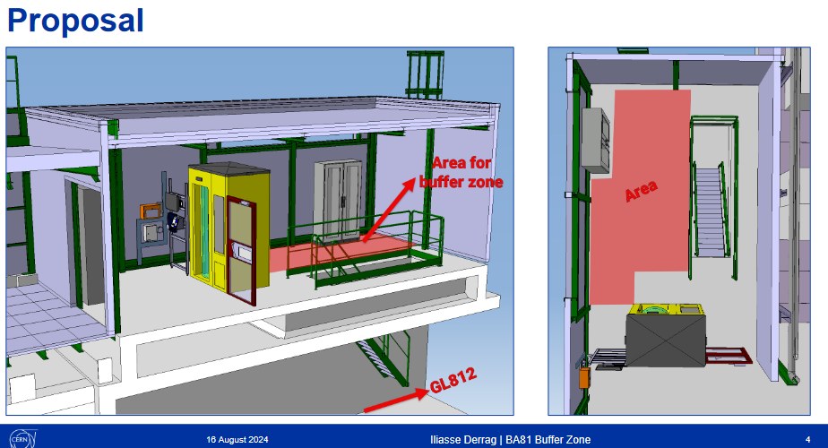
Integration North Area – YETS24-25 – TTs
REQUESTOR | TITLE | AUTHOR | EDMS link | ECR STATUS | Integration Model NEED | Integration Status | ICEA/EATM validation | Dates | Duration
HI-ECN3 | Installation 5 additional units of BLMs on P42 | Christos Zamantzas |  | TBC (->LS3) | YES | Not started | NO | Start sept-24 | 1 week
NACONS | BA81 Extension | Mehdi Abdel Kebir, Rachid Haddad | 3093423 - SPSX-SF-EC-0009 | Under Approval | YES | Completed | YES
NACONS | Ventilation for the BA81 Extension | Jani Lehtinen | 3156846 - SPSX-U-EC-0001 | To do | YES | Completed | YES
Operation | Buffer zone BA81 | Sylvain Girod, Iliasse Derrag | 3151414 - SPSX-J-EC-0007 | In work | YES | in progress | NO | End sept-24 | 1 week
NACONS | Fire Detection BA81 | Rachid Haddad | 3126083 - SPSX-SF-EC-0012 | Under Approval | YES | completed | YES
NACONS | Smoke Detection and Evacuation in BA81 | Michael Jeckel | ECR | Engineering check | NO |  | YES
BLM studies
BA81 extension (fire safety)
Buffer zone BA81

Slide 11
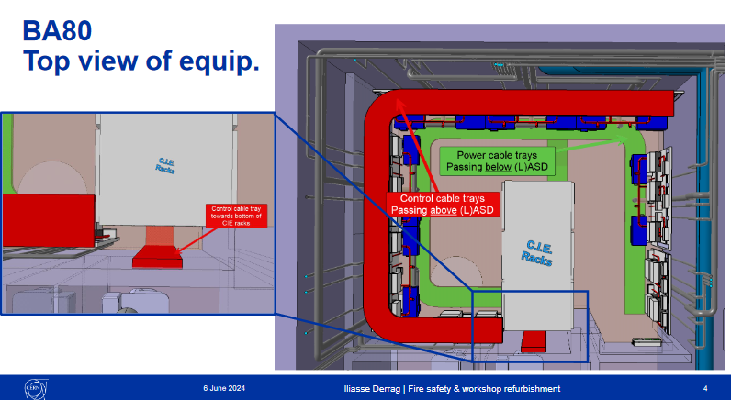
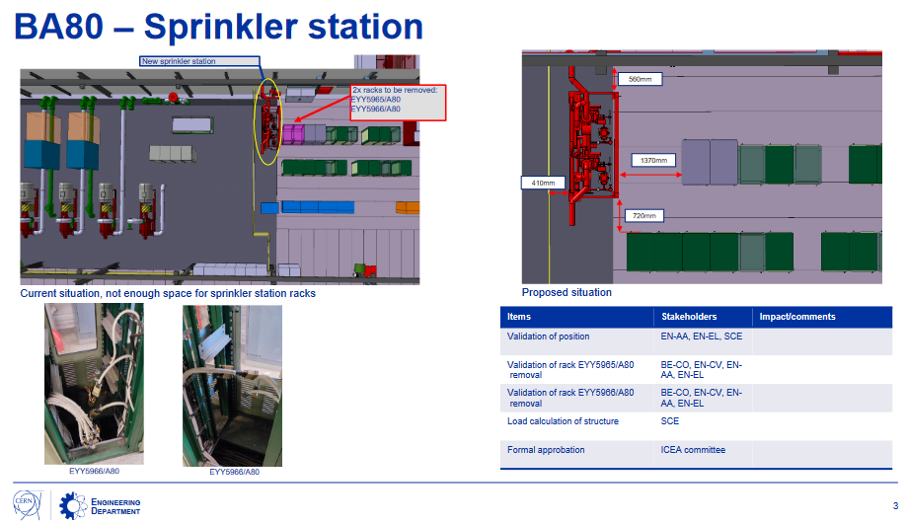
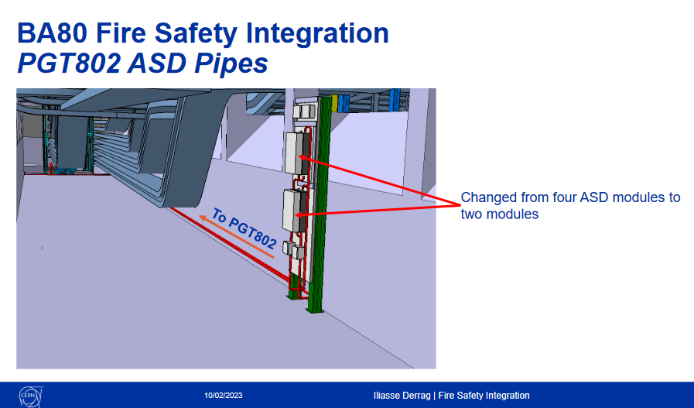
Integration North Area – YETS24-25 – TDC2/TCC2/BA80
REQUESTOR | TITLE | AUTHOR | EDMS link | ECR STATUS | Integration Model NEED | Integration Status | ICEA/EATM validation | Deadline | Duration
Operation/user | Mise en place blindage BA80/ BTV BDF installation | Sylvain Girod / Rui Ximenes |  | To do | TBC | completed | YES
HI-ECN3 | SX prototype Target heads in TCC2 | Rui Franqueira Ximenes |  | TBC | NO
NACONS | Fire Detection BA80 | Rachid Haddad | 3128278 - SPSX-SF-EC-0014 | In work | YES | completed | YES
NACONS | BA80 Fire Detection Building | Florian Deperraz | 2997829 - SPSX-SF-EC-0005 | Under approval | YES | completed | YES
NACONS | Sprinkler installation TA801, PGT802 - GL802 | Florian Deperraz | 2930745 - SPSX-SF-EC-0004 | Released | YES | completed | YES
BA80 fire detection bldg.
Sprinkler installation
Fire detection BA80

Slide 12
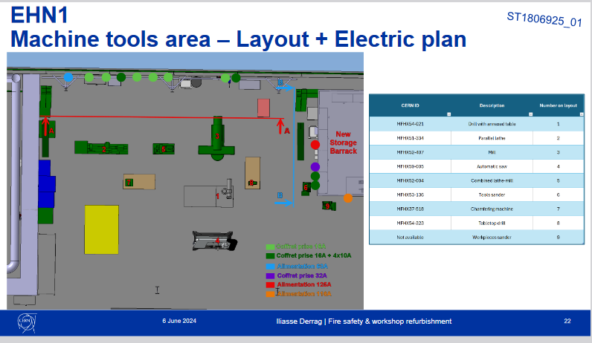
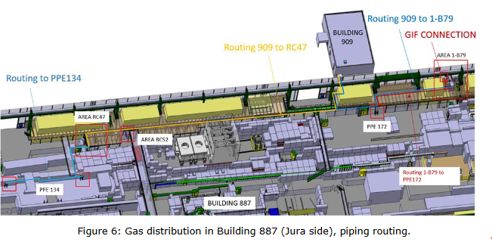
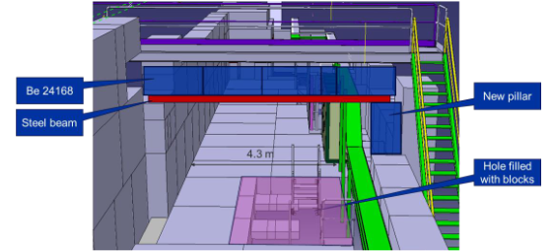
Integration North Area – YETS24-25 – EHN1
REQUESTOR | TITLE | AUTHOR | EDMS link | ECR STATUS | Integration Model NEED | Integration Status | ICEA/EATM validation | Deadline | Duration
NACONS | Gas consolidation EHN1 | David Jaillet | 2973540 - SPSX-F-EC-0005 | Released | YES | completed | YES
Operation | Reorganisation atelier EHN1 | Iliasse Derrag | 3089621 - SPSX-J-EC-0005 | Engineering check | YES | completed | YES
Operation | Upgrade of XEMC support on H8 beamline | Eva Kamenicka |  | To do | YES | in progress | NO | Oct-24 | 2 weeks
NACONS | Consolidation project for gas extraction for EHN1 PJ_346 | Jani Lehtinen |  | To do | YES | completed | YES
NACONS | PPE144 patch panel installation with passarelle modification | Sylvain Girod | 3121860 - SPSX-J-EC-0006 | Under approval | YES | completed | YES
Operation/users | Madmax TBC | Maarten Van Dijk |  | TBC | YES | stand-by | NO
NACONS | Smoke Detector in EHN1 Galleries | Michael Jeckel | 3072500 - SPSX-SF-EC-0008 | Under approval | YES | completed | YES
Operation/users | GIF++ extension / gas balcony | Martin Jaekel |  | To do | YES | completed | NO
NACONS | Replacement turbine chauffage jura lausanne EHN1 | Fred Juban |  | To do | NO
Reorganisation atelier EHN1
Gas consolidation EHN1
PPE144 modification

Slide 13
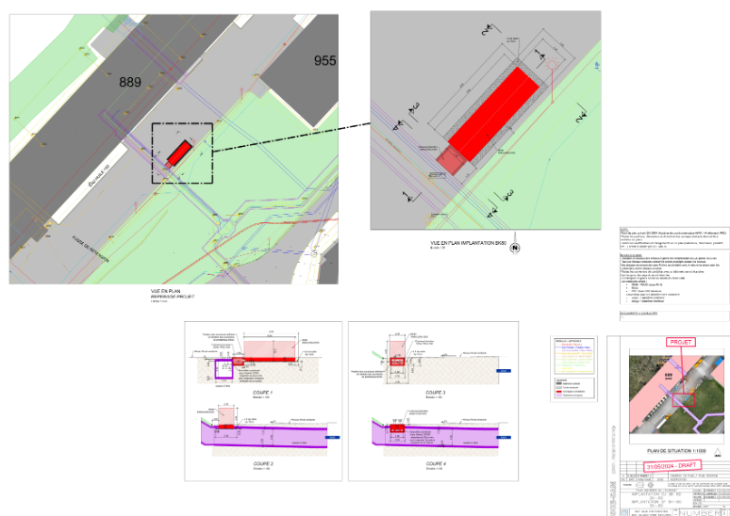
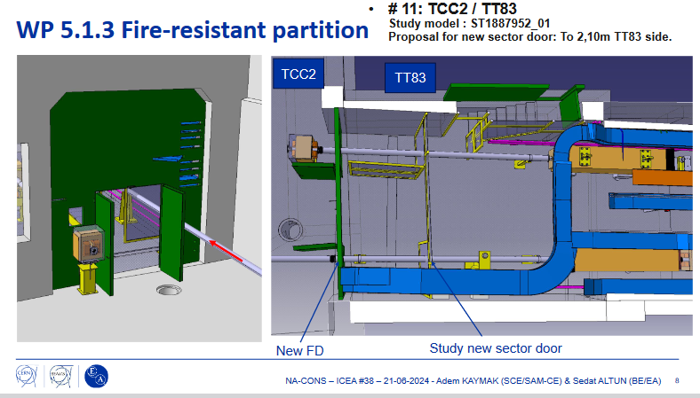
Integration North Area – YETS24-25 – All
REQUESTOR | TITLE | AUTHOR | EDMS link | ECR STATUS | Integration Model NEED | Integration Status | ICEA | Deadline | Duration
NACONS | Installation of BK80, BK81, BK82 electrical substations in the NA during run 3 (works for YETS 24-25) | Eva Cano Gonzalez | 3126108 - SPSX-E-EC-0005 | Under approval | YES | completed | YES
NACONS | Fire doors Doors 21, 34, 35, 36, 37, 39, 55, 56, 57, 58a, 58b | Adem Kaymak | 3119539 - SPSX-SF-EC-0010 | Under approval | YES | completed | YES
NACONS | Fire doors Doors 7, 32, 21, 34, 35, 36 | Adem Kaymak | 3120106 - SPSX-SF-EC-0011 | Under approval | YES | completed | YES
NACONS | Optical fibre installation EHN1, EHN2, BA82 (IT), BX83 918 (IT) ECN3 | Jeremy Blanc |  | To do | TBC | Stand-by
NACONS | Rad hard profile monitors TBC | Inaki Ortega |  | To do | TBC | Stand-by
NACONS | XBPF Installation | Inaki Ortega |  | To do | YES | Stand-by
NACONS | Protection against accidental contacts for normal conducting magnets (149/290) | Olivier Crettiez | 3124339 - SPSX-M-EC-0004 | Under approval | NO
NACONS | CESAR renovation | Maciej Peryt | 3095571 - SPSX-C-EC-0002 | Released | NO
P42 dump
Fire doors

Slide 14
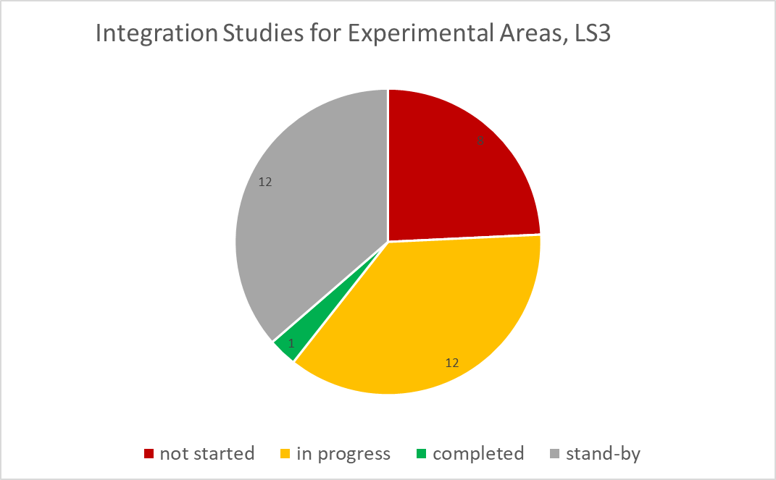
Integration Studies Experimental Areas LS3
Not started: activity needs an integration study, not yet started
In progress: integration study started
Stand-by: integration study started but in stand-by waiting for external inputs
Completed: study completed and approved by ICEA* (where applicable)
 | Integration Studies
North Area | 27
East Area | 2
AD Complex | 4
HiRadMat | 0
TOTAL | 33
*Integration Committee for Experimental Areas (ICEA)
https://indico.cern.ch/category/14476/

Slide 15
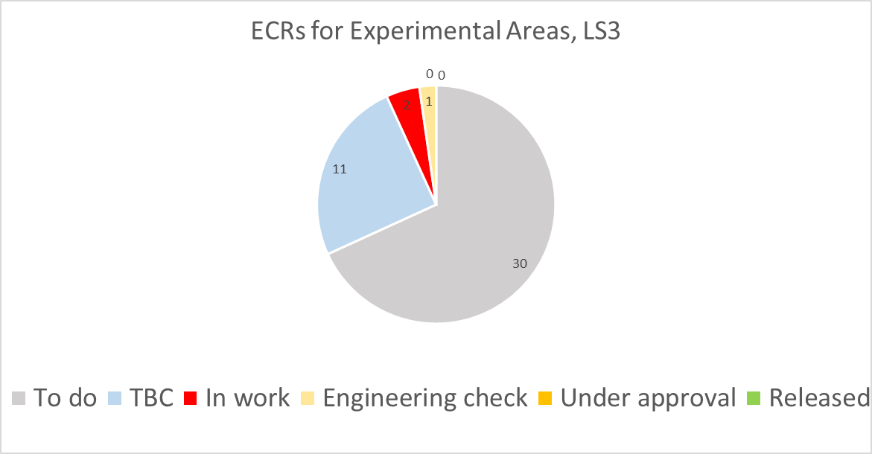
ECRs for Experimental Areas LS3
To do: activity in need of ECR from planning/PLAN, author contacted, waiting for answer
TBC: activity to be confirmed
In work: draft version available/author is writing
Engineering check: document circulating for first round of comments
Under approval: document circulating for final approval
Released: document approved and presented to EATM/IEFC
 | ECR
North Area | 34
East Area | 5
AD Complex | 5
HiRadMat | 0
TOTAL | 44

Slide 16
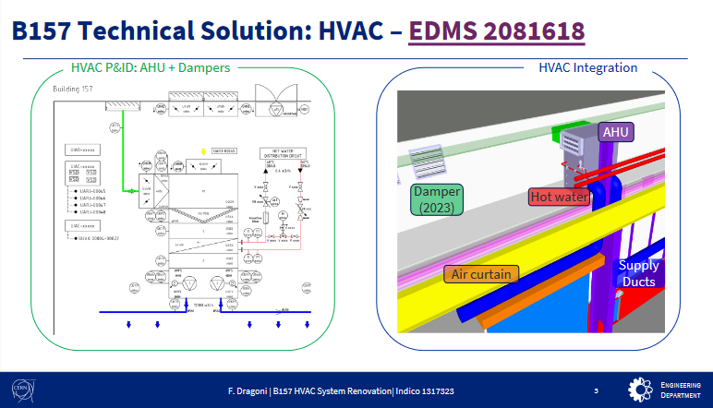
Integration/ECRs East Area – LS3
REQUESTOR | ZONE | TITLE | AUTHOR | TYPE | STATUS | Integration Model | Integration Status | ICL/EATM validation | Period for integration study | Duration
BE-EA | East Area | XCET body exchange | Giulia Romagnoli | ECR | To do | NO | not needed | N/A
EAR | East Area | Renovation HVAC of the building 157 | Francesco Dragoni | WPD | Released | YES | Stand-by | NO | in discussion with GL
BE-EA | East Area | Electron beam in T10 Beamline of the East Area | Maarten Van Dijk | ECR | To do | TBC | Stand-by | NO
User | East Area | P349 in T11 experimental area |  | ECR | TBC | TBC | Stand-by
HEARTS | East Area | T08 beamline modifications |  | ECR | TBC | TBC | Stand-by
Renovation HVAC of the building

Slide 17
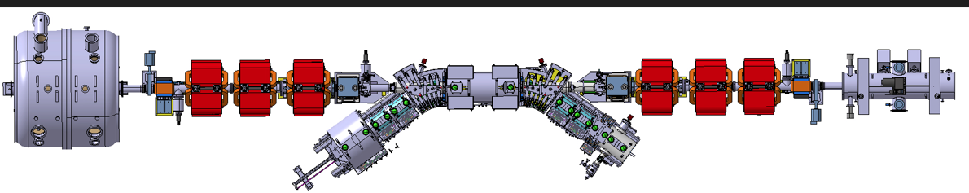
Integration/ECRs AD – LS3
PERIOD | ZONE | TITLE | AUTHOR | TYPE | ECR STATUS | Integration Model | Integration Status | EATM validation | Period for integration study | Duration
LS3 | AD | New AD e-cooler installation | Adriana Rossi | ECR | To do | YES | in progress | NO | 2024-2025 | 2 month?
LS3 | AD | Power converters and magnets to be changed in line DI | EPC | ECR | TBC | NO | not needed
LS3 | AD | Equipment BCCCA | BI | ECR | TBC | TBC | TBC |  | 2025 | 1 week
LS3 | AD | Exp. Telmax 2nd part “ligne horizontale” | Francois Butin | ECR | TBC | TBC | TBC |  | 2025 | 4 weeks
LS3 | AD | ALPHA control room 2nd floor | Francois Butin | ECR | TBC | TBC | TBC |  | 2025 | 3 weeks
AD | 2024 | 2025
Total Integration study with ECR | ~1 months | ~3 months
New AD e-cooler installation

Slide 18
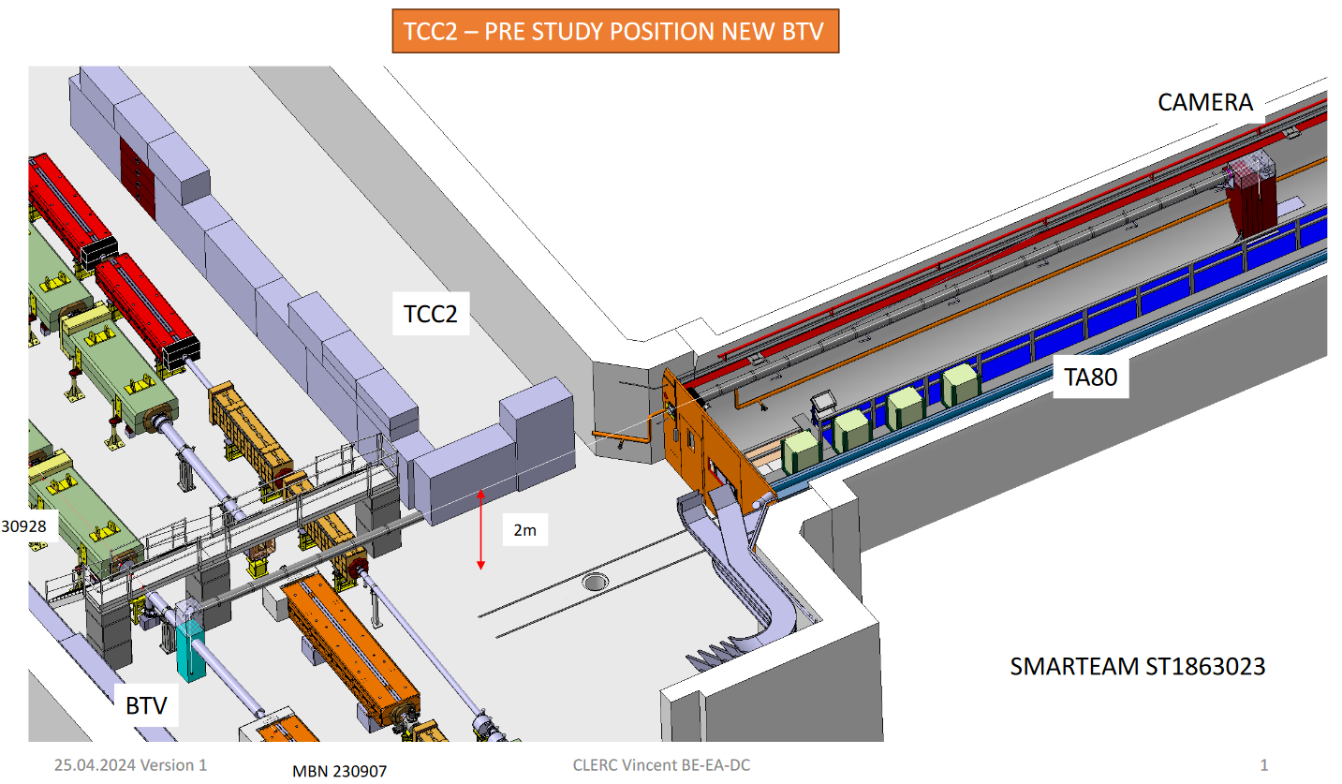
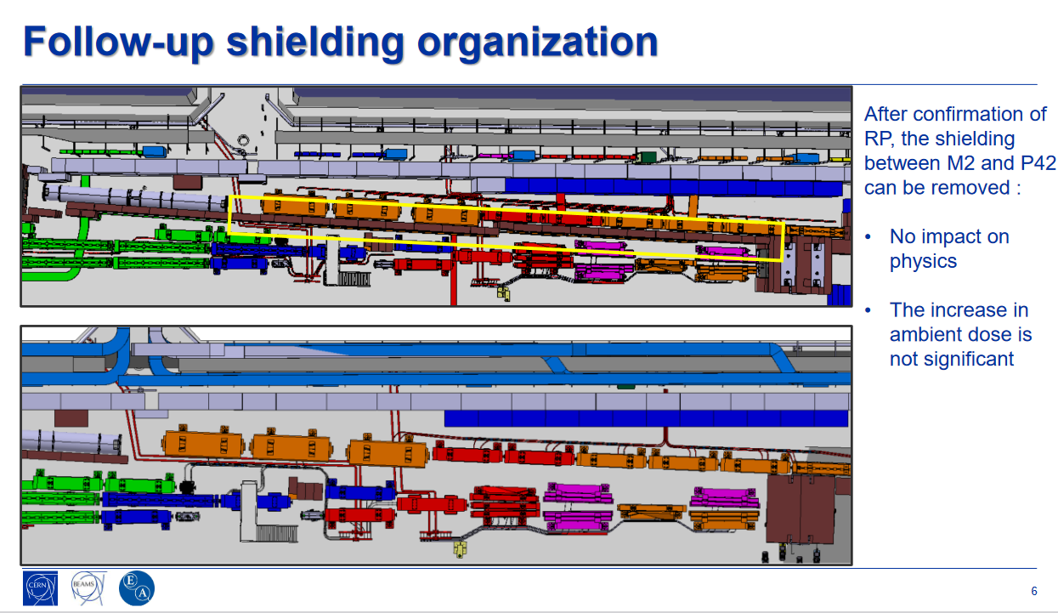
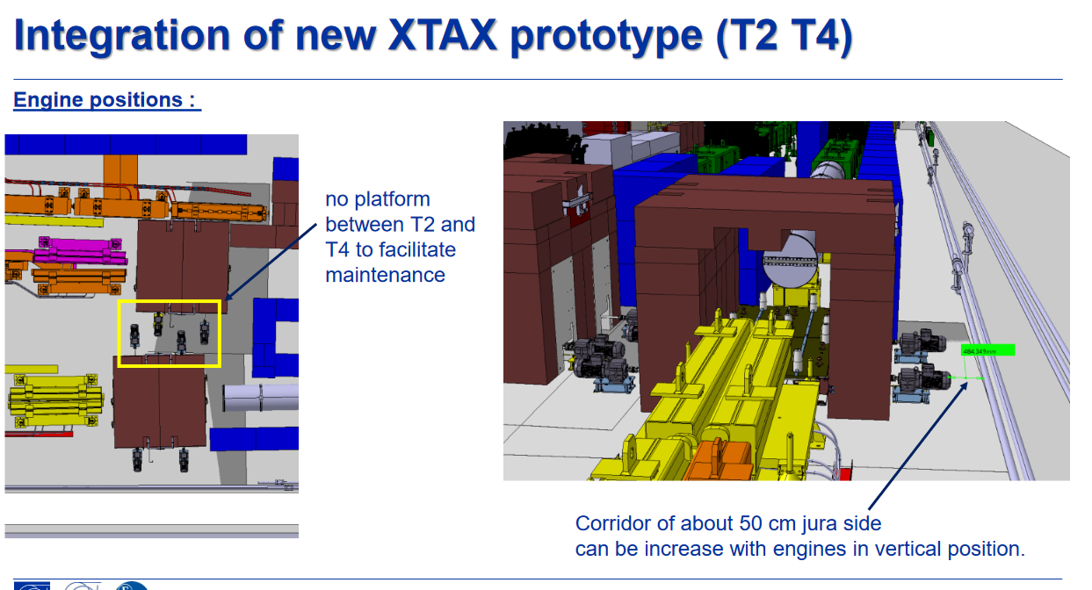
Integration/ECRs North Area TDC2/TCC2 – LS3
REQUESTOR | TITLE | AUTHOR | EDMS link | JIRA link | ECR STATUS | Integration Model | Integration Status | ICEA/EATM validation | Period for integration study | Duration
NACONS | (Re)installation of BSP.043167 and BSP.043062 | AURELIE GOLDBLATT |  |  | In work | YES | stand-by | NO | 2024-2025 | 2 weeks
NACONS | XTAX New Design in TCC2 | Miguel Lino |  |  | To do | YES | in progress | NO | 2024 | 2 weeks
NACONS | BA80 Power converters | Ivan Josifovic |  |  | To do | YES | In progress | NO | 2024-mid25 | 3 months
NACONS | BTV 230925 installation in TCC2 | Nikos Charitonidis |  |  | To do | YES | in progress | NO | 2024 | 2 weeks
NACONS | New Layout TCC2 | Michael Lazzaroni |  |  | To do | YES | in progress | NO | 2024 | 1 month
NACONS | BA80 Cooling Station Consolidation | Laurentiu Vlasceanu |  |  | To do | YES | stand-by | NO | 2025 | 1 month
NACONS | Overpressure system TDC2 | Jani/Serge |  |  | To do | TBC | stand-by |  | 2025 | 1 month
NORH AREA | 2024 | 2025 | 2026
Total Integration study with ECR | ~2 months | ~5 months
BTV installation in TCC2
New TCC2 Layout
XTAX new design in TCC2

Slide 19
Integration/ECRs North Area EHN1/EHN2/ALL – LS3
REQUESTOR | TITLE | AUTHOR | EDMS link | JIRA link | ECR STATUS | Integration Model | Integration Status | ICEA/EATM validation | Period for integration study | Duration
Operation | Patch panel PPE211 EHN2/M2/BA82 and othe modifications to PPE211 | Sylvain Girod |  |  | To do | YES | not started | NO | Jan25-Dec25 | 2 weeks
Operation | Shielding Improvement for the High Intensity Hadron Operation of M2 | Dipanwita Banerjee | 2868386 | DOC-304 | Eng. check | YES | completed | YES
Operation/users | ILC Beam Dump on the H4 beamline | Krystian Sidorowski |  |  | TBC | YES | in progress | NO
NACONS | XCET gas control and gas panel upgrade | Giulia Romagnoli |  |  | To do | NO | not needed
NACONS | XCET gas racks, N2 flushing and GHG gas lines installation | David Jaillet |  |  | To do | YES | not started | NO | Jan25-Jun25 | 3 months
REQUESTOR | TITLE | AUTHOR | EDMS link | JIRA link | ECR STATUS | Integration Model | Integration Status | ICEA/EATM validation | Period for integration study | Duration
NACONS | Fire doors Doors | Adem Kaymak |  |  | To do | YES | in progress | Partially | 2024-2026 | 2 months
NACONS | XPBF Installation | Inaki Ortega |  |  | To do | YES | in progress | NO | 2024-2025 | 1 month
NACONS | BIS/WIC implementation | Ivan/Richard |  |  | To do | YES | in progress | NO | 2024-mid25 | 1 week
NACONS | Pulsed/stable network renovation | Eva Cano |  |  | To do | TBC
NACONS | SCADA/UPS/AUG | Eva Cano |  |  | To do | TBC
NACONS | Dry risers , CAFS installation (2x TDC8,2x R-270 EHN1, 2x R-290 EHN1, 2x EHN2, 2x bottom of 911, 2x bottom of 912 2 x PA80), fire damper and duct modification | Jani Lehtinen/Miikka Leinonen |  |  | To do | YES | in progress | Partially | 2024-mid25 | 1 month
NORH AREA | 2024 | 2025 | 2026
Total Integration study with ECR | ~ 1 month | ~ 4 months | ~ 3 months

Slide 20
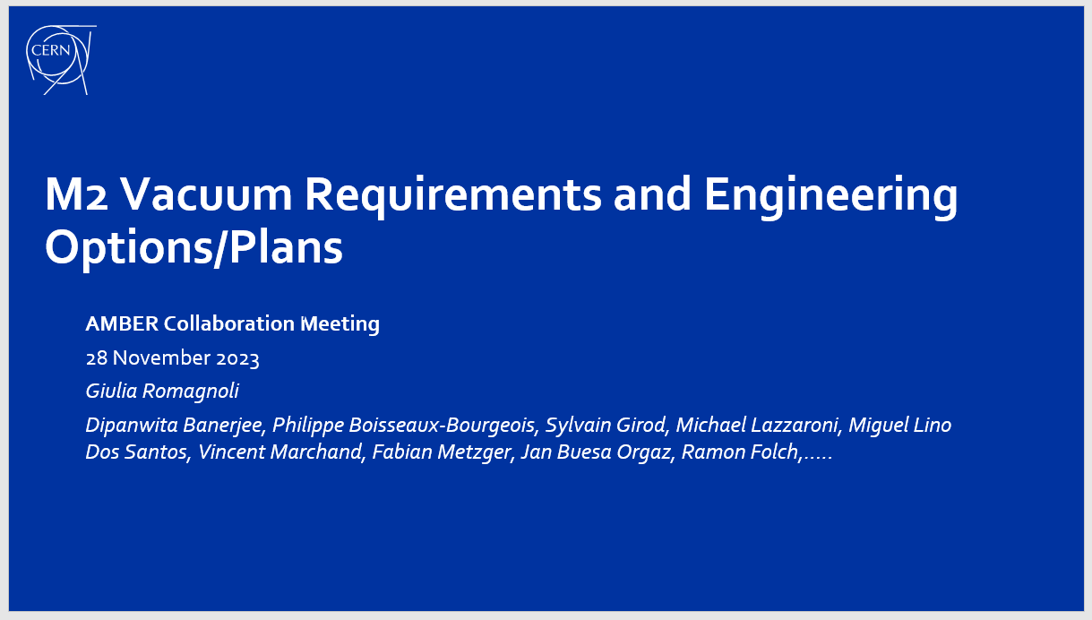
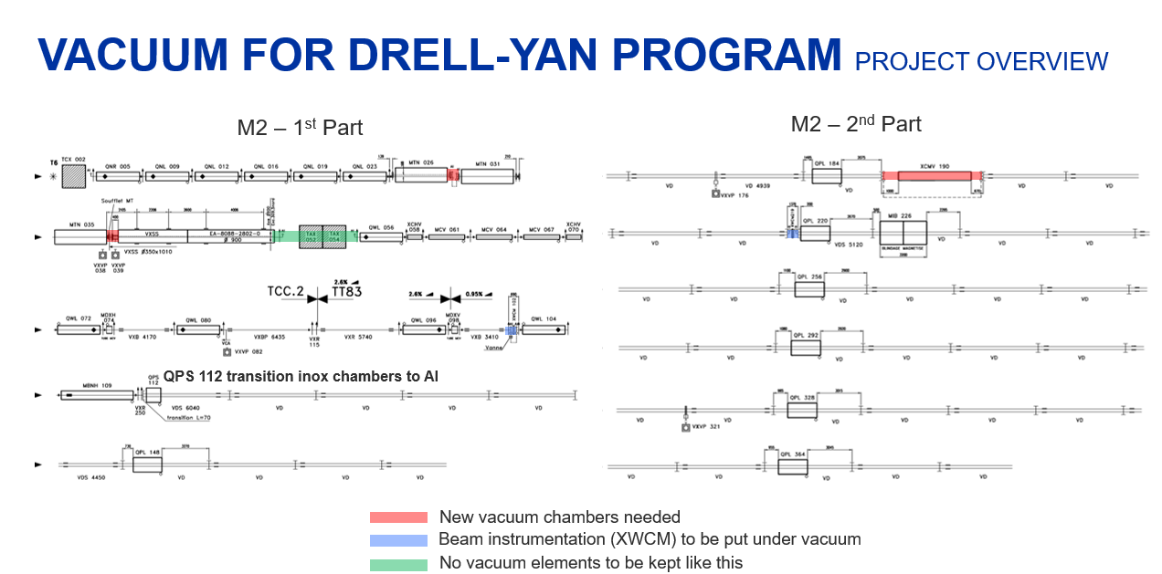
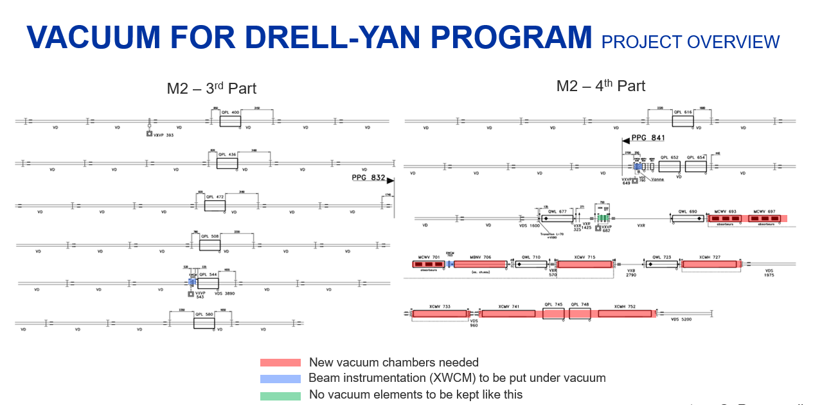
Integration/ECRs North Area M2– LS3
REQUESTOR | TITLE | AUTHOR | EDMS link | JIRA link | ECR STATUS | Integration Model | Integration Status | ICEA/EATM validation | Period for integration study | Duration
NACONS | Replacement and installation of XCSV on M2 instead of XCBV | Giulia Romagnoli |  |  | To do | YES | not started | NO | Jan25-Dec25 | 2 weeks
NACONS | Consolidation of XCM collimators in M2 beamline | Giulia Romagnoli |  |  | To do | YES | not started | NO | Jan25-Dec25 | 6 months
NACONS | M2 Vacuum Upgrade | Giulia Romagnoli |  |  | To do | YES | not started | NO | Jan25-Dec25 | 6 months
NORH AREA | 2024 | 2025 | 2026
Total Integration study with ECR |  | ~12 months
Engineering specifications for M2 vacuum

Slide 21
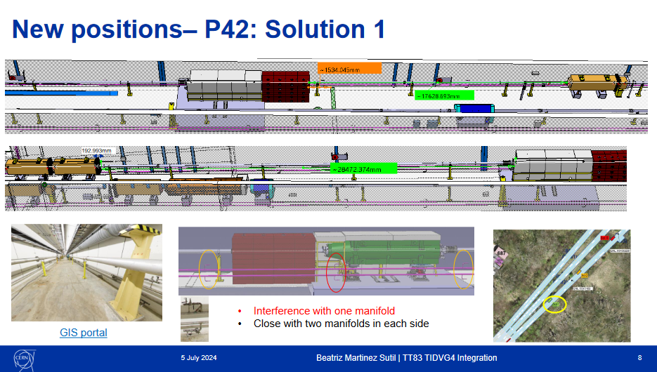
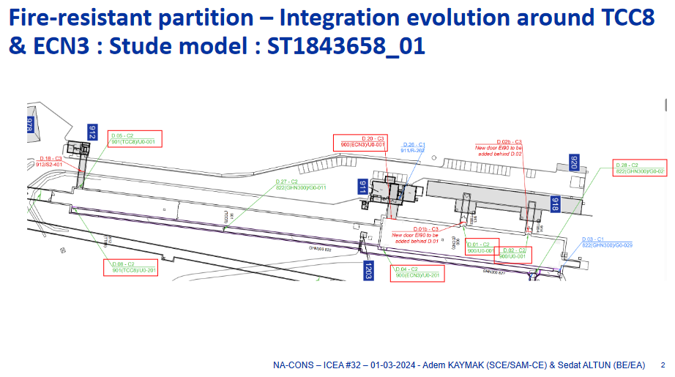
Integration/ECRs North Area (HI)ECN3 – LS3
REQUESTOR | ZONE | TITLE | AUTHOR | TYPE | EDMS link | JIRA link | ECR STATUS | Integration Model | Integration Status | ICEA/EATM validation | Period for integration study | Duration
HI-ECN3 | North Area | Service trench rerouting | Fernando Pedrosa | ECR |  |  | To do | YES | in progress | NO | 2024 | 2 weeks?
HI-ECN3 | North Area | P42 Dump | Rui Franqueira Ximenes | ECR |  |  | To do | YES | in progress | NO | 2024 | 2 weeks
HI-ECN3 | North Area | XTAX, VXSS and magnets change for P4 line | Laurence Nevay | ECR |  |  | To do | YES | in progress | NO | 2024-2025 | 1 month ?
HI-ECN3 | North Area | P42 Beam instrumentation re-installation | Laurence Nevay | ECR |  |  | To do | YES | not started | NO | 2024-2025 | 2 weeks?
HI-ECN3 | North Area | P42 XTCX/XCHV removal | Giulia Romagnoli | ECR |  |  | To do | NO | not needed
HI-ECN3 | North Area | NA62 Dimountling | Hans Danielsson | ECR |  |  | To do | YES | not started | NO | 2025 | 2 months
NACONS | North Area | Fire Detection ECN3 | Rachid Haddad | ECR | 3126099 | EADOC-471 | In work | YES | stand-by | NO | 2025 | 2 months
HI-ECN3 | North Area | Installation beam stopper P4 line | Rui Franqueira Ximenes | ECR |  |  | TBC
HI-ECN3 | North Area | Installation new BLM system for K12 TDC2, for ECN3 (part 2) TT83, TT85 | Christos Zamantzas | ECR |  |  | To do | YES | not started |  | Start sept-24 | 1 month
NACONS | North Area | Fire door 11 | Adem Kaymak |  |  |  | To do | YES | stand-by | NO | 2025-2026 | 1 week
HIECN3 | 2024 | 2025
Total Integration study with ECR | ~2 months | ~6 months
P42 dump
Fire detection ECN3

Slide 22
Integration study phase
T0 – 7 months min.
ECR circulation
T0 – 6 months
Planning EDMS
T0 – 4 months
Installation
T0
ECR – validation
T0 – 5 months
Conclusions - Integration
Follow-up :
  ECR → EATM, IEFC, coordination meeting
  Integration→ ICEA, ICL, EATM
  NACONS project (TCC, project boards, WPs meetings, etc…) + HI-ECN3 Project
  Tools → JIRA-KANBAN, EVM
Activities inventory: PLAN, IMPACT, Meetings (SBA, EATM…)
2024, 25 & 26 Integration studies (listed above) duration compatible with the current workforce (Design offices, Origins, STAFF) and the others design works of BE-EA design office

Slide 23

Conclusions ECRs
Discussion with groups and authors on going….to finalized the “to do”, “TBC” and “in work”
Deadline for first circulation for YETS24/25 = end of September 2024
Deadline for first circulation for LS3 = 17th November 2025

Slide 24
THANK YOU!!

