Slide 1
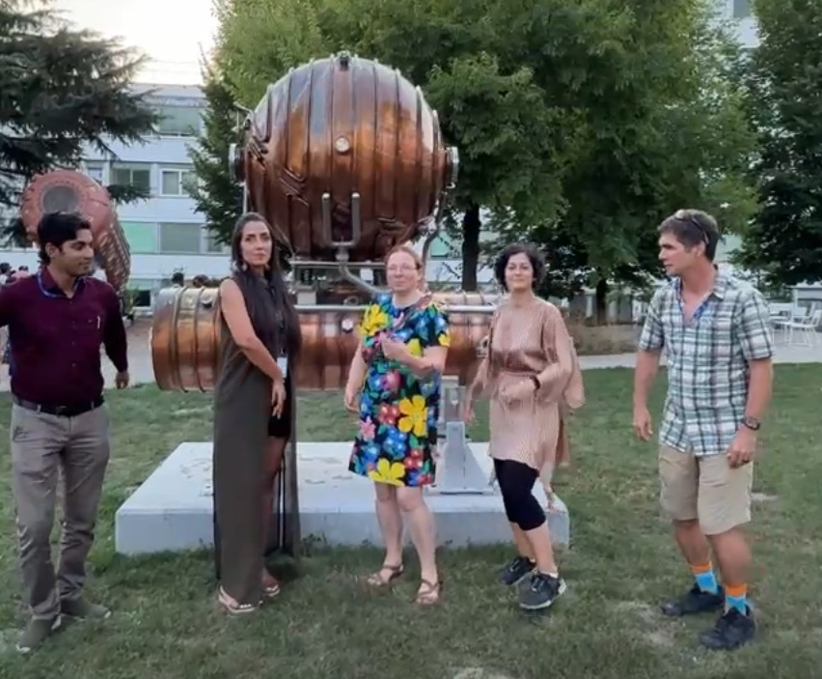
Particle Accelerators
ITW2025 Study Group 7
Nour (Lebanon), Will (Peru), Marija (Serbia), Aili (Estonia), Suman (India)

Slide 2
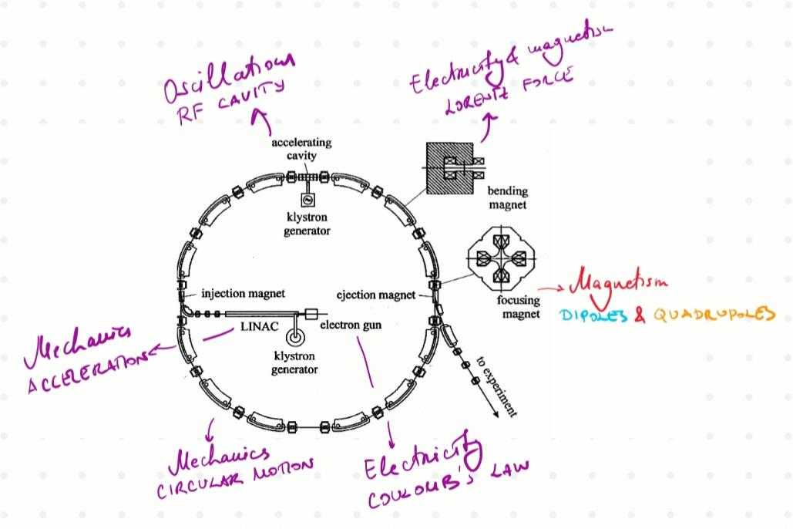
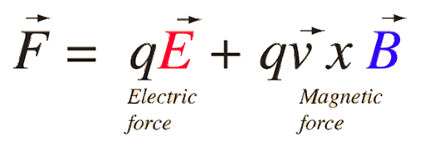
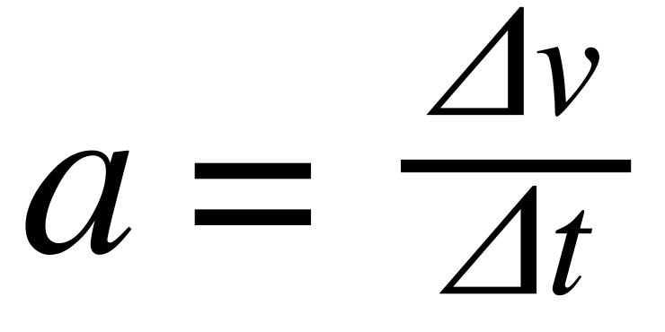
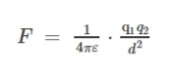
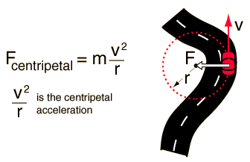
Curriculum & Classroom Connections

Slide 3
Key Ideas/Best Practice Example
Accelerators use electric fields to increase particle speed and magnetic fields to steer and focus the beams
Particle interactions
(Coulomb's Force & Collisions)
Synchronizing (Oscillations)
Linear vs Circular
Students demonstrate particle acceleration
Notes:
Outline the key components of an accelerator
Particle
Electric field (RF cavity)
Drift Tube
Magnetic field
Students assigned a role
Act out accelerator
Linear accelerator
Circular accelerator
Highlight differences between types of accelerators and also their connections

Slide 4
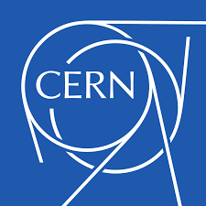
Potential Students’ Conceptions & Challenges
Scale & Size Misconception –
Microscopic and Macroscopic scales
Purpose Confusion –
Not energy production but particle production
Complex Terminology & Acronyms
CERN, LHC, ALICE, ATLAS, CPS, SPS
Invisible Processes
difficulty visualizing particle motion, collisions, and detection
What accelerators are not?
Only used by physicists
Always colliders
Blackhole creators

Slide 5
Useful Material & Resources
For Students
CERN Education Resources: https://home.cern/resources
CERN’s “Accelerating Science” Booklet (Free PDF)
CERN “Accelerator Toolbox”: https://acceleratingnews.web.cern.ch/
Interactive Simulation – PhET “Charges and Fields” & “Magnet and Compass”:https://phet.colorado.edu
YouTube Channels :CERN official channel.
3D Models
.
📖 For Colleagues
CERN Academic Training Lectures (Video Archive): https://indico.cern.ch/category/5961/
CAS – CERN Accelerator School: https://cas.web.cern.ch/
Accelerator & Beam Physics Notes: https://www.slac.stanford.edu/
Accelerator Software Tools (For Demonstrations) G4Beamline – particle tracking simulation. MAD-X – CERN’s accelerator design program.

Slide 6
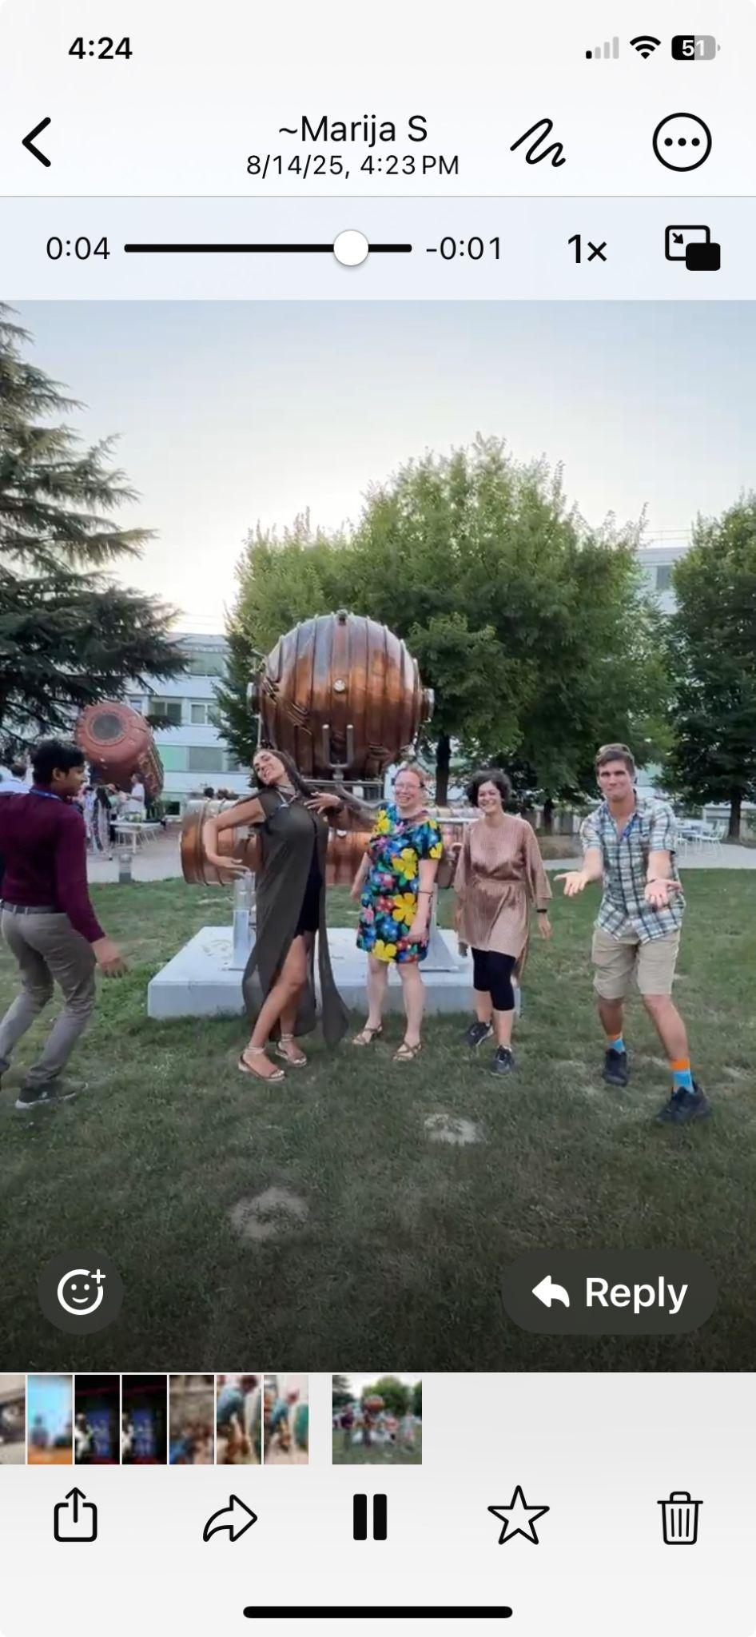






ITW2025 Study Group 7
Nour (Lebanon), Will (Peru), Marija (Serbia), Aili (Estonia), Suman (India)
One way in which our thinking has changed…
view
lifted
ed
but not strangers
to Earth

