Slide 1
Particle Detectors
ITW2025 Study Group 1

Slide 2

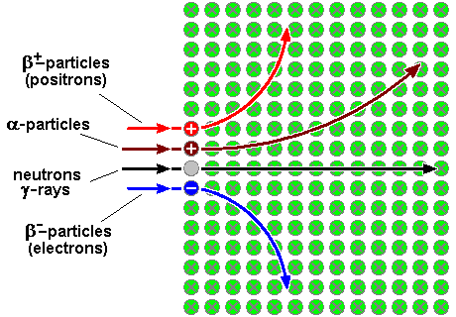
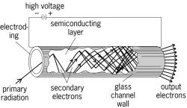
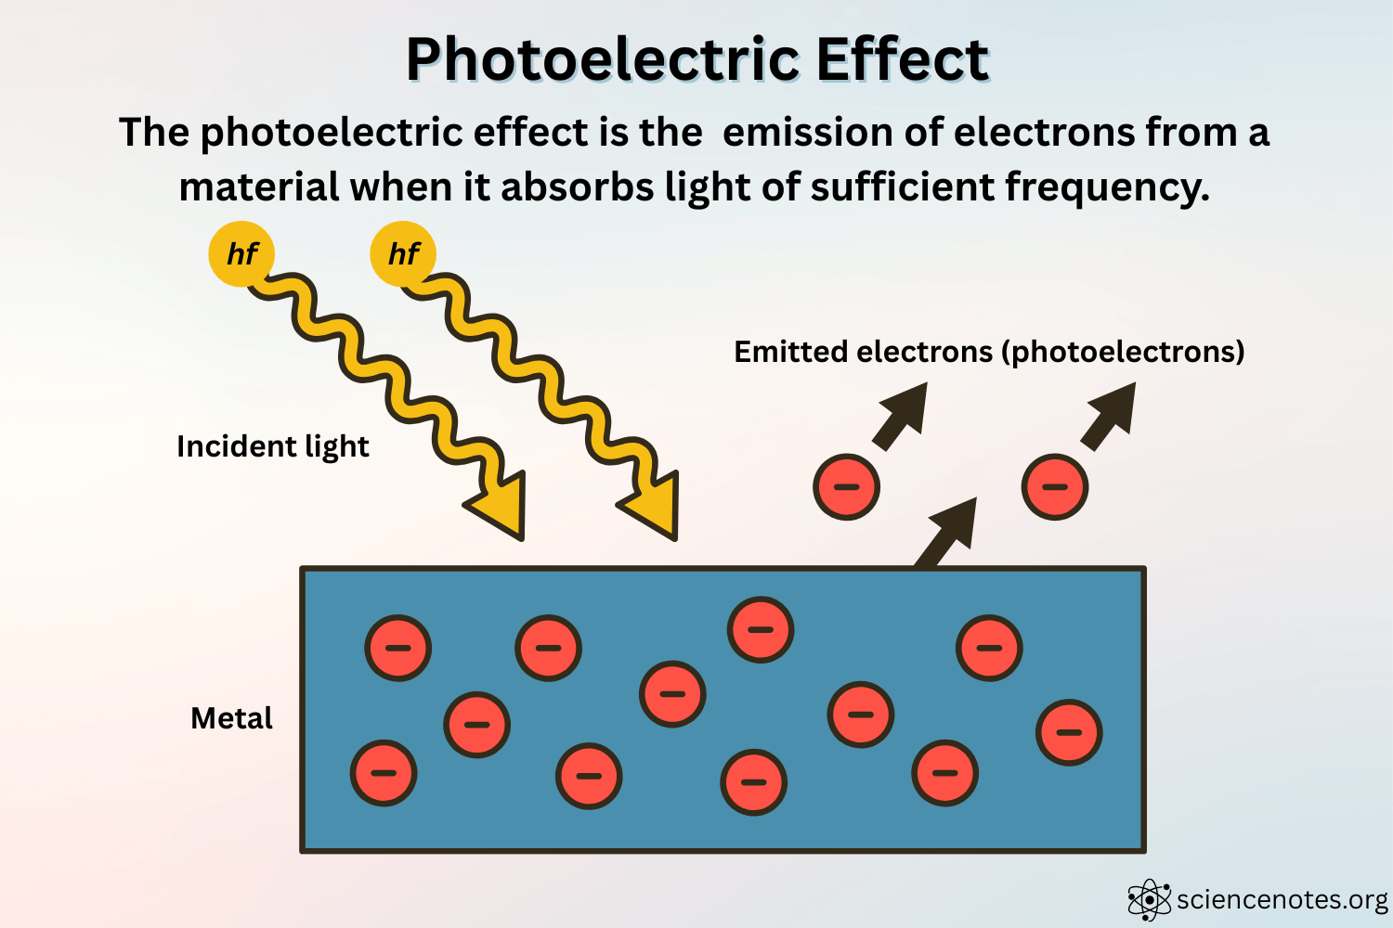
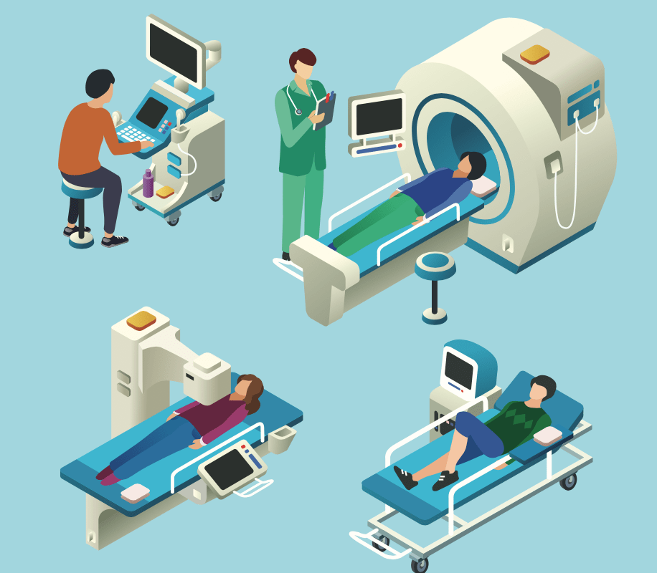
Careers in physics
Even if there is no particle physics specific section in your curriculum, connections can be made:
Electromagnetism
Compton scattering and photoelectric effect
Medical applications
Ex. of Individual teaching practices
Experiments/activities
Simulations/videos/animated videos
Field trips/museum visits, workshops
Invite a researcher to the classroom

Slide 3
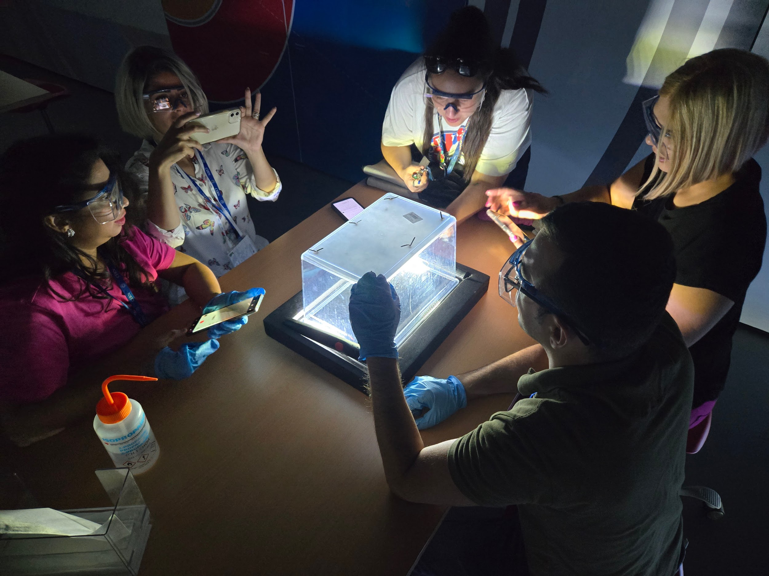
Key Ideas
Showcase the most important aspects of the topic that you consider to be key for a meaningful instruction
Magnets: Used in particle detectors to bend path of the charged particles or focus charged particles, allowing for momentum measurement.
Detector material: Typically made of silicon or other sensitive materials to track particle interactions. ( Semiconductors, dense metals…)
Conductivity and superconductivity: Essential for efficient operation, in creating strong magnetic fields. (Superconductive coils)
Signal aquisition: Involves capturing and processing electric signals generated by particle interactions to identify and analyze particles.
Data Processing: Collecting, analyzing, and interpreting the vast amounts of data generated by particle interactions. Advanced algorithms and computing systems to filter, reconstruct, and store meaningful events.
Cloud Chamber: A simple particle detector that visualizes charged particle tracks.

Slide 4
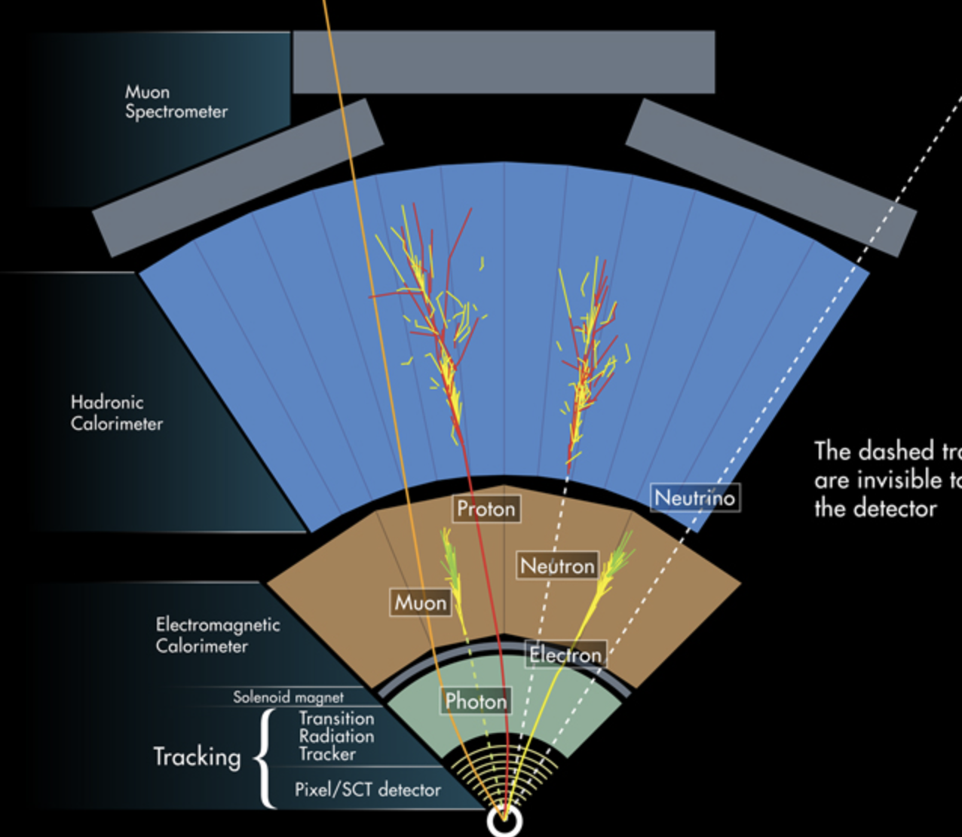
Potential Students’ Conceptions & Challenges:
illustrate elements of the topic that might obstruct a successful introduction in the classroom.
RIDDLE TIME:Who follows trails without a map?Who uncovers truth from whispers?
POTENTIAL STUDENTS’ CONCEPTIONS
Detectors see particles like a CAMERA.
All particles are detecting in one single detector.
Detectors are only used in big labs like CERN.
CHALLENGES: Particles are invisible and Detectors record evidence of particles tracks, not visual images of particles.SUB-DETECTORS- Tracker – measures charged particle paths.Electromagnetic Calorimeter – measures energy of electrons and photons.Hadronic Calorimeter – measures energy of hadrons.Muon System – detects muons.We use detectors in everyday life, like Metal detector, Light sensor , Cloud chamber kit, Geiger counter kit.

Slide 5
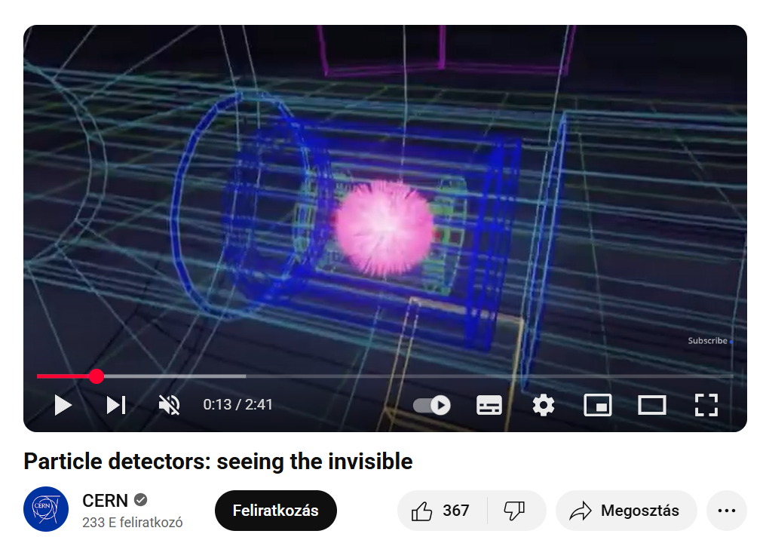
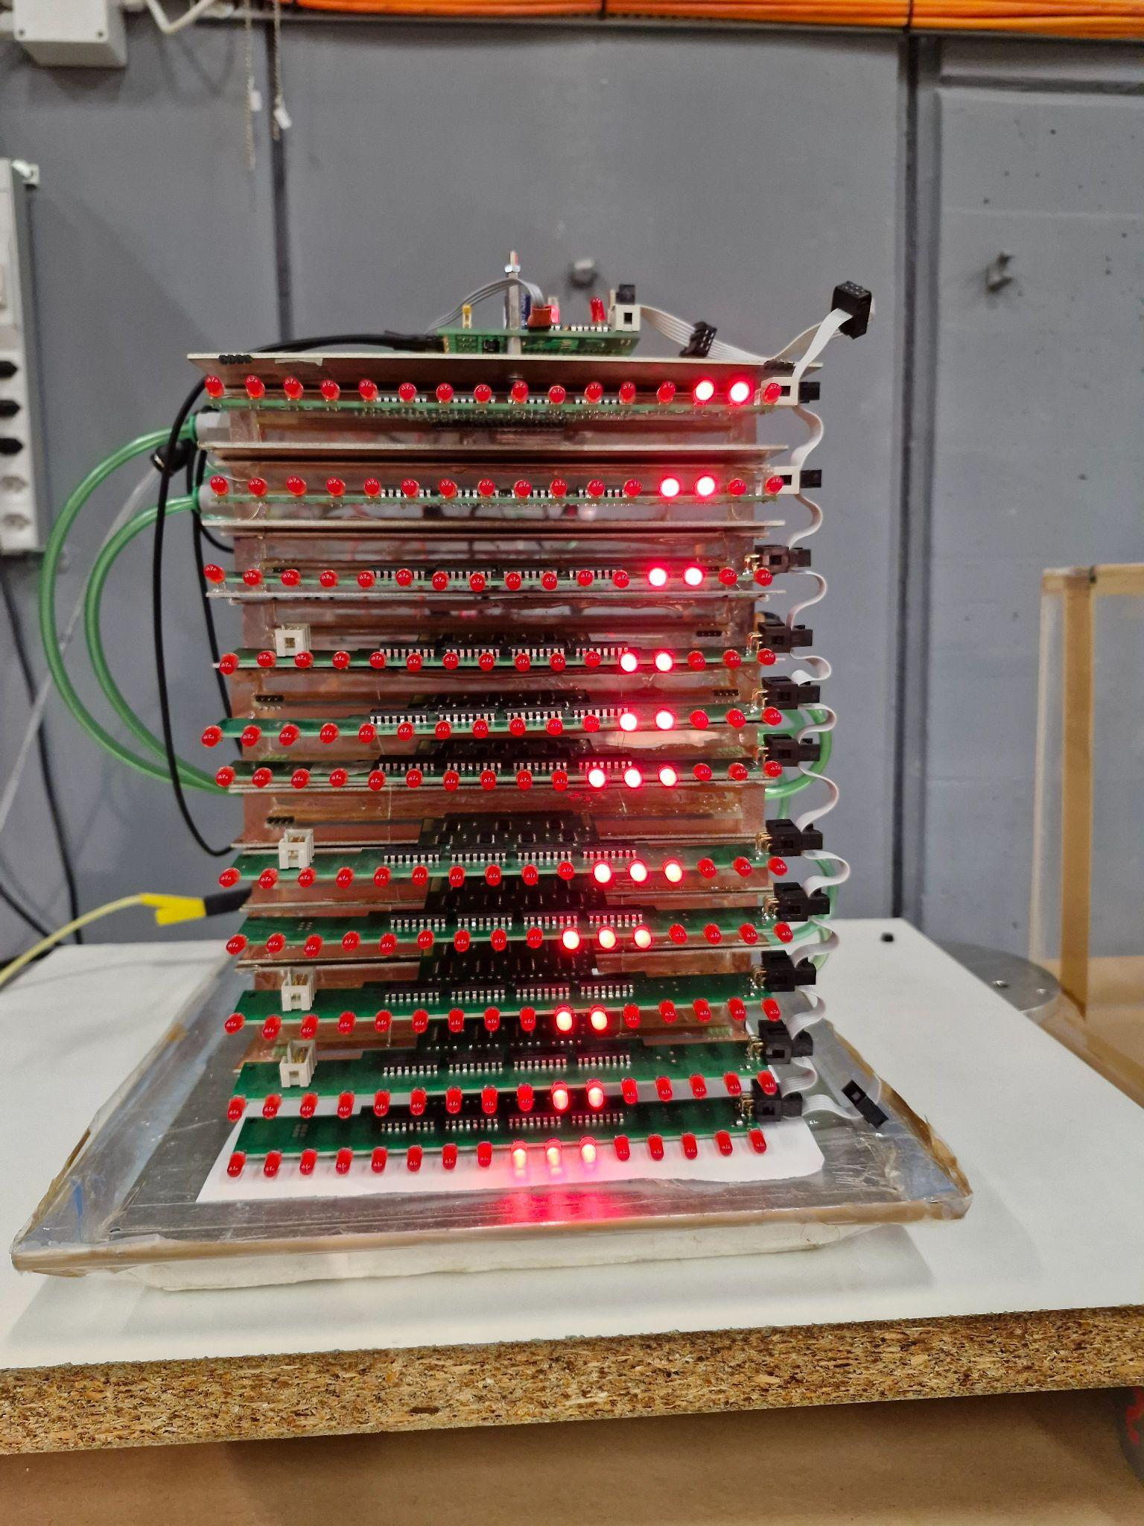
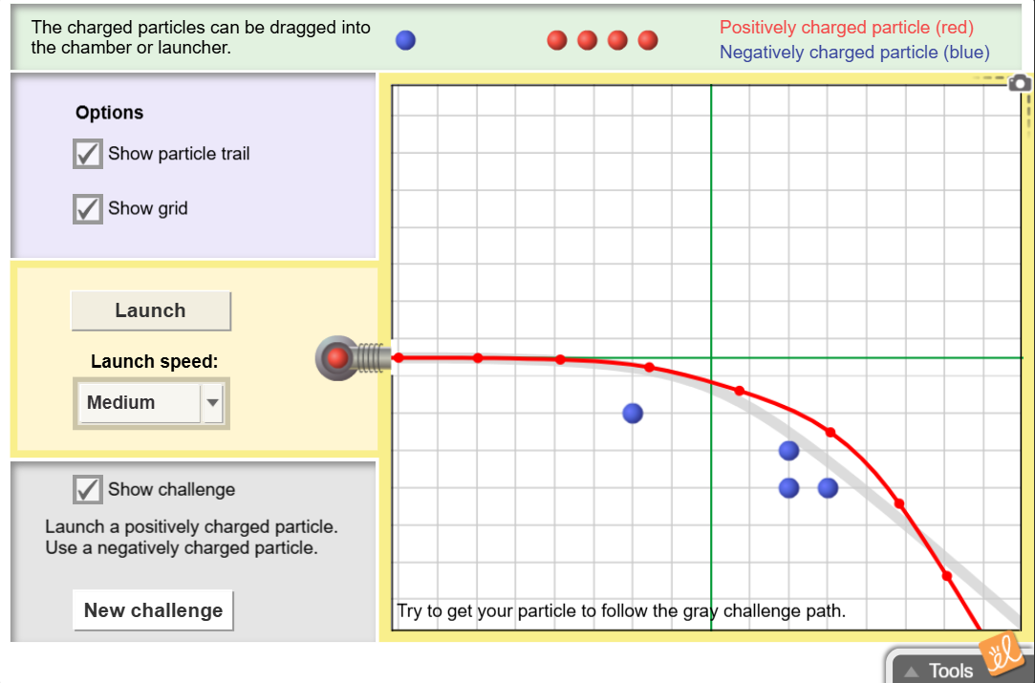
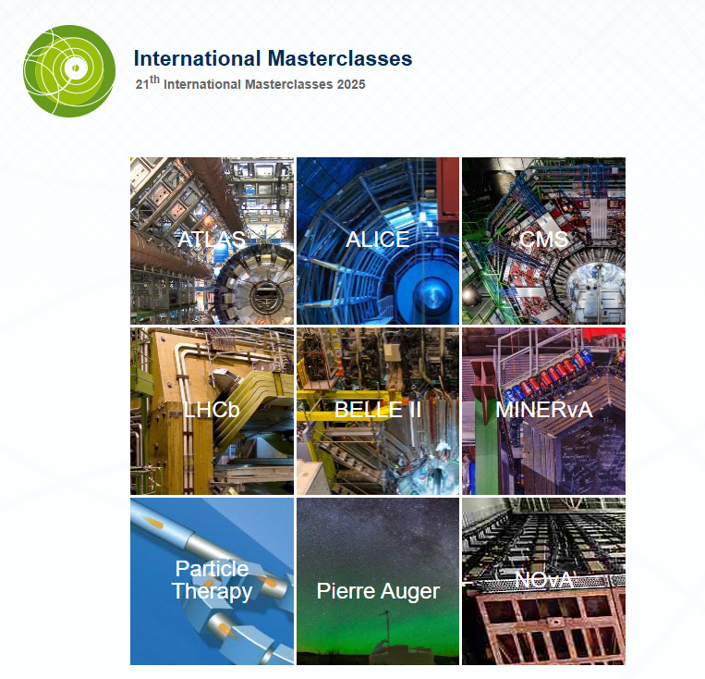
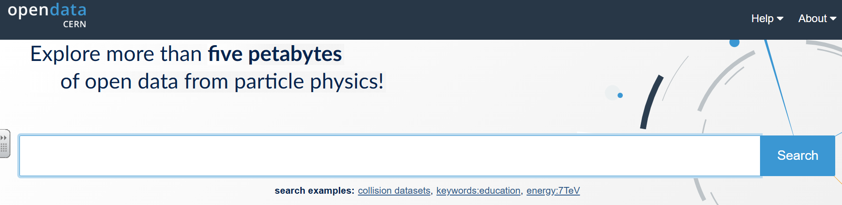
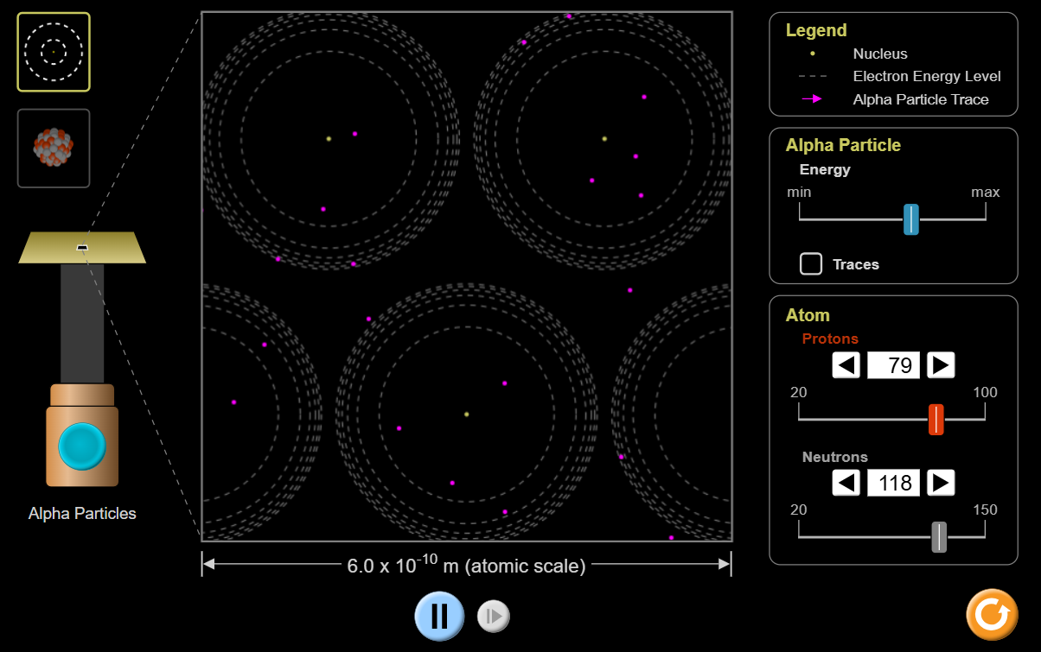
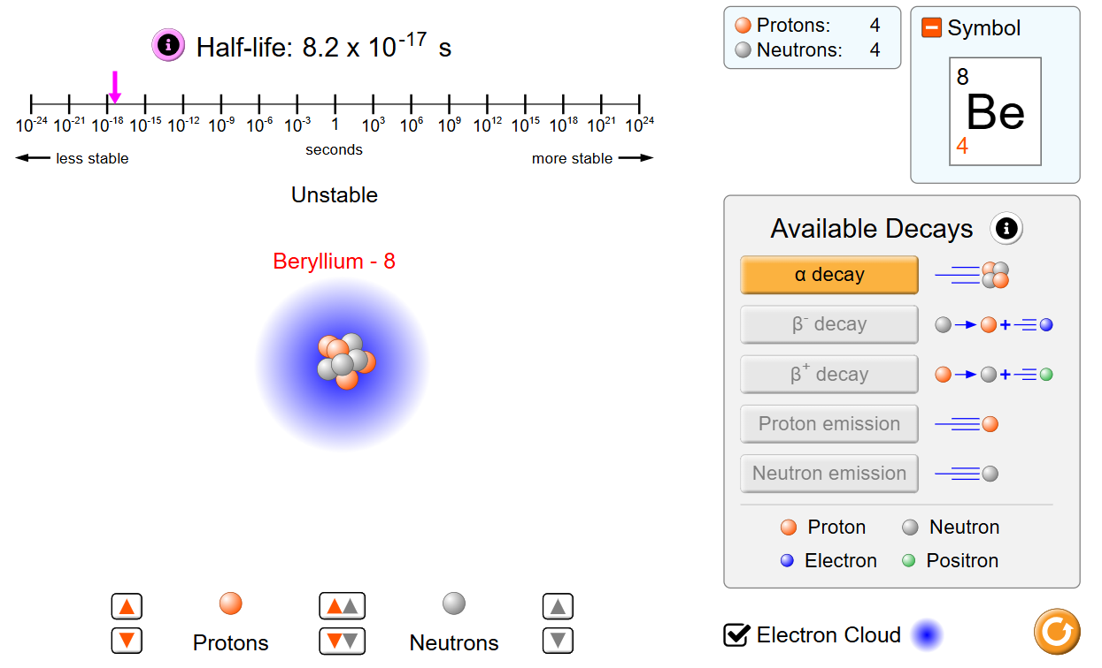
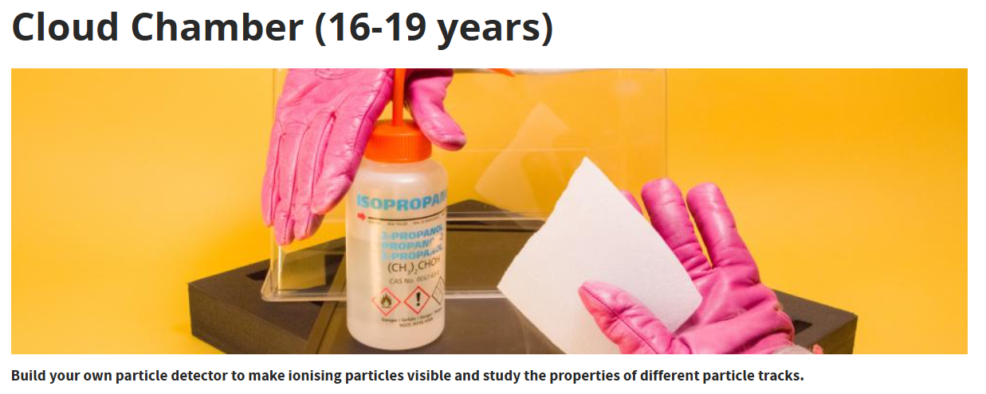
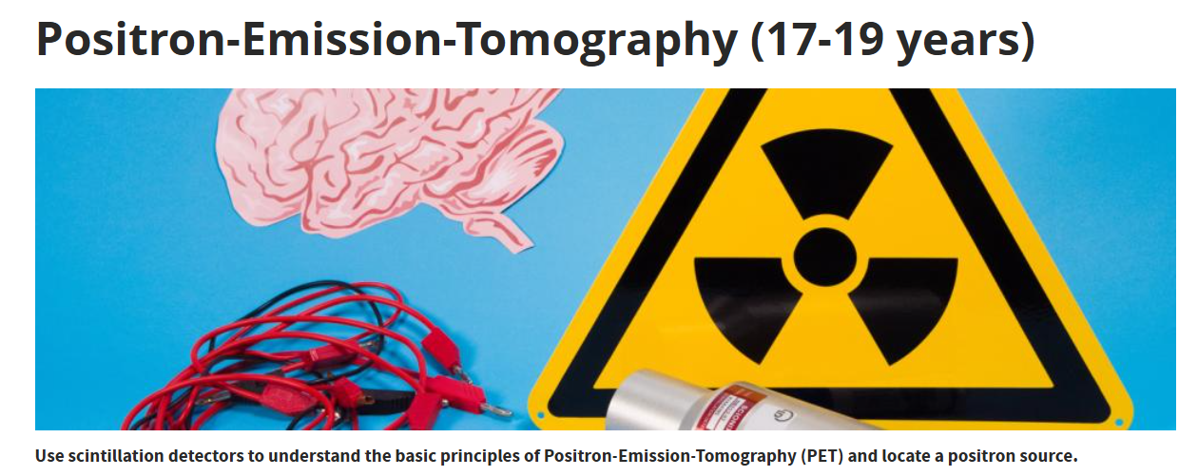
Useful Material & Resources
opendata.cern.ch - real LHC datasets for students
physicsmasterclasses.org - ATLAS and CMS Masterclasses - hands on particle physics activities
youtube.com - CERN
PhET Colorado - simulation
https://home.cern/ - detector overview
https://gizmos.explorelearning.com/find-gizmos/launch-gizmo?resourceId=632
https://sciencegateway.cern

Slide 6
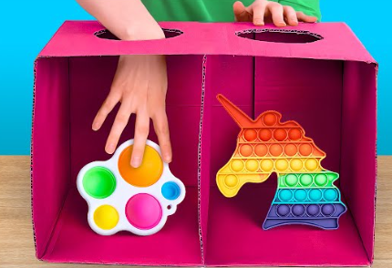
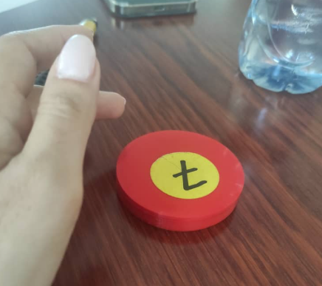
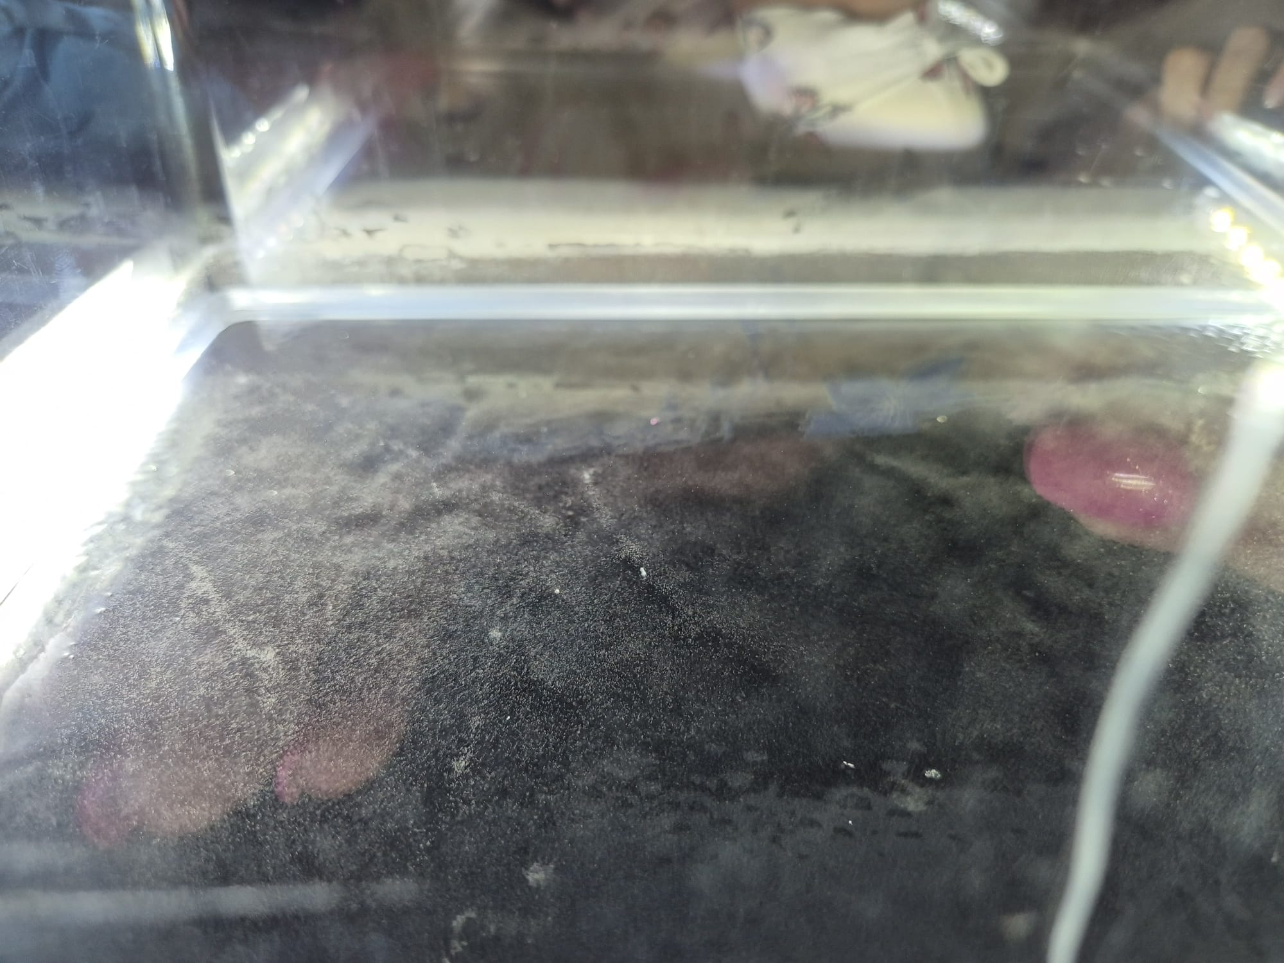

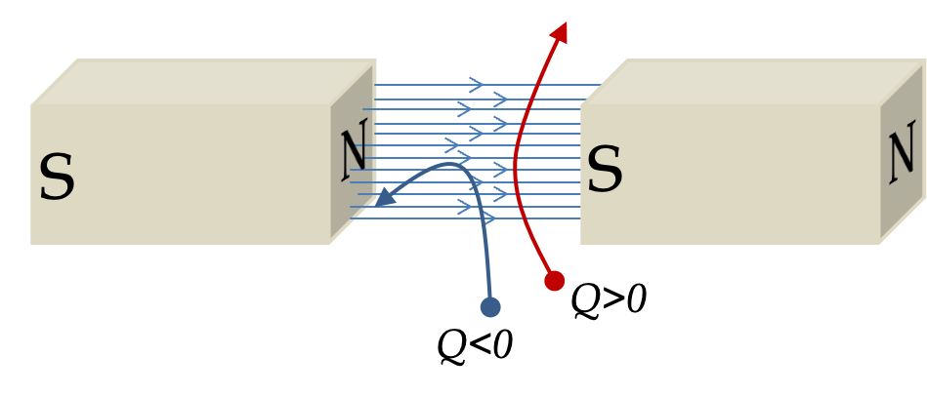
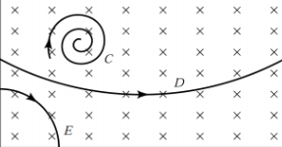
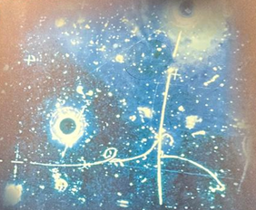
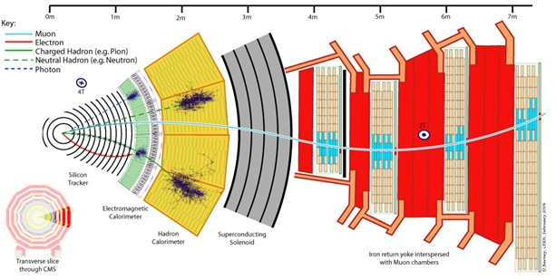
Best Practice Example
Mystery box activity can be designed and implement in various ways, and it serves as a great example for familiarizing students, or illustrating the concept of “ detecting” and “ indirect observation”.
After a collision, particle detector can detect resulting particles by “tracking” the path which they travel.
Magnet, Magnet, Magnet!
https://home.cern/resources/video/experiments/alice-general-video

Slide 7

ITW2025 Study Group 1
Mesi (Hungary), Chris (USA), Matin(Iran), Ramya (India), Eren (Turkey)
One way in which our thinking has changed…
Highlights, snapshots, farewell messages…
Multidisciplinary
Particle physics in my classroom
Inspired.
Fascinating.
Fundamental concepts

Slide 8
Click for Video!

