Slide 1
Normal-conducting magnet consolidation in TCC2
Philip Schwarz on behalf of the project team
23.09.2024

Slide 2
Introduction
Courtesy of Thomas Zickler and Yacine Kadi

Slide 3
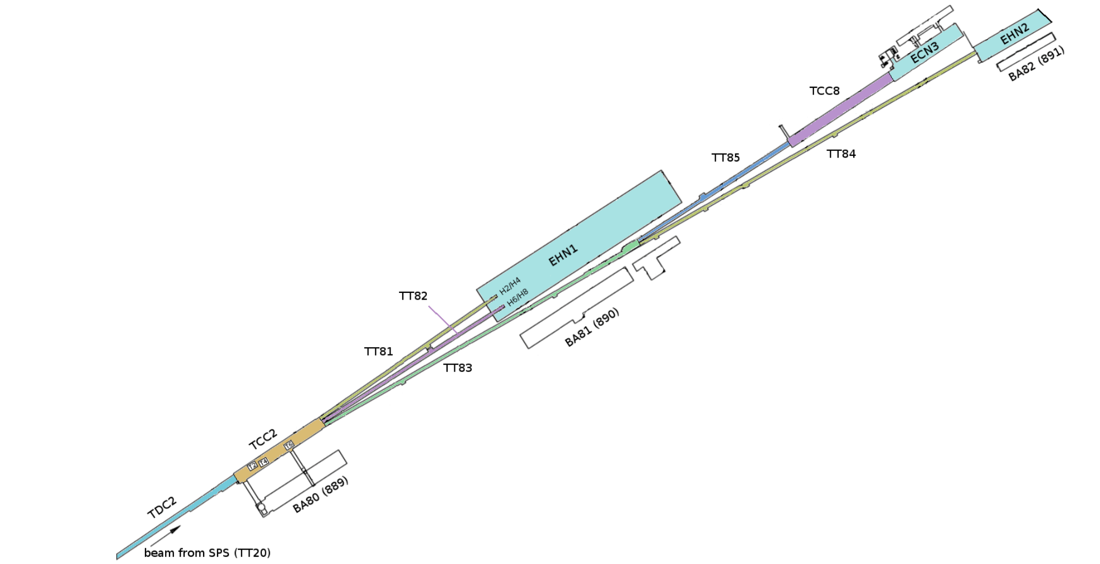
North experimental area (NA) - introduction

Slide 4
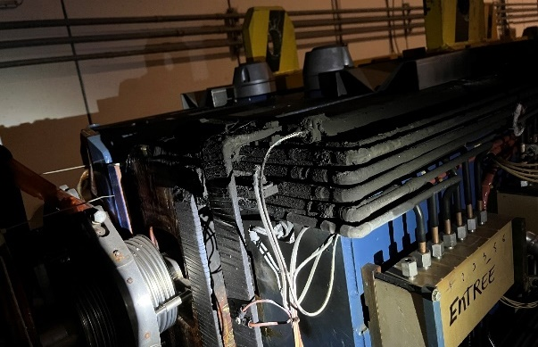
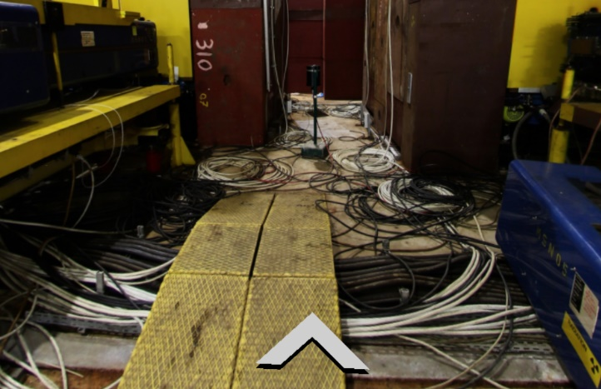
TCC2 Full Renovation
Courtesy T. Zickler,
Indico 1447430
Fire on MSN.X022031 (2023)
Motivation:
NACONS Baseline: Consolidation of the NA Target Zone TCC2
Modifications and upgrades required for HI-ECN3:
Wobbling, VXSS, XTAX, BLM, BTV,..
TCC2 Full Renovation (extension of scope):
  Unexpected increase of failure rates in TCC2 during Run3 (XTAX4, VXSS4, MTN, MSN, QNL,…)
  Replacement and repair of faulty or degraded equipment
  Mitigation of safety issues: DC cables on the ground (and in water)
  Mitigation of cooling water issues: leaks, faulty connections, flooding,…
  Mitigation of access issues: limited circulation path/access to highly radioactive equipment
  Optimization of a high-rad area respecting ALARA
  Unique possibility to clean up high-rad zone with maximum cool-down time
  The Full Renovation Plan has been presented to the NA-CONS/HI-ECN3 Steering Committee (8.-9.8.2024) and the ATSMB (19.8.2024)
Cables on the floor (and in water)

Slide 5
Recommendations of the NA-CONS/HI-ECN3 Steering Committee
Courtesy T. Zickler,
Indico 1447430
  The committee is convinced that the refurbishing and reconfiguration of TCC2 is now unavoidable, although the impact both on budget and on schedule for fixed target experiments have to be discussed with:
    LS3 committee, to assess the impact on LS3 activities, related to the availability of equipment and service groups.
    IEFC, to discuss the schedule of the last year of operation
    Physics coordinator and SPSC, to clarify whether a compromise can be found between the need to stop as early as possible operation to provide sufficient radiation cooling, and the need for certain FT experiments to collect as many events as possible before LS3.
  We therefore recommend to provide by mid September a report detailing the different possible scenarios with appropriate KPIs to the various actors above, to put them in the best situation to take a good decision.
  In particular, detailed Work and Dose planning for the different scenarios (12, 15 or 18 months of cooldown), or at least for the most impacting activities (e.g. the dismantling of the most radioactive equipment: XTAX, magnets etc... ).
  Also, maximum dose to individuals in the most exposed groups should be provided.

Slide 6
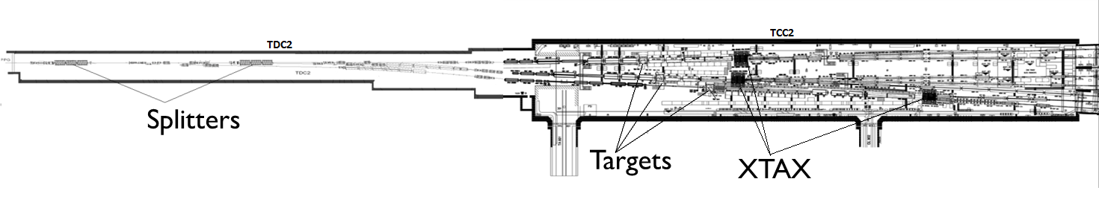
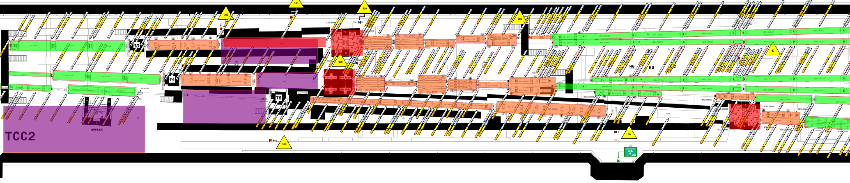
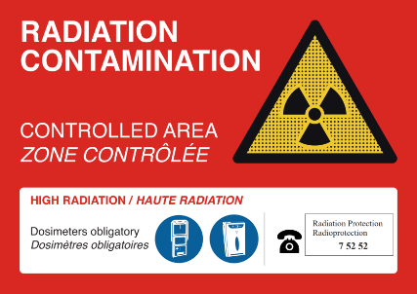
Radiological aspects
Courtesy T. Zickler,
Indico 1447430
Radiological situation for TDC2/TCC2 during LS3 expected to be similar as in LS1
Anticipated work can only be performed under the following conditions:
A reasonable cooldown time (> 6 months) can be guaranteed, and
all highly radioactive elements are temporarily removed from TCC2
Minimize dose to intervening teams
Removal of obstacles
Optimize workflow and intervention time
> 2000 uSv/h
> 2000 uSv/h
> 2000 uSv/h
> 2000 uSv/h
< 500
< 500
< 50 uSv/h
< 500
< 500
<100
<50
< 100
< 500
< 50 uSv/h
< 1000 uSv/h
< 500 uSv/h
< 100 uSv/h
< 50 uSv/h
< 1000 uSv/h
< 50 µSv/h
< 100 µSv/h
< 500 µSv/h
< 1000 µSv/h
> 2000 µSv/h

Slide 7
TDC2 Partial Renovation
In TDC2 only the 6 MSSBs (splitters) and 4-6 other magnets will be removed from the beamline but will stay in TDC2 during LS3. To mitigate potential risks of damages, the three MSBB magnets in stock will be refurbished and certified to become operational spares.
In addition, there is not enough MDLV spare magnets available. For this magnet type, a SPS CONS request was approved in July 2024 (EDMS 2637599). The procurement of these spare magnets is ongoing and will cover eventual needs of TDC2.
At the current stage, no further consolidation of the magnets in TDC2 is requested, as radiation levels are lower than in TCC2, and spares are available; so, at this stage, we consider that operation of TDC2 can be ensured during Run4 with the mitigation measures listed above.

Slide 8
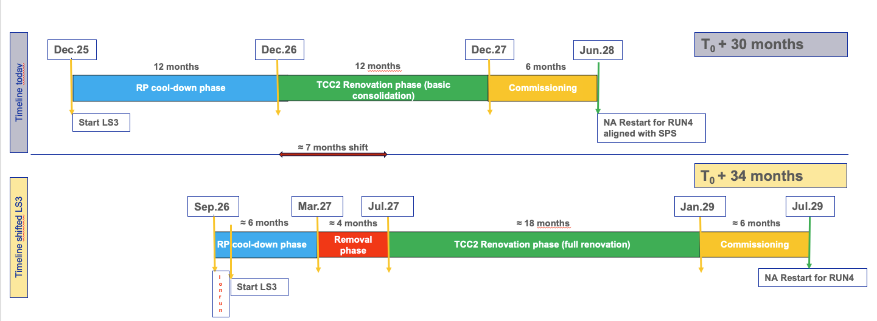
Preliminary planning of renovation
Courtesy Y. Kadi

Slide 9
Situation and proposed strategy

Slide 10
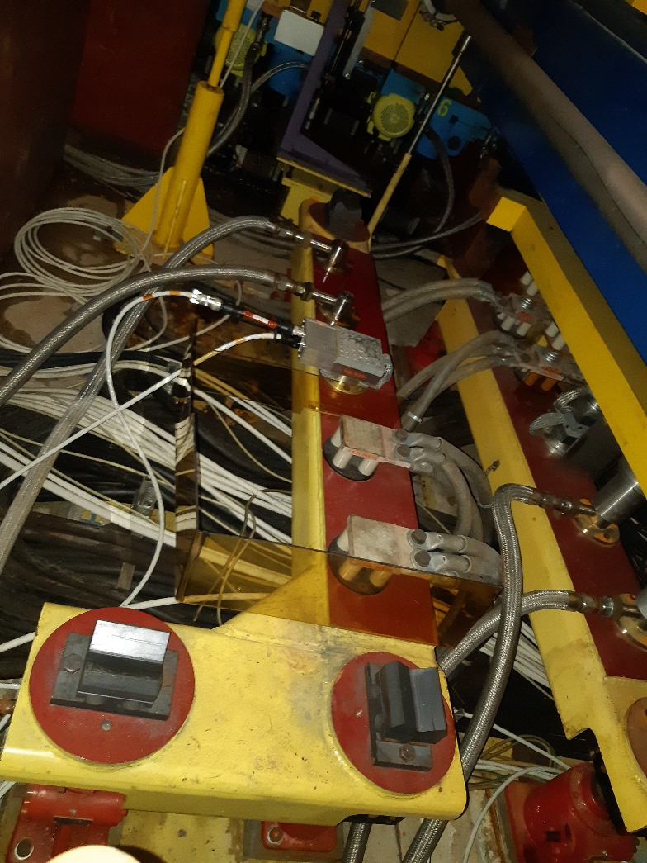
TCC2 magnets – current situation
93 magnets installed in TCC2
  45 magnets on plug-in base (MTN, QNR/L(B), MSN, QSL)
  48 magnets in “normal” configuration
Most magnets have not been moved since 45+ years
Plug-in magnets reach their end-of-life
  Most of them are in a fragile state (more detail following)
  High radiation environment leads to embrittlement of cabling insulation (DC and signal cables)
  Any intervention in the vicinity of the magnets bears high risk of their damage
  Repair in-situ mostly not possible due to residual radiation
  Not enough operational spares to replace all magnets
  No possible replacement magnets exist in our storage
Plug-in base

Slide 11
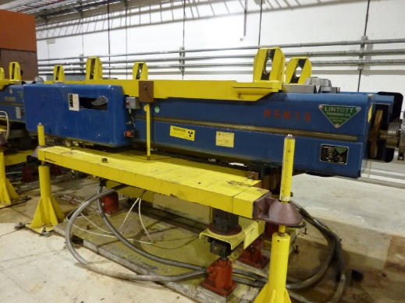
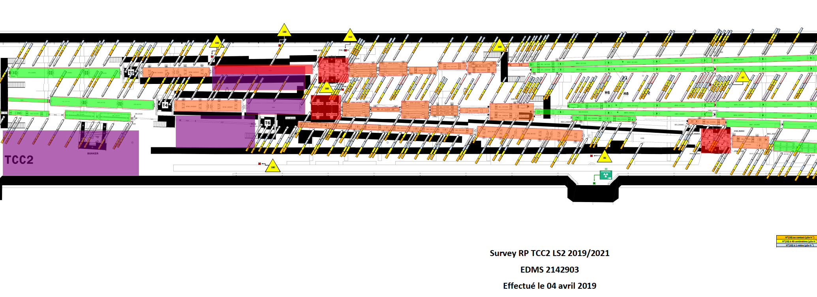
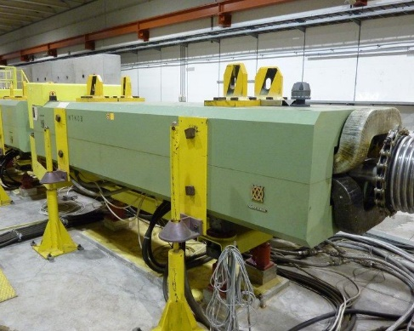
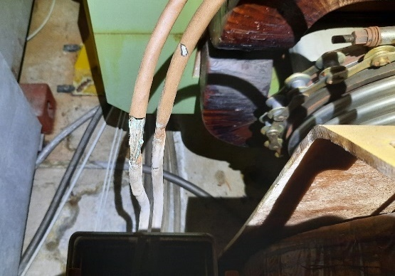
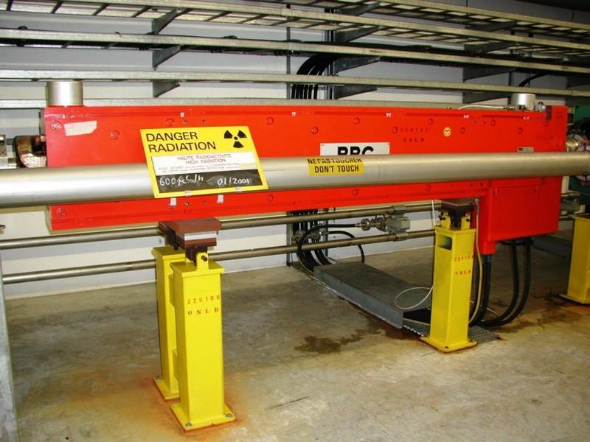
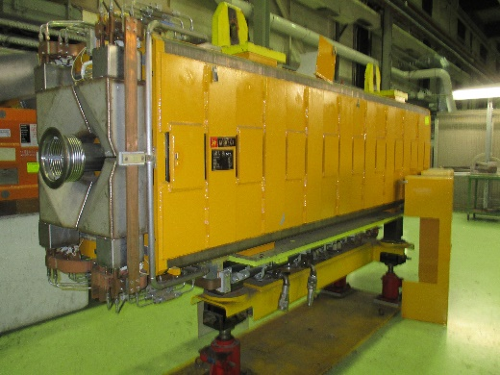
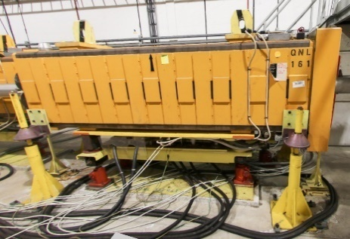
Plug-in types
8 MSN Fire on MSN.X022031 (2023)
Courtesy Yann Pira, Xavier Palle
10 MTN+3MTS Cabling on MTN.040007 (2022)
5 QSL
1 QNRB / 5 QNLB
14 QNL

Slide 12
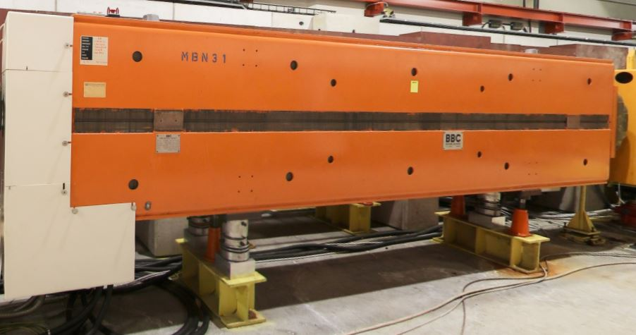
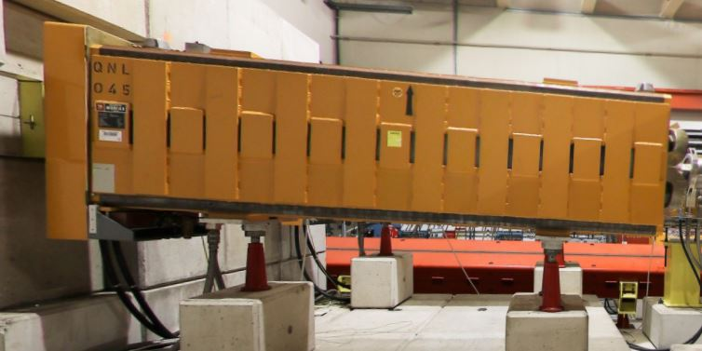
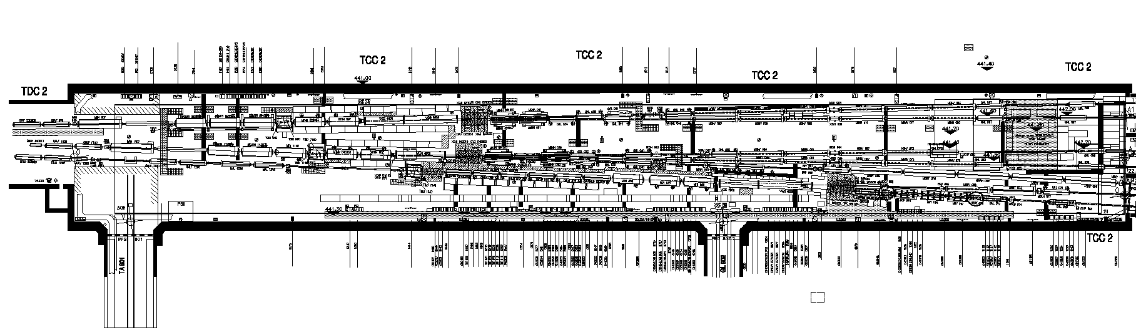
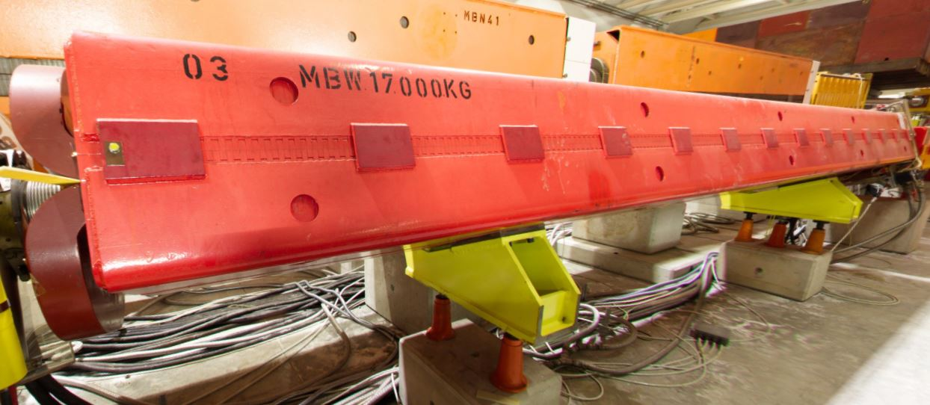
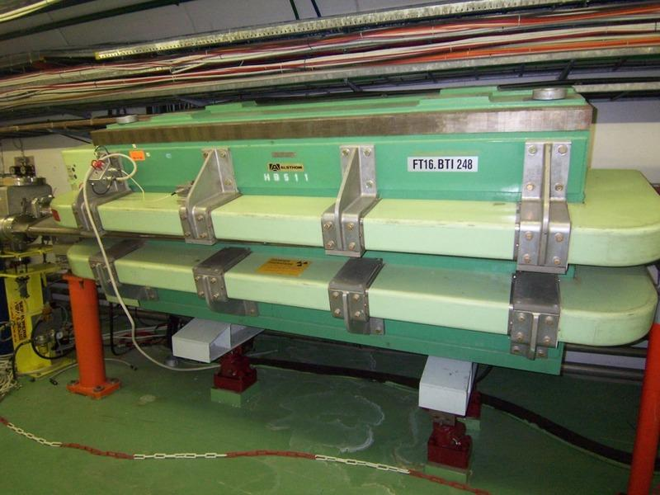
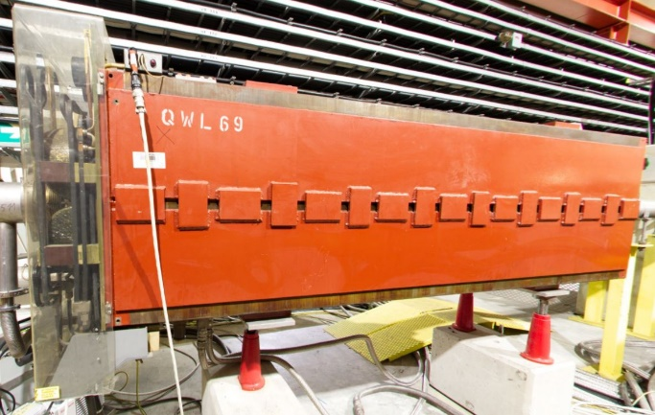
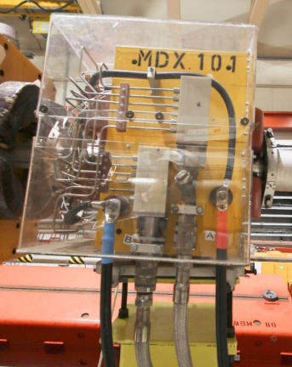
“Standard” types
24 MBN (2 H and 22 V)
7 QNL
5 MBW
3 MCV
3 QWL
4 MDX

Slide 13
Treatment strategies
 | Type | Installed | Operational Spare | Magnets in Stock, non-validated | Strategy | Comment
Plug-in | MTN | 10 | 1 | 1 | Replace | NC 2736854
 | MTS | 3 | 0 | 0 | Prepare spare during LS3 | Same as MTN, but with collimator block installed
 | MSN | 8 | 0 | 2 | Replace | +2 highly-activated magnets in stock
 | QSL | 6 | 2 | 13 | Replace
 | QNL | 14 | 0 | 4 | Refurbish during LS3 | in lower activation areas than QNLB and QNRB
 | QNLB | 5 | 1 | 3 | Prepare spares during LS3
 | QNRB | 1 | 0 | 0 | Prepare spare during LS3 | 3 magnets become available after LS3 from K12
 | MSSB | 6 | 0 | 3 | Prepare spares during LS3 | Installed in TDC2
Standard | MBNH | 2 | 0 | 14 | Refurbish during LS3
 | MBNV | 22 | 1 | 11 | Refurbish during LS3
 | MDX | 4 | 3 | 30 | Refurbish during LS3
 | MCV | 3 | 0 | 7 | Refurbish during LS3
 | MBW | 5 | 0 | 4 | Refurbish during LS3
 | QWL | 3 | 0 | 38 | Refurbish during LS3
 | QNL | 7 | 3 | 23 | Refurbish during LS3
 | MNPA | 1 | 1 | 3 | Replace | Needs to be replaced by a laminated magnet

Slide 14
Strategies summary
24 High-risk plug-in base magnets will be replaced
  10 MTN magnets
  8 MSN magnets
  6 QSL magnets
60 Medium-risk magnets will be refurbished
  21 QNL (of which 14 are on plug-in bases)
  24 MBN (22 vertical and 2 horizontal)
  4 MDX
  5 MBW
  3 QWL
  3 MCV
8 spares will be prepared
  1 MTS
  1 QNRB
  3 QNLB
  3 MSSB (TDC 2)

Slide 15
Magnet replacement

Slide 16
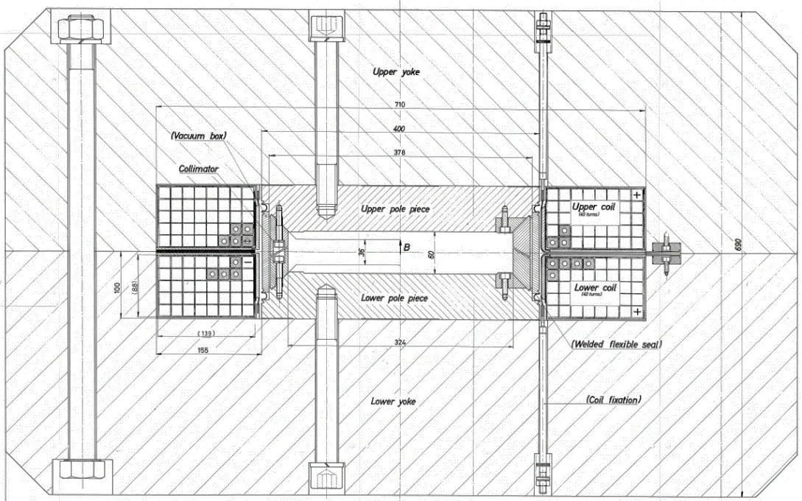
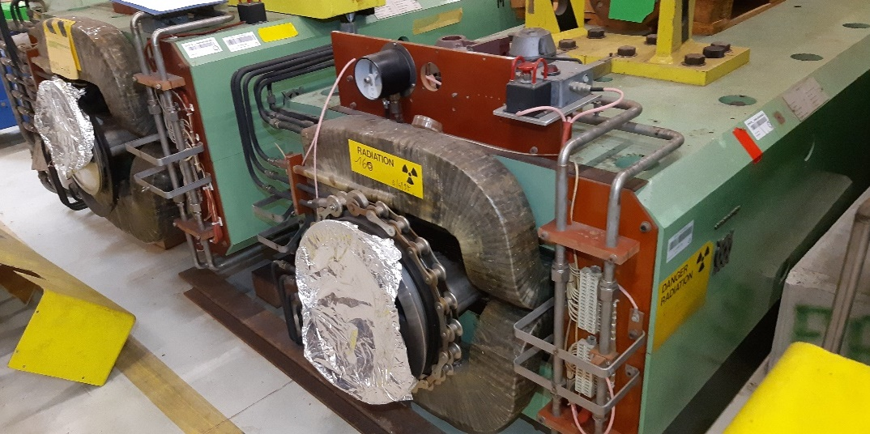
Proposal MTN
Manufacturing of 12 magnets
  10 installed, 2 spares
Motivation
  End-of-life reached for installed magnets
  Low number of magnets in stock
  Change to laminated version
    Allows PPM operation for physics
    Improves energy consumption
Challenges
  Pole part of the vacuum
  Radiation hard design required
  Quite saturated already (2D simulations)
MTN magnets, 23 t, 4 m long

Slide 17
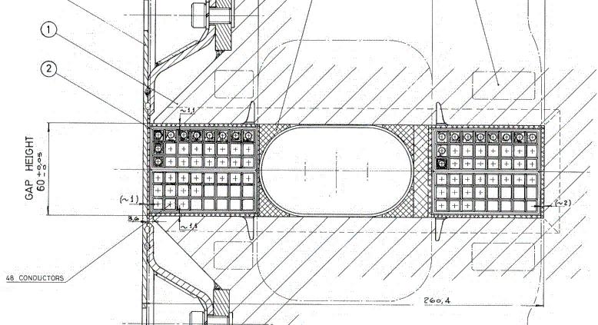
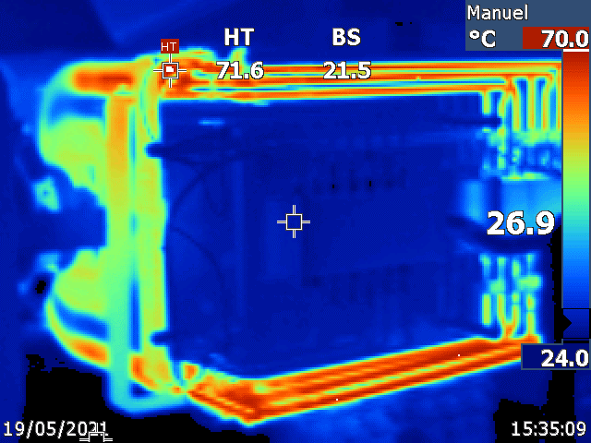
Proposal MSN
Manufacturing of 10 MSN magnets
  8 installed, 2 spares
Motivation
  End-of-life reached for installed magnets
  Low number of magnets in stock
  Design flaws present
    Water speed >4 m/s (<3 typically required)
    Current density ~32 A/mm² (typically <10)
  High temperature change during cycles
Challenges
  Restricted space available
  Radiation hard design required
MSN magnets, 6.6 t, 3.6 m long

Slide 18
Proposal QSL
Manufacturing of 8 QSL magnets
  6 installed, 2 spares
Motivation
  End-of-life reached for installed magnets
  Shorter QSL prerequisite for MSN design
  High incentive for energy savings
  Design flaws present
    Water speed >4 m/s (<3 typically required)
Challenges
  Restricted space available
  Radiation hard design required
QSL, 3.8 t, 3.3 m long

Slide 19
Preliminary timeline
Design, procurement, production and installation during LS3 is very challenging
Required budget and resources to be presented during the CSR & MTP 2025
Market survey currently in preparation that procurement can be based on
Foreseen timeline for MTN (critical path), MSN and QSL in shadow
 | 2024 |  |  |  |  |  |  |  |  |  |  |  |  |  | 2025 |  |  |  |  |  |  |  |  |  |  |  |  |  |  |  |  |  |  |  |  |  |  |  | 2026 |  |  |  |  |  |  |  |  |  |  |  |  |  |  |  |  |  |  |  |  |  |  |  | 2027
Activity | Jun |  | Jul |  | Aug |  | Sep |  | Oct |  | Nov |  | Dec |  | Jan |  | Feb |  | Mar |  | Apr |  | May |  | Jun |  | Jul |  | Aug |  | Sep |  | Oct |  | Nov |  | Dec |  | Jan |  | Feb |  | Mar |  | Apr |  | May |  | Jun |  | Jul |  | Aug |  | Sep |  | Oct |  | Nov |  | Dec |  | Jan |  | Feb |  | Mar |  | Apr |  | May |  | Jun |  | Jul |  | Aug |  | Sep |  | Oct |  | Nov |  | Dec
Gathering information
Set-up of functional specifications
Functional specifications ready
Design phase
Design reports approved
Mechanical design + specifications
NA-CONS / HI-ECN3 steering committee
CSR 2025
Request submission to MTP 2025
Specification committee
IT dispatch
Bidding period and validation
Adjudication propsoal
Finance committee
Contract placement
Production
Delievery of first series magnet
Certification
Installation

Slide 20
Budget and resources
Budget and resources estimated based on East Area magnet procurement
Two designs will have to pass through the Finance Committee
Number of spare magnets chosen according to magnet type installation locations
Waste management not included in estimations (~460 t, (highly) activated)
Plug-in bases to be replaced alongside their magnets
One STAFF engineer required
Priority for magnet production / replacement
  MTN
  MSN
  QSL

Slide 21
TCC2 refurbishment

Slide 22
Treatment strategies
 | Type | Installed | Operational Spare | Magnets in Stock, non-validated | Strategy | Comment
Plug-in | MTN | 10 | 1 | 1 | Replace | NC 2736854
 | MTS | 3 | 0 | 0 | Prepare spare during LS3 | Same as MTN, but with collimator block installed
 | MSN | 8 | 0 | 2 | Replace | +2 highly-activated magnets in stock
 | QSL | 6 | 2 | 13 | Replace
 | QNL | 14 | 0 | 4 | Refurbish during LS3 | in lower activation areas than QNLB and QNRB
 | QNLB | 5 | 1 | 3 | Prepare spares during LS3
 | QNRB | 1 | 0 | 0 | Prepare spare during LS3 | 3 magnets become available after LS3 from K12
 | MSSB | 6 | 0 | 3 | Prepare spares during LS3 | Installed in TDC2
Standard | MBNH | 2 | 0 | 14 | Refurbish during LS3
 | MBNV | 22 | 1 | 11 | Refurbish during LS3
 | MDX | 4 | 3 | 30 | Refurbish during LS3
 | MCV | 3 | 0 | 7 | Refurbish during LS3
 | MBW | 5 | 0 | 4 | Refurbish during LS3
 | QWL | 3 | 0 | 38 | Refurbish during LS3
 | QNL | 7 | 3 | 23 | Refurbish during LS3
 | MNPA | 1 | 1 | 3 | Replace | Needs to be replaced by a laminated magnet

Slide 23
Removal / installation activities
Cleaning activities
  Disconnection of the magnets and plug-in bases
  Removal of the water hoses and manifolds
Installation activities
  Follow-up of the transport and installation of the magnets
  Procurement and installation of new water hoses / manifolds
  Connection of magnets and plug-in bases
  Support to other groups for any magnet related questions
Layout of the area and sequence of activities under discussion
Exact estimates to be done once activities and responsibilities clearly defined
Scope assumed:
  Procurement and installation of all manifolds after separation valve
  Procurement and installation of all flexible hoses
  Follow-up of zone refurbishment linked to magnets

Slide 24
Proposal for refurbishment
Concerns 60 magnets of six types
Motivation
  The magnets will be removed from the area to allow for the refurbishment of the zone
  Types proposed for refurbishment show less signs of degradation and have sufficient magnets in stock
  Standardisation of manifold designs would allow for removal of organic gaskets in the area
  Replacement of interlock cabling on these magnets allows to replace the system most susceptible to radiation damage
Work proposed
  Start preparation of spares in Q3/2025 with magnets from storage
  Continuous exchange and refurbishment of magnets during LS3

Slide 25
Proposal for spare preparation
Spares should be prepared for MTS (1), QNRB (1), QNLB (3), MSSB (3)
Motivation MTS
  These magnets are of the MTN type, but with an additional collimator installed, rendering them not suitable for replacement with laminated magnets
  Thus, preparing one spare for the three installed magnets should ensure a possible restart
Motivation QNRB, QNLB
  These magnets are subject to too residual dose rates (QNRB, QNLB) to justify refurbishment even during a long shutdown period
  Enough magnets are available in stock, however, to guarantee a timely restart of the facility, even if these magnets are not refurbished
Motivation MSSB
  Plug-in base magnets moved to reduce ambient dose rate for the replacement of the TCSC
Work proposed
  Prepare an adequate number of spare magnets from the magnets available in stock

Slide 26
Radiological aspects
Courtesy T. Zickler,
Indico 1447430
Radiological situation for TDC2/TCC2 during LS3 expected to be similar as in LS1
Anticipated work can only be performed under the following conditions:
A reasonable cooldown time (> 6 months) can be guaranteed, and
all highly radioactive elements are temporarily removed from TCC2
Minimize dose to intervening teams
Removal of obstacles
Optimize workflow and intervention time
> 2000 uSv/h
> 2000 uSv/h
> 2000 uSv/h
> 2000 uSv/h
< 500
< 500
< 50 uSv/h
< 500
< 500
<100
<50
< 100
< 500
< 50 uSv/h
< 1000 uSv/h
< 500 uSv/h
< 100 uSv/h
< 50 uSv/h
< 1000 uSv/h
< 50 µSv/h
< 100 µSv/h
< 500 µSv/h
< 1000 µSv/h
> 2000 µSv/h

Slide 27
Work plan
Before LS3 and during RP cool-down (October 25 – December 26)
  Preparation of 36 spares using magnets from stock
    1 MTS, 11 QNL (4 plug-in, 7 standard), 11 MBNV, 2 MBNH, 2 MDX, 3 MCV, 4 MBW, 2 QWL
During LS3 (December 26 – December 27)
  Refurbishment of 10 magnets using magnets from stock
    3 QNLB, 1 QNRB, 2 MDX, 1 QWL, 3 MSSB
  Refurbishment of 22 magnets using magnets from the machine
    11 MBNV, 1 MBW, 10 QNL (plug-in)
    Sequence chosen such that highest residual dose rate is treated last
    Rotation with existing FSU can be done to reduce individual exposure

Slide 28
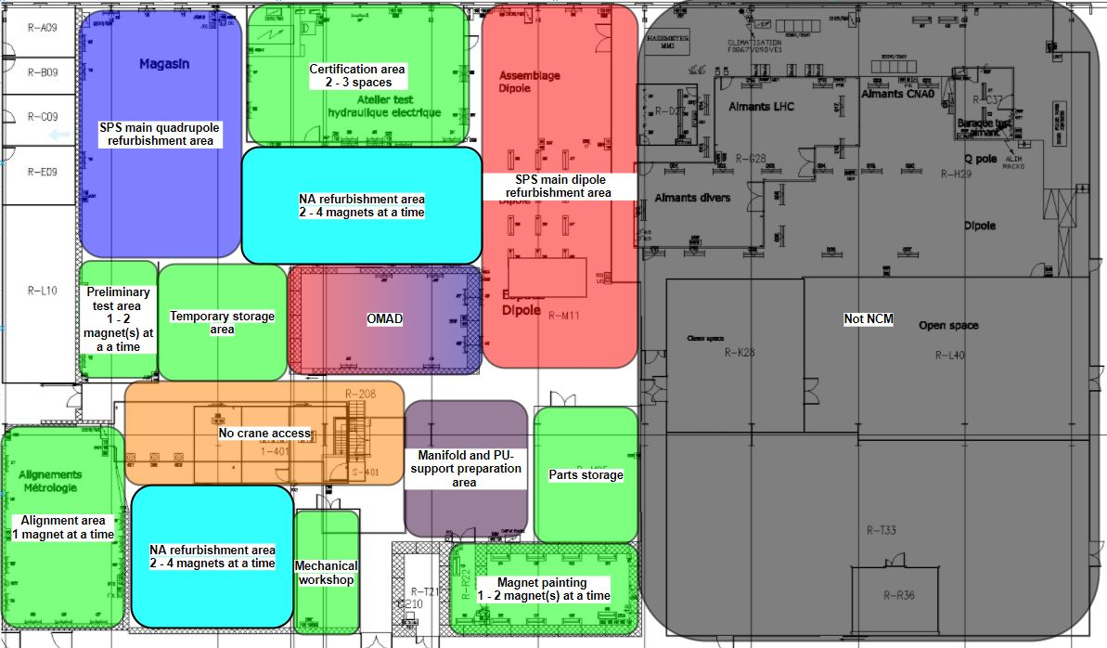
867 layout

Slide 29
Budget and resources
Budget and resources estimated based on regular refurbishment work
Storage after removal from TCC2 to be clarified (about 400 – 500 m² needed in 954)
Includes budget for magnetic measurements / fiducialisation
Advanced start with magnets from stock allows to
  Educate potentially new personnel
  Alleviate dose to personnel by removing more activated magnets from the list of magnets to be prepared
  Create a margin with respect to LS3 duration
  Spread of workload

Slide 30
Activities linked to spare coverage
(not part of TCC2 refurbishment)

Slide 31
Spare situation
About 420 magnet of 44 types are installed in the North Area (including TCC2)
23 of these types currently have 0 certified spares
Currently approved WP 2.2.1 of NA-CONS aims at increasing this number by preparing 3 magnets per year
However, progress is slow as about 2 magnets require exchange during the YETS
Work proposed
  Following the continuous refurbishment during LS3, continue the preparation of certified spares until all magnet types are adequately covered by certified spares relative to their installed number
  Requires the preparation of 61 magnets
  of 37 types

Slide 32
Summary

Slide 33
Activities summary
TCC2 activities
  Replacement of 24 magnets of three types
  Refurbishment of 60 magnets of six types
  Preparation of eight spare magnets of four types
  Follow-up of removal / installation
NA spare coverage activity
  Prepare 60 certified spares of 37 types from magnets from stock
One additional STAFF technician and one STAFF engineer required

Slide 34
A possible team configuration with experienced staff (helping already with the preliminary study)… if resources are provided to maintain the other activities
Philip Schwarz
  Project coordination
  Mechanical design and magnet procurement lead
Alexey Vorozhtsov (TEMP)
  Magnet design
  Magnet procurement follow-up
Maxime Dumas
  Mechanical design and magnet procurement follow-up
  TCC2 refurbishment activities follow-up
Cyril Cot
  Renovation activities in the workshop follow-up
New technician & engineer

