Slide 1
Geometry of beam line for BDF/SHiP final focus and dilution system
Alexander Gorn, Dipanwita Banerjee, Fabian Metzger, Laurie Nevay, Francesco Velotti, Matthew Fraser
29.08.2024

Slide 2
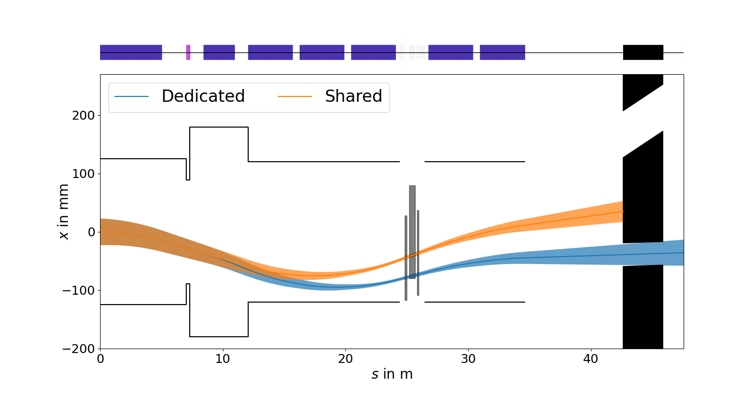
TCC2 XTAX modifications
Negative wobbling (q<0, pc -> H8 = 300 GeV)
MTN.241128
MTN.241142
MTN.X0400005
MTN.241135
MTN.X0400003
We need to change the geometry of the P42 line for the new XTAX concept.

Slide 3
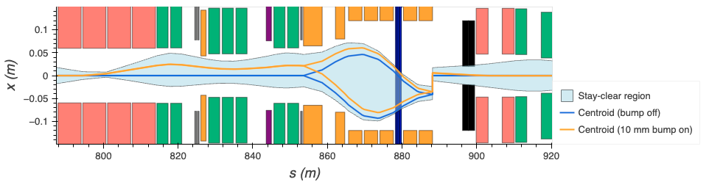
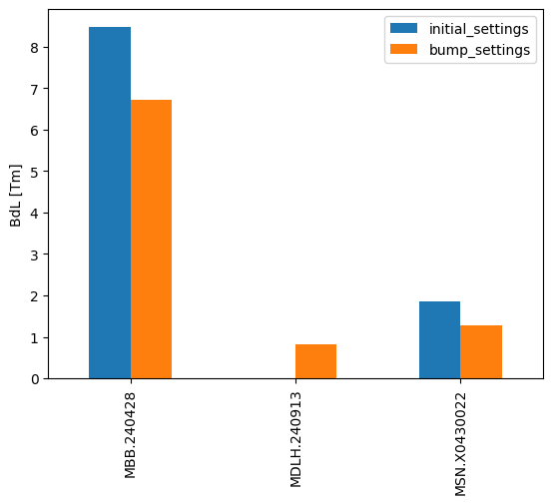
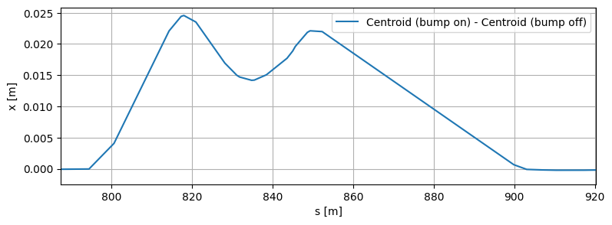
Horizontal offset at T4
Stay-clear region allows to offset the beam at T4 by maximum 10 mm
Bumpers:
  MBB.240428
  MDLH.240913
  MSN.X0430022
B1
B2
B3
Bumpers settings
  MBB.240428
  MDLH.240913
  MSN.X0430022

Slide 4
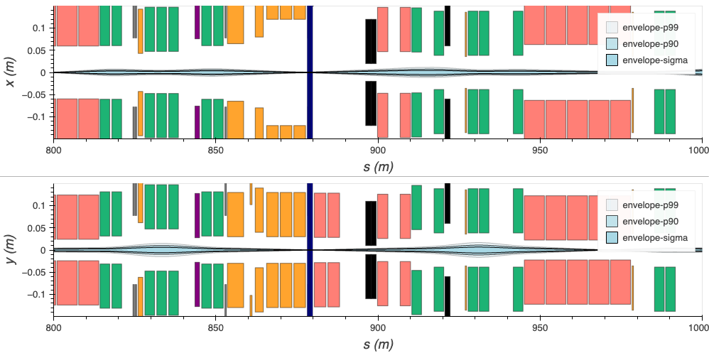
Horizontal offset at T4: P42 modifications

Slide 5
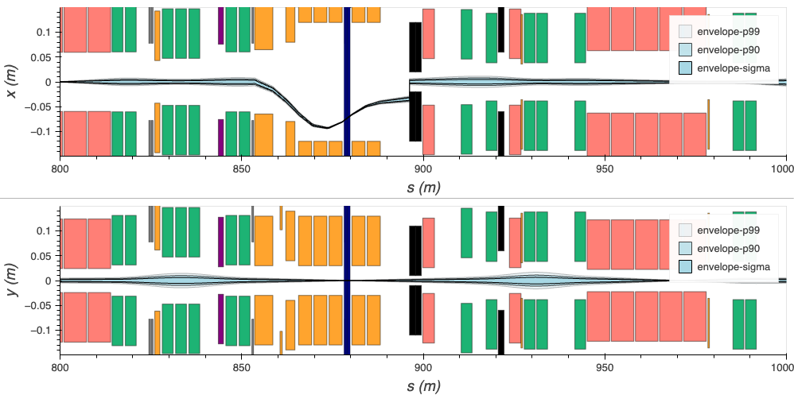
Horizontal offset at T4: P42 modifications

Slide 6
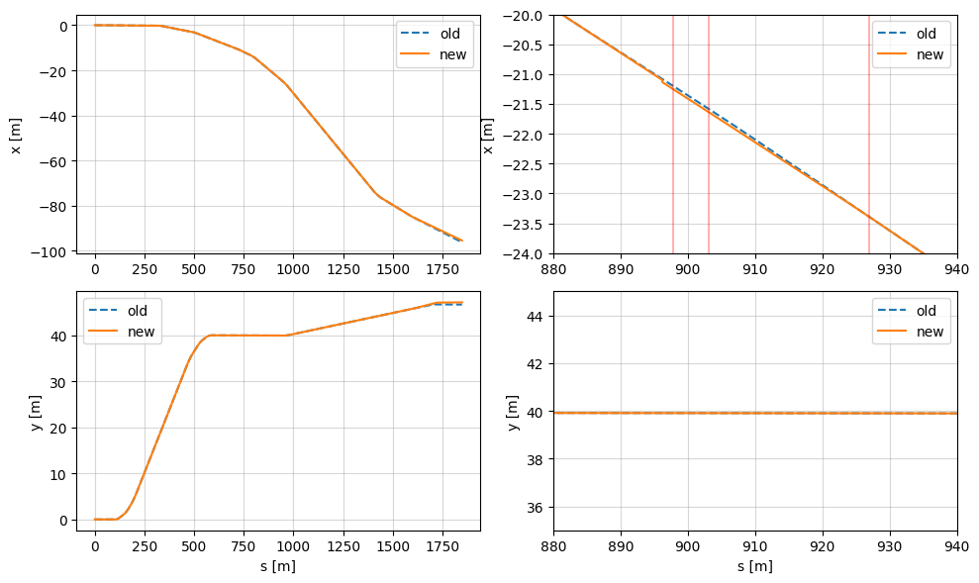
Horizontal offset at T4

Slide 7
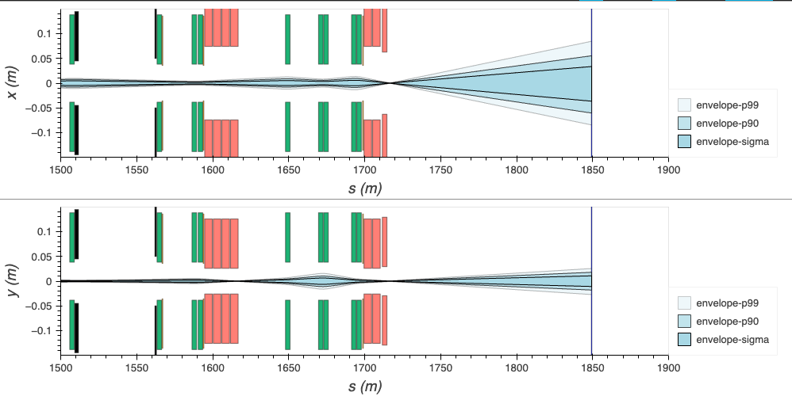
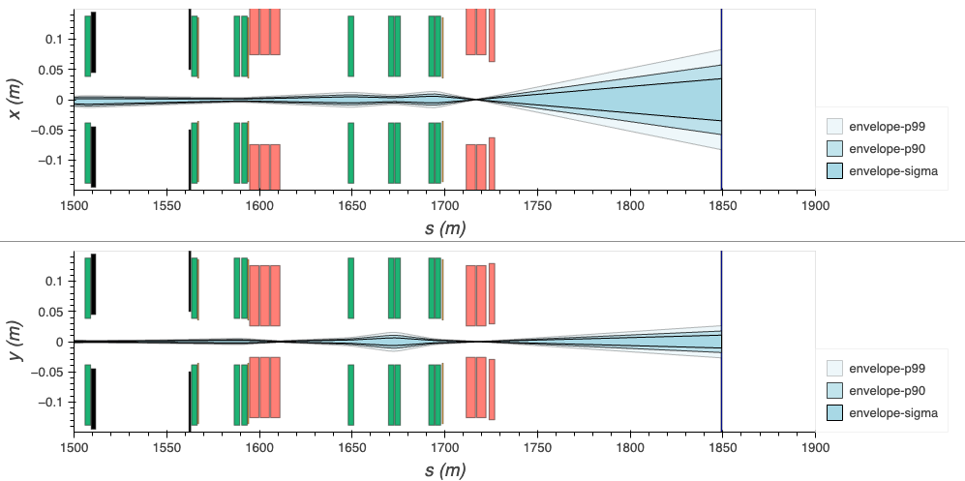
Offset at BDF target
MBNV.X0450823
MBNV.X0450829
MBNH.X0430730
MBXGD.X0450834

Slide 8
Offset at BDF target
MBNH.X0450823
MBNV.X0450829
MBNV.X0430730
MBXGD.X0450834

Slide 9
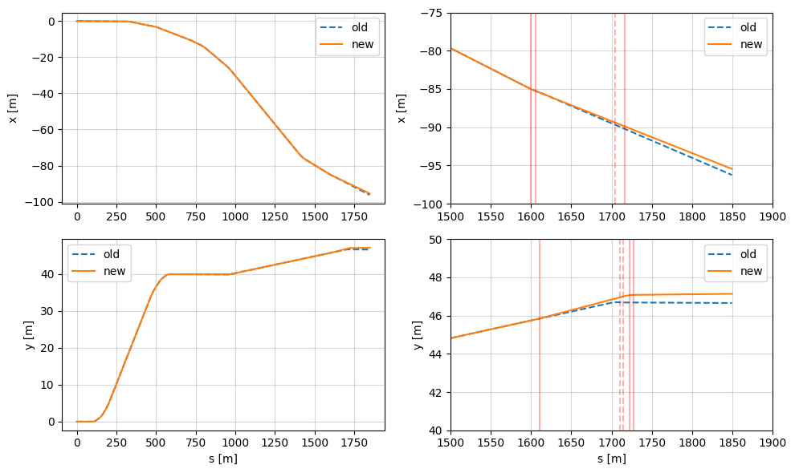
Horizontal offset at T4
0.8 m shift
towards Jura
0.5 m vertical shift

Slide 10
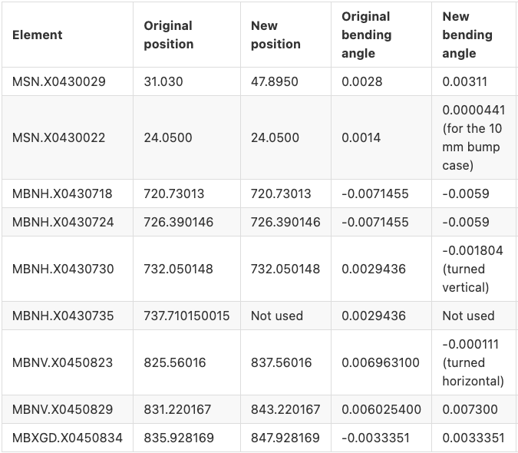
Summary of the changes in P42

Slide 11
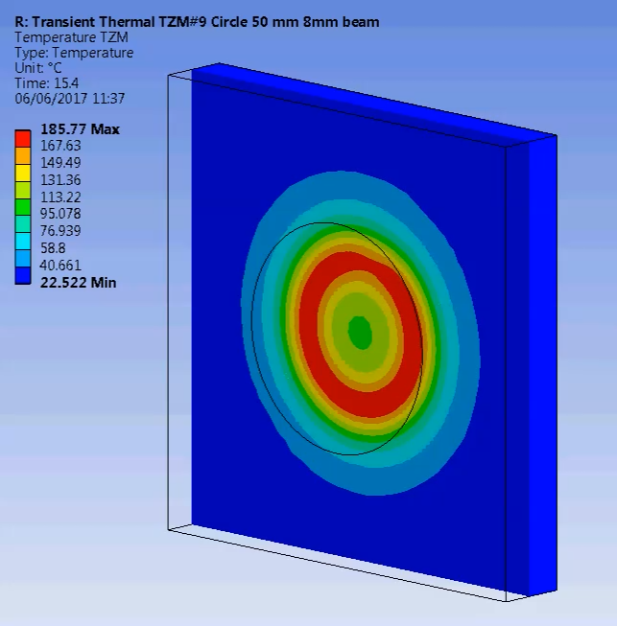
Final focus and dilution system: requirements
SPS Beam Dump Facility - Comprehensive Design Study: CERN-2020-002
Round beam with 𝛔 = 8 / 16 mm on target
50 mm sweep radius @ 4 Hz
About 120 m drift
About 80 m is needed to fit 4 magnets and achieve 50 mm sweep.
The model is to be updated.
Possible solution – 4 magnets (2 per plane)

Slide 12
Summary and the next step
We need to iterate the madx model comparing it to the 3D integration model.
  Currently 154.5 m from QNL.X0430817 entrance
Double check the target position and the angle between NA62 and future SHiP line.
  Currently 3.878 mrad
Current concept of the dilution system is feasible for the new beam line geometry. The model is to be updated.

Slide 13
Thanks for your attention!

Slide 14
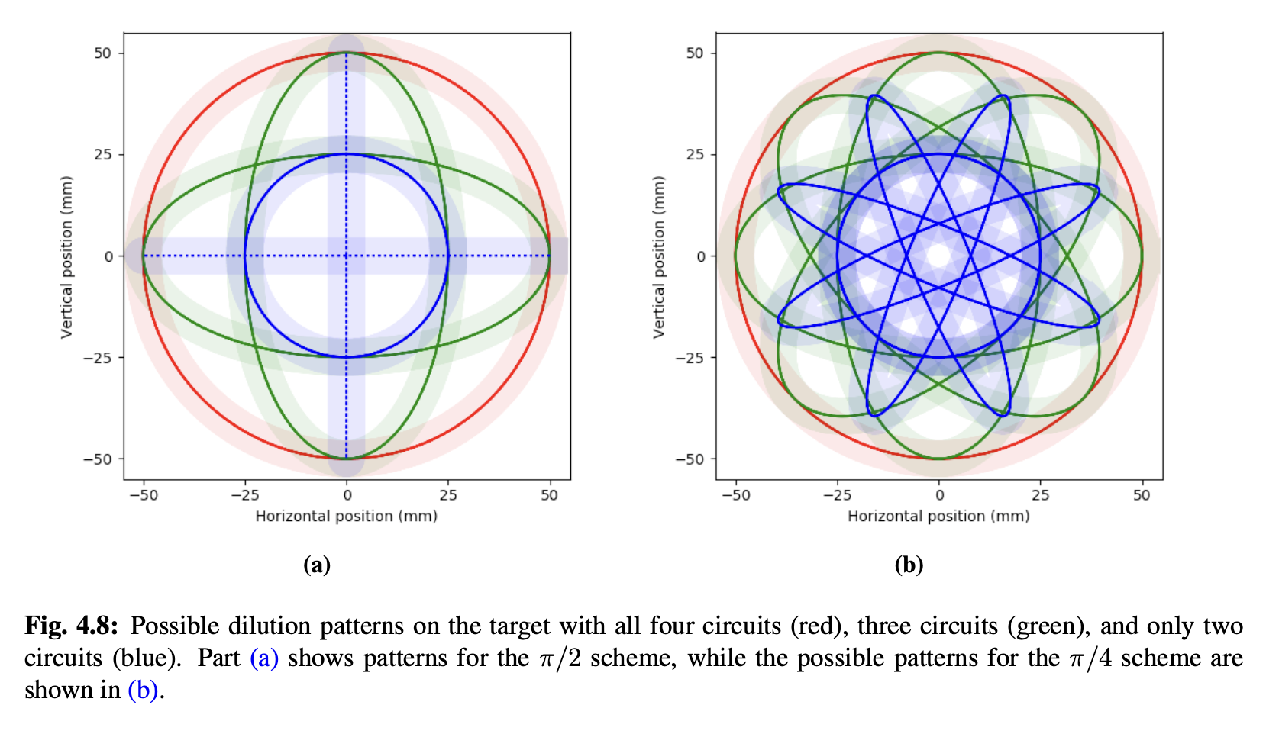


Final focus and dilution system: dilution failure
Since 4 magnets are needed we can do:
  $π$/2 scheme: 2x orientated in H + 2x orientated in V, de-phased by 90 degrees
  $π$/4 scheme: each magnet rotated by 45 degrees, and each de-phased by 45 degrees
Dilution system failure showed the 90 degrees scheme is better
Loss of one magnet for 1 full spill does not require replacement of the target in $π$/2 scheme

Slide 15
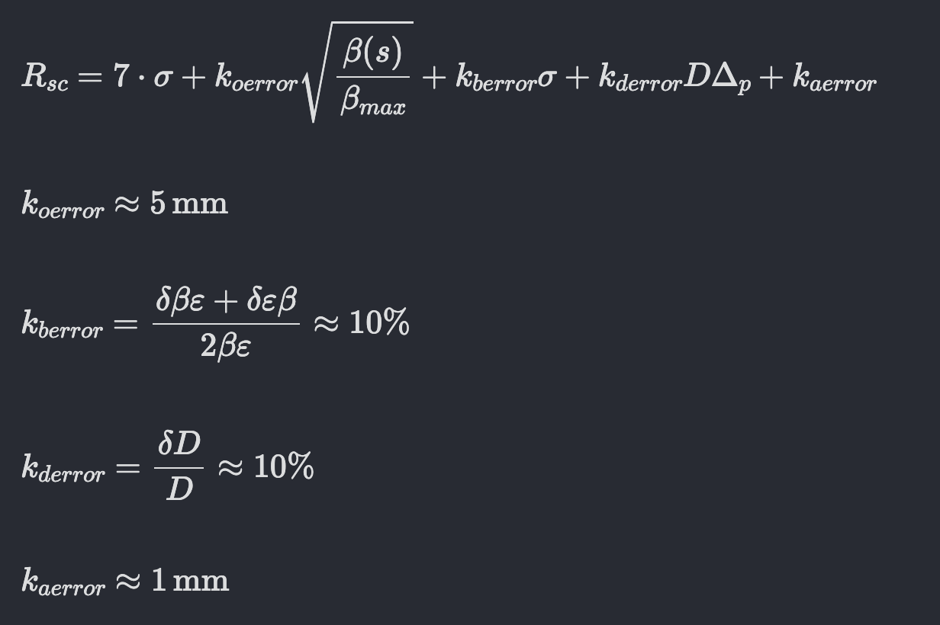
Stay clear region
More info: C. Bracco, Injection: Hadron Beams, CAS 2017
Stay clear reagion (SCR) takes into account beam size plus size, orbit, dispersion and alignment errors.

Slide 16
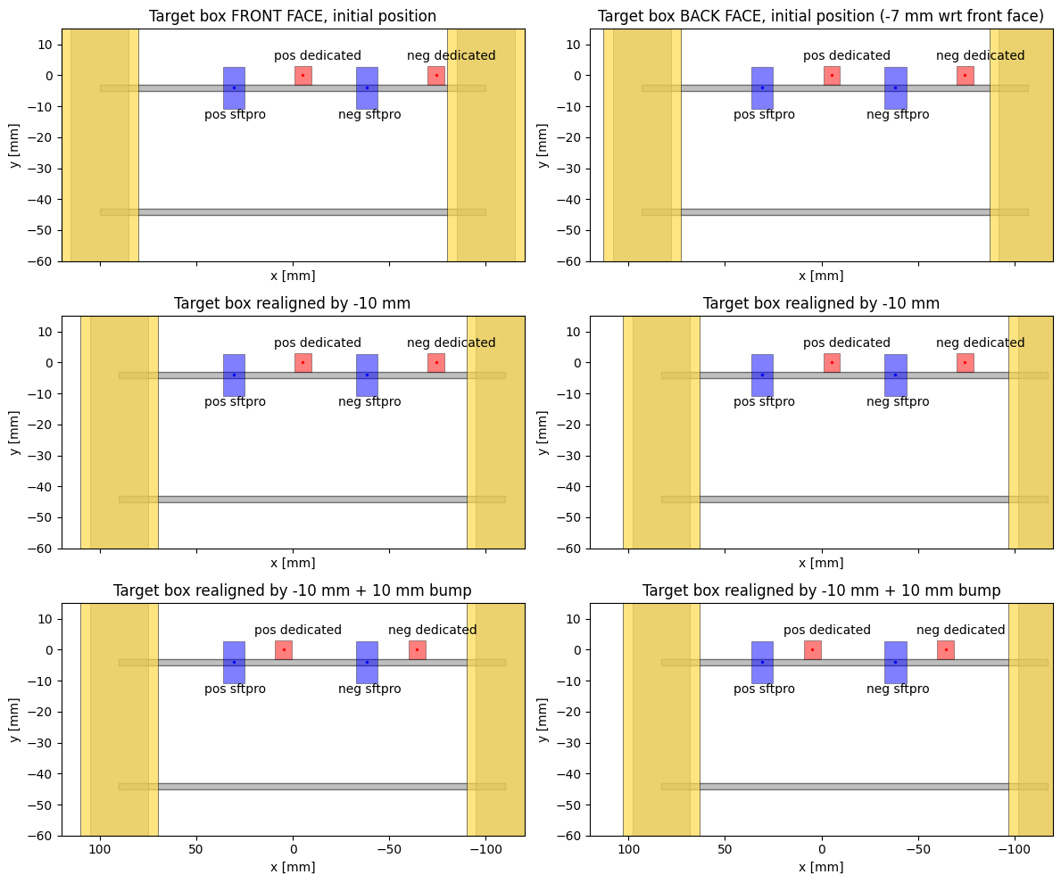
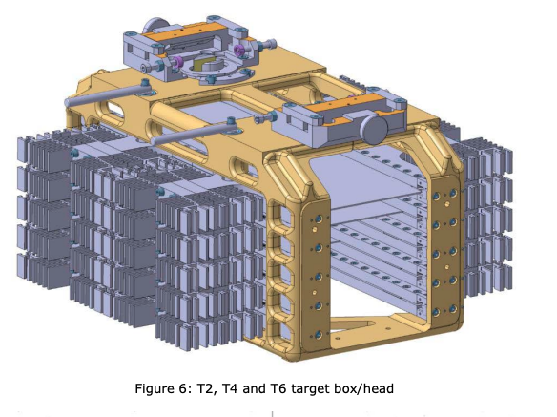
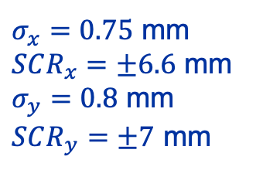
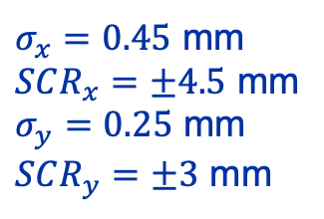
SCR at T4: Both wobbling scenarios
Dedicated
SFTPRO
$σ_{x}=0.45$ mm
$SCR_{x}=±4.5$ mm
$σ_{y}=0.25$ mm
$SCR_{y}=±3$ mm
$σ_{x}=0.75$ mm
$SCR_{x}=±6.6$ mm
$σ_{y}=0.8$ mm
$SCR_{y}=±7$ mm

Slide 17
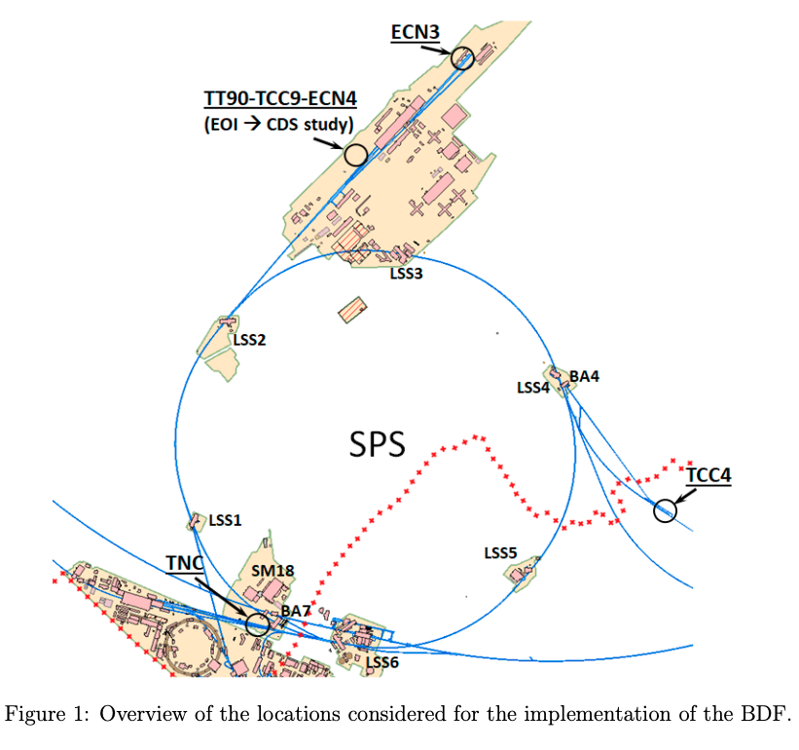
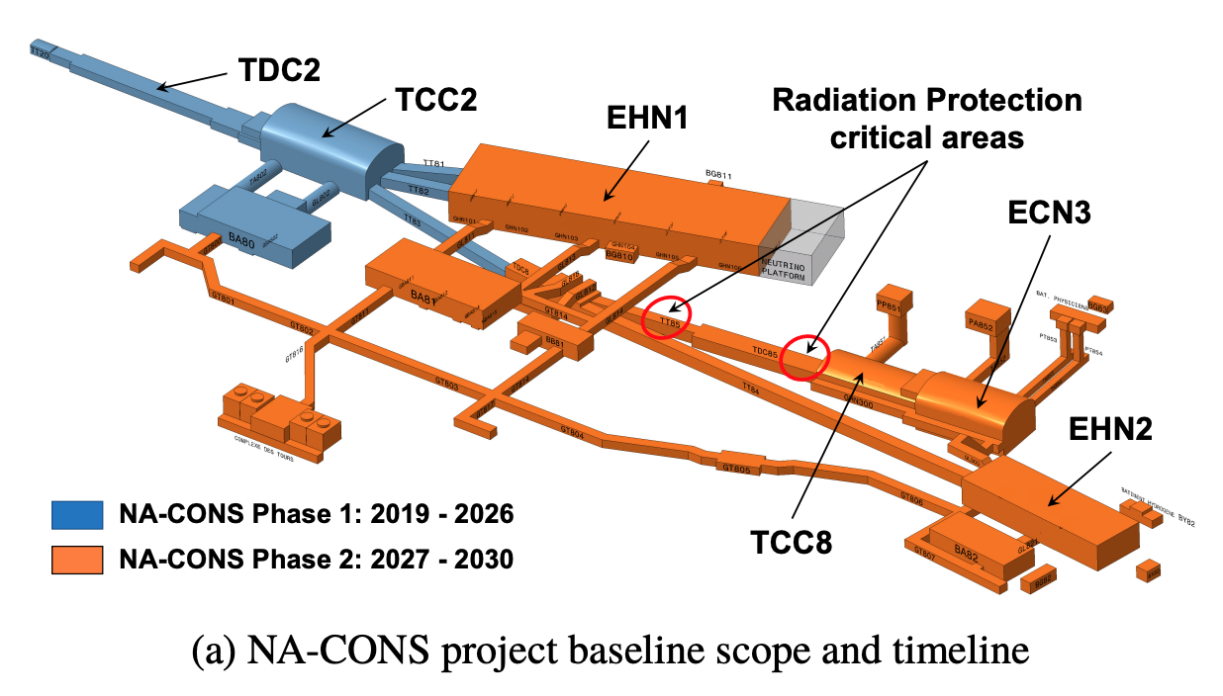
Delivery for ECN3: overview
Final SHiP location
*Study of alternative locations for the SPS Beam Dump Facility
*Study of alternative locations for the SPS Beam Dump Facility
Multiple locations, such as TNC, ECN4, ECN4 and TCC4 were concidered for BDF/SHiP. Eventually, ECN3 was approved providing the opportunity to benefit from slow-extracted beam from LSS2 and synergy with NA-CONS project.

Slide 18
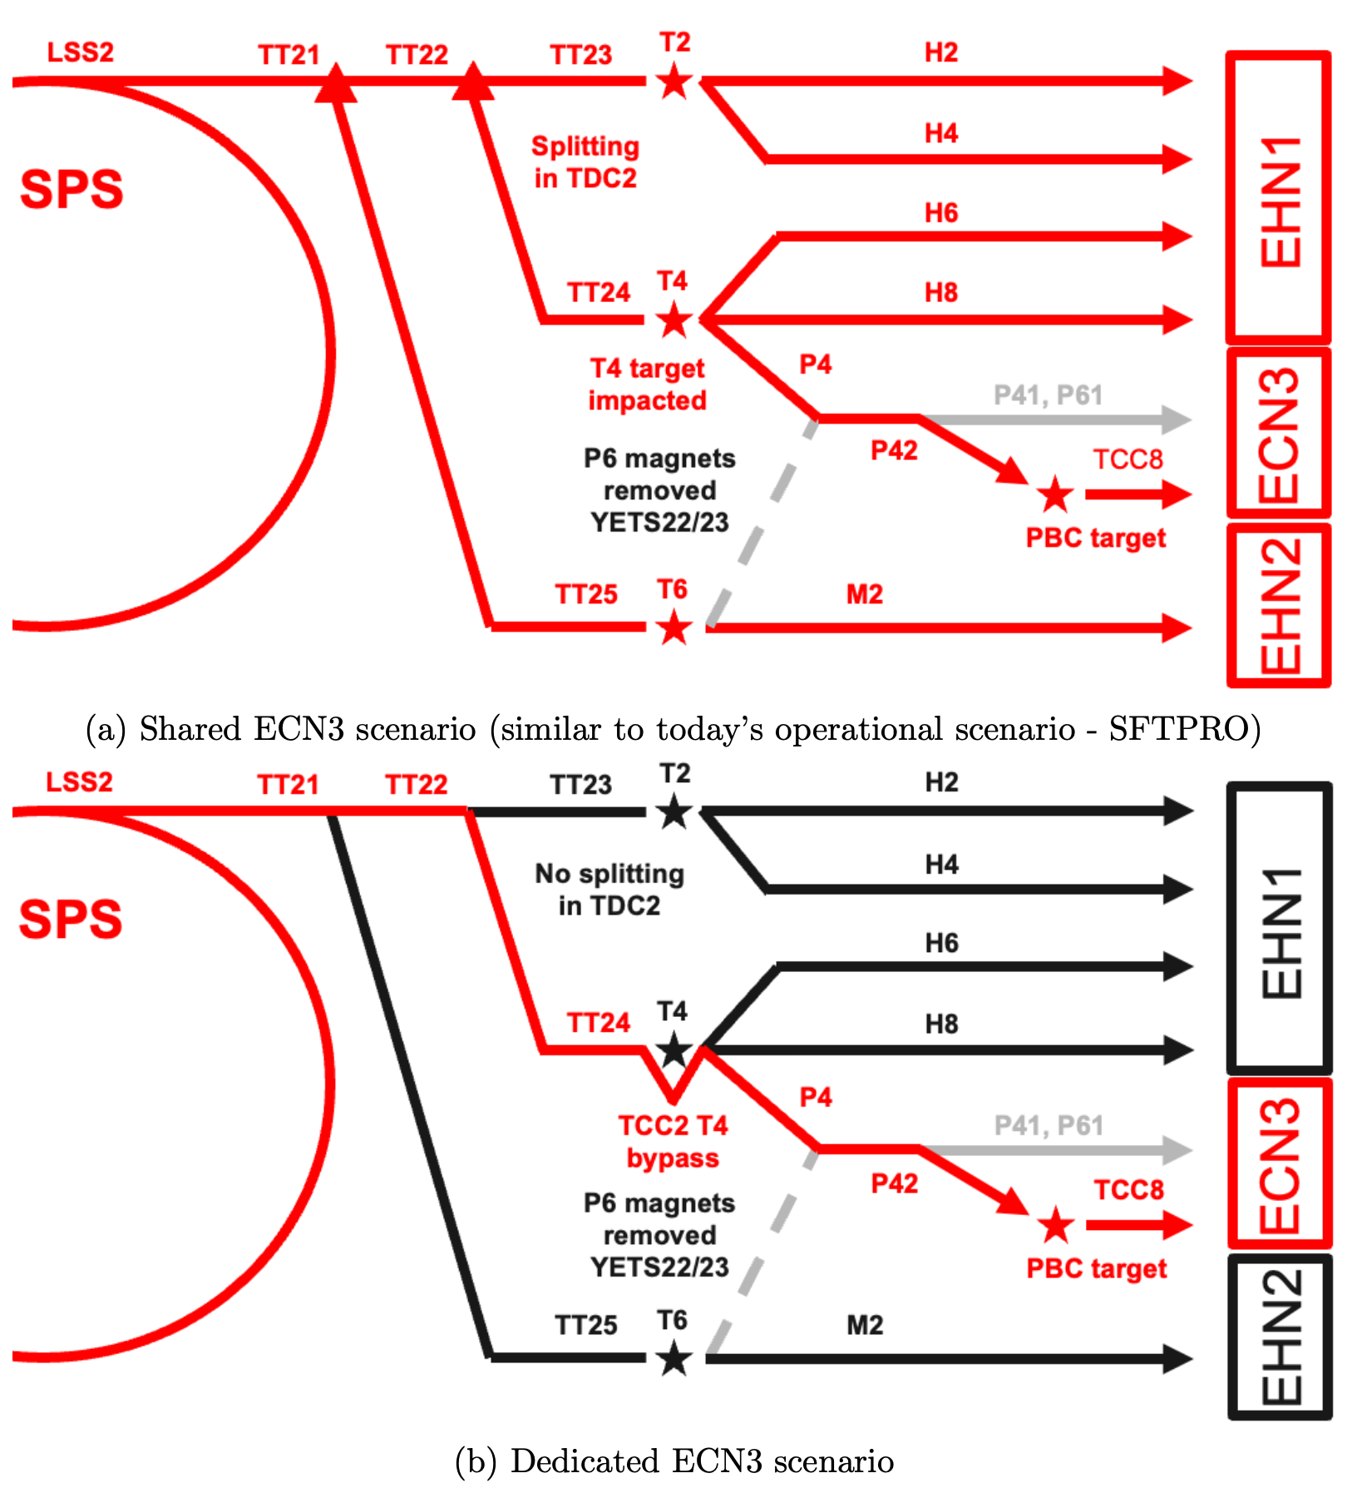
Delivery for ECN3: operation scenarios
*Findings of the Physics Beyond Colliders ECN3 Beam Delivery Task Force
Beam delivery for ECN3 starts in SPS LSS2 with slow-extraction to TT21. Then the beam is either split at the end of TT21 and TT22 or not depending on scenario. Downstream the line it passes through the T4 target in TCC2 and P42 line until it is finally transferred to T10 target in TCC8.

Slide 19
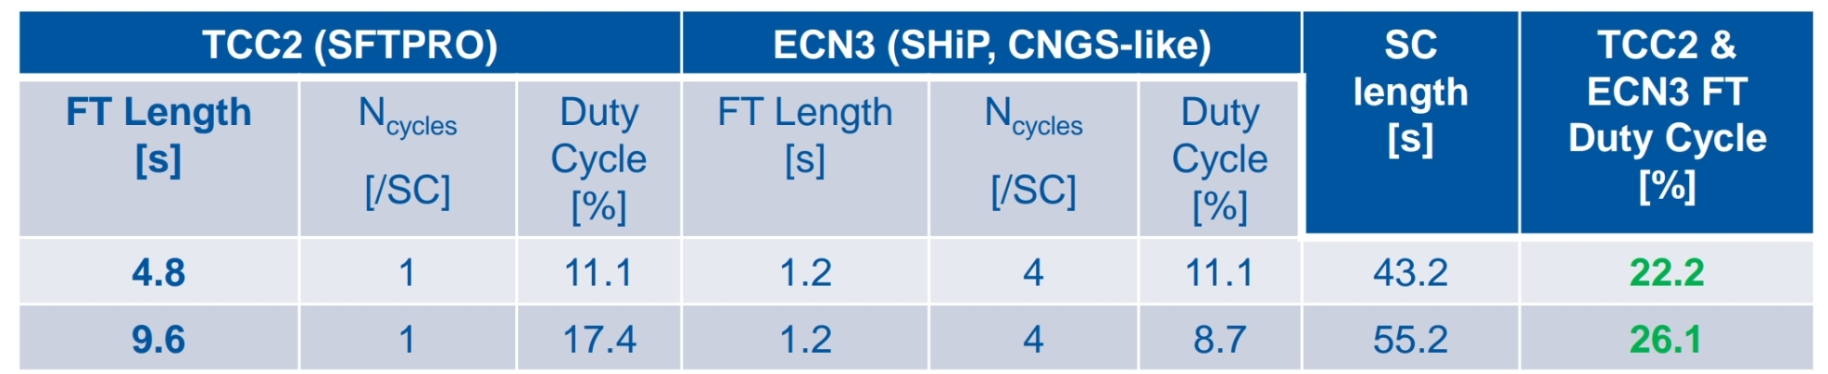
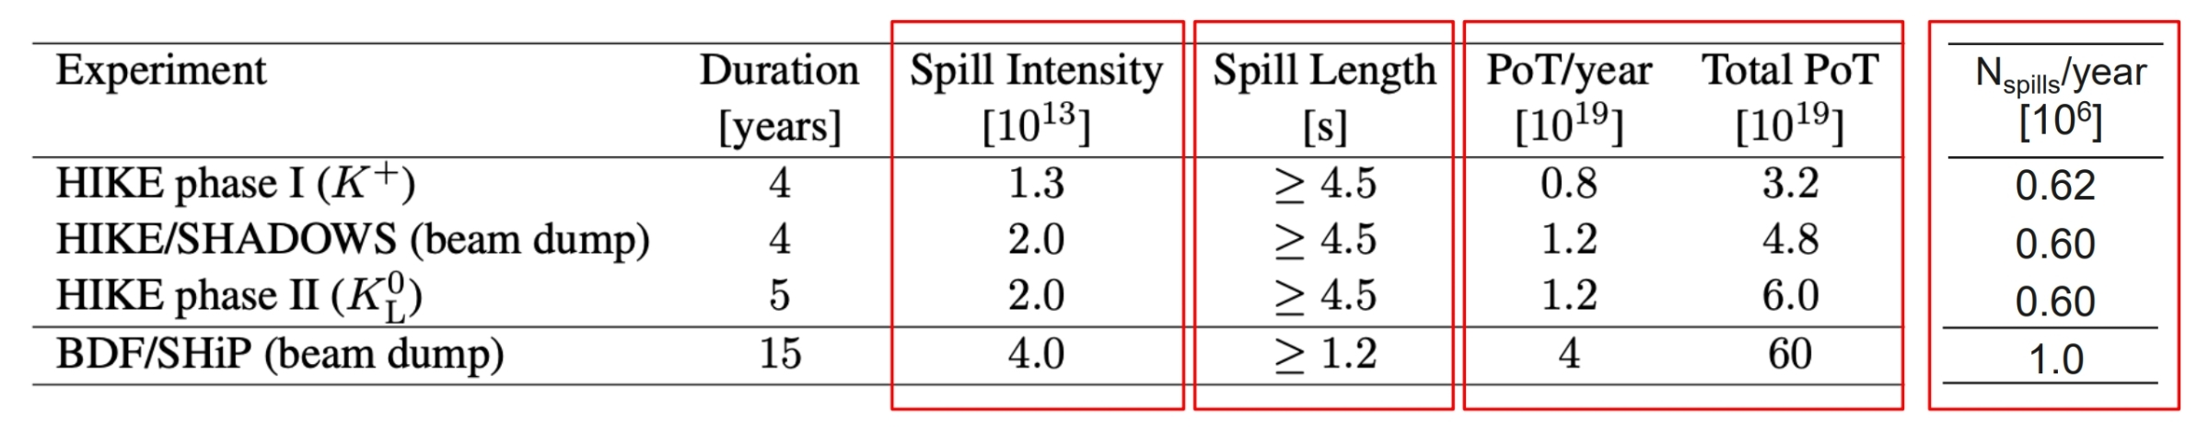
Delivery for ECN3: beam parameters
Findings of the Physics Beyond Colliders ECN3 Beam Delivery Task Force
Beam delivery for ECN3 starts in SPS LSS2 with slow-extraction to TT21. Then the beam is either split at the end of TT21 and TT22 or not depending on scenario. Downstream the line it passes through the T4 target in TCC2 and P42 line until it is finally transferred to T10 target in TCC8.

Slide 20
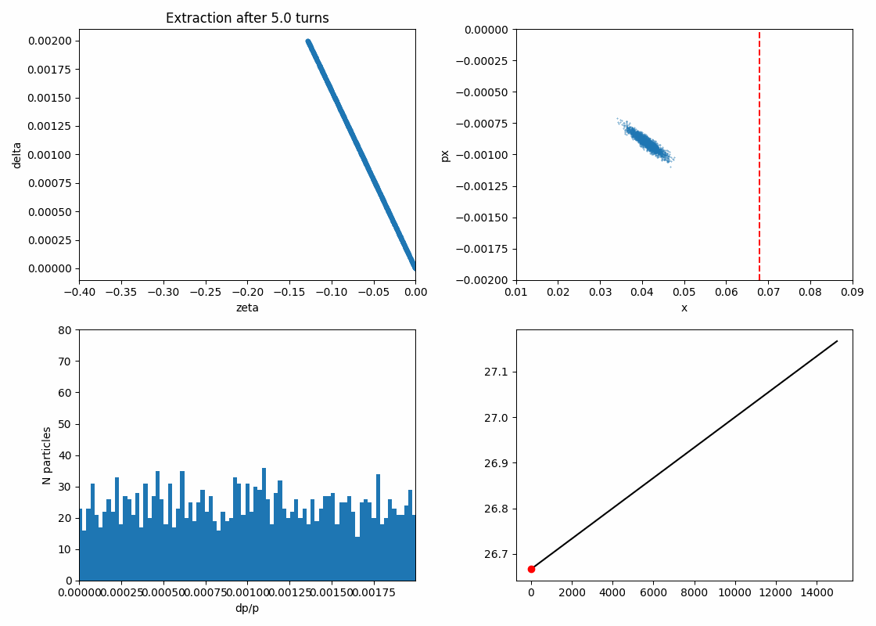
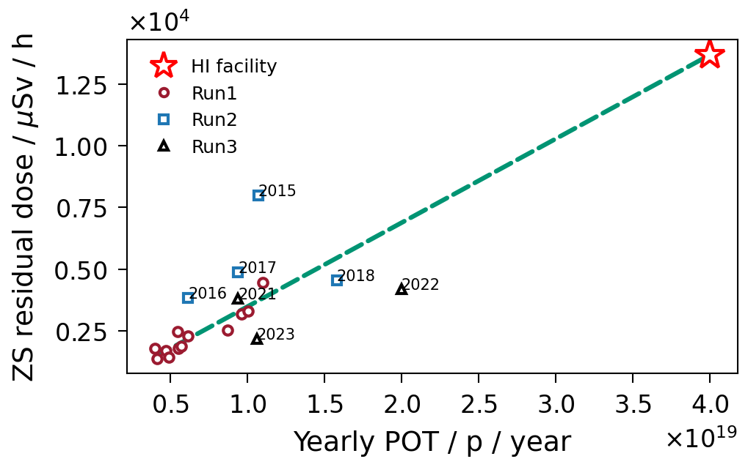
Slow extraction in LSS2: ZS activation problem
COSE: Constant Optics Slow Extraction
Beam losses on ES cause activation and, thus, limit max POT.
We need to significantly reduce these losses (x4) to keep the dose at the level of Run 3.
Goal > Run 3

Slide 21
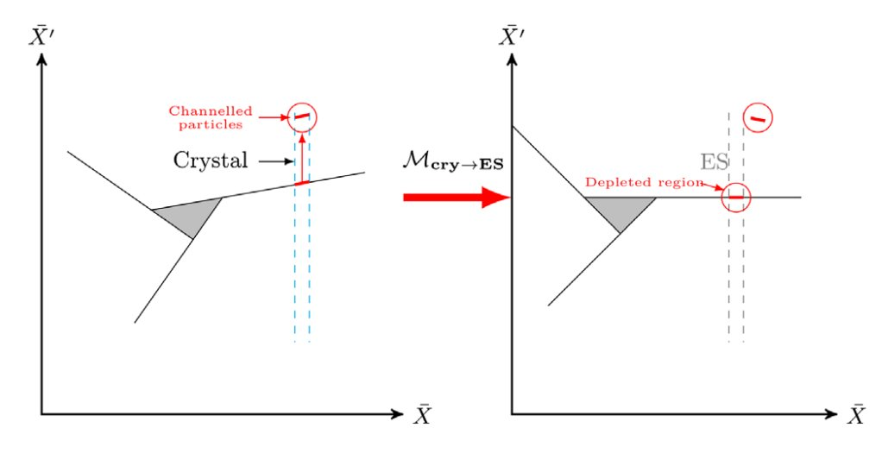
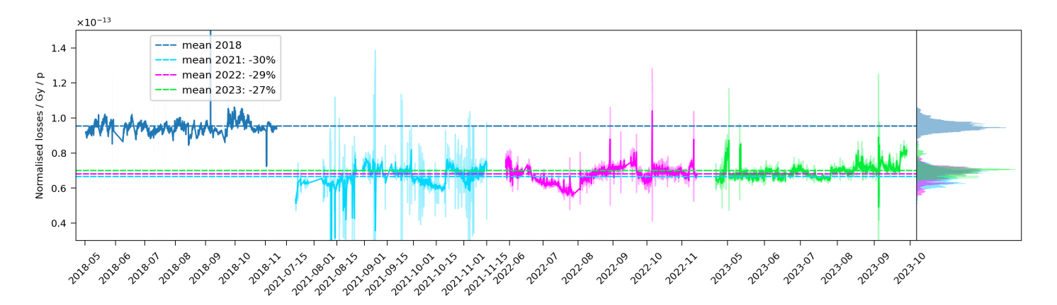
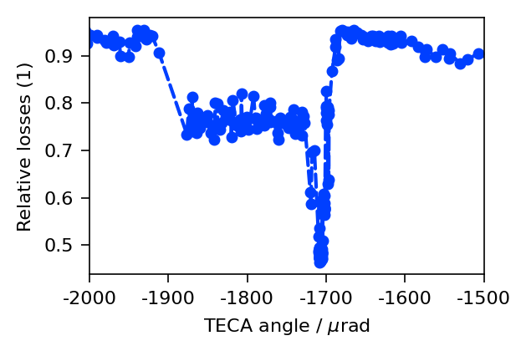
Slow extraction in LSS2: losses reduction (CS)
Crystal shadowing of ZS is now proven technique:
  Operational goniometer in SPS LSS2
CERN in-house development of advanced crystal technology (DECRYCE project):
  Now: single crystal aligned in shadowing (VR) for LSS4 ~ factor 2 loss reduction
  Future: arrays of crystals aligned in volume reflection promising up to a factor 10 beam loss reduction and replacement of septa with crystals altogether
LSS2 gonio in OP since LS2
~30% loss reduction
LSS4 gonio R&D:
~ 55% loss reduction

Slide 22
Delivery for ECN3: splitting VS dedicated
Shared delivery: splitting
Dedicated delivery: no splitting
Deflected right by B field
Losses
~ 5%
No Losses
TT20 optics changed to transport beam through splitter aperture
B
B
Continues straight, undeflected
*Findings of the Physics Beyond Colliders ECN3 Beam Delivery Task Force
Beam delivery for ECN3 starts in SPS LSS2 with slow-extraction to TT21. Then the beam is either split at the end of TT21 and TT22 or not depending on scenario. Downstream the line it passes through the T4 target in TCC2 and P42 line until it is finally transferred to T10 target in TCC8.

Slide 23
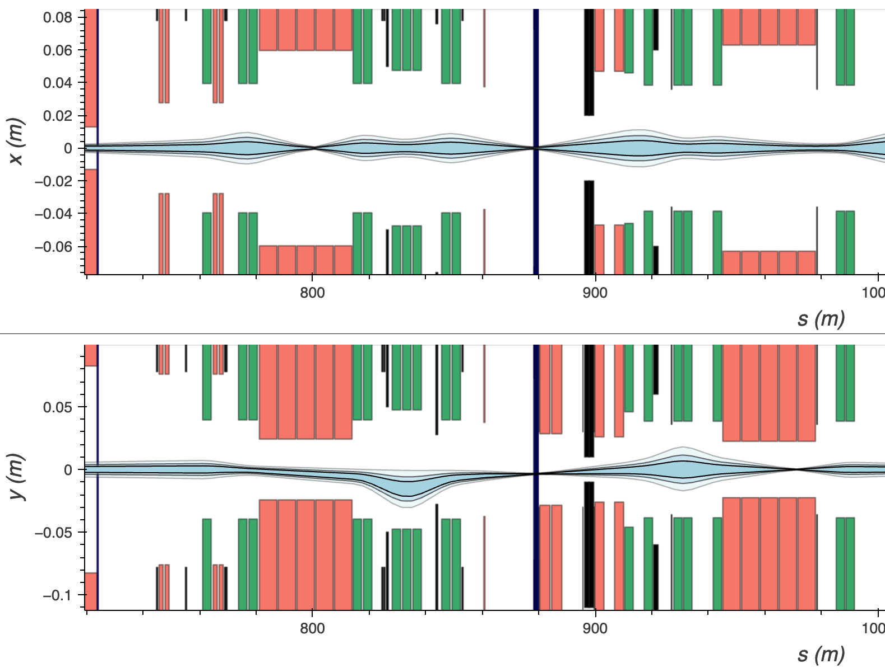
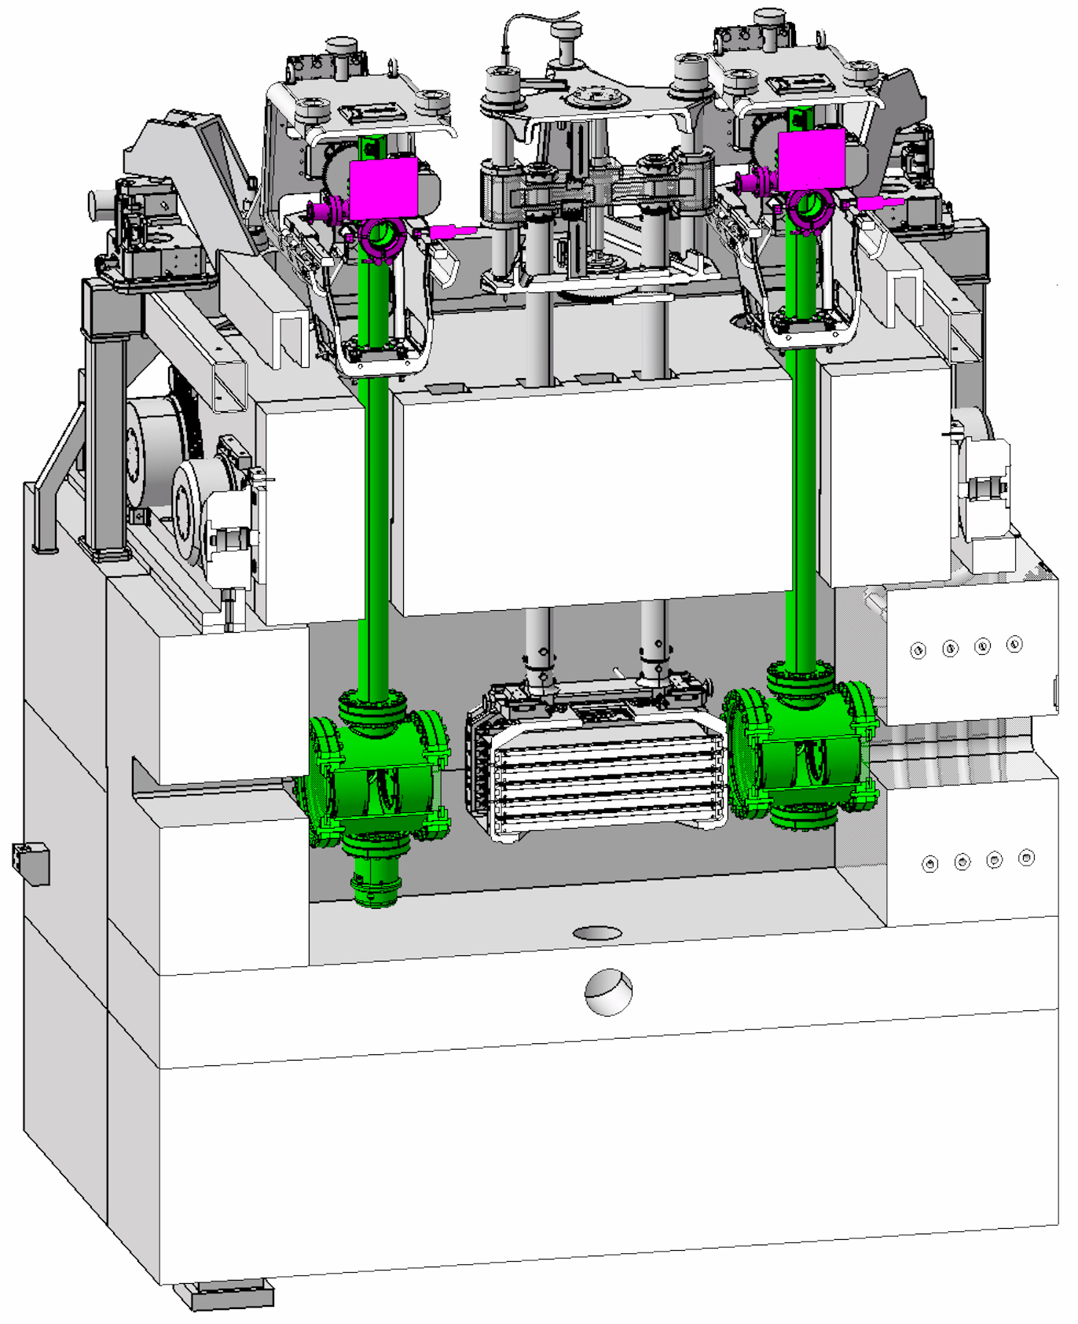
Delivery for ECN3: bumping around T4
bump off
bump on
mdlv.2402
mnpa 30
mcxca.x04301
On SHARED cycle one of the sheets in T4 target is aligned with the beam orbit. In case of DEDICATED cycle, there is no need to hit T4 target, so it is proposed to bump around using mdlv.2402, mcxca.x04301 and new mnpa 30 correctors.
Modifications to equipment in TCC2 for SHiP need urgent design and specification to meet NA-CONS Phase 1 deadlines (installation in LS3), namely a simplified P42 XTAX under vacuum.

Slide 24
Delivery for ECN3: bumping around T4
bump off
bump on
mdlv.2402
mnpa 30
mcxca.x04301
On SHARED cycle one of the sheets in T4 target is aligned with the beam orbit. In case of DEDICATED cycle, there is no need to hit T4 target, so it is proposed to bump around using mdlv.2402, mcxca.x04301 and new mnpa 30 correctors.
An optimized solution for SHiP and future H6/H8 operation is under urgent design.

Slide 25
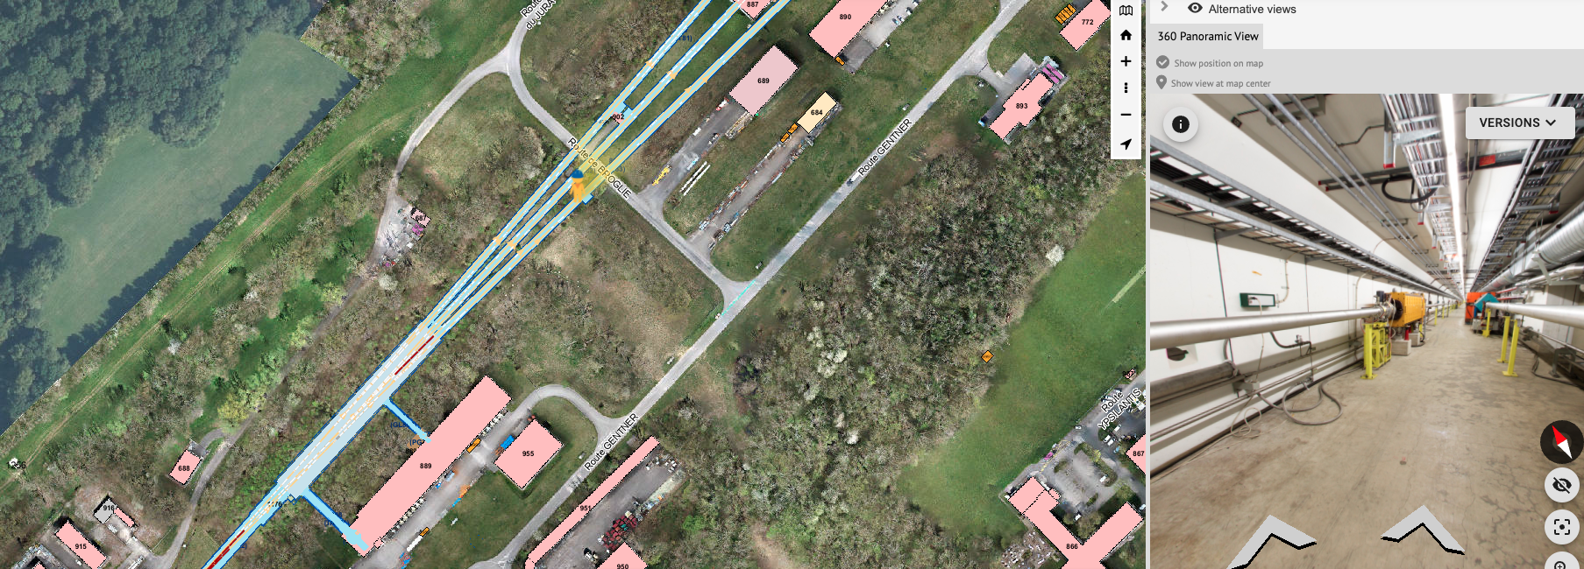
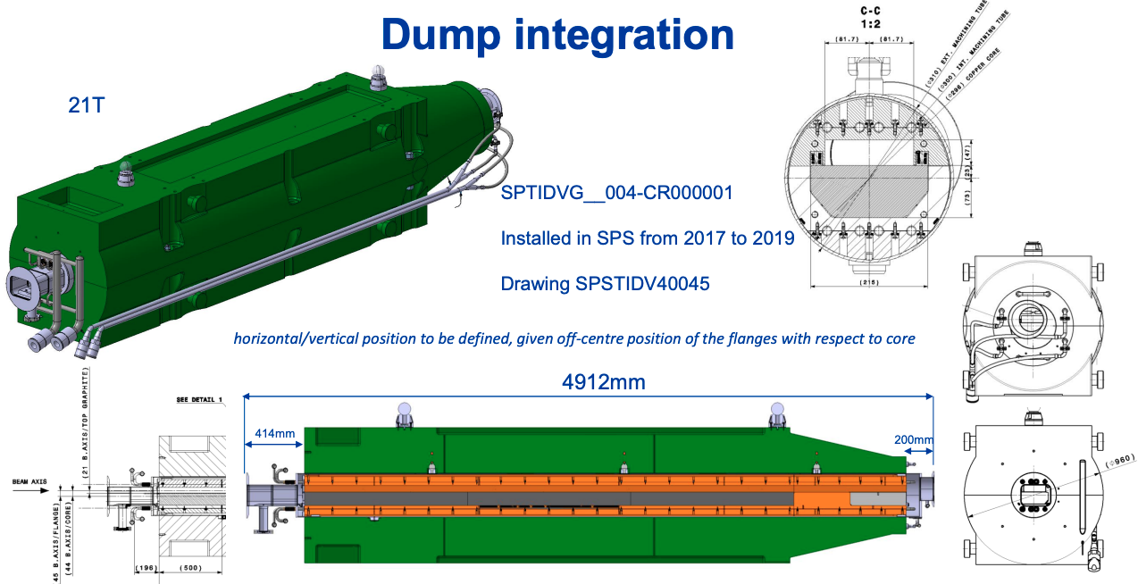
P42 beam dump: location
213 m from T4
*Damien Grenier, Rui Ximenes, Maria Ornedo, ECN3 High Intensity P42 Dump
Also, it is proposed to install a new dedicated absorber in the upstream part of P42 (Absorber face is 213 m downstream T4 center). Protons on the SHARED cycle will be dumped either if (1) transmission losses in P42 are above the acceptable level or (2) the beam pose problems for the experimental user in ECN3. Protons on the DEDICATED cycle will be dumped only in case of emergency.

Slide 26
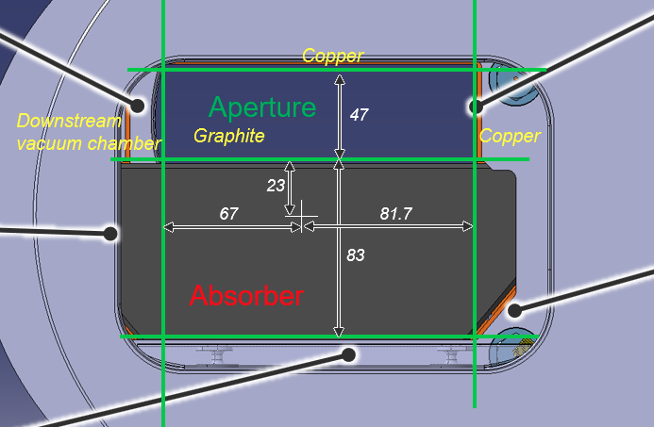
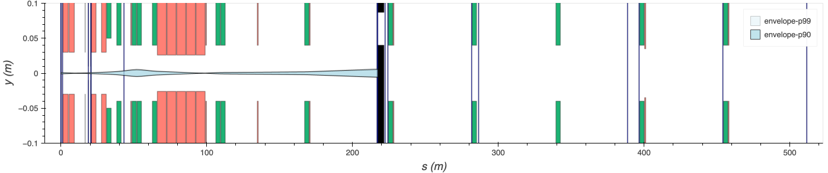
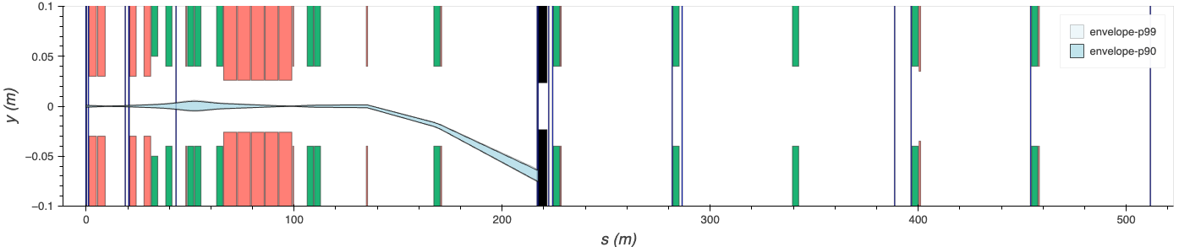

P42 beam dump: operation
Post LS3 before ECN3 commissioning
TIDVG
TIDVG +63.5 mm
mdx
off
$d$ = 40 mm
Beam
During/after ECN3 commissioning
TIDVG
+0 mm
mdx
on
115-150 m
213 m
After LS3, but before ECN3 commissioning TIDVG will be installed with a vertical offset in order to block the beam from coming to ECN3 target and keep this area safe for intervention. During and after ECN3 commissioning the dump vertical position will be lowered, so the protons are dumped only when the upstream corrector is on.

Slide 27
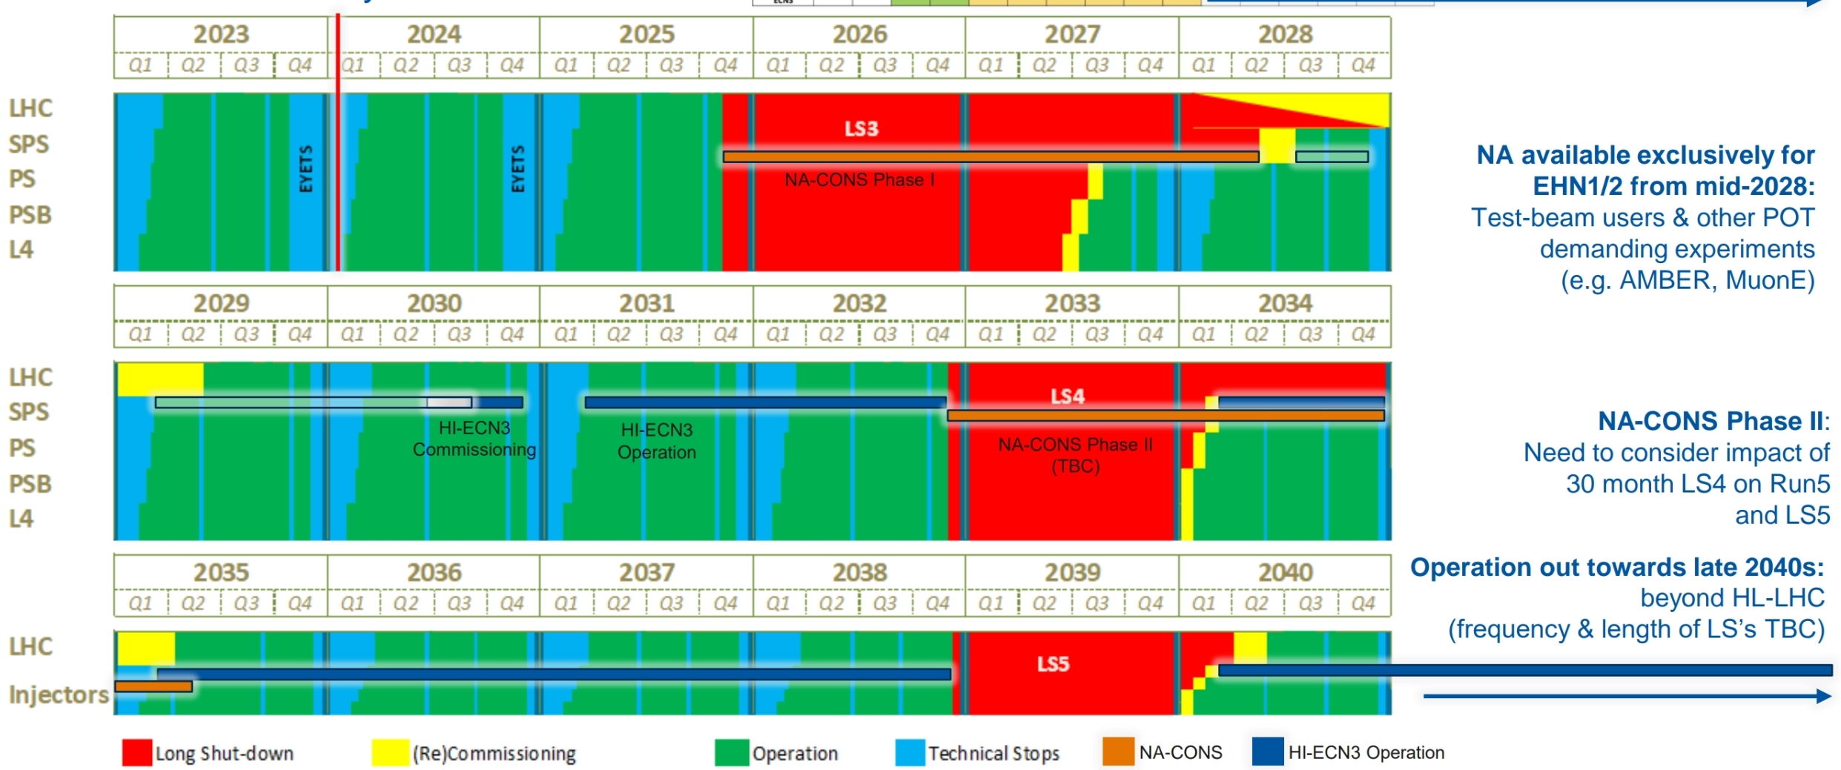

Slide 28
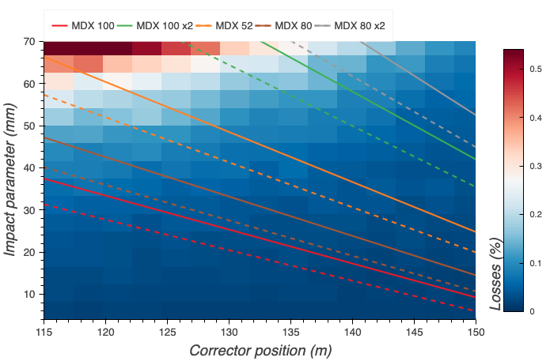
P42 beam dump: required modifications
Post LS3 before ECN3 commissioning
TIDVG +63.5 mm
mdx
off
During/after ECN3 commissioning
TIDVG
+0 mm
mdx
on
115-150 m
213 m
Location for the dump corrector should be chosen between 115 and 150 m downstream T4 center depending on the magnet type. Two MDX with 100 gap give enough strength to install the corrector close to downstream quadrupole and be able to dump the protons at any vertical position on the absorber face with minimal losses.

Slide 29
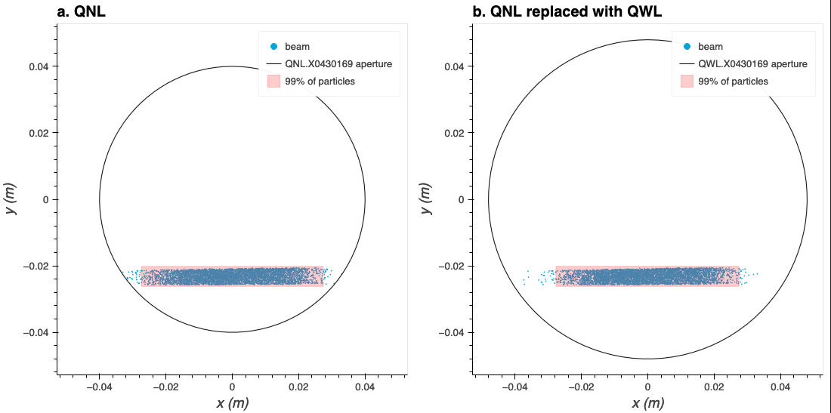
P42 beam dump: required modifications
Post LS3 before ECN3 commissioning
TIDVG +63.5 mm
mdx
off
During/after ECN3 commissioning
TIDVG
+0 mm
mdx
on
115-150 m
213 m
QNL.X0430169 and MCXCA.X0430171 will be replaced with QWL and MCXCA having larger apertures to minimize unwanted losses and provide more flexibility in dumping angle.

Slide 30
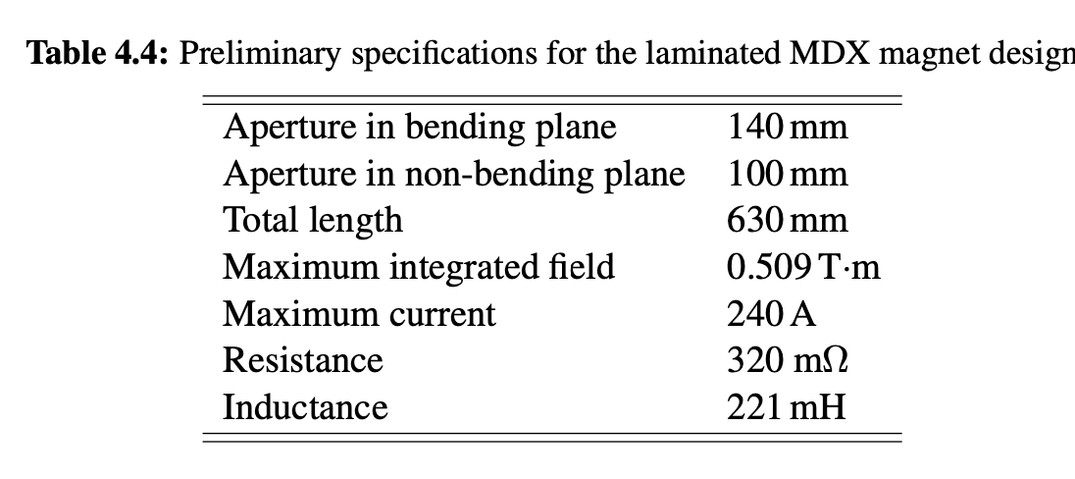
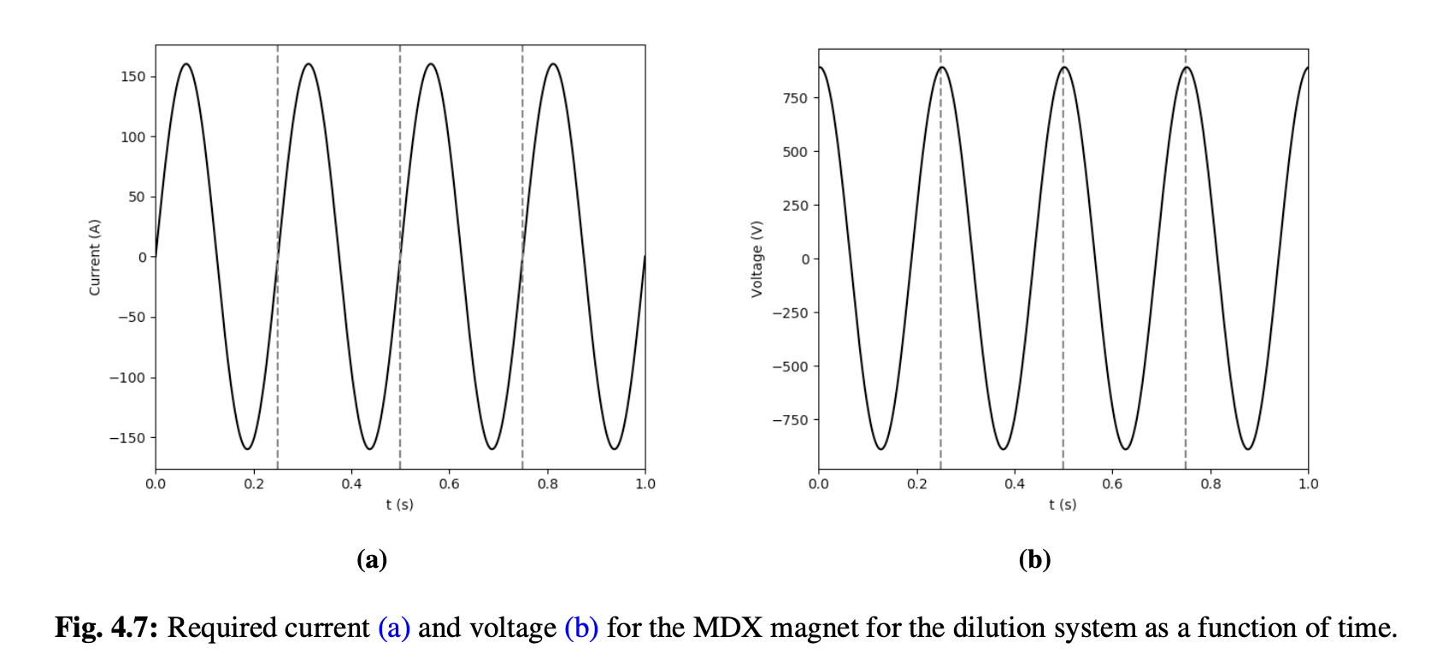
Hardware
4 MDX magnets (2 per plane)
4 SIRIUS_2S (1 per magnet):
  2S to get 1.8 kV for 4 Hz
  Fully programmable function
  4 quadrant operation (bipolar current & voltage)
  Info from Gilles Le Godec (2018)
Drift of 100 m from dilution system to target (no optics in between)
M. Fraser BDF/SHiP Final Focus and Dilution System HI-ECN3 WP2 meeting 10th April 2024

Slide 31
Final focus and dilution system: beam instrumentation
For BDF/SHiP CDS BI considered:
    A 2D position & beam size monitoring system, screen-type, ~ 50m upstream the target for offline monitoring and images every 100 ms
    A beam current monitor
    A target beam monitoring system
To be discussed:
    Live beam position monitoring
    CCC in TCC8 or SEM device
    Do we need to look at target front-face

