Slide 1
Lifetime Issues

Slide 2
Recap: Simulation
Set up three lots of simulations:
  No radiation
  Mean Radiation
  Quantum Radiation
100 000 particles over 20 000 turns, z lattice
Observe beam sizes for verification
Observe loss rates

Slide 3
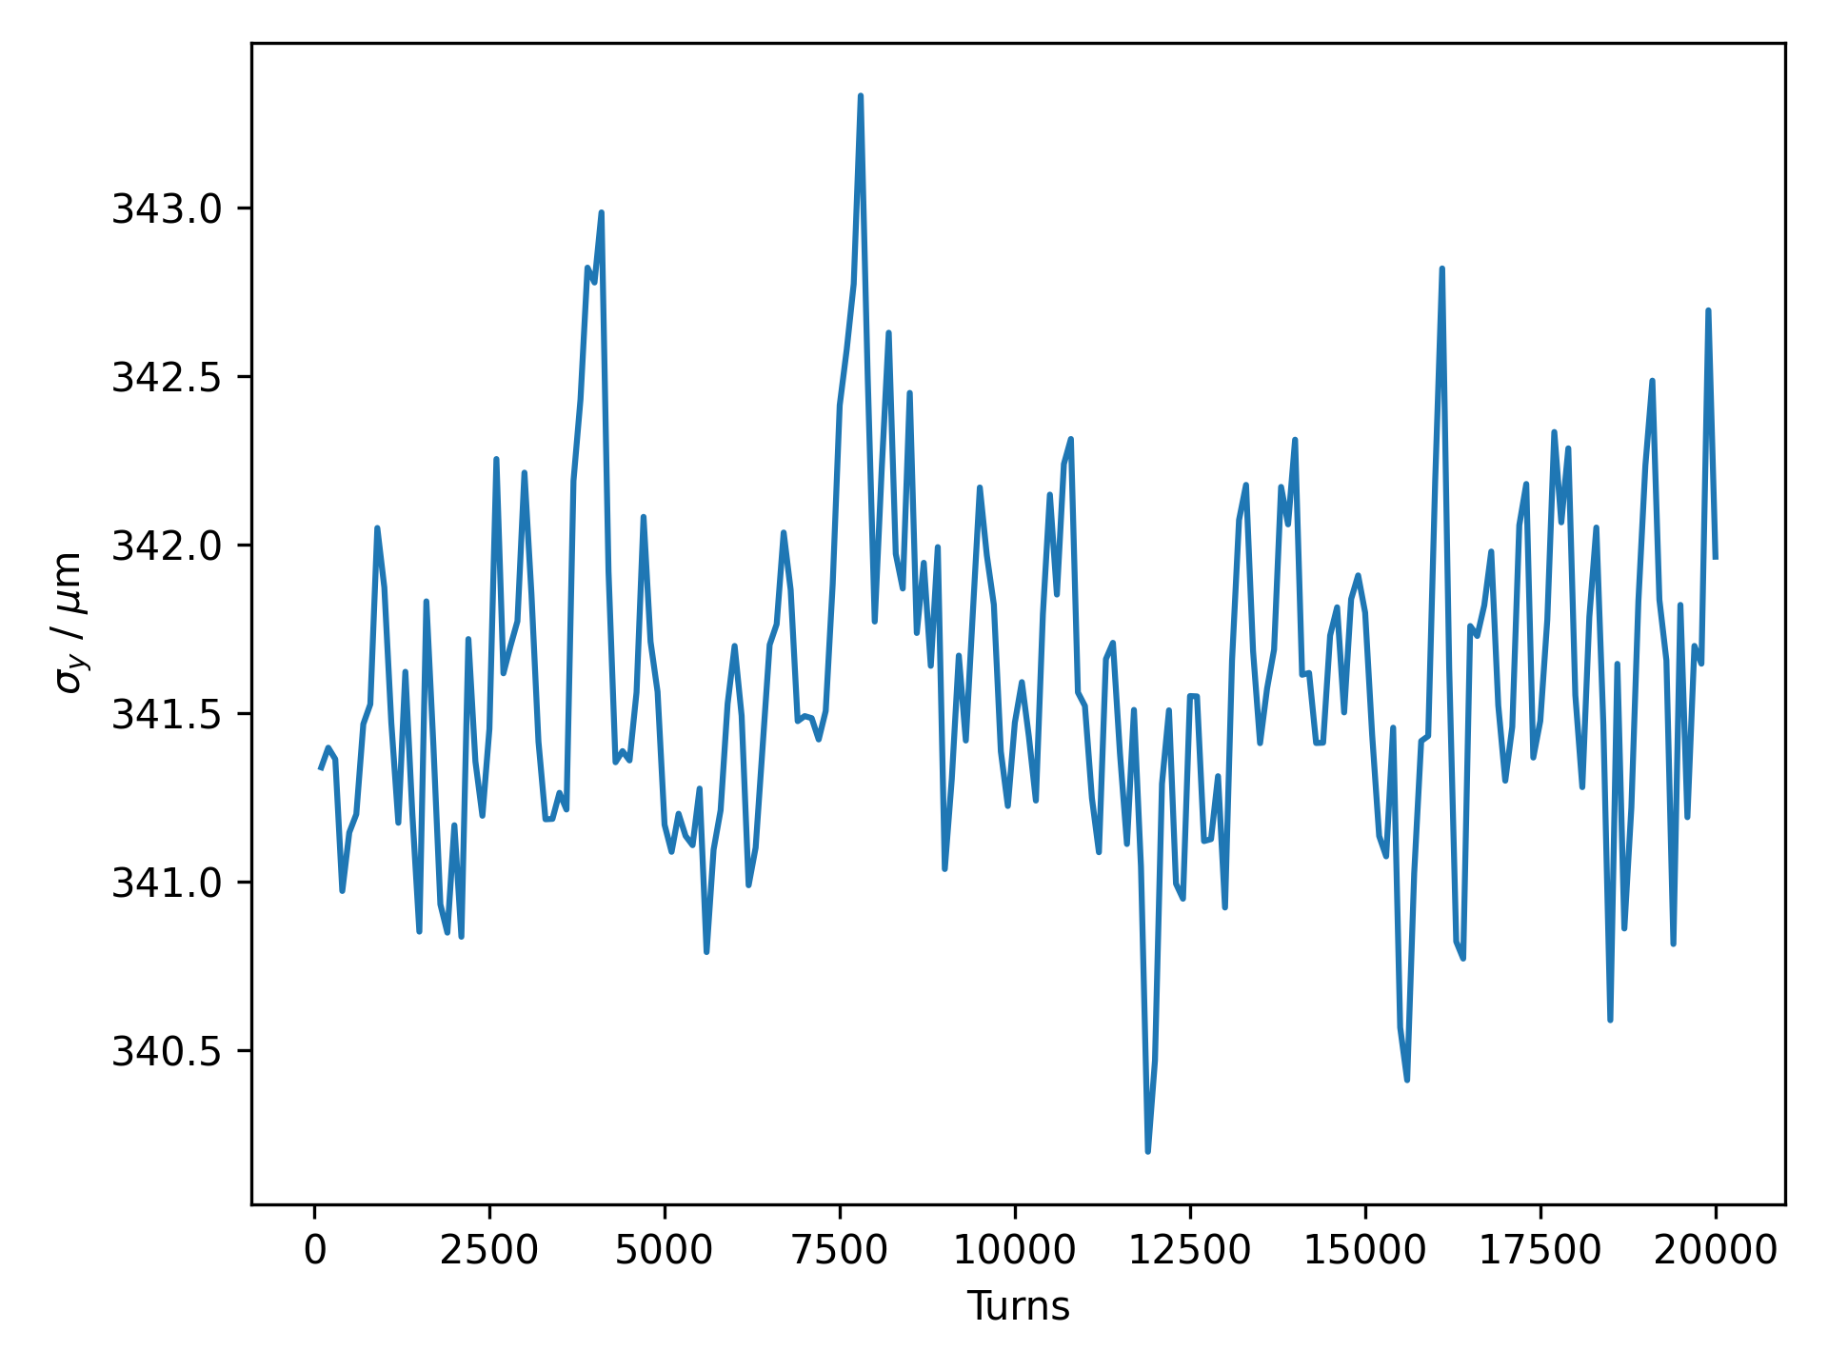
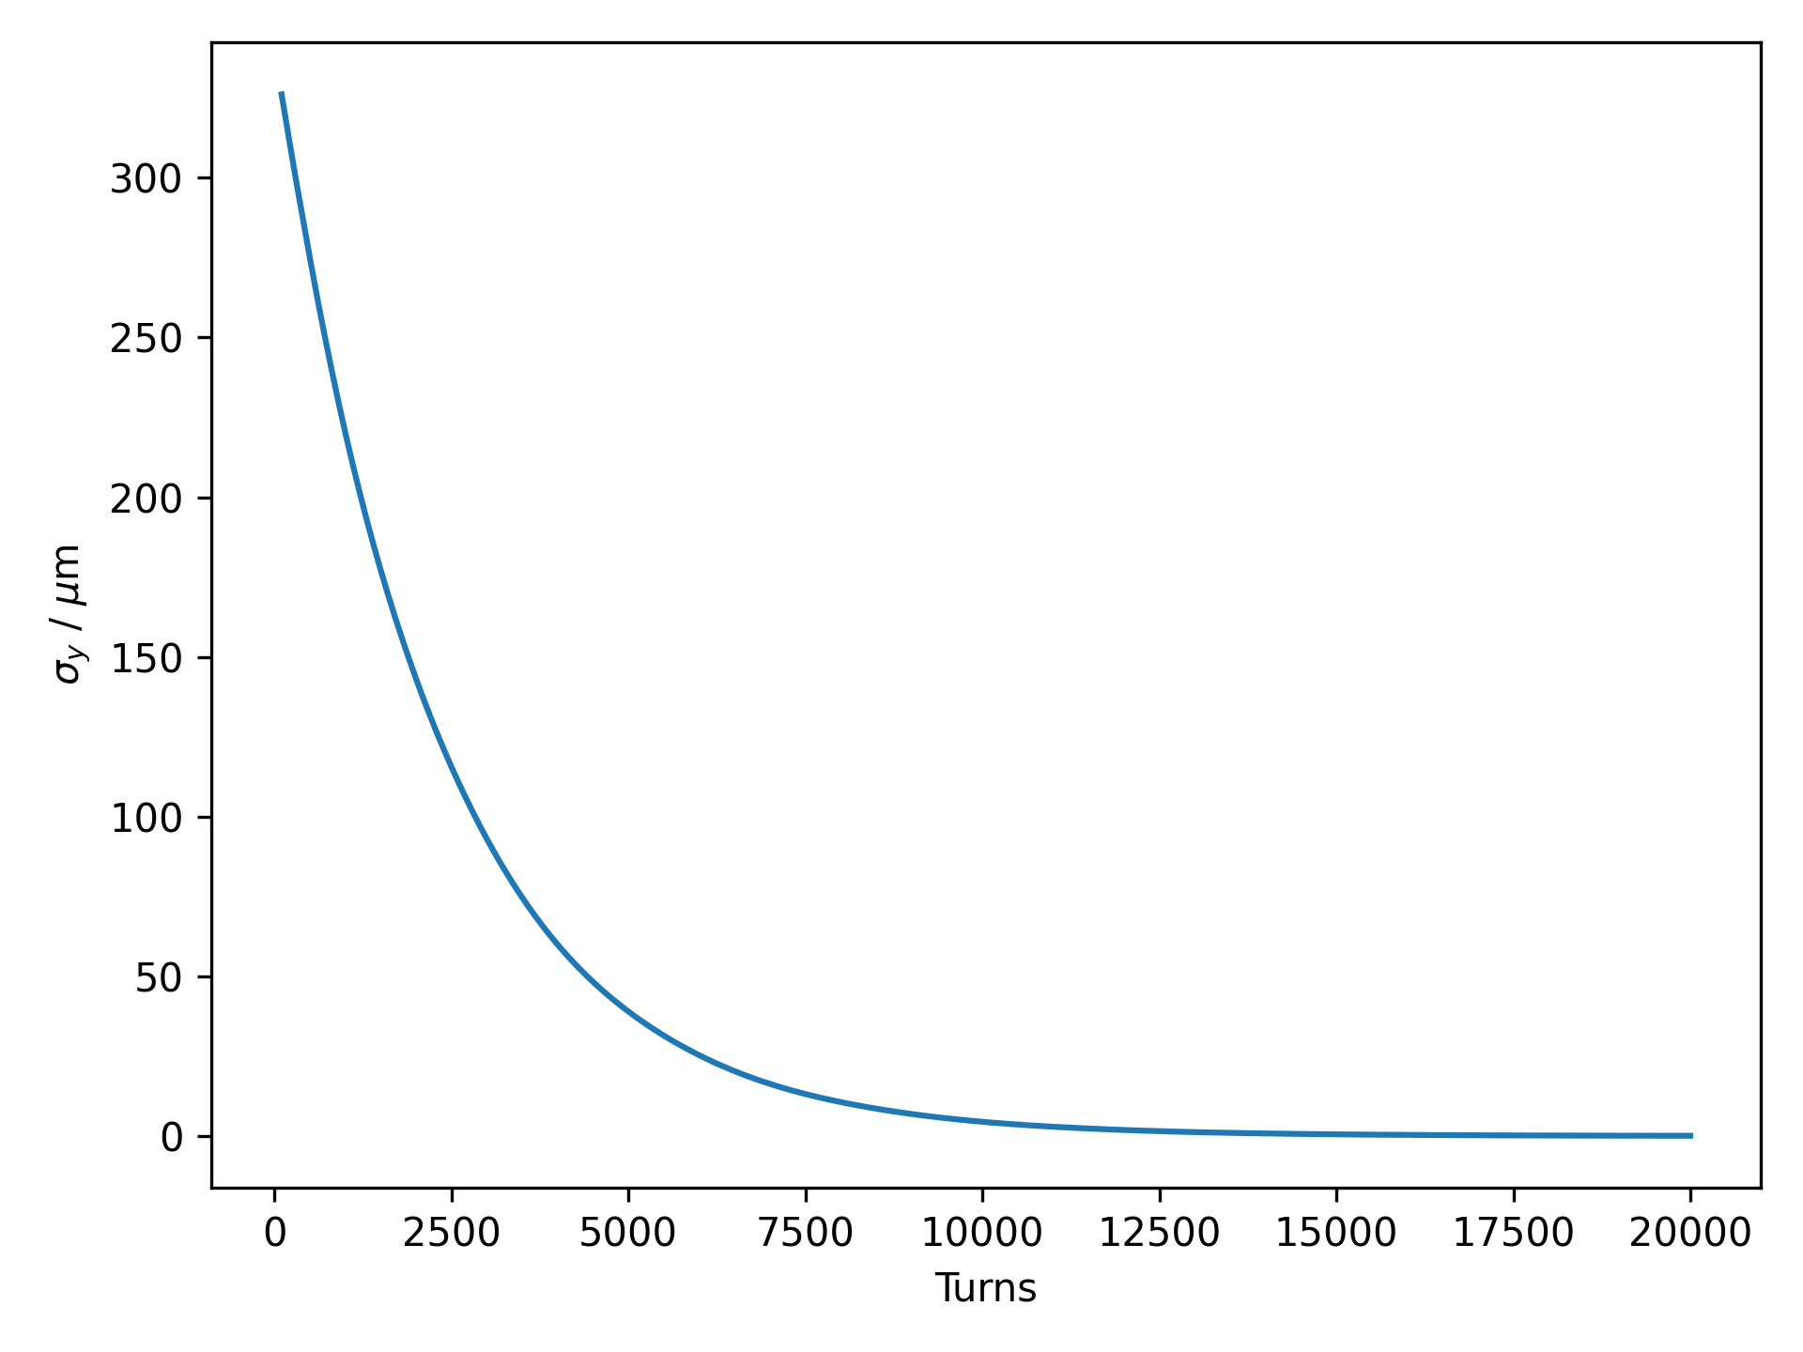
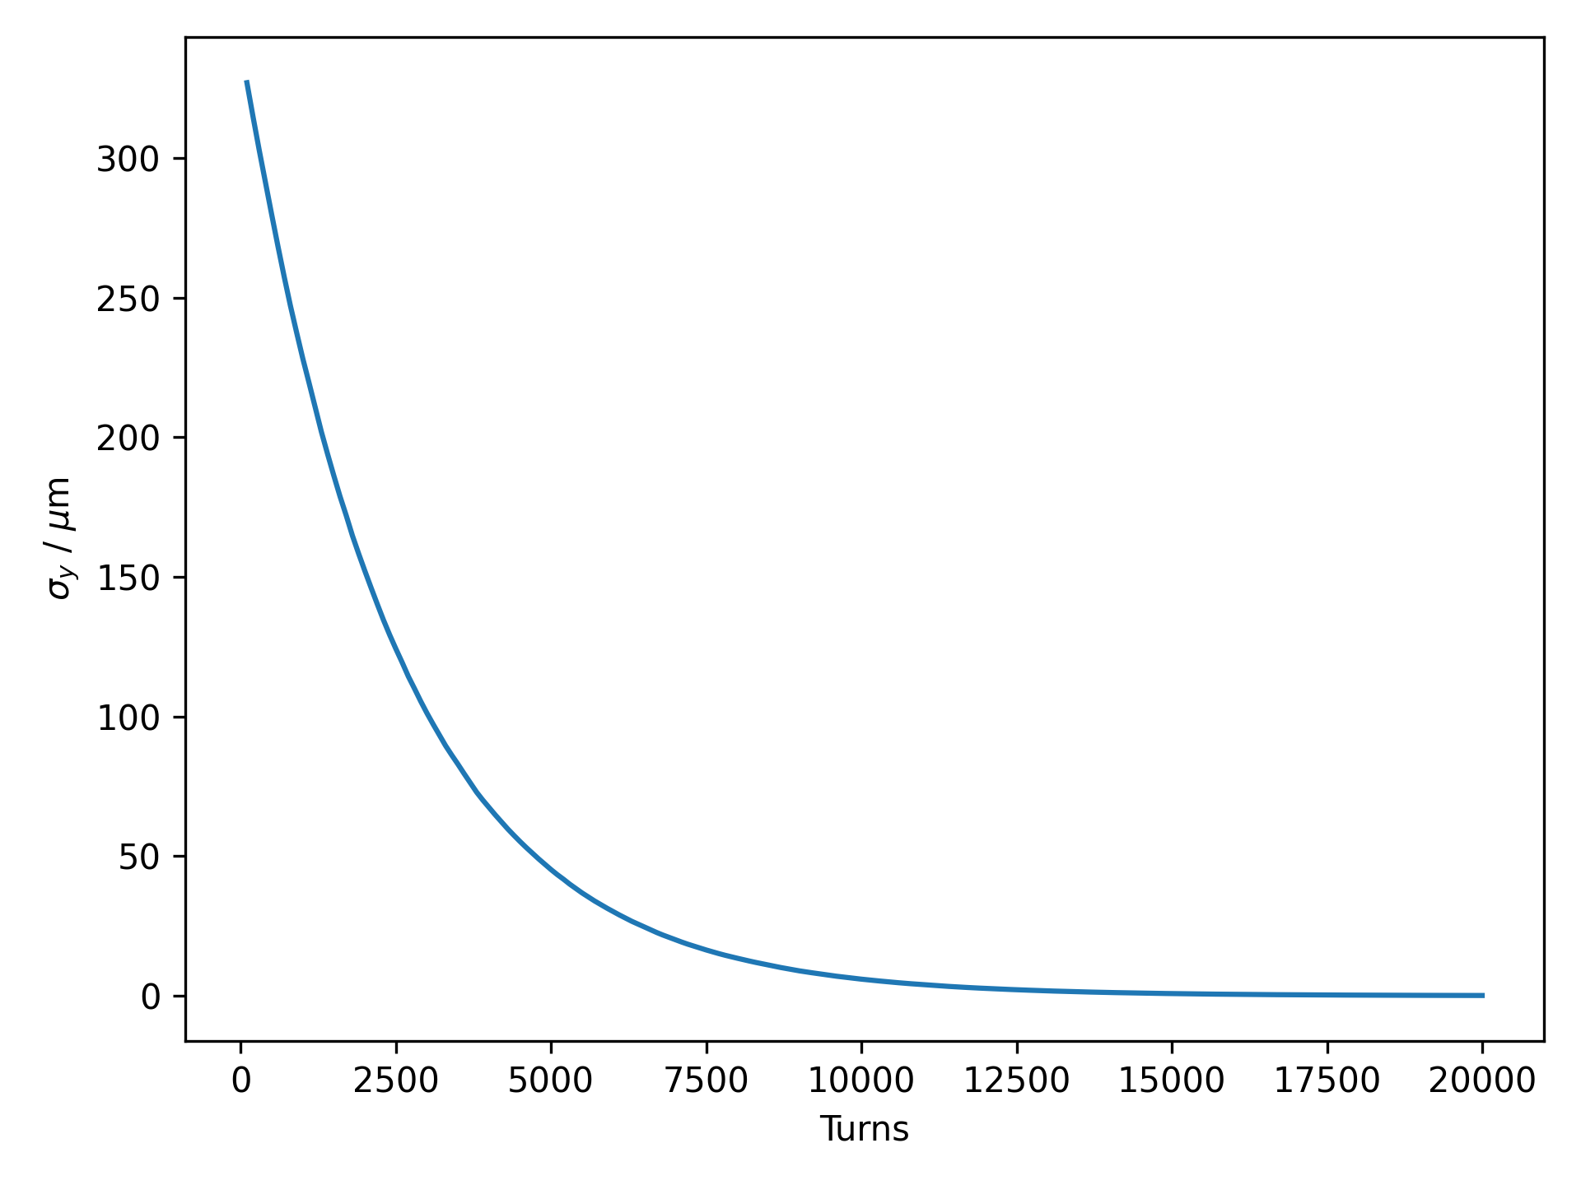
Vertical Beam Size

Slide 4
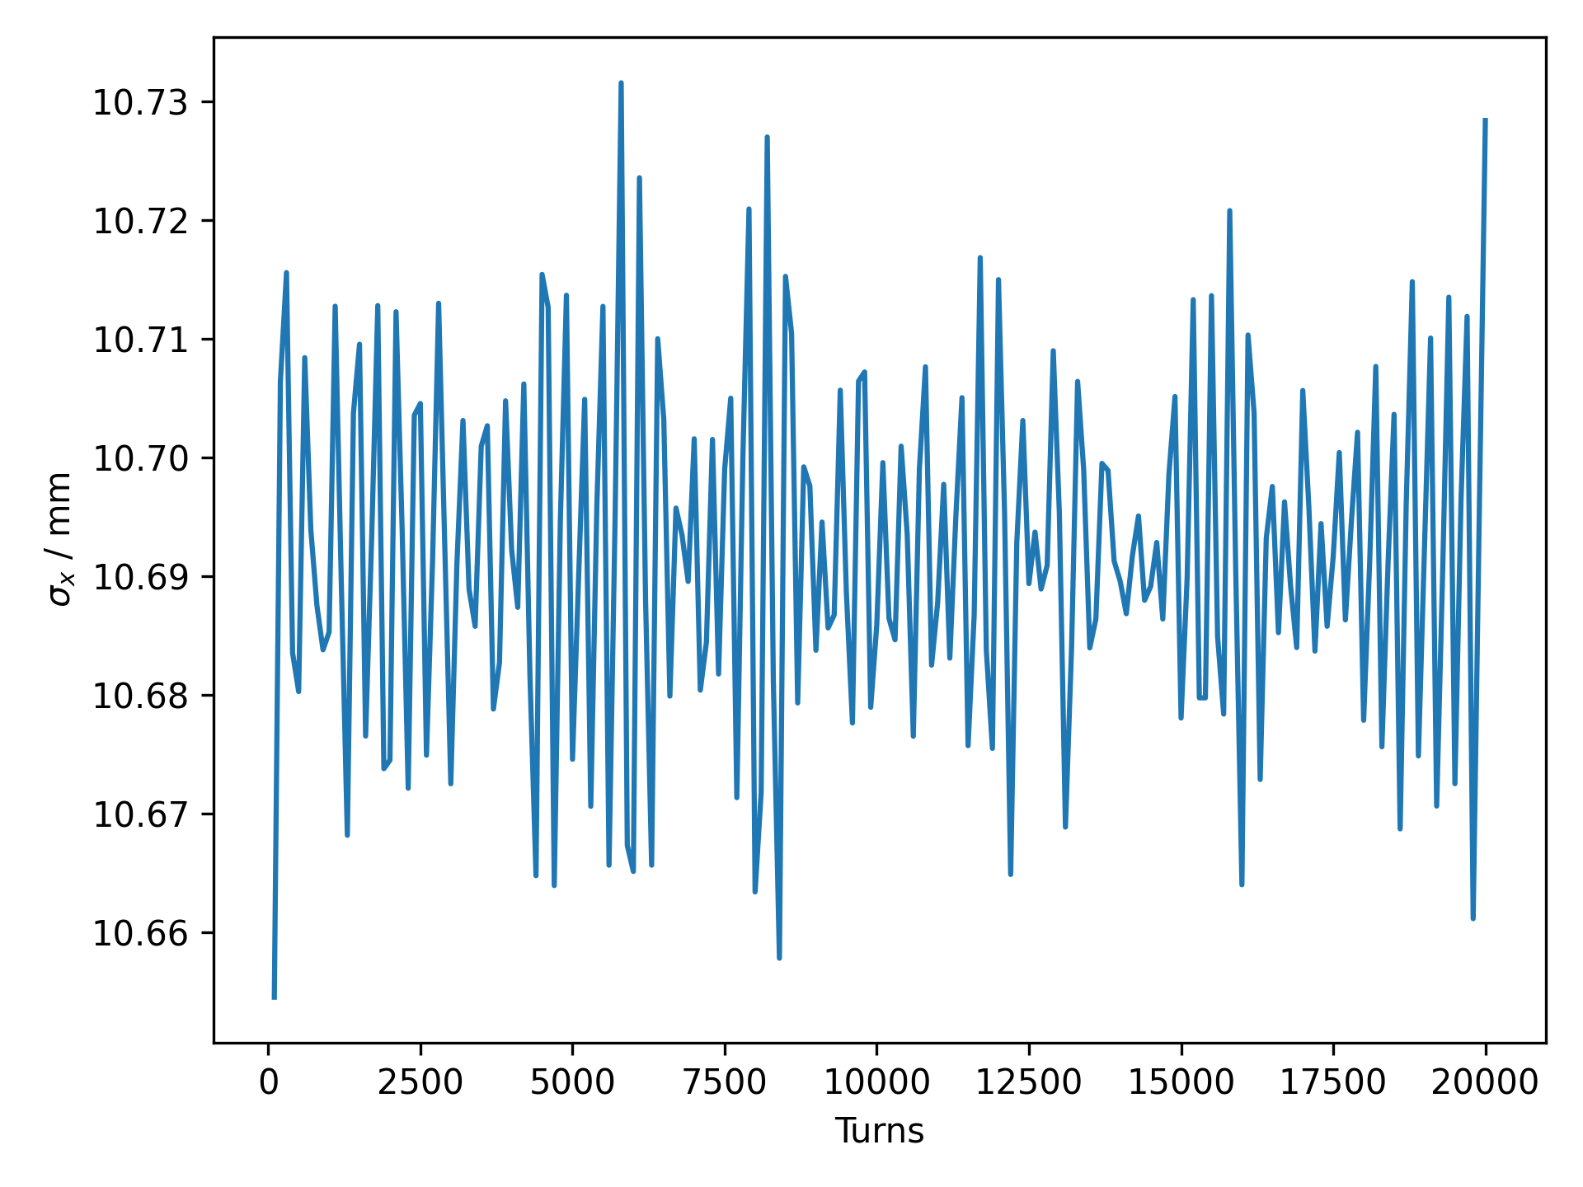
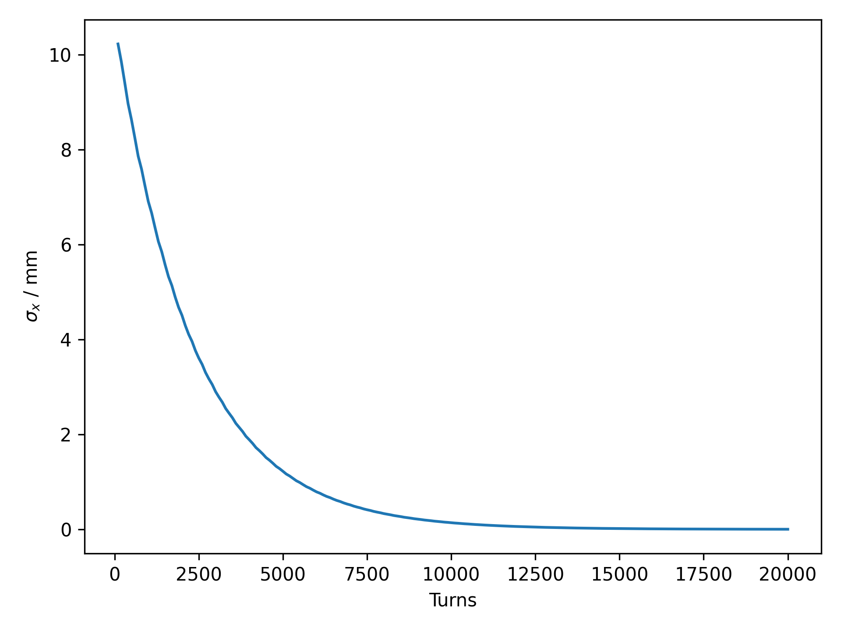
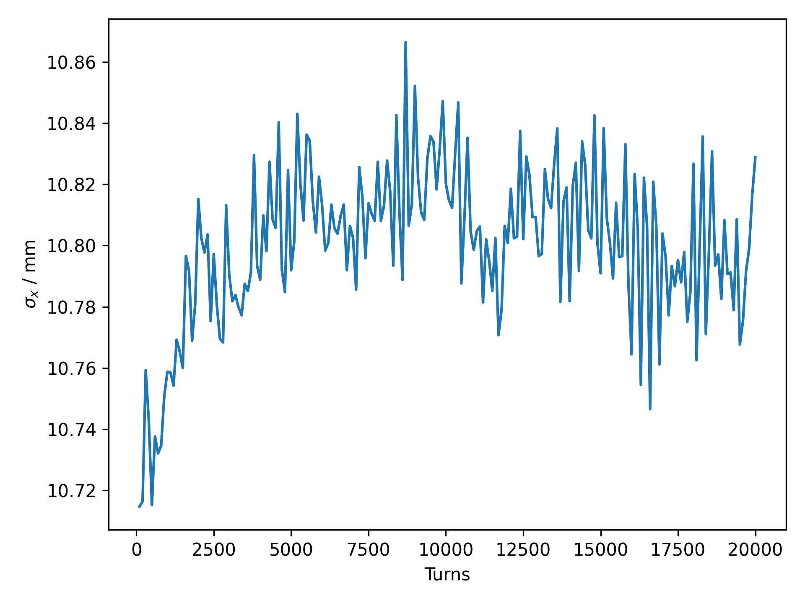
Horizontal Beam Size

Slide 5
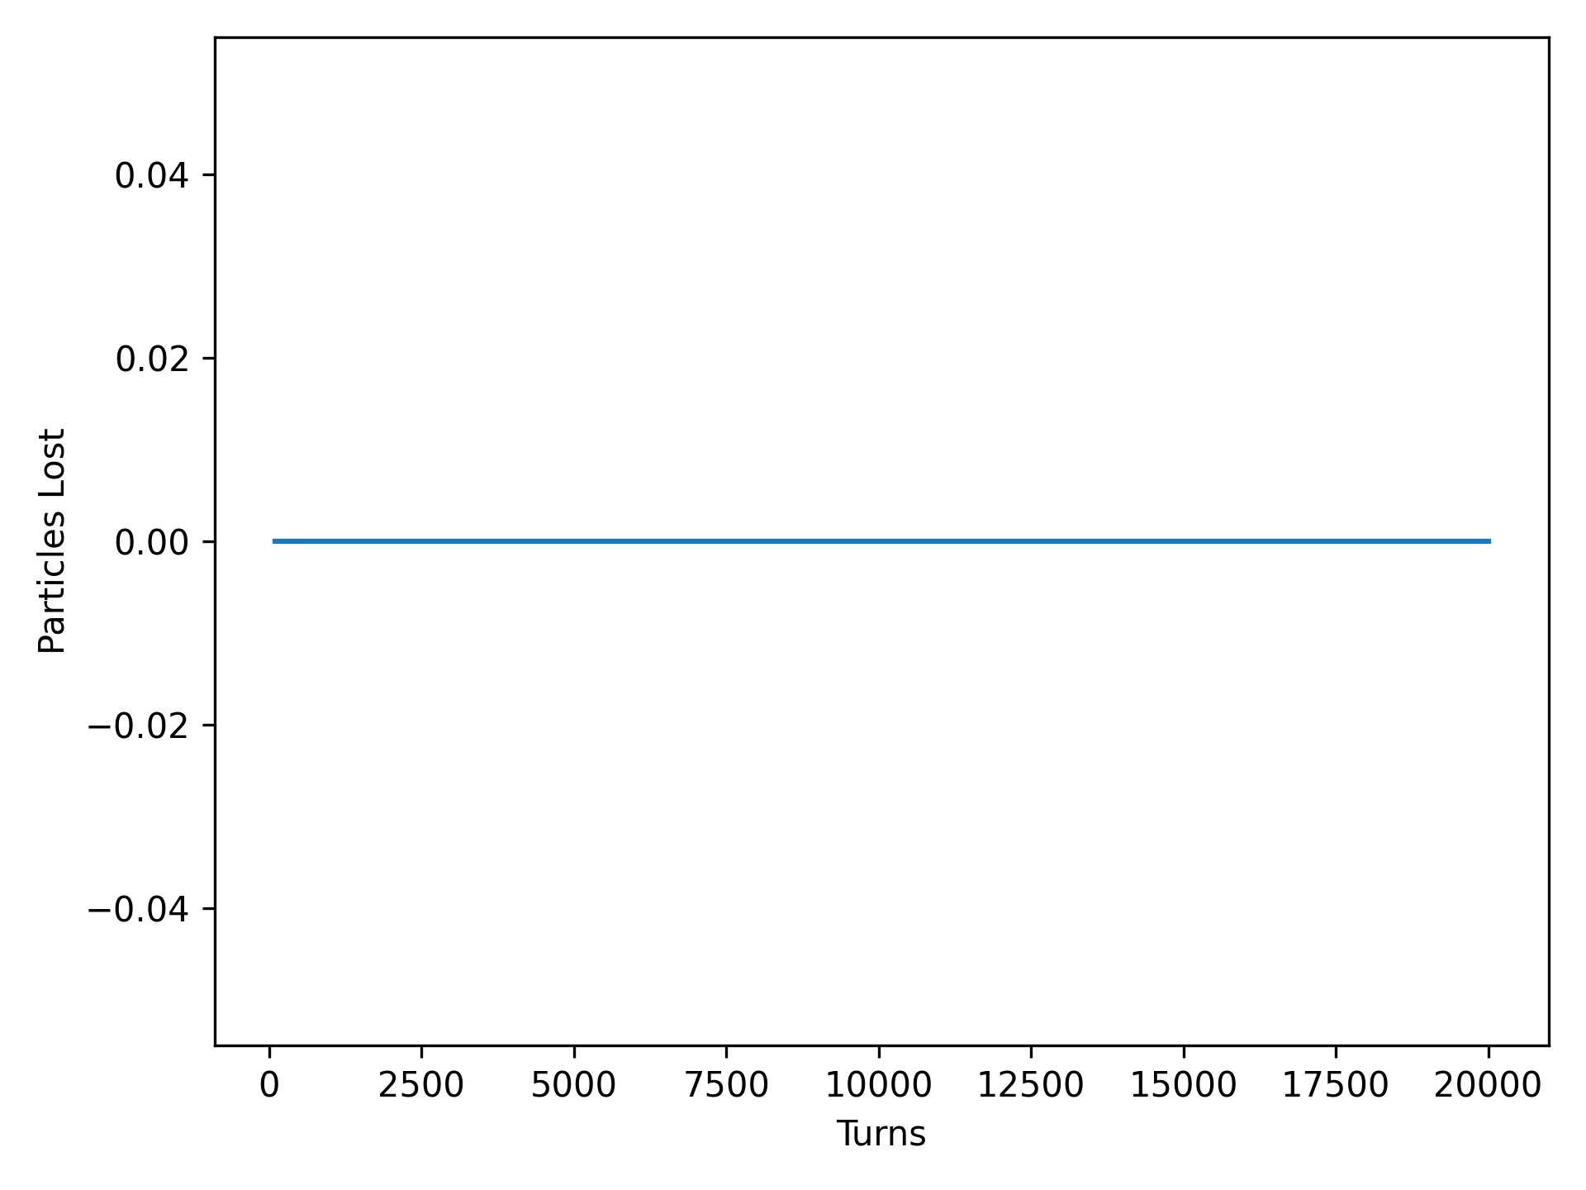
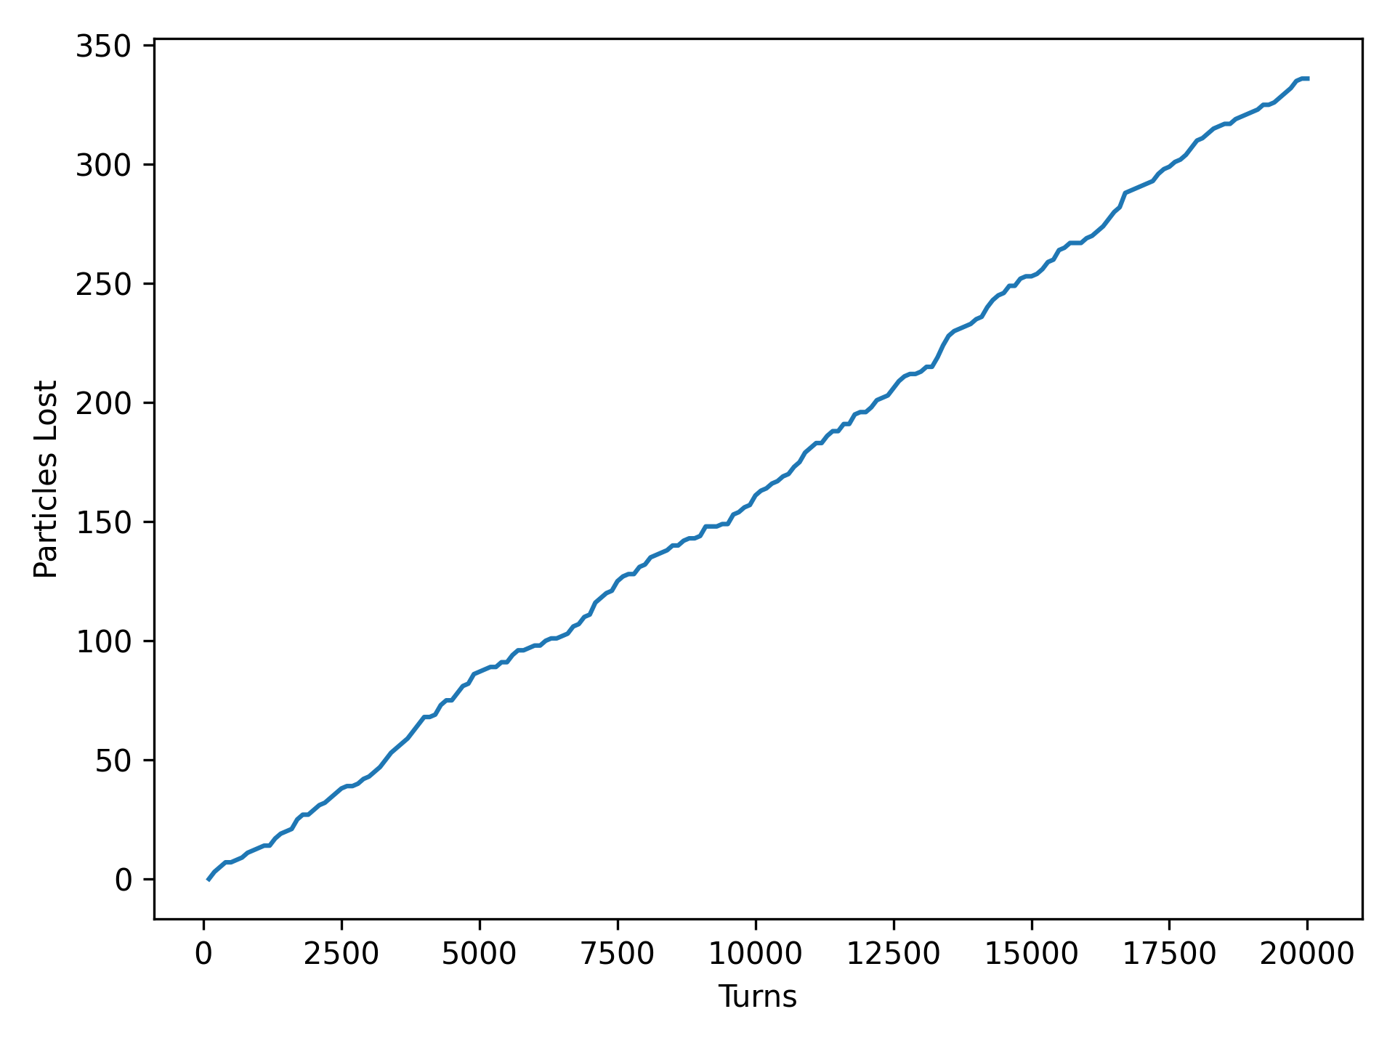
Particles Lost

Slide 6
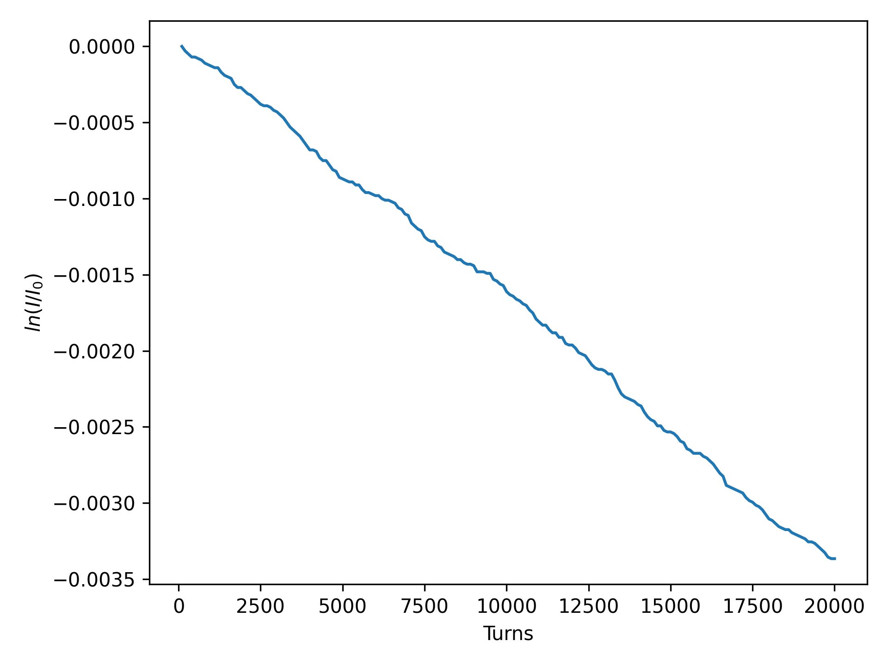
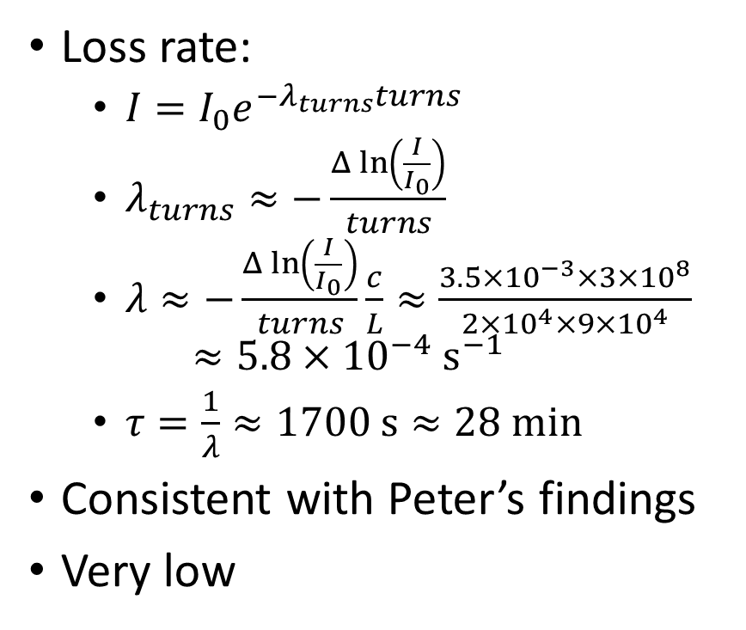
Quantum Loss Rate
Loss rate:
  $I=I_{0}e^{−λ_{turns}turns }$
  $λ_{turns}≈−\frac{Δ\ln\left(\frac{I}{I_{0}}\right)}{turns}$
  $λ≈−\frac{Δ\ln\left(\frac{I}{I_{0}}\right)}{turns}\frac{c}{L}≈\frac{3.5×{10}^{−3}×3×{10}^{8}}{2×{10}^{4}×9×{10}^{4}}$
  $≈5.8×{10}^{−4}{ s}^{−1}$
  $τ=\frac{1}{λ}≈1700 s≈28 min$
Consistent with Peter’s findings
Very low

Slide 7
Method
Identified large amount of losses (>300) when tracking 100,000 Gaussian particles over 20,000 turns
Aim: create reproducible particles for further studies:
  Created 100,000 particles starting at (0,0) with different random number generator seed [1,100 000]
  Still lost (>300 particles) but uniquely identifiable
  Set up very simplified job with just these particles and forwarded to Gianni
Gianni tracked particles to the element where they are lost and checked behaviour at loss
  Synchrotron radiation error flag

Slide 8
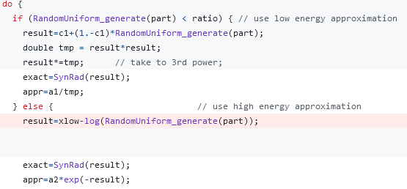
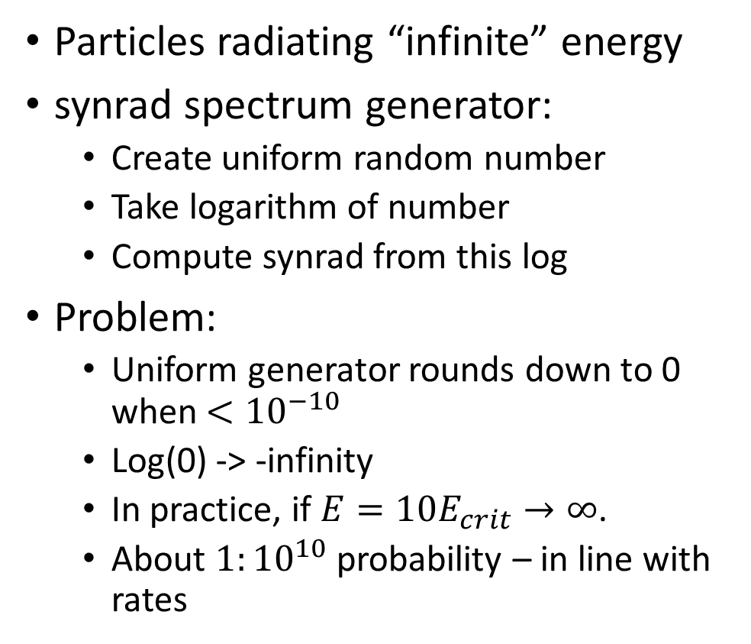
Problem
Particles radiating “infinite” energy
synrad spectrum generator:
  Create uniform random number
  Take logarithm of number
  Compute synrad from this log
Problem:
  Uniform generator rounds down to 0 when $<{10}^{−10}$
  Log(0) -> -infinity
  In practice, if $E=10E_{crit}→∞$.
  About $1:{10}^{10}$ probability – in line with rates

Slide 9




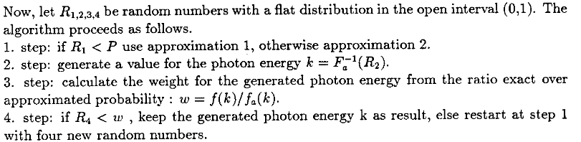
https://cds.cern.ch/record/443490/files/SCAN-0008048.pdf

Slide 10
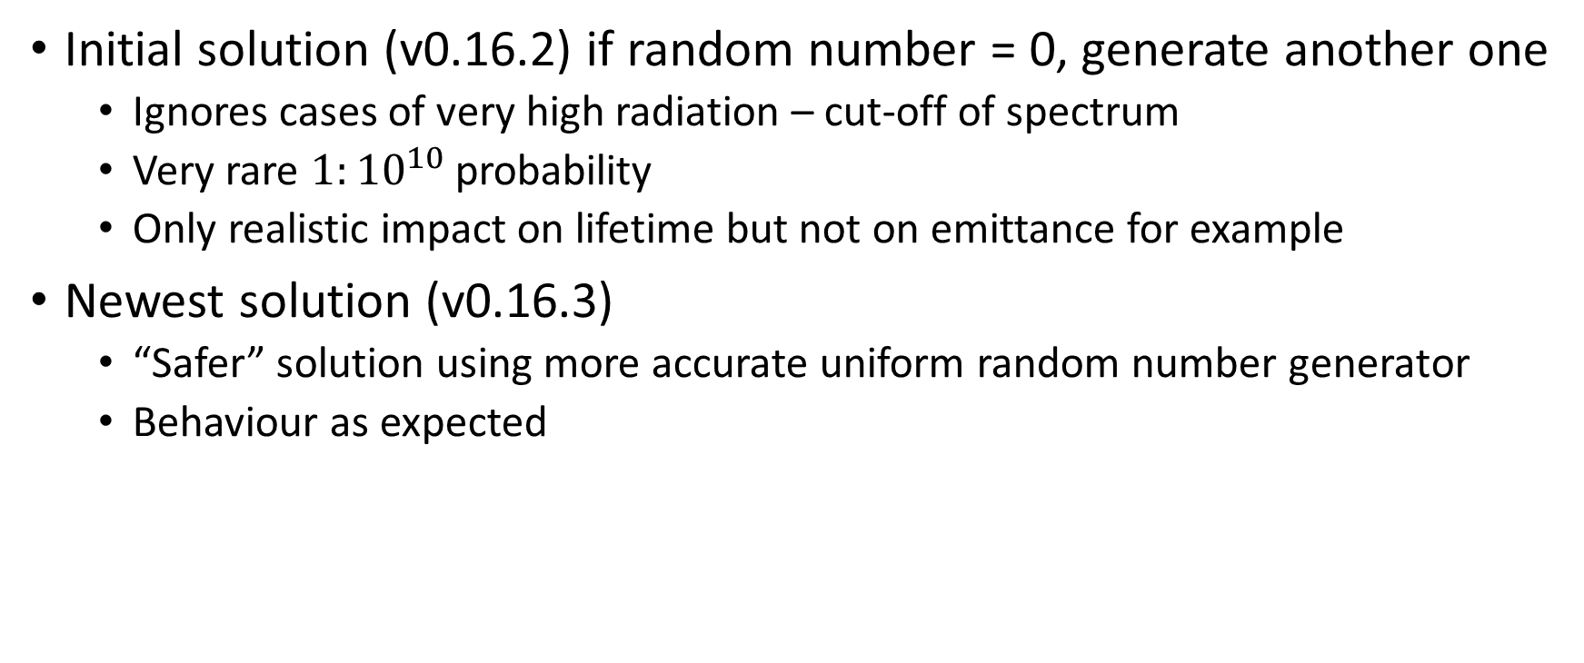
Solution
Initial solution (v0.16.2) if random number = 0, generate another one
  Ignores cases of very high radiation – cut-off of spectrum
  Very rare $1:{10}^{10}$ probability
  Only realistic impact on lifetime but not on emittance for example
Newest solution (v0.16.3)
  “Safer” solution using more accurate uniform random number generator
  Behaviour as expected

Slide 11
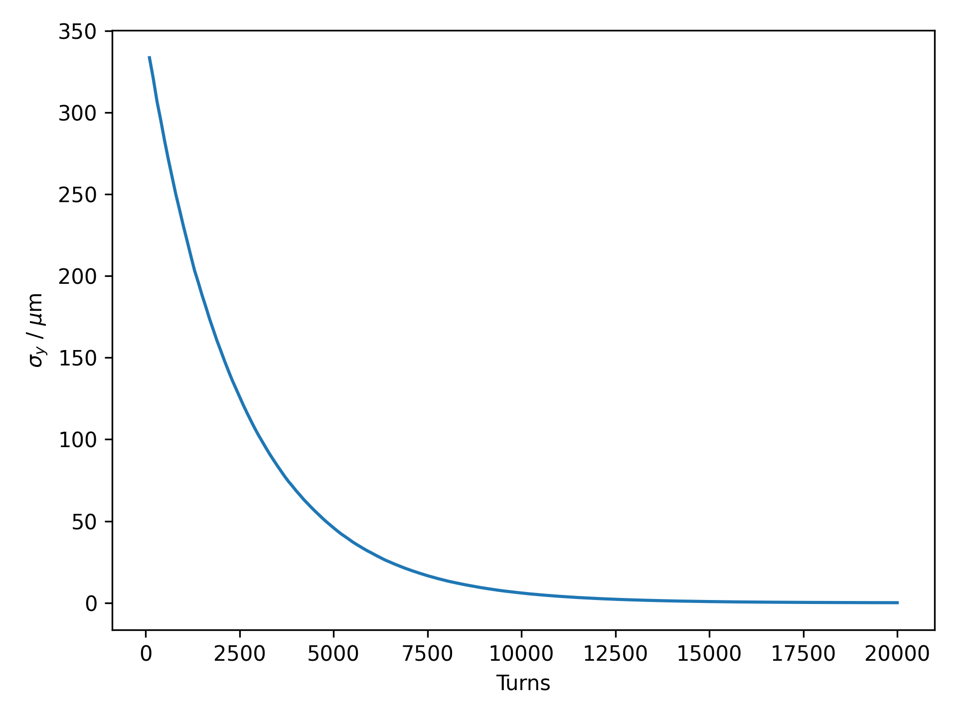
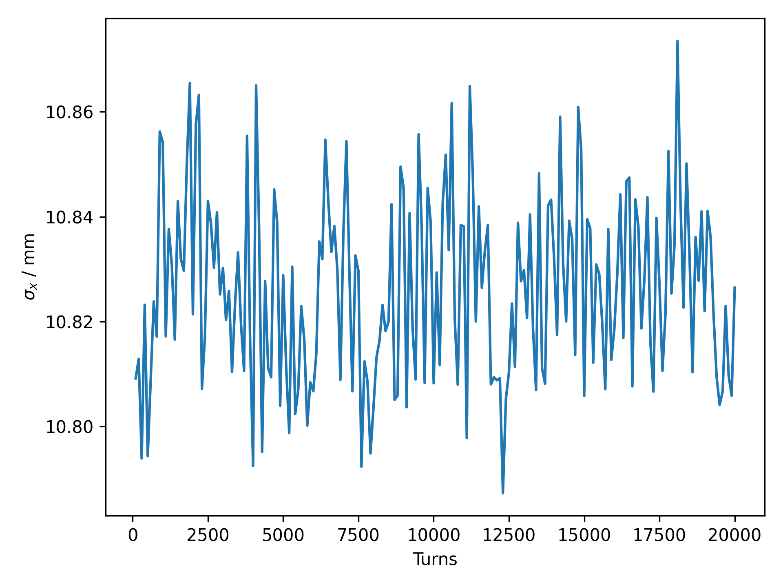
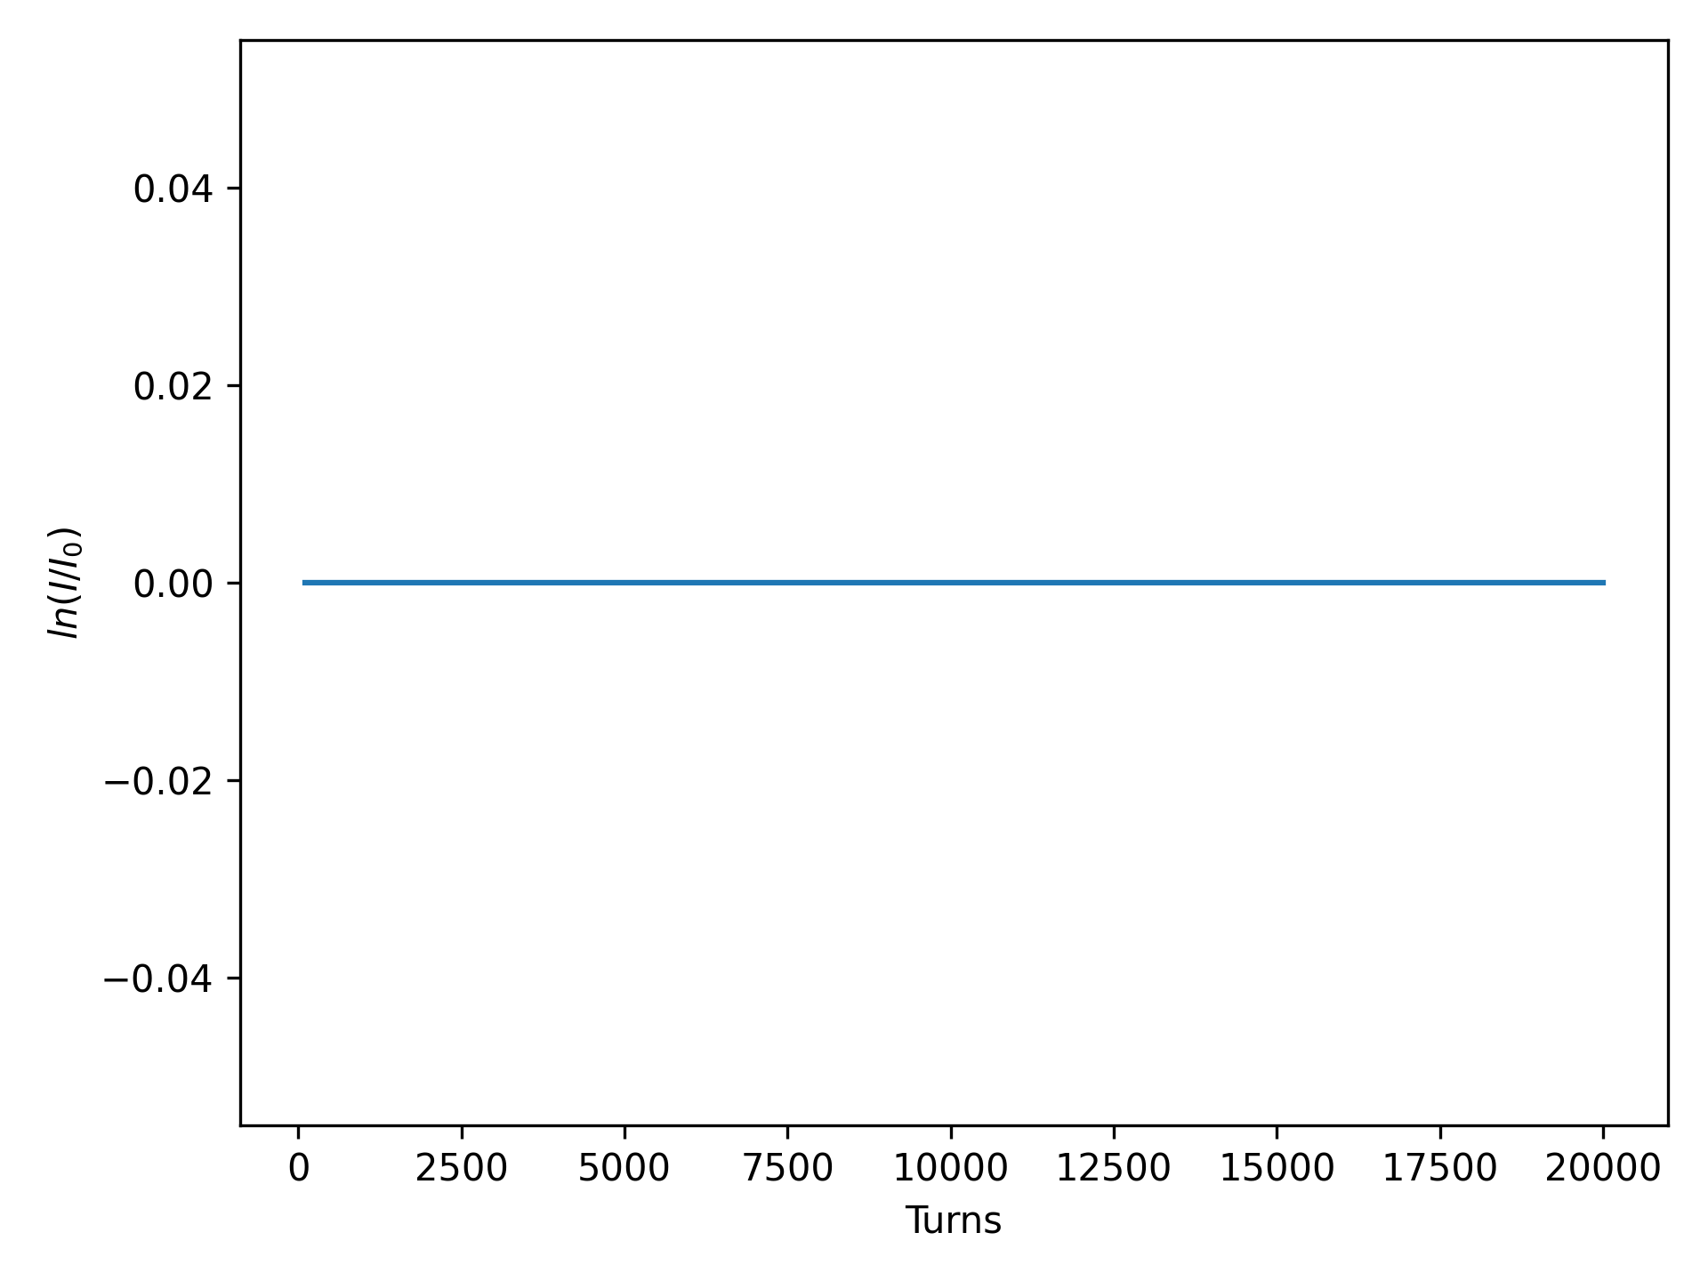
Beam Sizes and Losses

Slide 12
BS Lifetime?
Aim to send off a simulation with the new SR generator and beam-beam element before BB24
Need to obtain the appropriate script from Peter or modify current one accordingly (installing BB)
Ideally demonstrate sensible (hopefully agreeing with SAD) by the end of this week

Slide 13
Other Matters – Preliminary Results
DA with errors, mean radiation and BB
First study introducing random vertical alignment errors
  In tt lattice
  On all sextupoles (coupling)
  On all quadrupoles (coupling and orbit)
Simulate 20 identical seeds each with and without BB

Slide 14
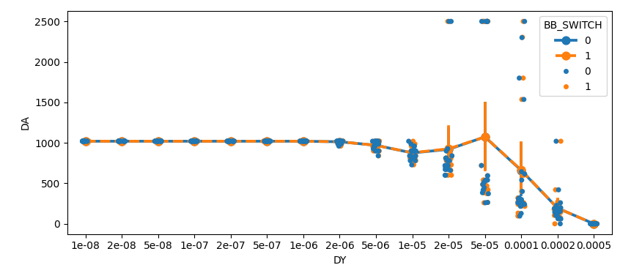
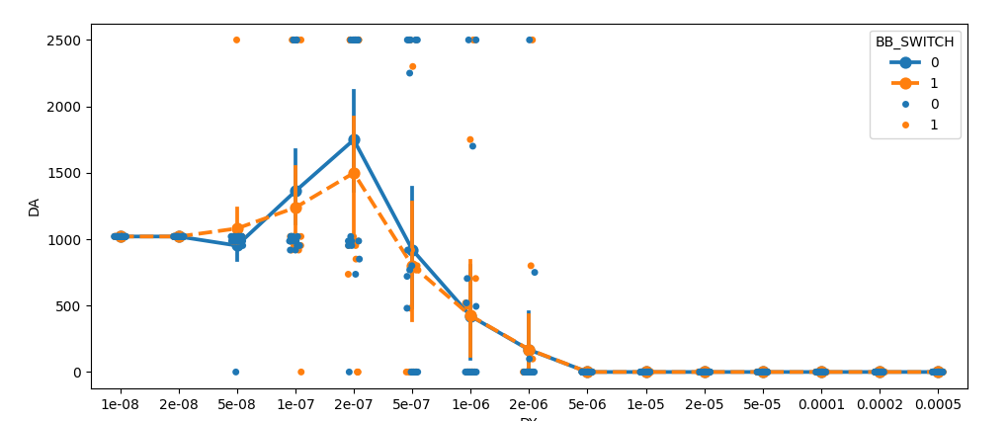
Overall seemingly very small perturbation from BB
Some strange cases with all particles surviving
  Probably optics failing at high coupling – wrong normalised coordinates
  Need to filter or adjust for these cases
Aim to have this fixed and accurate comparison for the BB24 workshop (on top of plots with single lens)
Sextupoles
Quadrupoles

