Slide 1
Modelling resonant depolarisation for FCC-ee
C. Kiel, J. Keintzel, F. Zimmermann

Slide 2
Overview
Theory
Model
Results
Summary and outlook

Slide 3
Motivation
Precise and accurate measurement of beam energy using resonant depolarisation

Slide 4
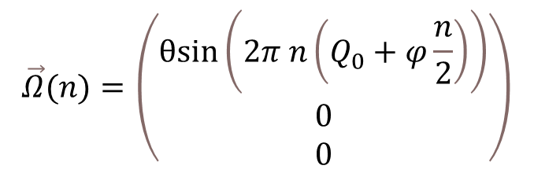

Theory
Electric field
Spin
Spin variations follow BMT- equation
Spin reacts to magnetic and electric fields
Spin precession in accelerator (spin tune)
Beam depolarisation by applying an electric field on the beam
$$\frac{ⅆ\vec{s}}{ⅆt}≡\vec{Ω}\left(\vec{v},\vec{E},\vec{B}\right)×\vec{s}$$
Magnetic field
BMT-equation
Start of scan
step
Field strength
$$\vec{Ω}(n)=\left(\begin{matrix}θsin\left(2π n\left(Q_{0}+φ\frac{n}{2}\right)\right) \\ 0 \\ 0\end{matrix}\right)$$
Number of turns

Slide 5
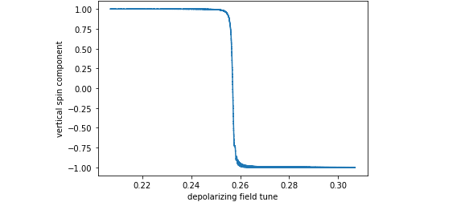

Theory
Resonant behaviour of the spin when the electric field frequency corresponds to the spin tune
Resonance
Lorentz energy factor
Gyromagnetic anomaly of the electron
$aγ=Q$
Spin tune
Goal of the depolarisation: precise measurement of beam energy

Slide 6
Model
Self-developed simplified python code
Storage ring with only dipoles (only vertical magnetic field)
Vertical initial spin
Spin tune Q=103.257
Depolariser modelled as an oscillating external driver (radial electric field)
Single or multiple particles
Synchrotron oscillations
Energy spread
Goal : finding dependence of depolarisation to the
  Strength of the depolarising field
  Step size of the scan
  Direction of the scan

Slide 7
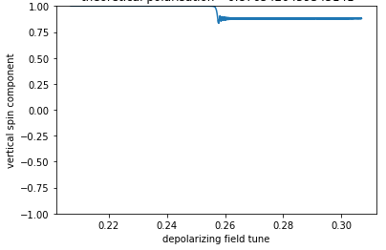
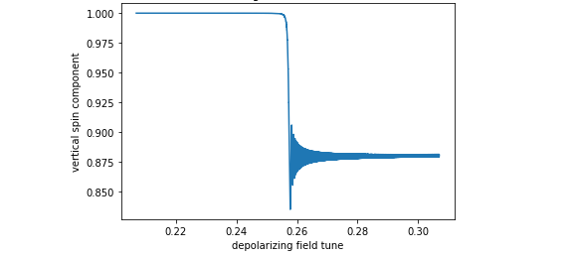


Results – strength of the depolarising field
1 particle, no synchrotron oscillations
10⁵ turns, $θ$ = 10⁻², $φ$=10⁻⁶
10⁵ turns, $θ$ = 10⁻³, $φ$=10⁻⁶
Stronger field leads to a stronger depolarisation

Slide 8
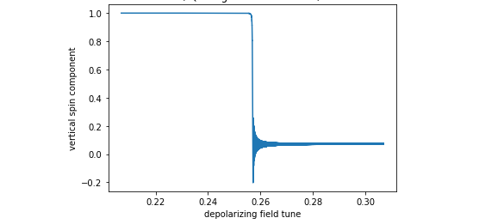
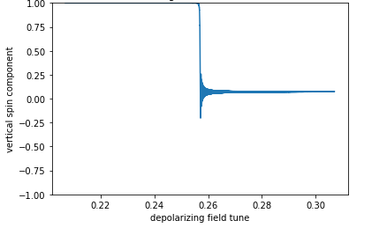


Scan precision
1 particle, no synchrotron oscillations
10⁵ turns, $θ$ = 10⁻³, $φ$=10⁻⁶
10⁶ turns, $θ$ = 10⁻³, $φ$=10⁻⁷
Smaller steps lead to stronger depolarisation

Slide 9
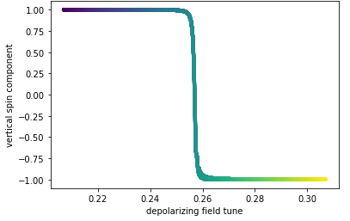
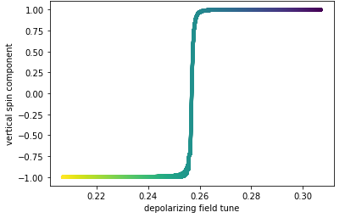
Changing scan direction
1 particle, no synchrotron oscillations, 10⁵ turns, $θ$ = 10⁻², $φ$=10⁻⁶
Depolarisation does not seem to change with scan direction

Slide 10
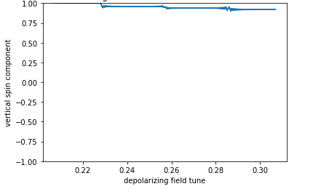
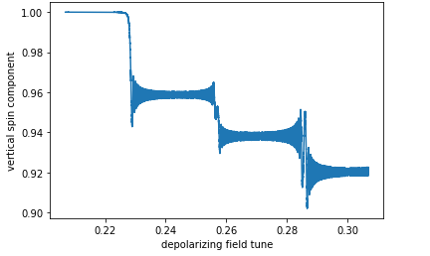

Adding synchrotron oscillations
1 particle, with synchrotron oscillations, 10⁵ turns, $θ$ = 10⁻³, $φ$=10⁻⁶
$$aγ$$
Q_{s}
Q_{s}
Depolarisation also at synchrotron tune sideband

Slide 11
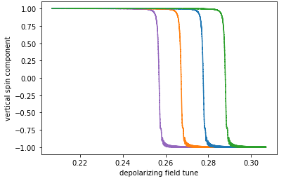


Resonance for different energies
4 distinct particles, no synchrotron oscillations
10⁵ turns, $θ$ = 10⁻², $φ$=10⁻⁶
δ₁=0
δ₂=10⁻⁴
δ₃=2x10⁻⁴
δ₄=3x10⁻⁴
Resonance linked to energy as $aγ=$ Q

Slide 12
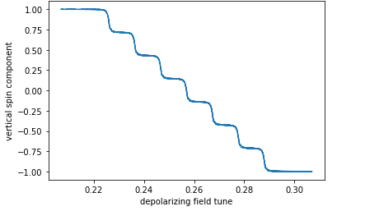
Average spin with energy spread
7-particle bunch with different momenta, no synchrotron oscillations
δ₁=0
δ₂=10⁻⁴
δ₃=2x10⁻⁴
δ₄=3x10⁻⁴
δ₅ = -10⁻⁴
δ₆ = -2x10⁻⁴
δ₇ = -3x10⁻⁴
Each particle’s resonance clearly visible

Slide 13
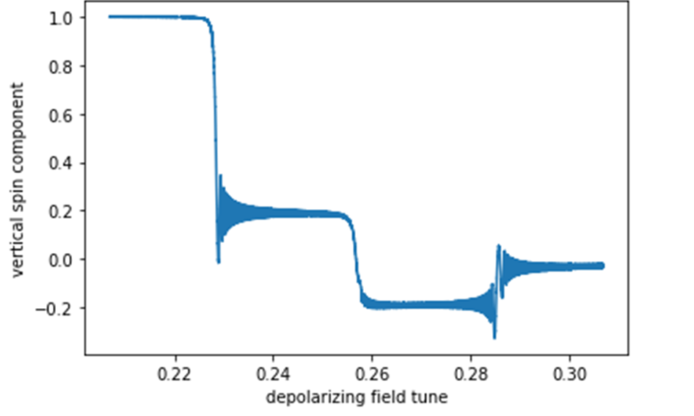
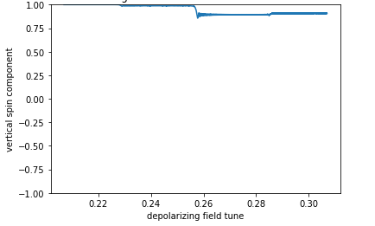
Considering synchrotron oscillations
7-particle bunch with different momenta, synchrotron oscillations
δ₁=0
δ₂=10⁻⁴
δ₃=2x10⁻⁴
δ₄=3x10⁻⁴
δ₅ = -10⁻⁴
δ₆ = -2x10⁻⁴
δ₇ = -3x10⁻⁴
How can we distinguish resonance from sidebands in experiments?

Slide 14
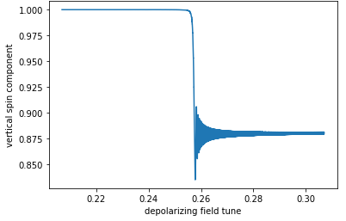

What does theory say ?
1 particle, no synchrotron oscillations, 4x10⁵ turns, $θ$ = 10⁻², $φ$=10⁻⁶
Initial polarisation
Final polarisation
$$P=P_{0}\left(2ⅇ^{−x}−1\right)$$
$$x=\frac{1}{φ}{\left(\frac{\left(1+aγ\right)θ}{4aγ}\right)}^{2}$$
Spin tune
Spin kick
Theory: 0.877
Simulation: 0.880
Scan precision
M. Froissart and R. Stora, Nucl. Instrum. Meth. 7, 297 (1960)
M. Bai, Overcoming Intrinsic Spin Resonances by using an RF Dipole, PhD thesis, Indiana U. (1999)

Slide 15
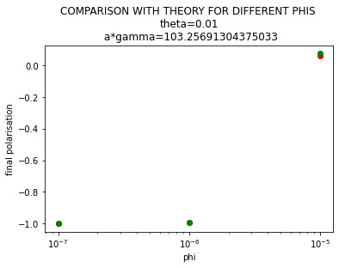
Simulated results agree well with theoretical predictions

Slide 16
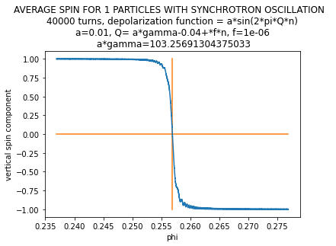
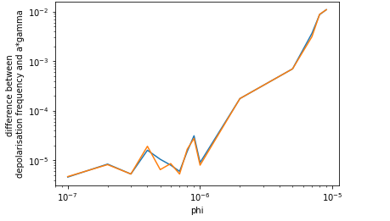
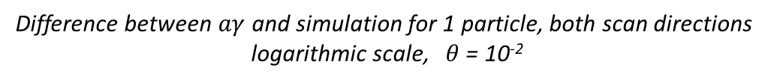
Accuracy of found depolarisation frequency
Difference between $aγ$ and simulation for 1 particle, both scan directions
logarithmic scale, $θ$ = 10⁻²
1 particle, no synchrotron oscillations, $φ$=10⁻⁶ , $θ$ = 10⁻²
Onward scan
Backward scan
depolarising field tune
Error increases with $φ$, very little difference between scan directions

Slide 17
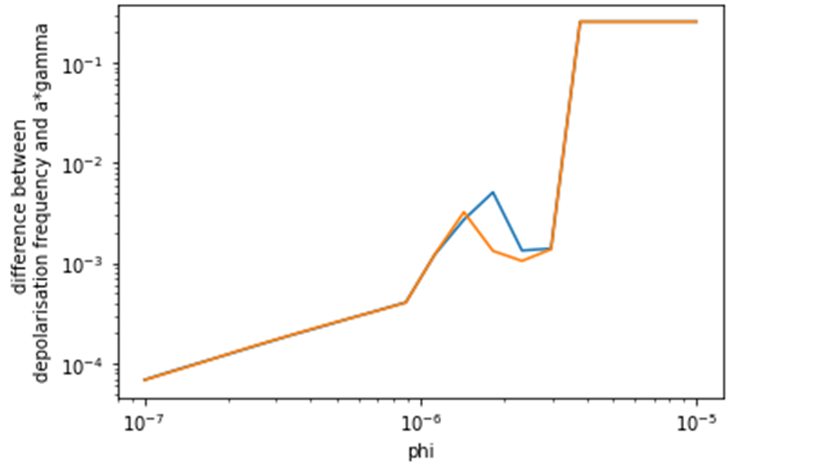
Accuracy of found depolarisation frequency
Difference between $aγ$ and the simulation for 100 particles with synchrotron oscillations
both scan directions, logarithmic scale, $θ$ = 10⁻²
Onward scan
Backward scan
Absolute error one order of magnitude higher for Gauss energy distribution
spin turns less than with 1 particle

Slide 18
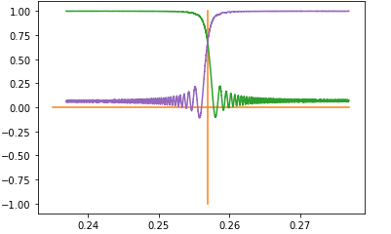
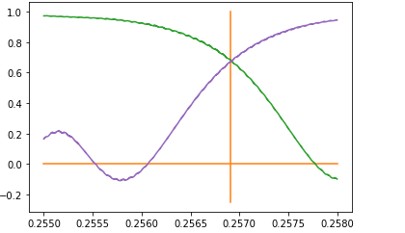
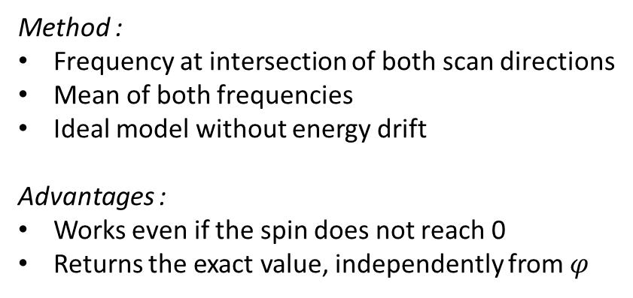
Improving precision
Method :
Frequency at intersection of both scan directions
Mean of both frequencies
Ideal model without energy drift
Advantages :
Works even if the spin does not reach 0
Returns the exact value, independently from $φ$
100 particles and synchrotron oscillations, $φ$=2x10⁻⁶ $θ$ = 10⁻²
Vertical spin component
Vertical spin component
depolarising field tune
depolarising field tune

Slide 19
Summary
Successful creation of simplified model to simulate resonant depolarisation in storage rings
Field strength and step size influence depolarisation
Without synchrotron oscillation, energy spread in a particle bunch smooths out the depolarisation curve
With synchrotron oscillation, visible synchrotron side bands
High precision measurements by using both scan directions in a simple model
Outlook
Include energy drift
Include synchrotron radiation
Develop measurement procedure to distinguish synchrotron sidebands from beam energy

