Slide 1
User meeting
Techno-CLS (H2) week 33-34
For information
Stefano Carsi
stefano.carsi@cern.ch
68691

Slide 2
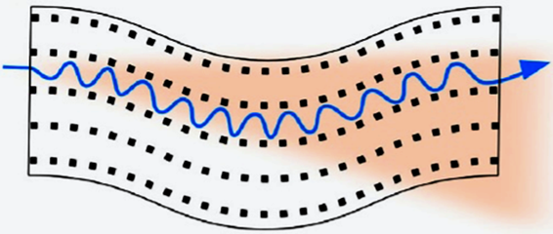
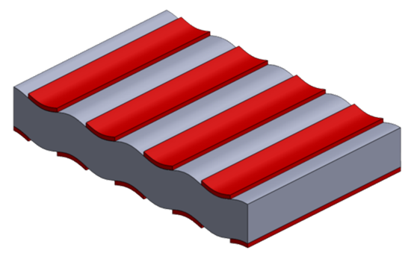
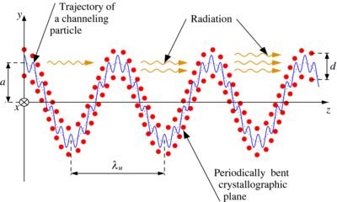
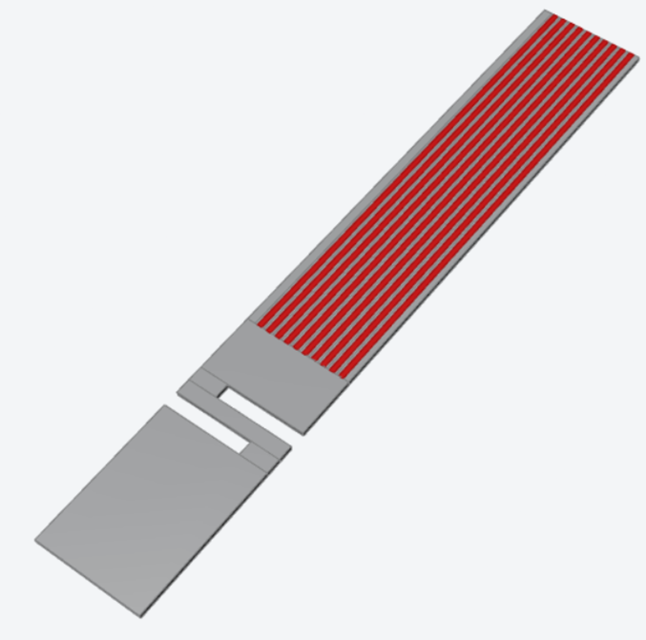
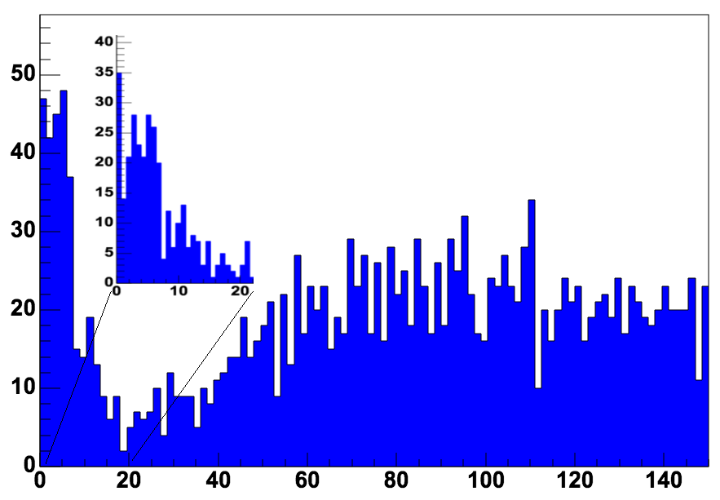

Crystalline undulator for TECHNO-CLS
GOAL
Measure the radiation emitted by the undulator
Geant 4 simualtions Calorimeter Signal
undulator peak
“thin”substrate ~ hundreds of nm
“thick”substrate
~160 um
MeV

Slide 3
Summary of the week
This week everything went smoothly and was dedicated to the collection of statistics
The data acquired looks very promising, even though a deep analysis may be performed in the next months to have a correct estimation of the undulator radiation
This experiment was kind of complicated: the whole first week was spent only in the alignment of the sample and in choosing of the operational condition. The second week we obtained turned out to be much more important than what we were expecting, making the conclusion of the beamtest possible

Slide 4
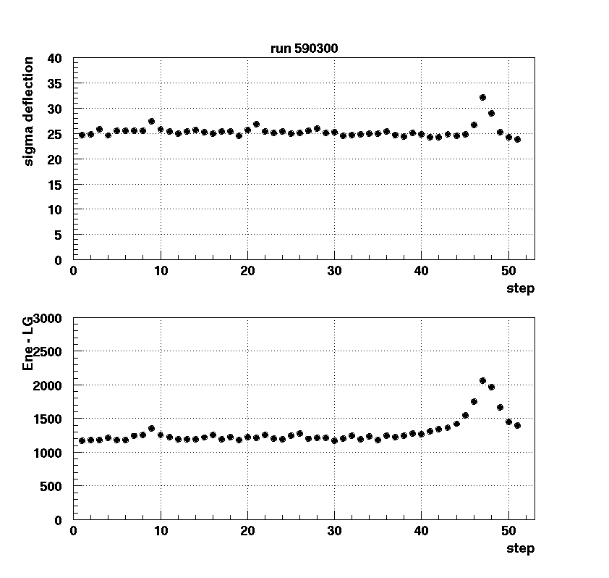
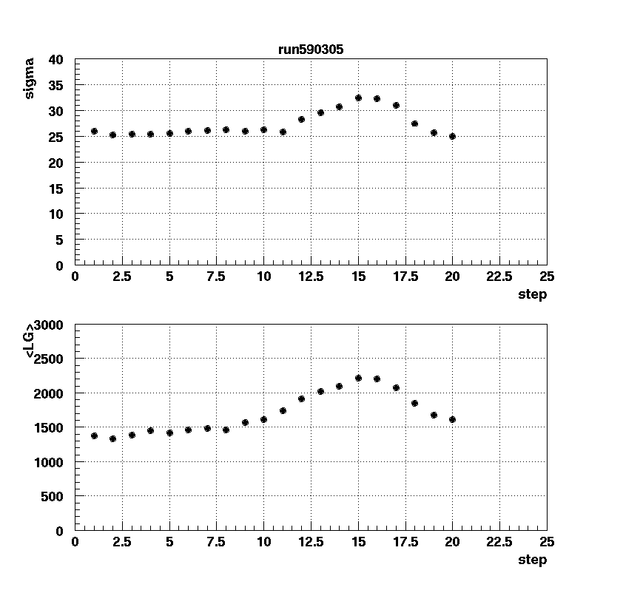
Crystal alignment with the channelling radiation

Slide 5
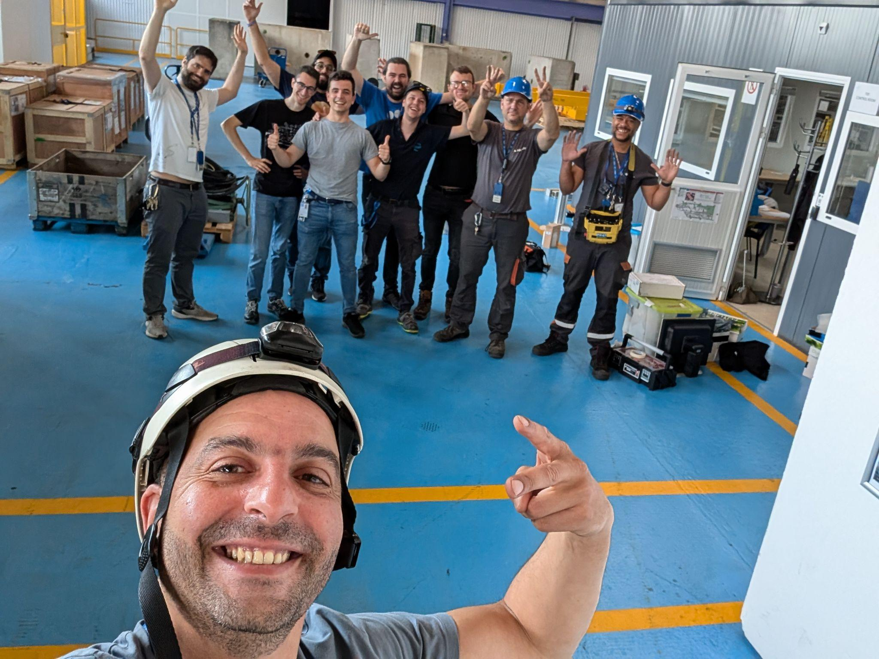
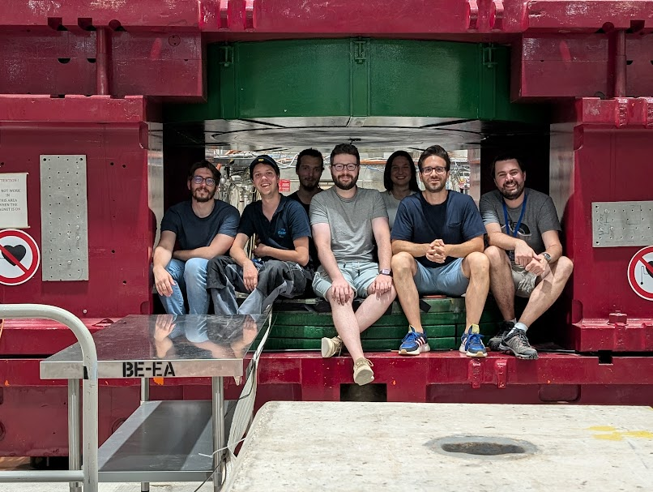
A personal parenthesis
In three days I will start a new job opportunity and this is my last day here at CERN
I want to say a big thanks to all the people I had the opportunity to meet and that was part of this beautiful experience in my life

Slide 6
