Slide 1
Status of NCM magnet projects for SHiP
Philip Schwarz
09.09.2024

Slide 2
Outline
SHiP Hadron Absorber
SHiP Laminated MDX
SHiP Dilution system magnets

Slide 3
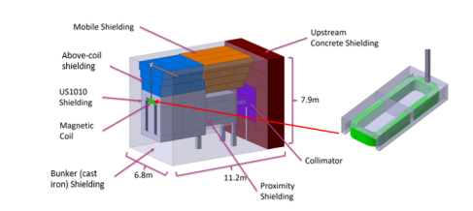
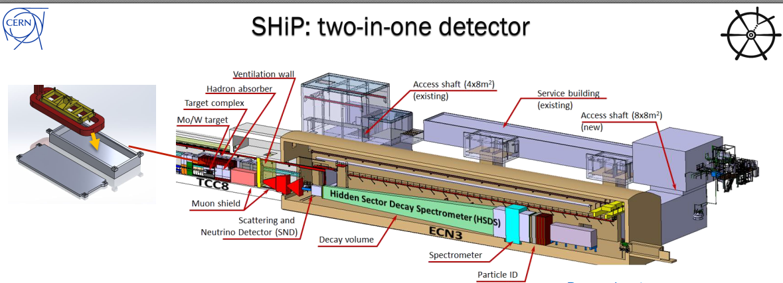
SHiP – Hadron Absorber
Description:
  Magnetised iron block after SHiP target
  Conceptual design defined in yellow report CERN-2020-002
  Embedded within the target vacuum vessel
Parameters
  B: >1.6 T in iron (for 5 m long shielding)
  High radiation environment ~ 0.1 MGy/y
  Redundancy required
  Cooling to be defined
  Length under study
  Figure: SHiP Hadron Absorber
  Figure: SHiP detector layout

Slide 4
SHiP – Hadron Absorber status
Timeline:
  Preliminary studies should be done within next 6 months
  Functional specification to be approved by then
  TDR to be done until end 2025
  Installation is foreseen for 2029
Budget:
  Currently 1 MCHF is budgeted

Slide 5
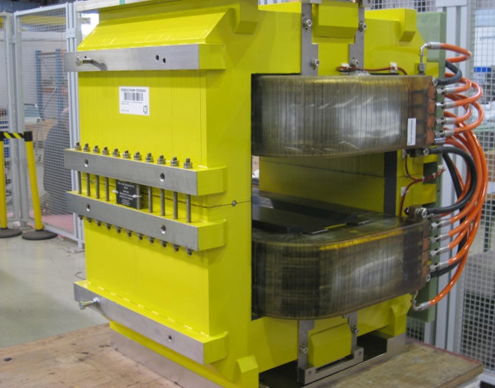
SHiP – laminated MDX for pulsed operation
Description:
  Replacement of 13 MDX solid-yoke corrector magnets currently installed in beamline P42
  To allow for pulsed operation, replacement by laminated magnets
  Design similar to east area MDX L
Status:
  Definition of gap pending
  Functional specification to be provided until end 2024
  Test on-going whether the replacement is required
Timeline:
  2 MDX required to be operable in pulsed mode by end of LS3
  11 MDX to be finished until 2029
Budget:
  585 kCHF is budgeted for this exchange
  Figure: MDXL as used in EA

Slide 6
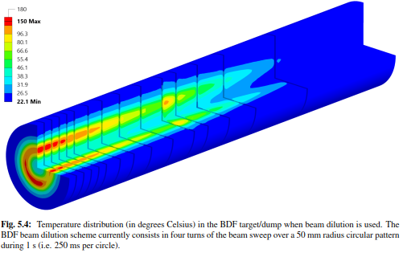
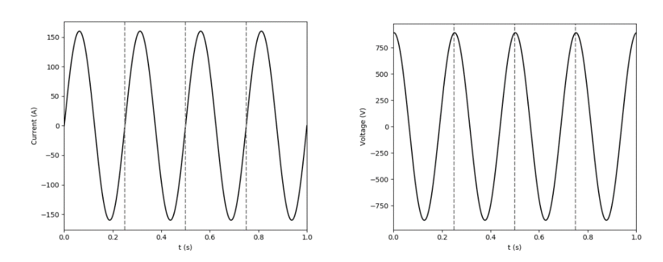
SHiP – dilution system
Description:
  Vertical and horizontal deviation of beam @ 4 Hz to distribute heat load on target
  Initially, two laminated MDX per plane were foreseen
Status:
  Existing magnets proposed
  Magnetic measurement of MCA magnets done and magnet seems to be able to follow 4 Hz operation
Timeline:
  Magnetic measurements to be analysed until the end of the year
  Installation of the system until 2029
Budget:
  500 kCHF foreseen

