Slide 1
Transverse stability studies
L. Giacomel, G. Iadarola, X. Buffat, N. Mounet, K. Paraschou
Sptember 3 2024

Slide 2
Planned studies
  Instabilities growth rates at injection (MD9405): already presented (https://indico.cern.ch/event/1304705/#11-stability-and-noise-studies)
  Improved tune shift measurements (MD13583): presented today
  Chromaticity measurement in physics conditions with BTF and ADT-AC dipole (MD13463): presented today

Slide 3
Improved tune-shift measurements (MD13583)
Some single-bunch tune-shift measurements were performed this year during other MDs (rematched IR7 optics and HL-LHC cycle) to validate impedance improvements
Good agreement with the expected tune-shift reduction was observed for B1V, B2H and B2V, but not for B1H
The origin of this discrepancy is not clear, and we would like to exclude inaccuracies in the impedance model
MD plan:
  Inject and ramp a fat pilot (0.5e11 p/b) and a slim nominal (1e11 p/b - tbc)
  Ramp them to flat-top
  Perform several tune measurements on the two bunches with ADT single-turn kicks with different machine settings (chromaticity, octupoles, damper)
  Repeat the measurements exciting the bunches with AC-dipole ADT kicks, scanning the ADT settings (ramp-up time, excitation length, excitation tune)
  Repeat the AC-dipole excitations with different machine settings (chromaticity, octupoles)

Slide 4
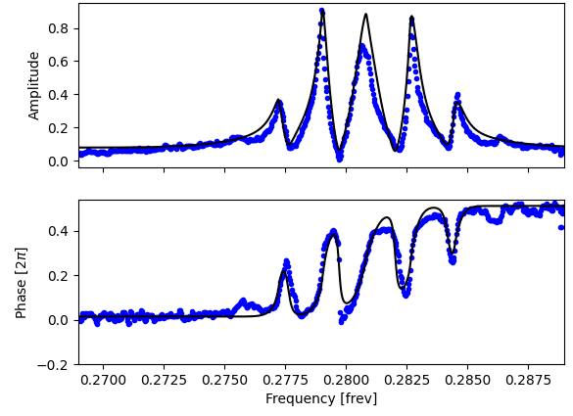
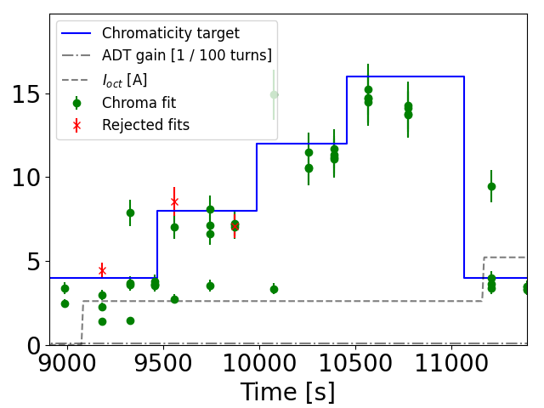
Chromaticity measurement in physics conditions with BTF and ADT-AC dipole (MD13463)
Chromaticity measurements with full beams at flat-top with the energy modulation are not possible (due to losses).
A new method based on anon-linear fit of the Beam Transfer Function (BTF) was tested at injection in MD (CERN-ACC-NOTE-2023-0014) and a new system was deployed for operational use.
The non-linear fit is not straightforward and we need more data at top-energy to refine it.
We would also like to test a new method which is based on measuring the head-tail phase-shift during and AC-dipole ADT excitation (on non-colliding bunches).
Plan: follow operational cycle (full beam) and stop first at flat top, then at end of squeeze, and finally at the start of collisions, to measure chromaticity with the two methods, varying Q', damper gain, octupole current and excitation settings (for the AC-dipole mode)

Slide 5
Requests for MD4 and MD5
  Instabilities growth rates at injection (MD9405): 4 hours
  Improved tune shift measurements (MD13583): 8 hours
  Chromaticity measurement in physics conditions with BTF and ADT-AC dipole (MD13463): 8 hours

