Slide 1
Electron cloud studies for MD4/MD5
L. Mether and K. Paraschou
for the e-cloud team

Slide 2
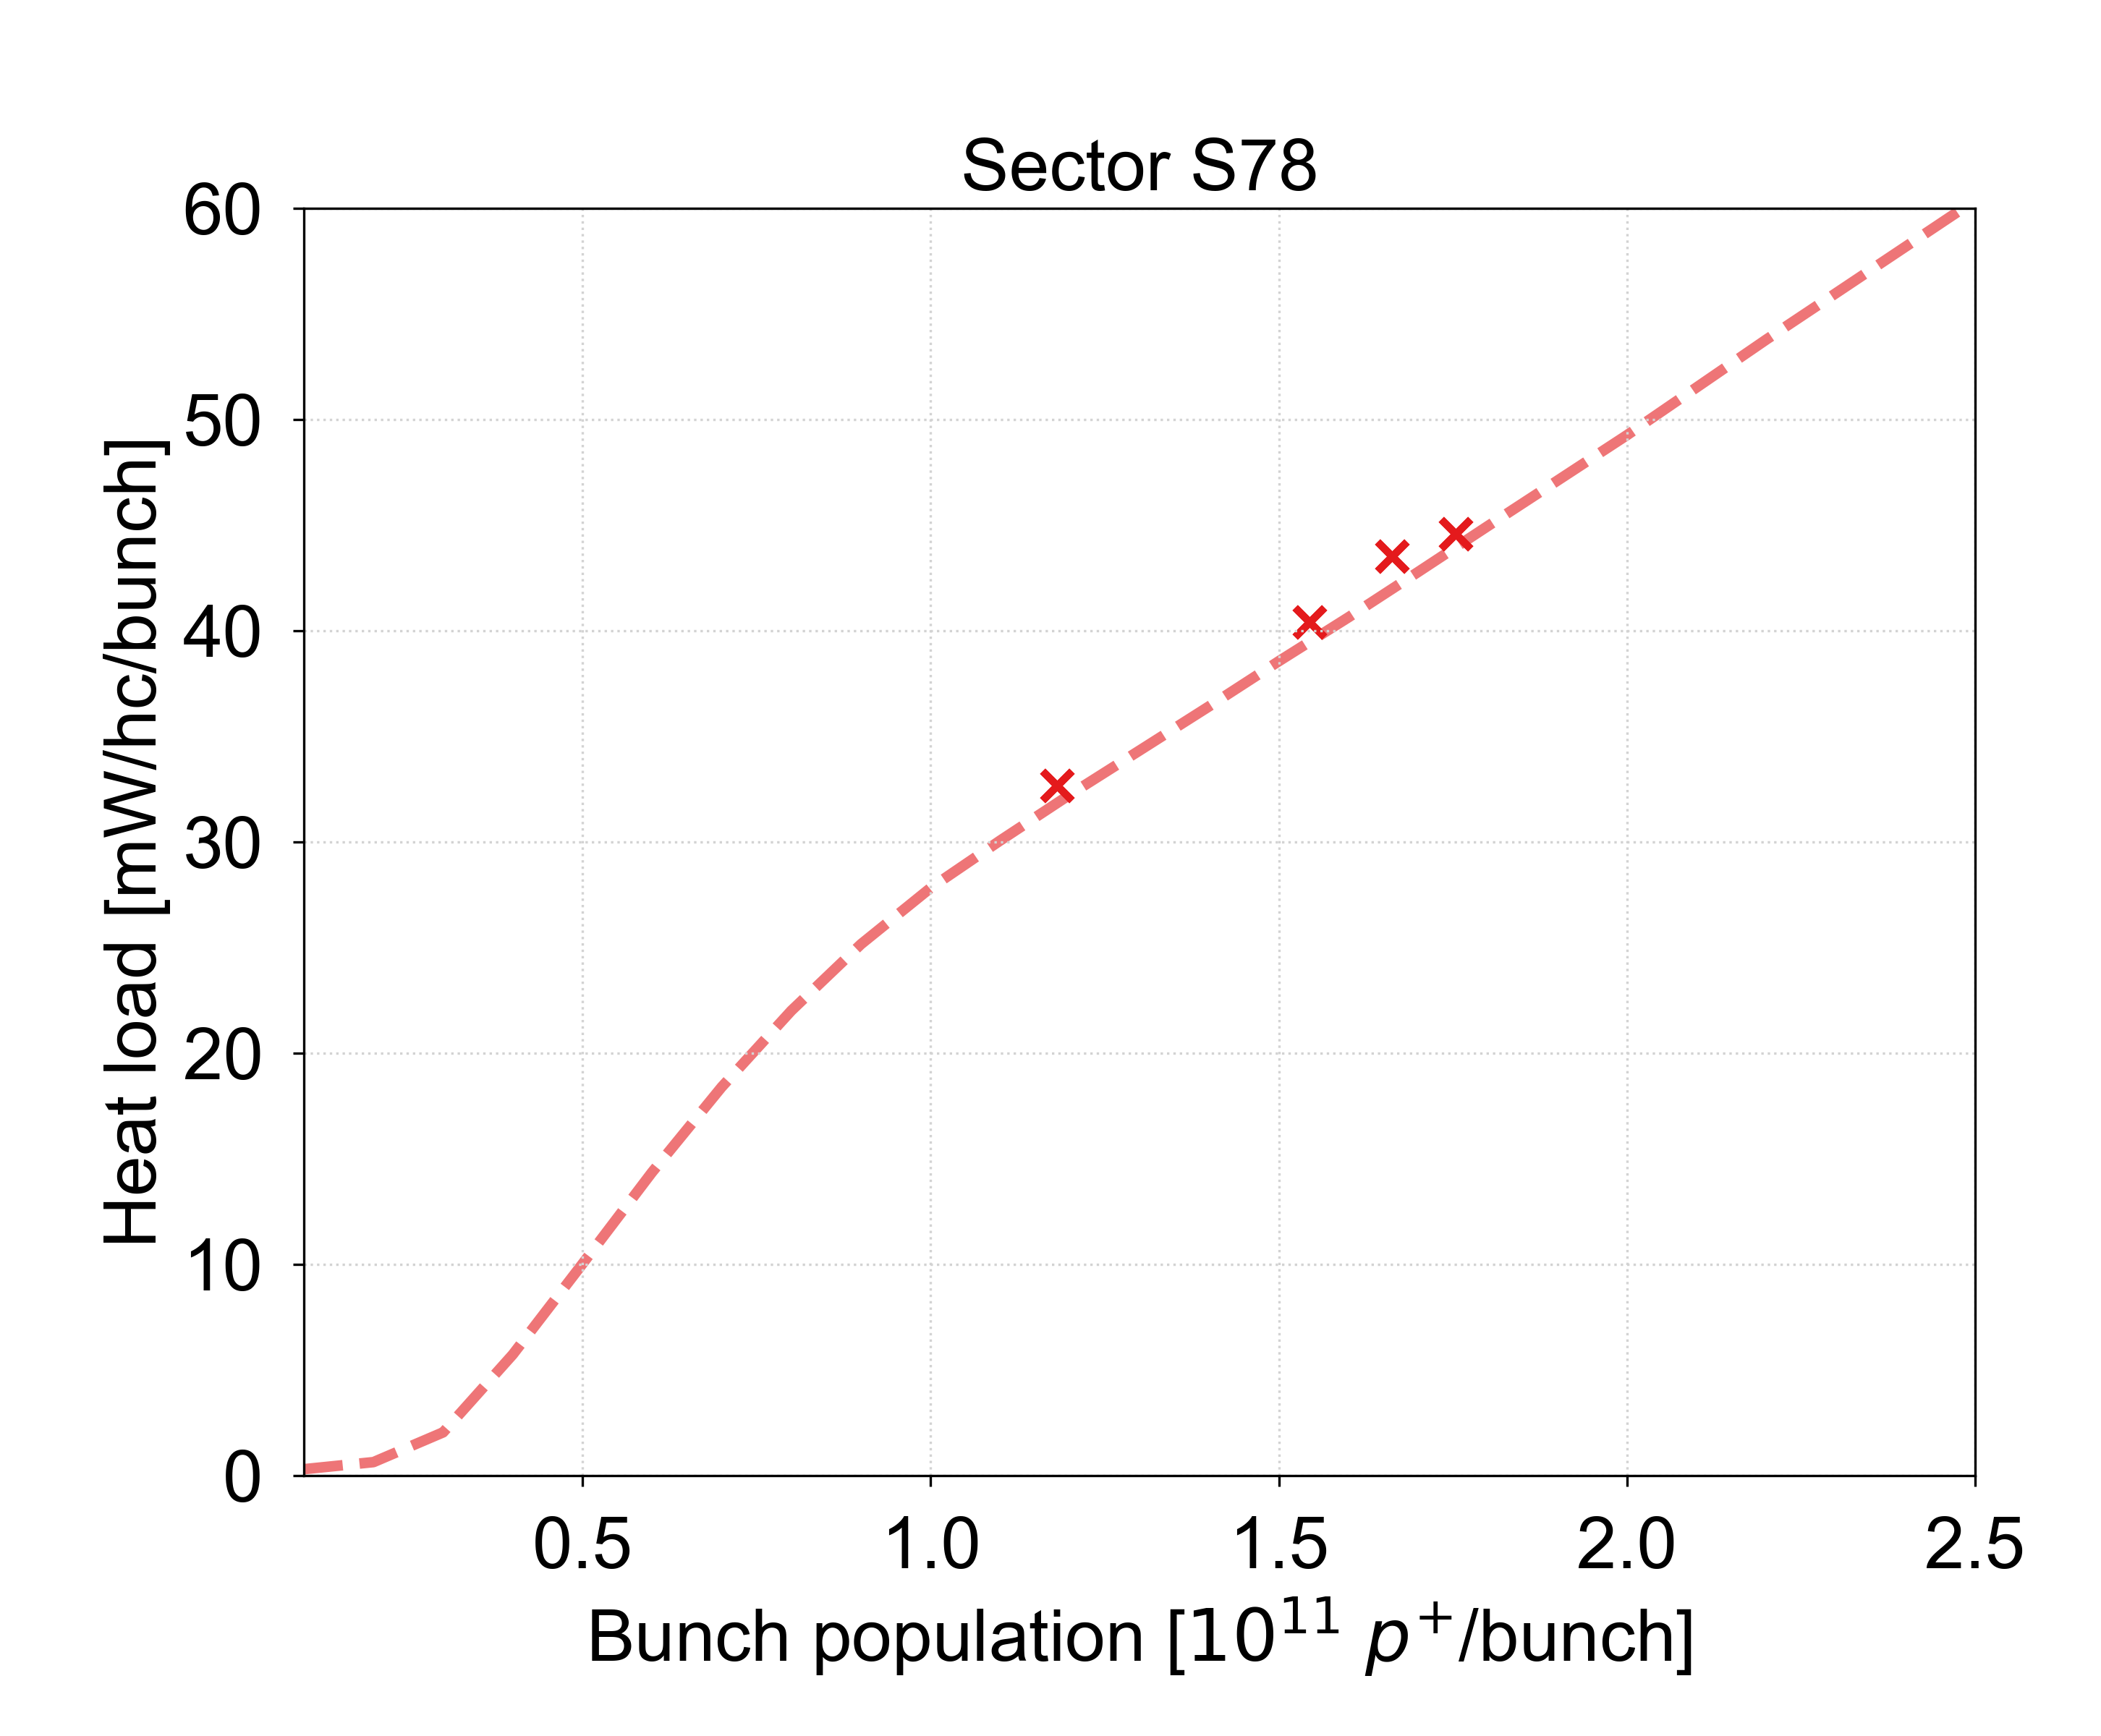
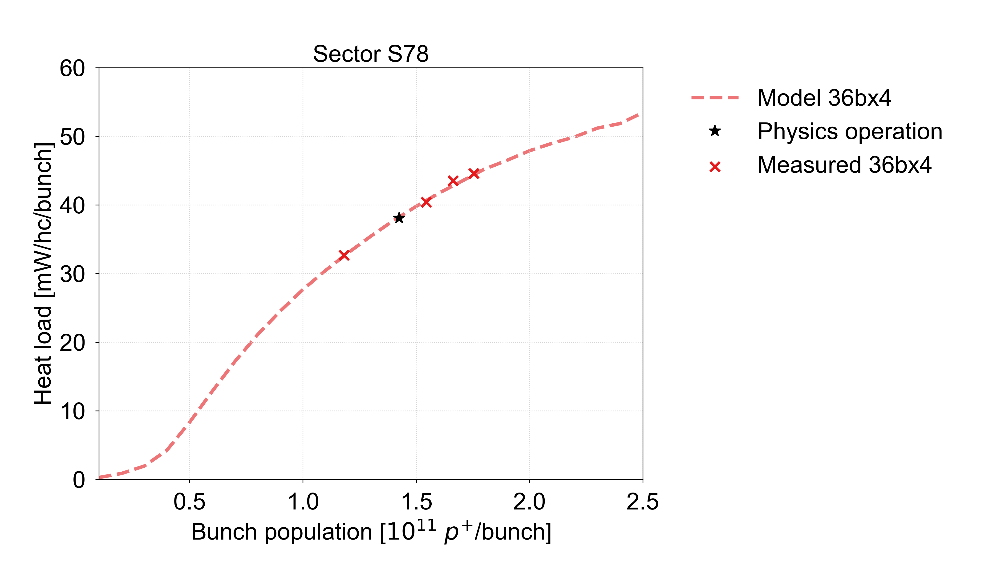
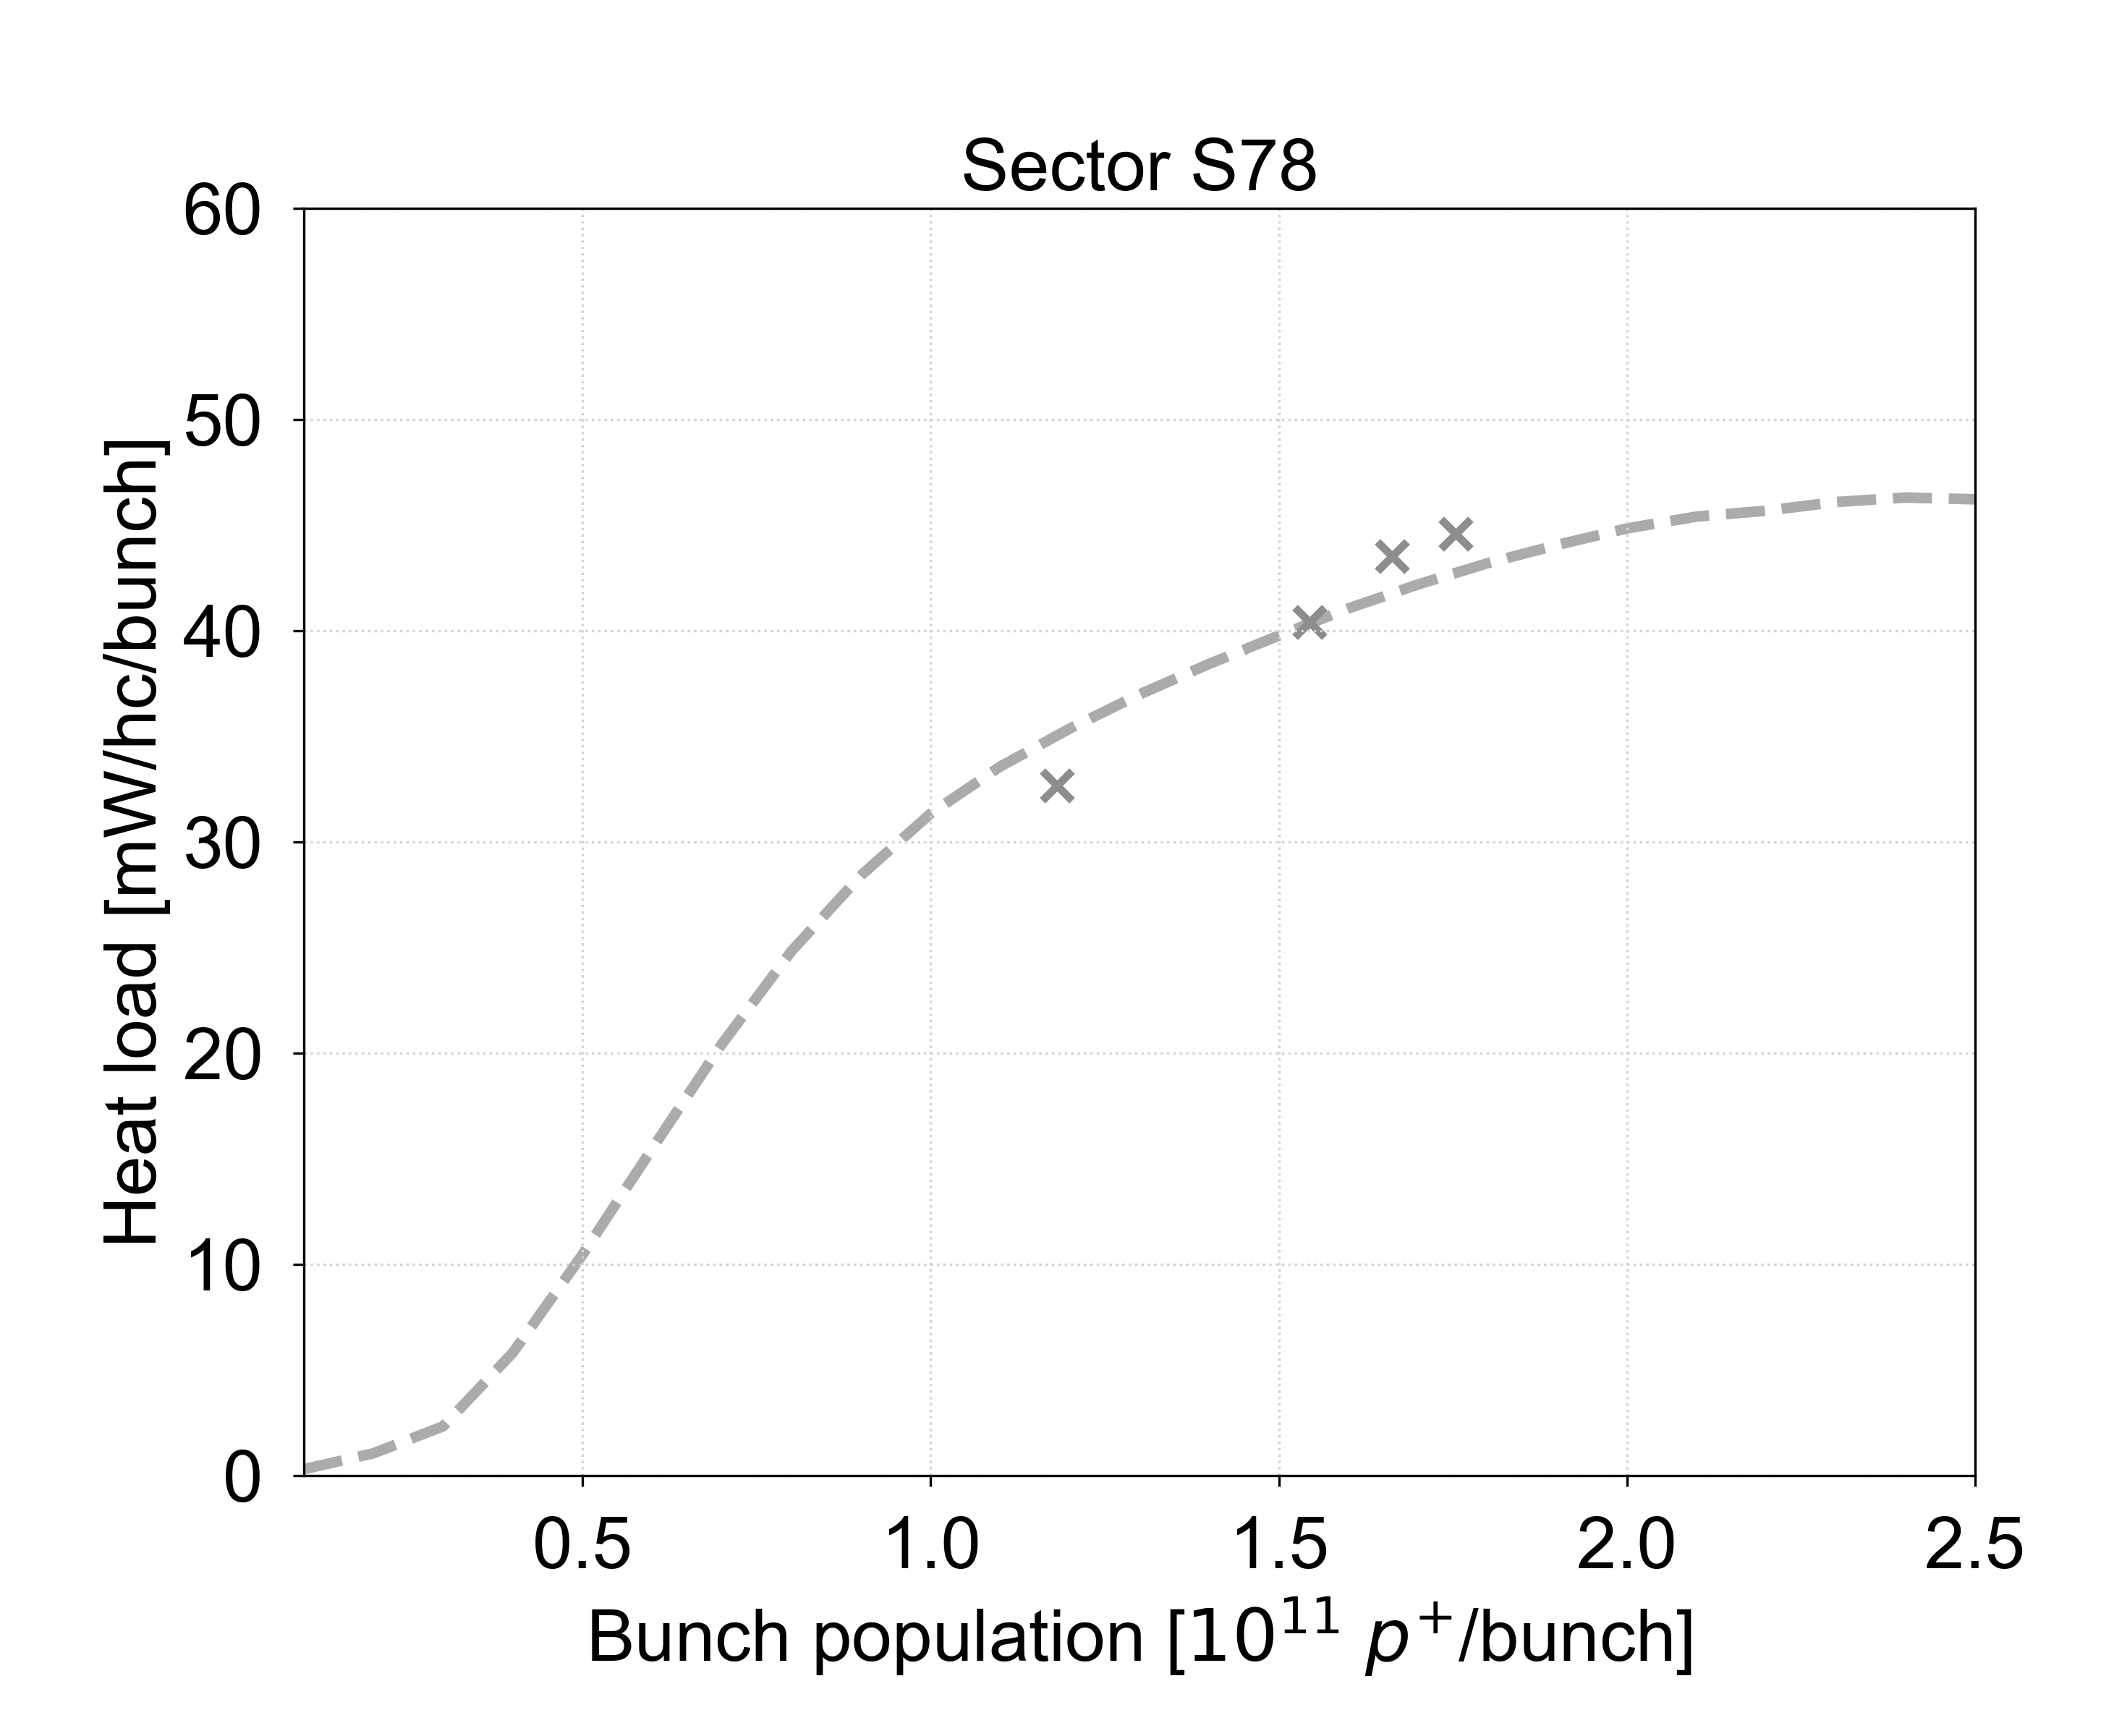
Motivation for heat load measurements
The heat loads are currently the best available observable for a quantitative estimate of e-cloud around the LHC
  Allow to deduce the Secondary Emission Yield (SEY) of the surface, which is then used to estimate the heat load for different intensities, filling schemes, energies etc.
Model benchmarked with measurements in 2022 with up to ~1.8e11 ppb → so far good estimates for Run 3
  Large uncertainty when extrapolating to 2.3e11 p/b, where slightly different models give quite different results

Slide 3
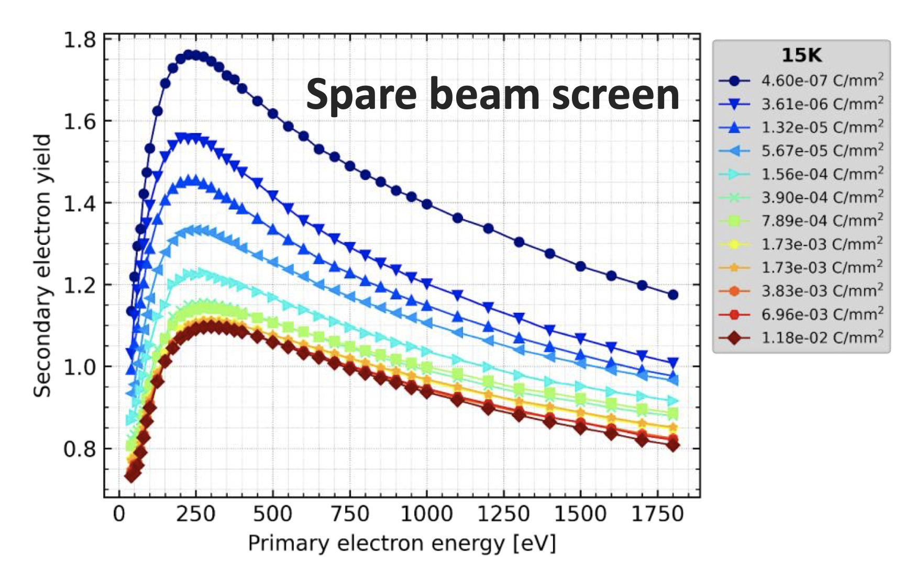
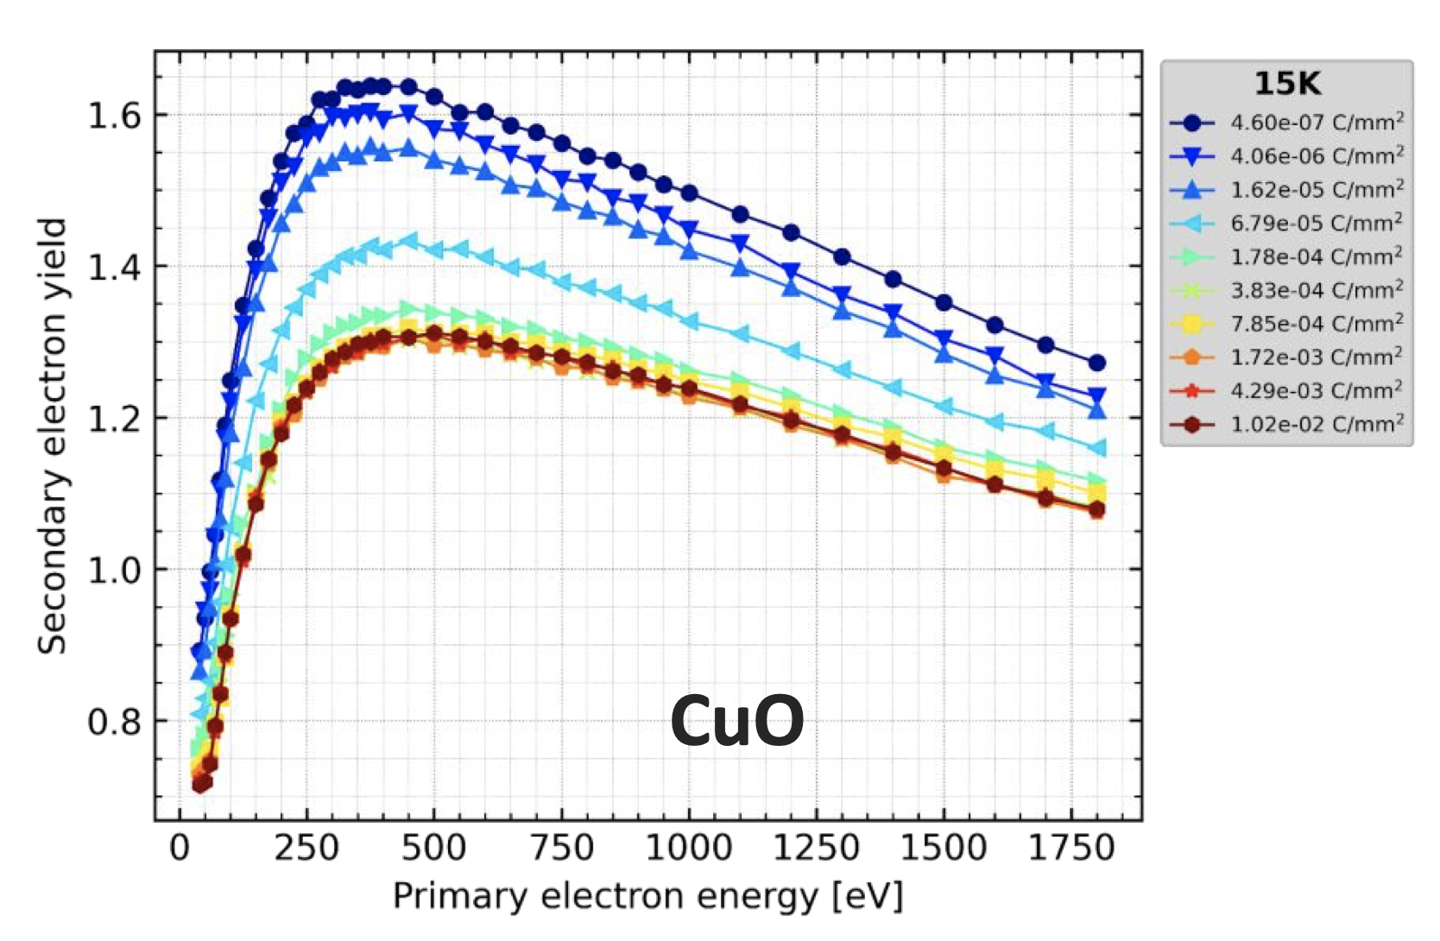
Motivation for heat load measurements
The heat loads are currently the best available observable for a quantitative estimate of e-cloud around the LHC
  Allow to deduce the Secondary Emission Yield (SEY) of the surface, which is then used to estimate the heat load for different intensities, filling schemes, energies etc.
Model benchmarked with measurements in 2022 with up to ~1.8e11 ppb → so far good estimates for Run 3
  Large uncertainty when extrapolating to 2.3e11 p/b, where slightly different models give quite different results
Lab measurements indicate not only different SEY value, but different SEY curve for degraded surfaces (CuO)
  Aiming to use both Cu₂O and CuO SEY curves to fit the machine status, but more data is needed to converge on fit
V. Petit, JAP23

Slide 4
MD9551: Heat load with high bunch intensity at injection
Motivation:
Improve estimates of cell-by-cell heat loads for the HL-LHC era
  Direct measurements give reliable data for selecting half-cells for BST and defining cryo margins in Run 4
Setup:
Inject beam in trains of 2x48 bunches (96 bpi) and ~900 bunches per beam with up to 2.3e11 ppb
  Measurements in 2022 with ~800b of 1.8e11 ppb at 450 GeV were poor due to low heat load
Store beam for ~30 minutes for a reliable heat load estimate
Repeat for lower intensities (e.g., 1.9e11, 1.5e11 1.1e11 ppb) with the number of bunches increased
to give similar heat load for 2.3e11 ppb (e.g., 1000b, 1200b, 1400b)
Time:
8h at 450 GeV

Slide 5
MD12843: Heat load measurements
Motivation:
Measurements to improve estimates of cell-by-cell heat loads and for direct comparison with Run 2 data
Setup:
Inject and ramp (in cases 2-4) fills for the following heat load measurements:
  At injection
  At flat top
  At flat top with only B1
  At flat top with only B2
Use trains of 2x48 bunches (96 bpi) and ~2400 bunches per beam with 1.2e11 ppb
(~145 W/hc expected in S78 with both beams at 6.8 TeV)
  If possible, set bunch length target at flat top shorter than in operation (ideally ~1.1 ns to match Run 2 conditions)
Store beam for ~30 minutes for a reliable heat load estimate
Time:
10h at 450 and 6.8 GeV

