Slide 1
AD BCCCA insulation vacuum
G. Khatri for BCCCA team | SY-BI-XEI
26 Aug 2024,

Slide 2
Outline
Photos

Slide 3
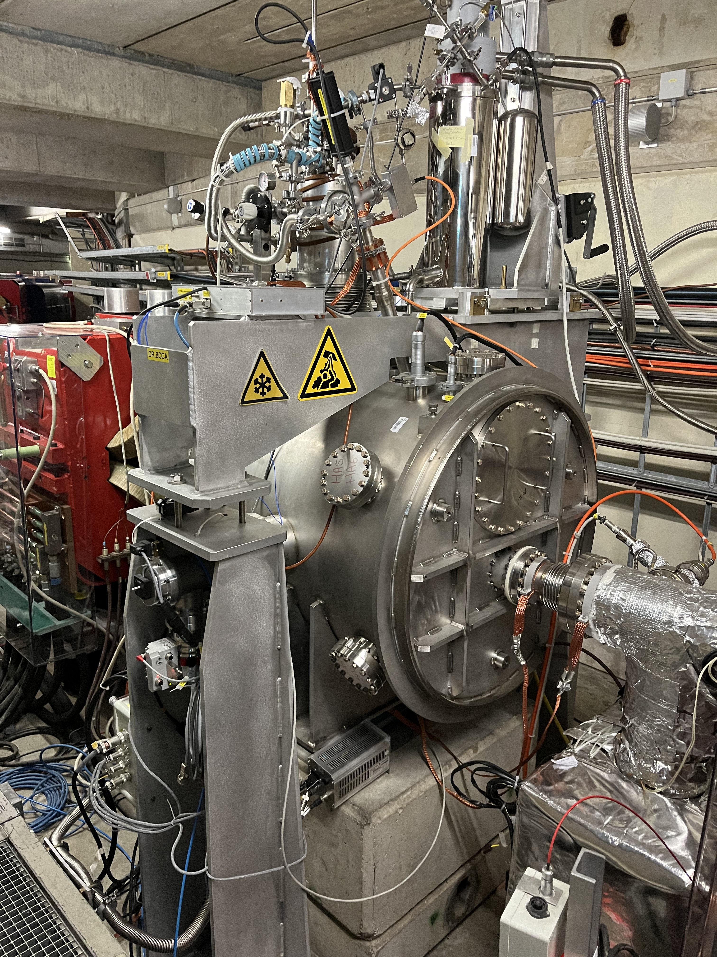
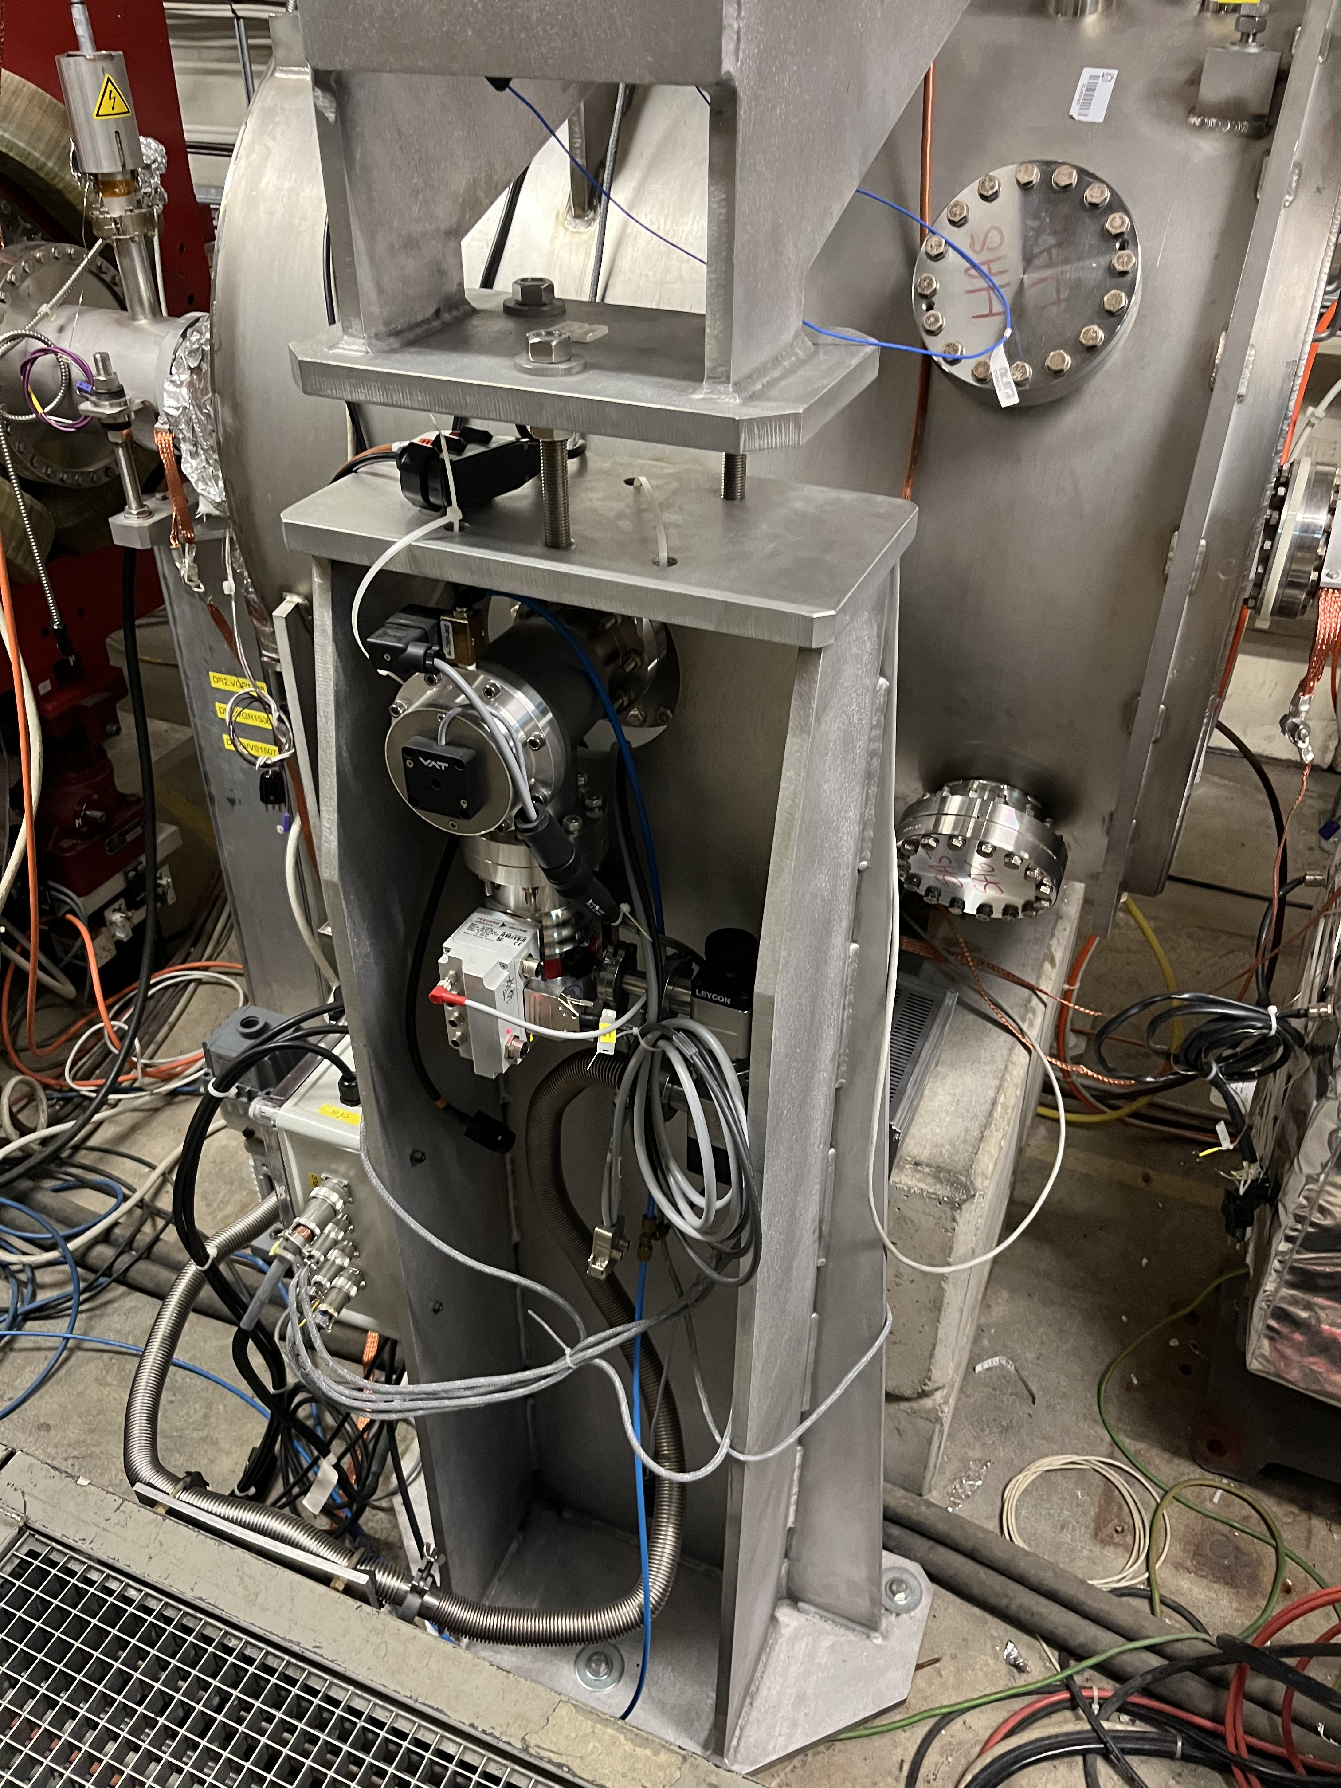
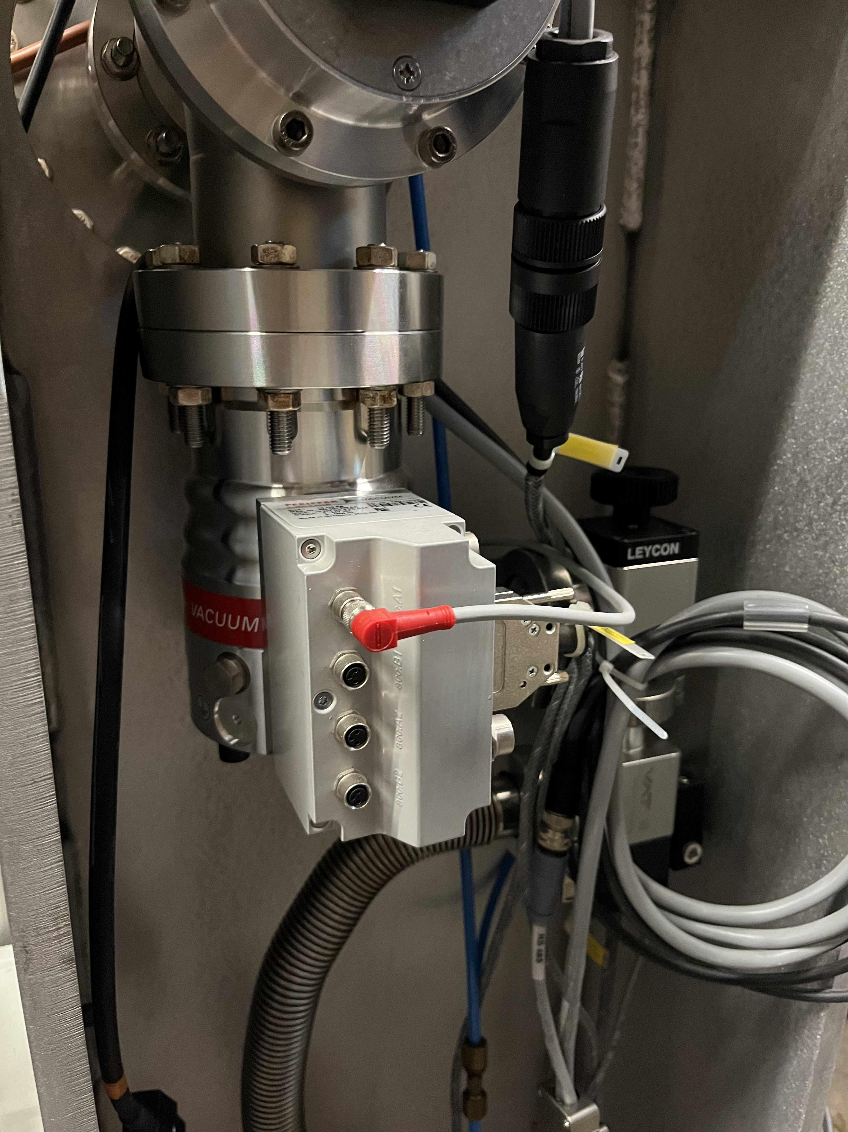
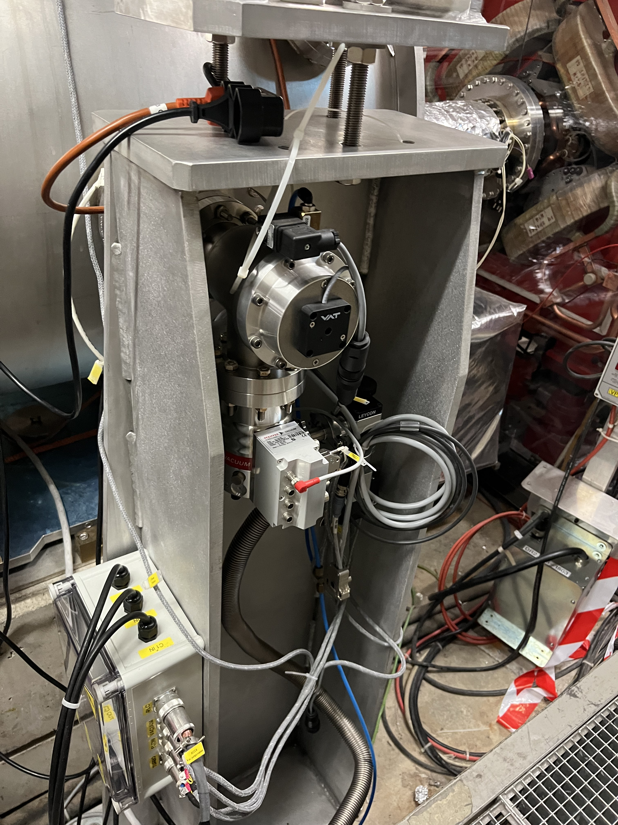
Failed pump

Slide 4
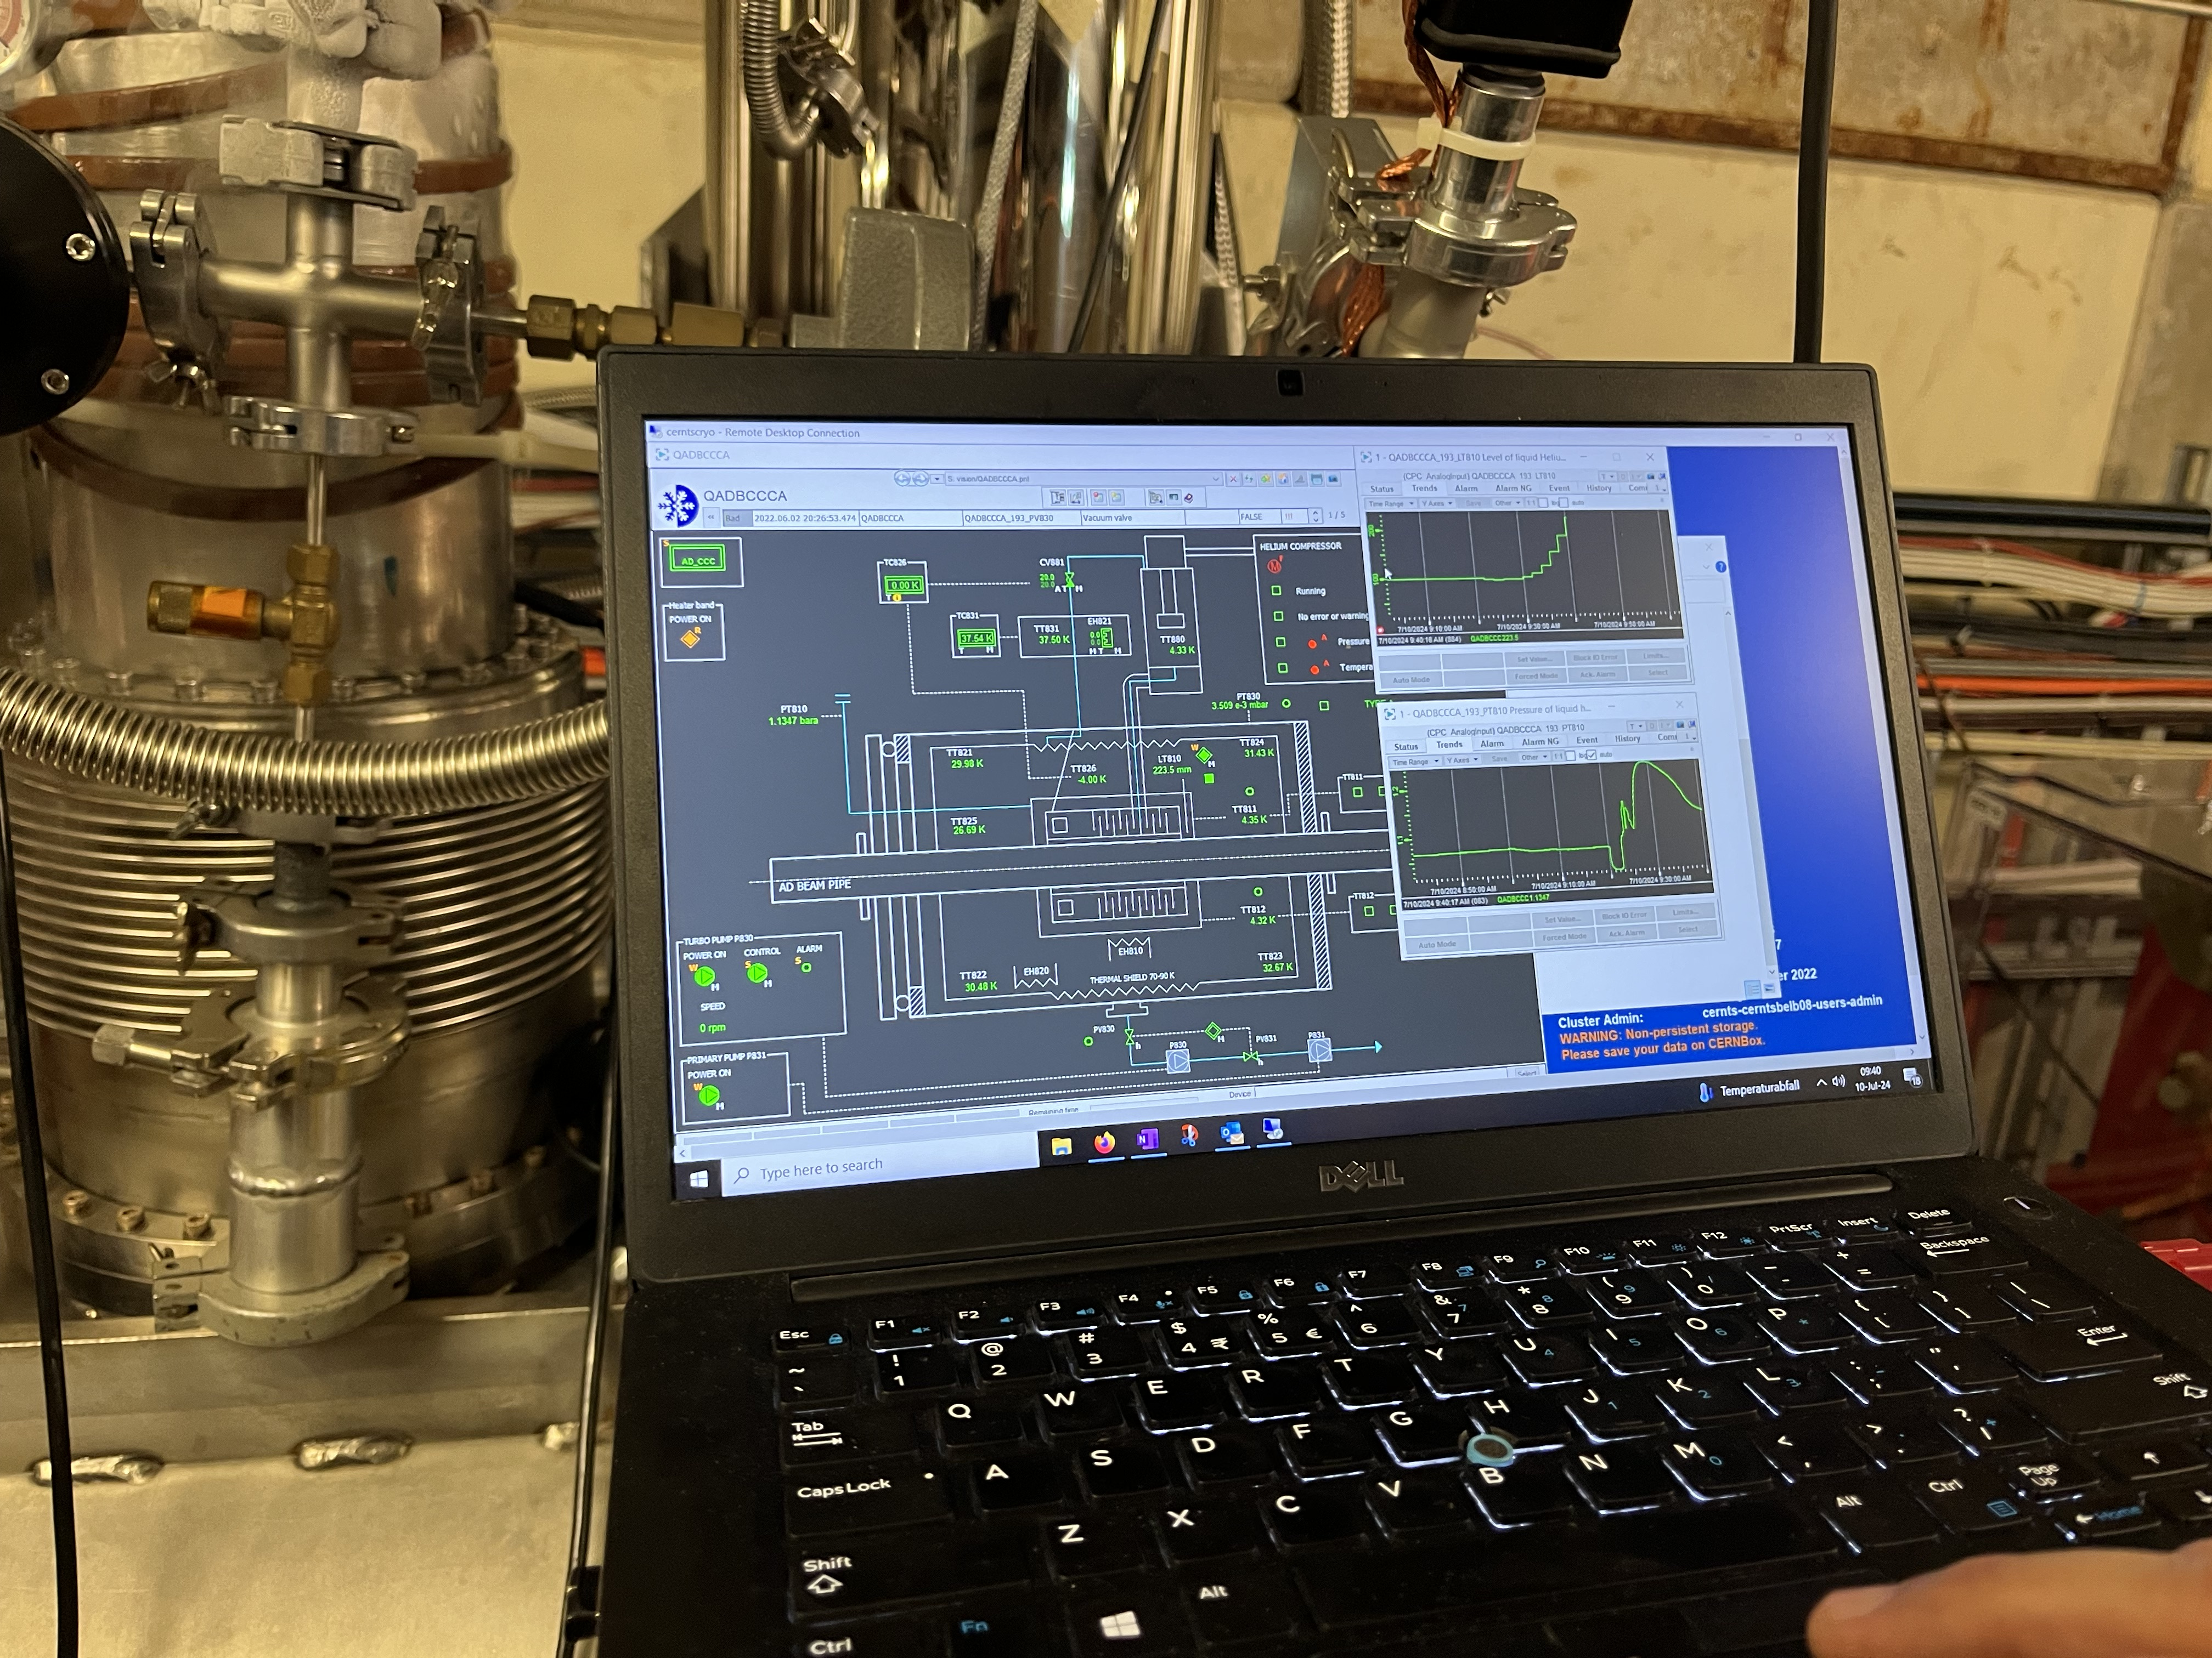
Control GUI

