Slide 1
Pileup Issues and Simulation in CMS
Mike Hildreth
Université de Notre Dame du Lac & Fermilab
Representing the CMS Collaboration

Slide 2
Overview
Overview of MinBias simulation in CMS
  Machinery
  cpu/memory performance
Data/MC Comparisons
  evolution of detector/physics quantities vs. occupancy
  sensitivity to out-of-time pileup
Data Overlay

Slide 3
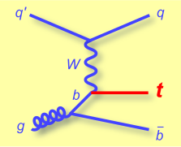
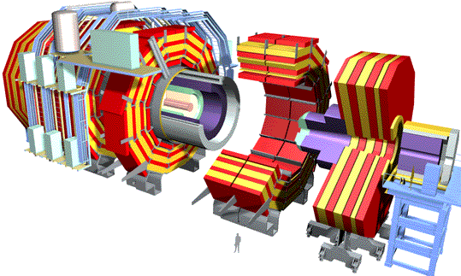
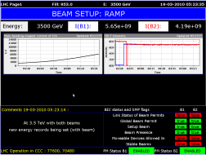
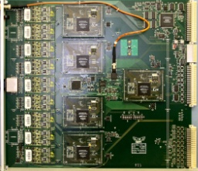
Pileup Simulation Machinery
Physics Generators
Particle 4-vectors
Geometry/Material Description
Geant 4
Simulated Hits from Pileup Interactions
Simulated Hits
Electronics Simulation
Simulated Raw Data
Noise Model

Slide 4
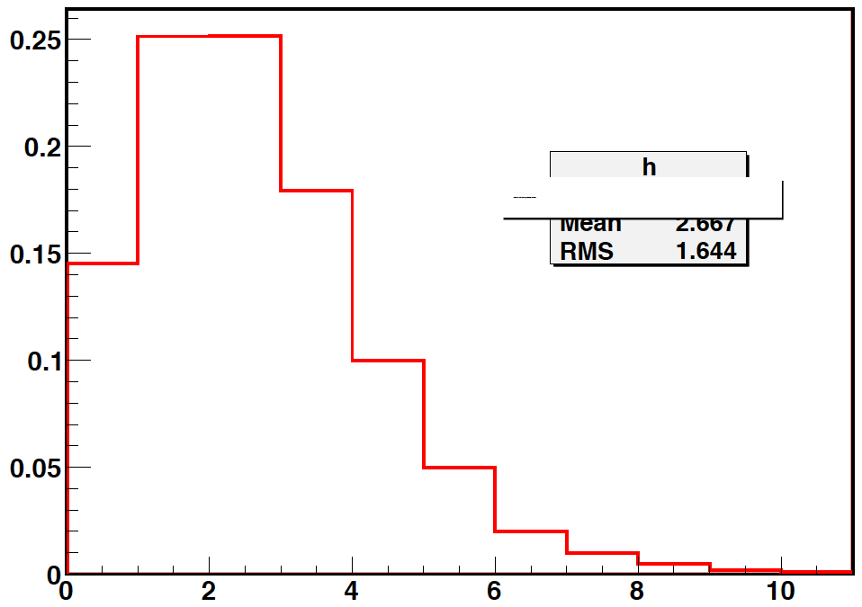
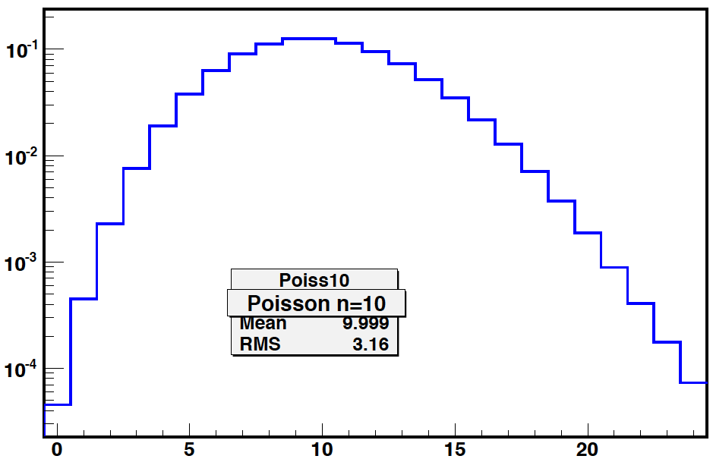
Pileup Simulation Overview
Pure MC inputs used to simulate pileup interactions
  Pythia8 Tune 4C for Summer 11 production of minbias events
Distribution of the number of interactions per beam crossing chosen in advance to simulate a desired luminosity profile:
2010
2011(a)
Poisson <n>=10
2011 “Flat to 10” Distribution chosen for “early running” MC
# of pileup interactions
# of pileup interactions
2010 distribution chosen half-way through data taking. Extrapolation based on expected instantaneous luminosity. Matched data almost perfectly.
2011 distribution chosen well before running. Designed to generically represent data up to Summer Conferences. Reweighting necessary to match data luminosity distribution.

Slide 5
Pileup Simulation Overview (II)
For each event, the instantaneous luminosity is chosen from the input distribution at random
  The number of in- and out-of-time interactions to be overlaid are selected individually from a poisson distribution based on the chosen luminosity and the total inelastic cross section
    (we have used σ_{tot} = 71.3mb)
  Out-of-time interactions are simulated for each beam crossing that is “in scope” for a given production run
    can do any arbitrary bunch configuration in 25ns steps
      times of Geant SimHits are shifted to match bunch assignment
      Digitization simulation considers hit times for pulse shapes
    typically, simulate ±125ns worth of bunch crossings
Collection of Geant SimHits from all of the minbias events and hard-scatter “signal” event are merged, then processed by digitization/electronics simulation
  no simulation of “double-hard-scatter” (yet)

Slide 6
CPU/Memory Performance Issues
Some timing/performance results from earlier this year
  (major improvements since then, not quite finished…)
  increase in memory usage above no-pileup case:
D. Lange
Scenario | Pileup + Digi time (a.u.) | Reco time (a.u.)
No pileup | 2.3 | 3.0
Flat10+Tail (2011a) | 8.9 | 7.1
Peak=14 (~3x10³³) | 6.6 | 8.7
Peak=20 | 9.6 | 14.5
Peak=32 (~5x10³³) | 12.3 | 26.1
Scenario | ΔDigi Vsiz | ΔReco Vsiz
Peak=14 (~3x10³³) | +510 | +272
Peak=20 | +468 | +383
Peak=32 (~5x10³³) | +628 | +836
comprehensive evaluation of new code performance not available yet
also dramatically improved recently

Slide 7
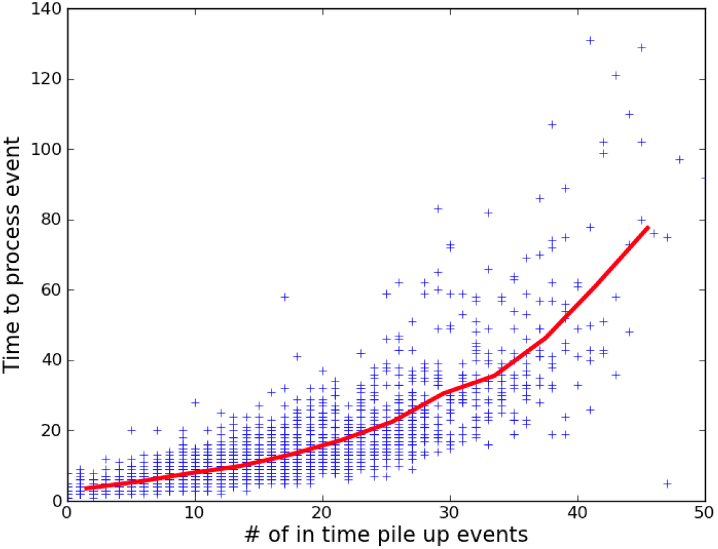
The generic worry:
Any sort of processing time can increase quadratically (or worse):
CMS process: complete re-evaluation of code for Digitization, Pileup overlay, and Reconstruction (on-going)
  target worst offenders, restructure if necessary
  currently: re-working of Pileup overlay to cope efficiently with sLHC simulation (250 interactions in- and out-of-time)
processing time (arbitrary units)

Slide 8
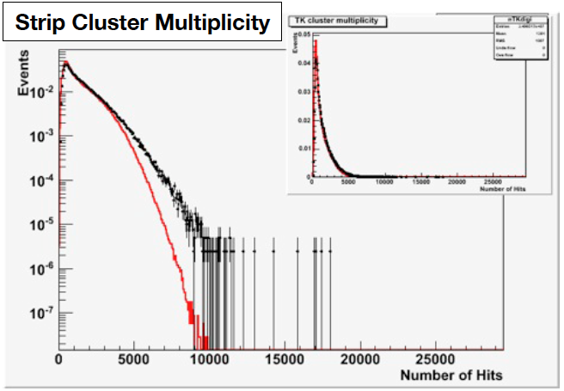
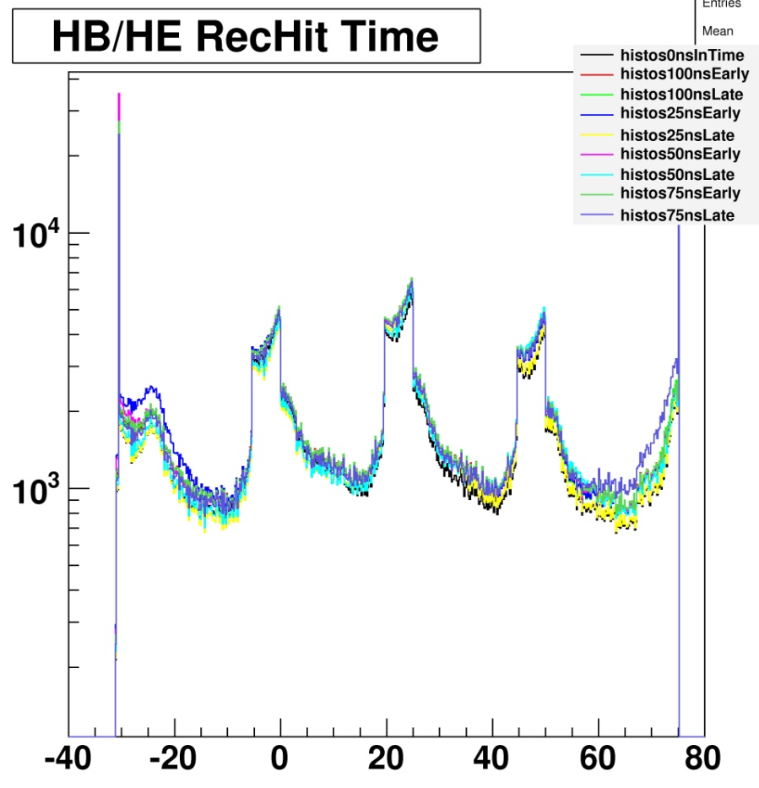
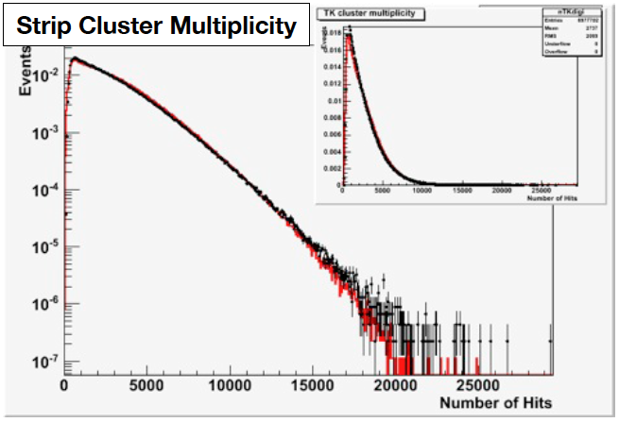
Pileup Simulation Validation
Time of reconstructed hits for interactions at different times:
  proper time shift, simulation and reconstruction of out-of-time energy
Tracker occupancy:
K. Burkett
J. Temple
No Pileup
CMS MC Preliminary
CMS Preliminary 2010
Hadronic Calorimeter
With Pileup
time (ns)
Data
Simulation
CMS Preliminary 2010

Slide 9
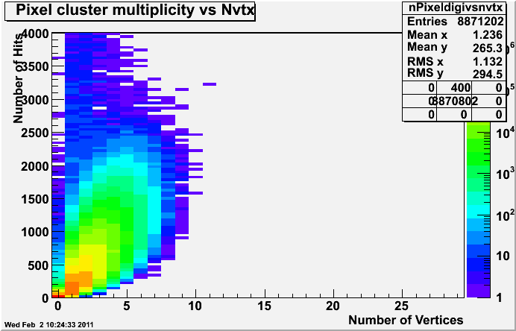
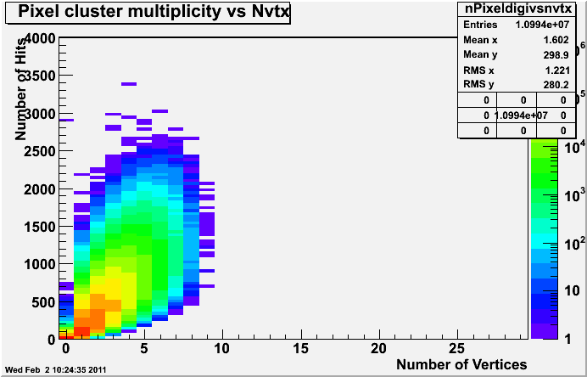
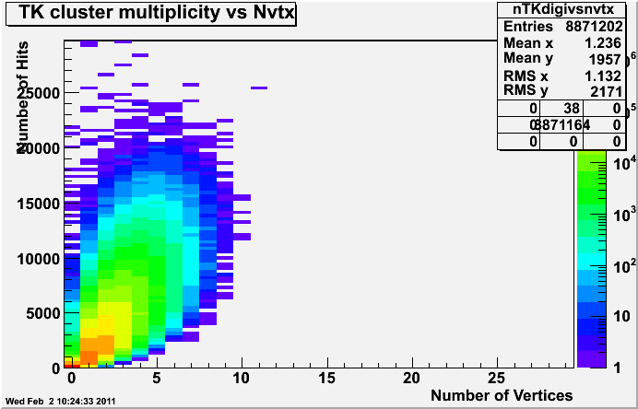
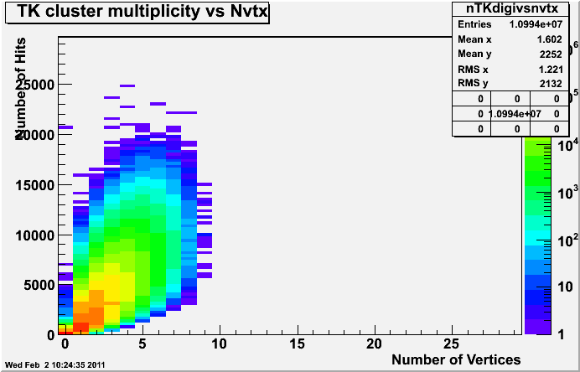
Pileup Simulation Validation (II)
Tracker Occupancy (2011):
A. Venturi
MC
CMS Preliminary
CMS Preliminary
Data
CMS Preliminary
CMS Preliminary
Data
MC

Slide 10
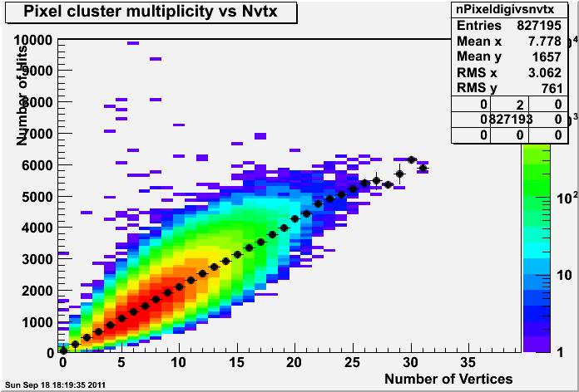
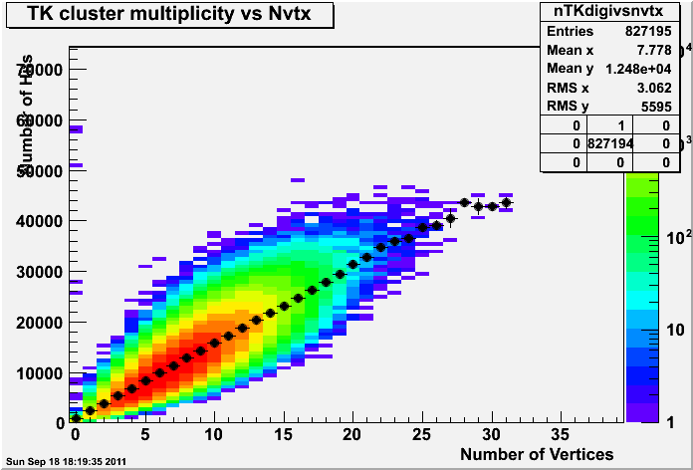
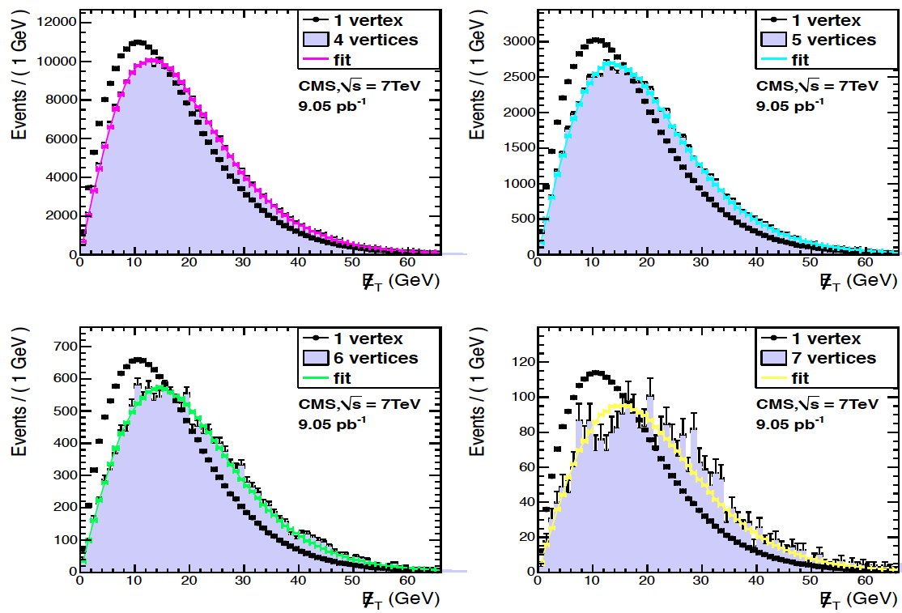
Effects of Pileup
First, checks of “linearity” assumption with Data:
  at lower luminosities, does 1+1=2?
  vertex vs. cluster multiplicities: linear out to large n_{vtx}
  MET: n vertices = (1 vertex distribution)*n
A. Venturi
CMS Preliminary 2011
CMS Preliminary 2011
2011 JINST 6 P09001

Slide 11
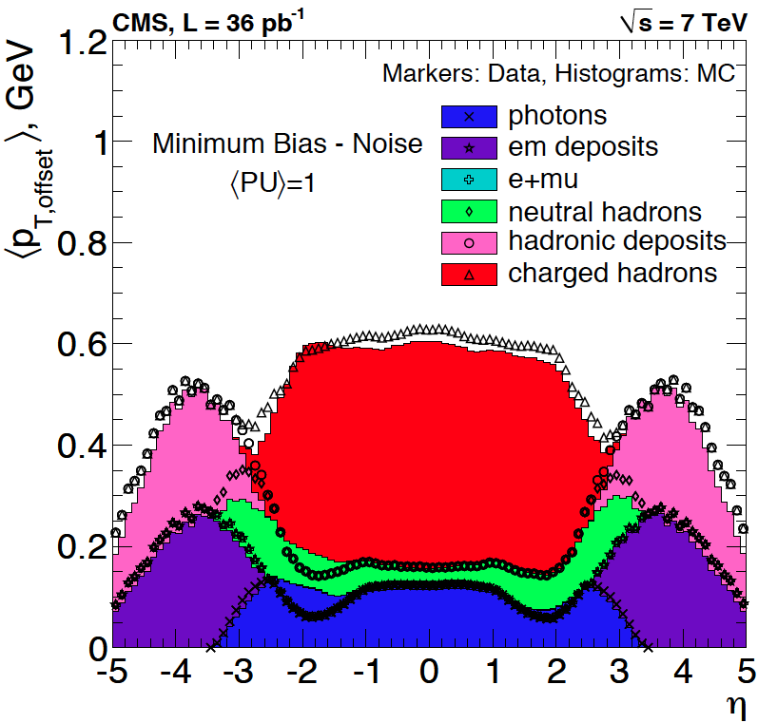
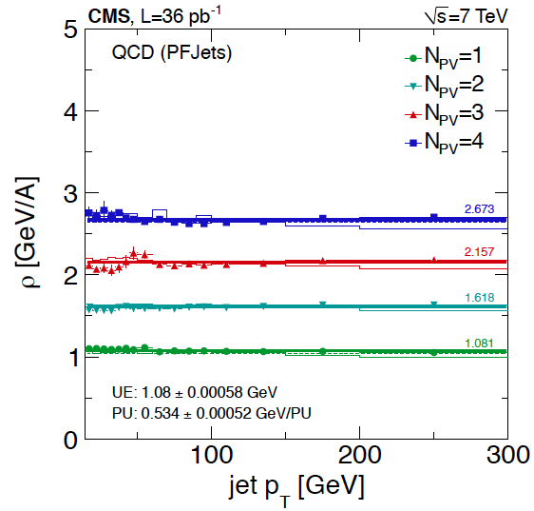
Effects of Pileup
Occupancies and Jet Resolution:
arXiv:1107.4277; CMS-JME-10-011
Composition and angular distribution of measurable energy/particle depositions in CMS for single min-bias events
Event-by-event Particle Flow p_{T} density for different number of additional interaction vertices
Can be subtracted to mitigate effects of pileup

Slide 12
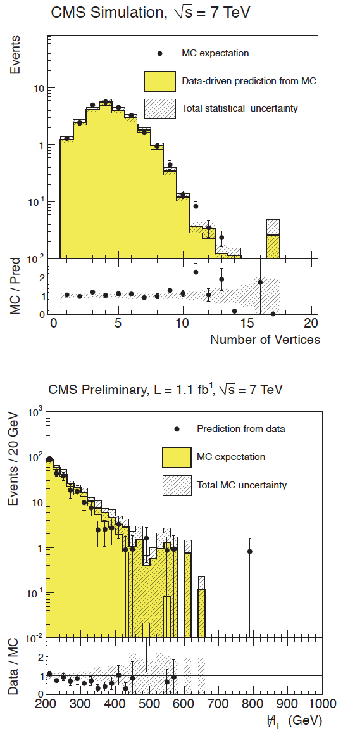
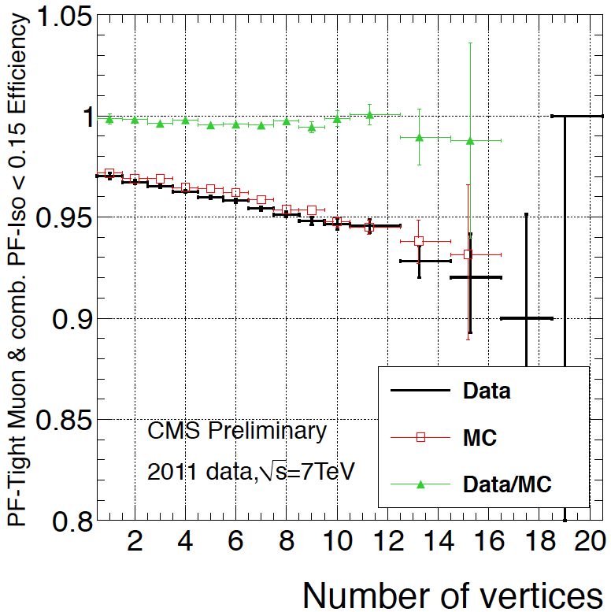
Pileup Modeling
Degradation of isolation efficiency due to extra energy in cone:
Closure test for modeling the number of vertices: SUSY search in Jets + MET final state
μ-ID
CMS PAS SUS-11-04
Proper modeling of tails in missing H_{T} distribution for higher pileup data
# of vertices
Effect of this trend can be mitigated by subtracting the average energy density ρ in the cone
CMS PAS HIG-11-013

Slide 13
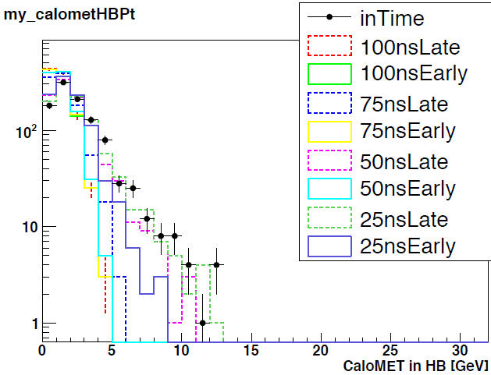
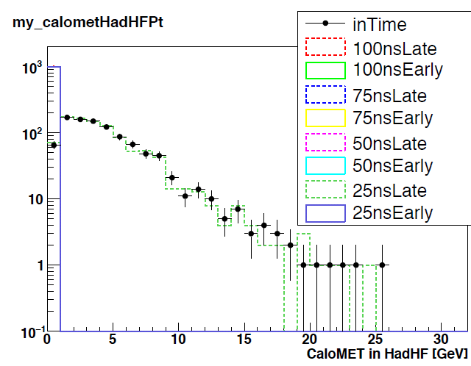
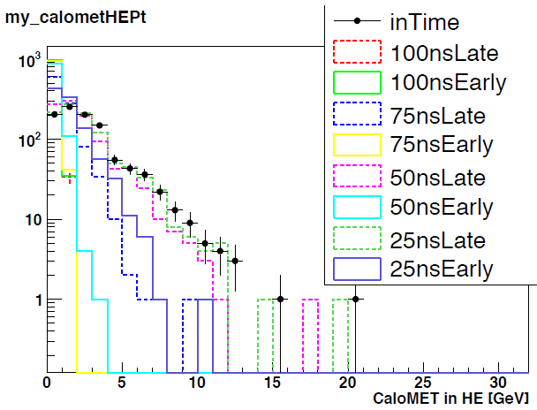
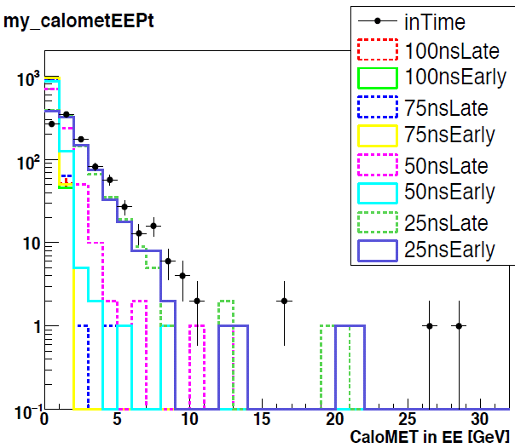
Sensitivity to Out-of-Time Pileup
Pure out-of-time MC minbias samples: plots of MET
A. Apresyan
HB: some sensitivity to 50ns
CMS MC Preliminary
HF: sensitive to 25ns late
CMS MC Preliminary
HE: some sensitivity to 50ns
EE: sensitive to ± 25ns
CMS MC Preliminary
CMS MC Preliminary

Slide 14
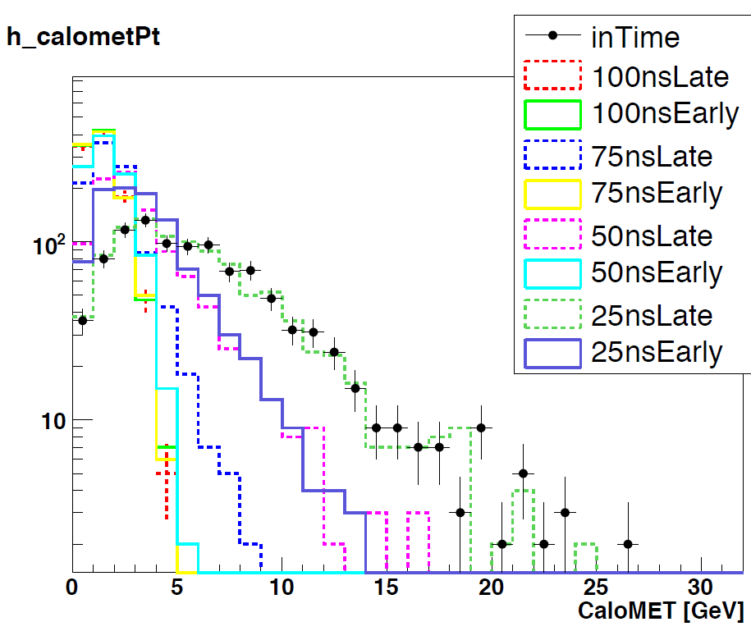
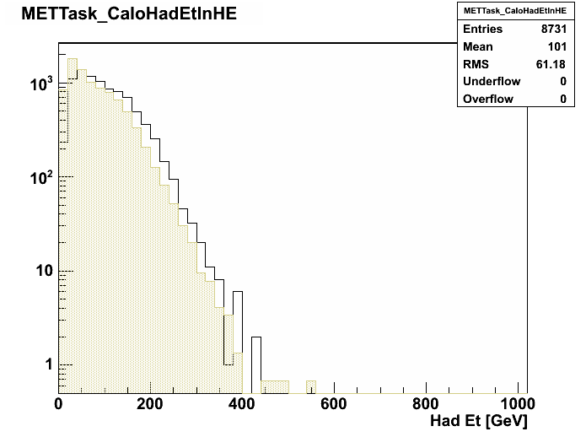
Sensitivity to Out-of-Time Pileup
Aggregate Result:
  sensitivity to additional energy in adjacent 25ns and 50ns bunches will cause tails in the MET distributions if readout changes are not made
    under study
Comparison of Data taken with 50ns and 75ns bunch spacing
  equal bunch luminosities
  expected differences seen in various subdetectors
    more energy in forward region
  accuracy of modeling still under study
CMS MC Preliminary
HE SumE_{T}
50ns
75ns
CMS Preliminary

Slide 15
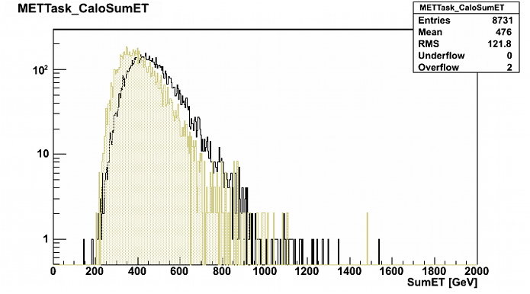
Sensitivity to Out-of-Time Pileup
Aggregate Result:
  sensitivity to additional energy in adjacent 25ns and 50ns bunches will cause tails in the MET distributions if readout changes are not made
    under study
Comparison of Data taken with 50ns and 75ns bunch spacing
  equal bunch luminosities
  expected differences seen in various subdetectors
    more energetic deposits
  accuracy of modeling still under study
CMS MC Preliminary
Total SumE_{T}
50ns
75ns
CMS Preliminary

Slide 16
Data Overlay
CMS also has capability to overlay Data events
  on Data, or MC
Hit combination can be done at single-channel level (Digitization)
  or at higher level: Reconstructed objects
Has been used for
  Trigger studies (Data-on-Data overlay)
  Tracking & Vertexing efficiency studies (Track embedding)
  Calorimeter noise studies (Data-on-MC overlay)
Full deployment is pending an “upgrade” to the Tracker MC geometry
  differences between ideal MC geometry and as-built detector are currently too large for track reconstruction for, e.g., data tracks included in MC events

Slide 17
Conclusions
Pileup Simulation is not an easy problem
  generator issues
    (not discussed here)
    do our generators actually match the physics?
  CPU/Memory consumption will continue to be problematic
    especially for sLHC
    constant vigilance required to keep this under control
      may require simplification of simulations
    out-of-time pileup is difficult to study/quantify
Current implementation very successful at “modest” luminosity
  low and high-level objects well-modeled in present simulation
  detailed studies on-going

